Slide 1
NEW RESULTS ON STERILE NEUTRINO OSCILLATIONS FROM MINOS+
Jacob Todd
on behalf of the MINOS+ Collaboration
5 May 2017
Joint Experimental-Theoretical Physics Seminar

Slide 2
Outline
Neutrino Oscillations
Beyond Three Flavors?
MINOS & MINOS+
Searching for Sterile ν’s
An Improved Fit Paradigm
New Results!
The MINOS+ Collaboration
Argonne · Athens · Brookhaven · Caltech · Cambridge · Campinas · Cincinnati · Fermilab · Goiás · Harvard · Holy Cross · Houston · IIT · Indiana · Iowa State · Lancaster · Manchester · Minnesota-Twin Cities · Minnesota-Duluth · Otterbein · Oxford · Pittsburgh · Rutherford · São Paulo · South Carolina · Stanford · Sussex · Texas A&M · Texas-Austin · Tufts · UCL · Warsaw · William & Mary

Slide 3
Neutrino Oscillations

Slide 4
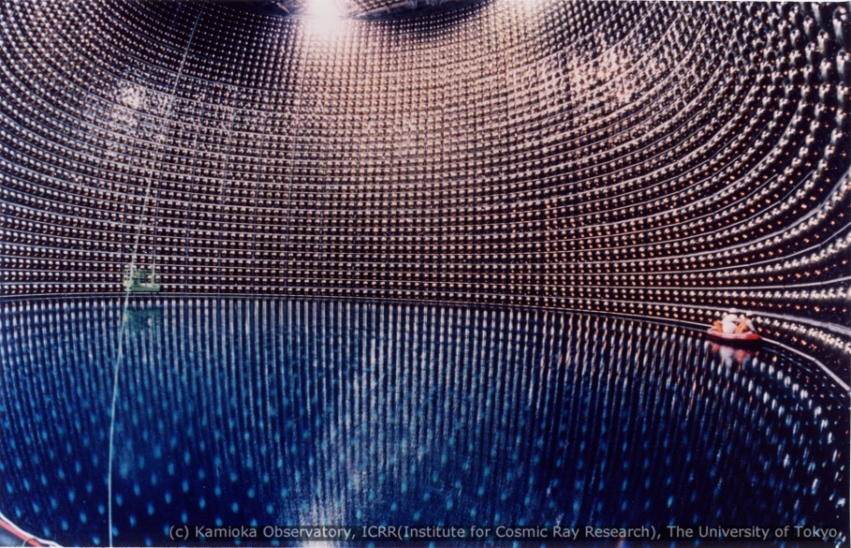
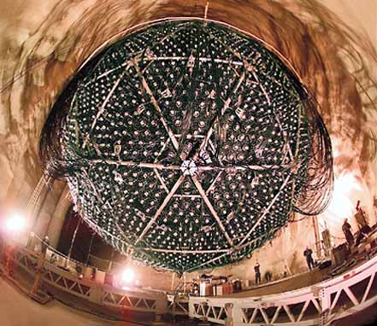
Neutrino Oscillations – Observed!
Super-Kamiokande (Super-K)
Search for ν_{μ} produced in atmosphere by cosmic rays
Deficit of upward going compared to downward going ν_{μ}
Sudbury Neutrino Observatory (SNO)
Search for ν_{e} produced in solar nuclear fusion
Deficit in expected ν_{e} flux with total number of neutrinos as expected

Slide 5
Neutrino Oscillations
Each mass eigenstate propagates with a different velocity
Probability of flavor change from α to β
Method due to: Akhmedov, E. and Smirnov A. Phys. Atom. Nucl. 72 (2009) 1363-1381.

Slide 6
Neutrino Oscillations - Formalism
Amplitude of oscillations – depends on {θ₂₃, θ₁₃, θ₁₂, δ_{CP}}
Oscillations

Slide 7
Neutrino Oscillations - Formalism
Atmospheric (& Accelerator) Neutrinos
Reactor & Accelerator Neutrinos
Solar (& Reactor) Neutrinos
MINOS & MINOS+

Slide 8
Current Three Flavor Picture
Two mass splitting scales:
Atmospheric:
Δm²_{atm} ≈ 2.4 x 10⁻³ eV²
Solar:
Δm²_{sol} ≈ 7.5 x 10⁻⁵ eV²
(36 – 59)%
~30%
Solar mixing non-maximal:
θ₁₂ ≈ 34°
< π/4
Small but non-zero θ₁₃:
θ₁₃ ≈ 9°
Large atmospheric mixing:
θ₂₃ ≈ 45°
~2.5%

Slide 9
Remaining Unknowns
Is θ₂₃ maximal?
In which octant is θ₂₃?

Slide 10
Remaining Unknowns
Is θ₂₃ maximal?
In which octant is θ₂₃?
Do neutrinos violate CP?
What is the value of δ_{CP}?

Slide 11
Remaining Unknowns
Normal Ordering
Inverted Ordering
Is θ₂₃ maximal?
In which octant is θ₂₃?
Is ν₃ heaviest or lightest?
Do neutrinos violate CP?
What is the value of δ_{CP}?

Slide 12
Remaining Unknowns
?
Are there more than three neutrino mass states?
?
Is θ₂₃ maximal?
In which octant is θ₂₃?
Is ν₃ heaviest or lightest?
Do neutrinos violate CP?
What is the value of δ_{CP}?

Slide 13
Beyond Three Flavors

Slide 14
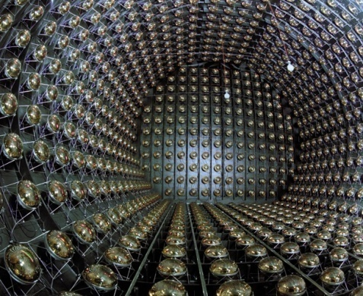
Beyond Three Flavor Oscillations?
Evidence For:
Null Result:
LSND
Excess of electron antineutrinos from decay-at-rest (~3.8σ)
A. Aguilar-Arevalo et al. Phys. Rev. D64 (2001), p. 112007.

Slide 15
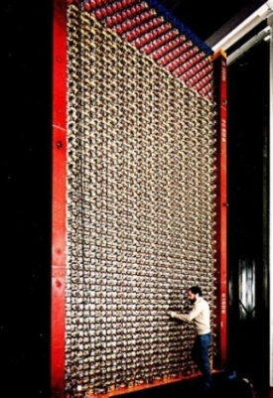
Beyond Three Flavor Oscillations?
Evidence For:
Null Result:
KARMEN2
No excess above background from spallation source with decay-at-rest
Church et al. Phys. Rev. D66 (2002), p. 013001.

Slide 16
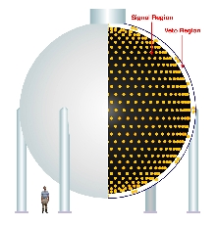
Beyond Three Flavor Oscillations?
Evidence For:
Null Result:
MiniBooNE
Designed motivated by LSND, KARMEN results
Observed Low-energy excess in electron flavor
Neutrinos (~3.4σ)
Antineutrinos (~2.8σ)
A. Aguilar-Arevalo et al. Phys. Rev. Lett. 110 (2013), p. 161801.

Slide 17
Beyond Three Flavor Oscillations?
Evidence For:
Null Result:
MiniBooNE/SciBooNE
Search for muon (anti)neutrino disappearance in neutrino beam
Dual-detector fit over short baselines
SciBooNE as near detector and MiniBooNE as far detector
No evidence seen in either neutrino or antineutrino channels
Mahn, K et al. Phys. Rev. D85 (2012), p. 032007.

Slide 18
Beyond Three Flavor Oscillations?
Evidence For:
Null Result:
Reactor Flux
Recalculation of expected reactor flux found systematic bias in previous predictions
New prediction is ~6%(~2.5σ) greater than world average of experimental measurements
Indicates observed deficit
However …
Deficit
Gariazzo et al. (2017). arXiv: 1703.00860 [hep-ex]

Slide 19
Beyond Three Flavor Oscillations?
Evidence For:
Null Result:
An et al. (2017). arXiv: 1704.01082 [hep-ex]
Reactor Flux
New measurements by Daya Bay indicate the neutrino oscillations explanation is disfavored
“…incompatible with Daya Bay’s observation at 2.6σ.”

Slide 20
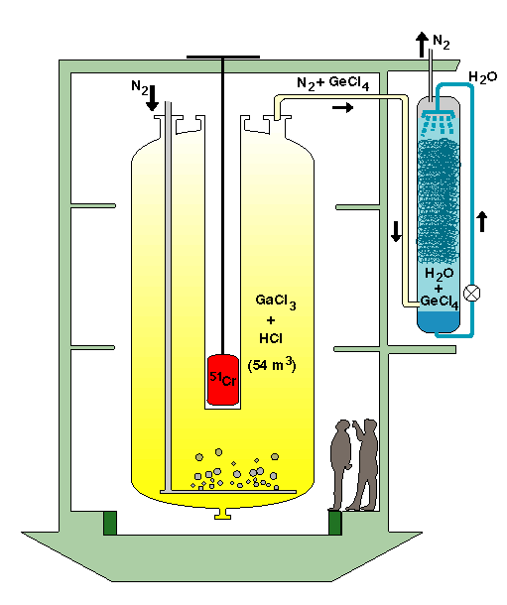
Beyond Three Flavor Oscillations?
Evidence For:
Null Result:
Gallium Anomaly
GALLEX & SAGE
Designed for radiochemical detection of solar neutrinos
Measured rates for calibration sources ⁵¹Cr and ³⁷Ar was ~2.7σ below expectation
Gariazzo et al. J.Phys. G43 (2016) 033001
DOI:10.1088/0954-3899/43/3/033001

Slide 21
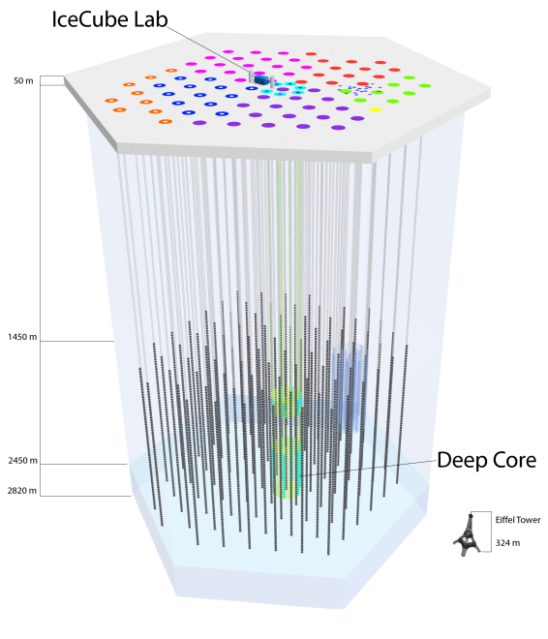
Beyond Three Flavor Oscillations?
Evidence For:
Null Result:
IceCube
Detects no evidence of beyond three flavor oscillations in atmospheric neutrinos traversing the earth
M.G. Aartsen et al. Phys. Rev. Lett. 117 (2016) 071801

Slide 22
Beyond Three Flavor Oscillations?
Evidence For:
Null Result:
NOνA
Observed 95 NC events compared to a prediction of 83.7 events
No evidence for NC disappearance observed in the NuMI beam
NOvA Collaboration,
APS April Meeting 2017

Slide 23
How Many Light Neutrino Flavors?
Bounds from CMB measurements by Planck:
Sum of neutrino masses Σm_{ν} < 0.26 eV
Effective number of relativistic species (N_{eff}) consistent with three flavors
Combination of conflicting results favors Δm²₄₁ ~ 1.7 eV²
Global fits show increasingly precise allowed regions
Z⁰ invisible linewidth measurements constrain the number of light active flavors
Three flavors very strongly preferred
Sterile neutrinos?
Potential solution to open questions ranging from the neutrino sector to cosmology
Gariazzo et al. J.Phys. G43 (2016) 033001
DOI:10.1088/0954-3899/43/3/033001

Slide 24
How Many Light Neutrino Flavors?
Bounds from CMB measurements by Planck:
Sum of neutrino masses Σm_{ν} < 0.26 eV
Effective number of relativistic species (N_{eff}) consistent with three flavors
Combination of conflicting results favors Δm²₄₁ ~ 1.7 eV²
Global fits show increasingly precise allowed regions
Z⁰ invisible linewidth measurements constrain the number of light active flavors
Three flavors very strongly preferred
Sterile neutrinos?
Potential solution to open questions ranging from the neutrino sector to cosmology

Slide 25
(3+1) Flavor Model with a Sterile Neutrino
Dominant observable in MINOS+

Slide 26
MINOS & MINOS+

Slide 27
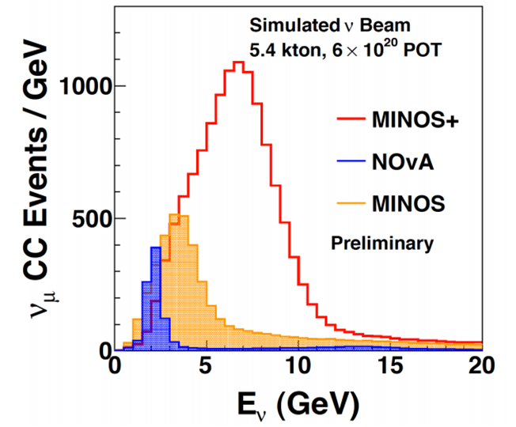
MINOS & MINOS+ Experiments
MINOS (Main Injector Neutrino Oscillation Search) is a long-baseline neutrino oscillations experiment which sampled the NuMI beam
MINOS+ is an extension of MINOS which sampled the NuMI beam in a medium-energy configuration

Slide 28
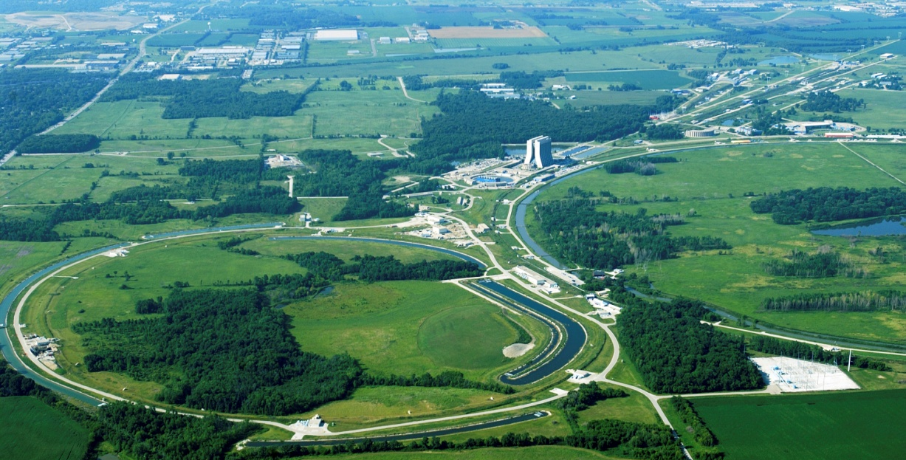
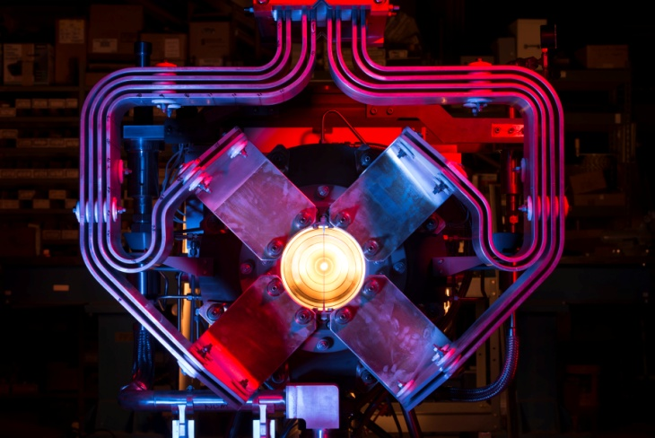
The NuMI Beam
120 GeV/c p from FNAL Main Injector
Upgraded NuMI Specs:
Rep rate: 1 spill/1.33sec
5e13 POT/spill
10 microseconds long
Beam power:
MINOS+ 560kW peak
Current Run 700kW
MINOS ND
Target Hall
NuMI beam in the diagram is configured to focus π⁺; results in a beam rich in muon neutrinos
Beam run with horn current reversed will focus π⁻ to produce optimized beam for muon antineutrinos

Slide 29
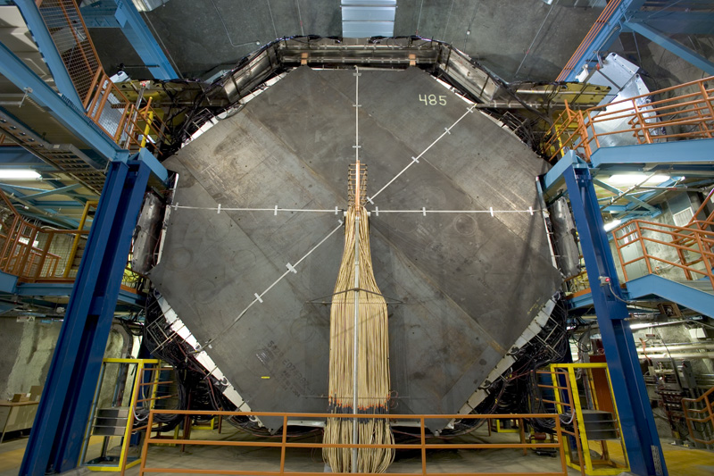
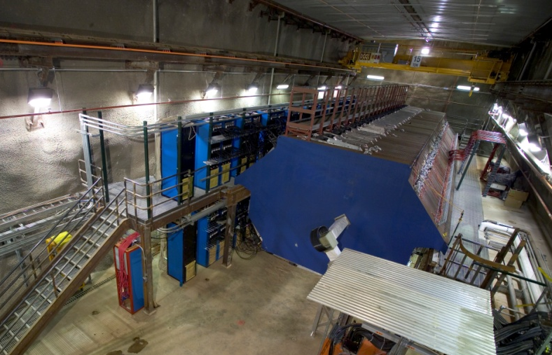
MINOS/MINOS+ Detectors
MINOS and MINOS+ use two functionally identical magnetized steel-scintillator tracking sampling calorimeters
Many systematic uncertainties cancel to first order
Veto Shield
8m
4.8m
3.8m
Coil
Beam Spot
Coil
Far Detector:
735 km downstream from target
5.4 kton total mass
4.2 kton fiducial mass
714 m depth
Near Detector:
1.04 km downstream from target
~ 1 kton (980 tons) total mass
23.7 ton fiducial mass
100 m depth

Slide 30
Integrated Proton Exposure
MINOS/MINOS+ collected a total of ~ 25 x 10²⁰ POT in 11 years of running
Current Analysis
Neutrinos
Neutrinos
Antineutrinos
Neutrinos
10.56 x 10²⁰ POT
MINOS
5.80 x 10²⁰ POT
MINOS+

Slide 31
Event Topologies

Slide 32
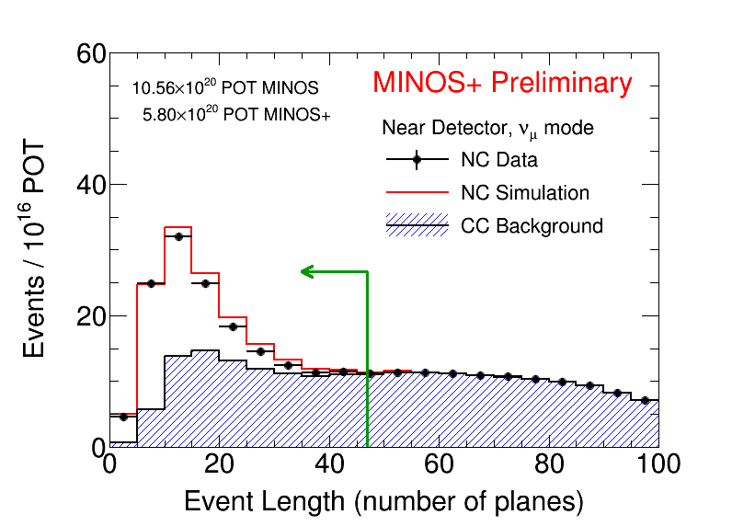
Neutral Current Event Selection
NC current interactions are selected after cleaning poorly reconstructed events
Events are selected based on the properties of hadronic showers and the absence of muon-like tracks
NC Selection Cuts:
Event Length
Extension of track beyond hadronic shower

Slide 33
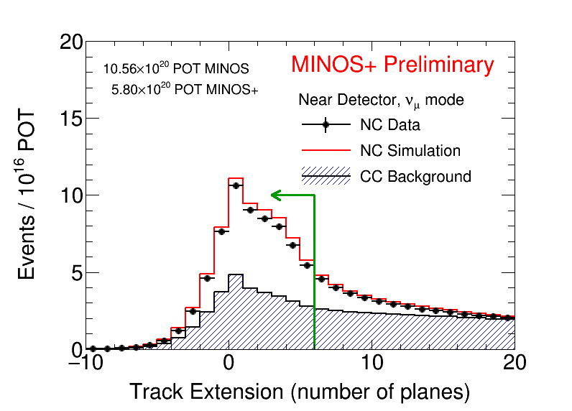
Neutral Current Event Selection
NC current interactions are selected after cleaning poorly reconstructed events
Events are selected based on the properties of hadronic showers and the absence of muon-like tracks
NC Selection Cuts:
Event Length
Extension of track beyond hadronic shower

Slide 34
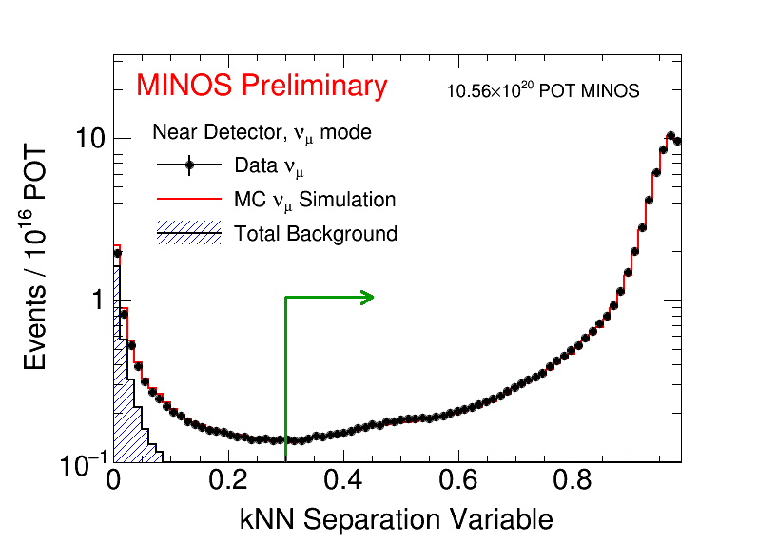
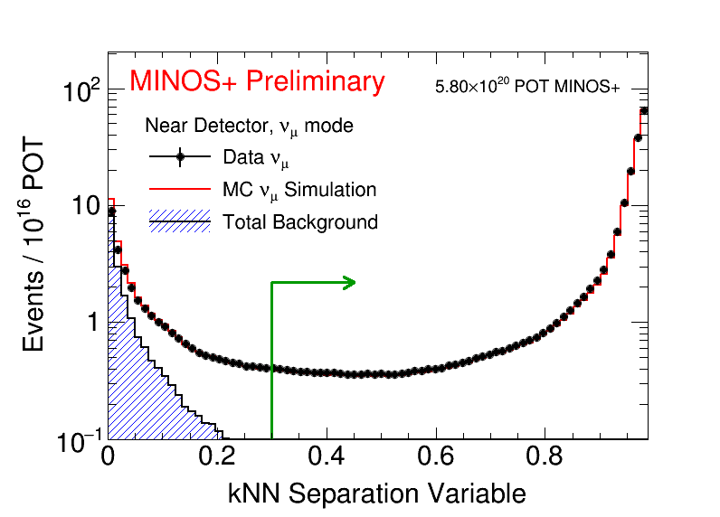
Charged Current Event Selection
Muons from ν_{μ} CC interactions identified using multivariate topological ID and a kNN algorithm with inputs:
Track Length
Energy deposition in transverse track profile
Mean dE/dx
Energy loss fluctuations
MINOS
ν_{μ} CC-like events
MINOS+

Slide 35
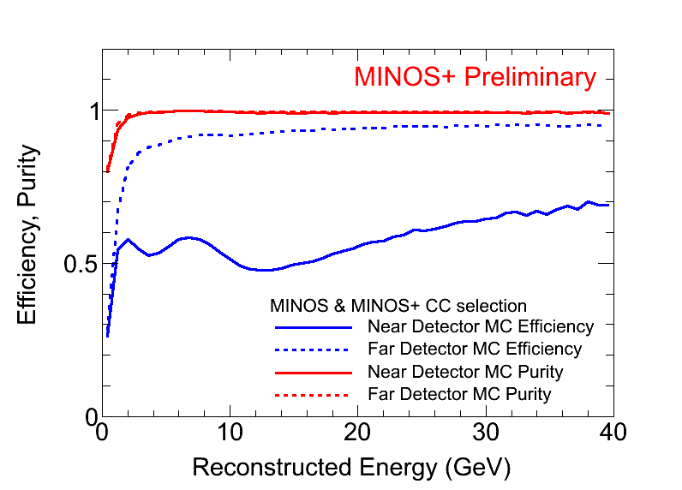
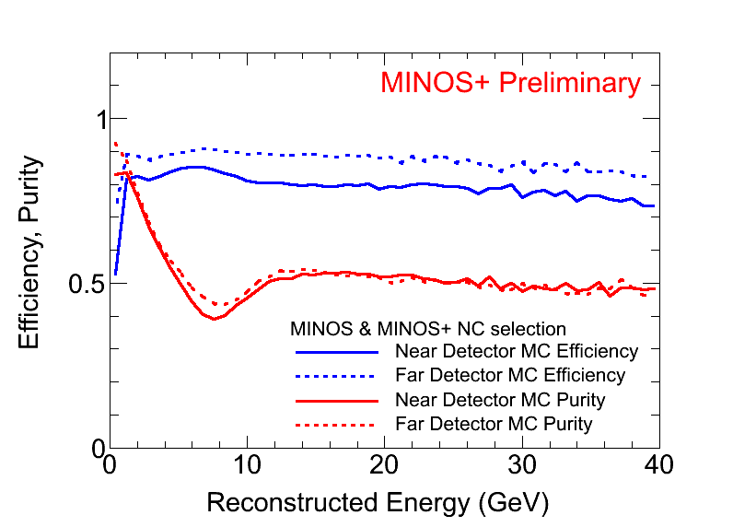
Selection Efficiency & Purity
CC selection:
ND efficiency reduced by tracks ending in the region of the magnetic coil
NC selection:
Purity reduced in both detectors due to the peaking of CC backgrounds
Overall selection efficiency >80% for both NC and CC events in the Far detector
CC
NC

Slide 36
Detecting Muon Neutrino Disappearance
Toy MC Simulation
Set by Nature
Propagation length determined by neutrino source, detector position
Collect a spectrum of neutrino energies to sample the probability

Slide 37
Detecting Muon Neutrino Disappearance
Toy MC Simulation
Neutrino oscillations cause rate depletion and spectral distortion
Unoscillated
Rapid oscillations smeared
Oscillated
First oscillation maximum

Slide 38
MINOS+ Three Flavor Oscillations
MINOS & MINOS+ data provide evidence for muon neutrino disappearance consistent with three flavor oscillations at the atmospheric mass-splitting scale

Slide 39
MINOS+ Three Flavor Oscillations

Slide 40
Comparison to Other Experiments
Normal Ordering
Inverted Ordering

Slide 41
Searching For Sterile ν’s

Slide 42
Three Flavor Oscillations Probability
Ratio of oscillated to unoscillated spectra corresponds to the oscillation probability:
Increasing L_{ν}/E _{ν}
Fixed L_{ν}
Increasing E _{ν}

Slide 43
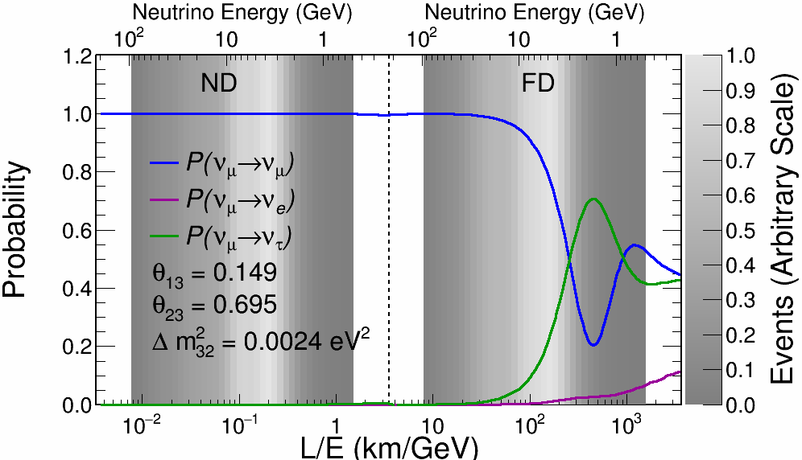
Three Flavor Oscillations Probability
Increasing E _{ν}
Increasing L_{ν}/E _{ν}

Slide 44
Three Flavor Oscillations Probability
Increasing E _{ν}
sin²(2θ_{μμ})
Increasing L_{ν}/E _{ν}

Slide 45
Three Flavor Oscillations Probability
Increasing E _{ν}
Δm²_{μμ}
Δm²
(1st osc. max)
10²
10
1
10⁻¹
10⁻²
10⁻³

Slide 46
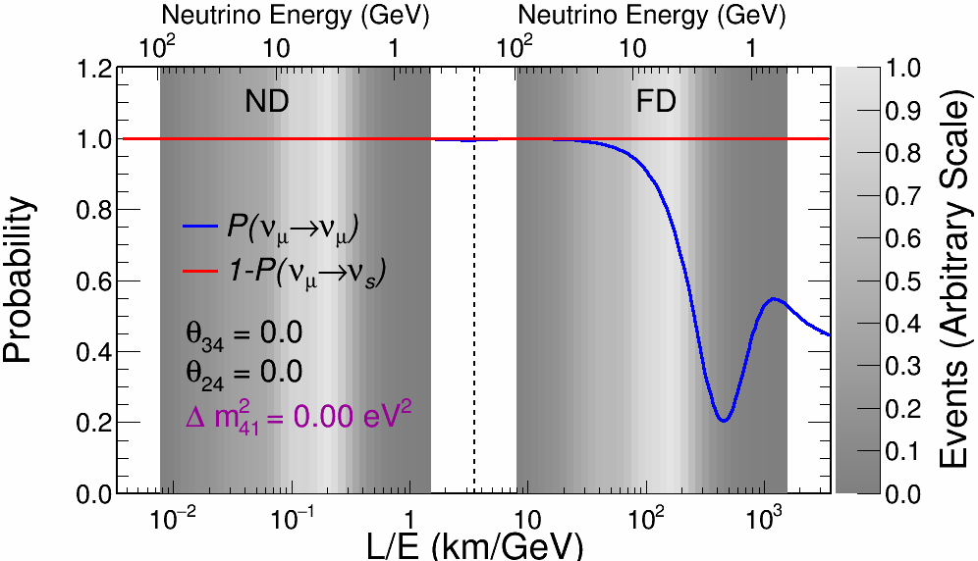
Three Flavor Oscillations Probability
Increasing E _{ν}
Δm²
(1st osc. max)
10²
10
1
10⁻¹
10⁻²
10⁻³

Slide 47
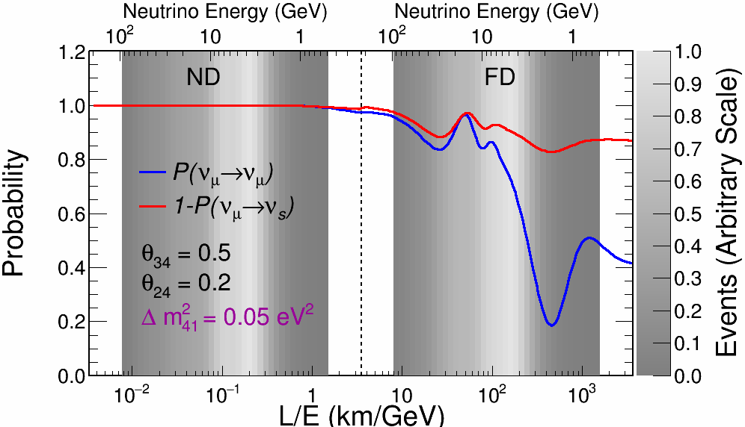
Sterile (3+1) Oscillations Probability
Increasing E _{ν}
Δm²
(1st osc. max)
10²
10
1
10⁻¹
10⁻²
10⁻³

Slide 48
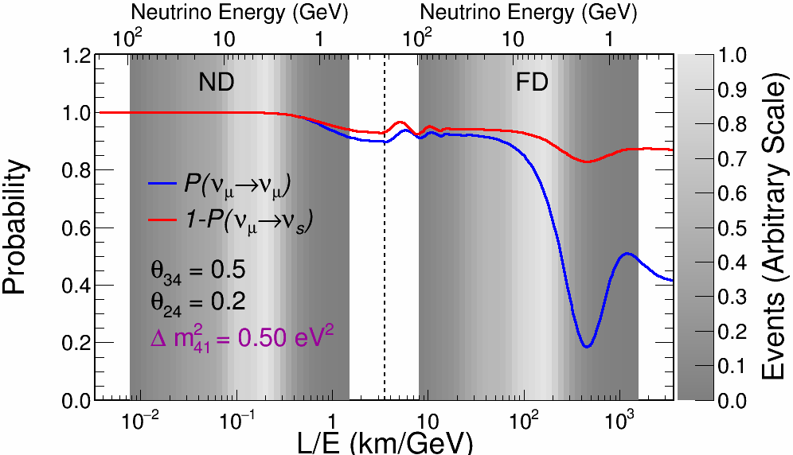
Sterile (3+1) Oscillations Probability
Increasing E _{ν}
Δm²
(1st osc. max)
10²
10
1
10⁻¹
10⁻²
10⁻³

Slide 49
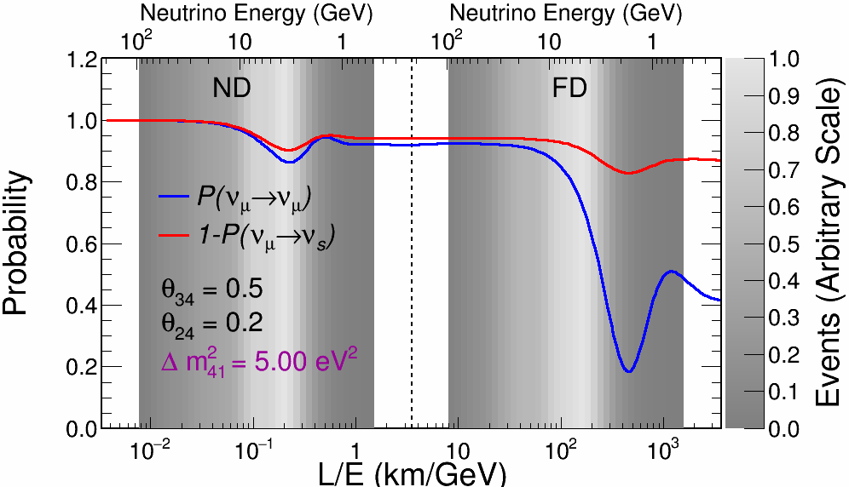
Sterile (3+1) Oscillations Probability
Increasing E _{ν}
Δm²
(1st osc. max)
10²
10
1
10⁻¹
10⁻²
10⁻³

Slide 50
An Improved Fit Paradigm

Slide 51
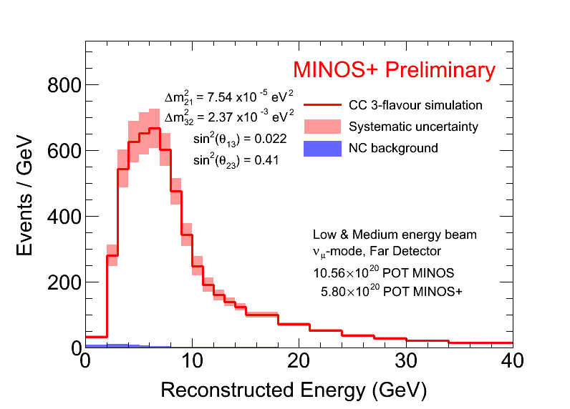
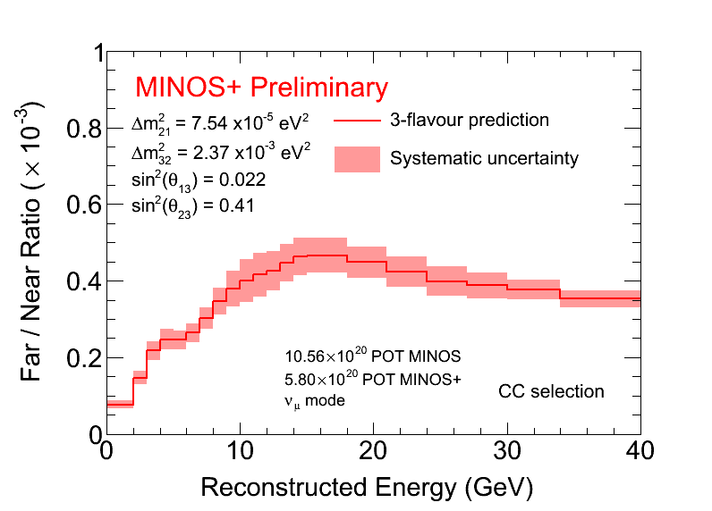
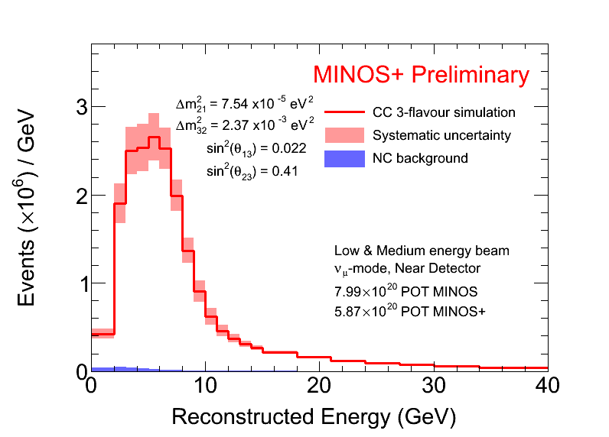
Sterile Search Paradigm
Previous MINOS sterile analyses used a Far-over-Near Ratio method for fitting
Far
Far
Near
Near

Slide 52
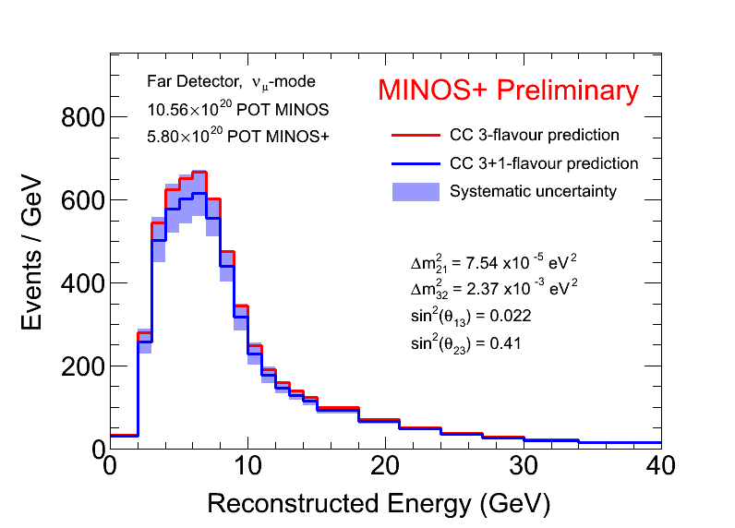
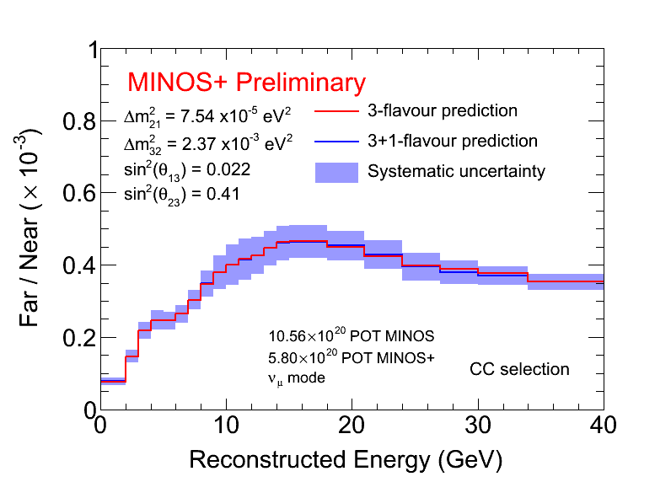
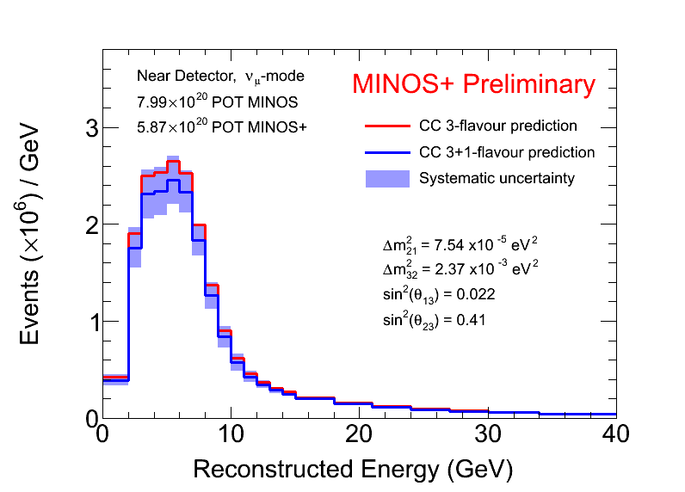
Sterile Search Paradigm
Here we present results using a simultaneous two-detector fit method, fully utilizing both detectors
Fit parameters:
{Δm²₄₁, Δm²₃₂, θ₂₃, θ₂₄, θ₃₄}
Parameters set to zero:
{θ₁₄, δ₁₃, δ₁₄, δ₂₄}
Far
Far
Near
Near
Sample Parameters:
θ₂₄ = 0.2;
Δm²₄₁ = 80.0 eV²;

Slide 53
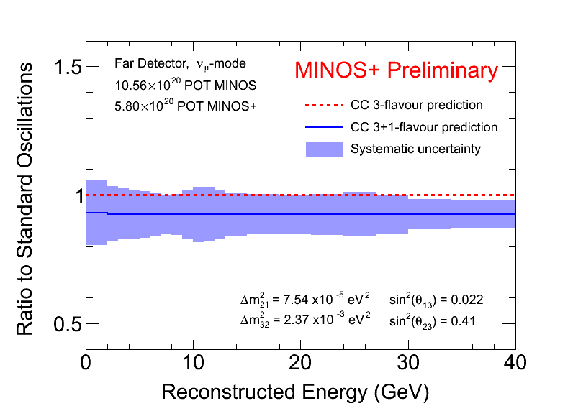
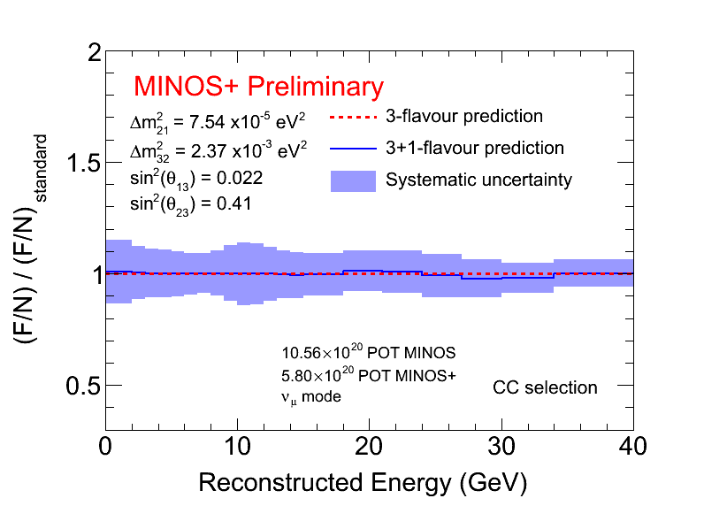
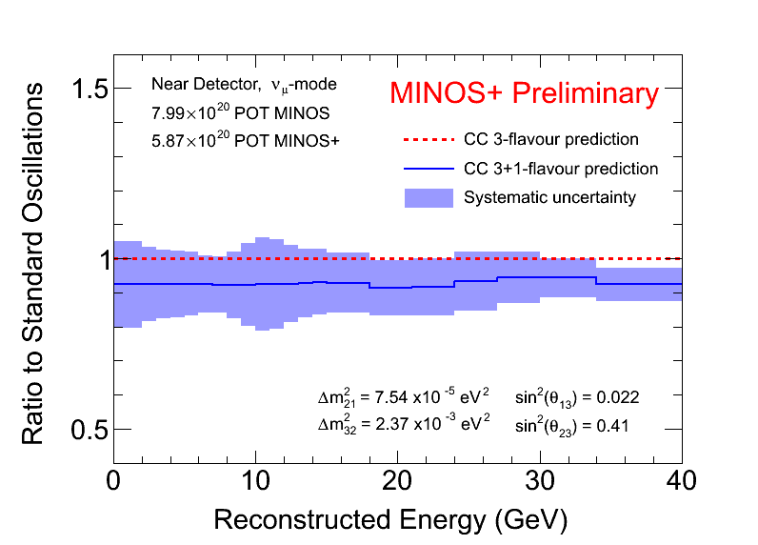
Sterile Search Paradigm
Here we present results using a simultaneous two-detector fit method, fully utilizing both detectors
Fit parameters:
{Δm²₄₁, Δm²₃₂, θ₂₃, θ₂₄, θ₃₄}
Parameters set to zero:
{θ₁₄, δ₁₃, δ₁₄, δ₂₄}
Far
Far
Near
Near
Sample Parameters:
θ₂₄ = 0.2;
Δm²₄₁ = 80.0 eV²;

Slide 54
Systematic Uncertainties
We consider 44 total sources of systematic uncertainty in five categories
Largest contributions arise from energy calibration uncertainty for NC events and cross-section uncertainties for CC events
Statistical and systematic uncertainties are incorporated via covariance matrix
Covariance matrix cross-terms allow for cancellation of uncertainties
Sources of Systematic Uncertainty

Slide 55
Covariance Matrix Behavior
-1
σ_{F}²
σ_{FN}
σ_{N}²
σ_{FN}
Δ_{F}
Δ_{N}
1
[V⁻¹] =
,
σ_{FN}
σ_{N}²
k
σ_{FN}
σ_{F}²
Δ_{F}
Δ_{N}
Δ_{F}
σ_{N}²
σ_{FN}
,
χ² ~
σ_{FN}
σ_{F}²
Δ_{N}
Δ_{F}
2
Δ_{N}
σ_{N}²
σ_{F}²
2
σ_{FN}
Δ_{N}
Δ_{F}
χ² ~ 2

Slide 56
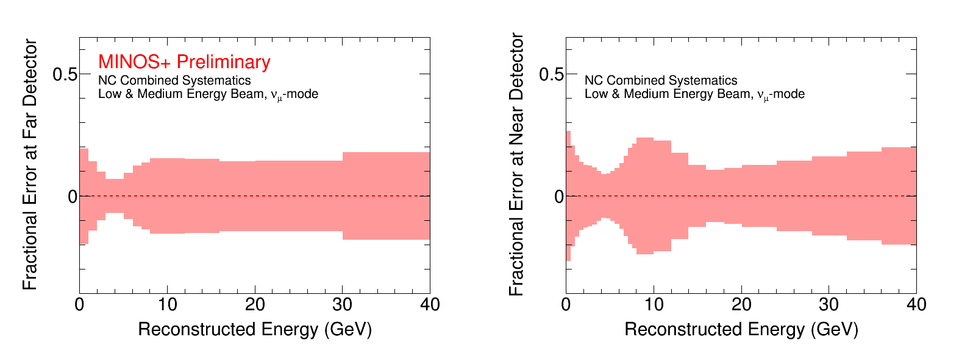
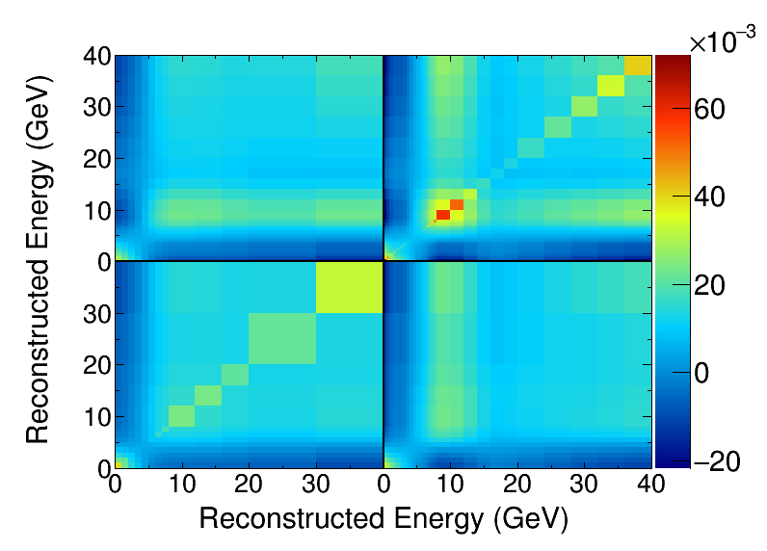
Neutral Current Systematic Uncertainties
Far
Near
Full Covariance Matrix
Near x Far
Near x Near
Far x Far
Far x Near

Slide 57
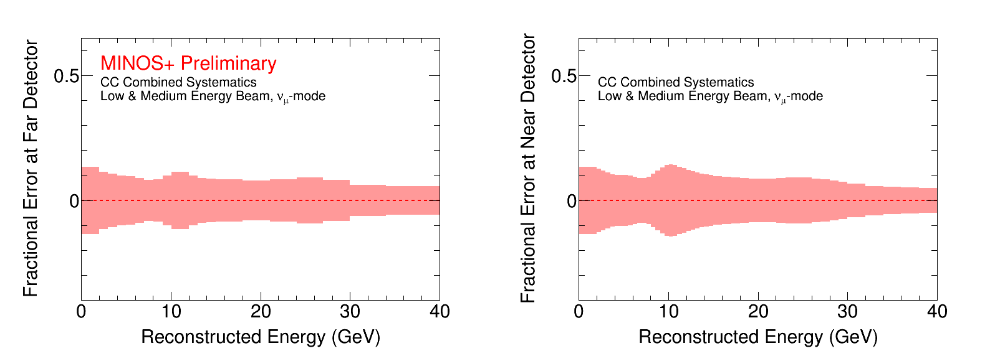
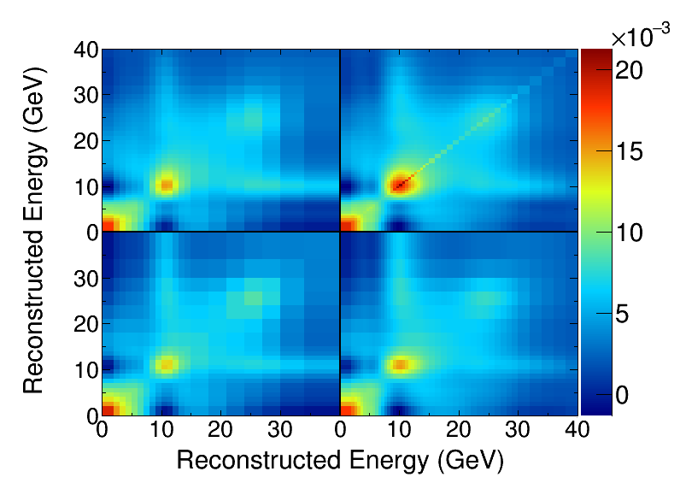
Charged Current Systematic Uncertainties
Far
Near
Full Covariance Matrix
Near x Far
Near x Near
Far x Far
Far x Near

Slide 58
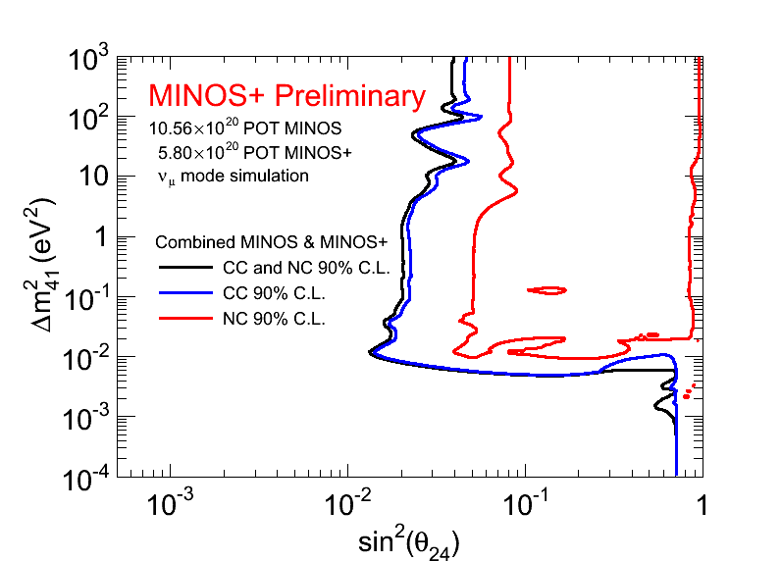
Experimental Sensitivity
Sensitive to:
θ₂₄ ≥ 0.2;
Near Detector
dominates
θ₂₄ ≥ 0.14;
Far Detector dominates
NC oscillations with
Δm²₄₁ ~ Δm²₃₂ or
Δm²₄₁ < Δm²₃₂

Slide 59
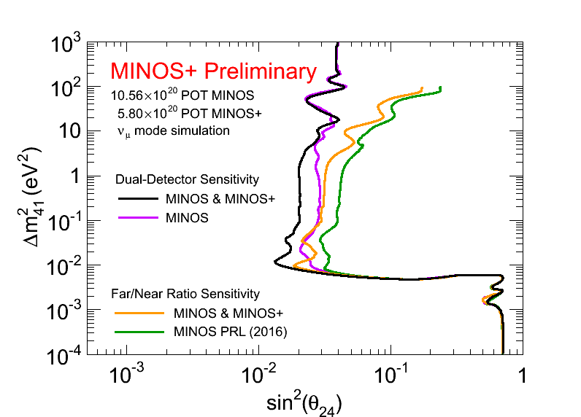
Improving the Sterile Search
Sensitivities are calculated using the two fit methods indicated
Far/Near ratio methods lose coverage in Near Detector dominated region
Phys. Rev. Lett. 117, 209901 (2016)

Slide 60
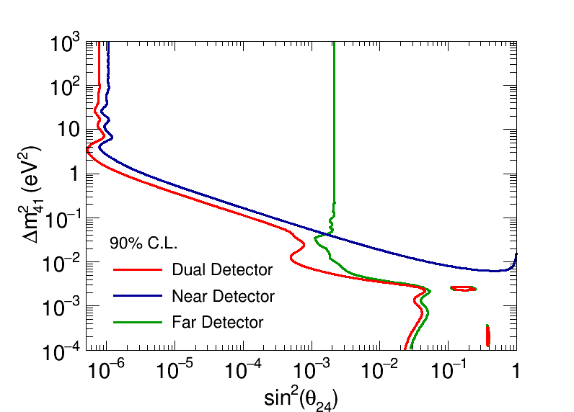
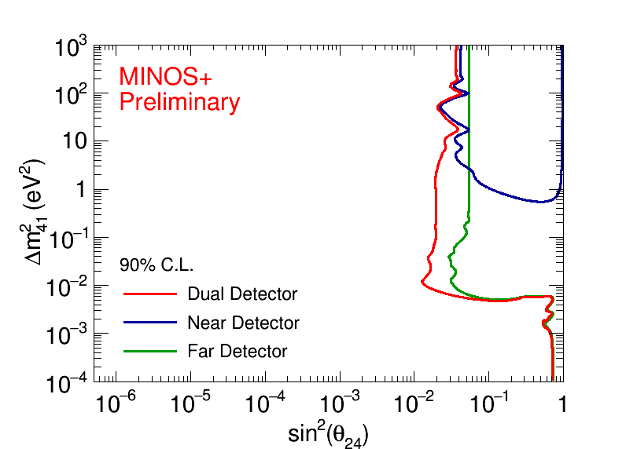
Individual and Joint Detector Sensitivity
Statistical Uncertainty Only
+ Systematic Uncertainty
Statistics only fit is dominated by the ND for mass-splitting scales larger than 0.05 eV²
~22.2 million CC events observed in the ND
~6300 CC events in FD
FD assists ND with small, flat increase in sensitivity due to deficit cross-check
ND significantly cancels systematic uncertainties in FD yielding factor of 2 improvement

Slide 61
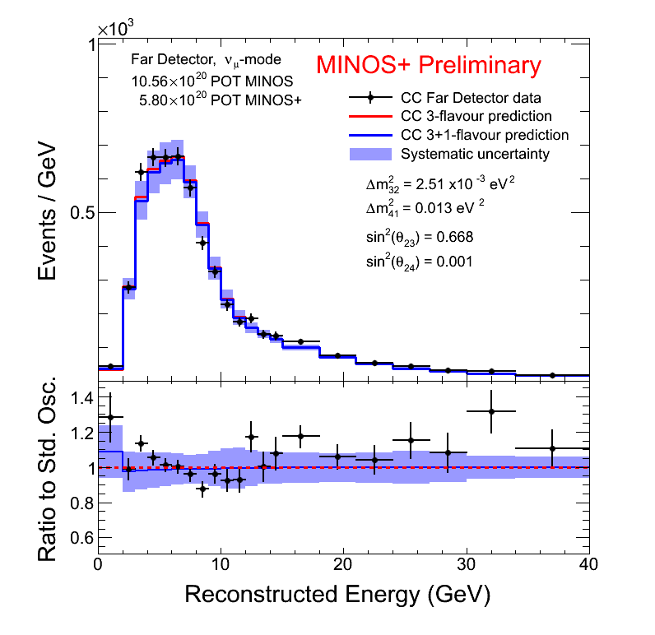
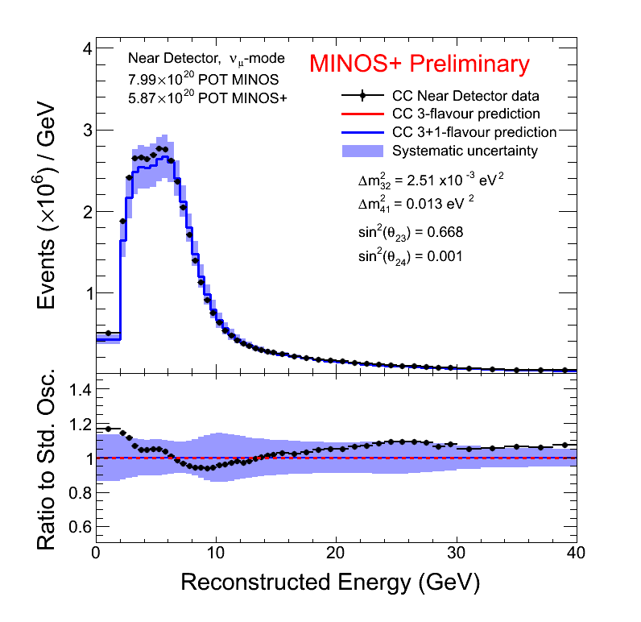
Data Reconstructed Energy Spectra
CC Events
Far
Near

Slide 62
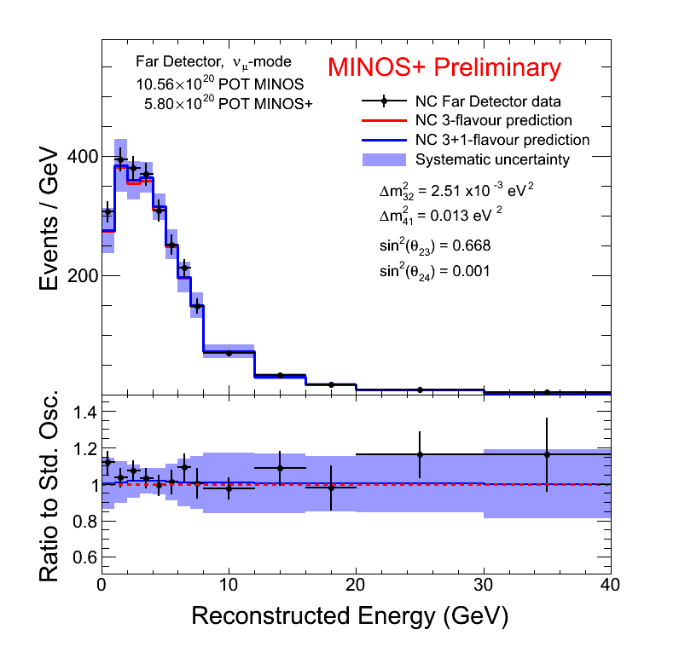
Data Reconstructed Energy Spectra
NC Events
Far
Near

Slide 63
Exclusion Limit for Δm²₄₁ vs. θ₂₄
Limit is constructed using Unified Approach of Feldman and Cousins
MINOS & MINOS+ data excludes parameter space over seven orders of magnitude in Δm²₄₁
The exclusion limit falls within the 2σ expected sensitivity band which accounts for the effects of systematic fluctuations

Slide 64
Comparison with Other Experiments
New limit improves constraint of the previous MINOS analysis
Constraint improved by Near Detector contribution for
Δm²₄₁ > 4 eV²
Increased tension with global best fit
Displayed in this parameter space by setting:
*S. Gariazzo, C. Giunti, M. Laveder, Y.F. Li, E.M. Zavanin, J.Phys. G43 033001 (2016)

Slide 65
Experimental Combinations

Slide 66
Combining Independent Experiments
We want to compare MINOS/MINOS+ disappearance limits to the LSND and MiniBooNE appearance allowed regions
In the 3+1 flavor model, we can accomplish this by combining with a reactor electron antineutrino disappearance limit
MINOS/MINOS+:
Daya Bay/Bugey-3:
LSND:

Slide 67
MINOS+ Disappearance Limits
MINOS/MINOS+ limit recalculated using CLs method
Exclusion limit results are consistent between two independent methods

Slide 68
Combination Strategy
For each row of fixed Δm²₄₁, compute the combined limit in the appearance parameter space
Convert CL_{s} from a surface in the 2D space (sin²2θ₁₄, sin²θ ₂₄) to a 1D space in sin²2θ_{μe}
sin²2θ_{μe} = sin²2θ₁₄sin²θ ₂₄
Largest CLs value is the conservative choice
For each fixed Δm²₄₁, calculate CL_{s} for all combinations in the space (sin²2θ₁₄, sin²θ₂₄)

Slide 69
MINOS & Daya Bay/Bugey-3
Previous combination of MINOS data with Daya Bay/Bugey-3 resulted in a strong 90% C.L. limit which excludes appearance allowed regions for Δm²₄₁< 1 eV²
*S. Gariazzo, C. Giunti, M. Laveder, Y.F. Li, E.M. Zavanin, J.Phys. G43 033001 (2016)
^J. Kopp, P. Machado, M. Maltoni, T. Schwetz, JHEP 1305:050 (2013)
Combined : Phys. Rev. Lett. 117, 151801
MINOS : Phys. Rev. Lett. 117, 151803
Daya Bay : Phys. Rev. Lett. 117, 151802

Slide 70
New Combined Result
Preliminary result of the ongoing collaborative effort between MINOS/MINOS+ and Daya Bay (with inclusion of Bugey-3 data)
Significant increase in the constraint at Δm²₄₁ > 10 eV² due to two-detector fit method, as expected
A new combination with a larger Daya Bay data set is planned
*S. Gariazzo, C. Giunti, M. Laveder, Y.F. Li, E.M. Zavanin, J.Phys. G43 033001 (2016)
^J. Kopp, P. Machado, M. Maltoni, T. Schwetz, JHEP 1305:050 (2013)

Slide 71
New Combined Result
Preliminary result of the ongoing collaborative effort between MINOS+/MINOS and Daya Bay (with inclusion of Bugey-3 data)
Significant increase in the constraint at Δm²₄₁ > 10 eV² due to two-detector fit method, as expected
A new combination with a larger Daya Bay data set is planned
*S. Gariazzo, C. Giunti, M. Laveder, Y.F. Li, E.M. Zavanin, J.Phys. G43 033001 (2016)
^J. Kopp, P. Machado, M. Maltoni, T. Schwetz, JHEP 1305:050 (2013)

Slide 72
Summary and Future Plans
MINOS & MINOS+ are continuing to lead the search for sterile neutrinos in muon neutrino disappearance in long-baseline experiments
A new two-detector fit method, better utilizing both MINOS+ detectors, has been developed and implemented successfully
MINOS+ finds no evidence of sterile neutrino mediated oscillations in a (3+1)-flavor model
New bounds increase the already strong tension with the global allowed region
MINOS & MINOS+ data place a strong exclusion limit in the muon neutrino disappearance parameter space, spanning seven orders of magnitude!
Combination between MINOS/MINOS+ and Daya Bay/Bugey-3 sets a more constraining upper bound in electron neutrino appearance space for high Δm²₄₁
Additional 50% statistics still to analyze from MINOS+
Electron neutrino appearance, and a Large Extra Dimension analysis still to come…stay tuned to MINOS+ !

Slide 73
Thank You from MINOS+
The MINOS+ Collaboration would like to express our sincere thanks to the many Fermilab groups who provided technical expertise and support in the design, construction, installation and operation of the experiment
We wish to thank the crew at the Soudan Underground Laboratory for their efforts in maintaining and running the Far Detector
We also gratefully acknowledge financial support from DOE, STFC(UK), NSF and thank the University of Minnesota and Minnesota DNR for hosting us

Slide 74
Backup

Slide 75
Beyond Three Flavor Oscillations?
Evidence For:
Null Result:
NOMAD
Search for electron neutrino appearance in
muon neutrino beam
Data consistent with no oscillations case
Astier, P. et al. Phys. Lett. B570 (2003) p. 19-31.

Slide 76
Beyond Three Flavor Oscillations?
Evidence For:
Null Result:
Cosmology
Planck sets bounds on parameters of the power spectrum of the Cosmic Microwave Background
N_{eff}
m_{eff}^{Sterile}
Bounds can be recomputed for oscillations parameter space
Bridle et al. Phys.Lett. B 764 (2017) 322

Slide 77
Global (3+1) Flavor Fits including MINOS Data
Phys. Rev. Lett. 117, 221801 (2016)
DOI: 10.1103/PhysRevLett.117.221801
Gariazzo et al. (2017). arXiv: 1703.00860 [hep-ex]

Slide 78
MINOS+ Data Checks
CC
NC
Far Detector selected event rates remained stable over the course of two years of MINOS+ running
Vertex locations of selected events in the Far Detector uniformly distributed within the fiducial volume
Event Vertices

Slide 79
Beam Hadron Composition
Using truth information this plot shows the NuMI beam composition for the
combination of low (MINOS) and medium energy (MINOS+) configurations as neutrinos
(both CC and NC) interact within the MINOS ND as a function of true energy in Monte Carlo simulation.

Slide 80
Near Detector Baseline Variations
Plotted is the distance travelled by CC neutrino events which have decayed
from their parent hadron which interact inside the ND in Monte Carlo simulation. Note the target is at the far right
and the end of the decay pipe is at the far left. To explain further, events that are produced
at the target will have to travel the full 1.04km to the ND, hence why the target is on the
right of this plot.

Slide 81
MINOS+ Physics

Slide 82
MINOS+ Physics

Slide 83
Detector Instrumentation
Magnetized steel plates with scintillator strip/PMT instrumentation
Steel thickness: 2.54 cm
Intraplane distance: 5.96 cm
Magnetized with a B-field ~1.3T
Range and curvature energy estimation for μ tracks
Distinguish between μ+ and μ- tracks
U V U V U V U V U V

Slide 84
Pile-Up Effects
Occupancy of the Near Detector during beam spill requires time and space slicing
Split events with showers may fake NC events
Pre-selection cleaning cuts:
Consecutive planes with signal
Pulse height fraction
Fake NC Event

Slide 85
Charged Current Event Selection
Muon tracks from ν_{μ} CC interactions selected by a kNN algorithm operating in a 4-dimensional multivariable topology
kNN Input Variables:
Track Length
Mean dE/dx along the track
Energy loss fluctuations along the track
Energy deposition in transverse track profile

Slide 86
Charged Current Event Selection
Muon tracks from ν_{μ} CC interactions selected by a kNN algorithm operating in a 4-dimensional multivariable topology
kNN Input Variables:
Track Length
Mean dE/dx along the track
Energy loss fluctuations along the track
Energy deposition in transverse track profile

Slide 87
Charged Current Event Selection
Muon tracks from ν_{μ} CC interactions selected by a kNN algorithm operating in a 4-dimensional multivariable topology
kNN Input Variables:
Track Length
Mean dE/dx along the track
Energy loss fluctuations along the track
Energy deposition in transverse track profile

Slide 88
Charged Current Event Selection
Muon tracks from ν_{μ} CC interactions selected by a kNN algorithm operating in a 4-dimensional multivariable topology
kNN Input Variables:
Track Length
Mean dE/dx along the track
Energy loss fluctuations along the track
Energy deposition in transverse track profile

Slide 89
Simulated Energy Spectra with Backgrounds
CC Events
Far
Near

Slide 90
Simulated Energy Spectra with Backgrounds
NC Events
Far
Near

Slide 91
Effect of Systematic Uncertainties
We consider 44 total sources of systematic uncertainty in five categories
Largest contributions arise from energy scale uncertainty for NC events and cross-section uncertainties for CC events
Statistical and systematic uncertainties are incorporated via covariance matrix
Covariance matrix cross-terms allow for cancellation of uncertainties

Slide 92
Injected Signal Validation
A sterile neutrino signal was introduced into the fit framework from the allowed region of the most recent global best fit point
Parameters:
θ₂₄ = 0.15
Δm²₄₁ = 1.65 eV²
Gariazzo et al. J.Phys. G43 (2016) 033001
DOI:10.1088/0954-3899/43/3/033001

Slide 93
Injected Signal Test Spectra
CC Events
Far
Near

Slide 94
Injected Signal Test Spectra
NC Events
Far
Near

Slide 95
Injected Signal Validation
A sterile neutrino signal was introduced into the fit framework from the allowed region of the most recent global best fit point
Parameters:
θ₂₄ = 0.15
Δm²₄₁ = 1.65 eV²
The signal is recovered:
Method is functioning as expected
Global best fit region is accessible to the fit

Slide 96
CLs Method in MINOS+
For each (Δm²₄₁, θ₂₄) point:
Generate 3-flavor pseudo experiments using PDG parameters
Generate 4-flavor pseudo experiments using the current (Δm²₄₁, θ₂₄) point
Set θ₂₃, θ₃₄, and Δm²₃₂ to the best fit to data at each grid point
Fit each fake experiment to both the 3-flavor and 4-flavor hypotheses to build the Δχ² distributions
H1 is excluded at ≥ (1-α) C.L if CLs < α

Slide 97
Combination Strategy
For each point in the parameter space, combine Δχ² distributions

Slide 98
Sterile Neutrino Search Overview
MC Simulation, Reconstruction
Evaluate Systematic Uncertainty
Select NC Event Samples
Select CC Event Samples
Data Collection, Calibration, Reconstruction
Steps above are completed prior to fitting…

Slide 99
Sterile Neutrino Search Overview
Evaluate Systematic Uncertainty
Steps below are done during fitting…
Select NC Event Samples
Select CC Event Samples
Oscillate
FD NC Prediction
ND NC Prediction
FD CC Prediction
ND CC Prediction
FD+ND NC
Prediction
FD+ND NC
Data
FD+ND CC
Data
FD+ND CC
Prediction
Minimize test statistic to quantify evidence for oscillations hypothesis
Covar NC
Covar CC
χ² Total
χ² NC
χ² CC

