Slide 1
AI-on-chip: Microelectronics for enabling data reduction at source
An Engineer’s perspective
Farah Fahim
User’s meeting
June 15, 2022

Slide 2
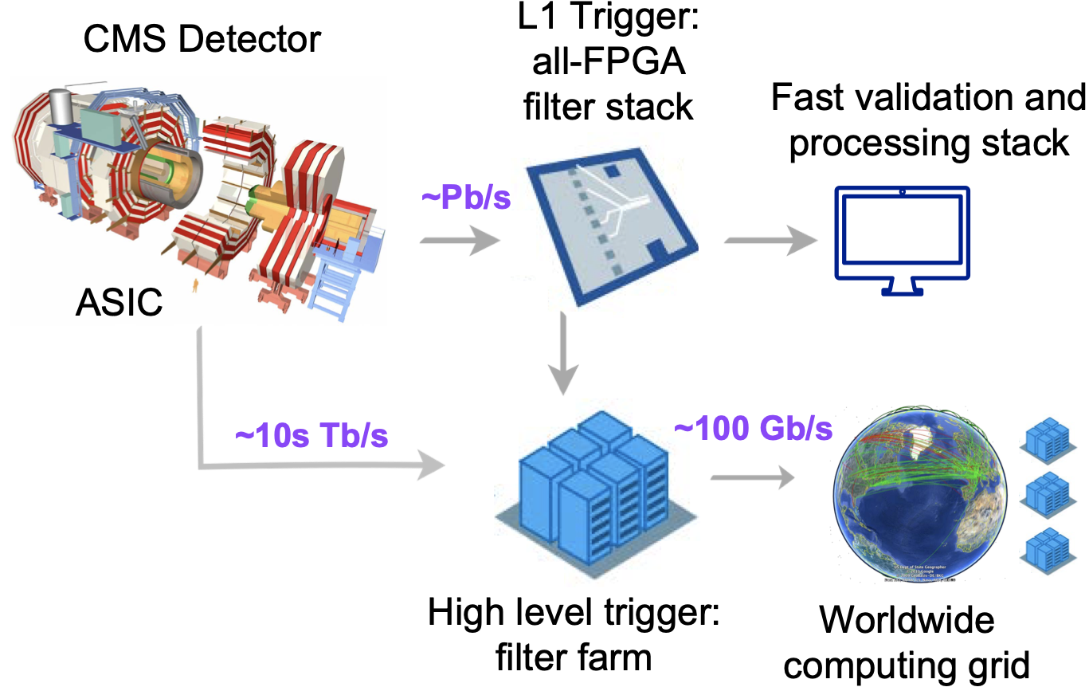
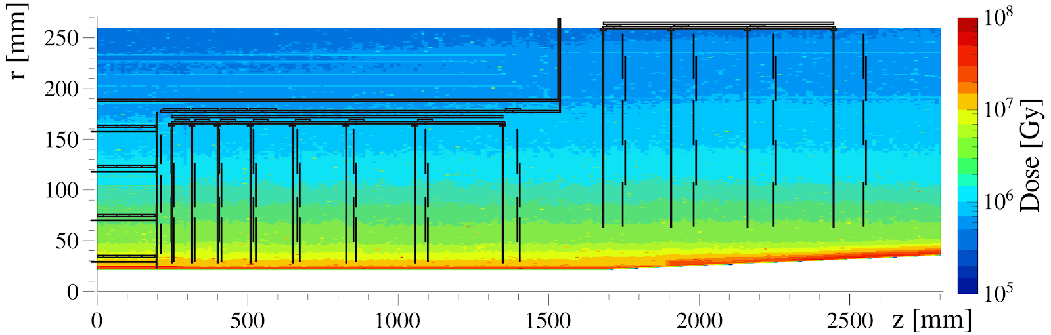
Major challenges at HEP detectors
EXTREME RADIATION ENVIRONMENT
E.g. HL LHC: Total ionizing dose : ~ 1 Grad
Single event effects :
Flux of > 20 MeV hadrons = 10 MHz/cm²
Target 1 error every ~10s for 6M channel detector.
Radiation tolerant design and Triple Modular Redundancy for SEE mitigation
OCCUPANCY
LHC: 50 pile up to HL-LHC: 200 pile up
Requires more granular detectors → increasing data volume, power consumption, more complex on-detector electronics
DATA VOLUME
On detector data compression of 4 – 15% eventually better than < 1%

Slide 3
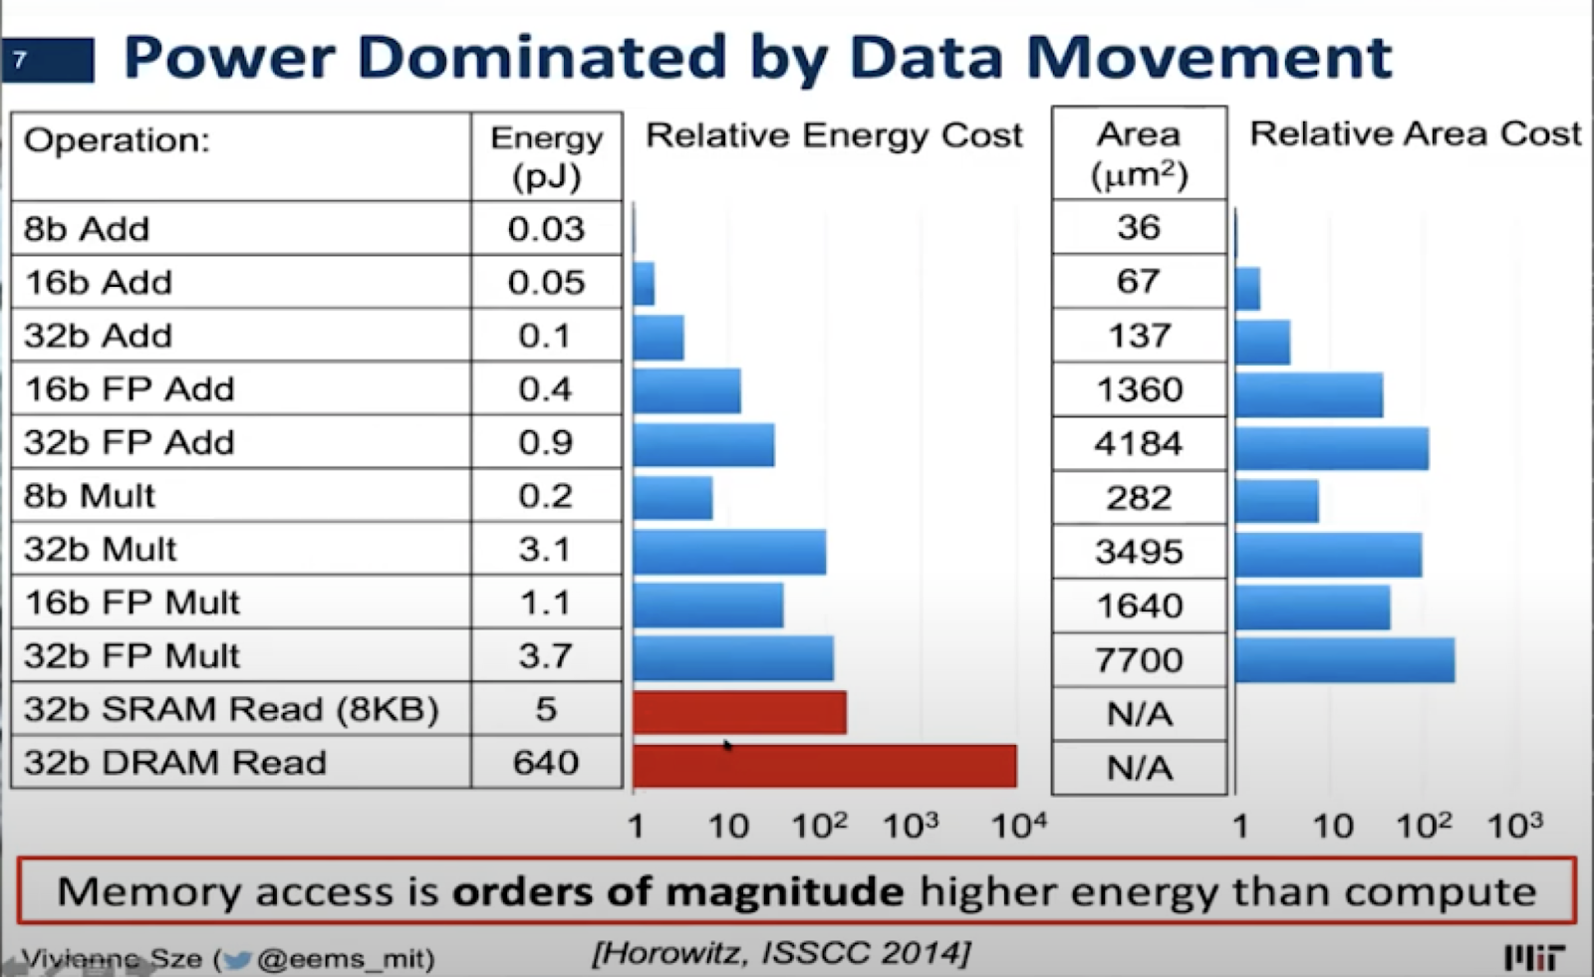
Why do we need data processing on the edge
POWER: CV²f x (data volume) problem
Total power consumption to move data from pixel to periphery: 1 pJ/bit (~ 5mm distance)
Total power consumption to move data off-chip: > 0.1 nJ/bit
Minimize C,V
3D Integration (high density, low capacitance interconnect)
Low voltage signaling
Reduce data
Typically just zero-suppression for on-detector electronics – OK for sparce data
HL LHC:
Higher granularity, higher occupancy, higher precision
=> needs NEW APPROACH

Slide 4
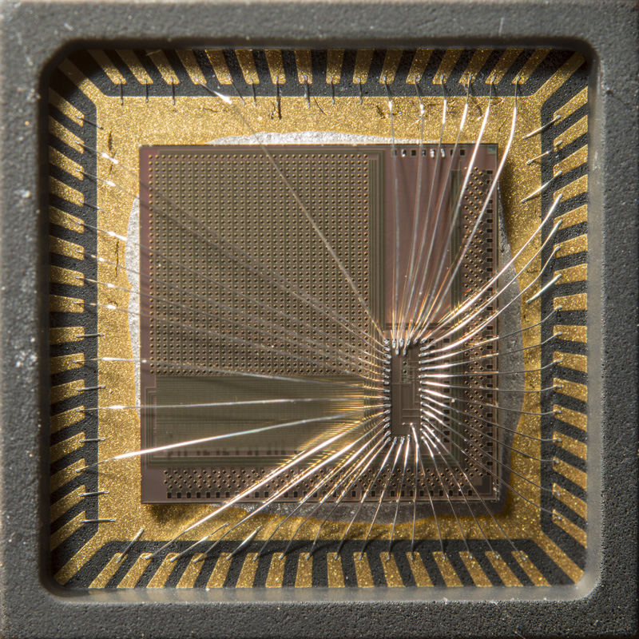
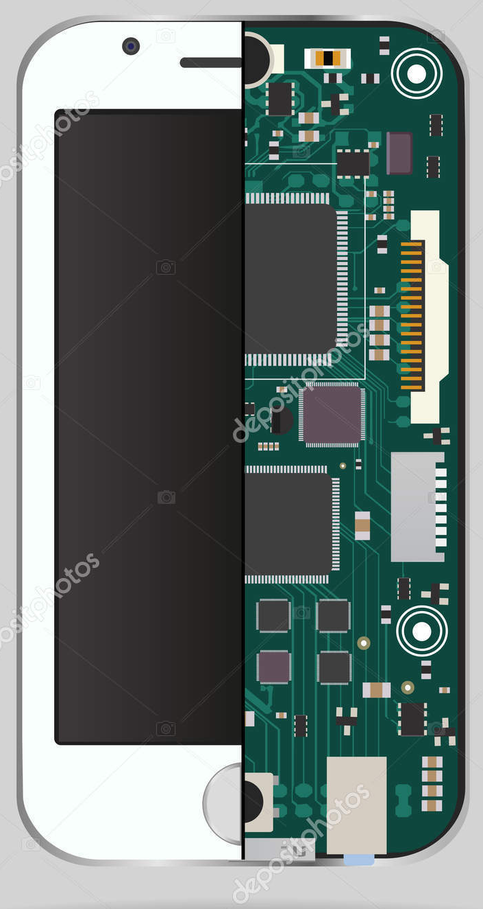
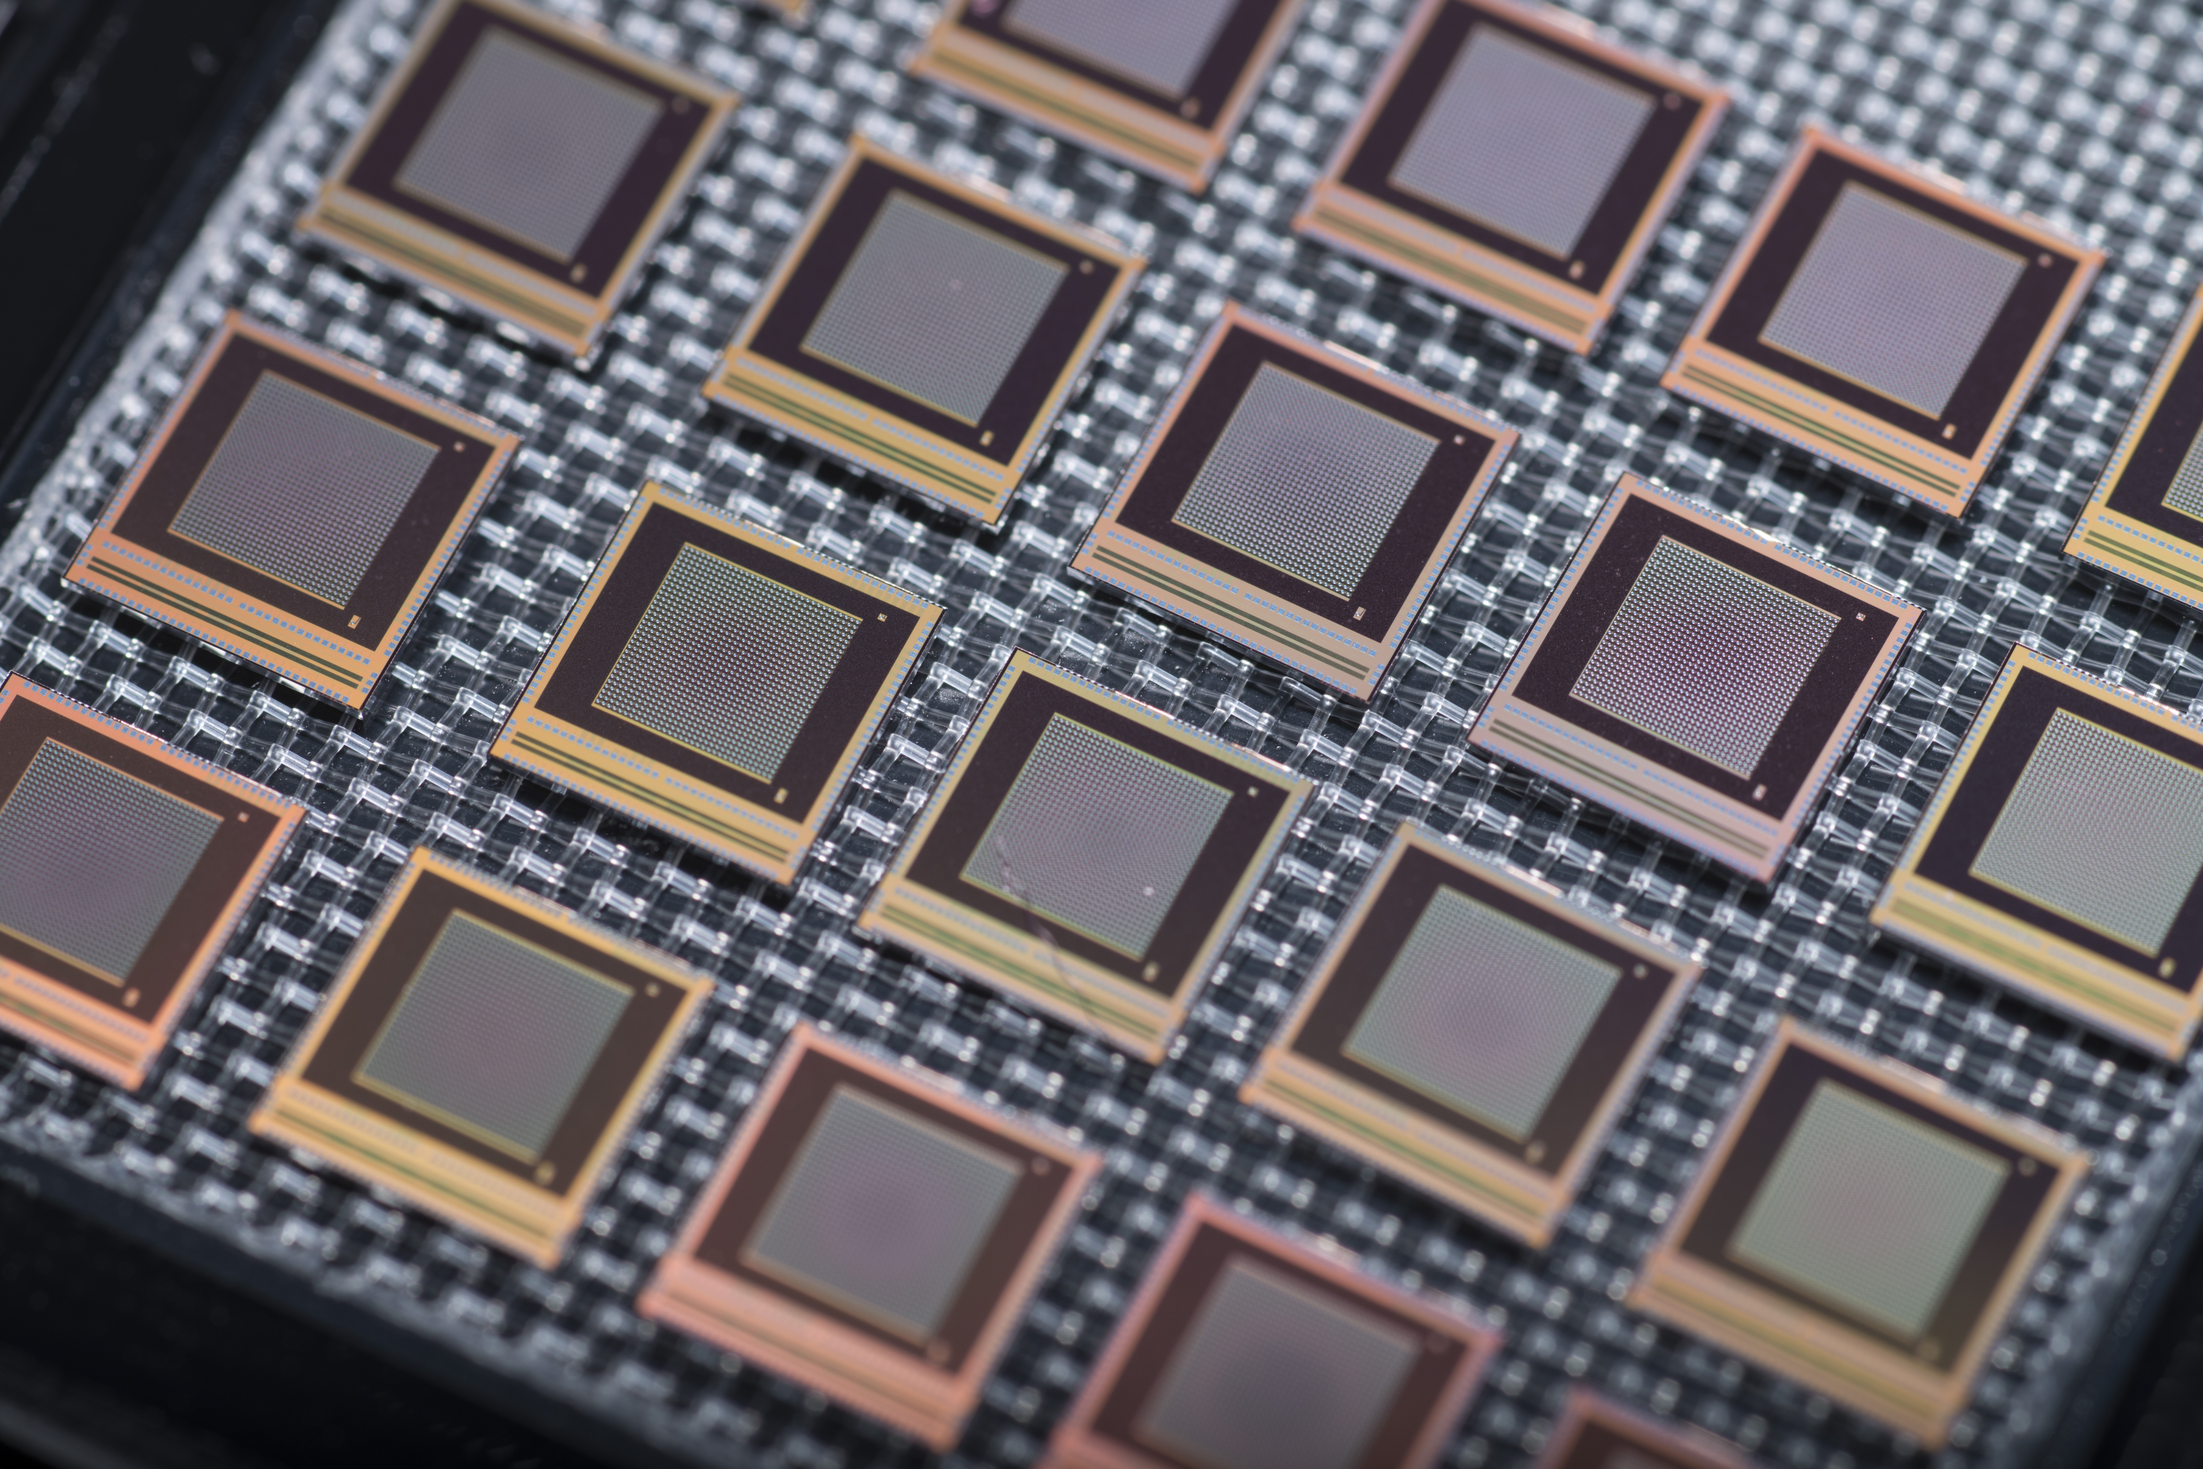
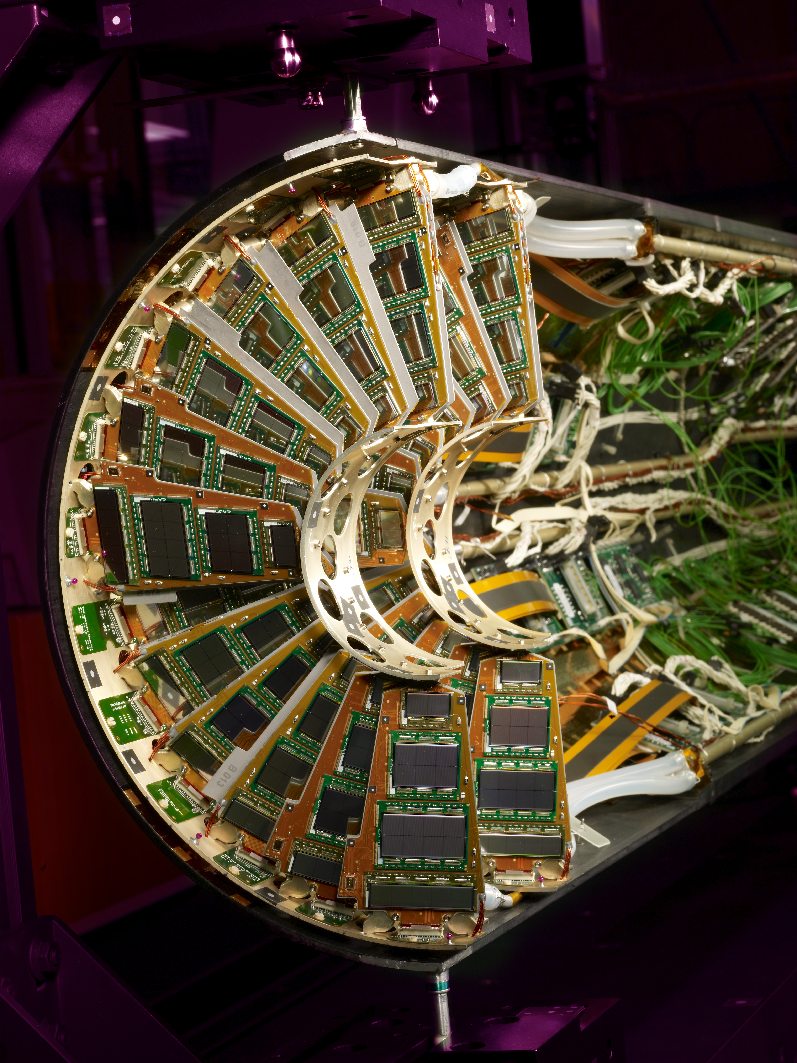
Fermilab Microelectronics Capabilities and Mission
ACADEMIC RESEARCH
INDUSTRY – PRODUCT DRIVEN
NATIONAL LABS: ADVANCED SCIENTIFIC INSTRUMENTATION
Support interdisciplinary research
Enables new scientific discovery and foundational engineering
Novel solutions
Mission: new knowledge and education of students
Support scientific experiments operating in extreme environments
Mid-size scaling for large experiments
Mission: robust performance over several decades
Support consumer electronics
Mature designs
Mission: incremental product driven design

Slide 5




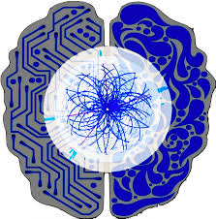


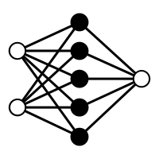
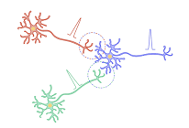

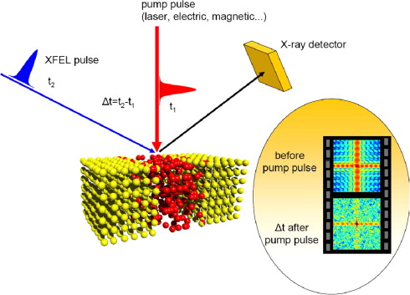
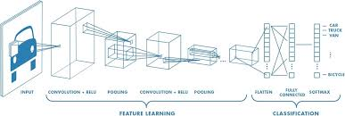
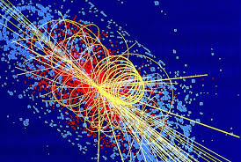
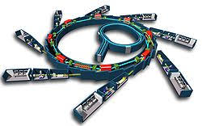
Co-design: Physics – Algorithm – Microelectronics Hardware
System on Chip
Heterogenous System in Package
Digital scaling / Mixed signal approach
Integrated non-volatile memory / 3DIC / Wireless (5G)
Resource constrained environment
  High Radiation
  Limited Power/Material budget
  Where should this intelligence be added ?
Efficiency and reconfigurability
  Ultra-low energy per inference at extremely high rates (10’s ns)
  Reprogram both network and parameters
  On-chip learning / inference
Physics based Algorithms
  Independent events
  Depth vs. classification
  Compression vs. filtering
Hardware
Interdisciplinary
Codesign
Efficiency and Reconfigurability
Resource constrained extreme environment
AI
Physics
Physics based distributed AI
HL-LHC / XFEL / Synchrotron light sources
CNN / SNN/ Transfer learning/ Distributed AI

Slide 6
Step 1: How to do it? Establish design methodology

Slide 7
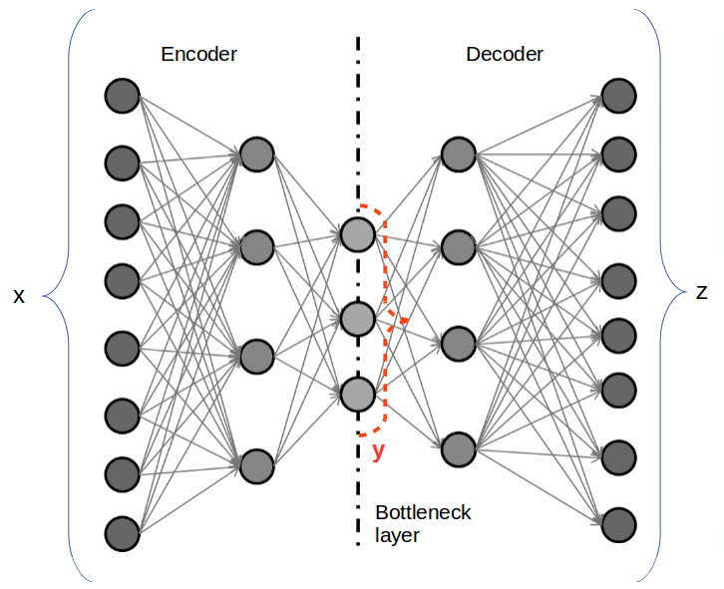
Deep Neural Network: Autoencoder for data-compression
Compressed data
- Efficient power and bandwidth usage
On-detector ASIC
Original data
Decoder
Encoder
Reprogrammable weights
Off-detector FPGA
Reconstructed data
Rate: 40MHz
Work in latent space
Pruned network
Full decoding with mirror weights
reconfigurable
Enable edge compute : Data compression for efficient usage of power and bandwidth
Programmable and Reconfigurable: ability to reprogram weights to adjust for detector conditions and eventually lead to self-learning intelligent detectors
Hardware – Software codesign : Algorithm driven architectural approach
Optimized : Low power and Low latency
Operating in extreme radiation environment: 200 M rad
Autoencoder for data compression is the first use case towards a DNN based on-chip learning and inference

Slide 8
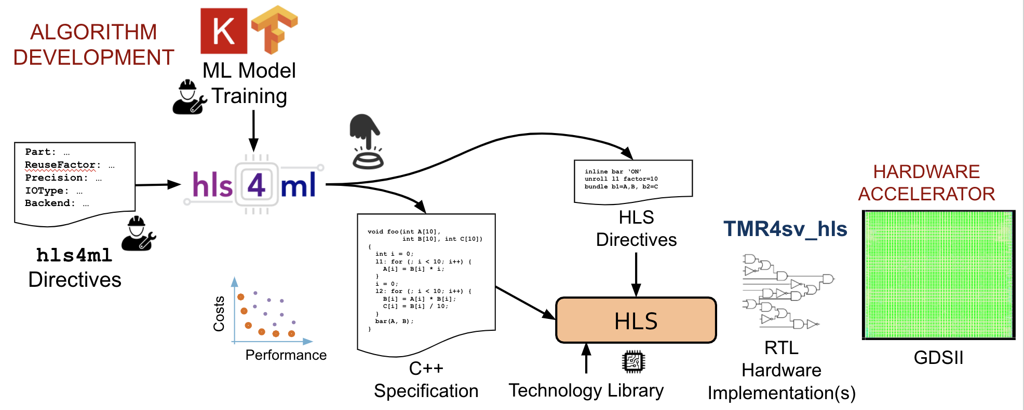
Physics Driven Hardware Co-design
Algorithm development based on Physics data
hls4ml simplifies the design of on-chip ML accelerators
    | hls4ml directives | << | HLS directives |
    C++ library of ML functionalities optimized for HLS
TMR4sv_hls: Triple Modular Redundancy tool for System Verilog & HLS
Automated Triple Modular redundancy
Notes:
We want to present a new paradigm in physics driven hardware co-design for ASICs
We have come up with an entire tool flow to go from algorithm development to ASIC implementation
ML physics algorithm are developed on Keras and Tensor flow by model training
Which then feeds into hls4ml tool – developed by Fermilab & collaborators –
It essentially provides a set of directives to simplify the design of on-chip accelerators
This output feeds into a commercially available High level synthesis tool to generate RTL for digital implementation. We Can implement TMR at this stage along with other RTLs. Finally leading to a layout for manufacture
Next slide please

Slide 9
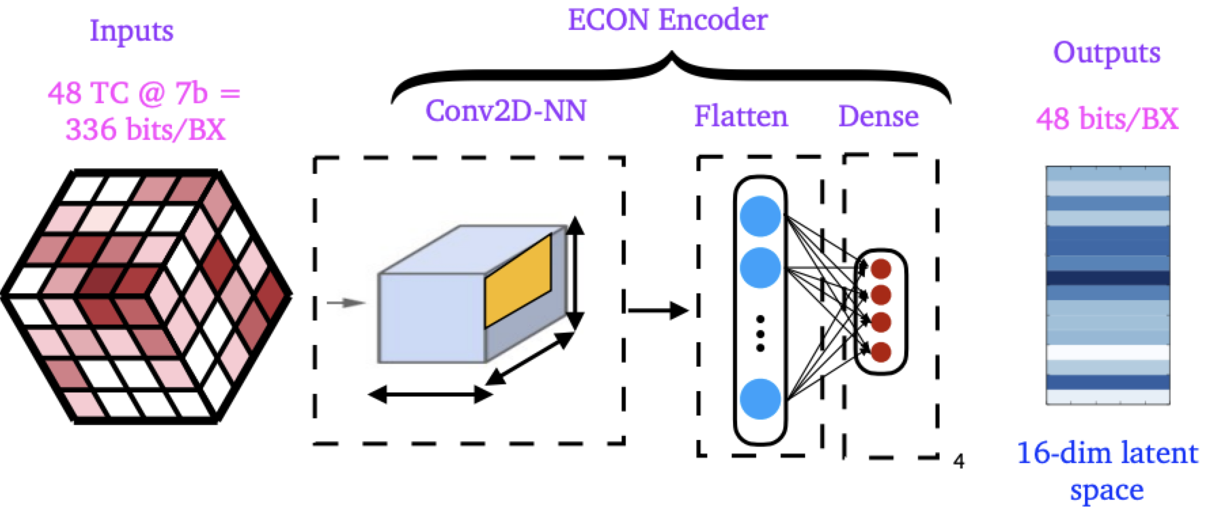
HL LHC High Granularity Calorimeter*: Data flow
Fully reconfigurable to adapt to different detector geometries
CNN: Encodes information by correlating spatial features
conv2D layer – extract spatially corelated geometric features
Flatten layer – Vectorizes the 2D image from the conv2D layer [8 x 4 x 4 = 128 x 1]
Dense layer – aggregates the various features to provide higher order information
ReLU – an activation function which introduces non-linearity by applying thresholds (part of both the conv2D and dense layers)
Notes:
ReLU – Rectified linear unit

Slide 10
Rapid design prototyping
Neural Network architecture optimization

Slide 11
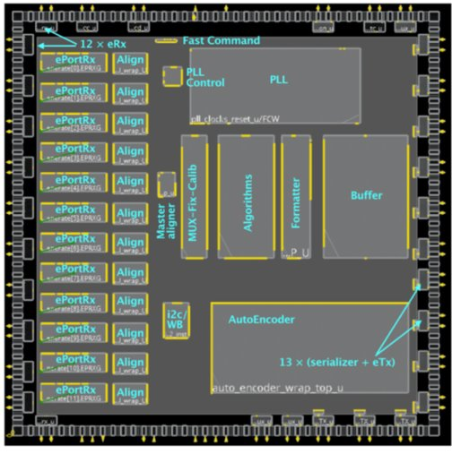
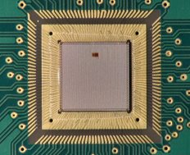
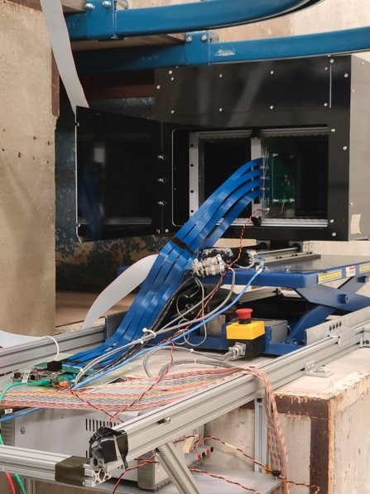

1st AI-on-chip for HEP: ECON Autoencoder
It works as intended !!!
Performance comparable to other expert algorithms
Rad hard with fully triplicated weights immune to Single Event Effects
Successful collaboration with Siemens mentor
Successful demonstration of hls4ml for ASICs

Slide 12
Step 2: How to reuse and verify? Develop and leverage open source tools

Slide 13
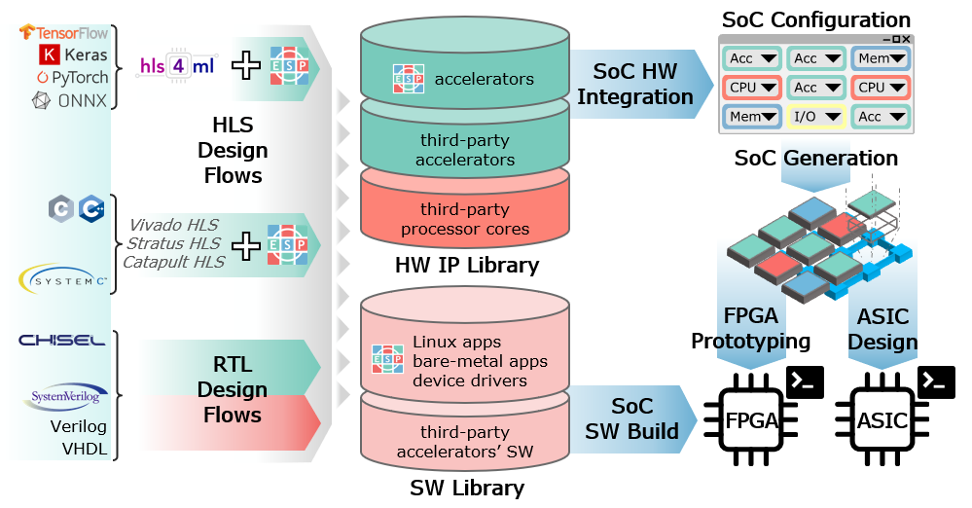
Embedded Scalable Platform
Accelerator Flow
Simplified design
Automated integration
SoC Flow
Mix & match floorplanning GUI
Rapid FPGA prototyping
Expanded to chip prototyping and verification by emulation
ESP website: esp.cs.columbia.edu

Slide 14
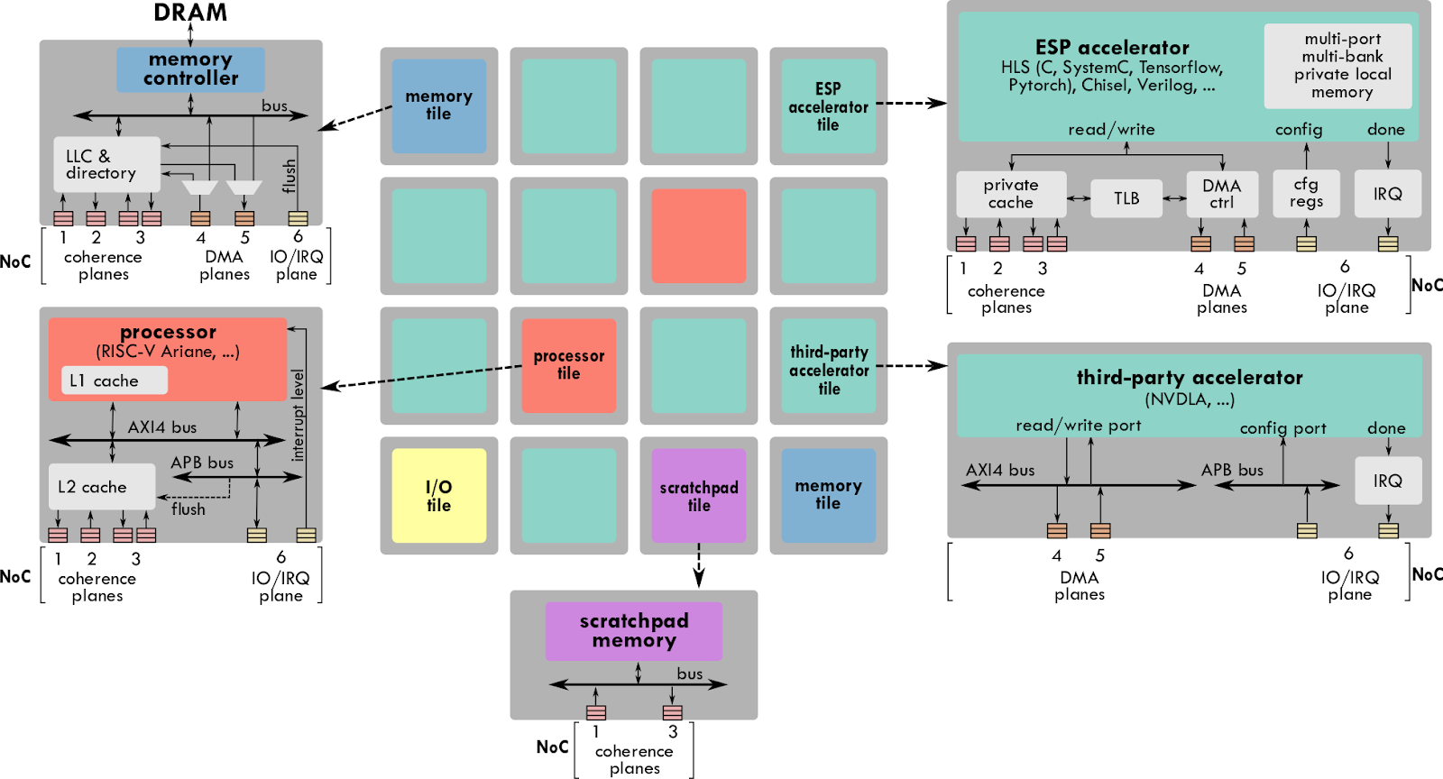
ESP Architecture
Mix and match IP
Design and Reuse approach

Slide 15
Tiny ASIC for Tiny ML on the edge
off-chip host
Processor:
Configures the accelerator
Pre-processing the inputs
Post processes and validates the accelerator performance
No floating point unit
Programmable
Accelerator: DNN for anomaly detection
Bad recreation = Anamoly
Memory:
SRAMs
Register files
1.2 mm² ASIC in 22 FDSOI
Entirely digital: Compact
Low power: Reduce Vdd < 0.5V
processor tile
IO and auxiliary tile
ZeroRISCY RISCV processor (Ibex)
25KGE
ULP 0.5V standard cell
Debug unit & SPI
NoC: Network on chip
memory tile
accelerator tile
Memory
200KB memory
DP ultra-low power
DNN Accelerator
designed with hls4ml
for TinyMLPerf app

Slide 16
Status
Chip is currently being tested
Investigated open source IP, tools and platforms
Established a path towards programmable data processing and verifying the hardware-software interface
Generic – yet specific to extreme environment operation

Slide 17
Step 4: Can we make it more energy efficient? Neuromorphic, Analog and Beyond CMOS

Slide 18
Pixel detector for phase III upgrades
Goals for scientific discovery
System level constraints
Pixel level solution
Novel Device Development Highly Granular Sensors capable of producing both precise timing as well as charge information
Frontend Signal processing
Backend Data processing
New Machine learning algorithms for data processing (feature extraction and fast Inference)
ROIC
Top level Architecture
Data filtering by determining track momentum on-chip
Create hierarchical network and enable parallel computation.

Slide 19
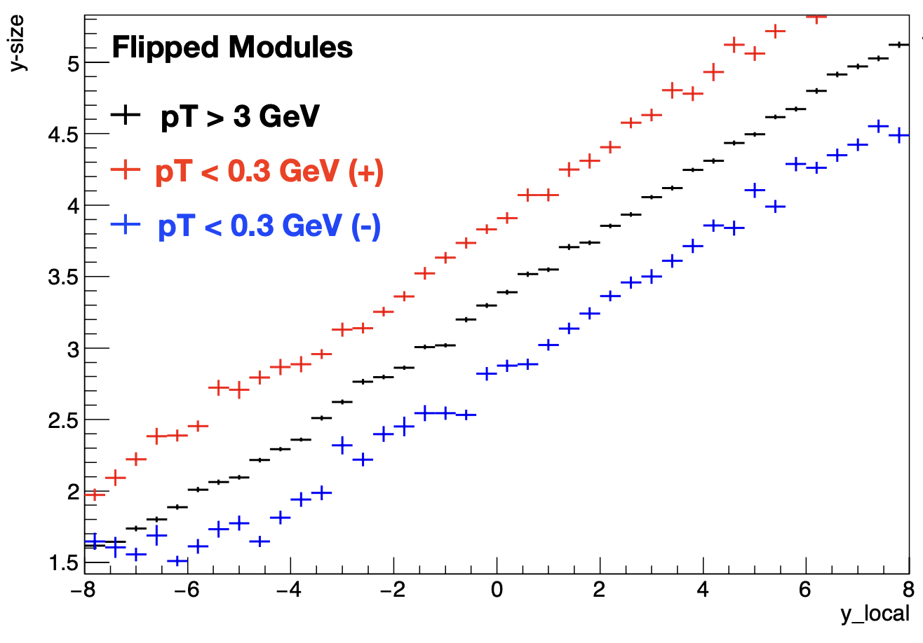
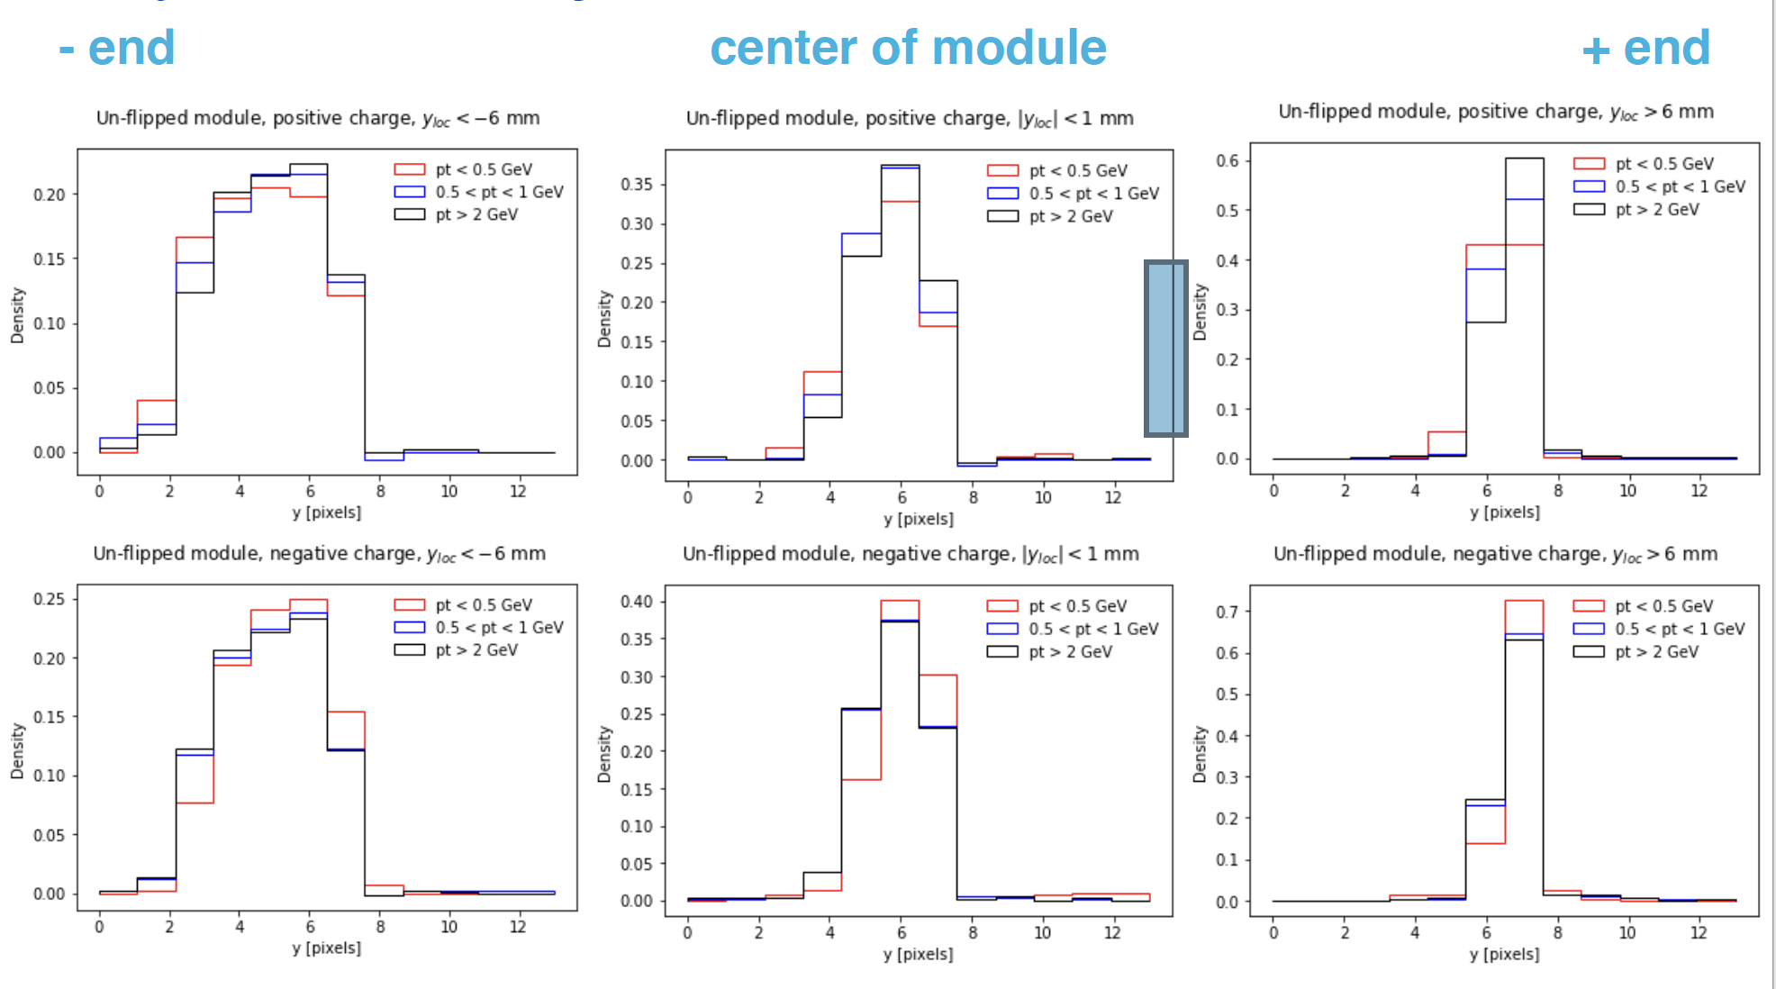
Physics informed algorithm development
M. Swartz, JHU
There is a strong correlation between the cluster shape/size and the location within a module
Low momentum positive tracks increase cluster size
Low momentum negative tracks decrease cluster size
Filtering: Developing an algorithm to classify clusters – TRANSMIT or DISREGARD:
3x to 80x data compression?

Slide 20
Hardware options: Proposed ML implementation
Analog – Mixed Signal implementation using floating gates or memristive cross-bar arrays
Digital neuromorphic implementation
Sensor (Preamp)
Neuron
On-chip feature classification using DNN
Sensor (Preamp)
On-chip feature classification using DNN
Sensor (Preamp)
Neuron
Sensor (Preamp)
Further compressive layers
Sensor (Preamp)
Neuron
ADC
Sensor (Preamp)
ADC
Sensor (Preamp)
Neuron
Sensor (Preamp)
ADC
Sensor (Preamp)
Neuron
Sensor (Preamp)
Sensor (Preamp)
Neuron
Sensor (Preamp)

Slide 21
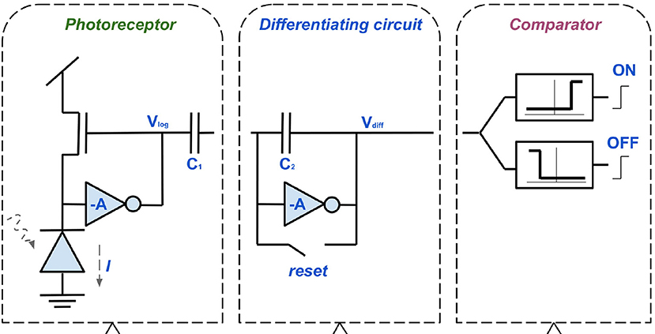
Frontend – Modified DVS pixel (Dynamic Vision System)
Low power and area pixel architecture ( DVS systems in 65 nm process of 9 × 9 µm² to 18 × 18 µm² have been demonstrated). Will not change much in 28 nm process
Creates a pulse train ( 2-5ns) dependent on the total charge in the pixel (spikes)
Large signals produce closely spaced spikes, small signal produce fewer farther spaced spikes
A negative pulse can dynamically reset the pixel (or can continue)
Information is time encoded in the pulse train
Non-uniformity correction and per pixel trimming can be handled by weight pruning (reusing resources)

Slide 22
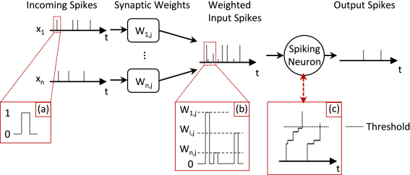
Neuromorphic approaches: digital spiking neural network
Local neighborhood for 1st stage of classification
  Compute total energy and track angle by spatio-temporal correlation
Mature systems are based on these SNNs e.g. Loihi, True-North, Spinnakar (in adv geometry nodes 14 nm and below)
Low–power since it runs without a clock
HL- LHC case: since events are uncorrelated between bunches we don’t need a complex network requiring historic information

Slide 23
Converting raw data to local information
Use Neural Network as a classifier
Determine 3D position (finer than pixel size)
Total charge
Angular momentum
Timing information
Early decision: KEEP / DISCARD Determine if cluster has useful information

Slide 24
Vector Matrix Multiplication
D. Strukov, UCSB
Analog implementation
Small footprint, programmable, large resistors
Basic building block of neural network

Slide 25
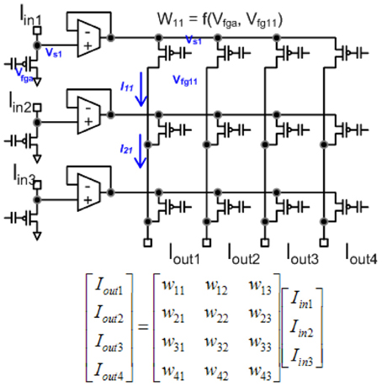
Integrate a Field programmable Analog Array (FPAA)
J. Hasler, Georgia Tech
Programmable Floating gate transistors for weights and switches
Structures are available in standard CMOS process (have been demonstrated in 350 nm to 40 nm nodes)
Radiation performance – unknown
Uses operation transconductance amplifier (OTA) with floating gates for Vector Matrix multiplication
Reconfigurable architecture by using a switch matrix and Manhattan routing to define interconnections

Slide 26
Use the pixel area for starting the classification process
Group 4 pixels together and share their analog well (similar to RD53)
Create computational analog blocks which gathers information from nearest 8/15 neighbors
CAB based on a TIA (FG or analog memristor)
Create hierarchical network.
Local physics information is important to determine track properties
Energy is shared within small area, which contains the angular information
CAB
CAB
CAB
CAB

Slide 27
Memristive cross-bar arrays
D. Strukov, UCSB
Use of programmable resistors ( 1 – 10 GΩ
Small footprints ( < 1µm²)

Slide 28
What’s next? Long term plans and impact beyond HEP

Slide 29
PHYSICS driven: sensor, microelectronics and algorithm development

Slide 30
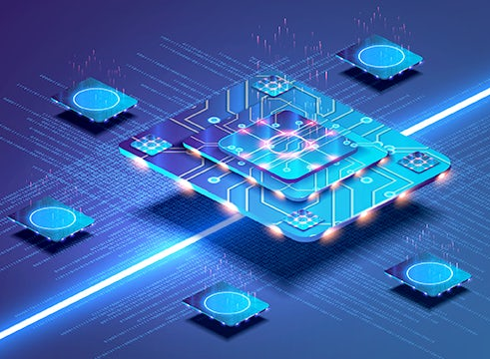
Design Goals for the next 20 years: Enable Smart Sensors
Low power, low noise, ultra-sensitive analog for sensor signals (both amplitude and time)
SOC approach for integrated digital (reconfigurable, reprogrammable architectures)
AI-on-chip for compact ML inference models for edge compute (data processing at source)
Wireless / Integrated photonics (long distance data transfer)
Integrated THz electronics (short distance communication)

Slide 31

HEP experiments are equivalent to real life applications
Benchmarks set by HEP experiments are beyond the current needs of industry applications
Mid-scale prototyping for HEP experiments advance lab to fab innovation required for growth in semiconductor manufacturing

Slide 32
Acknowledgements
On behalf of several collaborators
Fermilab: Nhan Tran, Jim Hirschauer, Davide Braga, Doug Berry, Ron Lipton, Jennet Dickinson, Gauri Pradhan, Ben Parpillon, Christian Herwig
Northwestern University: Seda Memik, Manuel Blanco Valentin
Columbia University: Giuseppe Di Guglielmo, Davide Giri, Maico Cassel Santos, Luca Carloni
UIC: Corrinne Mills, Jieun Yoo, Amit Trivedi
JHU: Morris Swartz
and many others

