Slide 1
PIP-II Project
Allan Rowe
PIP-II IKC Technical Integration Manager
55th Annual Users Meeting
13-June-2022

Slide 2
Outline
Motivation & PIP-II Project Overview
PIP-II Project Status & Recent Major Achievements
Near Term Goals & Summary
13-June-2022

Slide 3

PIP-II Project Meets the P5 Report Mandate
Recommendation 13: Form a new international collaboration to design and execute a highly capable Long-Baseline Neutrino Facility (LBNF) hosted by the U.S. To proceed, a project plan and identified resources must exist to meet the minimum requirements in the text. LBNF is the highest priority large project in its timeframe.
Recommendation 14: Upgrade the Fermilab proton accelerator complex to produce higher intensity beams. R&D for the Proton Improvement Plan II (PIP-II) should proceed immediately, followed by construction, to provide proton beams of >1 MW by the time of first operation of the new long-baseline neutrino facility.
13-June-2022

Slide 4

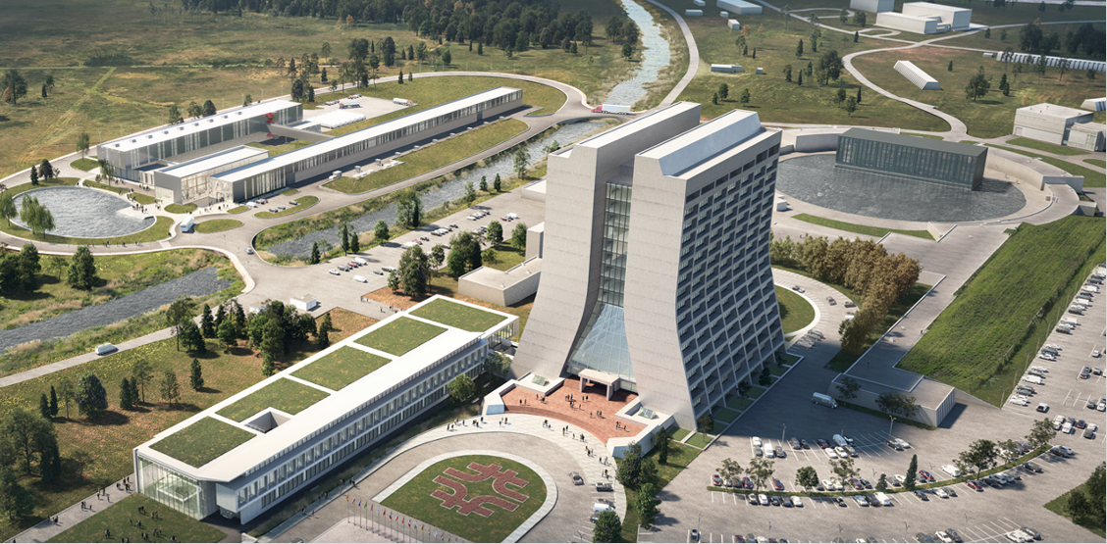
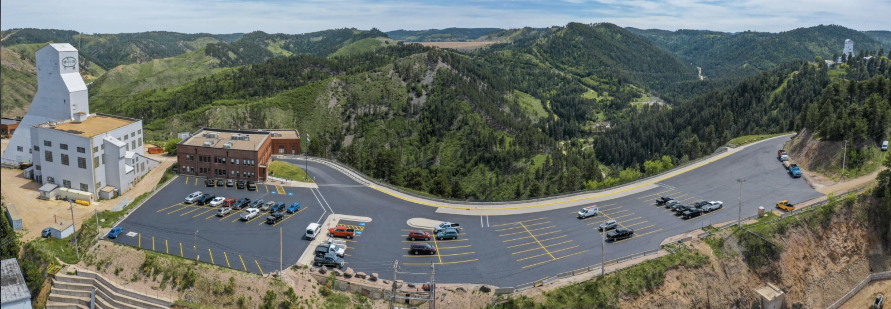
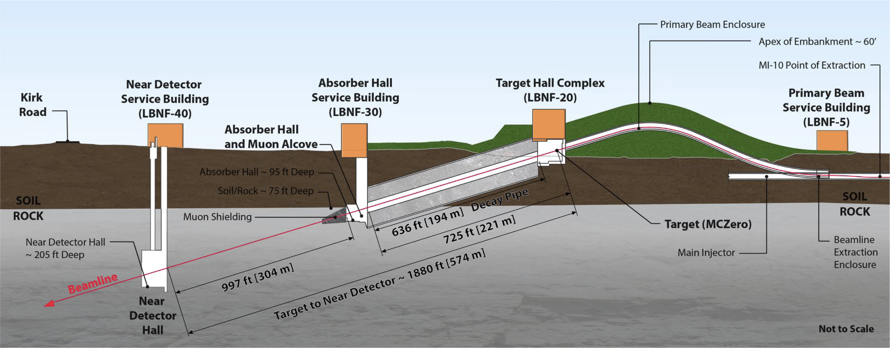
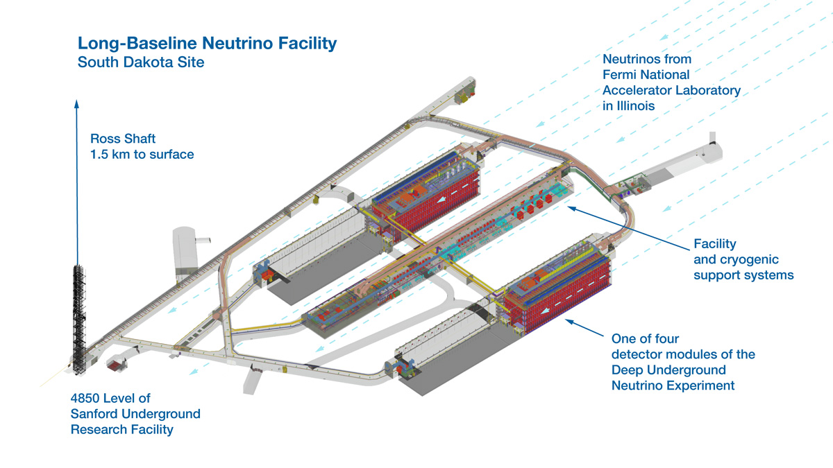

LBNF / DUNE / PIP-II
Sanford Underground Research Facility -- Lead, SD
Deep Underground Neutrino Experiment (DUNE) (LAr 4 x 10 kt (fiducial mass) detectors)
Located in Underground Caverns (1.5 km) (part of the LBNF scope)
Fermilab Complex and PIP-II
Provide 1.2 MW beam power
Batavia, IL
1300 km
Target (part of LBNF scope )
and Near Detector (part of DUNE scope)
Characterize primary $ν$ beam
Batavia, IL
13-June-2022

Slide 5

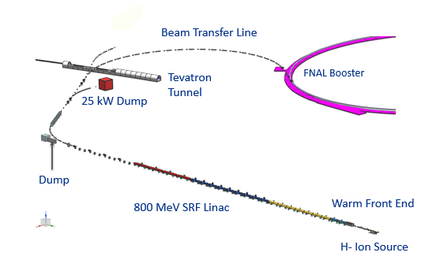
PIP-II Mission
PIP-II is an essential upgrade to the Fermilab accelerator complex to enable the world’s most intense beam of neutrinos to LBNF/DUNE and to serve broad physics research program for decades to come.
PIP-II Capabilities
Beam Power
1.2 MW proton beam
Upgradeable to multi-MW
Flexibility, multi-user capability
CW-compatible
Customized beams
Multi-user delivery
Reliability
Modernizes Fermilab accel complex
PIP-II Scope
800 MeV H− SRF linac
  CW RF Operations
Linac-to-Booster transfer line
Accelerator Complex Upgrades
  Booster
  Recycler
  Main Injector
Conventional Facilities
  Space reserved for two CMs for 1 GeV Upgrade
The PIP-II scope enables the accelerator complex to reach 1.2 MW proton beam on LBNF target
13-June-2022

Slide 6
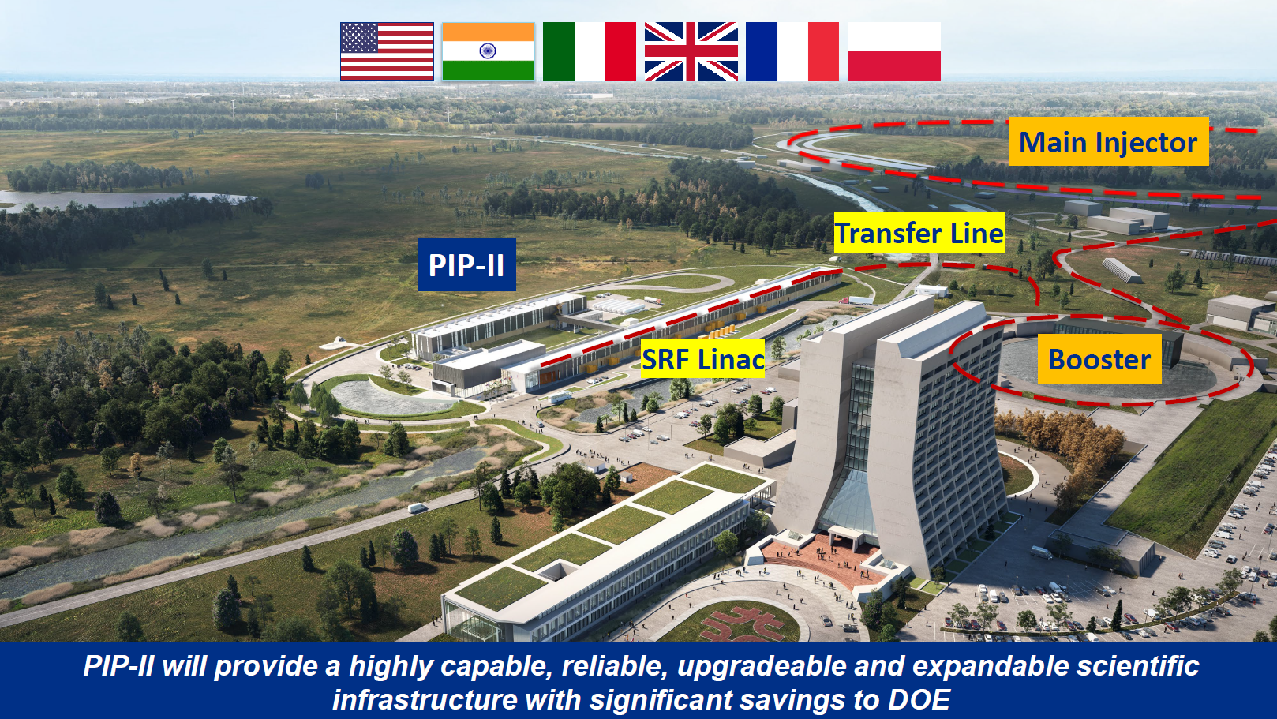
PIP-II will provide highly capable, reliable, upgradeable, and expandable accelerator infrastructure with significant savings to the DOE. TPC = $978MM + $310MM In-kind

Slide 7
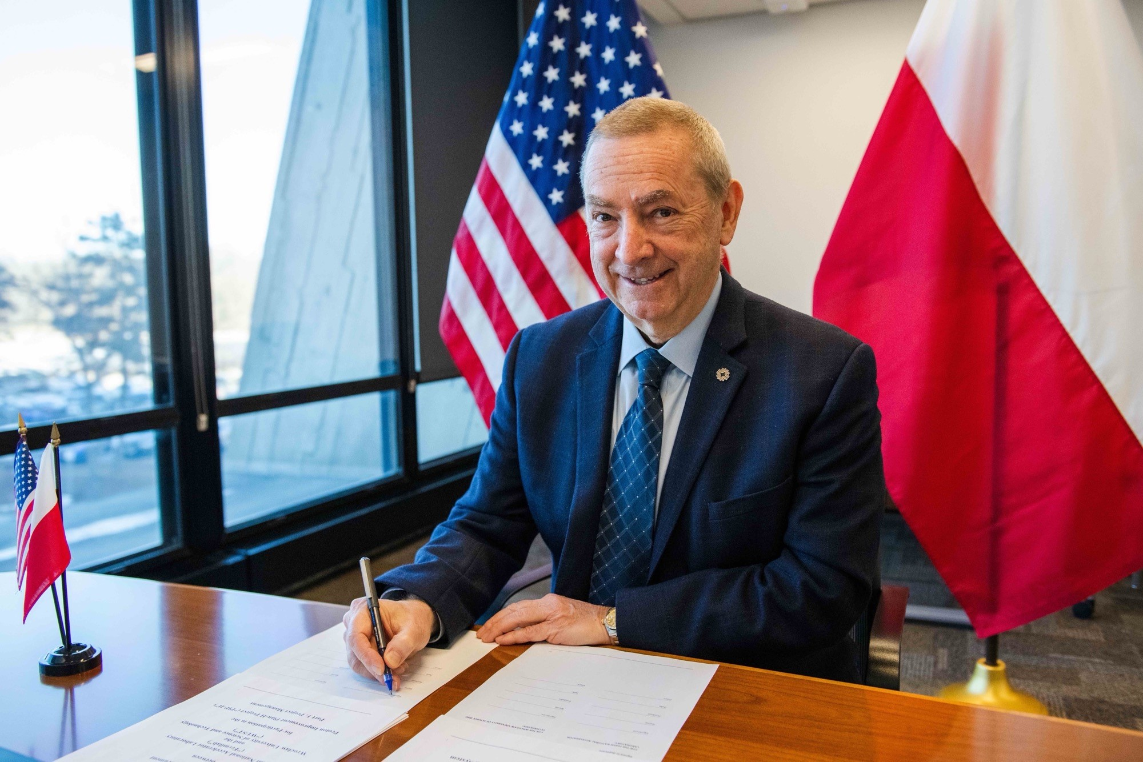



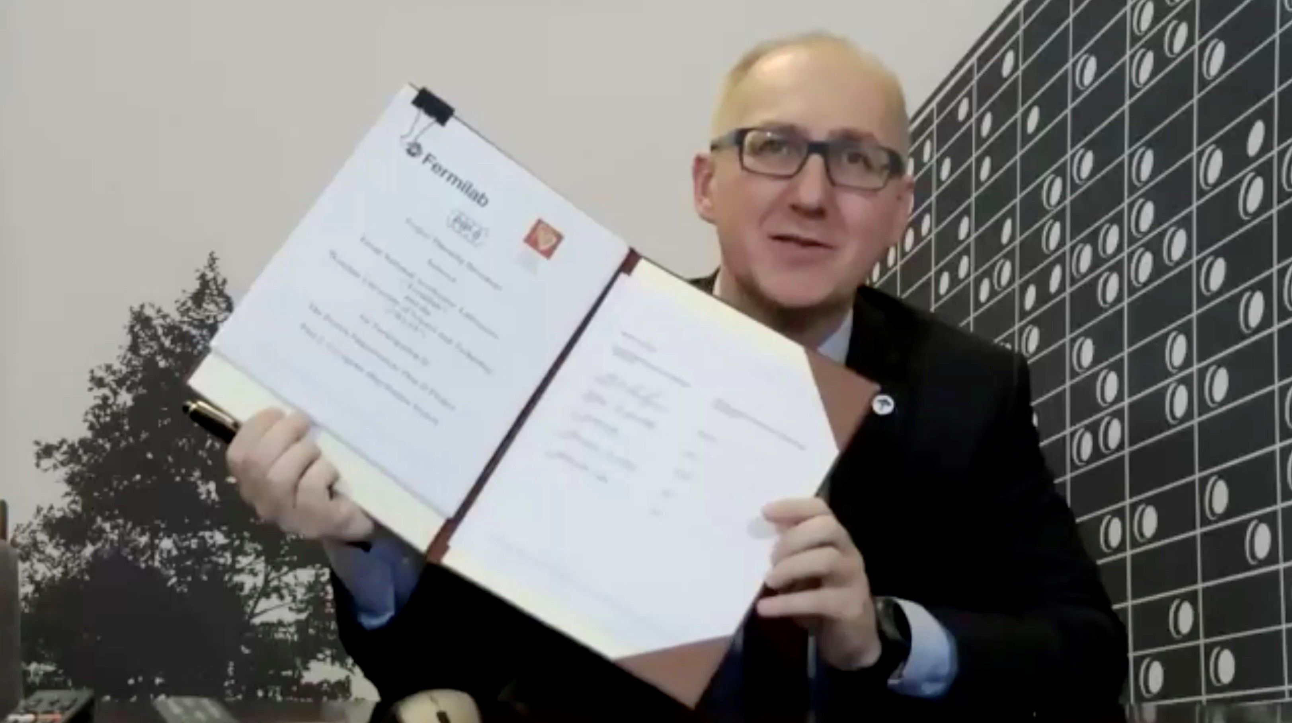
In-kind Contribution Status
All international legally binding agreements are signed and in-place.
Detailed Project Plans are signed with United Kingdom (STFC-UKRI), Italy (INFN), and Poland (WUST).
May-2021
June-2021
January -2022
France (CEA and CNRS) and India (DAE BARC and RRCAT) plans are nearing completion.
13-June-2022

Slide 8







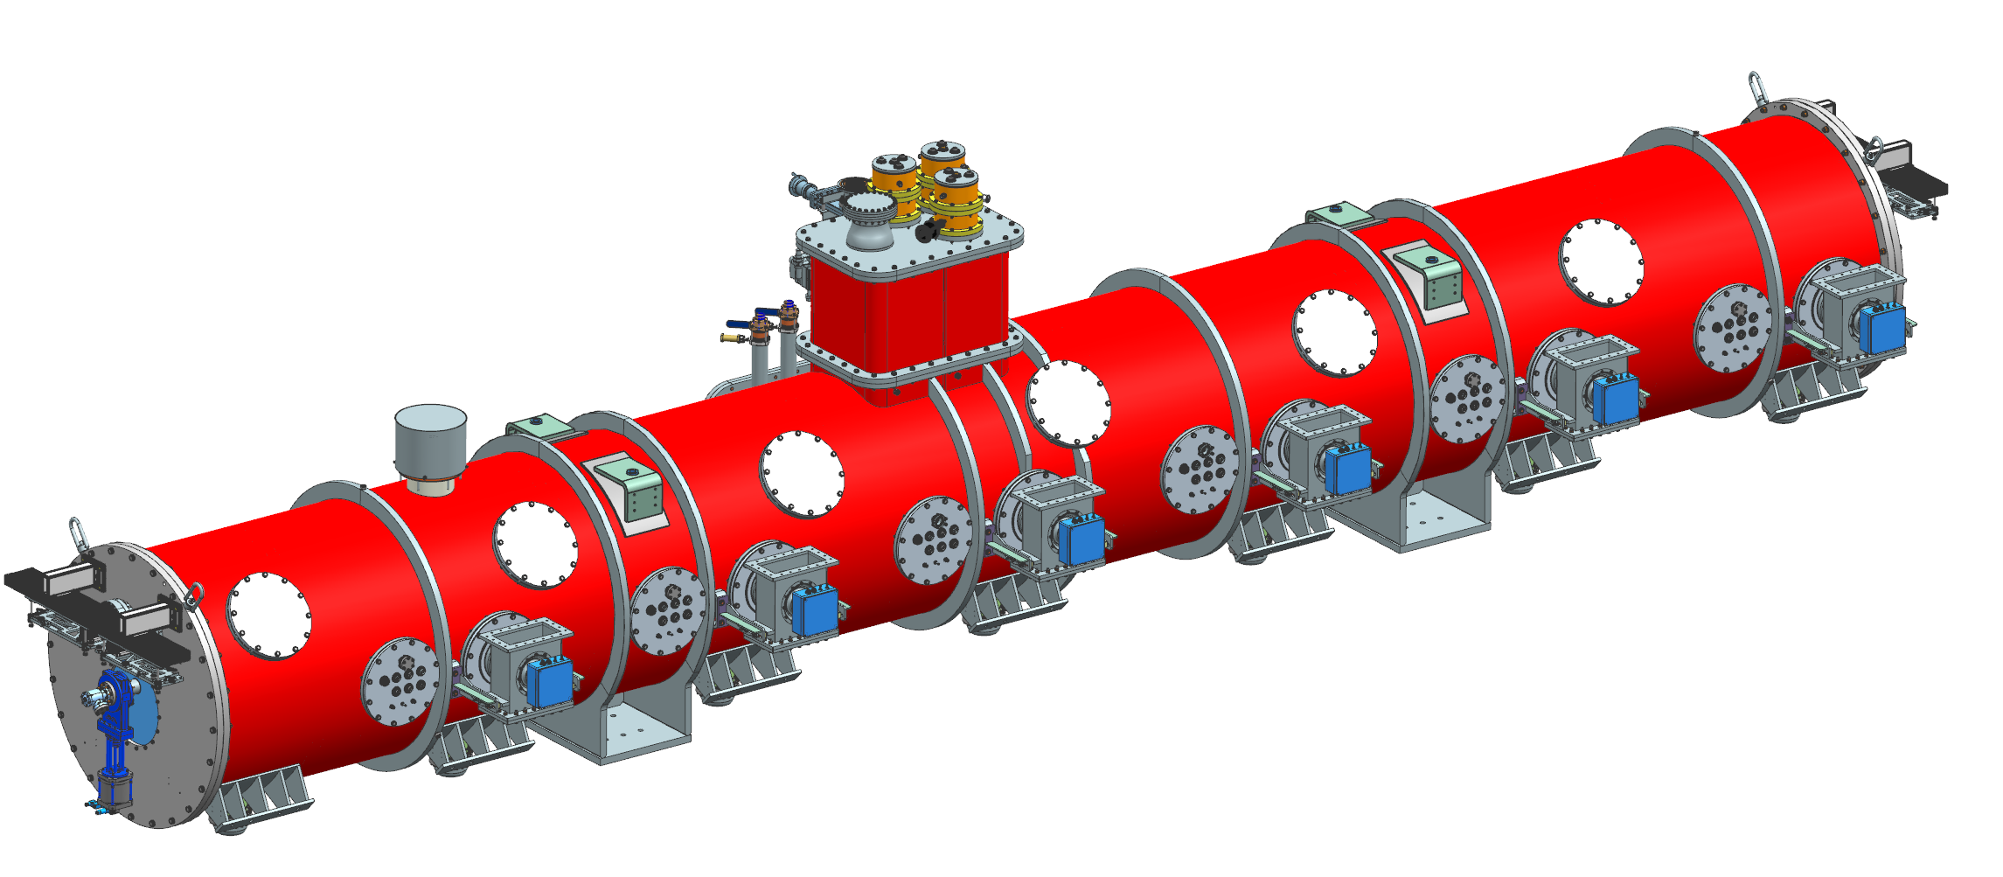

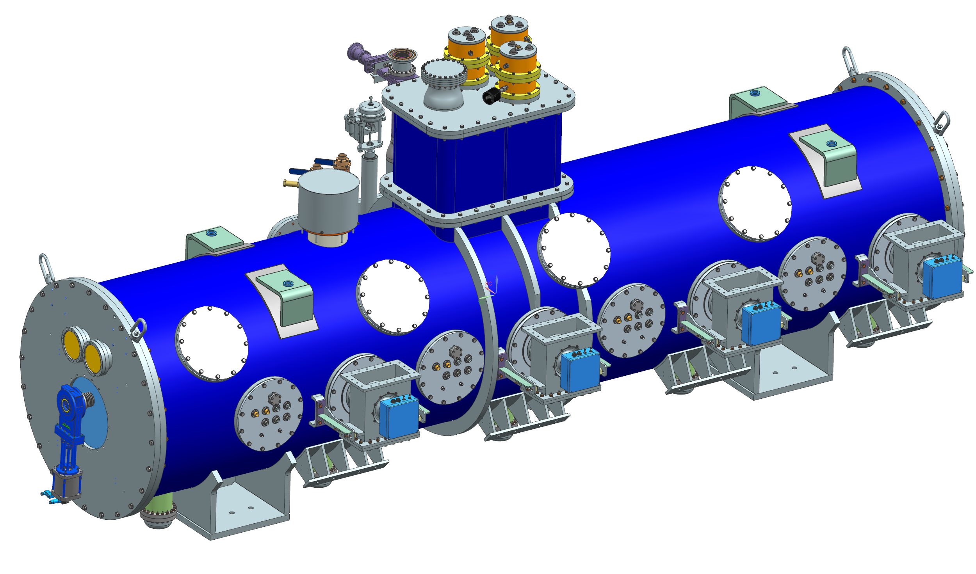
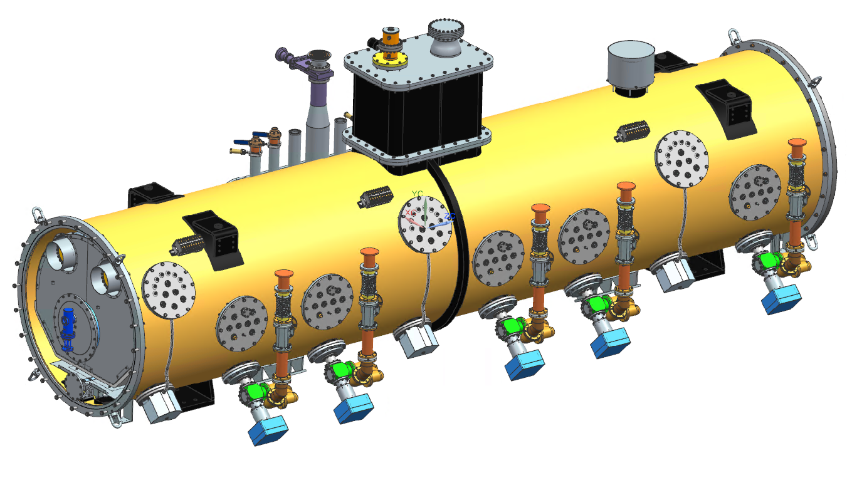
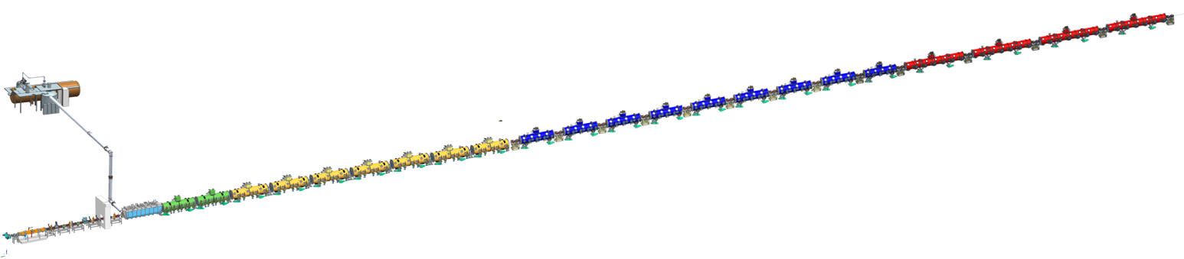

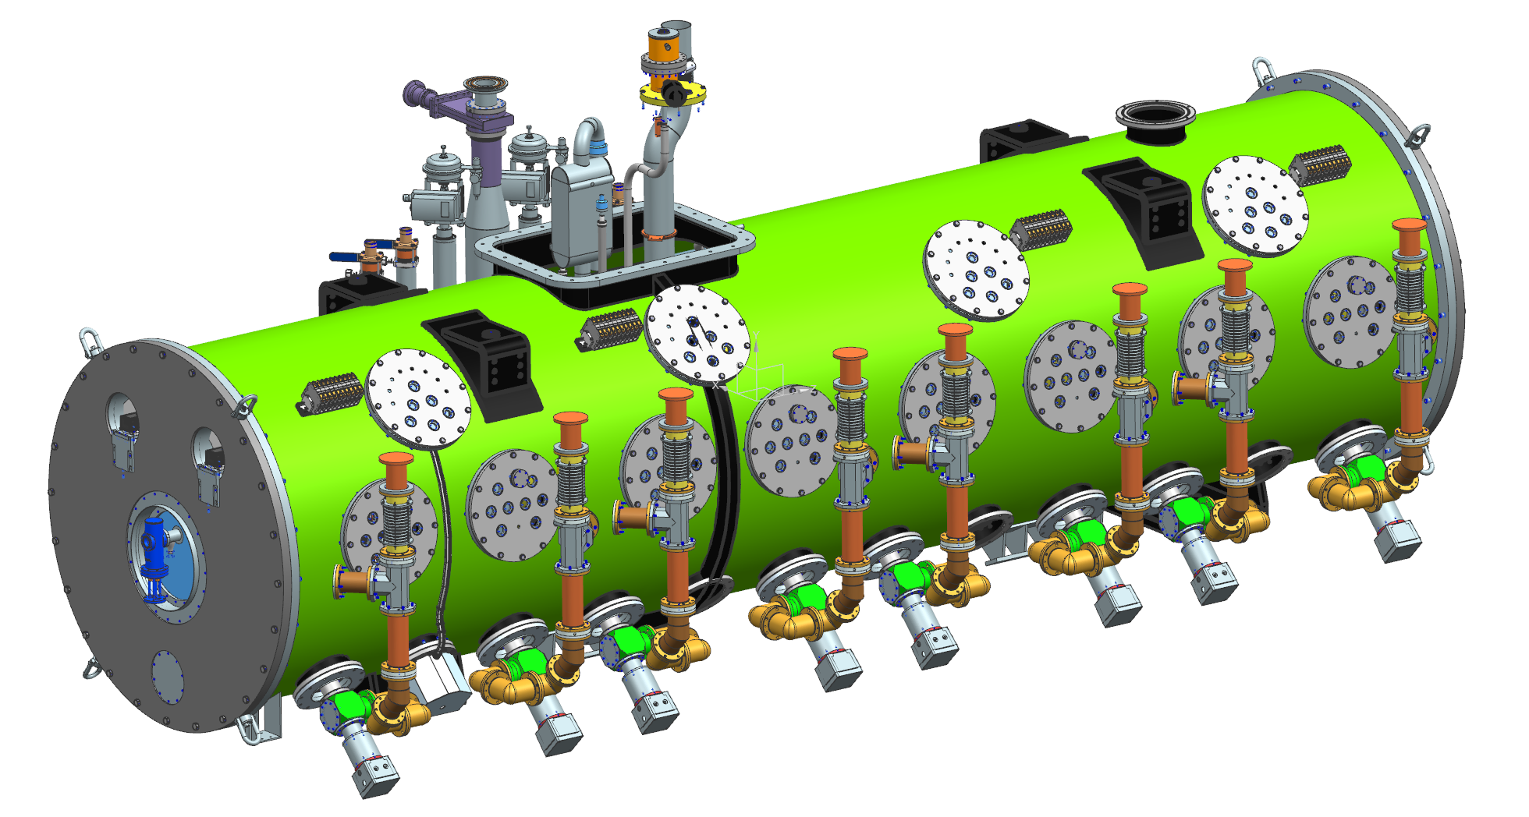


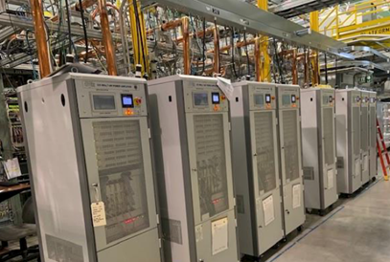
PIP-II 800 MeV SRF Linac
Elliptical
HB650 X 4
650 MHz
Cryoplant is largest single In-kind contribution
Elliptical
LB650 X 9
650 MHz
Single Spoke 2
SSR2 X 7
325 MHz
Single Spoke 1
pSSR1 X 2
325 MHz
HWR
162.5 MHz
833 MeV
Cryoplant
2.5kW @ 2K
516 MeV
177 MeV
Superconducting
CDS
RFQ
32 MeV
H- Ion source
10 MeV
2.1 MeV
RF Amplifiers + RT magnets
Room Temperature
PIP-II is the first U.S. accelerator project to be built with significant international contributions
8
13-June-2022

Slide 9
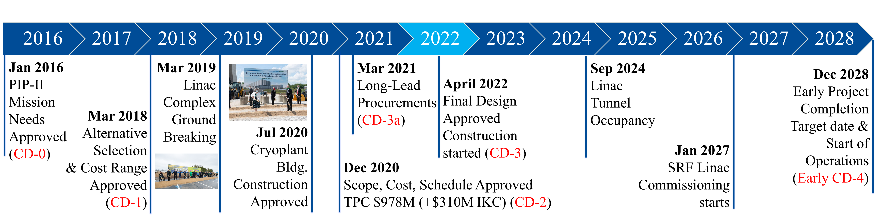
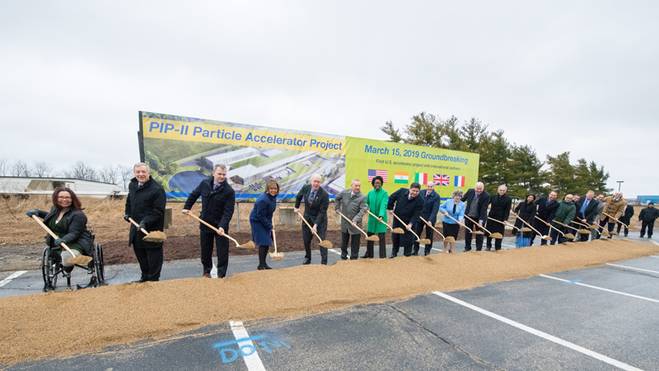
PIP-II Major Milestones
Jul 2020 Cryoplant Bldg. Construction Approved
PIP-II Ground-breaking
13-June-2022

Slide 10
PIP-II Project Status and Recent Major Achievements
13-June-2022

Slide 11
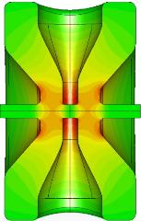
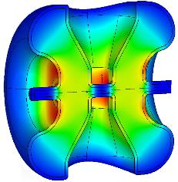




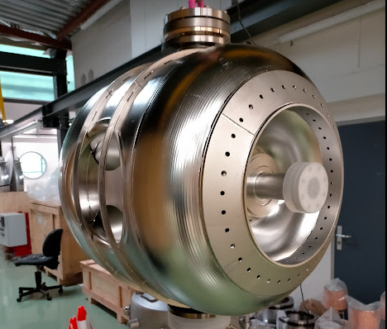
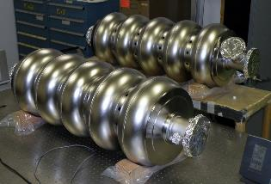
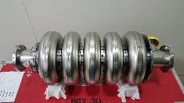
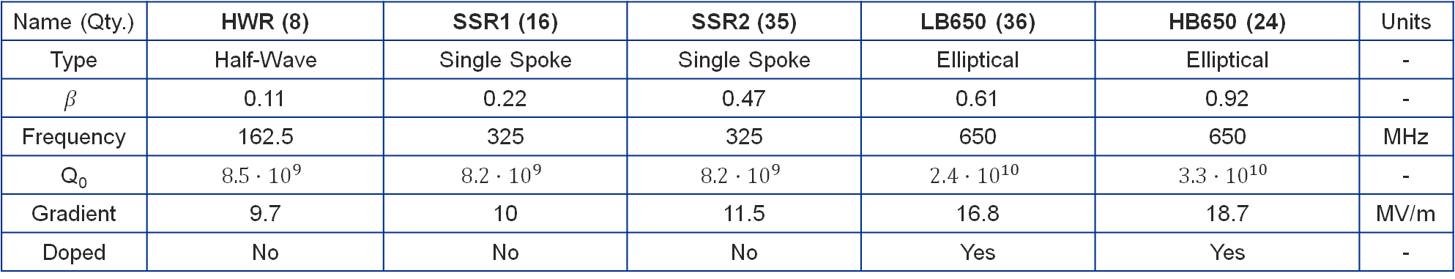
Progress in SRF & Cryogenics – PIP-II Cavity Development
Name (Qty.) | HWR (8) | SSR1 (16) | SSR2 (35) | LB650 (36) | HB650 (24) | Units
Type | Half-Wave | Single Spoke | Single Spoke | Elliptical | Elliptical | -
$$β$$ | 0.11 | 0.22 | 0.47 | 0.61 | 0.92 | -
Frequency | 162.5 | 325 | 325 | 650 | 650 | MHz
Q₀ | $$8.5∙{10}^{9}$$ | $$8.2∙{10}^{9}$$ | $$8.2∙{10}^{9}$$ | $$2.4∙{10}^{10}$$ | $$3.3∙{10}^{10}$$ | -
Gradient | 9.7 | 10 | 11.5 | 16.8 | 18.7 | MV/m
Doped | No | No | No | Yes | Yes | -
Prototypes validated
Prototype in progress
13-June-2022

Slide 12

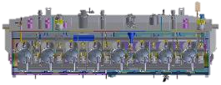
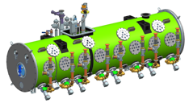
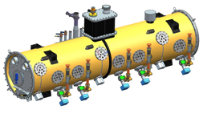


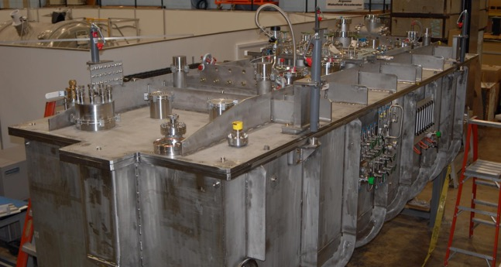
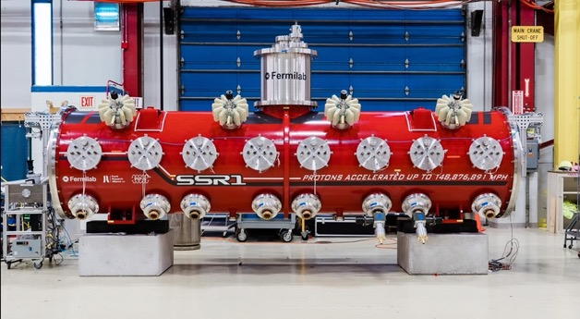
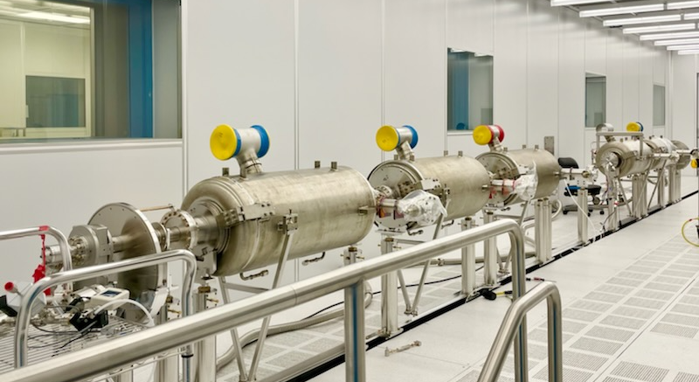

Progress in SRF & Cryogenics – PIP-II Cryomodule Development
5.9 m
5.3 m
6.5 m
5.5 m
9.9 m
HWR
SSR1
SSR2
LB650
HB650
Pre-Production Cryomodules
Prototypes validated
Prototype in progress
13-June-2022

Slide 13
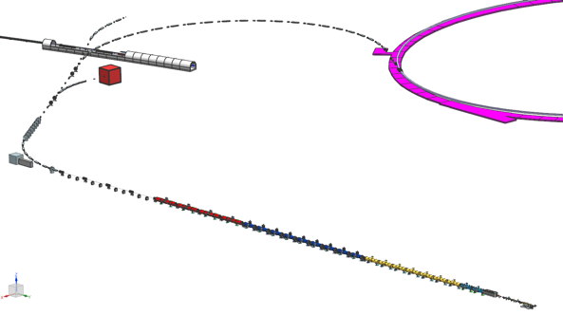
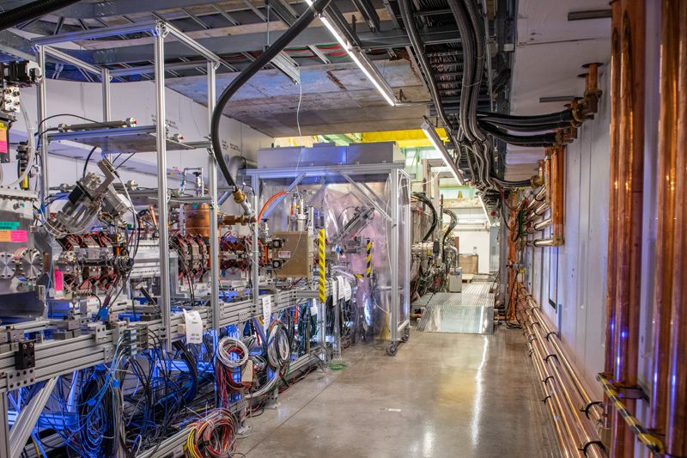
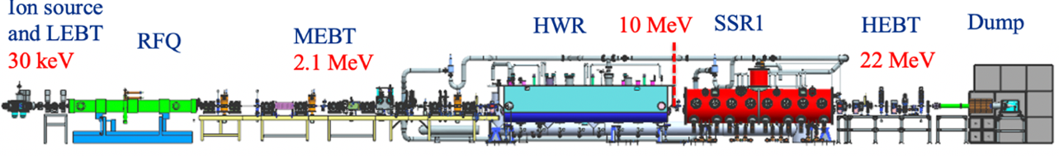


PIP2IT As Testbed for PIP-II Technologies
PIP2IT was a nearly complete PIP-II Warm Front End with the first two cryomodules, HWR and prototype SSR1
  PIP2IT Front End will be stored and reinstalled at PIP-II
PIP-II
13-June-2022

Slide 14
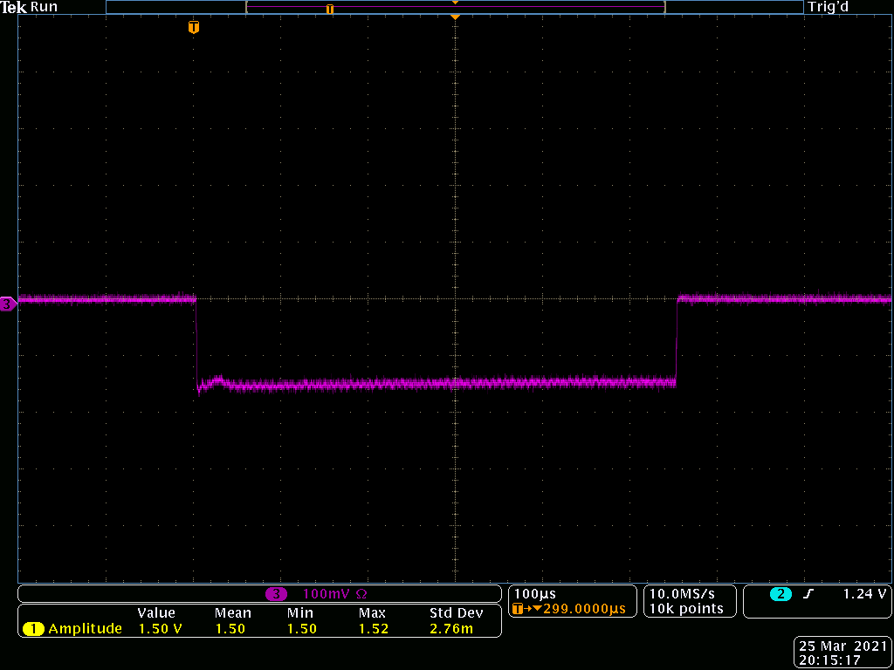
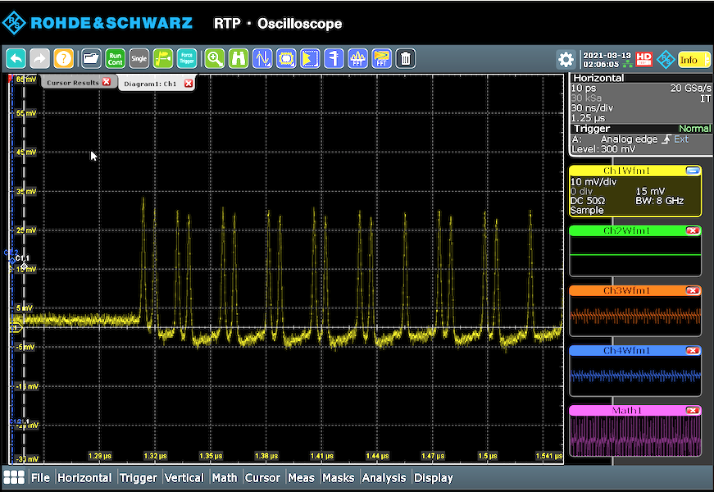
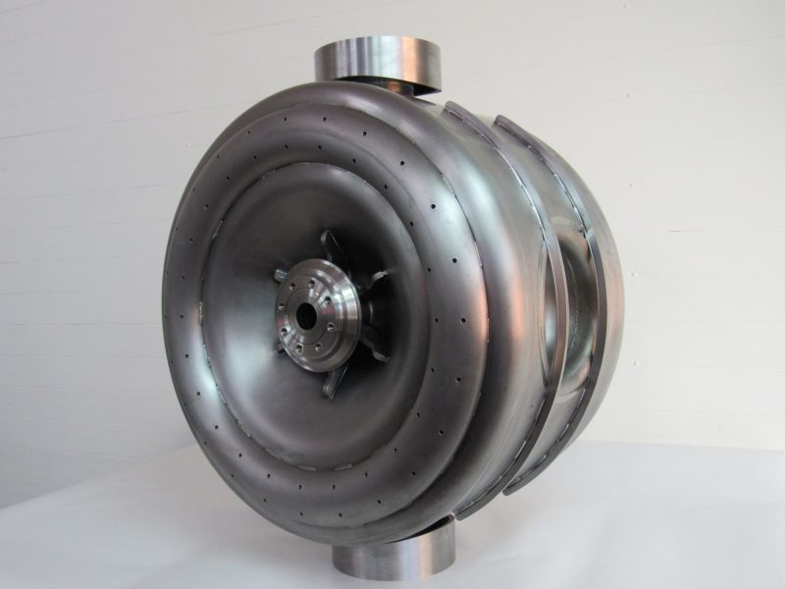
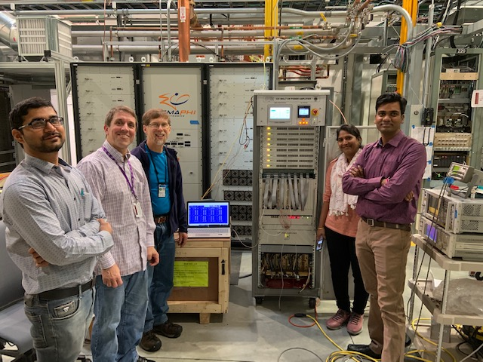
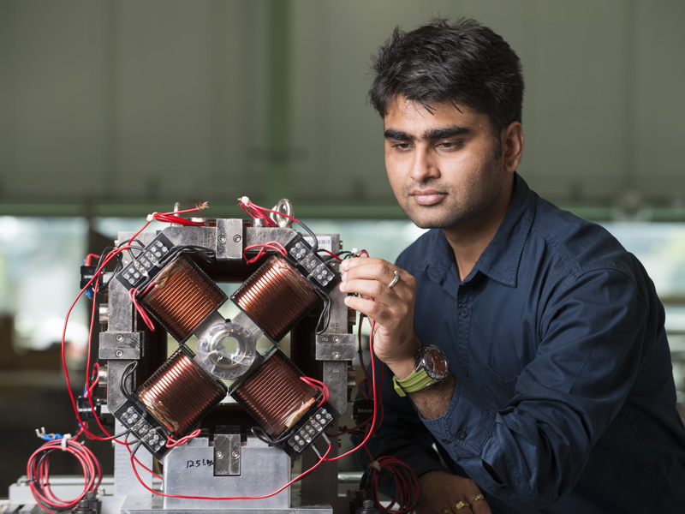
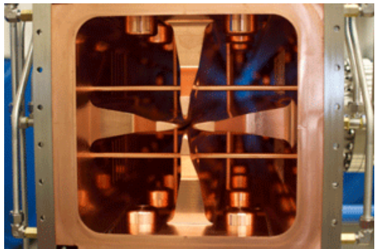
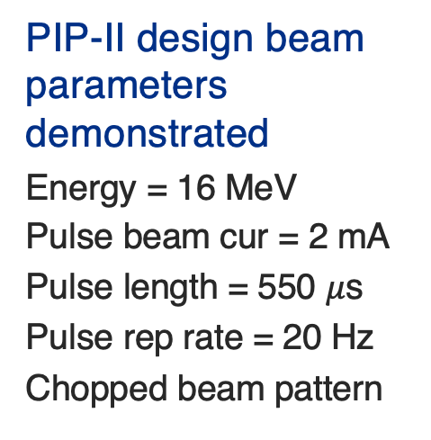
PIP2IT Tests Successfully Completed
PIP-II design beam parameters demonstrated
Energy = 16 MeV
Pulse beam cur = 2 mA
Pulse length = 550 $μ$s
Pulse rep rate = 20 Hz
Chopped beam pattern
Bunch-by-bunch chopping pattern required for LBNF demonstrated
MEBT chopper is critical for PIP-II operations, capable of removing individual bunches, provides arbitrary bunch pattern capability
Critical technologies demonstrated
Beam accelerated to 17 MeV
HWR and SSR1 Prototype cryomodules performance validated with beam
ML algorithm applied successfully to align orbit
Partner deliverables seamlessly integrated
Eight 7 kW amplifiers
SSR1 Cavity
RF MEBT magnets
Radio frequency quadrupole
Half Wave Resonator cryomodule
13-June-2022

Slide 15

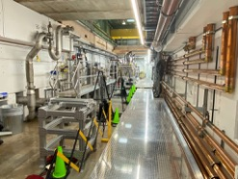
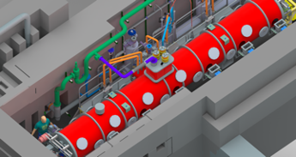
PIP2IT Transition to Cryomodule Test Stand
Infrastructure modifications for the 650 MHz cryomodule test stand are complete, ready for arrival of pHB650 cryomodule
Evolution of PIP2IT Test Facility (same area shown in all) images)
PIP2IT Test Accelerator
(April 2021)
PIP2IT Test Stand
Infrastructure installed
(May 2022)
CAD model of 650 MHz Test Stand with pHB650 cryomodule installed
(Fall 2022)
13-June-2022

Slide 16
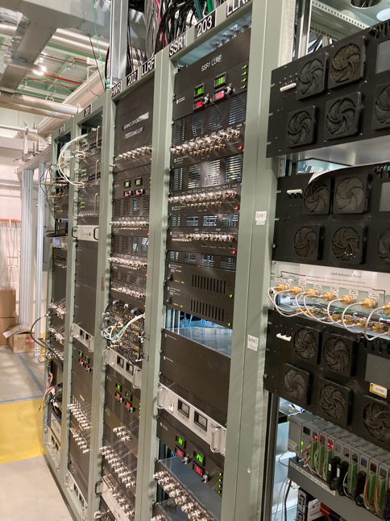
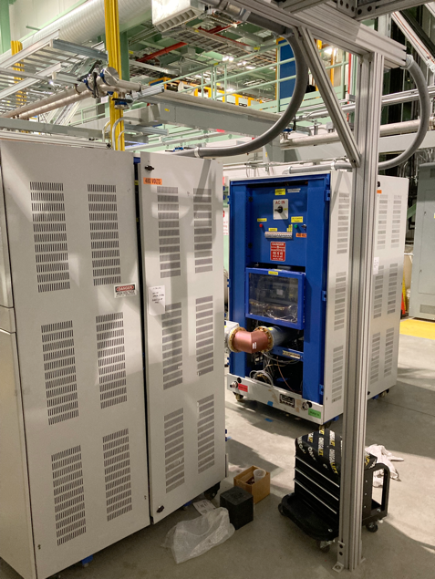
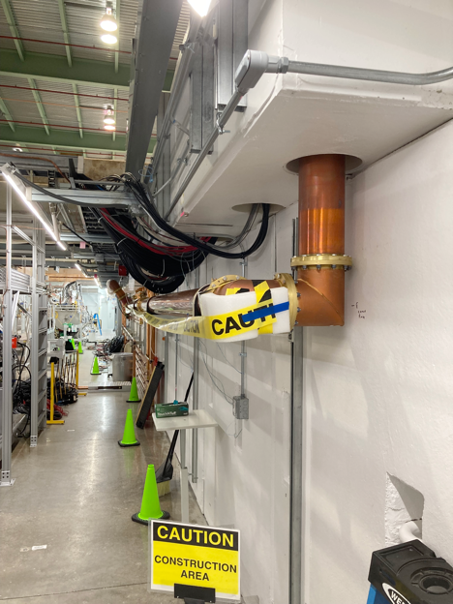
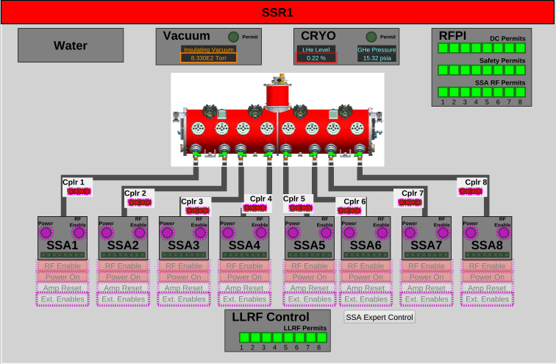
Progress in Accel. Systems
Test area demonstrations
  325 MHz, 650 MHz LLRF/RFPI control
  7 kW, 20 kW 325 MHz amplifiers
  40 kW 650 MHz amplifier
  RF Distribution
  Front end vacuum system
  Room temperature magnets
  Fully EPICs controls
Designs being finalized
  Vacuum systems
  Machine Protection Systems
  Integrated LLRF System
650 MHz LLRF
650 MHz, 40 kW SSA
EPICS user interface
650 MHz RF Distribution
13-June-2022

Slide 17
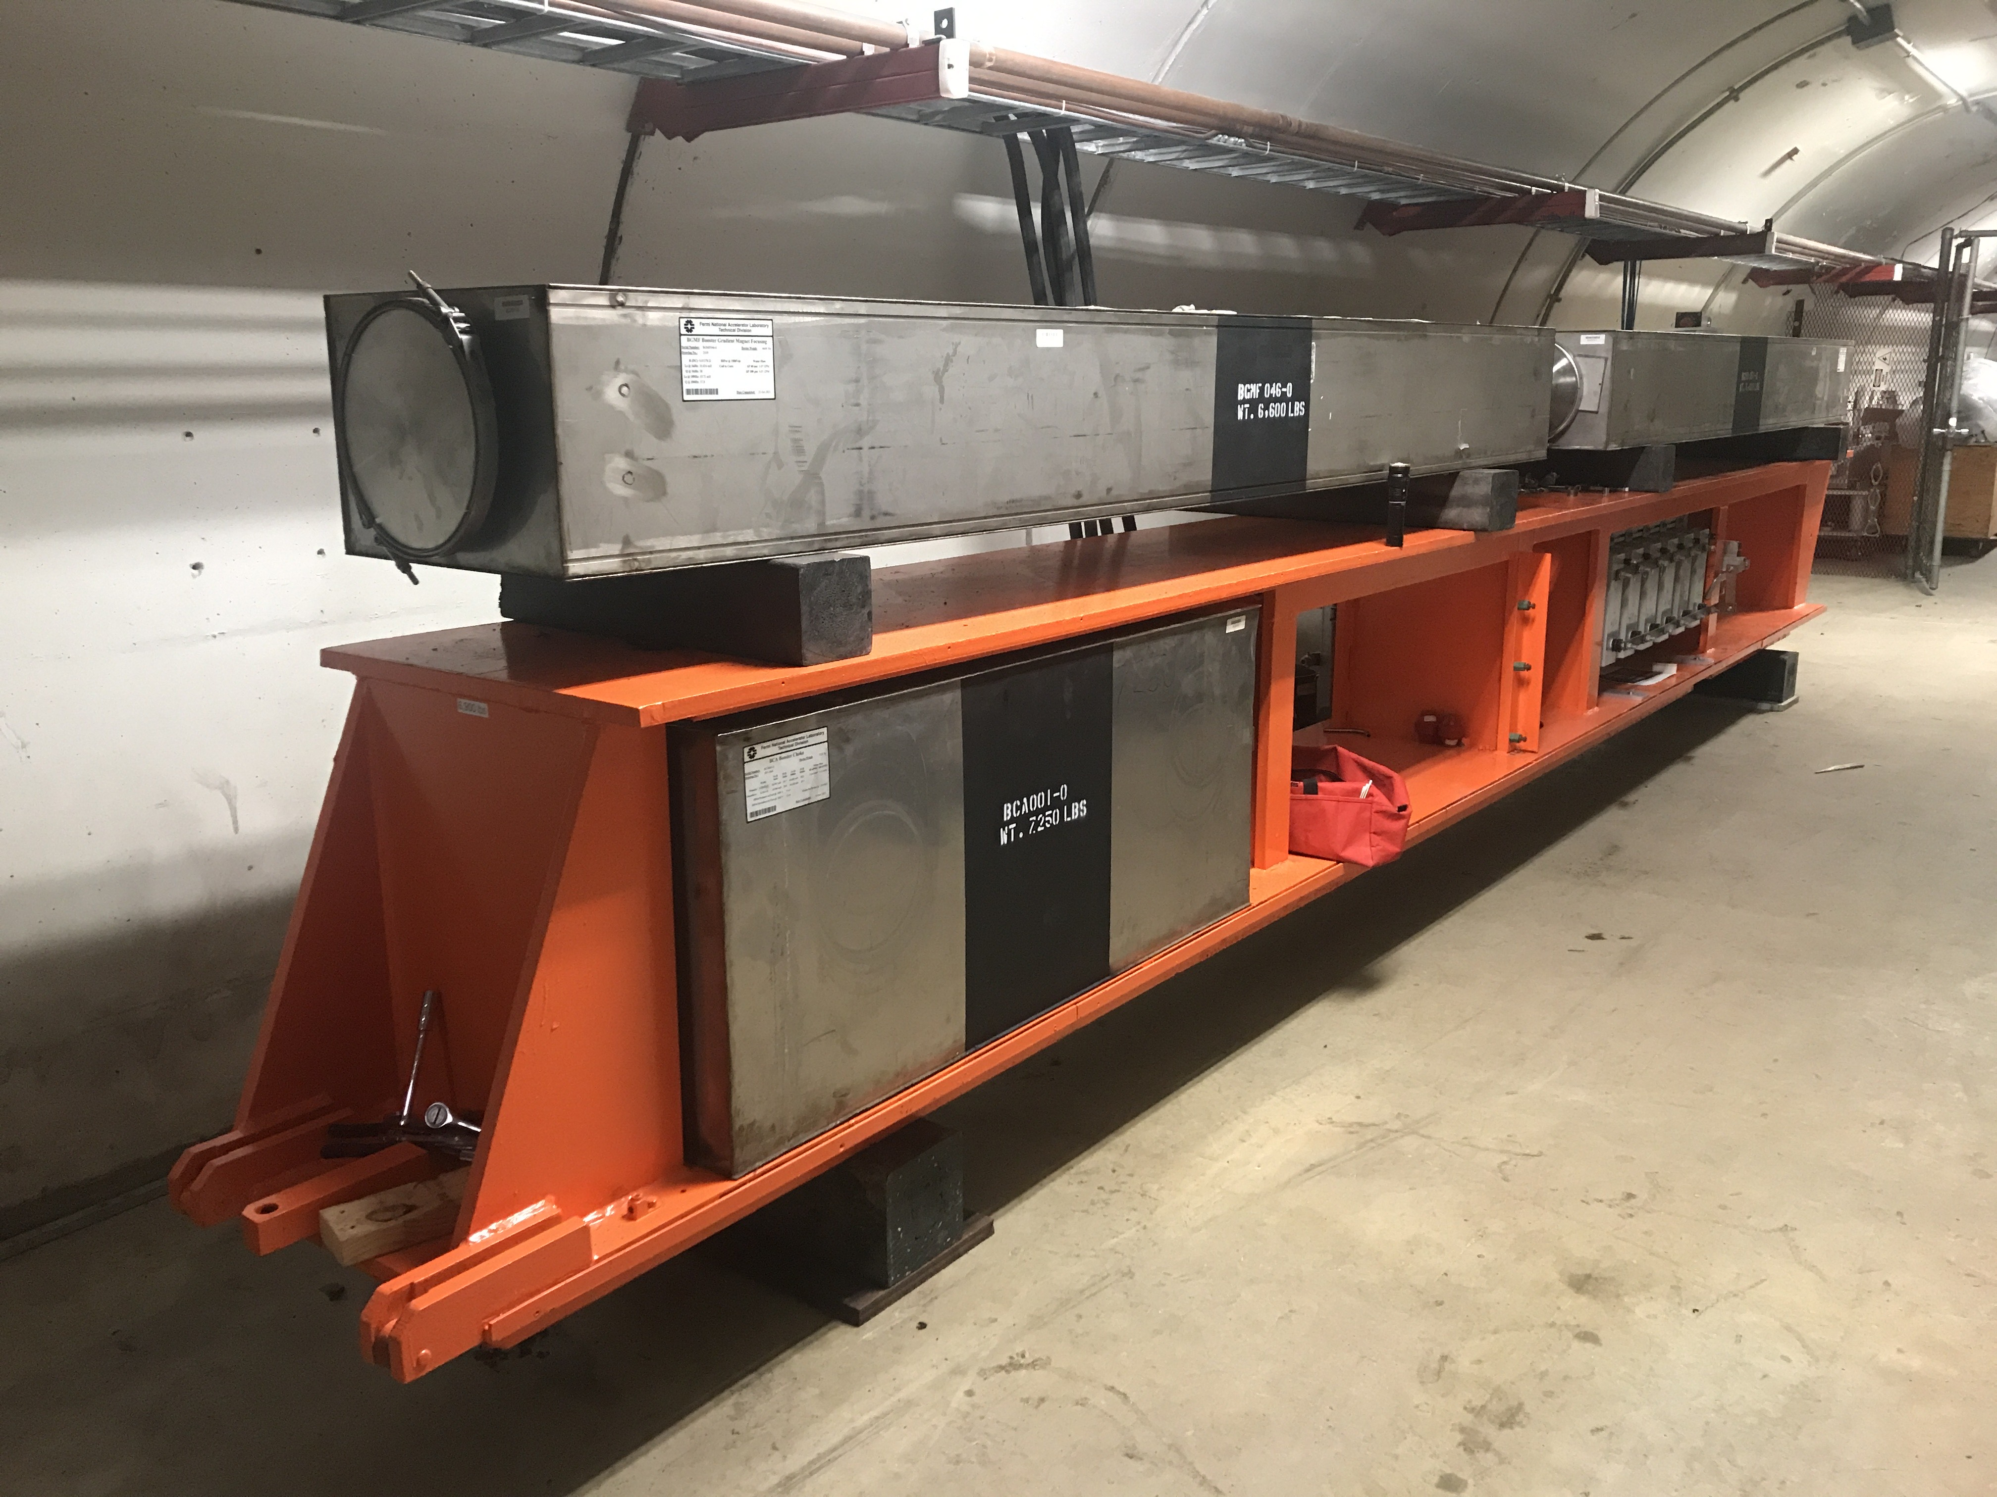
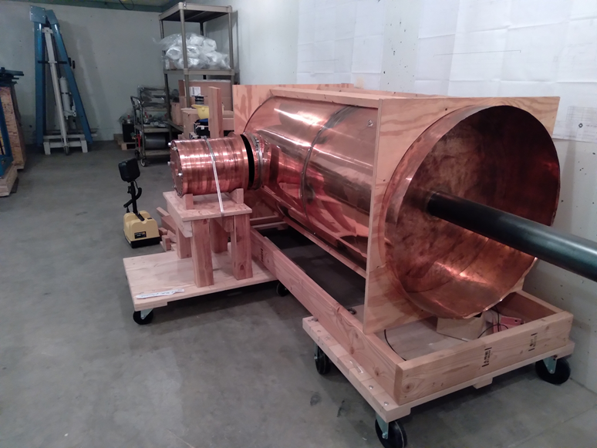
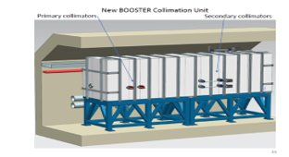
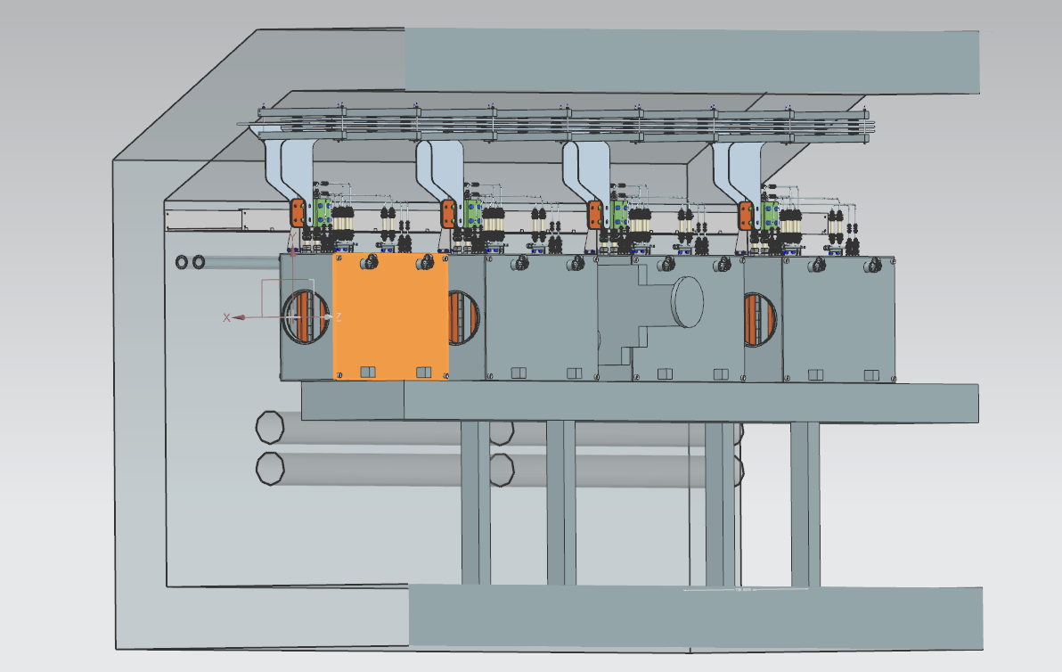
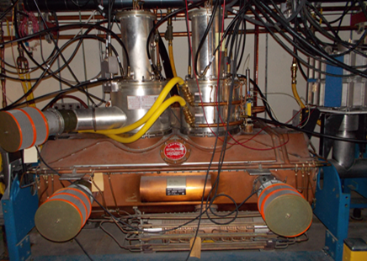
Progress in Accelerator Upgrades
All scope downstream of the SRF linac
Designs and Prototyping nearly complete
  Beam Transfer Line and Absorbers
  Specialty Magnets
  Booster RF upgrades
  Main Injector RF upgrades
  Recycler Ring 53 MHz RF cavities
Booster Gradient Magnets
RR Mock-up 53 MHz cavity with tuner
Booster Collimators
ORBUMP Magnets
Upgraded MI RF
13-June-2022

Slide 18
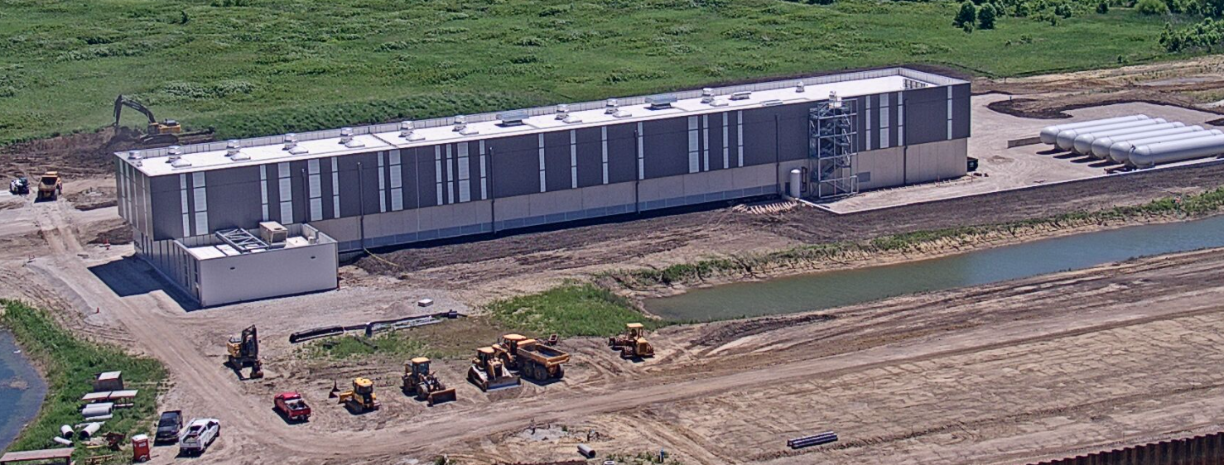



Cryogenic Plant Building Construction Progress
Authorization for Use and Possession in July 2022
Ribbon cutting - July 11th
June 2022
13-June-2022

Slide 19



Conventional Facilities Progress
Site Work Construction Package:
  Construction start in October 2021
  On track for completion in November 2022
Linac Complex (largest PIP-II contract)
  Issued for Proposals in April 2022
  Proposals received on June 7, 2022
Booster Connection
  Design completed
A0 Pond Restoration
13-June-2022

Slide 20
Near term goals & Summary
13-June-2022

Slide 21



Major PIP-II Milestones to complete in FY2022/23
Complete the Cryoplant Building Construction
Complete Prototype HB650 Cryomodule
Convert PIP2IT to a PIP-II Cryomodule Test Facility
Begin Linac Complex Construction
13-June-2022

Slide 22
https://pip2.fnal.gov/
Summary
PIP-II CD-3 is approved. Starting project execution phase with delivery in 2028.
PIP-II will enable the world’s most intense beam of neutrinos to the LBNF/DUNE; modernize Fermilab’s accelerator complex enabling science for decades to come;
PIP-II is breaking new ground as the first DOE/SC accelerator to be built with significant international contributions;
PIP-II International Partnerships are making excellent technical progress by completing designs, demonstrating critical technologies, and beginning project construction;
Strong support from Fermilab, Partners, Physics Community, OHEP, Office of Science, DOE, Congress;
Thanks to the Fermilab Users Community for your support
13-June-2022

Slide 23

Thank You
13-June-2022
Notes:
Keep

