Slide 1
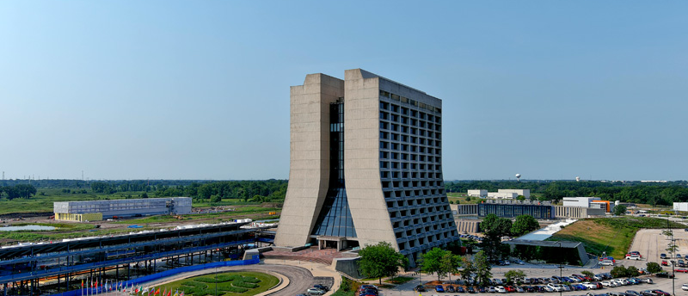
Annual Users Meeting
Your meeting to learn about FNAL research & activities
FNAL UEC 2021-2022
Catherine Ayuso (Mississippi State University) Biswaranjan Behera (Colorado State University) Rick Cavanaugh (U. of Illinois-Chicago & FNAL) Sridhara Dasu (University of Wisconsin), Chair Kristian Hahn (Northwestern University) Adam Lyon (Fermilab)
Ashley Back (Indiana University)
Sophie Middleton (CalTech)
Monica Nunes (Fermilab)
Alexx Perloff (University of Colorado)
Aleena Rafique (Argonne National Laboratory)
Nadja Strobbe (University of Minnesota)
Organized with help from Fermilab Students and Postdocs Association
6/13/22
FNAL Users Executive Committee

Slide 2
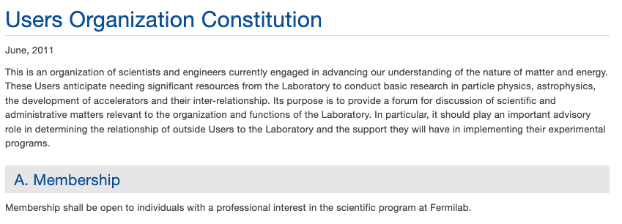
FNAL Users Organization & UEC
UEC strives to support you!
Users Executive Committee – 12 elected members
Every year 6 members are elected for 2-year terms
Nomination by 10-member petition for annual election
Nomination process for 2022-24 UEC begins this week
Volunteer to Serve on UEC
https://uec.fnal.gov/
6/13/22
FNAL Users Executive Committee

Slide 3
FNAL UEC Subcommittees
Your forum to learn about our activities & influence them, 2/22/22
Users Meeting (Sophie, Biswaranjan)
Responsible for bringing you this meeting!
Much effort went in to making this an informative and accessible one in hybrid mode!!
Unfortunately, had to adapt to Covid restrictions in the last minute – sigh!
Government Relations (Nadja, Adam)
Organized virtual congressional and executive office visits with USLUA in March
Excellent coverage of offices – over 100 meetings
Strong support from offices we met
Quality of Life (Aleena, Rick)
Plans for safely returning back to work, restoring all important in-person interactions
Tackling continued issues with laboratory access – new rules, dissemination of procedures
Handling trouble tickets – housing, cost increases, lab access issues, etc.
Education & Public Engagement (Alexx, Catherine)
Broad engagement with community, primarily on education efforts
New initiatives in improving Diversity, Equity and Inclusion
Coordination of new DEI initiatives with individual experiment efforts
6/13/22
FNAL Users Executive Committee

Slide 4
Excellent Science Outcomes Covid Not Withstanding
Intriguing Results
Potential new physics in g-2
Potential new physics in W-mass
Squashing the excesses in ν−spectra – sterile neutrino search
Substantial Results
100s of papers from CMS reporting SM measurements and limits of BSM parameter space
10s of papers from neutrino experiments on way to the determination of neutrino mass matrix fully
New Projects
Progress through the CD processes & new ML & QIS programs
Details on all of these in talks at this Users meeting
6/13/22
FNAL Users Executive Committee

