Slide 1
URA Honorary Awards
Ted Wackler Deputy Executive Director, URA
FERMILAB 54thANNUAL USERS (VIRTUAL) MEETING
August 2-6, 2021

Slide 2
UNIVERSITIES RESEARCH ASSOCIATION (URA)
Non-profit consortium of over 90 leading research-oriented universities.
Established 1967: prime contractor to DOE for the creation and operation of Fermilab.
Since 2007, operates Fermilab in partnership with University of Chicago through Fermi Research Alliance, LLC.
Since 2018, member of Honeywell-led team that manages and operates Sandia National Laboratories.
The Mission of URA
Establish and operate--in the national interest--unique laboratories and facilities for research, development, and education in the physical and biological sciences to expand the frontiers of knowledge, foster innovation, and promote the education of future generations of scientists.

Slide 3
URA Awards at Fermilab
URA Visiting Scholars Program
URA Honorary Awards ($10,000 stipend)
URA Tollestrup Award for Postdoctoral Research
URA Graduate Thesis Award
URA Early Career Award
Notes:
New slide to replace #3, above. Order now is the same as the order of the following slides. You talk about VSP first and then the honorary awards.
On the following slides you call the Tollestrup the “URA Alvin Tollestrup Award” not what’s listed here. What’s the correct title?
On the following slides you call the Graduate Thesis Award just “URA Thesis Award” so I added “Graduate”.

Slide 4
URA Visiting Scholars Program (VSP)
Established 2007, authorized through 2026
Competitive, peer reviewed awards for work at Fermilab by researchers from URA universities
Through spring 2021: $6.2 million total
490 awards
79 universities and Fermilab
Apply by August 30! https://www.ura-hq.org/awards/visiting-scholars-program

Slide 5
Visiting Scholars Program at Fermilab
S pring 2021
Carl Eric Dahl, Northwestern University
Clarke Esmerian, The University of Chicago
Austin Hinkel, University of Kentucky
Gourav Khullar, The University of Chicago
Shaun Lahert, Illinois Urbana-Champaign
Ievgen Lavrukhin, University of Michigan
Yin Lin, The University of Chicago
Middleton, Back & Gandrajula, Fermilab
Christian Pedersen, University College London
Alexey A. Petrov, Wayne State University
Matthew Portman, UC Irvine
Daniel R. Simons, The University of Iowa
Deheng Song, Virginia Tech
Matthew Strait, University of Minnesota
Samantha A. Usman, The University of Chicago
Osmond Wen, California Institute of Technology
Fall 2020
Saurabh Bansal, University of Notre Dame
Ohana Benevides Rodrigues, Syracuse University
Prudhvi Raj Varma Chintalapati, Northern Illinois University
Michael Dolce, Tufts University
Miranda Elkins, Iowa State University
Yiding Yu, Illinois Institute of Technology
5

Slide 6
URA Alvin Tollestrup Award for
Post Doctoral Research
For outstanding work conducted by a postdoctoral research fellow at Fermilab or in collaboration with Fermilab scientists

Slide 7
URA Alvin Tollestrup Award for Post Doctroral Research Award Committee
Michael Mulhearn, UC Davis, Chair
Jahred Adelman, Northern Illinois University
Brenna Flaugher, Fermilab
Christopher T. Hill, Fermilab
Matthew Toups, Fermilab

Slide 8
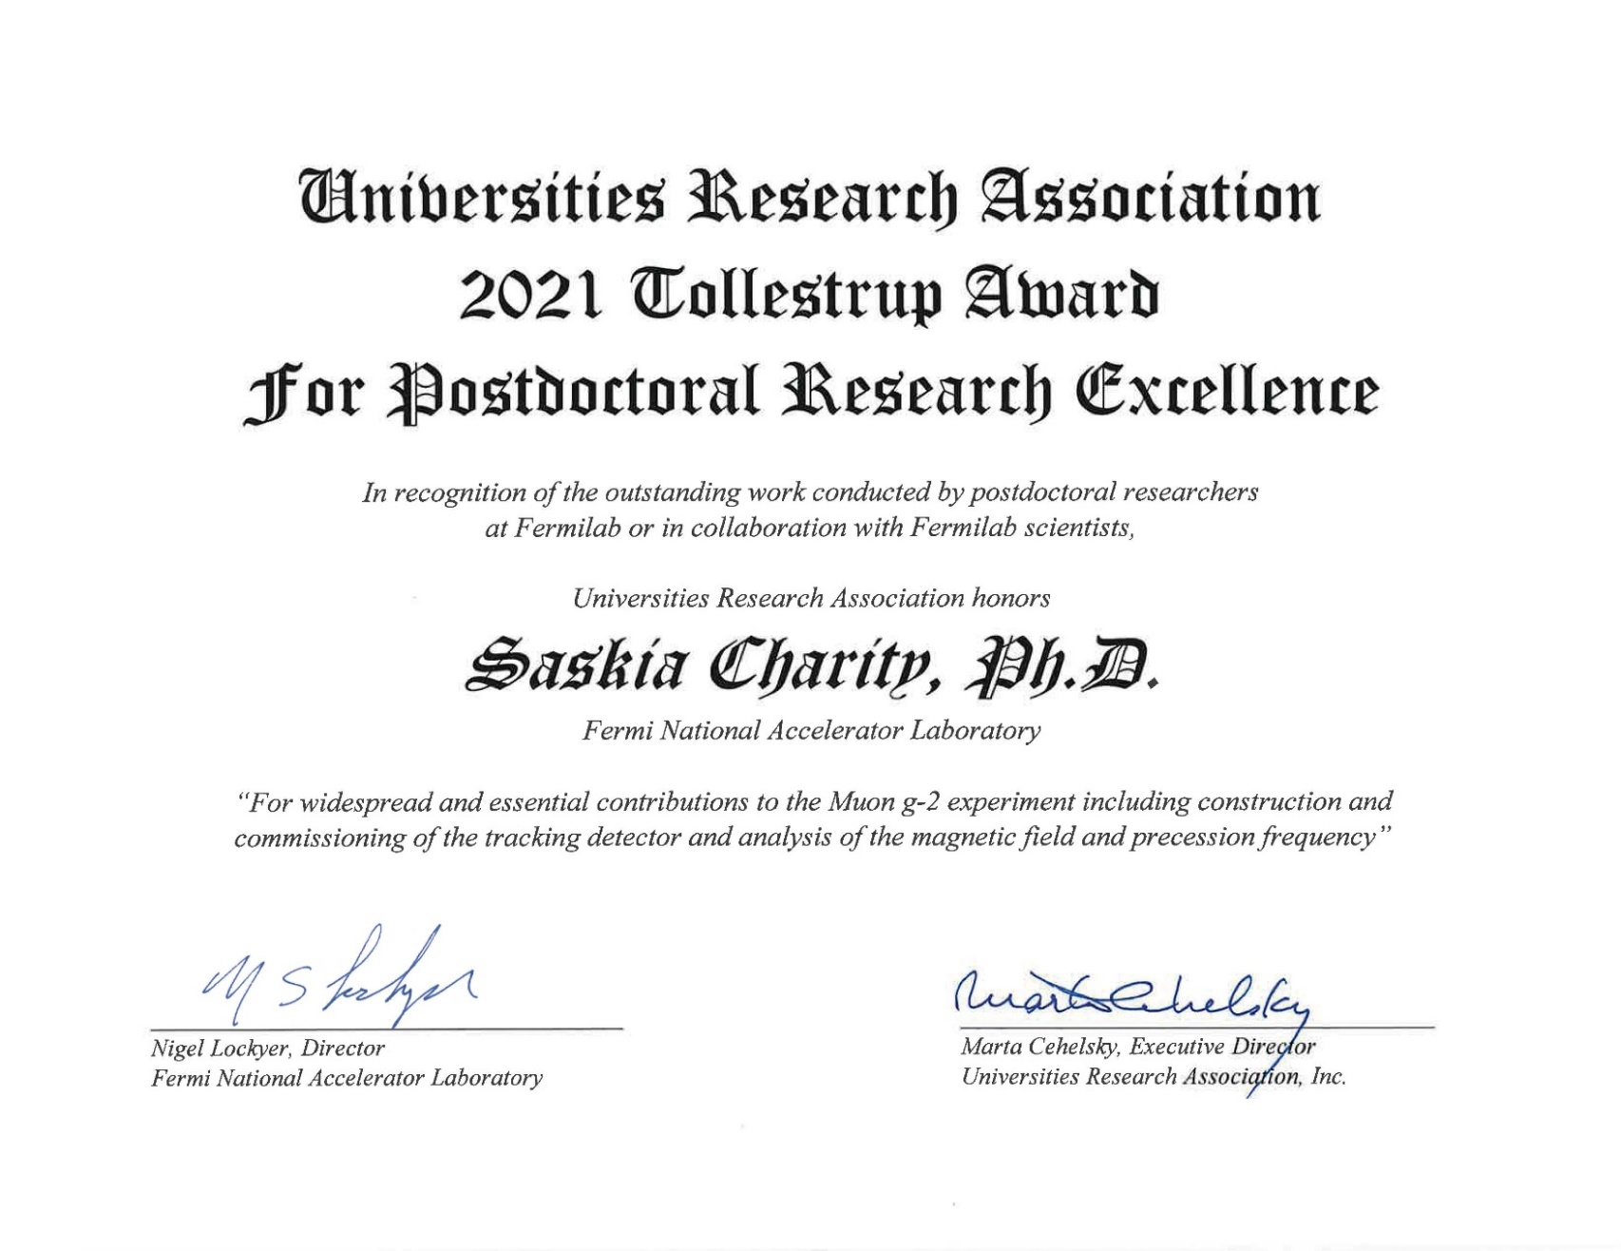

Slide 9
URA Graduate Thesis Award
For the outstanding doctoral thesis written on research at Fermilab or in collaboration with
Fermilab scientists

Slide 10
URA Graduate Thesis Award Committee
Chris Stoughton (astrophysics), Chair
Phil Adamson (Accelerator Division, Neutrino experiments)
Catherine James (Neutrino experiments)
Andreas Kronfeld (Theory)
Notes:
Ditto #10.

Slide 11
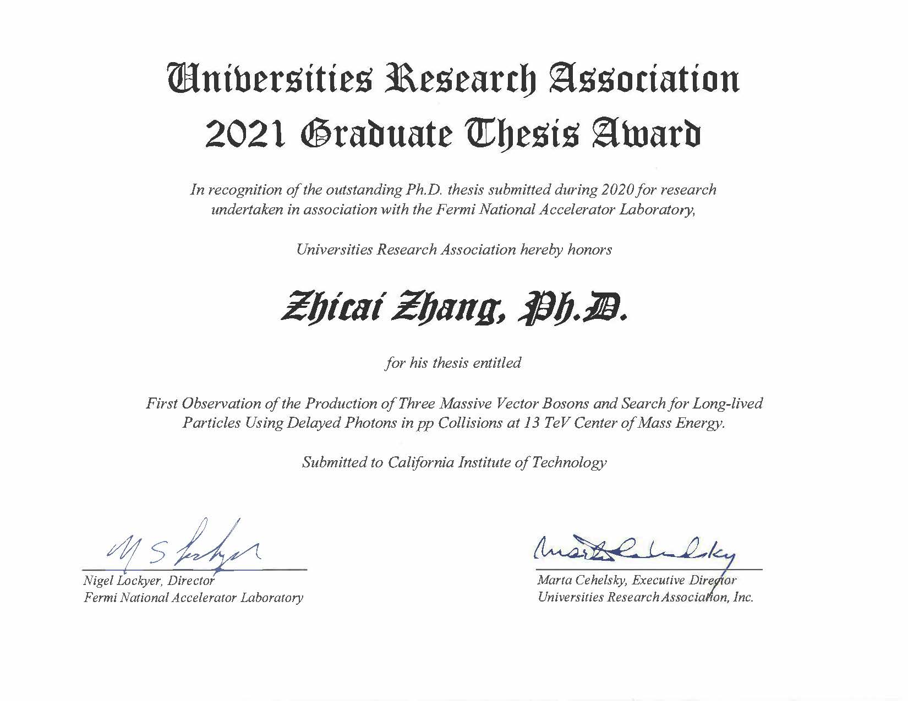

Slide 12
URA Early Career Award
For outstanding work conducted by an early career researcher at Fermilab or benefiting the Fermilab scientific program

Slide 13
URA Early Career Award Committee
Sarah Demers (Yale University), Co-Chair
Julie Whitmore (Fermilab), Co-Chair
Ken Bloom (University of Nebraska)
Paul Derwent (Fermilab)
Brenna Flaugher (Fermilab)
Patrick Fox (Fermilab)
Peter Wittich (Cornell University)

Slide 14
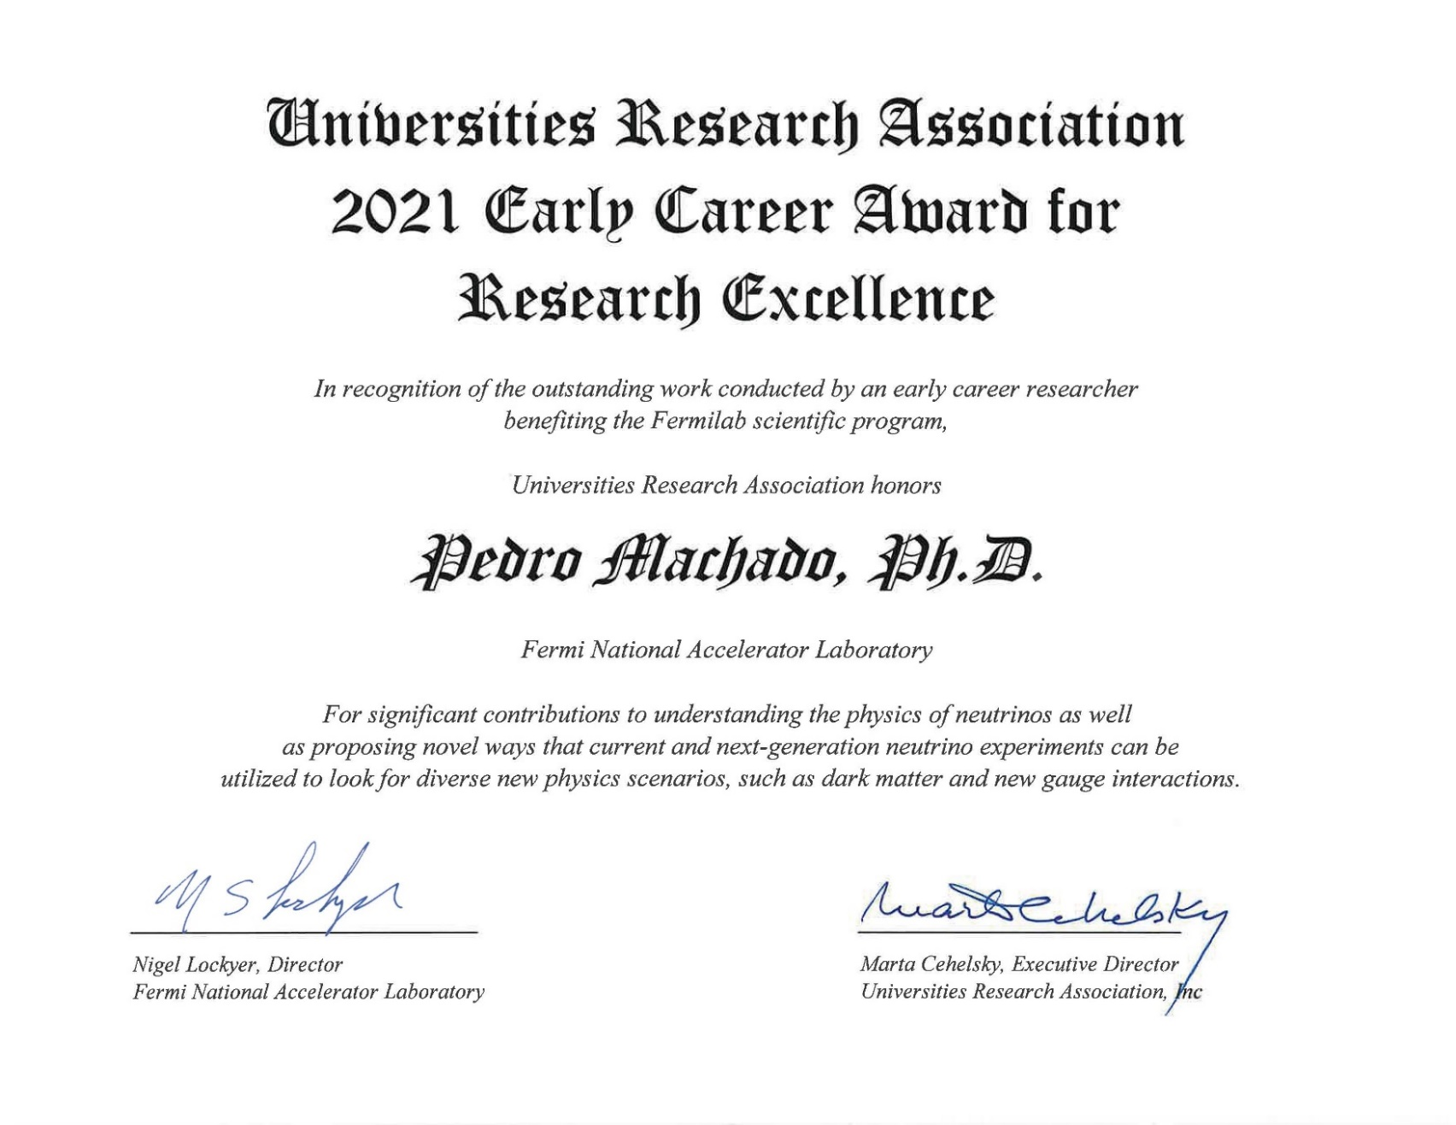

Slide 15
2021 URA Honorary Award Recipients
Saskia Charity Tollestrup Award for Postdoctoral Research
Zhicai Zhang Graduate Thesis Award
Pedro Machado Early Career Award

