Slide 1
Engineering at Fermilab
Silvia Zorzetti
53rd Fermilab Users Meeting
August 10-13, 2020

Slide 2
Engineering at Fermilab
Detector Technology
Trigger and Data Acquisition
Accelerators and Beam
Integrated Circuit Design
Target Systems
Cryogenics
Vacuum Systems
High Power RF
Superconductors
AI and Robotics
Quantum Technology
Applied Materials and Advanced Fabrication
R&D Engineering
Advance technology
Innovation
Increase efficiency
Improve quality
Cut costs
Reduce errors
Upgrade modern facilities

Slide 3
PIP-II

Slide 4
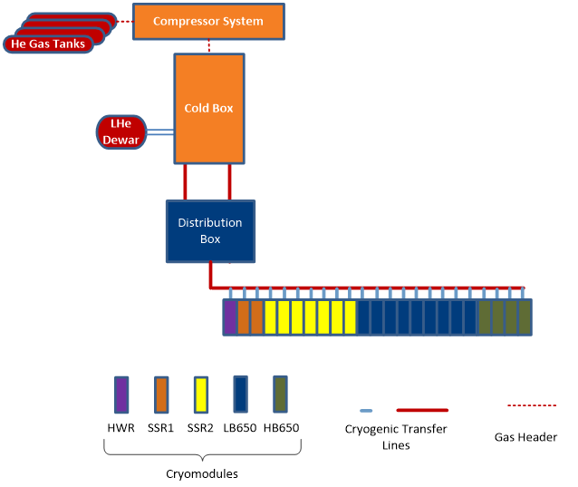
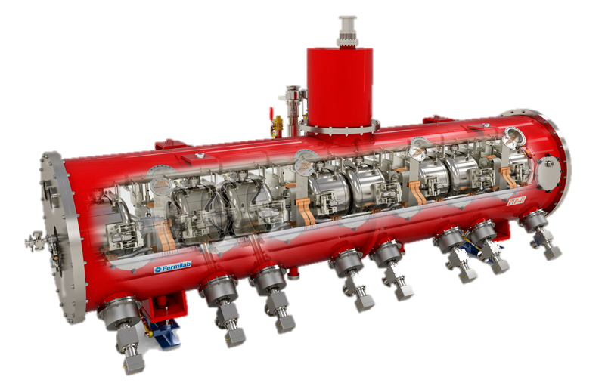
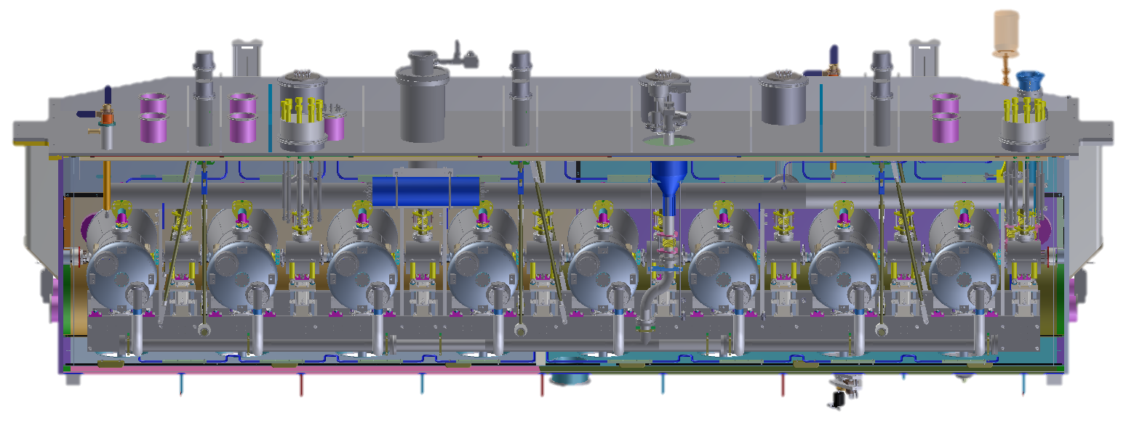
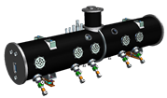
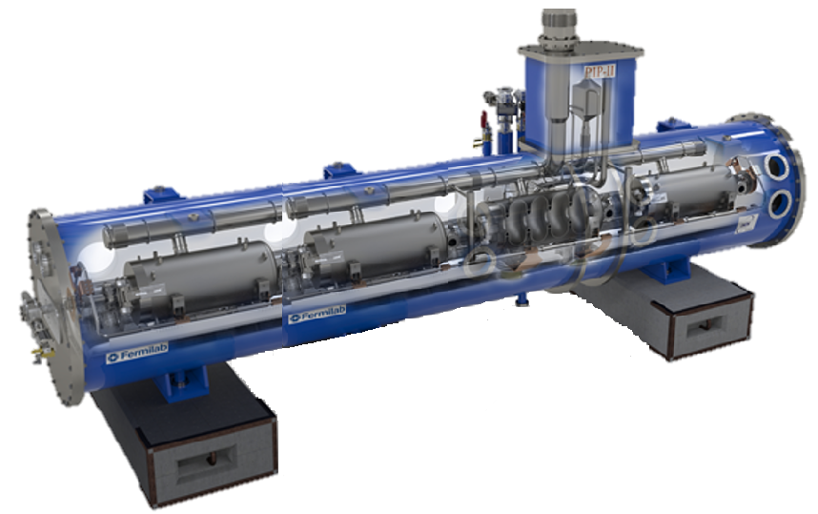
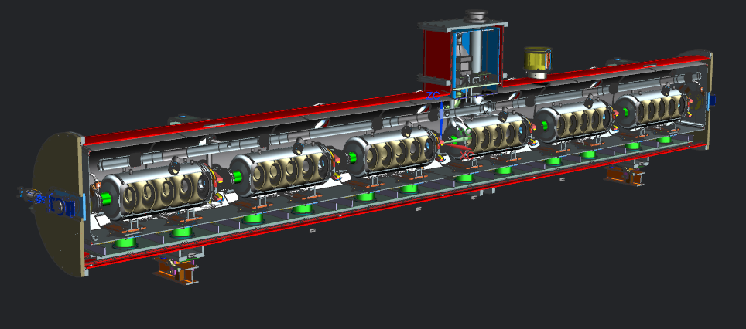
PIP-II SRF Cryo Scope
HWR X 1
SSR1 X 2
SSR2 X 7
LB650 X 9
HB650 X 4
S.K. Chandrasekaran, V. Roger

Slide 5
HB650 Design Scope
FNAL is design authority for HB650 CM & 650 MHz Tuners
CM design is through integrated design team
CEA, FNAL, RRCAT, STFC-UKRI
Thermal shield assembly design
RRCAT & FNAL
Strongback, interface to vacuum vessel, & end cap tooling
CEA
All other items on the CM
FNAL
Transportation frame for CM
STFC-UKRI
S.K. Chandrasekaran, V. Roger

Slide 6
Design continues mid lockdown
Fermilab engineers and scientists continue the work on CM design remotely, coordinating with international partners
https://news.fnal.gov/2020/06/accelerating-science-globally-pip-ii-engineers-continue-designs-for-particle-propelling-machine-from-home/

Slide 7
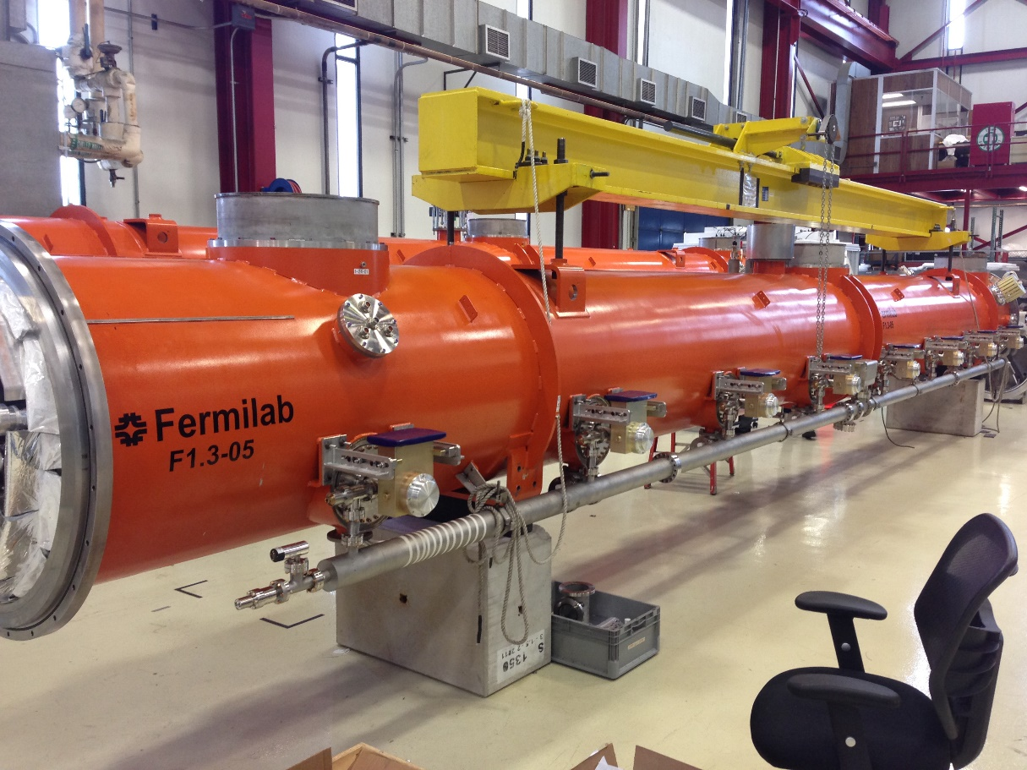
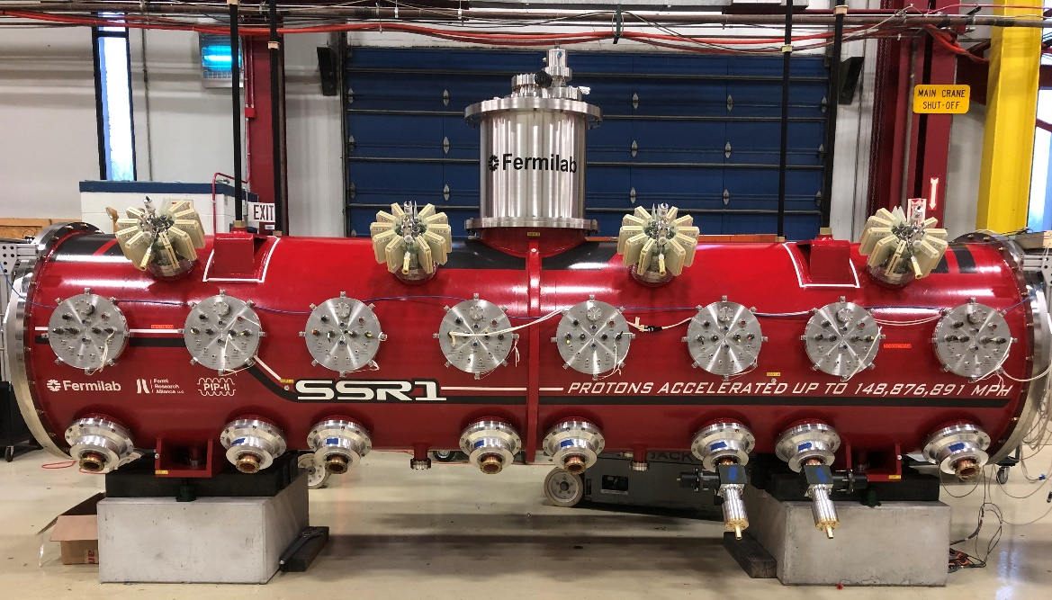
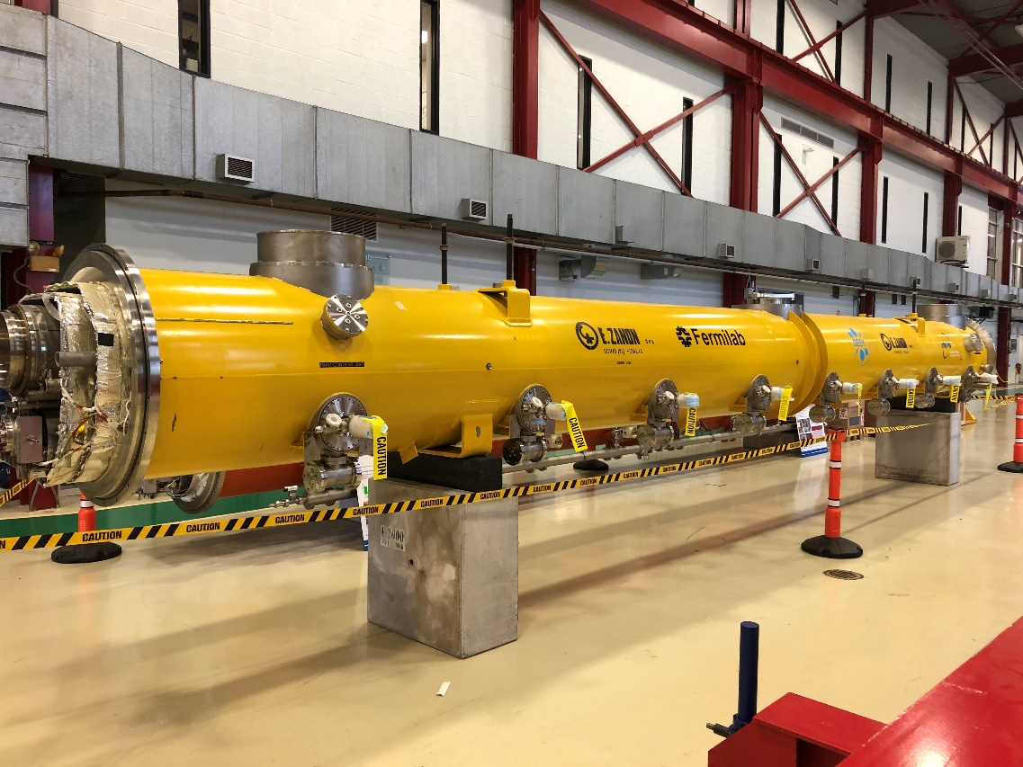
CM assembly at Fermilab
C. Grimm
ILC
1.3 GHz – 2 built, 6 planned
LCLS-II
1.3 GHz – 19 built
3.9 GHz.- 3 built
PIP-II
SSR1 – 1 built
C. Grimm
LCLS-II
PIP II-SSR1
ILC

Slide 8
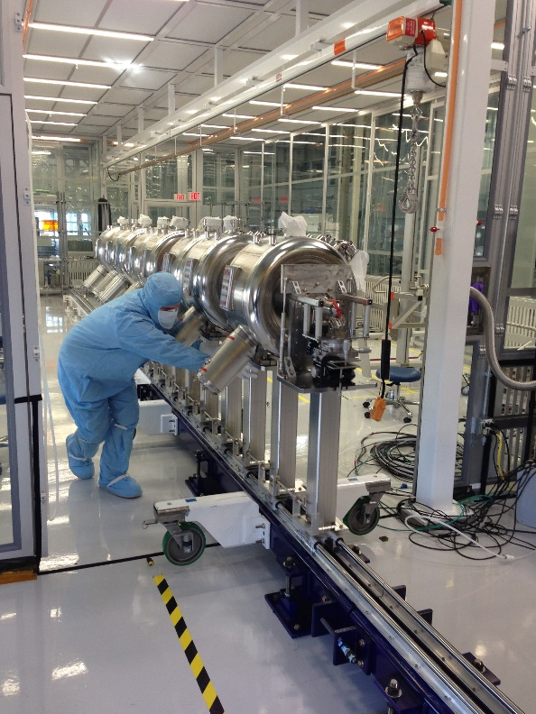
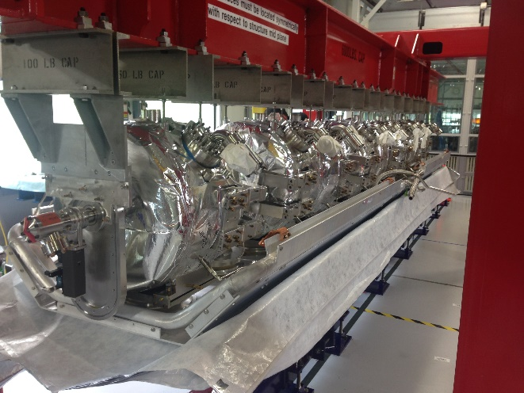
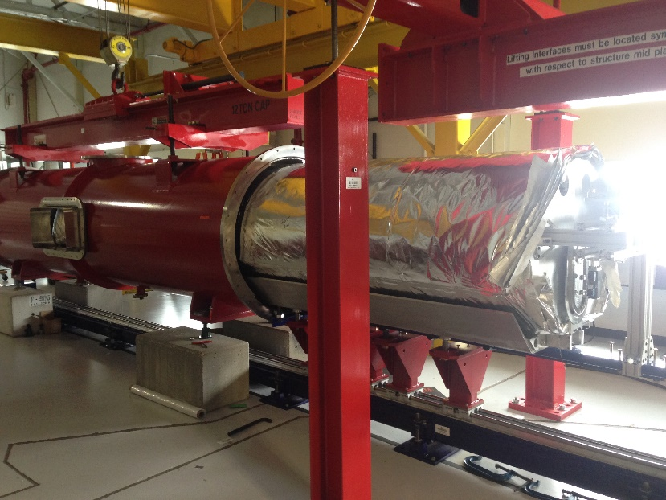
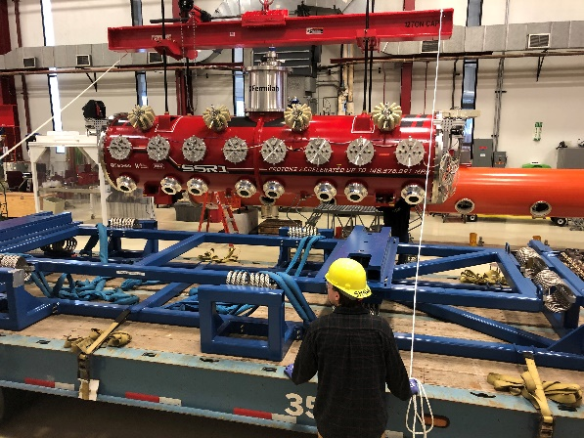
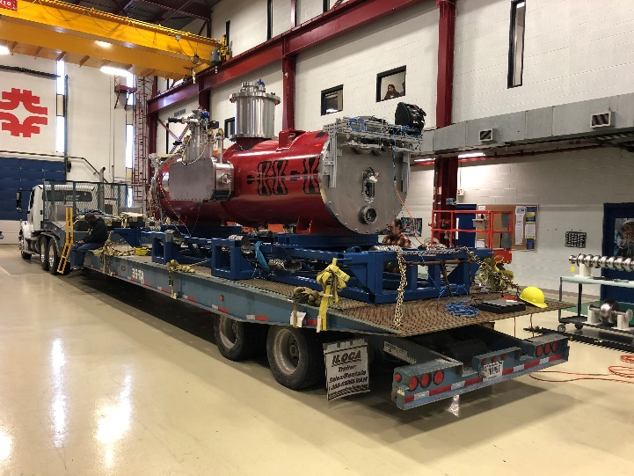
SSR1 assembly
Lower cavities on strongback
Coldmass insertion into the vacuum vessel
Align string in cleanroom
C. Grimm
Transportation
https://indico.fnal.gov/event/43274/contributions/190409/attachments/131934/161817/HB650_CM_FDR_26_Grimm_Cryomodule_Assembly_Experience_v2.pptx

Slide 9
Robotics and Computer

Slide 10
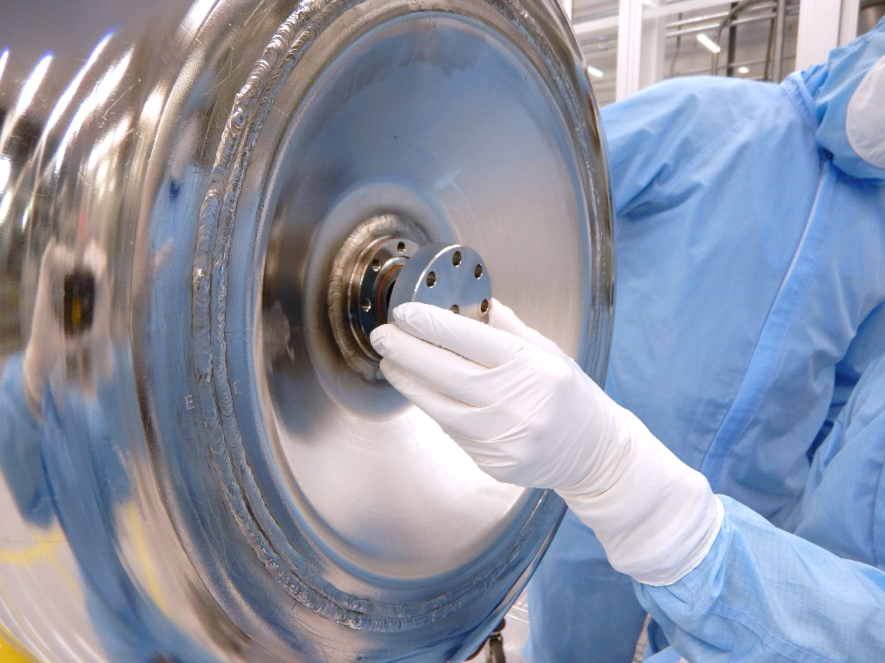
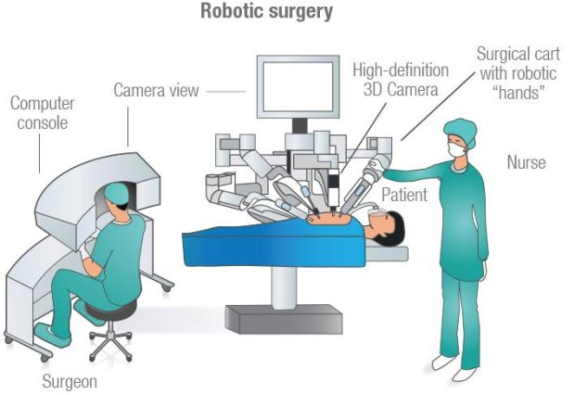
Automation for SRF applications
Manual operations in cleanroom
Operators are among the main sources of contamination
Performances highly depend on operator ability, experience and commitment
Robotically assisted operations
Reduce the risk of chemical and particulate contamination during critical assembly steps
Handling and positioning components in proximity of beamline aperture
Make the assembly process more efficient and systematic, in order to obtain repeatability in SRF performances
“People or systems? To blame is human.
The fix is to engineer”
R.J. Holden

Slide 11
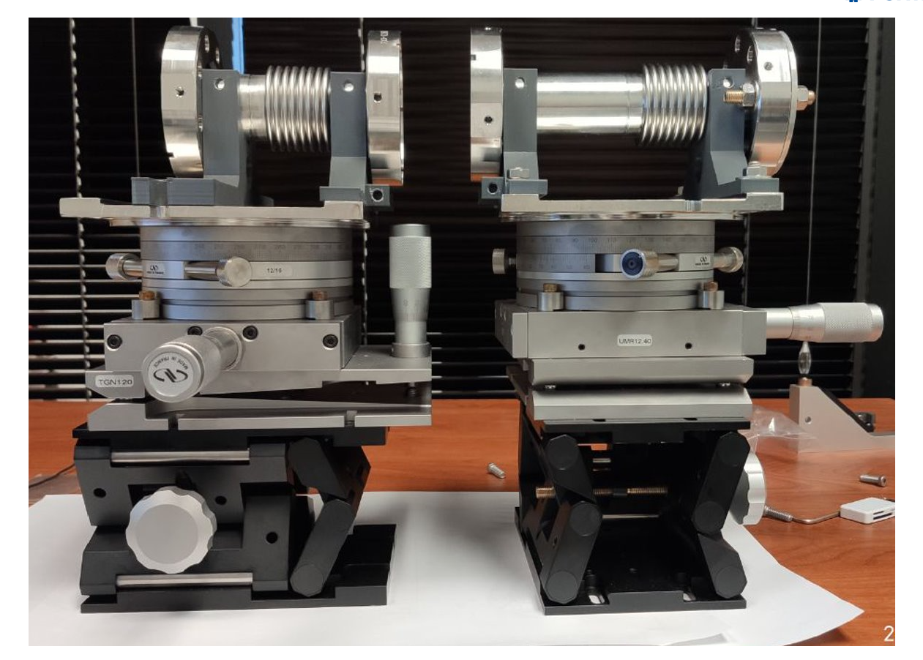
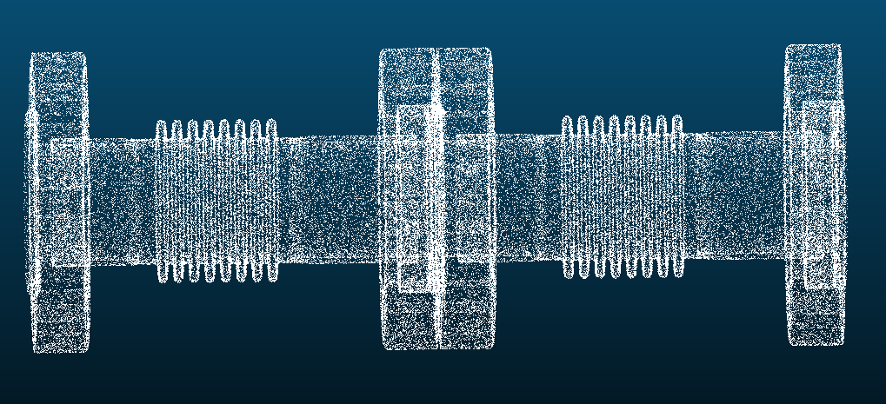
Targetless computer vision technology
Target-less computer vision technology, compatible with cleanroom
5mw laser projector
Point cloud technique combined with pose reconstruction
M. Parise, D. Passarelli
https://indico.cern.ch/event/817780/contributions/3716530/

Slide 12
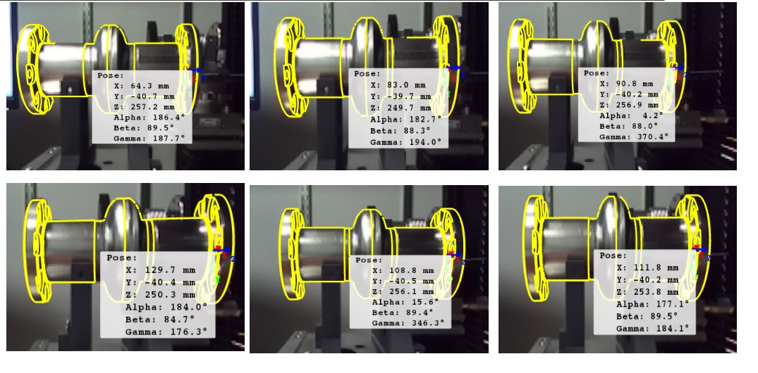
Pose reconstruction with point clouds - image
Performance evaluation
The cavity is mounted on translation stages to validate the position monitoring
Sub-micrometric accuracy for the translations
Translation
Rotation

Slide 13
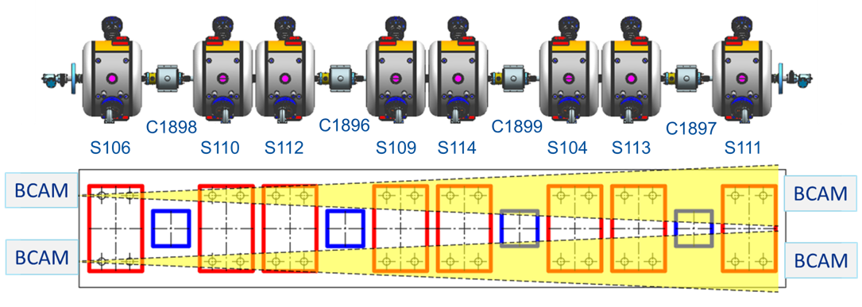
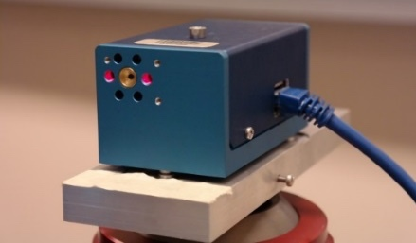
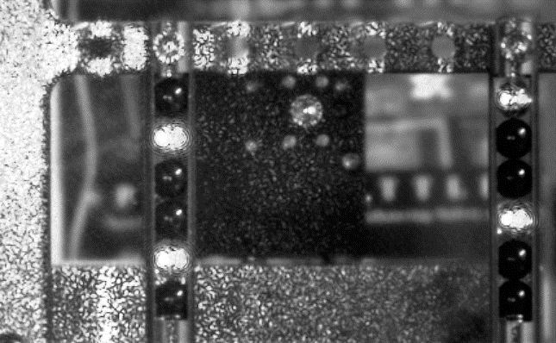
Computer vision for CM alignment monitoring
Use optical cameras for alignment monitoring of CM components
H-BCAM picture
Laser source
https://indico.fnal.gov/event/43274/contributions/191900/attachments/131929/162204/HBCAM_PIP-II_HB650_CM_FDR.pptx
HBCAM acquisition picture

Slide 14
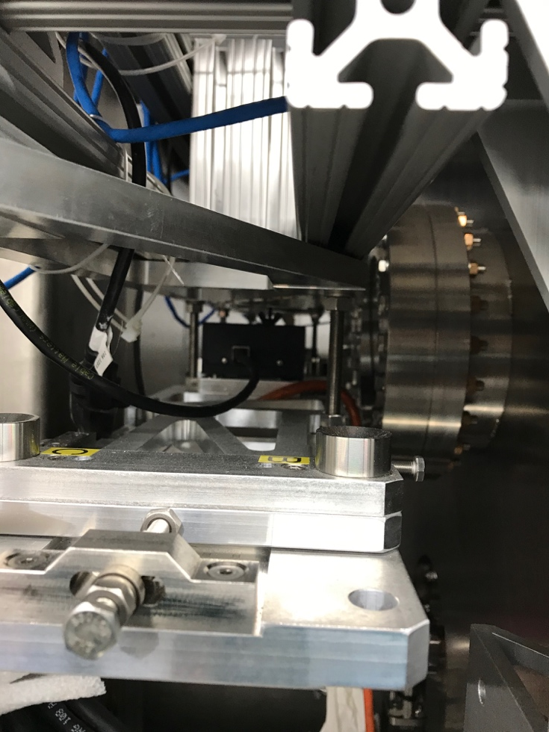
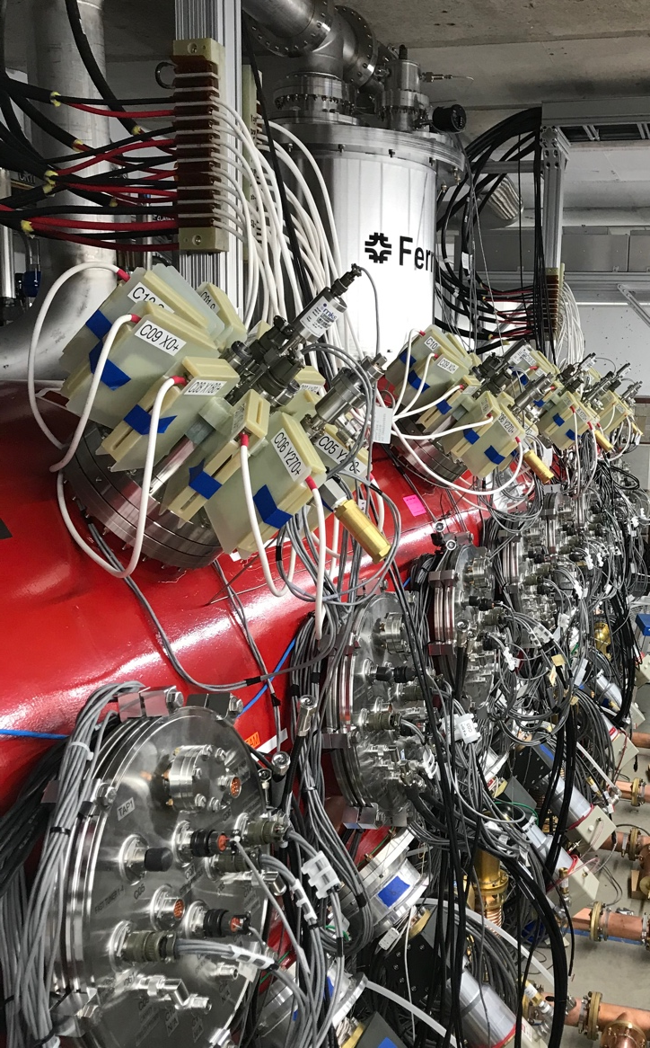
SSR1 cooldown position monitoring
Camera
Viewport
Full target view from the external H-BCAM

Slide 15
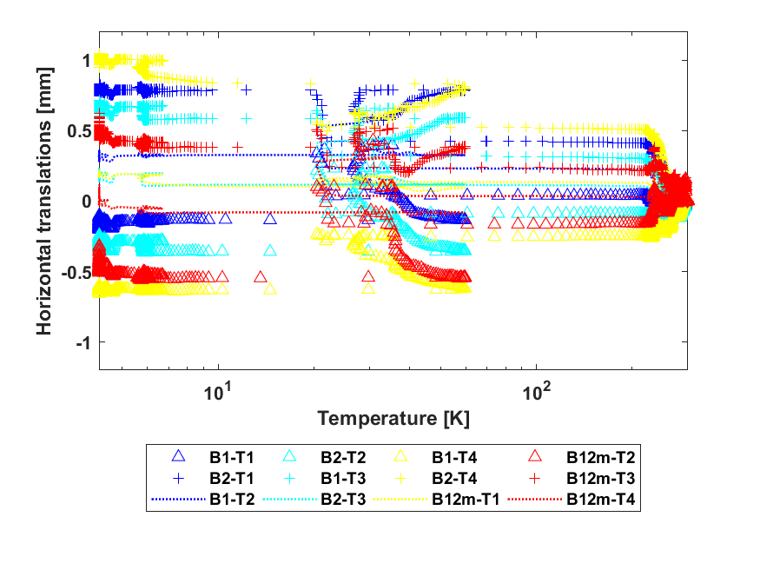
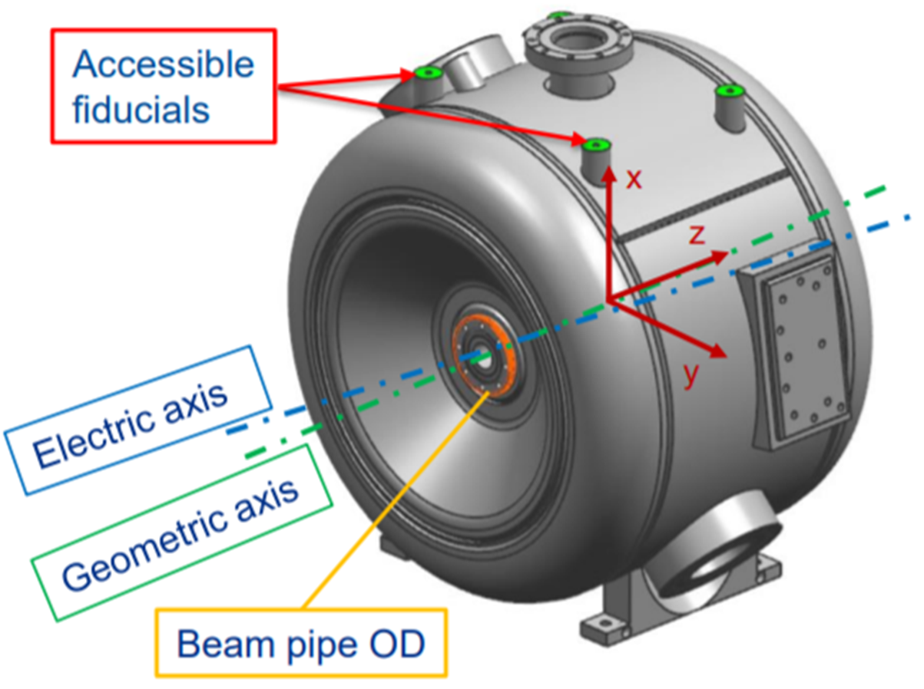
SSR1 cooldown position monitoring
T4
T3
T2
T1
Preliminary results
BCAM4
BCAM2 +
BCAM3
BCAM1 Δ
Upstream
Temperature sensors
Downstream
BCAM1 +
(+)
(-)
BCAM2 Δ

Slide 16
Quantum Computing

Slide 17
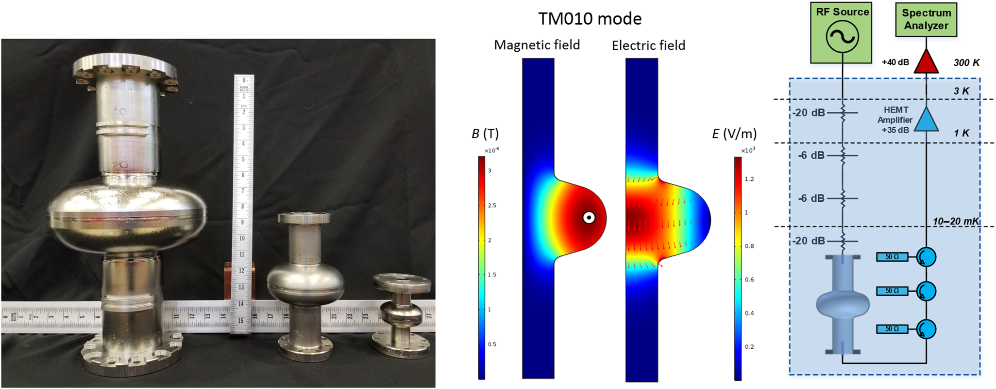
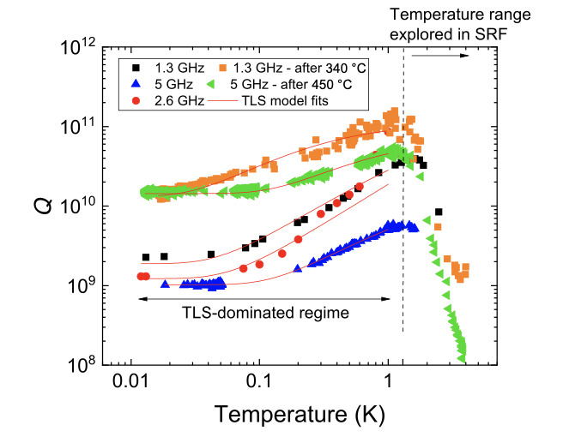
SRF Quantum Computing
Use accelerator technology to enable high coherent Quantum Computing systems
High Quality factor SRF cavities
Fermilab expertise in the development of custom analog and digital processing electronics for particle accelerators applications
Record high photon lifetime SRF cavities

Slide 18
Quantum Computing Laboratory
2 Dilution Refrigerators
High-end laboratory to enable multi-qubit characterization
Outstanding commercially available equipment
Oscilloscope, 128Gsa/s sample rate on all channels
AWG, 65 GS/s
Spectrum Analyzer with noise down to thermal floor limit
RF microwave signal generator with lowest phase noise in industry
Working on compact electronics to compare device testing at partners’ facilities

Slide 19
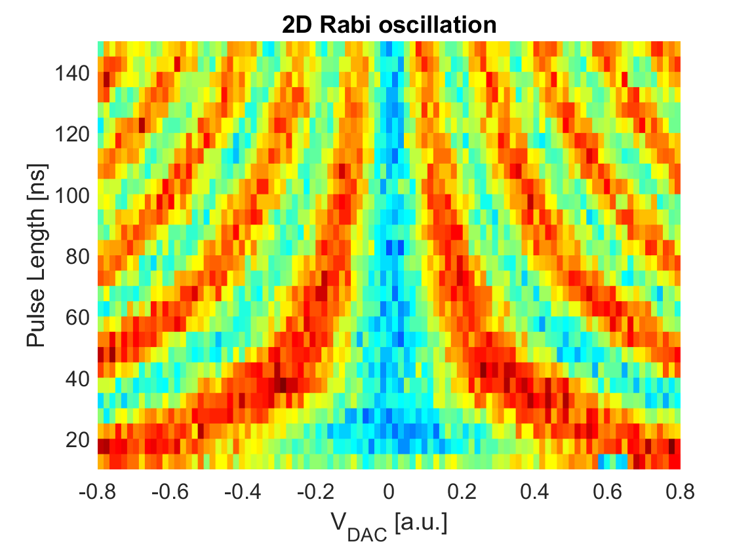
Full qubit characterization
Alice
Bob
Charlie
David
Qubit spectroscopy to identify the qubit
T1
T2

Slide 20
Innovation in accelerator technology

Slide 21
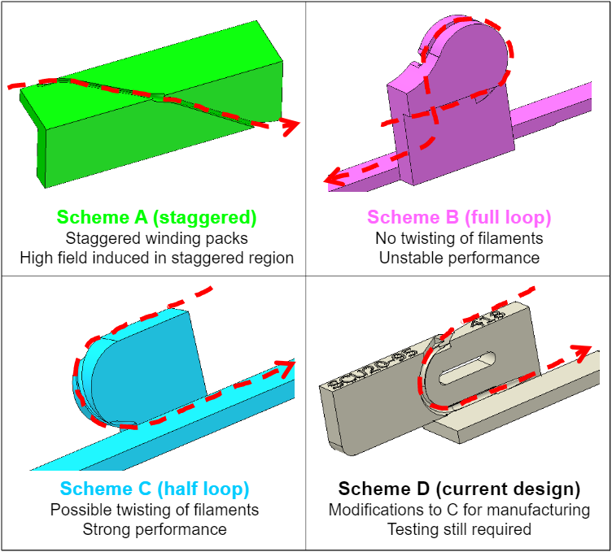
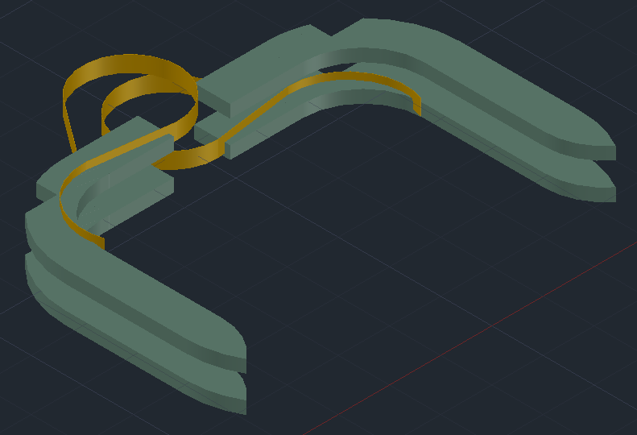
Additive Manufacturing
Use of 3D printed Glass Reinforce Plastic - GFP at cryogenic temperature:
Reduce production time (from months to days)
Increase number of suppliers
Allows for new complex shapes
Use 3D printed metal parts, for example for complex aluminum vacuum vessels:
New design mindset is required
Simplification of parts
Integration of multiple functions in one component
Outlook: Direct Additive printing of superconducting wires/tapes or bulk HTS
C. Boffo
Coil jump
HTS support in SC magnet

Slide 22
Conduction cooled systems
Optimal for stand alone systems:
Low cost of operation
Does not require complex infrastructure with cryo-lines
Position of the device in the beamline is flexible
Reduced safety requirements then bath cool systems:
Typically no pressure vessel stamp is required
No LH2 or LN2 filling procedures
No ODH or vent lines issues
Technology transfer to industry:
Optimal for small commercial systems even cyclotrons
SRF cavities in Nb₃Sn are a perfect applications (IARC/APS-TD)
Superconducting undulators and proton therapy gantry magnets
C. Boffo, R. Duley, V. Kashikhin, S. Posen

Slide 23
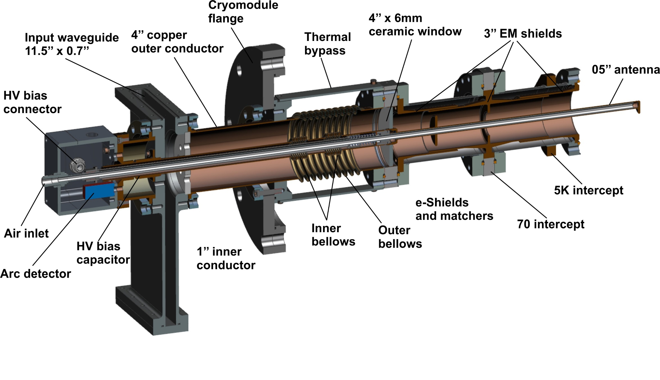
Innovative Main Coupler Design
Main couplers are ones of most important elements of accelerator which determine a reliable operation of whole machine.
It isolates an accelerator vacuum and transmits RF average power of tens and hundreds kW level into a cavity. In case of superconducting accelerator, a coupler is experienced a temperature difference from 0K to room temperature.
Design of reliable powerful main coupler is challenging task.
New type of 650 MHz coupler
Main features of new design:
no copper coating
ceramics is protected by shields
better cryogenics properties
Innovative type of couplers for superconductive accelerators was suggested, designed, built and rested in FNAL. This design allows to avoid a copper coatings and significantly reduce cryogenic loading from a coupler to cavity.
Electromagnetic shields replace a copper coatings and improve cryogenic properties.
S. Kazakov

Slide 24
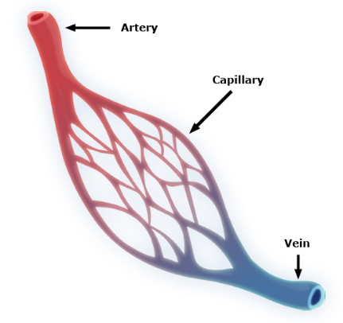
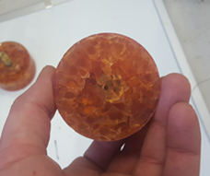
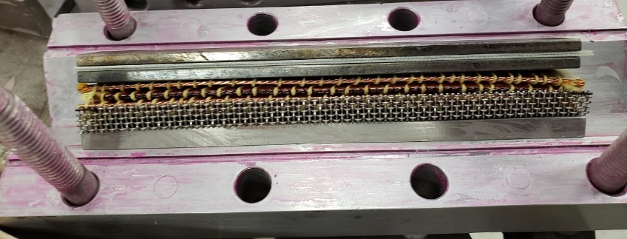
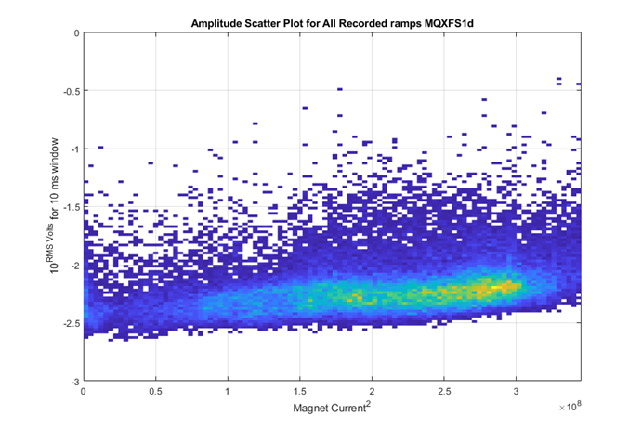
Development of New Processes and Exploration of New Materials for Superconducting Magnet Construction
To move beyond state of the art and enable robust high field magnet designs, new techniques and a better understanding of the interplay between magnet performance and magnet materials is needed.
Tougher stronger resins are a possibility
Development includes characterizing potential disturbance spectrum for superconducting magnet material and comparing to magnet tests
Enabling Technique: Open design space to tougher higher viscosity resins
Each crack could be one of these
Which all map on a magnet like this, potentially triggering a quench
Hypothesis: Quiet magnets exhibit better training performance
C. Boffo, S. T. Krave
Silvia Zorzetti | Engineering at Fermilab

Slide 25
Targetry

Slide 26
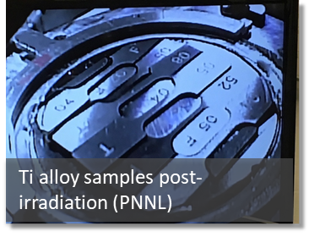
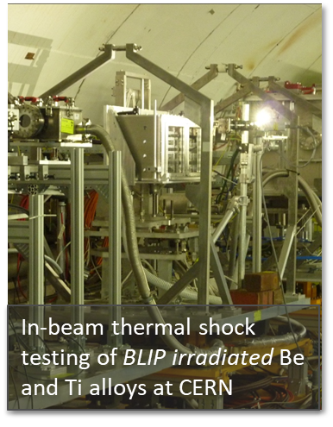
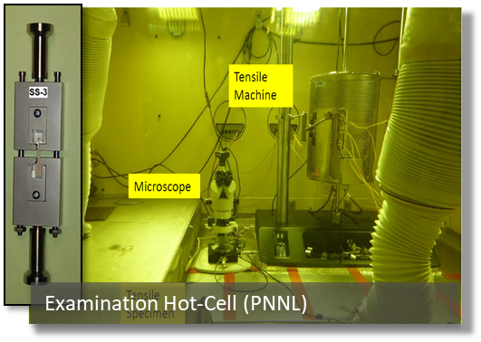
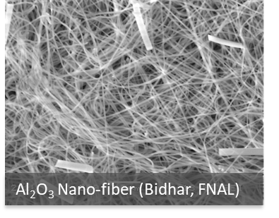
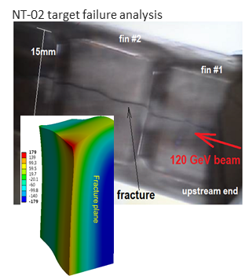
High Power Targetry R&D (AD-TSD)
R&D to optimize design & reliable performance of future multi-MW accelerator target facilities
Recent R&D activities
lti-material RaDIATE high energy proton irradiation run at BLIP, BNL
Thermal shock experiments at CERN’s HiRadMat facility
Examinations of spent targets and beam windows
Grew RaDIATE collaboration to 14 institutions & over 70 members
Future plans for HPT R&D
Global consensus to orient targetry R&D toward future HEP experimental programs
Conventional and novel materials R&D
High energy proton and low energy ion irradiations
In-beam thermal shock testing
Fundamental radiation damage effects modeling
Novel material development
Targetry application R&D
Novel target design and thermal management concepts
Semi-autonomous robotic remote handling
Fermilab targetry facilities
Irradiation and thermal shock testing capabilities at FNAL
R&D laboratory equipped with hot cells, characterization instruments and test stands
K. Ammigan, F. Pellemoine
Benefits to multi-MW targets
(NuMI 1 MW, LBNF 1.2/2.4 MW, J-PARC 1.3 MW)
Material choice
Cooling system design and operating temperatures
Tolerable beam intensities
Expected lifetimes

Slide 27
Cryogenic ASICS

Slide 28
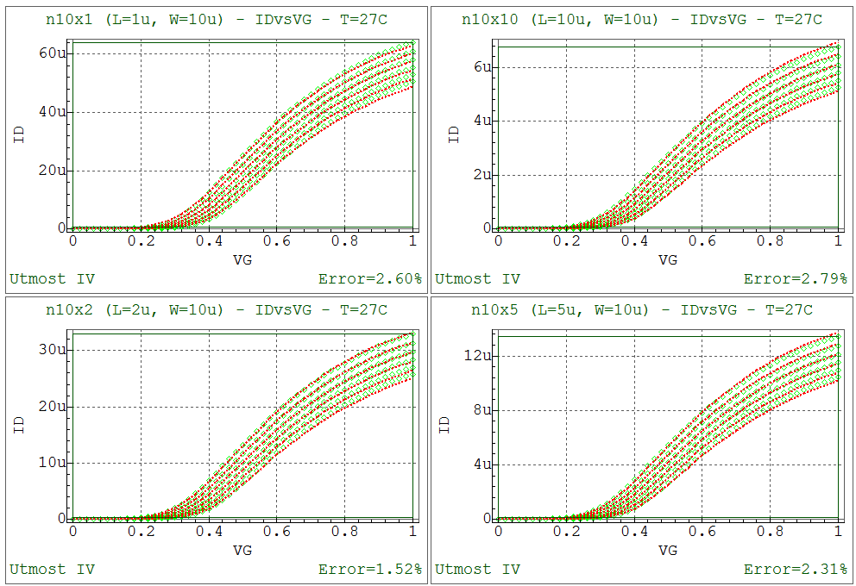
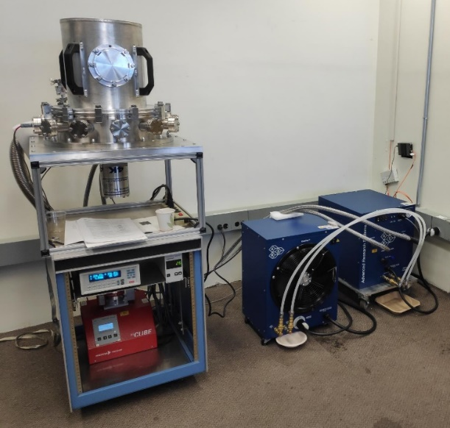
LDRD: Characterization and Development of Nanoscale Integrated Circuits for Quantum Systems and Deep Cryogenic Detectors
(Davide Braga, PPD/EED)
Cryogenic ASICs offer unique low-noise performance and a path to scaling for bot QIS and HEP applications
Main Objectives:
Characterization of advanced nanoscale CMOS (22 nm FDSOI) for cryogenic temperature for QIS (4K and below) and HEP (LHe, LXe, LAr).
Development of device models for seamless integration with standard, state-of-the-art EDA IC design tools.
Provide a toolkit for designing complex ASICs with high confidence of reliability
Impact:
Acquire in-house infrastructure and know-how for testing and characterization of cryo electronics
Develop tools to enable the design of complex integrated circuit in an advanced technology
Support and attract work for QIS and HEP (competitive advantage)
D. Braga
CMOS device models
4K custom cryocooler
August 10-13, 2020
Silvia Zorzetti | Engineering at Fermilab

Slide 29
Thanks to
K. Ammigan, J. Bernardini, D. Braga, C. Boffo, S.K. Chandrasekaran, R. Duley, D. Frolov, C. Grimm, V. Kashikhin, S. T. Krave, M. Parise, D. Passarelli, F. Pellemoine, S. Posen, V. Roger

