Slide 1
Present and Future Particle Accelerators at Fermilab
Jeffrey Eldred, for Accelerator Division
Fermilab User’s Meeting (Introduction Series)
August 10th, 2020

Slide 2
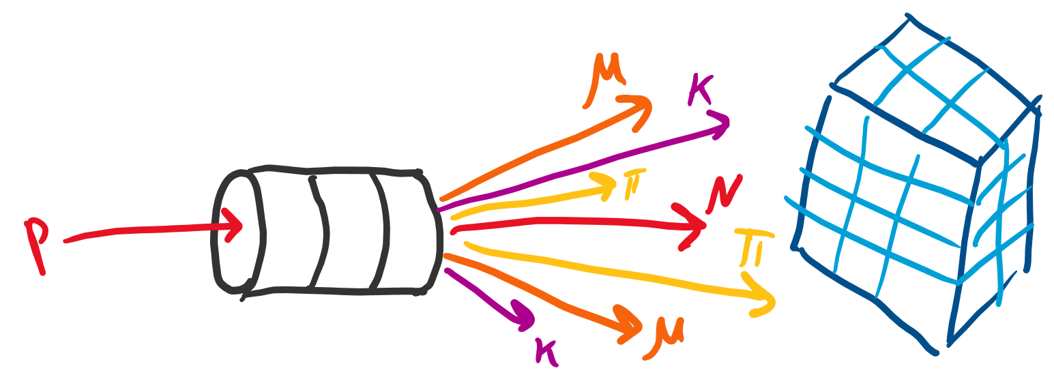
2
Cartoon of Particle Accelerator Experiments
Proton-beam
Target
Detector
Secondary Particles
The Fermilab Accelerator Complex is optimized to deliver intense proton beams at a variety of GeV-scale energies.
2
Jeffrey Eldred | Present & Future Particle Accelerators at Fermilab
Notes:
2
2
2

Slide 3
3
3
3
Jeffrey Eldred | Present & Future Particle Accelerators at Fermilab
Notes:
3
3
3
3
3
3

Slide 4
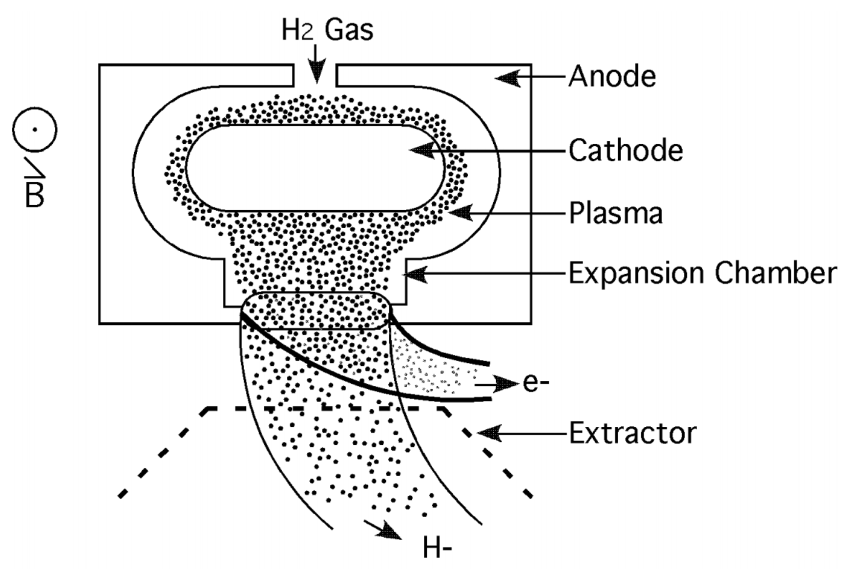
4
Magnetron H⁻ Source
H₂ gas
B. Worthel et al., Linac Rookie Book
H⁻ ions
protons
The particle beam starts as a H₂ gas, which is bombarded with electrons to ionize it, and the H⁻ ions are extracted.
4
Jeffrey Eldred | Present & Future Particle Accelerators at Fermilab
Notes:
4
4
4

Slide 5
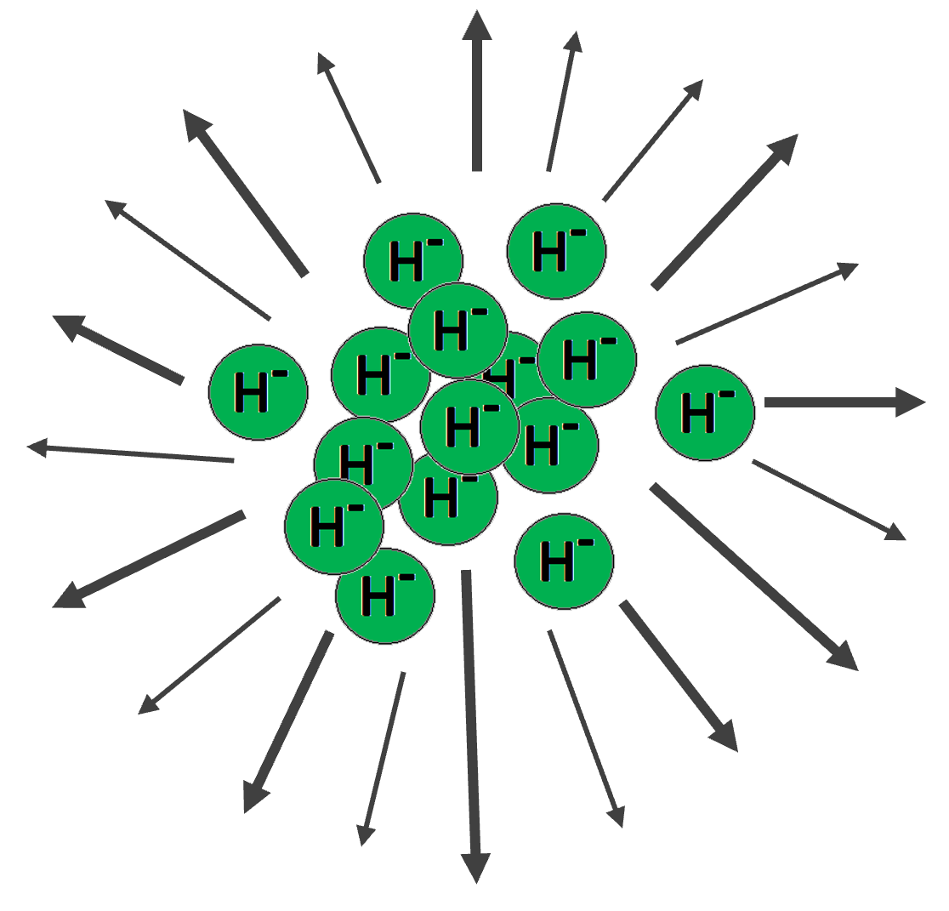
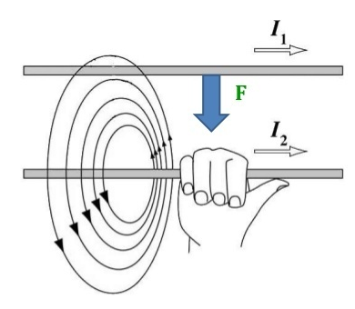
5
Acceleration for Beam Stability
Electric Repulsion:
Magnetic Attraction:
Weakened Repulsion with Acceleration:
5
Jeffrey Eldred | Present & Future Particle Accelerators at Fermilab
Notes:
5
5
5

Slide 6
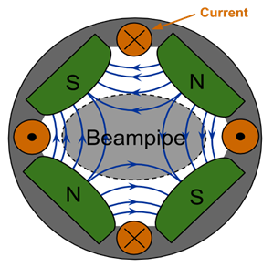
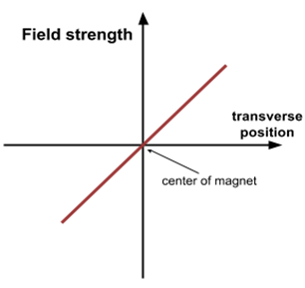
6
Focusing for Beam Stability
Quadrupole Magnet:
Linear Restoring Force:
D. Barak, B. Harrison, A. Watts, Concepts Rookie Book
Alternating Focusing Magnets:
6
Jeffrey Eldred | Present & Future Particle Accelerators at Fermilab
Notes:
6
6
6

Slide 7
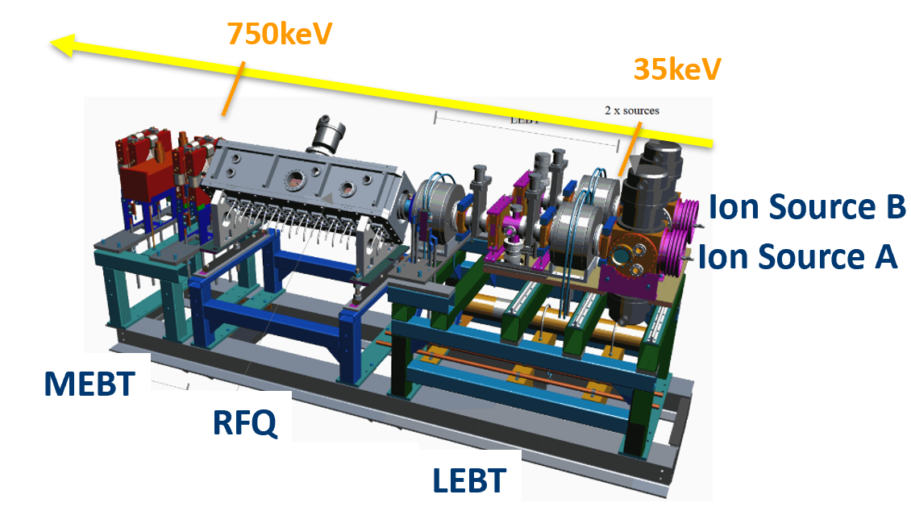
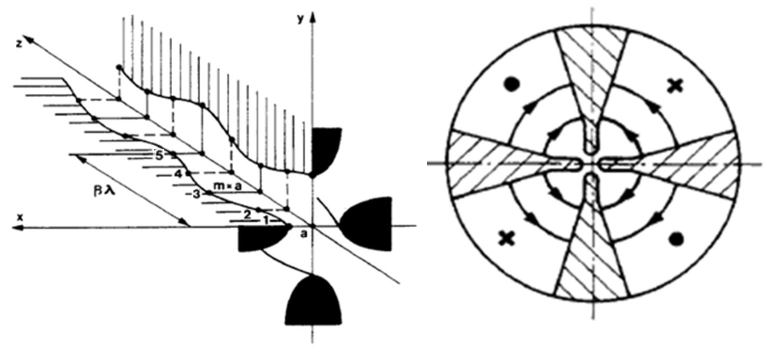
7
RFQ = Radiofrequency Quadrupole
K. Seiya, NuFACT19
Italian INFN-LNL
The RFQ accelerates and focuses the beam simultaneously.
7
Jeffrey Eldred | Present & Future Particle Accelerators at Fermilab
Notes:
7
7
7

Slide 8
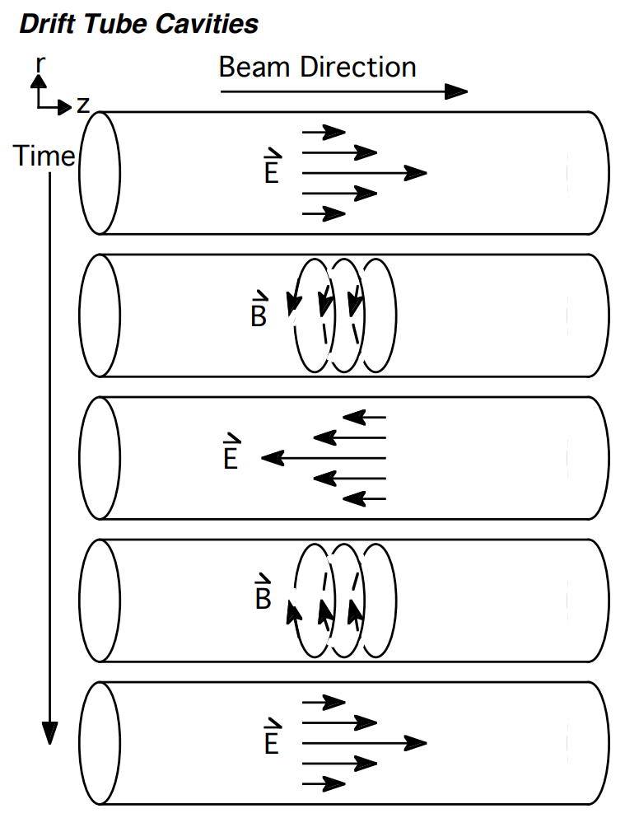
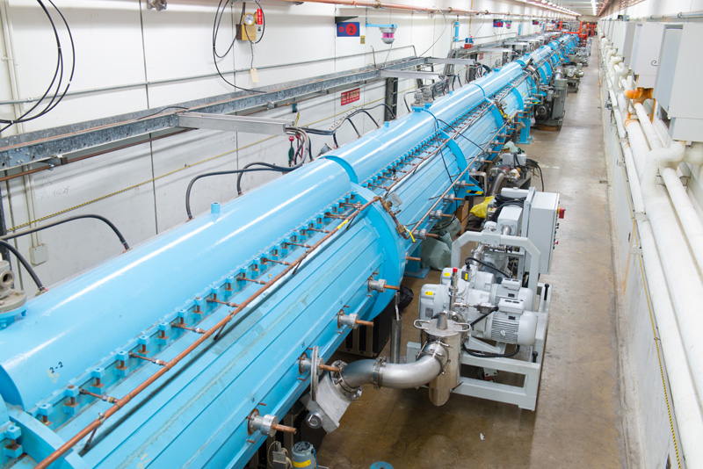
8
Linac = Linear Accelerator
B. Worthel et al., Linac Rookie Book
D. Barak, B. Harrison, A. Watts, Concepts Rookie Book
The Linac is a powerful single-pass accelerator design to get the H⁻ particles to relativistic energy very quickly.
8
Jeffrey Eldred | Present & Future Particle Accelerators at Fermilab
Notes:
8
8
8

Slide 9
Fermilab Linac – 400 MeV
K. Seiya, NuFACT19
RFQ->
Drift-tube linac Side-coupled linac
The length, frequency, and design of the RF cavities change as the beam accelerates.
Ultimately 400 MeV H- ions are delivered.
Status
Linac output: 25mA
Pulse length: 35 μsec
Efficiency: 96%
9
Jeffrey Eldred | Present & Future Particle Accelerators at Fermilab

Slide 10
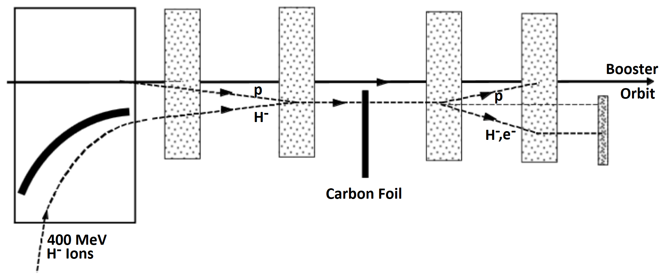
10
H⁻ Injection through Carbon foil into Booster
B. Worthel et al., Booster Rookie Book
Carbon foil strips the two electrons from the proton.
Proton beam accumulates in the Booster ring.
Unstripped H- ions are sent to an absorber.
10
Jeffrey Eldred | Present & Future Particle Accelerators at Fermilab
Notes:
10
10
10

Slide 11
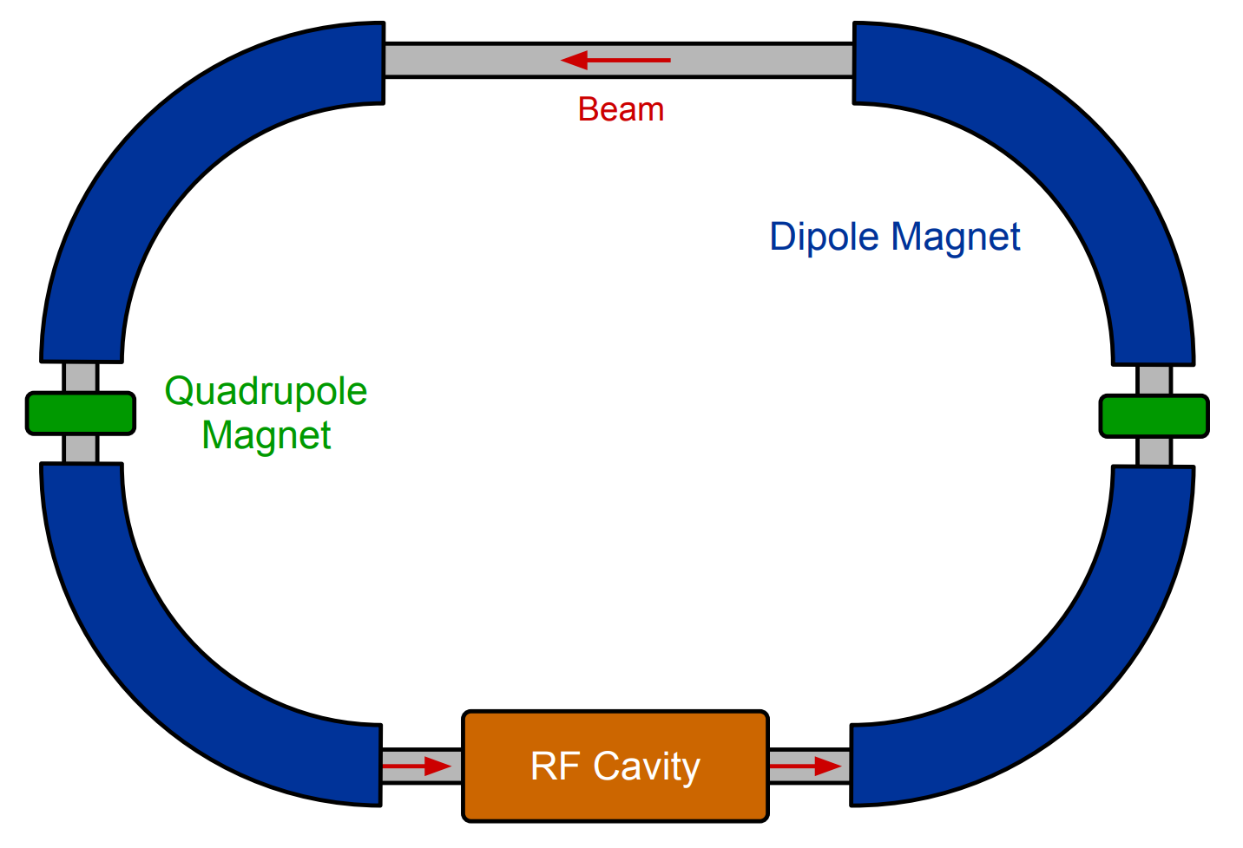
11
Simplified Diagram of a Synchrotron
B. Worthel et al., Booster Rookie Book
D. Barak, B. Harrison, A. Watts, Concepts Rookie Book
11
Jeffrey Eldred | Present & Future Particle Accelerators at Fermilab
Notes:
11
11
11

Slide 12
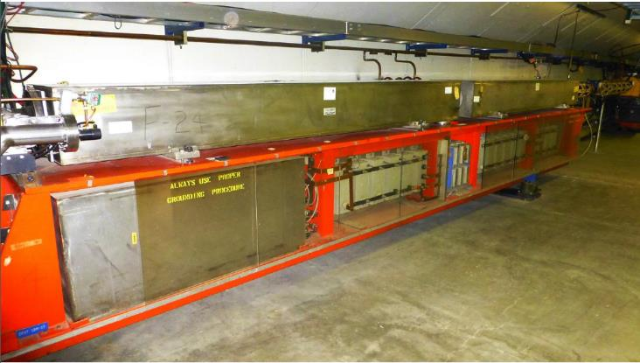
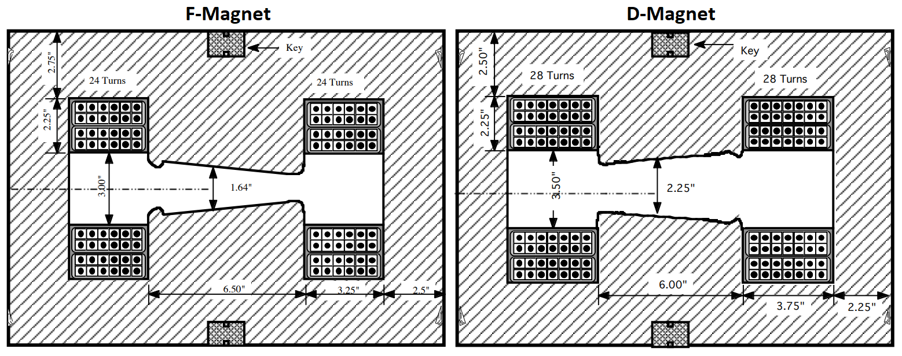
Fermilab Booster – 8 GeV
15Hz Resonant circuit synchrotron
Accelerating protons from 400MeV to 8GeV in 33.33msec
K. Seiya,NUFACT19, B. Worthel et al., Booster Rookie Book
F-Magnet
D-Magnet
Status
Intensity: 4.5e12 protons
Efficiency: 94%
Number of protons per hour: 2.3e17 pph
Choke
Resonant Capacitor
Record flux: >2.5e17 pph in FY18
Operational: 2.3e17 pph
Goal: 2.7e17 pph in FY22
12
Jeffrey Eldred | Present & Future Particle Accelerators at Fermilab

Slide 13
13
13
13
Jeffrey Eldred | Present & Future Particle Accelerators at Fermilab
Notes:
13
13
13
13
13
13

Slide 14
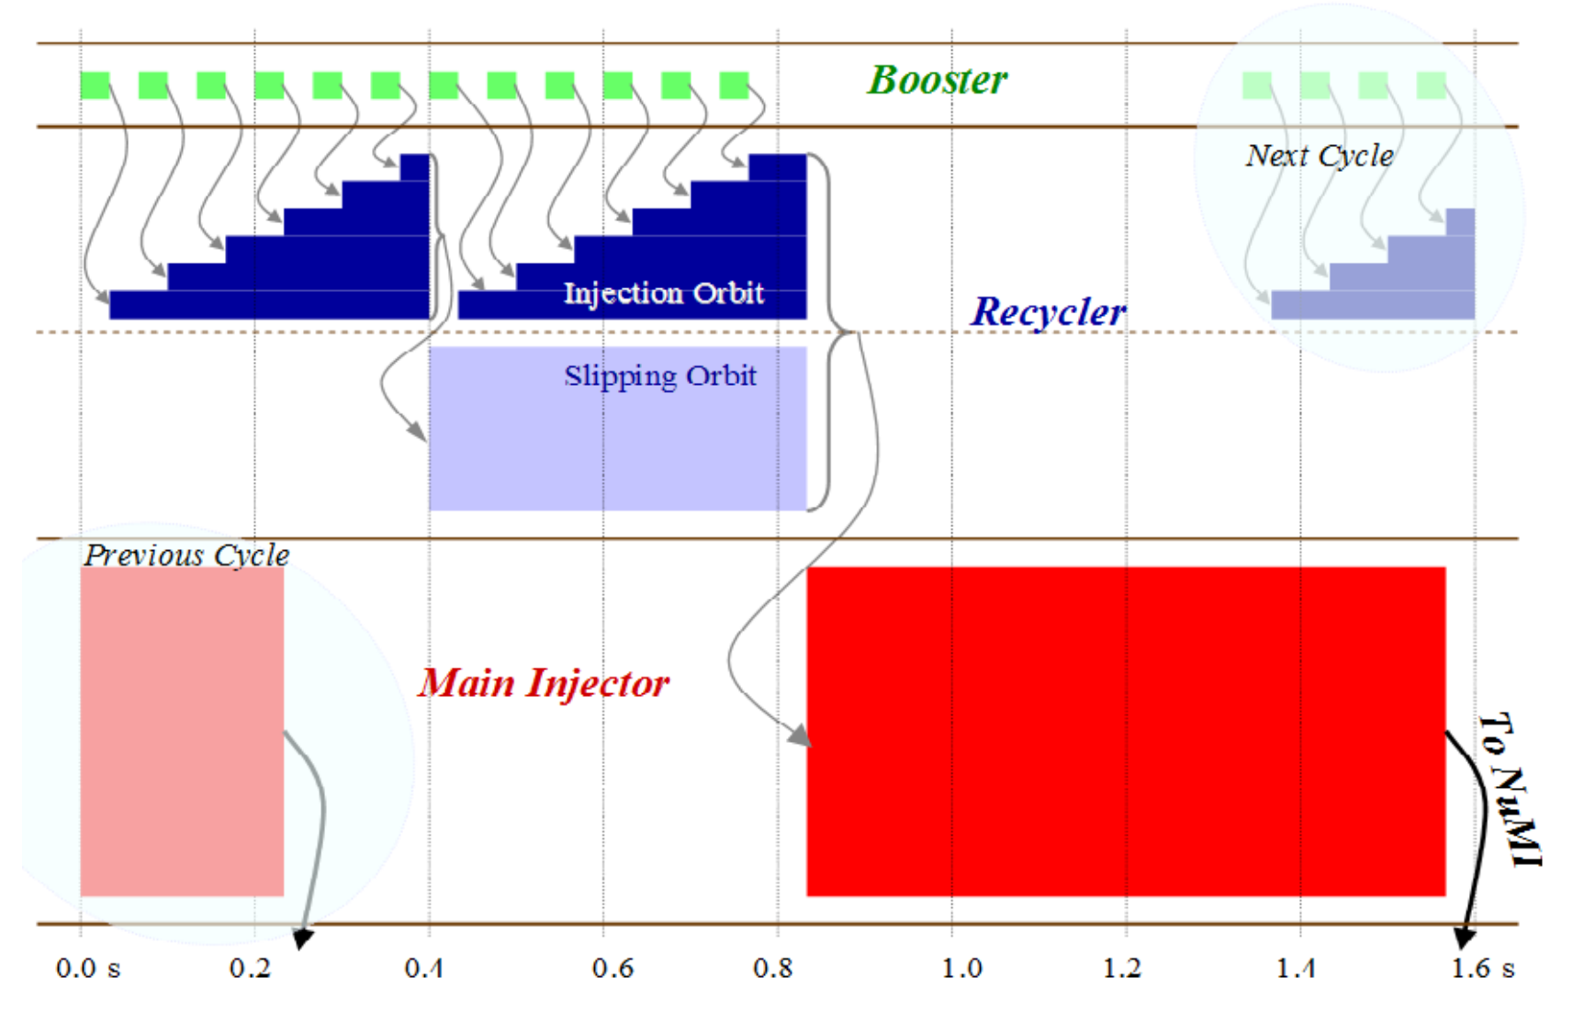
14
Filling the Main Injector
D. S. Ayres, NOvA Technical Design Report
14
Jeffrey Eldred | Present & Future Particle Accelerators at Fermilab
Notes:
14
14
14

Slide 15
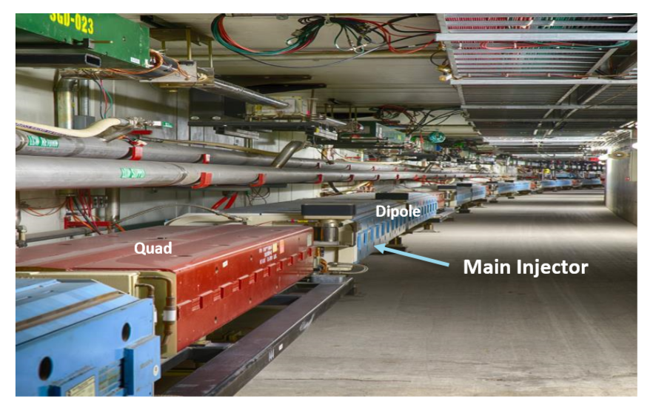
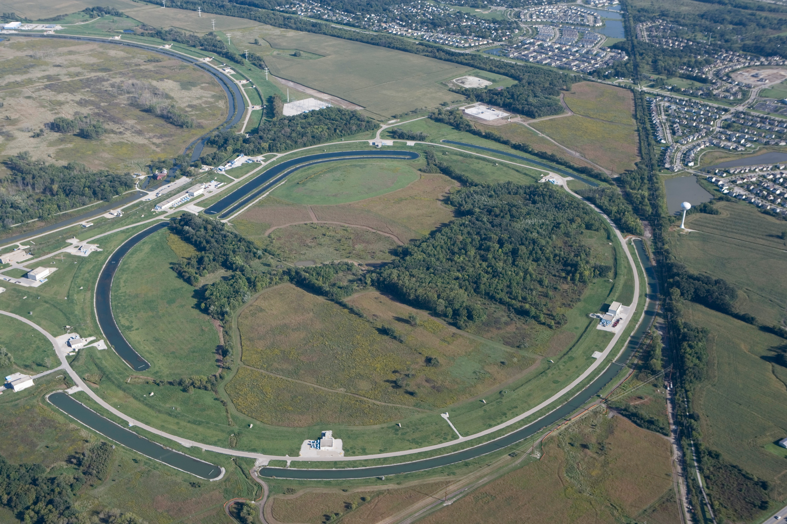
15
Main Injector – 120 GeV
Recycler (RR):
8GeV fixed energy storage ring with permanent magnets.
I. Kourbanis,
K. Seiya, NUFACT19
Main Injector (MI):
8GeV –120GeV
Synchrotron
Status
Intensity: 53e12 protons
Energy Loss: 1 kJ
Cycle time: 1.333 s
15
Jeffrey Eldred | Present & Future Particle Accelerators at Fermilab
Notes:
15
15
15

Slide 16
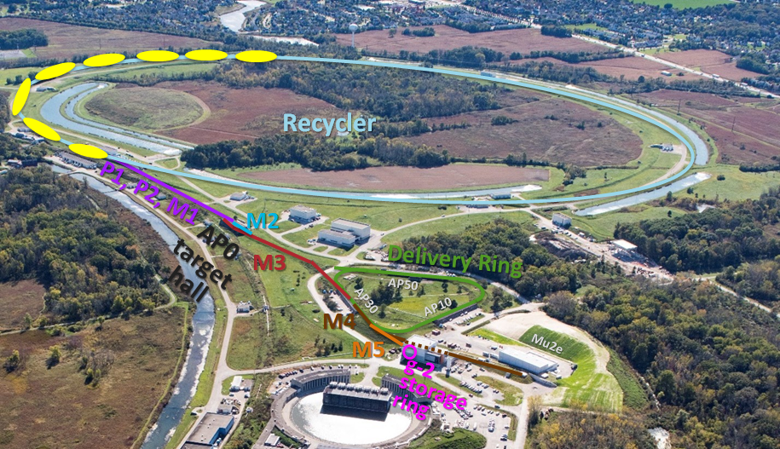
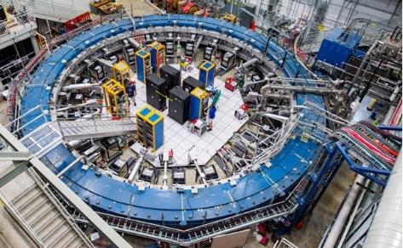
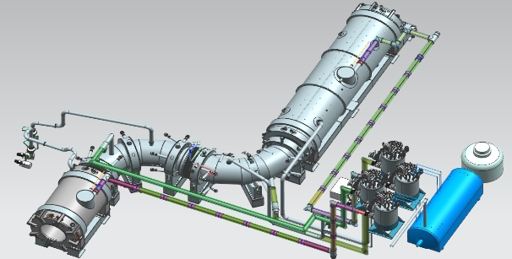
16
Delivery Ring & Muon Campus
K. Seiya, NUFACT19
Mu2e being built
g-2 started 2017
16
Jeffrey Eldred | Present & Future Particle Accelerators at Fermilab
Notes:
16
16
16

Slide 17
17
17
Future Proton Complex
17
Jeffrey Eldred | Present & Future Particle Accelerators at Fermilab
Notes:
17
17
17
17
17
17

Slide 18
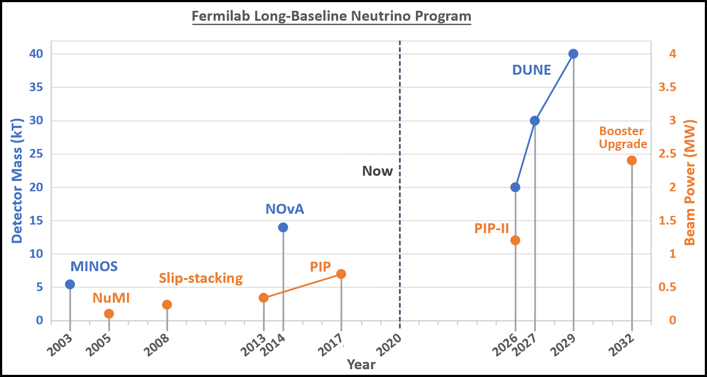
18
Beam Power and Detector Size
DUNE long-baseline neutrino program calls for 2.4 MW
18
Jeffrey Eldred | Present & Future Particle Accelerators at Fermilab
Notes:
18
18
18

Slide 19
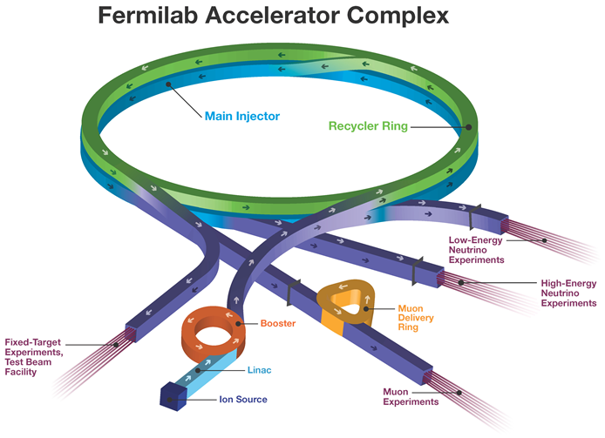
19
19
Fermilab Upcoming Upgrades Now 750kW
19
Jeffrey Eldred | Present & Future Particle Accelerators at Fermilab
Notes:
19
19
19
19
19
19

Slide 20
20
20
Fermilab Upcoming Upgrades PIP-II 1.2MW
1.2 MW LBNF
Neutrinos
to DUNE
PIP-II SRF
Linac
0.8 GeV
20
Jeffrey Eldred | Present & Future Particle Accelerators at Fermilab
Notes:
20
20
20
20
20
20

Slide 21
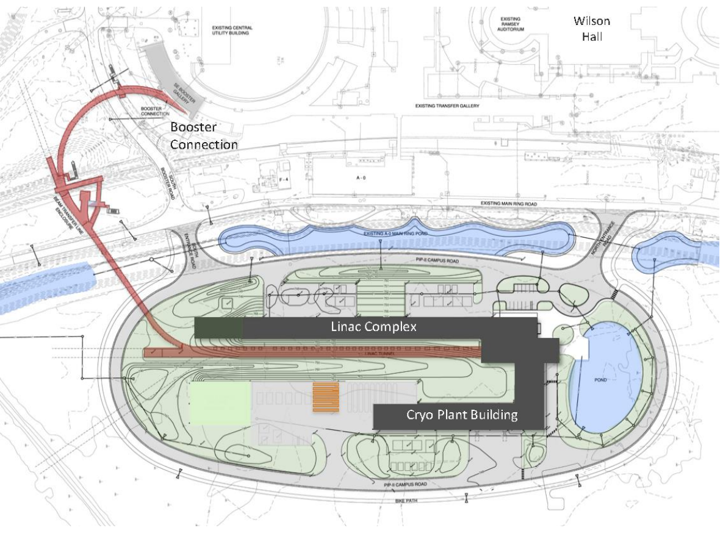
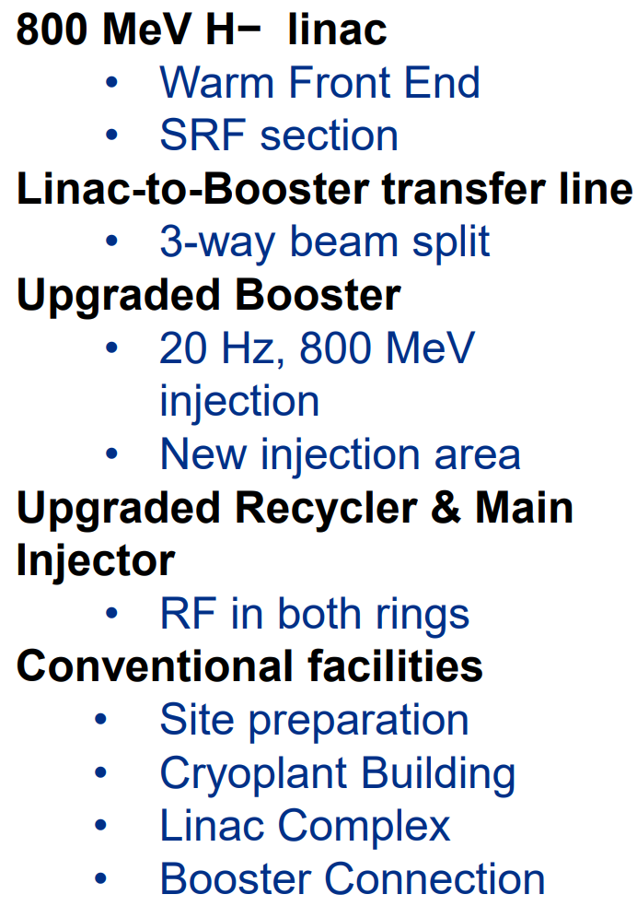
21
21
PIP-II Linac & Upgrade
E. Pozdeyev, SpaceCharge19
21
Jeffrey Eldred | Present & Future Particle Accelerators at Fermilab
Notes:
21
21
21
21
21
21

Slide 22
22
22
Fermilab Upcoming Upgrades Future 2.4MW
2.4 MW LBNF
Neutrinos
to DUNE
Recycler?
Replace
Booster
PIP-II SRF
Linac
1-3 GeV
22
Jeffrey Eldred | Present & Future Particle Accelerators at Fermilab
Notes:
22
22
22
22
22
22

Slide 23
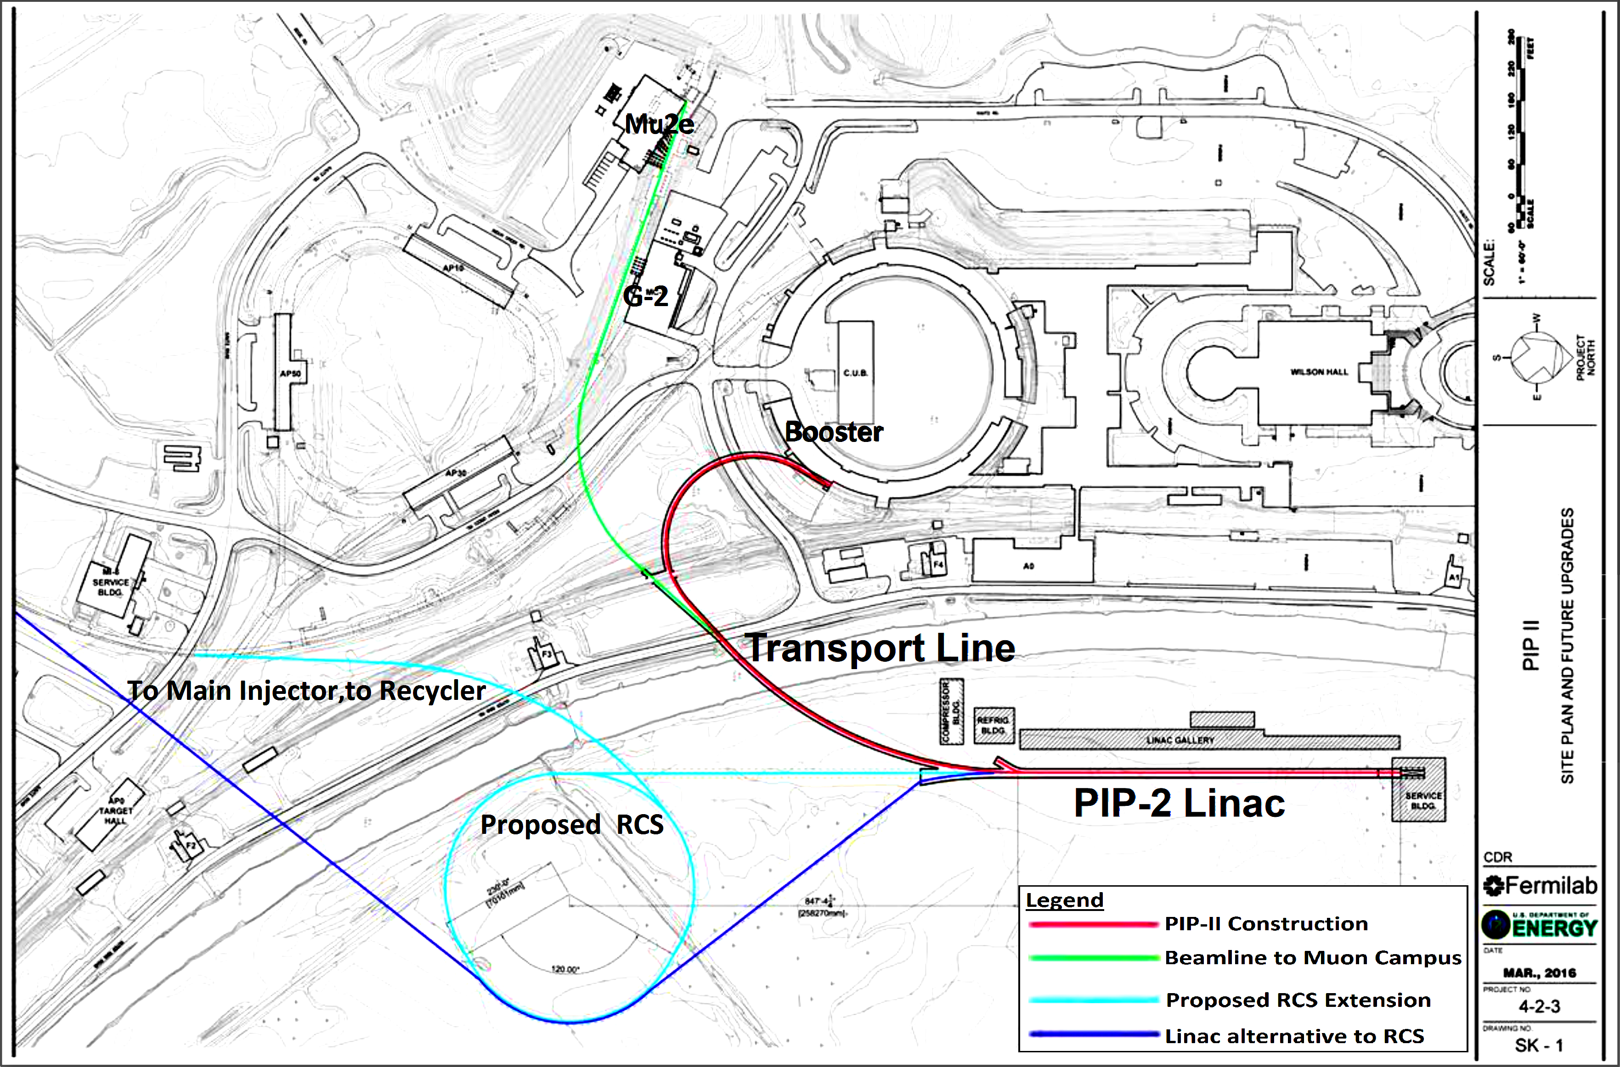
23
23
Replace Booster with RCS and/or Linac
S. Dixon
(Linac and RCS not to scale)
23
Jeffrey Eldred | Present & Future Particle Accelerators at Fermilab
Notes:
23
23
23
23
23
23

Slide 24
24
8 GeV Linac Option – other beamlines
Main Injector
(MI)
Recycler?
Optional
Accumulator
Ring
PIP-II
Linac
8 GeV Linac
24
Jeffrey Eldred | Present & Future Particle Accelerators at Fermilab
Notes:
24
24
24

Slide 25
25
Rapid-Cycling Synchtron (RCS) Option – other beamlines
Main Injector
(MI)
Optional
Storage
Ring
RCS
Optional
Injector
Ring
PIP-II
Linac
Optional 1-3 GeV Linac Upgrade
25
Jeffrey Eldred | Present & Future Particle Accelerators at Fermilab
Notes:
25
25
25

Slide 26
26
26
Accelerator R&D
26
Jeffrey Eldred | Present & Future Particle Accelerators at Fermilab
Notes:
26
26
26
26
26
26

Slide 27
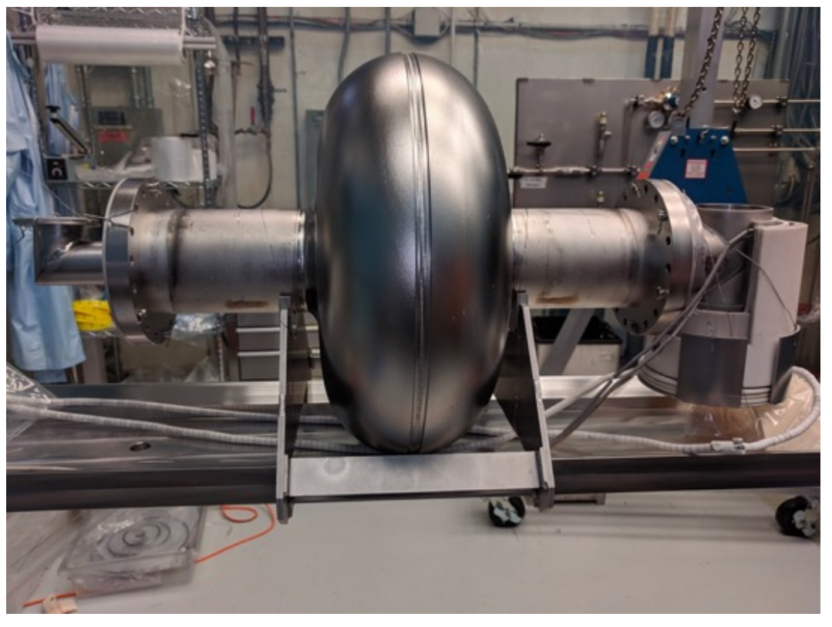
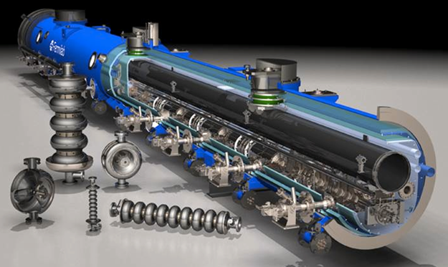
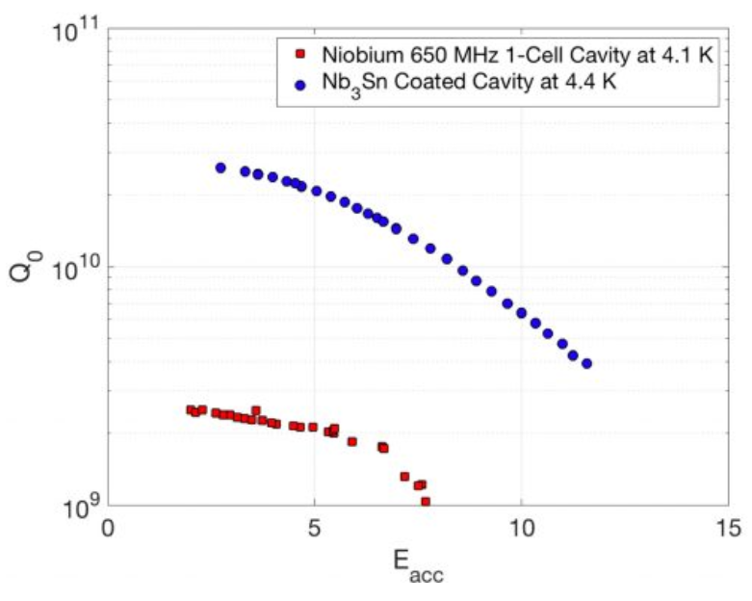
27
Superconducting RF at Fermilab Technology Divisipn
S. Posen. 2018
Fermilab has a cutting-edge
superconducting RF R&D program to make accelerators more powerful, more efficient, and more affordable.
27
Jeffrey Eldred | Present & Future Particle Accelerators at Fermilab
Notes:
27
27
27

Slide 28
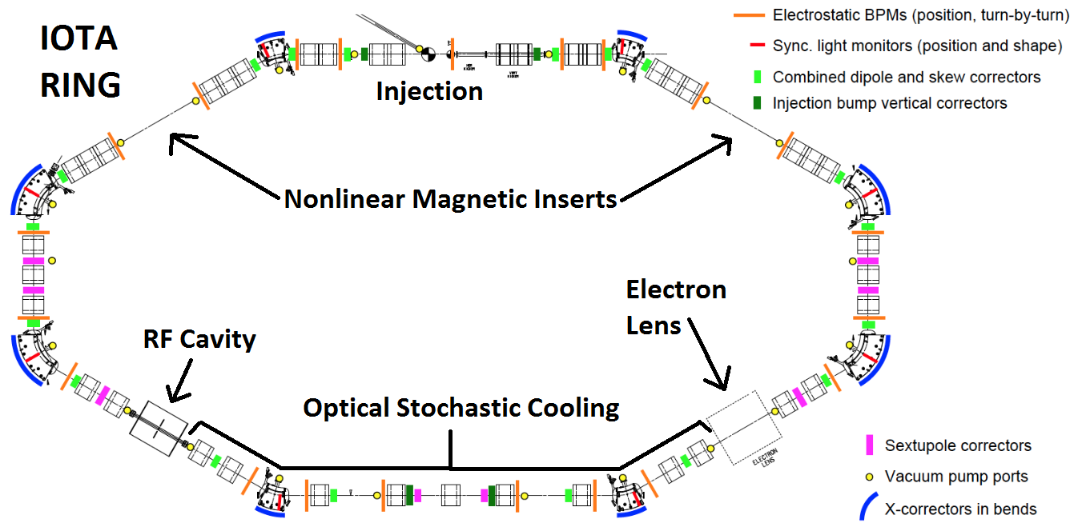
28
FAST/IOTA – Accelerator R&D Facility at Fermilab
S. Antipov et al., JINST 2016
28
Jeffrey Eldred | Present & Future Particle Accelerators at Fermilab
Notes:
28
28
28

Slide 29
29
29
Thank you!
Any Questions?
29
Jeffrey Eldred | Present & Future Particle Accelerators at Fermilab
Notes:
29
29
29
29
29
29

