Slide 1

Accelerator Physics
Beam Physics in Synchrotrons
Rob Ainsworth
User’s meeting
10 August 2020

Slide 2
Outline
Grand challenges of accelerator and beam physics
How to increase intensity
  Space charge issues
  Mitigations in FNAL complex
  Looking to the future – IOTA
  Instabilities
How to improve beam quality
  Optical Stochastic cooling

Slide 3
Accelerator and Beam Physics Grand Challenges
Grand challenge #1 (beam intensity): How do we increase beam intensities by orders of magnitude?
Grand challenge #2 (beam quality): How do we increase beam phase-space density by orders of magnitude, towards the quantum degeneracy limit?
Grand challenge #3 (beam control): How do we measure and control the beam distribution down to the level of individual particles?
Grand Challenge #4 (beam prediction): How do we develop predictive “virtual particle accelerators”?

Slide 4
Grand Challenge #1
Grand challenge #1 (beam intensity): How do we increase beam intensities by orders of magnitude?
Important for FNAL accelerator complex as we try to increase beam power in the future
Why is this a challenge?
  Space charge - repulsive force between particles in a bunch
  Instabilities
But first, a quick intro to linear focusing and resonances

Slide 5
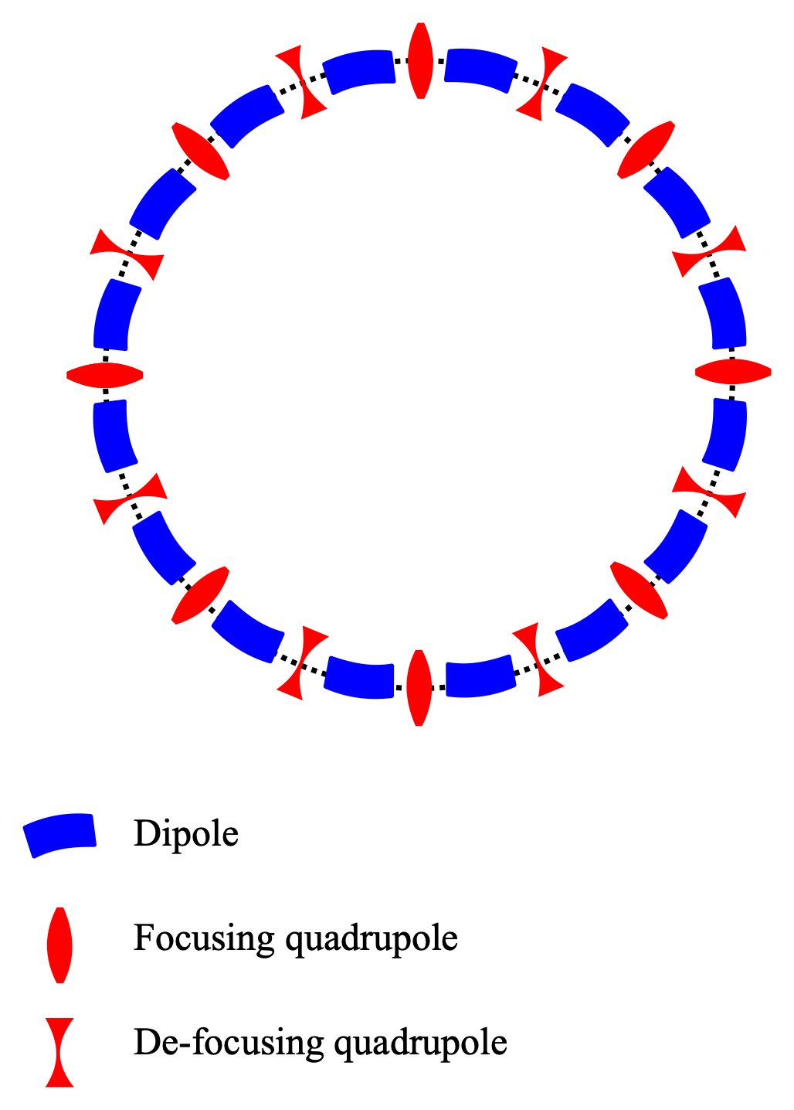
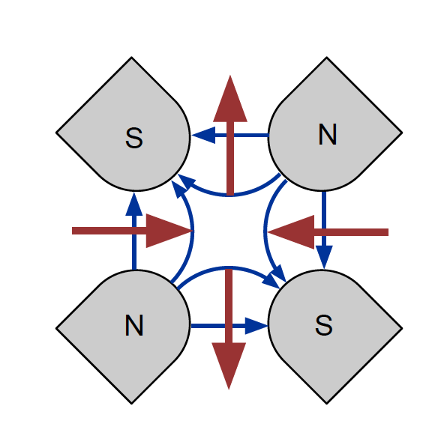
Linear focusing
Dipole magnets to steer the beam
Quadrupole magnets to focus the beam
Quads focus in one plane and de-focus in the other

Slide 6
Betatron tune
Alternating focusing means the beam oscillates as it goes around the ring
Betatron tune - The number of oscillations the beam makes in one revolution
For example, In the Fermilab Recycler, the horizontal tune is 25.44 and the vertical tune is 24.39
The fractional part is very important!

Slide 7
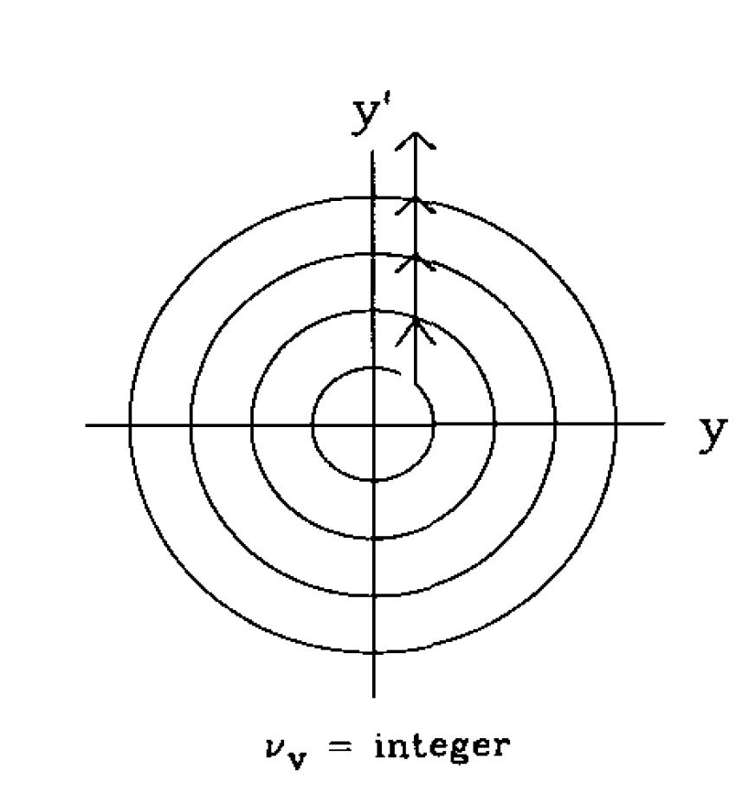
Integer resonance
Suppose the fractional part was zero i.e. the tune is an integer
If we have an error in a dipole magnet
Particle would receive same kick every revolution
  Eventually hit the beam pipe
  Irradiate accelerator components

Slide 8
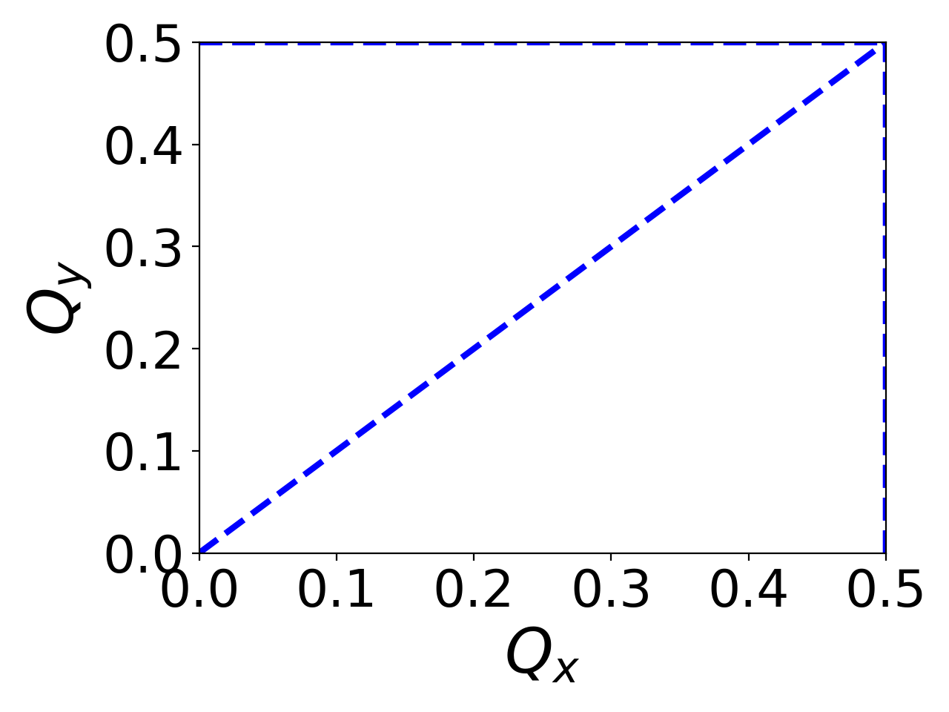
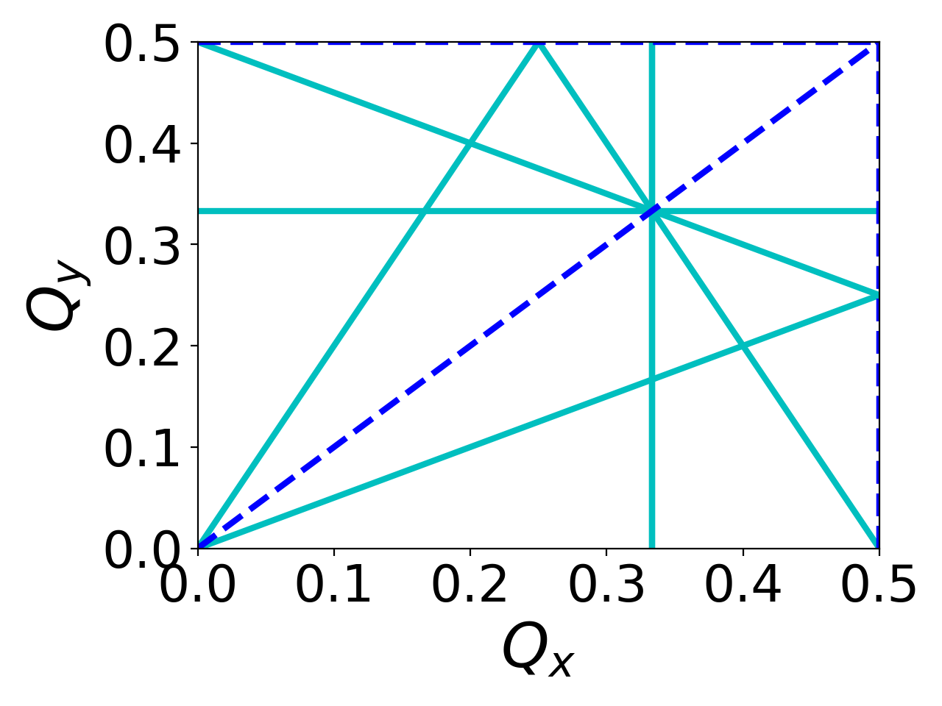
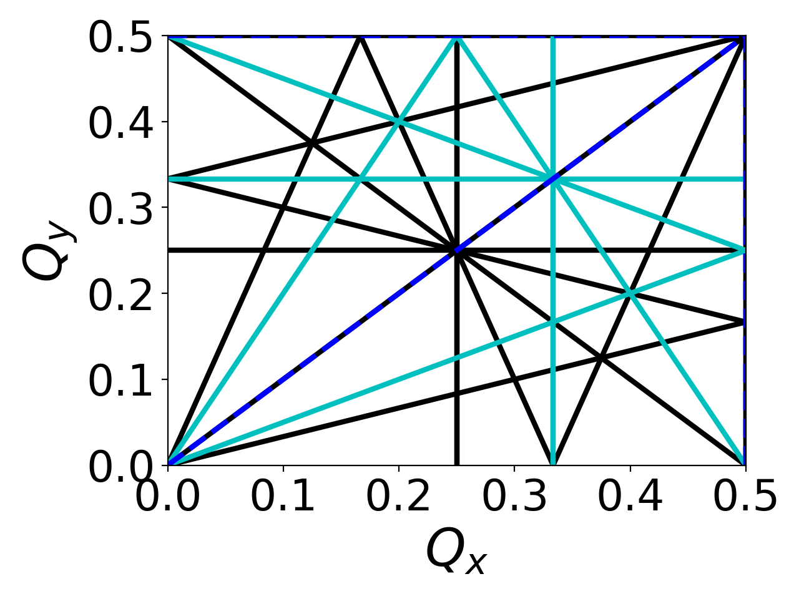
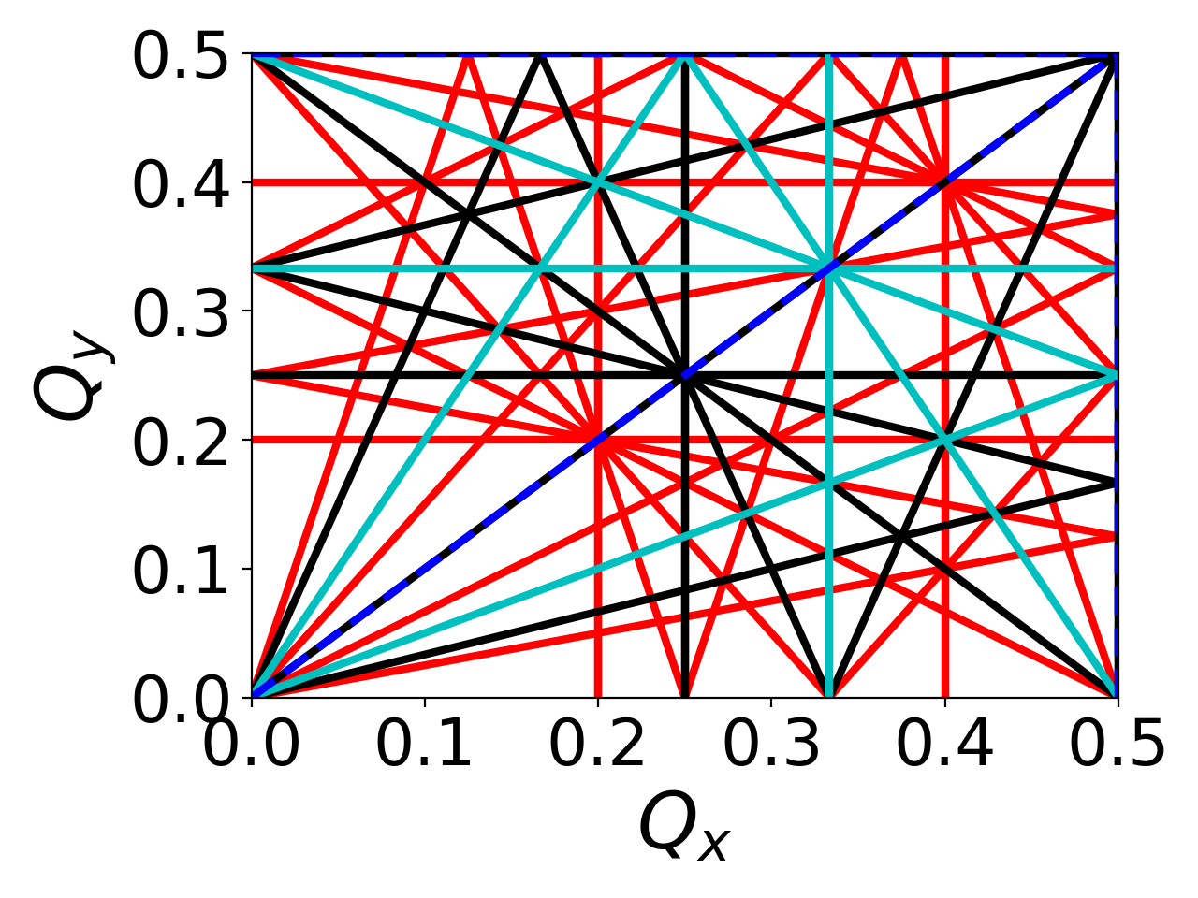
Resonances – many more possible
2nd order
3rd order
4th order
5th order

Slide 9
Intensity issues from space charge

Slide 10
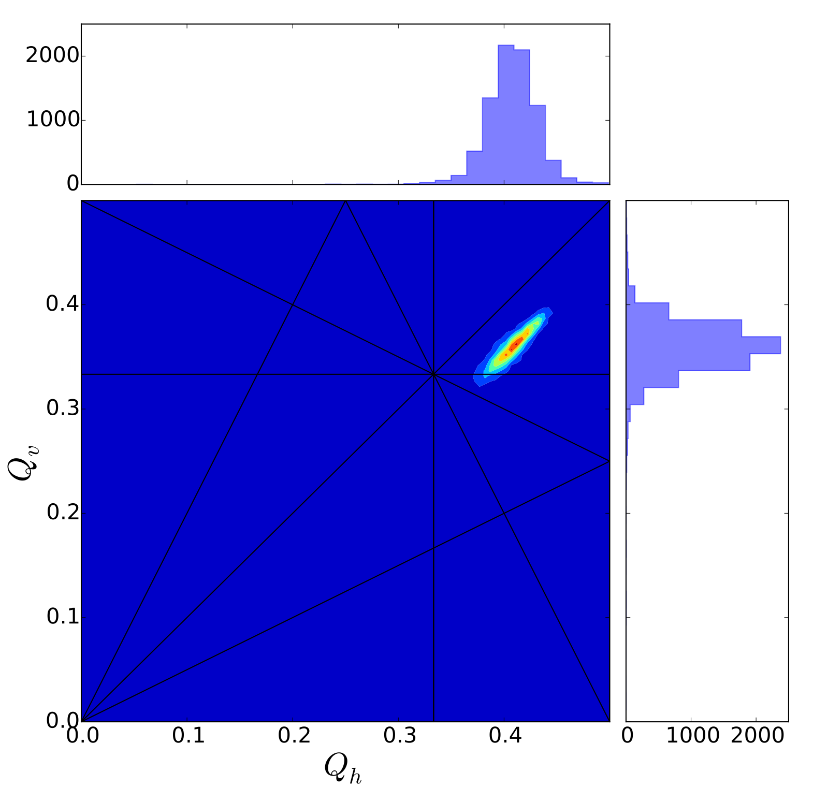
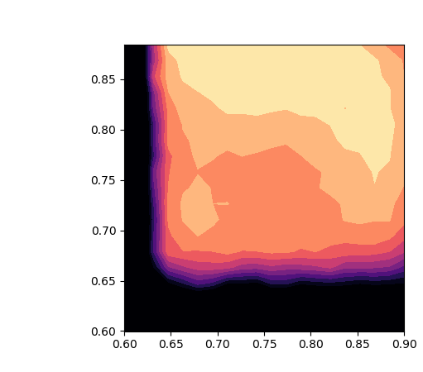
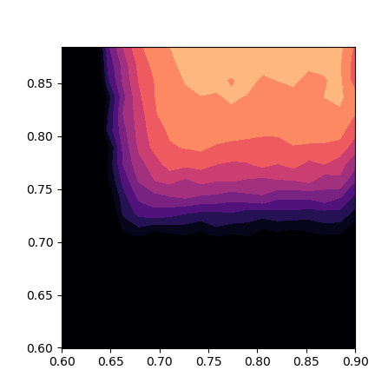
Space charge
Inside a bunch, each there is a spread of tunes
Space charge increases this spread with intensity
  More likely for particles to cross resonant lines
  Reduction in available tune space
Low intensity
High intensity
Qy
Qy
Example measurements
In Booster
- effect of half-integer
resonance
Qx
Qx

Slide 11
Difficult to compensate space charge
Actively trying to correct resonant lines in
FNAL complex

Slide 12
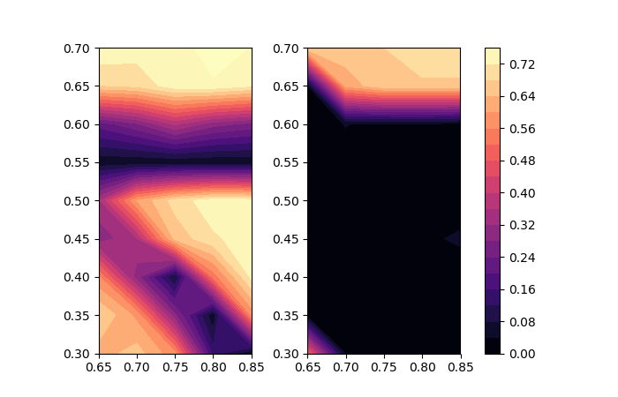
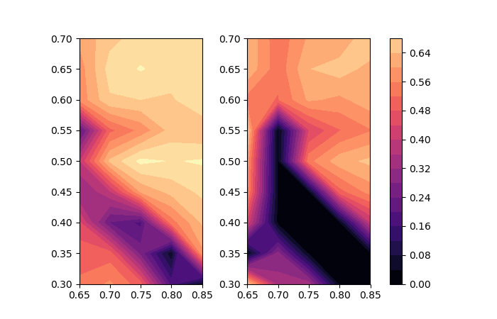
Half integer correction in the FNAL booster
The half integer resonance can be compensated using quadrupoles at appropriate locations
Before Correction
After Correction
Early
transmission
Late
transmission

Slide 13
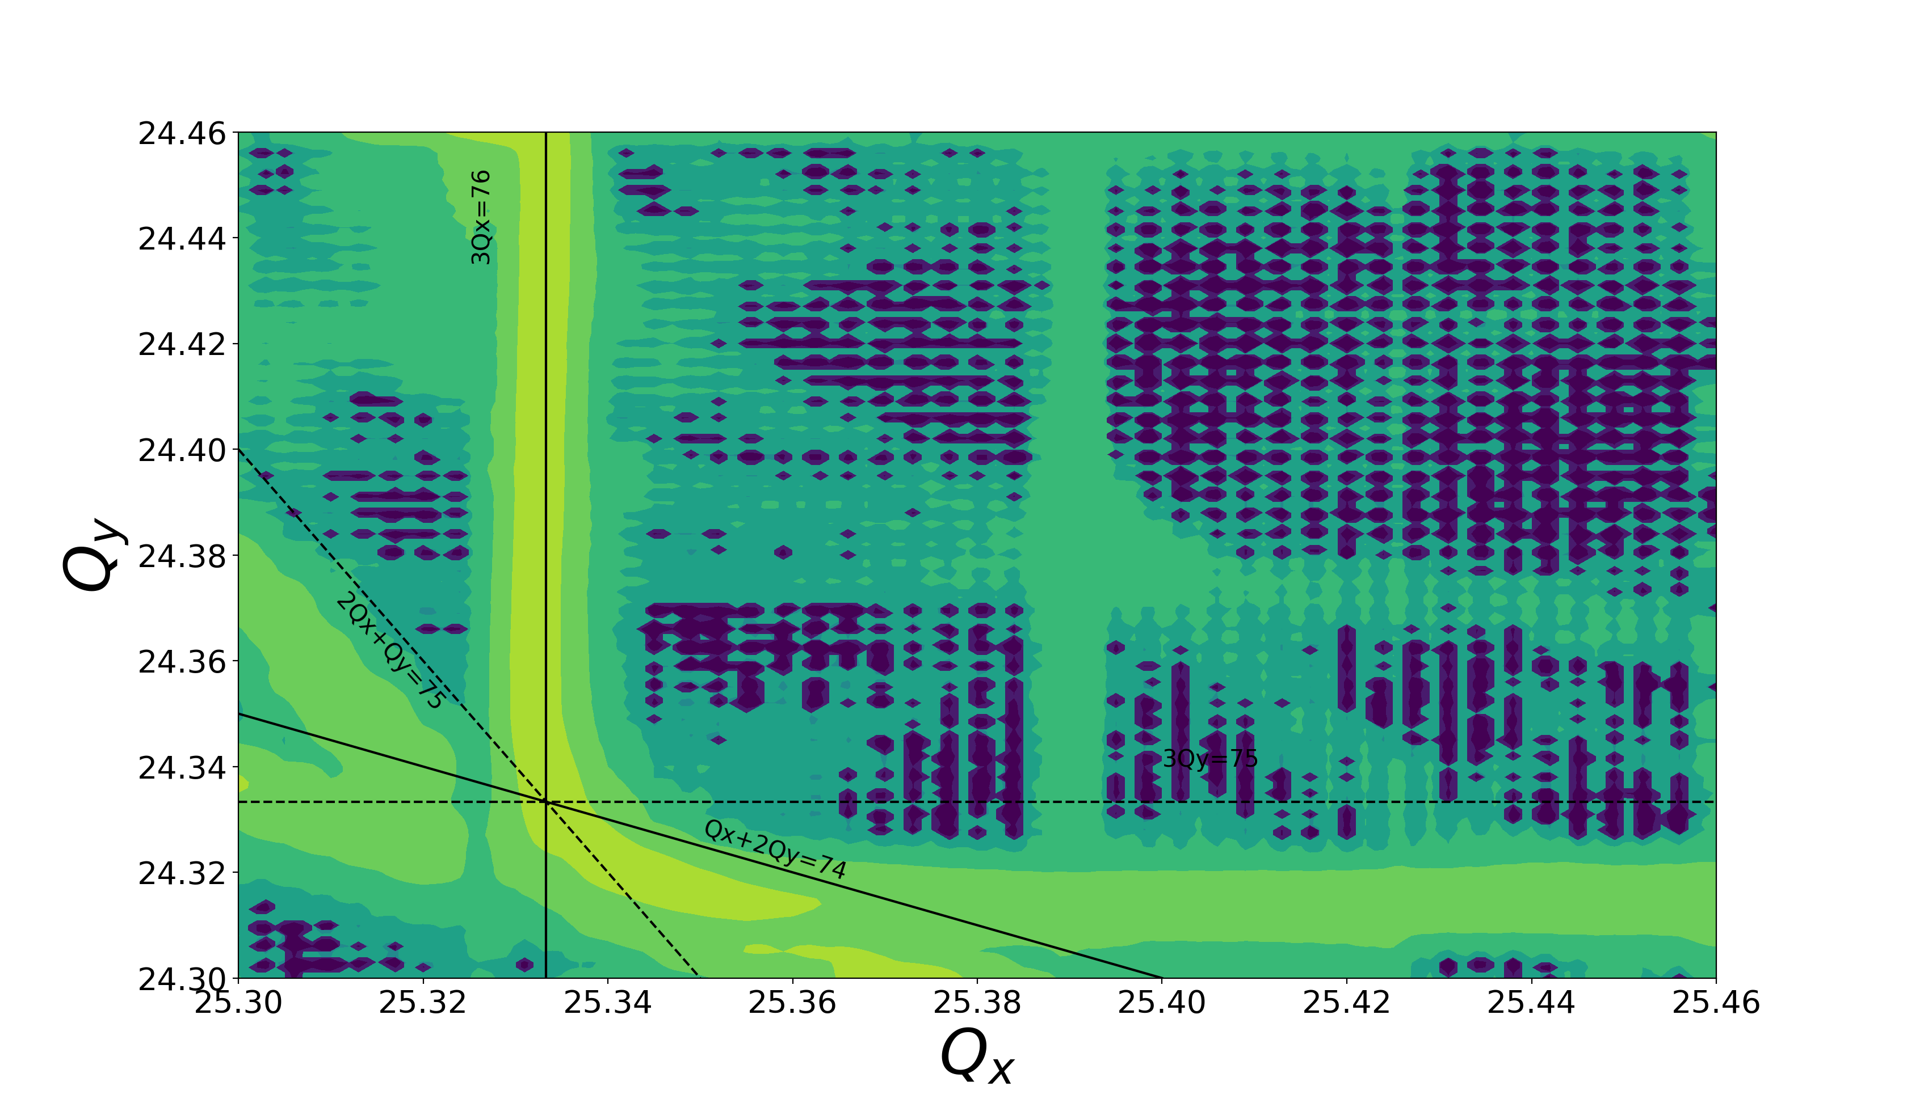
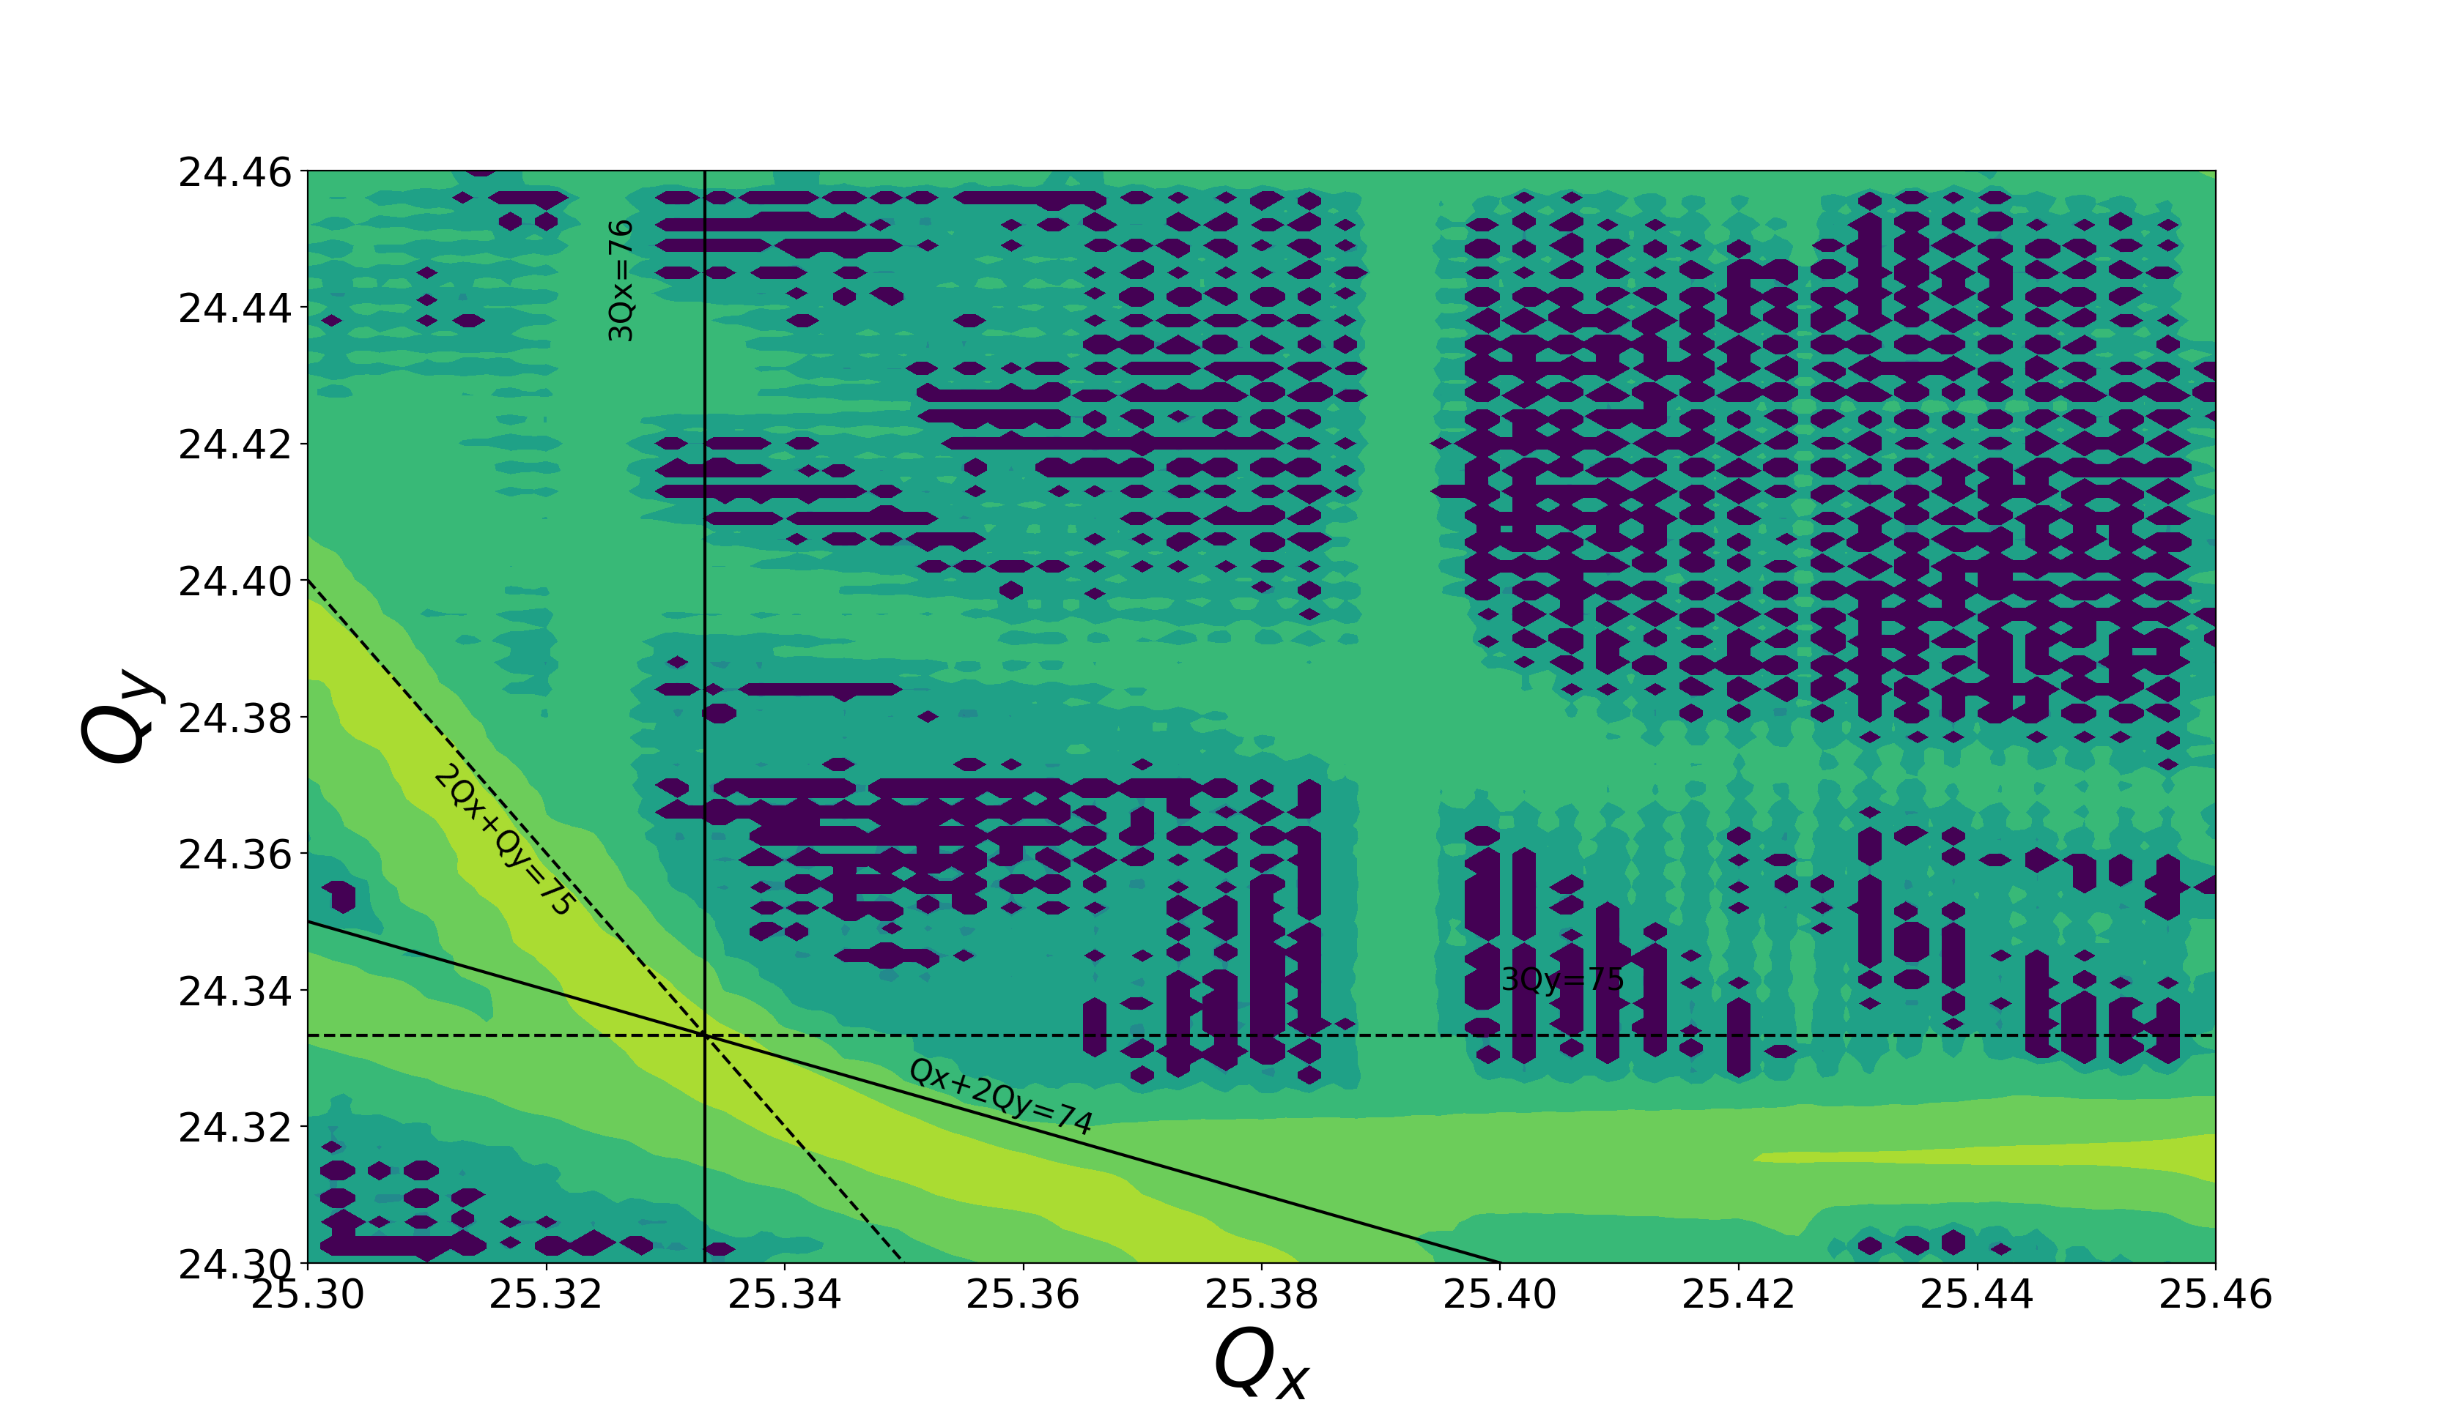
Third order compensation in FNAL Recycler
Third order resonances can be compensated using sextupoles at appropriate locations
Before Correction
After Correction
Side-effects – May make other lines stronger

Slide 14
Is there a better way?
Compensating resonances is tricky
  May drive other resonances
  Multiple lines
Is there a better way?
  Rethink how we design our accelerators
  Move away from linear focusing to a non linear approach
Such an approach is being tested here at FNAL
  Nonlinear integrable optics

Slide 15
Motivation for nonlinear integrable optics
We want to build an optical focusing system that
  Is strongly nonlinear = strong dependence of oscillation frequency on amplitude
  Is 2D integrable and stable
  Can be realized with magnetic fields in vacuum
Mathematically, that means the system should
  Possess two integrals of motion
  Field potential satisfies the Laplace equation
Practical benefits relevant to future HEP machines
  Reduced chaos in single-particle motion, e.g. helpful for space-charge suppression
  Higher beam current and brightness from strong immunity to collective instabilities via Landau damping

Slide 16
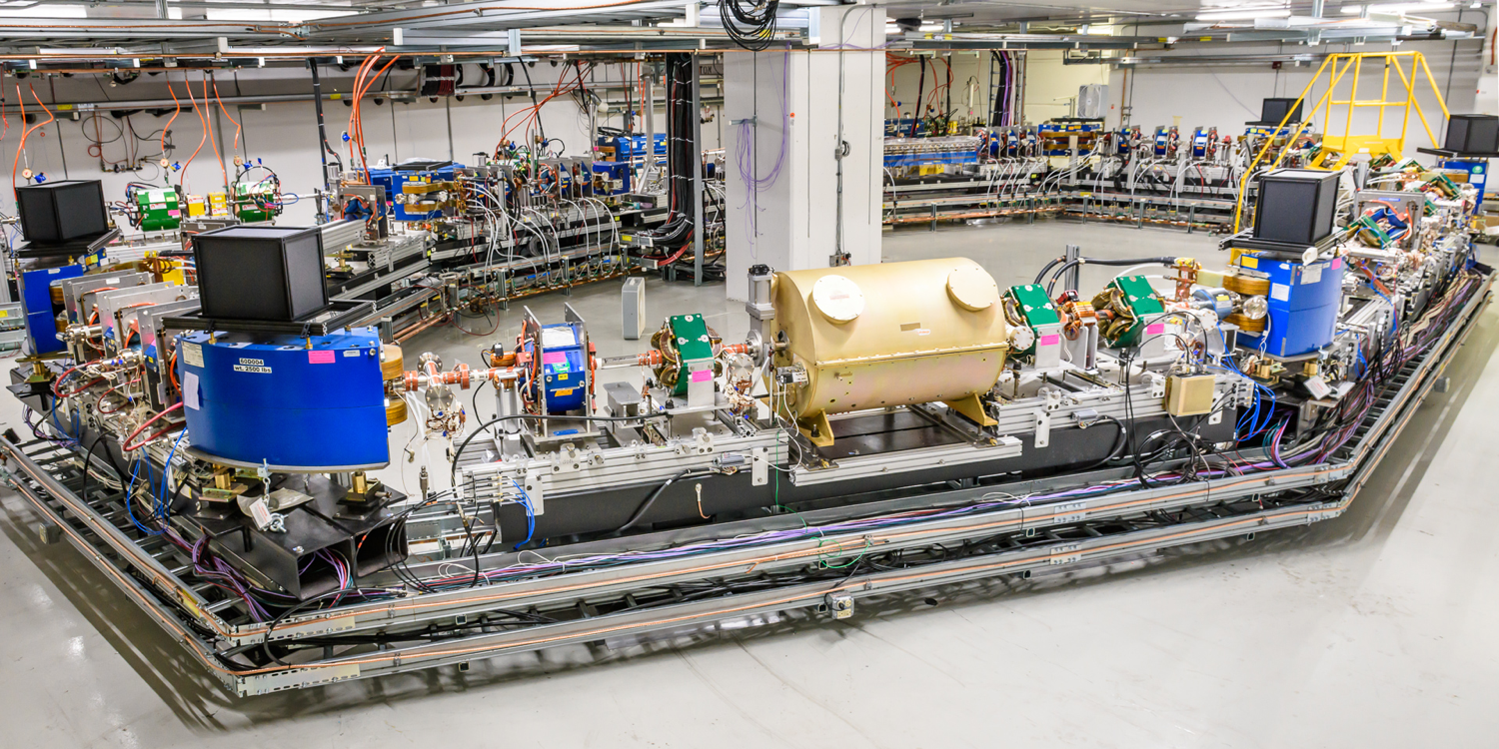
Integrable Optics Test Accelerator (IOTA)

Slide 17
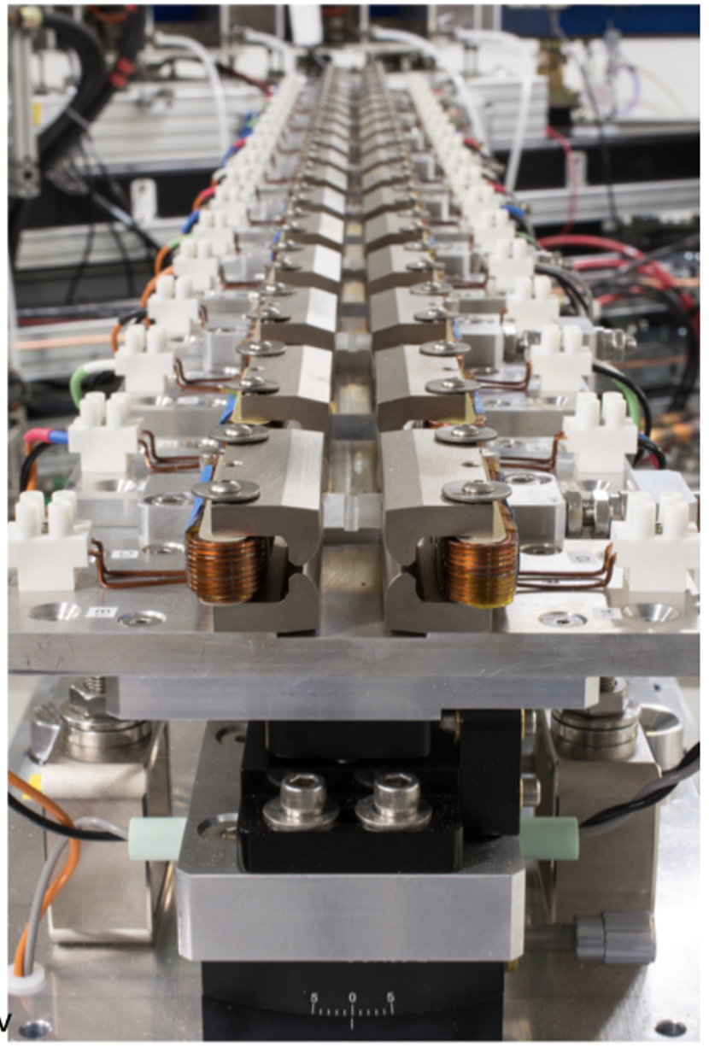
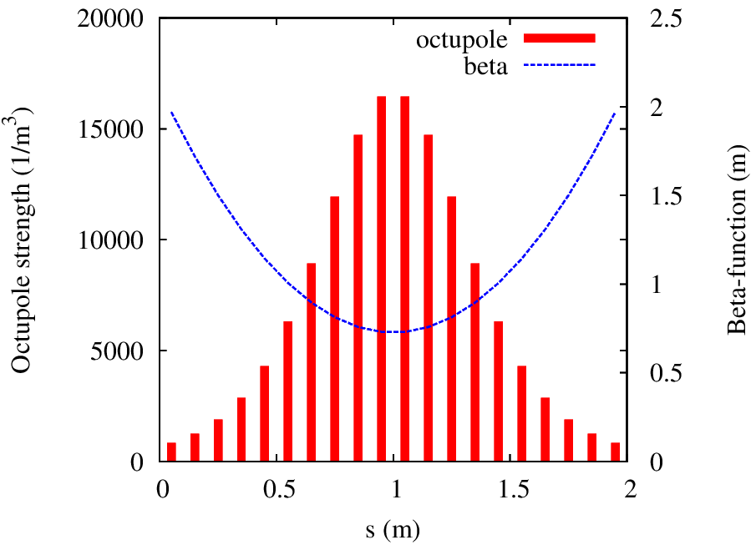
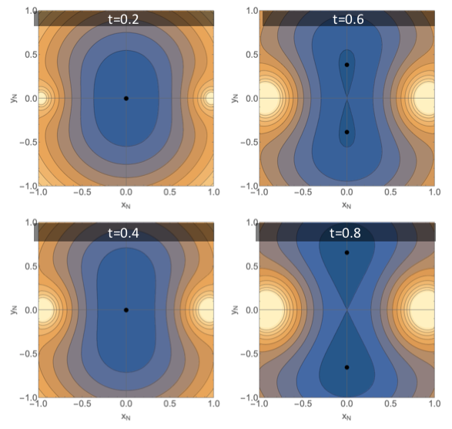
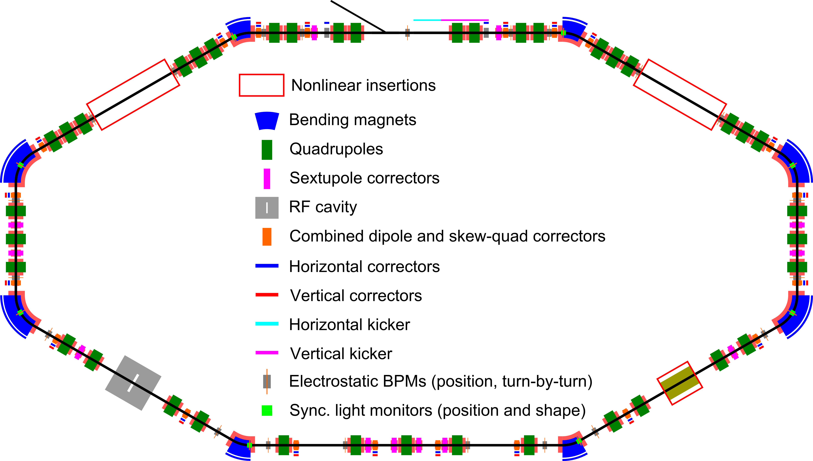
Nonlinear integrable optics at IOTA
Take a linear lattice and add a non-linear insert
Recent run tested two inserts
  a quasi-integrable insert implemented as octupole string
  insert with 2 invariants, aka Danilov-Nagaitsev or Elliptic potential

Slide 18
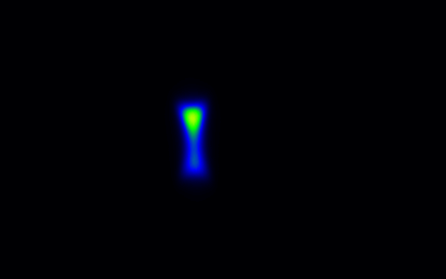
Stable beam on the integer
Real-time video of IOTA beam
in NIO optics on integer resonance

Slide 19
Instability Studies
We see instabilities everyday operationally
Some are protected by feedback systems but not all
Important to study to develop mitigation strategies

Slide 20
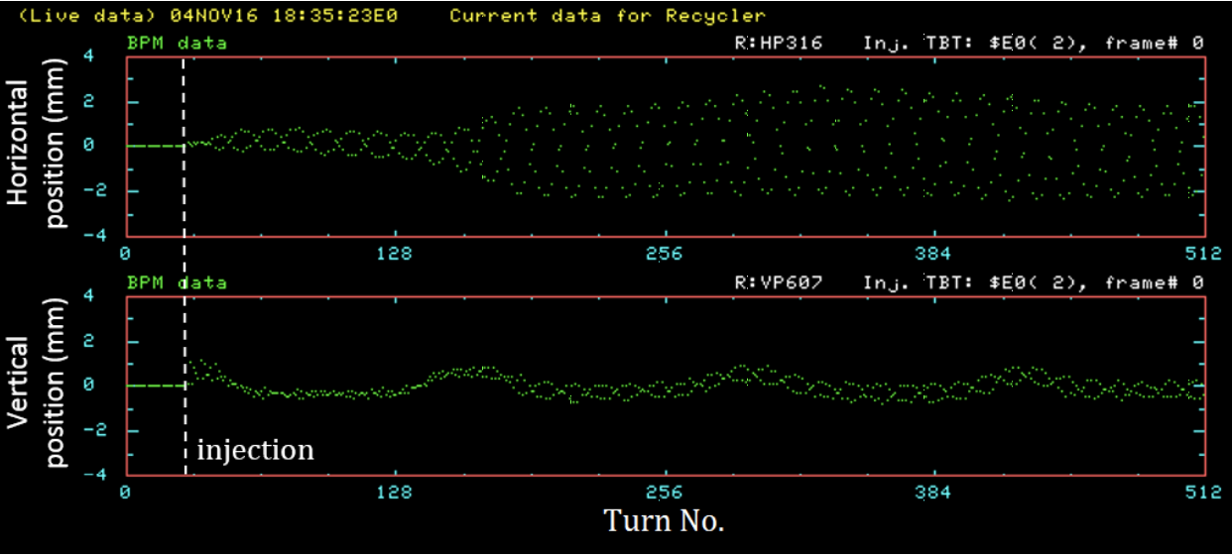
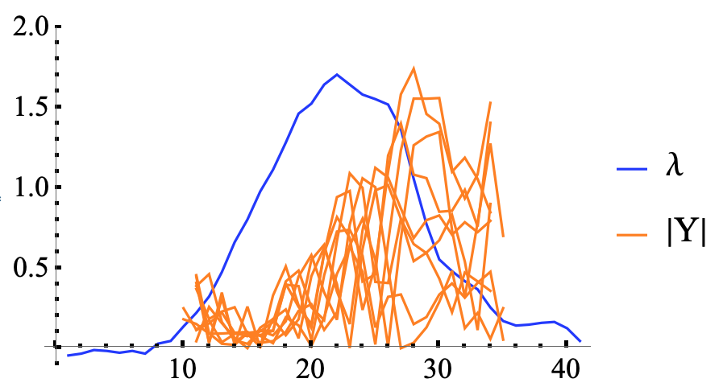
Instabilities Studies
Electron cloud instabilities
  Proton bunch interacting with electrons inside the vacuum chamber
  An issue during commissioning of Recycler
Instabilities in the presence of strong space charge
  Prediction of new instability – Convective instability (A. Burov)
  Observed in dedicated booster studies
Dedicated experimental research program(ECA) beginning soon
  Excite instabilities in a controlled way
  Will explore how instabilities depend on space charge

Slide 21
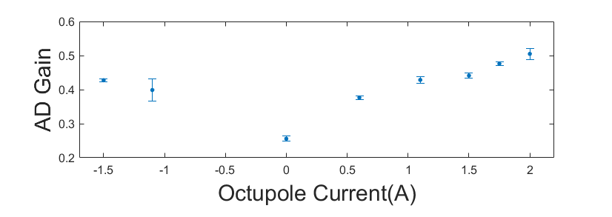
Instabilities – IOTA can help with that too!
Non-linear integrable optics can help with coherent instabilities
A coherent instability requires many of the particles to be working collectively
The large tune spread from nonlinear integrable optics helps damp this
Studies on-going at IOTA
  Observed factor of 2 increase in the threshold with octupole insert on
Instability
threshold

Slide 22

Grand challenge #2
Grand challenge #2 (beam quality): How do we increase beam phase-space density by orders of magnitude, towards the quantum degeneracy limit?
$$ℒ \sim \frac{fN_{b}N^{2}}{4π{σ_{x}}^{∗}{σ_{y}}^{∗}}$$
Decrease beam size

Slide 23
Improving beam quality with cooling

Slide 24
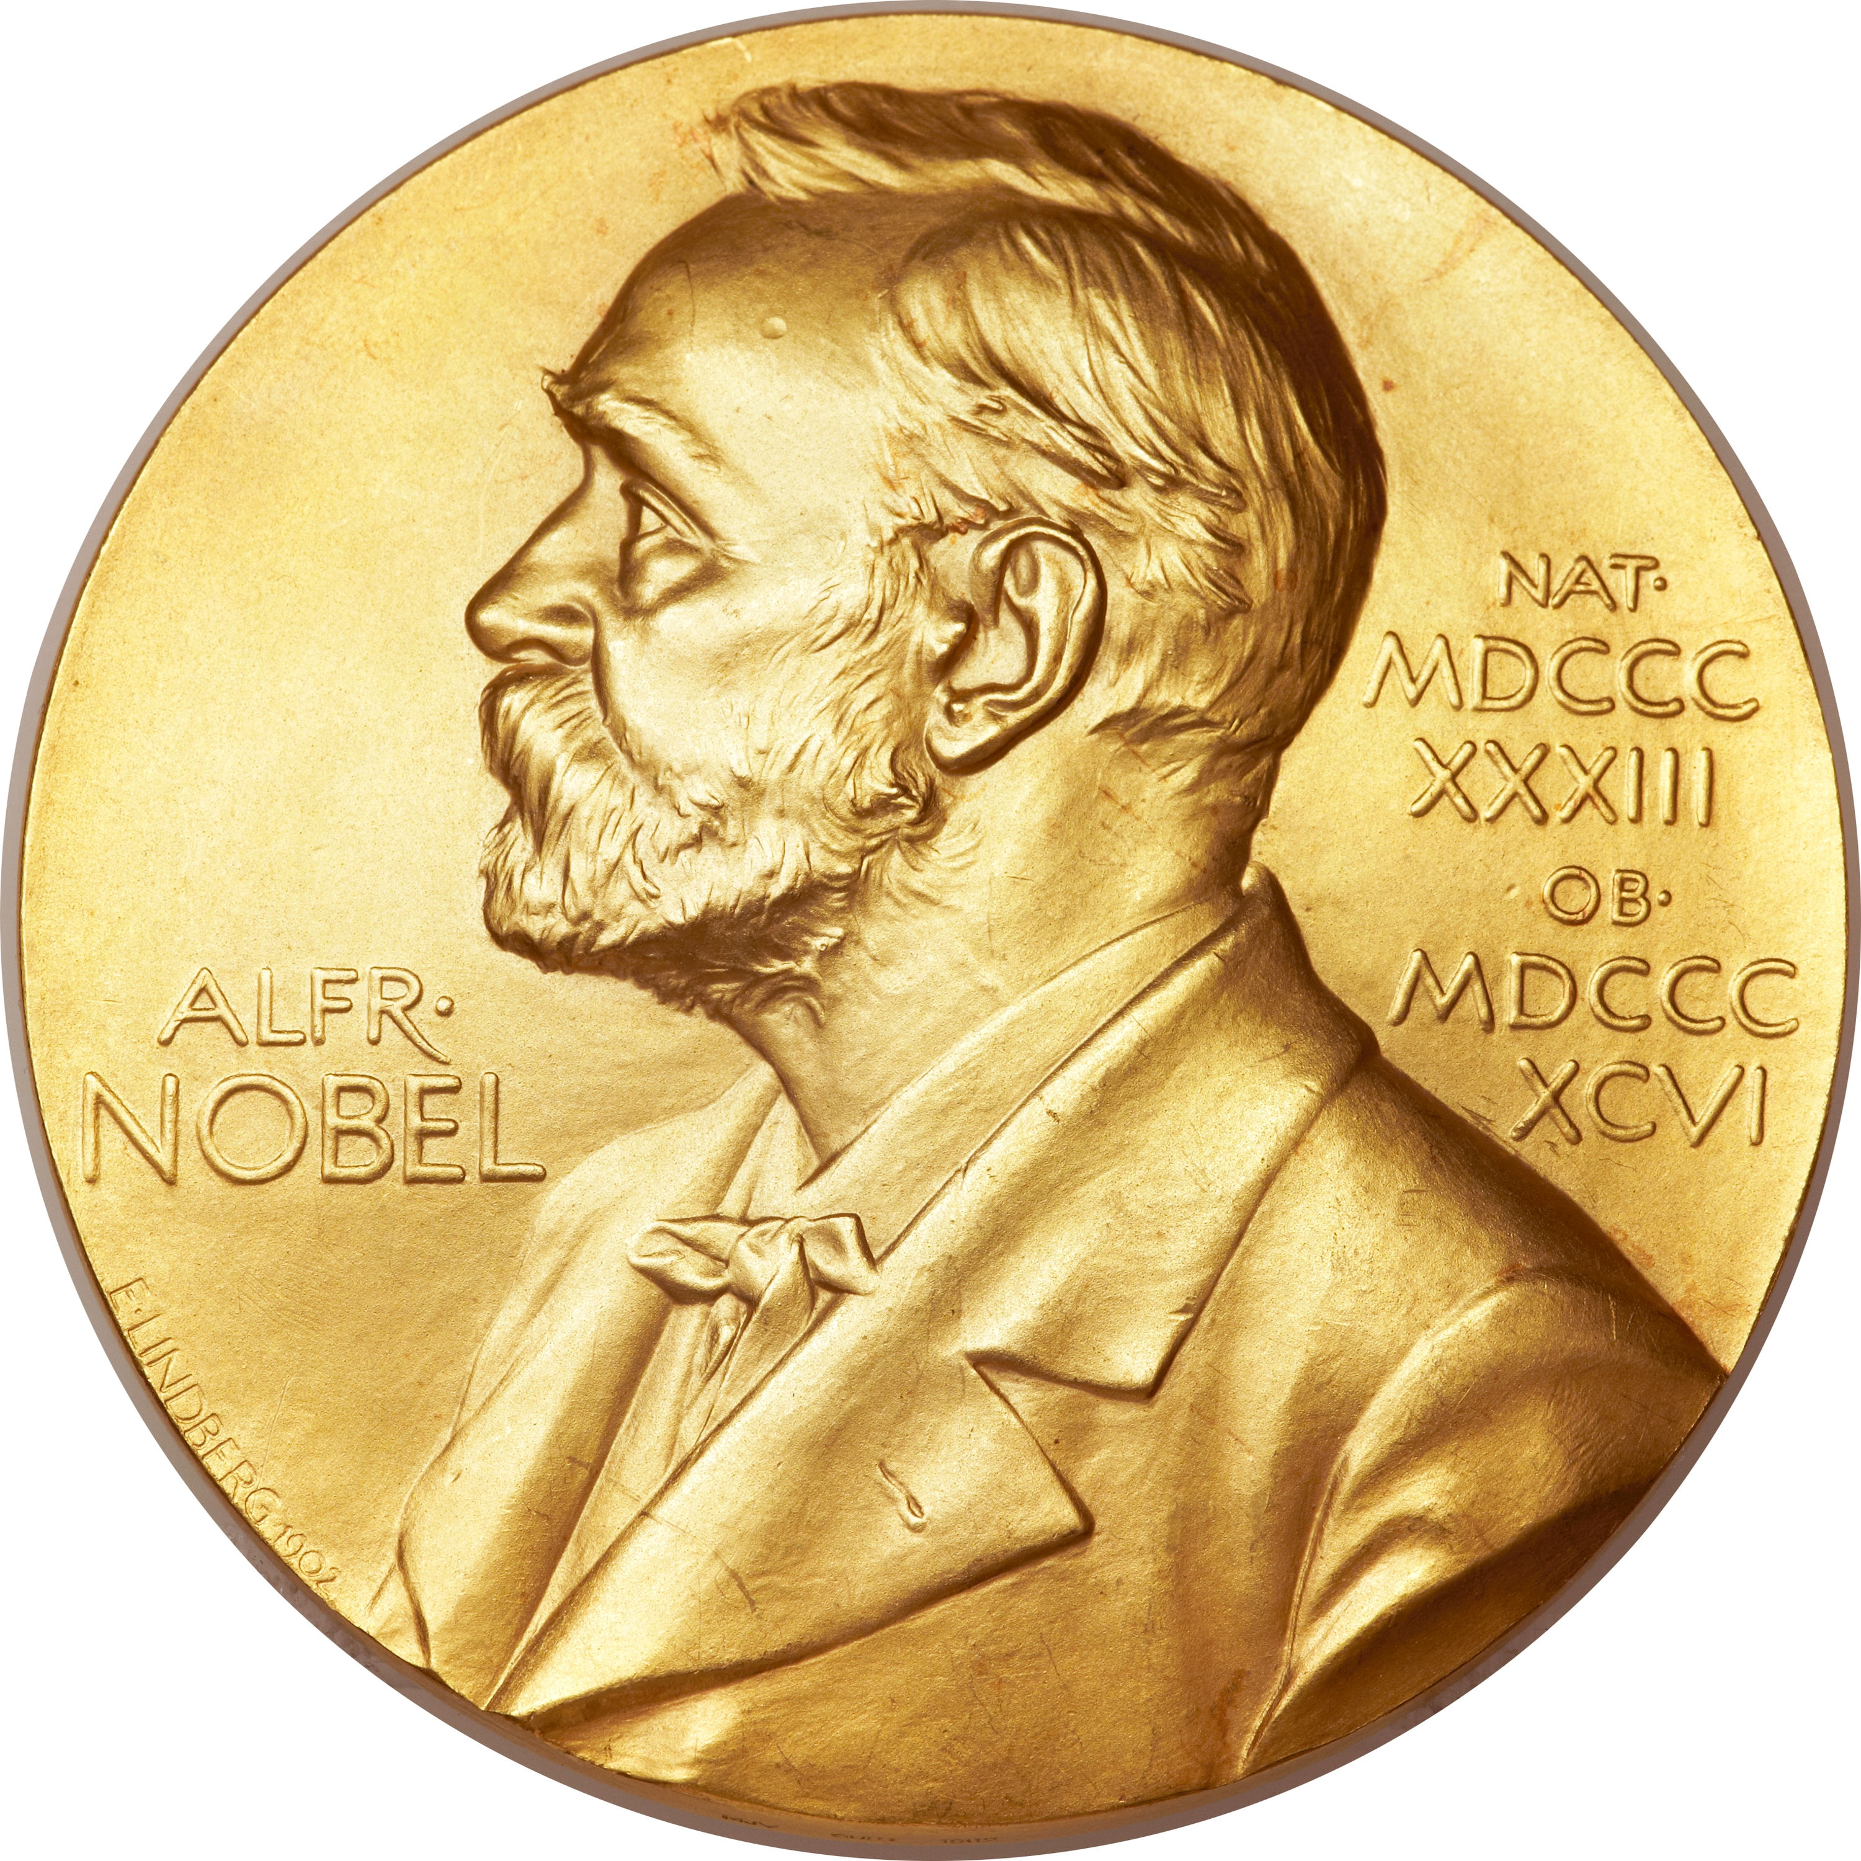
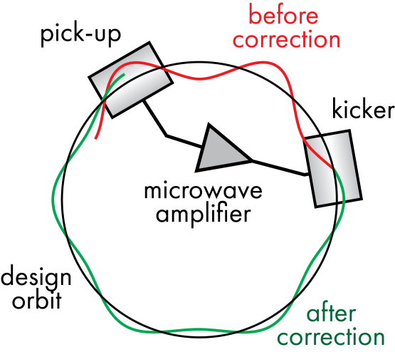

SC: a powerful technique but limited to GHz BW
$$ℒ \sim \frac{fN_{b}N^{2}}{4π{σ_{x}}^{∗}{σ_{y}}^{∗}}$$
1984 Nobel: van der Meer/Rubbia
We can increase beam brightness if we have granular information about particle ensemble.
Bandwidth (time resolution) of feedback system controls cooling rate
Simplified stochastic cooling system

Slide 25
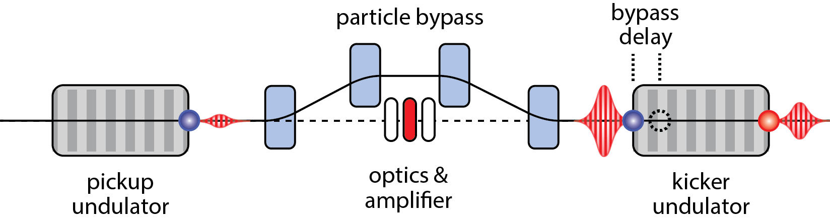
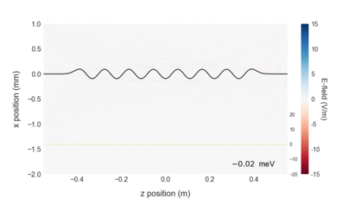
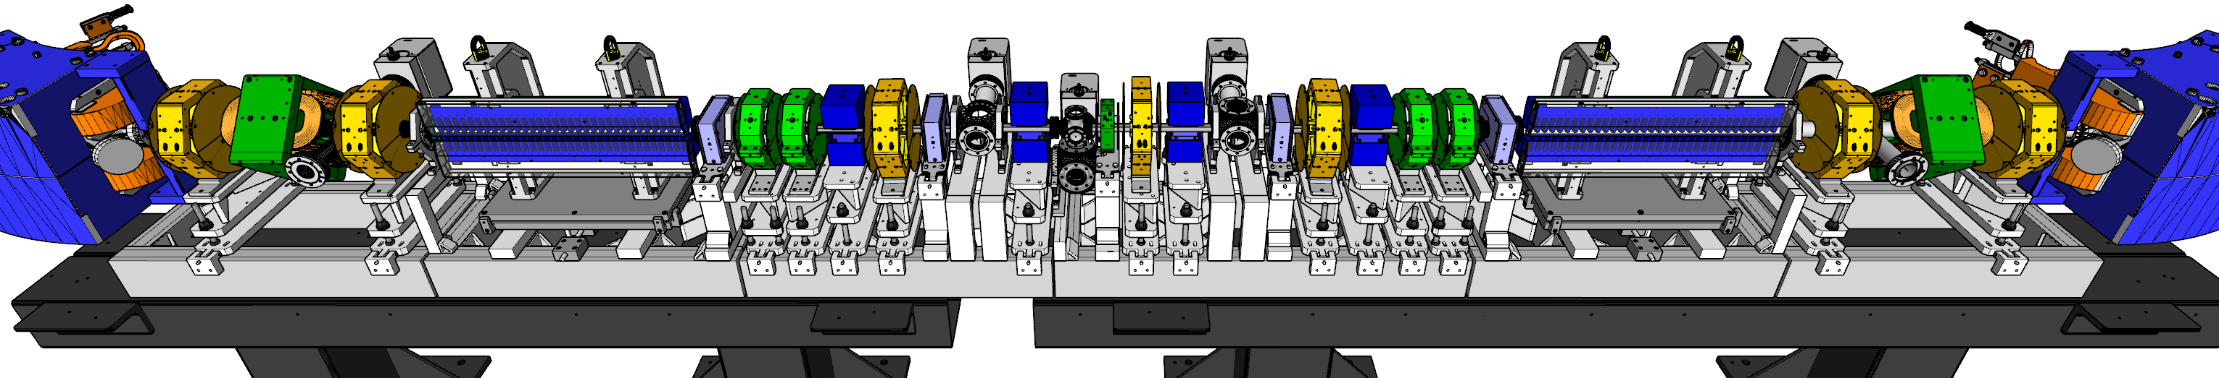
OSC extends the SC principle to optical bandwidth
Energy exchange vs. delay
Microwave hardware of SC replaced with undulators, lenses and amplifiers
Potential for 10³ – 10⁴ increase in cooling rate over SC (~10 THz vs few GHz)
OSC is at an intersection of fundamental beam-physics studies and pathfinding for operational systems in cooling, control and sensing
Potential applications: direct cooling of high-energy hadrons (~0.25-6 TeV); perf. enhancement in med.-energy ring coolers; specialized SR-damping systems for light sources; advanced beam sensing and control

Slide 26
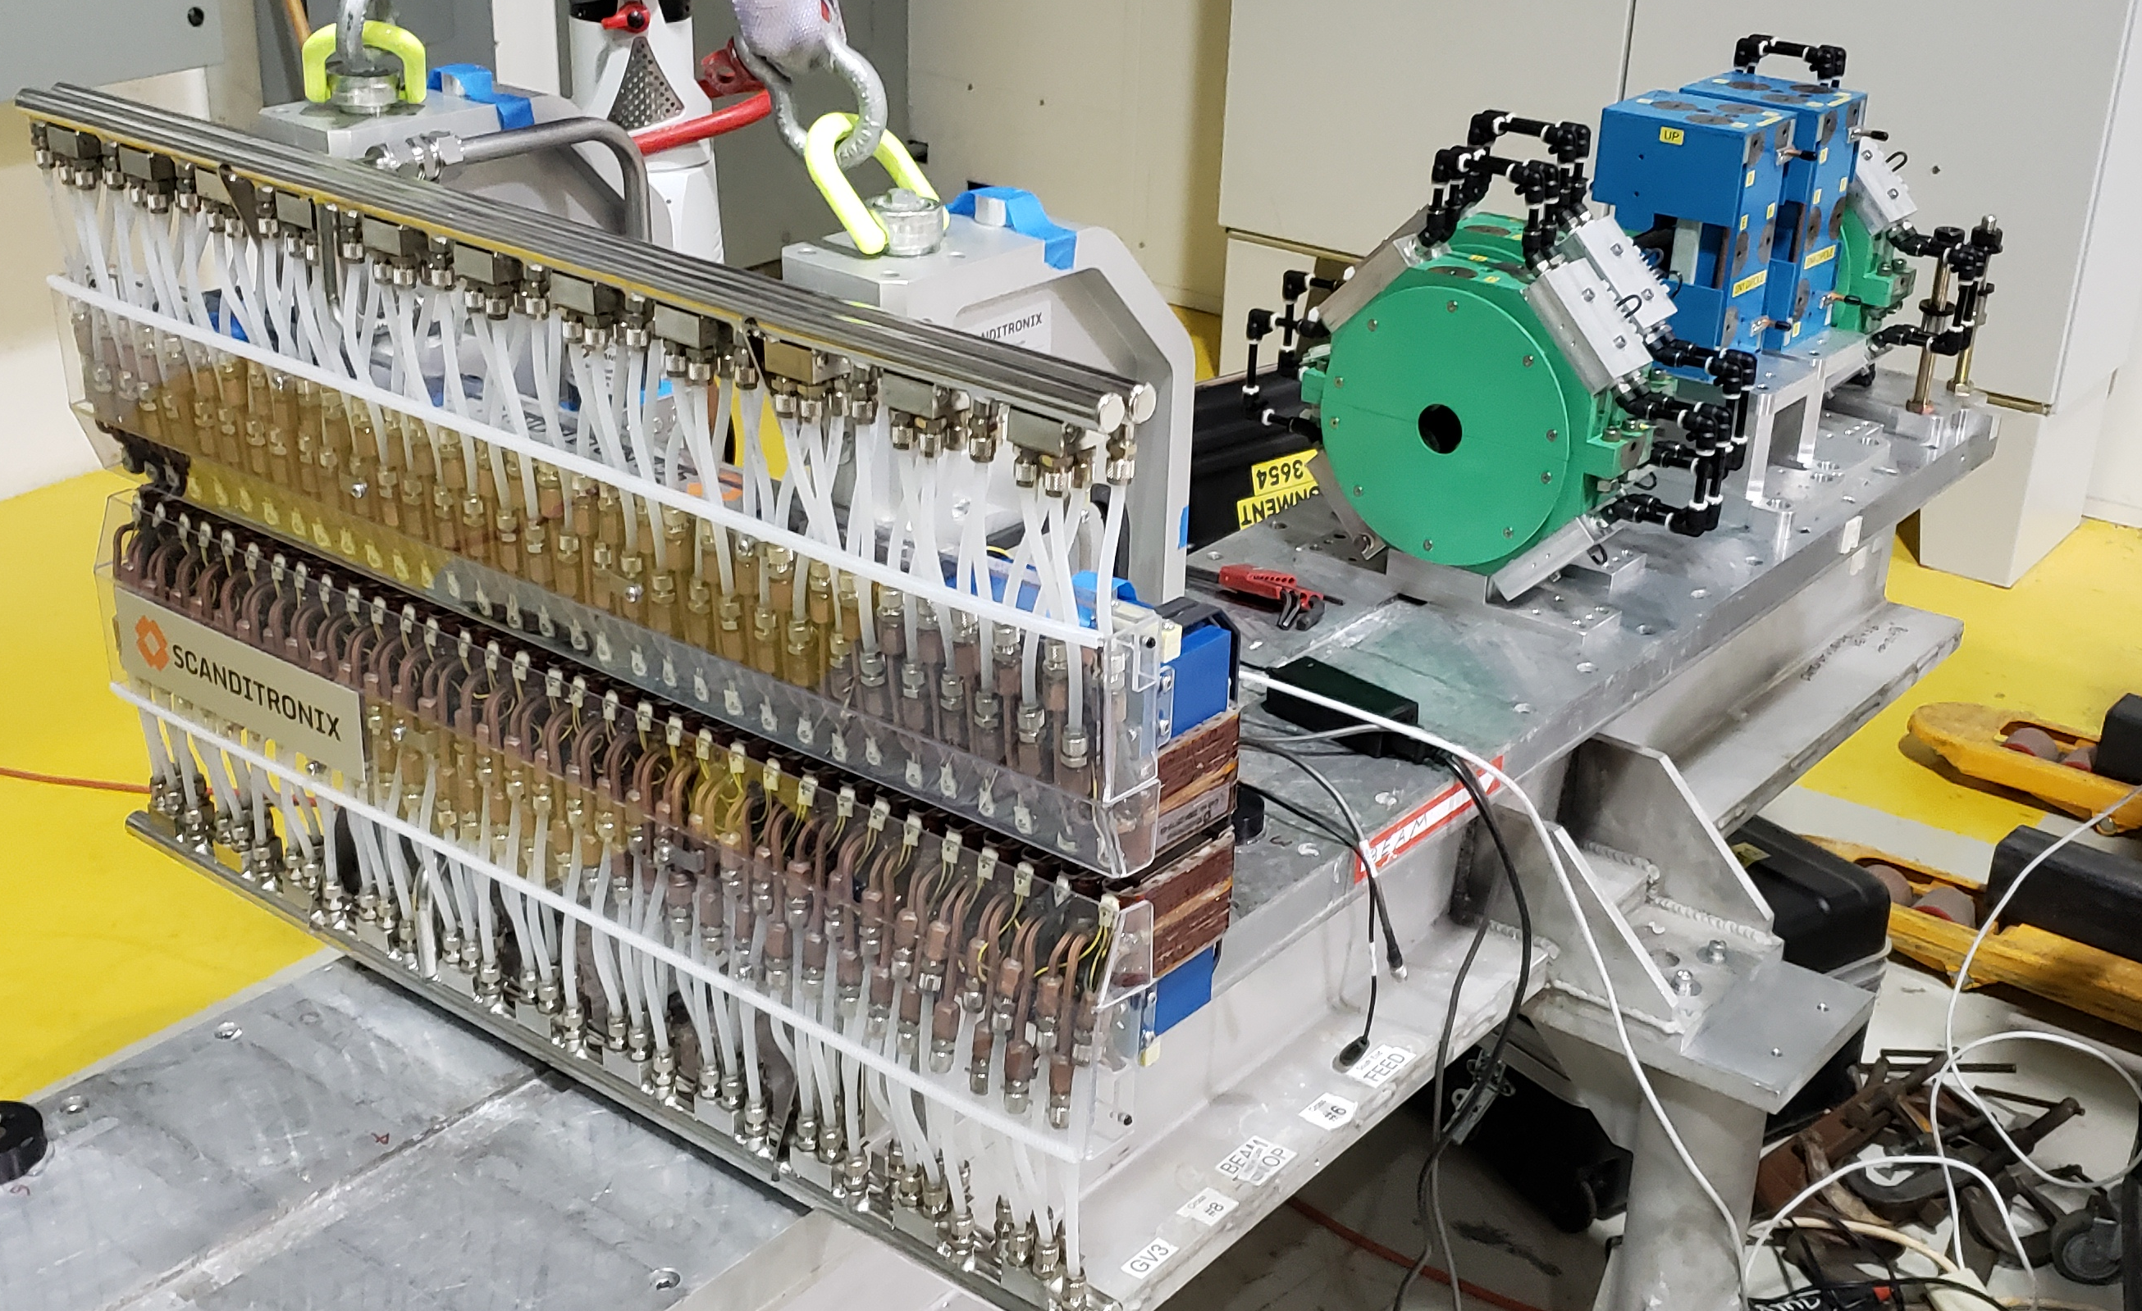
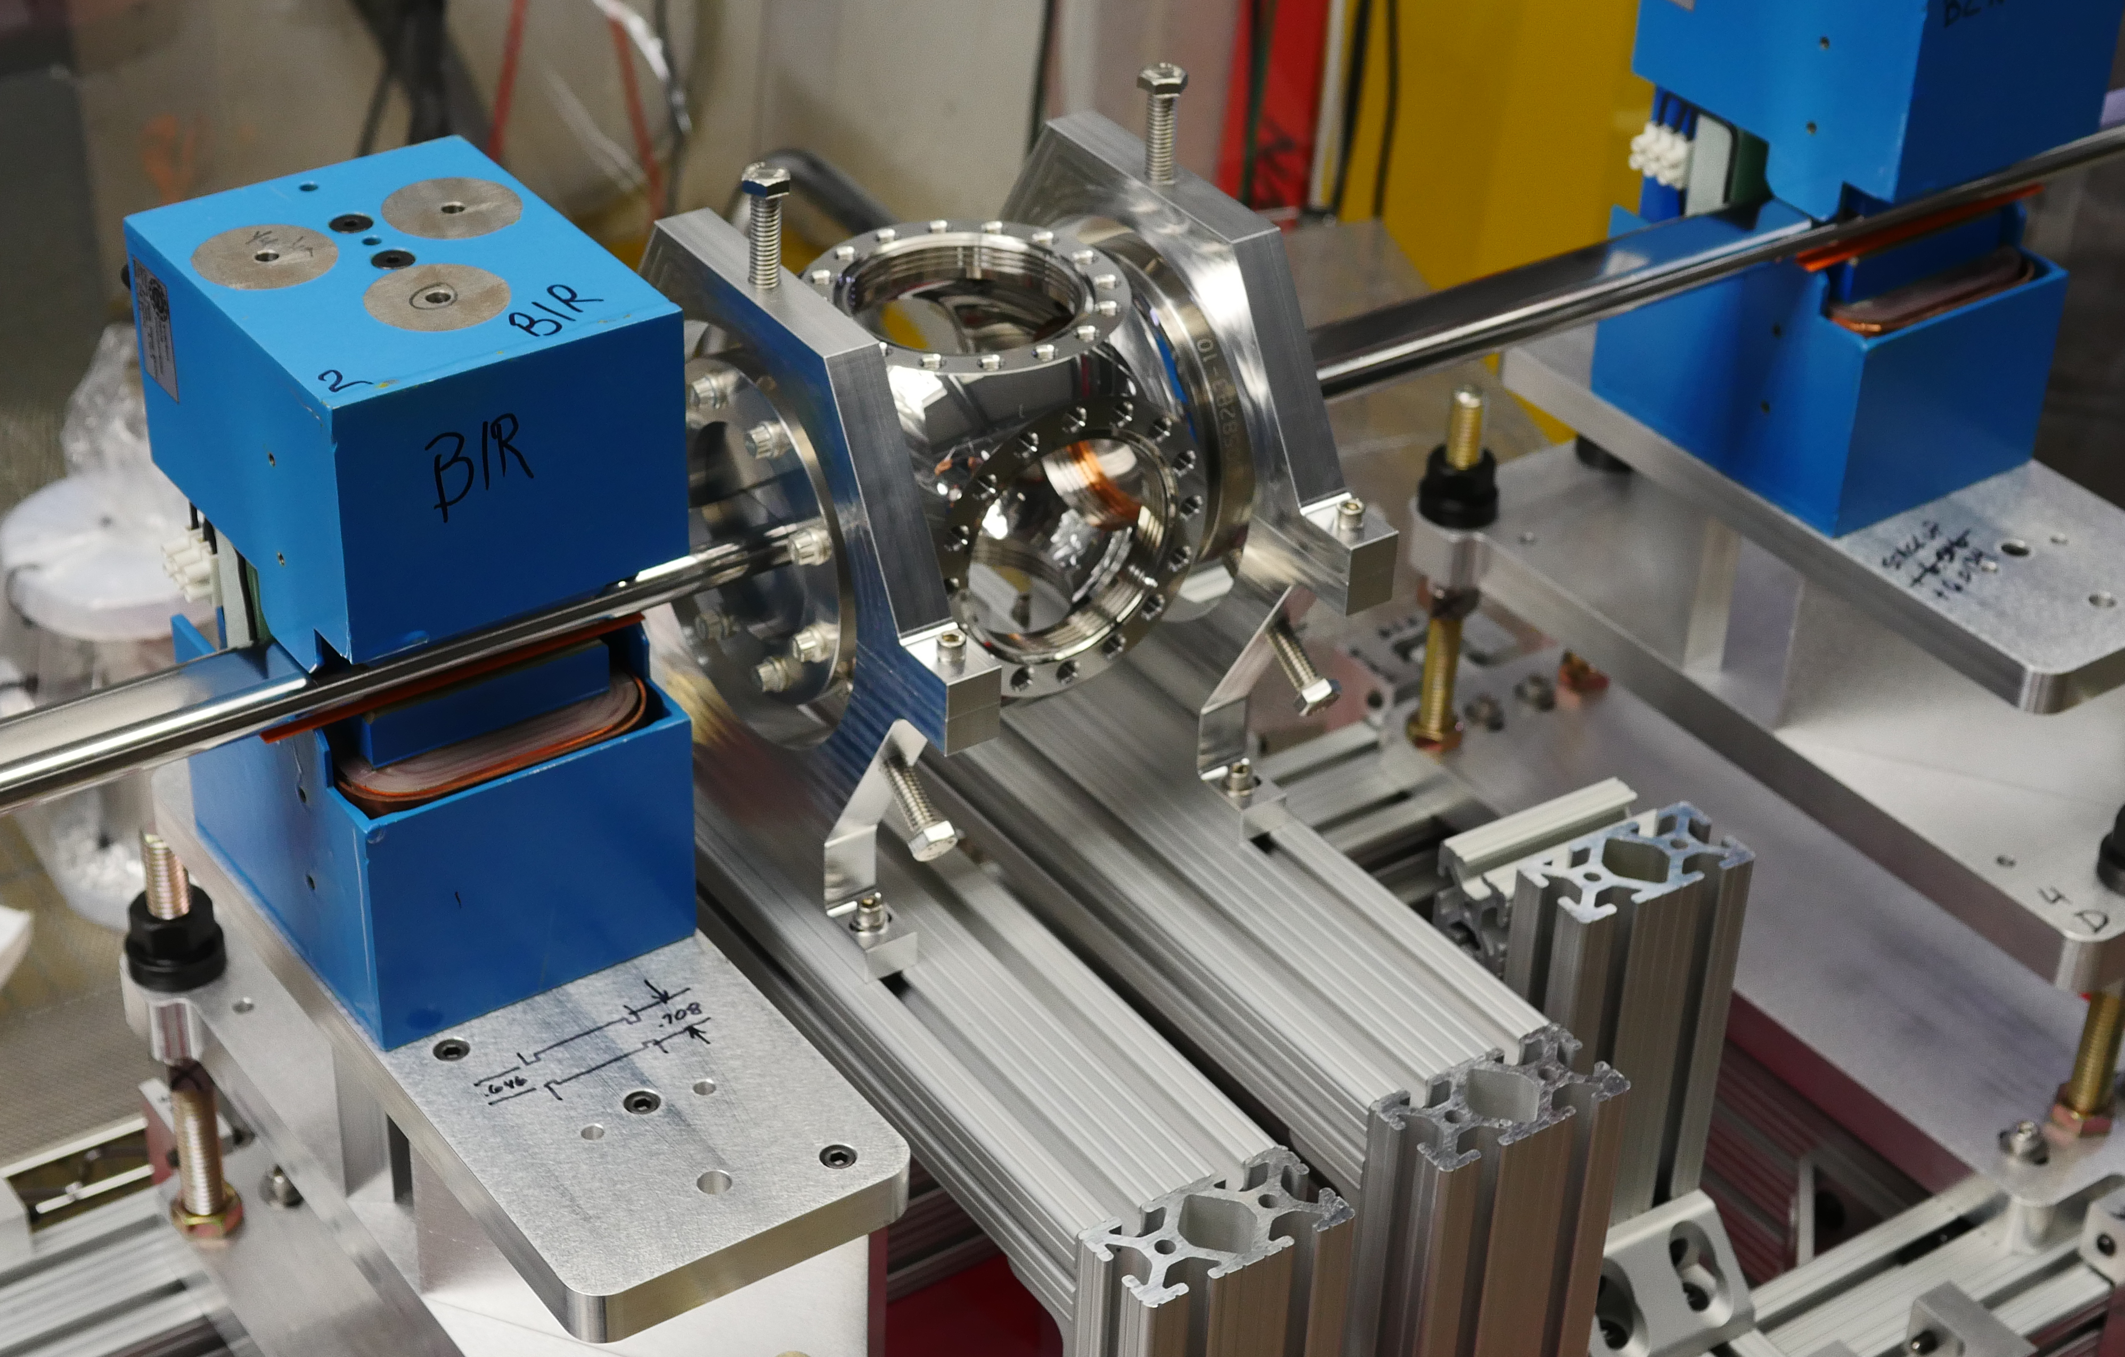
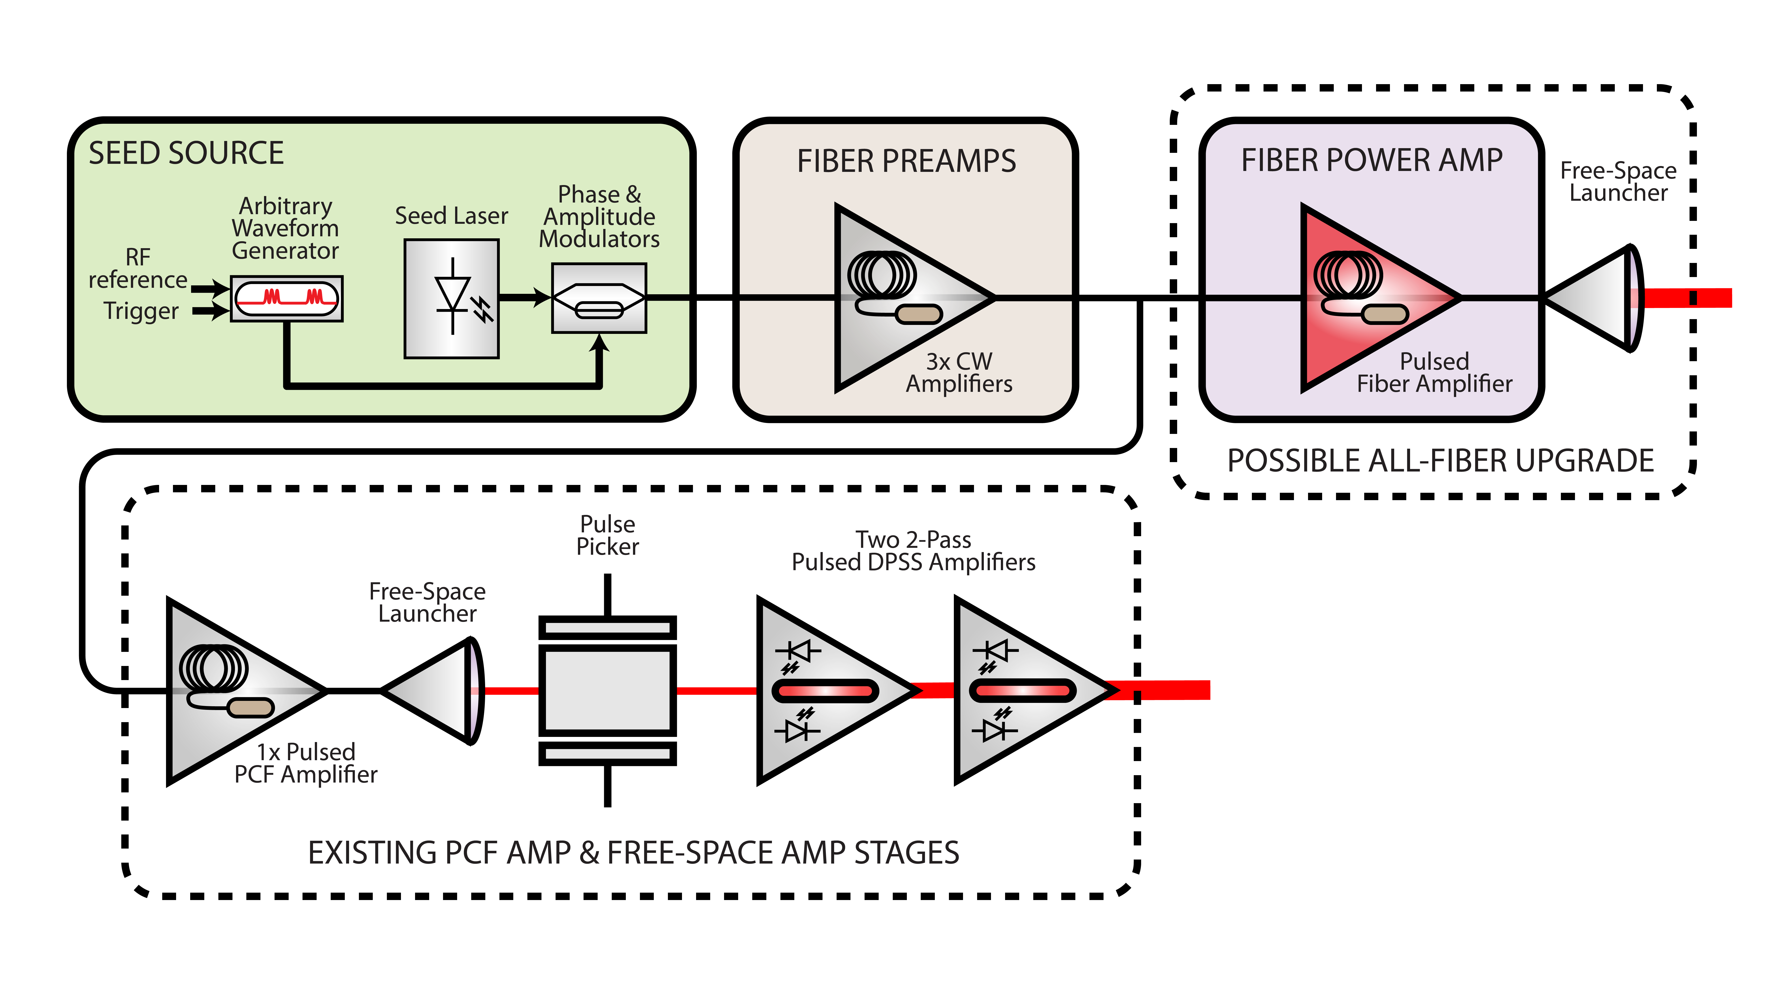
OSC program @ IOTA takes a staged approach
Phase I: Non-amplified OSC
Explore OSC physics decoupled from technological challenges related to high optical gain
Includes OSC studies with a single electron in IOTA
OSC elements are nearing completion and systems are being integrated
Experiments begin in ~Sep ’20 (world’s first demo)
Phase II (ECA): Amplified OSC and advanced control/sensing
Develop a high-gain (1000x) amplified-OSC system at IOTA; leverages previous FNAL/DOE investments in Linac-Laser-Notcher system
Develop specialized Machine-Learning systems and diffractive optics for advanced sensing and control
Focus on conceptual and technological paths towards operational systems
Amplified-OSC experiments beginning in ~FY’22/23

Slide 27
Summary
Increasing intensity involves many challenges
  Space charge effects, instabilities are just a few examples
Looking to the future
  IOTA is testing a novel method to redefine how we build our machines
  World’s first OSC demonstration this year
    New cooling method to improve beam quality
Thanks to J. Eldred, J. Jarvis, S. Nagaitsev and A. Valishev for slides

Slide 28
Backup slides

