Slide 1
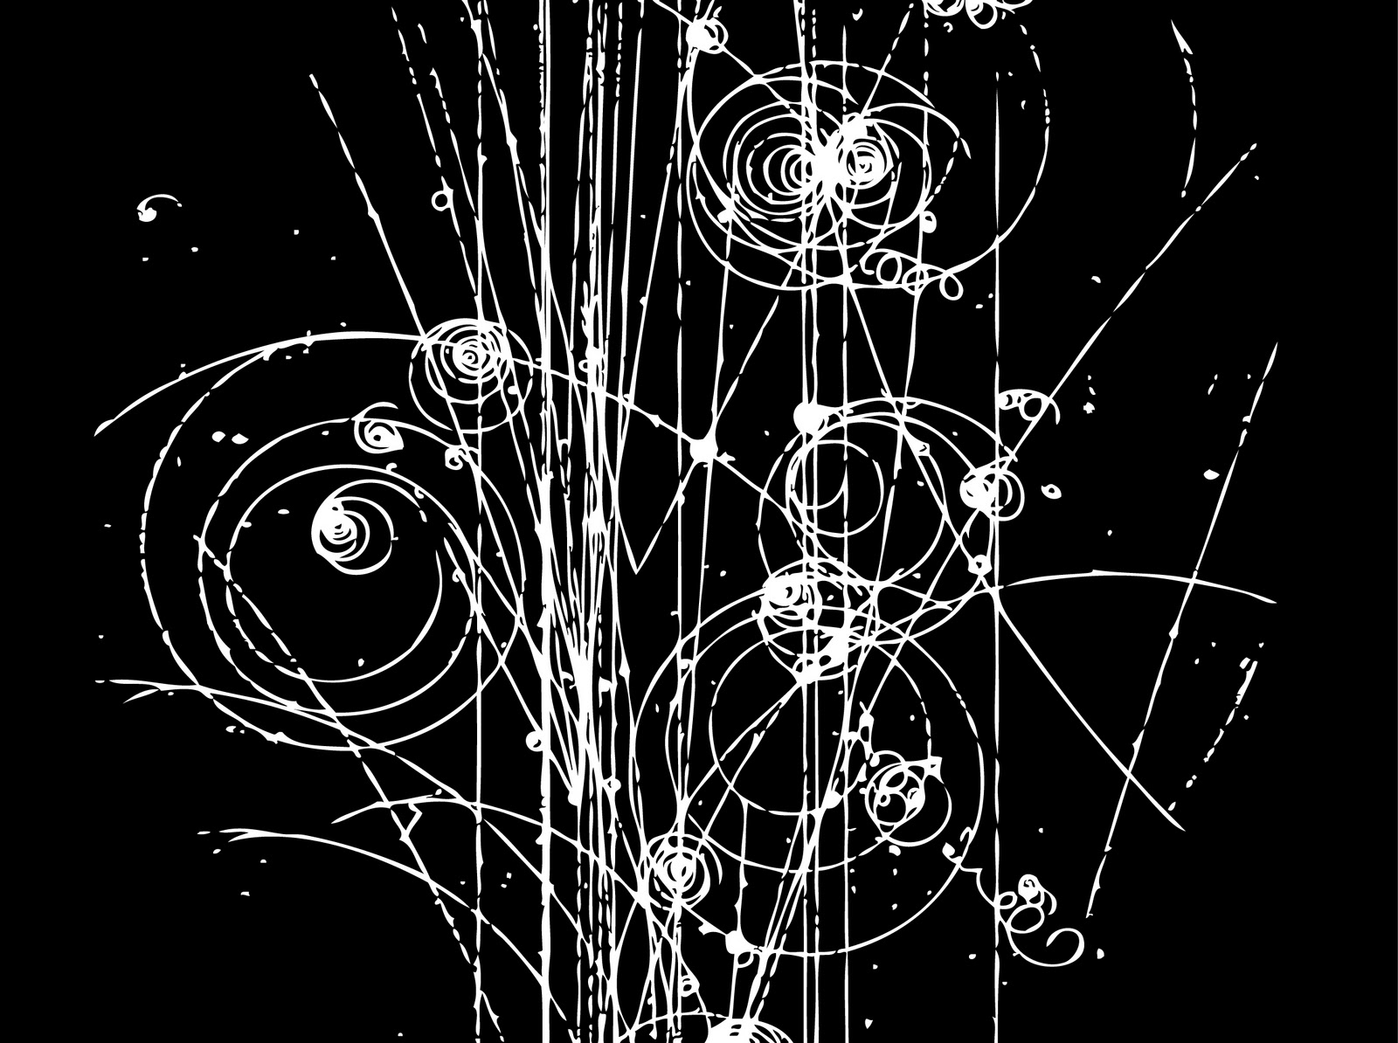
The Physics of Particle Detectors
Erik Ramberg
Summer, 2015

Slide 2
The spectrum of particle physics
Energy regimes:
  1 meV: ν masses & axions: STJ, High-Q cavities
  1 eV: astrophysics photometry: TES, CCD, MKID
  1 KeV: X-ray physics; dark matter: Pixel Arrays, Crystals
  1 MeV: Solar/supernova ν : Water cerenkov, Liquid Scint.
  1 GeV: ν osc., rare decays: LAr, Straw tubes
  1 TeV: Colliders EW, SUSY: Silicon strips, calorimetry
  1 ZeV: Cosmic rays: Ground arrays, satellites
Particle species commonly encountered:
  Photon, electron, proton, kaon,
  neutron, muon, neutrino, ‘Phonon’, ‘
  quasi-particles’, nuclei, ions, etc.
As this shows, particle physics (more than any other field) has an immense reach in energies and particle species to detect. Because of this, the field has had a rich tradition of detector innovation and development.
24 orders of magnitude!

Slide 3
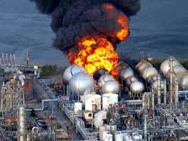
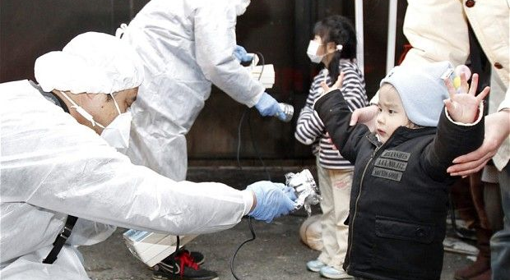
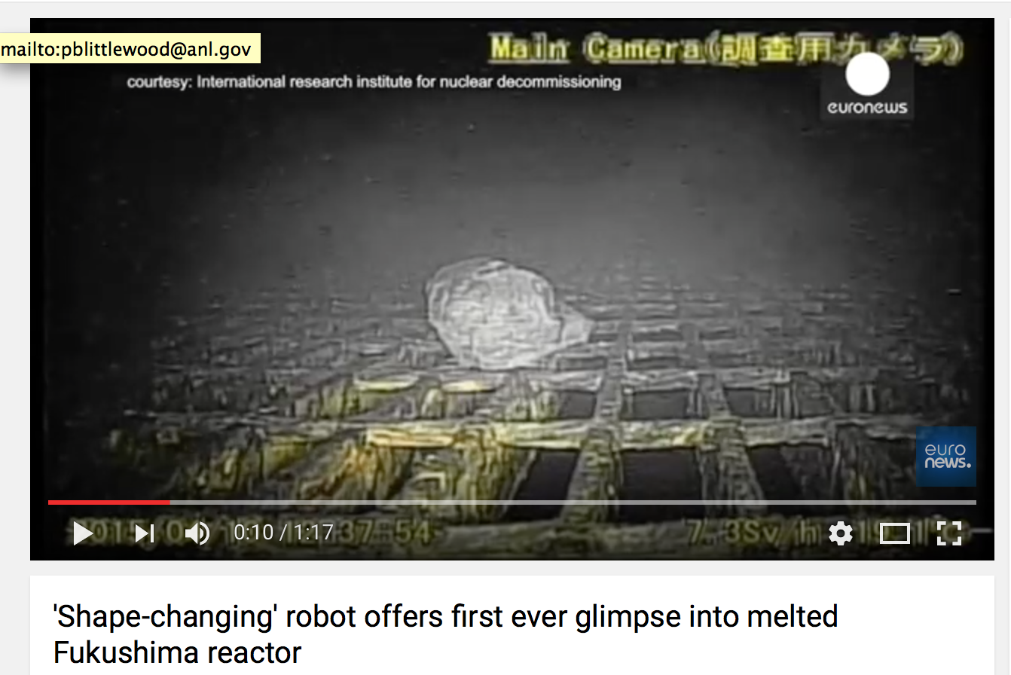
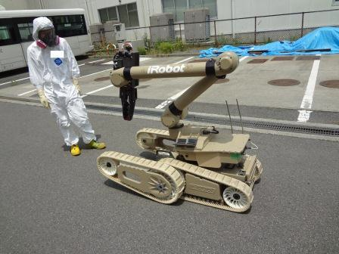
We do know that subatomic particles exist, they are essentially ‘invisible’ to human senses and can be harmful or deadly in some circumstances.
Send in the robotic particle detector:
https://www.youtube.com/watch?v=dQY8pFhlFY8
Stopped working after a few hours, but obtained incredible footage and measurements of deadly radiation levels
→ Particle detection can be crucial in an emergency

Slide 4
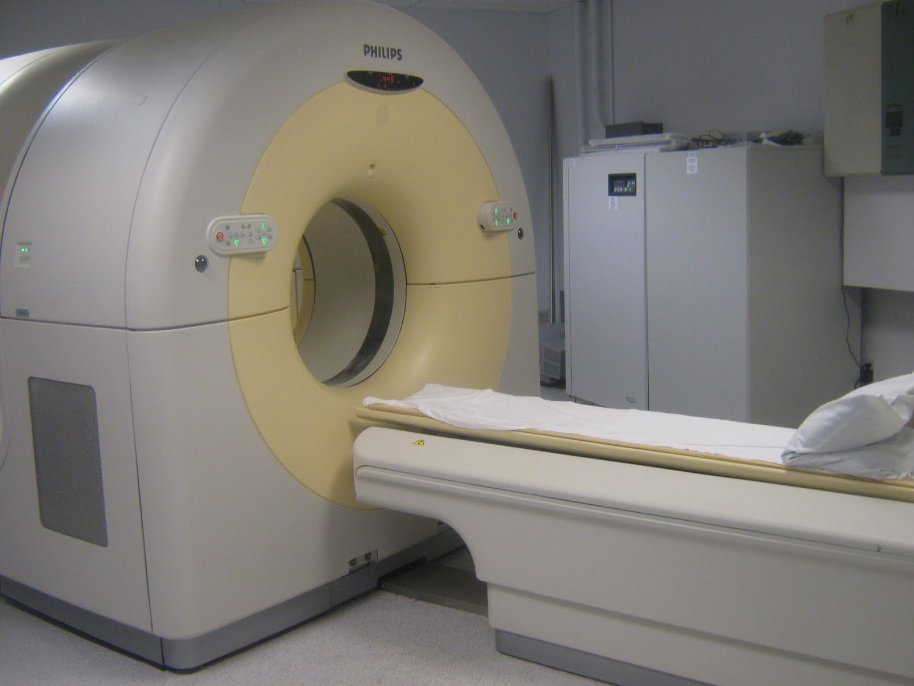
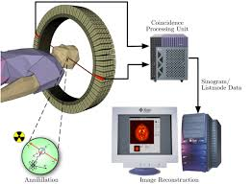
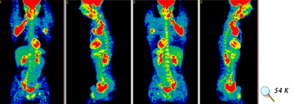
Particle Detection in Medicine
PET imaging uses positron source (like Na22) and captures the energy of the two gammas coming from the electron-positron annihilation to form a line segment along which the event took place.
Gives excellent information on biological activity rather than density (such as a CT scan)
Particle detection is an important medical tool

Slide 5
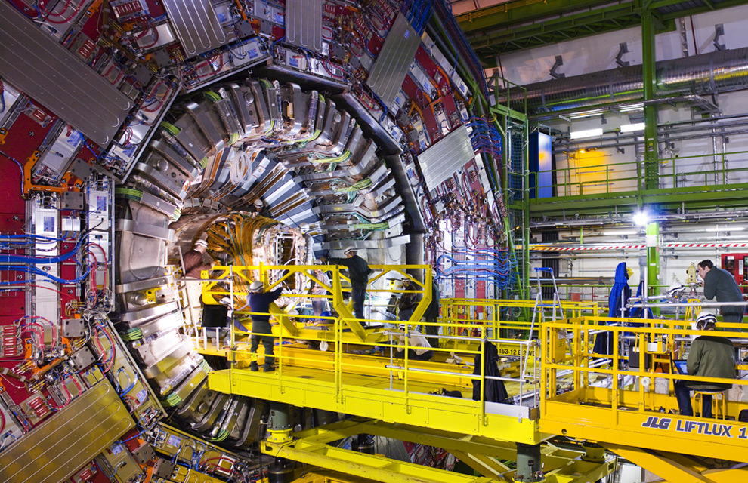
The giant collider detectors at LHC
Particle detectors teach us about the universe and are way cool!

Slide 6
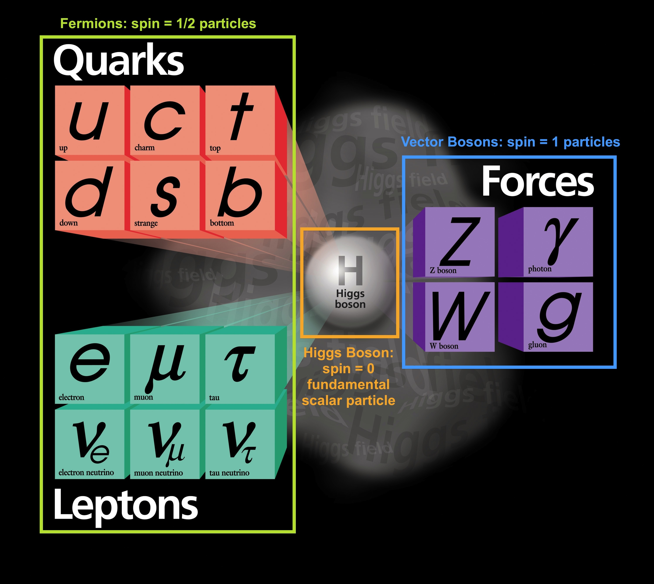
A one slide review of the
Standard Model of Particle Physics
  Leptons:
    are fundamental
    appear individually in nature
      electron + electron neutrino
      muon + muon neutrino
      tau lepton + tau neutrino
  Quarks:
    Particles that make up protons and neutrons and lots of other particles
    appear in nature only in groups of
      2 quarks
      π⁺ = ud
      J/Ψ = cc
      Υ = bb
      3 quarks
      p = uud
      Λ⁰ = uds
      Λ⁰_{b} = udb
Force carrying particles:
Strong – gluons binds quarks together into nuclei
Weak – W/Z mediate transitions between flavors
Electromagnetic - gamma couples to electric charge
Mesons
Baryons
Don’t forget the antiparticles !!

Slide 7
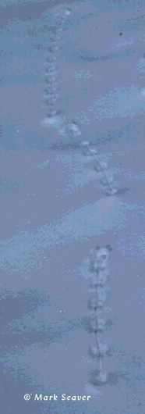
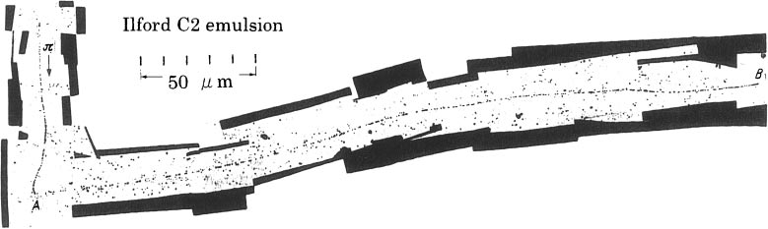
Tracks
Particles leave tracks, just as animals leave tracks, from which we deduce their presence. What can we learn ?
  What do the tracks tell us ?
    how heavy was the animal ?
    was the animal running ?
    being hunted ?
    tired ?
  What do the emulsion tracks tell us?
    Particle ionization – related to velocity
    Charge
    Estimate of mass
    Fact that it decayed into something else
    lifetime
Discovery of pion to muon decay in 1947 by Powell and Occhialini

Slide 8

Magnetic force acting on particles
Charged particle moving in magnetic field will experience Lorentz force and will thus bend its trajectory
Lorentz Force
ρ = radius of curvature
Momentum
Particle moves perpendicular to magnetic field:
The faster the particle goes, the greater is its radius of curvature and the more magnetic field is needed for the same deflection

Slide 9
Energy and Momentum
A ‘spectrometer’ uses a magnetic field to measure momentum
A ‘calorimeter’ measures the energy of a particle by absorbing it or by causing it to ‘shower’
Einstein’s special theory of relativity formula
Energy collected in a calorimeter
Curvature in magnetic field
Can determine the mass, and thus identity of the particle

Slide 10
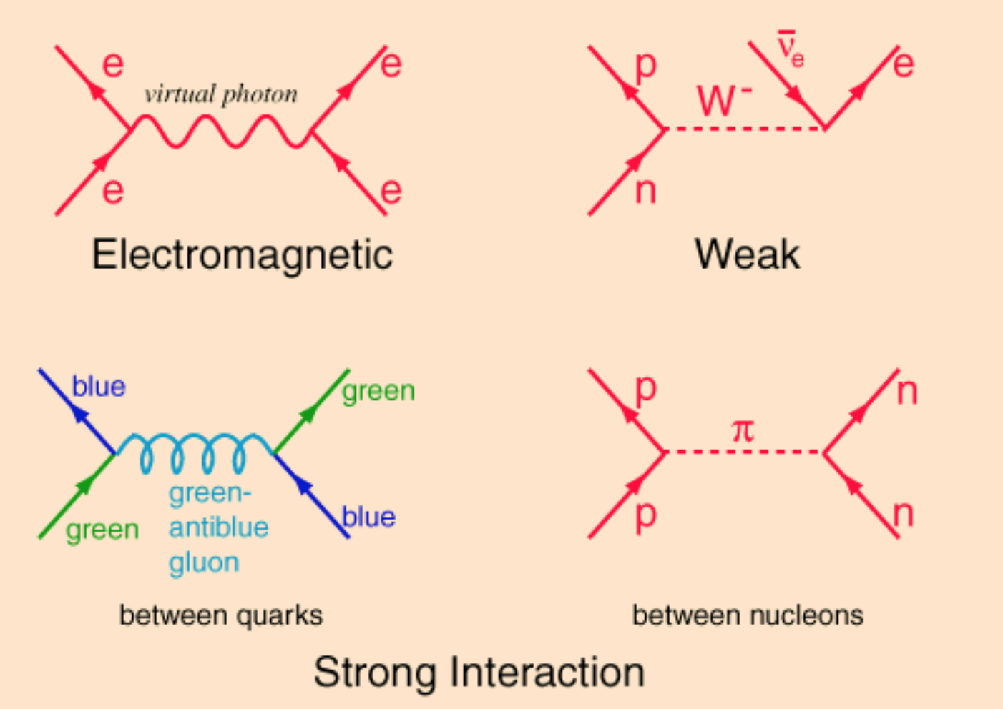
Particle Decays
Electromagnetic and Strong decays aren’t directly visible, since these processes take place so quickly 10⁻²⁰ seconds or less – (cτ < nanometer)
Weak processes take place on time scale of 10⁻¹² sec or more (cτ > millimeter)

Slide 11
Energy Loss (Bethe-Bloch)
Energy loss per cm (dE/dx) by heavy charged particle (M > m_{μ})
  primarily by ionization and atomic excitation
  mean rate of energy loss given by Bethe-Bloch equation
  dE/dx in units of MeV g⁻¹ cm²
  dE/dx depends only on β, independent of M
  I ≈ I₀ Z , with I₀ ≈ 10 eV
  Z/A does not differ much for most elements, except for hydrogen
γ

Slide 12
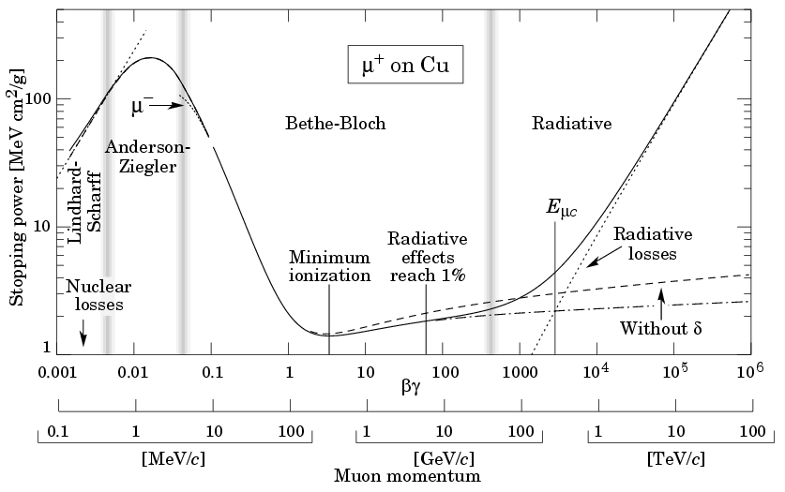
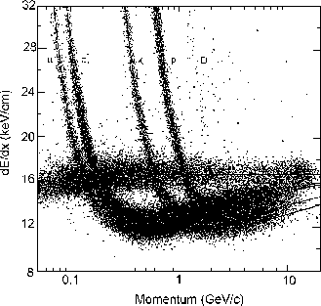
Minimum Ionizing Particle (MIP)
μ
π
K
p
D
e
You can reconstruct the identity of a particle by measuring its momentum in a magnetic and its rate of ionization (de/dx). But it doesn’t work for minimum ionizing particles (> 1 GeV)

Slide 13
Amplifying and converting the signals from particle interactions
Quite often, we operate on the threshold of changes of state:
  Photographic emulsion – very sensitive chemical reaction ready to occur if given a photon impact
  Cloud Chambers – super-cooled, ready to condense around ionization
  Bubble Chambers – super heated, ready to boil around ionization
  Geiger Tubes, Spark Chamber, RPC – Voltage is set just at the edge of sparking – all it needs is an impetus
  Transition edge sensor – on threshold of change of state between normal and superconducting

Slide 14
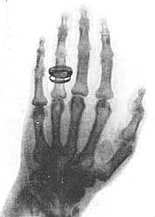
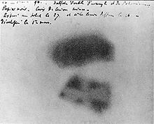
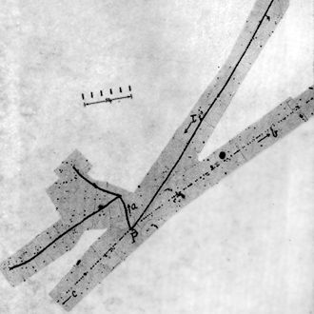
Film and Emulsion
Natural radioactivity was discovered by Becquerel accidentally from the darkening of photographic film by a Uranium salt.
Roentgen used film as his X-ray detector
Emulsions developed to be sensitive to radiation were used in the discovery of the pion and the ‘strange particles’, and continue to be used for neutrino physics (Opera) and dark matter detection.
Image of Roentgen’s wife’s hand. This creates a world-wide sensation (1896) and has immediate consequence for medical treatment.
Image of Becquerel's photographic plate which has been fogged by exposure to radiation from a uranium salt.
K->π⁺π⁻π⁻
Discovery of kaon by Powell and Ochialini - 1947

Slide 15
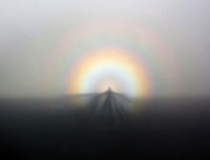
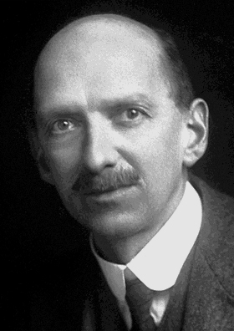
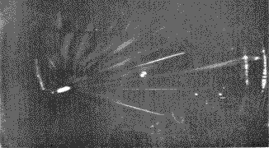
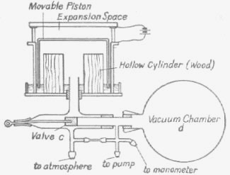
C.T.R. Wilson: The Cloud Chamber
Wilson was a Scottish meteorologist at the Cavendish Labs
Fascinated by clouds in the Highlands, especially the ‘Brocken Spectre’
Built a chamber to play with purified air
Clouds condense around ionization when piston is pulled and volume becomes supersaturated

Slide 16
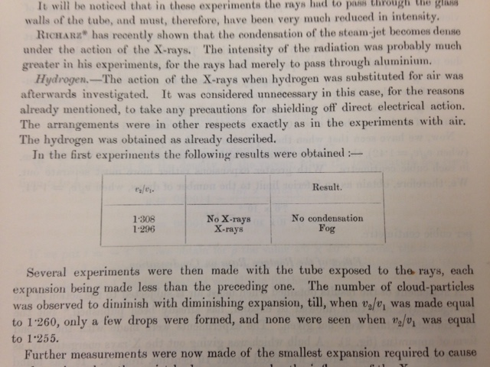
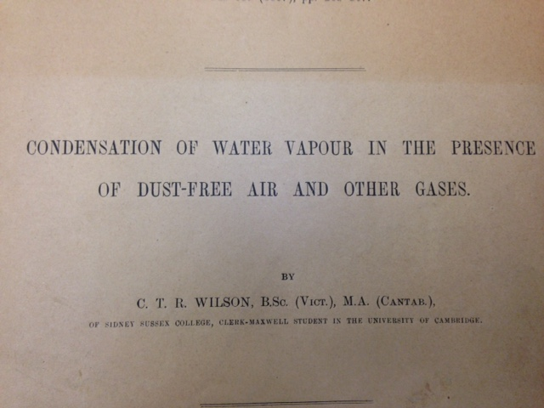
The birth of particle detector experimentation
Wilson made the first true particle physics experiment.
He brought in a ‘Roentgen Ray’ tube and put it in front of his cloud chamber. (1896)
His table of results is one of the most beautiful that I’ve ever seen. Here it is:

Slide 17
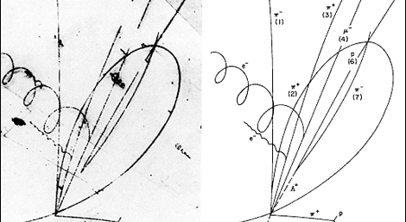
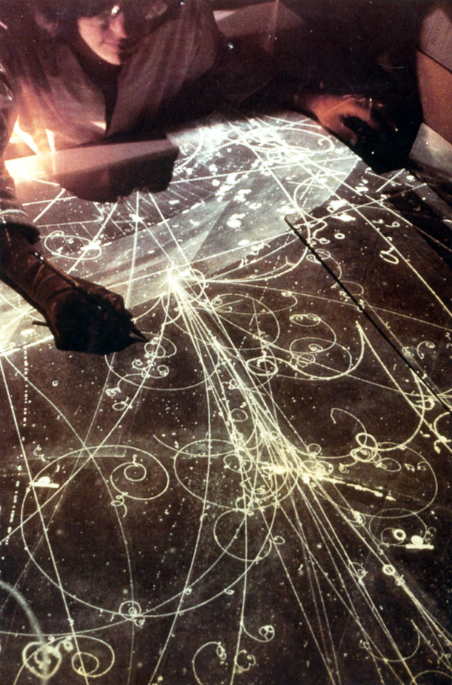
A similar technique: Bubble Chambers
Simply raise the temperature of any liquid under pressure
Release the pressure quickly. (piston or bellows) in time with incoming particles
The first bubbles will coalesce around the ionization trail
Take a photograph
Repressurize quickly since otherwise the chamber will bubble uncontrollably
Tracks are curved because of a magnetic field
Discovery of the Σ_{c}++ (Note the Lambda particle decaying to Proton + Pion)

Slide 18
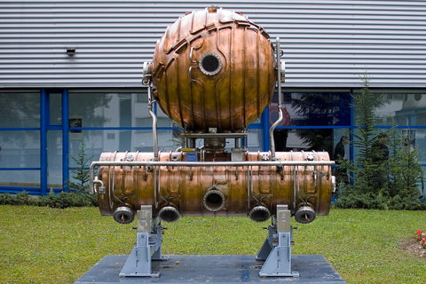

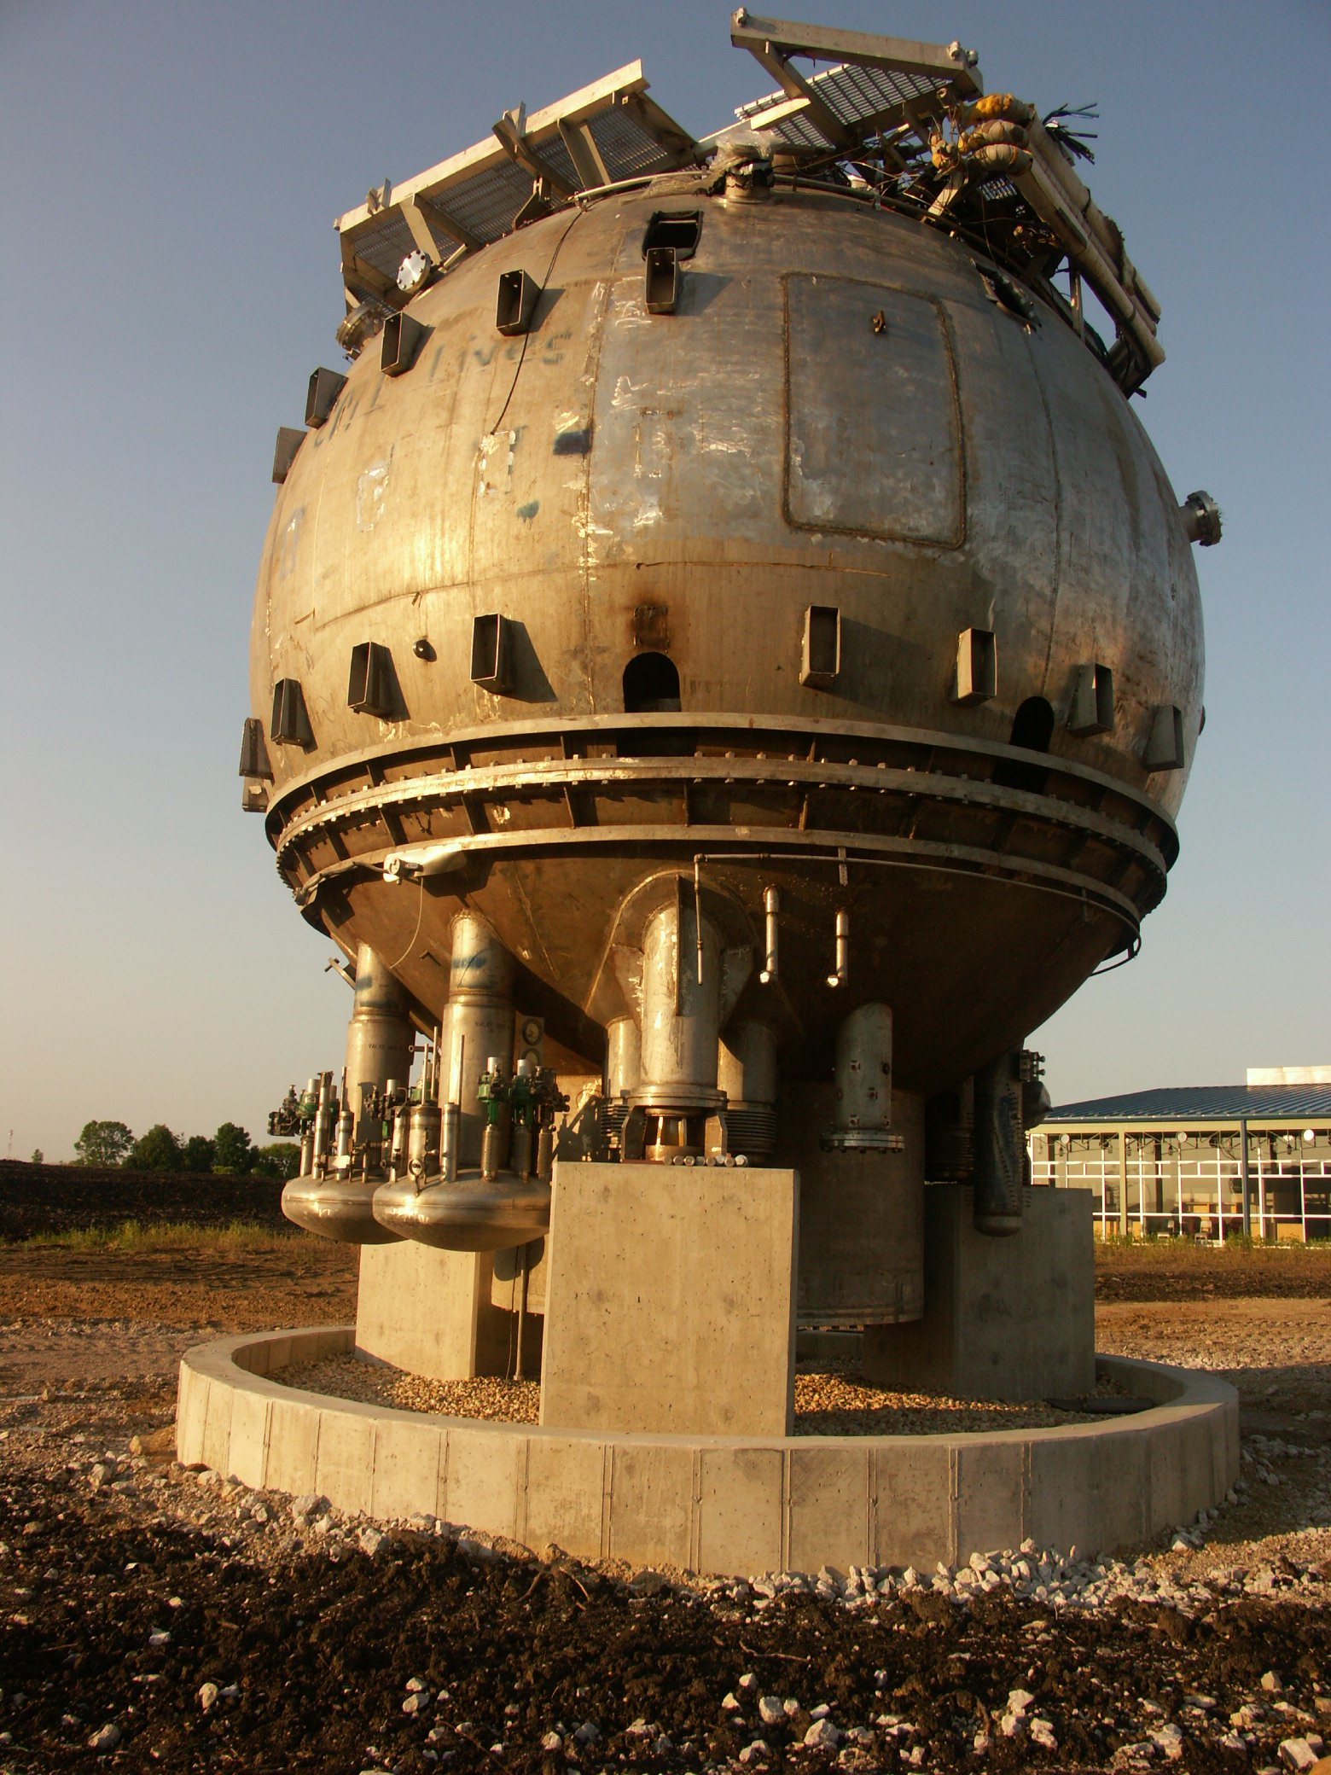
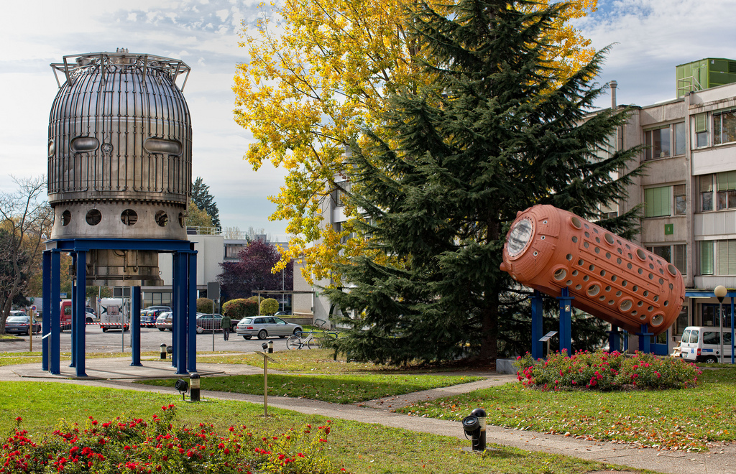
The bubble chamber fell into disuse as a detector but gained an important role as ornament!

Slide 19
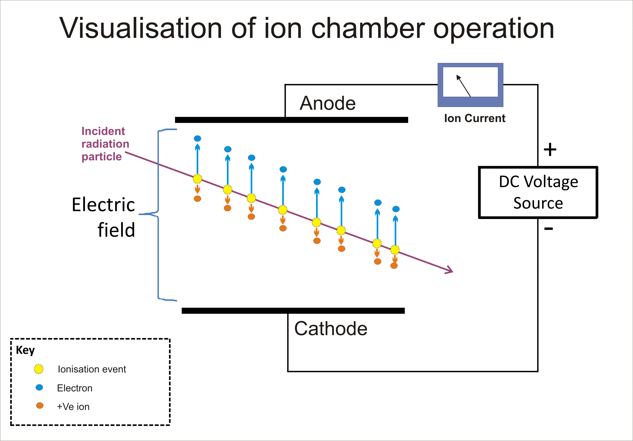
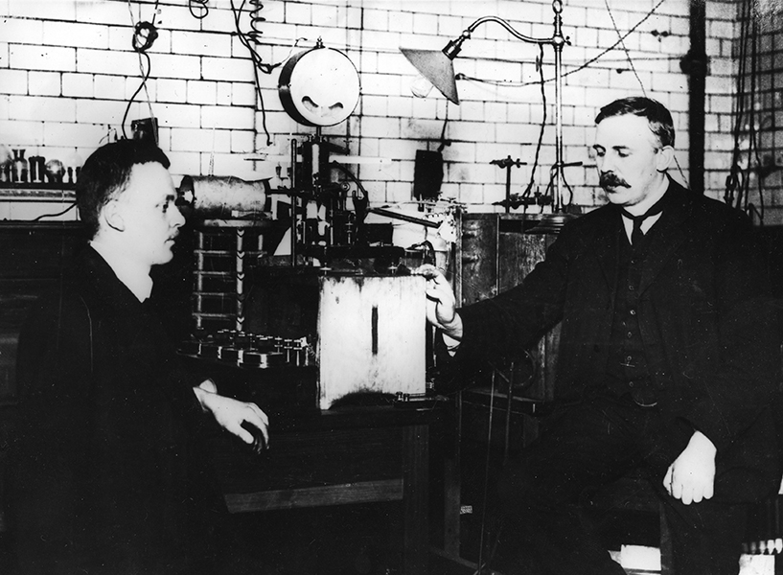
To speed up data collection, need an electronic readout, not a photograph+scan.
About 20-100 ion pairs per centimeter of gas = 10⁻¹⁷ Coulombs
Collect in 100 nanosecond in a 100 Ohm cable = 10⁻⁸ Volts = 10 nanoVolt!!!
Thus, to see an individual particle, you will need amplification of on the order
of 10⁵ to get any decent signal

Slide 20
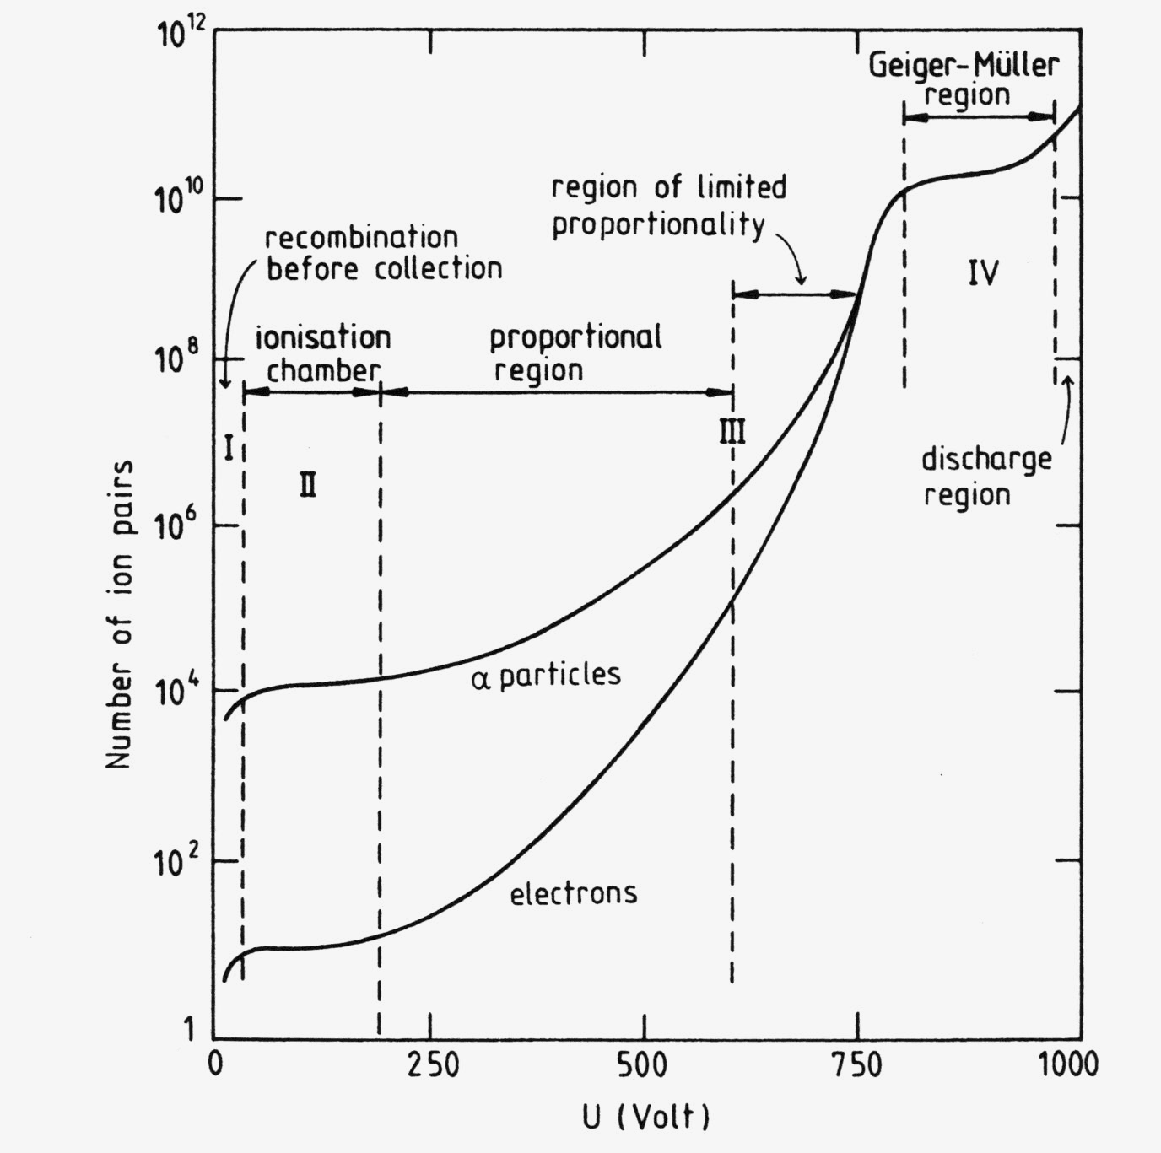
Wire chamber operation as you raise the voltage
As voltage increases, then you start to get very high electric fields next to the wire.
In this region you can get amplification from electrons being accelerated and hitting more gas atoms.
You get a “proportional effect” until you turn the voltage up even further – then you get a self-sustaining spark. That is called the “Geiger avalanche” region

Slide 21
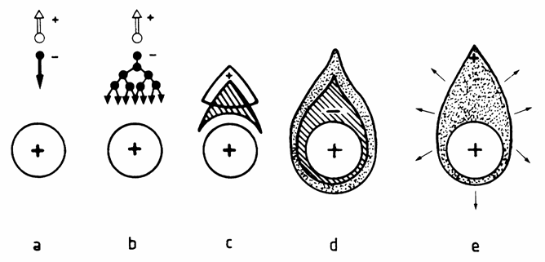
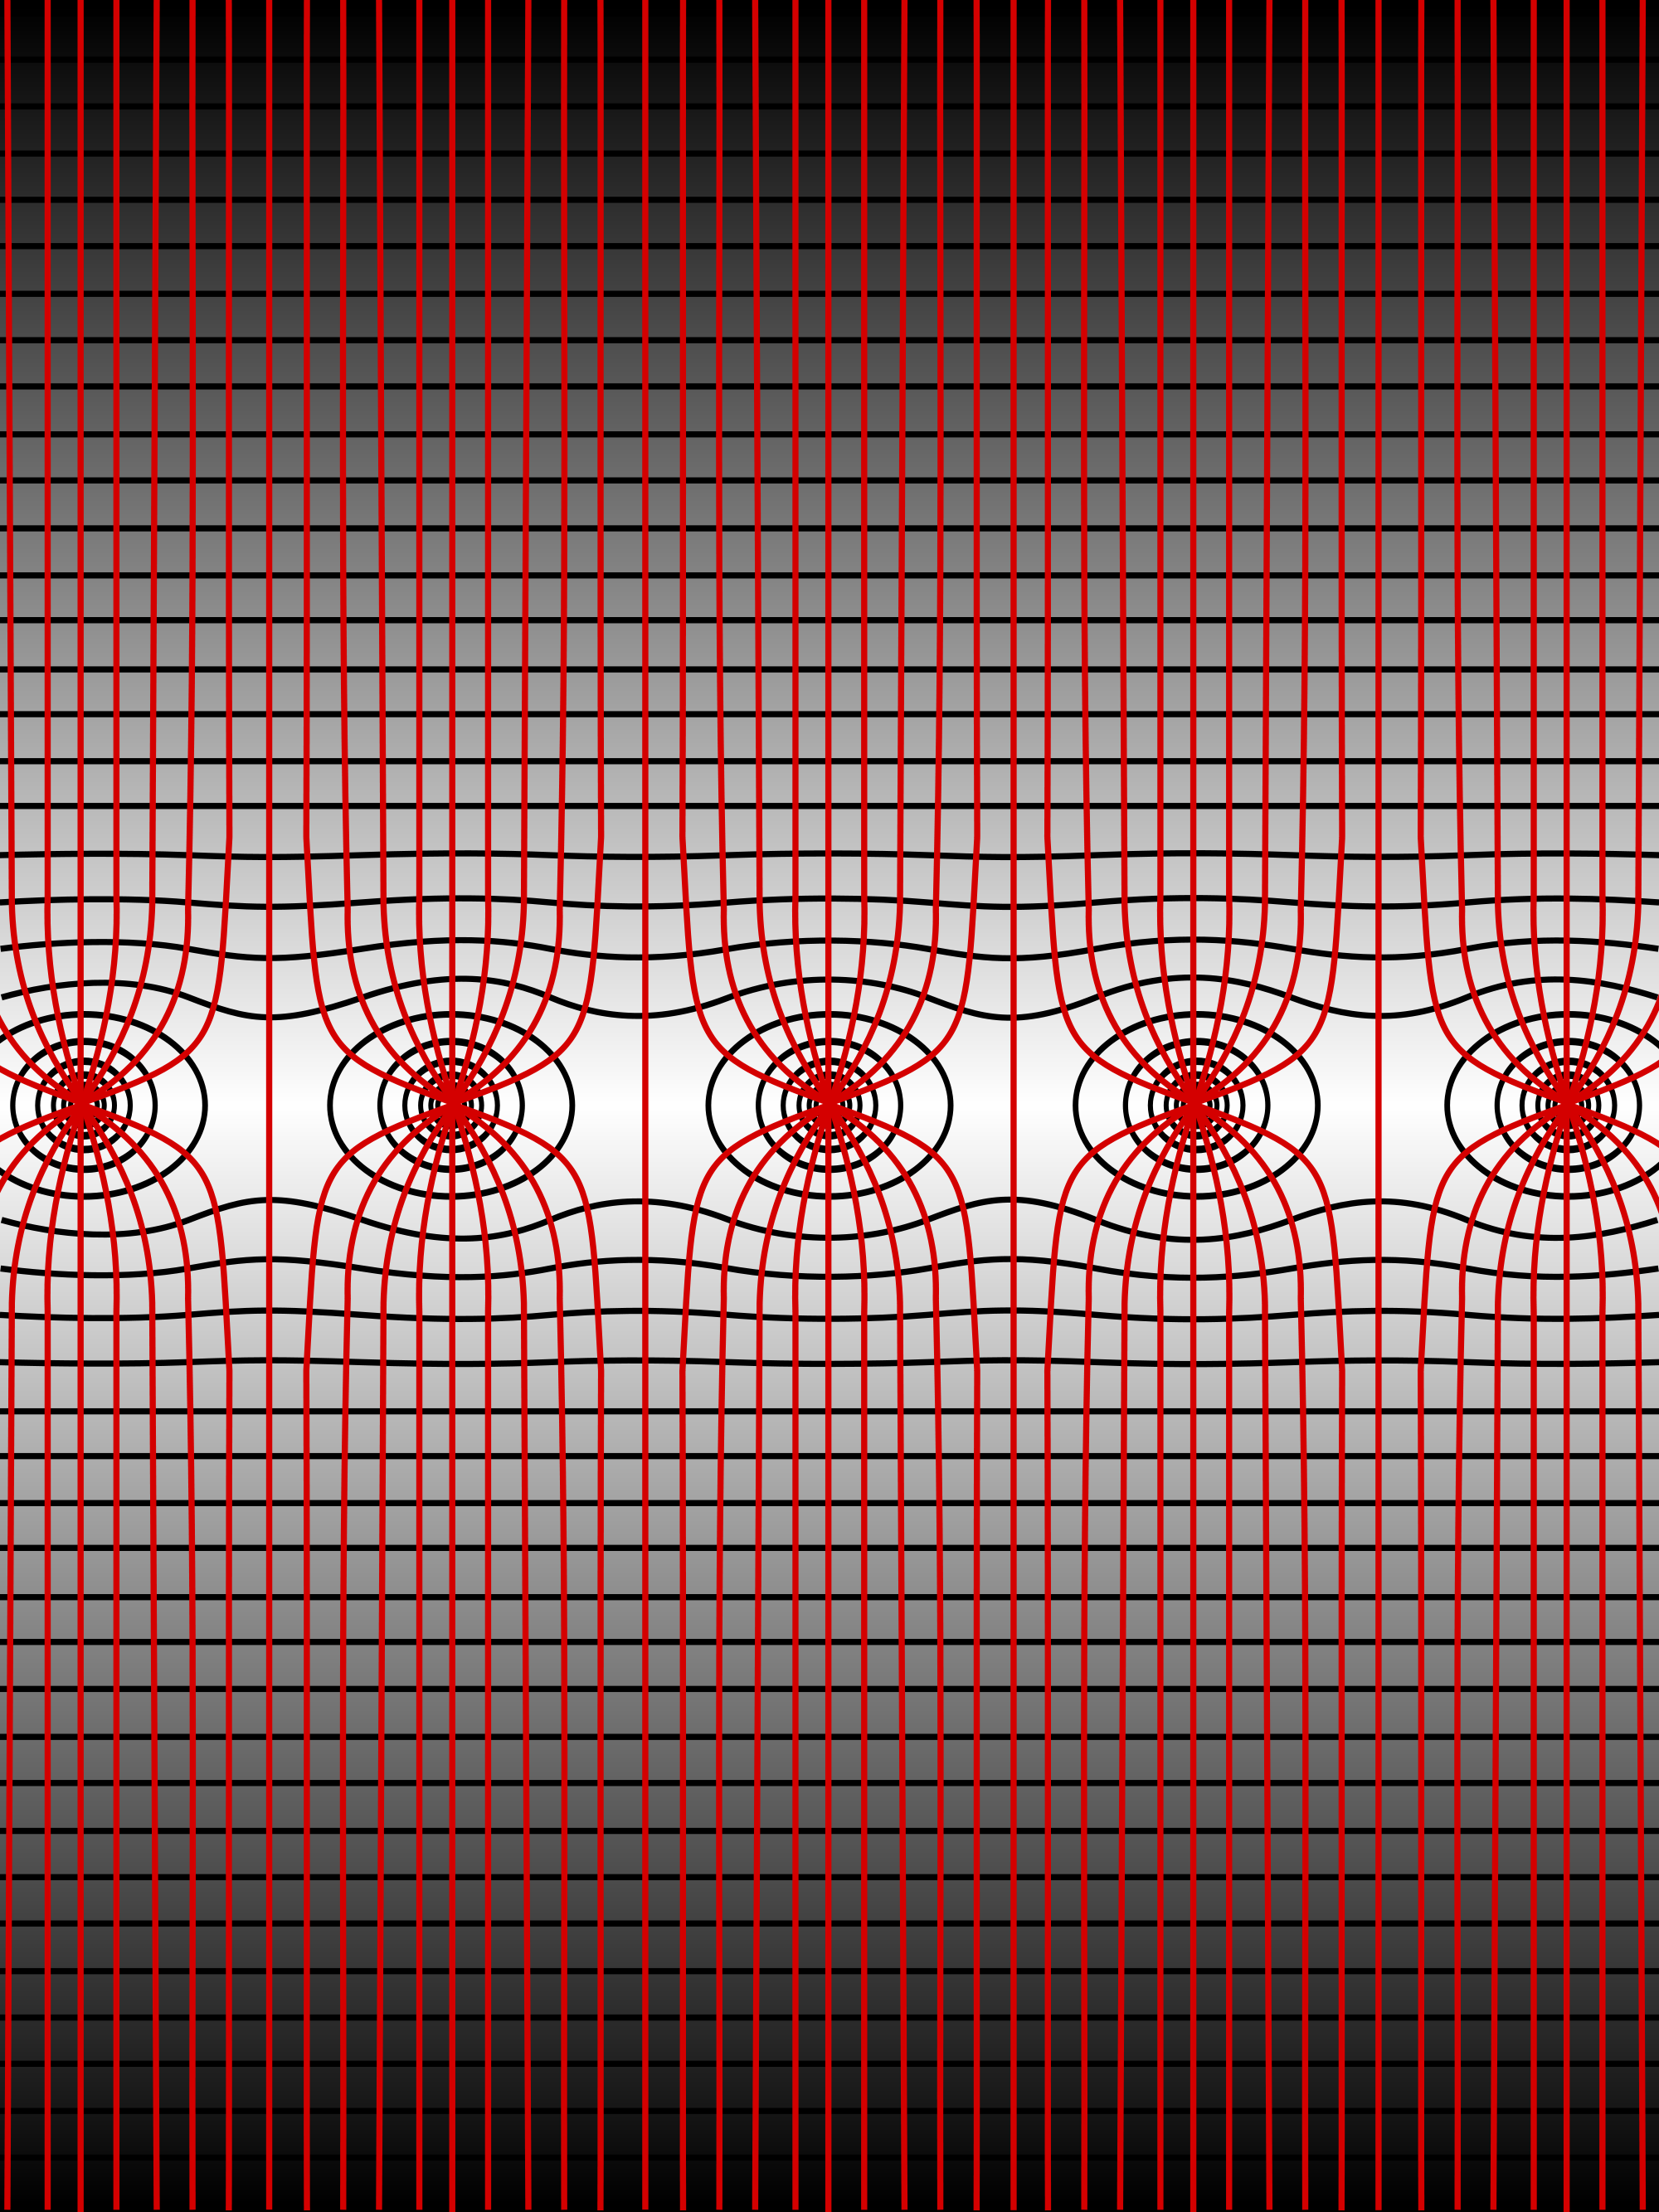
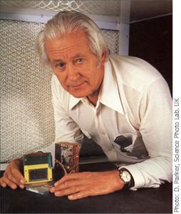
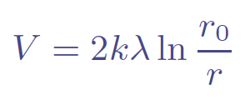
Multi Wire Proportional Counters
Georges Charpak won a Nobel prize for the invention of this crucial particle physics technique
Can get significant gain around a wire, if the wire is thin enough, since the electric potential increases inversely with radius r:
electron sees an avalanche region where the potential it gains causes further ionization
Implement every wire with a charge sensor and you can then see individual tracks with better than 1 mm resolution.

Slide 22
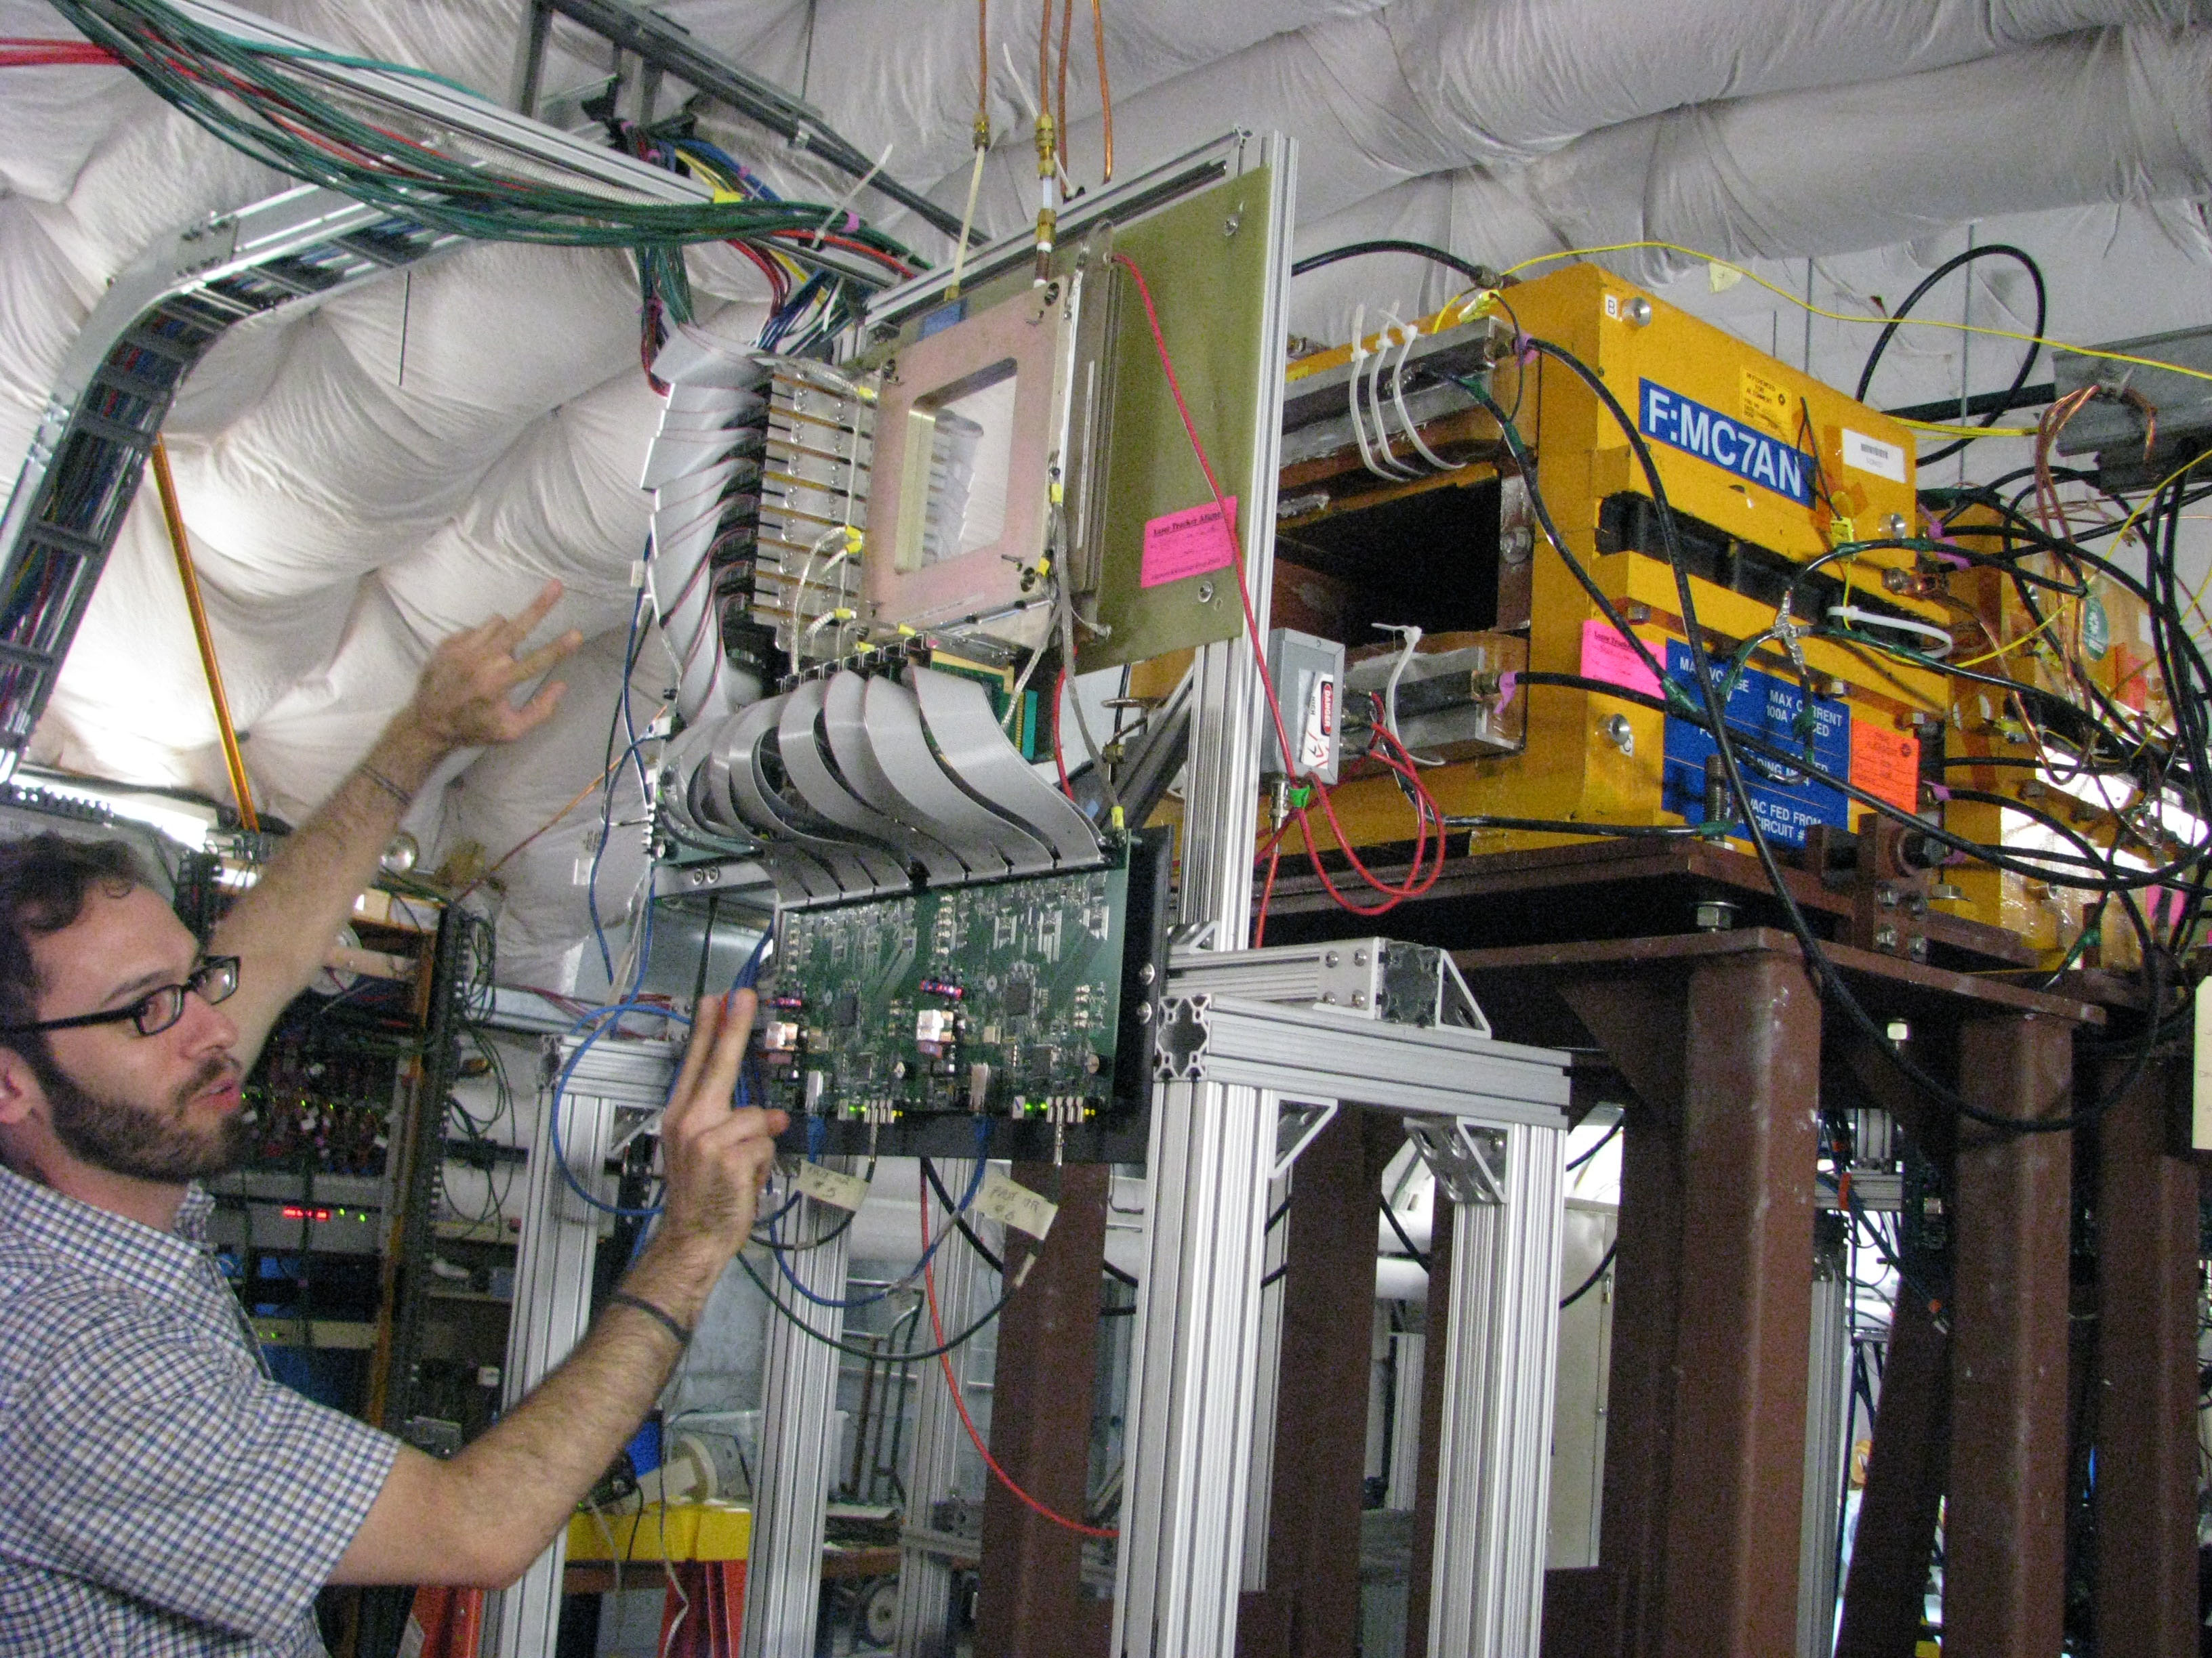
Remember our magnetic field:
Charged particle moving in magnetic field will experience Lorentz force and will thus bend its trajectory
X
X
X
X
X
ρ
X
X
X
X
X
X
X
X
X
X
X
X
X
X
X
X
X
X
X
X

Slide 23
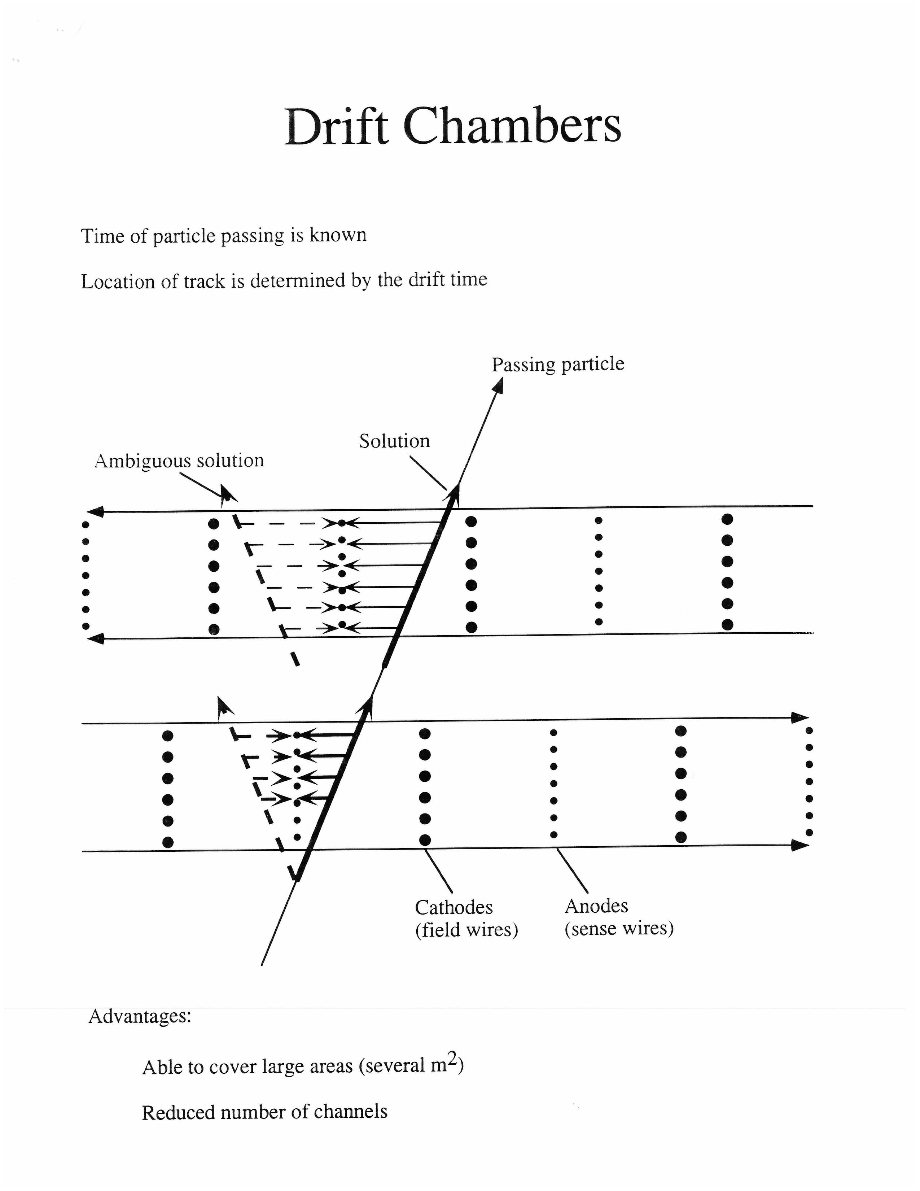
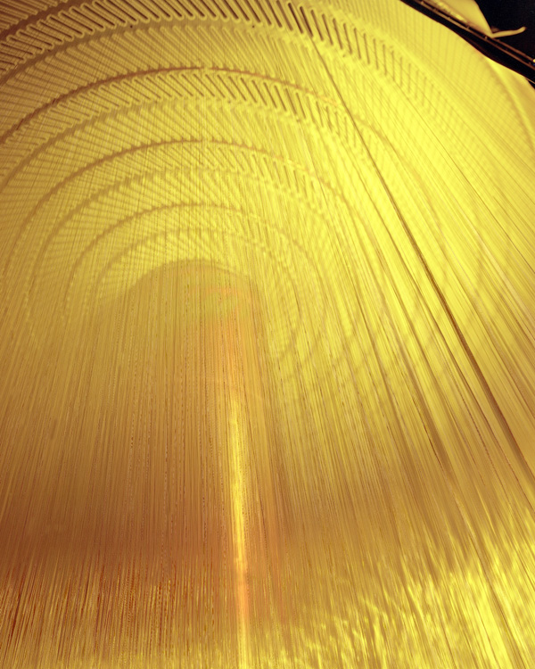
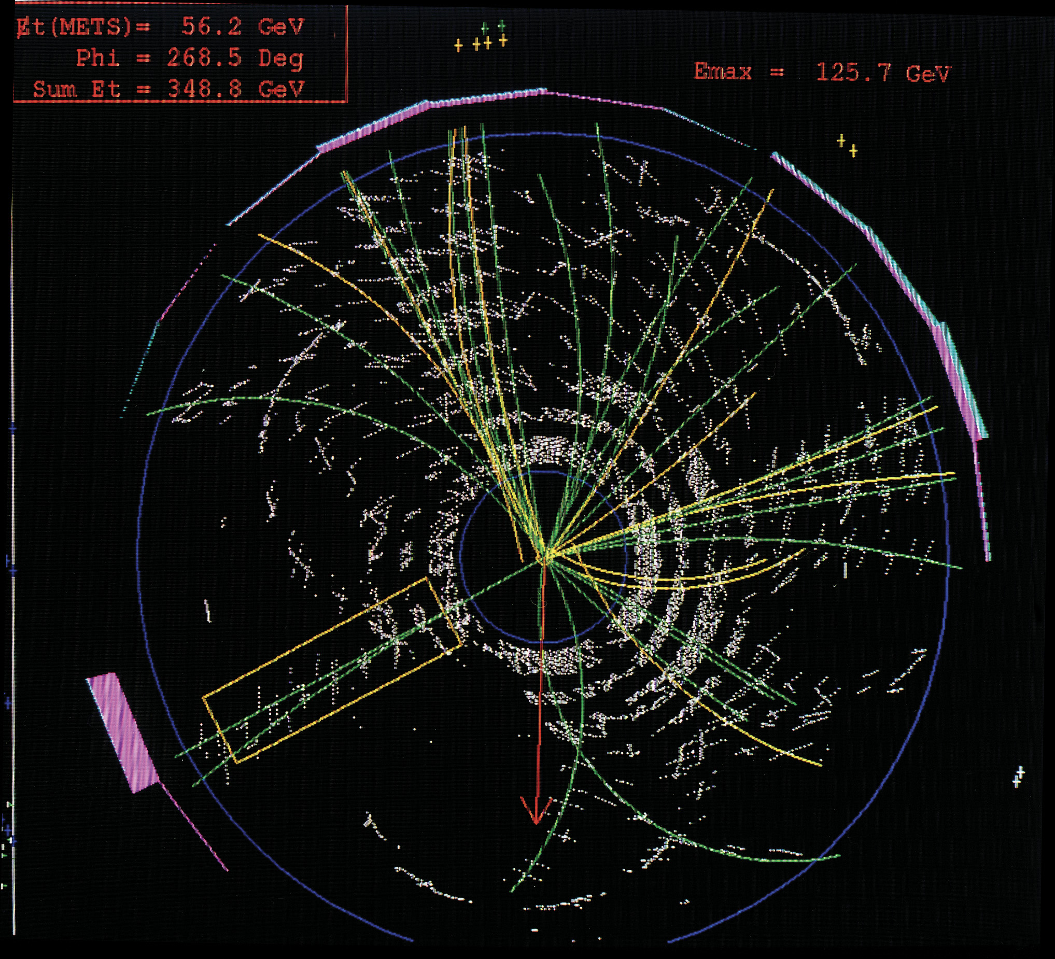
CDF Outer Drift Chamber
Drift speed ~10 cm per microsecond

Slide 24
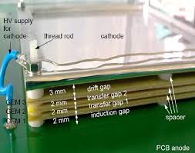
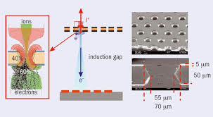
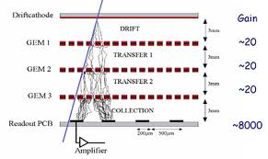
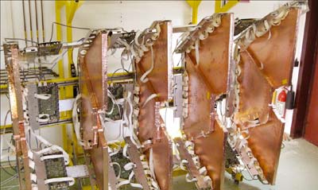
Micropattern Detectors – GEM’s
GEM = ‘gaseous electron multiplier’
Use 2 or 3 layers to get large gain
Very versatile gas chamber – no easily broken wires
Fabio Sauli at CERN invented this technology

Slide 25
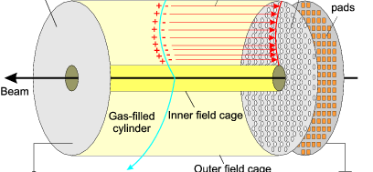
The Time Projection Chamber (TPC)
A very large volume single plane drift chamber
Particle trajectory in X & Y measured by the wires or GEM readout
Position in Z measured by the drift time. Typically both an electric field and a magnetic field in the Z direction so you can see curvature of the track.
Invented by Dave Nygren at LBNL
(Note: you can use a liquid instead of a gas in the sensitive volume of a TPC)

Slide 26
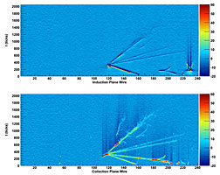
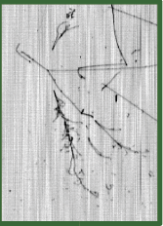
Liquid Argon TPC
Large liquid argon Time Projection Chamber – 'bubble chamber’ for neutrinos and dark matter
  Electrons and argon ions drift in an electric field
  Charge is collected on stretched wires
  The readout electronics builds an image of the neutrino interaction

Slide 27
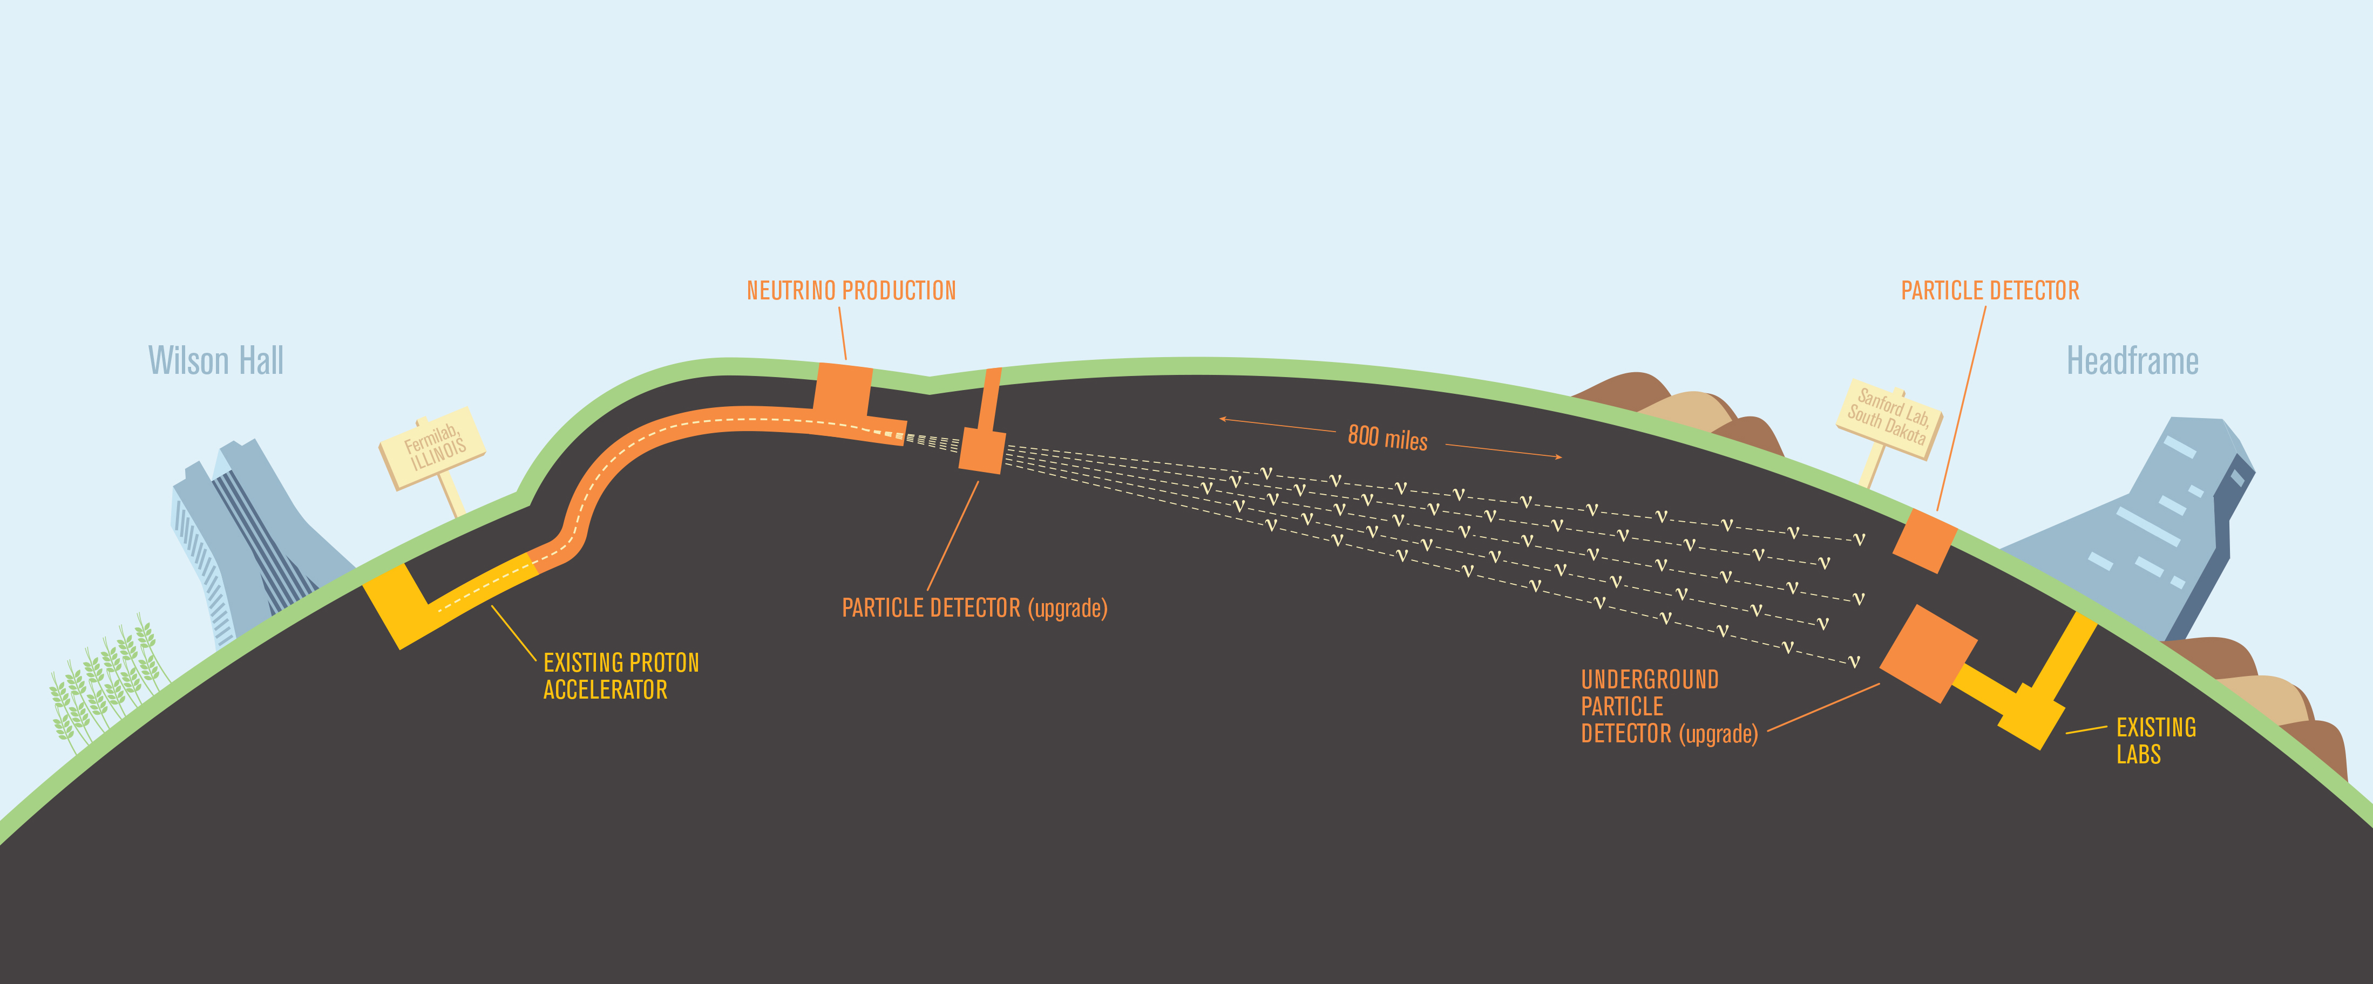
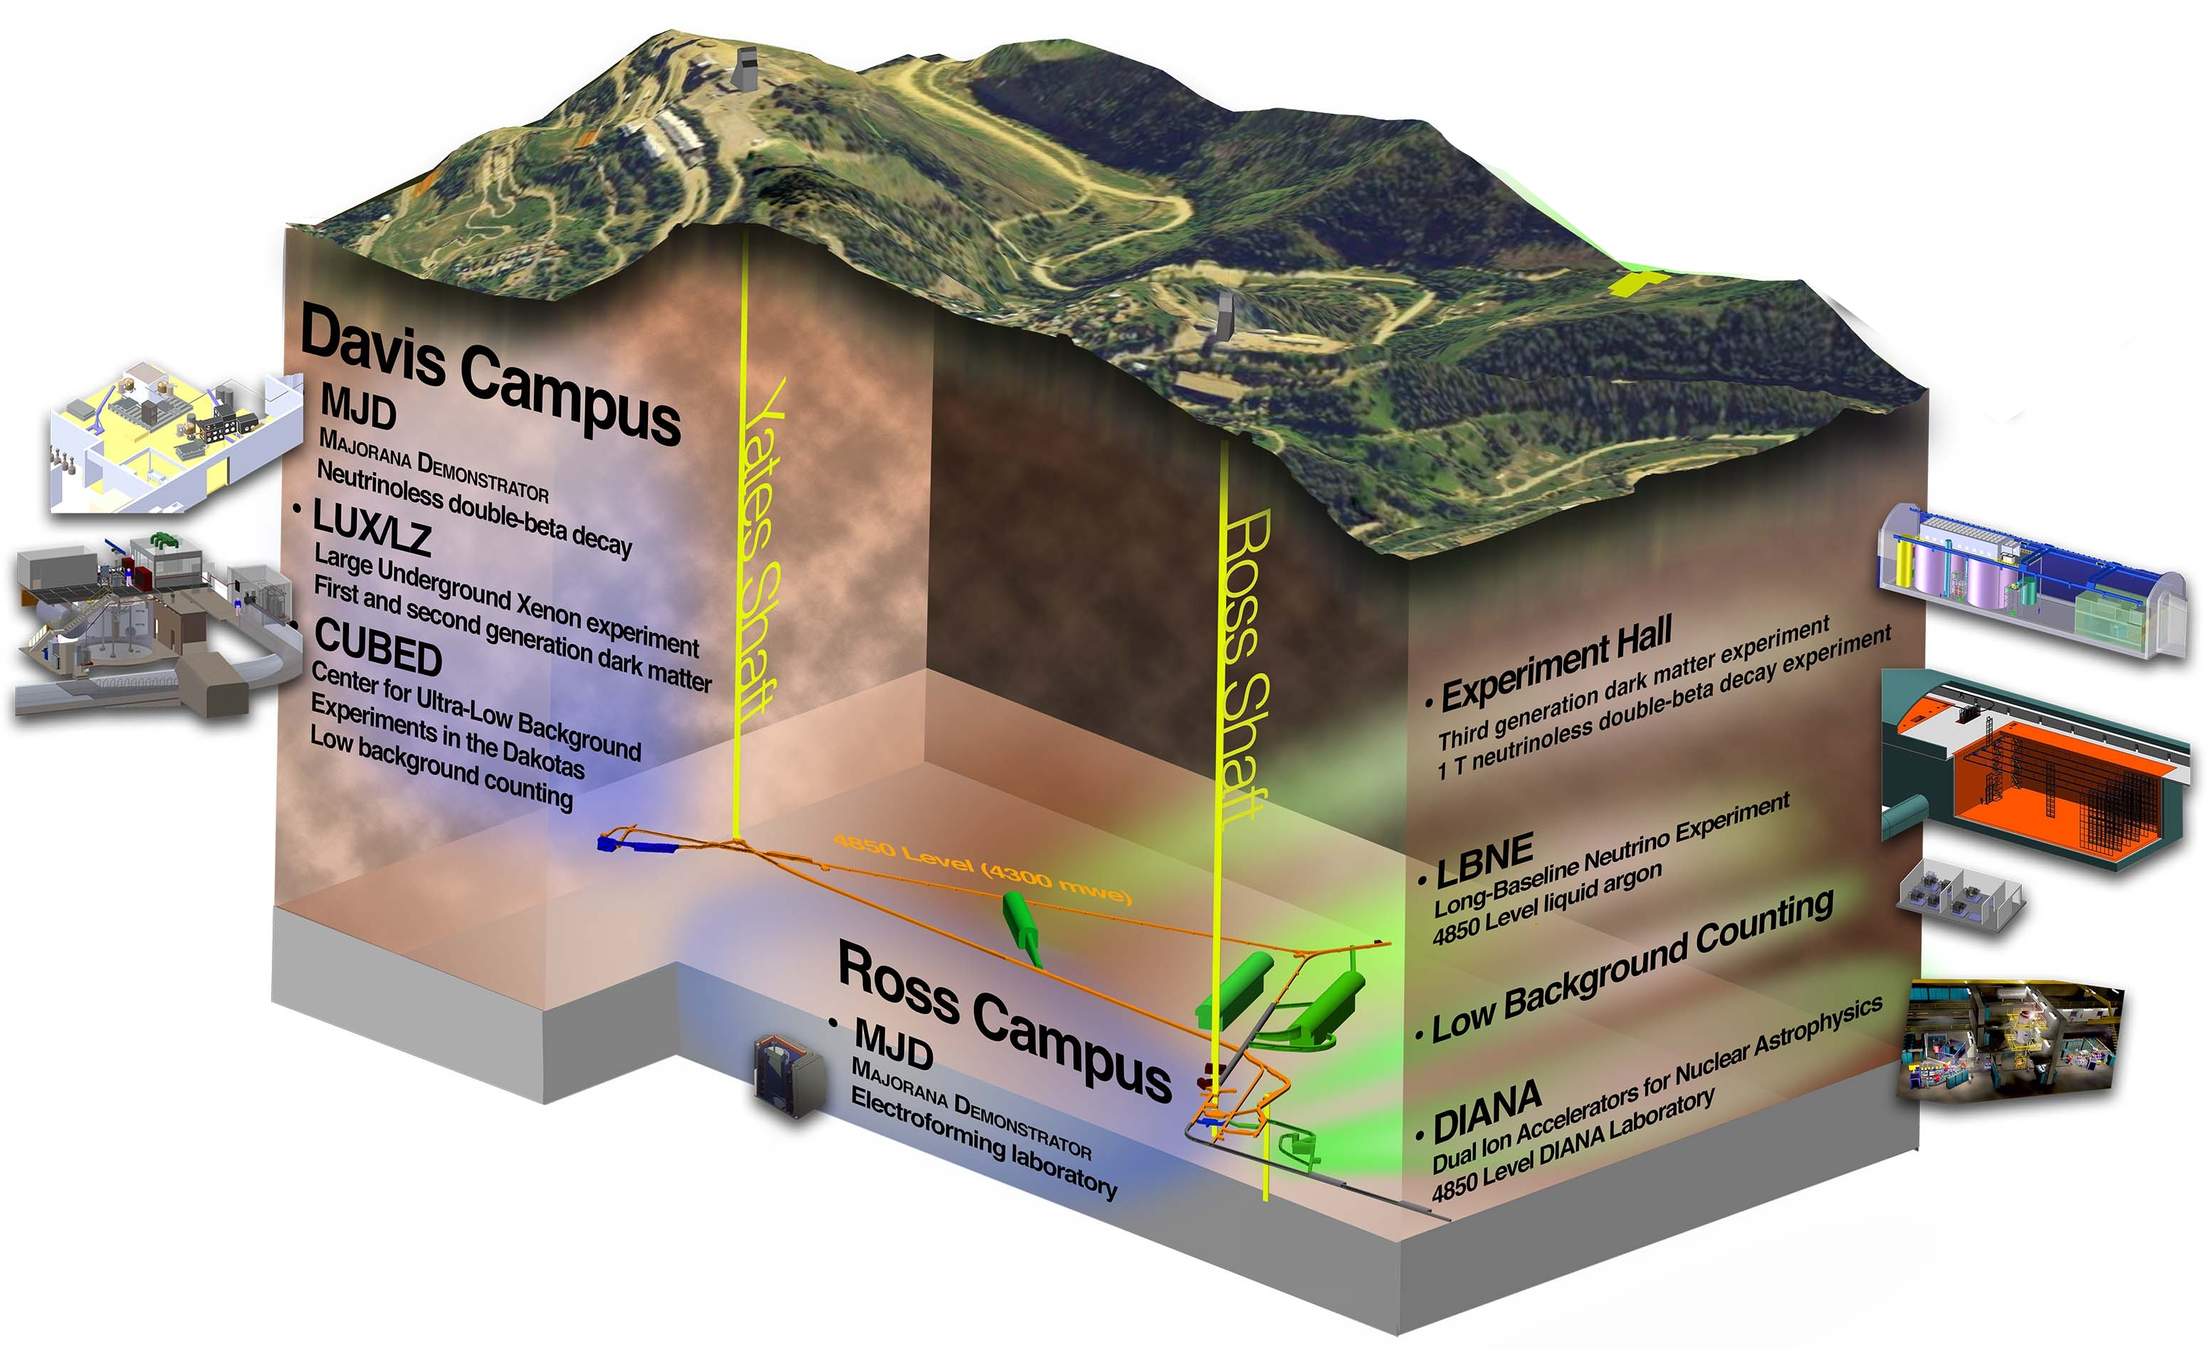
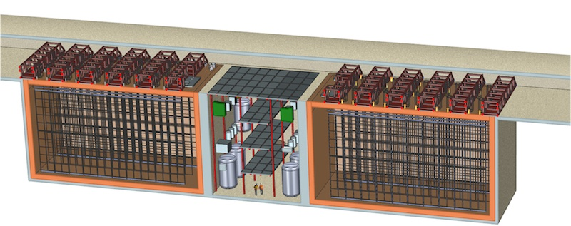
DUNE = ‘Deep Underground Neutrino Experiment
DUNE would send a beam of neutrinos 1300 km from Fermilab to a mine with a 10 kiloton liquid argon TPC detector in Lead, South Dakota

Slide 28



Scintillators
For many applications, simply want a signal when a particle crosses a certain area.
One of the simplest ways to do that is with a piece of plastic, embedded with an organic scintillator that glows when it is energized by a charged particle.
Offshoot from the earliest days of particle physics

Slide 29




Phototubes
A vacuum tube light amplifier – Gain of about 1 million – Invented in 1944
Each stage (‘dynode’) in the tube releases 3-5 electrons for each electron that hits it.
For a 10 stage tube you get total gain of ~3¹⁰ or >10⁵

Slide 30

Muon Scintillator Pixel Counter: DØ
Single pixel counter
  Scintillator with wavelength shifting fiber to make the blue light turn into green light
  PMT readout
  calibration signal
  scintillator covered with plastic
  to make it light tight
  Position resolution of single hit is only a few cm

Slide 31


Muon Scintillator Wall at D0
Pixel octant

Slide 32


The Cerenkov-Vavilov effect (another way to produce light – not ionization)
Occurs when particle is going faster than the nominal speed of light in that medium (i.e. βn > 0, where n is the index of refraction of the material)
Can be thought of as a ‘shock-wave’ of light, similar to sonic boom
Liquid, gas or solid Cerenkov detectors (can be used for fast triggering on particle species or energy)
RICH = ‘Ring Imaging Cherenkov detector measures the ring of light

Slide 33



The Super-Kamiokande Detector
Water filled Cerenkov neutrino detector
50,000 tons of pure water + 13,000 phototubes
In 1998, discovered definitive evidence for neutrino oscillations.
In 2001, a worker broke one of the tubes, which sent a shockwave to the adjacent PMT, which broke and sent a shockwave to the next, ETC.
7000 tubes destroyed, at a cost of $20M
Restored to perfection!

Slide 34



Calorimetry
A Shower of Particles! Turning energy into mass – 1000’s of particles and antiparticles can be produced from one incident particle.
Then they are absorbed by eventually pairing up with the anti-particles produced in the shower
Different physical scale between Electromagnetic and nuclear (‘hadronic’) showers – both longitudinally and laterally
Muons often exit at the back
Neutrons can be missing energy
Geisen formula for EM shower

Slide 35

Hadronic and EM Showers

Slide 36


Calorimeter energy resolution
Heavy inorganic scintillating crystals essentially see all the energy of the shower and give on the order of ~1-5% for a GeV electron
Sampling calorimeters, typically with layers of lead or iron and plastic scintillator, give much poorer energy resolution (~15% - or much worse for hadrons)
CDF Central Barrel Calorimeter

Slide 37



A Calorimeter as big as a state
The Pierre Auger Observatory in Argentina, with local denizens observing the installation of a water Cerenkov detector
Also has 4 stations of phototube arrays looking at N2 fluorescence

Slide 38



Icecube
Icecube is an array of phototubes embedded in the ice at the South Pole designed to study neutrino interactions.
The detector encompasses a cubic kilometer of ice as the target/detector

Slide 39



Putting it together at LHC’s two great detectors:
Nice interactive version of CMS detector:
https://www.i2u2.org/elab/cms/graphics/CMS_Slice_elab.swf
Also, a wonderful video outlining the design of ATLAS and how each component works can be found on YouTube:
https://www.youtube.com/watch?v=iYRQpcJVQx8

Slide 40
Resolution in trackers
Scintillator bars 10 mm
Scintillating fibers: 1 mm
Wire chamber: .5 mm
Drift chamber: .1 mm
TPC: .05 mm
Silicon: .005 mm
(Emulsion beats all of these at .0001 mm resolution! But there is no direct readout. It has to be taken out of your detector and developed and then searched for tracks)

Slide 41
The clear winner in the high resolution game
In the early 80s various groups adapted “planar” silicon technology to particle detectors
Fast (~10ns)
Precise (~5-10 microns)
Low mass
One drawback is that the charge yield in a typical 300 micron thick silicon detector is about 10⁴ electrons/holes per passing particle.
Therefore there is a premium on low noise circuits and cooling of the silicon to reduce thermal noise.

Slide 42

Silicon detectors
Small amounts of doping in semiconductor gives rise to a diode structure across the crystal. When reverse voltage is applied, then the crystal becomes fully depleted, with no current flowing. When a particle traverses the silicon, then current will flow to the electronic readout - similar to how a multi-wire chamber produces signals.

Slide 43



Pixelation in Silicon Detectors
These types of detectors are some of the most sophisticated devices ever built
High speed readout (25 nsec), small pitch (40 microns), and 10’s of gigabits/sec readout speed

Slide 44




Silicon detector replacement for the phototube: ‘SiPM’ = Silicon PhotoMuliplier
An array of pixels that are operated right at the edge of Geiger avalanche mode
Output is the same pulse height for each photon that hits
Basically counts the number of photons

Slide 45

The Invisible Universe
There is good evidence that we live in a cloud of unseen particles, called ‘dark matter’, that clumps up at the galaxy cluster scale. We haven’t seen this matter in the lab or at the collider detectors, or in our telescopes – only through its gravitational effect
In dark matter searches need unprecedented event sensitivity:
  1 nuclear recoil per ton of active volume per year
  That recoil results in perhaps 10 KeV of energy and the nucleus recoils for about a micron.
The name of the game is purity, sensitivity and background rejection

Slide 46



Dark Matter Detectors
Need lots of mass, high sensitivity
Rejection of radioactive background
Energy deposit of ~KeV for WIMPs – no tracks are seen – just single events
silicon and germanium detectors
PICO Bubble chamber
Liquid argon and xenon scint. detectors

Slide 47

Superconducting detectors
Production of broken Cooper pairs, called ‘quasi particles’, can be on the order of 1000 electrons per eV
TES – transition edge sensor
STJ – superconducting tunnel junction
MKID – microwave kinetic inductance det.
MCAL – micro-calorimeter

Slide 48


First Transistor
John Bardeen, William Shockley and Walter Brattain
Working at GE after the war to replace the vacuum tube triode gate with a solid state device
Achieved this with Germanium semi-conductor ‘transistor’
Won Nobel prize for the transistor
Robert Noyce and Jack Kilby subsequently won a Nobel for integrated circuits, which form the heart of silicon detector readout chips
"What we didn't realize then was that the integrated circuit would reduce the cost of electronic functions by a factor of a million to one, nothing had ever done that for anything before" - Jack Kilby

Slide 49


A word on electronic readout
Many detector systems have custom readout circuits that can sift very quickly through the torrential downpour of data coming in from millions of detector elements.
ASIC’s (‘Application Specific Integrated Circuits’) can contain 1000’s of transistors on a single chip

Slide 50
Q: Are there still big challenges in detector R&D?
A: Yes! everything is extremely challenging!
What is most of the Universe made of?
  Dark Matter experiments need unbelievable sensitivity and background rejection
Is Dark Energy just a mysterious ‘Cosmological Constant’?
  Need to measure billions of galactic spectra to achieve enough accuracy
The most attractive theory of particle physics – Supersymmetry – has not been seen yet.
  Will we need a larger machine?
  How do we run the LHC full tilt and survive (can silicon survive when there are 10¹⁶ particles per cm² ?
Do the fundamental constants of particles deviate from QM predictions?
  Need sensitivity of parts per billion
Remember: ALL experiments need a detector
and your results will depend on its performance

