Slide 1
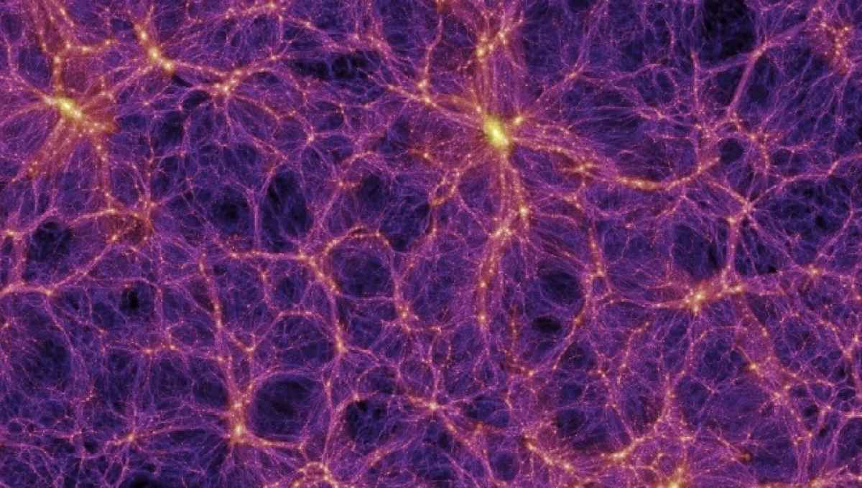
Revealing the nature of dark matter
Dan Hooper

Slide 2
What is in our Universe?

Slide 3
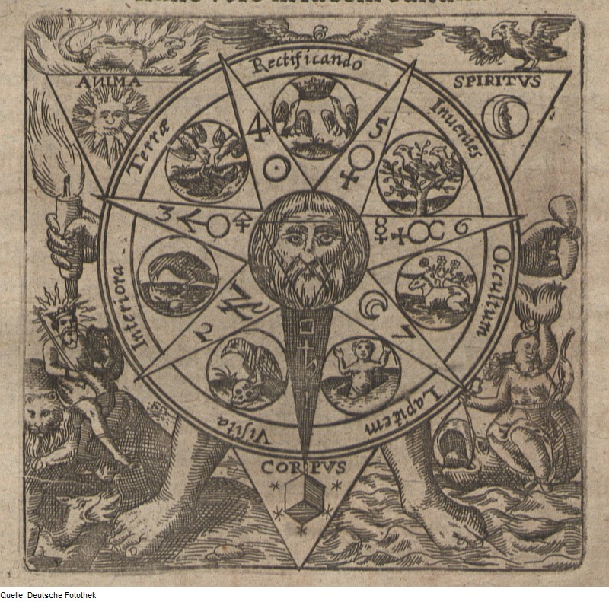
Notes:
17th century alchemy – four elements in corners

Slide 4
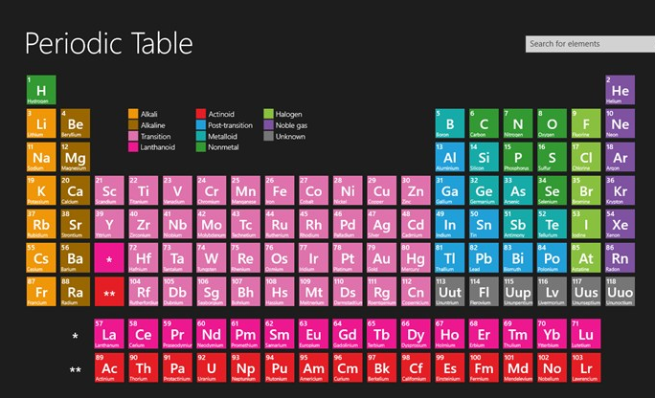

Slide 5
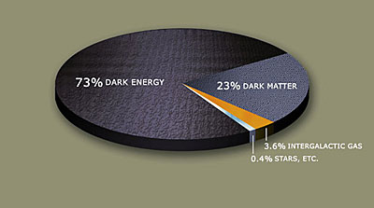
Notes:
Of the ~4% normal matter, most is hydrogen and helium; 0.03% in heavy elements, 0.3% in neutrinos

Slide 6
Why Dark Matter?

Slide 7
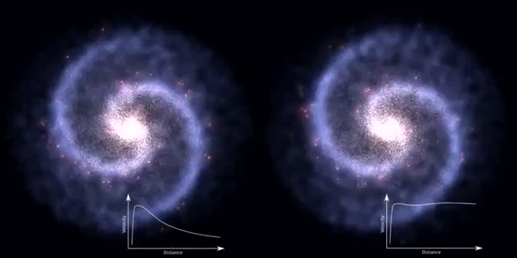
Galaxy Without Dark Matter Galaxy With Dark Matter

Slide 8
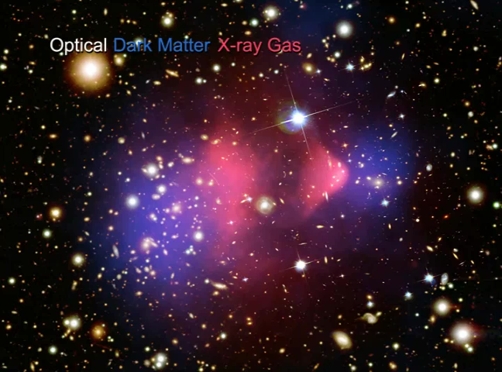

Slide 9
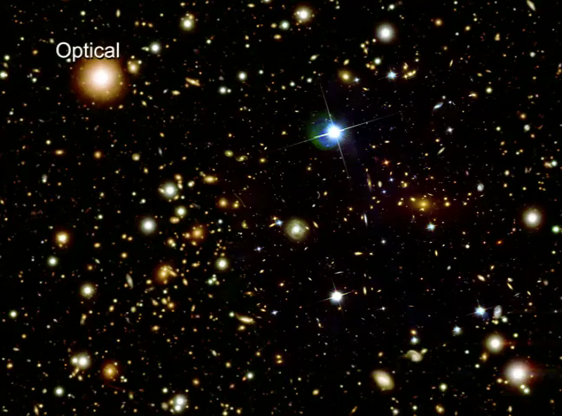

Slide 10
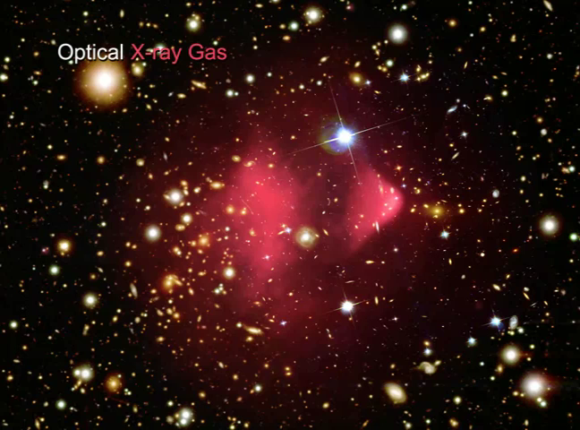

Slide 11
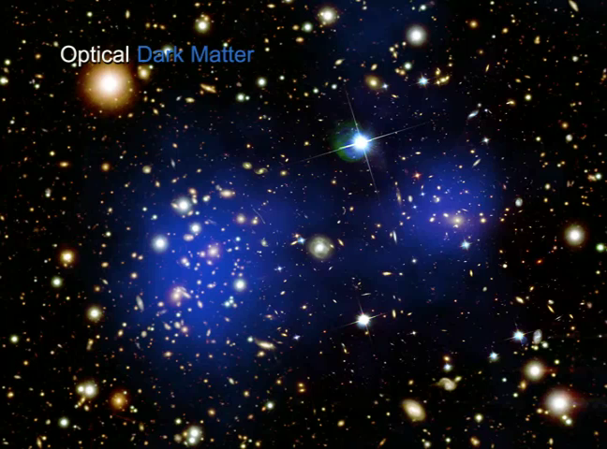

Slide 13
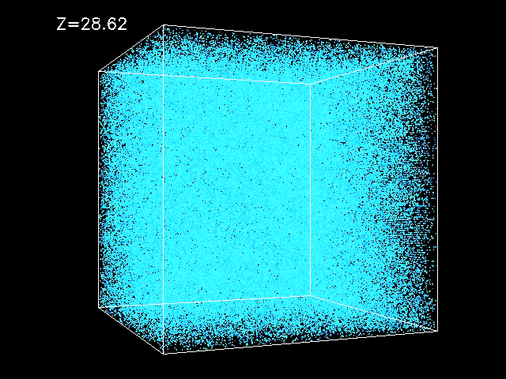

Slide 15
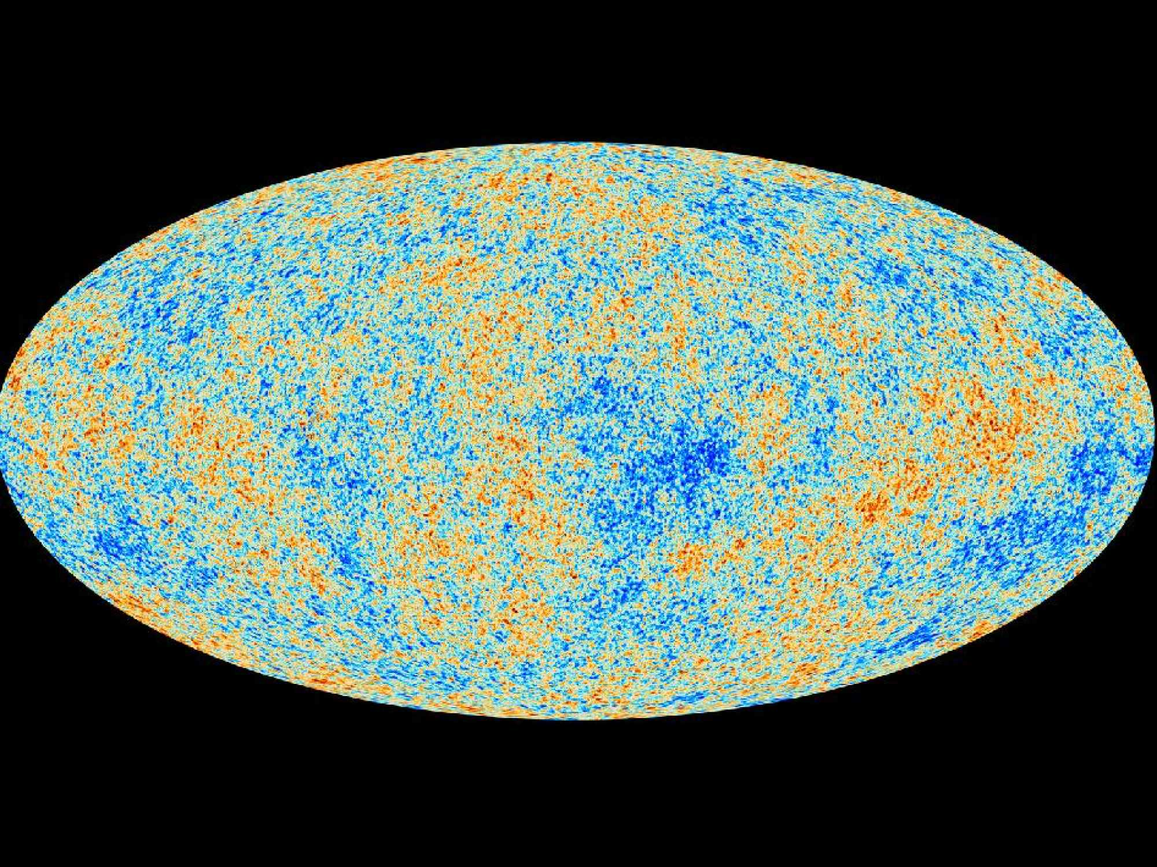

Slide 16
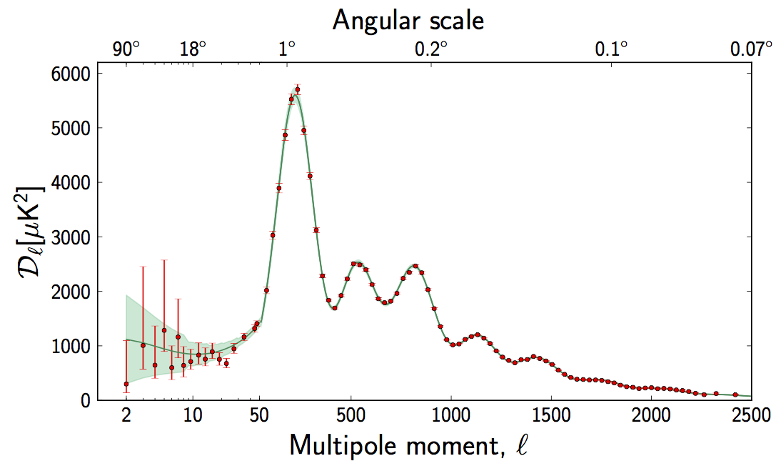

Slide 17
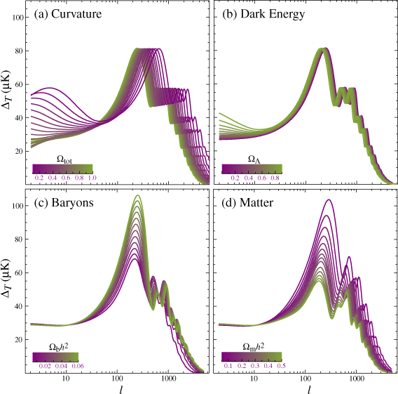

Slide 18
84.3±2.2% of the matter in our universe is dark matter

Slide 19
What is the Dark Matter?

Slide 20
Why is Dark Matter so dark?

Slide 21
Why is Dark Matter so dark?
Why is ordinary matter so bright?

Slide 22
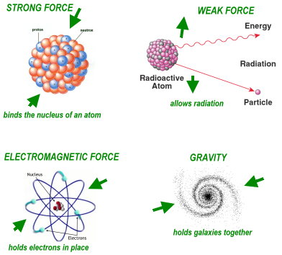
The Four Forces of Nature

Slide 23
The Four Forces of Nature

Slide 24


Slide 25
Electromagnetic Force

Slide 26
Electromagnetic Force
Strong Force

Slide 27
Electromagnetic Force
Strong Force
Unstable

Slide 28
Electromagnetic Force
Strong Force
Unstable
Too fast moving or “hot” to make up much of the dark matter

Slide 29
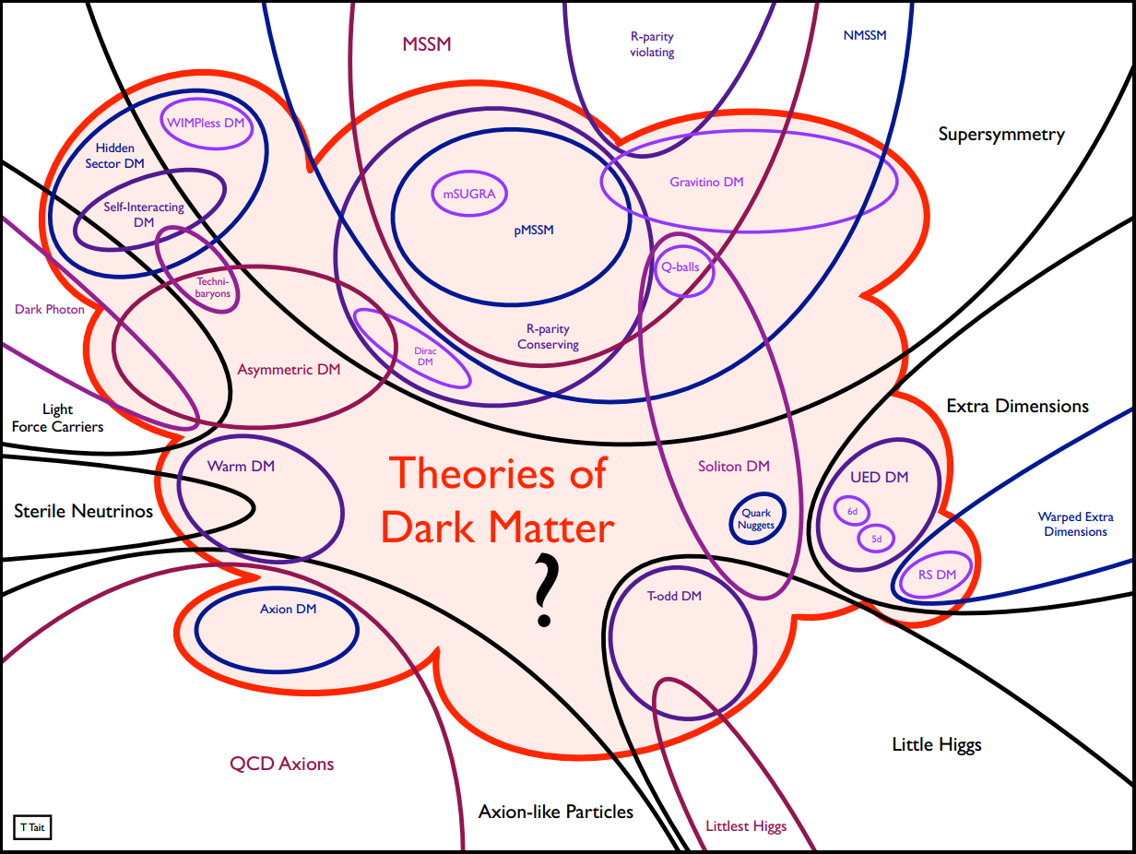

Slide 30
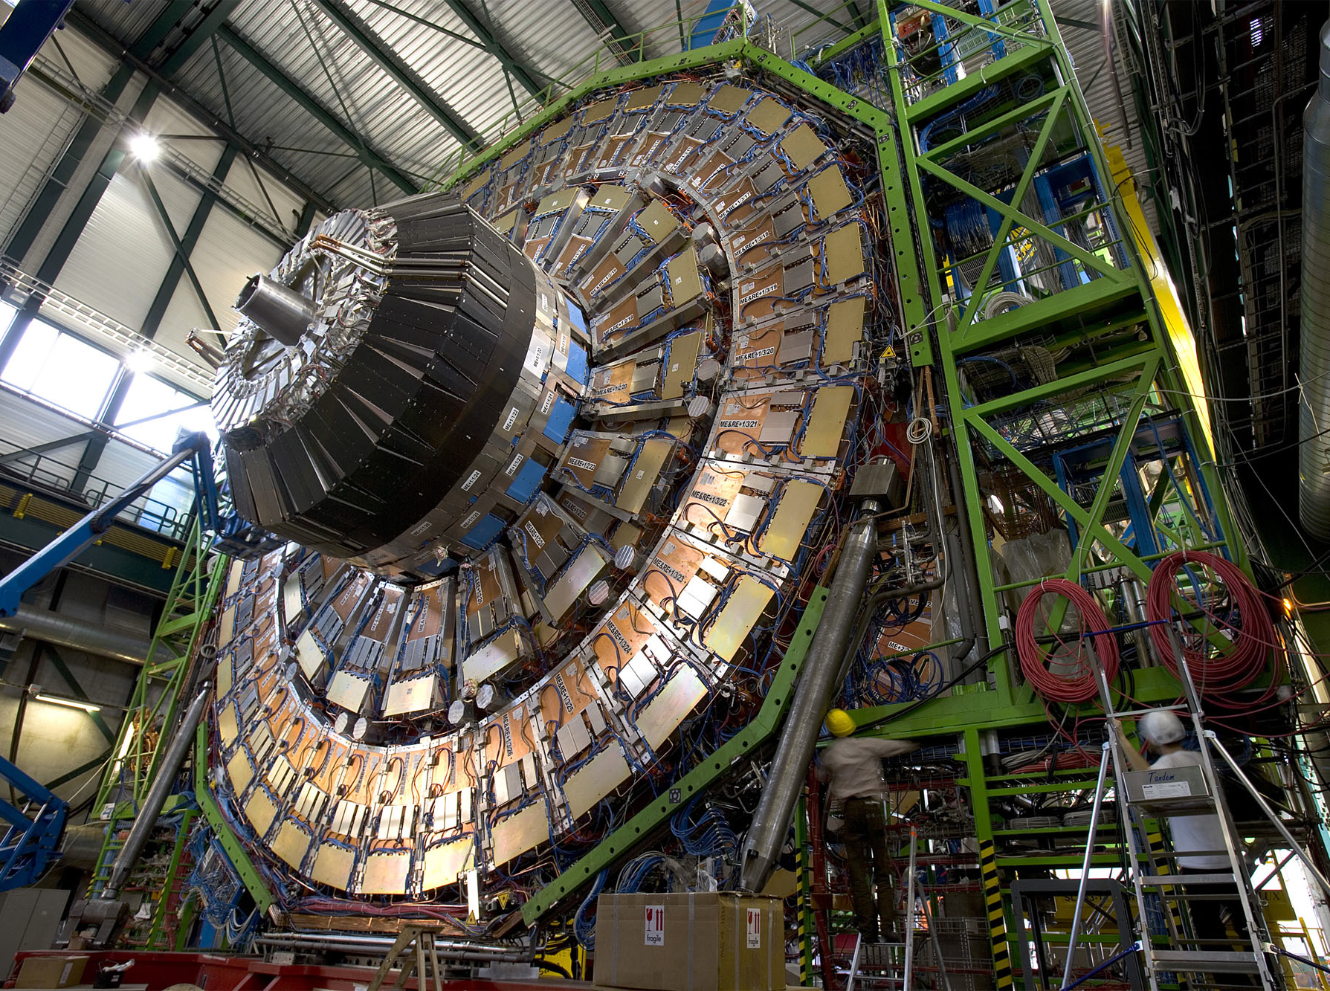
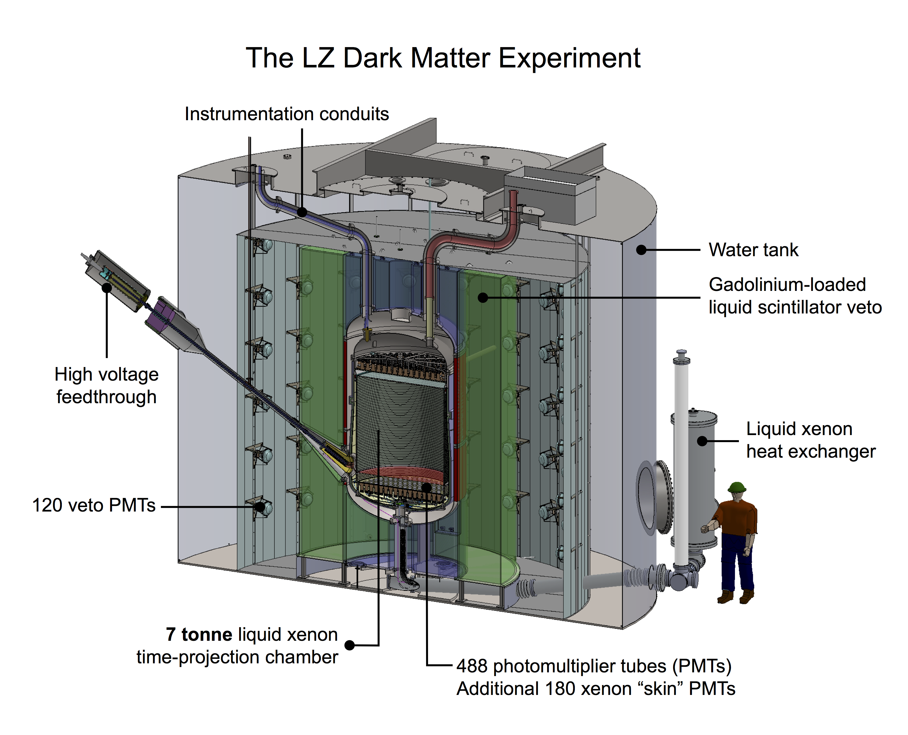
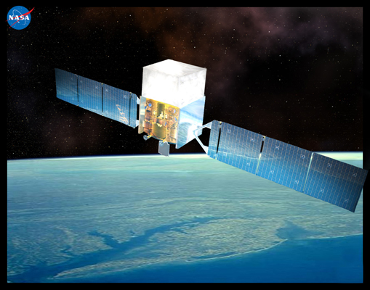
Searching for Evidence of Dark Matter Particles

Slide 31
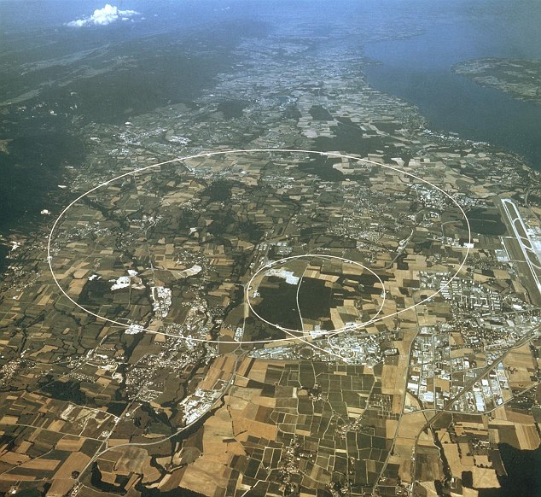
Notes:
-17 mile circular underground tunnel
-Protons are accelerated in both directions to 99.999997% of the speed of light, and are then collided head-on inside of enormous detectors
-Design Goal: 600 million collisions per second

Slide 32
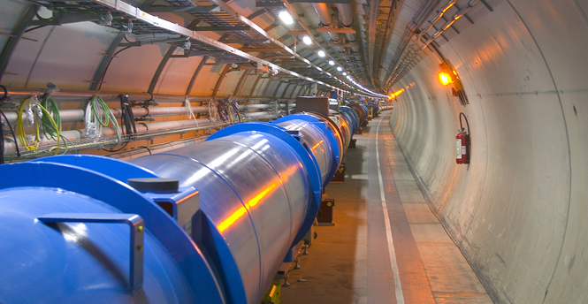

Slide 33
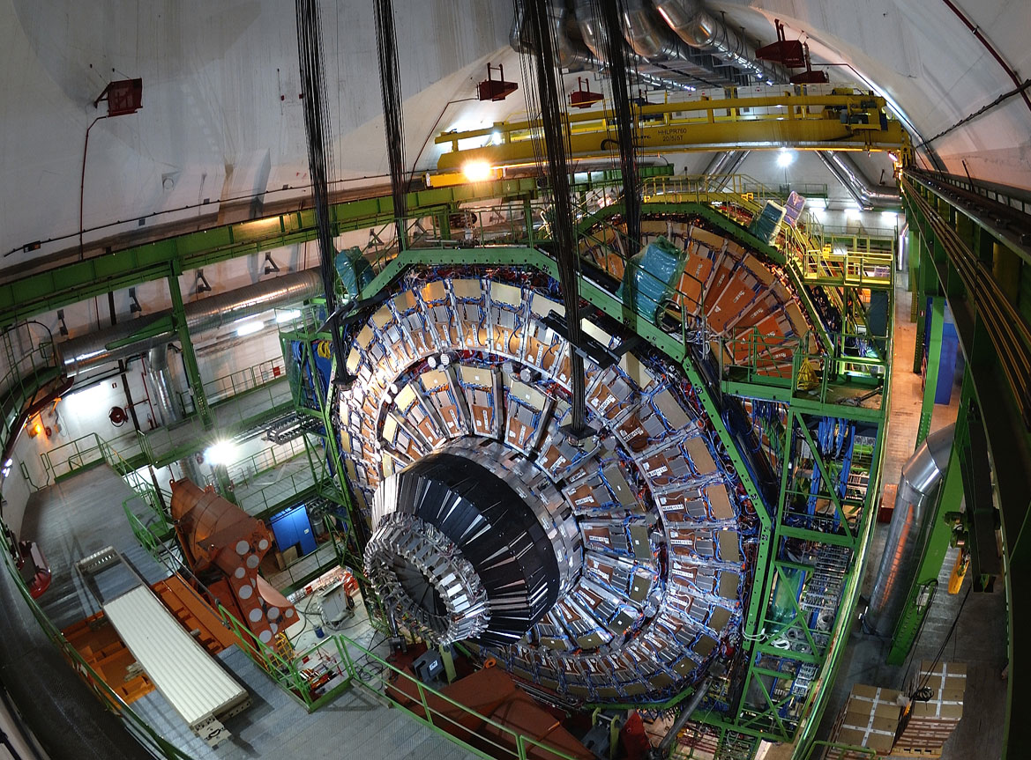

Slide 35
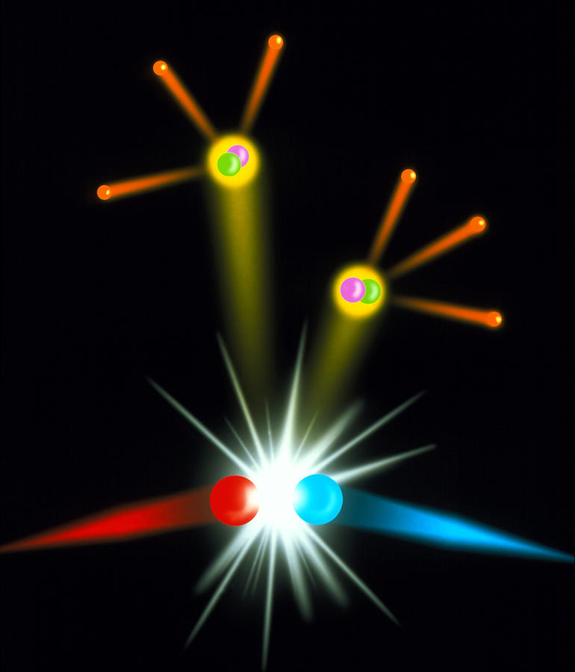
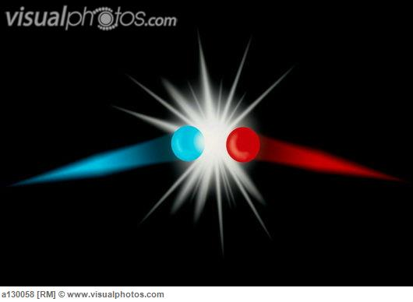

Slide 36
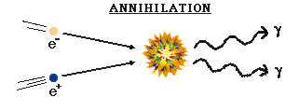
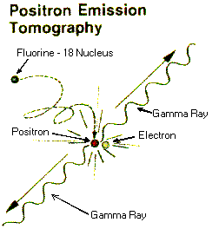
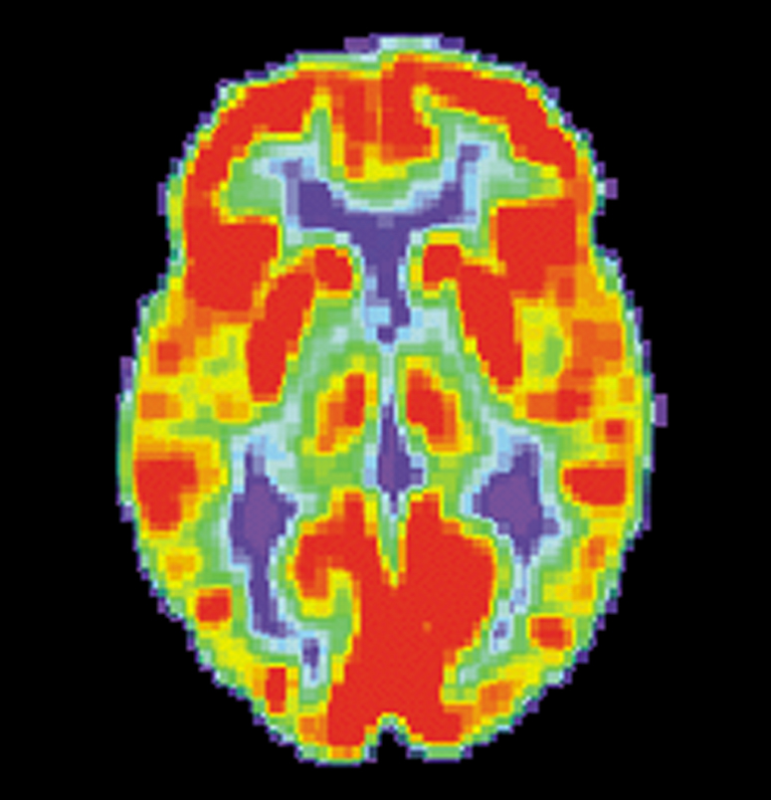

Slide 38
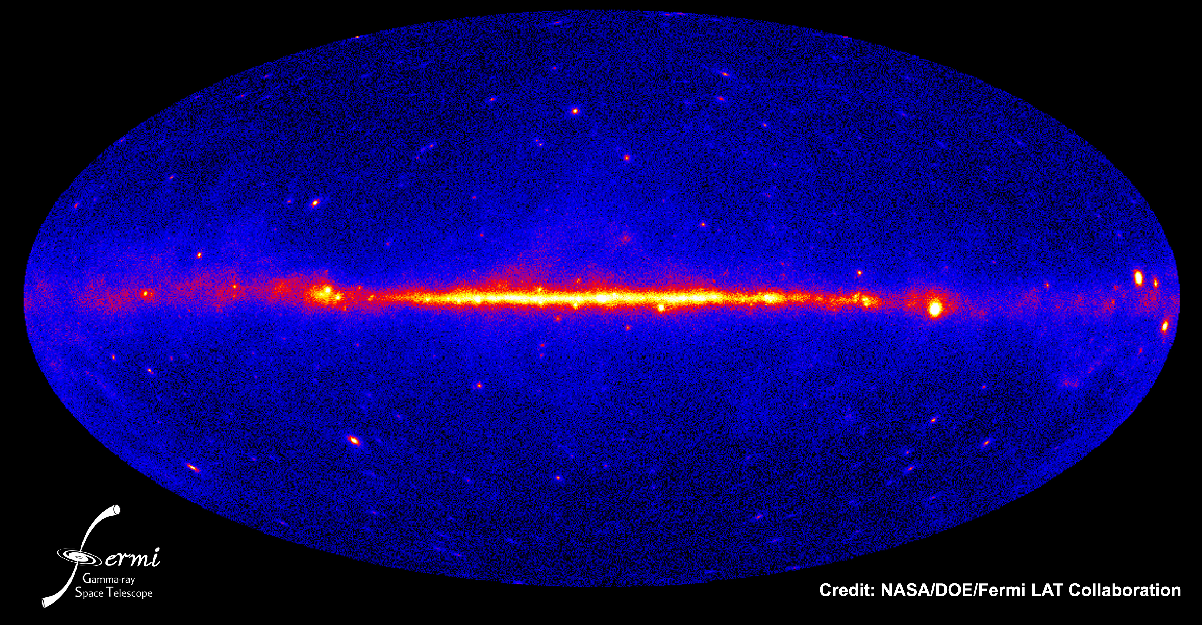

Slide 39
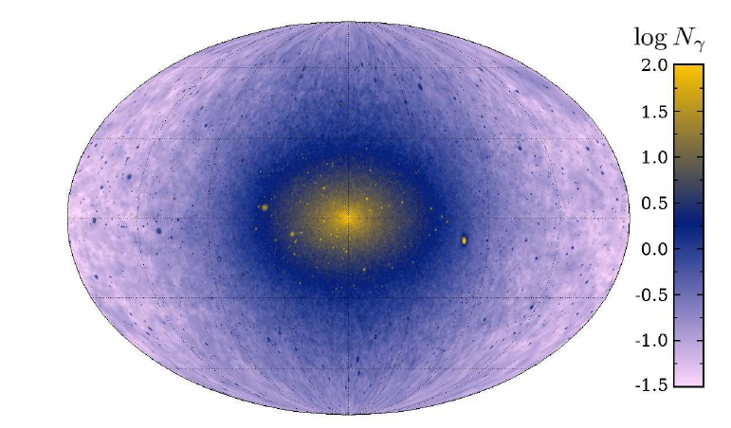
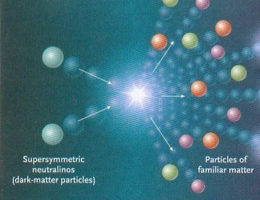

Slide 40
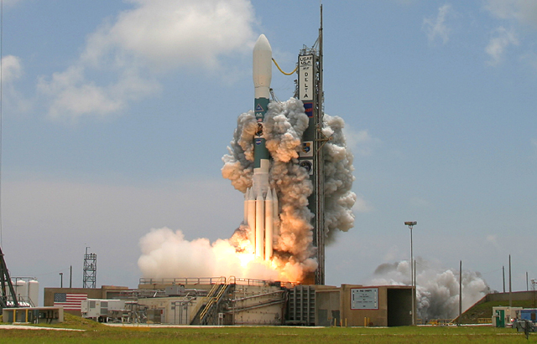
Timeline
June 2008 – Fermi is successfully launched into orbit

Slide 41
Timeline
June 2008 – Fermi is successfully launched into orbit
Aug. 2009 – Fermi data becomes publicly available

Slide 42

Timeline
June 2008 – Fermi is successfully launched into orbit
Aug. 2009 – Fermi data becomes publicly available
Oct. 2009 – Lisa Goodenough and I present the first paper on Fermi’s observations of the Galactic Center

Slide 45
“The Galactic Center is a very challenging region.” – Julie McEnery

Slide 46
“The Galactic Center is a very challenging region.” – Julie McEnery
Goodenough and Hooper’s proposal is “Pretty shaky.” – Jan Conrad

Slide 47
“The Galactic Center is a very challenging region.” – Julie McEnery
Goodenough and Hooper’s proposal is “Pretty shaky.” – Jan Conrad
“What were you smoking when you wrote that paper?” – Troy Porter

Slide 48
Timeline
June 2008 – Fermi is successfully launched into orbit
Aug. 2009 – Fermi data becomes publicaly available
Oct. 2009 – Lisa Goodenough and I present the first paper on Fermi’s observations of the Galactic Center
2010-2011 – Two follow up papers (with Lisa Goodenough, Tim Linden) slowly strengthen the case for a
dark matter-like signal

Slide 49
Timeline
June 2008 – Fermi is successfully launched into orbit
Aug. 2009 – Fermi data becomes publicaly available
Oct. 2009 – Lisa Goodenough and I present the first paper on Fermi’s observations of the Galactic Center
2010-2011 – Two follow up papers (with Lisa Goodenough, Tim Linden) slowly strengthen the case for a
dark matter-like signal
2012-2013 – Papers by other groups (UC Irvine, Canterbury) begin to appear, confirming our results

Slide 50




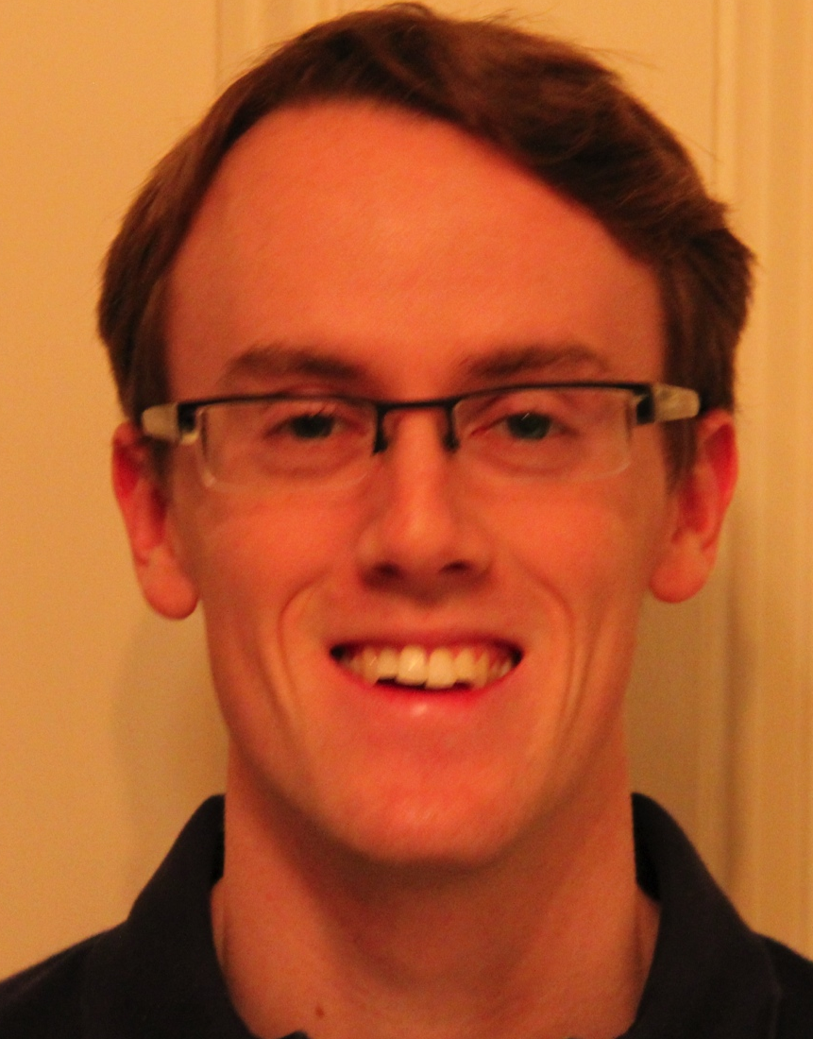



Slide 51
February 2014

Slide 52
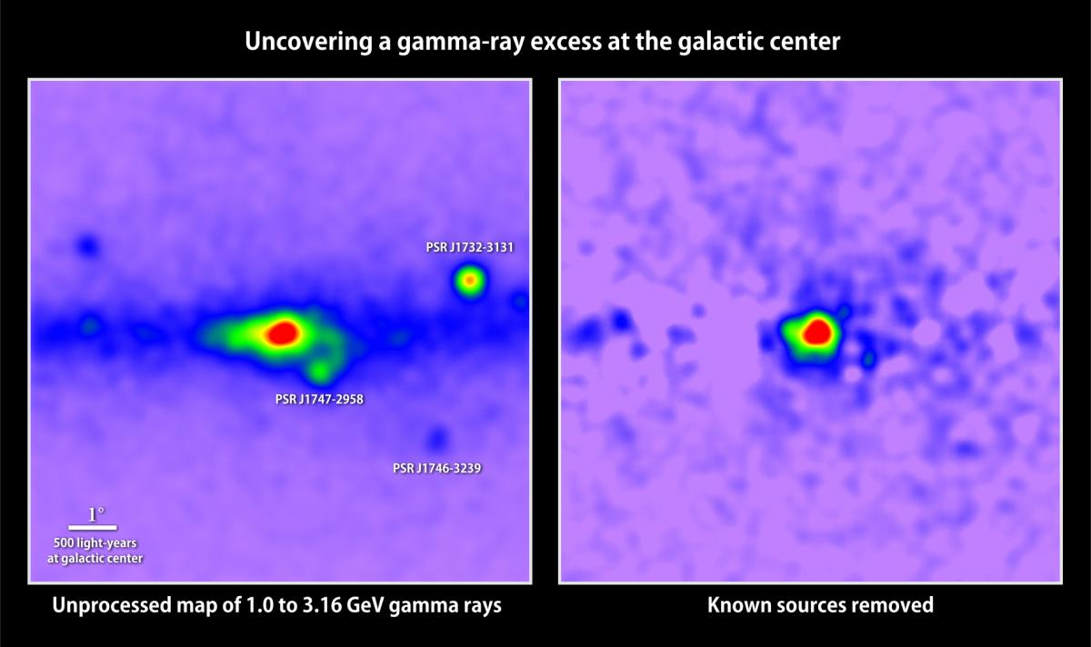

Slide 54
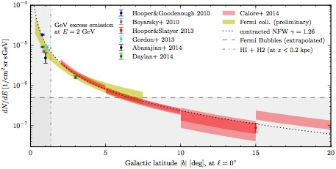

Slide 55
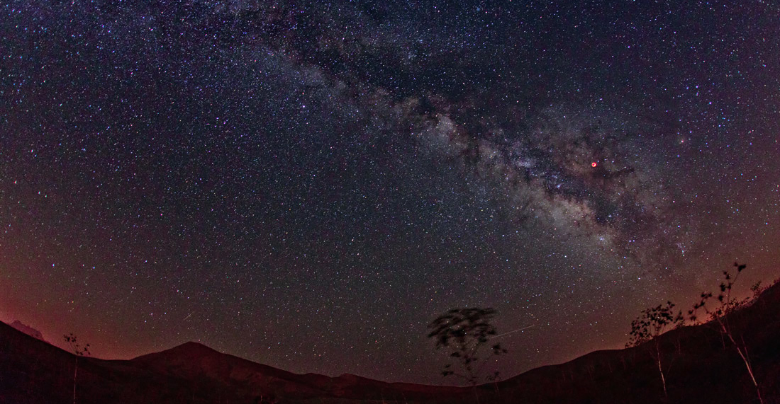
The Moon
The Galactic Center

Slide 56
The Moon
The Galactic Center

Slide 57
The Moon
The Galactic Center

Slide 58
2014 NASA Press Release:
  “A new study of gamma-ray light from the center of our galaxy makes the strongest case to date that some of this emission may arise from dark matter, an unknown substance making up most of the material universe. Using publicly available data from NASA's Fermi Gamma-ray Space Telescope, independent scientists at the Fermi National Accelerator Laboratory (Fermilab), the Harvard-Smithsonian Center for Astrophysics (CfA), the Massachusetts Institute of Technology (MIT) and the University of Chicago have developed new maps showing that the galactic center produces more high-energy gamma rays than can be explained by known sources and that this excess emission is consistent with some forms of dark matter.”
From Simona Murgia’s talk at the 2014 Fermi Symposium in Japan:
  “We find an enhancement approximately centered around the Galactic Center with a spectrum that peaks in the GeV range, that persists across the (background) models we have employed.”

Slide 59
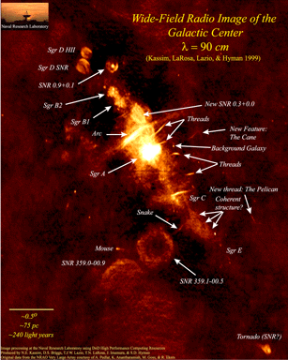
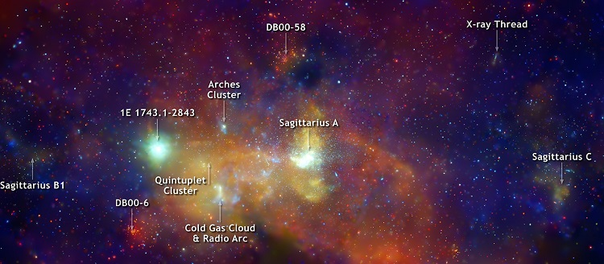
star clusters, supernova remnants, radio filaments, microquasars, pulsars, supermassive black hole, …
Notes:
Chandra (X-ray) and composite radio
Star Clusters, Supernova Remnants, Radio Filaments, Supermassive Black Hole

Slide 60
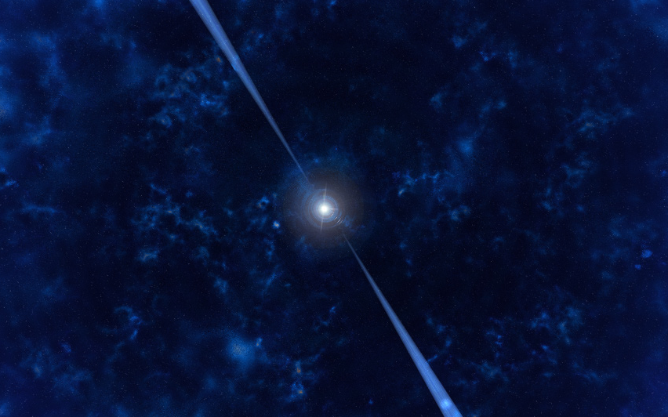
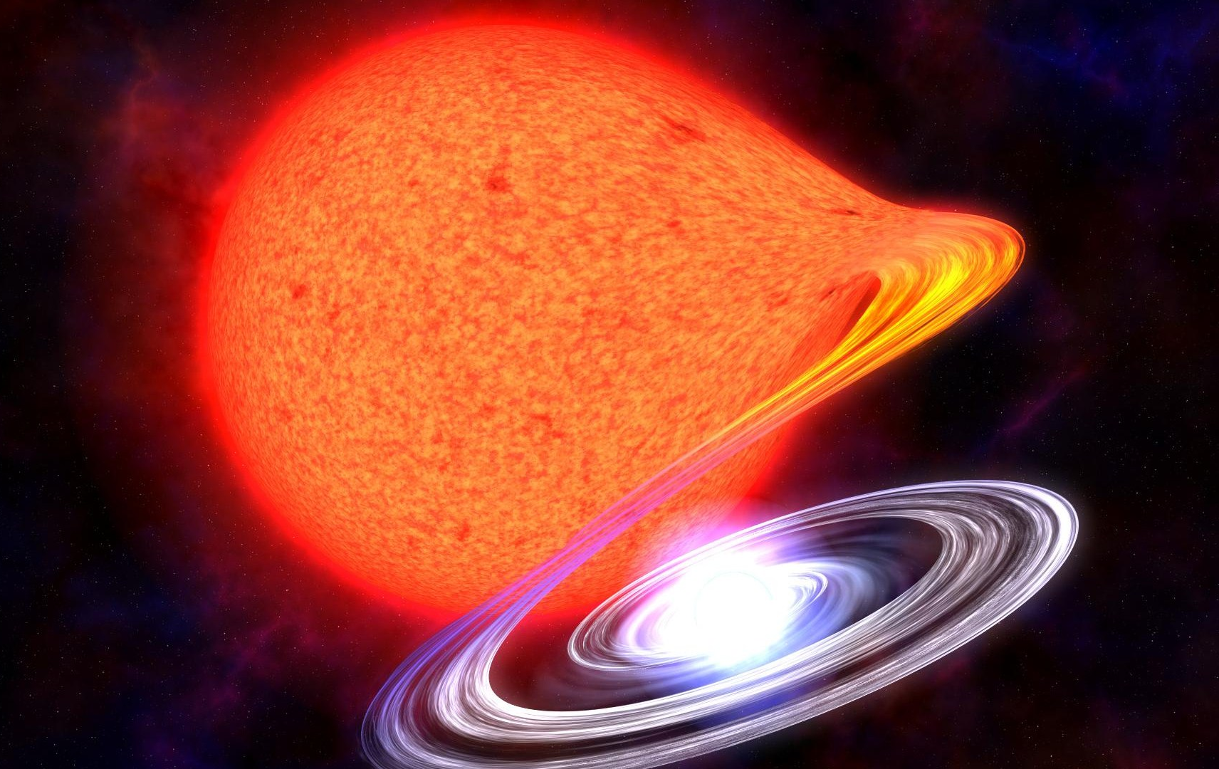

Slide 61
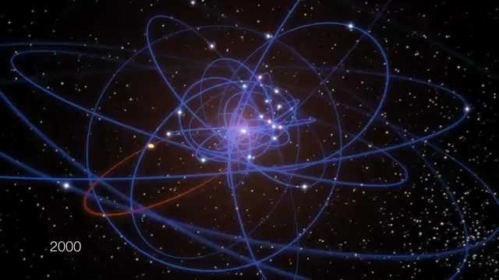

Slide 62
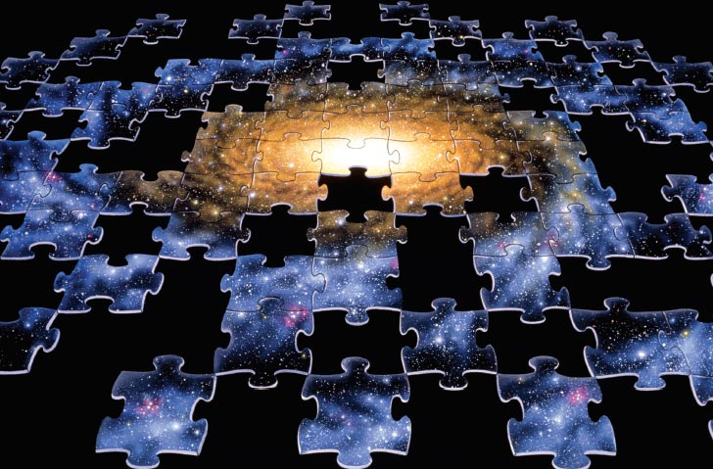

Slide 63
How is the dark matter distributed in the universe?
(Is this the beginning of dark matter cartography?)

Slide 64
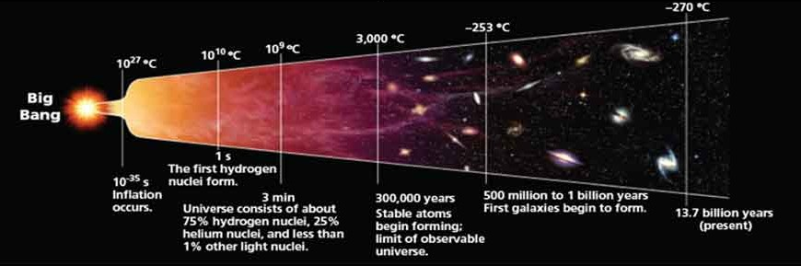
How and when did the dark matter form?
(Can we use dark matter to learn what the universe was like a billionth of a second after the Big Bang?)

Slide 65

How does dark matter fit into the underlying theory that describes our universe?
Quantum Gravity
Grand Unification
Supersymmetry?

Slide 66
