Slide 1
Welcome
Mark Pasmore

Slide 2
Agenda:
10:00 Introduction and Welcome Mark Pasmore, Baxter Healthcare
10:10 Physics of Radiation Sterilization - the Basics That You Need to Know to Consider Your Sterilization Options Thomas Kroc, Fermilab
10:50 Update from Team Nablo - Measurements of Effects on Polymers for All Three Radiation Modalities Mark Murphy, Pacific Northwest National Lab
11:30 Progress in Providing Guidance for the Industry - AAMI, ASTM, and Others John Williams, Medtronic
12:00 (Panel) Industry Interest in Alternative Radiation Technologies in Light of Current Events – Discussion of the Pre-Conference Survey Jodi Lieberman, Sandia National Laboratory & Joe Adduci, Argonne National Laboratory
12:30 P.M. Acknowledgments, Next Steps, & Free-form Q&A
1:00 P.M. Meeting Close
* Times are Central Standard Time

Slide 3
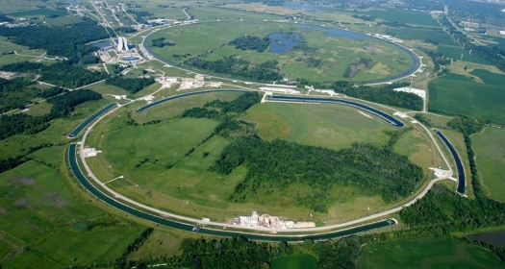
Presenters
- Thomas Kroc, Fermilab
- Mark Murphy, Pacific Northwest National Lab
- John Williams, Medtronic
- Jodi Lieberman, Sandia National Laboratory
- Joe Adduci, Argonne National Laboratory
- Panelists:
Byron Lambert, Suresh Pallai, Rodney Parker, and Paul Wynne
Fermilab – for Hosting
Attendees
Thank you!

