Slide 1
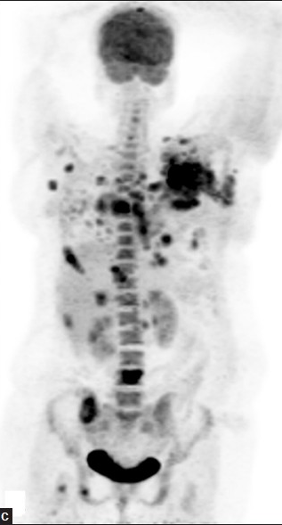
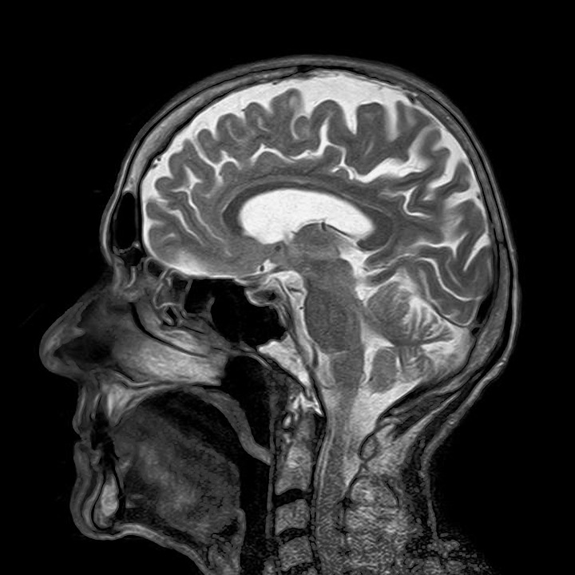
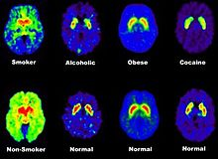
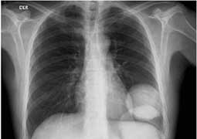
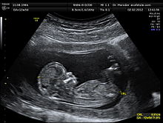
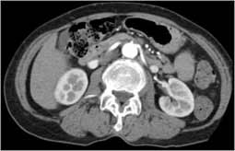
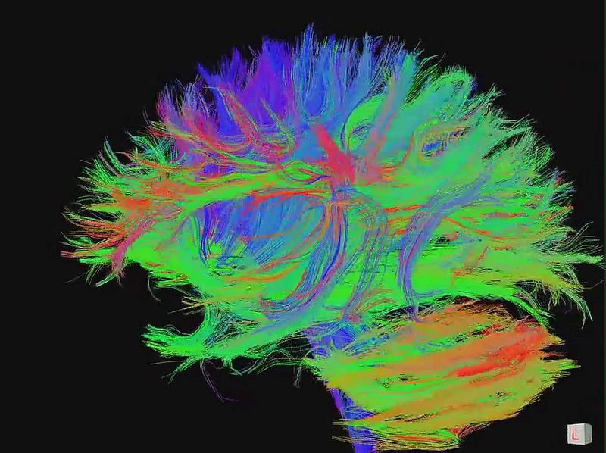
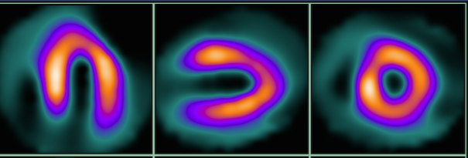
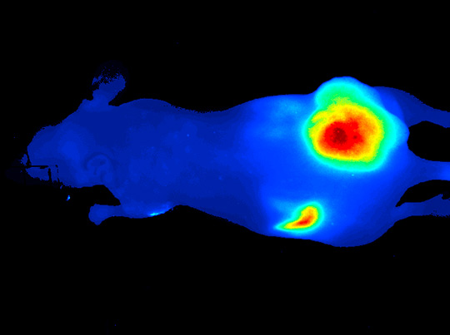
Medical Imaging
Chien-Min Kao
Associate Professor, Radiology and Medical Physics
University of Chicago

Slide 2
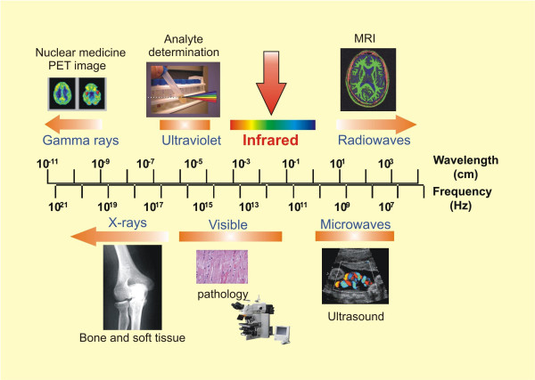

Slide 3
CM: confocal microscopy; MPM: multi-photon microscopy; LOT: laminar optical tomography; (M)FMT: (mesoscopic) Fluorescence molecular tomography; OCT: optical coherent tomography; (M)DOT: (mesoscopic) diffuse optical tomography; PAT: photoacoustic tomography
Depth of penetration [log]

Slide 4
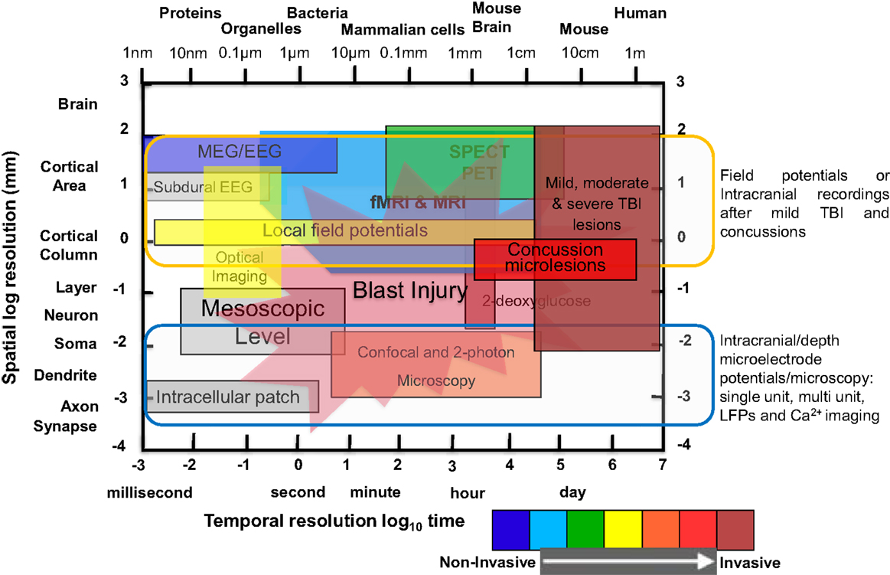

Slide 5
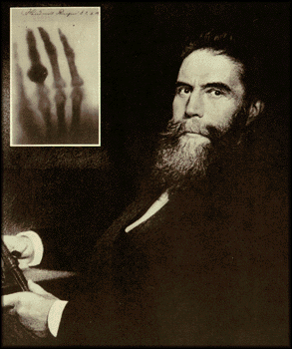
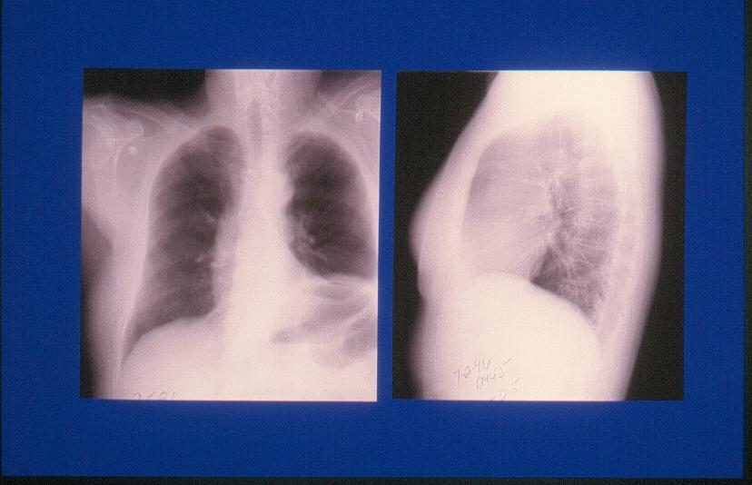
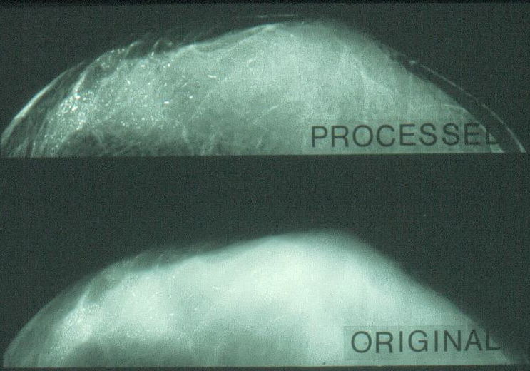
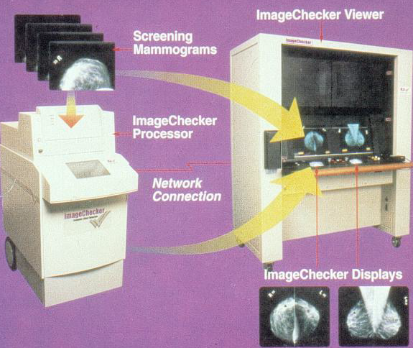
Digital Radiography
Anatomy Structure
3D→2D
Radiation
X-ray (~100keV)
Tissue Attenuation Coefficient
(Electron Density)
Wilhelm Röntgen
First Novel Laureate in Physics (1901)
Discovery of X-Ray: 11/8/1895
First “Medical” Image: 12/23/1895
Computer-Aided
Diagnosis (CAD)

Slide 6
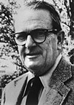
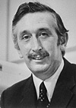
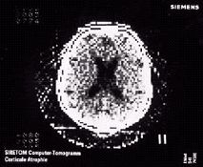
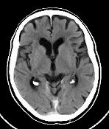
X-Ray Computed Tomography (CT)
X-ray (~100keV)
Tissue Attenuation Coefficient (Electron Density)
Anatomy & Structure
Alan M. Cormack
(1924-1998)
Sir Godfrey N. Hounsfield
(1919-2004)
~1975
2001
Medical CT spatial resolution: < 1 mm
Micro CT spatial resolution: ~ 1-10 mm
Alan M. Cormack and Sir Godfrey N. Hounsfield received the 1979 Nobel Prize in Physiology or Medicine for the development of computer assisted tomography (CT)

Slide 7
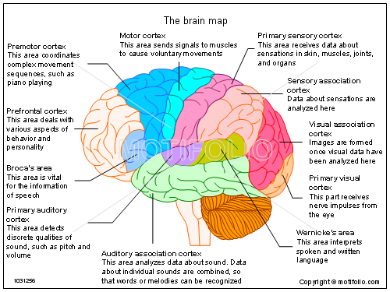
Functional vs Anatomical Imaging
Live or dead brain?

Slide 8
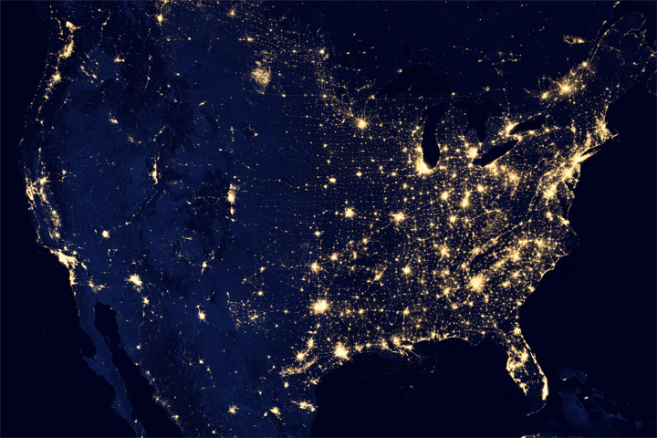
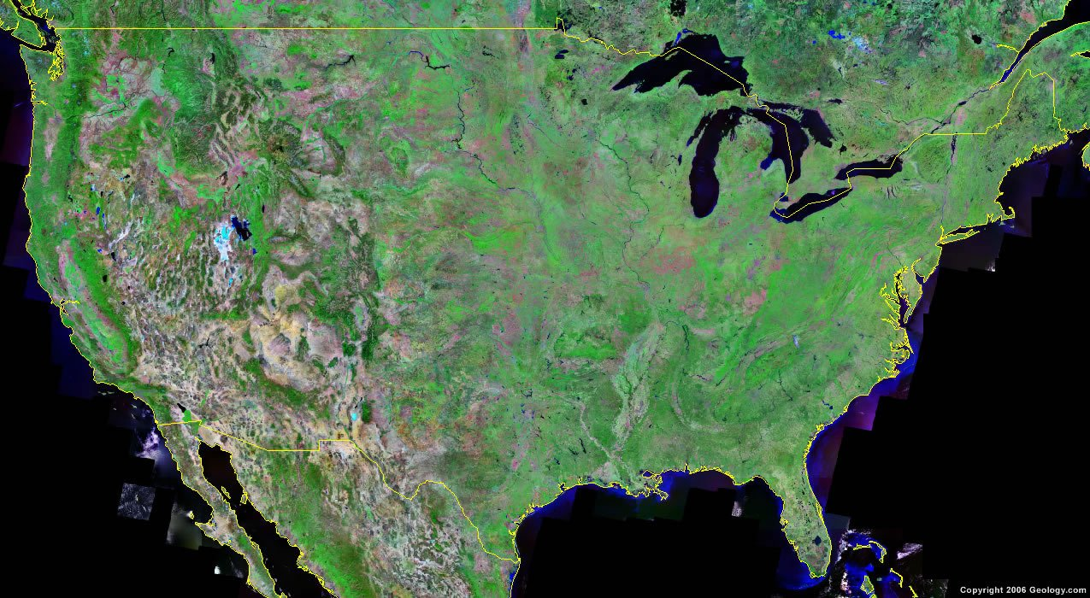
Functional imaging
“light up” activities

Slide 9
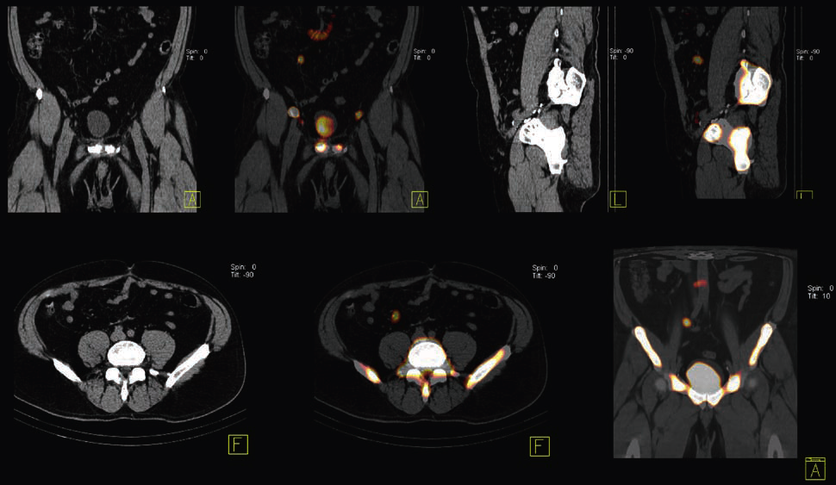
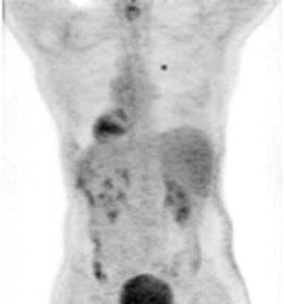
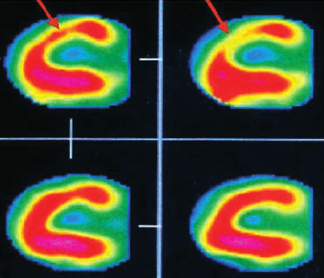
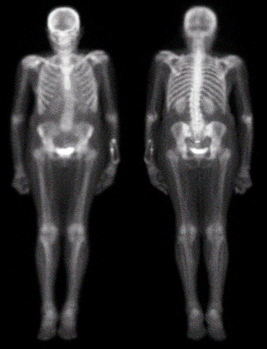
Nuclear Medicine Imaging
Tracer Kinetics & Distribution
+ Radiolabeled chemicals
= Function/Physiology
➔ molecular imaging
In-111 Prostate Cancer Imaging
Tc-99m HDP
Whole-Body
Bone Scan
Lung Cancer
Planar & Single-
Photon ECT (SPECT))
FDG-PET
stress
Tl-201 Cardiac Functional Scan
FDG-PET
rest

Slide 10
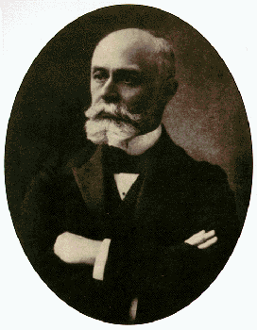
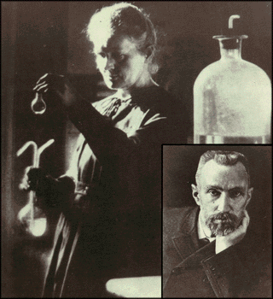
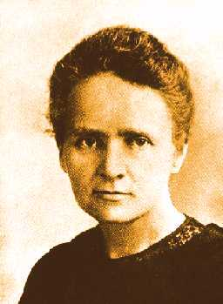
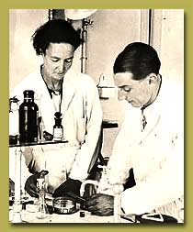
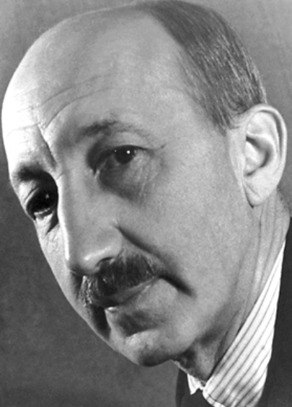
George
de Hevesy
(1885-1966)
Frederic Joliot
Irene Joliot-Curie
Antoine Henri Becquerel (1852-1908)
  Marie Sklodowska
  Curie
Pierre Curie (1859-1906)
Marie Curie (1867-1934)
Nobel Prize in Physics, 1903: Antoine Henri Becquerel, Pierre Curie, Marie Curie for the discovery of spontaneous radioactivity
Nobel Prize in Chemistry, 1911 by the discovery of the elements radium and polonium
Nobel Prize in Chemistry, 1935: for the discovery of stable elements could artificially produce radioactive elements.
Nobel Prize in Chemistry, 1941, for the use of isotopes as tracers in the study of chemical processes

Slide 11
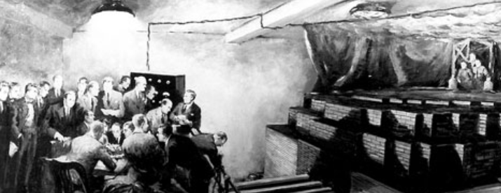
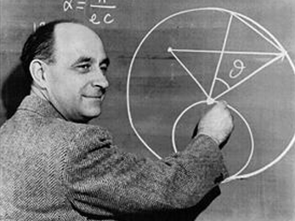
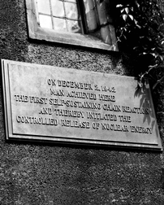
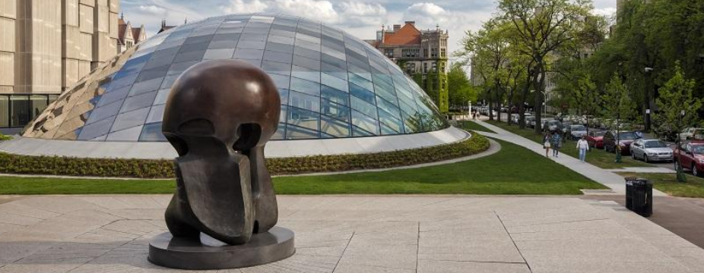
75th Chicago Pile-1 (CP-1) Commemoration
Manhattan Project
December 2, 1942
Chicago Pile - One (CP1)
Enrico Fermi (1901-1954) received
the 1938 Nobel Prize in Physics for
his demonstrations of the existence of
new radioactive elements produced by
neutron irradiation, and for his related
discovery of nuclear reactions brought
about by slow neutrons.
On December 2, 1942
Man Achieved Here
The First Self-Sustaining
Chain Reaction
And Thereby
Initiated the
Controlled Release
of Nuclear Energy

Slide 12
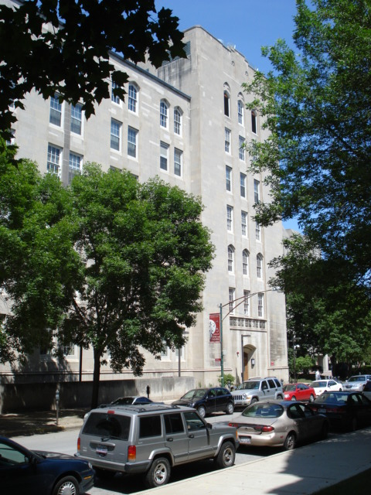
Historic Evolution to
Current Research
Post-WWII (1945)
“Atoms for Peace” Program
1953, Argonne Cancer Research Hospital (ACRH)
-- Peaceful Use of Atomic Energy in Medicine and Biology (both Diagnosis & Therapy)
1974, Franklin McLean Memorial Research Institute (FMI)
-- PET/SPECT
2005, Functional & Molecular Imaging Core (FMI)
-- Expanded into CT, Ultrasound, Optical Imaging, Emerging Technologies, Multi-Modality
Quantitative & Integrative Multi-Modality Functional & Molecular Imaging (QIM-FMI)

Slide 13
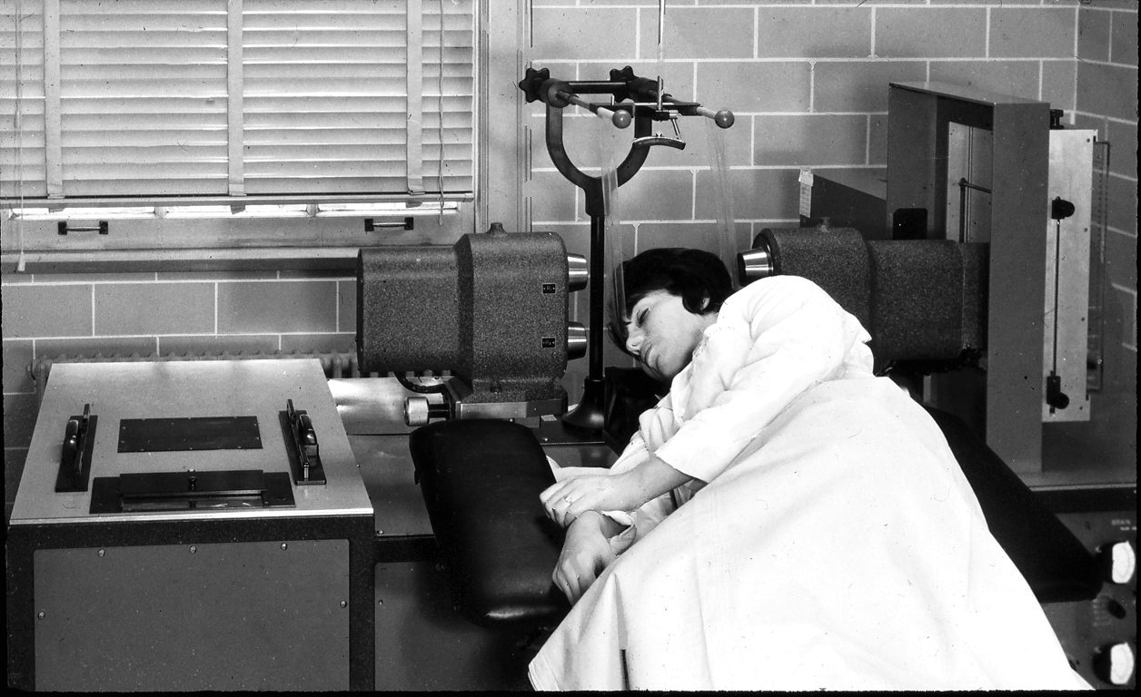
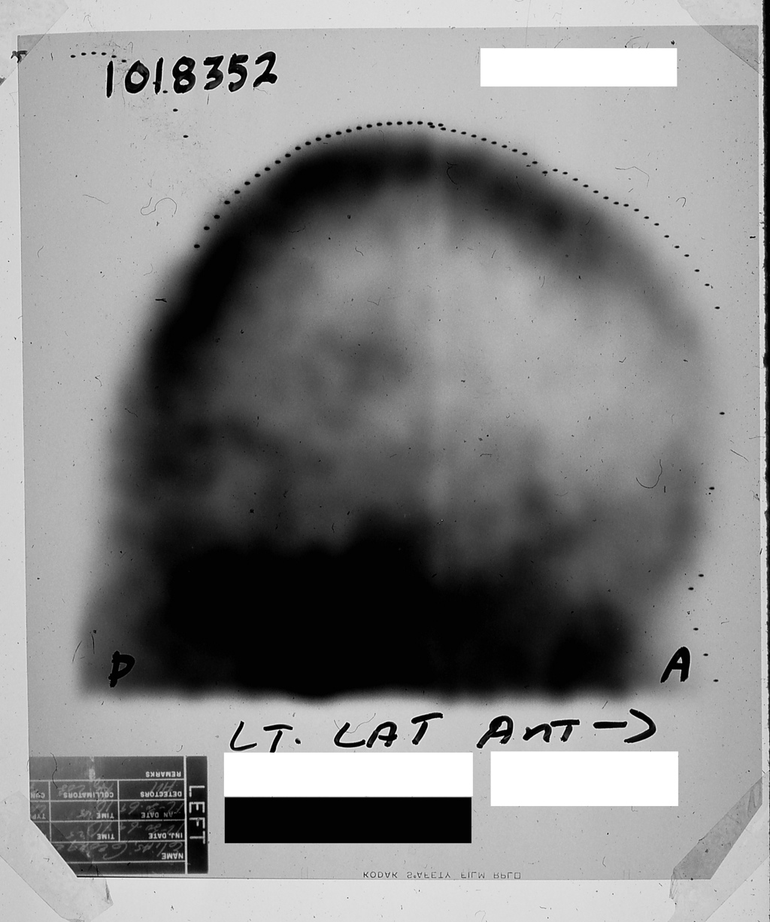
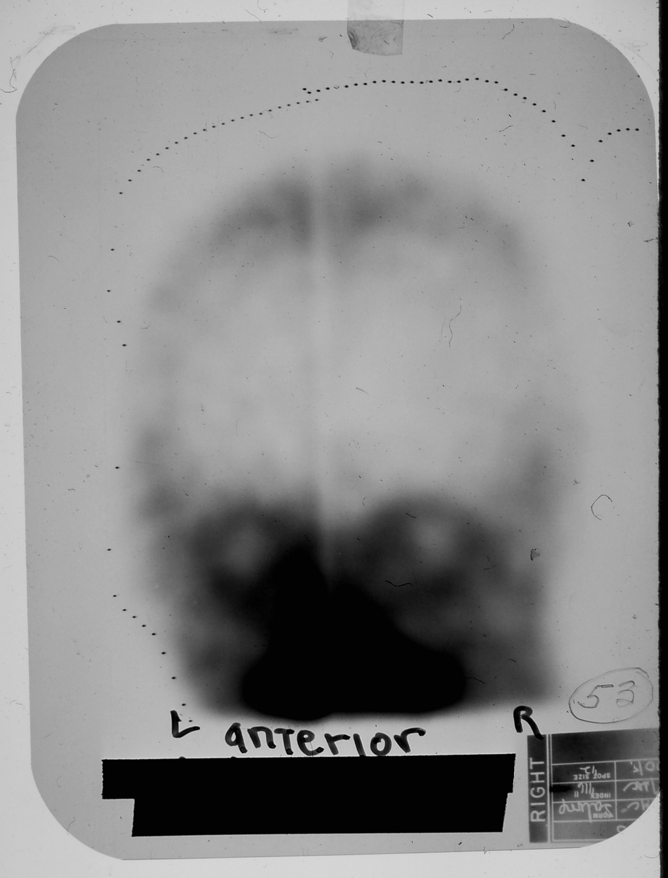
ACRH Brain Scanner
1962-63 The Birth of Modern Nuclear Medicine
First Tc-99m Brain Scan
“First Molecular Image”
Multi-Disciplinary ACRH Molecular Imaging Team
Paul Harper (Surgeon)
Robert Beck (Physicist)
Katherine Lathrop (Chemist)
Donald Charleston (Engineer)
Alex Gottschalk( Radiologist)
World’s First Tc-99m Brain Image, 1963
New Disciplines at Interfaces of
Biology, Medicine, Physics, Chemistry, Mathematics, Computer/Computing Science, Material Science/Engineering, Electrical Engineering + X

Slide 14
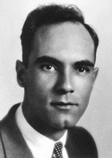
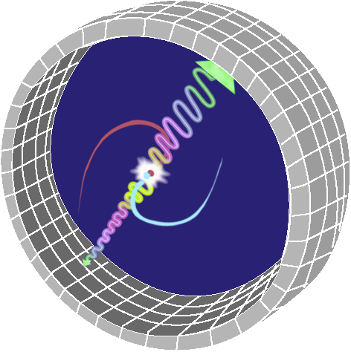
Positron Emission Tomography (PET): Principle
p → n + e⁺ + ν + energy
Carl David Anderson (1905­-91)
received the Nobel Prize in 1936 for the discovery of the positron.
At age 31, Anderson was then the youngest person to receive the Nobel Prize.
E = mc²

Slide 15
Positron-Emitting Nuclides

Slide 16
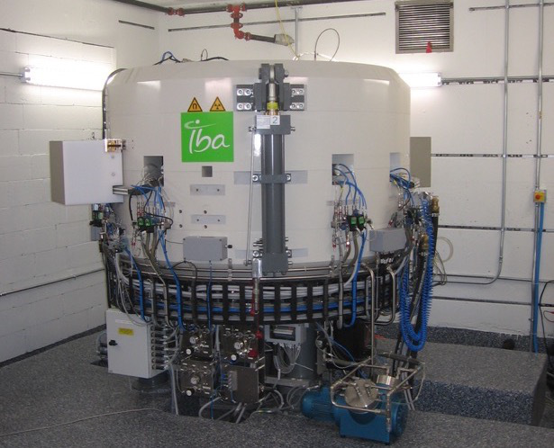
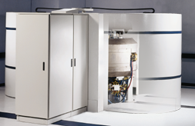
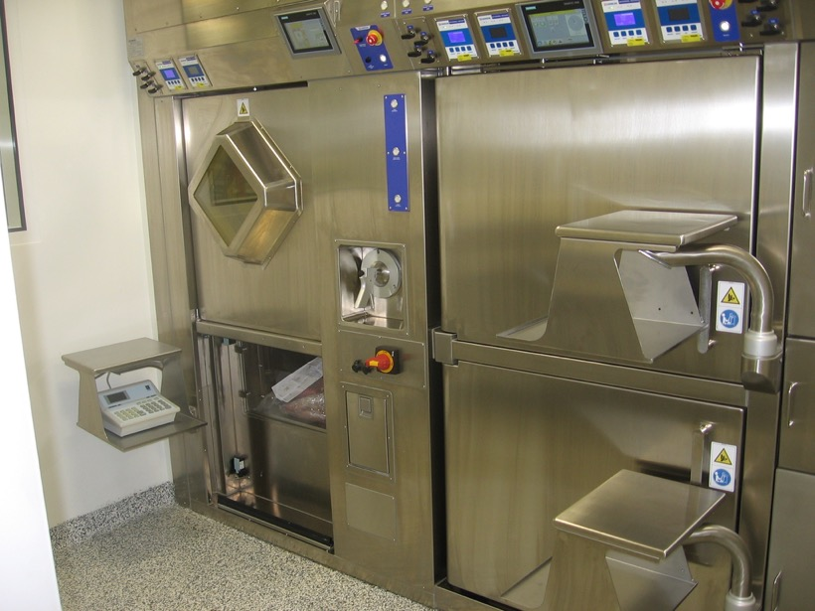
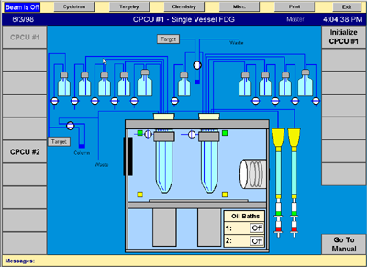
Production of Isotopes (Cyclotron)
Modern Medical Cyclotron
RadioChem
Synthesis
Module
UChicago new cyclotron and radiochemistry facilities (2017)

Slide 17
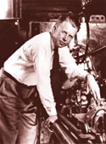
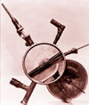
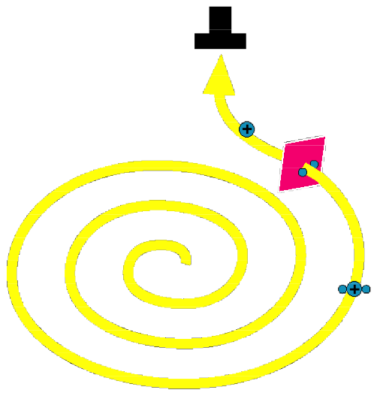
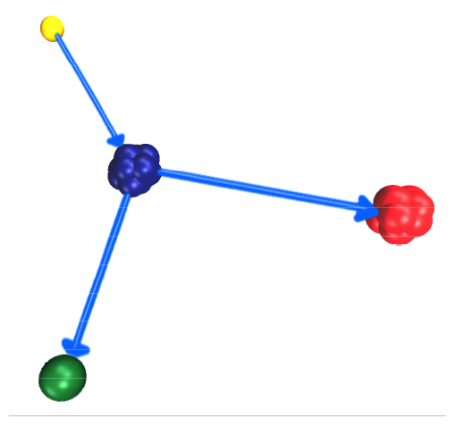
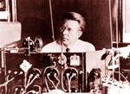

Production of Isotopes (Cyclotron)
¹⁸O (p,n) ¹⁸F
The first cyclotron
is built in late 1930
At the ion source
of the 184-inch
cyclotron in 1948.
Ernest Orlando Lawrence (1901-1958)
received the 1939 Nobel Prize in physics
for the invention and development of
the cyclotron
Lawrence at the
Controls of his
cyclotron
in Berkeley.
CS-15 Installed at UChicago-ACRH/FMI in 1968

Slide 18




Positron Emission Tomography (PET): Principle
Coincidence Detection
$$t_{i}=ε_{i}a_{i}×\int_{l_{i}}{f\left(\vec{r} \right)dl}$$
line integral
/ray sum
LOR sensitivity
(calibration)
LOR, l_{i}
subject attenuation
(measured using a tx source, or calculated from CT, MR images)

Slide 19




Positron Emission Tomography (PET): Principle
Image Reconstruction from projections:
2D FBP Demonstration

Slide 20



PET system
Share similar designs with HEP detectors but subject to different size and cost constraints and performance requirements

Slide 21



Scintillation Detector
photocathode
dynode
anode
gamma rays
e⁻
scintillator
≈10⁶ e/ph
Photomultiplier (PMT)
electrical signal
  time
  energy

Slide 22
PET Event Detection
Qualified energy?
yes
yes
Crystal IDs
(LOR)
Coin?
Qualified energy?
yes
Coincidence timing window (4-10 ns)
Energy window (400-650 keV)

Slide 23
PET Event Types
Scatter (B)
  Compton scattering in subject
  energy <511 keV
  depend on object size and scanner geometry
  distribution affected by subject shape
  cannot be easily measured
Randoms (C)
  accidental coincidences
  smaller coincidence windows → fewer randoms depend on activity levels
  relatively uniform distribution
  can be measured using delayed coincidences

Slide 24

PET Block Detector
(https://www.radiologycafe.com/radiology-trainees/frcr-physics-notes/pet-imaging)

Slide 25


Factors affecting resolution
Crystal size
depends on E_{max} of emitted positrons
              ¹⁸F rms = 0.23 mm
              ¹¹C rms = 0.39 mm
range is inversely proportional to the absorber density
Positron range
Intercrystal scattering
Photon acolinearity
d
significant for small crystals
FWHM = d/2
±0.25°

Slide 26


Block Detectors
Clinical PET: 4 mm detector pixels, ~80 cm diameter, 20 cm length ➔ 31,400 pixels
Event energy (pulse height) and time are derived from the summed pulse, assuming only one event within the processing time
Compromised count-rate capability
More lights (brighter scintillators and better light collection) → better statistics → better energy resolution, better spatial resolution, better timing
Faster scintillator and PMTs → faster timing
A
B
C
D
8x8 block detectors ➔ reduce electronic channels by x16
G Tarantola (2014)

Slide 27

FWHM= k_{R} C² + (d/2)² + R² + B²
(R. Lecomte, NIM 2004)

Slide 28


Slide 29


Depth-of-interaction (DOI) blurring
(from Siemens Medical)

Slide 30

Large Patient Problem
58 kg 89 kg 127 kg
(J Karp et al)

Slide 31

Time-of-flight (TOF) PET
Non TOF
TOF
(http://flc.desy.de/pet/intro/index_eng.html)
equal scan time
(M Conti, EJMMI Physics, 2011)

Slide 32

PET/CT
~500-600 ps with LYSO/PMT

Slide 33



Improve TOF resolution

Slide 34



Silicon Photomultiplier (SiPM)
SiPM/SPM/MPPC
SiPM/SPM/MPPC array
1-6 mm pixel, array format, 30-70 V, robust, MR compatible, TOF capable, low-cost potential
~1 inch, >1000 V, fragile, very sensitive to magnetic fields, TOF capable

Slide 36



Compact SiPM based PET detectors
double-ended
(SR Cherry et al)
Multi layered
(A. Del Guerra et al)
Side readout
(CS Levin et al)
Can support TOF also

Slide 37




PET/MR
Light Tight RF Shield with copper coating
LBS array with (ESR)
SiPM with circuit boards/ASICS
Thermal coupling
Aluminum mounting
25 cm AFOV
10.5% ER
390 ps CRT

Slide 38
Design Approaches

Slide 39
SiPM Based Inserts
16 detector modules
Axial FOV = 55m, ring diameter = 64mm
Carbon fiber tube for shielding
ID/OD: 60mm/100mm
1.2x1.2x10mm LYSO, 9x9 arrays, pitch 1.28mm
4x4 Hamamatsu SiPM array
Resistor charge network reduces output to 4
Resolution (OSEM/FBP): 0.75/1.31mm at center, 1.46/2.18mm at 14mm off center
CRT ~ 1.33 ns
Temperature and voltage controls
(GB Ko et al, Med Phys 2015)

Slide 40


SiPM

Slide 41
SiPM Based Inserts
1.2x1.2x10mm LYSO, 9x9 arrays, pitch 1.28mm
4x4 Hamamatsu SiPM array
Resistor charge network reduces output to 4
(GB Ko et al, Med Phys 2015)

Slide 42

Stripline (delay-line) Readout
PDs
preamp
DAQ
DAQ
PD outputs
DAQ
DAQ
SLs
DAQ
DAQ
Digital Signal Processing (FPGA)
high-speed serial output
The position of firing PD is determined using the propagation time difference.

Slide 43

UChicago detector module
2.54 cm
~5.0 cm
LYSO/SiPM arrays: 4x8 pixels (MPPC), 3.2mm pitch, 10mm thick
Power connector
SL outputs x8
~2.62 cm
curvy SLs to increase separation between SiPMs to 25 mm and $δt∼$ 400 ps
excellent pixel discrimination
Best CTR ~ 250ps
LED ~3 mV

Slide 44
Stripline Readout is Scalable
16 SiPMs/Stripline
32 SiPMs/Stripline

Slide 45


FPGA-only MVT sampling DAQ
Compact, high channel density
FPGA based: affordable, flexible, upgradable
Digital signal samples and serial digital output: robust, universal, digital signal processing
Clean IO interface and network ready: rapid system development
Do not require any proprietary parts and costly and length ASIC development
Intrinsic time resolution ~ 300ps
72ch board
Ethernet
power
Control FPGA
Sync clock
MVT FPGAs
DAC
amplifiers

Slide 46




PET Insert
14 modules; 2.5 cm axial FOV
16 pxiels per stripline
Initial phantom image
(3.0, 2.6, 2.2, 1.8, 1.4, 1.0 mm)

Slide 47
Stripline Readout/MVT DAQ
Substantial channel reduction
Alleviating engineering issues: heat dissipation, power consumption, space constraint.
Cost saving
Detached electronics
  Compactness
  mitigate RF and temperature control issues in PET/MR
Highly flexible, scalable DAQ electronics
With SL readout, multiple detectors can be daisy chained
The DAQ provides high channel density and is affordable
The DAQ produces digital samples
Use commodity electronics components and industry I/O standards

Slide 48

Bruker Peclinical PET Insert
eight 50x50x10mm continuous detector blocks, 12x12 SiPMs (SensL), resistive network row/column readout
High resolution w/ DOI
ID/OD = 114/198 mm
Carbon Fiber RF shielding
~ 1m long
(AJ González, NSSMIC 2016)

Slide 49
Tilable Detector Block/Panel Detector
SL board
16x16 LYSO
16x16 SiPMs
SL board
High-speed serial data, power, sync-clock cables
PC/Workstation
Power
Sync generator
Network switch
~50x50mm detector, 4 outputs per detector, DOI and TOF capable

Slide 50



Other trends: Dedicated Brain PET
Need higher resolution (1-2 mm) and sensitivity for Brain imaging
Mobile units can be useful for emergence care (stroke evaluation) and surgical room
PhotoDiagnostic Systems (PDS) NeuroPET/CT
Siemens HRRT
UChicago-HUST

Slide 51


Wearable Brain Imagers
To optimize sensitivity and image quality
(CE Bauer, Brain Behavior 2016)

Slide 52


Other Organ-Specific Systems
PEM Naviscan
Newsoft
Cardiac
PET
Notes:
241

Slide 53


Probes

Slide 54










EXPLORER: Total Body PET
From http://explorer.ucdavis.edu/

Slide 55



Proton therapy/In-Beam PET
T. Nishio et al.: Med. Phys. 33 (2006) 4190

