Slide 1
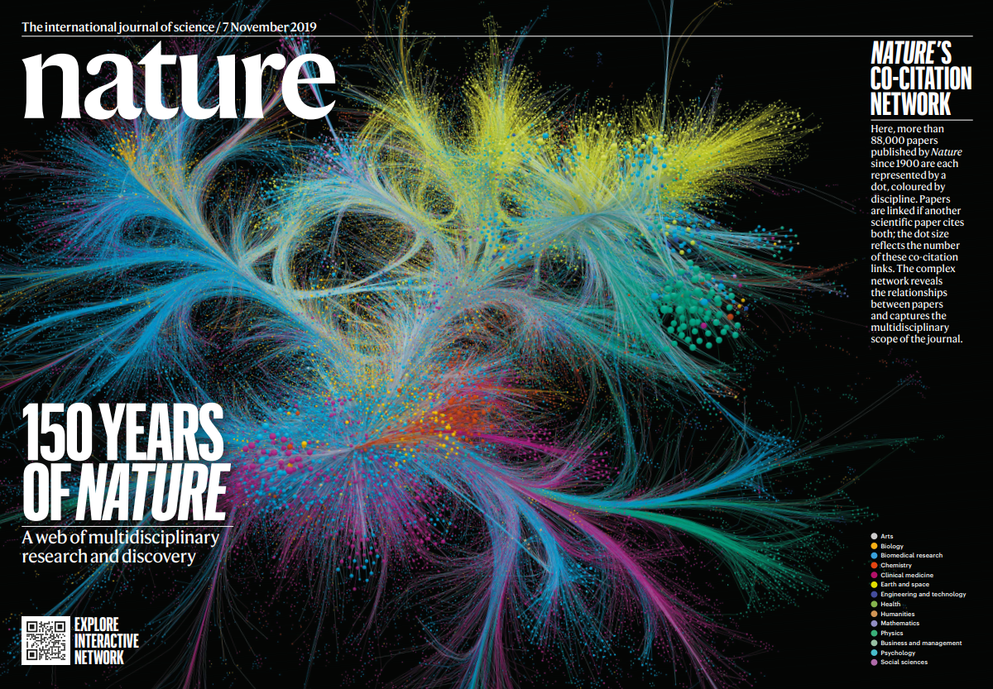
Inside Nature
Federico Levi Senior Editor, Nature
Fermilab, 13th March 2024

Slide 2
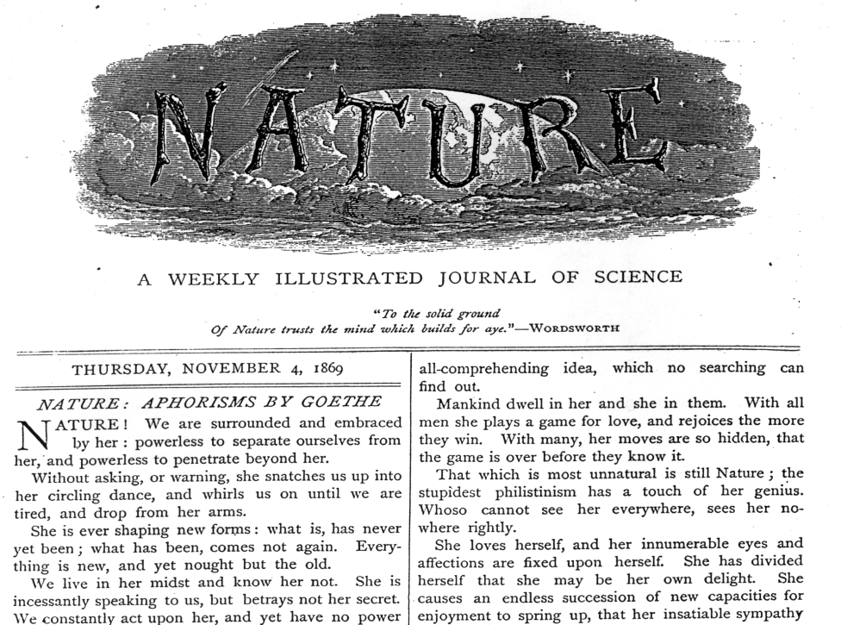
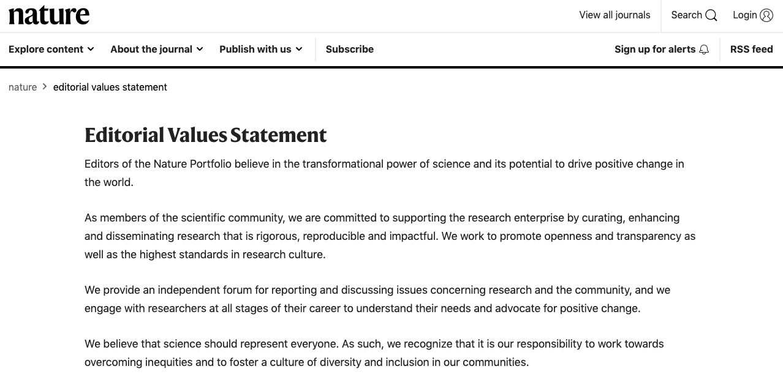
A weekly journal of science
First issue: November 1869
nature's mission statement
… to place before the general public the result of scientific discovery and to help scientists to learn about advances in all branches of natural knowledge …

Slide 3
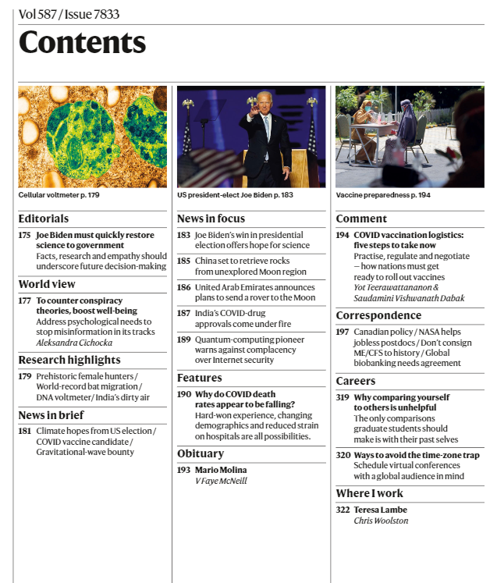
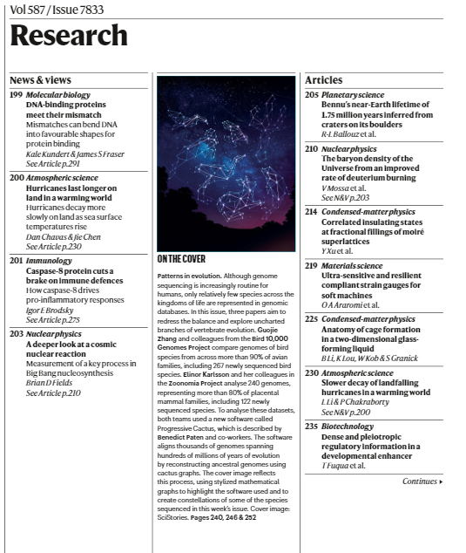
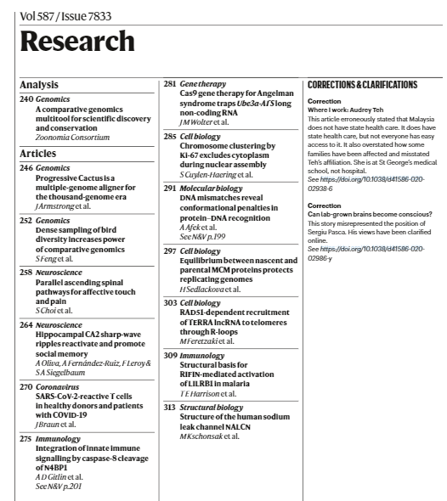
Magazine
Journal
Notes:
48,201 graphene-related papers, 2004 – 2014
830 in Nature journals
Nature 28,157 (0.3%)
Nature Physics 2,419 (%)
Nature Materials 3,165 (%)
Nature Nanotechnology 1,707 (%)
Nature Photonics 1,853 (%)
Nature Communications 4,679 (%)

Slide 4
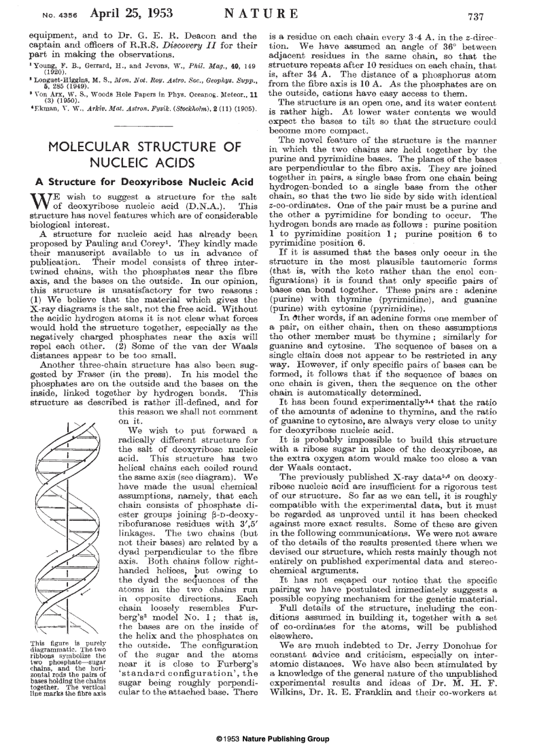
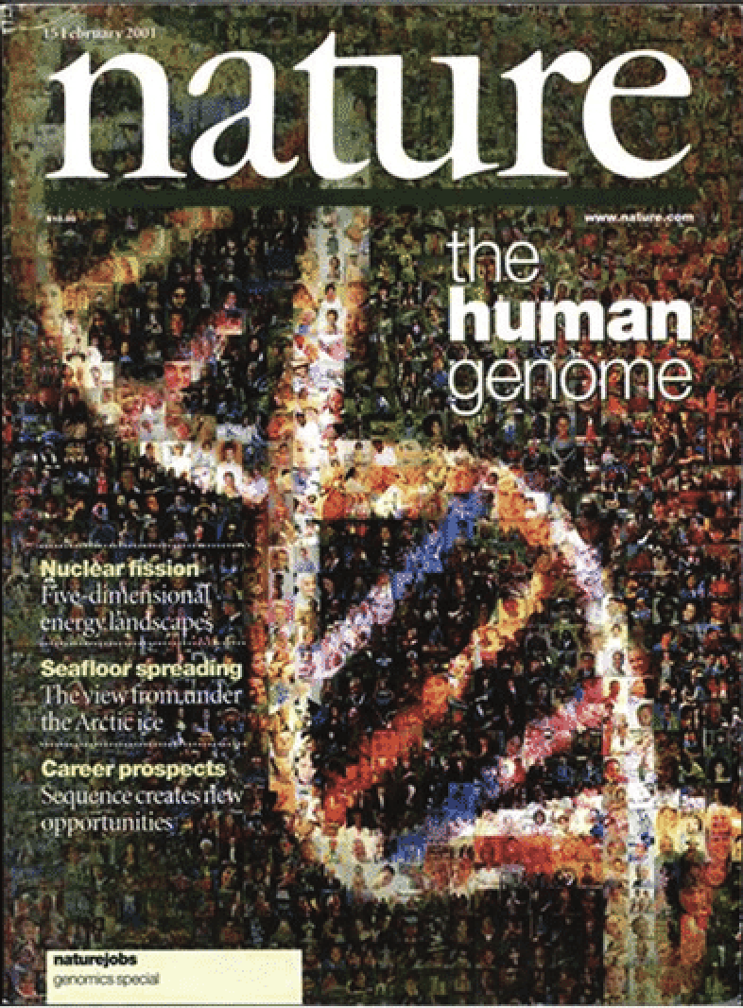
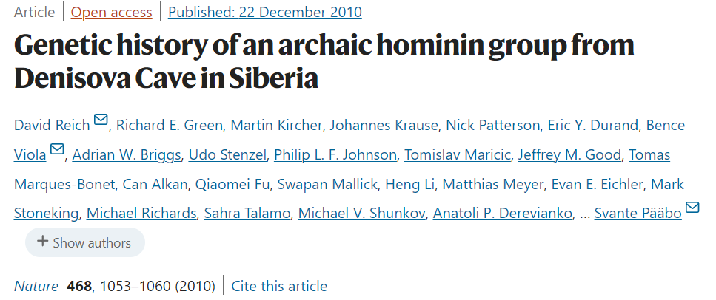
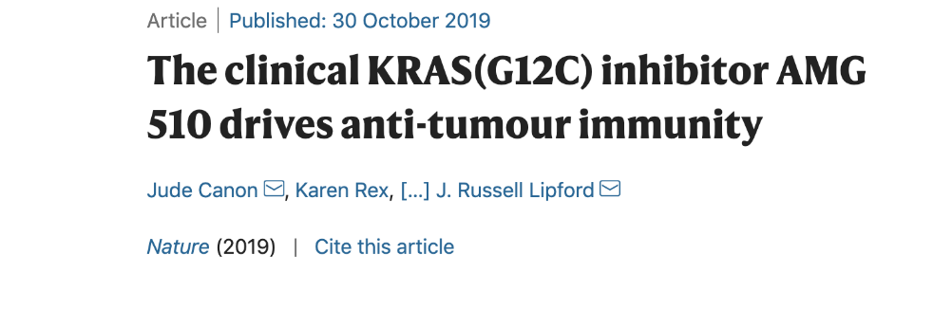
DNA & genomes
Notes:
48,201 graphene-related papers, 2004 – 2014
830 in Nature journals
Nature 28,157 (0.3%)
Nature Physics 2,419 (%)
Nature Materials 3,165 (%)
Nature Nanotechnology 1,707 (%)
Nature Photonics 1,853 (%)
Nature Communications 4,679 (%)

Slide 5
The ozone layer
Notes:
48,201 graphene-related papers, 2004 – 2014
830 in Nature journals
Nature 28,157 (0.3%)
Nature Physics 2,419 (%)
Nature Materials 3,165 (%)
Nature Nanotechnology 1,707 (%)
Nature Photonics 1,853 (%)
Nature Communications 4,679 (%)

Slide 6
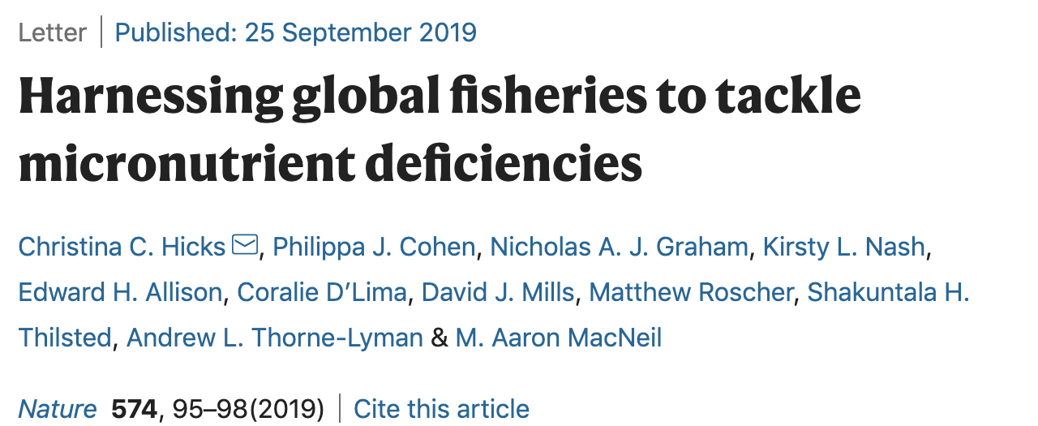
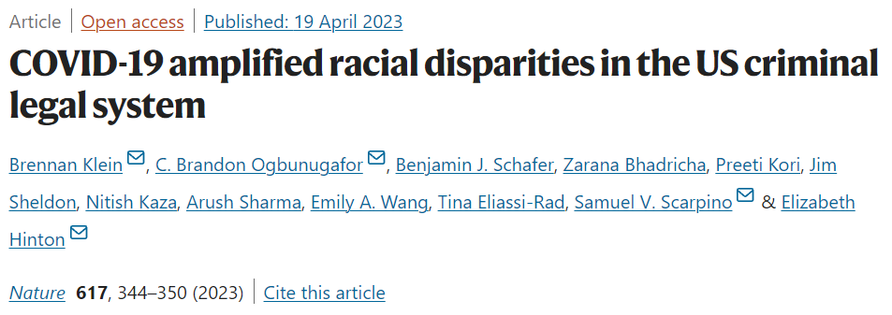
Expanding the scope – sustainability & social science
Notes:
48,201 graphene-related papers, 2004 – 2014
830 in Nature journals
Nature 28,157 (0.3%)
Nature Physics 2,419 (%)
Nature Materials 3,165 (%)
Nature Nanotechnology 1,707 (%)
Nature Photonics 1,853 (%)
Nature Communications 4,679 (%)

Slide 7
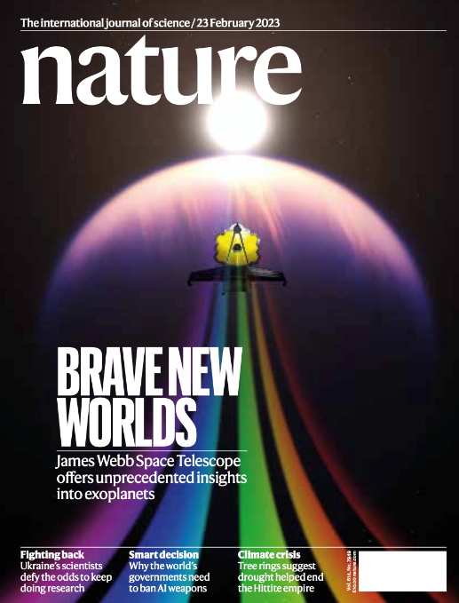
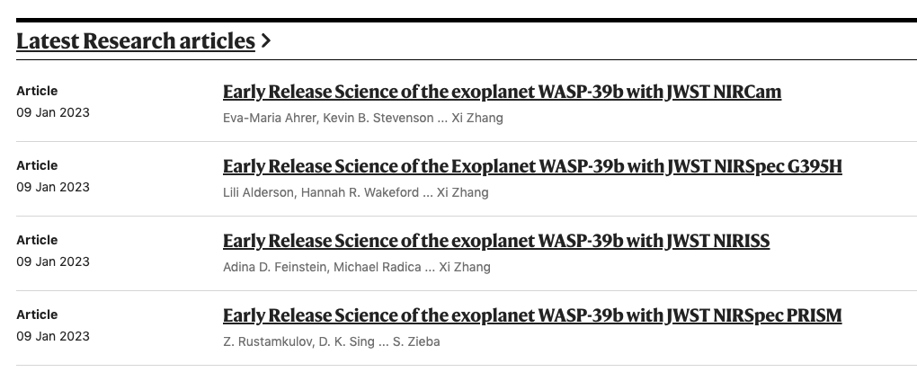
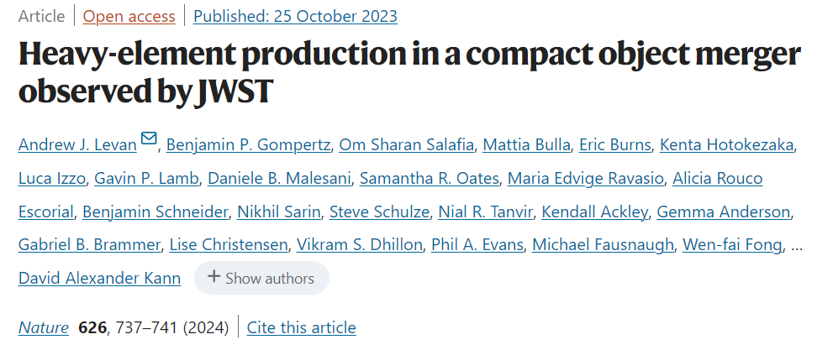
Celebrating fundamental science

Slide 8
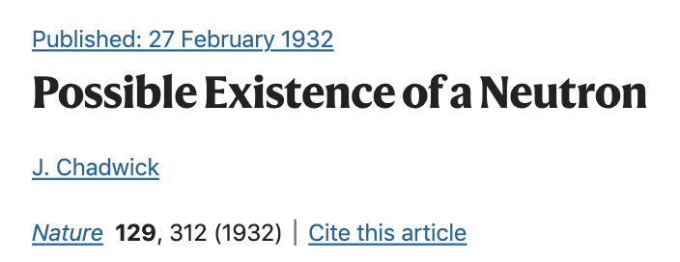
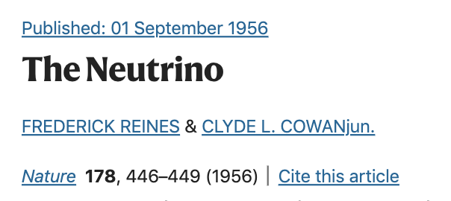
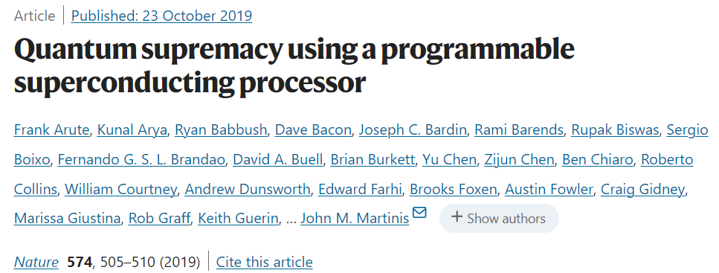
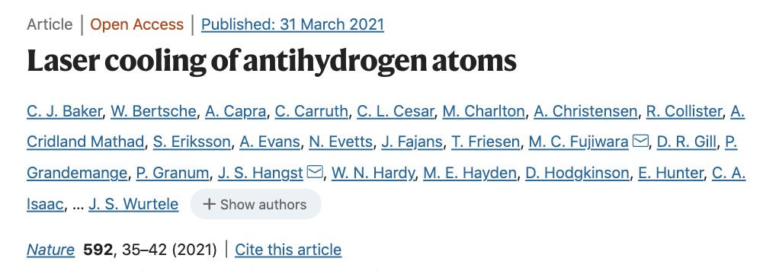
Celebrating fundamental science

Slide 9
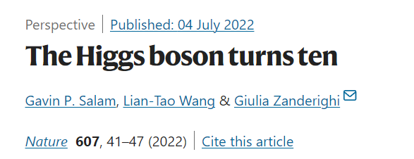
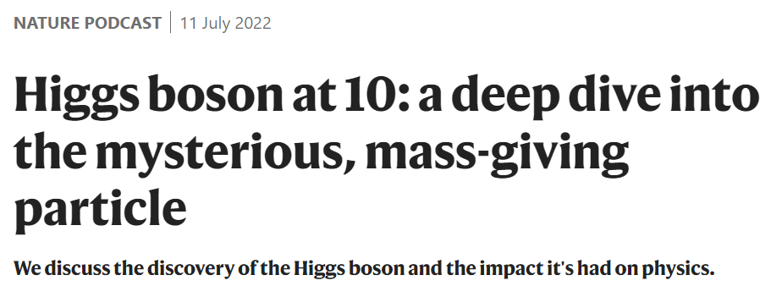
Ten years of Higgs

Slide 10
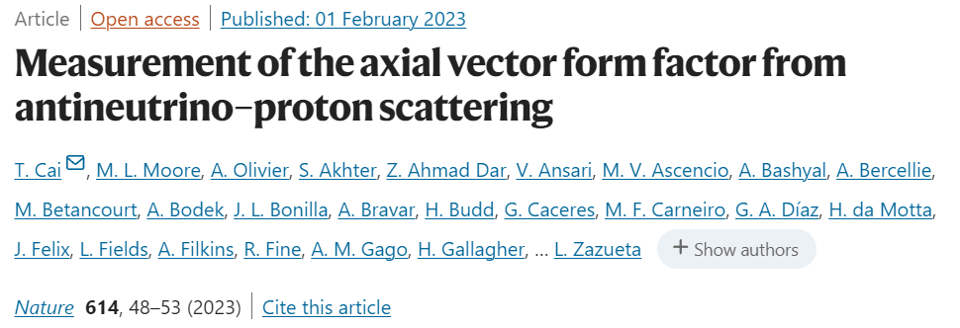
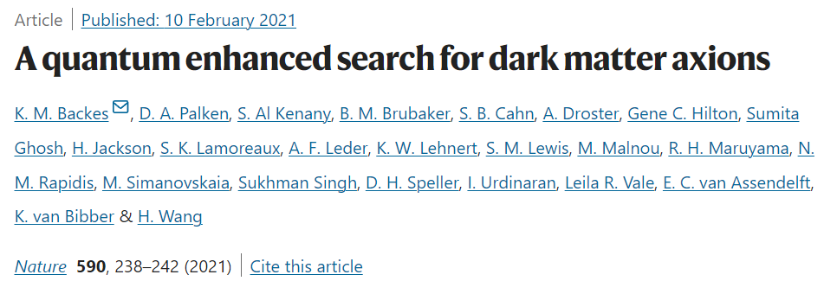
It’s not just “light” or “flashy” papers

Slide 11
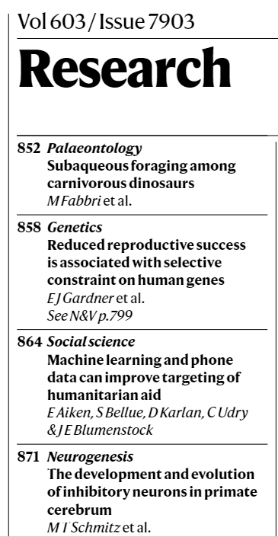
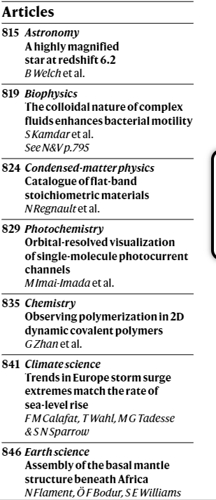
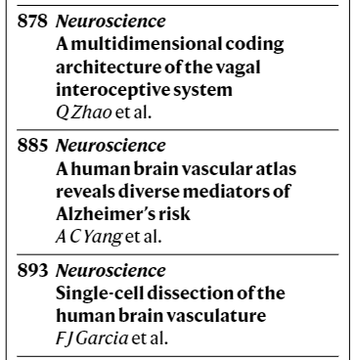
Journal editors
No external editorial board or society affiliation.
Full-time professional editorial staff.
40 editors (25 life sciences, 15 physical sciences).
Highly selective: 7-10% accept rate.
~ 20 articles per weekly issue.
~ 1000 papers per year (~ 70 fundamental physics).
Notes:
48,201 graphene-related papers, 2004 – 2014
830 in Nature journals
Nature 28,157 (0.3%)
Nature Physics 2,419 (%)
Nature Materials 3,165 (%)
Nature Nanotechnology 1,707 (%)
Nature Photonics 1,853 (%)
Nature Communications 4,679 (%)

Slide 12
The editorial process
… how are papers selected and published?

Slide 13
The editorial process
Submission
Preprint deposition
Data and code availability
Formatting (loose!)
Cover letter
To do at submission:

Slide 14
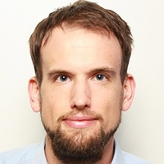
Nature’s physics and astronomy team
Federico Levi Fundamental physics
Tobias Roedel Condensed-matter physics
Leslie Sage Astronomy & Astrophysics
Optics & Photonics
Yann Sweeney
Computer science and robotics
Applied physics & Electronics
On average, around 8-10 new papers per week per editor.

Slide 15
Decision before review
Submission
Editorial decision
Peer Review
80-85%
Returned to author
We read the whole paper. Digest what has been done: What is the question? What is the answer? Study the related literature, establish what is new. Decide (alone or as a team) if the paper satisfies our editorial criteria.

Slide 16
Pre-submission enquiries
Designed to save researchers’ time before preparing their manuscripts.
Extended abstract + a couple of figures or similar amount of material.
Via email or through our manuscript submission portal.
The earlier in the process, the better!

Slide 17
Cover letters
Only seen by editors – a chance to pitch the paper with informal context.
Identify related manuscripts in press or submitted elsewhere.
Please suggest reviewers! And feel free to exclude others within reason.
Papers should speak by themselves. But cover letters can help and clarify.

Slide 18
Peer review
Submission
Editorial decision
Peer Review
Peer review
Now double blind or transparent.
At nature, an editor-intensive process
Reviewers:
2-4 experts with complementary backgrounds.
Assemble a diverse team of referees.

Slide 19
Post-review decision
50 %
Rejected
Submission
Editorial decision
Peer Review
Post-review decision
Revise
ADVICE not VOTES
Decision is for the editor, not for the referees, to make.
Decision based on arguments, relevance and background.
Difficult decisions involve more than one editor.
We often overrule reviewers, but not on technical issues.

Slide 20
Acceptance
Submission
Editorial decision
Peer Review
Post-review decision
7-10 %
Post-acceptance:
Copyediting, art editing
Press coverage
Dissemination (Highlights, N&Vs, etc.)
Accept

Slide 21
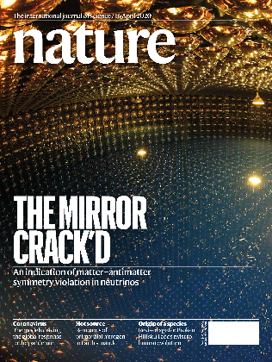
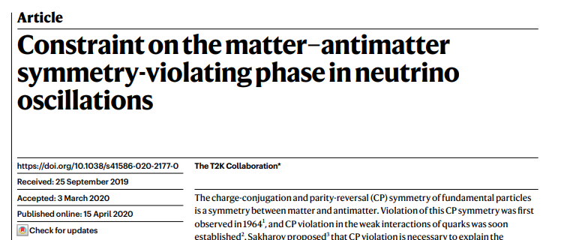
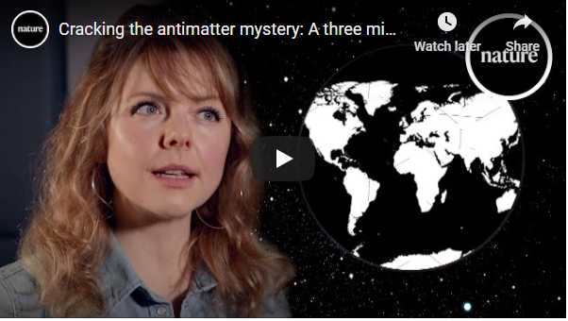
Dissemination

Slide 22
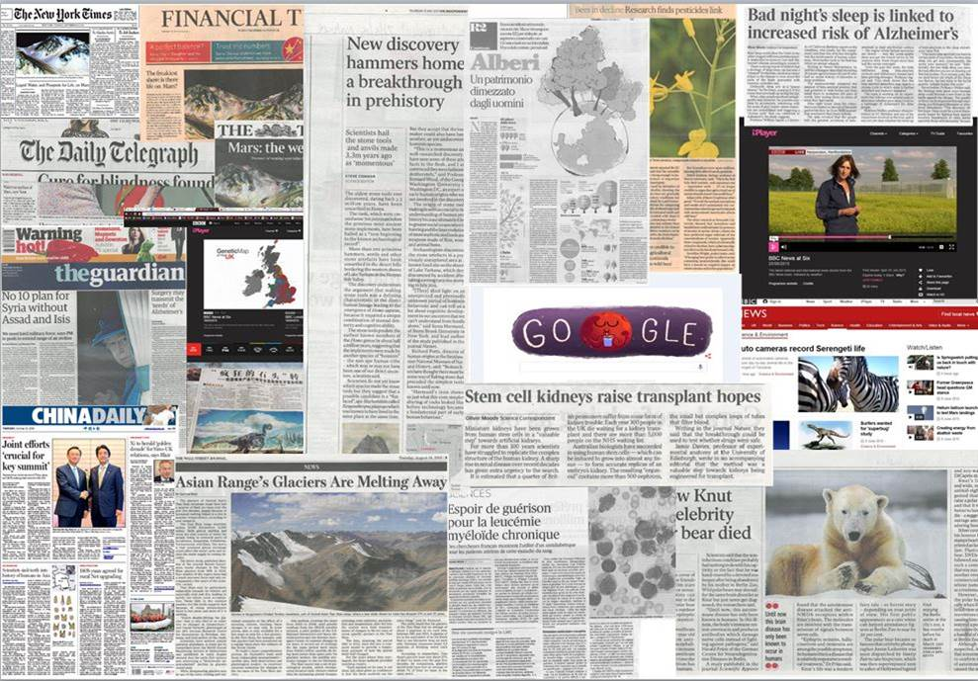
Press coverage
Nature papers get noticed and inform: in 2022 over 152,000 news stories generated
Notes:
We gave bring attention to your community.

Slide 23
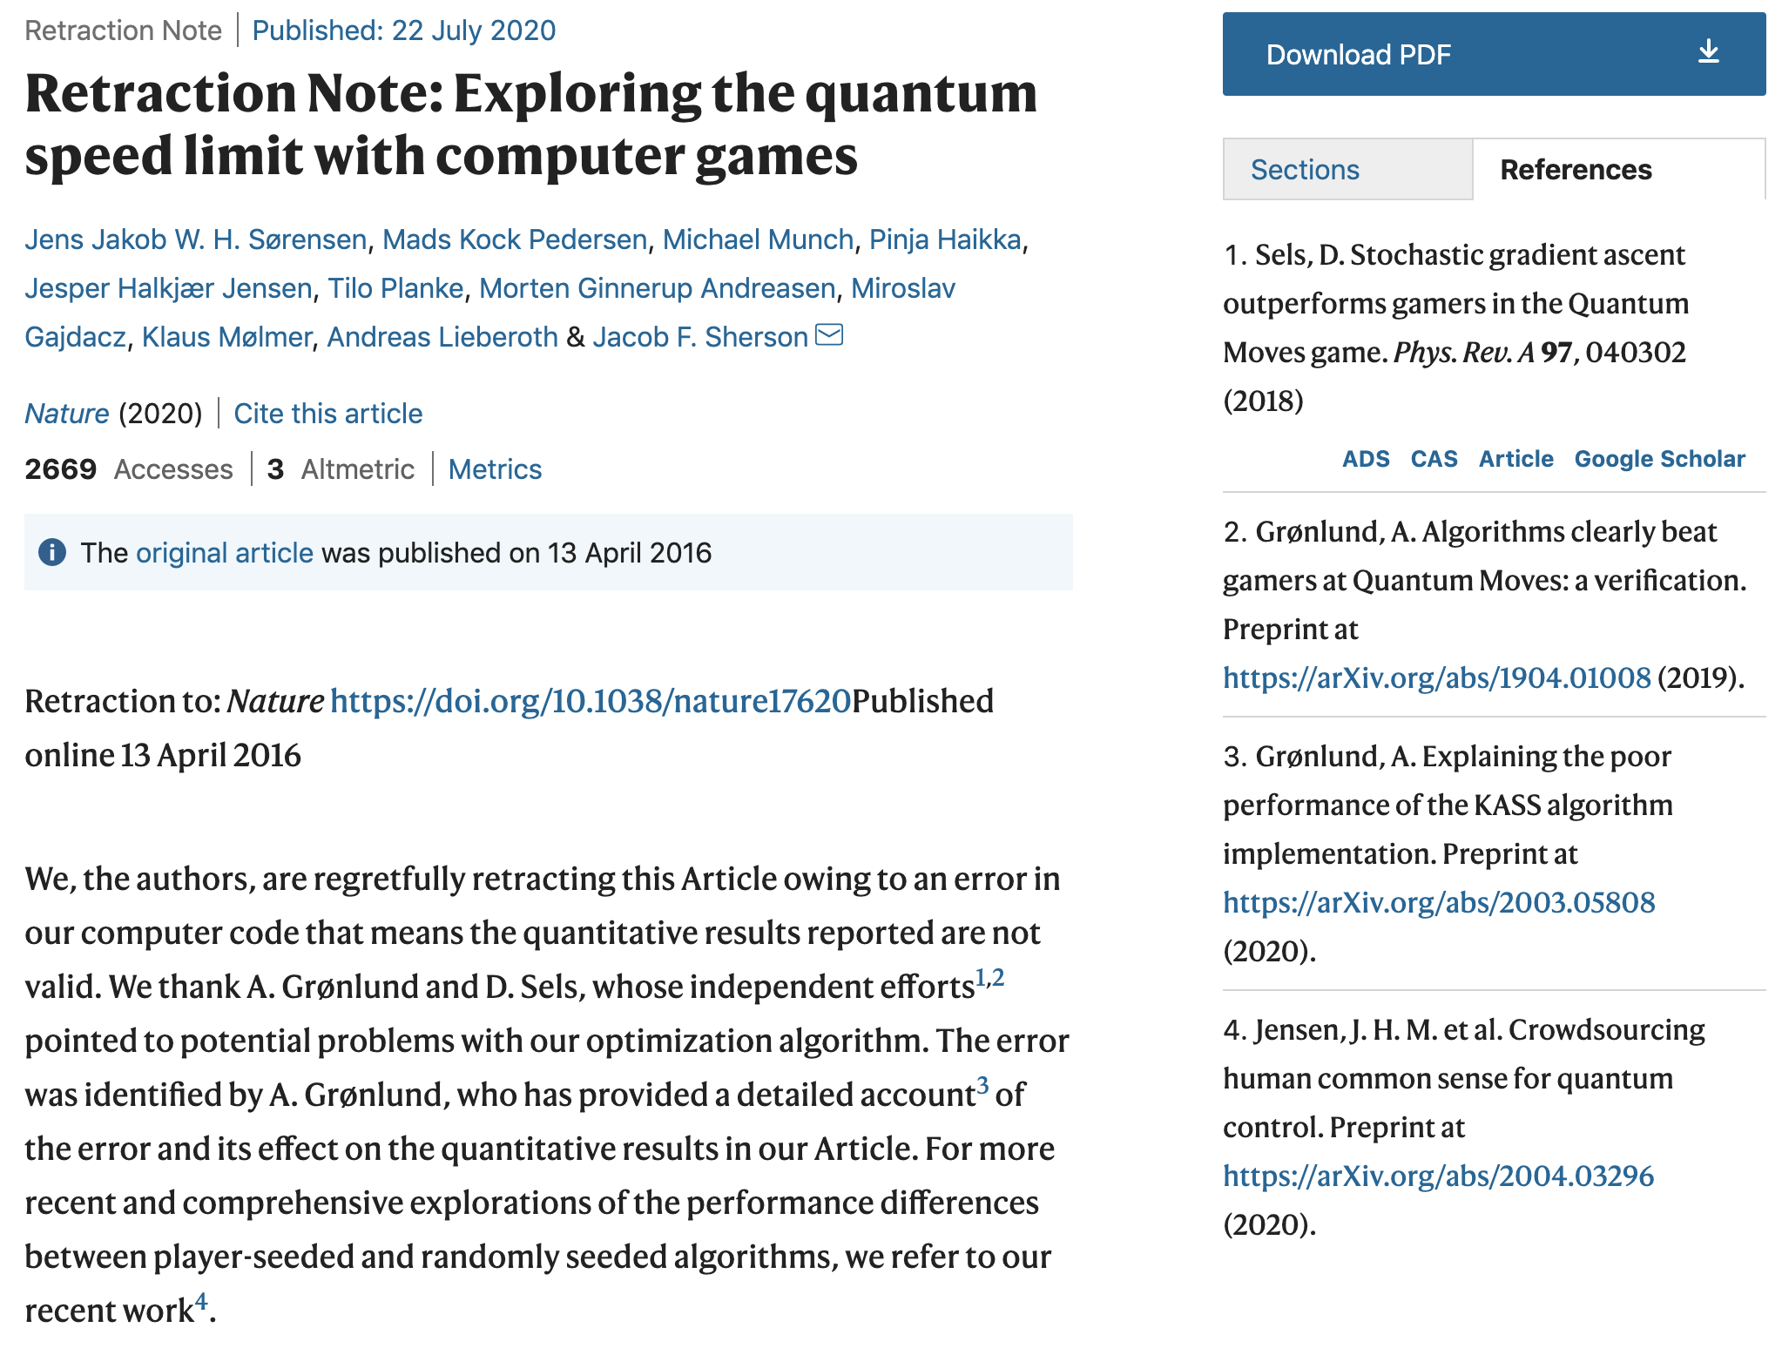
Correcting the record

Slide 24
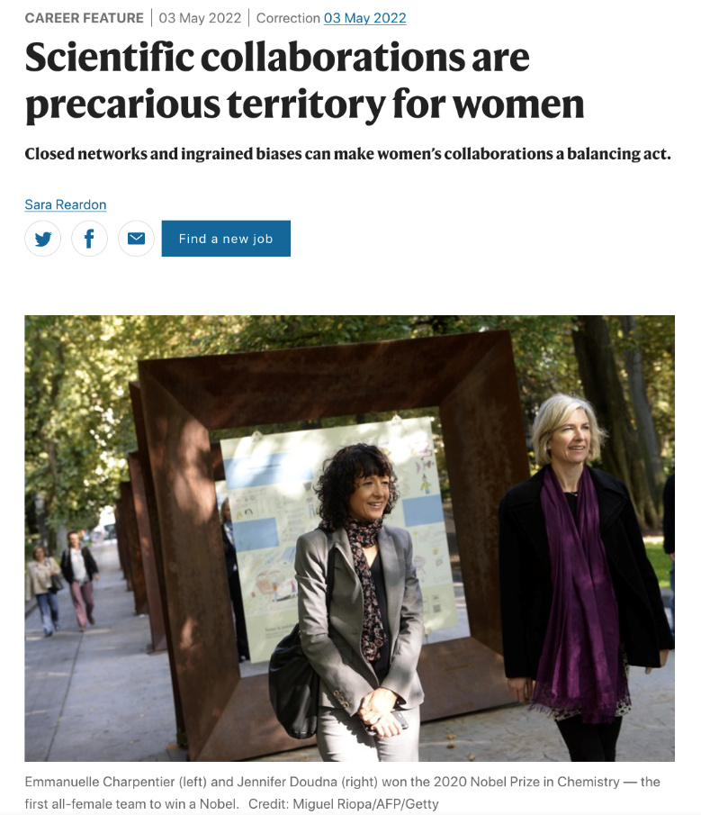
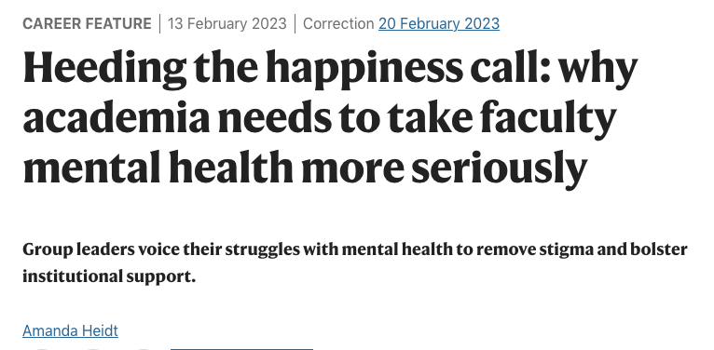
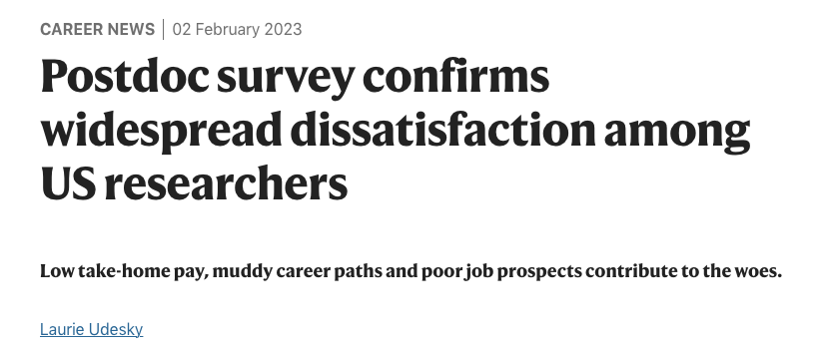
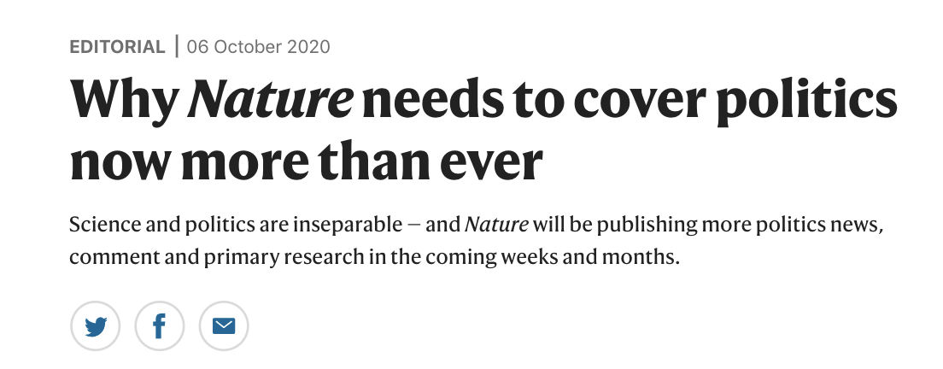
Advocacy

Slide 25
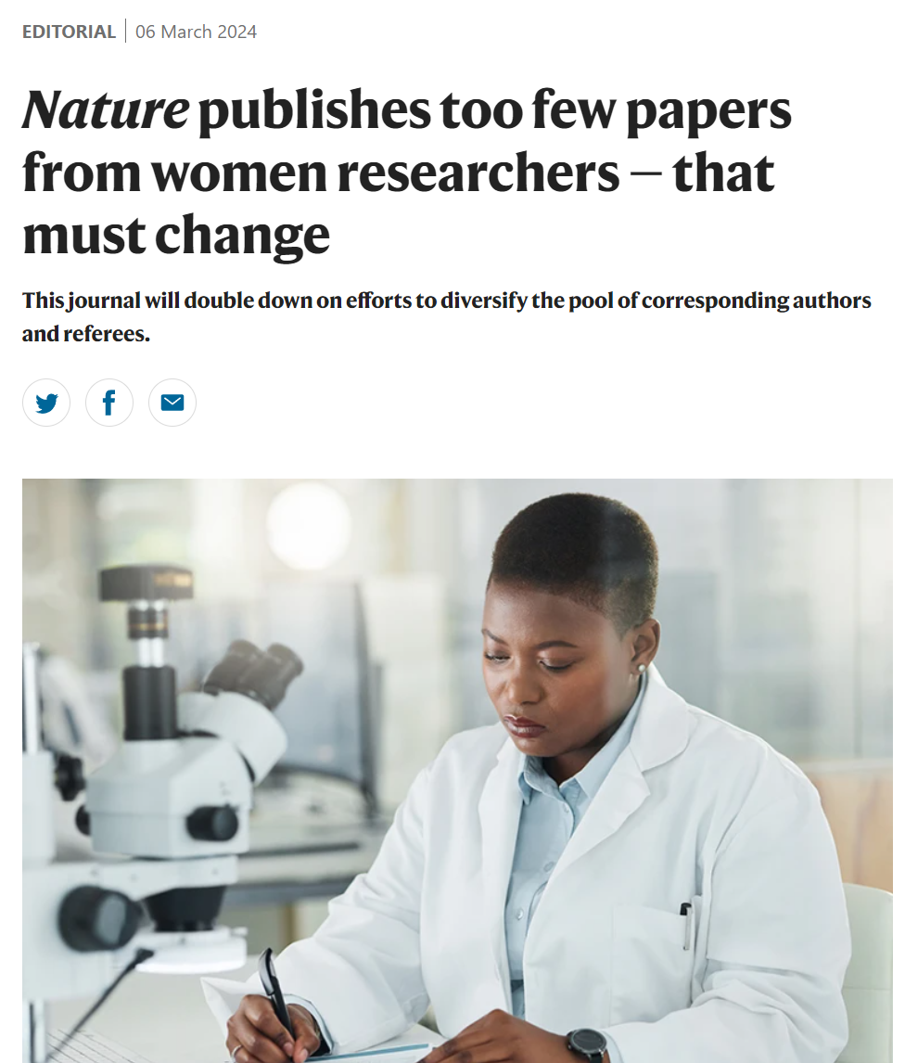
Supporting change

Slide 26
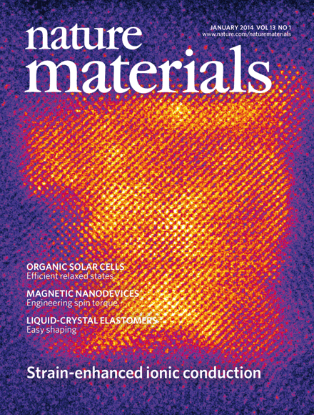
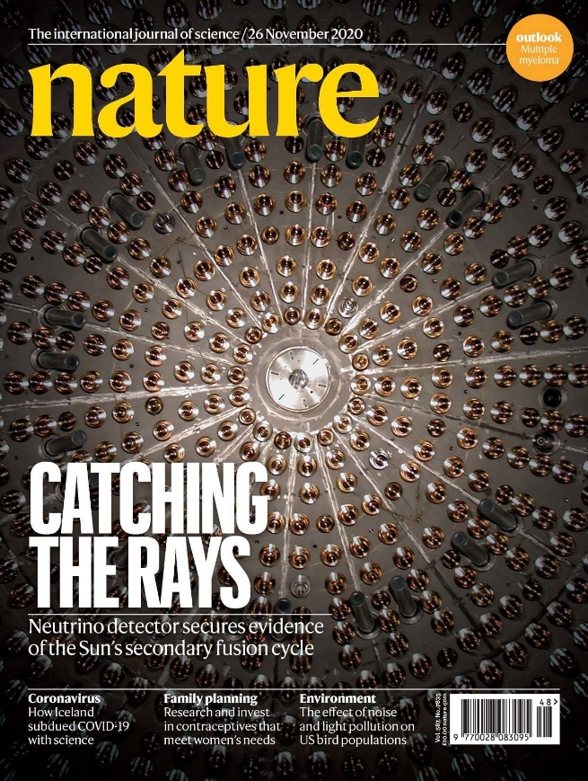
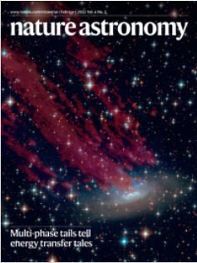
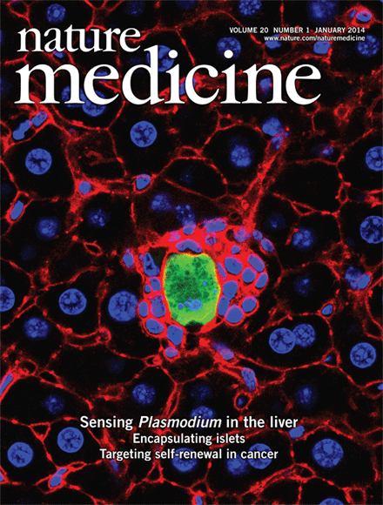
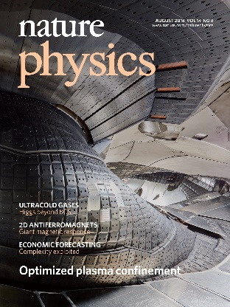
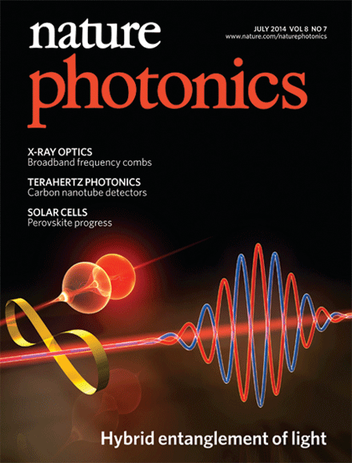
2002
1869
1995
2017
2005
2007
2018
2010

Slide 29
Thank you.
Federico.levi@nature.com
@fdlevi

