Slide 1
An Empire of Time and Tide
Royal Greenwich Observatory
Harrison H4 Watch (1759)
A precision portable time standard makes possible the determination of local longitude, e.g. by comparing time of local sunrise to known time of sunrise in London.

Slide 2
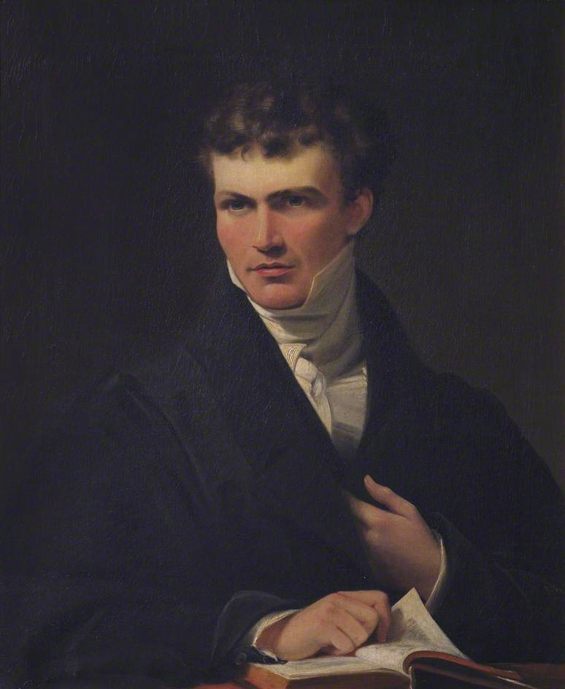
William Whewell FRS
1794-1866
Master of Trinity, Cambridge
“King of the One-Liners”
Anode, astigmatism, cathode, diamagnetic, dielectric, electrode, ion, nebular hypothesis, paramagnetic, philosophy of science, physicist, scientist

Slide 3
cotidal lines
Irish Sea
The German Ocean
William Whewell FRS
1794-1866
Master of Trinity, Cambridge
Pioneer of Scientific Crowdsourcing
His Great Tide Experiment of 1835 engaged 650 volunteers in 9 nations to measure tides every 15 minutes during a two-week period in June, 1835, yielding charts of cotidal lines and amphidromic points
3

Slide 4
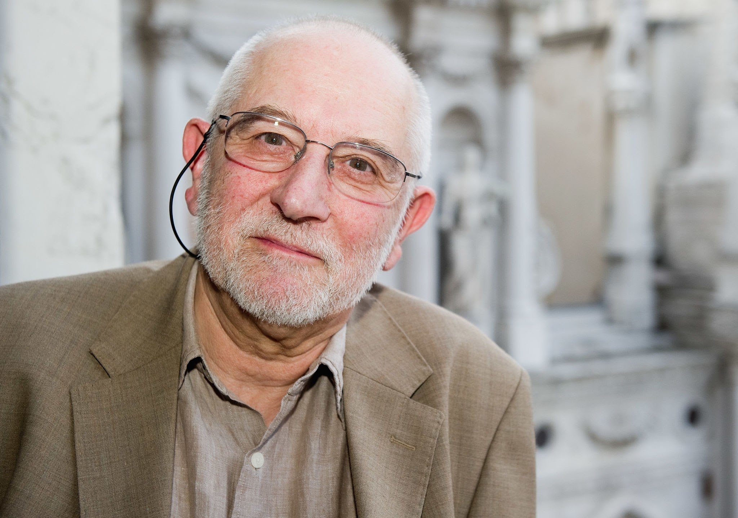
Prof. Sir Michael Berry FRS
Shih-I Pai Lecturer, 2012
4

Slide 5
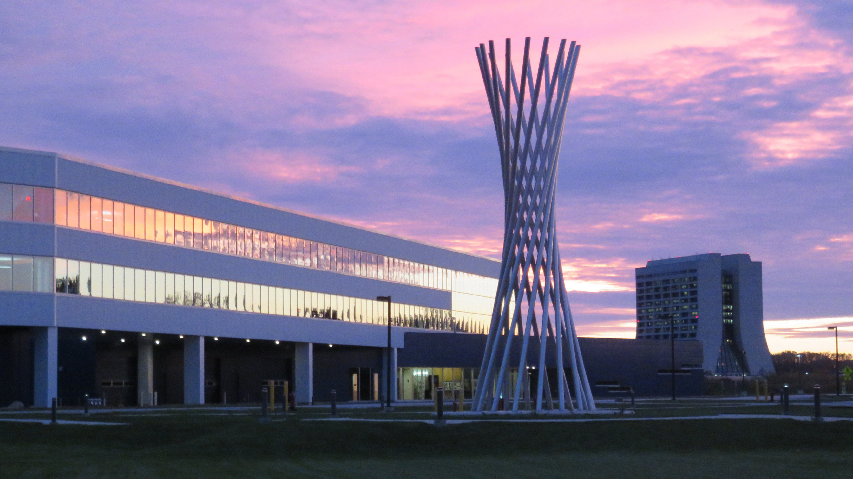
Generation, Detection and Application of Twisted Waves of Light and Neutrons
Dusan Sarenac¹ Melissa E. Henderson¹
Huseyin Ekinci¹ Charles W. Clark^{2,3}
Chandra B. Shahi² David Cory¹
Lisa DeBeer-Schmitt⁴ Michael G. Huber²
Connor L. Kapahi¹ Dmitry Pushin¹
¹Institute for Quantum Computing,
University of Waterloo
²National Institute of Standards
and Technology
³Joint Quantum Institute
⁴Oak Ridge National Laboratory
Tractricious
R. R. Wilson, 1988
FermiLab

Slide 6
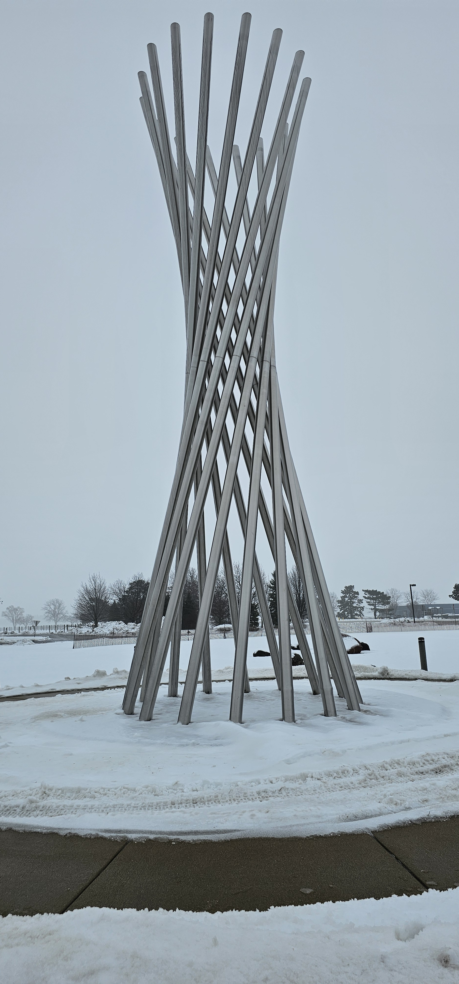
Generation, Detection and Application of Twisted Waves of Light and Neutrons
Dusan Sarenac¹ Melissa E. Henderson¹
Huseyin Ekinci¹ Charles W. Clark^{2,3}
Chandra B. Shahi² David Cory¹
Lisa DeBeer-Schmitt⁴ Michael G. Huber²
Connor L. Kapahi¹ Dmitry Pushin¹
¹Institute for Quantum Computing,
University of Waterloo
²National Institute of Standards
and Technology
³Joint Quantum Institute
⁴Oak Ridge National Laboratory
Tractricious
R. R. Wilson, 1988
FermiLab

Slide 7
Generation and Detection of Twisted Waves of Neutrons and Light
A golden jubilee
A new twist
Waves 101
Neutron as particle
Neutron as wave
The latest twist
Tractricious
R. R. Wilson, 1988
FermiLab

Slide 8
Generation and Detection of Twisted Waves of Neutrons and Light
A golden jubilee
A new twist
Waves 101
Neutron as particle
Neutron as wave
The latest twist
Tractricious
R. R. Wilson, 1988
FermiLab

Slide 9
A golden jubilee!
Prof. Sir Michael Berry FRS
9

Slide 10
Prof. Sir Michael Berry FRS
Shih-I Pai Lecturer, 2012
10

Slide 11
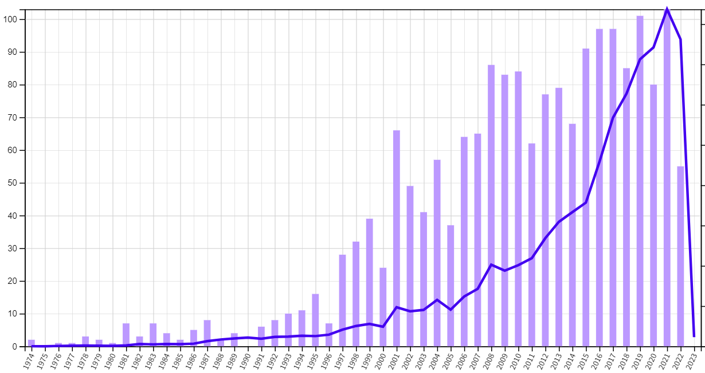
Citations by year, per Web of Science
Prof. Sir Michael Berry FRS
11

Slide 12
Citations by year, per Web of Science
CE
BCE
Year
12

Slide 13
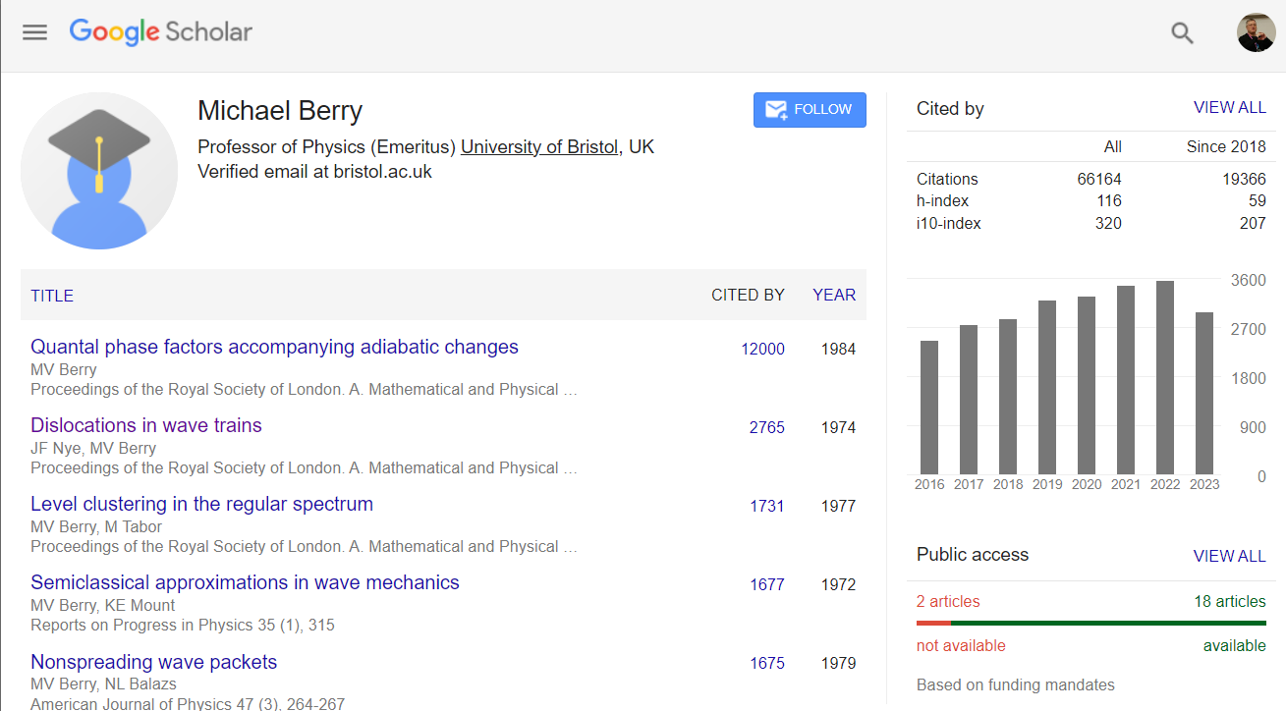
13

Slide 14
Generation and Detection of Twisted Waves of Neutrons and Light
A golden jubilee
A new twist
Waves 101
Neutron as particle
Neutron as wave
The latest twist
Tractricious
R. R. Wilson, 1988
FermiLab
14

Slide 15
Laser beams with screw dislocations in their wavefronts
V. Yu. Bazhenov, M. V. Vasnetsov, and M. S. Soskin
Institute of Physics, Academy of Sciences of the Ukrainian SSR
(Submitted 28 August 1990)
Pis’ma Zh. Eksp. Teor. Fiz 52, No. 8, 1037-1039 (25 October 1990)
flags.net
15

Slide 16
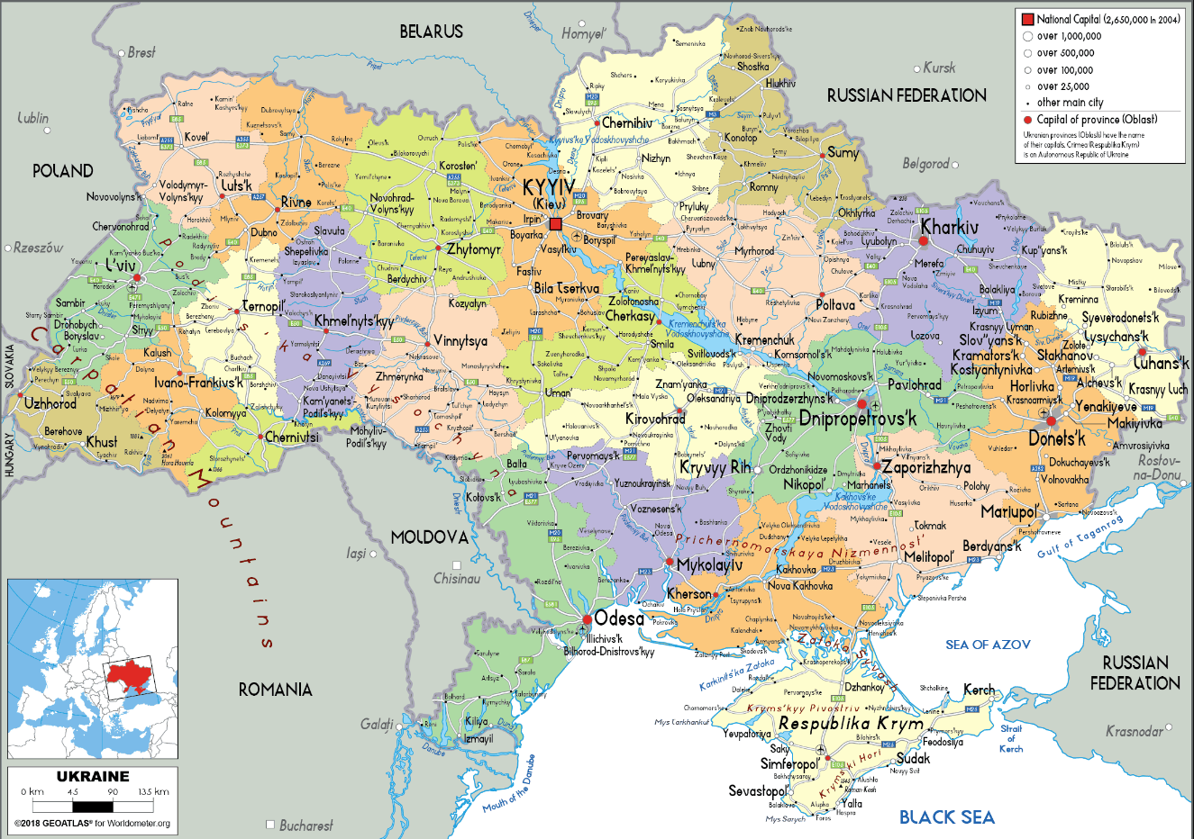
worldometers.info
16

Slide 17
Fig. 172. Amphidromy of the semi-diurnal tides in the Black Sea. Establishlisments of the stations (according to Sterneck [1922]).
Physical Oceanography, Vol. II, A. Defant (Pergamon Press, Oxford, 1960.
Contemporary geographical map, same scale (Norman Einstein, Wikipedia, 2005)
17
Norman Einstein, Wikipedia

Slide 18
ReferenceBeam
If the Reference Beam is a spherical wave and the Object Beam is a plane wave, then the hologram is the familiar Newton ring pattern.
Object Beam
Fiber
Braid
The 1990 holograms of Bazhenov, Vasnetsov and Soskin
R. W. Wood,
Physical Optics
18

Slide 19
ReferenceBeam
If the Reference Beam is a spherical wave and the Object Beam is a plane wave, then the hologram is the familiar Newton ring pattern.
Object Beam
Fiber
Braid
The 1990 holograms of Bazhenov, Vasnetsov and Soskin
R. W. Wood,
Physical Optics
Synthetic holograms using plane-wave reference beam: forked dislocation gratings with l = 1 and l = 2
Twist the braid and you unwrap Newton’s rings!
Above: Mach-Zehnder interferometer of Bazhenov et al. (1990)
Below: Hologram of optical vortex using spherical-wave reference beam
19

Slide 20
Generation and Detection of Twisted Waves of Neutrons and Light
A golden jubilee
A new twist
Waves 101
Neutron as particle
Neutron as wave
The latest twist
Tractricious
R. R. Wilson, 1988
FermiLab

Slide 21
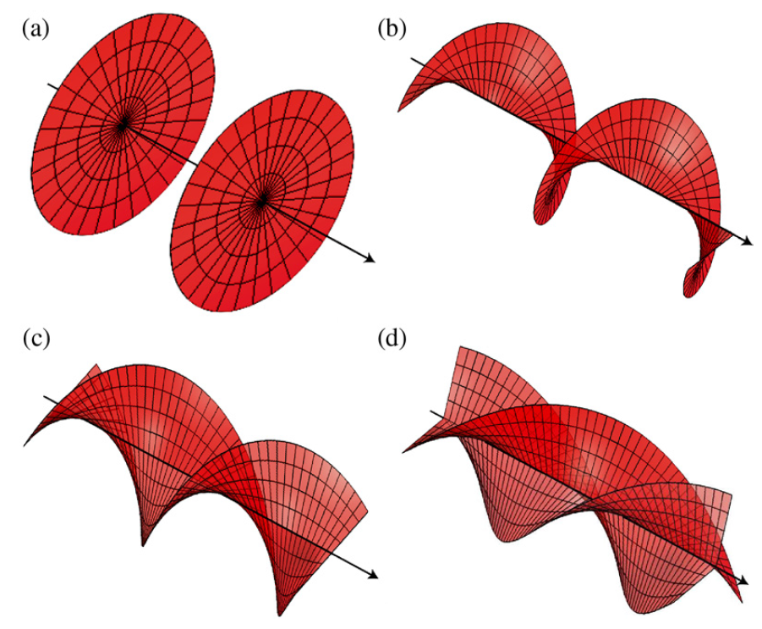
Waves 101: orbital angular momentum (OAM)
Orbital angular momentum
(OAM) waves
Implemented in light (1990),
ultracold atoms (2006),
electrons (2010), neutrons (2015),
neutral atom beams (2021)
A. M. Yao and M. J. Padgett, Adv. Opt. Photon. 3, 161–204 (2011)
Field amplitude carries a spiral phase exp (ilφ) . Helical phase fronts for
(a) l = 0, (b) l = 1, (c) l = 2, and (d) l = 3. l is the topological charge or the orbital angular momentum in units of the reduced Planck constant = h/(2π)
$$ℏ$$

Slide 22
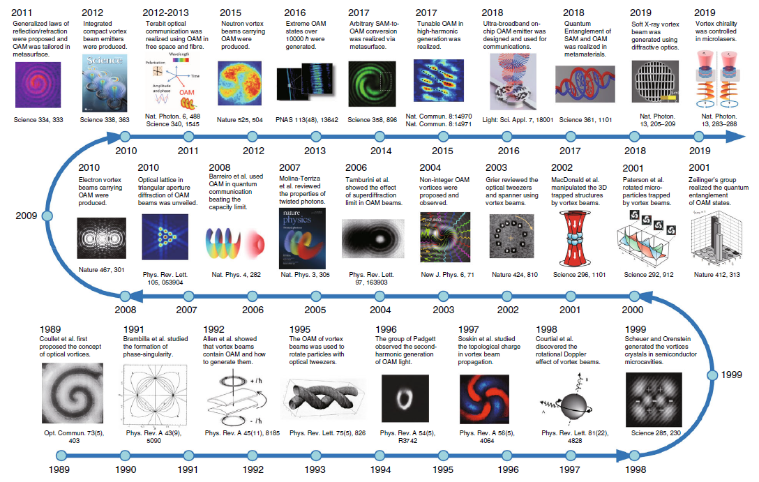
“Optical vortices 30 years on: OAM manipulation from topological charge to multiple singularities,
Y. Shen, et al., Light Sci. App. 8,90 (2019)

Slide 23
Published 30 August 2023
Three Amigos

Slide 24
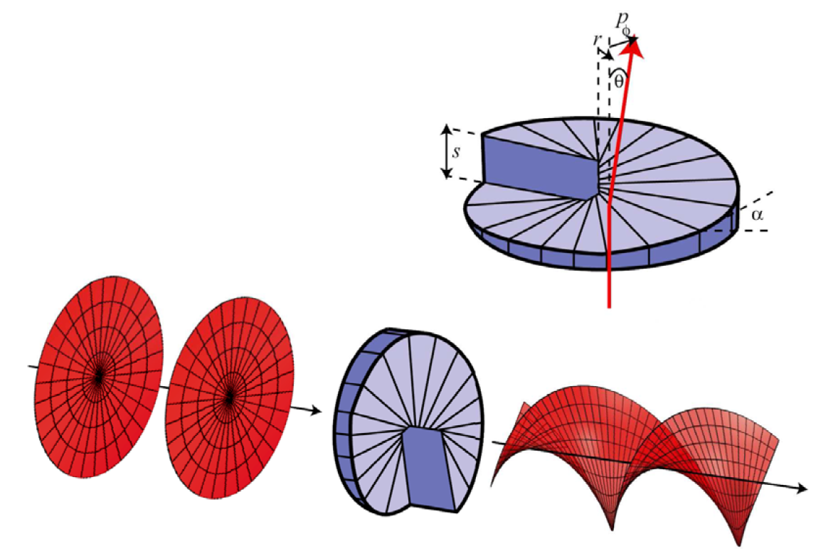
Generate OAM with transmission spiral phase plate (SPP)
A. M. Yao and M. J. Padgett,
Adv. Opt. Photon. 3, 161–204 (2011)
approximates the phase dislocation within optical figure tolerances of machining

Slide 25
More generally useful for OAM : nanofabricated forked-dislocation diffraction gratings
Transmission holograms on 20-nm-thick SiN nitride membranes for OAM of He, He*, He₂*: A. Luski, et al., Science 373, 1105 (2021)
Soskin
synthesis
(1990)
E-beam lithography:
Electron beam OAM
B. J. McMorran et al.,
Phil. Trans. Roy. Soc. A 375, 20150434 (2017)
25

Slide 26
Electrons with extremely high OAM diffracted from gratings with topological charge of (a) 200 (a) and (b) 800.
From B. J. McMorran et al., Phil. Trans. Roy. Soc. A 375, 20150434 (2017)

Slide 27
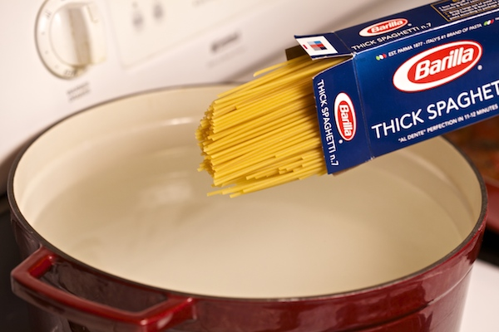
How can a particle twist around a central trajectory axis in the absence of external forces?
Image: Nicole Presley

Slide 28
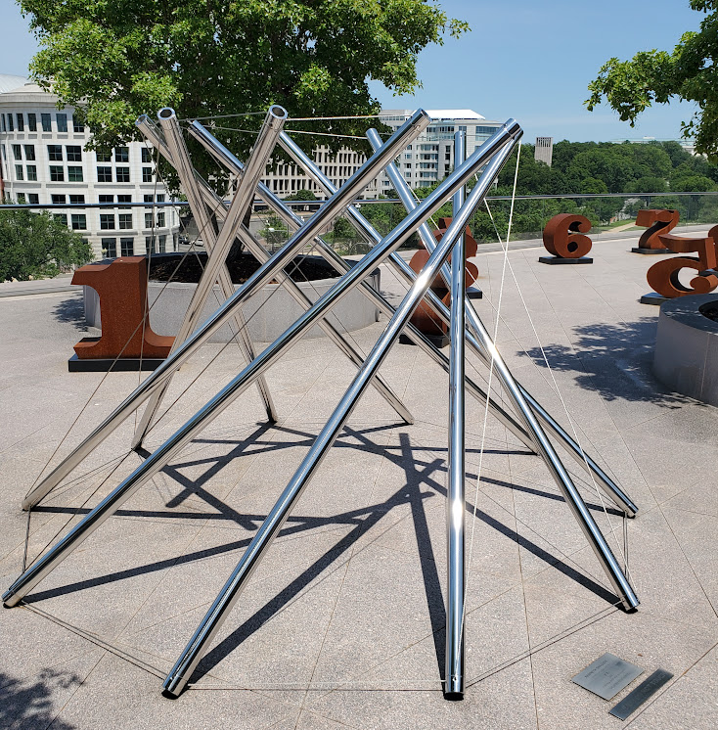
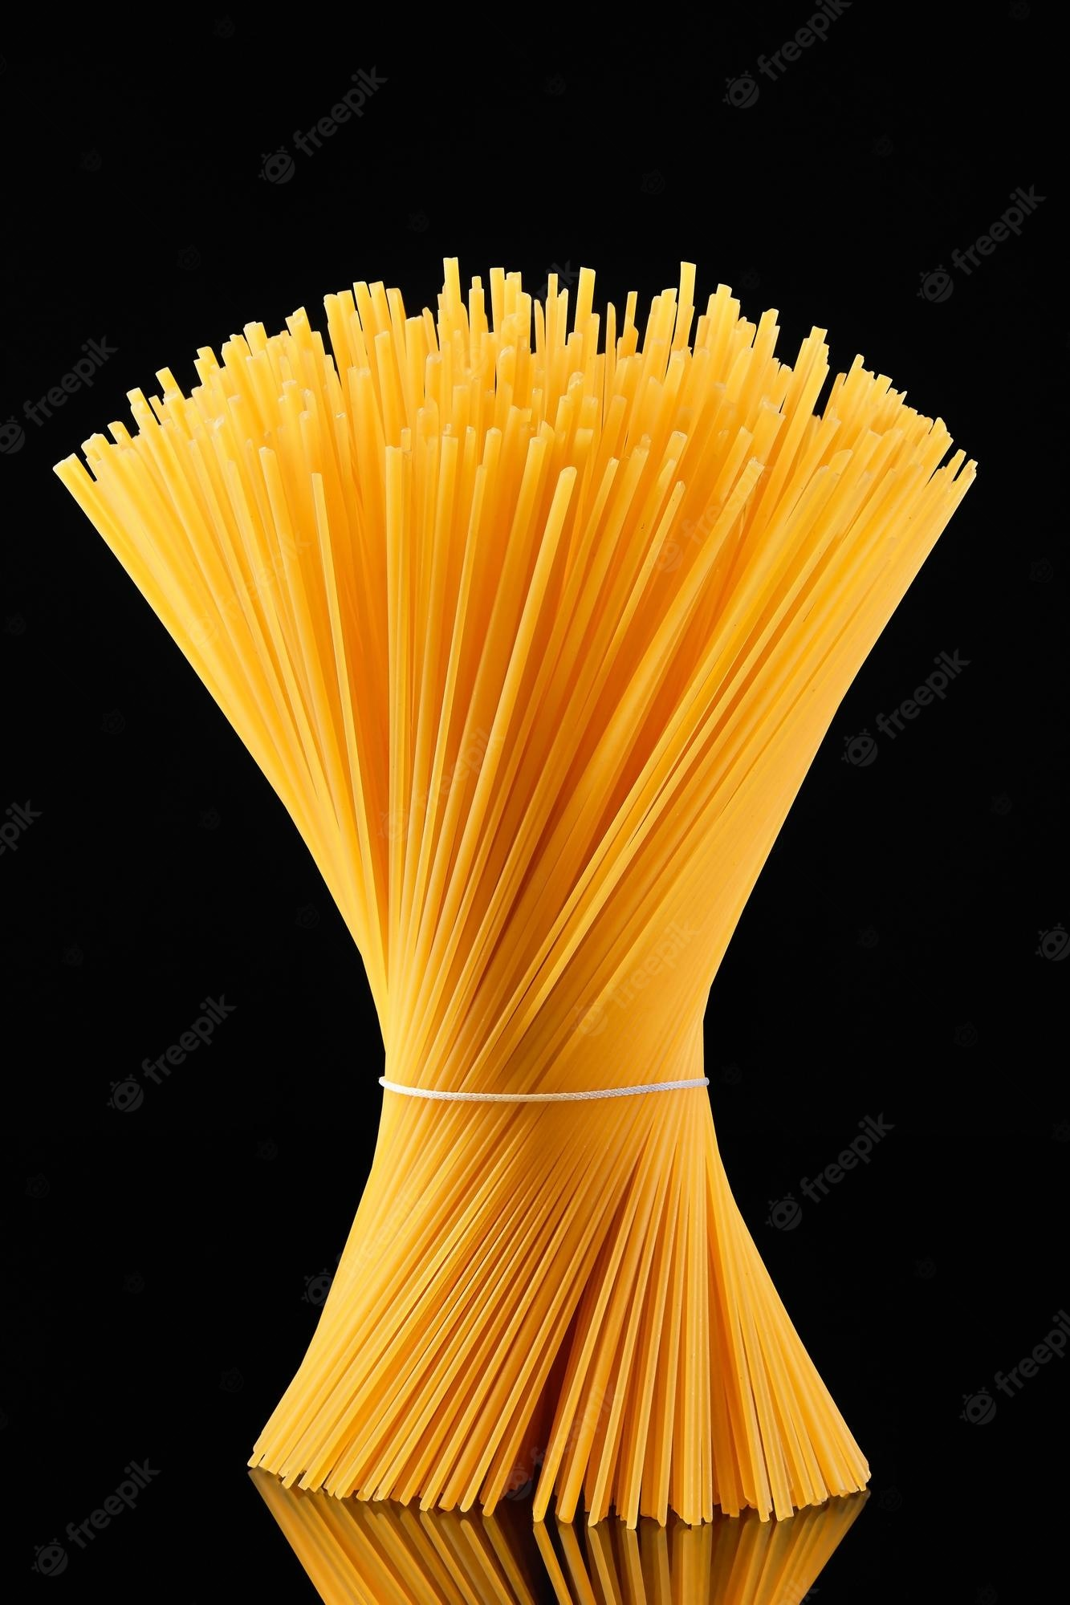
Spiral motion is a superposition of linear trajectories
Tractricious
R. R. Wilson, 1988
Image: Nicole Presley
V-X
Kenneth Snelson, 1968

Slide 29
Waves 101: orbital angular momentum (OAM)
We can only sculpt in a limited range
Orbital angular momentum
(OAM) waves
Implemented in light (1990),
ultracold atoms (2006),
electrons (2010), neutrons (2015),
neutral atom beams (2021)
A. M. Yao and M. J. Padgett, Adv. Opt. Photon. 3, 161–204 (2011)
Field amplitude carries a spiral phase exp (ilφ) . Helical phase fronts for
(a) l = 0, (b) l = 1, (c) l = 2, and (d) l = 3. l is the topological charge or the orbital angular momentum in units of the reduced Planck constant = h/(2π)
$$ℏ$$

Slide 30
Generation and Detection of Twisted Waves of Neutrons and Light
A golden jubilee
A new twist
Waves 101
Neutron as particle
Neutron as wave
The latest twist
Tractricious
R. R. Wilson, 1988
FermiLab

Slide 31
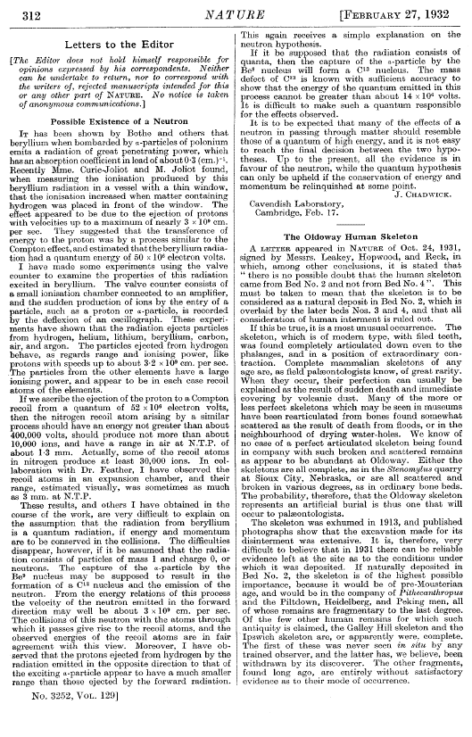
A zero-day attack!
Unanticipated in detail:
per Heisenberg (months later): the neutral neutron is a twin of the charged proton – isospin symmetry
Unique awesome power to penetrate all matter
31

Slide 32
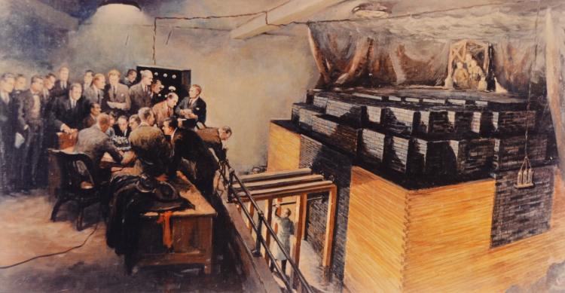
February 27, 1932
The most powerful source of energy yet known, from a wee particle discovered but 11 years before.
First controlled nuclear chain reaction attained with Chicago Pile 1. December 2, 1942
© Chicago Historical Society
32

Slide 33
February 27, 1932
The most powerful source of energy yet known, from a wee particle discovered but 11 years before.
First controlled nuclear chain reaction attained with Chicago Pile 1. December 2, 1942
What notable event occurred just about a year previously, on December 6, 1941?
© Chicago Historical Society
33

Slide 34
Management of the Hanford Engineer Works in World War II
What could possibly go wrong?

Slide 35
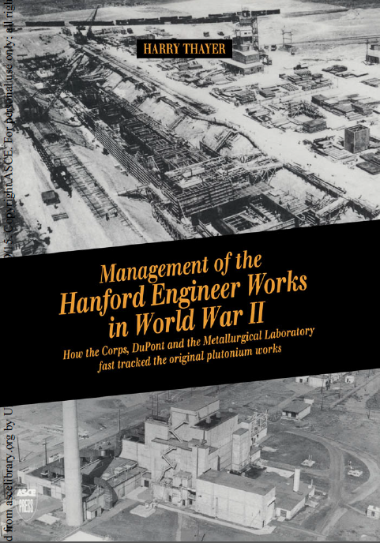
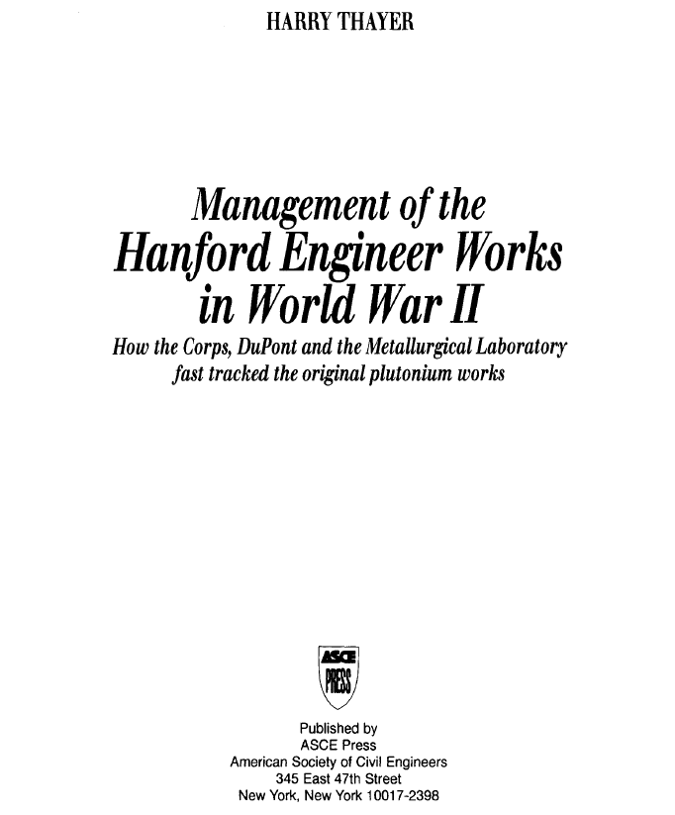
Management of the Hanford Engineer Works in World War II

Slide 36
Management of the Hanford Engineer Works in World War II
Mere details!

Slide 37
The Management Team

Slide 38
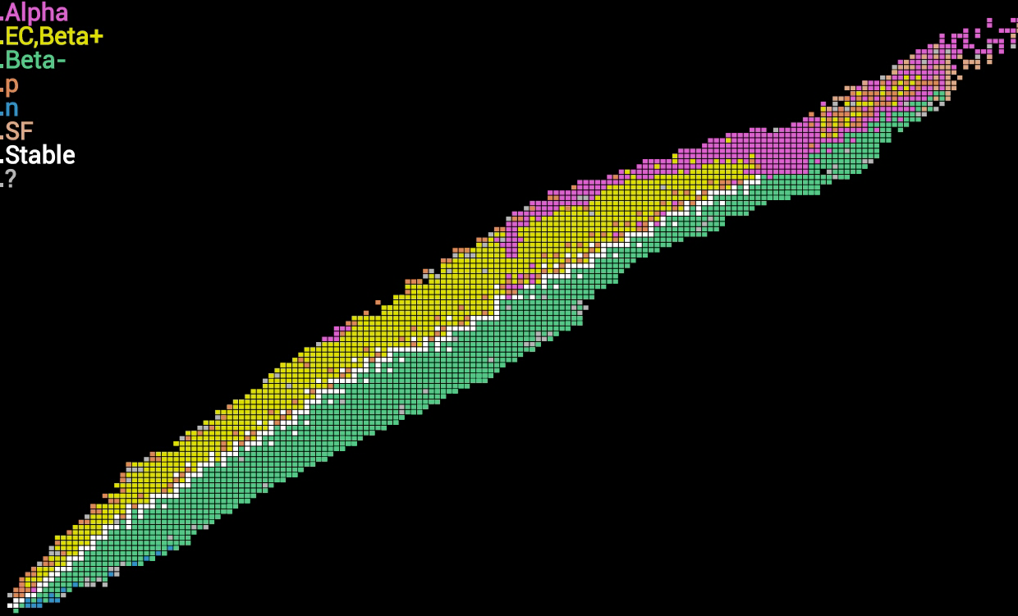
Chart of the Nuclides
IAEA Nuclear Data Section
Number of Protons Z →
38
Number of Neutrons N →

Slide 39
Chart of the Nuclides
⁶Li
IAEA Nuclear Data Section
³He
⁴He
¹H
²H
³H
Number of Protons Z →
Number of Neutrons N →

Slide 40
Chart of the Nuclides
IAEA Nuclear Data Section
Number of Protons Z →
The neutron is the only atomic nucleus that is electrically neutral, and thus able to penetrate matter at even the lowest energies.
Number of Neutrons N →

Slide 41
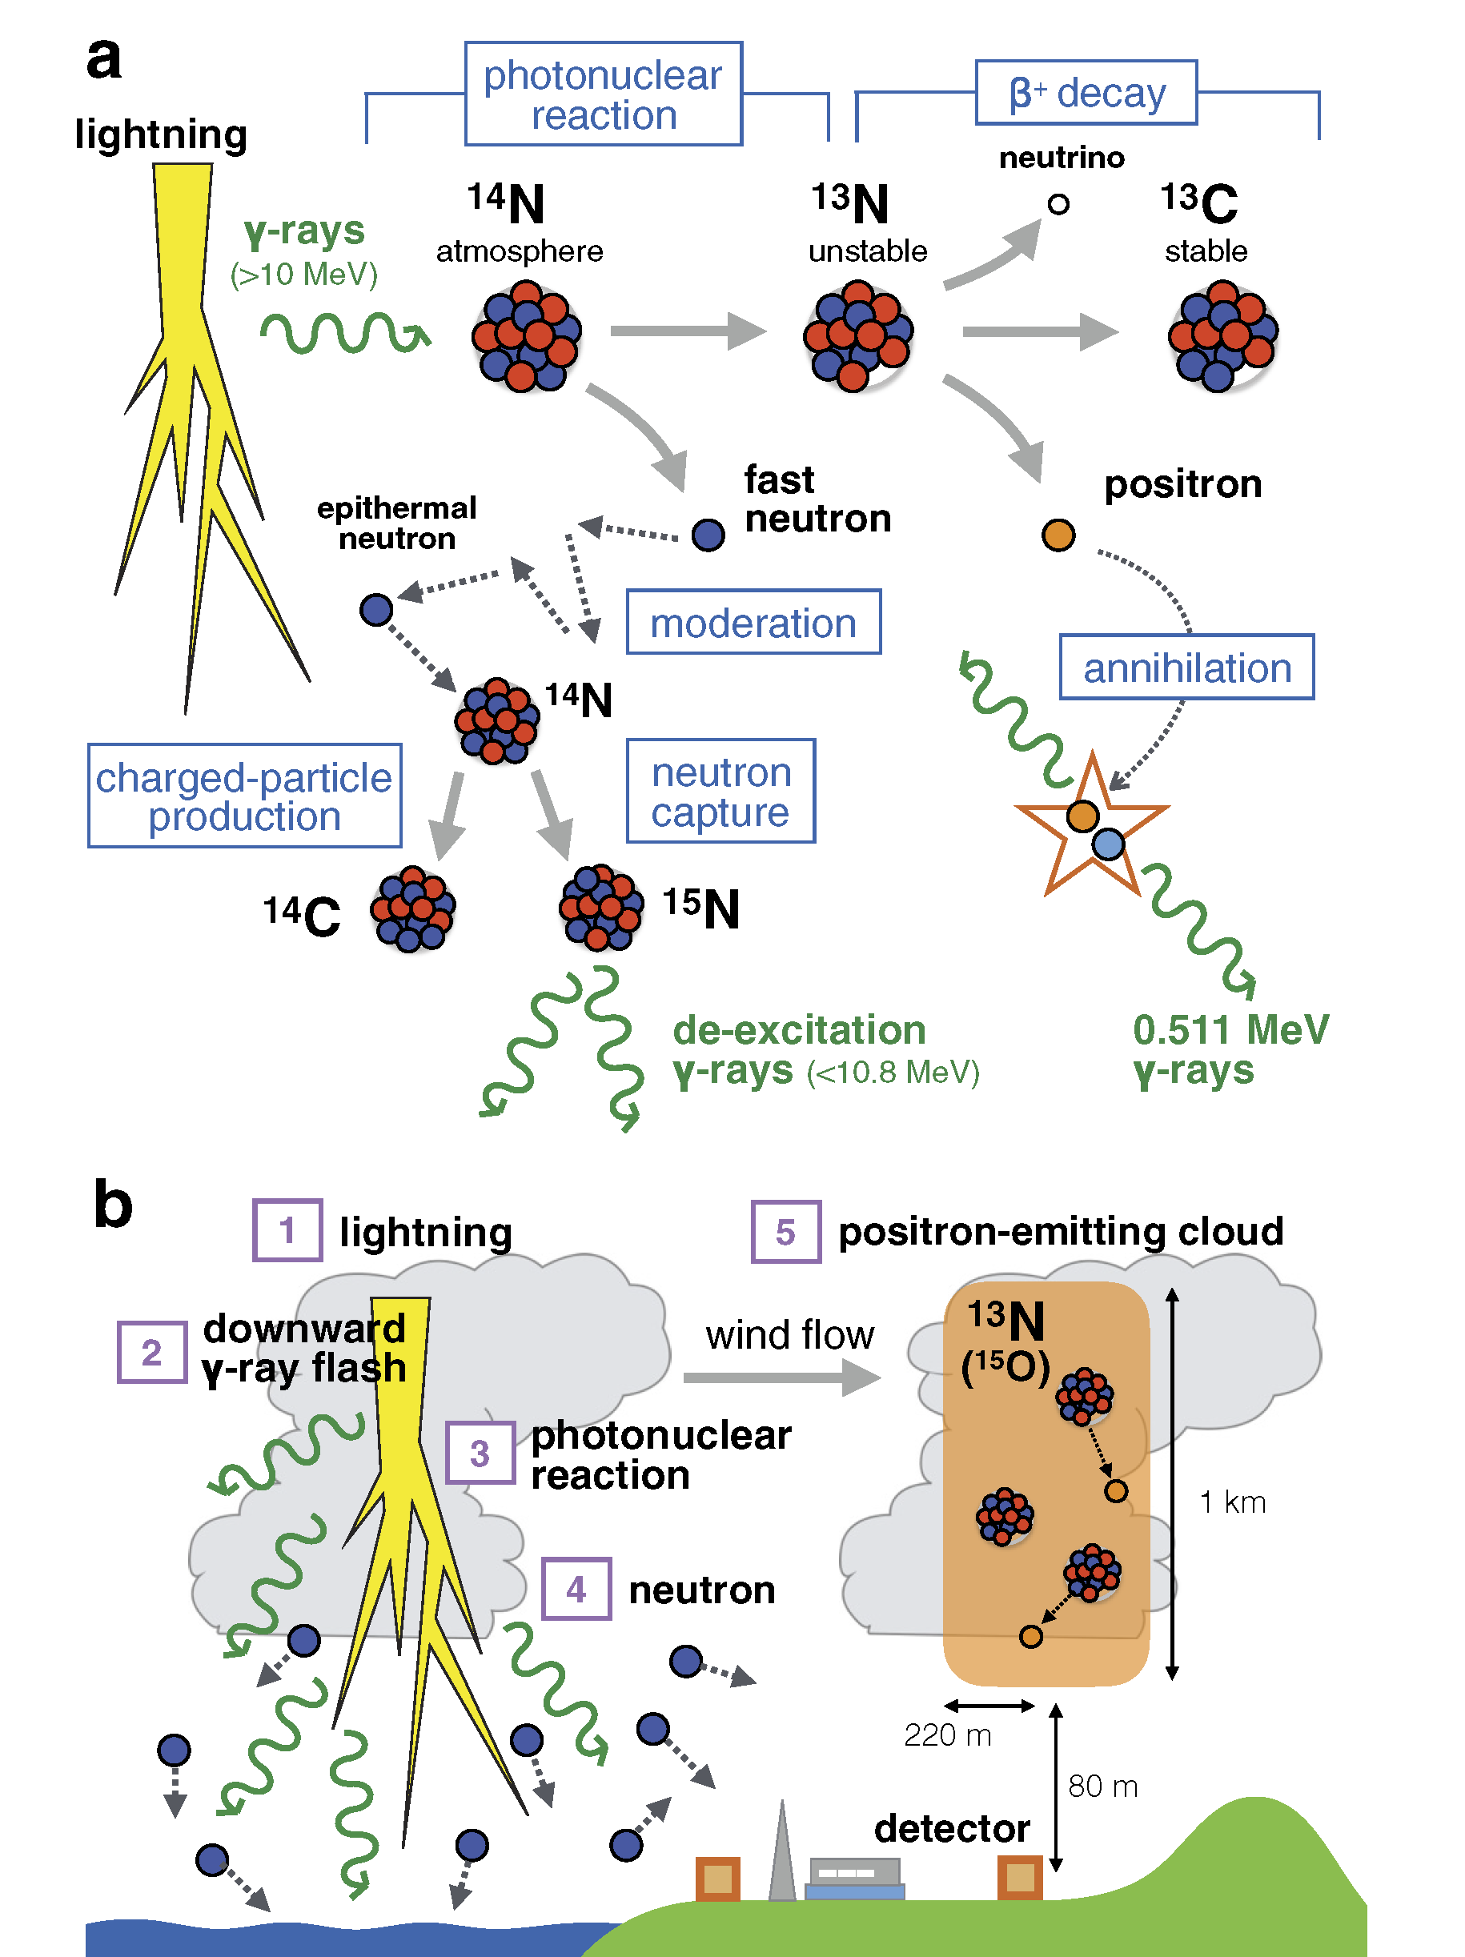
Photonuclear reactions triggered by lightning discharge
Teruaki Enoto, et al., Nature 551, 481 (2017)
The Philosopher’s Stone
Room-temperature neutrons effect transmutation of the elements:
n(¹⁴N,¹⁴C)p
This reaction, initiated by neutrons produced by cosmic-ray spallation in the Earth’s atmosphere, generates the unstable carbon-14 (t_{1/2} = 5700 years) used in dating applications.
20 million technicium diagnostic medical procedures/year made possible by thermal neutron-induced reactions.
41

Slide 42
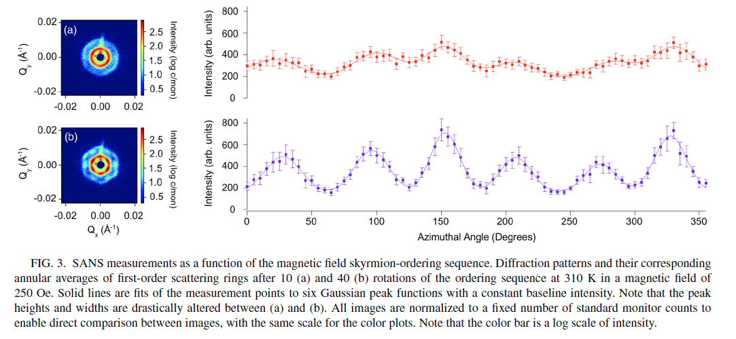
Small-angle neutron scattering (SANS) studies of skyrmions at the NIST Center for Neutron Research

Slide 43
Generation and Detection of Twisted Waves of Neutrons and Light
A golden jubilee
A new twist
Waves 101
Neutron as particle
Neutron as wave
The latest twist
Tractricious
R. R. Wilson, 1988
FermiLab

Slide 44
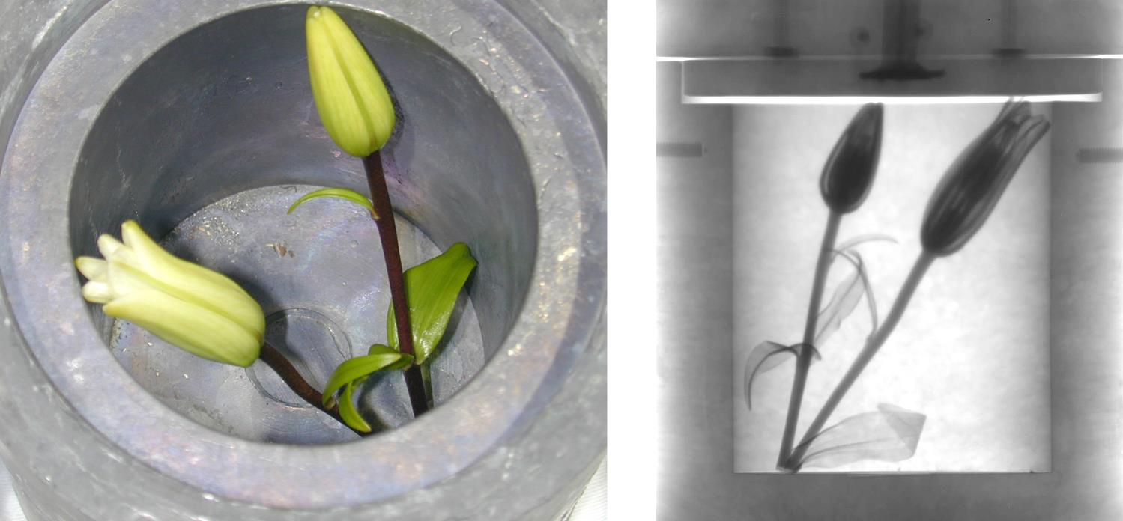
As seen from the side
by neutron radiography
Daniel Hussey, NIST
Lilies in Pb cask, photographed from above
The neutron is the only atomic nucleus that is electrically neutral, and thus able to penetrate matter at even the lowest energies.

Slide 45
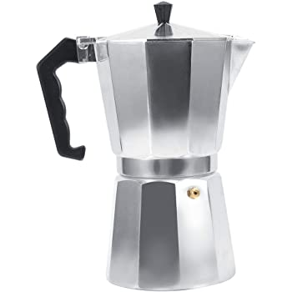
Amazon.com
Moka Pot
Neutron radiograph by Paul Scherrer Institute
The neutron is the only atomic nucleus that is electrically neutral, and thus able to penetrate matter at even the lowest energies.

Slide 46
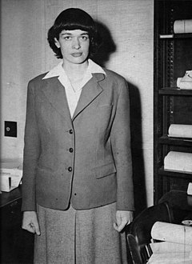
Sam Werner’s Rule of Twos
A thermal neutron has:
speed of 2000 meter/second
kinetic energy of 20 meV (millielectronvolt)
De Broglie wavelength of 2 Å (Ångstrom unit)
Leona Woods Marshall Libby
1919-1986

Slide 47
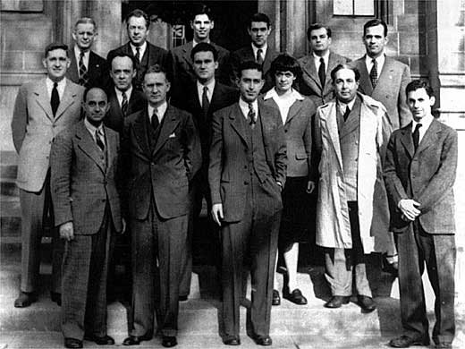
Sam Werner’s Rule of Twos
A thermal neutron has:
speed of 2000 meter/second
kinetic energy of 20 meV (millielectronvolt)
De Broglie wavelength of 2 Å (Ångstrom unit)
Leona Woods Marshall Libby
1919-1986

Slide 48
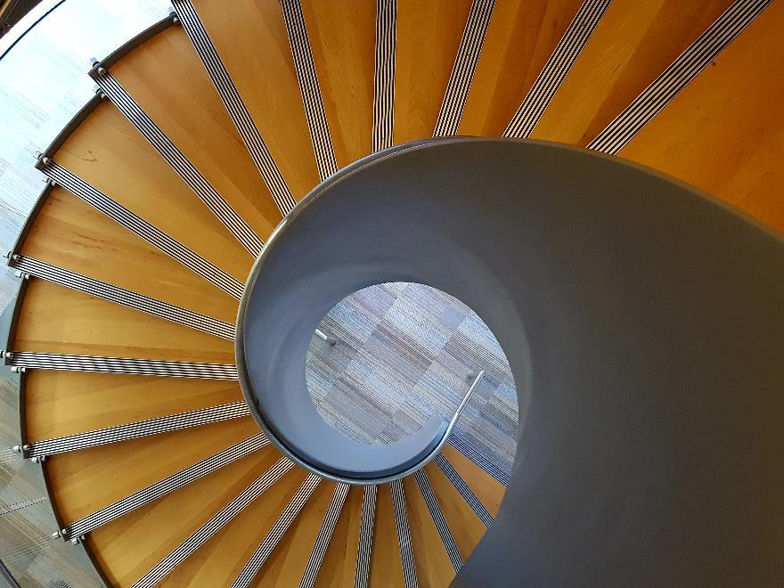
Propagation of these thermal/cold neutrons through matter is described by “neutron optics” in media with index of refraction n, where | n - 1 | ~ 10⁻⁶ .
Phase of wavefunction increases linearly with azimuthal angle ϕ.
Two 4π SPPs as seen from above, 10 mm and 15 mm diameter respectively. Milled from Al 6061 dowel by CNC machine in NIST shops.
A spiral staircase at the Joint Quantum Institute, College Park, MD.
Index of refraction n = 1 – 2.43 x 10⁻⁶
Control phase of λ =0.271 nm
De Broglie wave with 0.1 mm dimensional figure!

Slide 49
Generation and Detection of Twisted Waves of Neutrons and Light
A golden jubilee
A new twist
Waves 101
Neutron as particle
Neutron as wave
The latest twist
Tractricious
R. R. Wilson, 1988
FermiLab

Slide 50
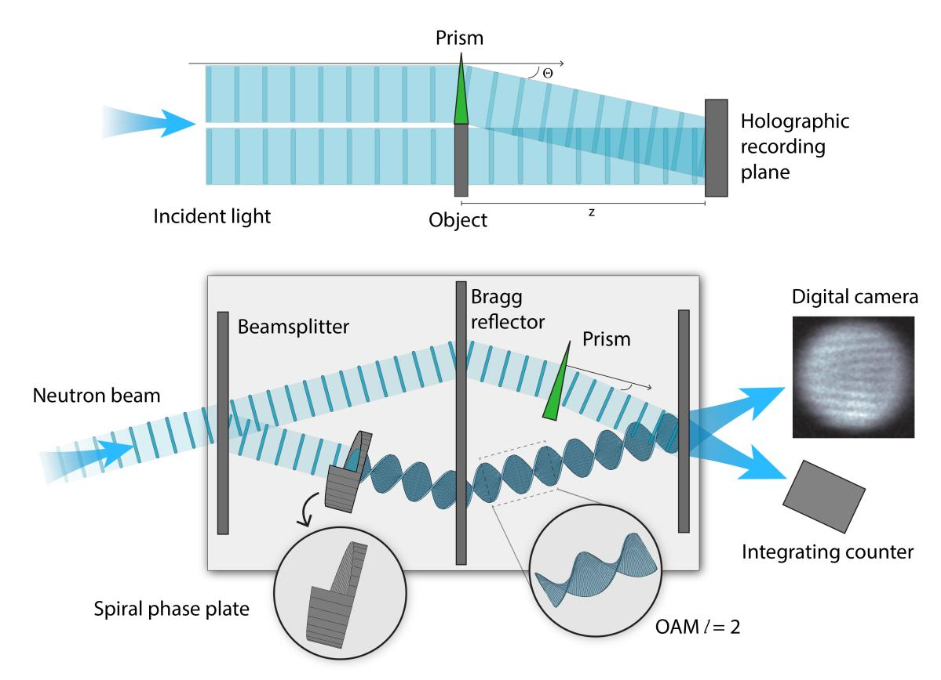
Neutron holography
Leith and Upatnieks configuration in a neutron interferometer

Slide 51
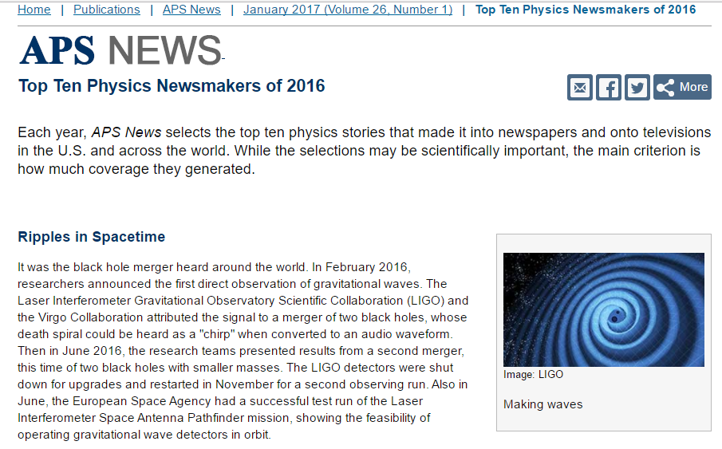
APS News Top Ten Physics Newsmakers of 2016
1. Ripples in Spacetime
2. Nobel Prizes
3. Rise and Fall of the 750 GeV Bump
4. Celebrity Elements
5. Neutron Holography
6. The Solar System’s 9th Resident?
7. Kokabee Freed
8. CERN’s First Female Director
9. Rosetta’s Last Signal
10. In Memoriam

Slide 52
Holography with a neutron interferometer
D. Sarenac, M. Arif†, C. W. Clark,
D. G. Cory, B. Heacock, M G. Huber,
C. Shahi and D. A. Pushin,
Optics Express 24, 22528 (2016)
Coherence length of neutron beams of ∼ 1 micron significantly diminishes contrast.
Ideal
Observed

Slide 53
We construct a synthetic hologram of forked dislocation gratings with critical dimensions matched to the neutron coherence length.

Slide 54
A 2,500 x 2,500 array of 6,250,000 forked dislocation gratings of micron-scale critical dimensions.
Far-field image hints at true vortex structure.

Slide 55
Spin-orbit coupling of neutron beams for analysis of chiral magnetic materials
PNAS | October 8, 2019 | vol. 116 | no. 41 | 20329

Slide 56
Generation and Detection of Twisted Waves of Neutrons and Light
A golden jubilee
A new twist
Waves 101
Neutron as particle
Neutron as wave
The latest twist
Tractricious
R. R. Wilson, 1988
FermiLab

Slide 57
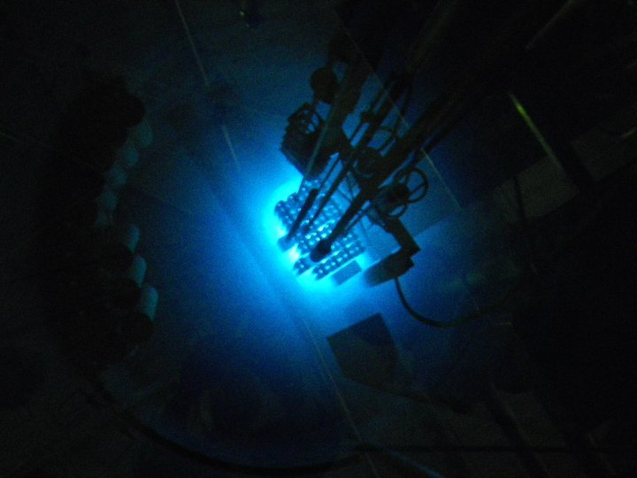
Photo: Etsy
Maryland University Training Reactor
University of Maryland, College Park
Licensed power: 0.25 MWt

Slide 58
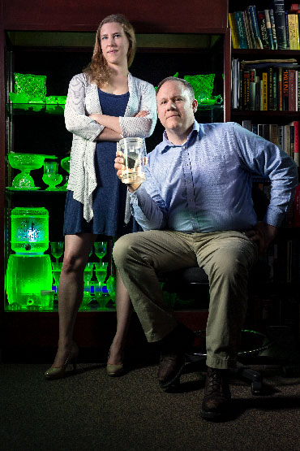
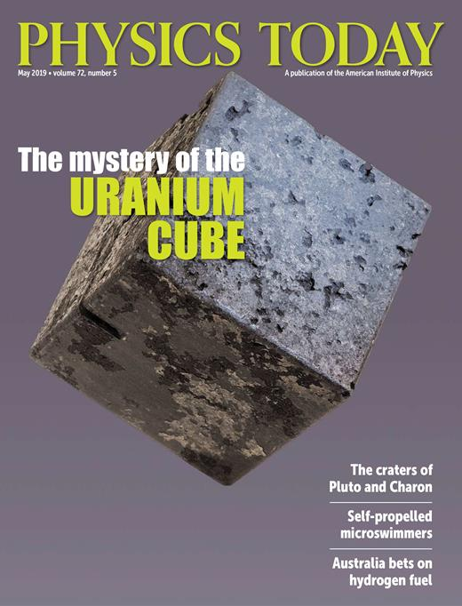

Slide 59
Just how electrically neutral is the neutron?
Particle Data Group
Prog. Theor. Exp. Phys. 2022, 083C01 (2022)

