Slide 1
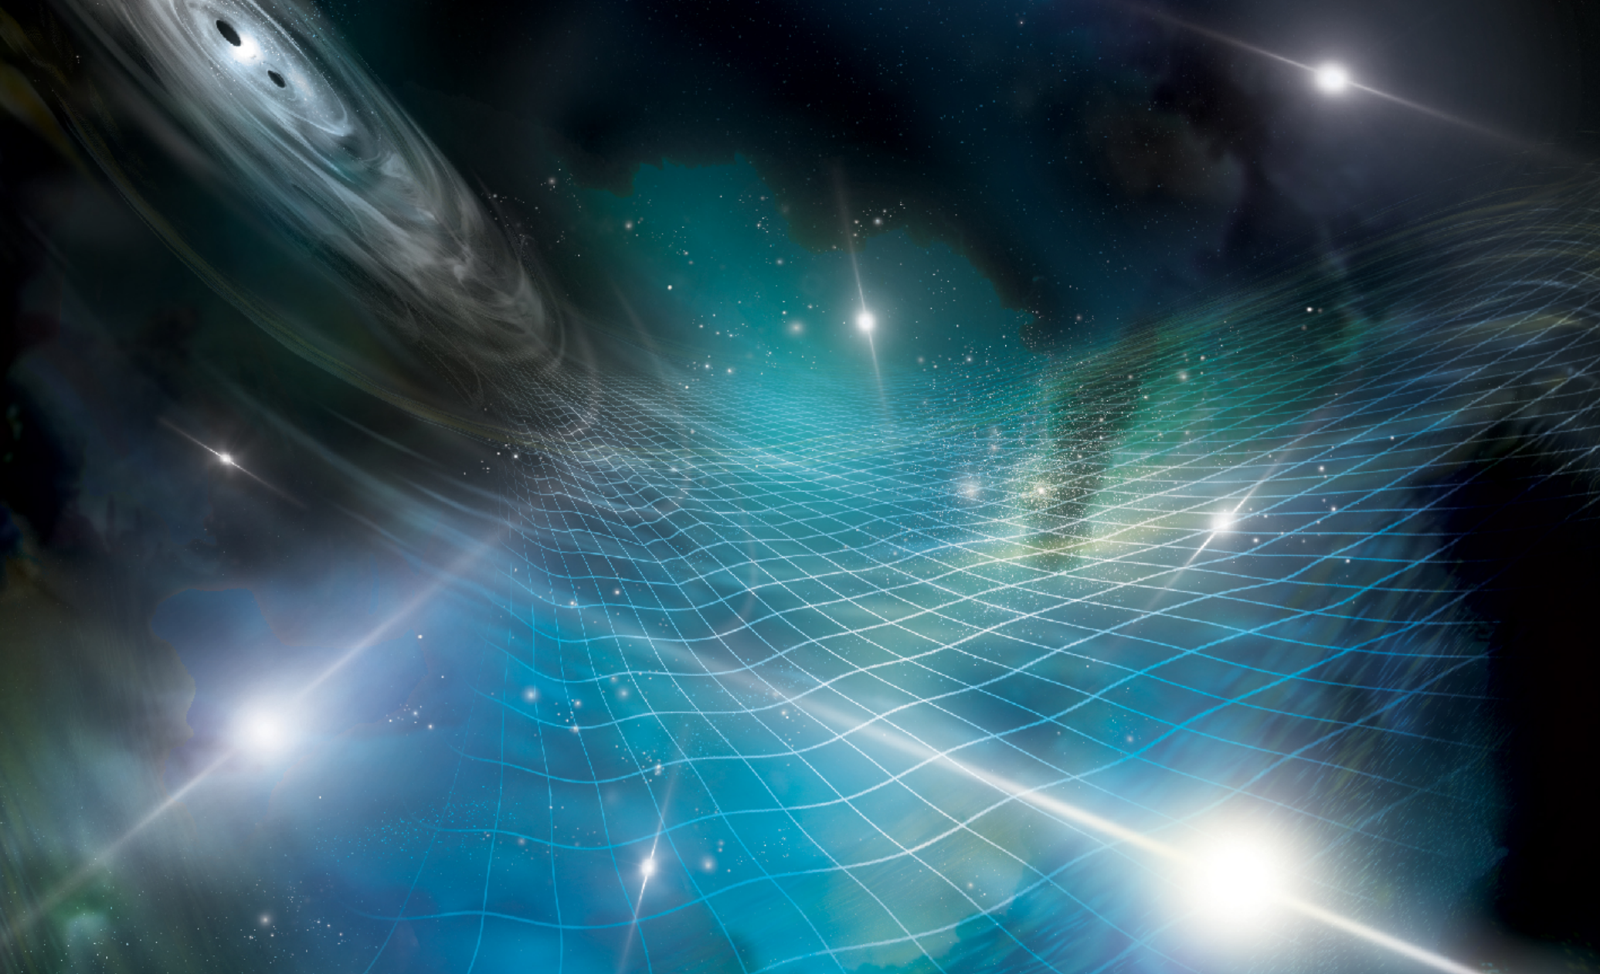



Patience is a virtue:
The 15-year
Gravitational Wave Results
Scott Ransom
Credit: NANOGrav/Sonoma State U./Aurore Simonnet

Slide 2

Sir Brian May
31 October 2023

Slide 3
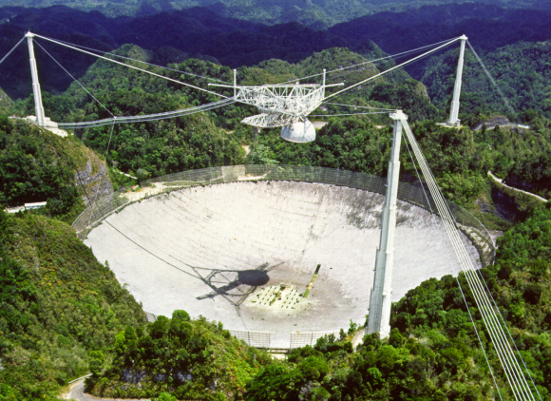
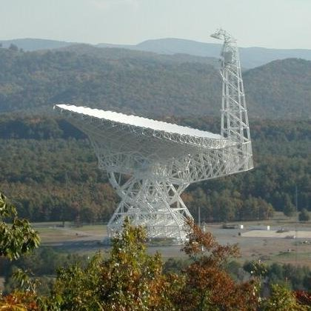
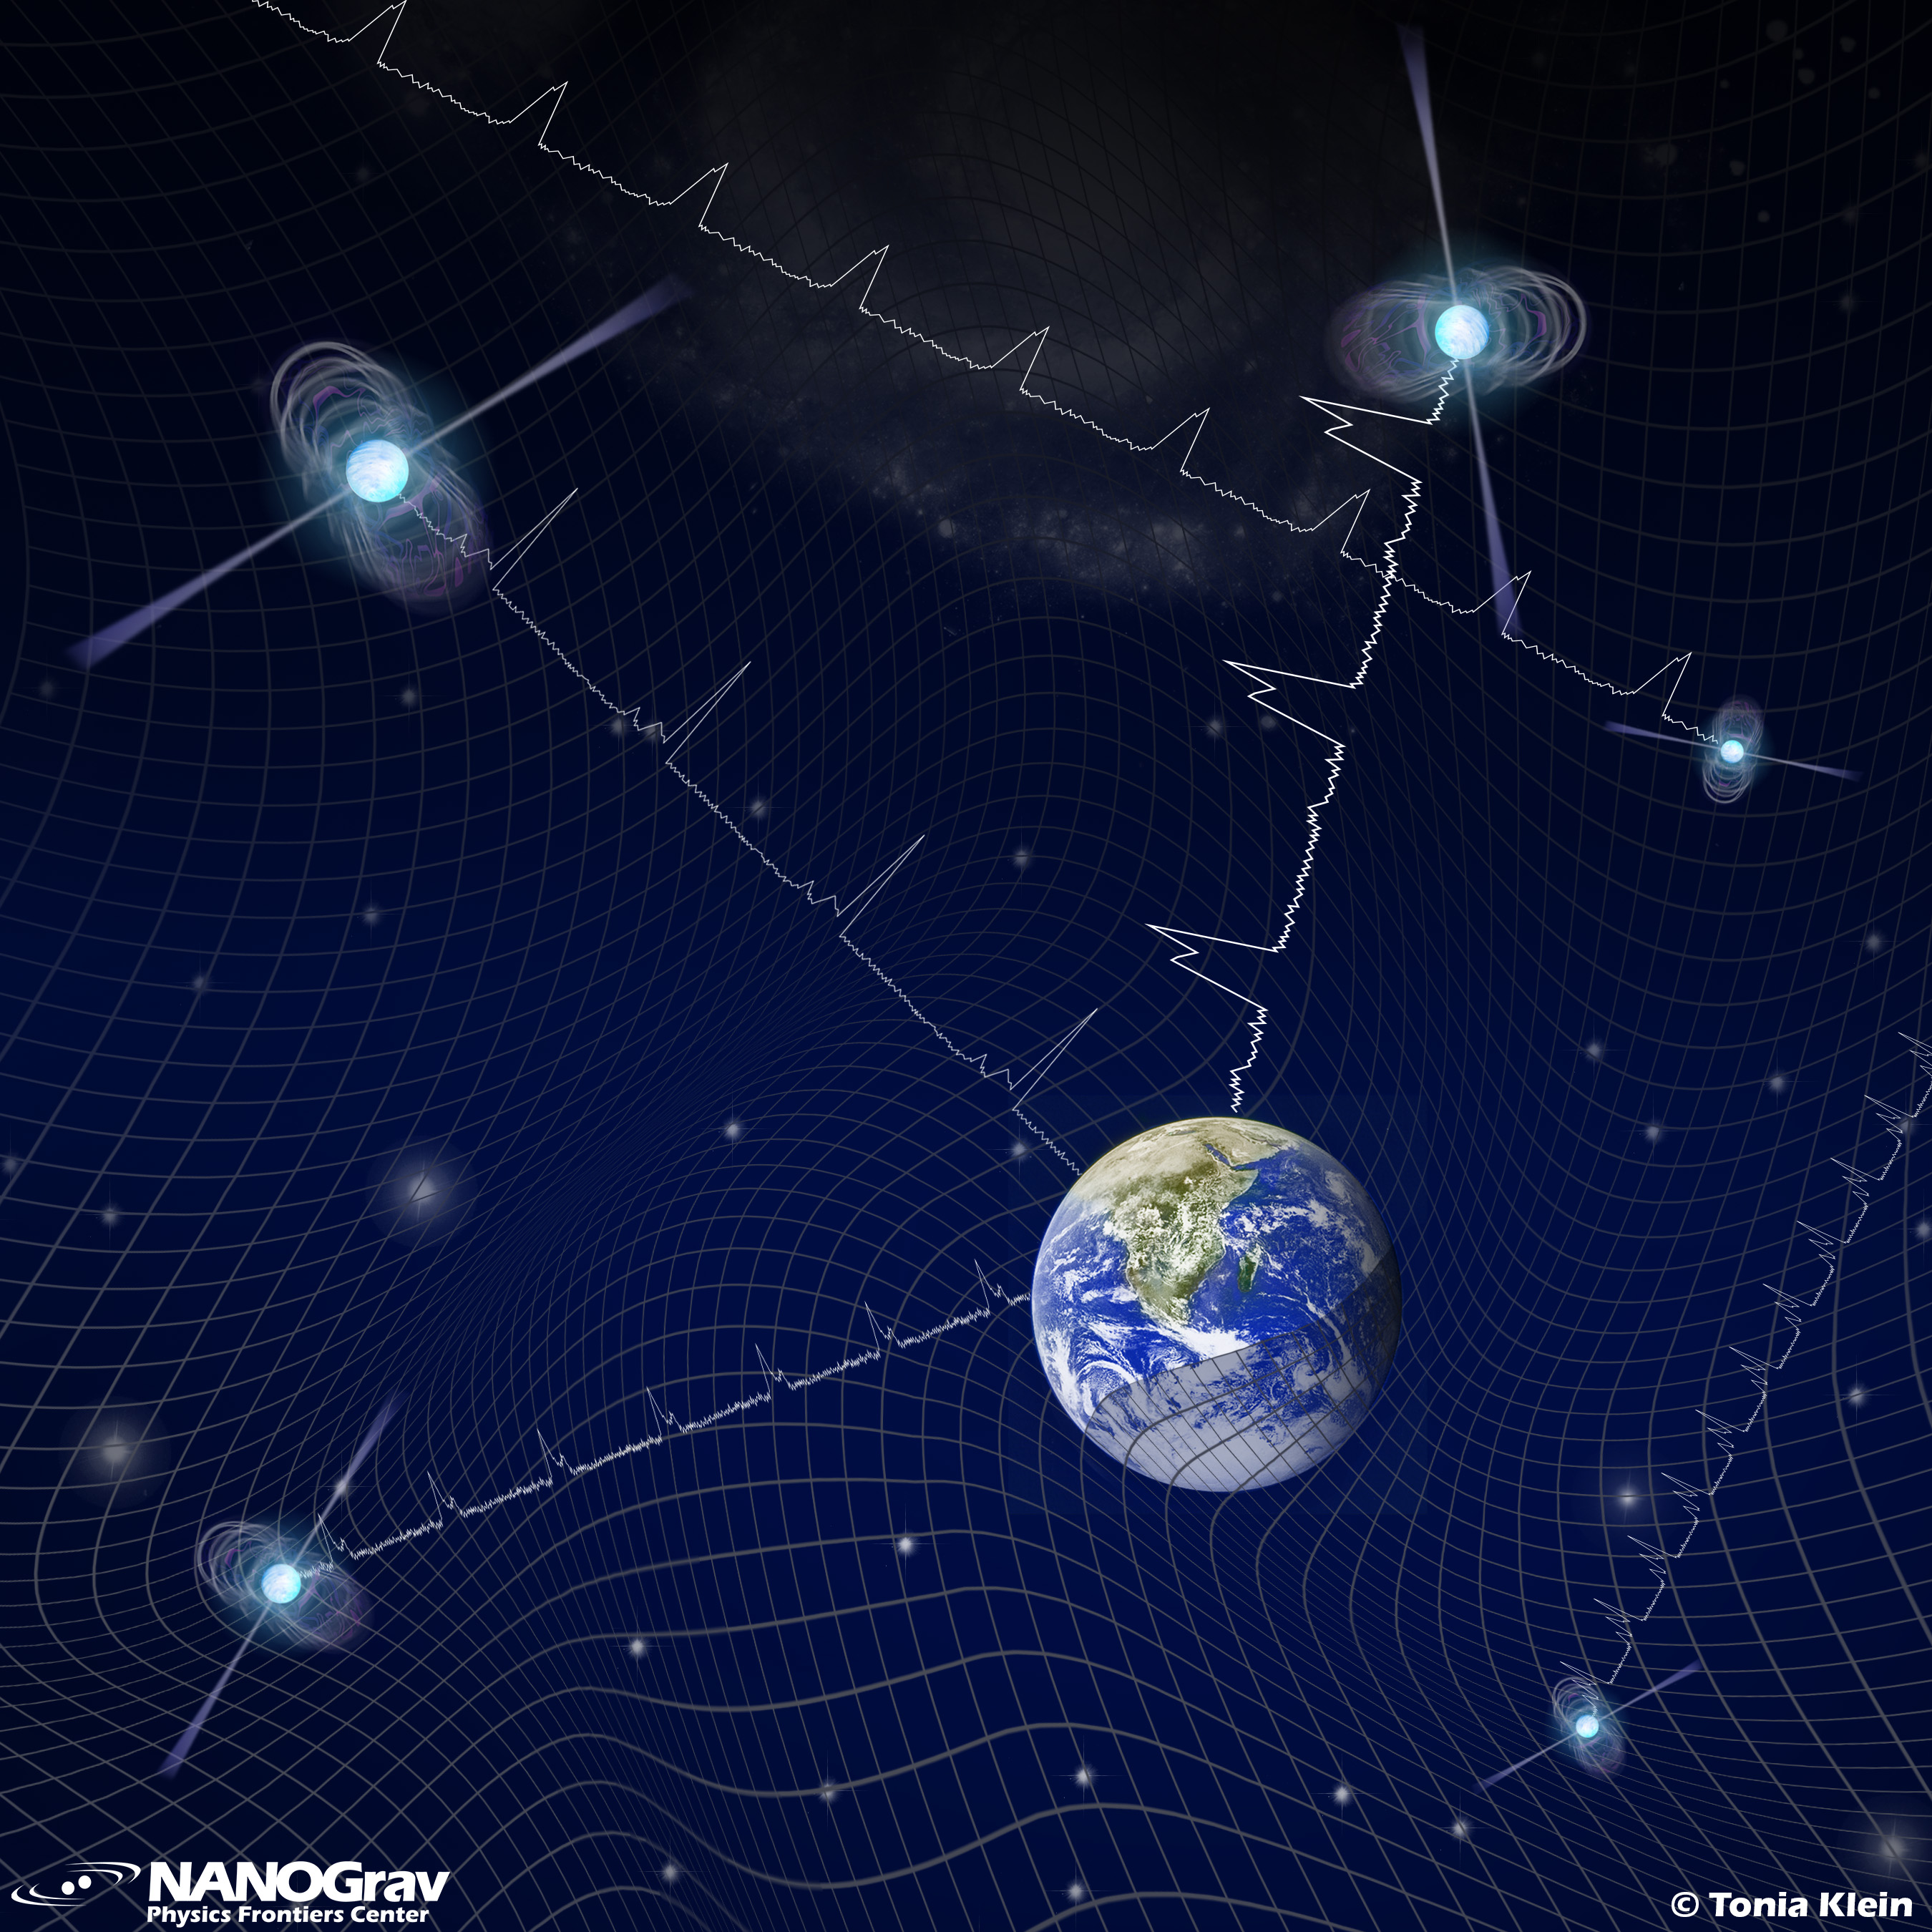
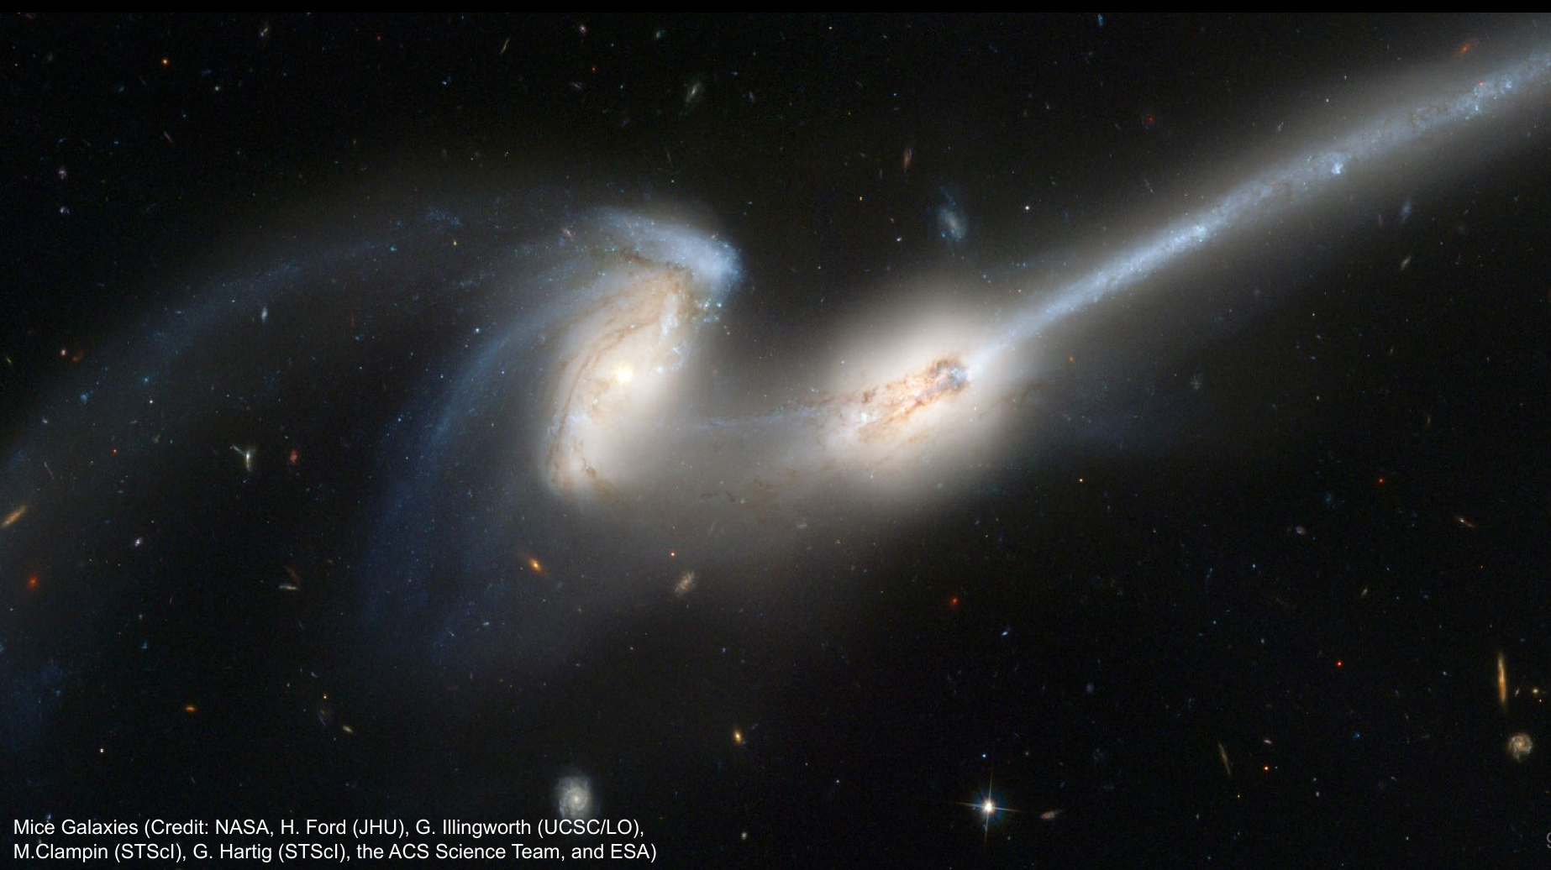
uses …
the world’s largest radio telescopes ...
to measure pulses from scores of pulsars ...
each spinning hundreds of times per second …
and together making a Galactic-scale detector …
that can detect the Earth bobbing on a “sea” of GWs …
emitted by all of the gargantuan black hole binaries …
in the centers of colliding galaxies ...
scattered throughout the Universe.

Slide 4
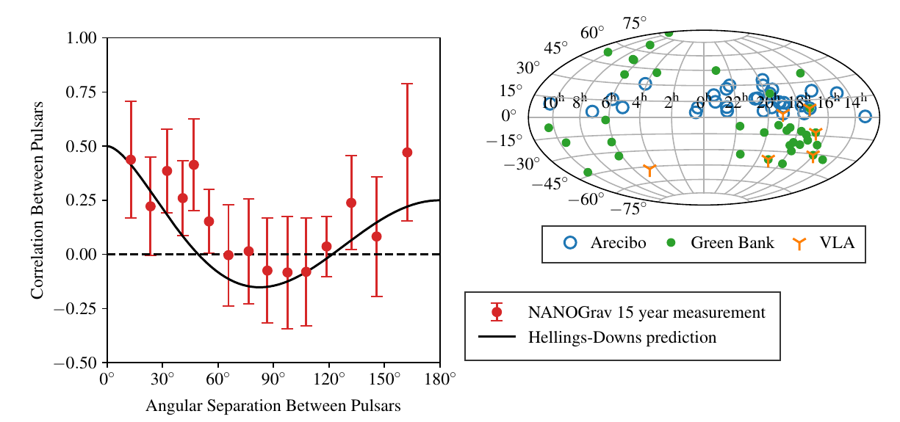
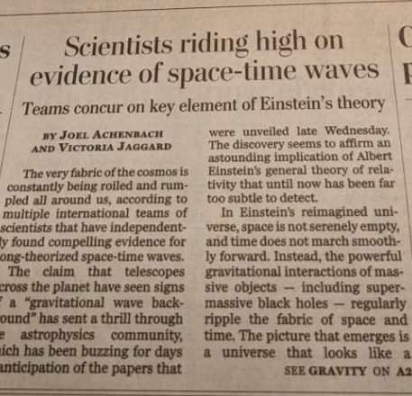
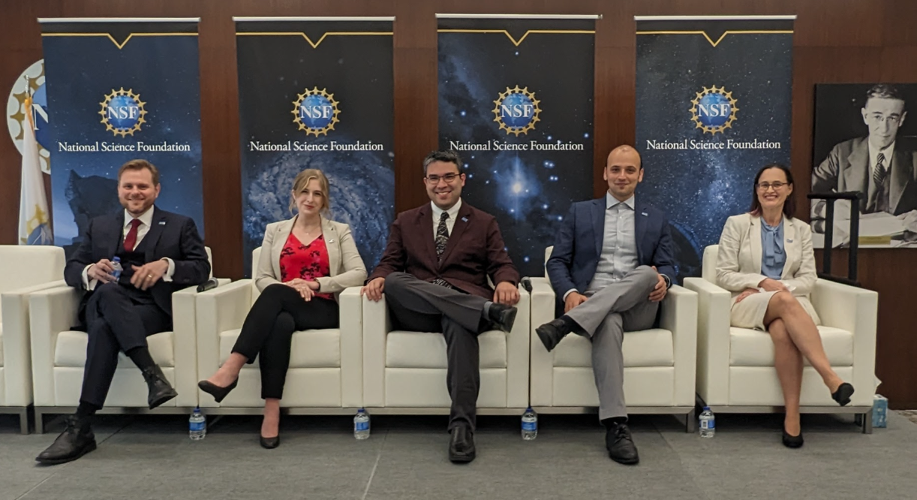
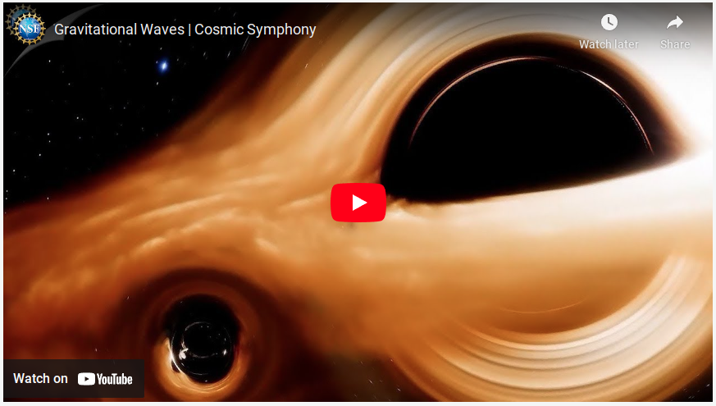
15yr Coordinated Release: June 2023
Washington Post, front page
https://youtu.be/c2EKbvnee3o

Slide 5

nanograv.org
Our mission is to detect nHz frequency gravitational waves using pulsar timing.
We are over 180 students and scientists and welcome new collaborators and members.

Slide 6
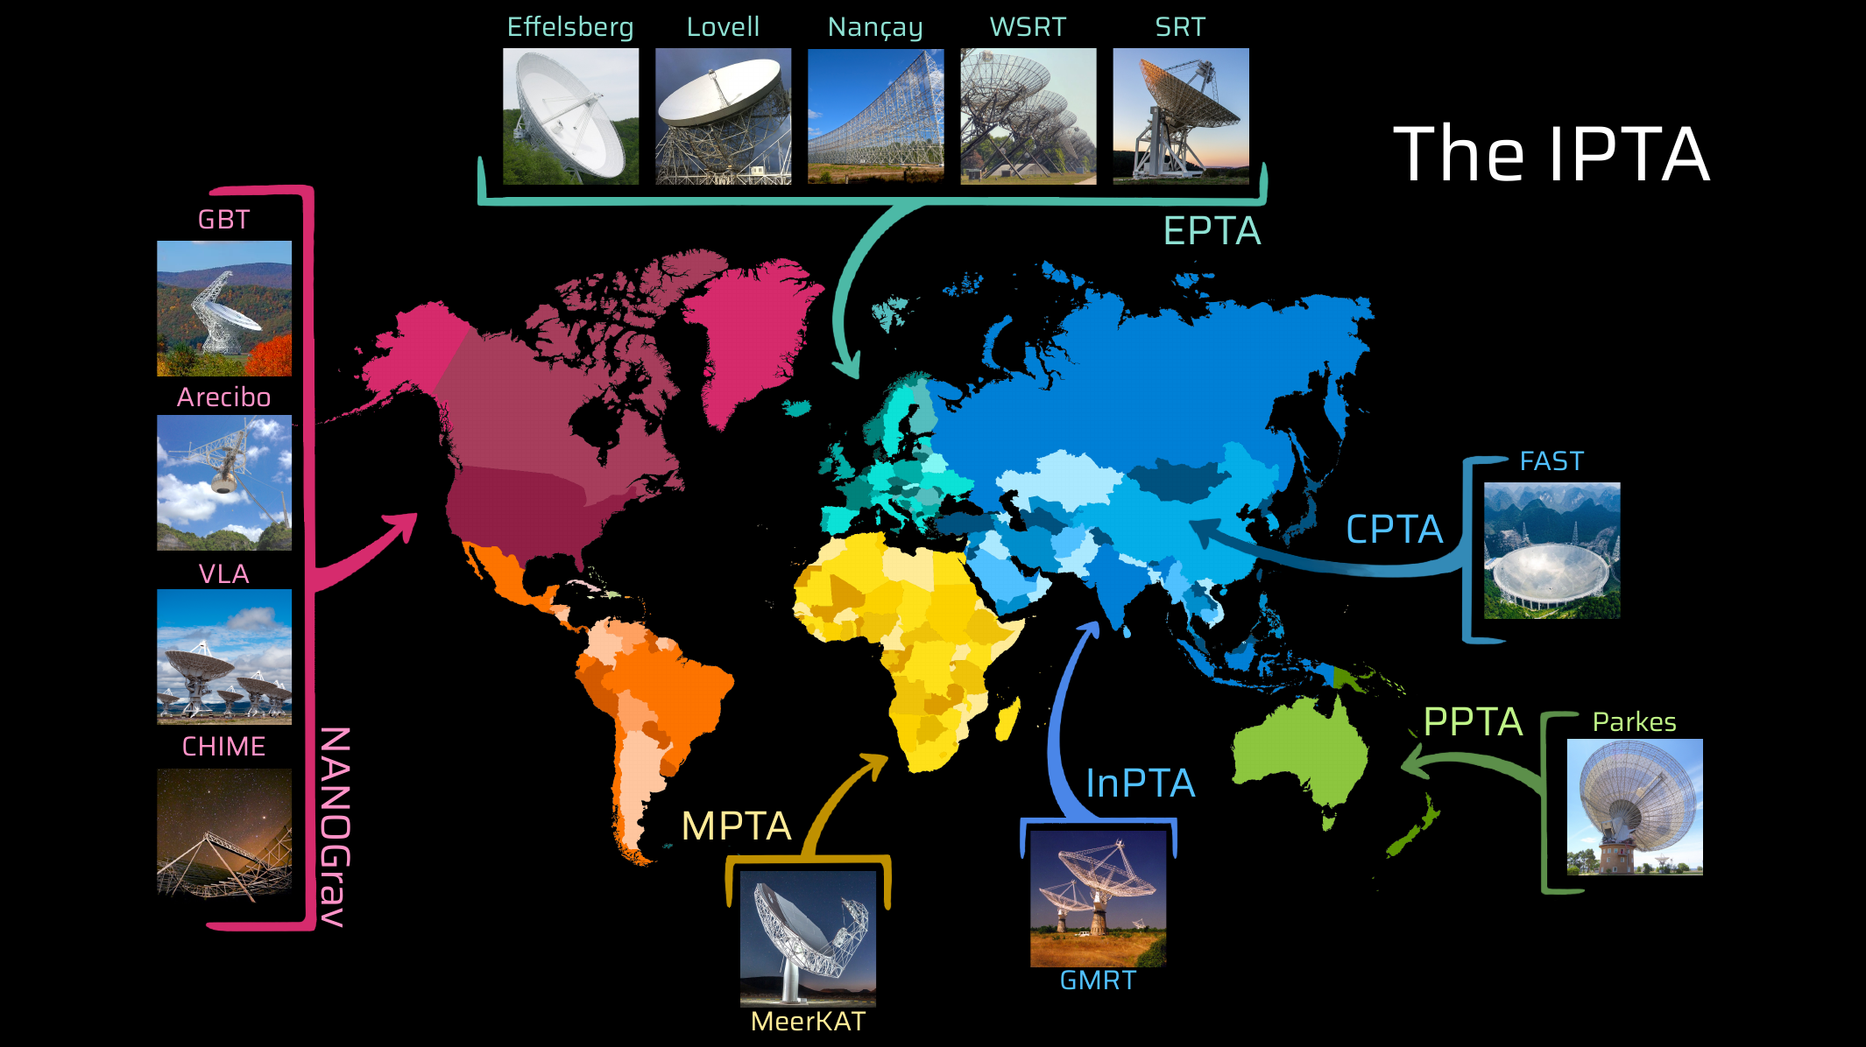
Figure by Thankful Cromartie

Slide 7
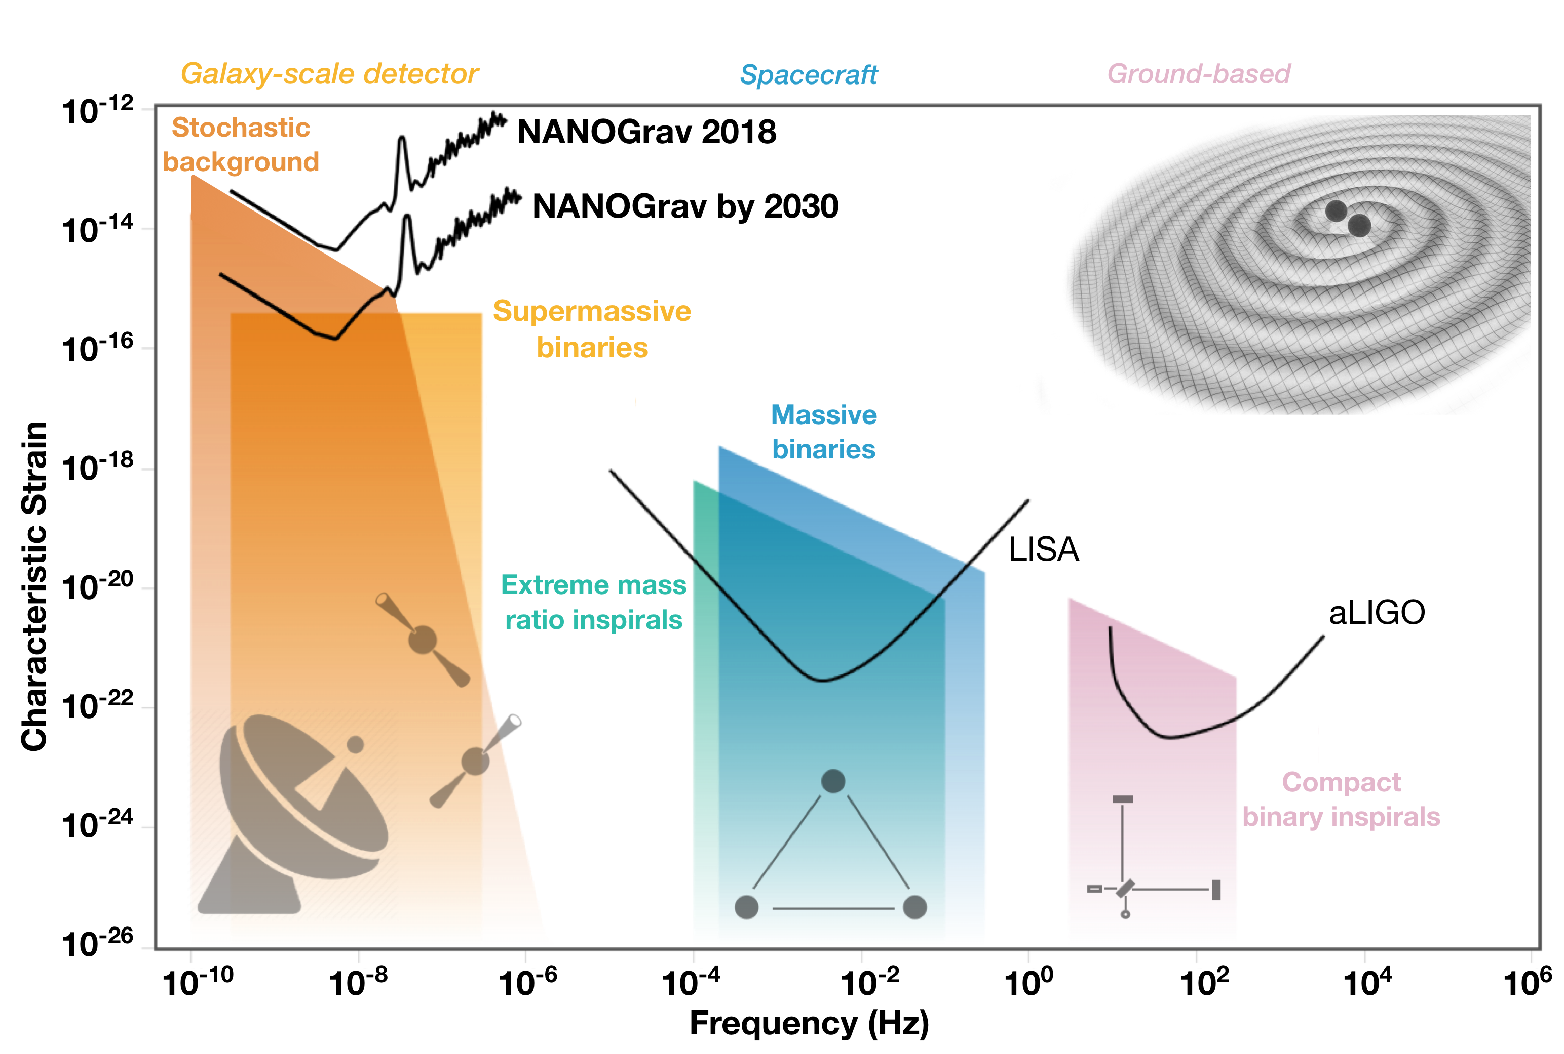
The Gravitational Wave Spectrum
S. Taylor, C. Mingarelli, adapted from
gwplotter.com (Moore, Cole, Berry 2014)

Slide 8
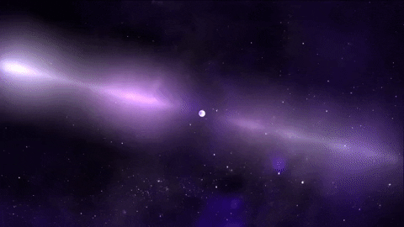
Pulsars!
Neutron stars
Cosmic clocks
Size of city
More mass than Sun
Can spin 700+ times per second
Courtesy NASA/GSFC

Slide 9
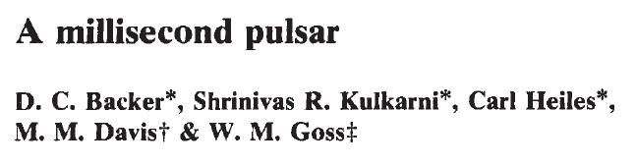

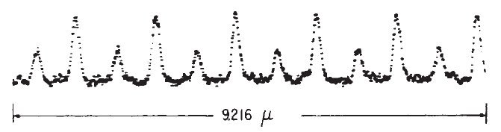
AO 1982:
Enigmatic bright, steep-spectrum, polarized, and scintillating radio source…
Using Arecibo: 1.558 ms pulsar (640 Hz)!
(6 pulses)
Courtesy: Bob Rood
21x faster than Crab! ~half an octave above “Concert A”!

Slide 10
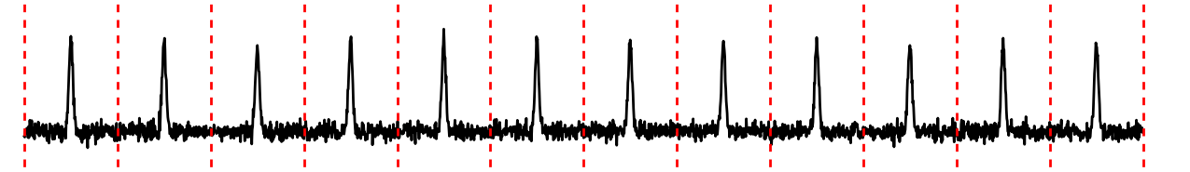

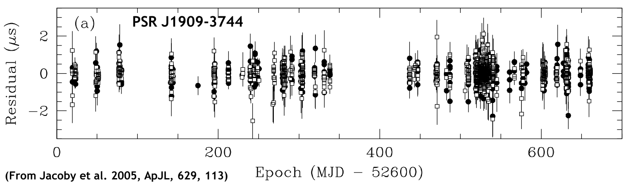
Pulsar Timing:
Unambiguously account for every rotation of a pulsar over years
Pulse Measurements
(TOAs: Times of Arrival)
Observation 1
Obs 2
Obs 3
Model
(prediction)
Pulses
Time
Measurement - Model = Timing Residuals
Predict each pulse to ~200 ns over 2 yrs!
Single day at telescope
Time in days

Slide 11
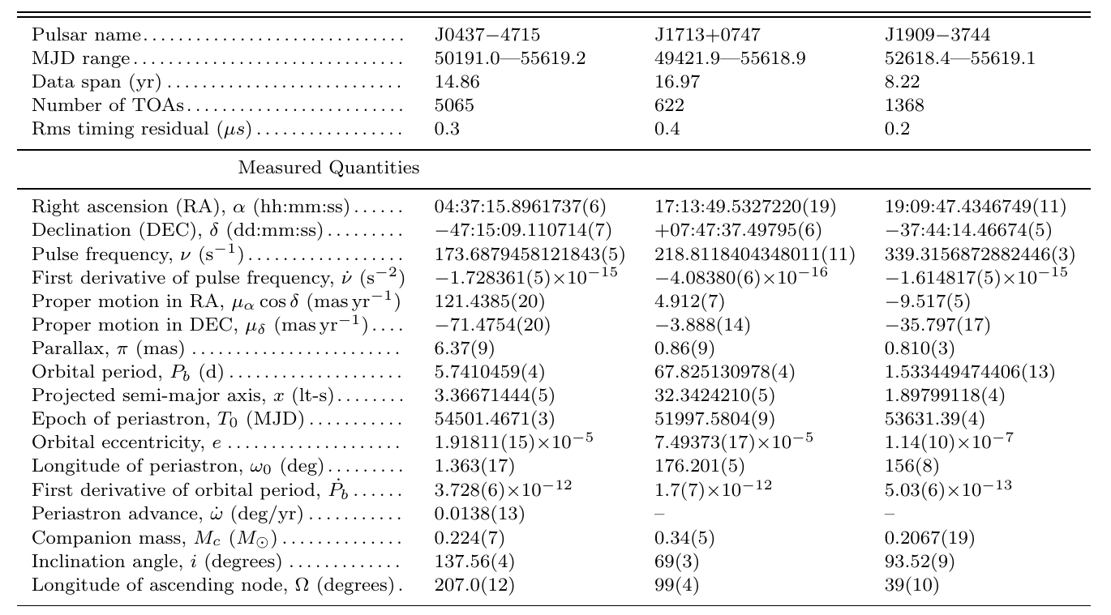
Exquisite precision:
Reardon et al. 2016,
MNRAS, 455, 1751

Slide 12
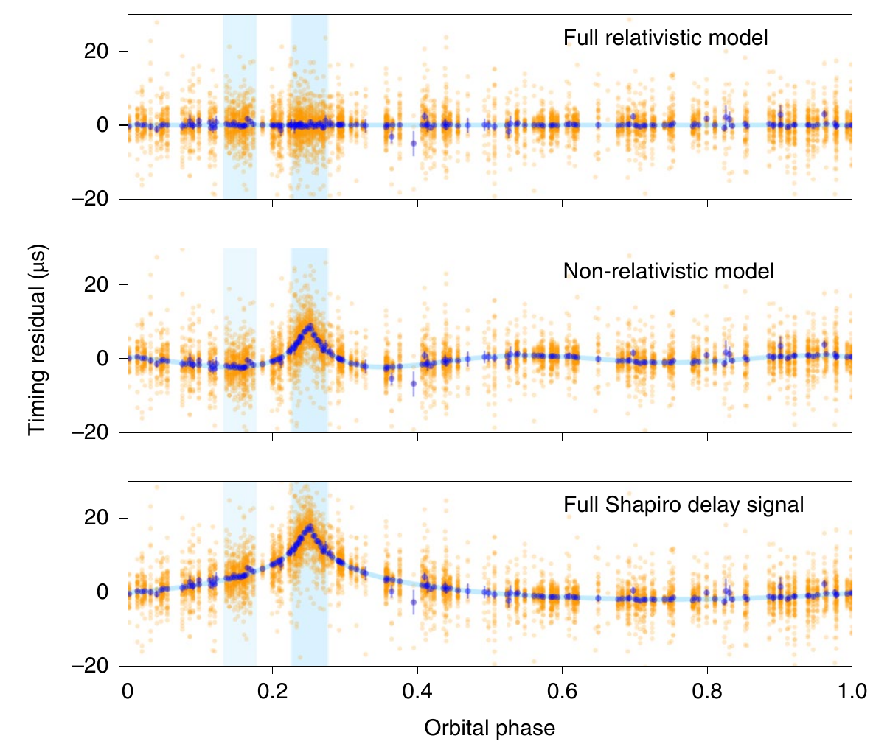

The most massive neutron star?
2.89 ms pulsar discovered with GBNCC survey (GBT)
NANOGrav data plus a dedicated GBT Shapiro Delay timing campaign
M_{psr} ~ 2.14M⊙+/- 0.1 M⊙
Highly constraining for NS Equation of State
Cromartie et al. 2020, Nature Astronomy, v4, 72

Slide 13
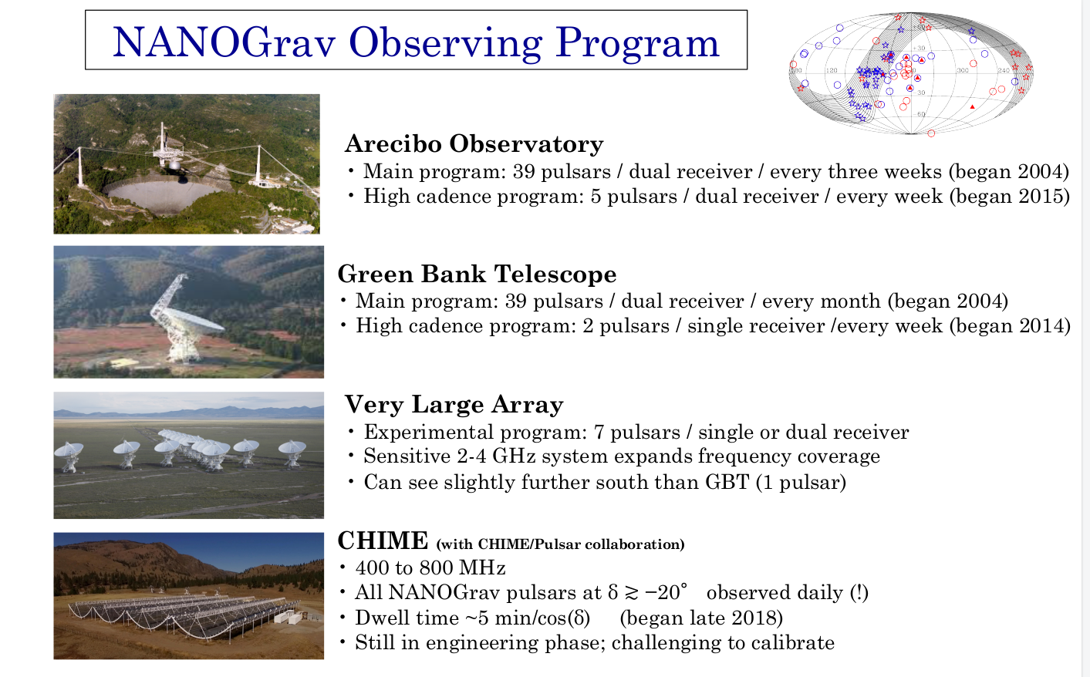
Slide by David Nice

Slide 14
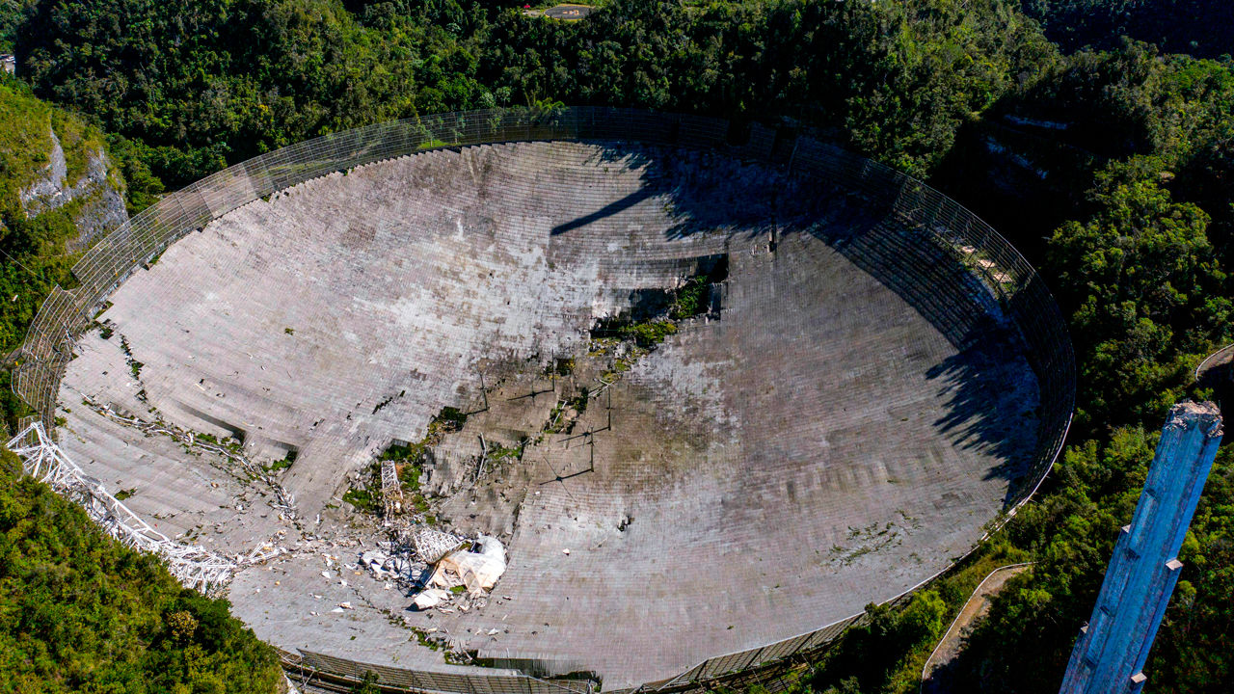
Loss of Arecibo
Aug 2020: Support cable failure damaged dish
Dec 2020: Catastrophic collapse
Devastating loss for NANOGrav, science, and Puerto Rico
Ricardo Arduengo, AFP via Getty Images

Slide 15
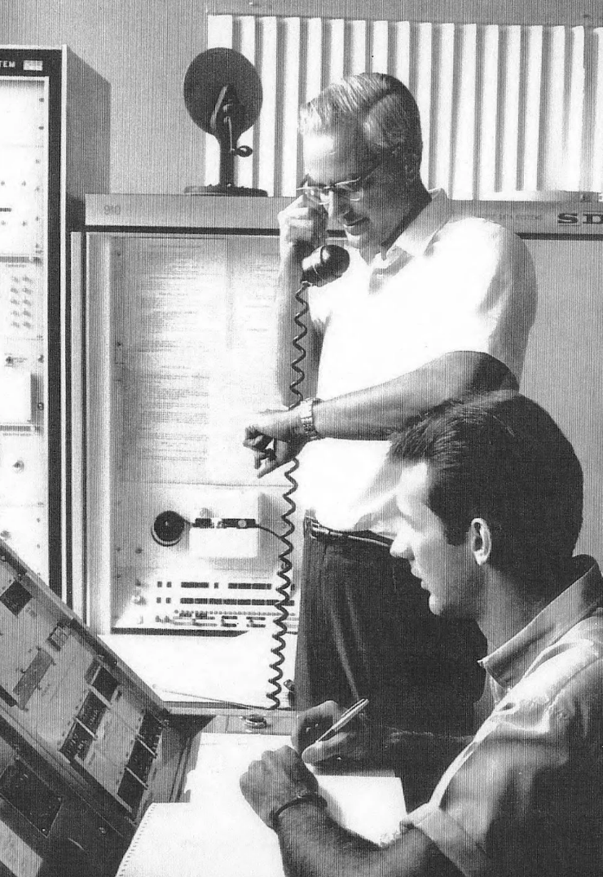
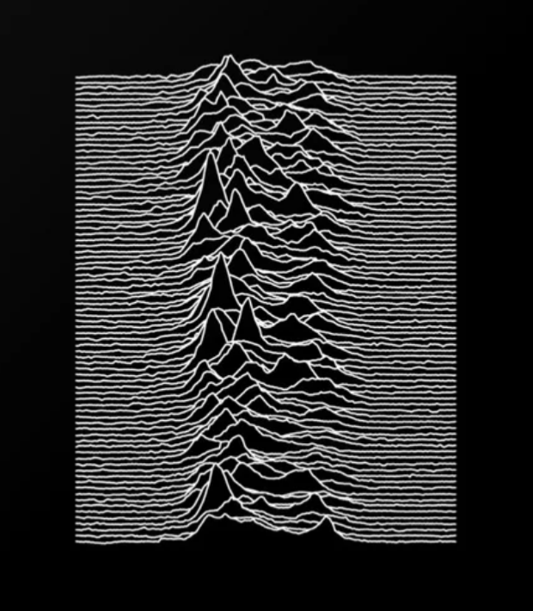

Arecibo’s Pulsar Legacy
1968 Crab spin period (Lovelace et al)
1970 pulsar nulling (Backer)
1974 1st binary pulsar (Hulse & Taylor)
1982 1st millisecond pulsar (Backer et al)
1989 indirect GWs from B1913+16 (Taylor & Weisberg)
1990 1st eclipsing MSP (aka black-widow; Fruchter et al)
1992 pulsar planets (1st exoplanets!; Wolszczan & Frail)
1994 microsec long-term timing (Kaspi, Ryba, & Taylor)
2008 an MSP in an eccentric orbit (Champion et al)
2014 1st non-Parkes FRB (Spitler et al)
2016 1st FRB repeater (Spitler et al)
2018 SEP test with triple system (Archibald et al)
… and much much more (plus non-pulsar science!)

Slide 16


RIP
+
GBT now covers ~70 MSPs every ~4 weeks (>600 hrs/yr)
Fully funded at ~$1M/year
Provides most of our
low freq observations!
Slide by David Nice

Slide 17
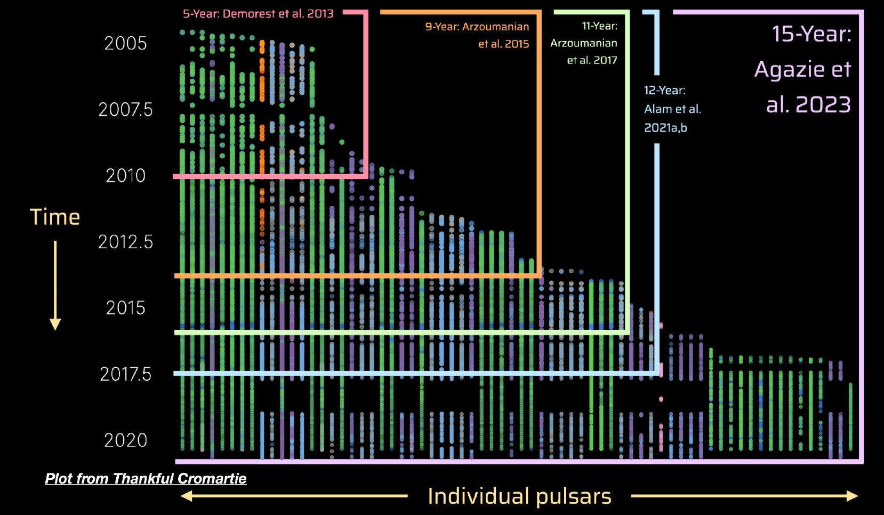
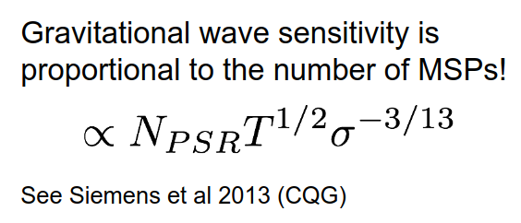

Slide 18
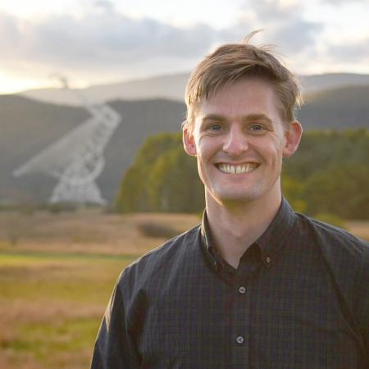
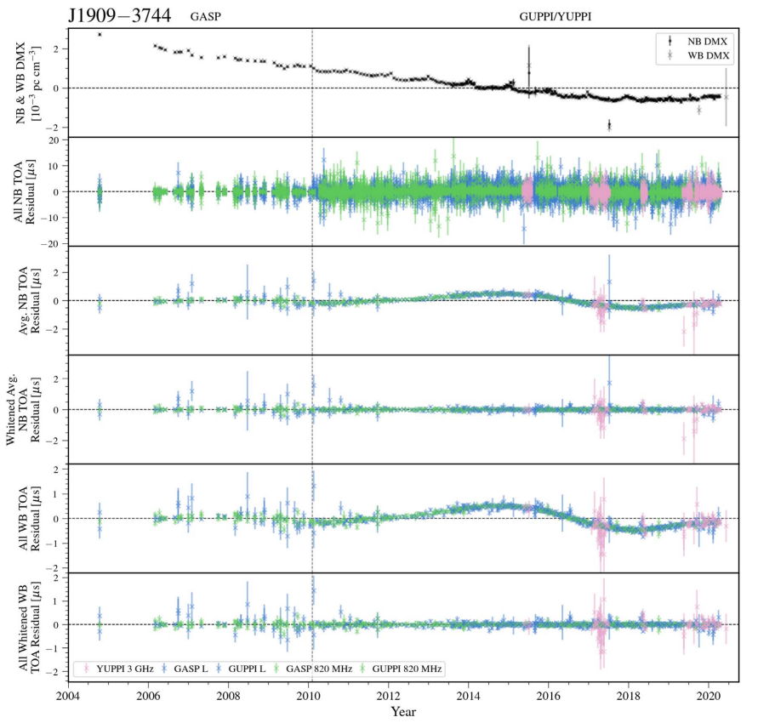

Joe Swiggum
Thankful
Cromartie
Timing residuals in microseconds
Agazie et al 2023 (Timing paper)
Year

Slide 19
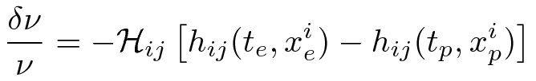
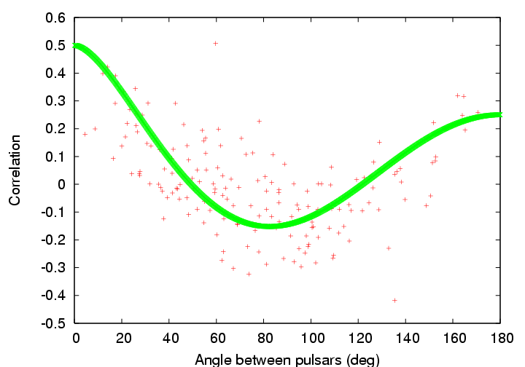
A Pulsar Timing Array (PTA)
Timing residuals due to a GW have two components:
“Pulsar components” are uncorrelated between MSPs
“Earth components” are correlated between MSPs
Signal in Residuals
Clock errors:
monopole
Ephemeris errors:
dipole
GW signal:
quadrupole
Two-point correlation function
e.g. Hellings & Downs, 1983, ApJL, 265, 39; Jenet et al. 2005, ApJL, 625, 123
Courtesy: G. Hobbs

Slide 20
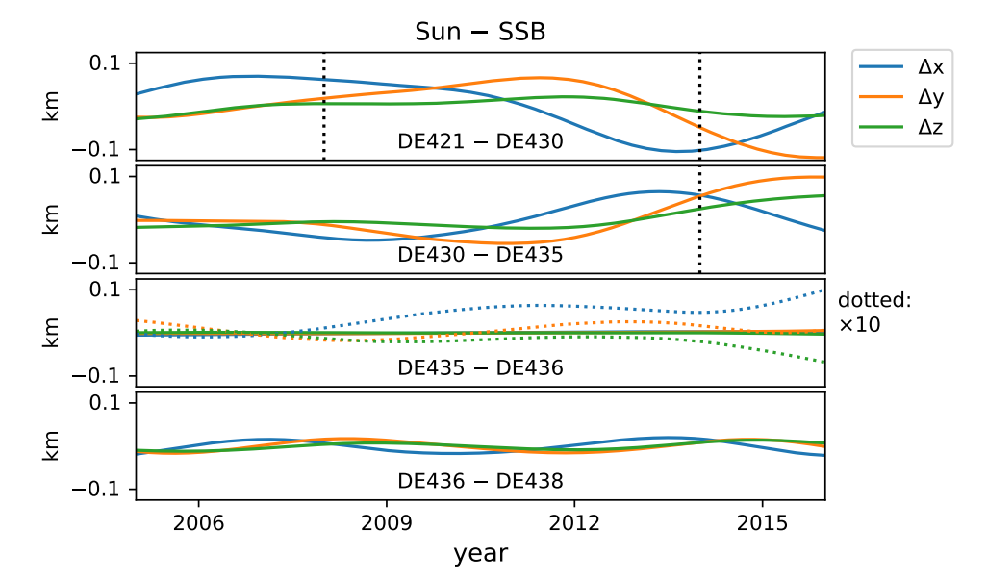
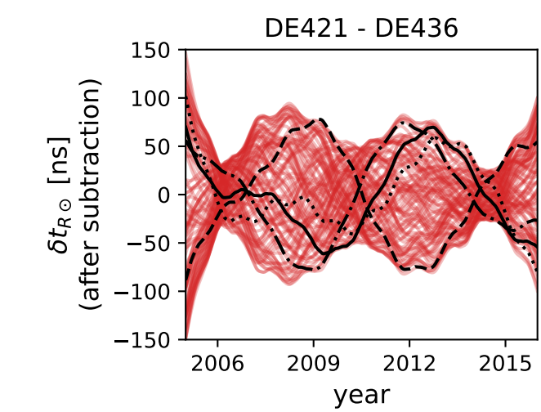
Where is the Solar System Barycenter?
Solar System ephemerides are uncertain mostly due to orbits of outer planets (esp Jupiter, pre Juno mission)
Causes ~100m errors in position of Solar System Barycenter
Vallisneri et al. 2020, ApJ, 893, 112

Slide 21
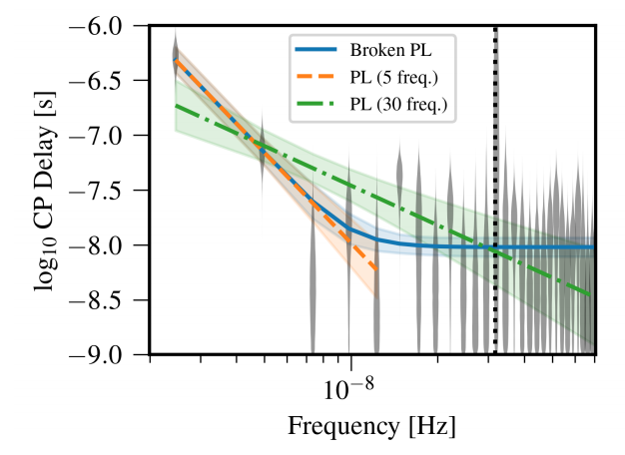
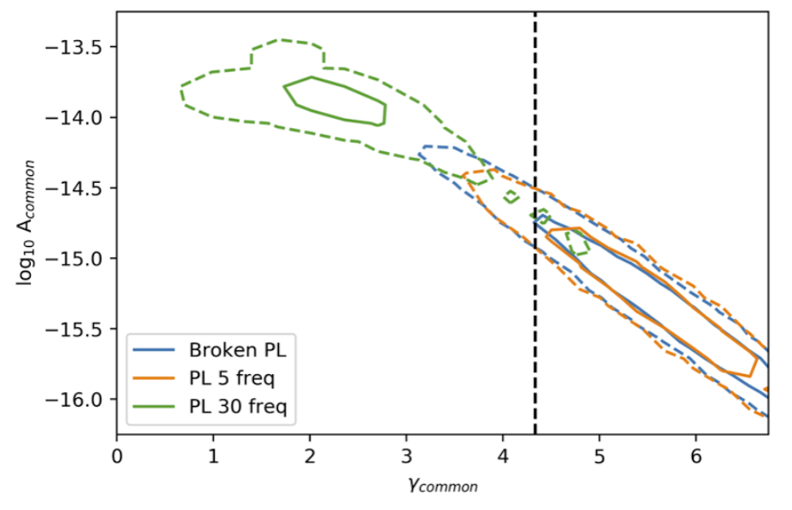
12.5 Year Bkgd Results
Strong evidence for uncorrelated common red noise process…
(Bayes factors of ~30,000:1 in favor for fixed SS Ephem)
Expected spectral index for a GWB from in-spiraling SMBHBs (𝞬=13/3)
Figures courtesy Joe Simon;
Arzoumanian et al. 2020, ApJL, arXiv:2009.04496

Slide 22
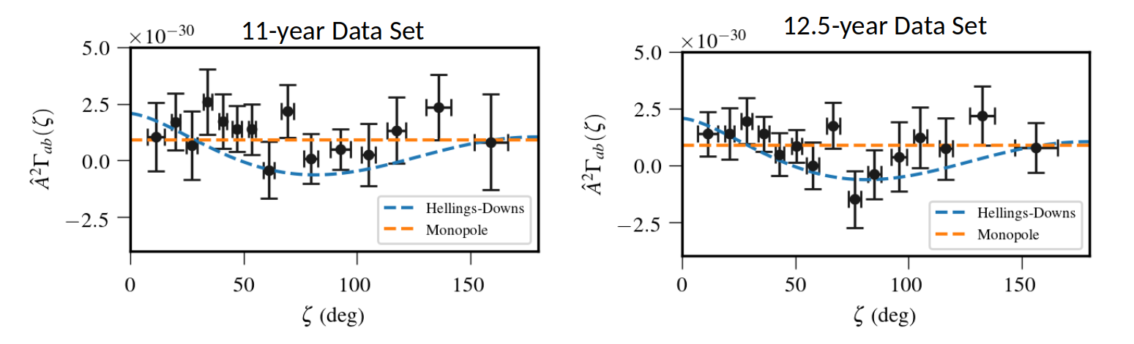
12.5 Year Bkgd Results
No good evidence of the required spatial correlations yet…
But the data are improving rapidly,
and there are ~2+ more years of data in the bank!
Figures courtesy Joe Simon;
Arzoumanian et al. 2020, ApJL, arXiv:2009.04496

Slide 23
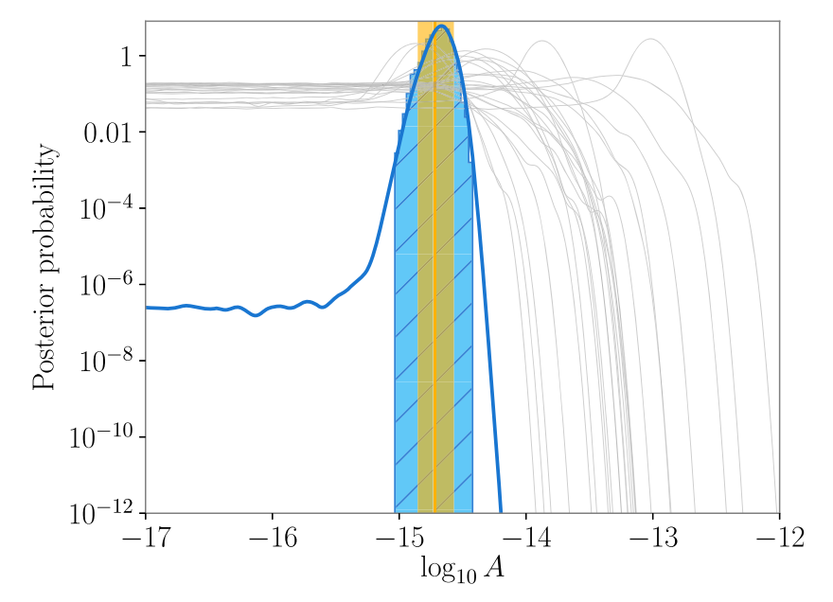
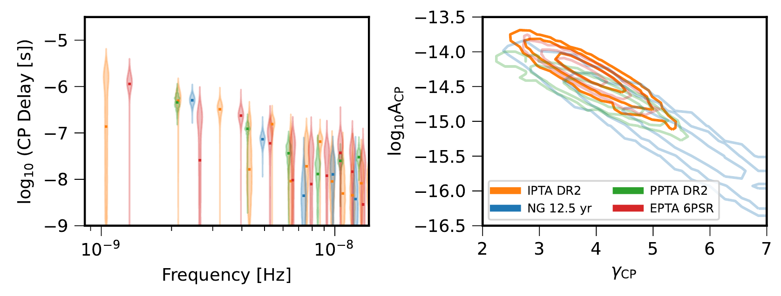
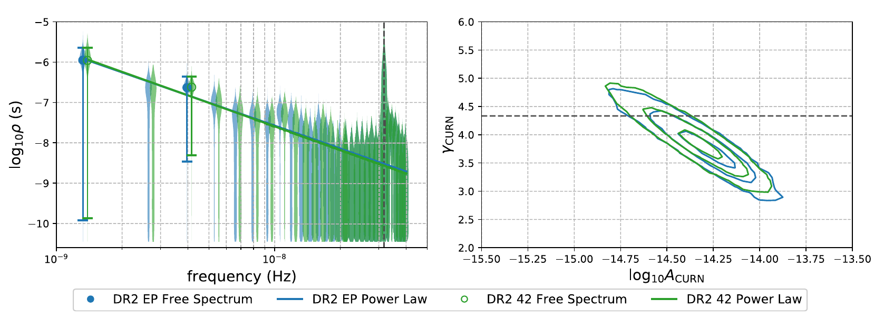
And the hints are not just NANOGrav...
Goncharov et al. 2021,
ApJL, 917, L19
arXiv:2107.12112
Antoniadis et al. 2022,
MNRAS, 510, 4873
arXiv:2201.03980
IPTA DR2
PPTA
EPTA
Chen et al. 2021,
MNRAS, 508, 4970
arXiv:2110.13184

Slide 24
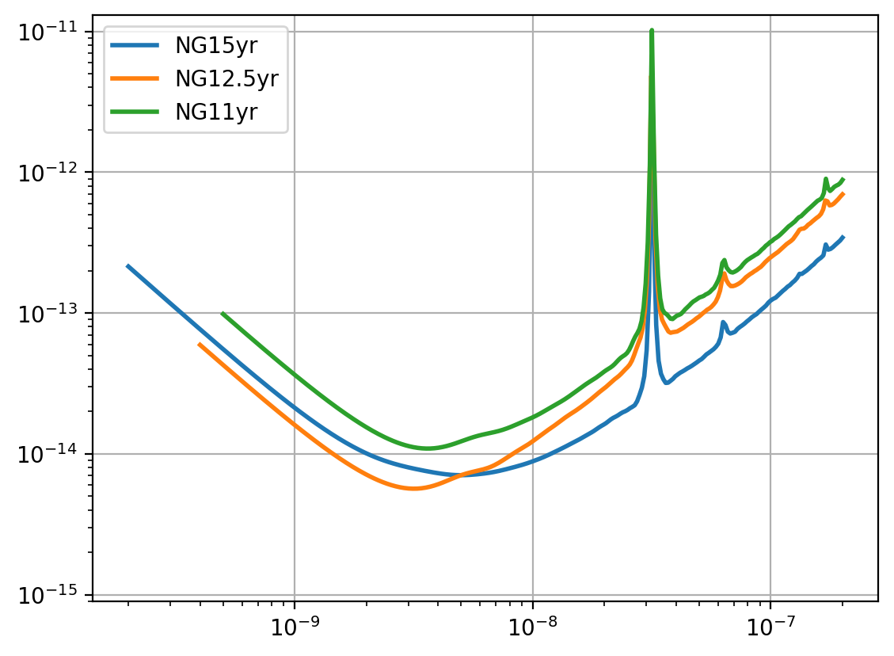
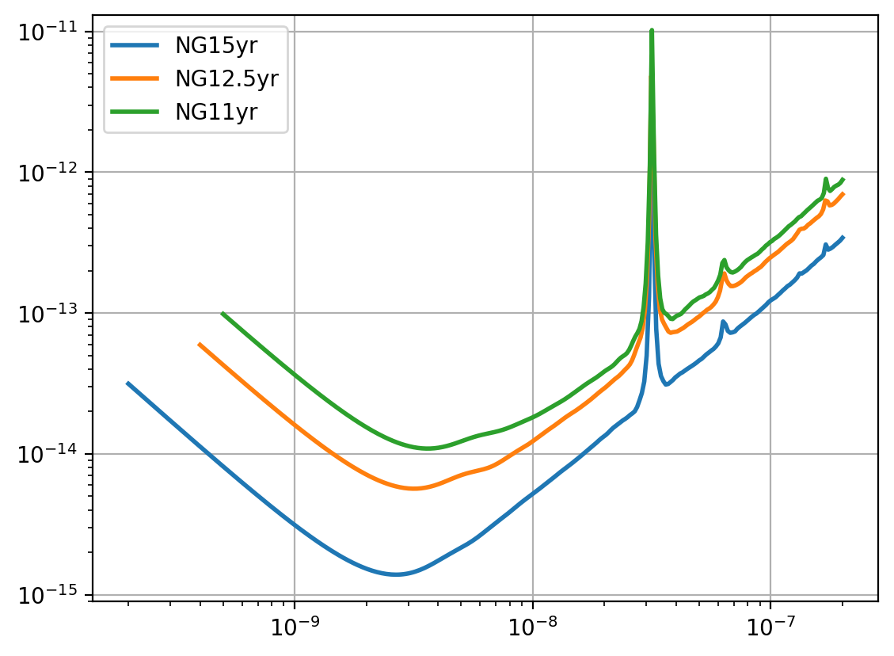
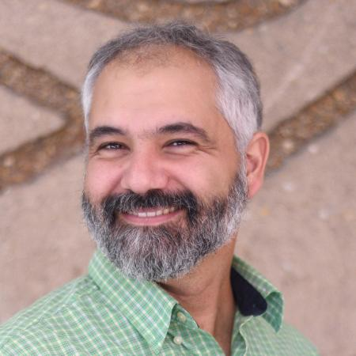
“Detector” Noise and (raw) Sensitivity
Position Fitting
(1 year)
Spin and Spindown fitting
Strain Sensitivity
White noise in
timing residuals
GW Background!
Frequency (Hz)
Jeff Hazboun
Hazboun, Romano, & Smith, 2019, PhRvD
Agazie et al. 2023, Detector Characterization

Slide 25
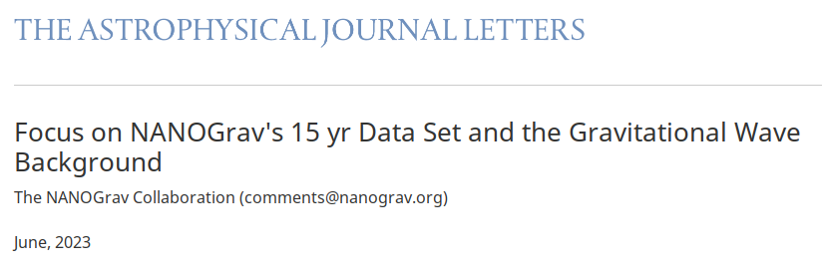


GW Background
Timing
Detector / Noise
New Physics
Individual SMBHBs
SMBHB GWB
Anisotropy
Plus more on the way...

Slide 26
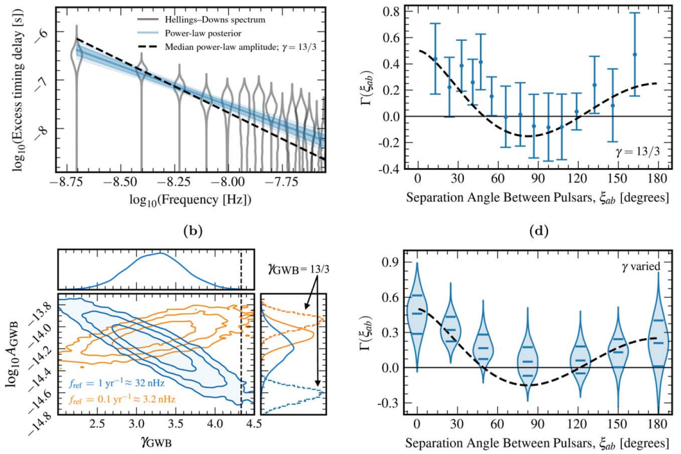


“Evidence for” a GW Background
Sarah Vigeland
Steve Taylor
Fig 1 from Agazie et al 2023 (GWB paper)

Slide 27
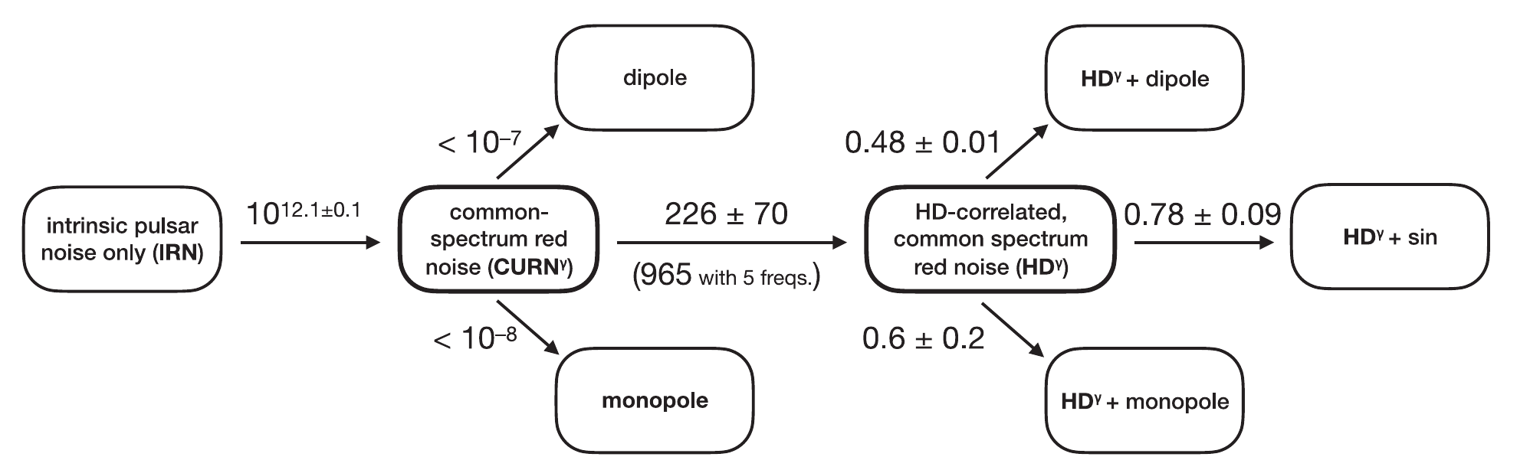
“Evidence for” a GW Background
Models
Bayes
Factors
Fig 2 from Agazie et al 2023 (GWB paper)

Slide 28

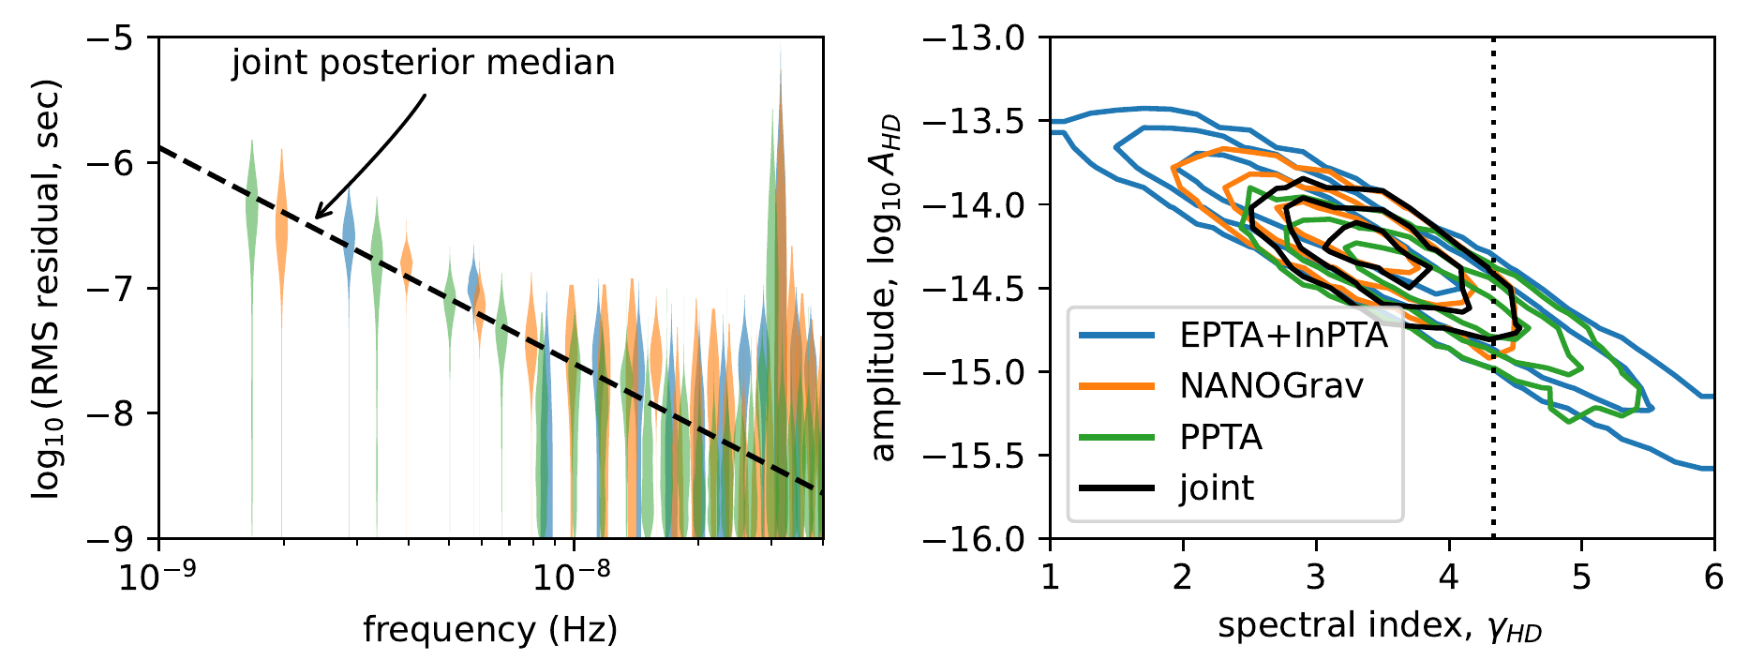
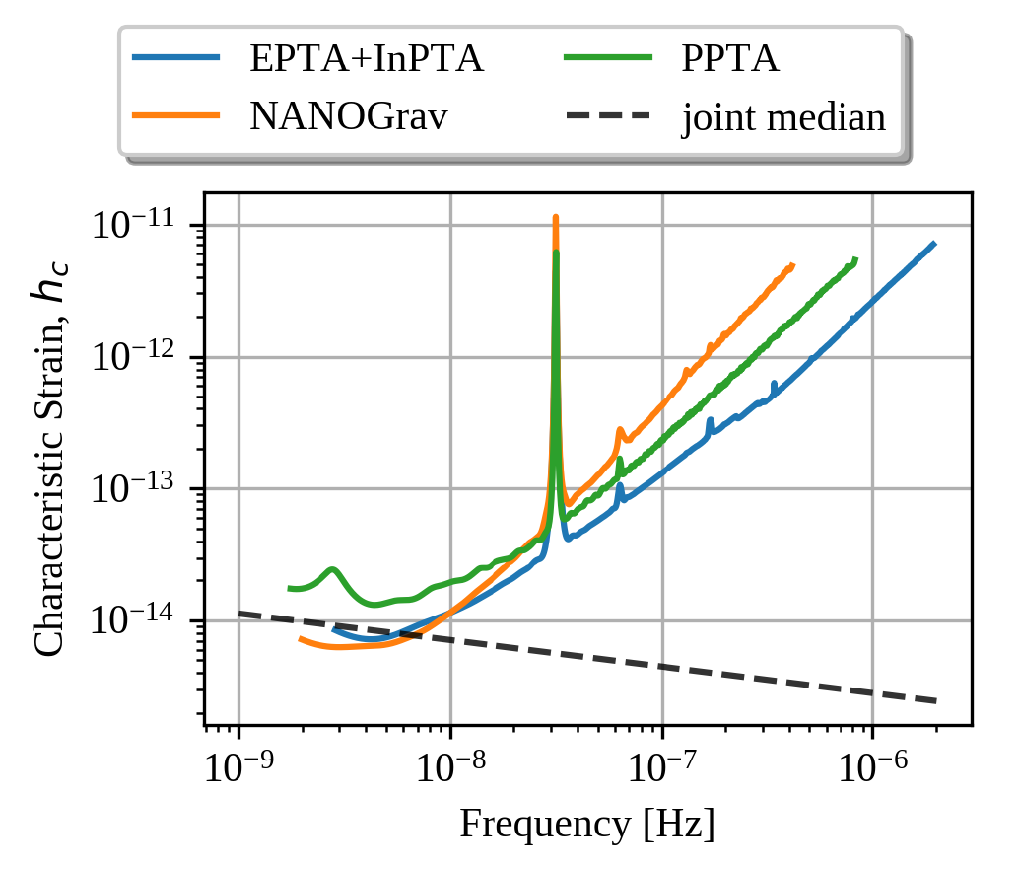
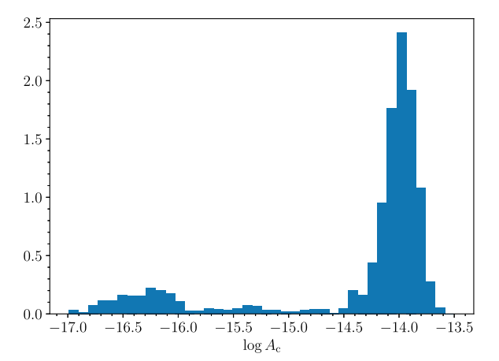
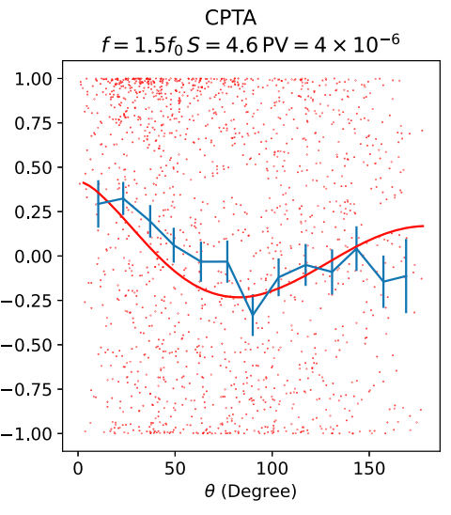
Does everyone agree?
Xu et al 2023,
23, 7, id.075024
IPTA et al 2023,
arXiv:2309.00693
T~3.5 yrs
57 MSPs
FAST
Correlation Coefficient

Slide 29

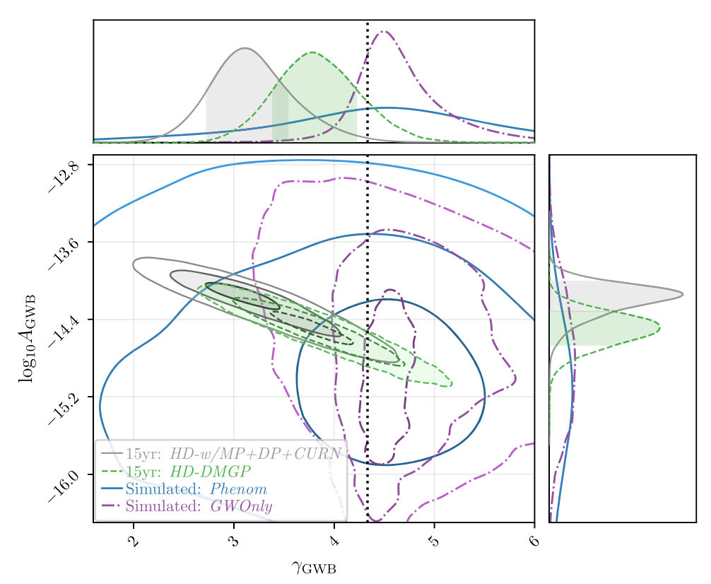
Black Holes?
(aka SMBHBs)
Luke Kelley
Agazie et al 2023 (Astro paper)
If SMBHBs are the source, they are possibly:
Slightly more massive than expected
Merge more frequently than expected

Slide 30
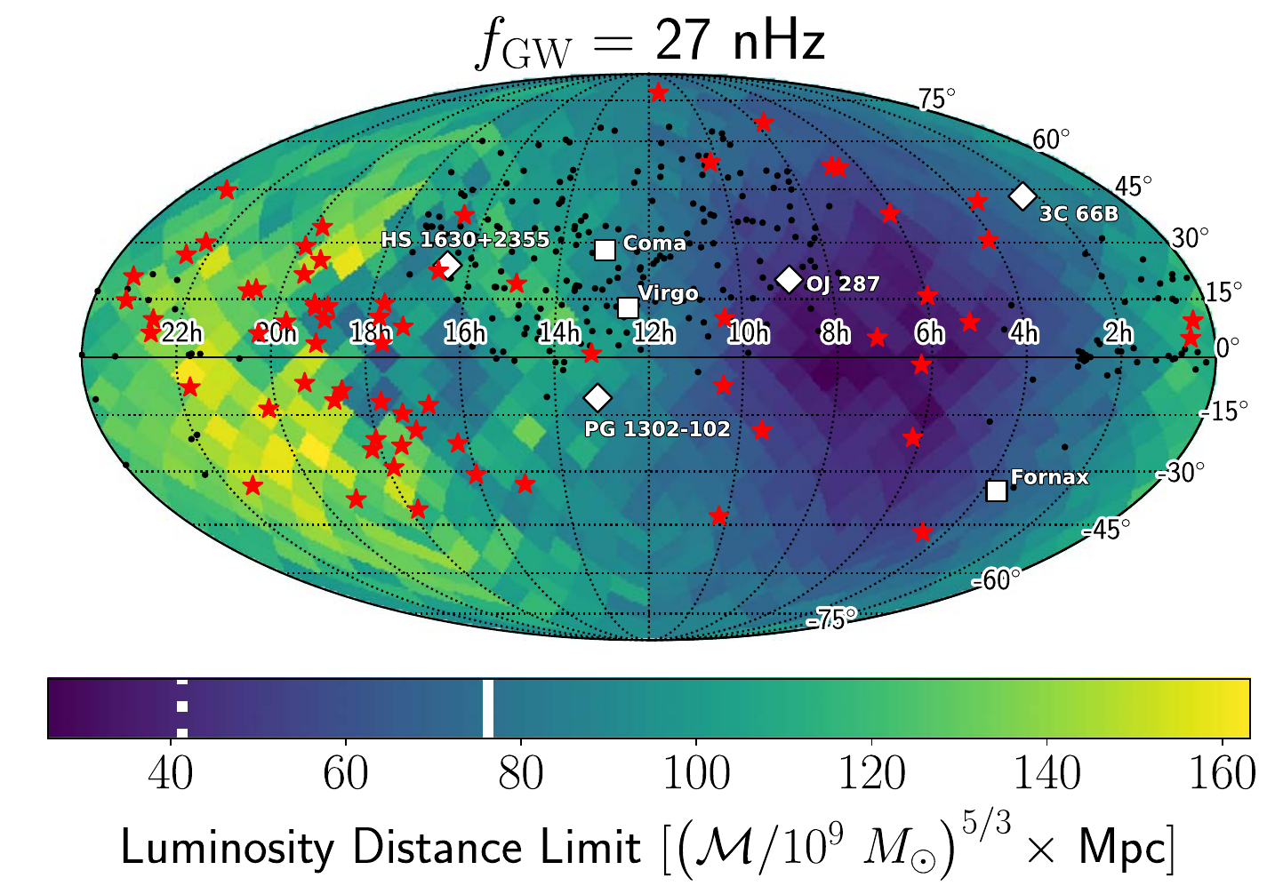
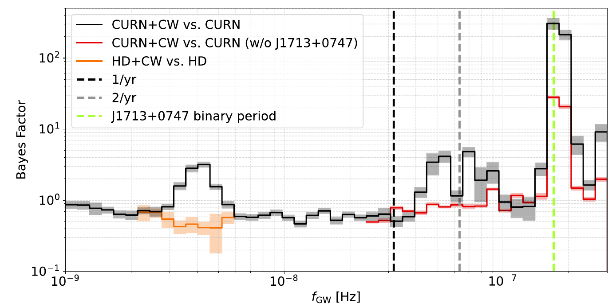


Continuous Wave (i.e. resolved) Sources?
Agazie et al 2023 (CWs paper)
No significant CWs yet...
~4 nHz “hint”
Bence Bécsy
Neil Cornish

Slide 31
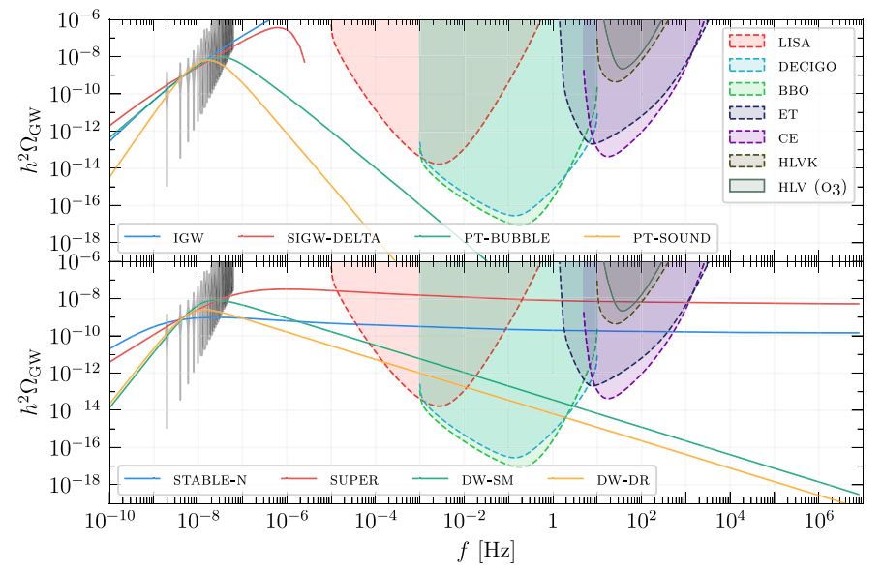



Andrea Mitridate
Kai Schmitz
New Physics?
Afzal et al 2023 (New physics paper)
Some new physics models:
Cosmic inflation
Scalar-induced GWs
1st-order Phase Transitions
Cosmic strings
Domain walls
Ultralight Dark Matter
(many others)

Slide 32

NANOGrav
15yr GWB
paper
paperscape.org

Slide 33






How will we tell the difference?
Cosmology = isotropic?
Agazie et al 2023, (Anisotropy) arXiv:2306.16221
SMBHBs =
non-isotropic (resolvable)?
Nihan Pol
No significant
evidence for anisotropy yet...

Slide 34



The future
3rd Data Release
GBT Ultrawideband
FAST & MeerKAT
Spiewak et al 2022,
PASA, 39, id.e027
DSA-2000
MeerKAT
IPTA
NANOGrav

Slide 35


Slide 36

Overlapping Pulsars
IPTA et al 2023,
arXiv:2309.00693

Slide 37


Dispersion
Lower frequency radio waves are delayed with respect to higher frequency radio waves by the ionized interstellar medium
t ∝ DM⁻²
(DM = Dispersion Measure)
High Freq
TOAs referenced to infinite frequency
And DM is a function of time!
Coherent
dedispersion
exactly
Removes
this effect
Low Freq

Slide 38

New Wideband Receiver for GBT
Need multi-frequencies to mitigate the interstellar medium
Current systems have <800 MHz BW
Ultra-wideband system will give 2x better timing, fewer systematics, and more protection from scintillation
820 MHz PF1
L-band
receiver

