Slide 1
Thinking about Agriculture while Thinking like a Physicist
Christopher Fasano
Department of Physics and Engineering
Monmouth College

Slide 2
Overview
Introduction—Why does it matter? What are the big questions and Why Physics and Agriculture? Do we have something to contribute?
Data—What is it like and how is it acquired? Connections to thinking like a Physicists
What might we learn? Modeling data like a Physicist.
Getting better data—building better models
The Future and How we contribute.

Slide 3
Introduction
Feeding a hungry world:
World Population Clock
How do we feed a hungry world in as an environmentally friendly way as we can?
How do we reduce the costs to make healthy food affordable?
How do we manage risks associated with food production? (Weather, blights, pests, etc.?
How do we do these things while respecting and supporting food producers in potentially wildly different cultures?

Slide 4
Introduction
Can we use data to build models to better understand food production to enable food producers to:
Make better decisions that increase profit and yield
Make better decisions to manage risks
Make better and more environmentally friendly decisions
Make tools available to producers everywhere.

Slide 5
Introduction
Physicists bring unique skills that may have been missing.
Data acquisition and instrumentation
Modeling to understand
Simplify, simplify, simplify (spherical cows)
Ideas, ideas, ideas—if we can learn to communicate well enough.

Slide 6
Why Connect Physics and Agriculture?
https://farmdocdaily.illinois.edu/2023/03/2022-county-crop-yields.html

Slide 7
Research that is Sensitive to Place
https://farmdocdaily.illinois.edu/2023/03/2022-county-crop-yields.html

Slide 8
…at small liberal arts college like Monmouth College—”Convergence Research”
Lots of colleagues across campus – My department: A condensed matter physicist, an astronomer, a nuclear theorist (me), a mechanical engineer and an electrical engineer. My good friends on campus: a biochemist, a neuroscientist, an economist, a marketing person. You get the idea….wildly divergent….
Lots of opportunities (really requirements) to do lots of things
Wide range of courses that cover both theory and experiment (all of the undergraduate physics curriculum and beyond)
Courses beyond physics (Applied Hydrogeology, etc.)
Wide freedom for “professional development”
Lots of intellectual freedom: “Nimble” and limited administrative size.
Limited resources and time (“We've got no money, so we've got to think”—E. Rutherford)
Lots of contact with undergraduates but no graduate students
Recognition of “place”

Slide 9
Big Questions
Agricultural systems are complex and farmers make many decisions. How can they make better decisions?
“Better” is a complex concept to discuss.
Better: More profitable, more yield, managed risk, safer, more environmentally friendly

Slide 10
Input Parameters
Things Farmers can control
Things Farmers can’t control
Choice of Crop
Choice of Hybrid
The planting density
Application (What, when, where, how, how much)
NPK
Herbicides
Pesticides
Fungicides
Biologics
Tillage (Cultural Practices)
Weather
Price of inputs (seed, fuel, chemicals)
Commodity Prices
Interest rates
Competition
Public Perception (GMOs, perceptions of safety)

Slide 11
Planting Data Properties
Many parameters…speed, spacing, down force….

Slide 12
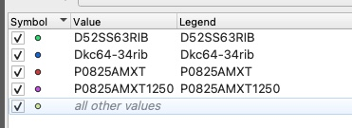
The Data: Planting Files
Planting file
Each planted seed is represented as a geospatially located point. The farmer must enter the correct hybrid usually by hand.
This kind of mixing of hybrids is common. The bag runs out…
RIB: “Refuge in a Bag”—some fraction (5%) is not the hybrid with traits.

Slide 13
The Data: Harvest in bu/acre

Slide 14
The Data: Harvest Data Yield in bu/acre

Slide 15
The Data: Connecting Planting and Harvest
There is a painful process of geolocating each harvest yield point and associating it with the closest planting point
If we are successful, we have associated hybrid, yield, and a geospatial point.

Slide 16
Soil Type: NCCPI (National Commodity Crop Productivity Index (Corn and Soybean)
Soil Productivity is rated from – 0.0 (Poor) to 1.0 (Excellent)

Slide 17
The Data: What do we learn?
Plot Number vs. Yield in bu/ac.
It’s a spectrum. We’re doing spectroscopy….with corn yields!
Here we see the effect of planting density on yield. (1000’s/ac)

Slide 18
The Data: What do we learn?
Yields for different soil types:
What hybrids perform best on each soil?

Slide 19
The Data: What do we learn?
Many hybrids on a single soil type

Slide 20
The Data: What do we learn?
Different growers with different yields – same hybrid, same soil type? Why?

Slide 21
The Data: What do we learn?
The effect can be dramatic

Slide 22
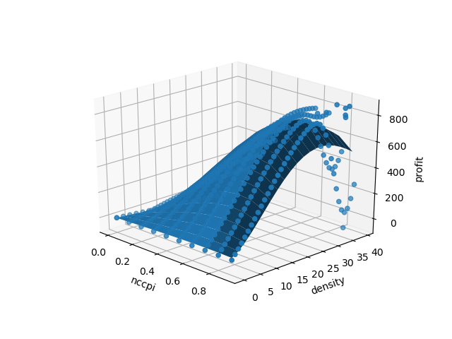
The Data: Yield != Profit
If the Yield goes up, but the costs go up faster, the profit curve turns over.

Slide 23
Imaging--NDVI Data: (NIR-R)/(NIR+R)
https://www.auravant.com/en/articles/precision-agriculture/vegetation-indices-and-their-interpretation-ndvi-gndvi-msavi2-ndre-and-ndwi/

Slide 24
NDVI Example
NDVI imaging can give in season data about the health of the crop from the color of the crop—acquiring it is challenging and expensive.

Slide 25
Modeling: An Example of a Mechanistic Model
Imagine and agricultural system is a kind of machinen or system
Example: Corn
Uses energy (sunlight) and other inputs as fuel (Carbon Dioxide, Nitrogen, etc.) to produce biomass and yield (sugar).
The dependence on inputs should be smooth and continuous because nature is smooth and continuous. This smoothness and continuity should allow us to describe systems for which we have no data provided we get the underlying workings right or right enough.

Slide 26
Mechanistic Models
Central Ideas Behind Mechanistic Growth Models
Growth is causal
Current state of a biological system is a function of the state of the system a moment before.
Properties like yield and biomass are a function of the state of the system
The rate of growth of the system is a function of the current state of the system
There are fixed, natural limits to the growth of a system
It is possible to capture both the state and growth of a system with an algorithm
By modeling temporal behavior of a system over many life cycles, it is possible to discover which inputs and parameters are most important.

Slide 27
Mechanistic Models
Explore these ideas:
Growth is causal
Growth is complex, but not random. There are intrinsic uncertainties, but it is possible to capture the causality in a sufficiently sophisticated algorithm
Current state of a biological system is a function of the state of the system a moment before.
State is broad—health, mass, potential, etc.
Properties like yield and biomass are a function of the state of the system
Yield and other properties develop in time with the state.

Slide 28
Mechanistic Models
The rate of growth of the system is a function of the current state of the system
There are fixed, natural limits to the growth of a system
There is a genetic potential that provides an upper bound on the state of the system. The system may not attain that potential and be limited by other factors (inputs, environment, etc.)
It is possible to capture both the state and growth of a system with an algorithm
When calibrated with enough data, we can write an algorithm that accurately models properties of the system (like yield) that depend on the temporal evolution of the system.

Slide 29
An Example of an Algorithm

Slide 30
Monte Carlo Runs

Slide 31
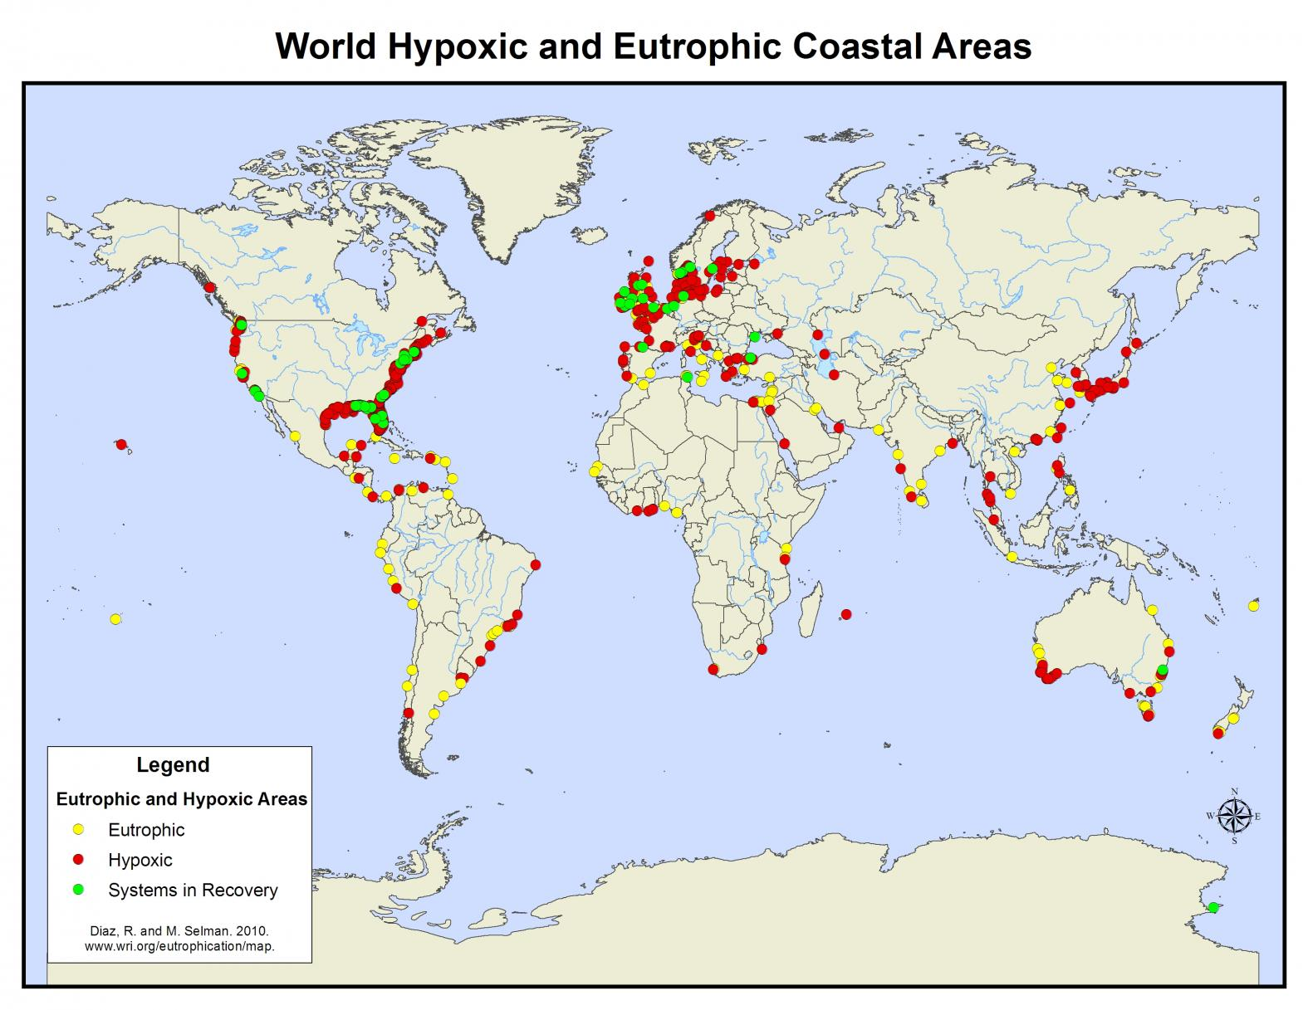
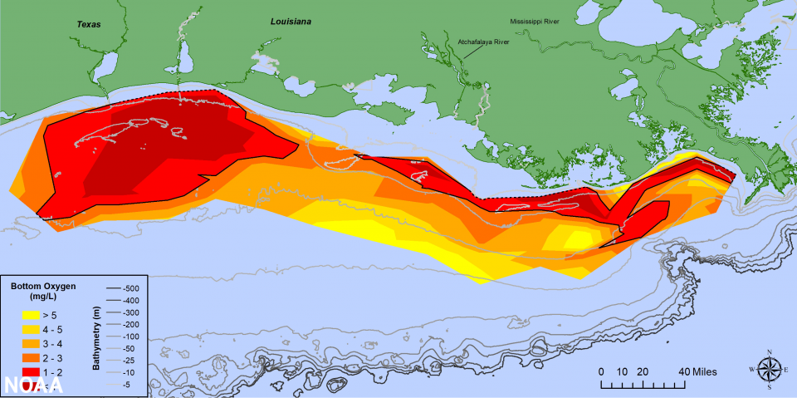
Future Data Needed: Nitrogen
By the late 1940’s observers began to see eutrofication in lakes in the United States
The presence of and abundance of nutrients, including nitrogen, presumably from the widespread application of nitrogen and other nutrients for agriculture was beginning to have harmful ecological effects
Figure 1: Eutrophic and Hypoxic Zones [4]
Figure 2: Gulf of Mexico Hypoxic Zone [1]

Slide 32
Data Acquisition: Nitrogen
We consider it to be of high intellectual merit and high scientific value to develop techniques that will allow us to measure how chemicals, beginning with nitrogen, move through soil and the environment at length scales that range from meters to hundreds of kilometers and time scales that range from hours to months and years. While these techniques begin with a focus on agriculture, if successful, may have profound effects on how we can understand transport and action.
NSF Convergence Accelerator Proposal with a multi-disciplinary team. Completion of our one-year study will lead to following deliverables:
Prototype nuclear technique (proton or neutron-bombardment and/or source-based, etc.) for finding ¹⁵N using identification of photon signatures with field deployable detectors.
Construct a calibration that allows us to make quantitative determination of the amount of 15N in a sample.
Prototype design of detectors and packages that allow easy deployment.
A “ground-truthing” process using known chemical techniques to verify the nuclear technique and drive detector development using stakeholder needs.

Slide 33
Huge Needs: We contribute?
Modeling is still crude
More and different data needed (e.g. Nitrogen)
Field Data is of poor quality
Need a systematic and careful approach with calibration
Need detailed application data
Need detailed meteorological data
Need ag-data acquisition professionals—a new career path
Need automation

Slide 34
Innovators and Entrepreneurs
What is an Innovator?
Does things differently or doing things that have never been done before – creating
Understand innovation never happens in a vacuum.
Understand that it takes many different points of view to fully grasp the complexity of economic, technological and other challenges.
Don’t take shortcuts and are not afraid of going after more complex solutions, even if it means taking higher risks.
Not afraid to break with the norm and push past conventional. They are aware customers don’t always know what they want.
Balance new ideas vs. experience.
Contribute new, unconventional ideas of their own.
https://www.forbes.com/sites/rebeccabagley/2014/01/15/the-10-traits-of-great-innovators/?sh=62b78b9a4bf4
What is an Entrepreneur?
Creates a new business, bearing most of the risks and enjoying most of the rewards.
Commonly seen as an innovator, a source of new ideas, goods, services, and business/or procedures.
Entrepreneurs play a key role in any economy, using the skills and initiative necessary to anticipate needs and bringing good new ideas to market.
Entrepreneurship that proves to be successful in taking on the risks of creating a startup is rewarded with profits, fame, and continued growth opportunities. Entrepreneurship that fails results in losses and less prevalence in the markets for those involved.
https://www.investopedia.com/terms/e/entrepreneur.asp

Slide 35
Physicists as Entrepreneurs?
What is an Entrepreneur?
Creates a new business, bearing most of the risks and enjoying most of the rewards.
Commonly seen as an innovator, a source of new ideas, goods, services, and business/or procedures.
Entrepreneurs play a key role in any economy, using the skills and initiative necessary to anticipate needs and bringing good new ideas to market.
Entrepreneurship that proves to be successful in taking on the risks of creating a startup is rewarded with profits, fame, and continued growth opportunities. Entrepreneurship that fails results in losses and less prevalence in the markets for those involved.
https://www.investopedia.com/terms/e/entrepreneur.asp
Physicists as Entrepreneurs?
Certainly innovators
Creating new businesses?
Taking risks?
Playing a role in the economy?
As innovators, physicists bring many things to the table to be successful entrepreneurs and entrepreneurs along with innovators solve interesting and important problems.
…But there are some steps.

Slide 36
Doing Physics is being an Innovator
What is an Innovator?
Does things differently or doing things that have never been done before – creating
Understand innovation never happens in a vacuum.
Understand that it takes many different points of view to fully grasp the complexity of economic, technological and other challenges.
Don’t take shortcuts and are not afraid of going after more complex solutions, even if it means taking higher risks.
Not afraid to break with the norm and push past conventional. They are aware customers don’t always know what they want.
Balance new ideas vs. experience.
Contribute new, unconventional ideas of their own.
https://www.forbes.com/sites/rebeccabagley/2014/01/15/the-10-traits-of-great-innovators/?sh=62b78b9a4bf4
Physicists:
Constantly creating new solutions to measure and calculate
Constantly collaborating and talking to find solutions. Always facing economic and technical constraints.
Face hard problems constantly.
New and clever solutions are always sought after. ”Clever” is high praise.
Looking to other fields and existing ideas to solve new problems..
Contribute new, unconventional ideas of their own.
Natural innovators

Slide 37
Innovation and Entrepreneurship by Accident
EPIC Report: Innovation and Entrepreneurship (I&E) has been incorporated into a number of education disciplines over the last 25 years or so but has not been broadly utilized in physics. At the same time, employers have indicated that while physics graduates are valuable, they lack some of the key skills and abilities that would greatly improve their performance in the workplace and are provided by I&E education.
What did we need to proceed?
A belief that those goals are not inconsistent
A willingness to learn many new things (to become a beginner)
A willingness to learn to talk to new people
A tolerance for risk.

Slide 38
Conclusions
Agriculture needs to advance with data—it’s the last major industry that is still in its infancy with respect to using data
Physicists bring an array of tools, insights, and techniques
There are tremendously important and interesting problems of all kinds, (experimental, theoretical, computational).
You need to become a beginner again—which is terrifying and exciting….
You need to learn to talk with and listen to the experts on the ground-–the farmers.

