Slide 1
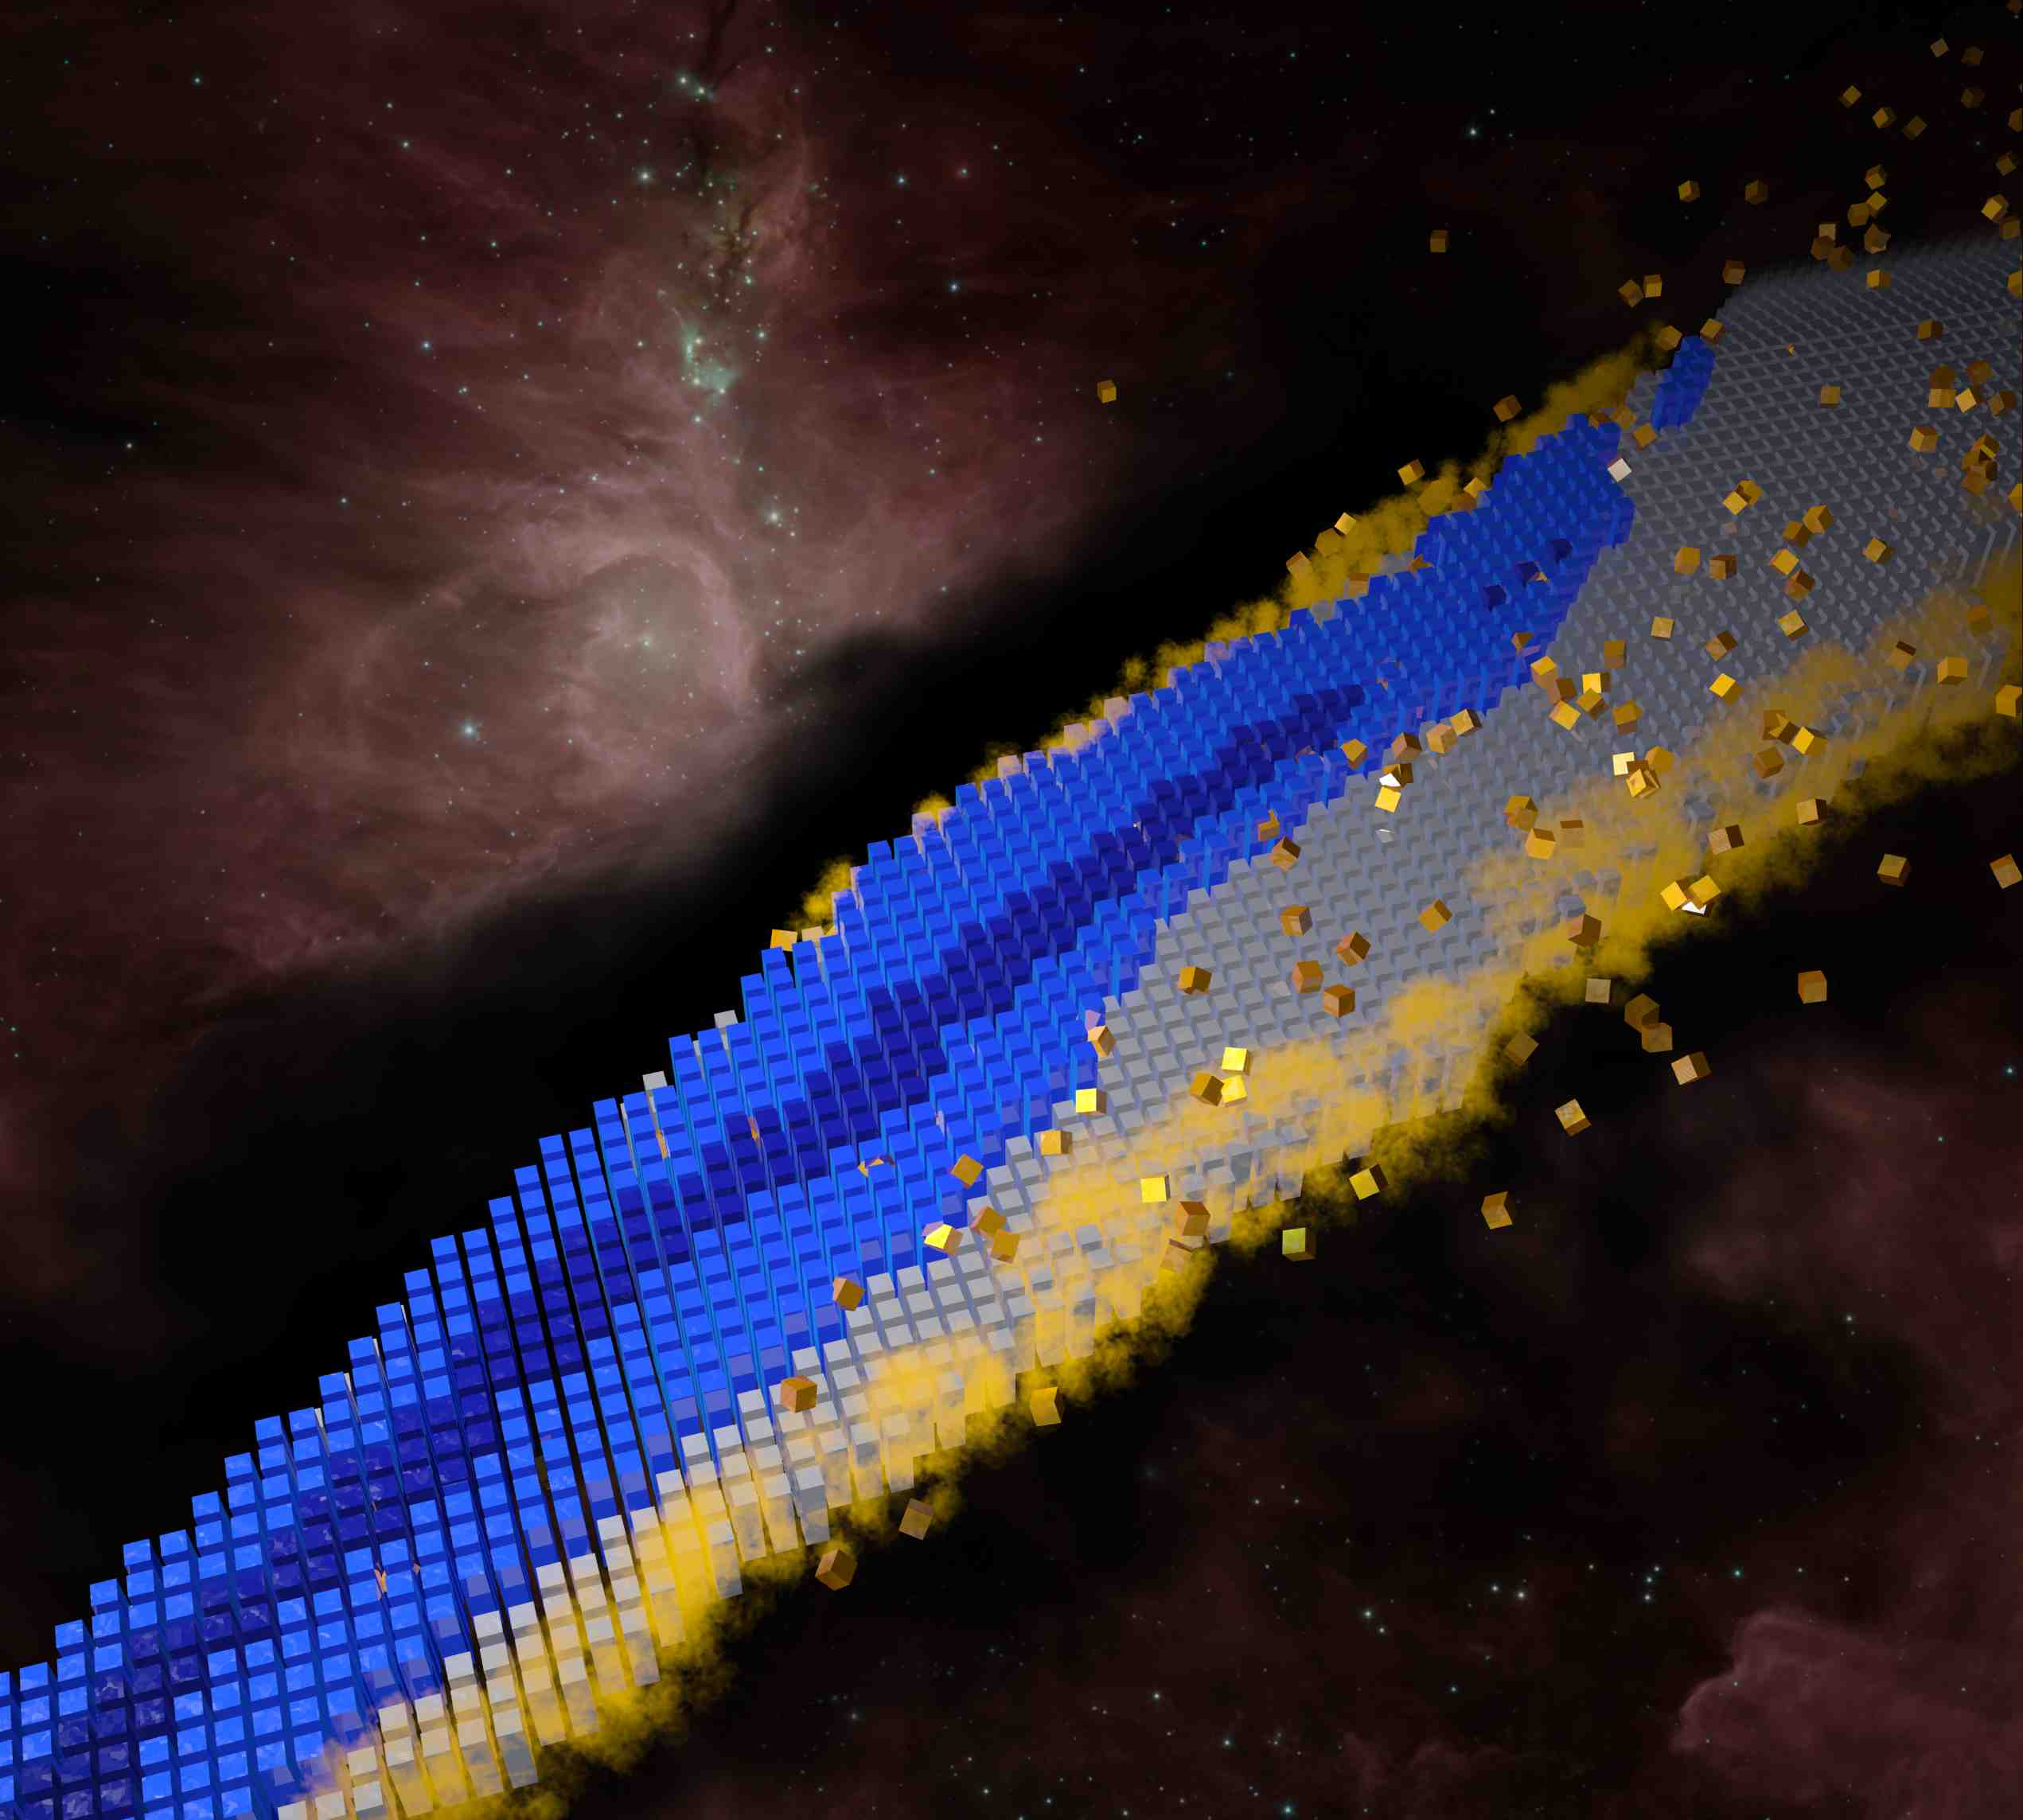
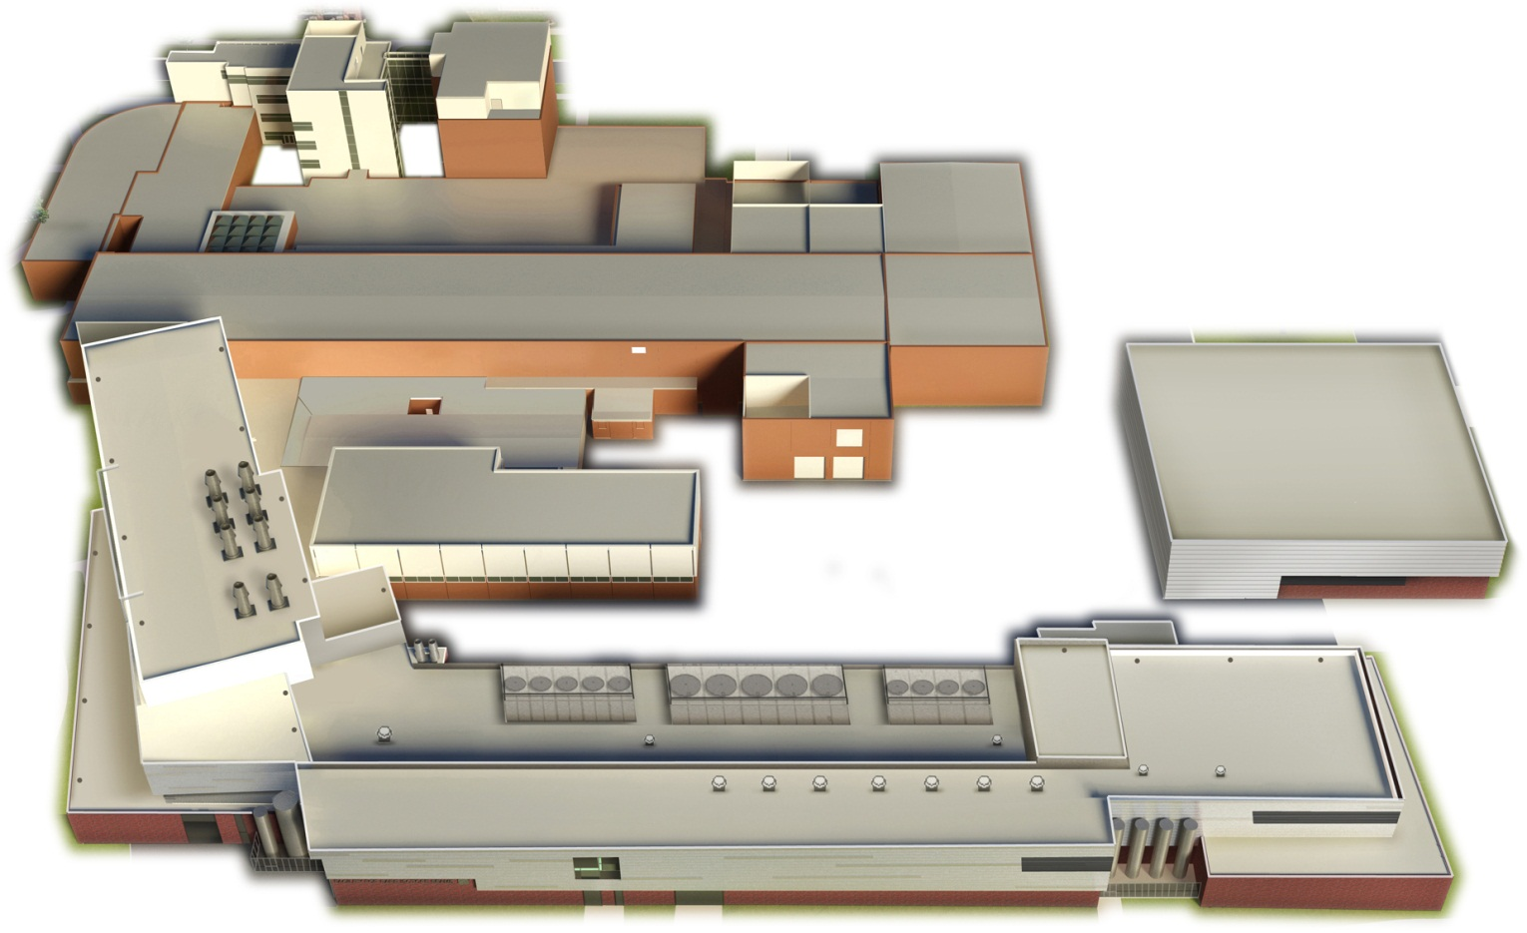
Excitement and Challenges in Nuclear Structure:
Science of Facility for Rare Isotope Beams (a 30,000-foot view)
Witold Nazarewicz (FRIB/MSU)
Colloquium, Fermilab, Sep. 20, 2023
FRIB update
Major science themes
Perspectives

Slide 2
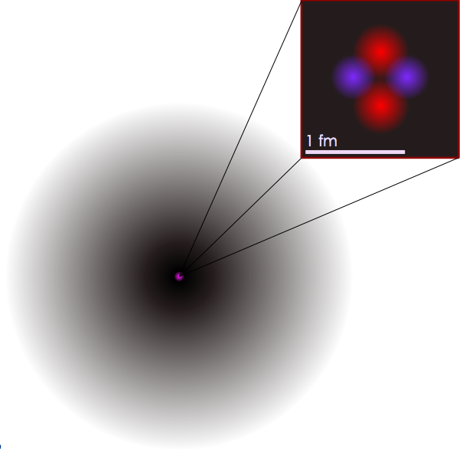
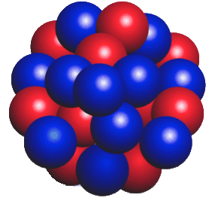
Prelude
“All the matter that makes up all the living organisms and ecosystems, planets and stars, throughout every galaxy in the universe, is made of atoms, and 99.9% of the mass of all the atoms in the (visible) universe comes from the nuclei at their centers which are over 10,000 times smaller in diameter than the atoms themselves” USNAS Decadal Study Report
Overarching questions:
Where do atomic nuclei and elements come from?
How are atomic nuclei made and organized?
What are the fundamental particles and forces at work inside atomic nuclei?
What are nuclei good for?

Slide 3
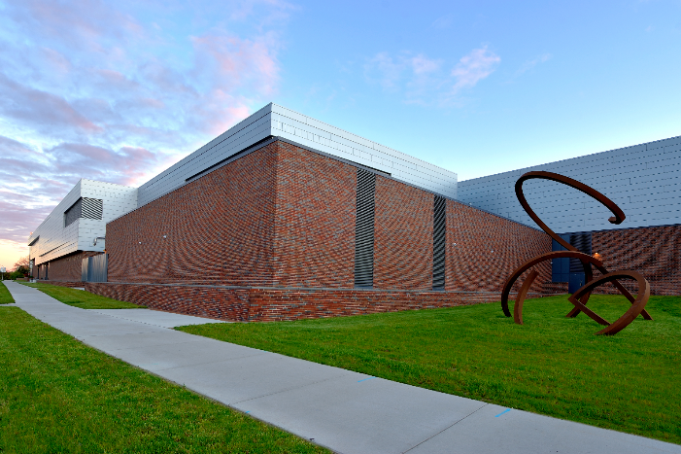
FRIB Laboratory
650 employees, incl. >45 faculty, >120 graduate and >120 undergraduate students
FRIB is a scientific user facility funded by the Department of Energy Office of Science (DOE-SC), Michigan State University, and the State of Michigan.
FRIB Project started in 2008, concluded on budget and ahead of schedule in January 2022; first experiments started in May 2022.
FRIB is facility for world-unique rare isotope research supporting the mission of the Office of Nuclear Physics in DOE-SC.
Rare isotopes are combinations of protons and neutrons that do not naturally exist on earth – they are made in stars and FRIB can make them until they decay.
FRIB enables scientists to make discoveries about the properties of these rare isotopes to better understand the physics of nuclei, nuclear astrophysics, fundamental interactions, and applications for society.
Notes:
Other Points to Mention:
DOE contribution $730 million
FRIB enables scientist to make discoveries in properties of atomic nuclei, nuclear astrophysics, tests of fundamental symmetries, and isotope research for society
More than 1,400 world-class scientists are engaged and belong to the FRIB Users Organization (FRIBUO)
Made possible by partnerships with the best in the nation and world; 13 active Work-for-Others agreements and 14 active MOUs

Slide 4
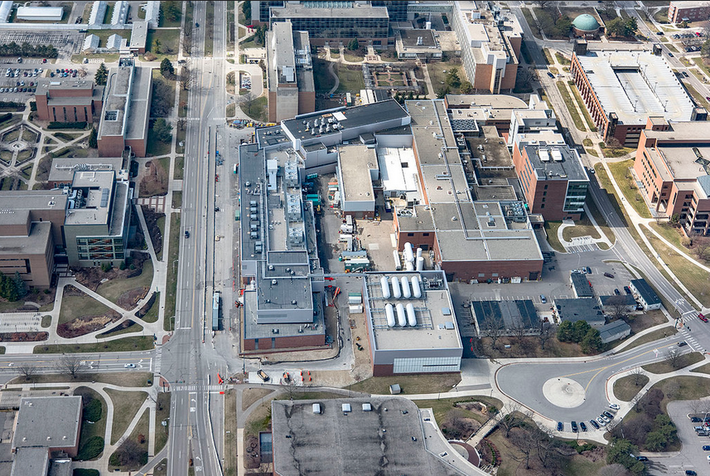
… located in the middle of the MSU Campus
Physics
Bio Chem
Chemistry
Plant Sciences
MSU Law
Vet School
Performing Arts
Each year, MSU awards 10% of the nation’s nuclear physics doctorate degrees.
Leading (No. 1-2) graduate nuclear physics program.

Slide 5
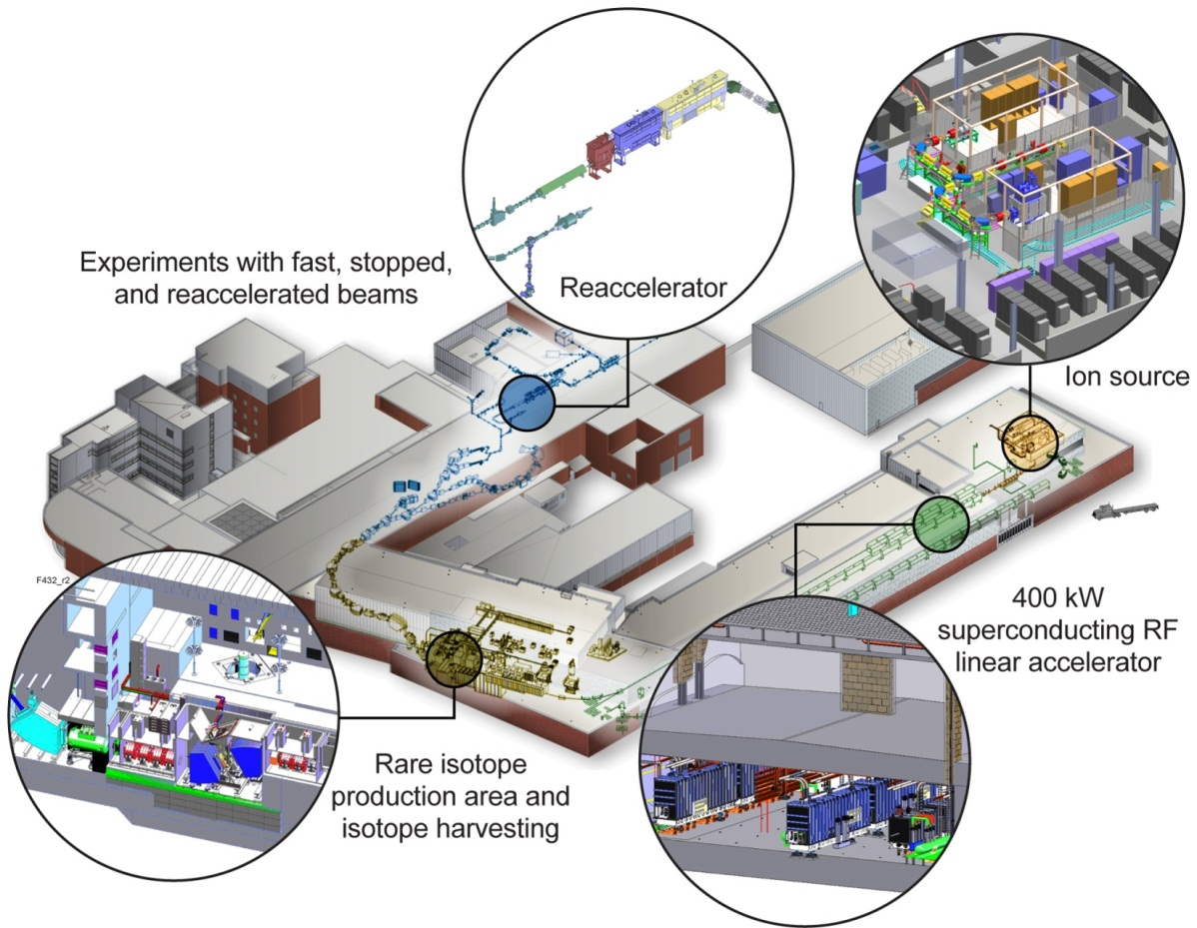
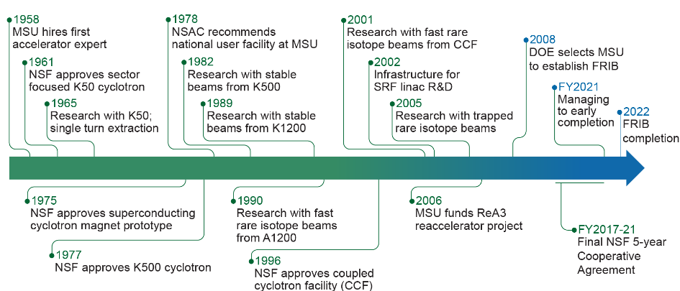
MSU has a 50-year history in accelerator-based science (NSF-funded)
  Cyclotron Laboratory (1965 – 1985)
  NSCL, National Superconducting Cyclotron Laboratory (1985 – 2021)
Major reinventions leveraged assets and kept Laboratory at cutting edge
  1965 proton beams, 1982 heavy ion beams, 1990 rare isotopes, 2001 coupled cyclotrons

Slide 6









Collaborating with National Laboratories
and International Partners
ANL
  Liquid lithium charge stripper
  Beam dynamics verification; β=0.29 HWR
  processing and testing; SRF tuner validation; beam dump
  SRF components development;
  RF couplers for multi-gap buncher
  β=0.65 upgrade cavity R&D
  SOLARIS
BNL
  Plasma window & charge stripper,
  physics modeling, magnets
FNAL
  Diagnostics, SRF processing
JLab
  Cryoplant; cryodistribution design & prototyping
  Cavity hydrogen degassing; e-traveler
  HWR processing & certification
  QWR and HWR cryomodule design and engineering support for production
LANL
  Proton ion source
LBNL
  ECR coldmass, beam dynamics;
  Nb₃Sn ECR coldmass
MIT
  CRIS
ORNL
  Remote handling, diagnostics;
  large-vessel vacuum, cryoplant controls
  FDSi
SLAC
  Cryogenics, SRF multipacting,
  physics modeling
RIKEN
  Helium gas charge stripper
  Rare isotope physics, fragment separators
TRIUMF
  Beam dynamics design, physics modeling SRF, QWR etching
INFN
  SRF technology
KEK
  SRF technology, SC solenoid prototyping
  RFQ; 2nd RFQ
IMP, Budker I,…
A. Presenter, Monthly Slides, Date
, Slide 6

Slide 7
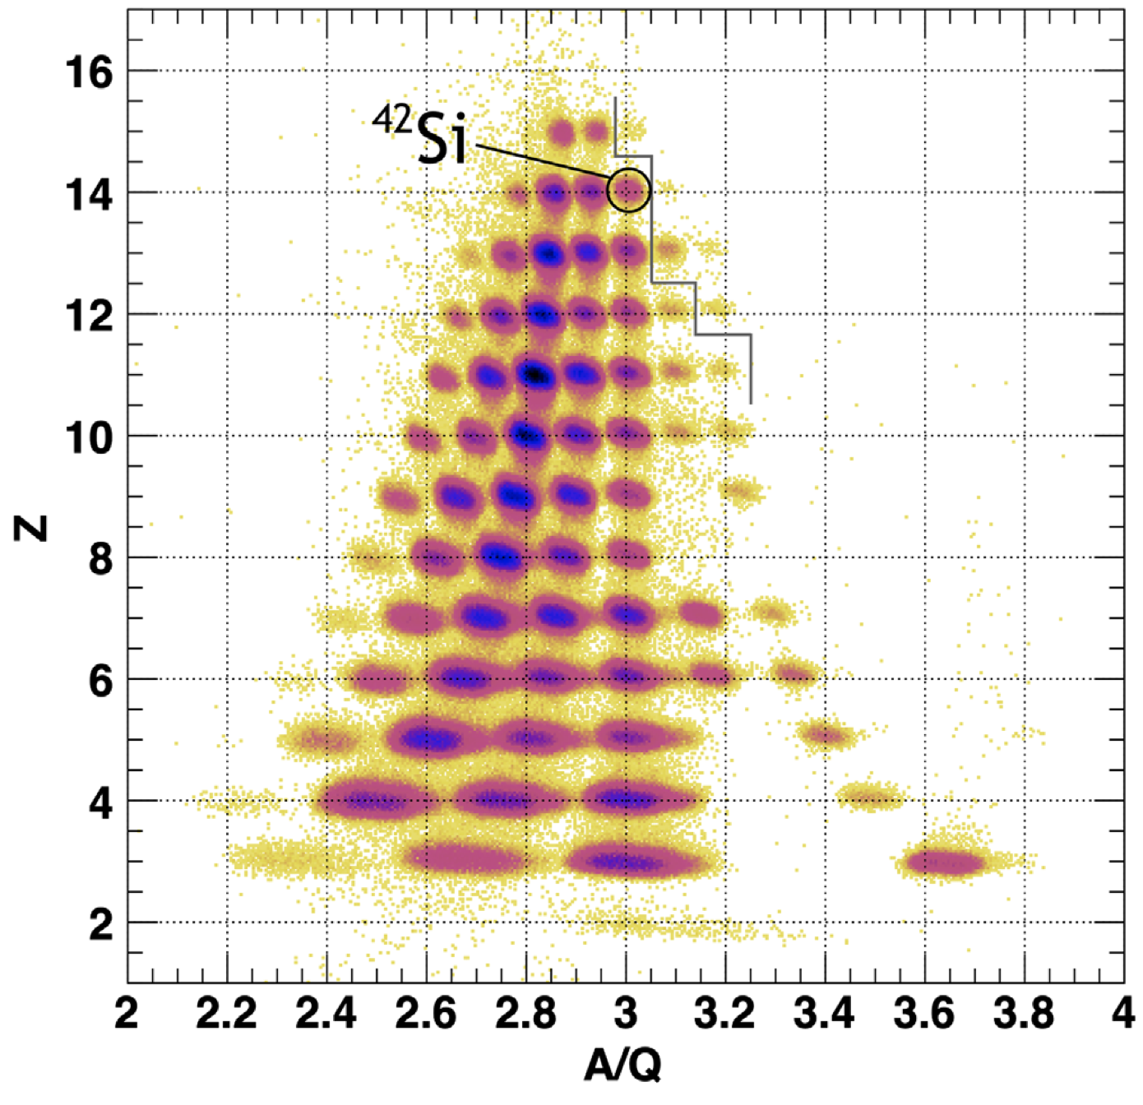
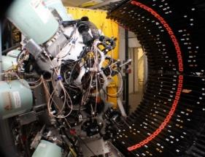
First Scientific User Experiments Concluded Successfully
  First papers already published:
  H. Crawford et al, Phys. Rev. Lett. 129, 212501 (2022) - Published 14 November 2022
  T. J. Gray et al., Phys. Rev. Lett. 130, 242501 (2023) – Published 13 June 2023
newly measured lifetimes
FRIB Decay Station initiator

Slide 8

FRIB Science is in the FRIB Logo
Properties of atomic nuclei
  Develop a predictive model of the atomic nucleus
  Determine the limits of nuclides
Societal applications and benefits
  Isotope harvesting for medicine and a variety of fields
Nuclear processes in the cosmos
  Origin of the elements
  Stellar explosions
  Neutron stars
Tests of laws of nature
  Tiny effects amplified in certain nuclei; complementary information to collider data
  Surrogate reactions: nuclear security
Middle circle:
FRIB capabilities (fast, stopped, reaccelerated, and harvested beams) that match the science program
Notes:
FRIB capabilities (fast, stopped, reaccelerated, harvested beams) that match the science program

Slide 9
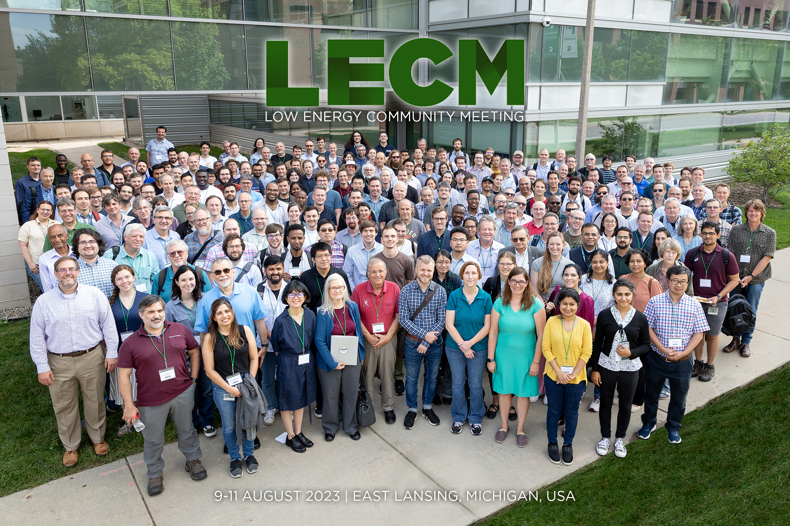
Users Engaged and Ready for Science
Users organized as part of independent FRIB Users Organization (FRIBUO)
  Chartered organization with an elected executive committee
  1,800 members (124 U.S. colleges and universities, 13 national laboratories, 52 countries) as of 31 August 2023
  21 working groups on instruments
  FRIB Theory Alliance
  FRIB-TA Fellows
  FRIB-TA Bridges

Slide 10
Major science themes

Slide 11
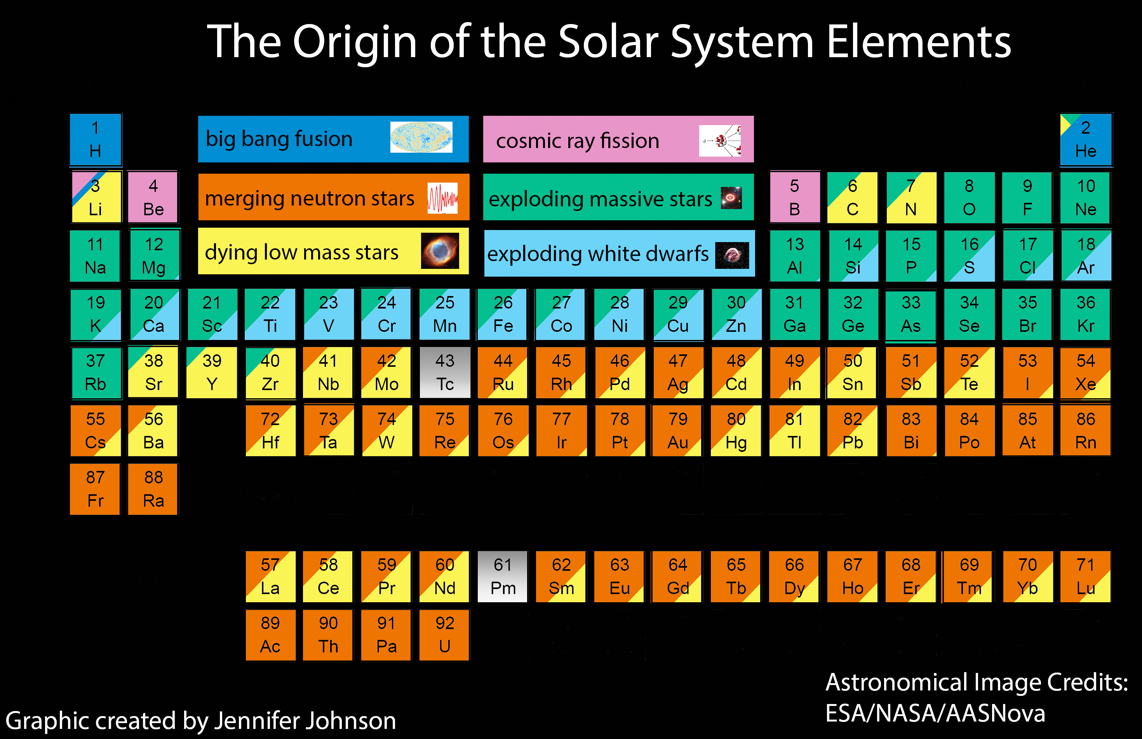
Where do atomic nuclei and elements come from?

Slide 12
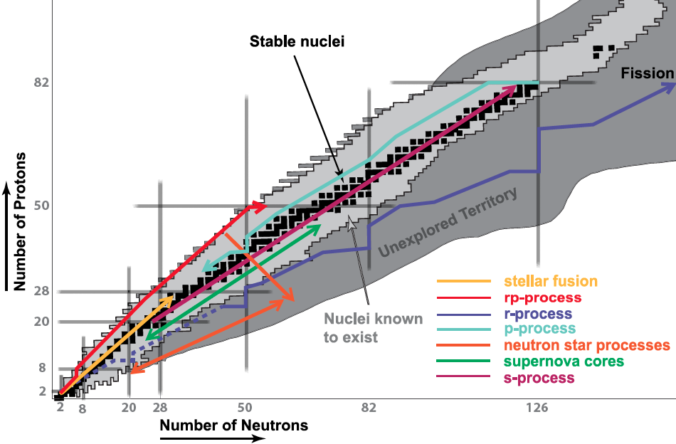
Rare isotopes are important to understand astrophysical scenarios

Slide 13
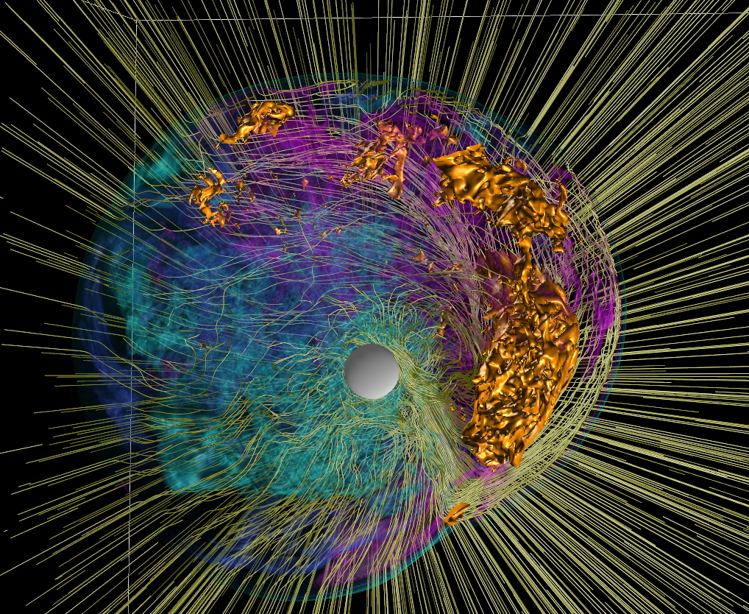
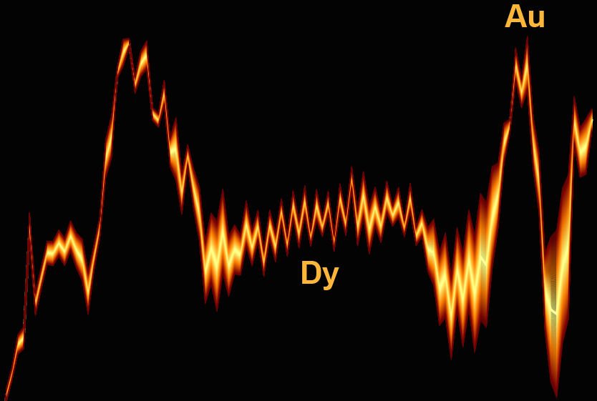
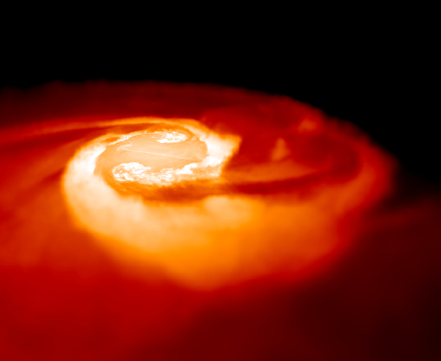
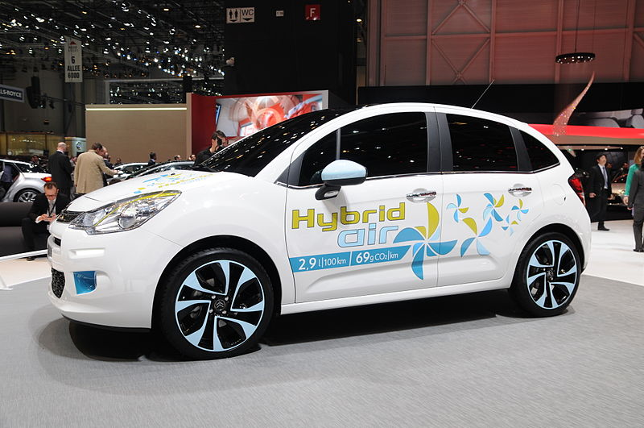
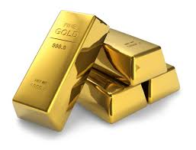
Half of the neutron-rich atomic nuclei heavier than iron are built by neutron driven r-process. The final abundances reflect the structure of nuclei, which determines the nucleosynthesis trajectories.
supernova
abundance
Nature 445, 58 (2007)
neutron star mergers
atomic number
Au
Dy
Mon. Not. R. Astron. Soc. 430, 2585 (2013)

Slide 14
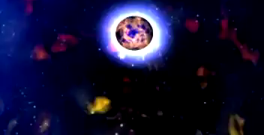
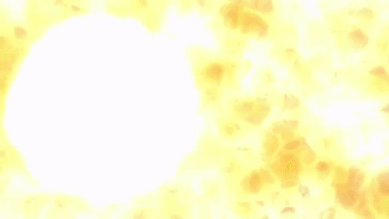
GW170817: a gravitational wave signal observed by the LIGO and Virgo detectors on 17 August 2017; collision of two inspiraling neutron stars with a total mass of 2.82 solar masses, duration of 100 sec.
NASA/Dana Berry
NASA/Dana Berry
The neutron star merger event is thought to result in a kilonova, characterized by a short gamma ray burst followed by a longer optical "afterglow" powered by the radioactive decay of heavy r-process nuclei
FRIB will give access to the extremely neutron-rich isotopes that have now been identified to play a key role in explaining the observed kilonova.
14

Slide 15
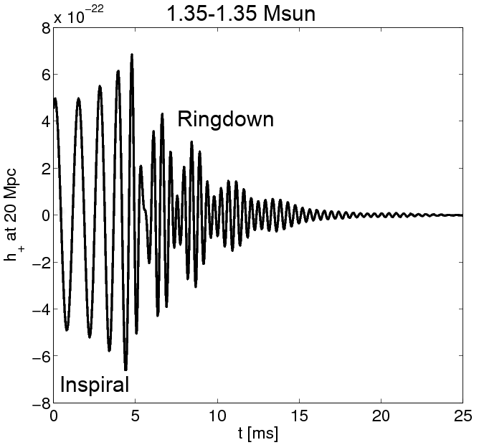
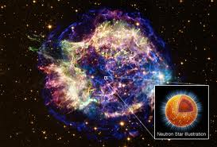
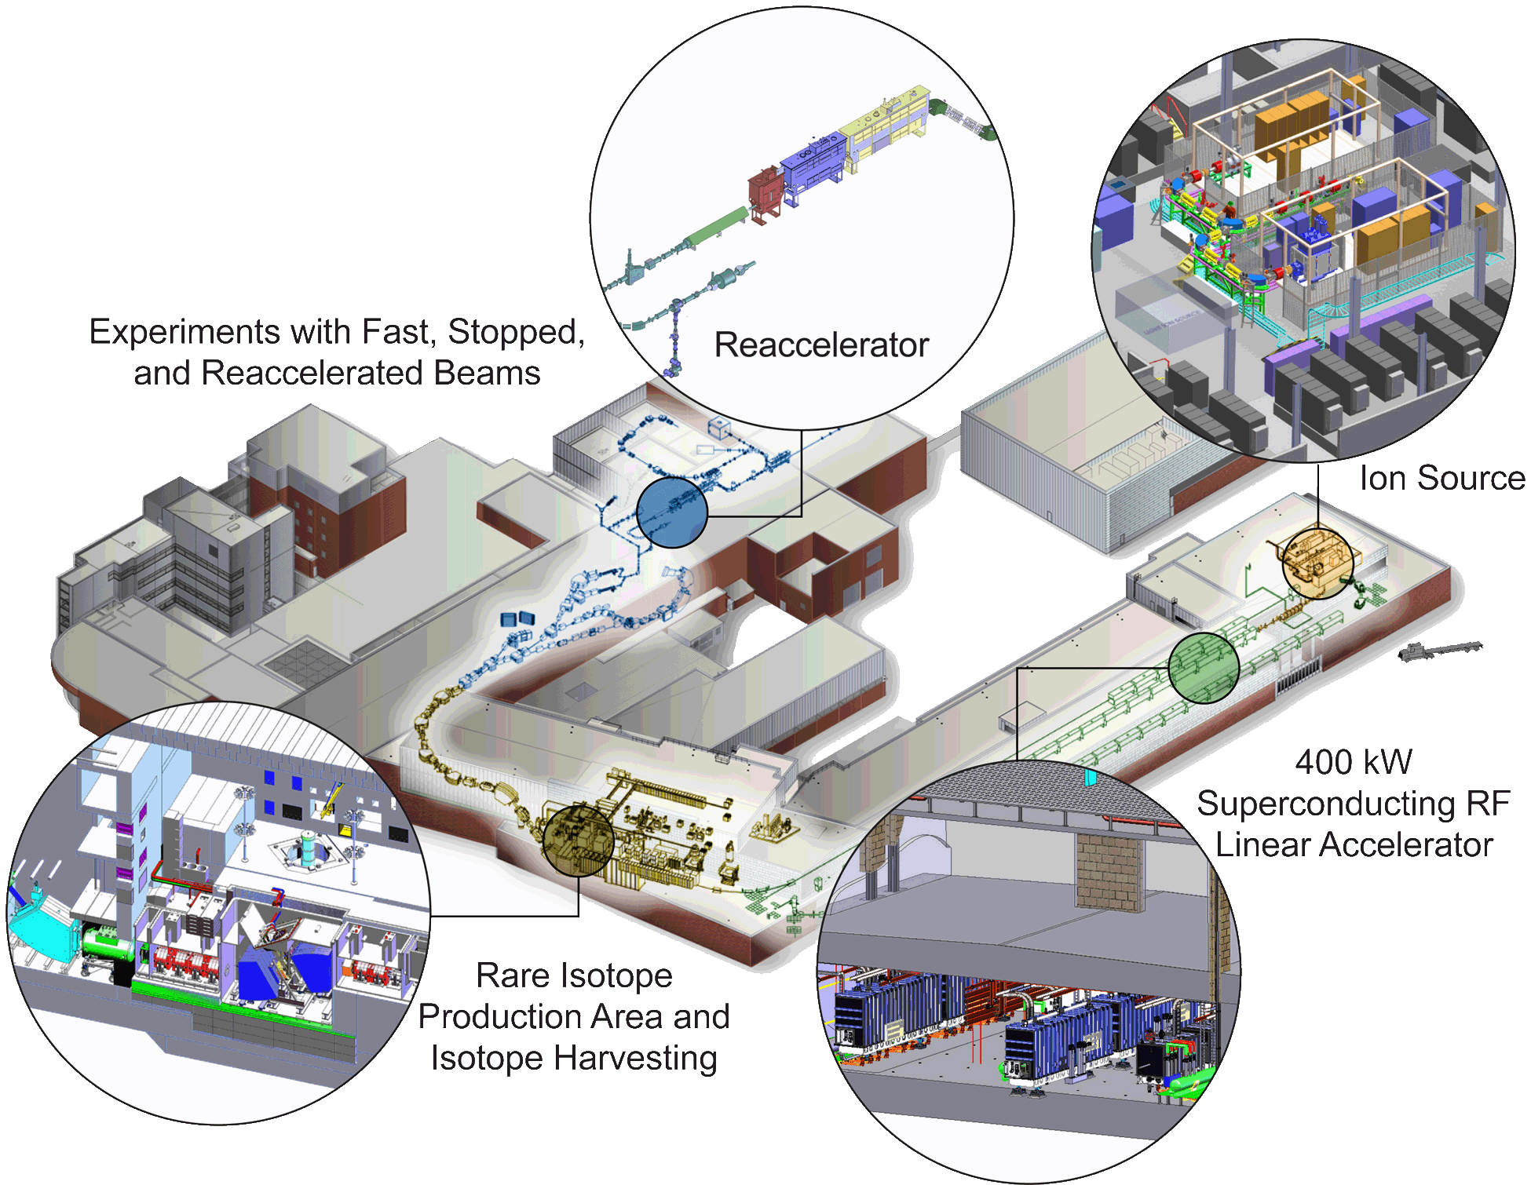

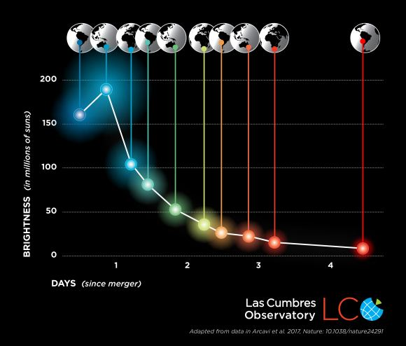
Quest for understanding the neutron-rich matter on Earth and in the Cosmos
GW signal
Data
EOS
NS mass
Kilonova: Time evolution determined by the radioactive decay of r-process nuclei.
Notes:
Multimessenger Astronomy

Slide 16
FRIB: r-process machine
By reaching into the r-process nuclei, FRIB will provide constraints on key observables
From M. Mumpower

Slide 17
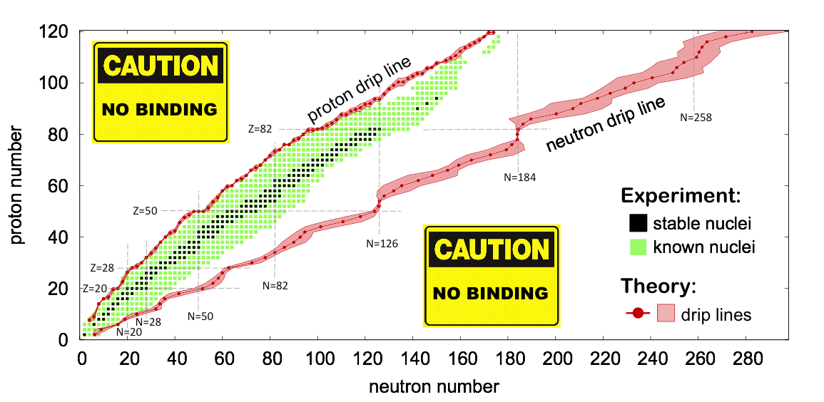
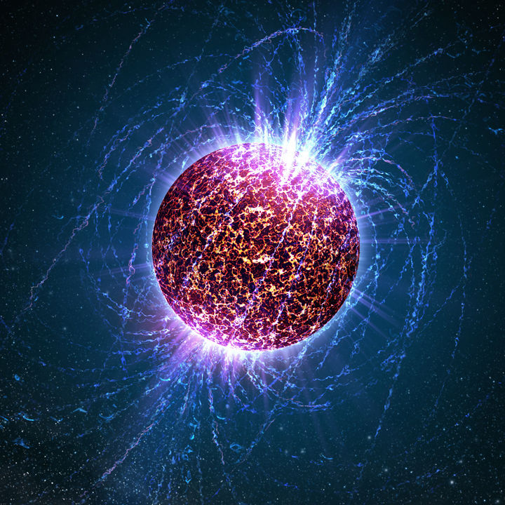
Exploring the Grand Nuclear Landscape
How are nuclei made and organized?
superheavy
nuclei
Unknown territory
N~10⁵⁷

Slide 18
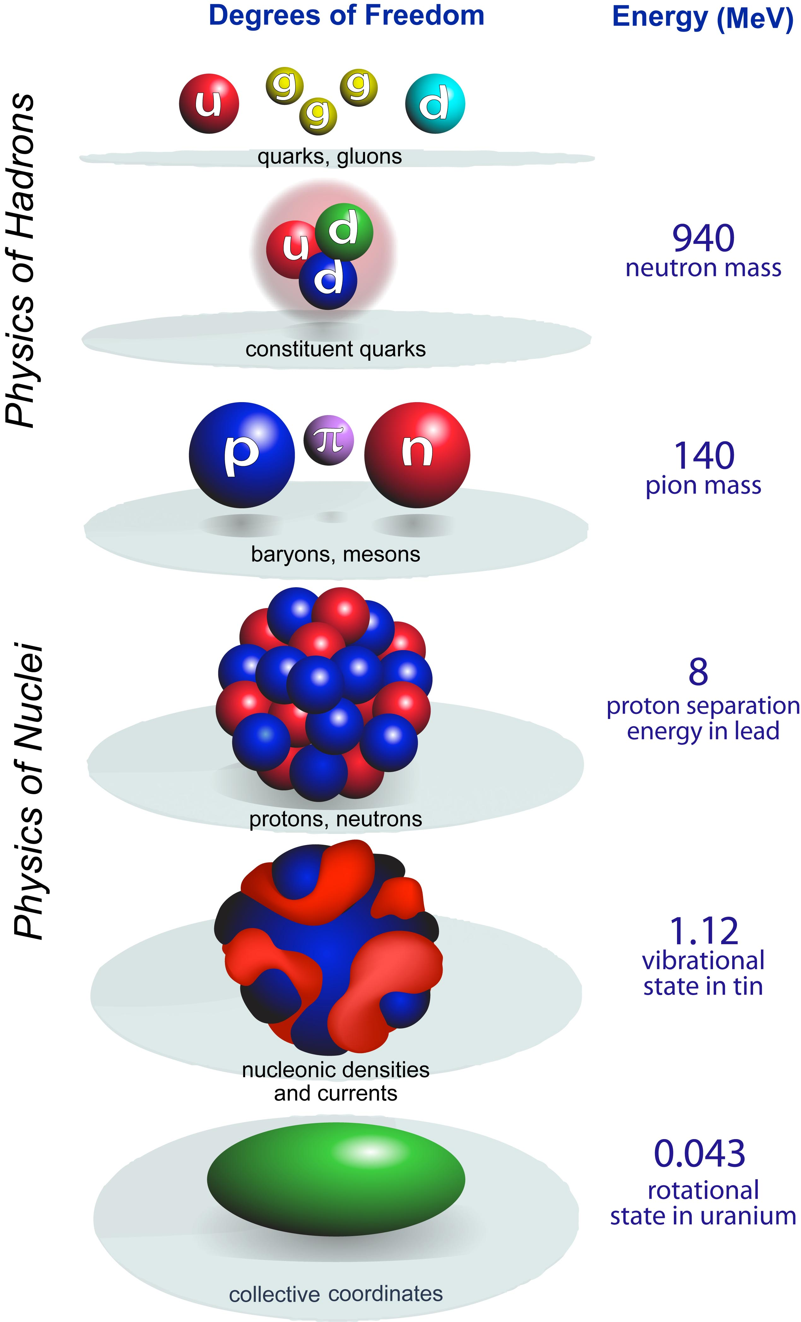
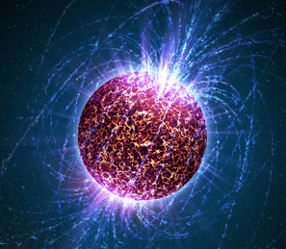
Baryon number
LQCD
scale
separation
1/3
sub-fm
quark
models
~1 fm
1
A-body
Effective Field Theory
several fm
2 - 294
CI
DFT
collective
~12 km
10⁵⁷
Notes:
All nuclear models are phenomenological but at different resolution

Slide 19
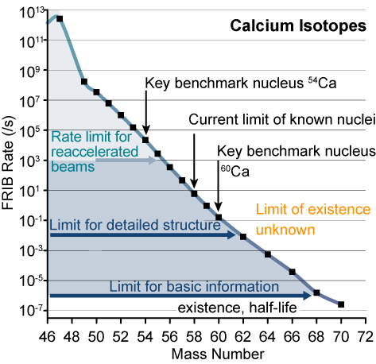
Example: Access to calcium isotopes at FRIB
Calcium isotopic chain (Z=20) is crucial
FRIB provides access to the relevant neutron-rich Ca isotopes with intensities sufficient to measure important observables
  Masses, half-lives, decay properties, single-particle and collective degrees of freedom
  Structure of heavy Ca isotopes will quantify the role of many-body forces and weak binding
In general: Long isotopic chains are essential
  Evolution of nuclear properties can be benchmarked as a function of isospin
Dripline at ⁷⁰Ca?

Slide 20

Extreme Nuclei: Open Quantum Systems
Structure of ⁹N
Charity et al. Phys. Rev. Lett. (2023)
7p+2n=α+5p (5p emitter)
Nitrogen-9 is a weakly bound grouping of 5 protons and an alpha particle. Its decay is like opening a set of nesting dolls; each decay reveals another nuclide which also decays by the emission of a single or a pair of protons

Slide 21
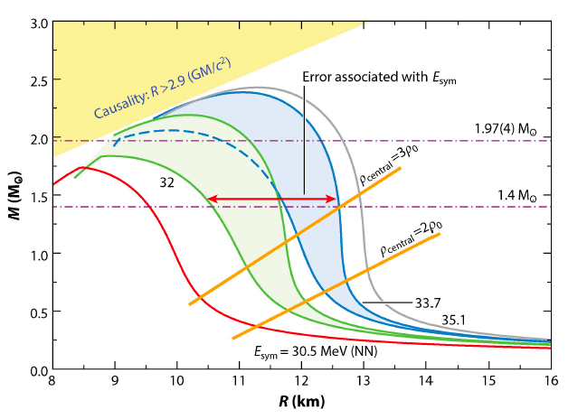
Nuclear matter equation of state
Annu. Rev. Nucl. Part. Phys. 65, 303 (2015)
Crustal structures in neutron stars
Access to nuclei with large neutron skins

Slide 22
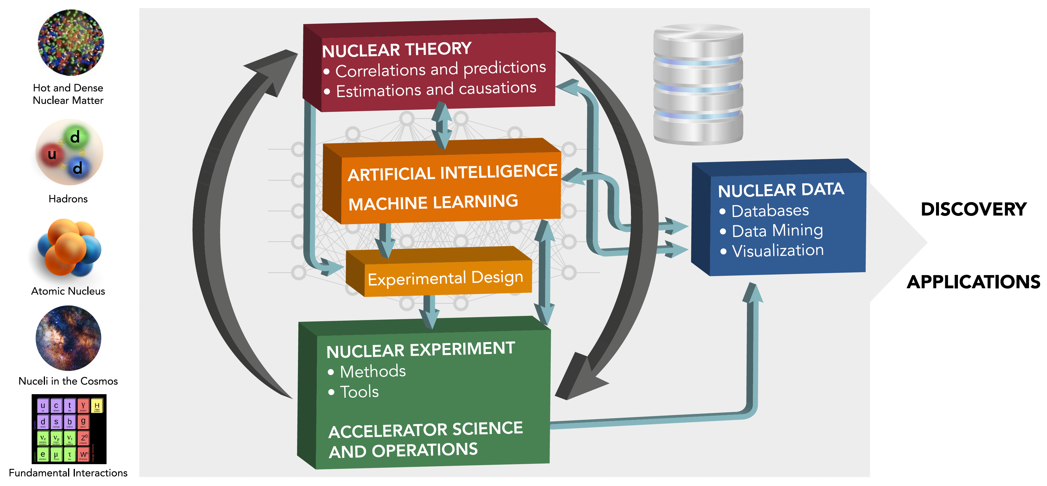
Machine learning and nuclear theory: big picture
Artificial Intelligence and Machine Learning in Nuclear Physics
A. Boehnlein et al., Rev. Mod. Phys. Rev. Mod. Phys. 94, 031003 (2022)
Many examples can be found there!
  Speeding-up the cycle of the scientific method through machine learning

Slide 23
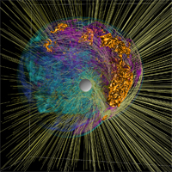
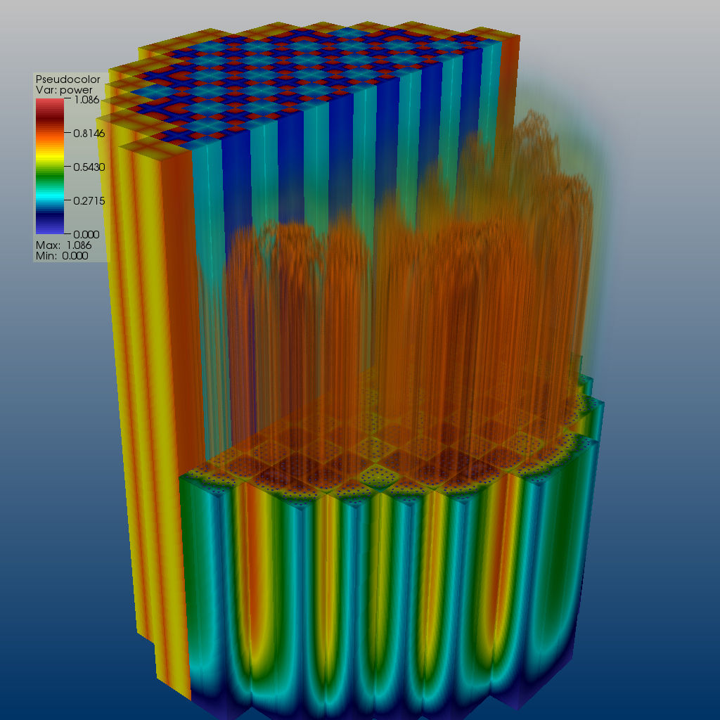
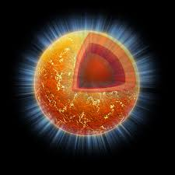

Machine learning & low-energy nuclear theory: Why?
ML tools can help us to speed up the scientific method cycle and hence facilitate discoveries
  Enabling fast emulation for big simulations
  Revealing the information content of measured observables w.r.t. theory
  Identifying crucial experimental data for better constraining theory
  Providing meaningful input to applications and planned measurements
ML tools can help us to reveal the structure of our models
  Parameter estimation with heterogeneous/multi-scale datasets
  Model reduction
ML tools can help us to provide predictive capability
  Theoretical results often involve ultraviolet and infrared extrapolations due to Hilbert-space truncations
  Uncertainty quantification essential
  Theoretical models are often applied to entirely new nuclear systems and conditions that are not accessible to experiment

Slide 24
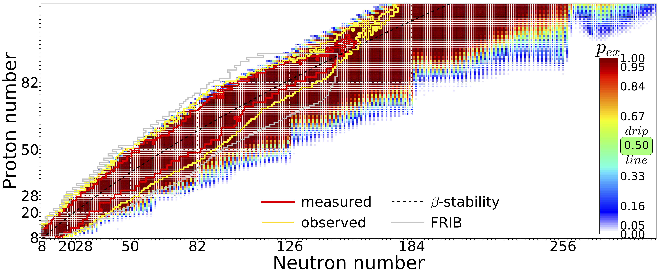
Quantified limits of the nuclear landscape
Neufcourt et al., Phys. Rev. C 101, 044307 (2020)
Predictions made with 11 global mass model and Bayesian model averaging
FRIB will double the knowledge of known nuclei; it will access 80% of all isotopes predicted to exist for elements below uranium
FRIB will extend the neutron drip line from Z=8 (now) to approximately Z=40

Slide 25

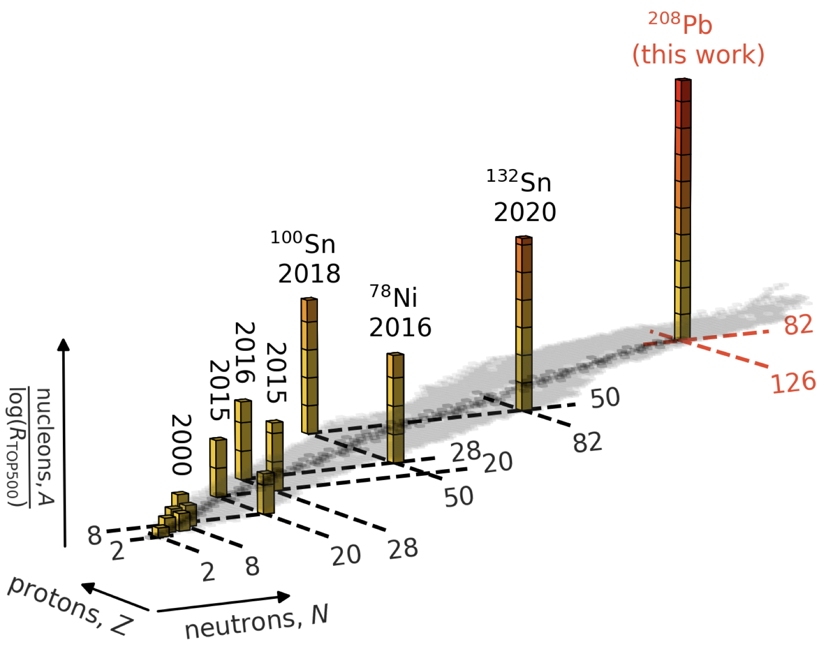
How to solve the nuclear many-body problem precisely?
Hu et al., Nature Phys. 18, 1196 (2022)
They explored 10⁹ different nuclear force parameterizations via history matching, confronted them with data in select light nuclei and arrived at an importance-weighted ensemble of interactions
Nuclei from NN+NNN interactions: CC and IM-SRG

Slide 26
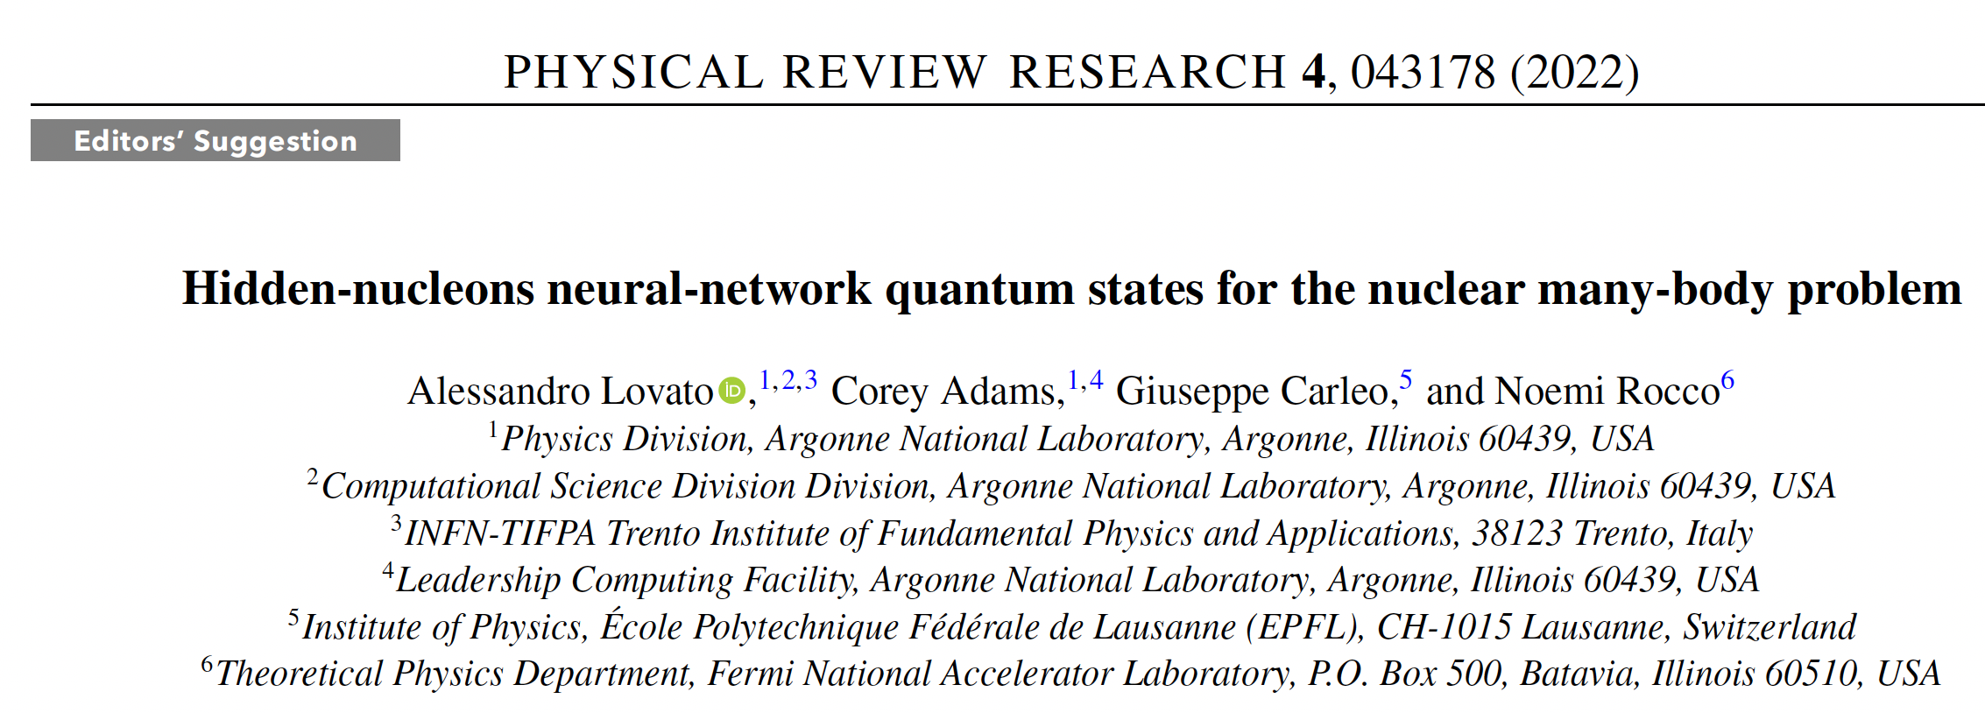
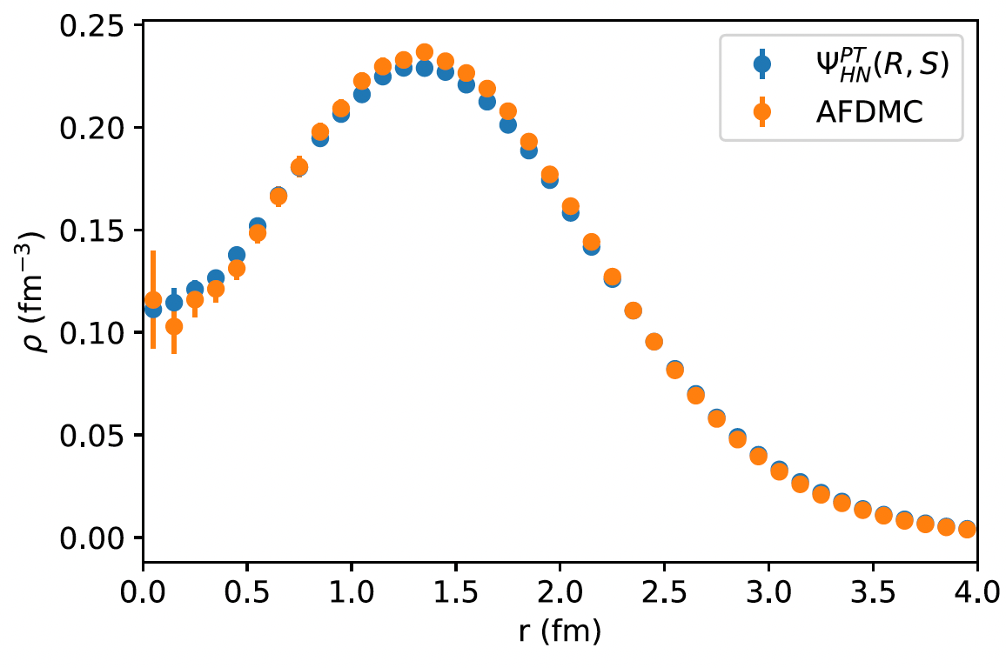
Point nucleon density of ¹⁶O as obtained with the hidden
nucleon ansatz (solid blue circles) compared with the perturbatively corrected
AFDMC estimates

Slide 27
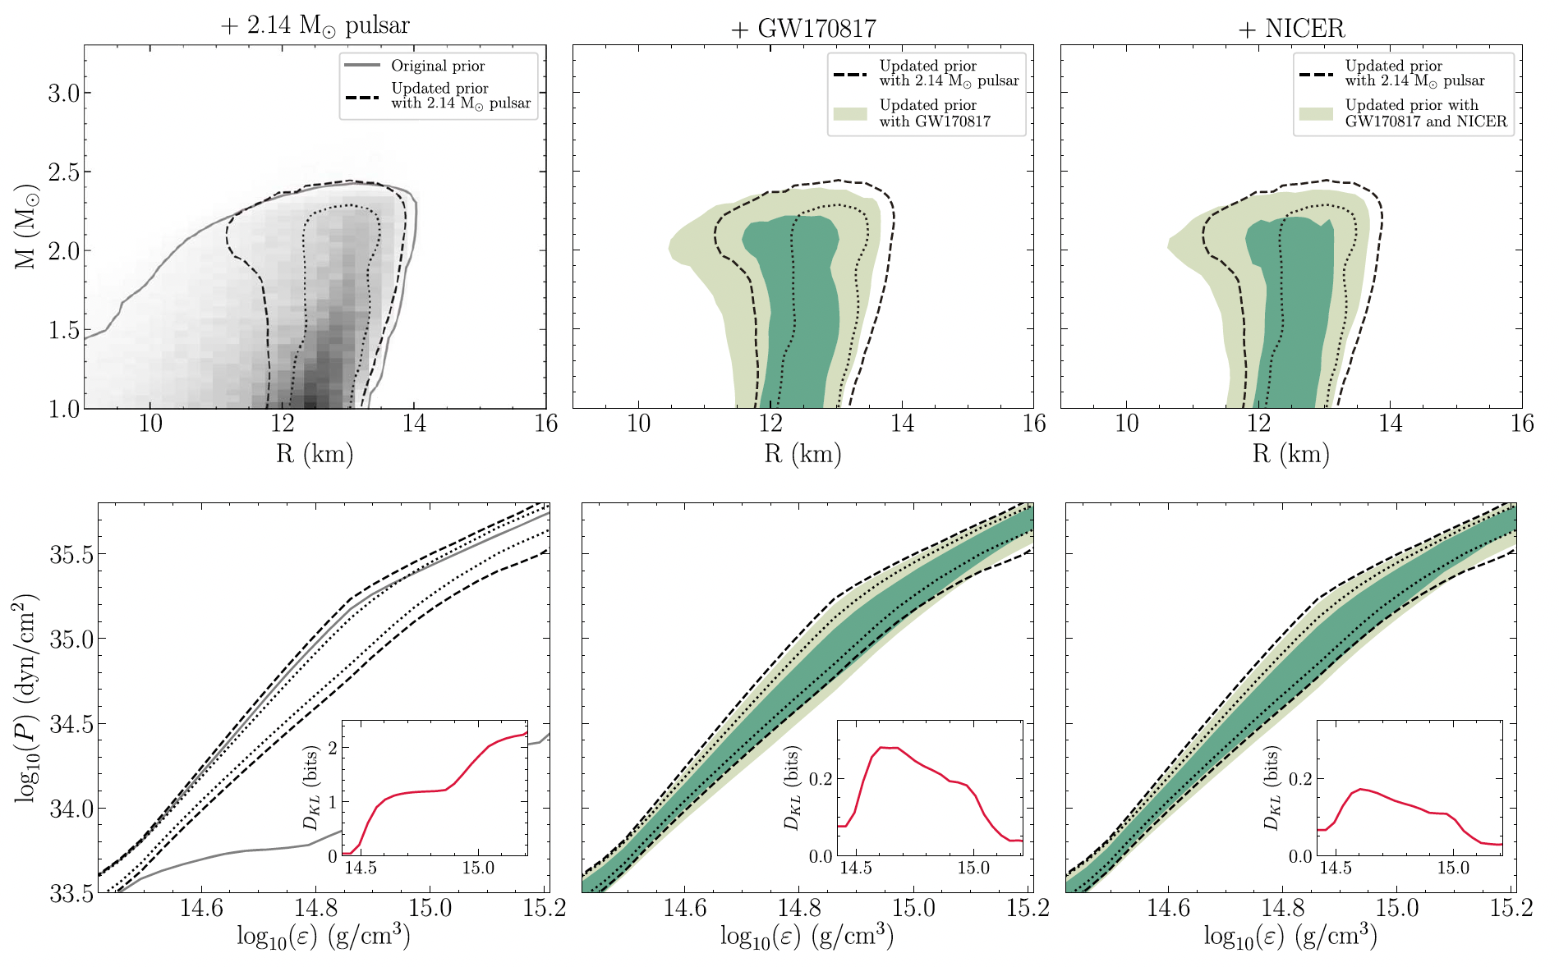
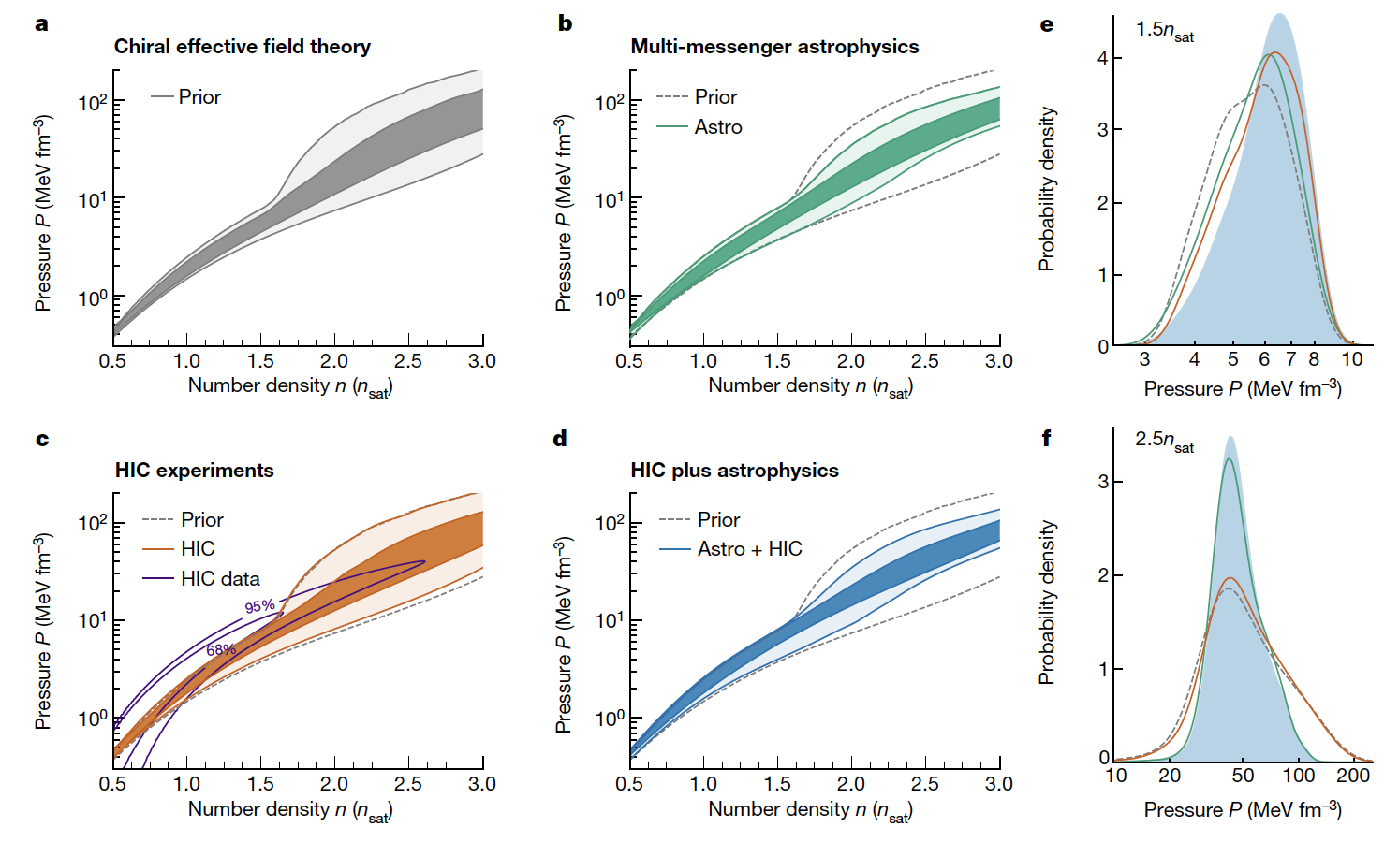
Equation of state of nuclear matter
Many Bayesian inference studies combining nuclear data and astrophysical observations
G. Raaijmakers et al., Constraining the Dense Matter Equation of State with Joint Analysis of NICER and LIGO/Virgo Measurements, AJ Letters, 893, L21 (2020)
S. Huth et al. Constraining neutron-star matter with microscopic and macroscopic collisions, Nature 606, 276 (2022)
(ASY-EOS@GSI)

Slide 28
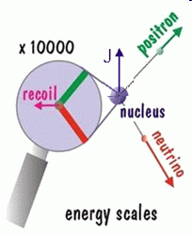
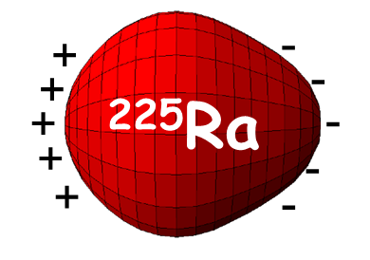
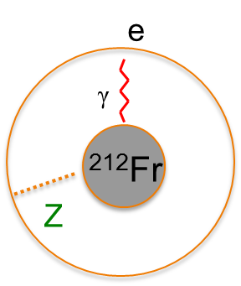
Rare isotopes put the Standard Model to the test
  Specific nuclei offer new opportunities for precision tests of fundamental symmetries.
  How will we turn experimental signals into precise information on physics beyond the standard model?
Angular correlations in β-decay
  Search for new particles and interactions
  Scalar and tensor terms probed
Permanent electric dipole moments in atoms
  Beyond the Standard Model
  Dominance of matter over antimatter (CP violation)
  ²²⁵Ra, ²²⁹Pa are special (several thousand times more sensitive than ¹⁹⁹Hg due to octupole deformation). Pioneering studies at ANL.
Parity non-conservation in atoms
  Weak charge in the nucleus, anapole moment (Francium isotopes)
Notes:
A=8 (Li, Be) experiments at ANL, Fierz term
6He beta decay, 20F

Slide 29
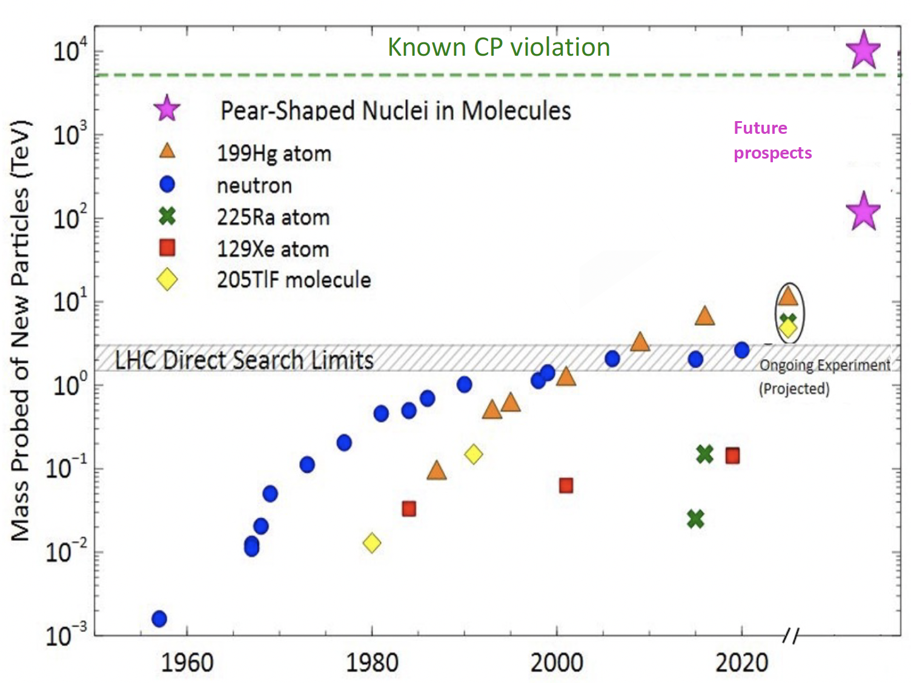
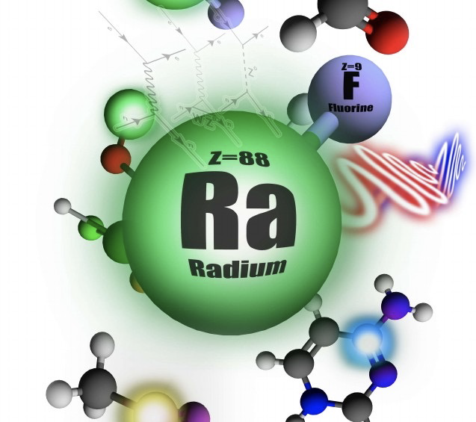
EDM searches – Exciting opportunities at FRIB
Enhancement:
Nuclear ~10³
Molecular ~10³
Figure thanks to Demille, Hutzler, Jayich, Garcia-Ruiz,…

Slide 30
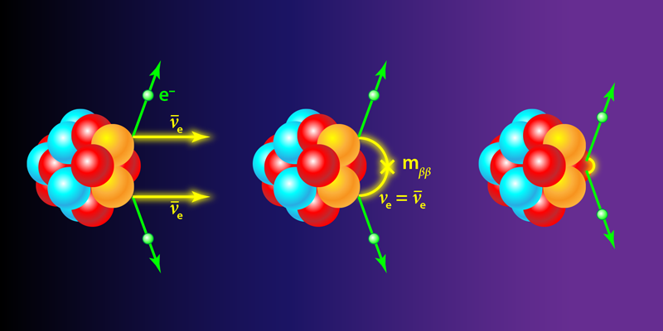
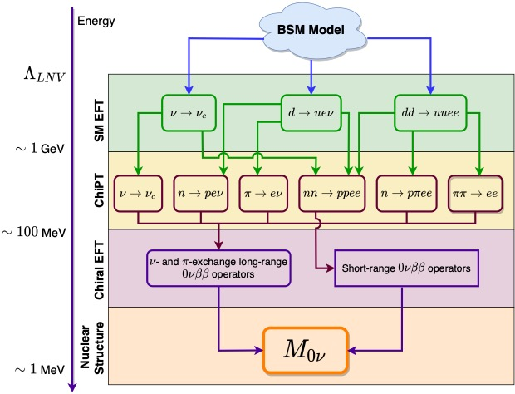
Neutrinoless double beta decay
V. Cirigliano et al., J. Phys. G 49, 120502 (2022)
A “tower of theories” leading to the computation of the nuclear matrix elements M_{0ν} that control the rate of 0νββ decay
OPERATOR!
Novario et al., Phys. Rev. Lett. 126,
182502 (2021)

Slide 31
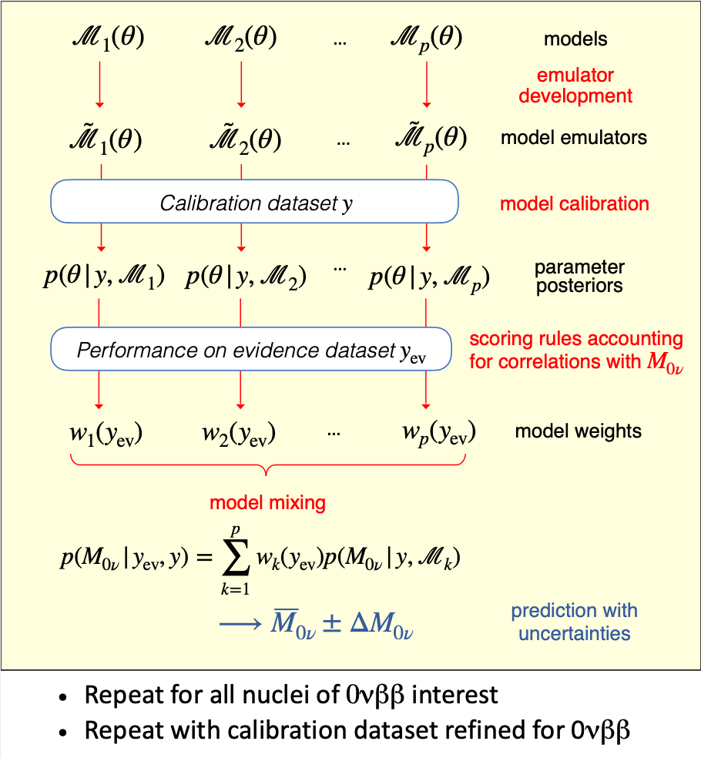
Quantified many body problem!
The road to calculations of M_{0ν} with uncertainty quantification that accounts for all limitations of the nuclear-physics calculation
V. Cirigliano et al., J. Phys. G 49, 120502 (2022)
A similar progress in the area of the EDM

Slide 32
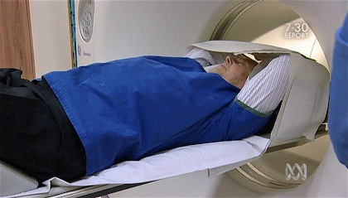
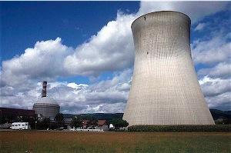
Who cares?
What are practical and scientific uses of nuclei?
Medical applications
  Isotopes for medical research
  Medical imaging and treatment of cancer and tumors
Energy
  Reliable calculation of fission and energy generation
  Allow mechanisms of radiation damage to be studied in detail
  Sensitive probes for the development of new materials, e.g., lithium-film batteries
Homeland security and defense
  Detectors at borders and throughout the country to detect nuclear material and components
  Nuclear scanning techniques to screen cargo and luggage
  Nuclear forensic methods to track and trace nuclear material
Workforce
  Development of talent for technical, medical, security, and industrial fields

Slide 33



FRIB’s on-line isotope harvesting capability is ideally suited to support a broad program in applied isotope research
Isotope harvesting provisions included in FRIB design - $13M grant awarded in 2021 by the DOE Isotope Program
Medical applications
Biochemistry and materials
Trace-nutrient transport in plants, soil, and the microbiome
Radio-thermal generators
Stewardship science applications
…
33

Slide 34
Perspectives

Slide 35






Some nuclei are more important than others
Over the last decade, tremendous progress has been made in techniques to produce and describe designer nuclei, rare atomic nuclei with characteristics adjusted to specific research needs and applications
nuclear structure
tests of fundamental laws of nature
⁴⁵Fe
+
-
+
-
+
²²⁵Ra
-
+
-
+
-
astrophysics
applications
¹⁸F,²²Na
¹⁴⁹Tb
FRIB can produce nuclei with desired properties to amplify effects of interest
Notes:
The Alchemist’s Dream Come True: nuclear physicists can transmute the elements
45Fe: decays by emitting a pair of protons thus telling us about proton superconductivity
18F,22Na: rare isotopes synthesized in Nova explosions
225Ra: Why More Matter than Antimatter? CP violation through EDM searches
149Tb: an “alpha knife”radionuclide that kills cancer cells

Slide 36

"It is exceedingly difficult to make predictions, particularly about the future” (Niels Bohr)
Looking into the crystal ball: year 2032 and beyond
(Ten years of FRIB operations)
The rate of progress is excellent!
J. Phys. G 43, 044002 (2016)
Notes:
The quote comes from a question and answer period during a seminar in Copenhagen where Danish Physicist Niels Bohr laid out the fundamental nature of quantum physics for the public. Included was the description of the Heisenberg Uncertainty Principle which basically says that you can't predict where a particle will be at a specific place in time, or vice versa. The question that triggered the answer was: What do you predict the influence of Quantum Physics will have on the world in the future?" and Niels Bohr said, somewhat tongue in cheek due to the prominence of the principle, that "it is exceedingly difficult to make predictions, particularly about the future" (because we can't even know what the state of our situation is NOW, much less in the future). Yogi never said it and Sam probably stole it if he ever uttered the phrase.

Slide 37
Looking into the crystal ball: year 2032 and beyond
Where do nuclei come from?
We will understand the QCD origin of nuclear forces and key operators. We will connect nuclei with hadrons.
We will develop the predictive and quantified A-body description of light and medium-mass nuclei and their reactions, including electroweak probes.
We will construct the spectroscopic-quality energy density functional that will extrapolate in mass, isospin, and angular momentum.
Key regions of the r-process will be accessible for the first time for mass and decay-property measurements. We will have a comprehensive description of weak transitions in nuclei and utilize them in multi-dimensional stellar evolution simulations.

Slide 38
Looking into the crystal ball: year 2032 and beyond
How are nuclei organized?
We will delineate the neutron drip line up to Zr (A=120) and for the light hypernuclei; will know if very long-lived superheavy elements exist in nature.
We will understand the mechanism of clustering and other aspects of open many-body nuclear systems.
We will develop the comprehensive reaction theory of medium-mass and heavy nuclei consistent with nuclear structure.
We will know the nuclear equation of state for normal and neutron matter from 0.1 to twice the saturation density. Gravitational waves will provide important constraints on EOS.

Slide 39
Looking into the crystal ball: year 2032 and beyond
What are nuclei good for?
We will have a (more) quantitative microscopic model of fission that will provide the missing data in the regions where measurements cannot be done.
We will predict important low-energy light-ion fusion reaction rates important for fusion research, astrophysics, and nuclear forensics.
We will improve the sensitivity of EDM searches in atoms by >6 orders of magnitude over current limits.
We will provide quantified and validated nuclear matrix elements for 0νββ

Slide 40

FRIB Upgrades
Option for energy upgrade to >400 MeV/u
Maintain Isotope Separation On-Line (ISOL) option
Upgradable to multi-user simultaneous operation of light /heavy ions with addition of a light-ion injector

Slide 41
Profound intersections
41

Slide 42
Summary
Revolution due to major advances in accelerator technology, experimental techniques, theory, and computing. Today, we are constructing a roadmap that will lead to a complete picture of atomic nuclei and their role in the cosmos. With FRIB, we are poised for breakthroughs
To Understand and Use…
Thank You

