Slide 1
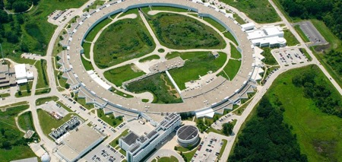
Towards coherent x-ray light sources: The APS Upgrade and Beyond
erhtjhtyhy
John byrd
Director, Accelerator Systems Division
Director, Argonne Accelerator Institute
Advanced Photon Source
Fermilab Colloquium
19 July, 2023

Slide 2
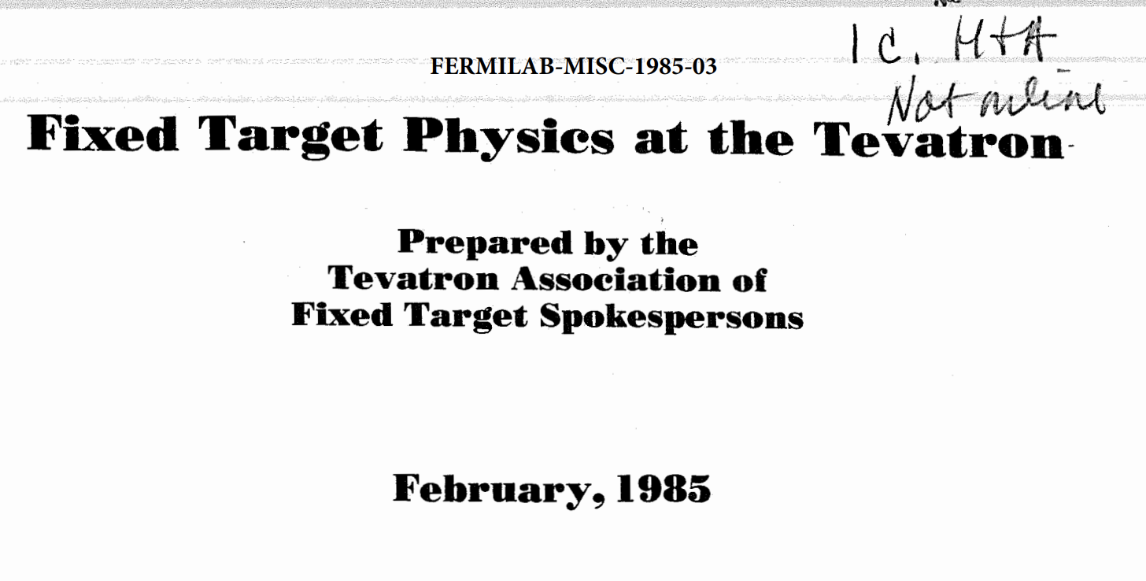
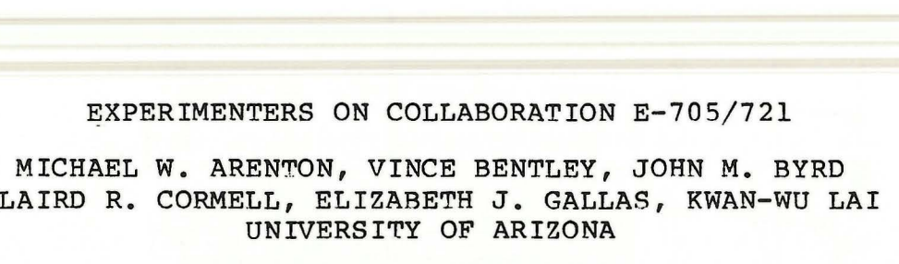
Fermilab is part of my origin story
I spent a fateful summer in 1984 at FNAL as a summer intern
I spent a summer at FNAL calibrating PMTs in the detector using a small source on a stick. I lived in a big house in the village (no A/C!)
I was able to join a dinner one evening with a group of physicists at Chez Leon that changed my life!
Amid the conversation of worldwide travel and science (and cognac!), I decided this is what I wanted to do with my life.
Summer jobs can make a difference.

Slide 3
We are now in a golden age of accelerators
We are building more new machines around the world than ever before with performance that was only dreamt of a decade ago.
We can design machines with micron beam sizes and micron stability over kms
We can measure and control timing jitters down to femtoseconds.
Palmer House Downtown Chicago

Slide 4
Overview
Selection of accelerator activities at Argonne
Introduction to storage ring light sources
A brief introduction to the physics of electron storage ring
Spatial and temporal coherence in synchrotron light
Advanced Photon Source and the $0.815B Upgrade
  Project overview and status
  Accelerator activities to support APS-U challenges
Development of Superconducting Undulators
Linac Extension Area
Cavity-Based XFELs
Beyond the APS Upgrade

Slide 5
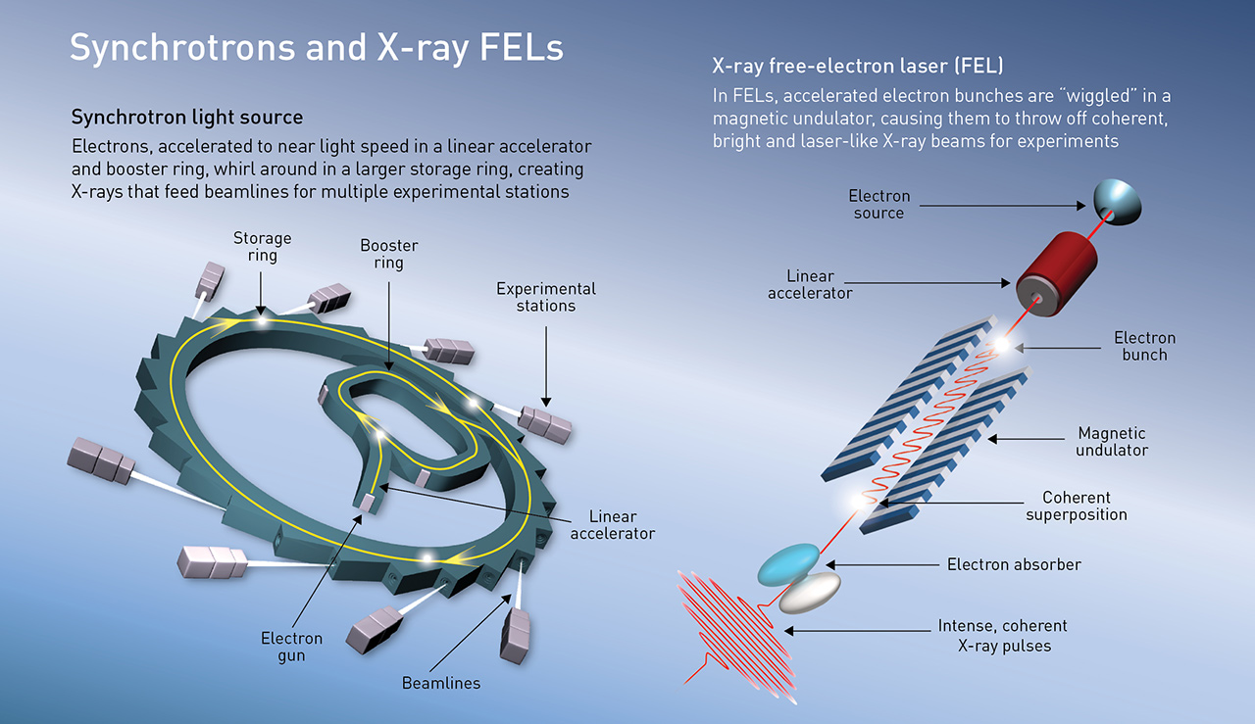
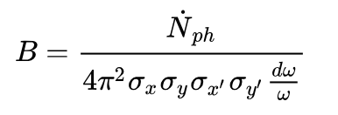
synchrotron light sources
Storage ring and linac-based light sources are being built worldwide to serve a broad variety of scientific users
Performance is specified by the brightness
Defined as photon flux per unit of phase space area of the photon beam per unit bandwidth

Slide 6
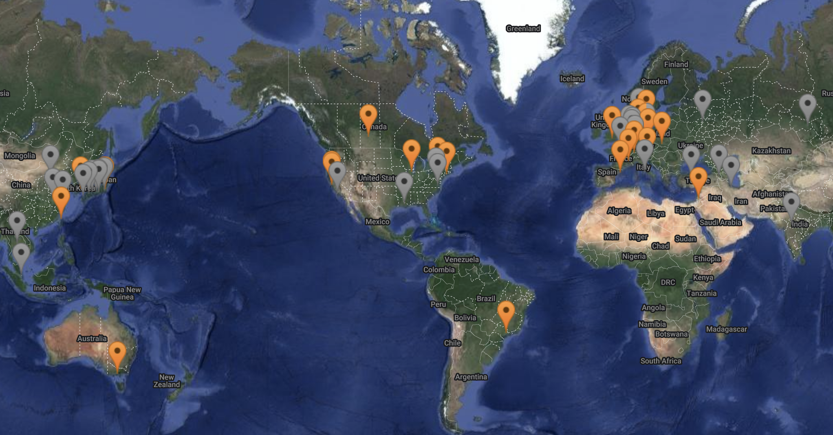
Light sources of the world

Slide 7
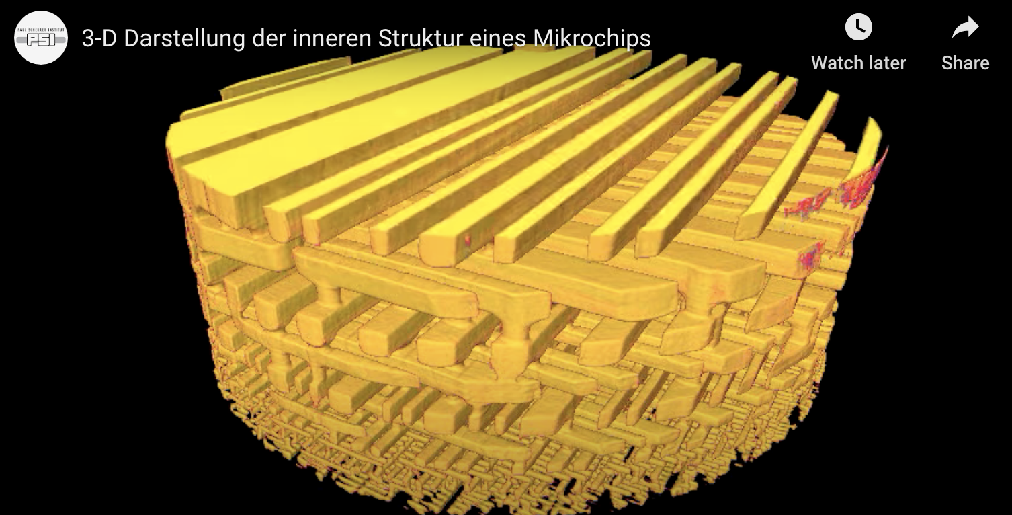
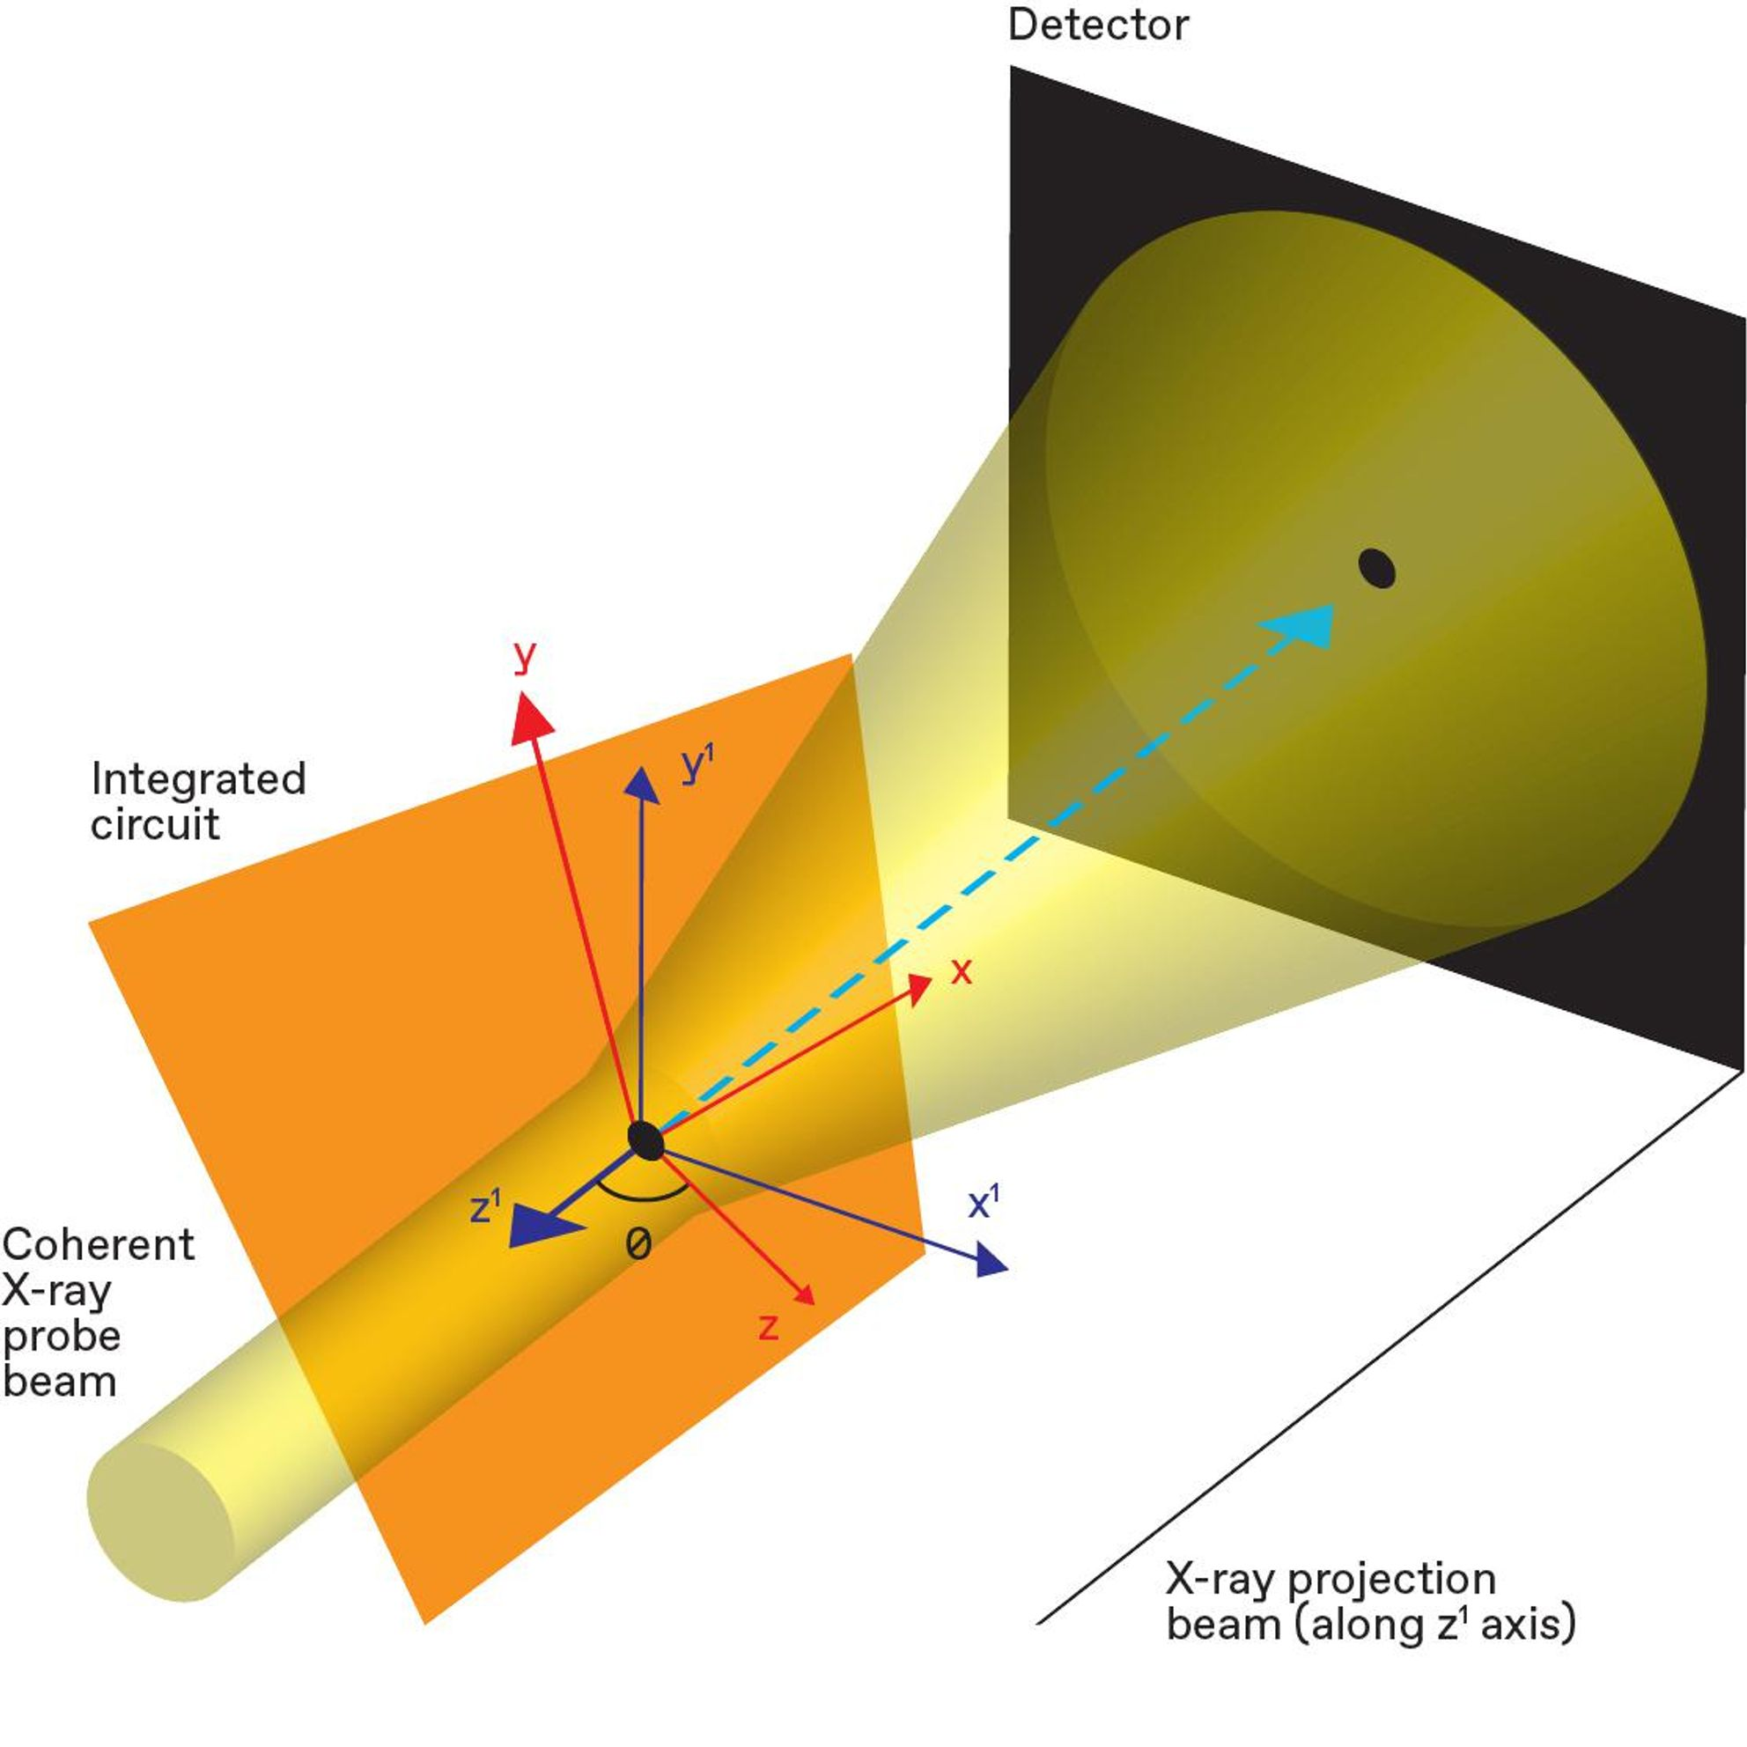
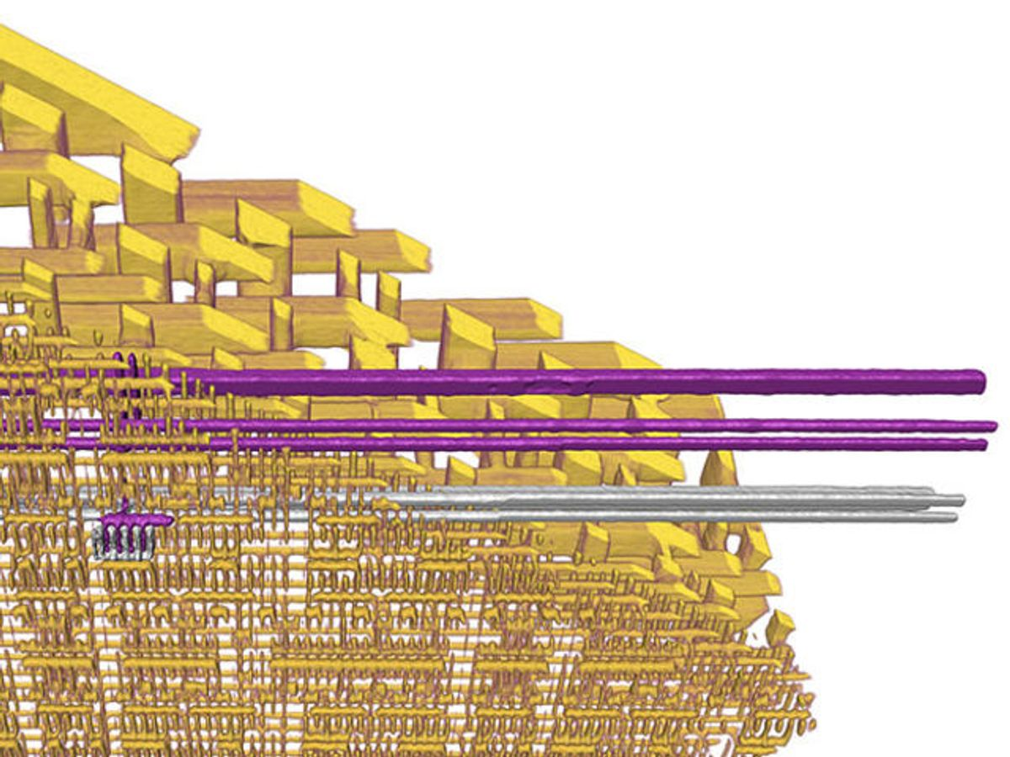
Using coherent diffractive imaging to map 3-d integrated circuits
New metrology techniques are needed are circuits build ”up”
Two recent experiments have demonstrated 3-D mapping of an IC that can reveal true structure.
Discussions are ongoing about possible use of 4th gen synchrotrons at semiconductor fabs!
In an edge-on position, this chip [orange] is too thick for X-rays to penetrate. But tilting the chip at an angle [see theta, center] makes the cross section thin enough. The mechanical stage the chip sits on [not shown] then rotates the sample within the X-ray beam around the z axis to project interference patterns onto a detector that can be used to reconstruct the chip’s interconnects.

Slide 8
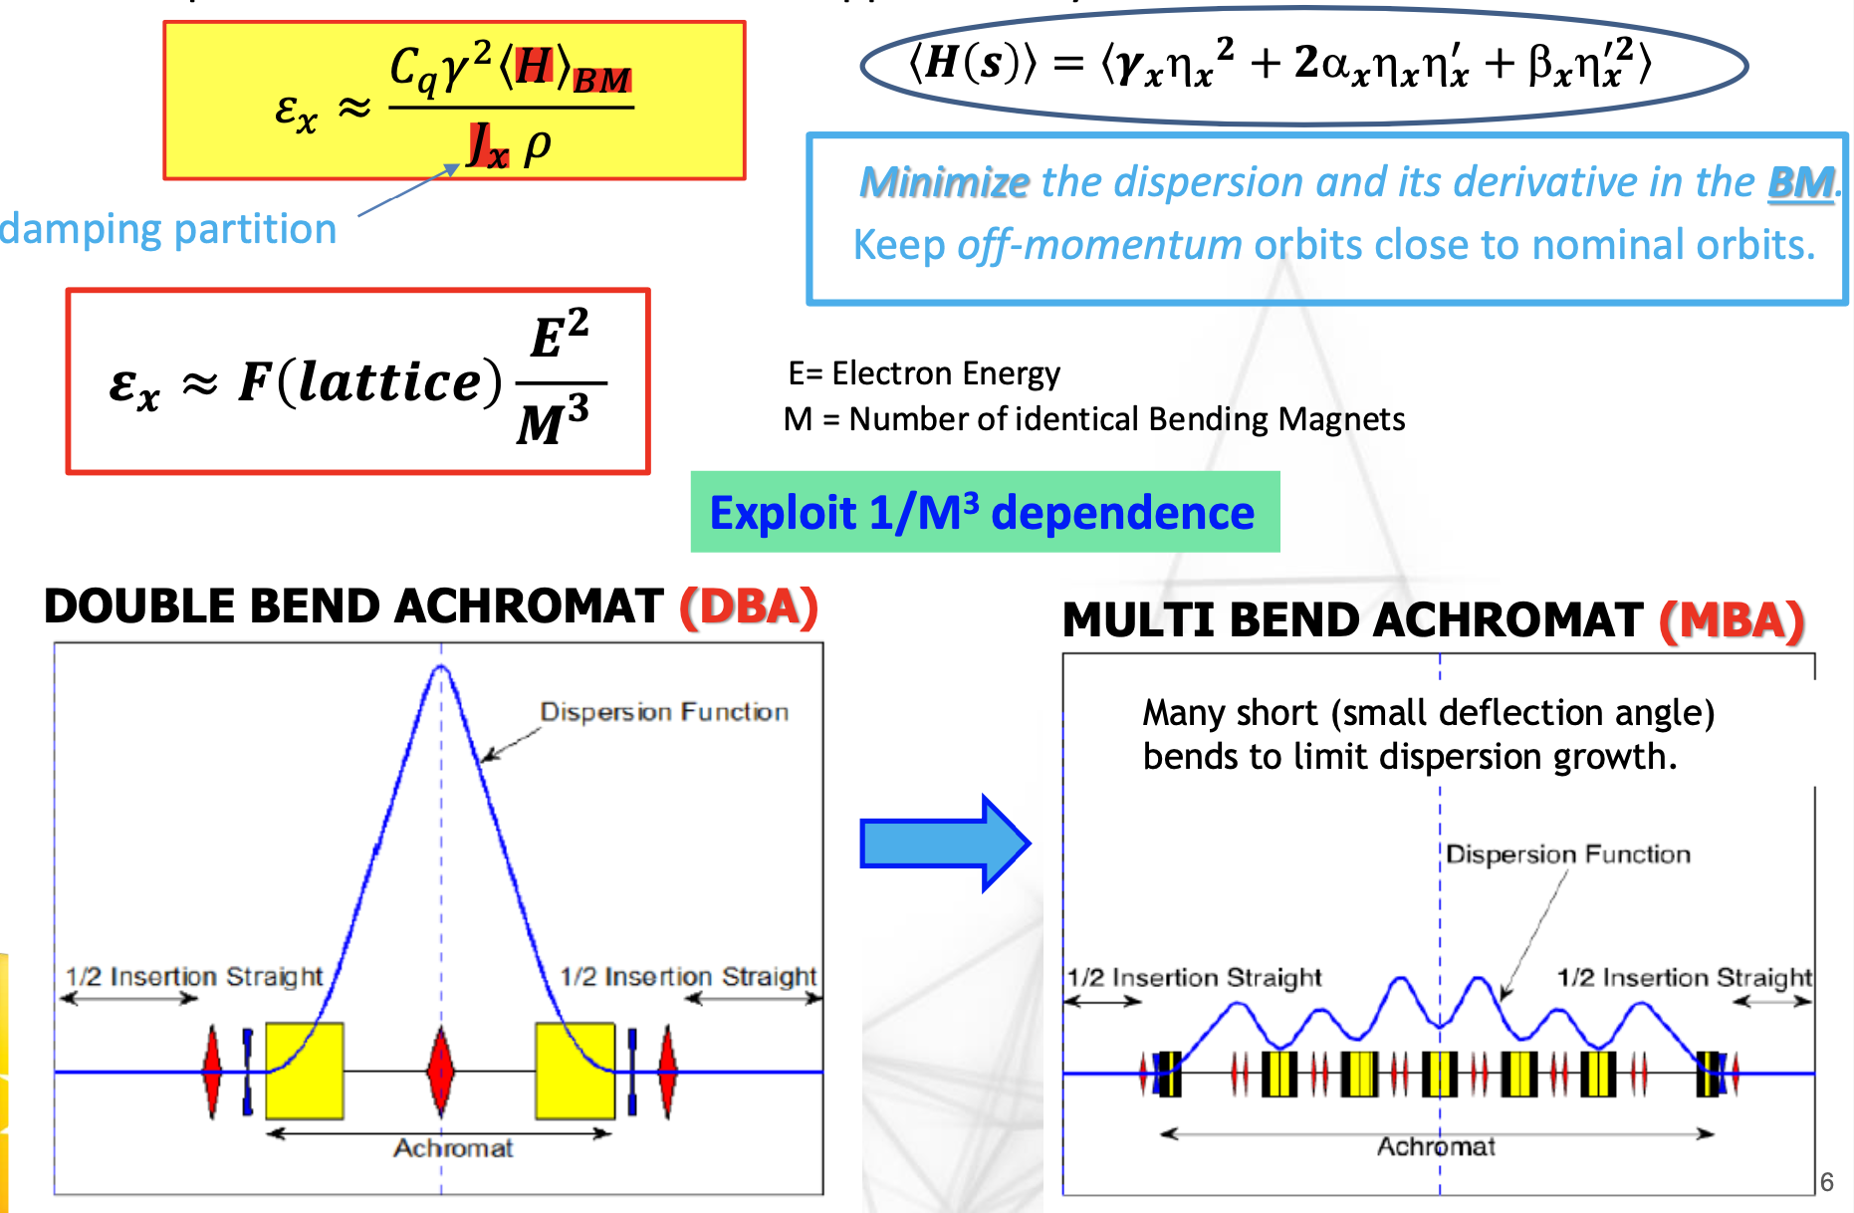
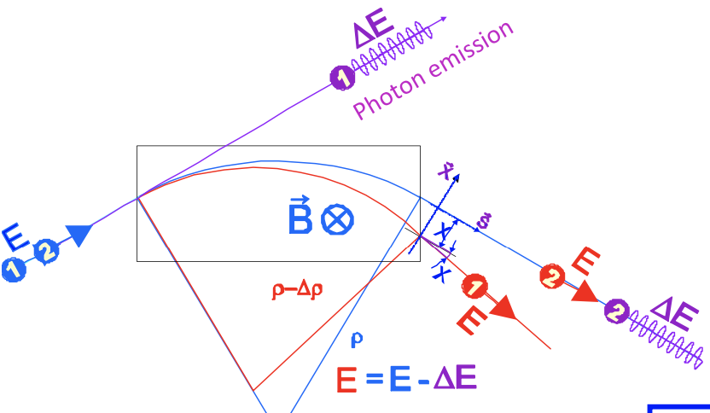
Equilibrium horizontal beam emittance
Physics at the current emittance levels is well understood if we can create the magnetic fields
Emittance a balance between quantum excitation and radiation damping.

Slide 9
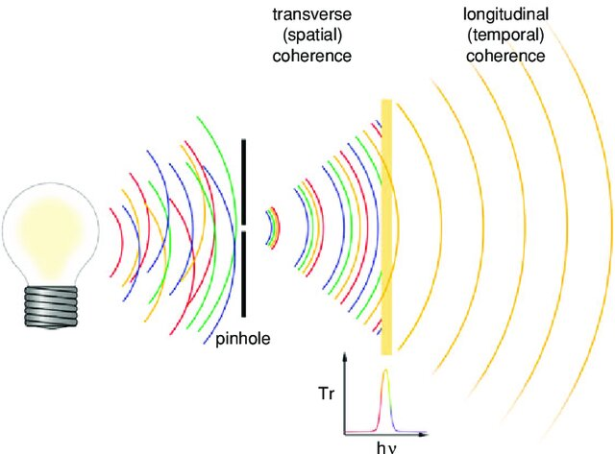

Coherence of synchrotron radiation
Small electron beams make effective slits for transverse coherence
Slits can make any light source transversely coherent but with significant loss in flux.
Bandpass filters add longitudinal coherence but with more loss in flux.
The ultralow emittance electron beam acts as a slit where all photon wavelengths larger than the emittance are coherent.
The undulator then acts as a bandpass filter with no loss providing a narrow linewidth.

Slide 10
The holy grail is a diffraction limited x-ray source
This has been the dream since the origin of synchrotron light
The minimum photon spot size is reached at the diffraction limit.
The production of large fluxes of coherent light at Angstrom wavelengths is expected to open whole new areas of x-ray sciences.
N.B. The physics of X-ray FELs requires the geometric electron emittance to meet this criterion to achieve lasing and thus is transversely coherent by definition.

Slide 11
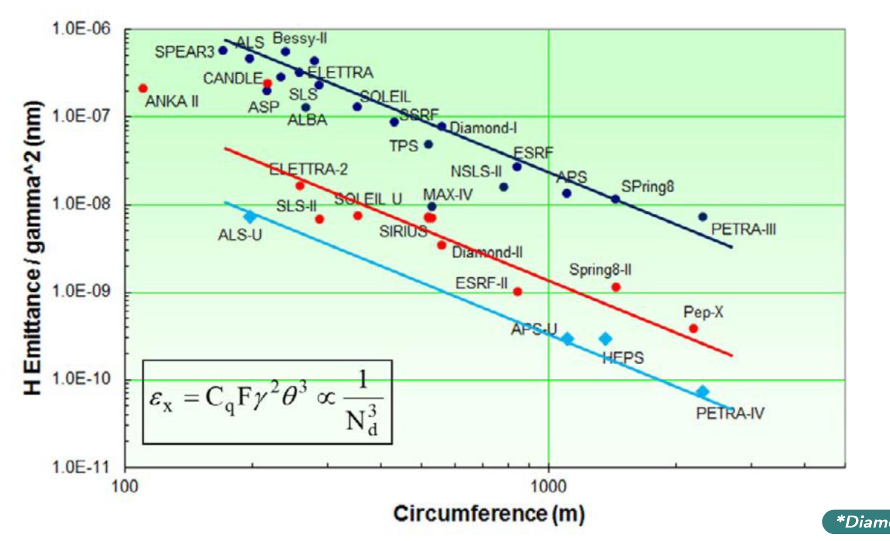
Storage ring light sources are now the most prevalent high energy scientific tools today
Over 30 modern rings either in operation or under development

Slide 12
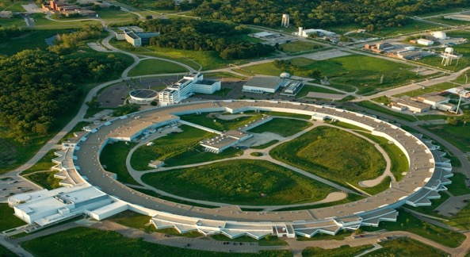
APS Accelerator Complex
7 GeV, 100 mA, 46 ID, 21 bend magnet BL,
3 fill patterns
Linac: S-band, 0.38 GeV, 30 Hz
Booster: 0.38-7 GeV, 2 Hz
PAR: 0.38 GeV, 2 Hz, 1-4 nC
Linac Extension
Area
The APS Upgrade (APS-U) will replace the main storage ring but keep the radio-frequency (rf) system. Injector systems will be reused and require increased performance.

Slide 13
APS Upgrade

Slide 15
APS-U will keep the US at the forefront of light sources

Slide 16
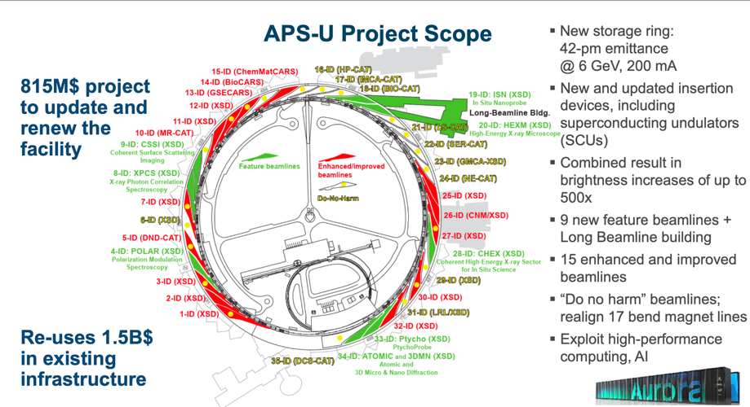

Slide 19
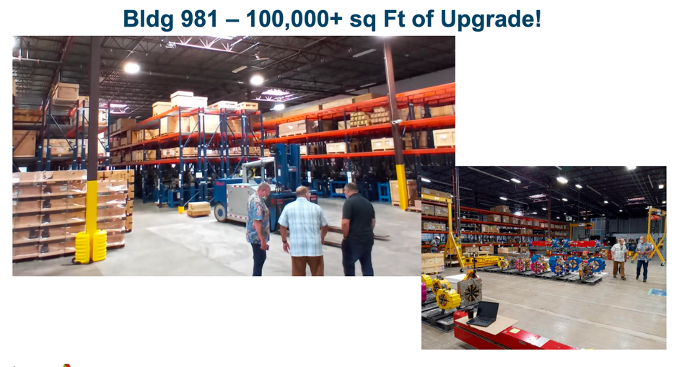

Slide 20
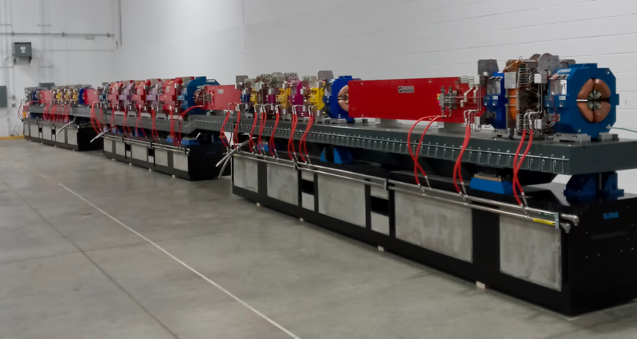
An assembled sector

Slide 21
There is no turning back now
The removal of the APS ring has begun…so far so good!
Important dates:
  April 17, 2023 – End of user operations
  April 24, 2023 – Start of Removal and Installation
  January 15, 2024 -- Accelerator Commissioning with Beam
  April 25, 2024 – Initial Storage Ring Operations
  October, 2024 – Threshold KPPs achieved
  December 2024 – Objective KPPs achieved
  March 2026 – CD-4 project complete

Slide 22
Studies at APS to support the Upgrade

Slide 23
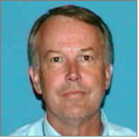
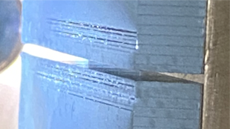
Understanding the IMPACt of APS-U beams on the vacuum chamber
APS-U beams have very high energy density and can damage components
The question of survivability of APS-U electron beam collimators to control beam loss in APS-U has been studied for the past two years; this will be a common problem in all 4^{th-}gen storage ring light sources with ultralow emittances
Some experimental studies in the APS have simulated the APS-U effect on test collimator pieces; however, we do not have a predictive capabilities on these effects
We are now working on an effort to develop and combine codes that can calculate beam impact effects for different materials and geometries; led by Jeff Dooling
Frame grab of video image during a strike showing ejecta
Collimator assembly after multiple full beam strikes; under metallurgy tests now

Slide 24
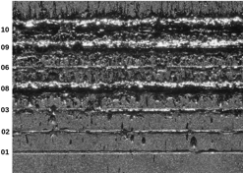
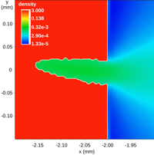
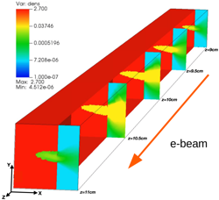
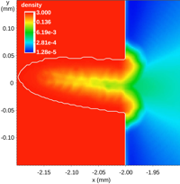
Modeling of HiGH-Energy-density beam strikes
Develop a predictive modeling capability that will guide design of chamber components
2D FLASH with release jump
Components include collimators, superconducting undulators, and the vacuum chamber itself.
Experiments have demonstrated damage, but experiments are time-consuming and expensive
Work to develop a multi-physics model that can provide guidance on how to protect at-risk components using elegant, MARS, and FLASH
Awarded DOE-FOA-2675 Accelerator Stewardship grant to continue this effort (August 2022)
1.5T_{vap}
January 2020 Expt.
Last deposition
3D FLASH simulation
Al
vac
1.0T_{vap}
J. Dooling et al., Physical Review Accelerators and Beams, vol. 25, no. 4, p. 043 001, 2022. DOI: 10.1103/PhysRevAccelBeams.25.043001
Prof. Dongwook Lee, University California Santa Cruz
Dr. Nathan Cook, RadiaSoft
Dr. Carlo Graziani, MCS/ANL
Dr. Alex Grannan, NED/ANL
At APS: Michael Borland, Ryan Lindberg, Gary Navrotski
Last deposition +5 ns
Al
vac

Slide 25

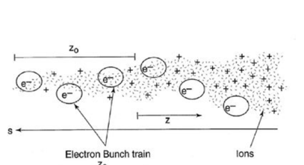
Ion instabilities are a potential problem for high brightness rings
A longstanding challenge for rings
Ion trapping occurs when a negatively charged beam ionizes residual gas inside the vacuum chamber.
Trapped ions can couple to the beam motion, leading to a coherent (usually vertical) instability. They can also cause incoherent effects, such as emittance growth.
The effect can increase the effective electron beam size by 2-3 times the natural beam size and reduce the effective beam brightness.
We are making a “definitive” study of ion effects for 4th generation storage rings. Led by Joe Calvey, Cornell PhD in 2013.

Slide 26
APS-U Prep: Gas injection experiment to fully understand APS-U ion instabilities
Nominal APS-U beam filling pattern (324 bunch) shows ion instability problems. Remediation techniques have been tested in APS.
Controlled gas leak installed in Sector 25 to create a pressure “bump” with a known beta function. Fully tested with no impact on storage ring pressure outside of the sector.
Use existing suite of tools to characterize instability behavior as a function of pressure, current, filling patterns, etc.
Latest machine studies on July show excellent results. Demonstrates ion instability goes away with APS-U fill pattern. Studies will continue over next year.

Slide 27


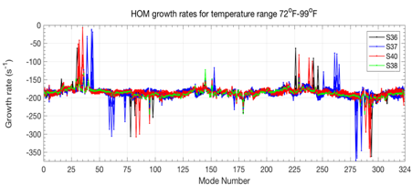
Mapping the RF cavity modes for stable APS-U operation
A new technique has been developed that allows complete characterization of cavity higher-order modes; critical for APS-U
The existing APS rf system is being kept for APS-U (minus 4 cavities)
The current rf cavities have mostly undamped HOMs that will cause instabilities for APS-U if not tuned correctly
We have used the new APS-U longitudinal feedback system (LFB) as a diagnostic tool to map all of the cavity HOMs for proper tuning for APS-U; led by Louis Emery, Sirisha Kallakuri, et al.
The measured growth/damping rate of each mode for 324 bunches
Each mode is individually excited and its response measured, allowing higher-order mode (HOM) identification
This will allow optimal tuning of HOMs for operation and ensure multibunch stability

Slide 28
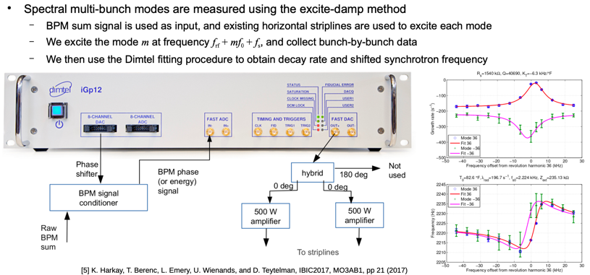
Beam-based characterization of HOMs using the Drive-damp technique
Modern FB systems have tremendous diagnostic capabilities

Slide 29
Some other notable accelerator activities
Happy to discuss with folks offline…..
Replacement of 2 MW 352 MHz RF klystron-based RF source with solid-state amplifiers.
Refurbishment of the 30 year-old 500 MeV electron linac injector
  Replacement of modulators/klystrons
  Replacement of analog RF controls with modern digital systems
  New timing systems, power supplies, etc.
Fast pulsers (<20 nsec) for on-axis injection
Maintaining and improving elegant, the leading code for accelerator modeling (Michael Borland.)
Complete rewrite of Accelerator Control System. Potential relevance to ACORN.

Slide 30
Accelerator R&D Initiatives

Slide 31
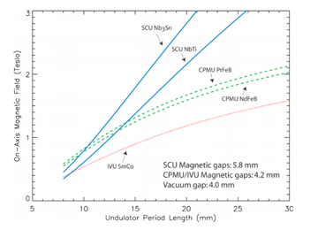
Magnetic field of various insertion device technologies
Motivation for Superconducting Undulators
A superconducting undulator (SCU) is an electromagnetic undulator that utilizes superconducting coils for generating magnetic field.
Superconducting technology-based undulators outperform all other technologies in terms of peak magnetic field and, hence, energy tunability of the radiation
Superconducting technology opens a new avenue for insertion devices
Calculated tuning curves for SCUs and for hybrid undulators.
Calculated on-axis magnetic fields of two cryogenic permanent magnet undulators (CPMUs), two superconducting undulators (SCUs) and on in-vacuum undulator (IVU) for a vacuum gap of 4.0 mm for period length from 8 mm to 30 mm.
E. Moog, R. Dejus, and S. Sasaki, “Comparison of Achievable Magnetic Fields with Superconducting and Cryogenic Permanent Magnet Undulators – A Comprehensive Study of Computed and Measured Values”, ANL/APS/LS-348, 2017.

Slide 32
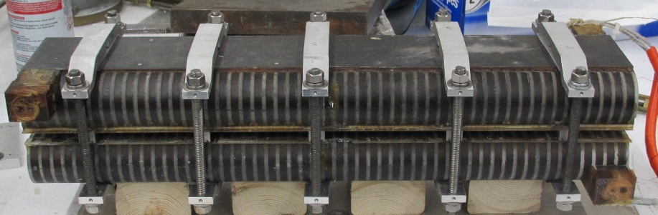
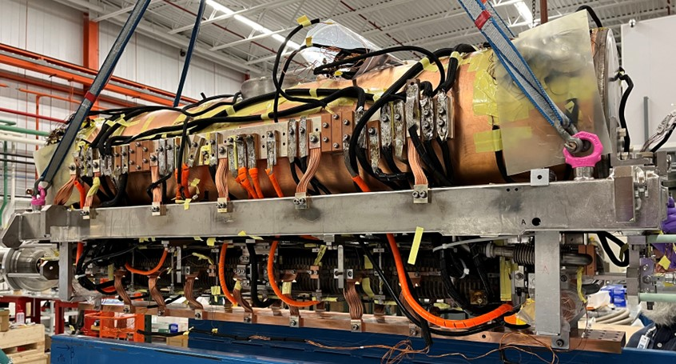
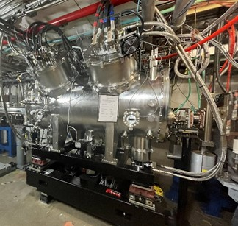
Development of Nb₃Sn undulators
First Nb3Sn magnet installed in an accelerator
Undulator specifications | Nb₃Sn | NbTi
Undulator Field, T | 1.17 | 0.97
K value | 2 | 1.6
Design current, A (~70 and ~80% of the I_{c}) at 4.2 K | 820 | 450
Period length, mm | 18 | 18
Magnetic gap, mm | 9.5 | 9.5
Magnetic length, m | 1.1 | 1.1
Vacuum gap, mm | 7.2 | 7.2
  A 3-year project supported by the DOE's Accelerator & Detector Research Program.
  Collaboration among three US National Labs:
    ANL (lead institution),
    FNAL (heat treatment),
    LBNL (protection system).
Cold mass assembly with the 1.1 m long Nb3Sn magnets
      Nb₃Sn SCU replaced NbTi SCU in APS’s Sector 1 and successfully delivered x-ray beams as the first Nb₃Sn-based SCU. Operated flawlessly until the start of the APS upgrade on April 17th, ‘23.
Nb₃Sn SCU cryostat in the APS’s SR

Slide 33
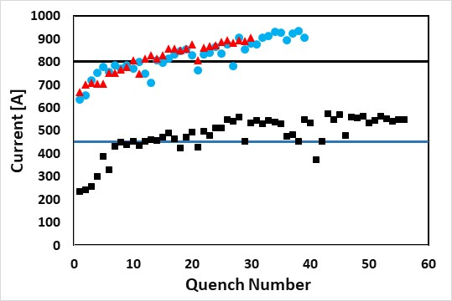
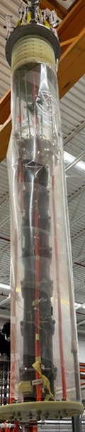
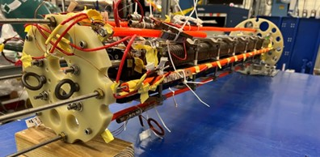
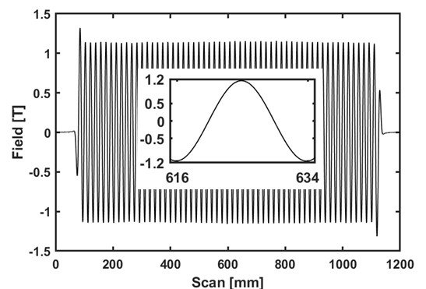
Undulator quench training and field measurements
Top 1.1-m-long Nb₃Sn magnet
Bottom 1.1-m-long Nb₃Sn magnet
1.1-m-long NbTi
1.1 m Nb₃Sn undulator magnet assembly
1.1m SCU magnets assembled in undulator configuration with diagnostic elements and quench trained
Undulator achieved design field without requiring additional training during the second cooldown
Phase error of <6 degrees achieved up to the maximum operating current
Vertical test set-up

Slide 34
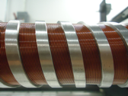
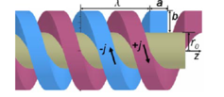
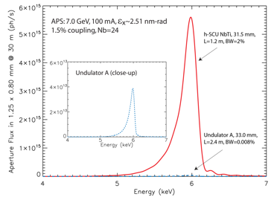
Helical undulators allow elliptical polarization
SCU technology offers the possibility of building circular polarizing helical undulators
We have recently completed a helical SCU (HSCU) for the APS
X-ray photon correlation spectroscopy program at the APS will benefit from the increased brilliance provided by an HSCU
Magnetic model of HSCU.
HSCU prototype coil winding.
Parameter | HSCU
Cryostat length (m) | 1.85
Magnetic length (m) | 1.2
Undulator period (mm) | 31.5
Magnetic bore diameter (mm) | 31.0
Beam vacuum chamber vertical aperture (mm) | 8
Beam vacuum chamber horizontal aperture (mm) | 26
Undulator peak field Bx=By (T) | 0.4
Undulator parameter Kx=Ky | 1.2
Calculated photon spectrum of helical SCU.

Slide 35
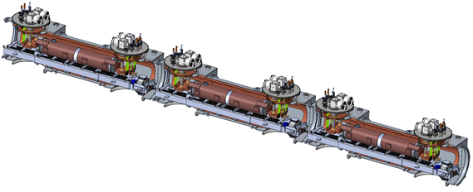
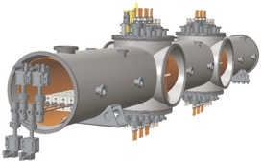
SuperConducting Undulators for FELS
A collaboration of Argonne and SLAC to extend the capabilities of LCLS-II
Superconducting undulators should become a baseline for future FELs because of higher magnetic field performance. Current R&D project to produce demo of 3 SCUs at end of LCLS HXR line.
One of the challenges is maintaining photon and electron beam alignment when cold.
Several FEL undulators in one cryostat is a possibility.
Alignment quad
Undulator segments (3)
Phase shifters (3)
Focusing quad
BPM
1.5 m
Beam
direction
15 cm
15 cm
70 cm
4 FELs
x & y position control
x & y position control
5.5 m
Courtesy of J. Fuerst, APS
FEL SCU cryomodule concept
A cryomodule with four FELs

Slide 36
Cavity based x-ray FEL (CBXFEL)
Achieve longitudinal coherence via an optical resonator at x-ray energies
Undulator
e-beam
X-rays
Two proposed schemes:
  Regenerative Amplifier FEL (SLAC)
    Requires only a few passes in optical cavity. Results in higher peak power ultrashort pulses.
  X-ray FEL Oscillator (Argonne)
    Requires long buildup of x-rays in cavity. Results in 2-3 order magnitude brightness increase over LCLS-II.

Slide 37
Proposal to build cavity and install in LCLS and test concept on LCLS-I
Use two-bunch beam pulse in CuRF linac to test effect on 2nd bunch
Total budget: $12.6M
ANL: $7.0M
Key Argonne Personnel: Kwang-Je Kim (PI), Yuri Shvyd’ko (co-PI), Deming Shu (co-PI), Marion White (PM), Ryan Lindberg, Lahsen Assoufid, Xianbo Shi

Slide 38
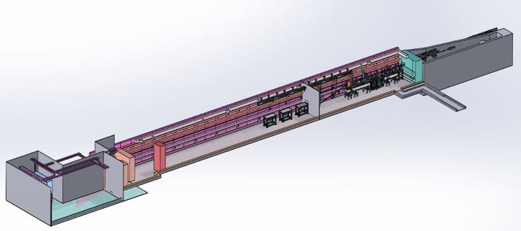
LEA: Linac Extension Area
booster
Chicane
RG2
RG1
PCG
L5 L4
L2
LEA
wall
375 ~ 500 MeV
LINAC
150 MeV
6 MeV
PAR
17m
53m
An existing radiation enclosure of ~ 53 m long;
The LEA beamline will utilize the first ~ 17 meter of the tunnel;
The end of the tunnel will serve as a S-band RF test stand.

Slide 39
Beyond the APS Upgrade
New initiative in enabling technology towards compact XFELs
XFELs are one of the newest tools our community can provide for ultrafast x-ray science.
Unfortunately, these machines tend to have a high cost/user experiment since the beam is typically dedicated to a single user or shared between a few users.
We have started an initiative in 2023 funded by lab LDRD funds, to begin to address this question with several efforts
  Compact Undulator Arrays: develop and demonstrate HPMU and SCU arrays that would allow independent FELs in the same space as an existing FEL
  Ultralow emittance electron source: Develop high gradient technology to further reduce the source emittance, allowing lasing at lower energies or lasing at shorter wavelength for an existing energy.
  Investigate modern ”high gradient” conventional RF acceleration

Slide 40

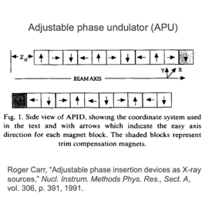
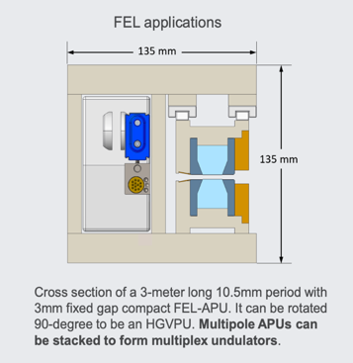


The Adjustable Phase undulator
New concept (based on similar past ideas) for a force neutral fixed gap undulator that adjusts field with longitudinal movement

Slide 41
Multiline Superconducting undulators
Fit multiple SCUs in a single cryostat
XFELs have long been recognized as an ideal application of SCUs.
The small aperture vacuum chamber can lead to relatively small magnets, opening the possibility of multiple SCUs/cryostat.
We have a begun a multiyear study addressing the challenges of achieving this.
4 FELs
A cryomodule with four FELs

Slide 42
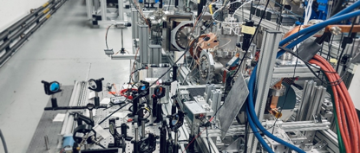





UltraHigh gradient RF gun
Recent breakthrough result at the Argonne Wakefield Accelerator using two-beam accelerator technology with <10 nsec RF pulses
LCLS gun is today’s standard & operates at 120 MV/m to produce the beam of 100 pC at emittance ~150 nm.
AWA demonstrated gun gradient of 400 MV/m with an X-band rf gun powered by ns-scale short rf pulses (published on Phys. Rev. Accel. Beams 25, 083402, August 2022).
With higher gradient, a reduction of emittance is expected and to be measured as the next step.
GOAL: High brightness beam
To achieve low emittance
High electric field ($𝓑$ ∝ $E^{α}$)
To overcome breakdown at high E
Short rf-pulse operation ($BDR∝E^{30} τ^{5}$)
High brightness beam is critical for reducing the footprint of future X-ray free-electron lasers (XFELs).
AWA Xgun beamline
diagnostic
beamline
A variation of the CLIC TBA scheme which uses a drive beam for creating the short RF pulse.
laser setup
John Power
Philippe Piot
Xueying Lu
X-band gun

Slide 43
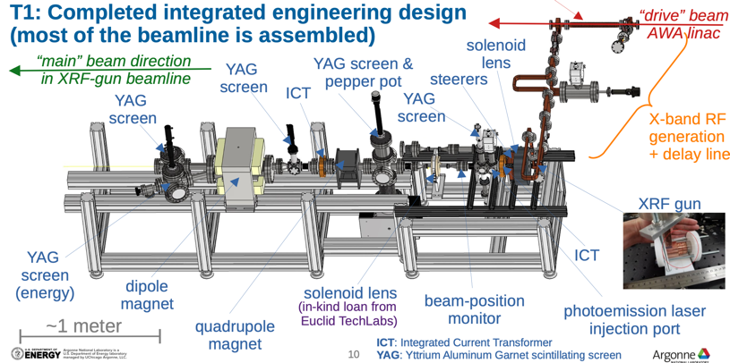
Experiment in progress to demonstrate emittance scaling in high field regime

Slide 44
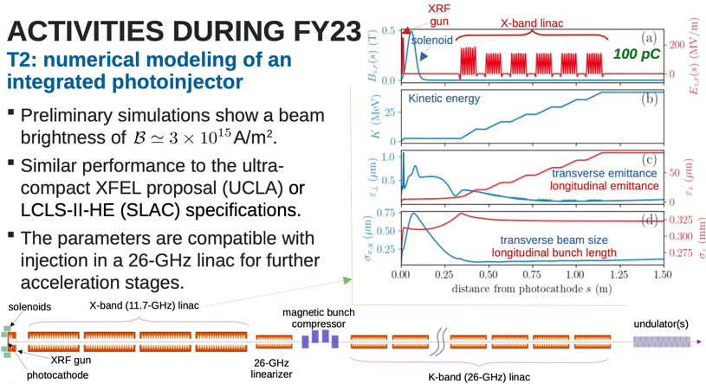
Preliminary model is promising for compact FEL
Still significant work to be done

Slide 45
Summary
Storage ring light sources are approaching the diffraction limit for Angstrom wavelengths.
The highest brightness electron storage ring in the world (APS-U) is being built and will be installed and commissioned in 2023-2024.
  Numerous leading-edge developments in accelerator technology and beam physics.
Funding for several high priority BES accelerator R&D projects is now funded
  Superconducting undulators for FELs
  CBXFEL
Work is ongoing looking to future light sources.
Argonne is fully engaged in the present golden age of accelerator development. Please come join us!

