Slide 1
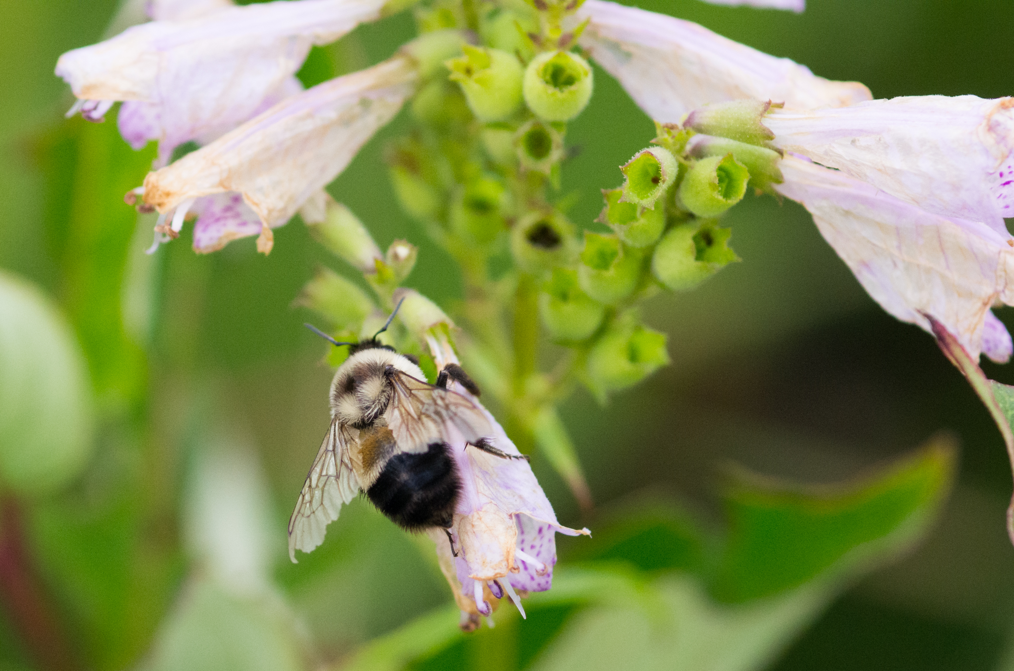

Slide 2
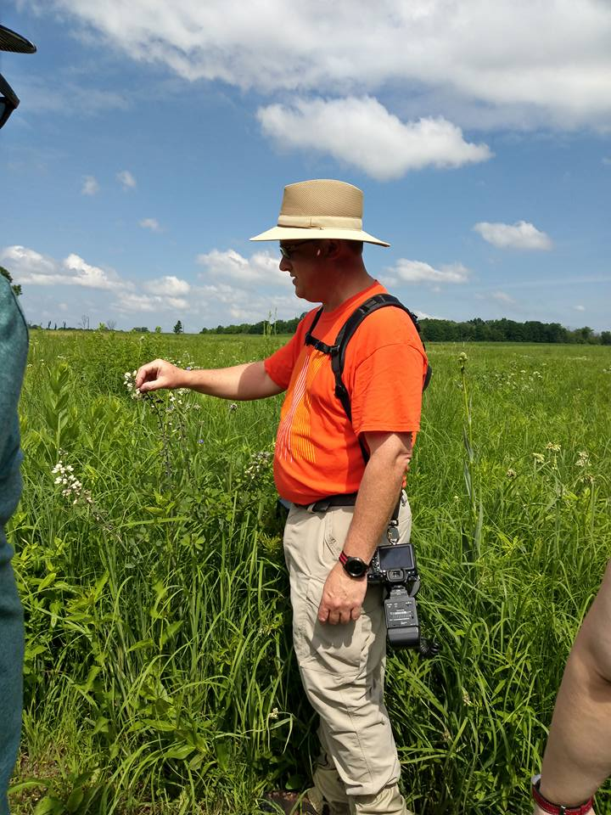
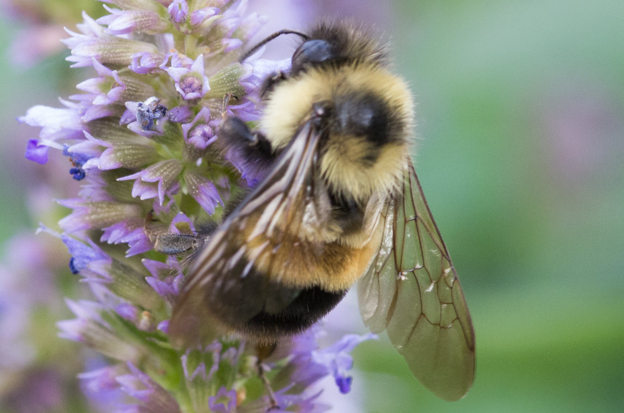
The Rusty-Patched Bumble Bee
Bombus affinis
Threats, decline, opportunities and hope.
Terry Miesle

Slide 3
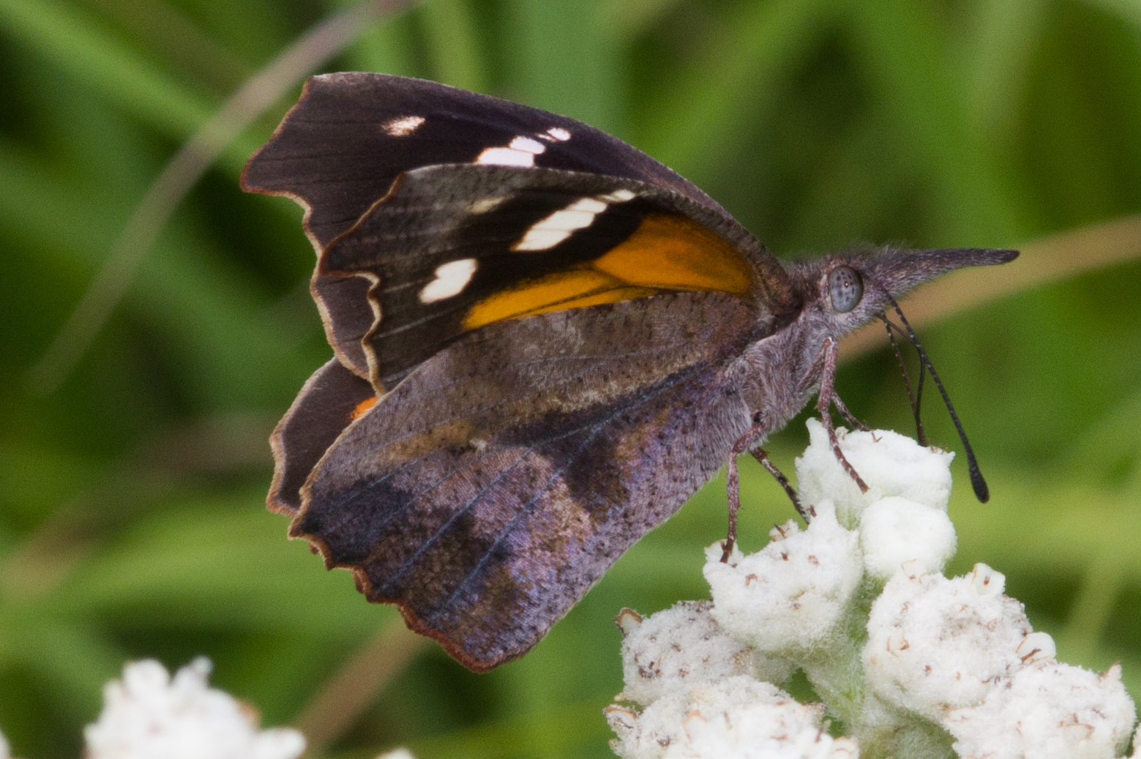
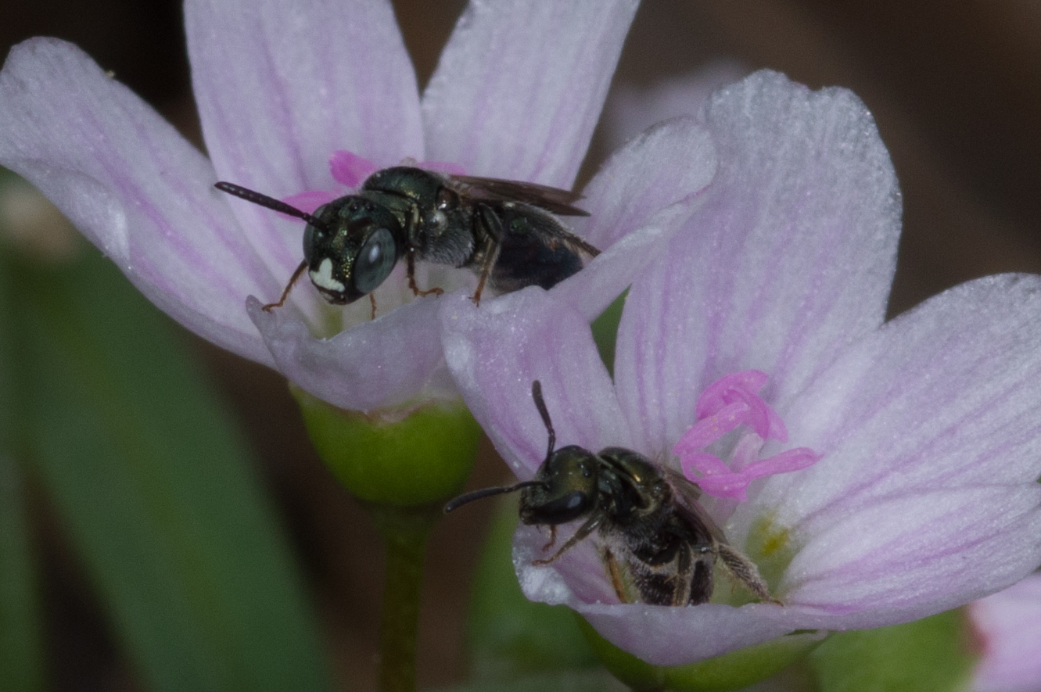
Insect monitoring
Formal monitor at Fermilab Natural Areas since 2014
Began recording Bumble Bees at home around 2000
Associated with Native Bee Awareness Initiative in 2015

Slide 4
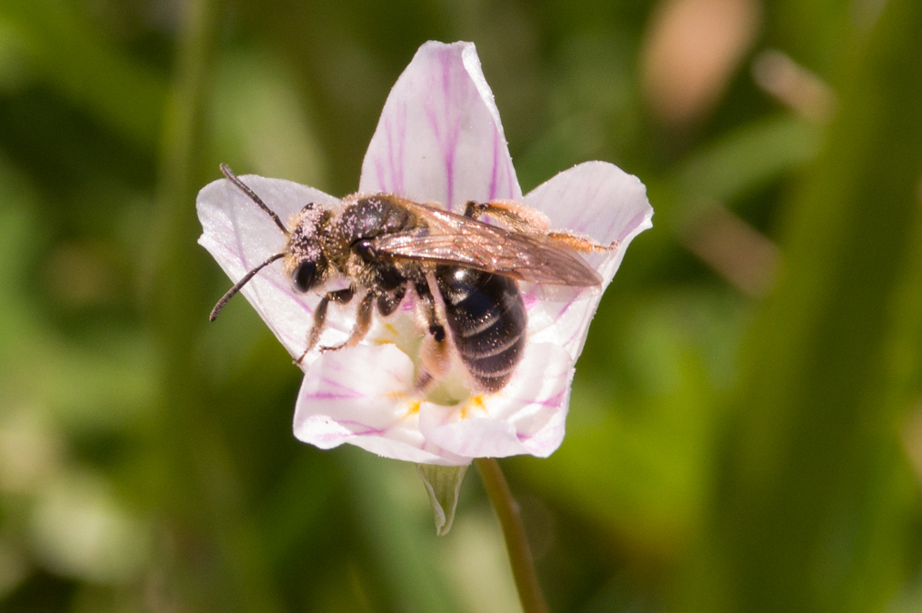
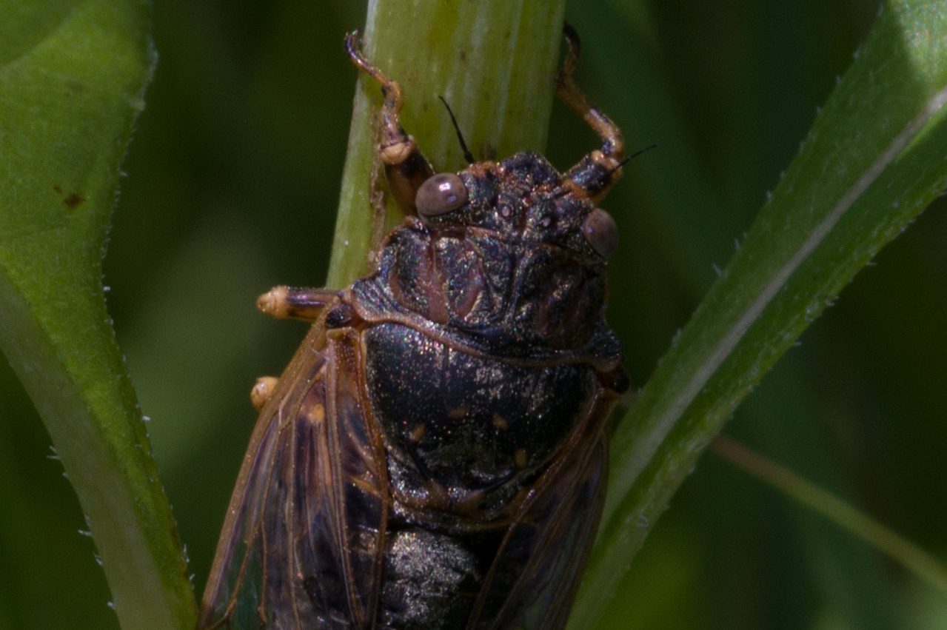
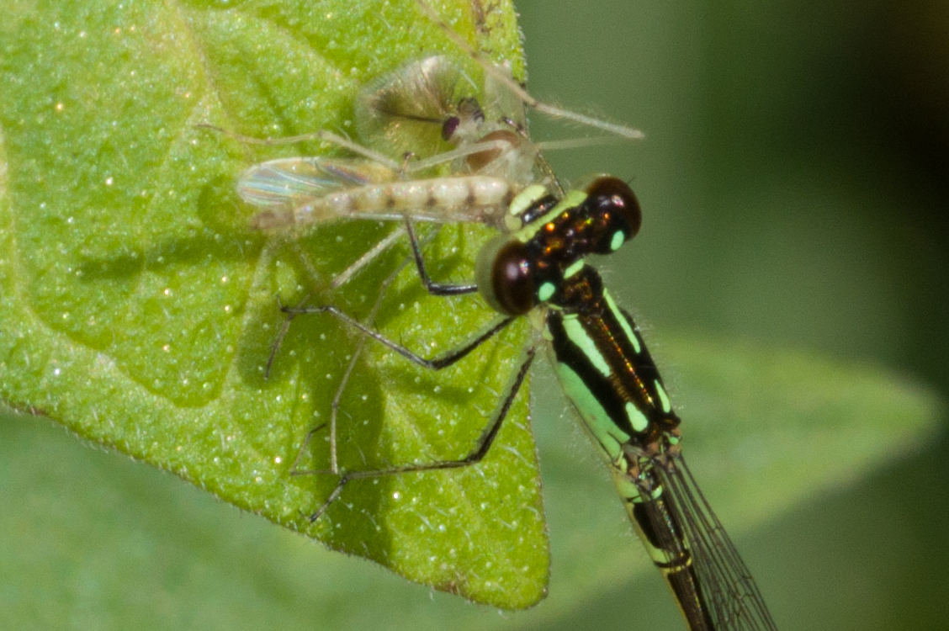
Citizen Science
Fieldwork has always been dominated by interested amateurs
Amateurs often specialize and can contribute significantly
I contribute to Beespotter, Bug Guide, and some others.
Data is useful even if not systematic
Data must be formatted with time and place information
Everyone can contribute.

Slide 5
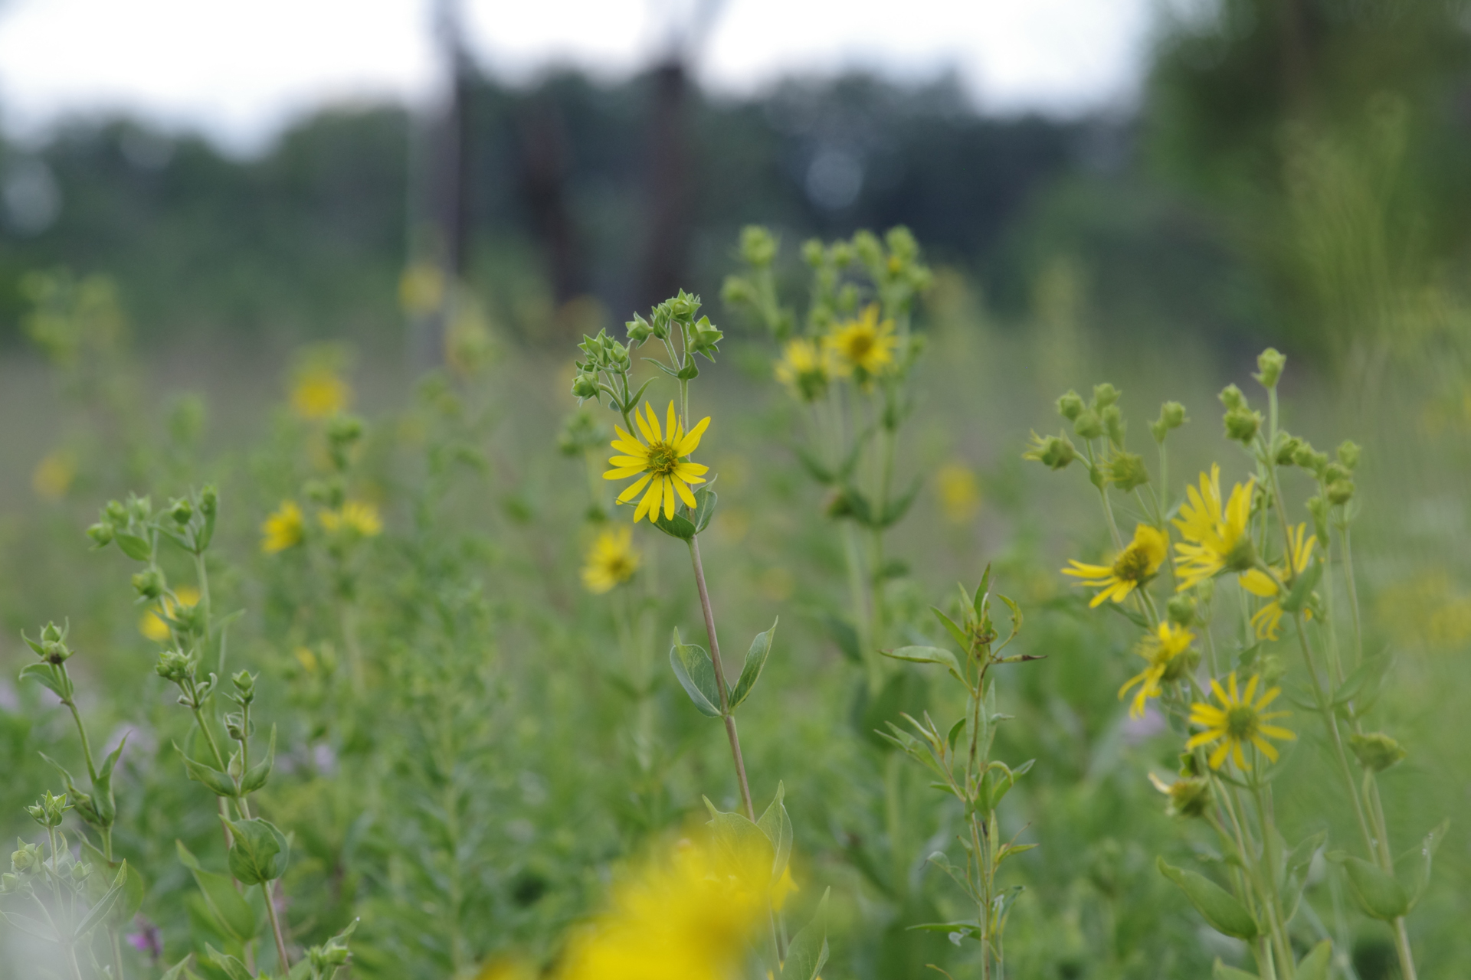
Chasing Bumblebees
In Fermilab Prairie 16 along Kirk Road

Slide 6
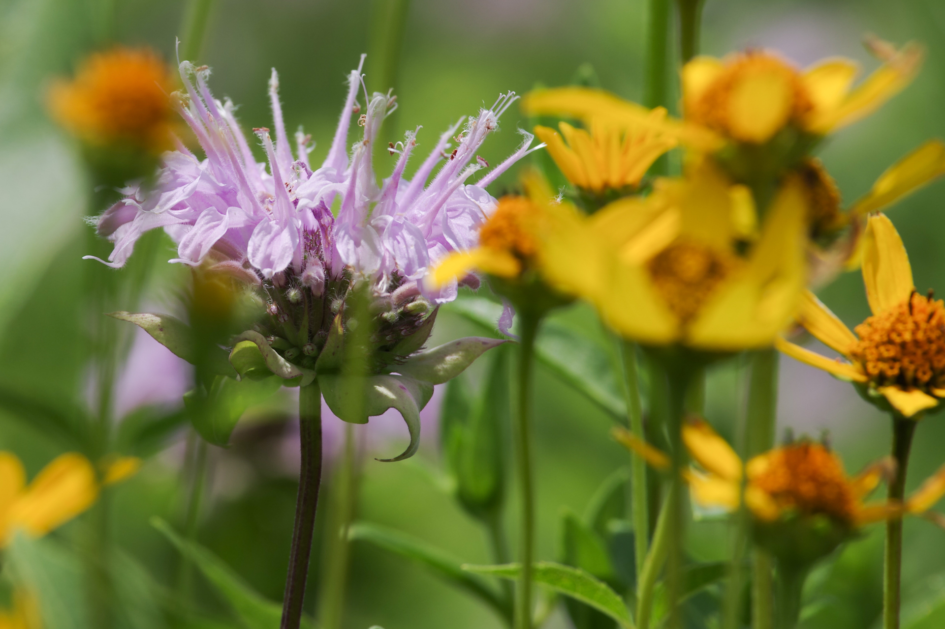
A good day, July 27 2018

Slide 7
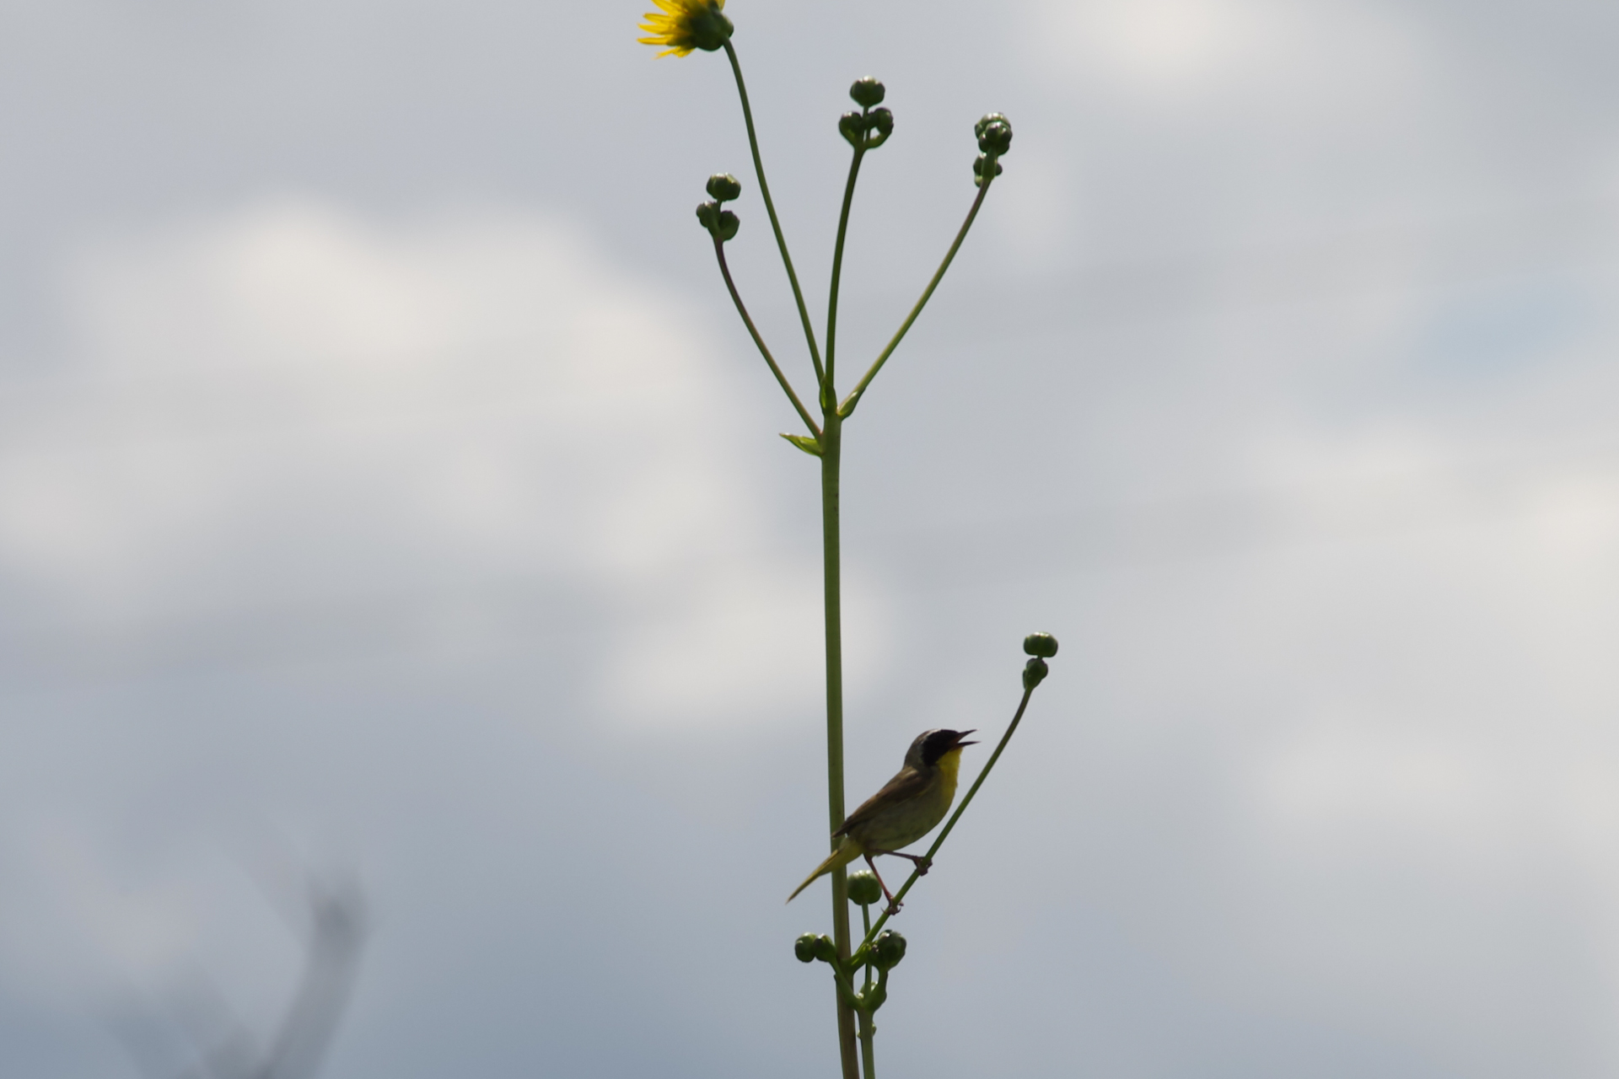

Slide 8
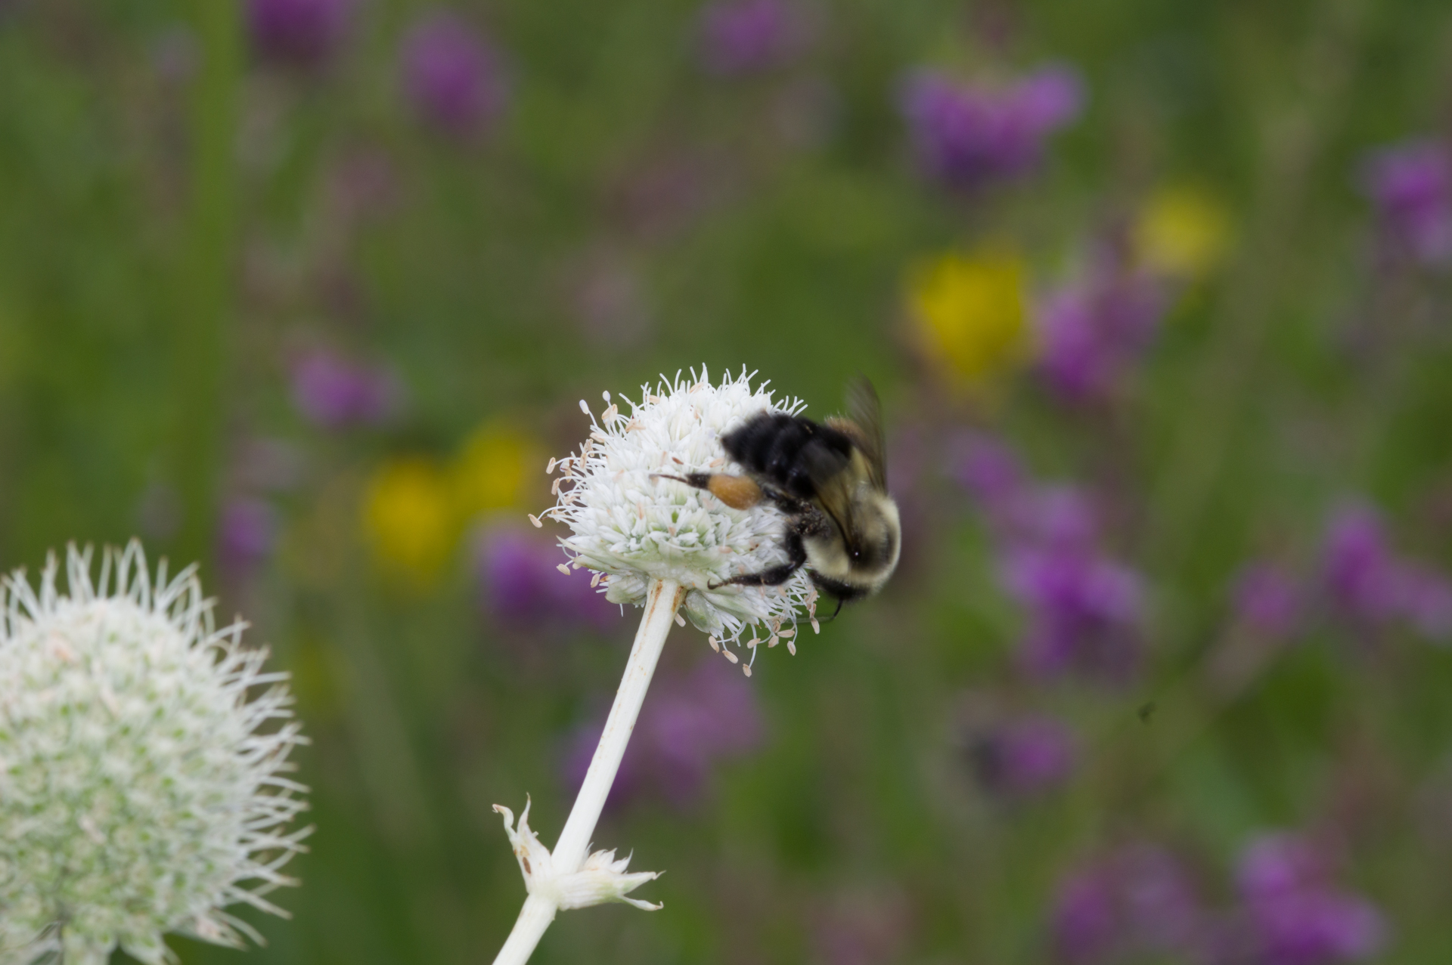
Bombus impatiens worker
On Rattlesnake Master

Slide 9
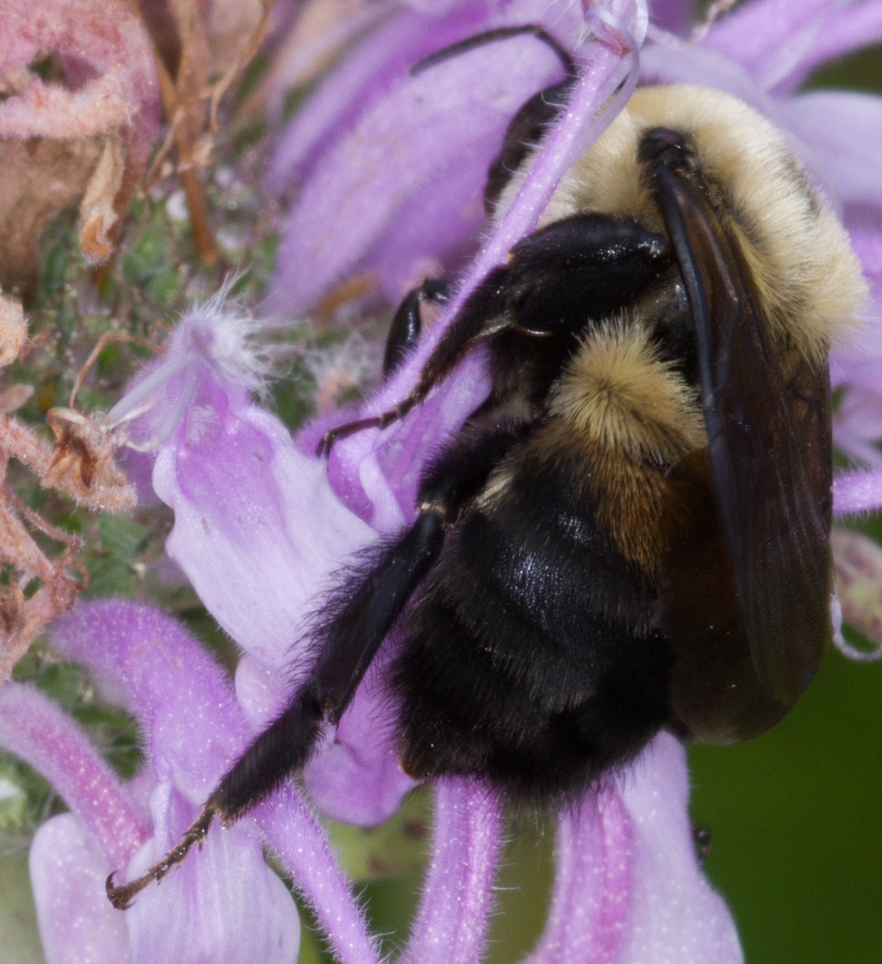
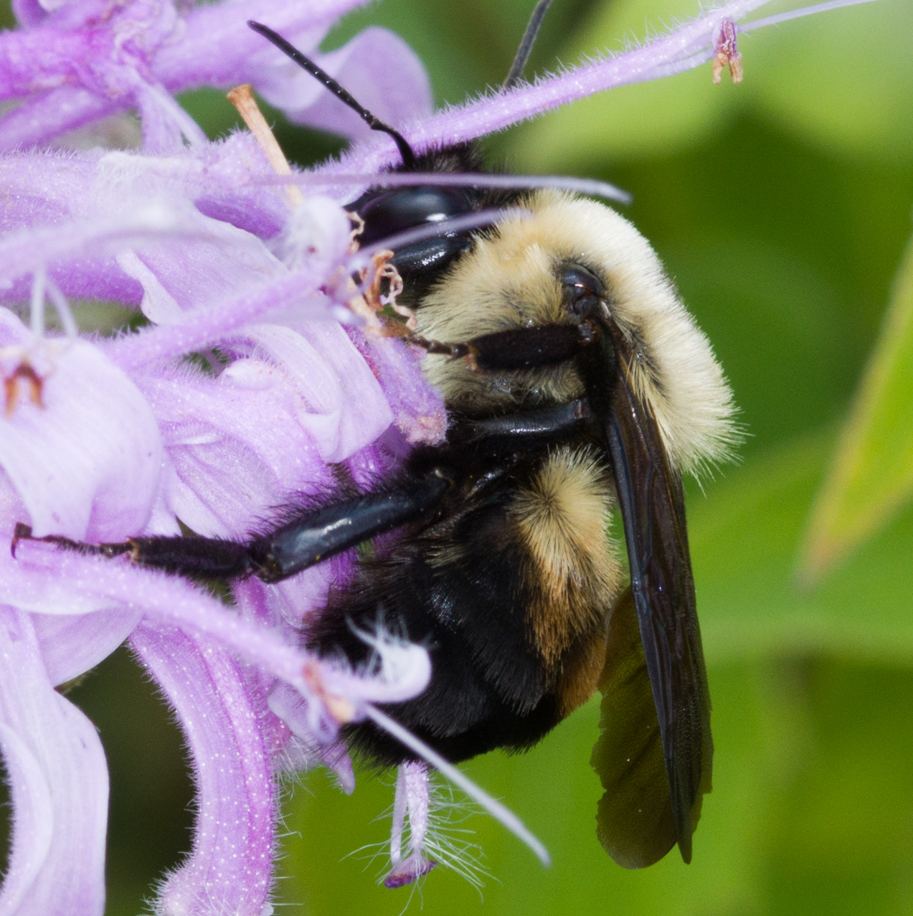
Bombus griseocollis
On Monarda fistulosa

Slide 10
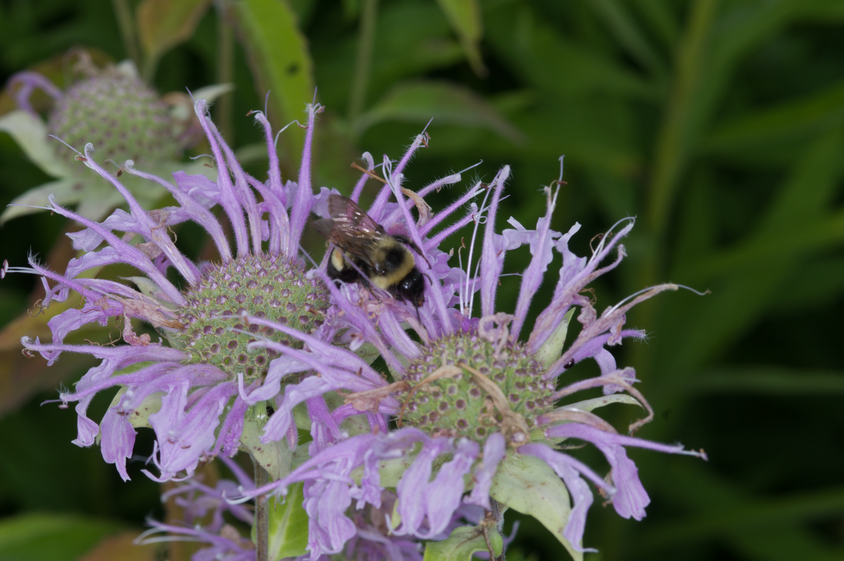
This looks promising.

Slide 11
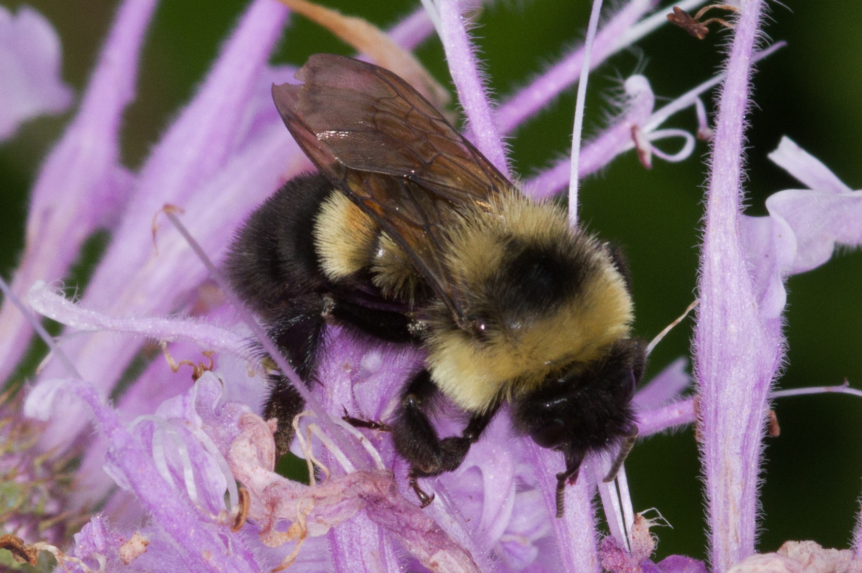
Bombus affinis
It is imperitive I get more images

Slide 12
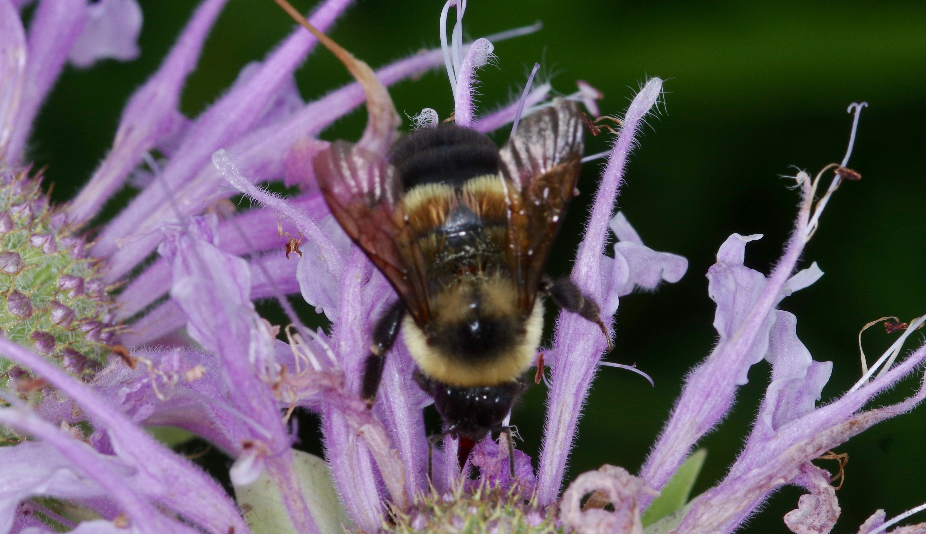
Views from several angles
Necessary for positive identification.

Slide 13
Ecology and Biology

Slide 14
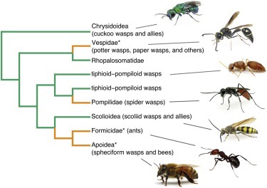
What is a bee?
Essentially, a vegetarian wasp.
Branched from Sphecoid wasps.
More closely related to the highly social ants than most wasp families.

Slide 15
Families of Bees
Melittidae (50 mya)
Apidae (87Mya)
Antophila
Megachilidae (50Mya)
Andrenidae (34Mya)
Halictidae (50Mya)
Colletidae (25Mya)
Stenotritidae (2Mya)

Slide 16
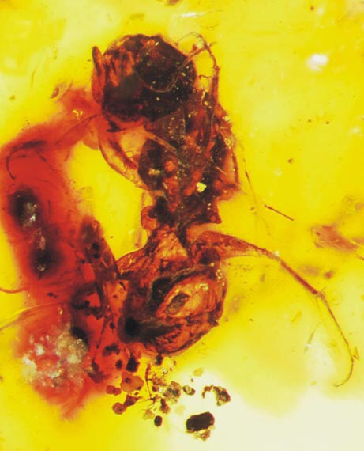
Insects drove flower development.
Melittosphex burmensis, trapped in amber over 100 mya. It lived in northern Burma about 35 to 45 mya earlier than the next oldest specimens known to science.
A mere 3mm long, it appears to have some characteristics of both bees and wasps.
Some modern wasps still feed their brood a mixture of prey and pollen.
Image: Science, 10/27/06

Slide 17
Strategies for Reproduction
Solitary Bees
Most species are in this category. A single female provisions the next generation. Very small families.
Primitively Social.
One female becomes the dominant sister and is the only breeder. The other subservient sisters help provision and guard the brood. Small families.
Eusocial.
Highly social behavior with a "queen" and workers. Large to huge families. We think most bees are in this category. They aren’t.

Slide 18
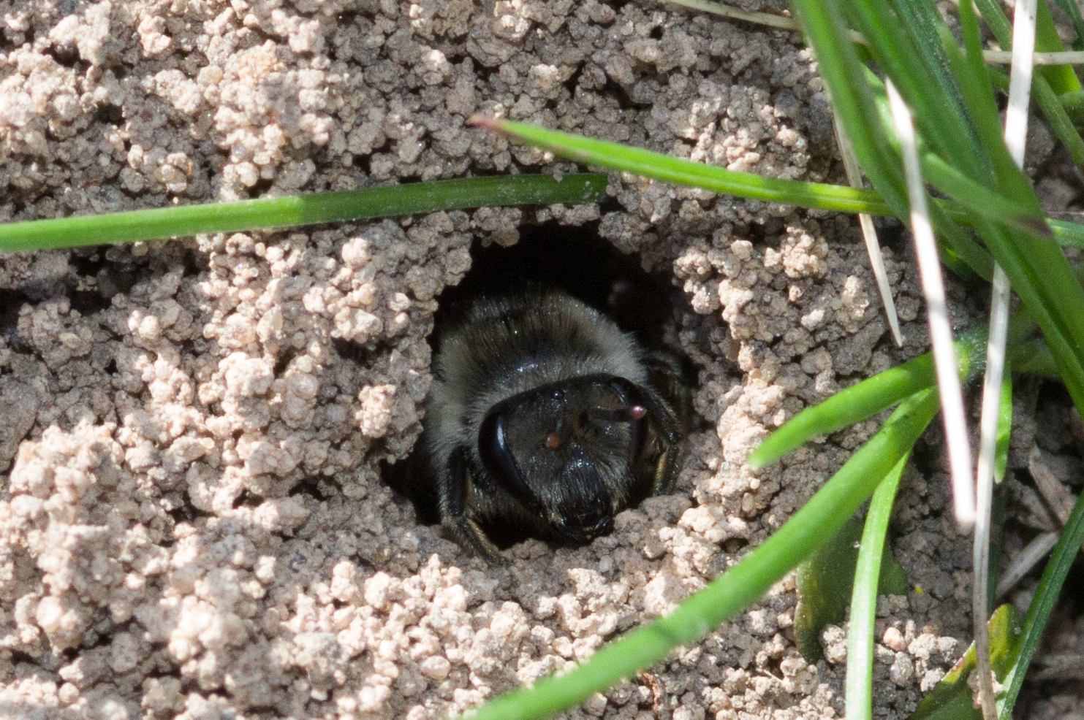
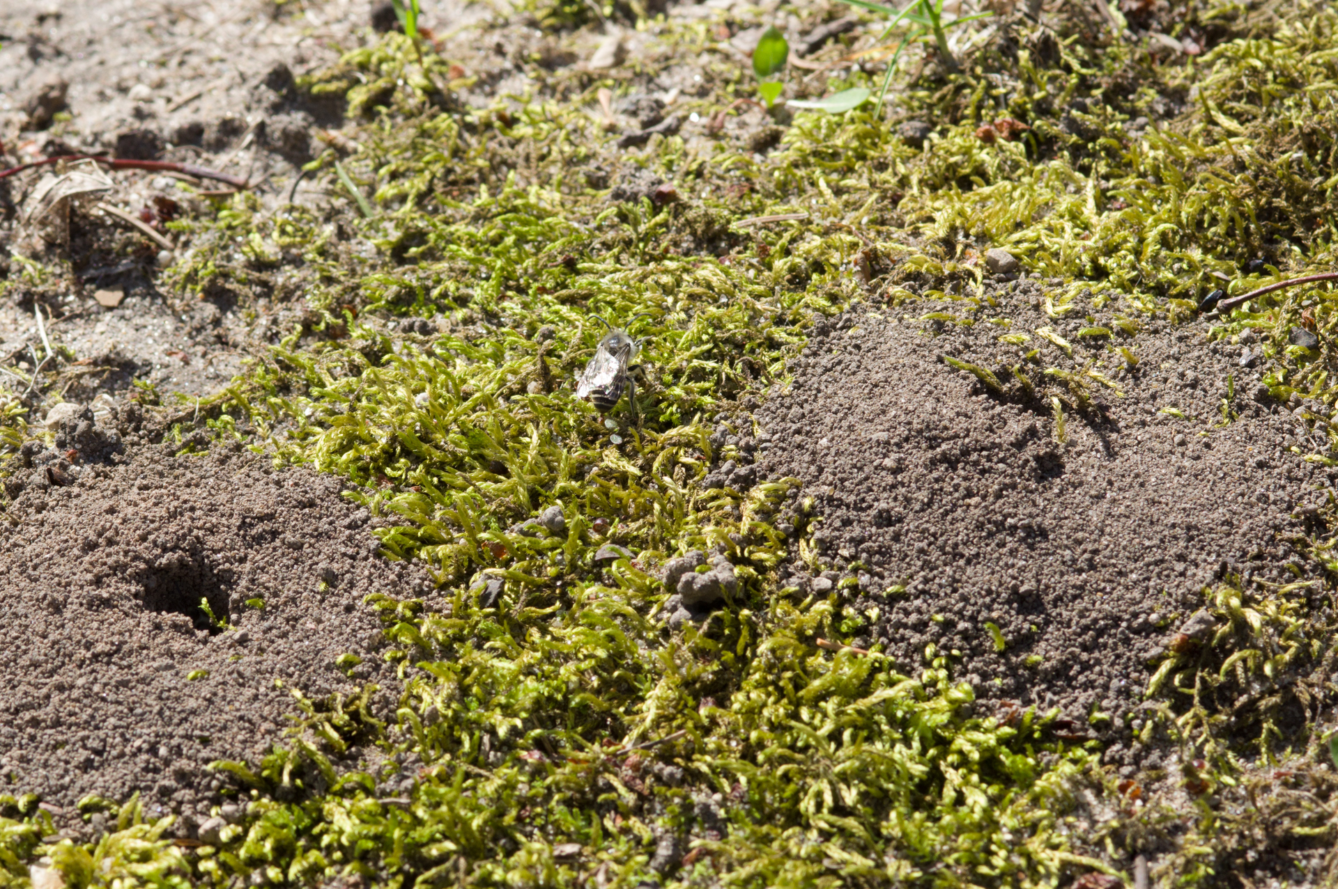
Bee Diversity
24,000+ species of bees worldwide, 4000+ in North America.
Estimated 400 species in the Great Lakes Region.
7 Families of bees, 6 present in this region.
7 species of Honey Bees, none native to North America.
Honey Bees are a domesticated animal, managed by humans.
70% of bee species nest in the ground.
Colletes inaequalis nests

Slide 19
Bee Lifecycle
Univoltine bees have one generation per year, multivoltine have several.
Females provision cells with pollen and nectar sufficient for development.
Cells are sealed in sequence, generally females before males.
Larvae mature in cells, may enter diapause, and emerge adult.
Mating occurs shortly after emergence of fertile Gyne.
Individual bees are active adults approximately 4 to 6 weeks whether the colony is univoltine, multivoltine or persistent. In eusocial colonies bees may have different jobs at different points in its life, a trait shared with ants.
Bees overwinter via different strategies. Foundresses hibernate as fertilized “queens.” Others mate upon emergence as adults in spring. Honeybees are the only group which have a persistent colony through several years.

Slide 20
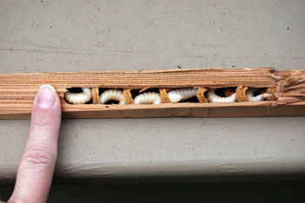
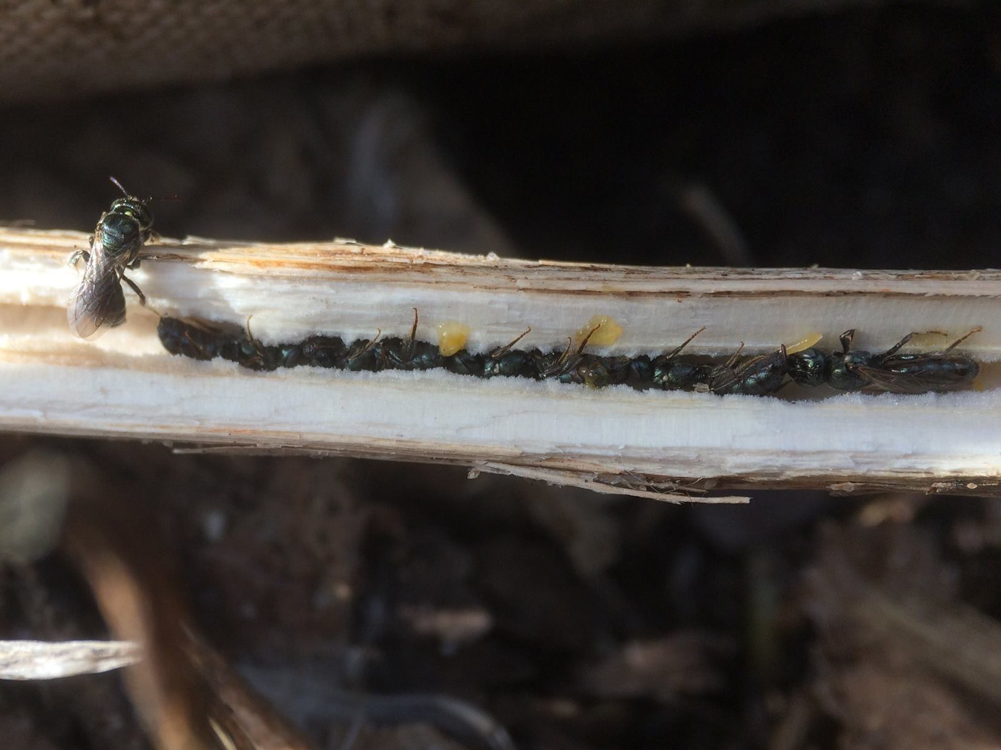
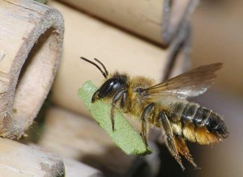
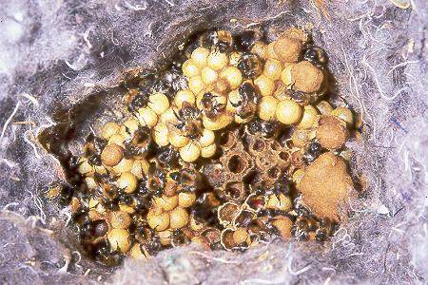
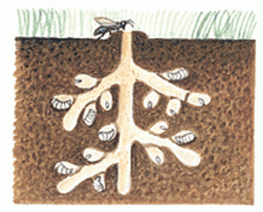

Slide 21
Bumble bee biology
Queen emerges from overwintering in hibenaculum.
Queen finds nest site.
Queen gathers resources for first batch of daughters.
Queen incubates daughters.
Daughter workers continue foraging through season.
Queen manages colony, deciding when to lay more eggs.
Queen can determine sex of offspring.
End of season Gynes and Males emerge to mate.
Fertilized founders finds overwintering site.
Males are haploid, single copy of genes.
Males disperse, do not return to nest.
Fertilized foundresses are the only survivors into next year.

Slide 22
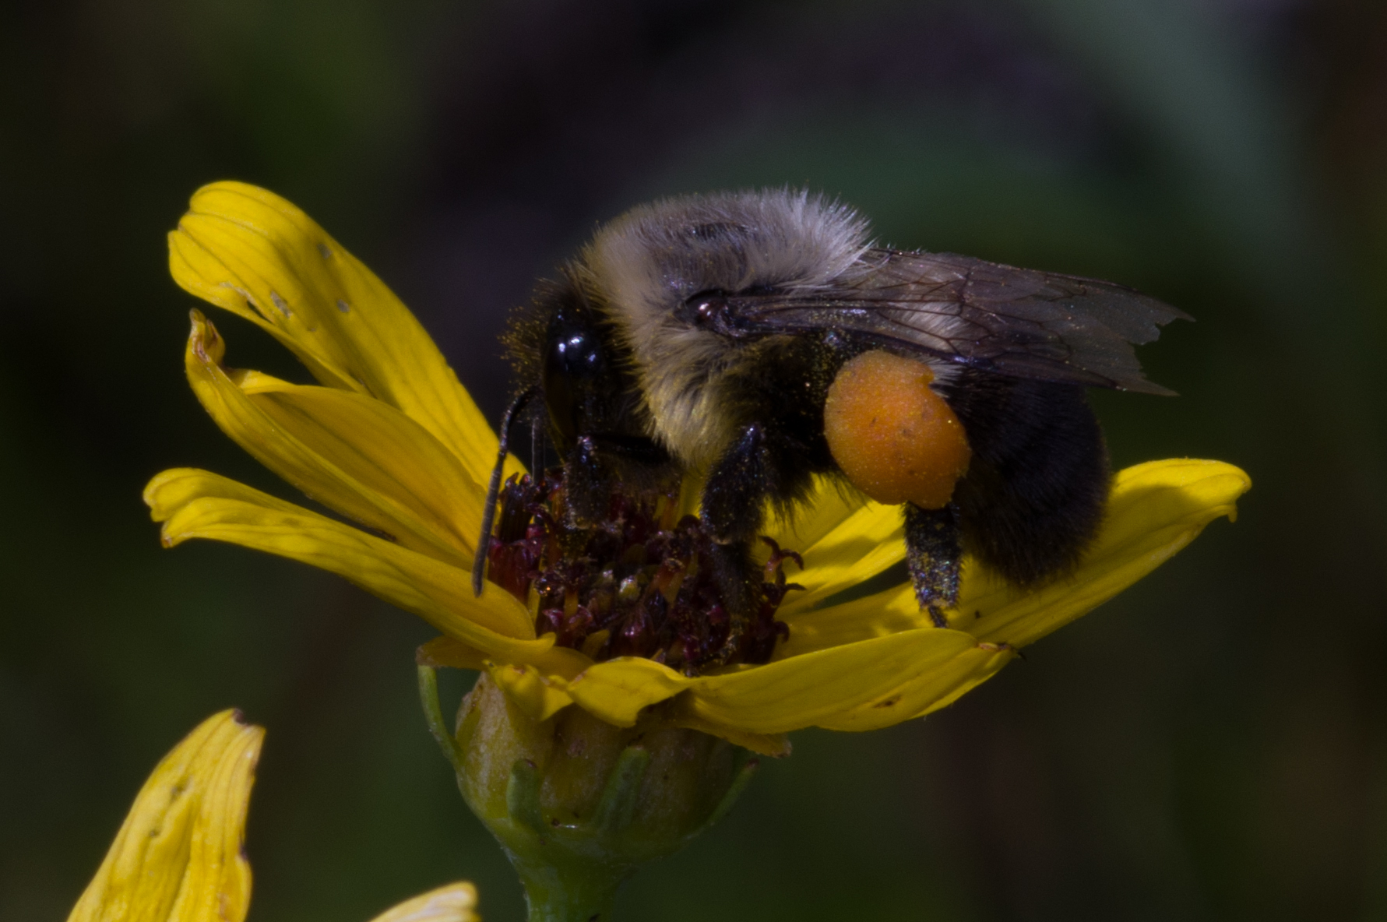
Requirements for Success
Resources. Appropriate quantity of flowers.
Nesting site. Typically abandoned rodent nests.
Reproduction. Access to suitable mates.
Generation. Overwintering sites.
Bees make a lot of decisions.

Slide 23
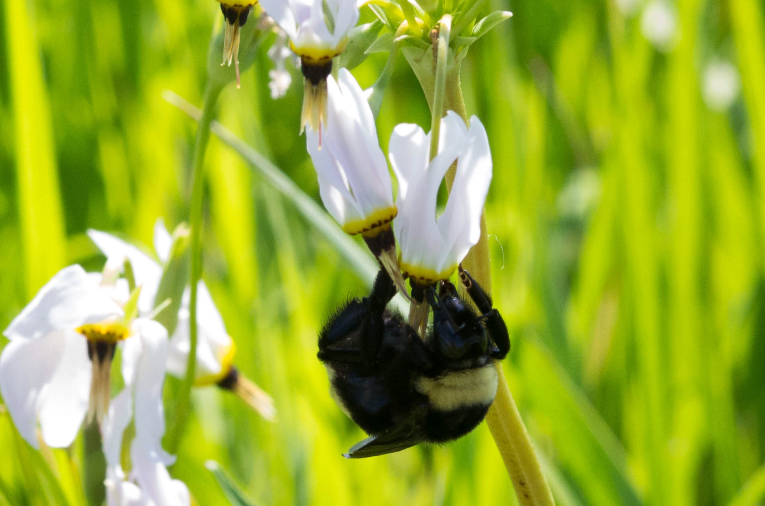
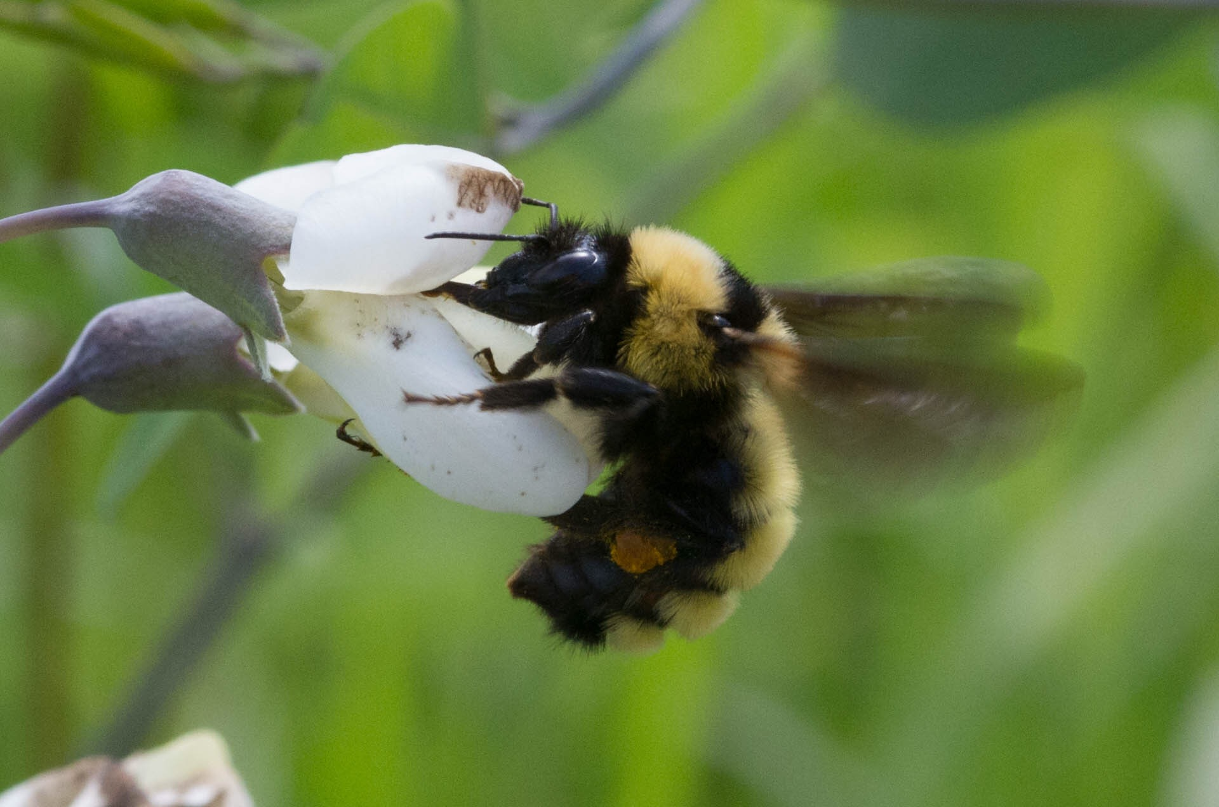
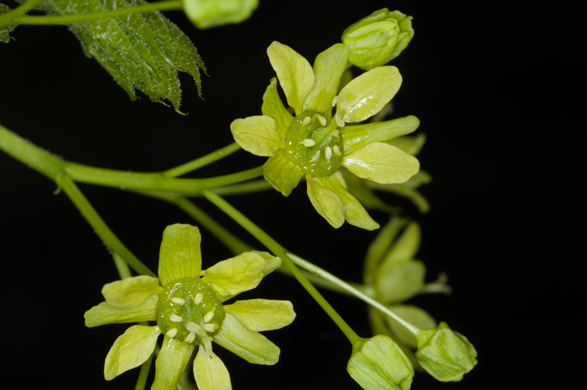
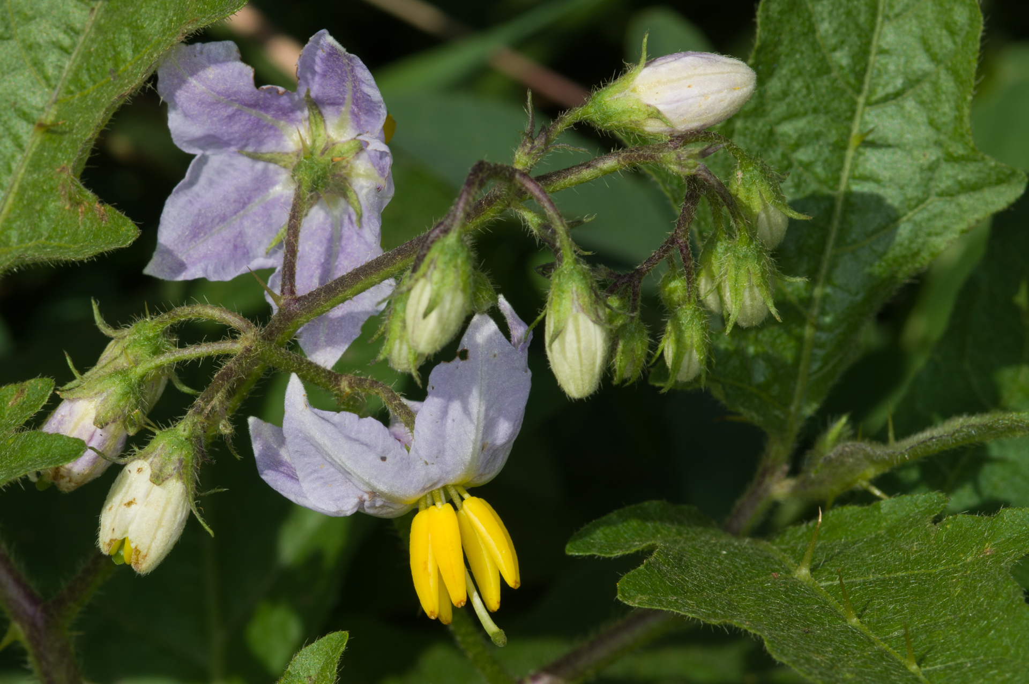
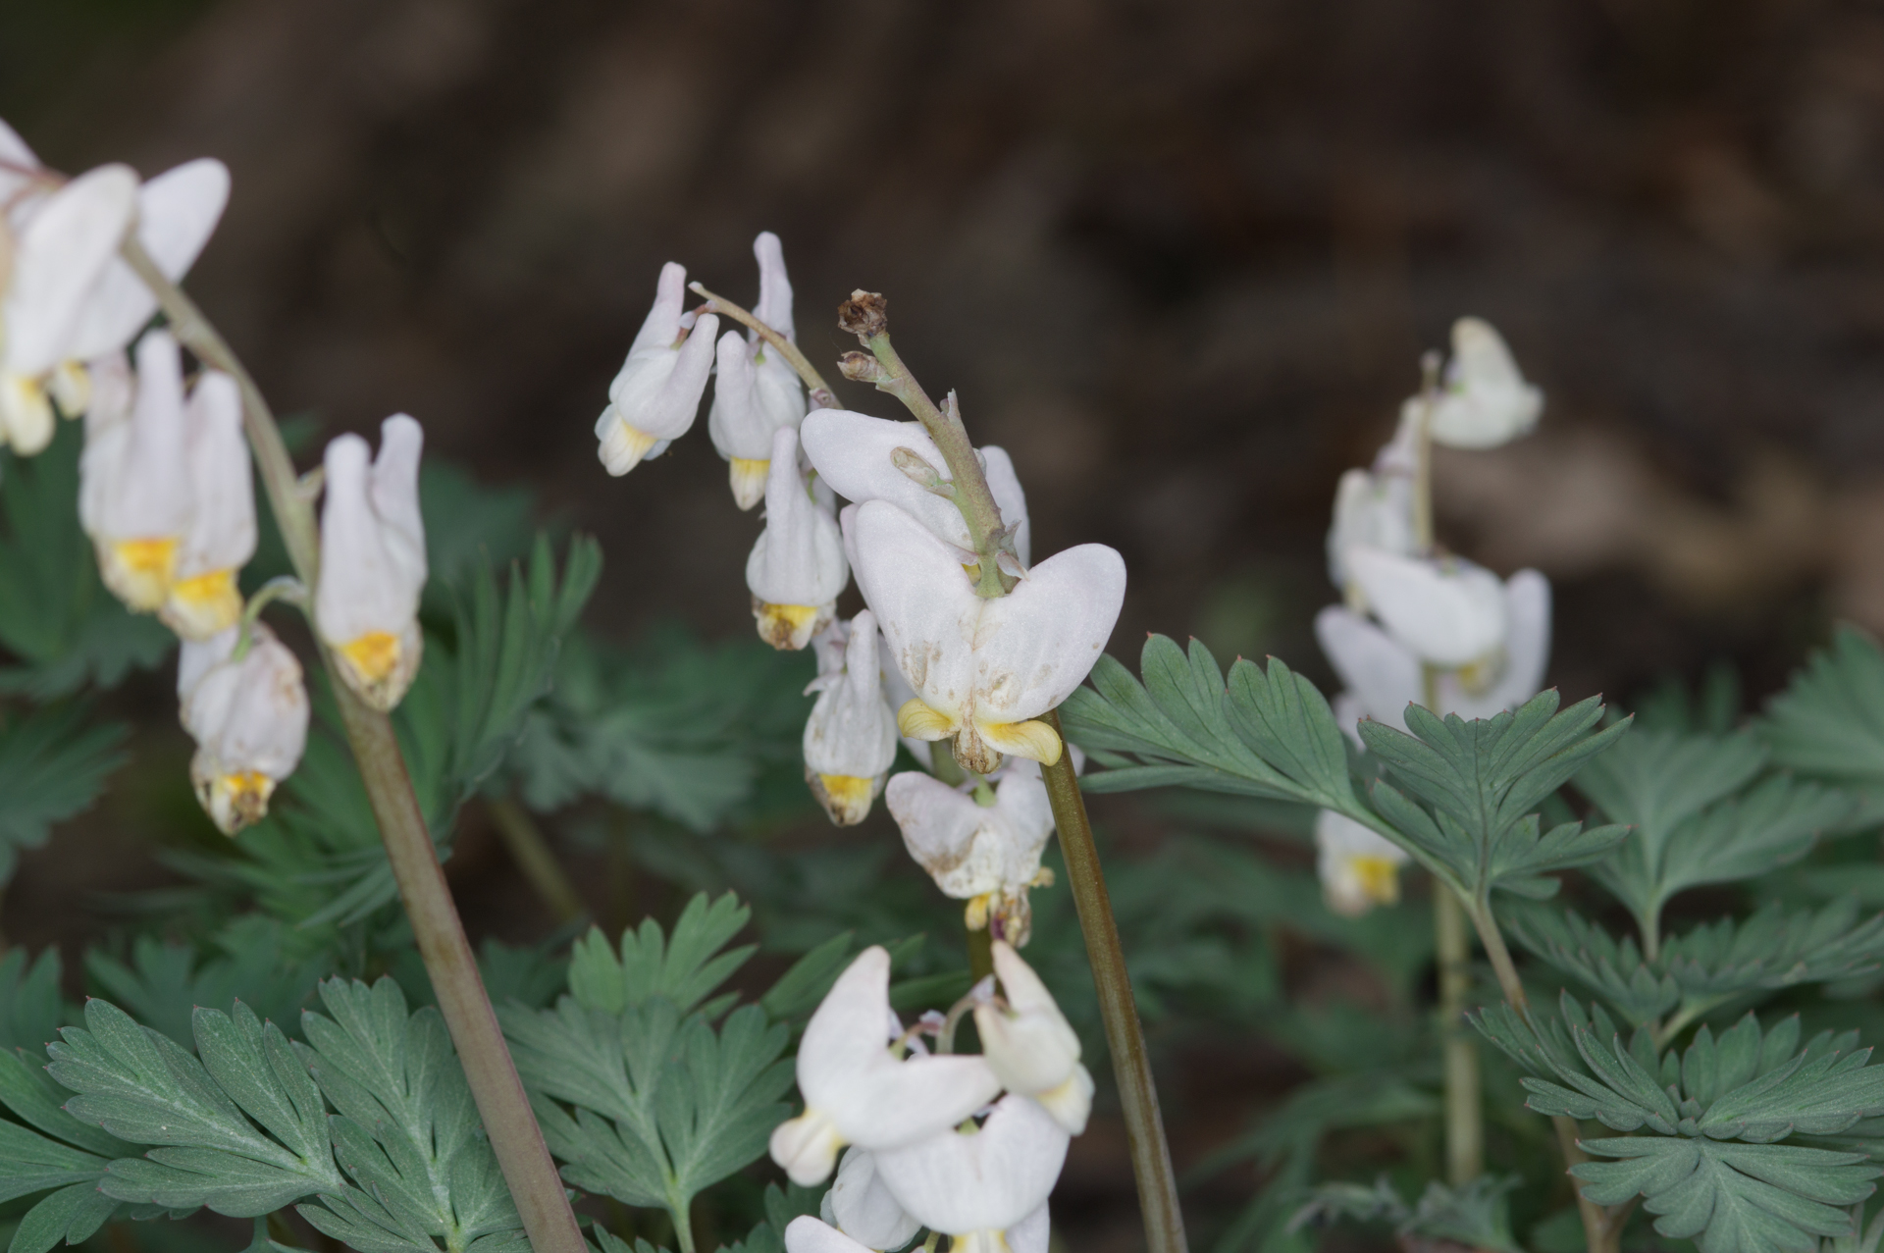
Important resources

Slide 24
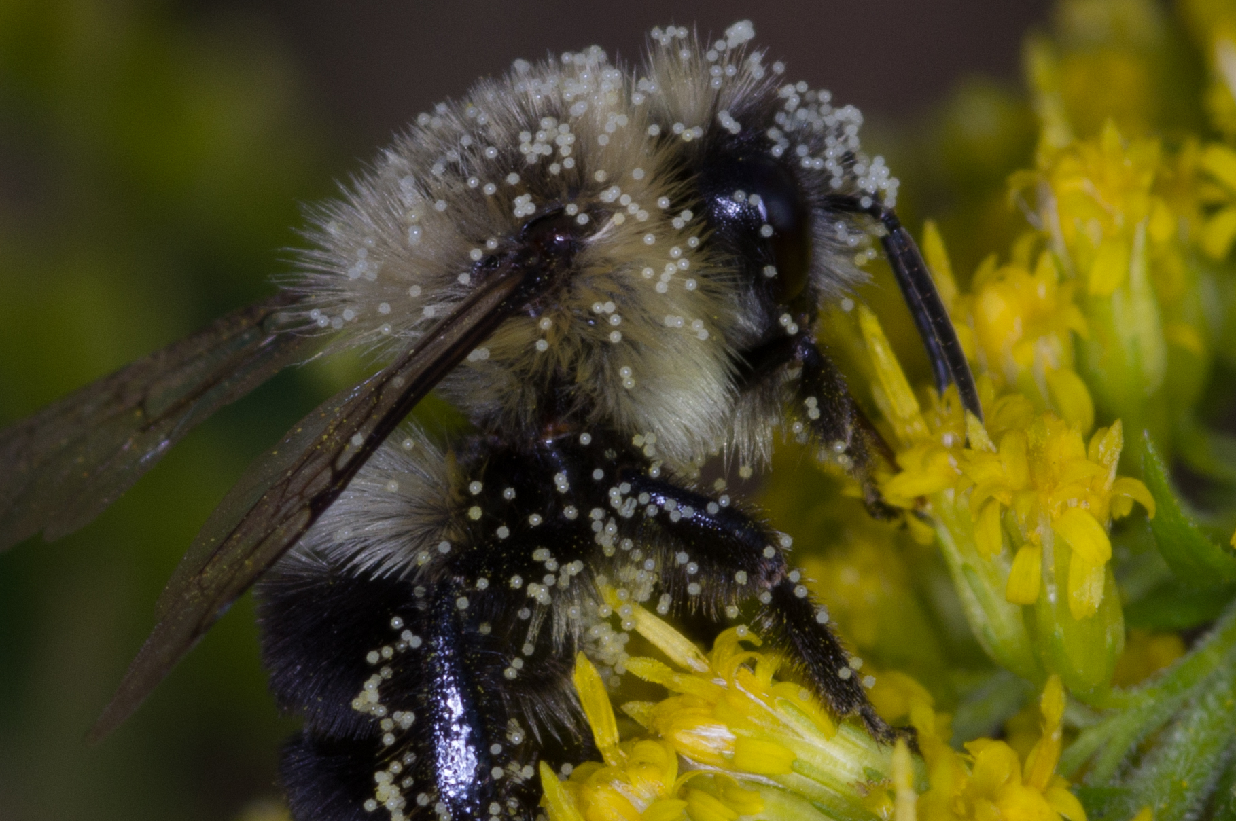
Identifying Bumble bees

Slide 25
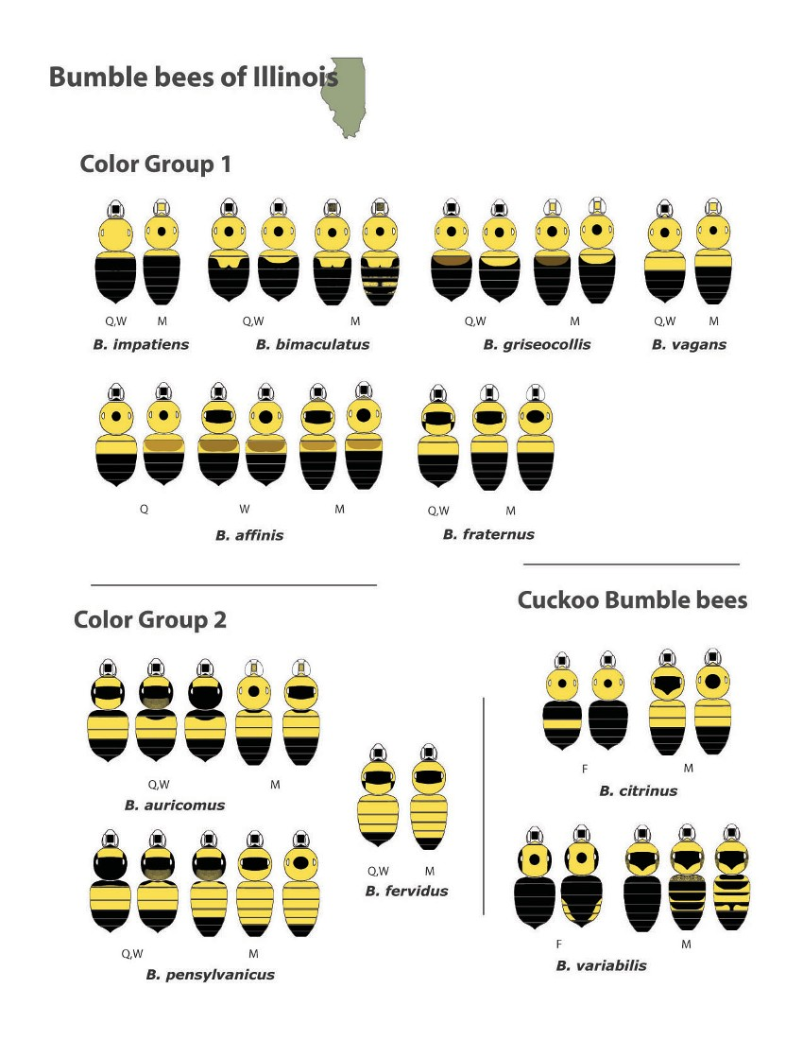
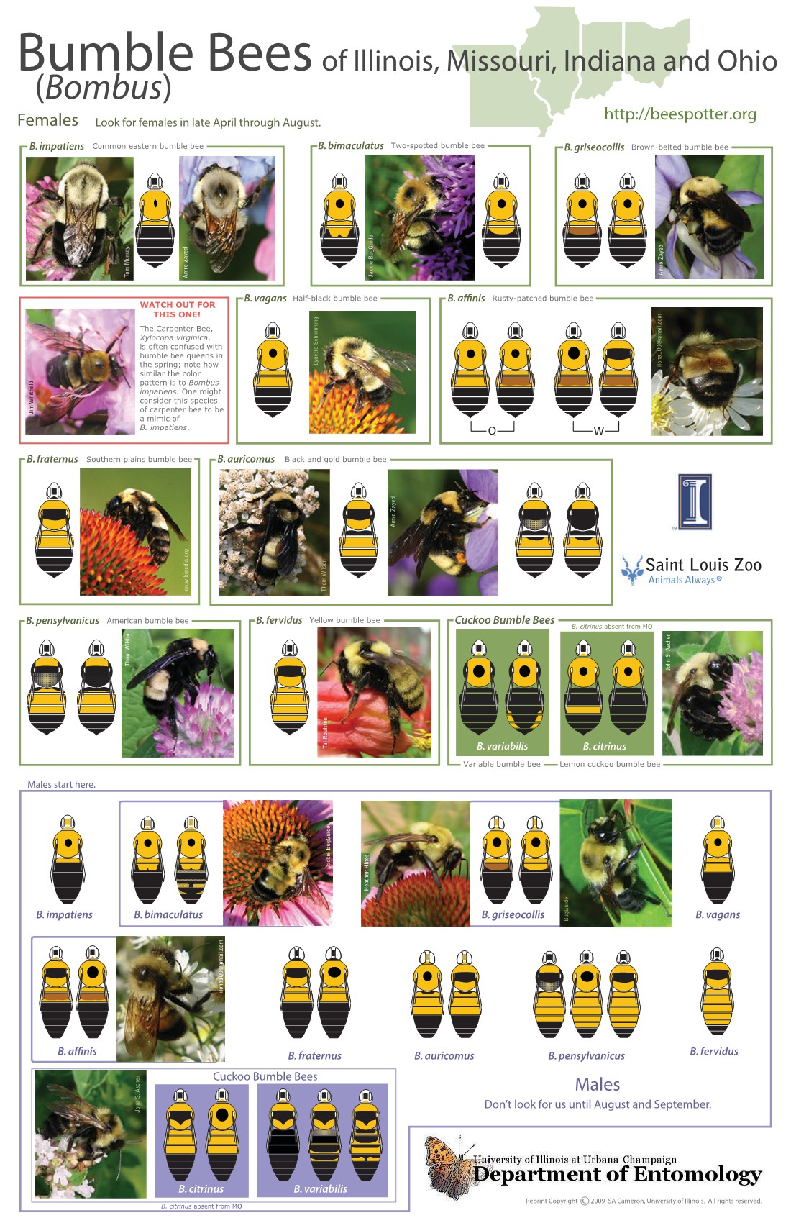

Slide 26
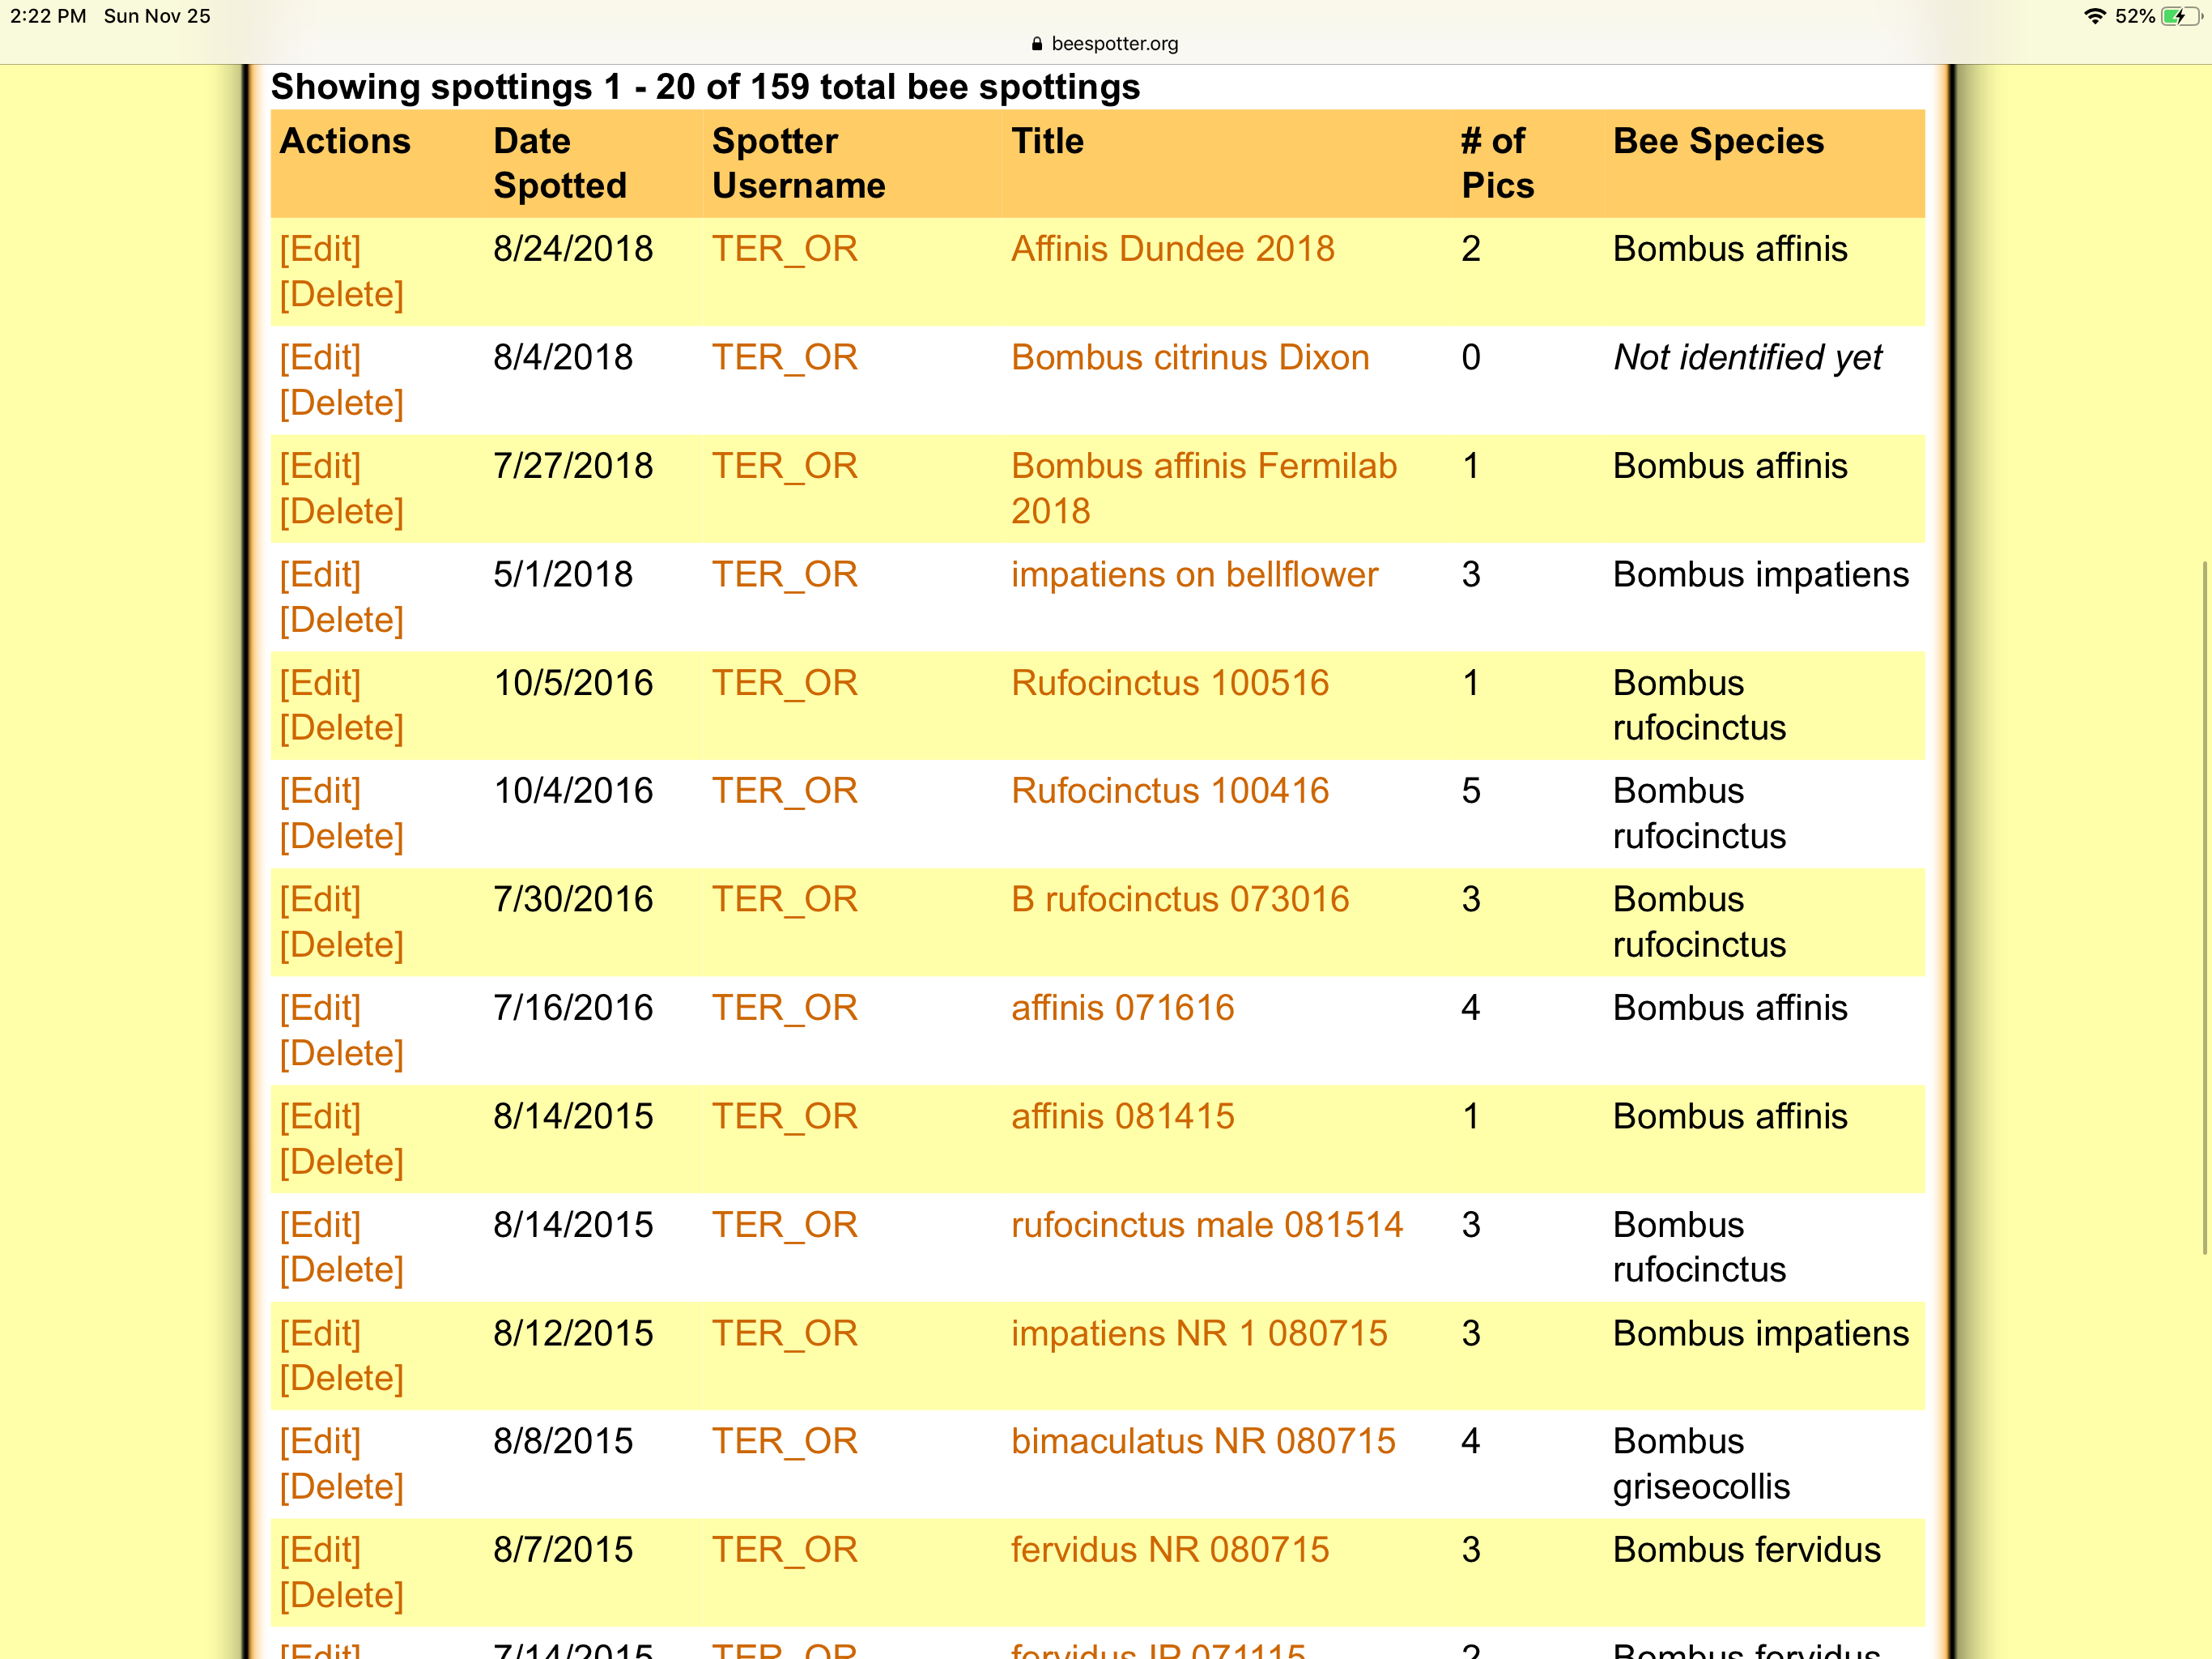
Submitting sightings

Slide 27
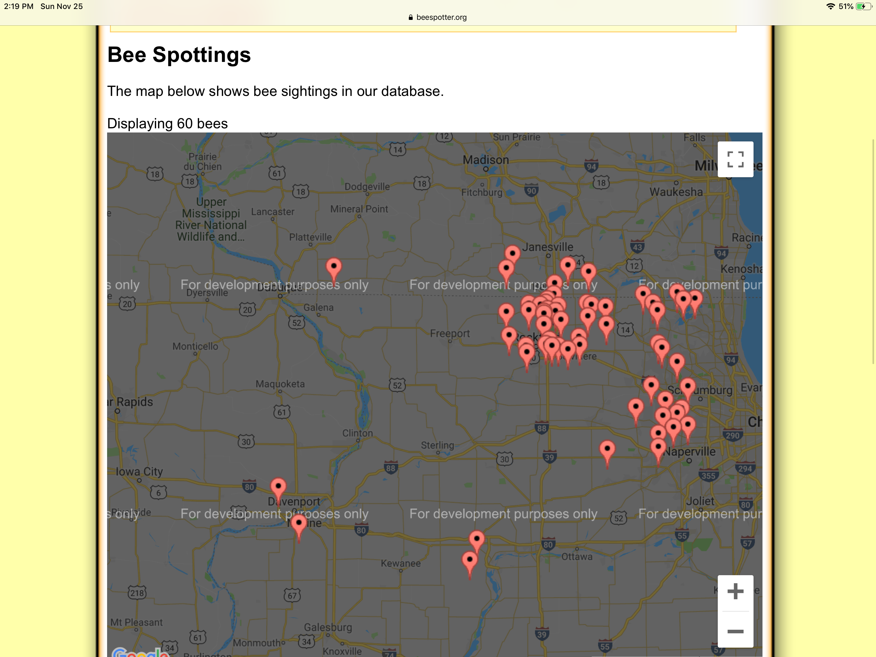
Bombus Affinis map 2018

Slide 28
Bombus affinis at Fermilab

Slide 29
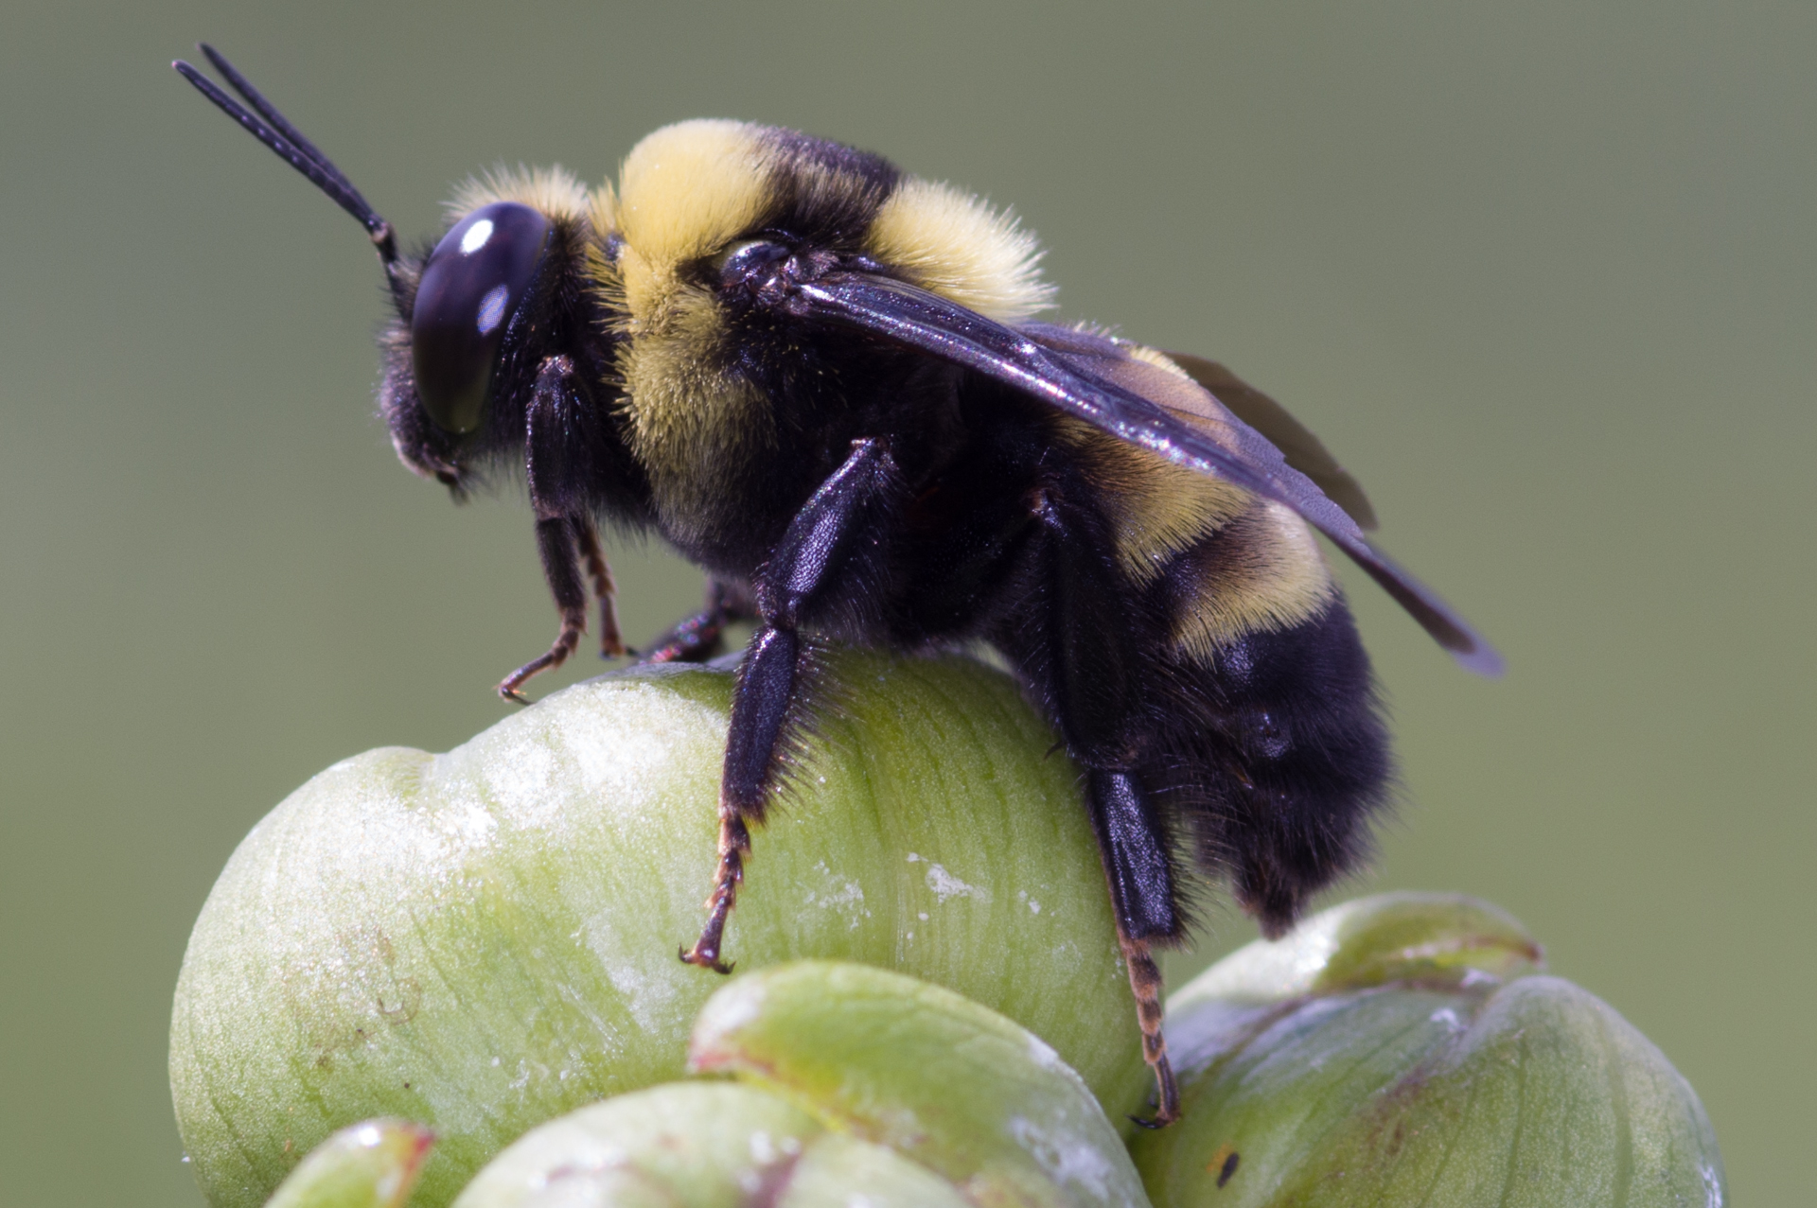
What to look for
Bombus auricomus
Tuft on head
Thorax and head hair patterns
Terga color pattern b,y,y,b,b,b,b
Wing vein pattern
Size*
13 Antenna segments
Large eyes
Facial hair, pale clypeus
No scopa basket on tibia
MALE

Slide 30
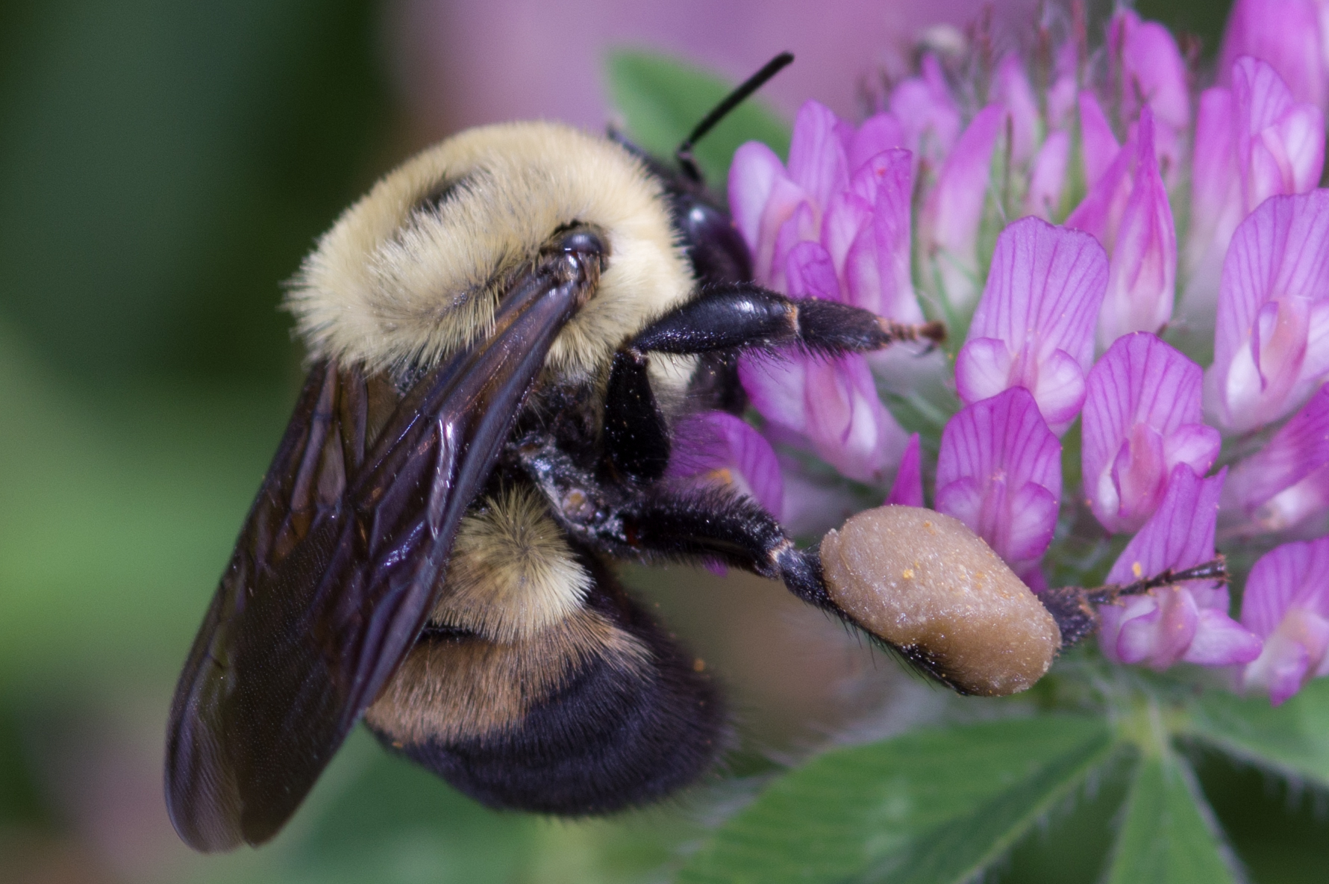
First tergite yellow, second a brown crescent
Early species, active through late July.
B.griseocollis
B. affinis
First tergite yellow, second brown crescent within yellow fill. Late species, active July through October.

Slide 31
B. rufocinctus
Terga one and two yellow.
Remaining terga usually brown...usually.
Tend to be small, round head and compact.
B. Affinis
Late season
Brown patch may be pale
Tend to be more narrow.

Slide 32
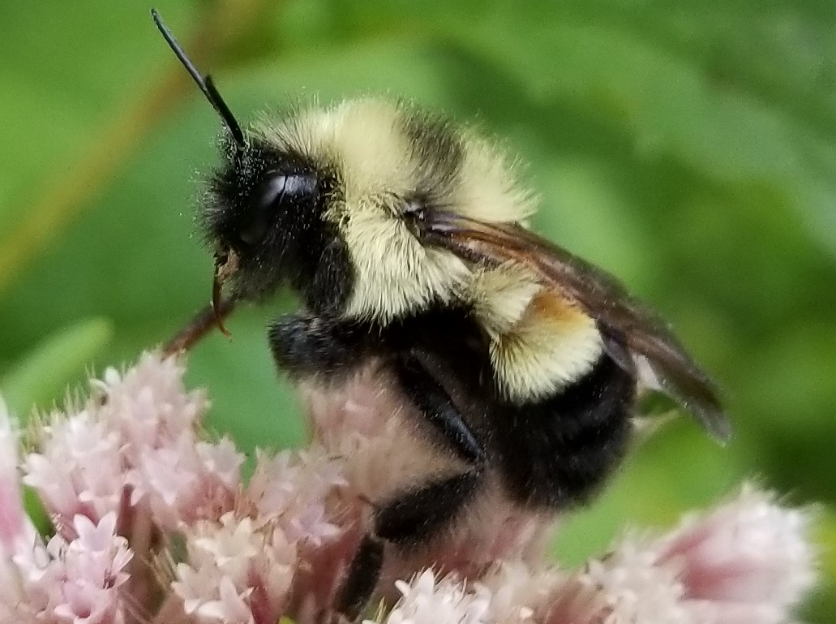
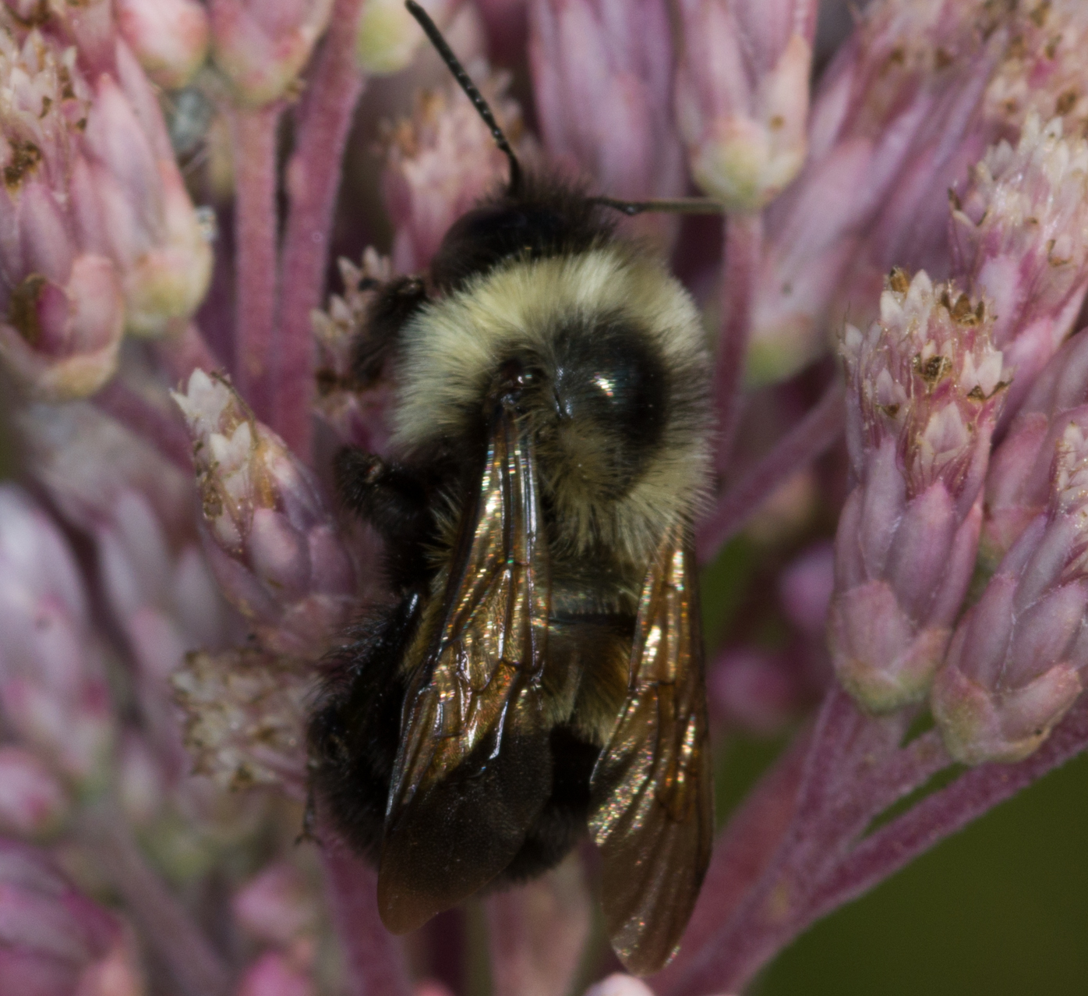
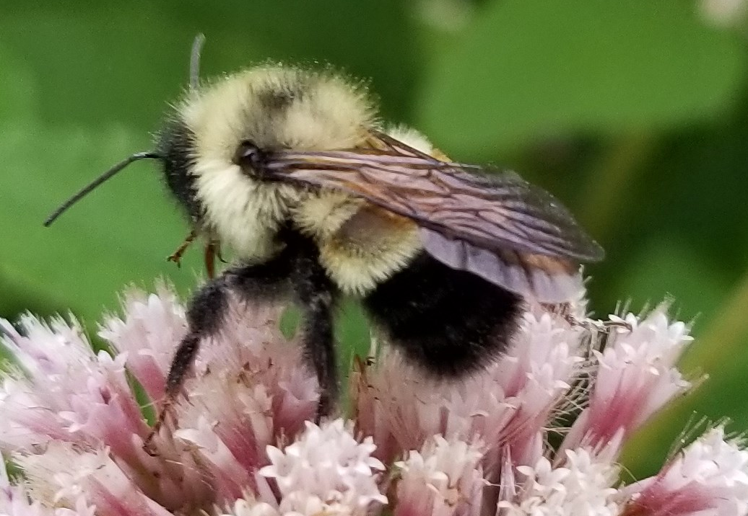
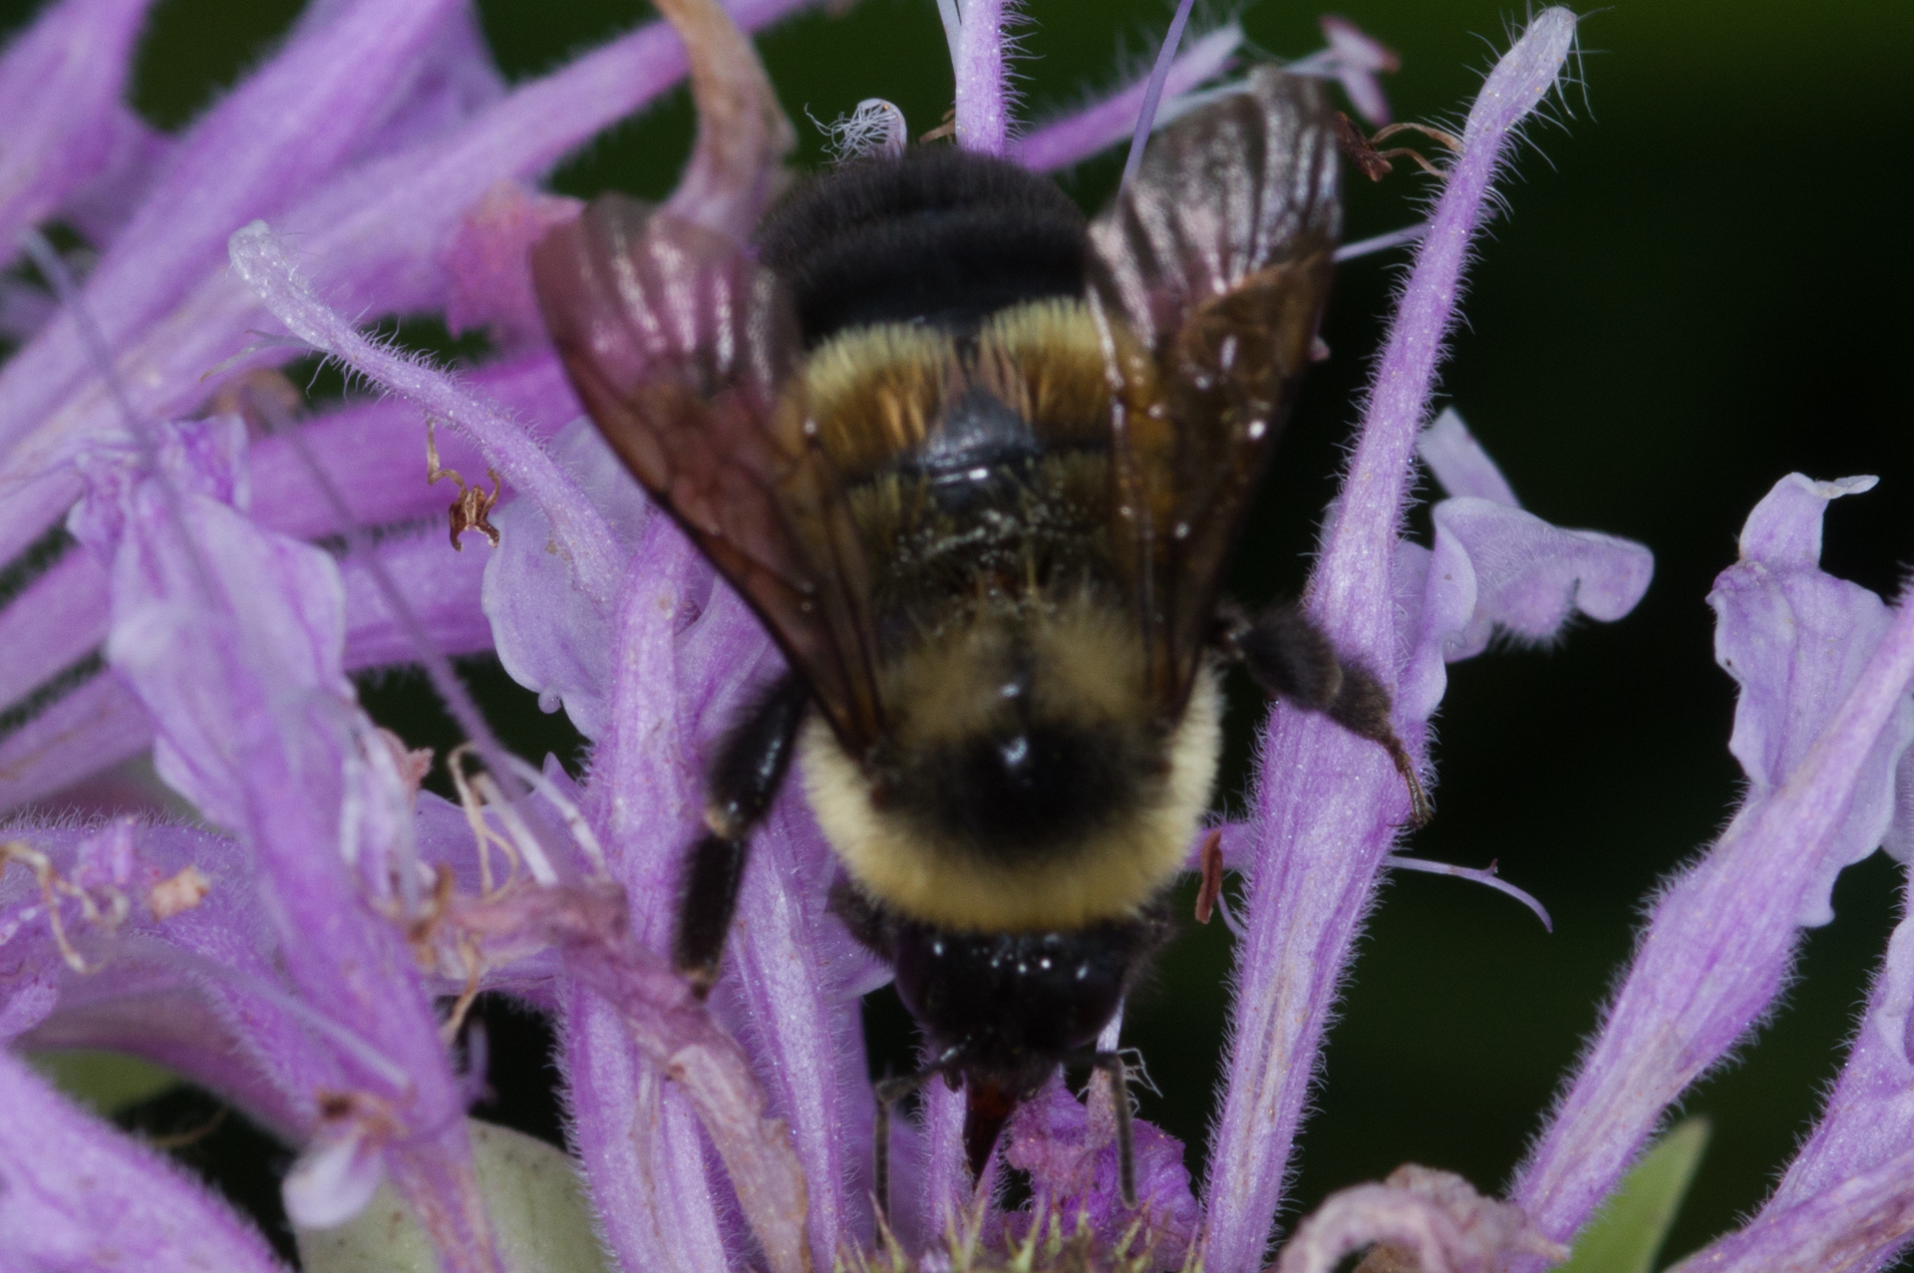
Rusty patched sightings 2018
Dixon Waterfowl Refuge
Male, East Dundee
Fermilab

Slide 33
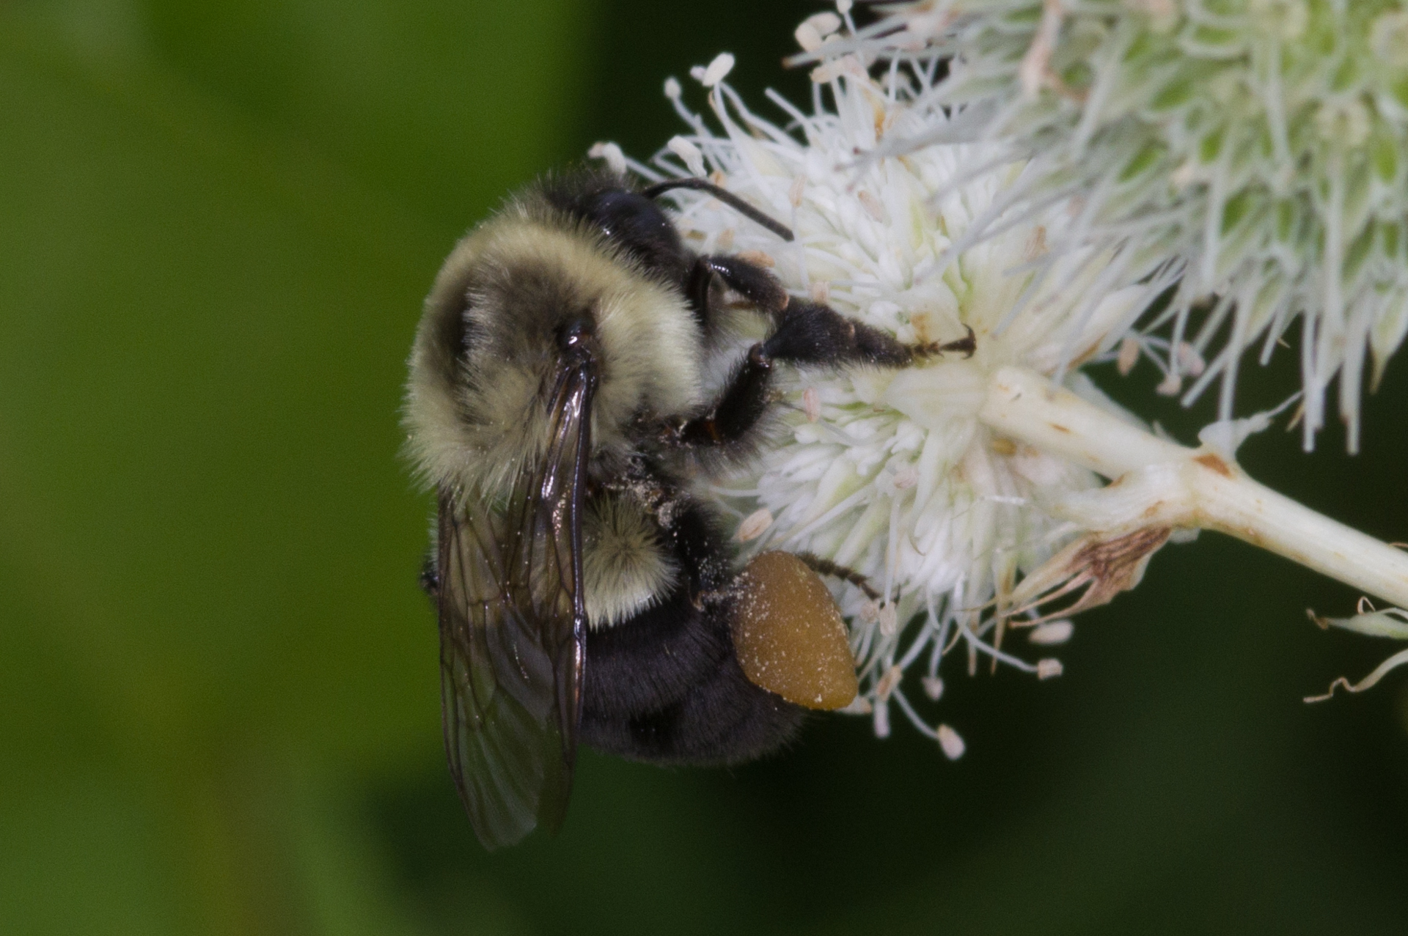
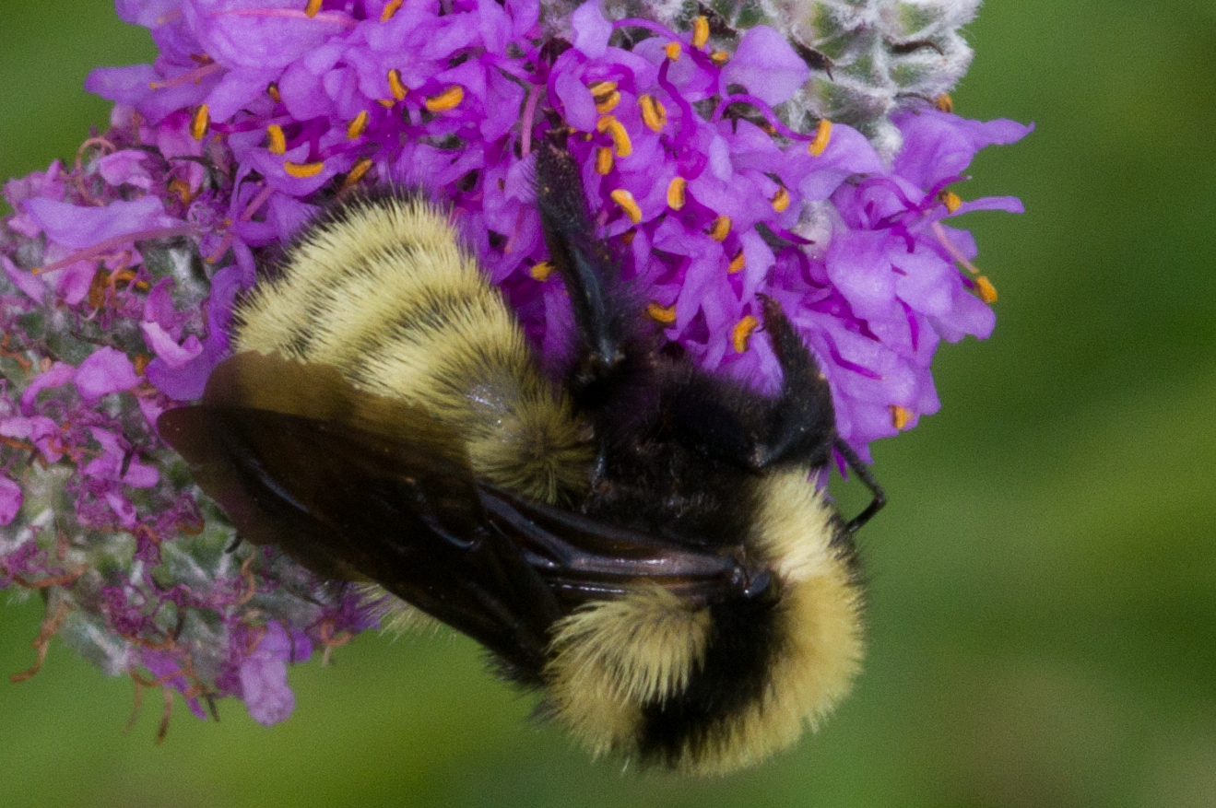
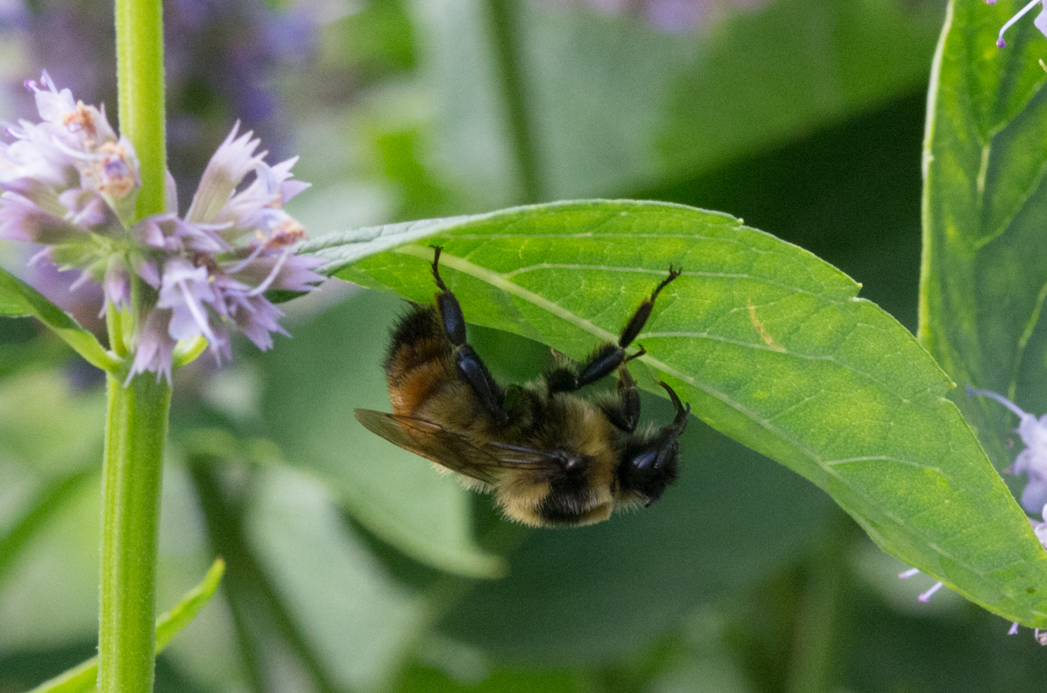
Bombus auricomus
Bombus fervidus
Bombus impatiens
Bombus rufocinctus

Slide 34
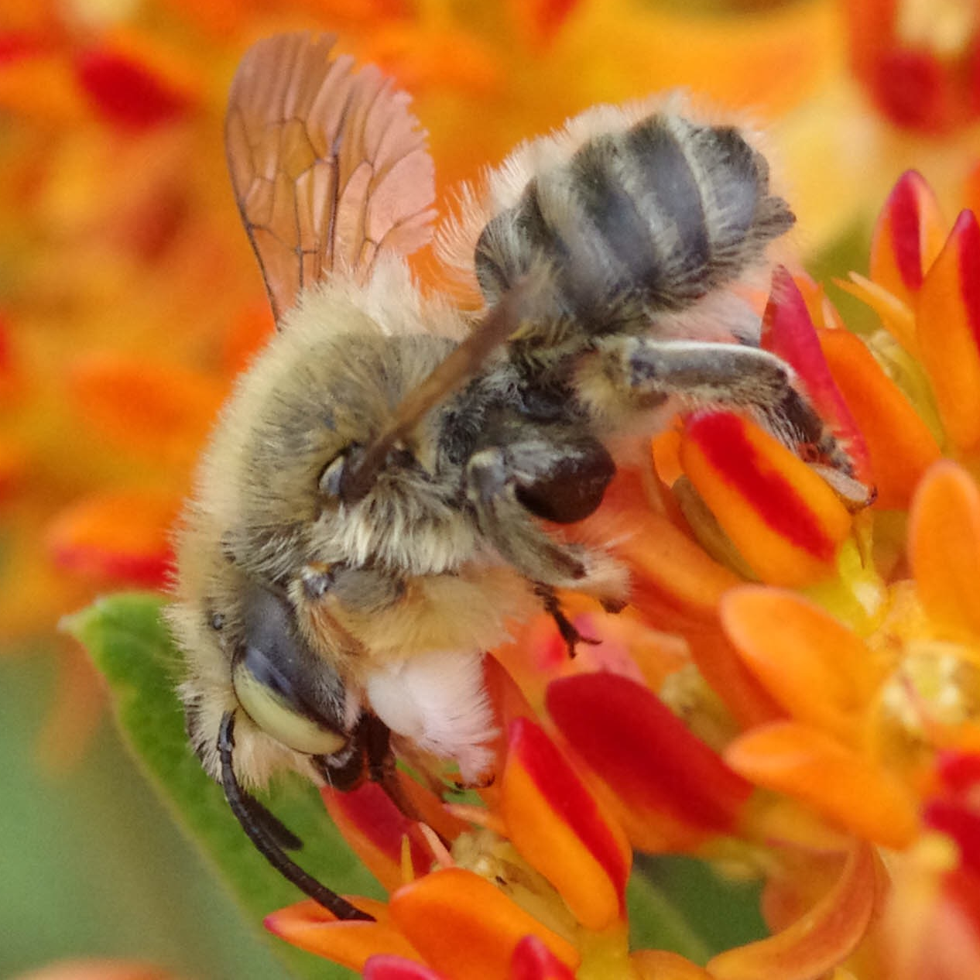
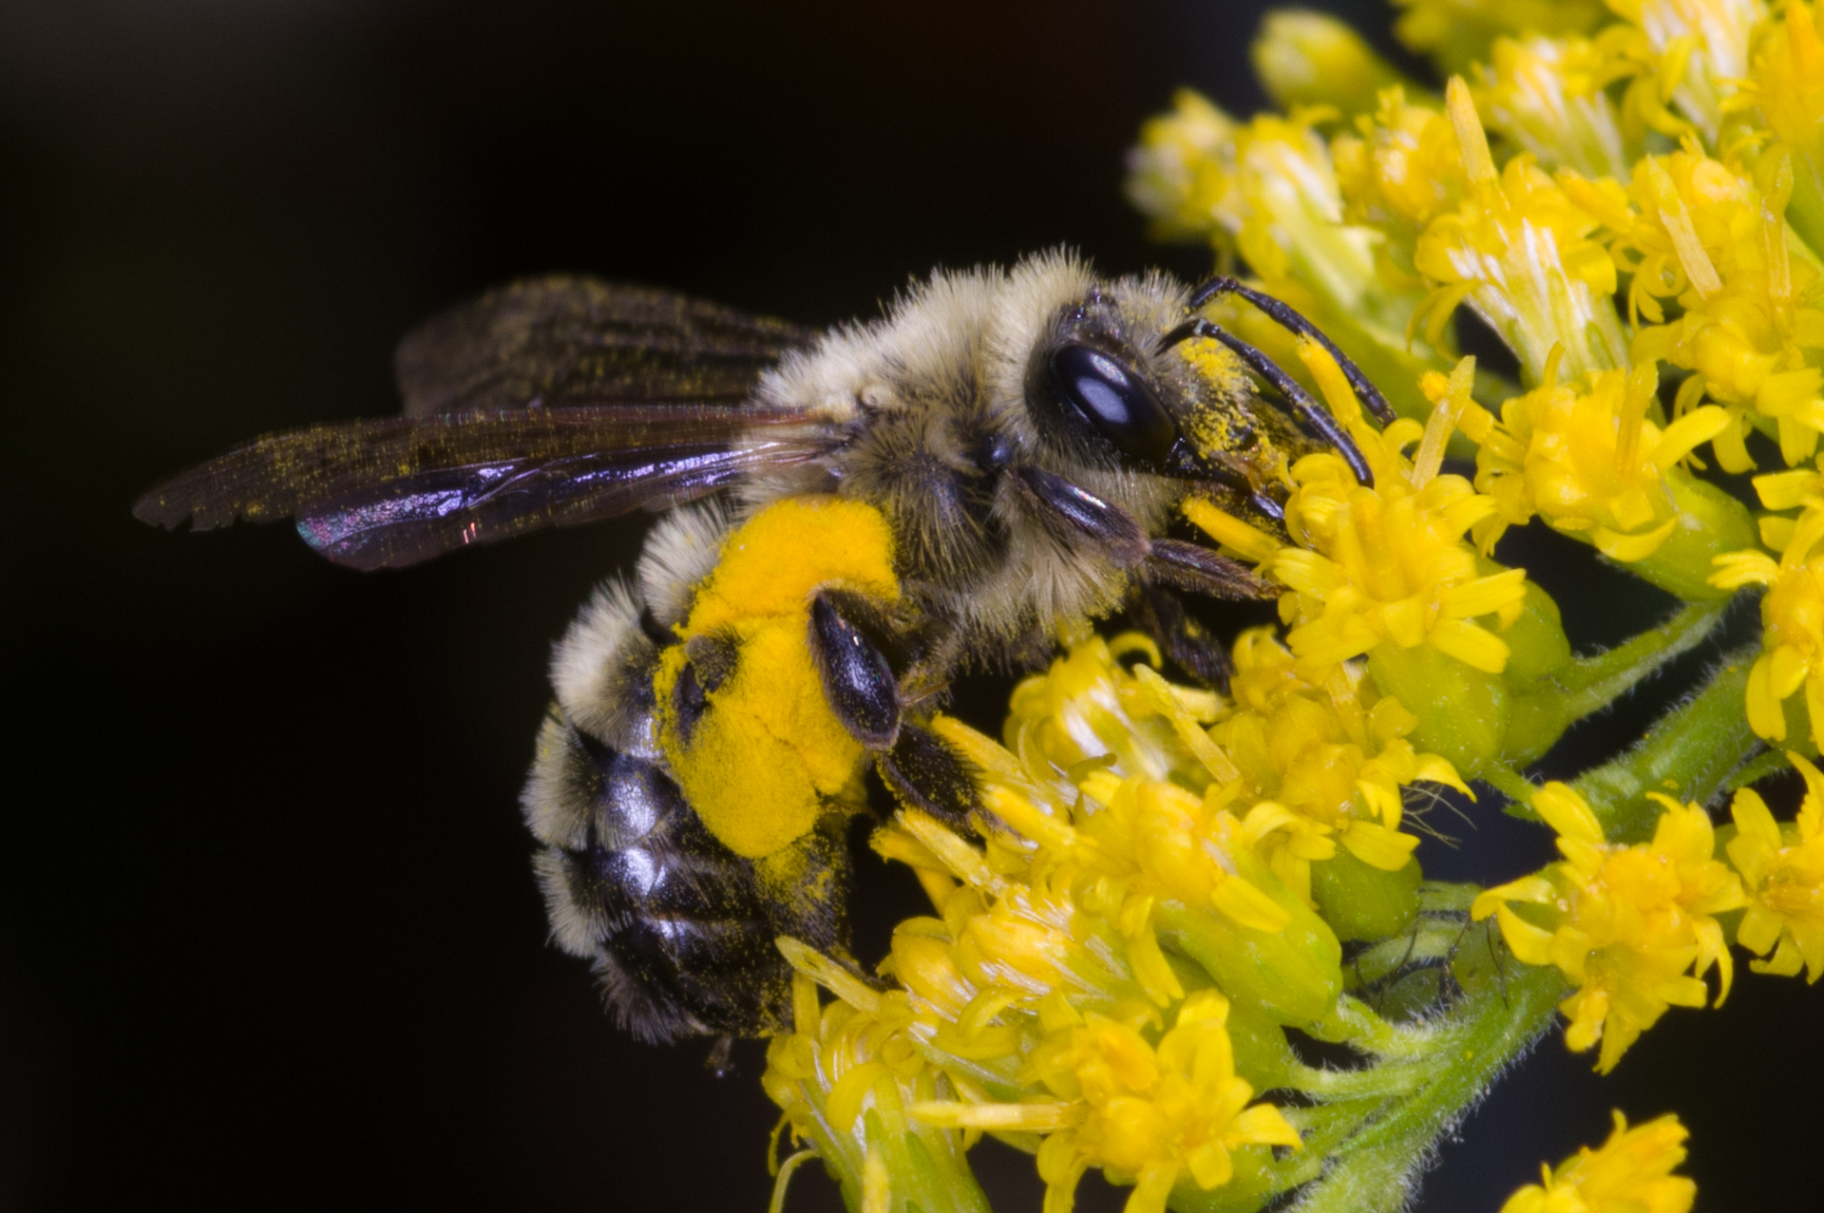
Other confusing bees
Megachile latimanus
Andrena hirticincta
Melissodes sp

Slide 35
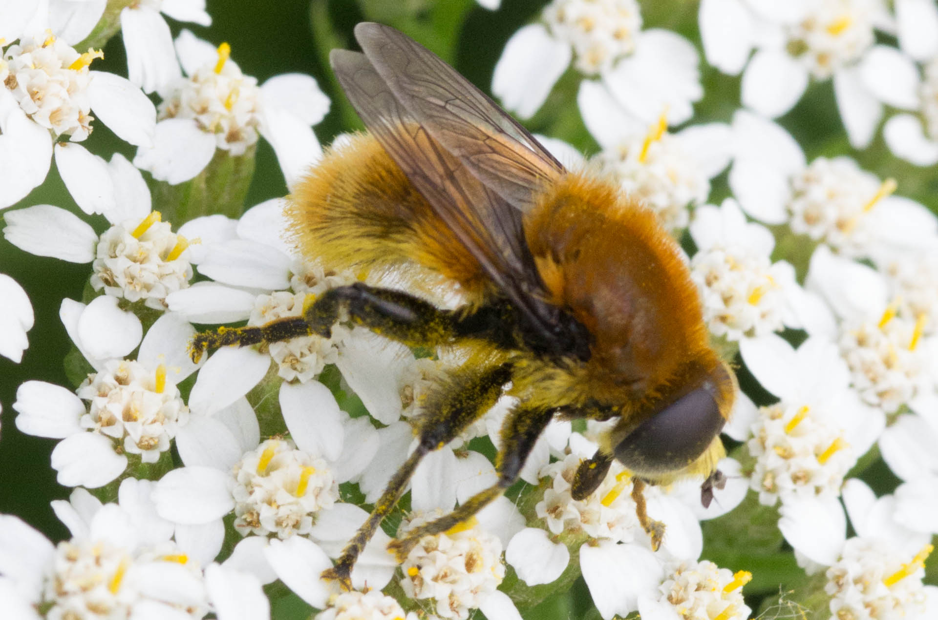
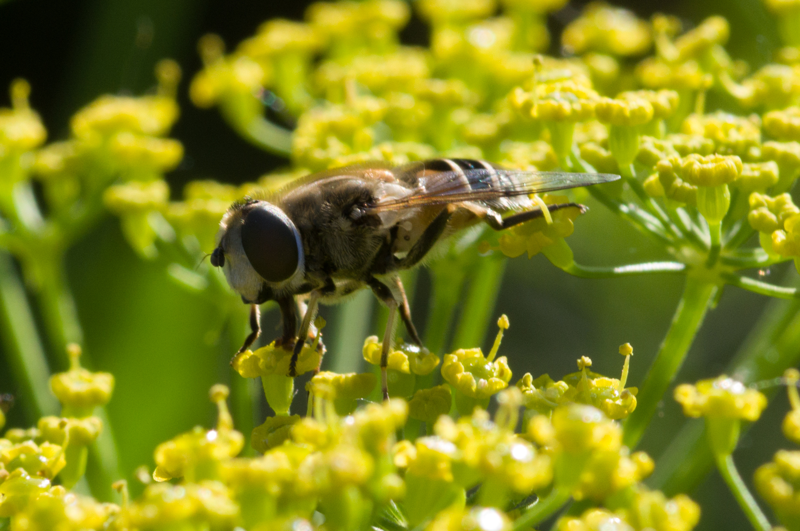
Flies which mimic bees

Slide 36
Threats
Why is Bombus Affinis endangered?
Habitat loss. Industrial agriculture and land use.
Population crash. Once a very common bee..
Health threats. Viruses, mites, invasives.
Global warming. Bumble territory compressing from South.
B. affinis family seems highly vulnerable to introduced diseases. A sister species, B. franklinii, may be extinct. Nosema bombi was introduced via commercially-reared bumblebees. Varroa mites weaken health and immunity.
Endangered means there is still hope.

Slide 38
Challenges for recovery
Fragmented populations across region. Reduces diversity.
Large colony size requires greater territory size.
(200 active workers, est. 1000 per season)
Notorious for well-hidden nest sites.
Short-tongue anatomy competes with honeybees.
Warming climate compresses range.
Pesticide use and land development.
Public confusion and lack of (good) information.

Slide 39
Requirements for development.
We are in a region with documented populations.
Considered sensitive and special requirements apply.
Surveys and ecological assessment are required.
USFWS managing ESA efforts
Involves N. A. Pollinator Protection Campaign.
Conservation of lands and plants required.
Working with landowners and agencies.
Education and outreach.
Active preservation and recovery plans.

Slide 41
USFWS RANGE MAP
This is our responsibility.

Slide 42
Bombus Affinis range overlay with neonicotinoid use.
This class of pesticides are potent insect neurotoxins.
Interference with social behavior and cognition.

Slide 43
What can we do?
Spread the word.
Plant native flowers and trees.
Protect open areas.
Embrace some mess.
Smart pesticide use.
Look and report.
Praise village and private plantings.
Be politically active.

Slide 44
Resources

Slide 45
Web resources
Beespotter
Xerces Society
Native Bee Awareness Initiative
Discover Life
Bug Guide
USDA
IUCN International Union for Conservation of Nature and Natural Resources.

Slide 46
Thank you!

