Slide 1
Digital art installations in museum exhibitions:
“Along the River during the Qingming Festival” and the Cyrus Tang Hall of China
Fermi National Accelerator Laboratory
April 17, 2019
Notes:
20 total slides

Slide 2
Presenter
Deborah Bekken, Ph.D. Adjunct Curator Co-Curator, Cyrus Tang Hall of China Field Museum
Co-Authors
Taylor Peterson, M.A.M. Exhibitions Digital Project Manager Project Manager, Cyrus Tang Hall of China Field Museum
Gary Feinman, Ph.D. Curator Co-Curator, Cyrus Tang Hall of China Field Museum
Lisa Niziolek, Ph.D. Research Scientist Content team, Cyrus Tang Hall of China Field Museum
Lu Zhang, M.A. Assistant Curator Content team, Cyrus Tang Hall of China Art Institute of Chicago

Slide 4
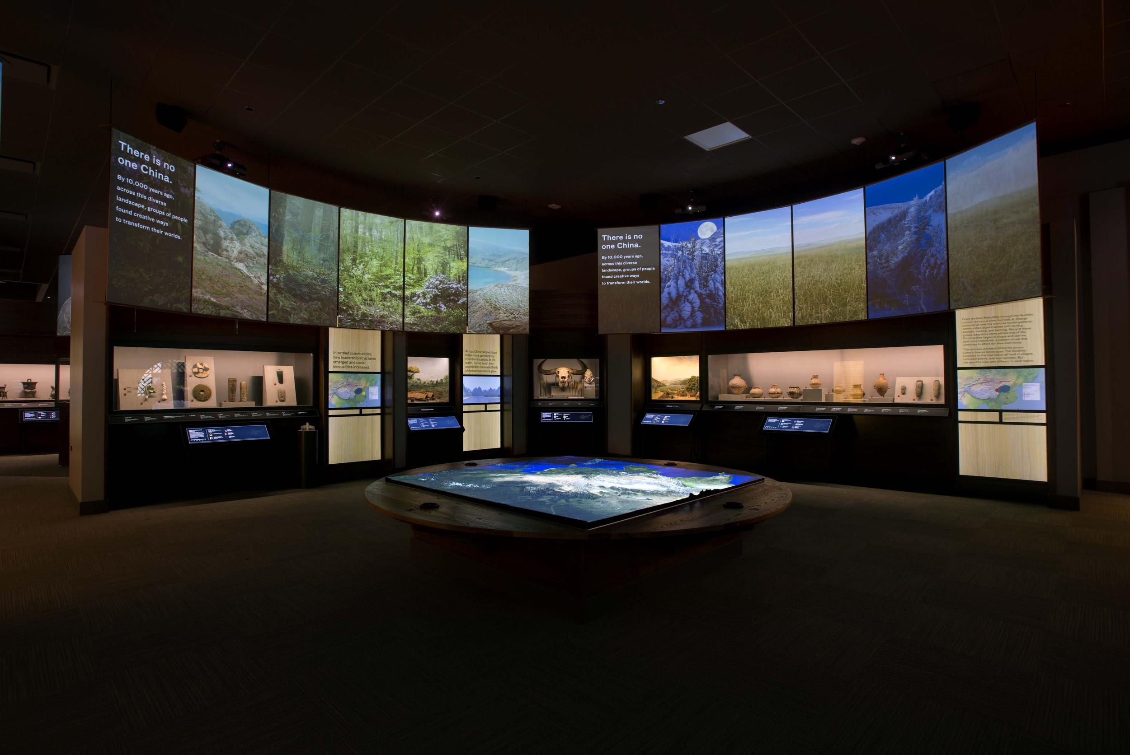
Cyrus Tang Hall of China
Notes:
Who is Cyrus Tang? Chicago business man, refugee from China, philanthropist

Slide 5
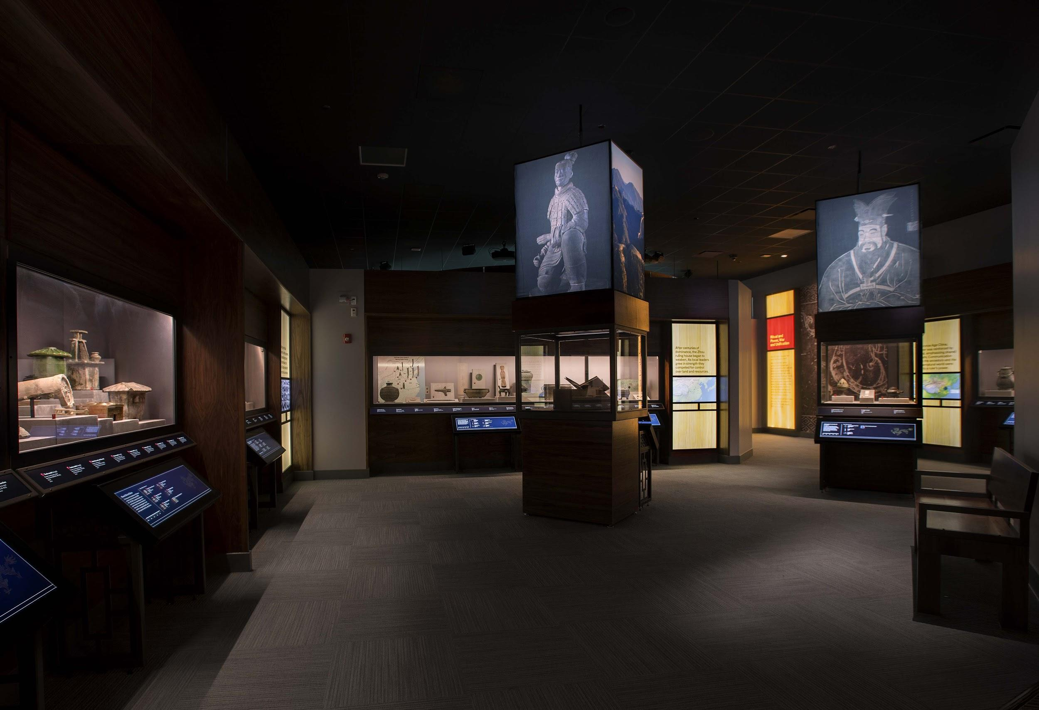
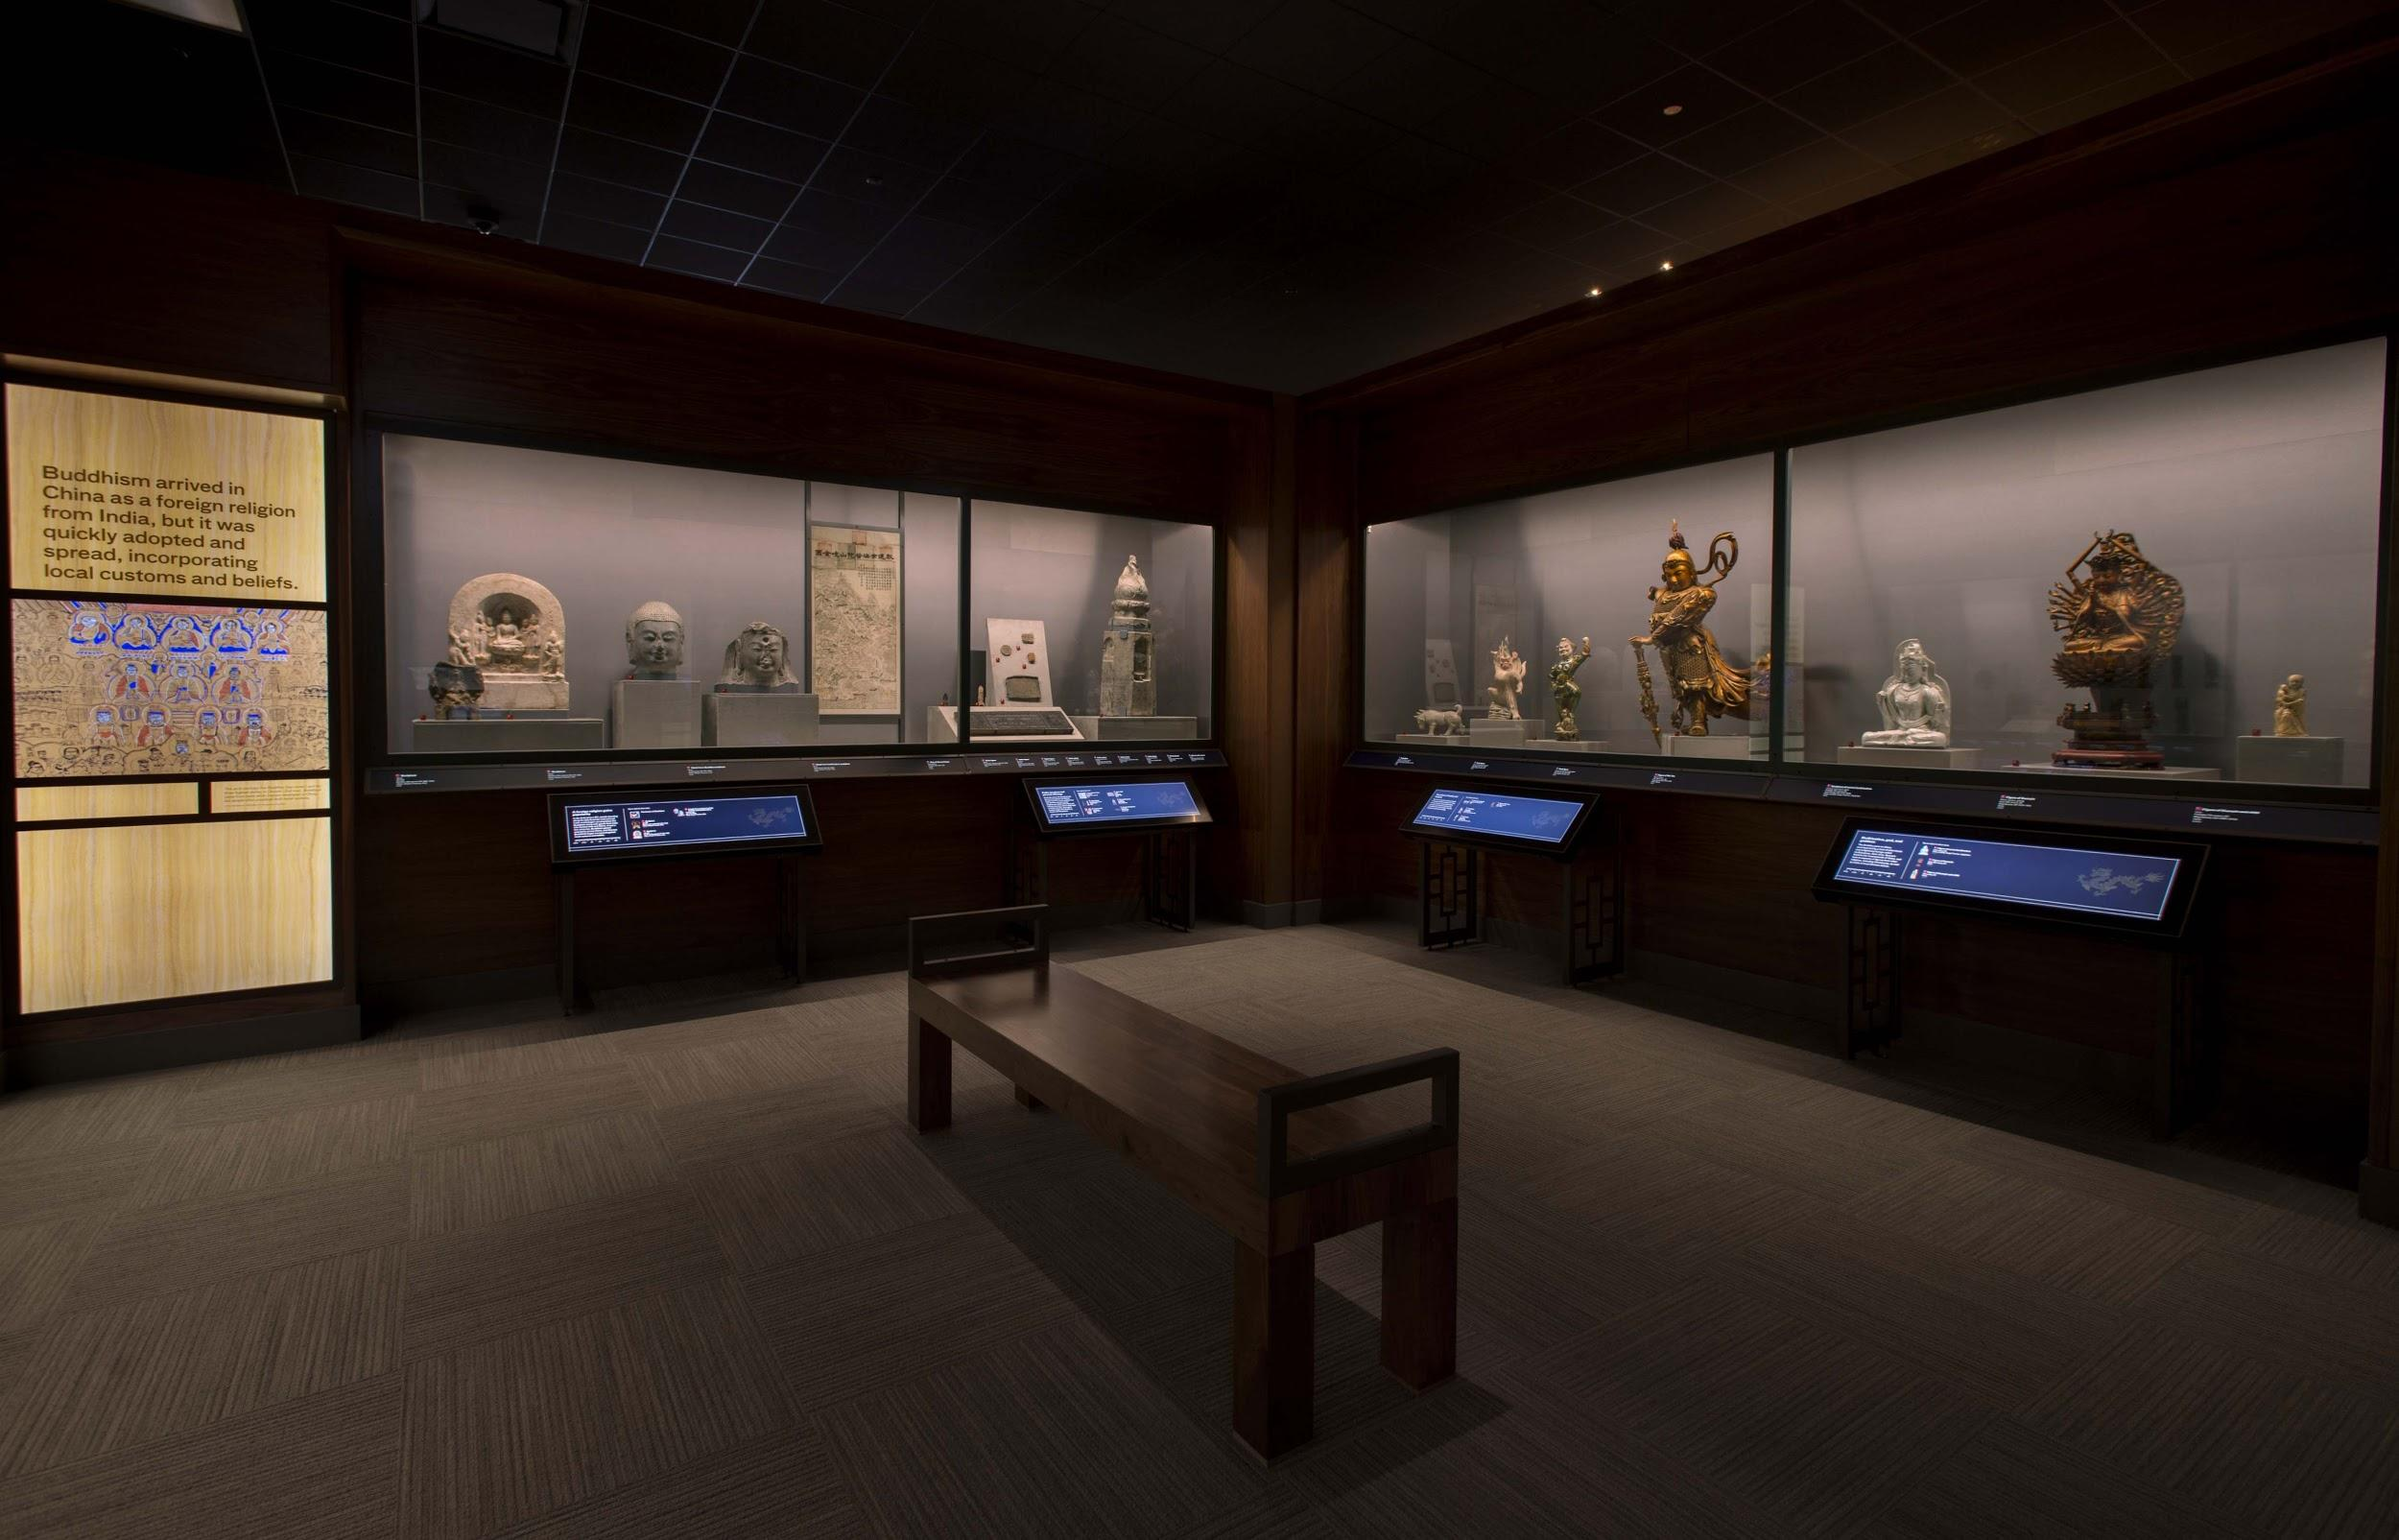
Exhibition overview
Opened: June 15, 2015
Size: 6,000 sq. ft.
No. of objects: 350+
Notes:
With front area and Sue Ling Gin garden extends to 9,000 square feet

Slide 6
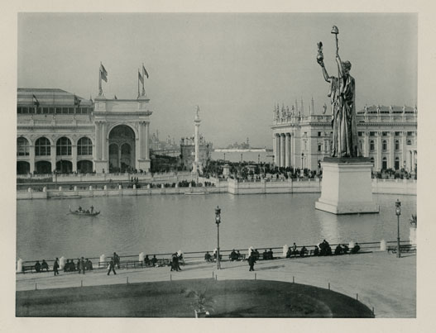
World’s Columbian Exposition
Chicago, 1893
Notes:
Have to begin with the origins of the collections and of the Museum

Slide 7
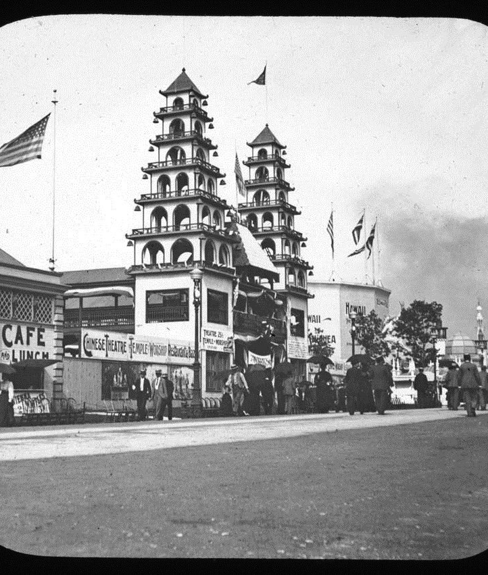
China boycotts Fair
Chinese Exclusion Acts renewed in 1892 through the Geary Act
Qing Dynasty government boycotts Fair in protest against restrictive immigration policies
Local Chinese community develops concession on the Midway via the Wah Mee Corporation, including Joss House, Chinese Theater and restaurant

Slide 8
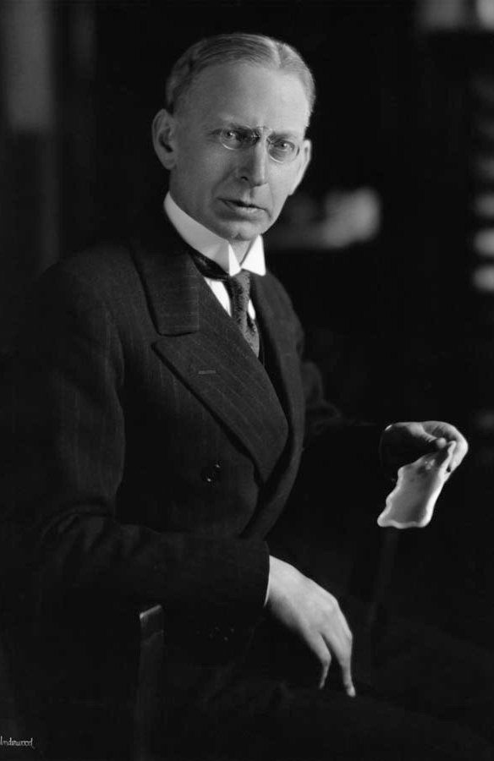
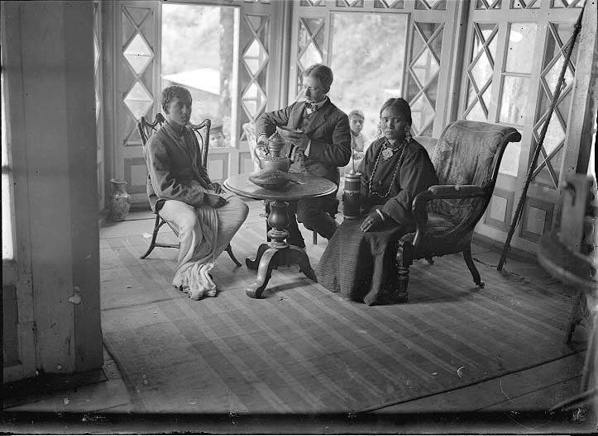
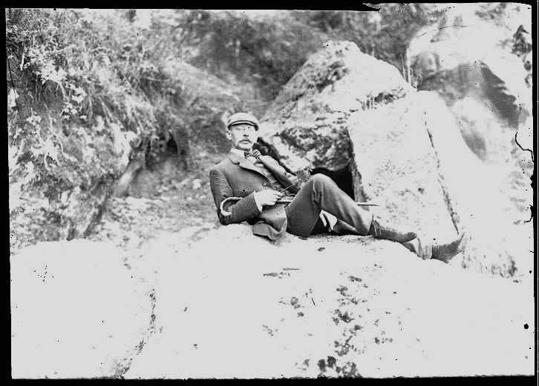
Notes:
Berthold Laufer 1874-1934

Slide 9
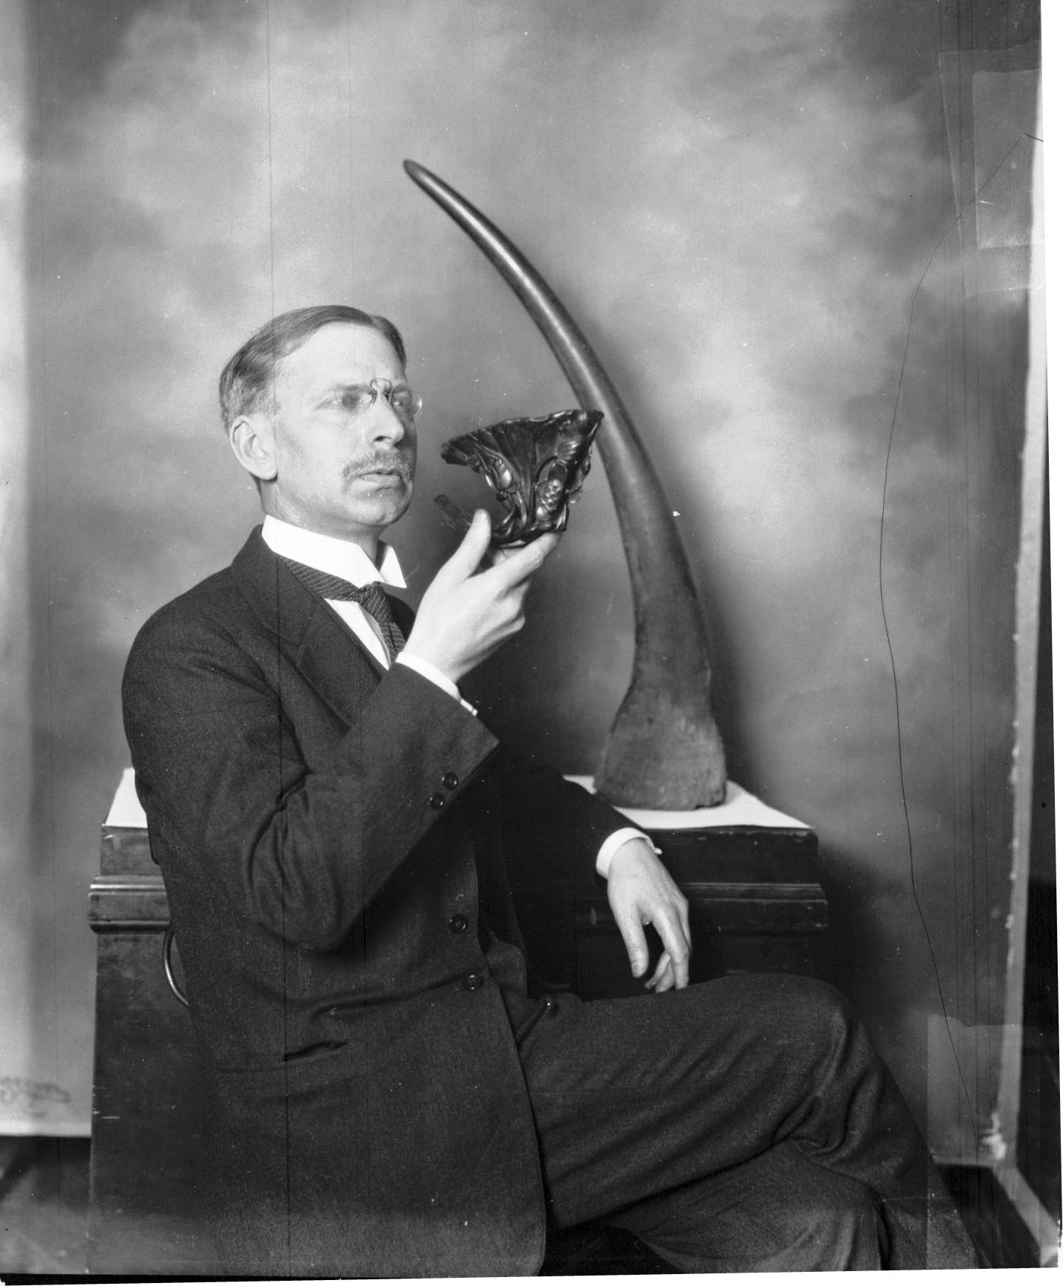
Building the Collection,
Contributions to Research
Berthold Laufer at Field Museum from 1908-1934
Two major collecting expeditions
Blackstone expedition, 1908-1910
Marshall Field expedition, 1923
Approximately 19,000 objects
More than 450 publications
Notes:
Chinese, Japanese, Tibetan, Manchu, Malay -- Russian, German, French, English

Slide 10
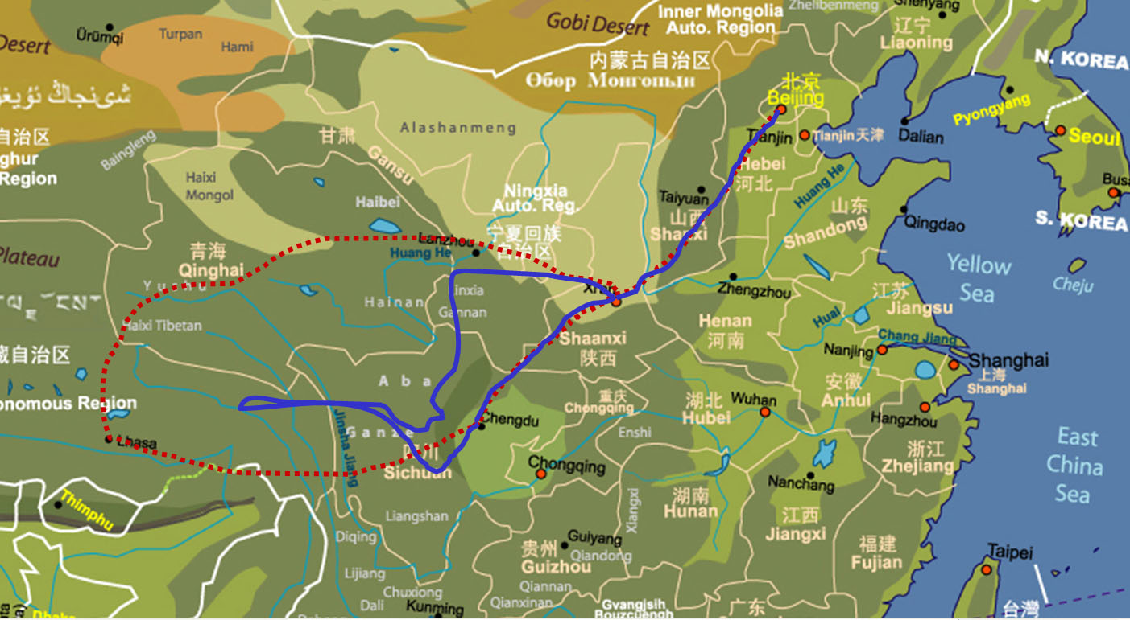
Blackstone Expedition
Planned route and actual travels

Slide 11
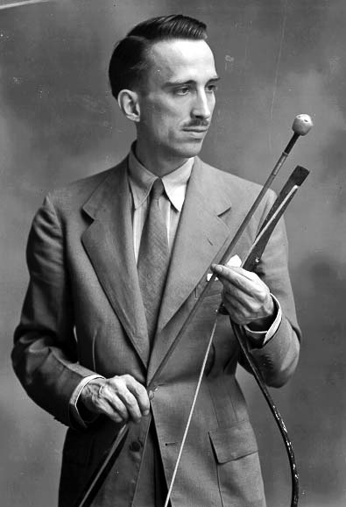
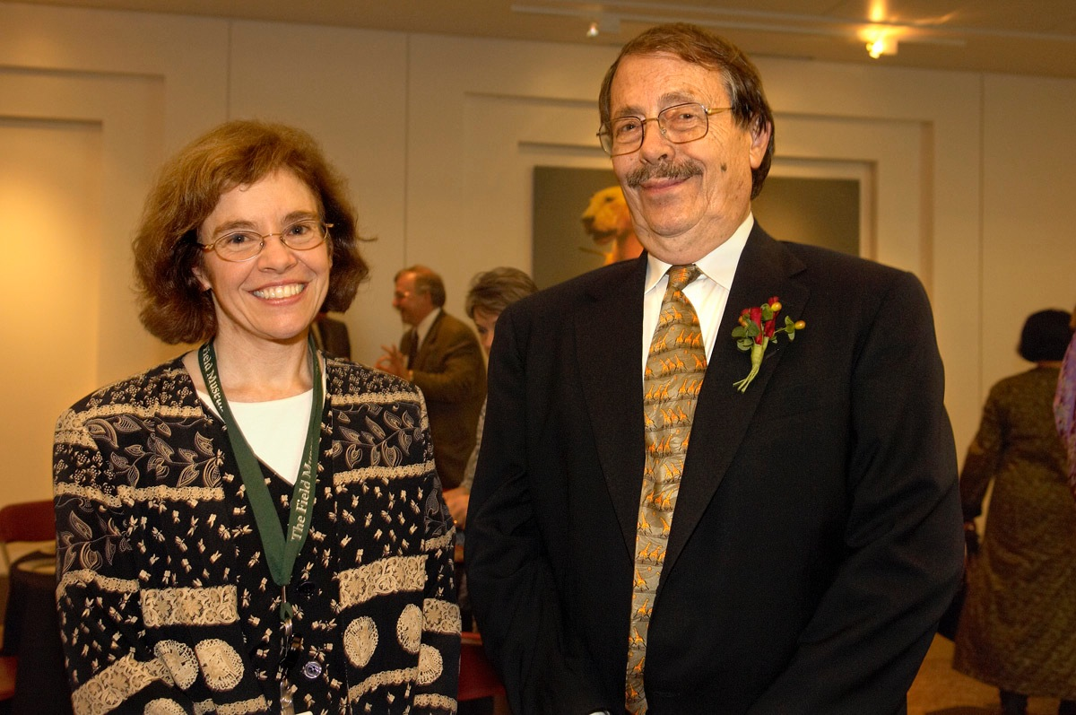
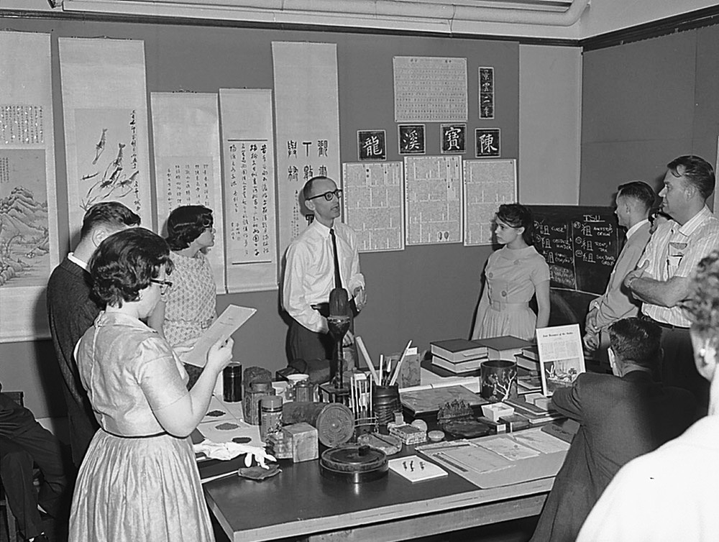

Slide 12
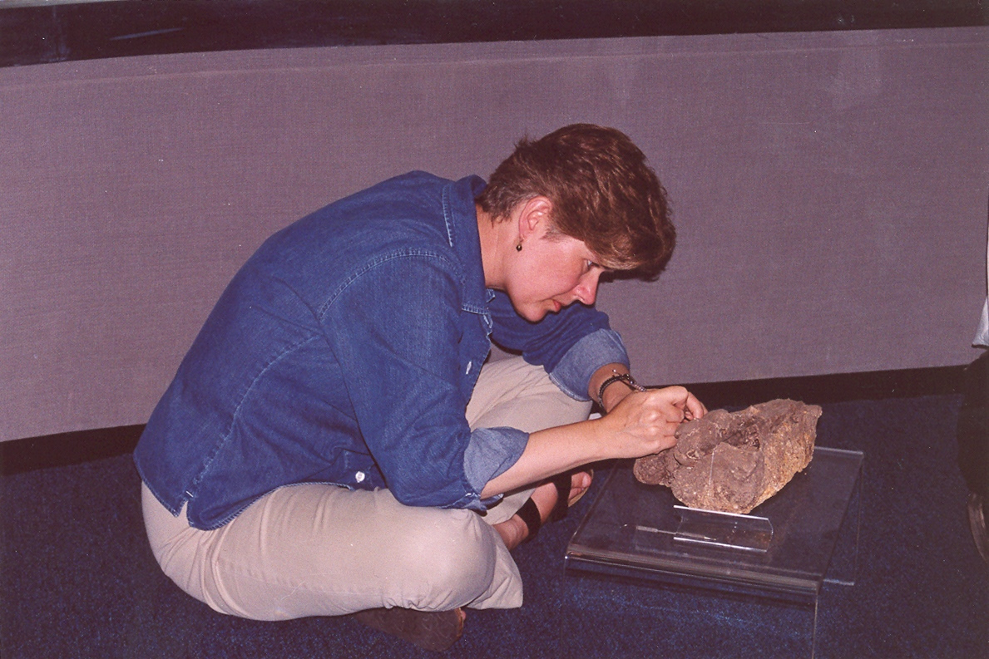
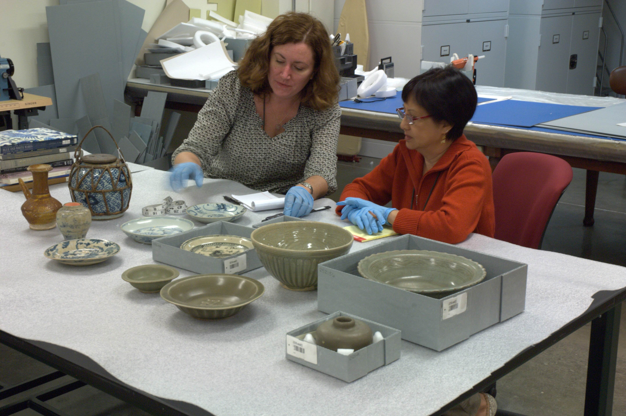

Slide 13
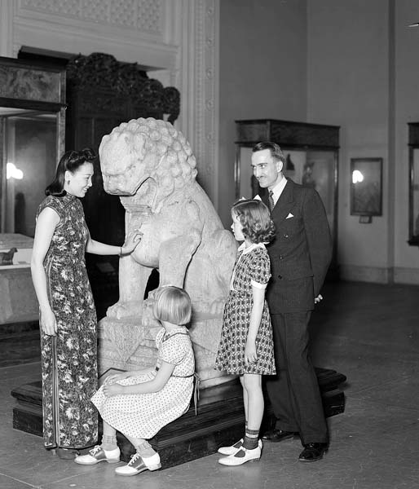
Donations have increased the collections holdings over time
Notes:
Sisters of Heaven
First woman to receive pilot’s license in China (1936)

Slide 14
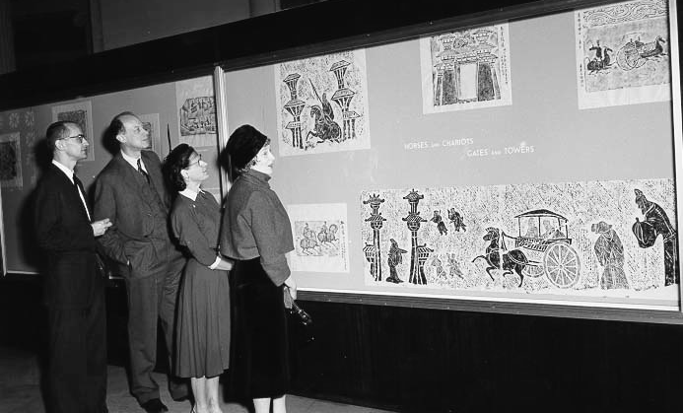
Chinese Rubbings or Ink Squeezes
Approximately 7,000 rubbings

Slide 15
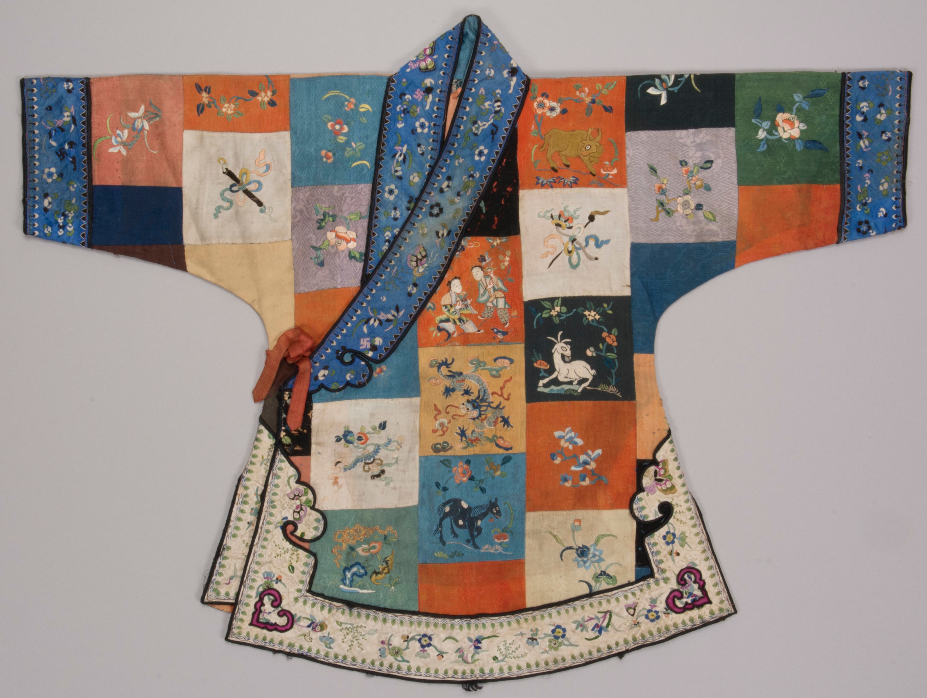
Archaeological and Ethnographic collections
Additional materials have augmented Field Museum collections over the last 100 years
Notes:
Schuster collection of textiles from 30s and 40s

Slide 16
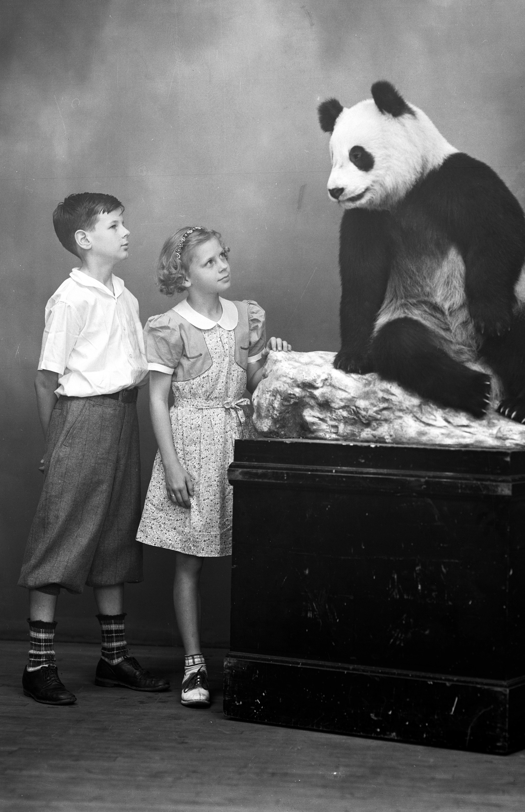
Ruth Harkness and Su Lin
Fashion designer and socialite Ruth Harkness brings first live panda cub to United States in 1936
Su Lin lives at Brookfield Zoo until 1938

Slide 17
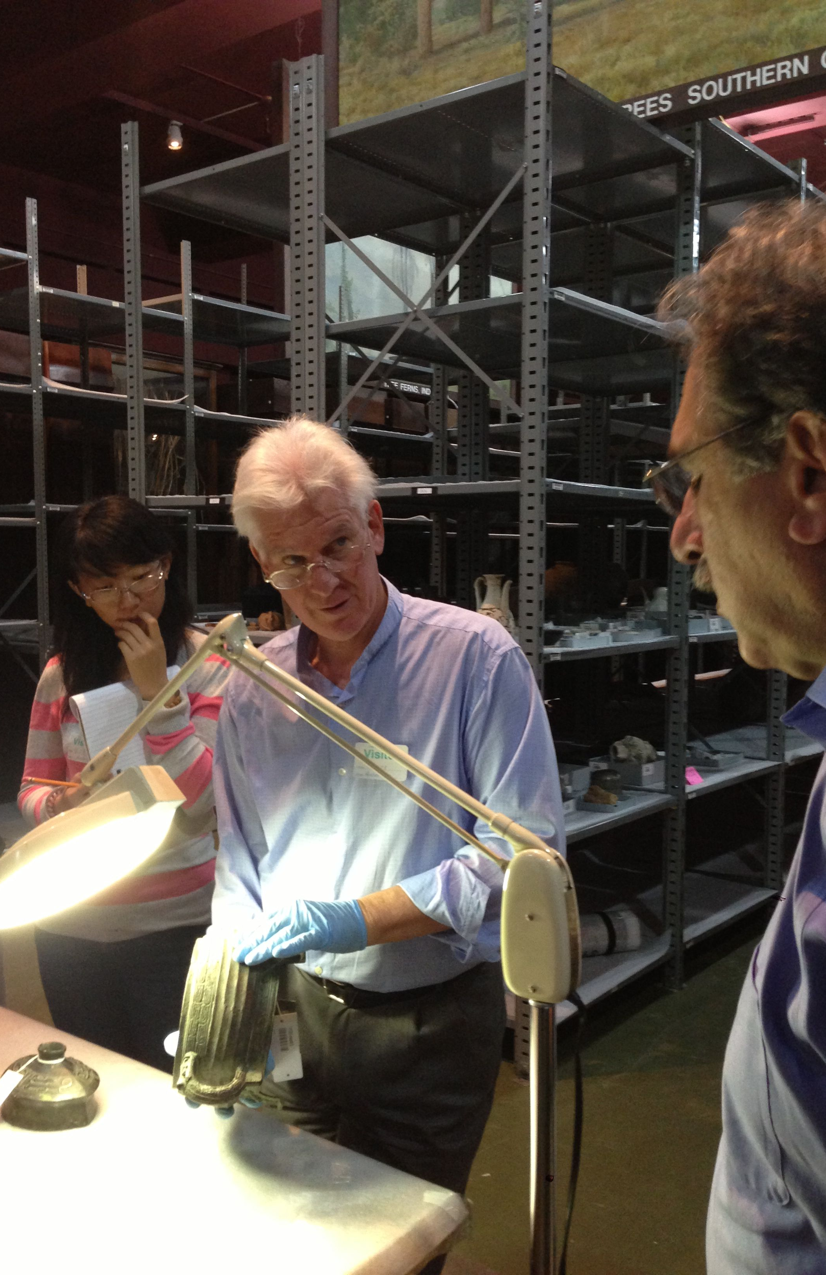
Scholar visits, or, it takes a village to know your collection
To date, more than 75 outside scholars have consulted with Field Museum on various aspects of the collection, and the list continues to grow
Notes:
Evaluating the collections for what we can pull into an exhibition is a complicated process
Why does it take so long for the Museum to build an exhibition?

Slide 18
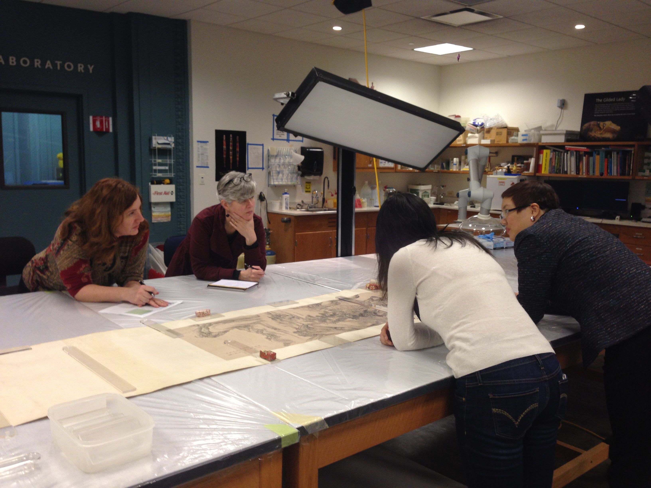
Notes:
Objects on paper and textiles require rotation schedules for long-term exhibitions
Depending on exposure time, must have a deep bench of like items of like size in order to rotate discreet cases

Slide 19
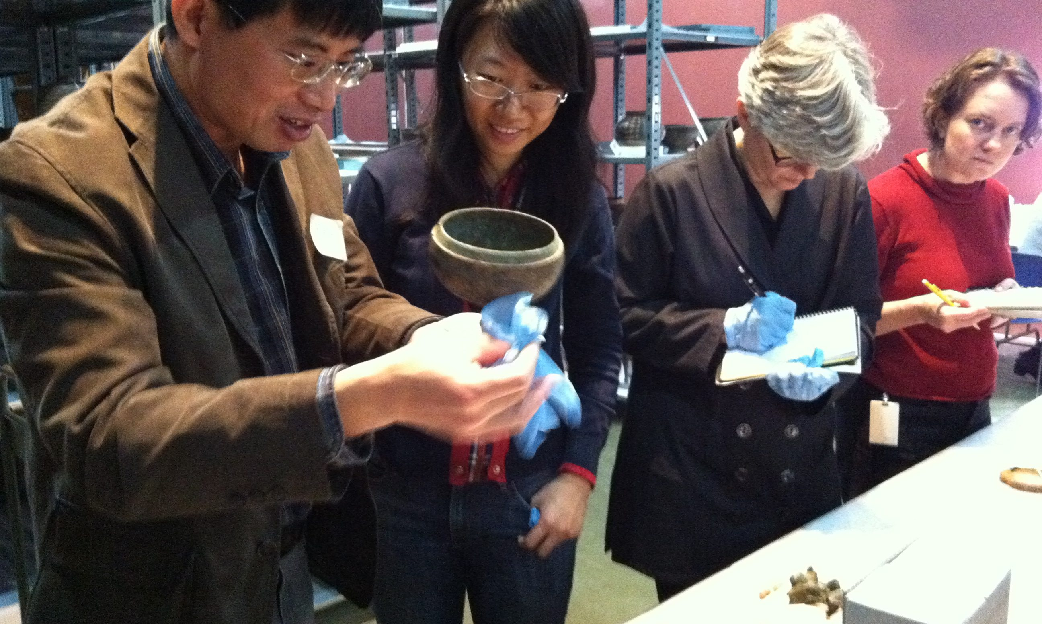
Understanding the past
Ancient materials offer an opportunity to explore the archaeological record

Slide 20
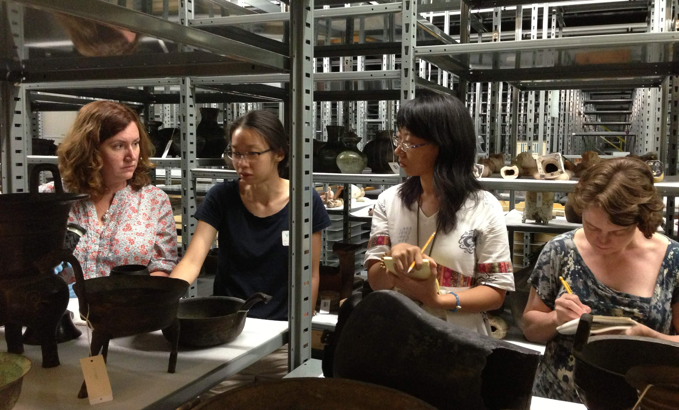
Evaluations from several perspectives
Evaluation of the collection ranges from quality, to representativeness, to authenticity

Slide 21
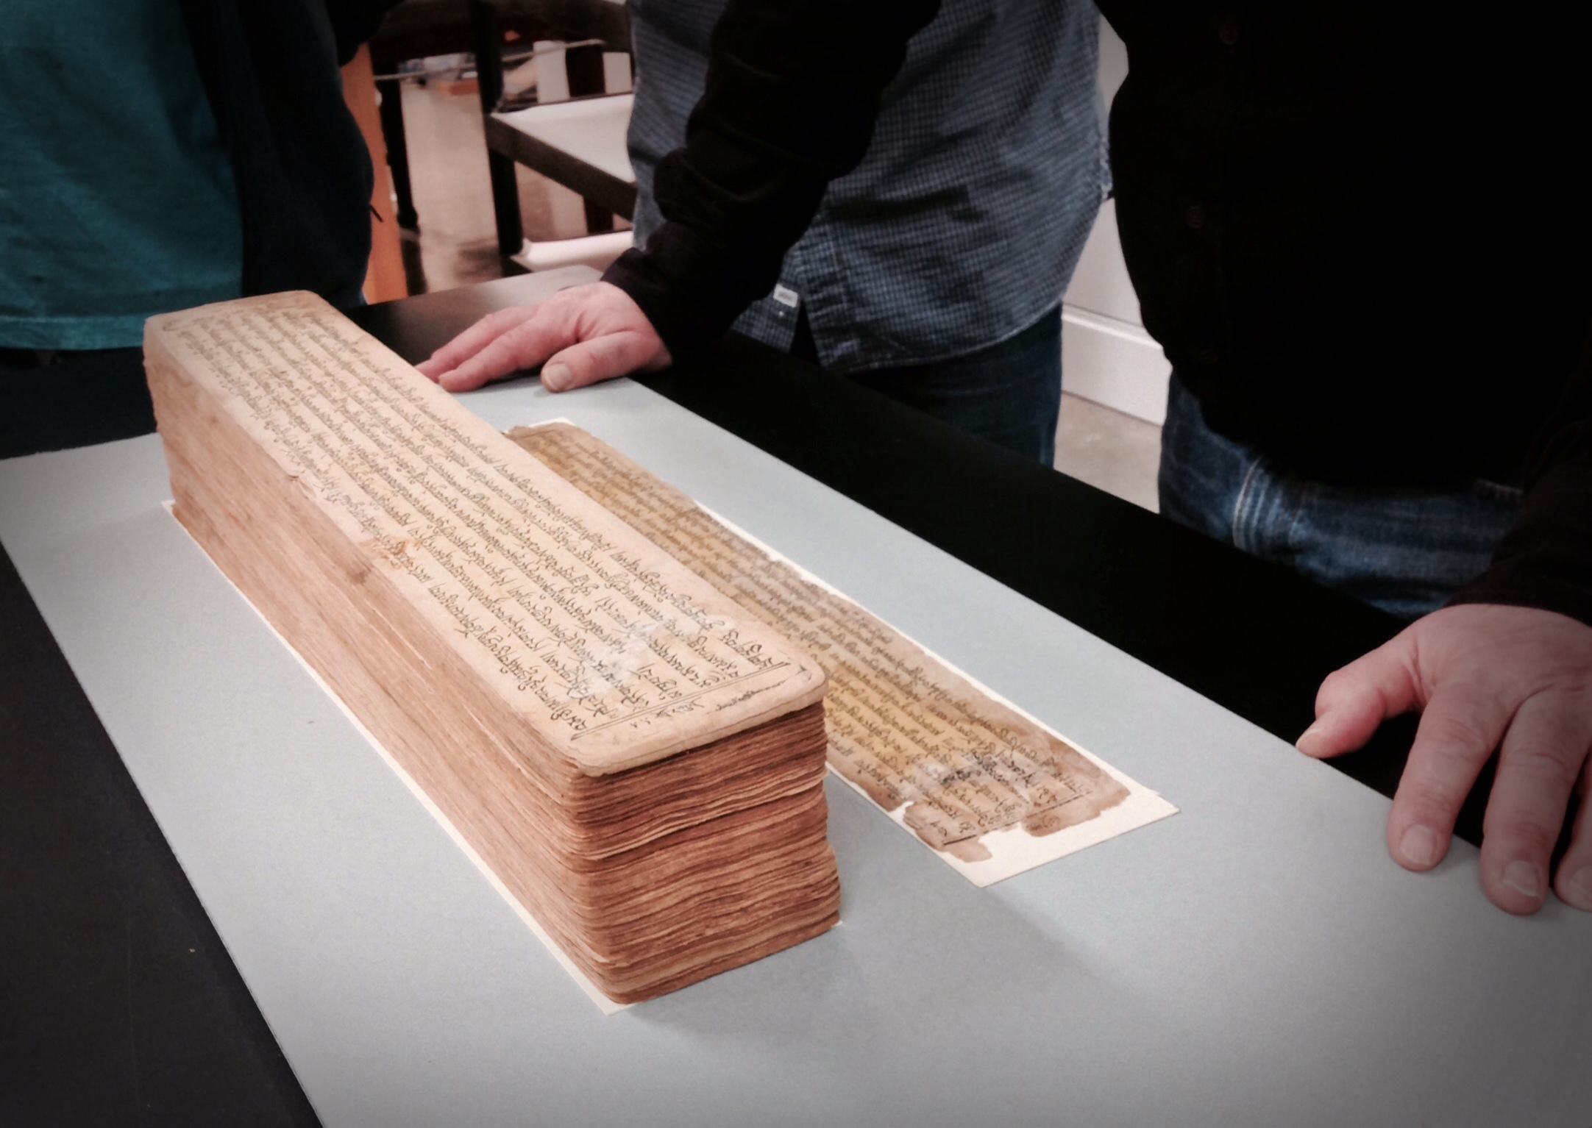
Notes:
Opportunities for students – use of the exhibition as a teaching tool was an aim of the content team

Slide 22
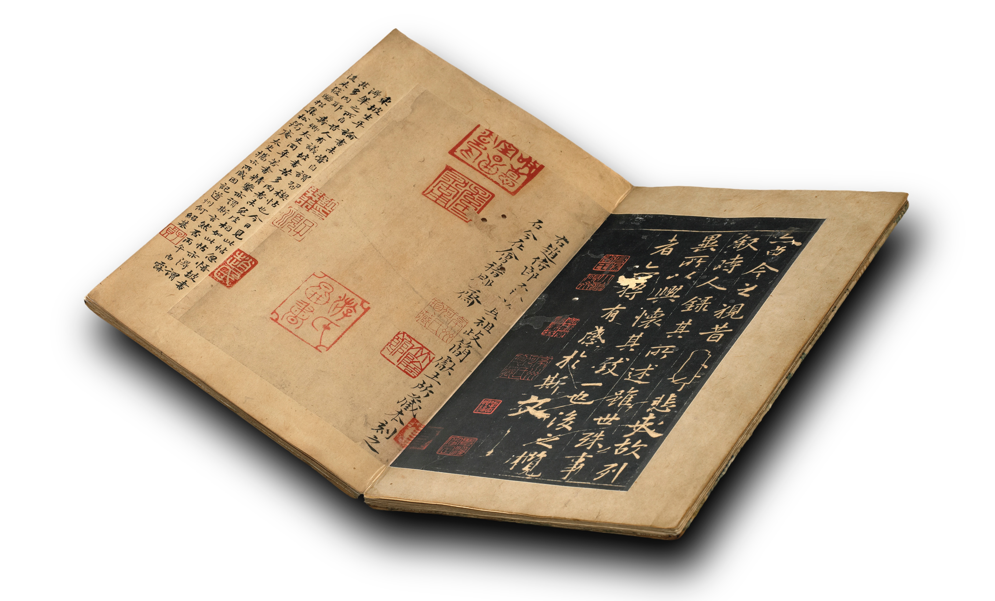
Fitting the pieces together
The Lanting Xu incorporates a story that begins in AD 353 and includes history, calligraphy, connoisseurship (and drinking)

Slide 23
Content Scope
Introduce visitors to thousands of years of Chinese history and culture
Not a strict chronological layout
Overarching messages unify exhibition
There is no one China
The paradox of constant change / continuity over time
Objects have many stories they can tell us

Slide 24
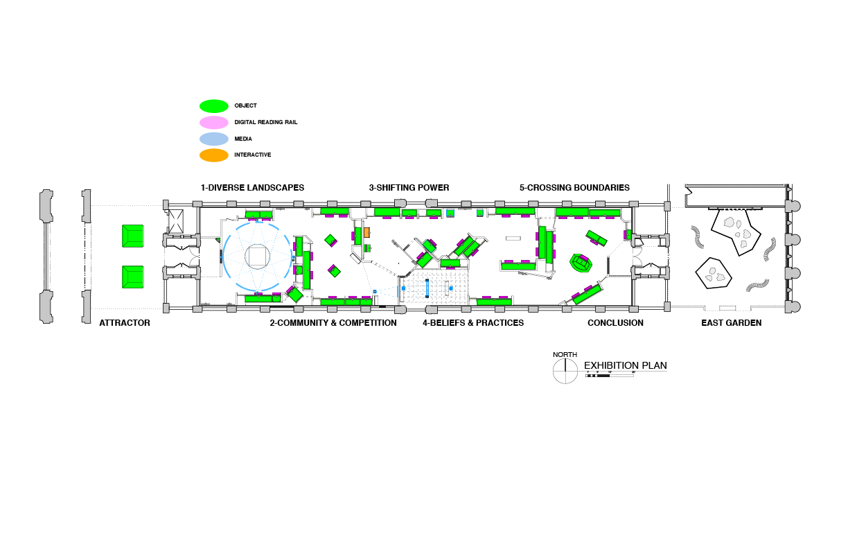
Notes:
QUICK WALKTHROUGH
5,000 years of history across 6 themed sections

Slide 25
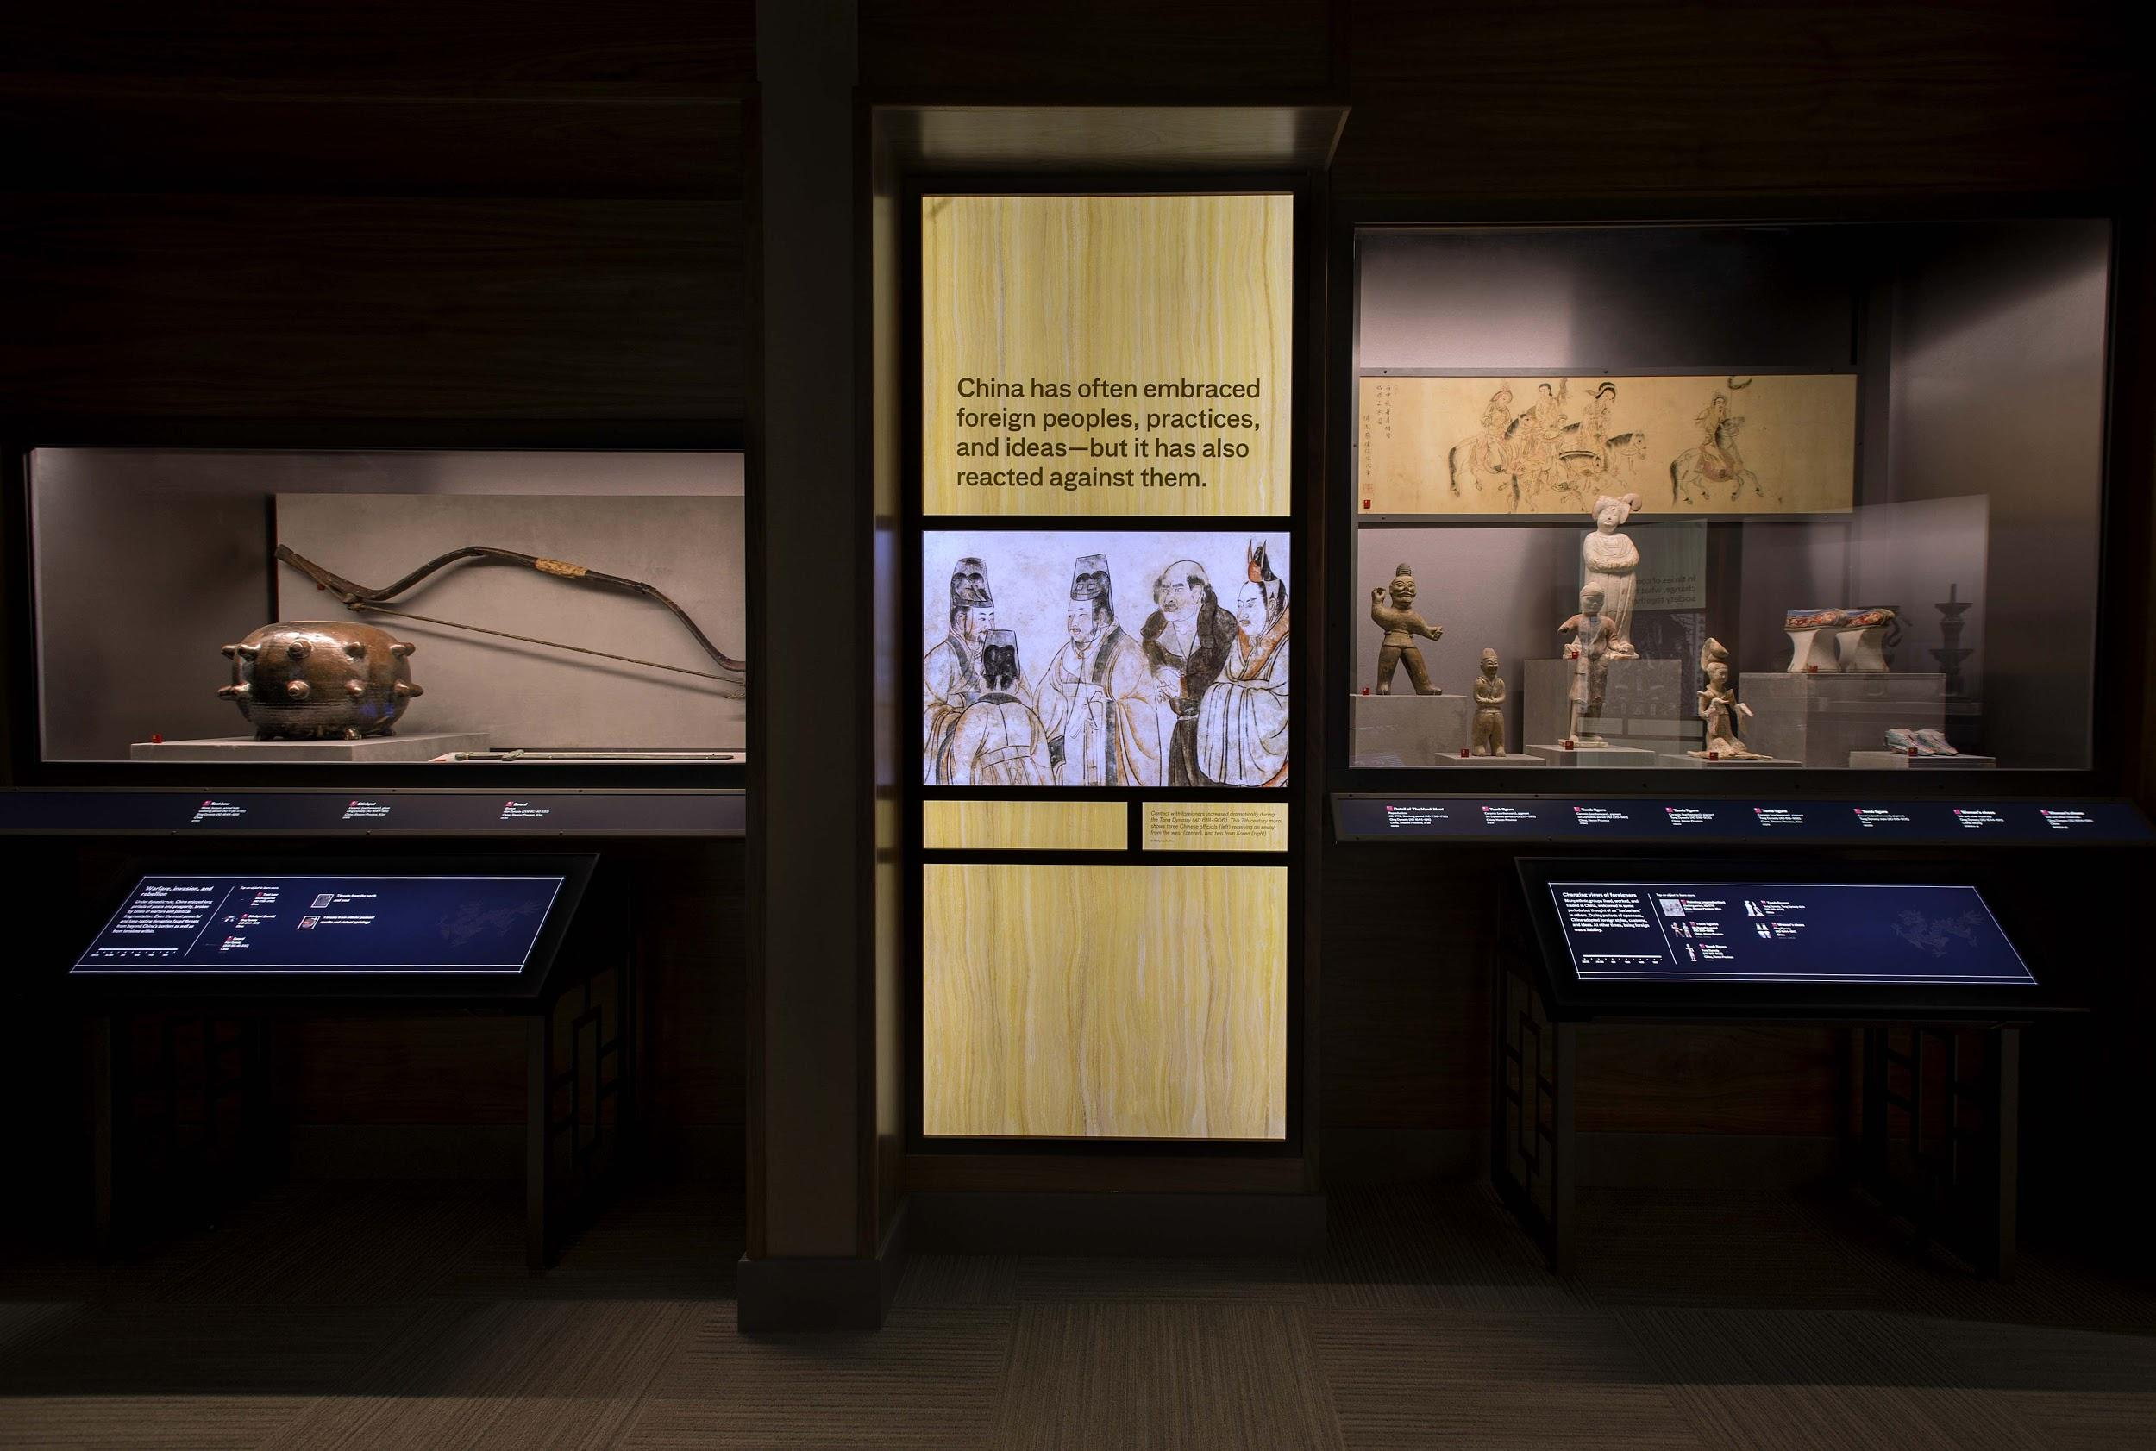
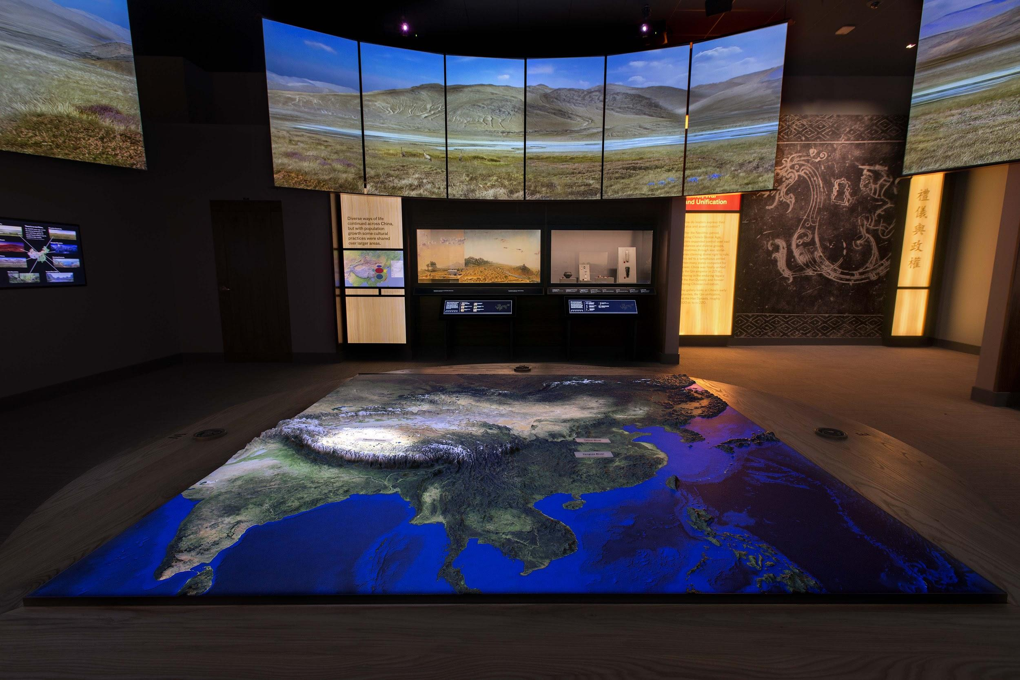
Use of technology throughout
45 digital reading rails (~1/case)
360-degree Landscape Projections

Slide 26
Digital Rail Design

Slide 27
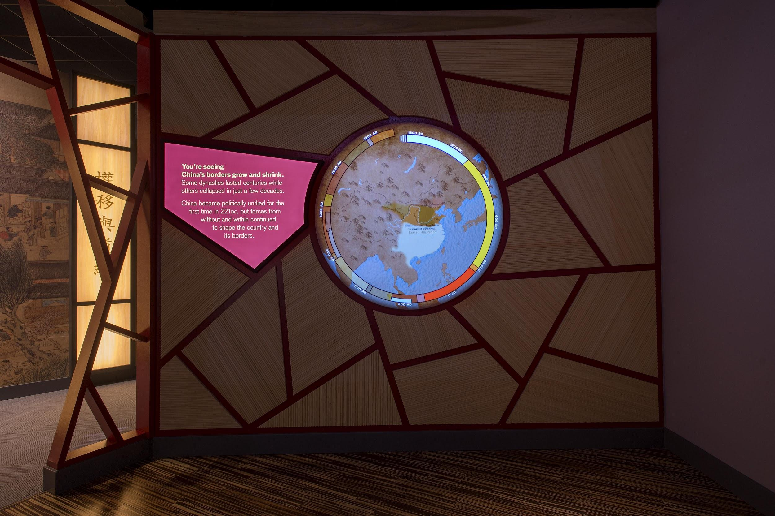
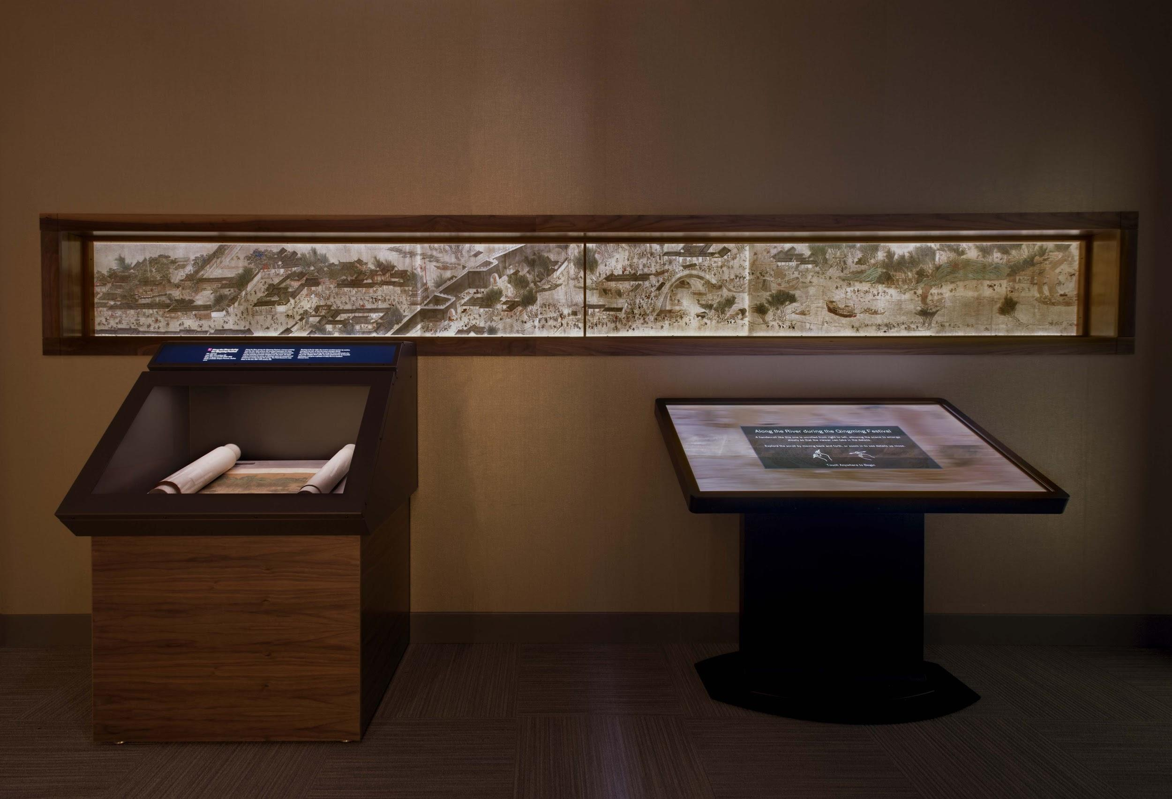
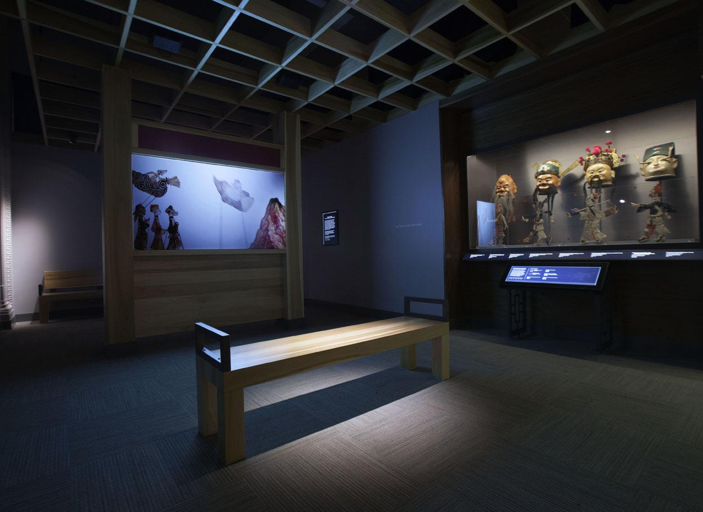
Use of technology throughout
Animated Dynastic Map
Qingming Scroll
Shadow Puppet Theater

Slide 28
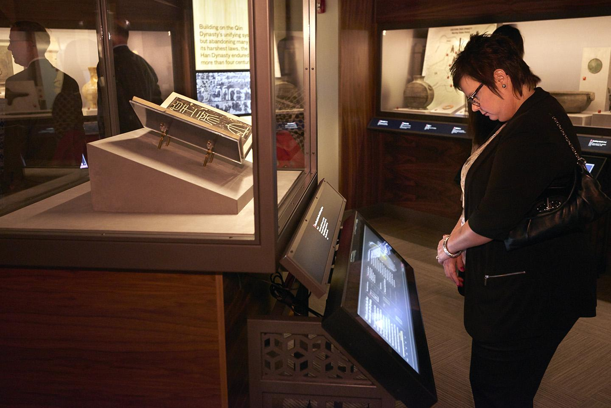
Approach to technology
Should play a supporting role to the objects
Design aesthetic: “fade into the background”

Slide 29
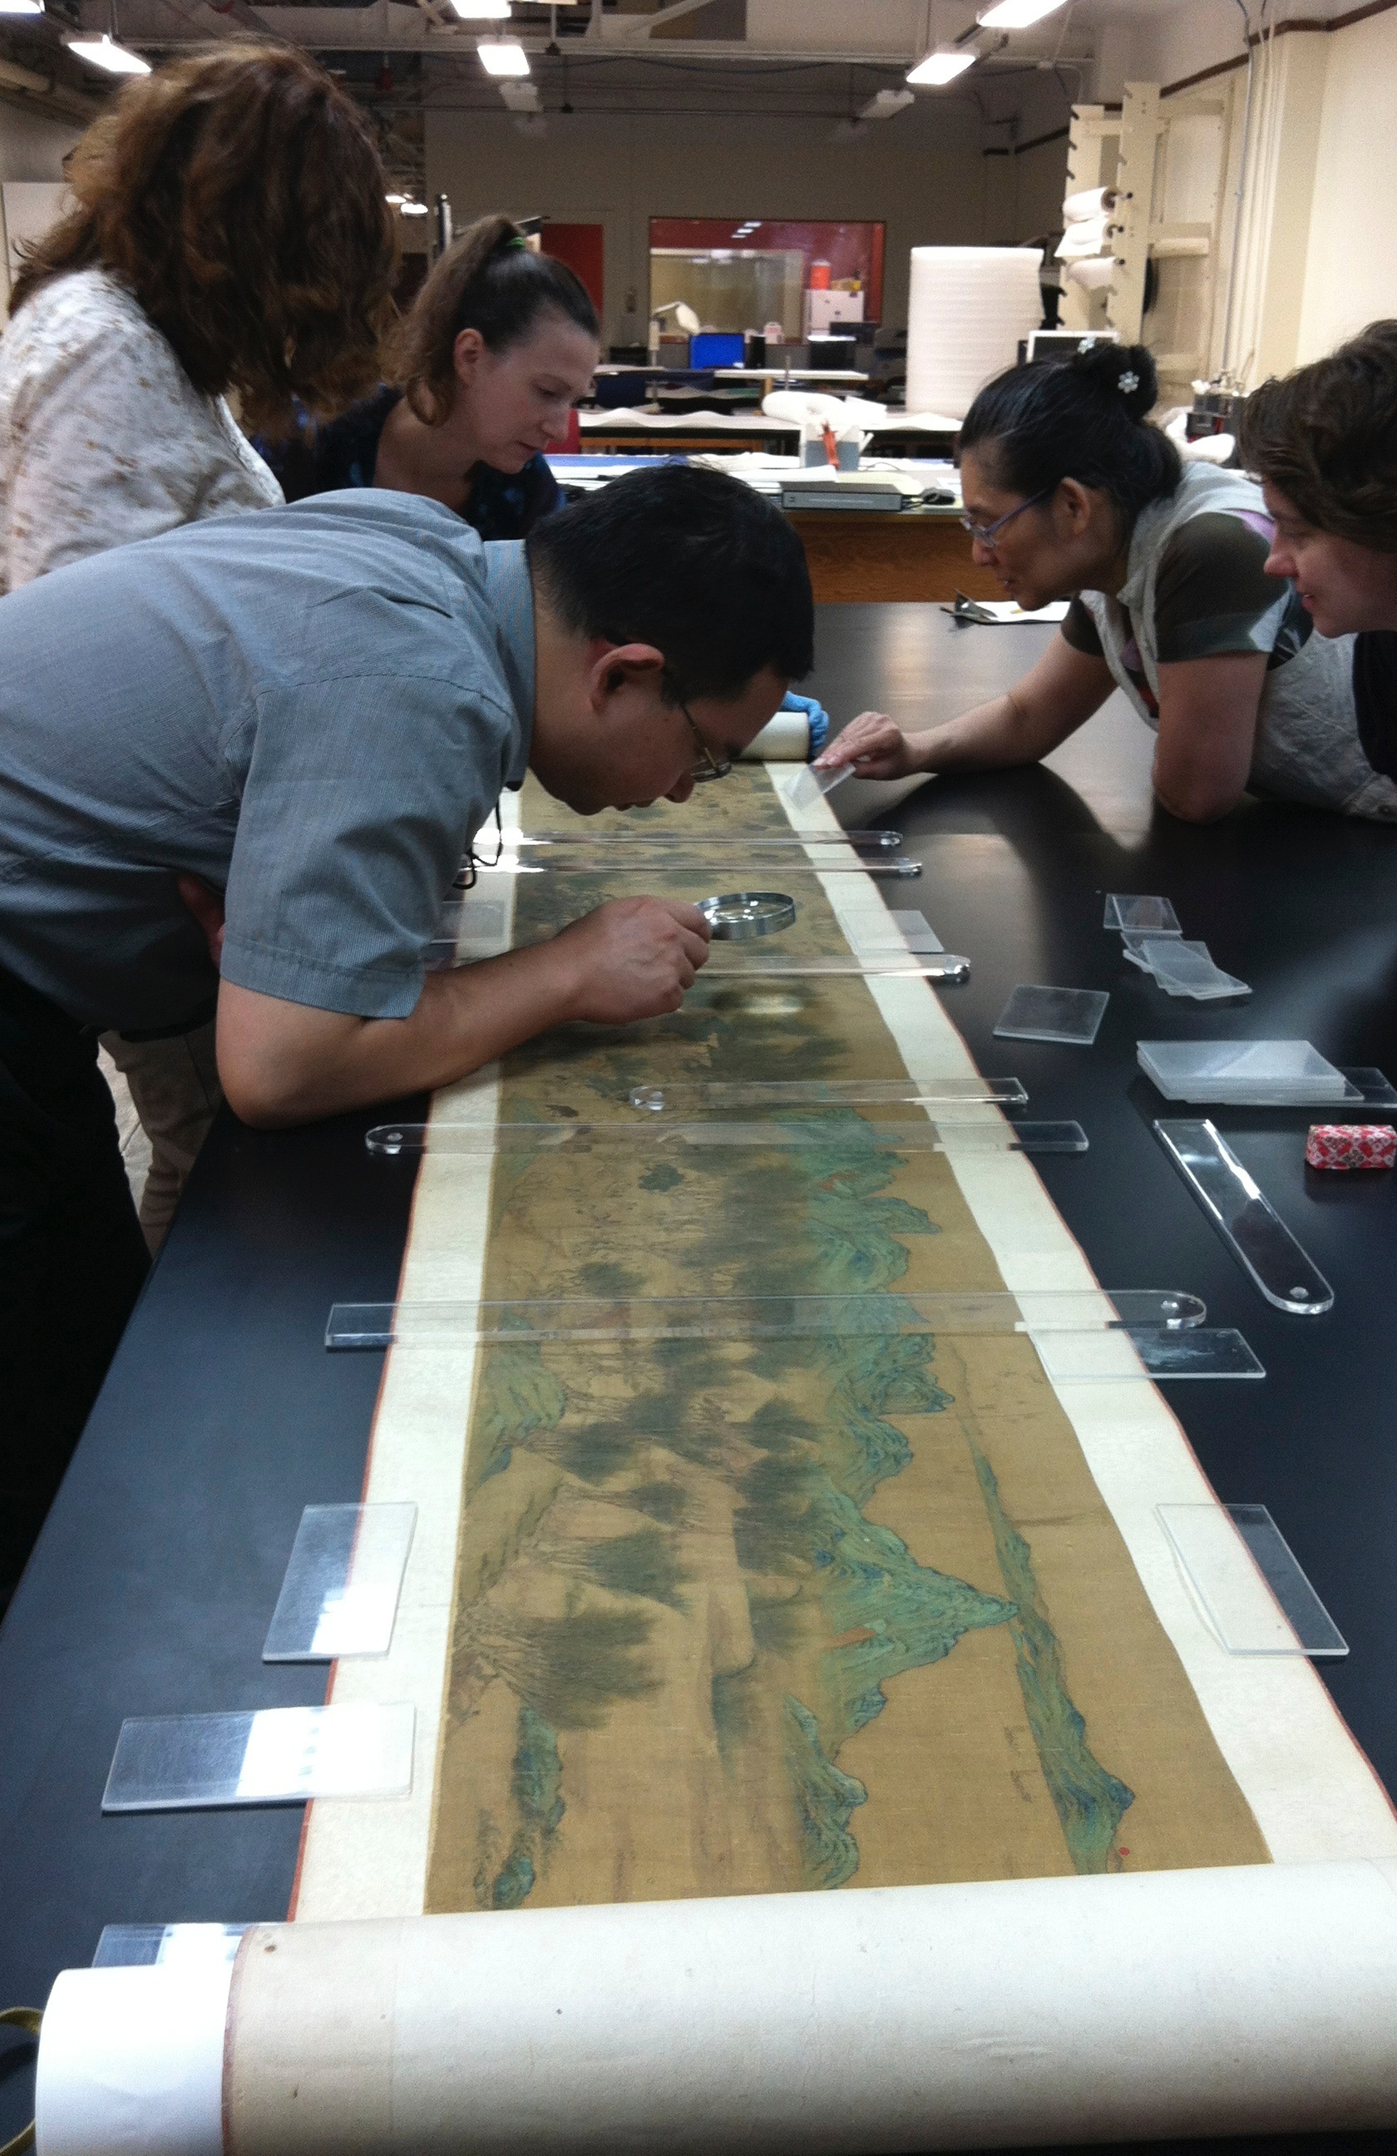
Choosing objects that can illustrate lived experiences
Along the River during the Qingming Festival offers opportunities to explore the activities of daily life as well as the reasons for the creation of the painting itself

Slide 30
Choosing the object for display
Artifact information:
Believed to date to late Ming period
Product of anonymous court painter
Donated to FM in early 1900s along with another scroll painting (“One hundred children at play”)
Why this one?
The topic is relatable, contains rich imagery & offers visitors access to scenes of daily life
Positioned at entry point to Gallery 3 (political cycles, social structures, community)

Slide 31
Notes:
Zhang Zeduan (1085-1145) Song Dynasty painter influential in Shan Shui school of landscape painting
Rainbow bridge scene famous for the original in which sailors racing to lower mast ahead of passing under the bridge

Slide 32
Along the River during the Qingming Festival
Content and display strategy:
Scroll
Lightbox (80% of image)
Touch table
Why digital?
Authentic visitor experience (visitors see handscroll in partial view)
Inherent sense of completeness in user experience
FM visitor evaluation reveals open-ended exploratory experiences are highly successful
Notes:
Scroll case = open to one scene at a time; case has approach lighting
Lightbox = serves as attractor but visitors can also see images up close if table is being used
painting as it was seen/used by Chinese scholars

Slide 33
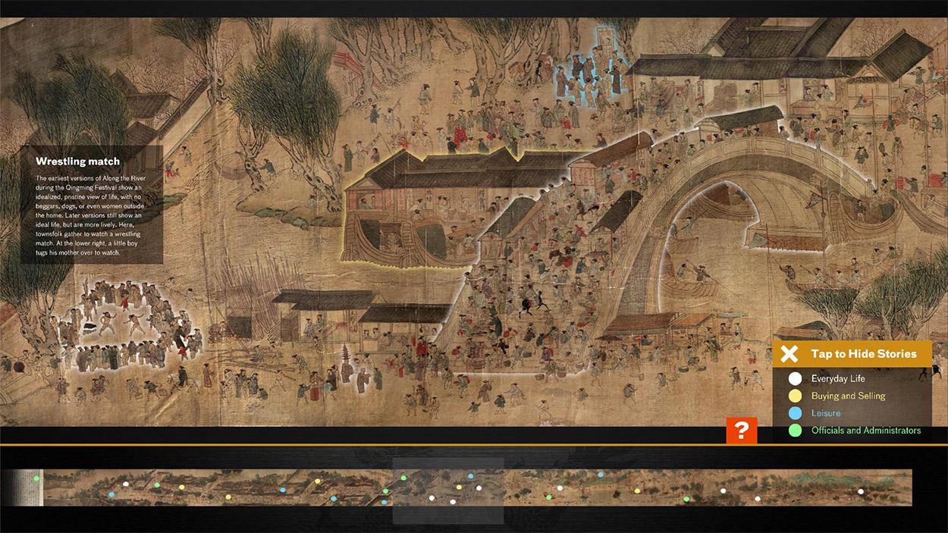
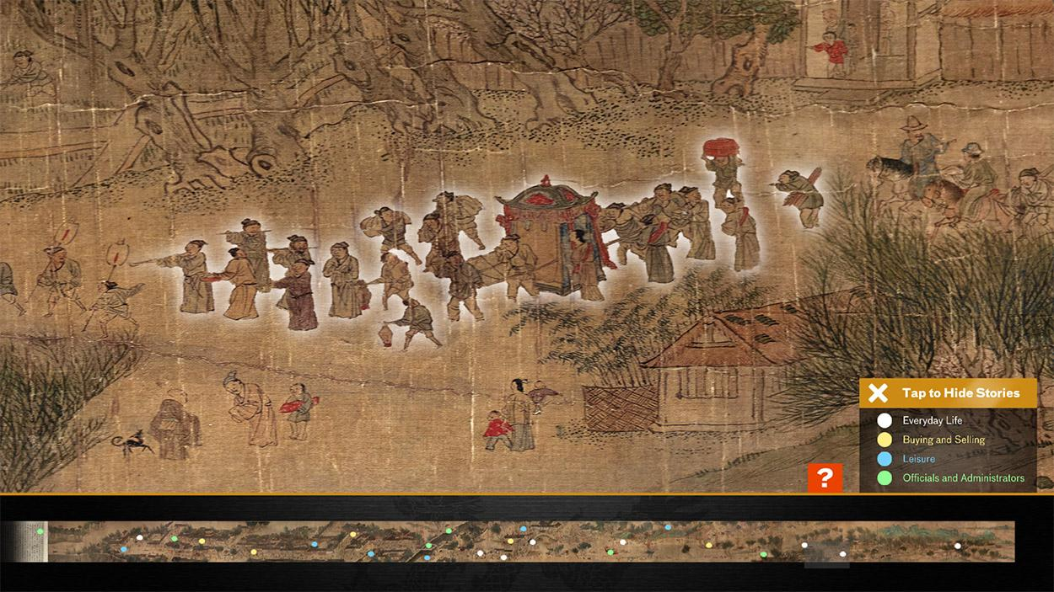
Touch table features
View full 27-foot image + colophons
Zoom in/out + navigate via “mini map”
Embedded label copy activated by hotspots

Slide 34
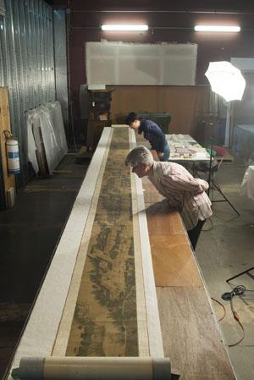
Digitally imaging the Qingming scroll

Slide 35
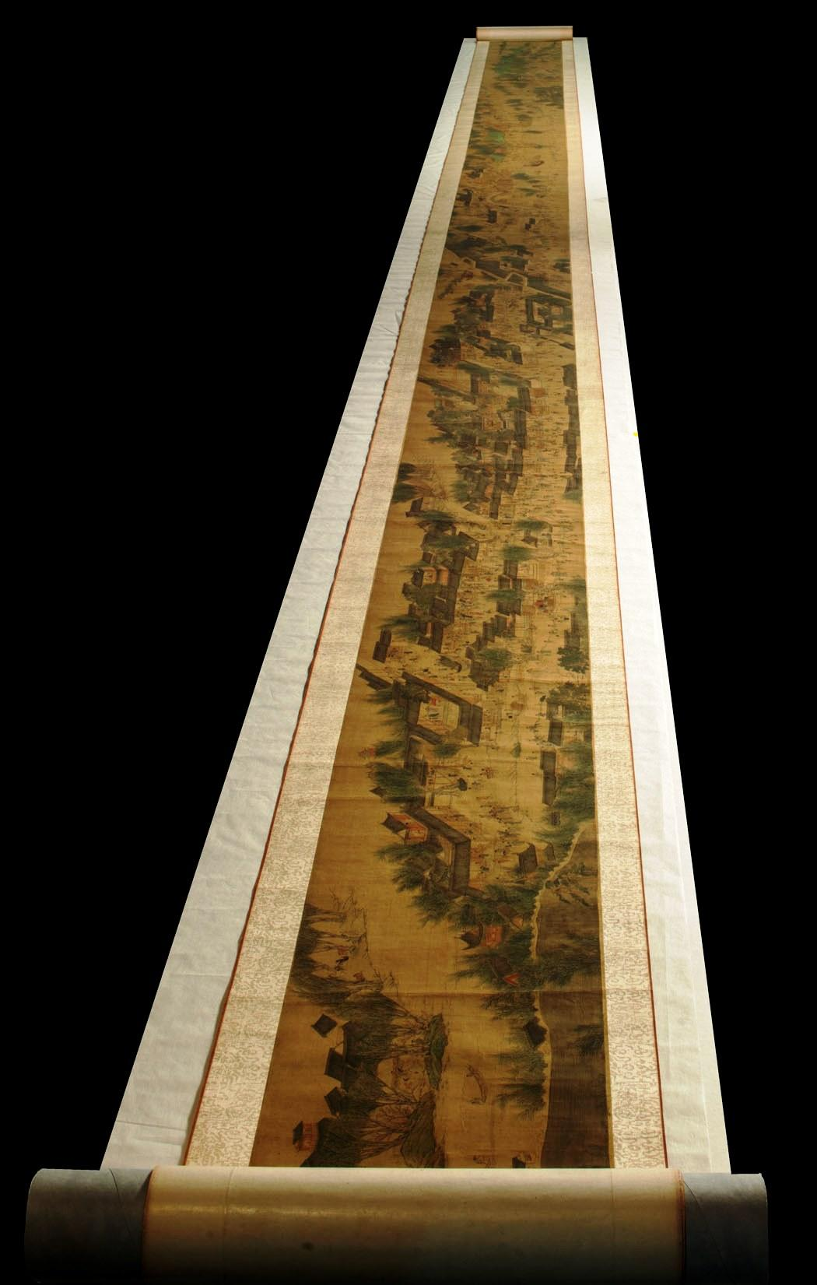
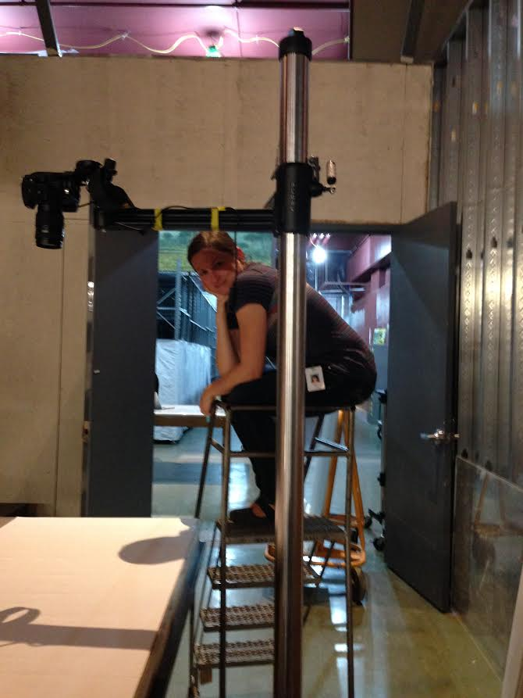
Challenges
Conservation
High-resolution imaging
Team built custom 36’ table & camera rig
2.3 GB images sliced into 66 sections
Custom photo editing & stitching
File transfer from photographer to programmer

Slide 36
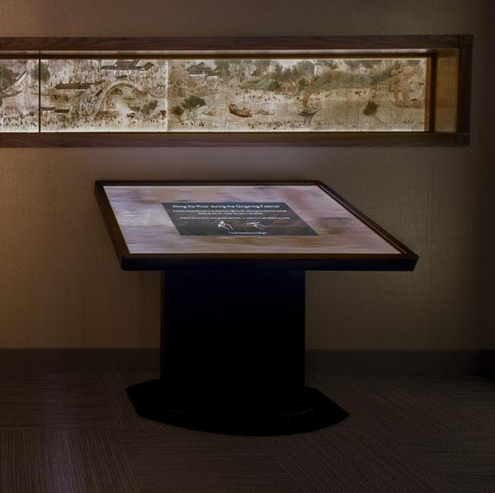
Creating a digital experience for visitors

Slide 37
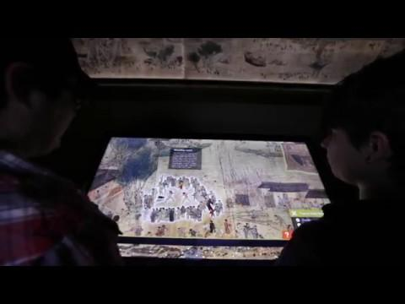
Process & programming
Produced by FM team:
Content development
Imaging
Back- and front-end programming (Unity)
Asset production
User testing
User Interface testing w/ FM visitors:
Adding zoom prompt
Mini map design
How to turn on/off hotspots (“+” to “x”)
Notes:
Unity benefits: for developing standalone apps & great for game dev / works well on any OS / 2D + 3D animations - 2D & sprites
Zoom testing results: Res so nice that visitors didn’t realize they could shift the size of the scroll

Slide 38
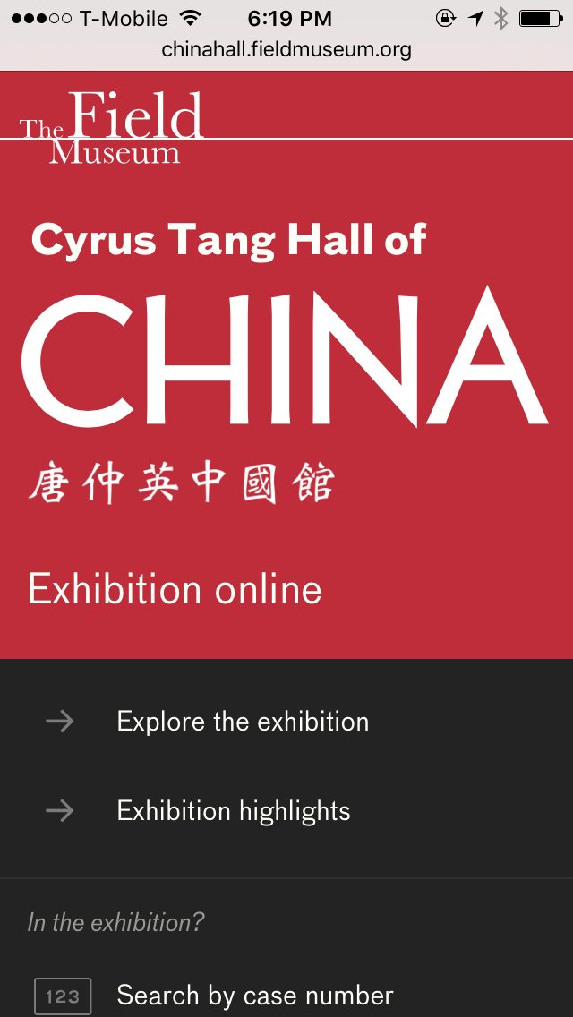
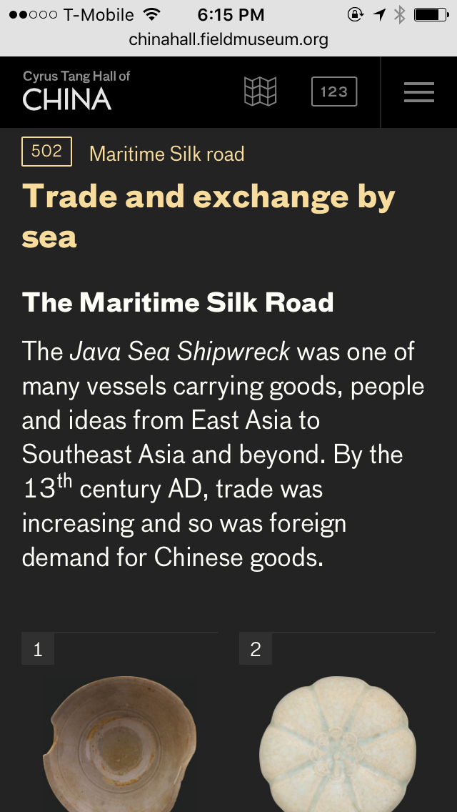
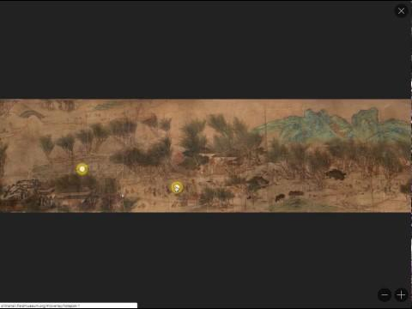
Exhibition Online
100% of exhibition content & experiences available online, for free
Gallery guide + at-home access
Developed by external partner
Native interactives adapted to work on mobile, tablet & desktop (HTML)
Go to: chinahall.fieldmuseum.org

Slide 39
Measuring success
Google Analytics embedded on all digital rails & touch table (ongoing evaluation)
Summative evaluation (summer 2018):
Capture rates show Qingming scroll is one of the three elements receiving most visitor interaction
Visitor flow reveals use of digital rails increases after visitors encounter Qingming scroll
Hypothesis for touch table:
Allows visitors to become comfortable with touching screens to find information
Allows visitors to realize that digital rail is not just label copy, but offers other experiences as well
Notes:
GA allows us to see usage rates and what bits of label copy users are accessing most often

Slide 40
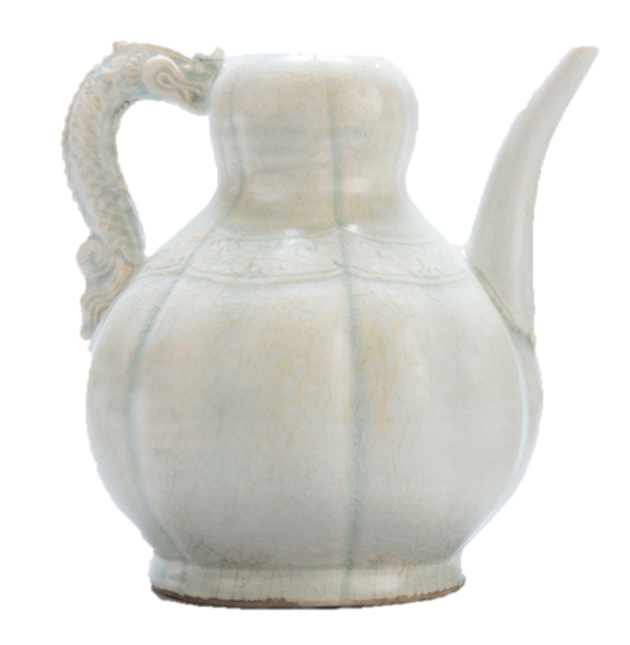
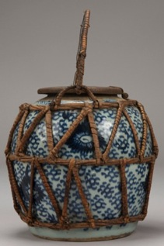
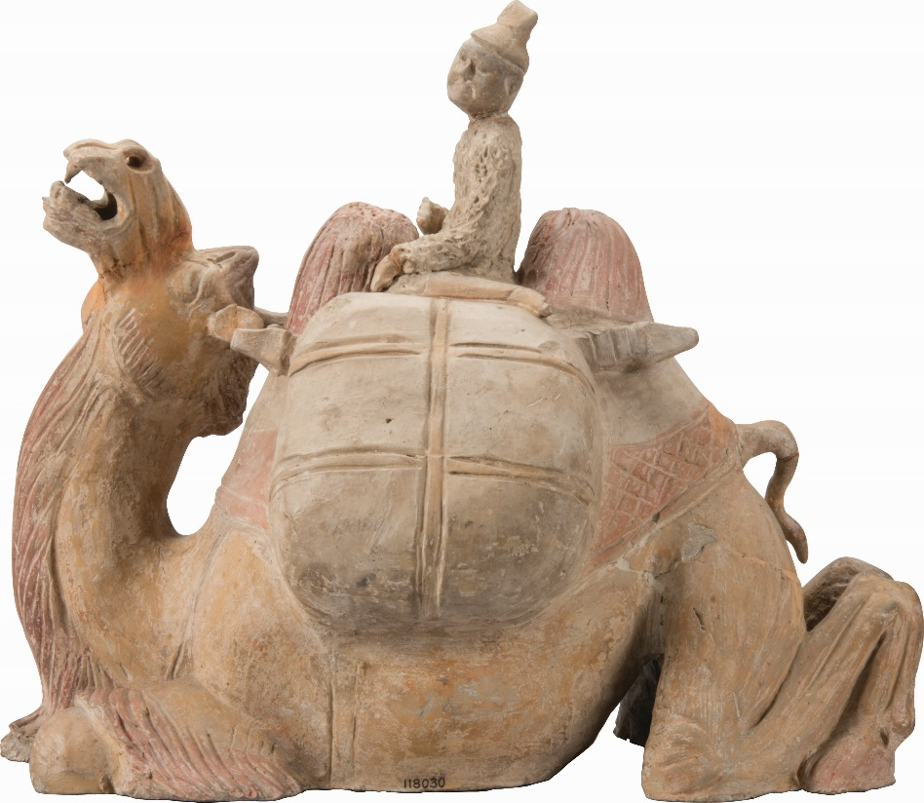
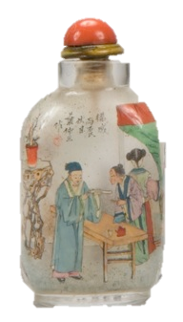
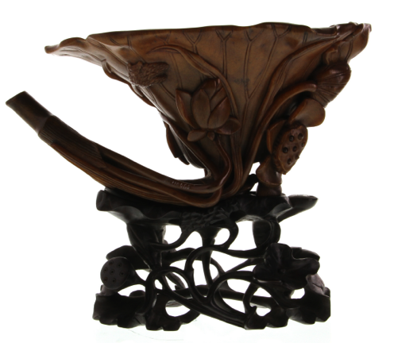
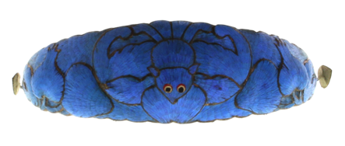
Notes:
Tomb figures (camel and rider)
Tang Dynasty (AD 618– 906)
China
118030, 118035
The two-humped Bactrian camel (Camelus bactrianus) carried goods for caravans on the roads around the Taklamakan Desert. Horses were well-suited for crossing grasslands and steppes, and donkeys were favored for mountain terrain, but camels, despite their notoriously bad tempers, were prized for their endurance in harsh desert climates. The large camel is loaded with cargo and rider, about to begin a journey.
Ewer
Ceramic (porcelain), qingbai glaze
12th–13th century AD
Song–Yuan period (AD 960–1368)
Made in China, Jiangxi Province, probably Jingdezhen
Excavated from Indonesia, Java Sea
350401
Money jar
Ceramic (porcelain), glaze, metal, plant fiber
18th–19th century AD
Qing Dynasty (AD 1644–1911)
Made in China
Acquired in the Philippines, Cebu Island
252224
Beaded belt with the Eight Daoist Symbols
Glass beads, cotton gauze, leather, embossed metal buckle
Probably AD 1900–1925
Late 19th–early 20th century AD
Malaysia
180024
The Peranakan Chinese people are descendants of Chinese traders and diplomats who settled in Malaysia, Singapore, and Indonesia during the 15th and 16th centuries AD. Living at the crossroads of global trade, Peranakans developed a flexible identity. It combines Chinese and local Malay heritage, as well as European practices. The beadwork on these belts is an example of how Peranakan communities melded practices from around the world to express their own identity.
Headband with bat design
Kingfisher feathers, metal, leather backing
19th century AD
Qing Dynasty (AD 1644–1911)
China
339349.A
During China’s Three Kingdoms period (AD 220–265), northern warhorses were traded for kingfisher feathers from the south used to decorate robes and bedcovers. Nearly 1,000 years later, the emperor criticized the killing of birds for “frivolous purposes” and outlawed the trade in kingfisher feathers. Scarcity only increased demand and encouraged smuggling.
In Chinese, the word for bat, fu, sounds like the words for “blessings” and “riches.” The bat is a common symbol for good fortune.
Symbols known as the “Three Plenties” decorate the headband’s sides (l-r): a peach (longevity), a pomegranate (fertility), and a Buddha’s hand citron (blessings).
Snuff bottle painted by Ye Zhongsan
Glass, pigment, coral
AD 1916
Republican period (AD 1912–1949)
China
232479
These bottles once held snuff, a mixture of powdered tobacco, herbs, and spices that’s inhaled as a stimulant. In the 17th century AD, European missionaries and diplomats introduced the Chinese emperor to snuff. It gained popularity among the court’s inner circles, then spread to scholar-officials. In the 18th and 19th centuries AD, wealthy southern merchants used imported snuff to mimic the scholarly class. As snuff became more popular and accessible, it became less fashionable among the elite.
This bottle shows scenes from supernatural tales. Left: A scholar becomes engaged to a goddess disguised as a girl. Right: Climbing a tree to watch for wild beasts, a man spies a group of spirits.
The scenes on snuff bottle #15 (above) were painted from the inside. The “inside painting” technique started in the 19th century AD. Ye Zhongsan, who painted this bottle, was among the 20th-century specialists who mastered this art form. It shows his signature palette of bright, contrasting colors. To reach the inner walls, he worked with an angled brush and a bamboo stylus. A bottle might take a month or more to finish.
Rhinoceros horn cup with base
Rhinoceros horn, wood
Qianlong period (AD 1736–1795)
Qing Dynasty (AD 1644–1911)
China
110655
“Crab” (xie) sounds like the word for “harmony.” Paired with the lotus seedpod—symbolizing many sons—this cup could celebrate a fruitful marriage. Alternately, the crab’s shell could represent “armor” (jia), which also means “first.” The lotus plant (lian) and seeds (ke) stand for “series” (lianke), so the crab symbolizes the scholar who places first on a series of imperial exams.

Slide 41
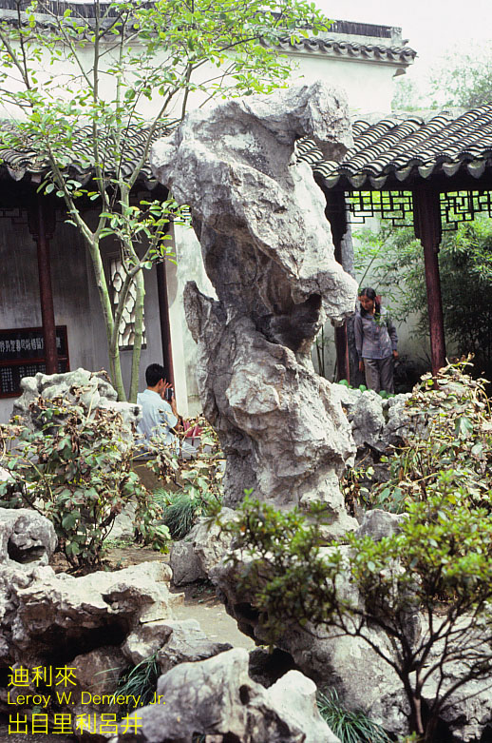
Suzhou Spirit Stones

Slide 42
The Sue Ling Gin Garden

Slide 43
New collaborations and exchanges
CityWindows Chicago-Beijing paper cuts series by Professor Qiao Xiaoguang

