Slide 1

Fractals, Multifractals, and Lacunarity of the Geologic and Fossil Records
Roy E. Plotnick
Earth and Environmental Sciences
University of Illinois at Chicago

Slide 2
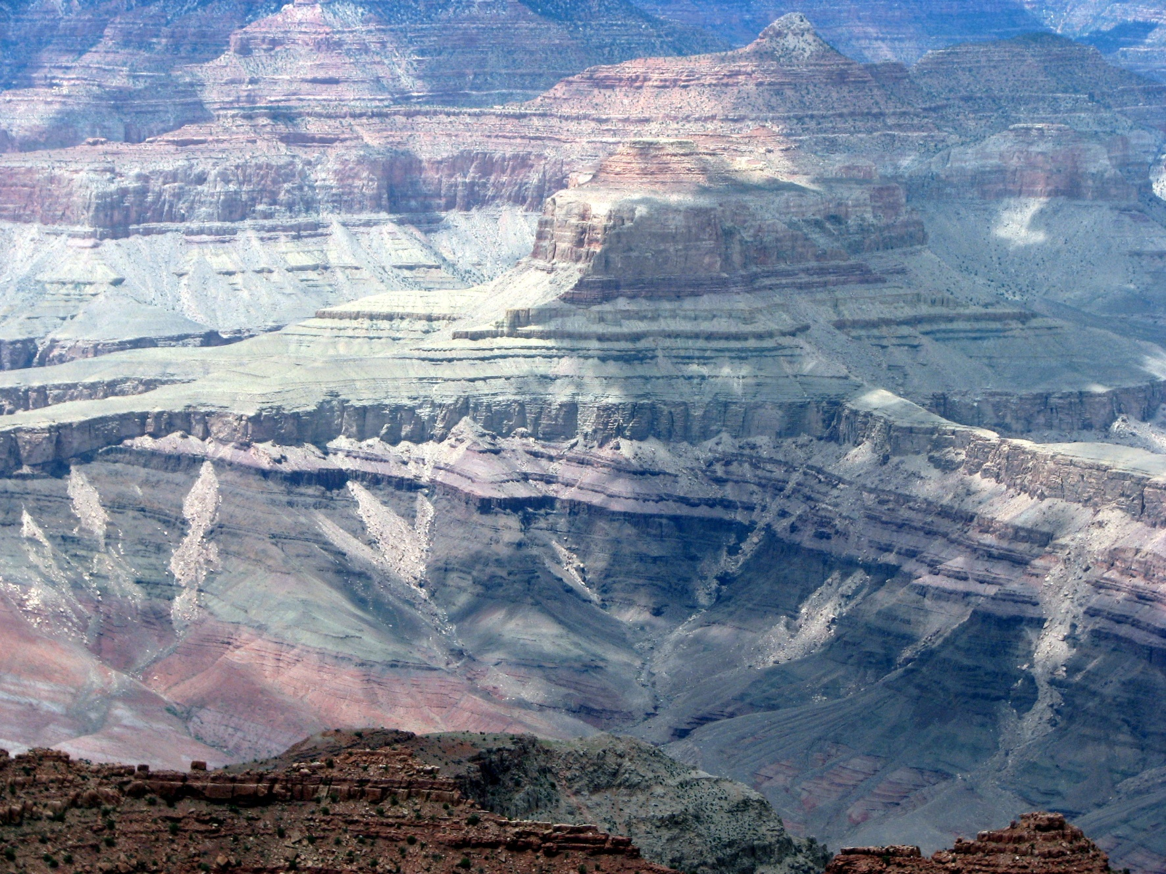
1. Gaps in the rock record
Grand Canyon @ Desert View

Slide 3
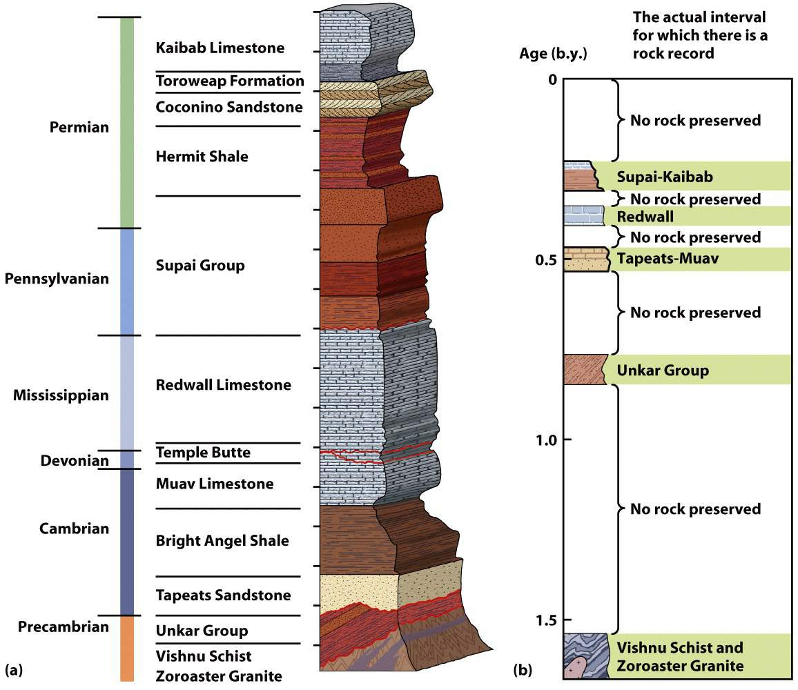
More Gap than Record
The Grand Canyon.
  Thick layers of strata.
  Numerous gaps.
  A partial record of geological history.
True of any one location on Earth

Slide 4
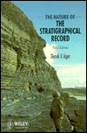
The Nature of the Stratigraphical Record – Derek V. Ager, 1973
Phenomenon of the gap being more important than the record: “the sedimentary pile at any one place on the earth’s surface is nothing more than a tiny and fragmentary record of vast periods of earth history.”
  “remember a child’s definition of a net as a lot of holes tied together with string. The stratigraphical record is a lot of holes tied together with sediment.”

Slide 5
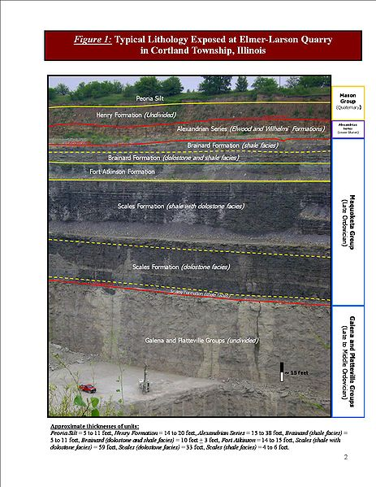
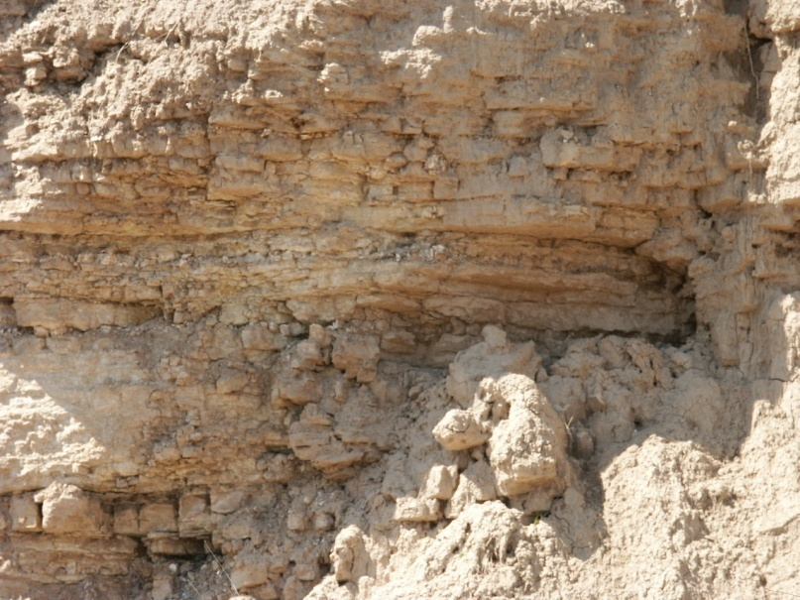
Gaps in time occur at all scales
Formation Boundaries
Bedding Planes
Silurian, Sycamore Quarry, IL

Slide 6
The “Sadler Effect”:
Sadler, P. M. 1981. Sediment accumulation rates and the completeness of stratigraphic sections. Journal of Geology 89(5):569-584.
Sediment accumulation rates are extremely variable, but are inversely related to the time span for which they are determined.
The slope of the regression of accumulation rate on time span varies with environment of deposition, and is an indicator of the completeness of stratigraphic sections.
This relationship between the net rate and the duration of accumulation may be explained primarily as a direct consequence of unsteady accumulation.

Slide 7
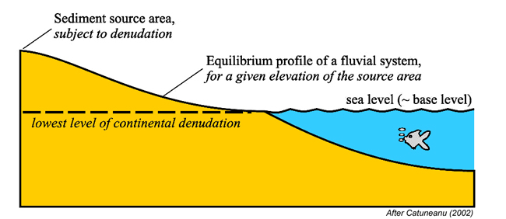
Base Level
surface to which sediment accumulation fills up to or erodes down to
Position can change if relative sea level changes (global sea level change; land movements)
Erosion
Deposition

Slide 8
Barrell, J. 1917. Rhythms and the measurements of geologic time. Geological Society of America Bulletin 28: 745-904.
- time-space distribution of deposition and non-deposition due to the alternating rise and fall of base-level.

Slide 9
The Cantor Dust: a simple fractal
Benoit Mandelbrot 1983. The Fractal Geometry of Nature
D = log 2/ log 3 = 0.6309 (a measure of space filling)

Slide 10
Plotnick, R. 1986. A fractal model for the distribution of stratigraphic hiatuses. Journal of Geology 94(6):885-890.

Slide 11
Why the Cantor dust in stratigraphy?
Miall, A. D. 2015. Updating uniformitarianism: stratigraphy as a set of 'frozen accidents' Pp. 11-36. In D. G. Smith, R. J. Bailey, P. M. Burgess, and A. J. Fraser, eds. Stata and Time: Probing the Gaps in Our Understanding. Geological Society, London, Special Publications, 404.

Slide 12
“there does, in fact, appear to be a natural hierarchy of process and preservation based on the natural time scales of sedimentary processes”
Miall (2014)

Slide 13
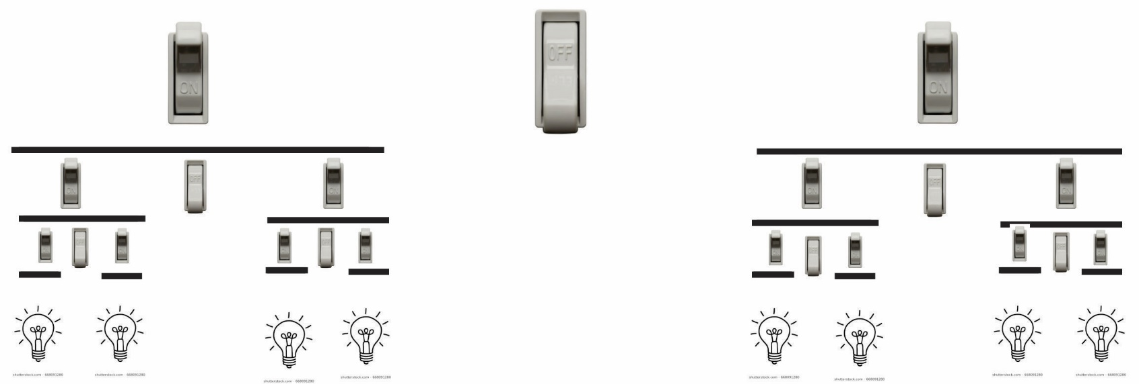
A hierarchy of controls will produce a Cantor distribution
-can be randomized: Lévy dust – same fractal dimension

Slide 14
2. How long are coastlines? (Mandelbrot 1983)
Koch curve
D = log 4/log (1/3) ≈≈ 1.262
D ≈ 1.5
Middleton, Plotnick, and Rubin 1995.
SEPM Short Course #36

Slide 15
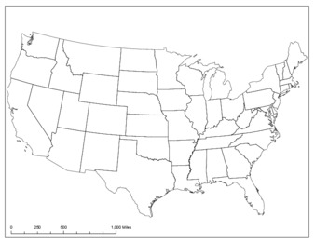
Jiang, J., and R. Plotnick. 1998. Fractal analysis of the complexity of United States coastlines. Mathematical Geology 30(5):535-546.
On average, the Atlantic coast has much higher fractal dimension than the Pacific coast.
Pacific
Atlantic
Based on NOAA data
Grouped data in 1º latitude bands
Divider method for calculating D

Slide 16
3. Sediment transport: 1/f noise
Prestegaard, K., and R. Plotnick. 1995. New models require new data: fractal and multifractal measures of gravel bedload. Pp. 113-126. In C. C. Barton, and P. R. La Point, eds. Fractals in Petroleum Geology and Earth Processes. Plenum, New York.
Plotnick, R. E., and K. Prestegaard. 1999. Fractal analysis of geologic time series. Pp. 193-210. In N. S.-N. Lam, and L. De Cola, eds. Fractals in Geography. Prentice-Hall, Englewood Cliffs, N.J.

Slide 17
White (Gaussian) noise
Discrete fractional Gaussian noise (H= 0.7)
White noise: independent increments
Discrete fractional Gaussian noise (dfGn:) successive increments either positively (persistent) or negatively correlated (antipersistent)
Fourier spectra for dfGn’s;
Power ∝ frequency = 1/f noise

Slide 19
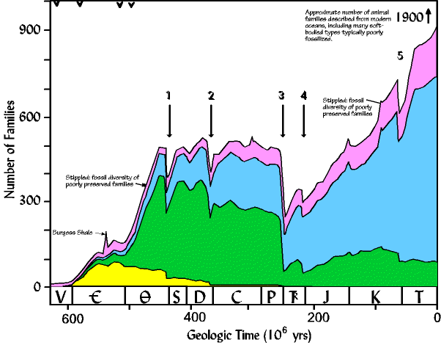
4. Biodiversity over Time
Redrawn from Sepkoski, J.J. Jr, 1984, A kinetic model of Phanerozoic taxonomic diversity, III. Post Paleozoic families and mass extinctions: Paleobiology 10:246-267. © ( original url by Lynn S. Fichter and Steve J. Baedke)

Slide 20
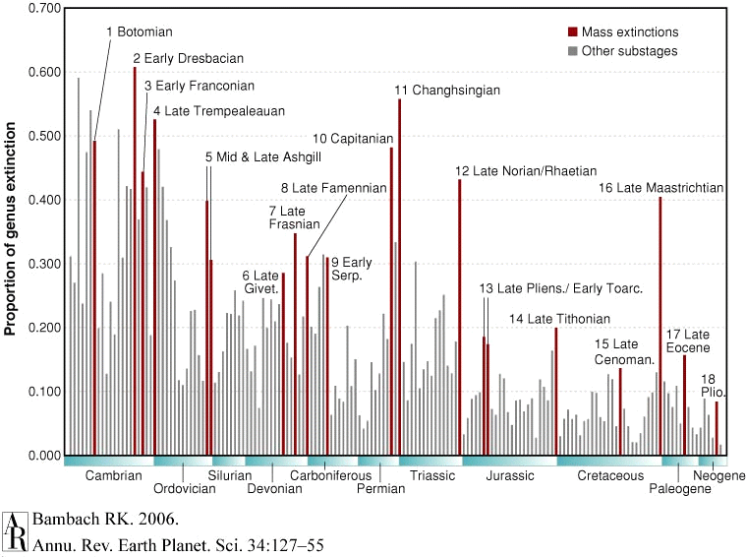
18 episodes of “mass extinction”
Three standout: end-Ordovician, end- Permian, and end-Cretaceous

Slide 21
Self-organized criticality (Per Bak):
Self-organized criticality (SOC): Set of models designed to simultaneously simulate two common phenomena in natural systems:
  fractal spatial structure
  power-law (1/f) temporal behavior of events.
although most events are small and frequent, some are very large and rare; there is no characteristic scale to the system.
many variants of the basic SOC model; the common factor is that they evolve to the critical state without an external driver; only internal interactions
gave rise to a large number of similar toy ‘‘evolution models’’ in the physics literature (Alicea, B., and R. Gordon. 2014. Biosystems 123:54-66; Plotnick, R. 2017. Lattice models in ecology, paleontology, and geology. In Autogenic Dynamics and Self-Organization in Sedimentary Systems. SEPM Special Publication.)

Slide 22
Sneppen, K., P. Bak, H. Flyvbjerg, and M. H. Jensen. 1995. Evolution as a self-organized critical phenomenon. Proceedings of the National Academy of Sciences of the United States of America 92(11):5209-5213.

Slide 23
No evidence for power-law behavior in macroevolution!
Kirchner, J. W., and A. Weil. 1998. No fractals in fossil extinction statistics. Nature 395(6700):337-338.
  Solé et al. reported that many extinction time series are statistically self-similar, with 1/f power spectra, suggesting that extinctions are driven by self-organized criticality or by other scale-free internal dynamics of the biosphere. Here we show that the apparent self-similarity and 1/f scaling reported by Solé et al. are artefacts of their interpolation methods. Extinction records that are not interpolated show no evidence of fractal scaling.
Also: Bak–Sneppen evolution model is highly abstract and is not based on properties of real ecological or evolutionary units. (Aronson and Plotnick, 1998; Plotnick and Sepkoski, 2001); e.g., assumes no external perturbations

Slide 24
An alternative model: multifractals
What are multifractals?
Replace on/off switches with rheostats, each cycling at a different frequency

Slide 25
Each level has its own fractal distribution and D-value (thus, multifractal)
Log-normal distribution of values (multiplicative)
Used to model quantitative, rather than binary patterns

Slide 26
Plotnick, R. E., and J. J. Sepkoski, Jr. 2001. A multiplicative multifractal model for originations and extinctions. Paleobiology 27(1):126-139
.
Genus level extinction and originations

Slide 27
NO raw number of originations per interval; PO per-taxon rate of origination; TO originations per million years; PTO per-taxon originations per million years
NE raw number of extinctions per interval; PE per-taxon rate of extinction; TE extinctions per million years; PTE per-taxon extinctions per million years.

Slide 31
5. Lacunarity Analysis: A General Technique for Spatial Analysis
  What is lacunarity?
  Concept introduced by Mandelbrot (1983)
  Objects can have the same fractal dimension (how much space is filled) but different textures (how that space is filled)
  Lacunarity reflects the size distribution of gaps (lacunae)
  A measure of translational invariance
  Originally developed for fractal objects; can be applied to any geometric pattern
Sierpinski carpets, both with D ≈ 1.8957
From Mandelbrot (1983)

Slide 32

Measuring Lacunarity
  Place a “gliding box” over one corner of the pattern (any dimensionality!)
  Count how many points are in the box (or sum the values in the box).
  Move the box one unit, overlapping the previous box. Count the points (or sum the values). Repeat so that the pattern is exhaustively recycled.
  Determine the mean $\overline{x}$ and variance s² of the number of points in the box
  Calculate the dimensionless lacunarity Λ at that box size:$\text{Λ}=1+{s^{2}}/{{\overline{x}}^{2}}$
  Repeat for a range of box sizes; plot log Λ versus log box size
Original algorithm:
Allain, C., and M. Cloitre. 1991. Characterizing the lacunarity of random and deterministic fractal sets. Physical Review A 44(6):3552-3558.
Applications:
Plotnick, R. E., R. H. Gardner, and R. V. O'Neill. 1993. Lacunarity indexes as measures of landscape texture. Landscape Ecology 8(3):201-211.
Plotnick, R. et al. 1996. Lacunarity analysis: A general technique for the analysis of spatial patterns. Physical Review E 53(5):5461-5468.
10 x 10 gliding boxes
20 x 20 gliding boxes

Slide 33
Lacunarity Analysis
  Measures the degree of clumping in the data – the higher the lacunarity, the greater the points are clumped at scale (greater variance of counts in gliding box)
  Shape of lacunarity curve indicative of patterns of clumping (gappiness) at multiple scales
  Y-intercept depends on overall density of pattern
More clustered
More regular

Slide 37
Lacunarity: Multifractals and biodiversity

Slide 38
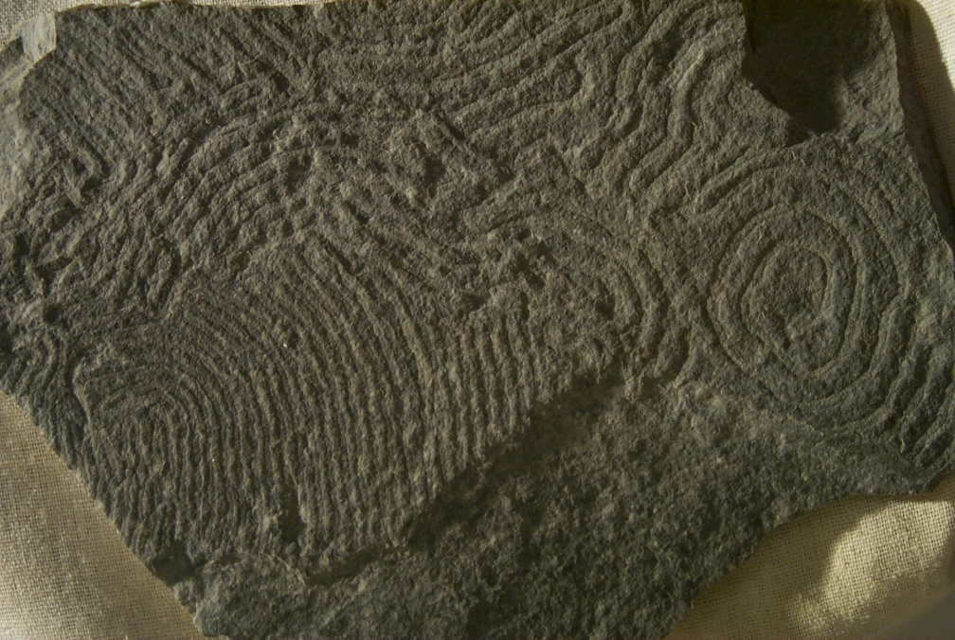
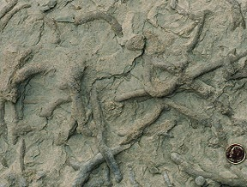
6. Modeling movement: trace fossils

Slide 39
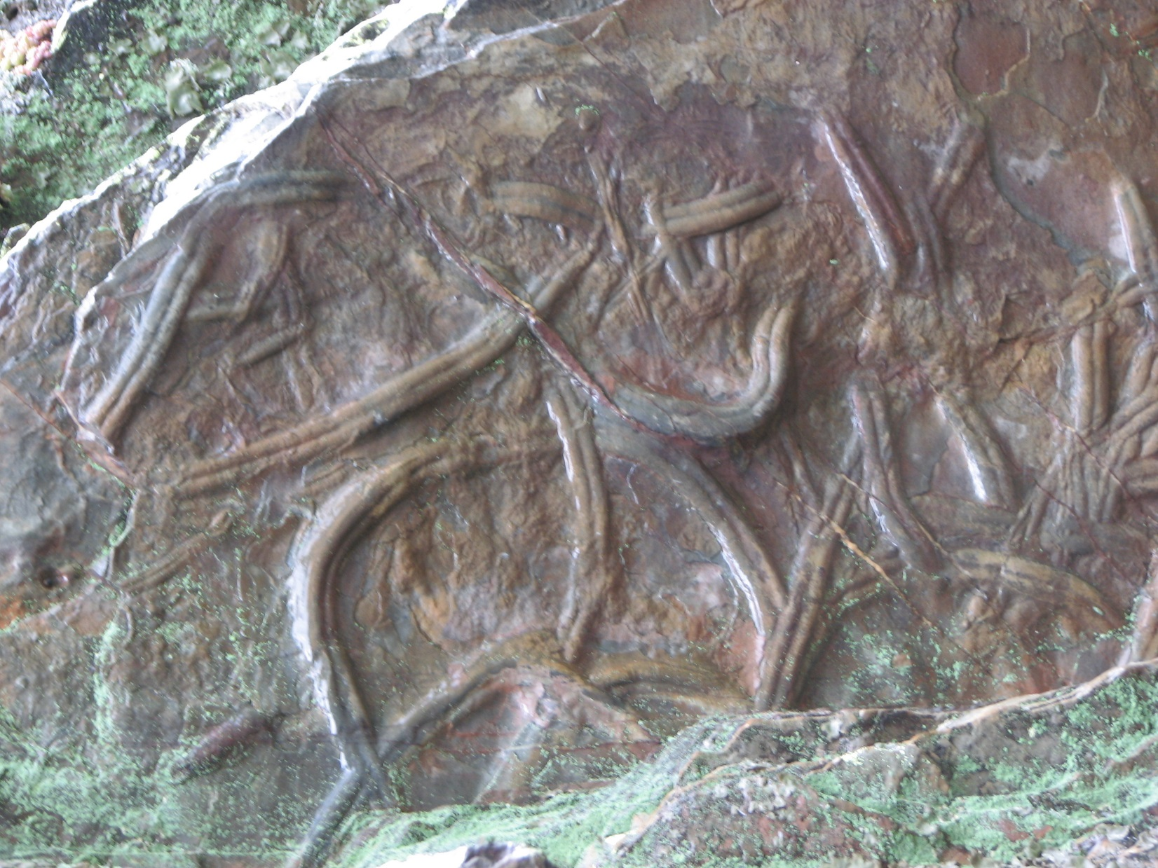
Cruziana (Ordovician)
Ichnological Park of Penha Garcia, Portugal

Slide 40
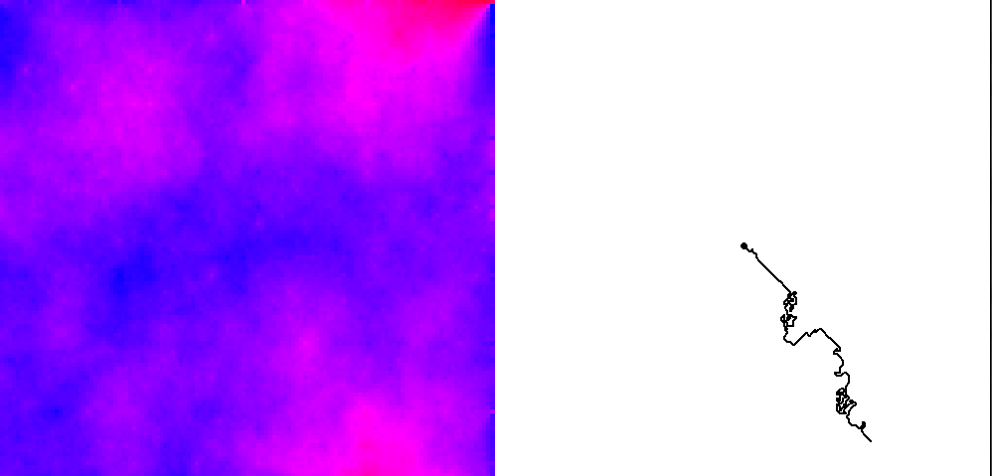
TraceMaker
An agent based model for simulating movement on and in the seafloor

Slide 41
Goals
Simulate animal movements consistent with basic behavioral biology (e.g., movement ecology paradigm)
What are the simplest possible “behaviors” that can produce complex movement patterns?
Testing of “what if” scenarios
A heuristic model: NOT for reproduction of specific ichnotaxa!
“In agent-based modeling (ABM), a system is modeled as a collection of autonomous decision-making entities called agents. Each agent individually assesses its situation and makes decisions on the basis of a set of rules. Agents may execute various behaviors appropriate for the system they represent.” – Bonabeau (2002, PNAS)

Slide 42

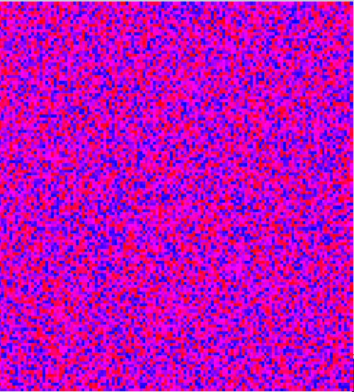
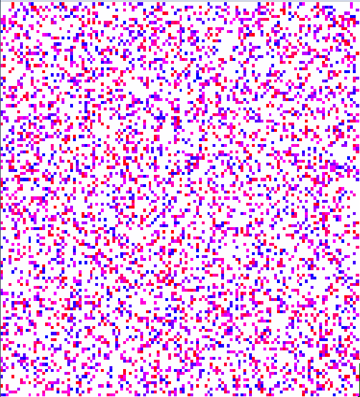
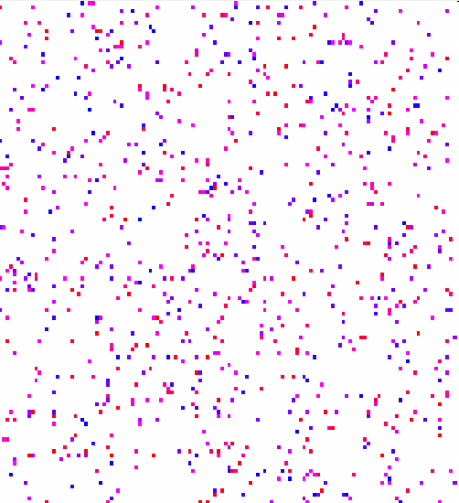
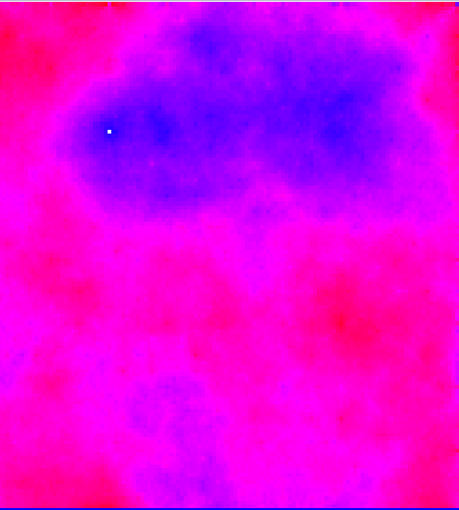
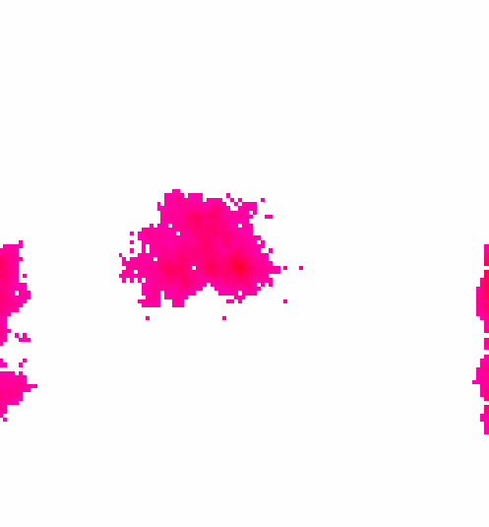
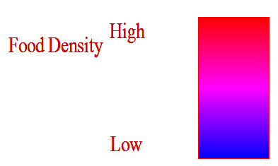
TraceMaker: 2-D Maps of Resources
128 x 128
Even
Random
Random clumps
Fractal
Fractal clumps

Slide 43
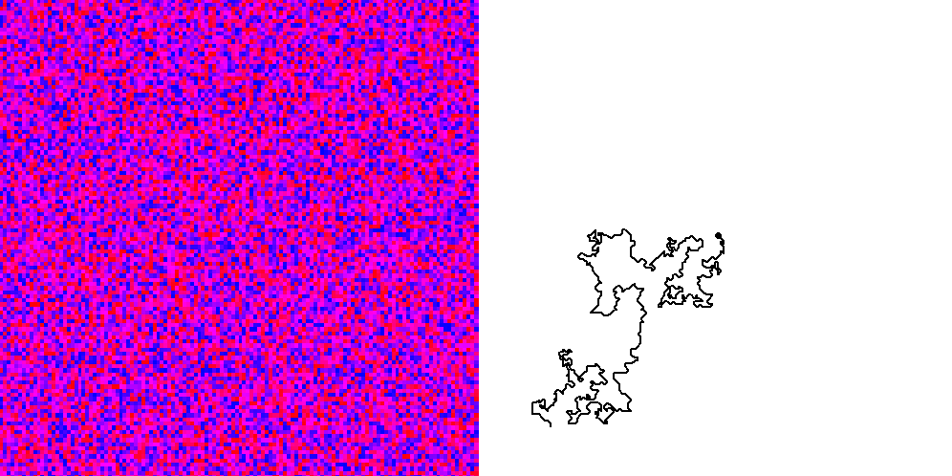
TraceMaker: 2-D Single Agent
Random

Slide 44
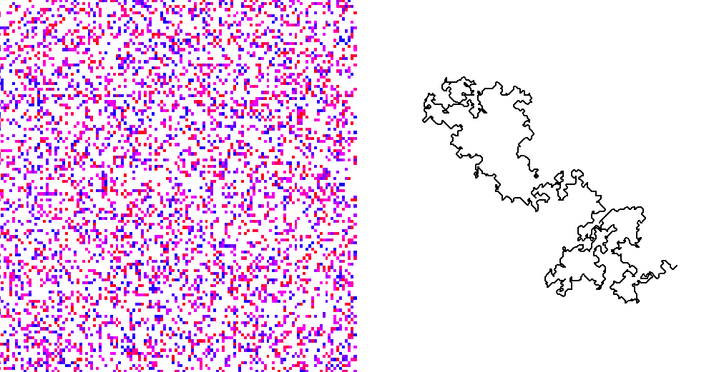
TraceMaker: 2-D Single Agent
Random clumps

Slide 45
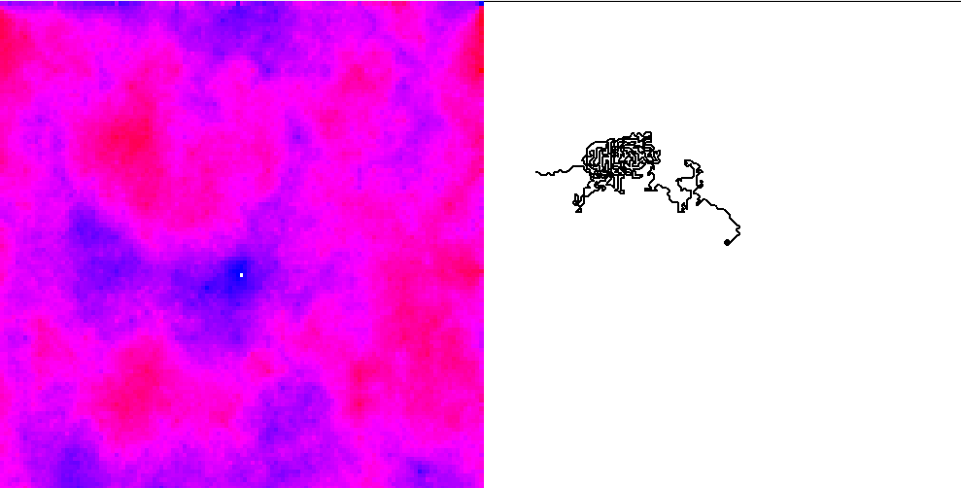
TraceMaker: 2-D Single Agent
Fractal

Slide 46
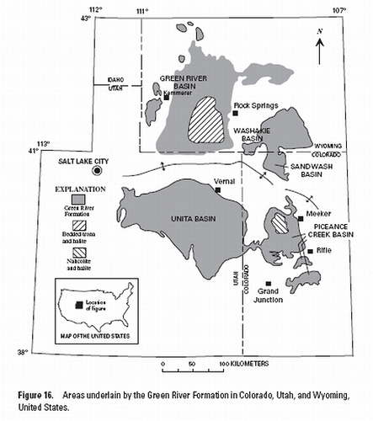
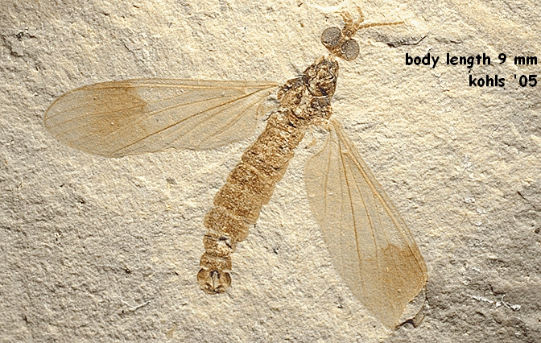
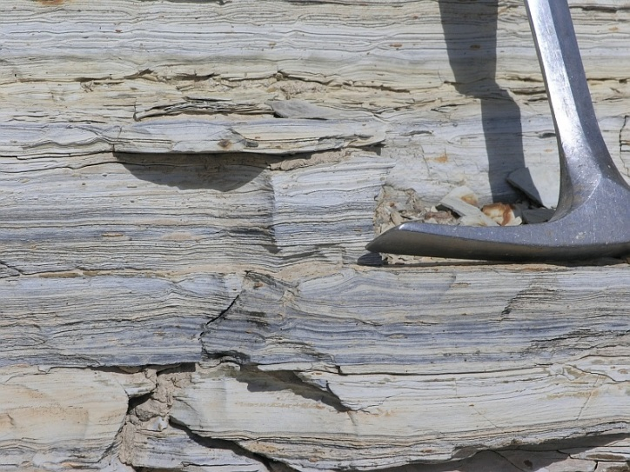
7. Distribution of fossil localities
Eocene lacustrine deposits of the Green River Formation of Colorado, Utah and Wyoming (approximately 48 – 51Ma in age; Smith et al, 2008).
Arrow indicates a locality

Slide 47
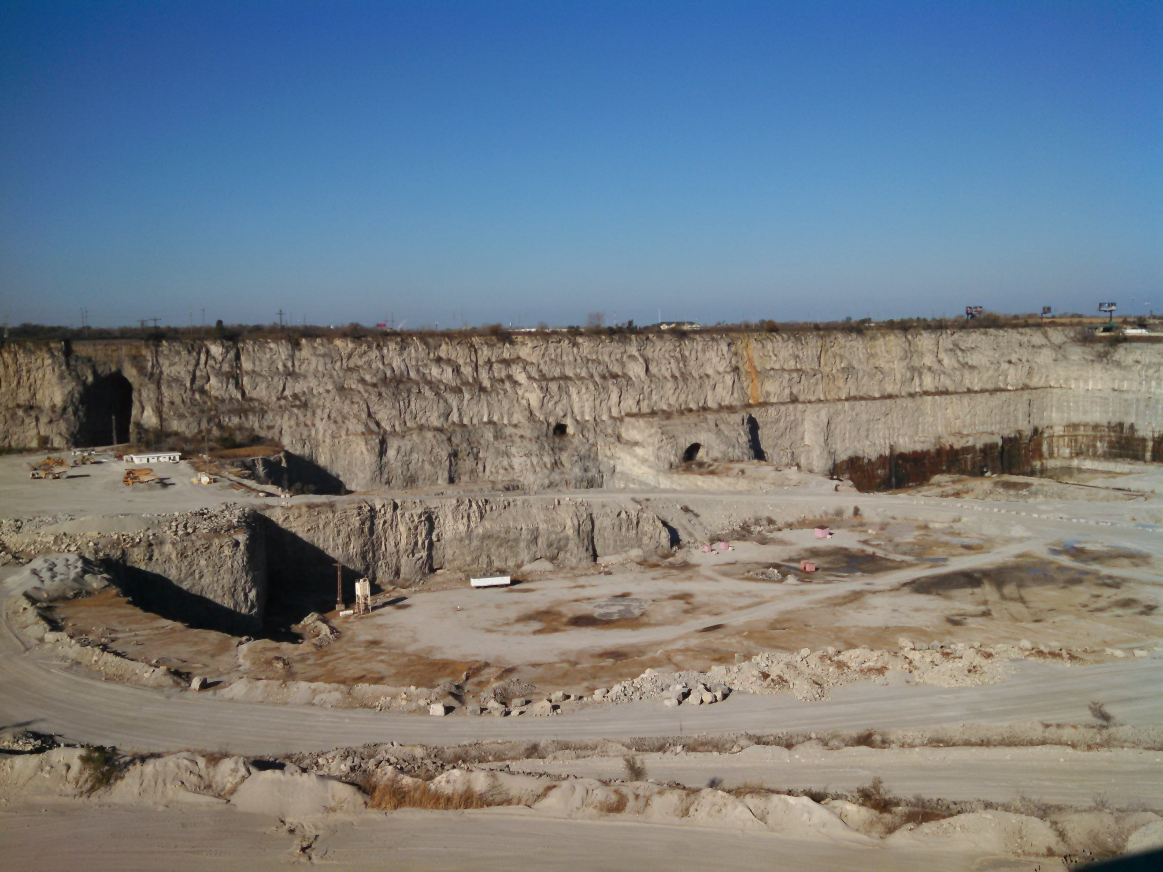
Thornton Quarry (Silurian), Illinois

Slide 48
What controls the distribution of localities?
To what extent is the observed distribution of localities a reflection of:
  Original:
    Environmental distribution
    Ecology
  Modification by:
    Fossil preservation processes (taphonomy)
    Geological processes
    Anthropogenic processes

Slide 49
Approach and Questions:
Used point spatial statistics to examine the distributions of localities in conterminous United States
  Latitudes, longitudes downloaded from Paleobiology Database
Are there common patterns or do they show changes over time?
Can we model the patterns? For example, complete spatial randomness (csr)
Plotnick, R. E. 2017. Recurrent hierarchical patterns and a fractal model for the distribution of fossil localities. Geology

Slide 50
Methods
Latitude and longitudes in degrees of fossil collections from the conterminous United States in seventeen time bins were downloaded from the Paleobiology Data Base
Parsed into terrestrial or marine depositional environments . All taxa were included.
Collections with duplicate coordinates were culled to remove the effect of multiple collections at the same coordinates, which might represent
  multiple stratigraphic units at the same location or
  an artifact of data entry within the PaleoDB
The remaining coordinates were then mapped on 0.1 degree resolution grids encompassing the longitude/latitude range of points. The resulting maps have an average of 94,000 grid cells with a mean of 684 cells occupied by at least one collection

Slide 51
Paleobiology Database
What is the
Paleobiology Database?
  The Paleobiology Database (or PBDB) is an open resource dedicated to documenting all fossil occurrences on the planet, along with associated bibliographic, contextual, and taxonomic data.
PBDB data are freely accessible under a CC BY license, which requires only attribution for use.
paleobiodb.org

Slide 52
Search for a Locality

Slide 53
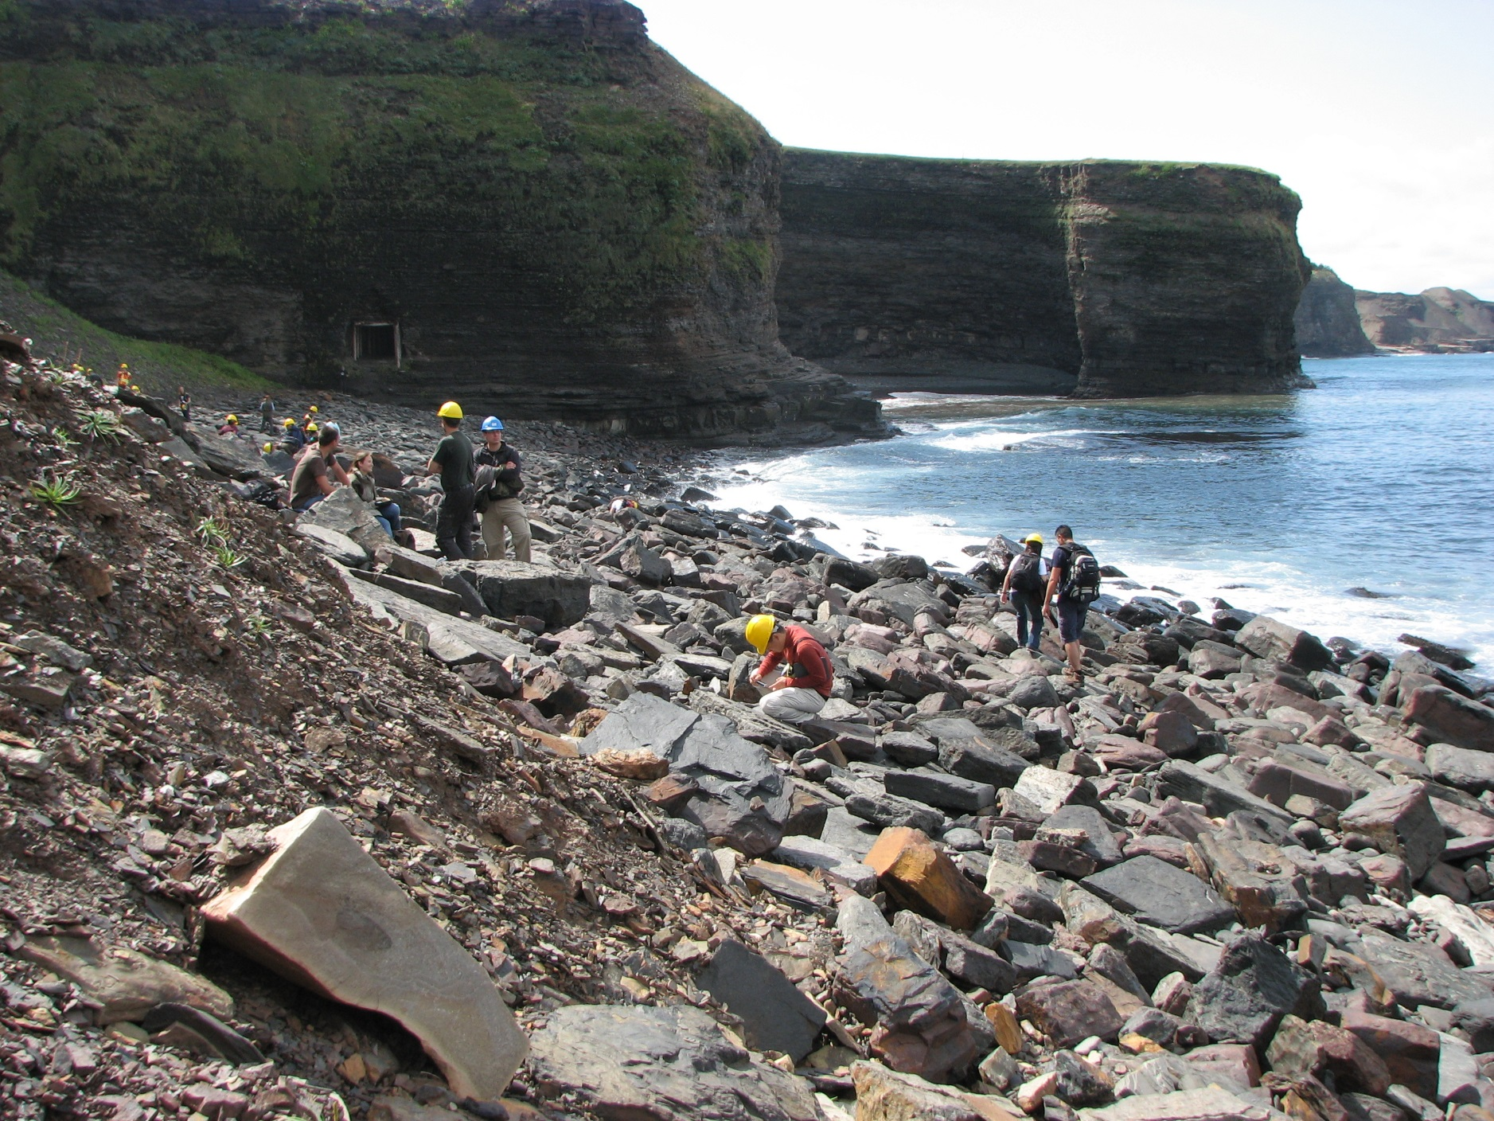

Slide 54
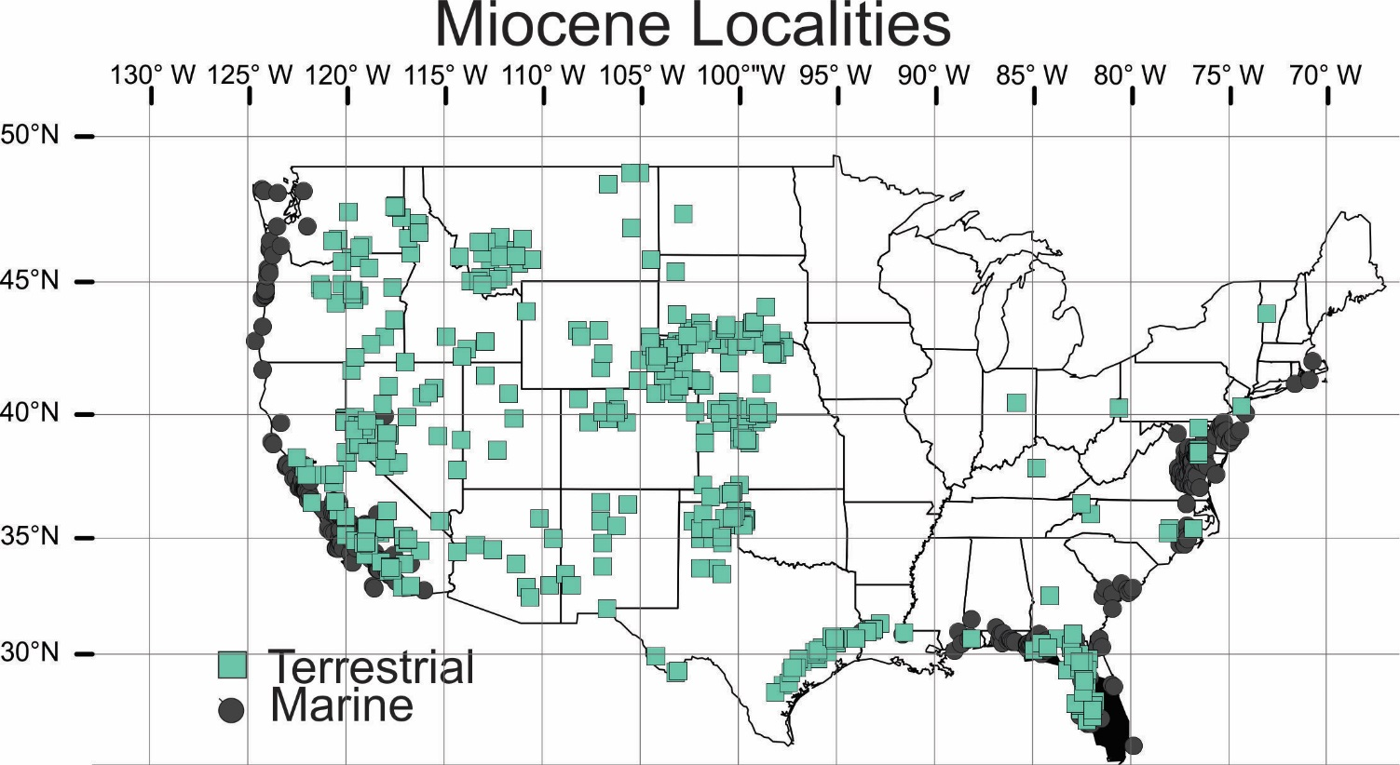
Miocene Fossil Sites
587 marine localities
483 terrestrial localities

Slide 55
 | Marine |  | Terrestrial
Time bin | Number of grid cells (0.1 square degree) | Number of sites | Number of grid cells (0.1 square degree) | Number of sites
Cambrian | 90582 | 414 |  | x
Ordovician | 111792 | 1633 |  | x
Silurian | 99188 | 418 |  | x
Devonian | 103930 | 1513 | 103930 | 82
Mississippian | 82980 | 1308 | 82980 | 44
Pennsylvanian | 73346 | 1531 | 90246 | 189
Permian | 74994 | 2270 | 31977 | 222
Triassic | 62928 | 514 | 48262 | 400
Jurassic | 53890 | 449 | 53890 | 319
Lower Cretaceous | 117936 | 411 | 87507 | 276
Upper Cretaceous | 109710 | 2032 | 108808 | 1069
Paleocene | 92191 | 462 | 86526 | 566
Eocene | 119240 | 967 | 119240 | 787
Oligocene | 92494 | 336 | 92494 | 181
Miocene | 126112 | 587 | 126112 | 483
Pliocene | 86457 | 300 | 88407 | 146
Pleistocene | 132480 | 395 | 134904 | 887

Slide 56
Are the sites “random”?
complete spatial randomness (csr), in which the fossil sites are located randomly and independently following a Poisson process, at a single scale within the mapped area
89 points randomly placed on a 100x 100 grid

Slide 57
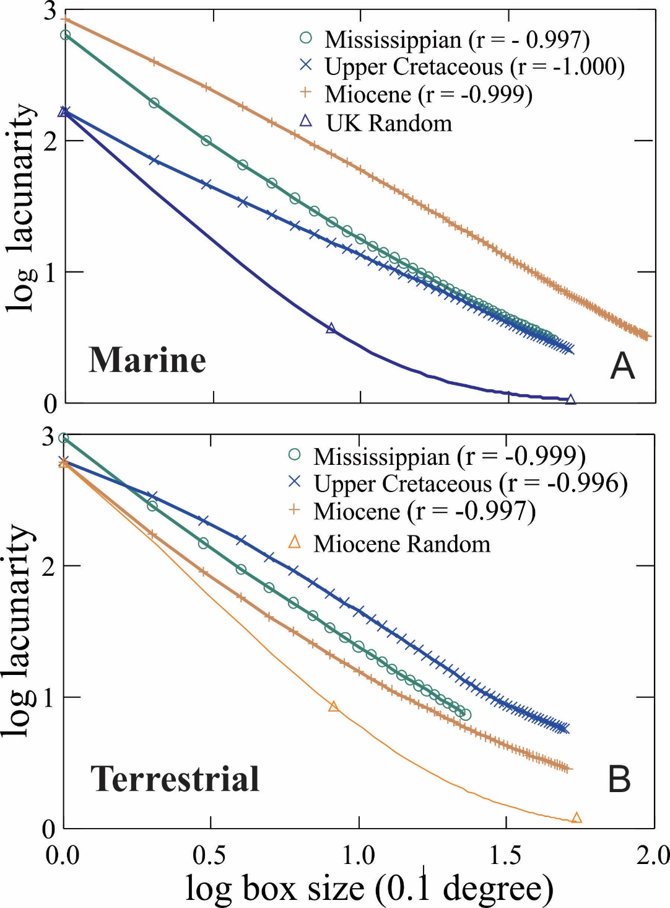
Lacunarity analysis: representative patterns

Slide 58
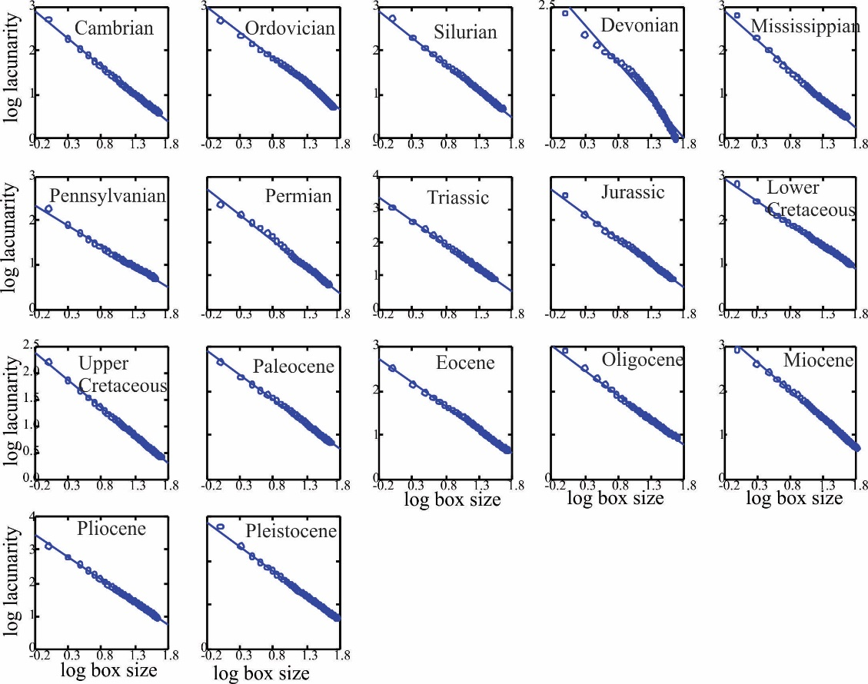
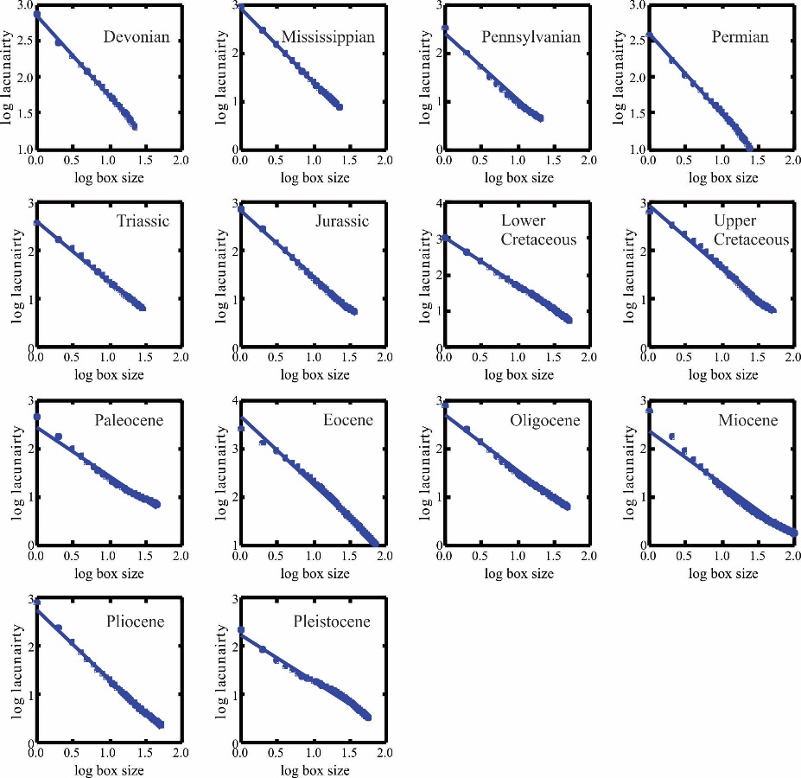
Lacunarity Analysis: Phanerozoic Patterns
Marine
Terrestrial
Nearly all Phanerozoic localities show a fractal distribution!
All correlations log₁₀lacunarity with log₁₀ box size r >0.99

Slide 59
2-D RANDOM MULTIFRACTAL MODEL FOR LOCALITIES: A Null Model
cutoff
multiply
Hierarchical probabilities at 11 different scales
Plotnick, R. E., and J. J. J. Sepkoski. 2001. A multiplicative multifractal model for originations and extinctions. Paleobiology 27(1):126-139.
Log-normal probability distribution

Slide 60
Same technique can make a map:
Fractal point map
Lacunarity

Slide 61
What does this mean?
For nearly all Phanerozoic time units, comparable patterns of spatial heterogeneity
  the distribution of fossil localities is self-similar
  clumping pattern of localities is the same at all spatial scales
Can be modeled using a simple multifractal model
  Probability of a fossil locality is a product of independent random spatial variables acting at different scales.
  Poisson process (crs) is not the appropriate model.

Slide 62
Implies that processes that produce mapped fossil localities are multiscale and multiplicative:
  Deposition
  Erosion
  Tectonics
  Accessibility
  Also original biology!! (“common cause”?) etc.
These need to parsed out to make sense of biogeographic and biostratigraphic patterns!

Slide 63
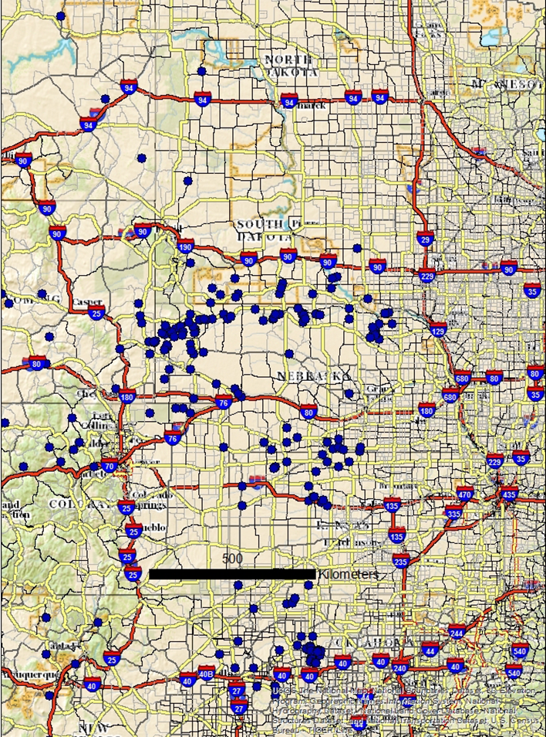
Walking to the Dead: Distance from Roads to Fossil Localities (w/Elena Graetz)
Distribution of Miocene
fossil localities
How much of the pattern is produced by accessibility, such as access to roads or presence roadcuts?
Road network may have fractal properties:. Zhang, H., and Z. L. Li. 2012. Annals of the Association of American Geographers 102(2):350-365.
Used ArcMap Near tool to determine distance localities to nearest roads.
Compared with random distributions of sites.

Slide 64
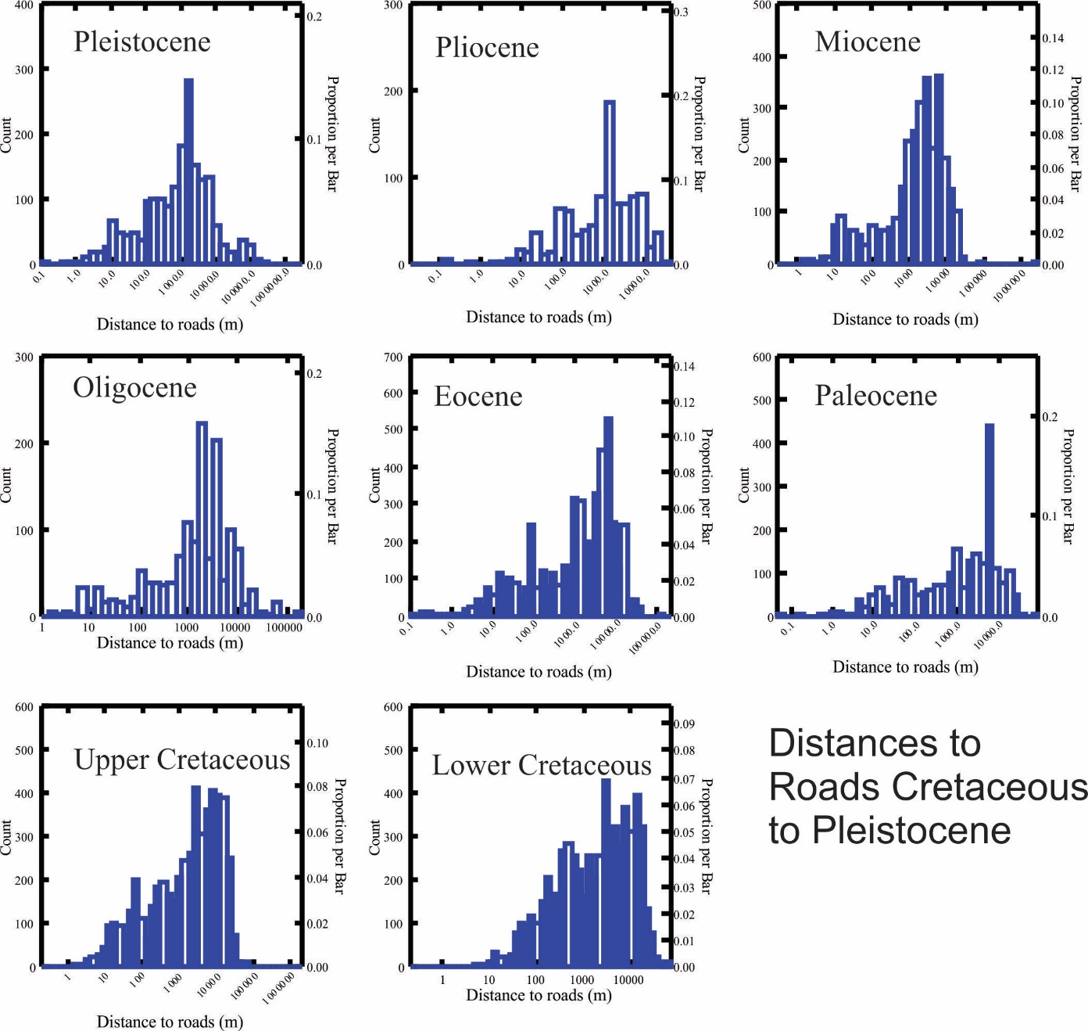
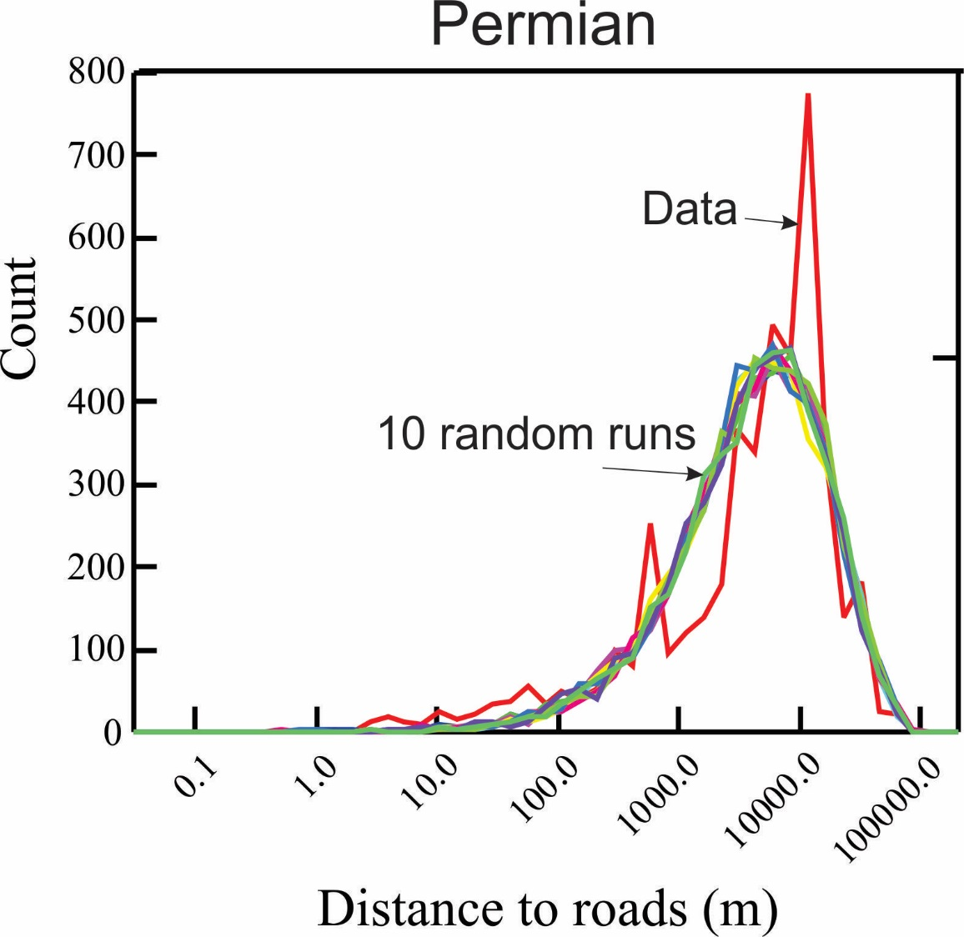
Bimodality:
Accessibility - close
Geology - far

Slide 65
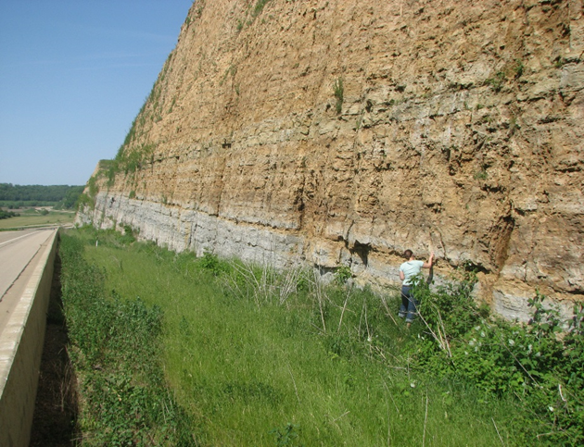
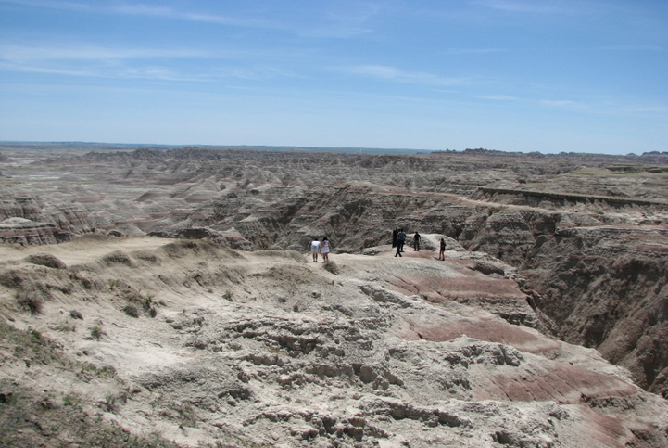

Roadcut in Wisconsin
South Dakota Badlands

Slide 66
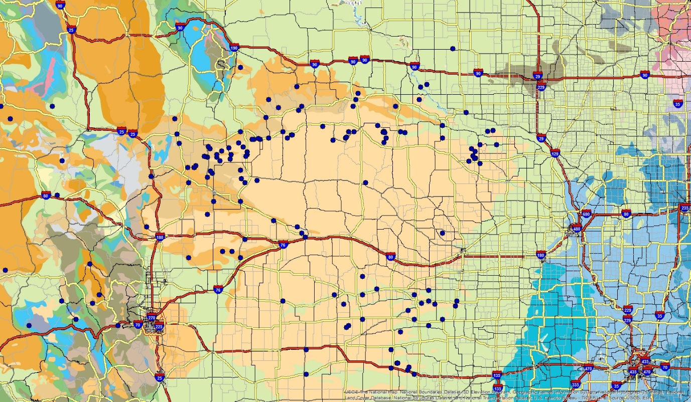
Miocene fossil localities relative to Miocene geology (light tan)

Slide 67
Some final thoughts on fractals (or what gets forgotten):
To be described as a fractal, an object must both:
  Have a non-integer fractal dimension and;
  Be self-similar (or self-affine).
Every geometric object has a fractal dimension, although this may be equal to its topological dimension.
Fractal dimension is a measure of degree of space filling; finding a non-integer dimension does not make an object fractal
  Lacunarity is a measure of how that space is filled
Objects may be self-similar (e.g., a line) without having a fractal dimension larger than its topological dimension.
Fractals are mathematical models for real objects and phenomena, such as when Mandelbrot used the Koch curve as a model for a coastline or when we use a sphere as a model for the Earth.

Slide 68
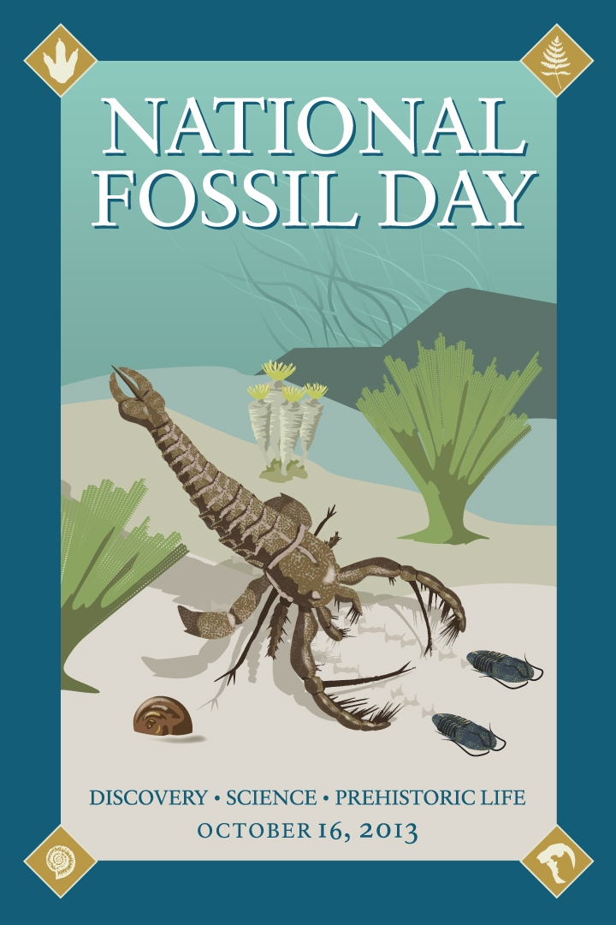
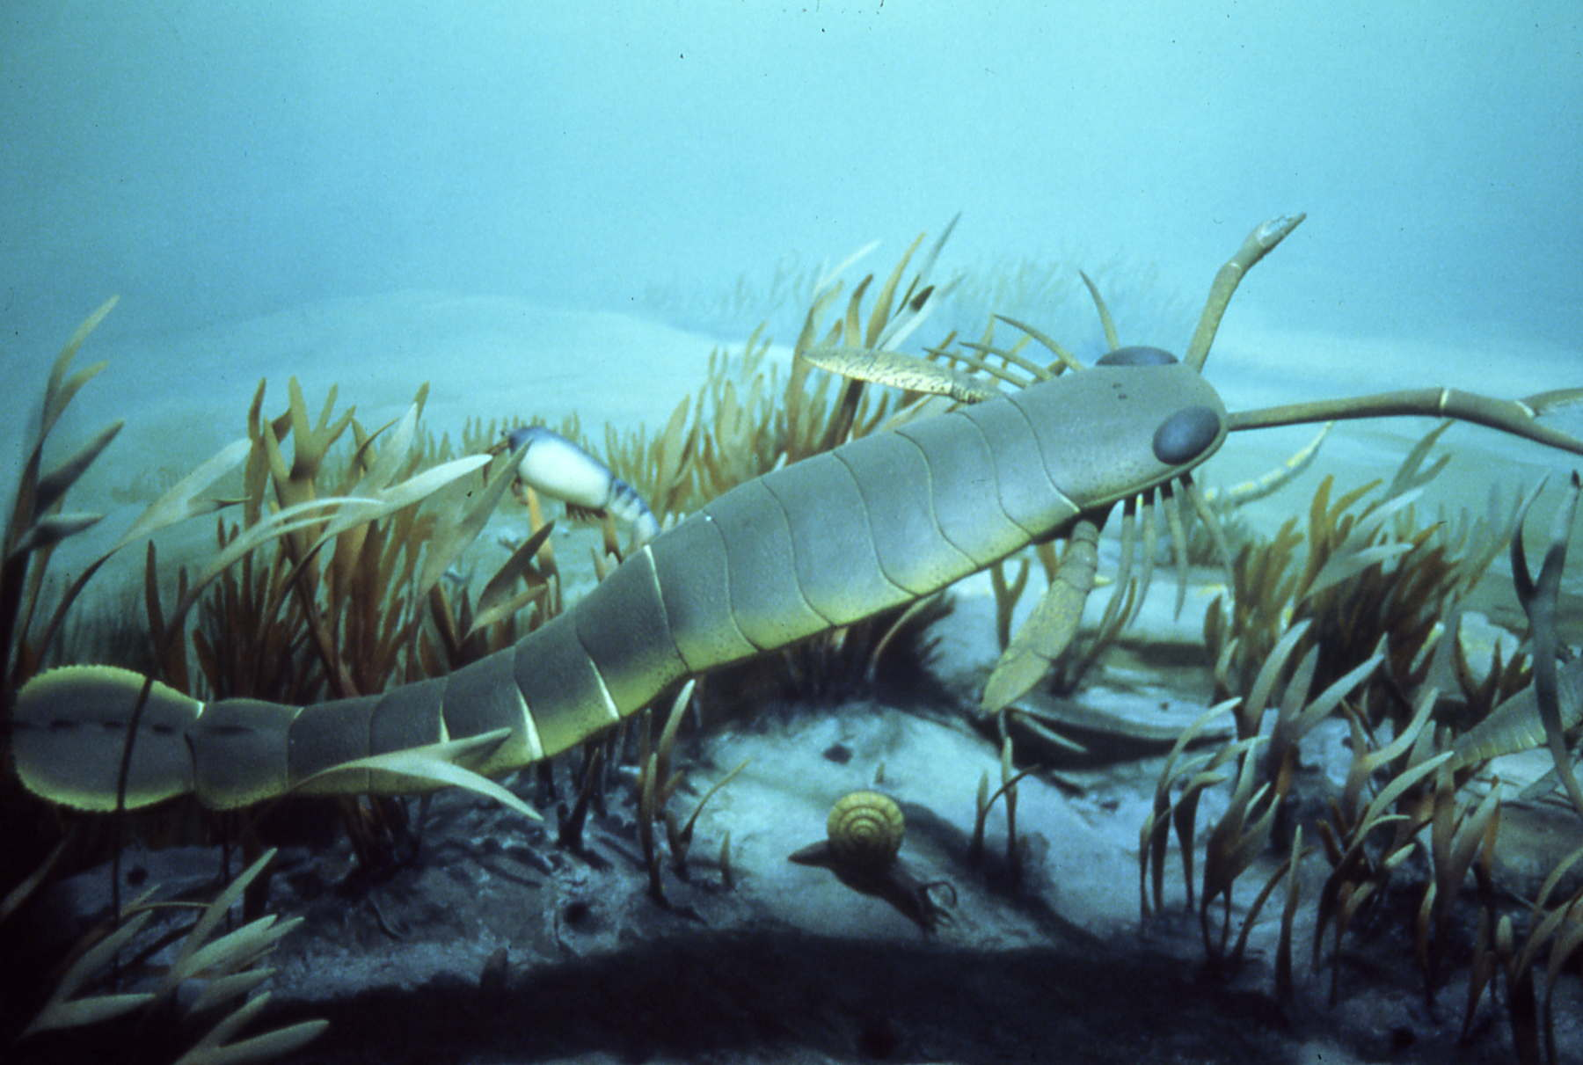
Questions? Insults?

