Slide 1
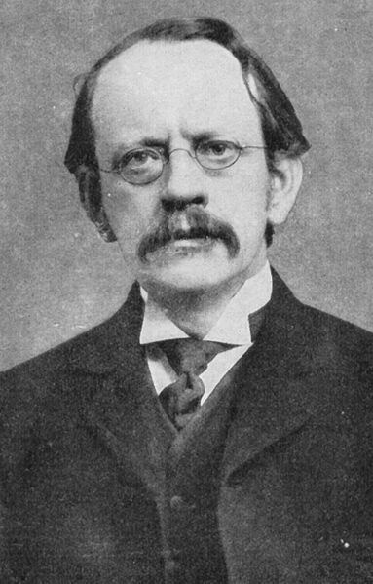
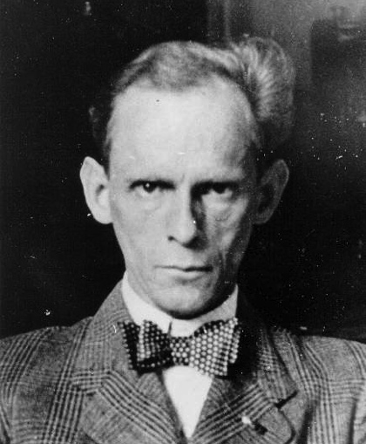
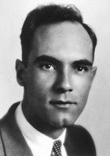
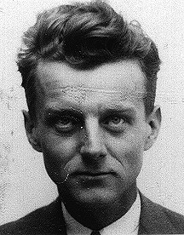
The Allure of Ultra-Precise Experiments:
(A tale of two Leptons)
e | μ
ν_{e} | ν_{μ}
Kunze
Lee Roberts
Department of Physics
Boston University
Thompson
roberts @bu.edu http://physics.bu.edu/show/roberts
Anderson Neddermeyer

Slide 2
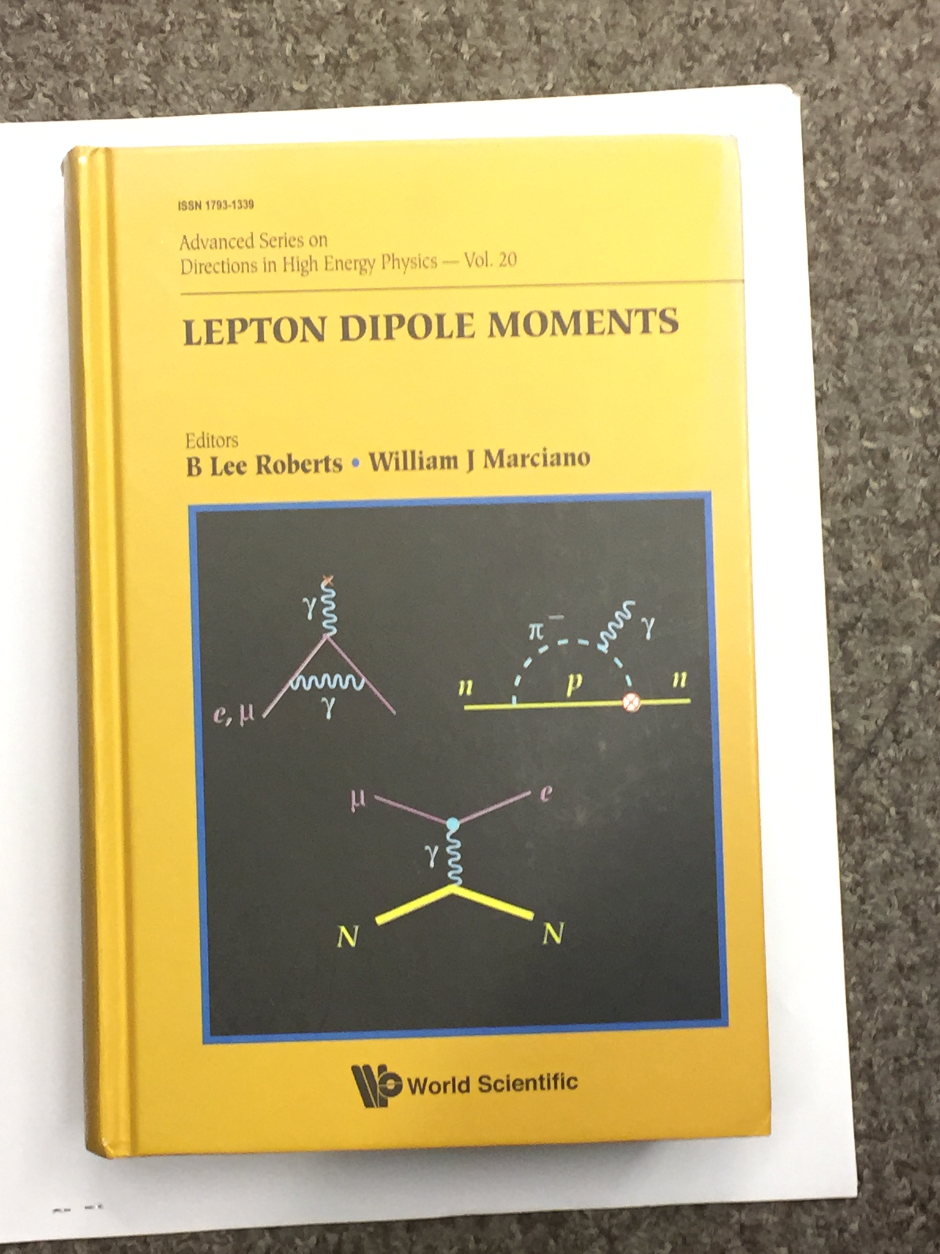
Acknowledgements
Lepton Moments International Symposia
  http://g2pc1.bu.edu/lept14/ and previous years.
  talks by Ed Hinds, Ben Sauer, Eric Cornell, Jun Ye, Dave DeMille
Lepton Dipole Moments
  Czarnecki and Marciano
  articles by Commins and DeMille
The most recent EDM papers
  See the list at the end

Slide 3
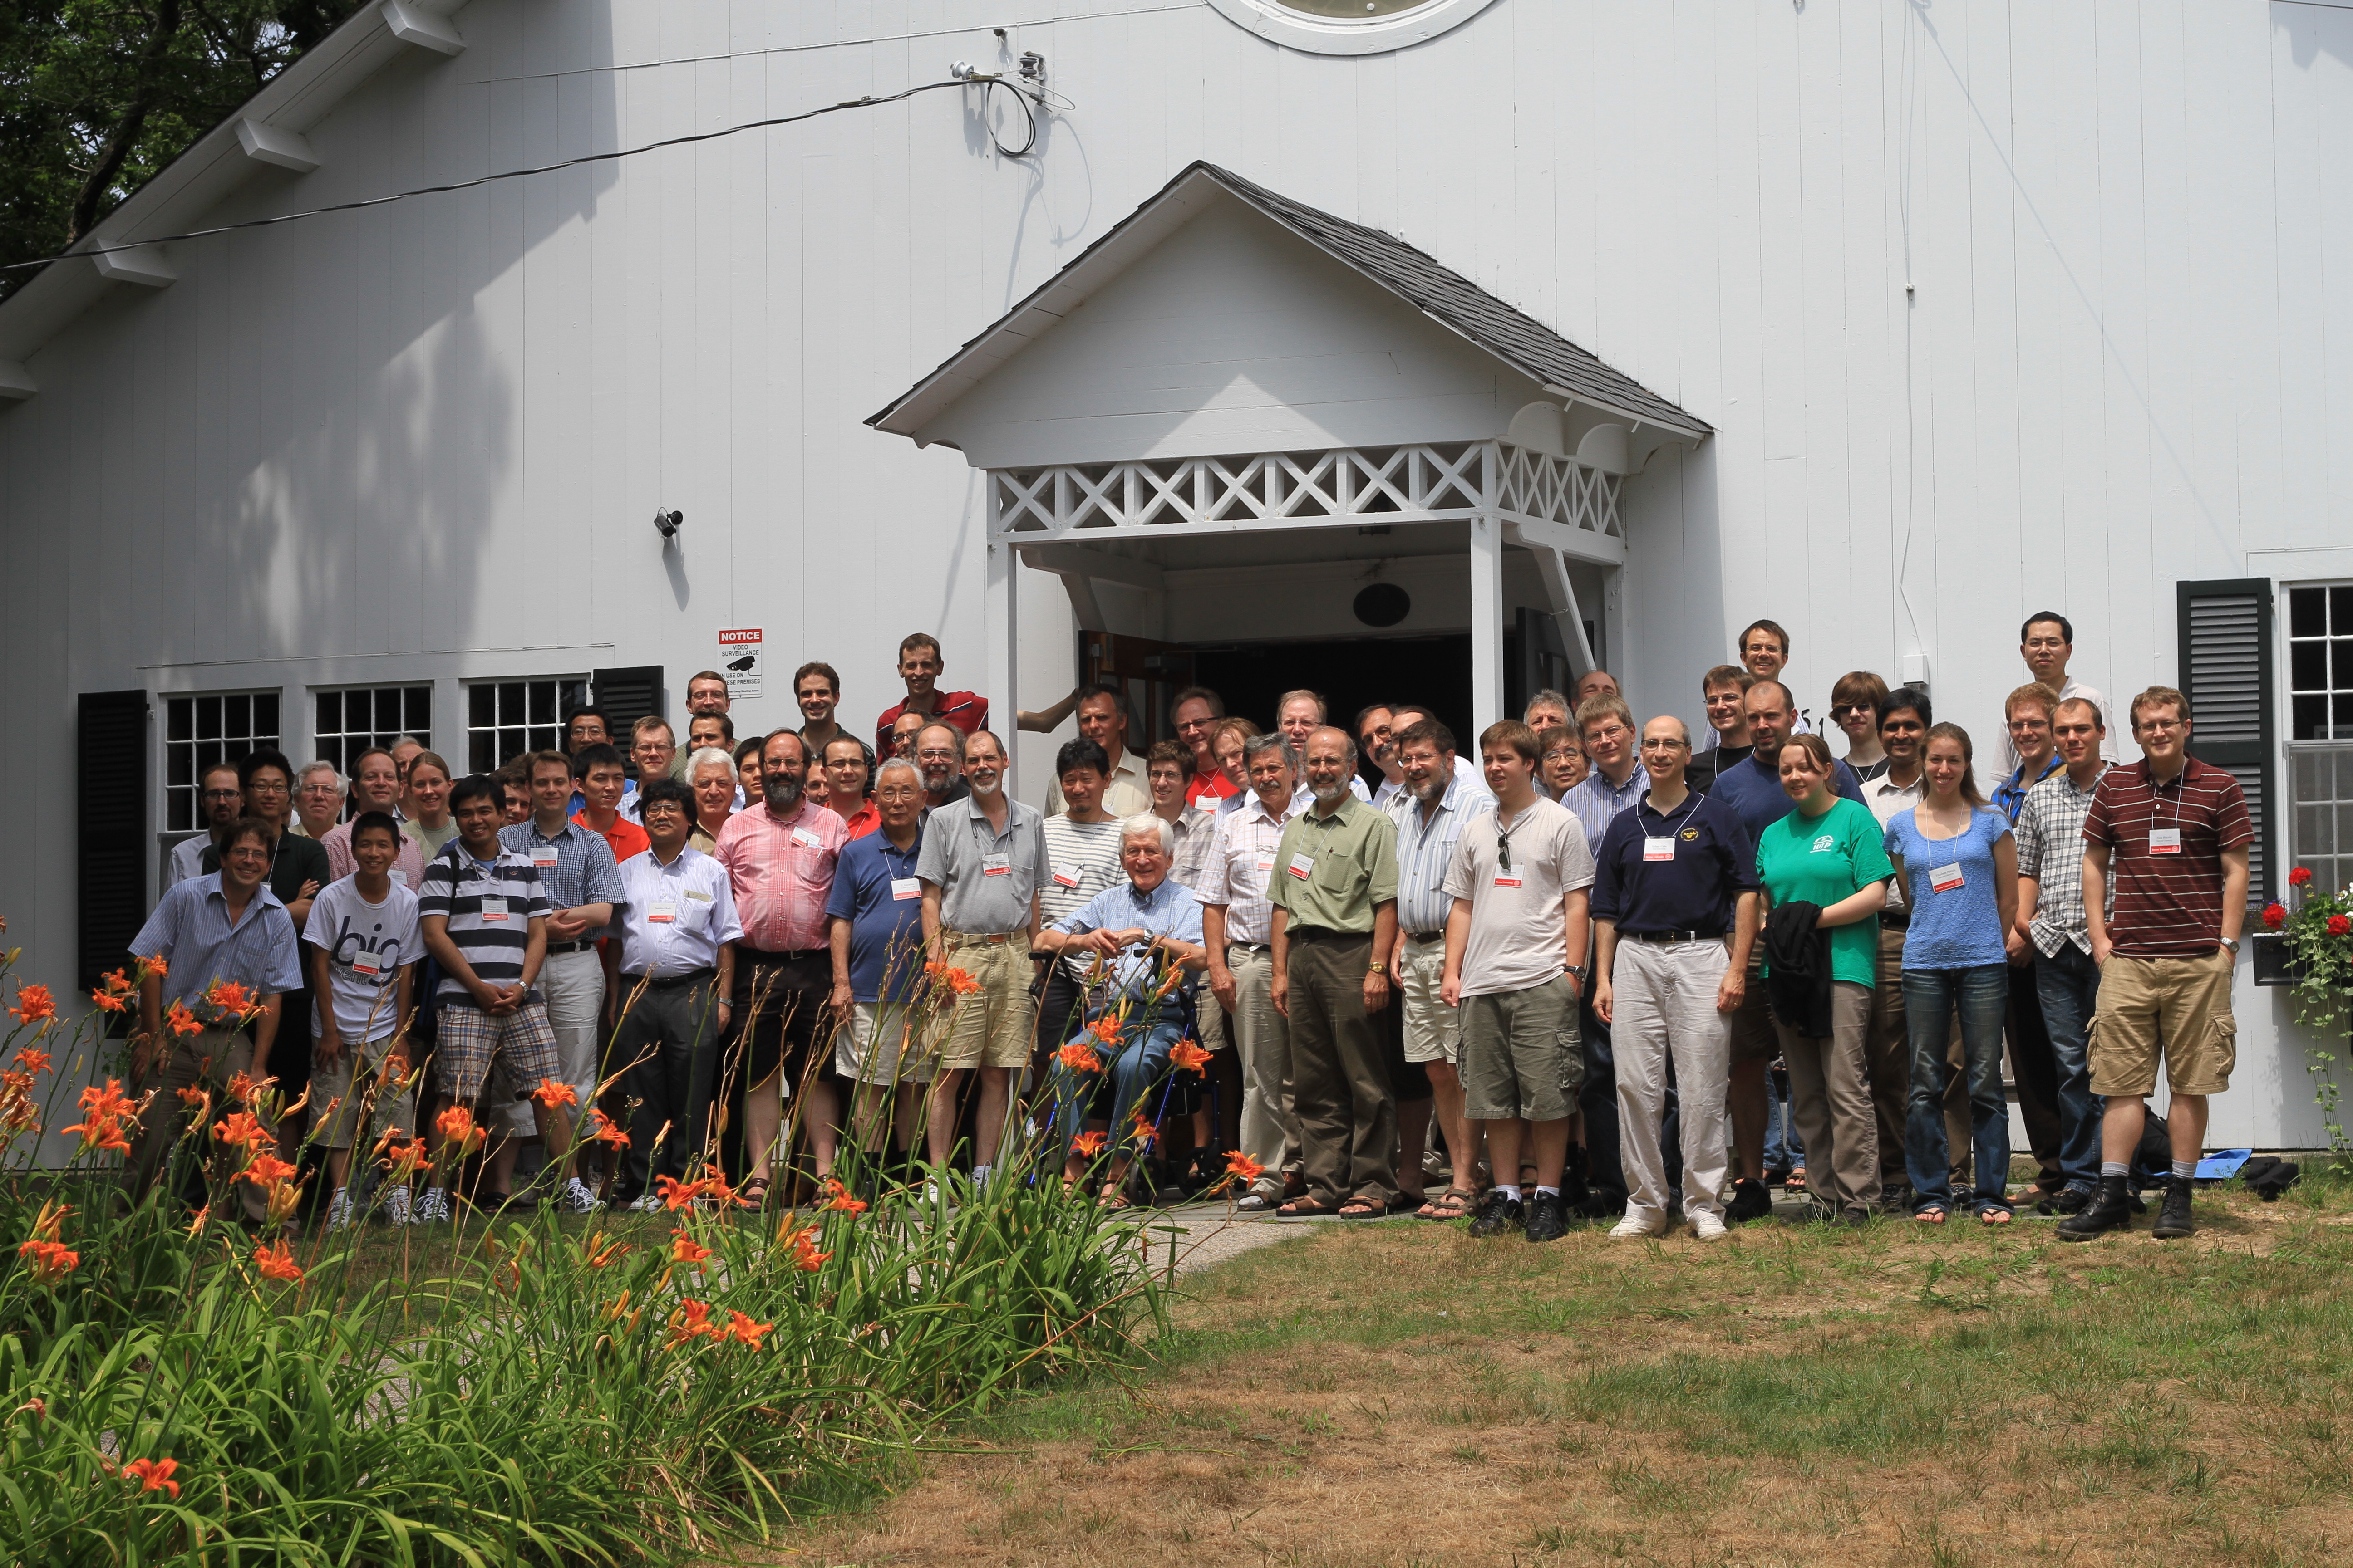
Dedication of LDM
Lepton Moment 2010

Slide 4
Outline (Old New Physics and new New Physics)
A few words about magnetic and electric dipole moments
The electron magnetic moment
  The beginning: g_{e} ≅ 2 and beyond
The muon discovery and magnetic moment
  The beginning: g_{μ} ≅ 2 and beyond
The search for EDMs
The electron EDM
Final remarks

Slide 5
  Goal: To understand how nature works.
Remember that quantum mechanics was once “new physics” and everything we know is built on the pioneering work of Schrodinger, Heisenberg, Thomas, Uhlenbeck and Goudsmit,
and especially Dirac, who produced the famous factor (g = 2); along with the foundation for modern field theory which assumes the Dirac equation as the beginning.

Slide 6
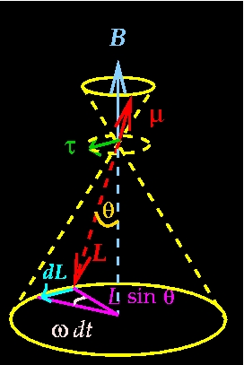
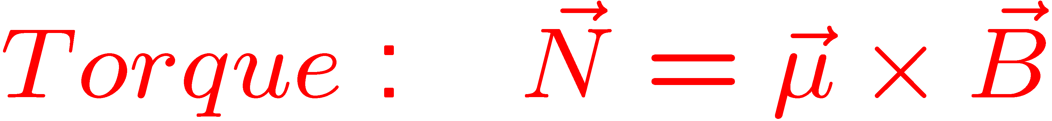
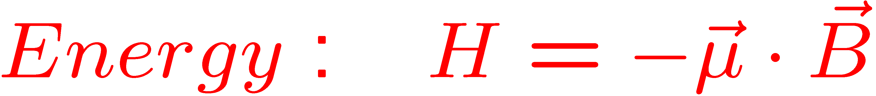
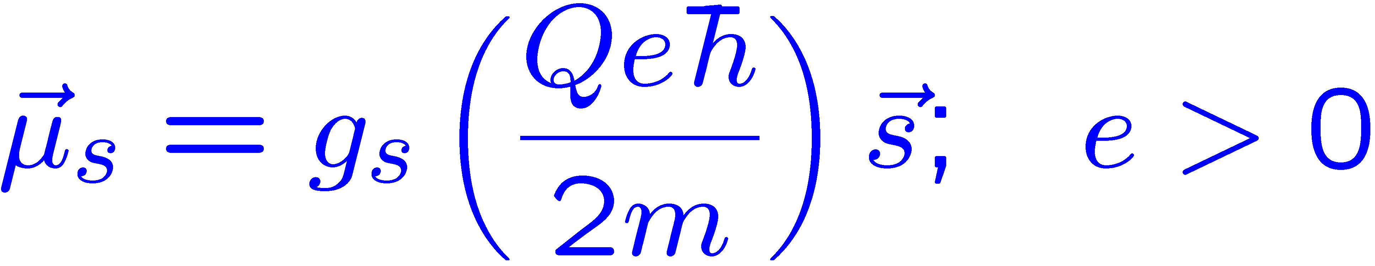
Magnetic Dipole Moments
Dipole in a B field:
μ_{s} for a particle with spin:
Larmor precession
Notes:
6

Slide 7
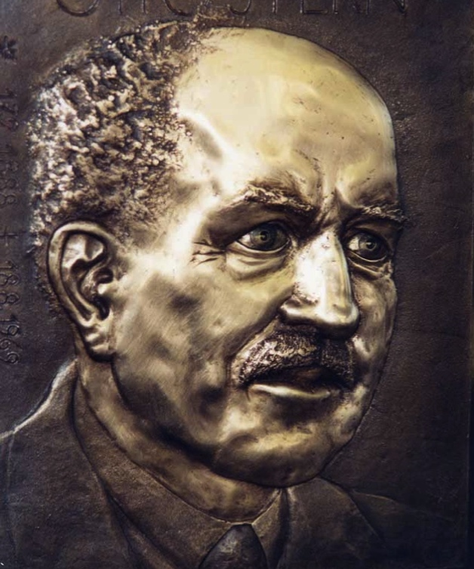
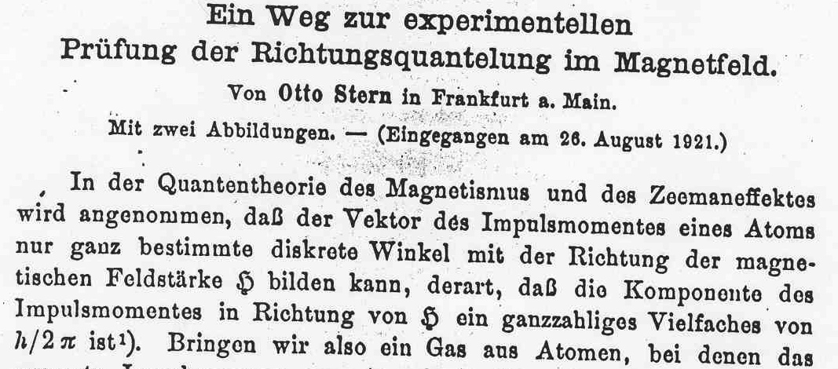
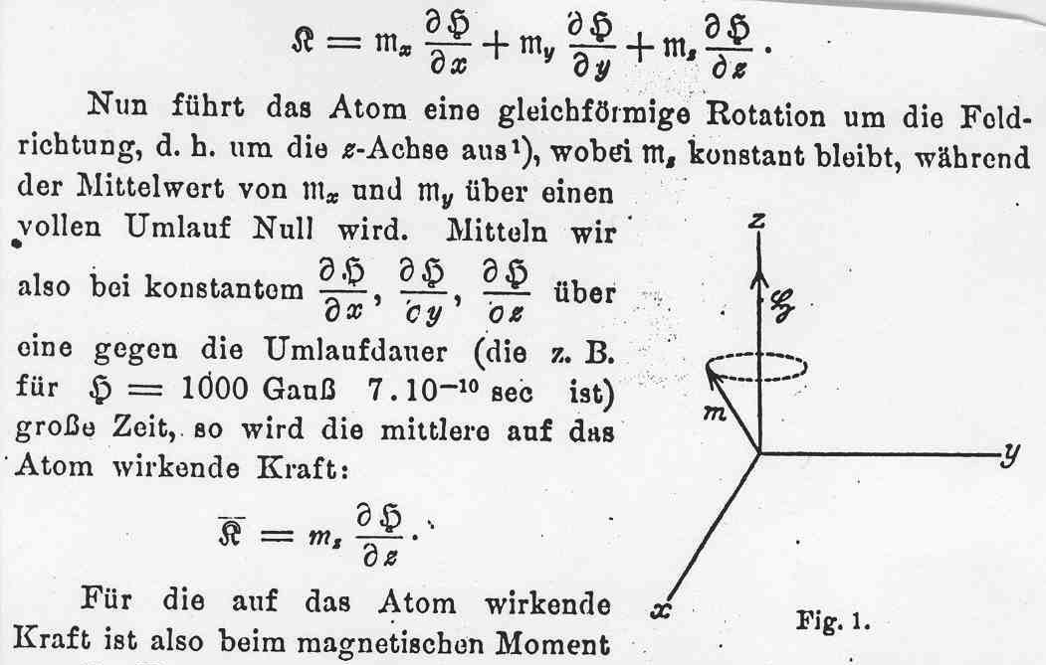
Measurements of Magnetic Dipole moments started with a proposal by Otto Stern to study space quantization:
Z. Phys. 7, 249 (1921)
B. L. Roberts, KVI, 18 February 2010
Notes:
7

Slide 8
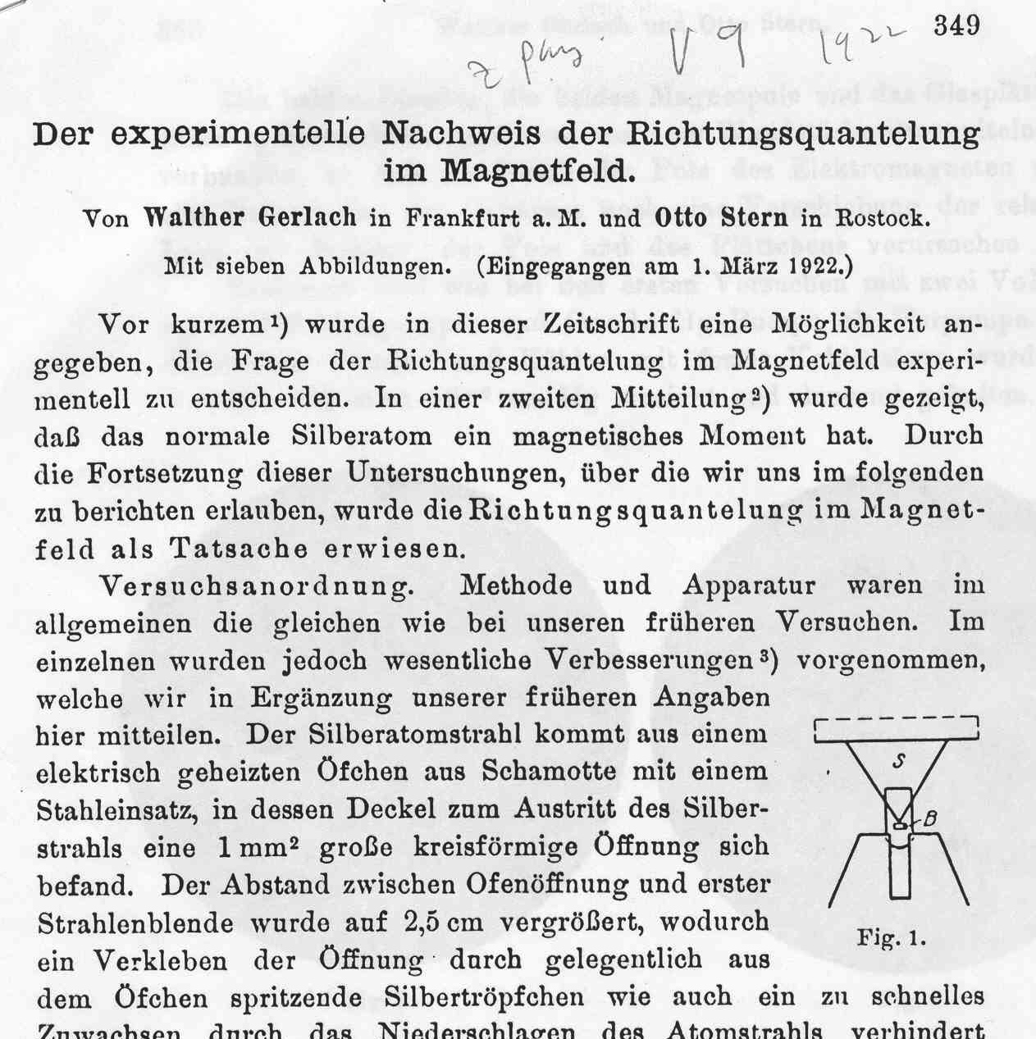
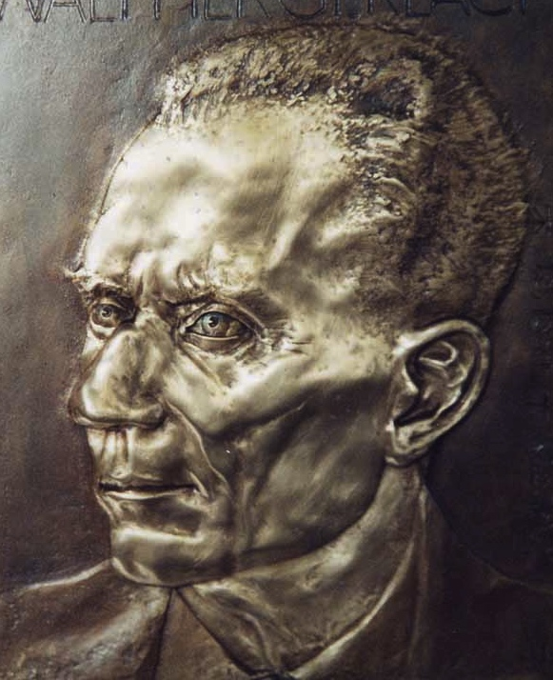
First Result from Walter Gerlach and Otto Stern
Z. Phys. 8, 110 (1922)
W. Gerlach
B. L. Roberts, Fermilab , 3 September 2008
Notes:
8

Slide 9
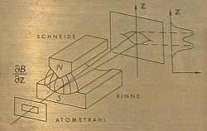
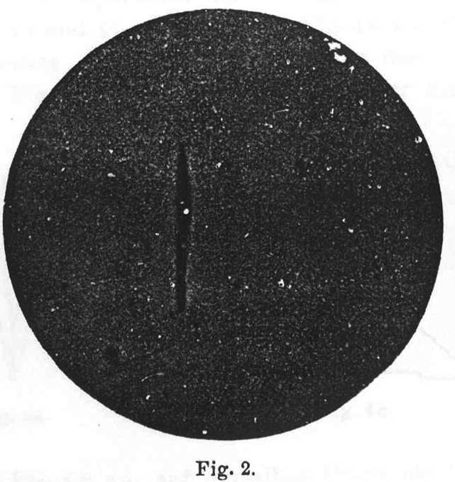
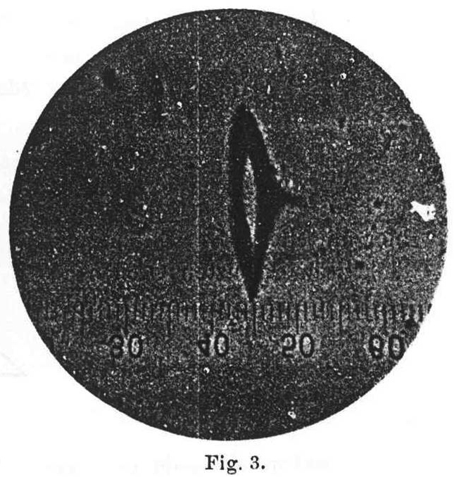
ohne Magnetfeld
mit Magnetfeld
B. L. Roberts, Fermilab , 3 September 2008
- p. 9/68
Notes:
9

Slide 10
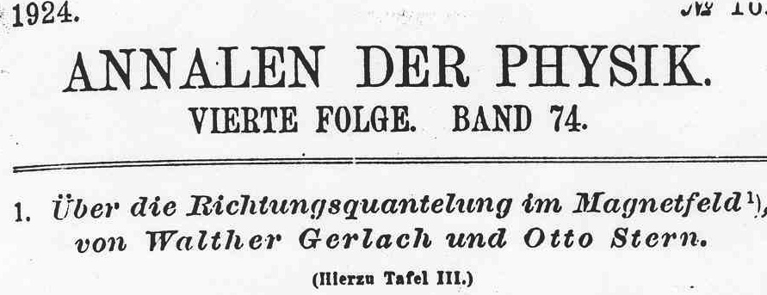
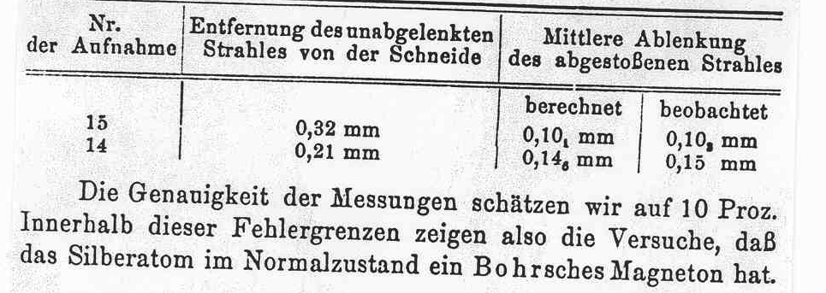
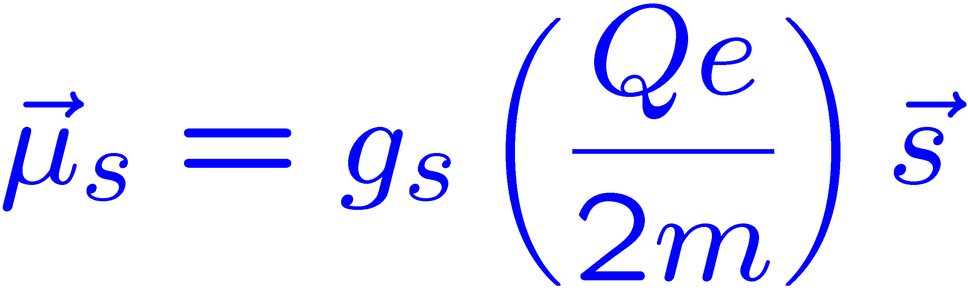
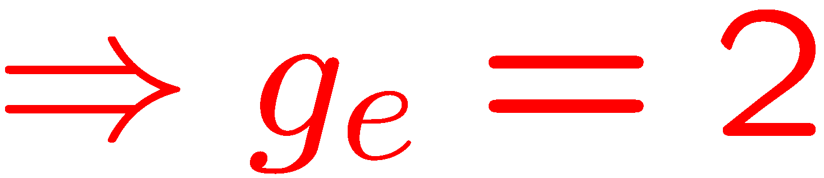
By 1924 they had published 3 papers plus this review article.
10% precision
in modern language
Notes:
10

Slide 11
What had to be understood to conclude g_{e} = 2 ?
Quantum Mechanics
Spin
Thomas Precession

Slide 12
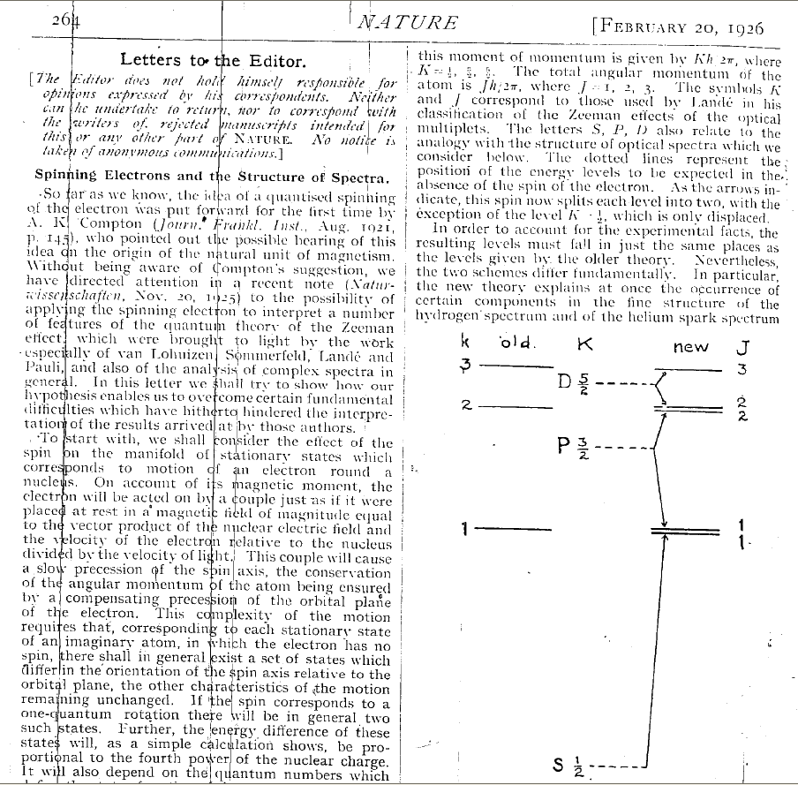
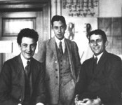
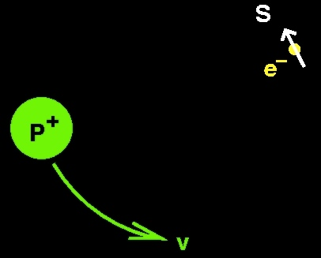
G.E. Uhlenbeck
S. Goudsmit postulated electron spin to explain fine- structure spectra
Klein, U & G
Naturwissenschaften 13, 953 (1925)
Nature 117, 264 (1926)
- p. 12/68

Slide 13
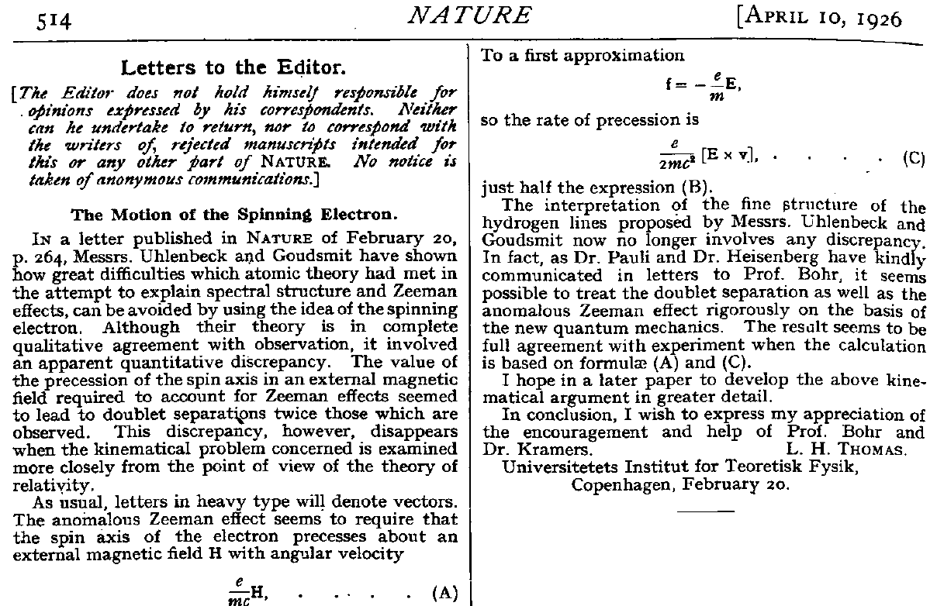
Only after L.H. Thomas’ paper deriving the famous factor of 2, did some people believe in spin.
Nature 117, 514 (1926)
Phil. Mag. 3, 1 (1927)
B. L. Roberts, KVI, 18 February 2010

Slide 14
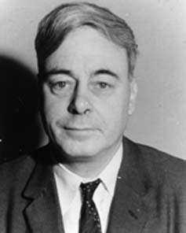
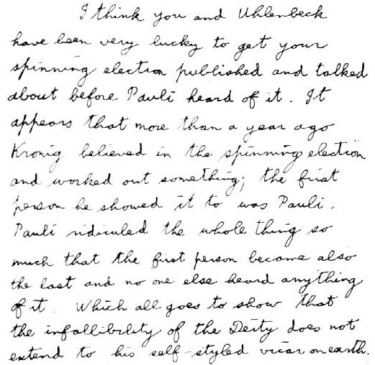
Thomas later told Goudsmit that Pauli ridiculed the idea when he first heard the suggestion from Kronig.
L.H. Thomas
B. L. Roberts, Fermilab , 3 September 2008
- p. 14/68

Slide 15
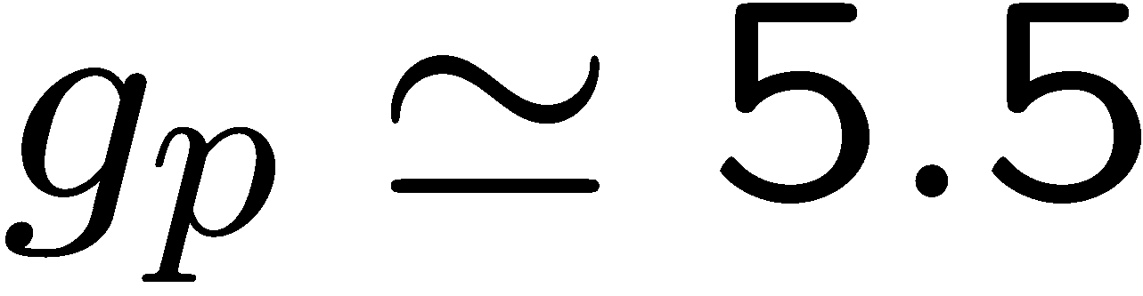
An aside: The g-value of the proton
In 1933, against the advice of Pauli who believed that the proton was a pure Dirac particle, Stern and his collaborators showed that:
which has something to do with its internal structure.
Internal structure can also change g from 2.

Slide 16
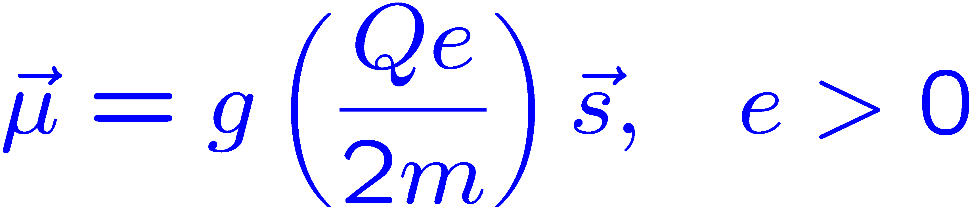
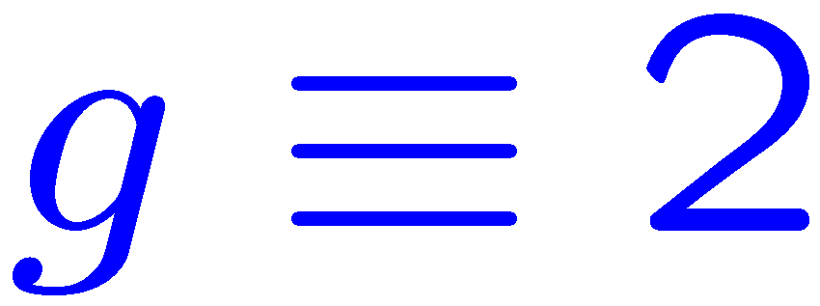
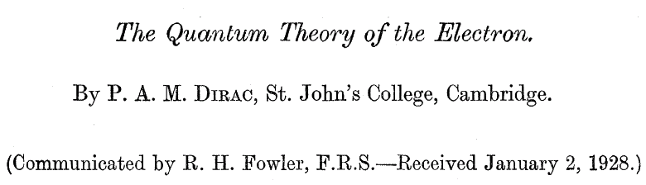
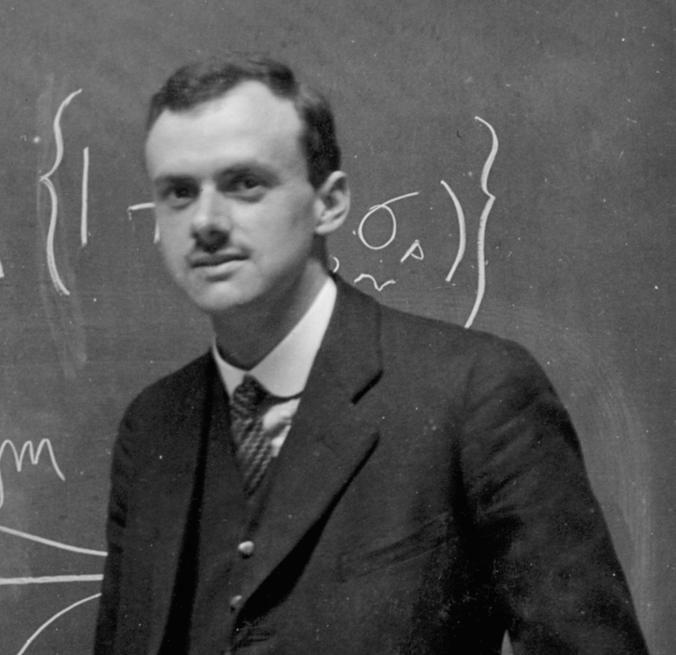
Theory of Magnetic and Electric Dipole Moments
Proc. R. Soc. (London) A117, 610 (1928)
Notes:
16

Slide 17
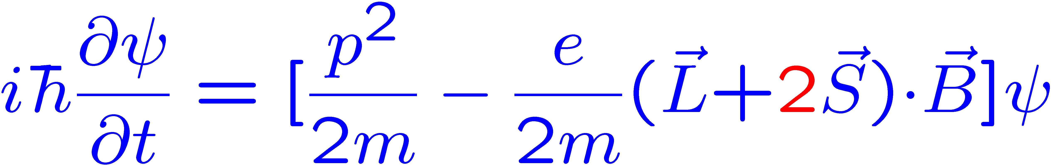
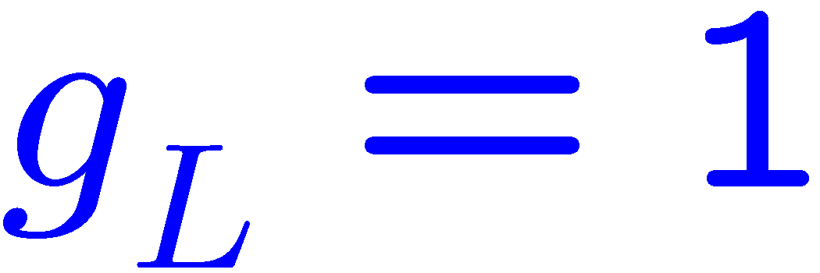
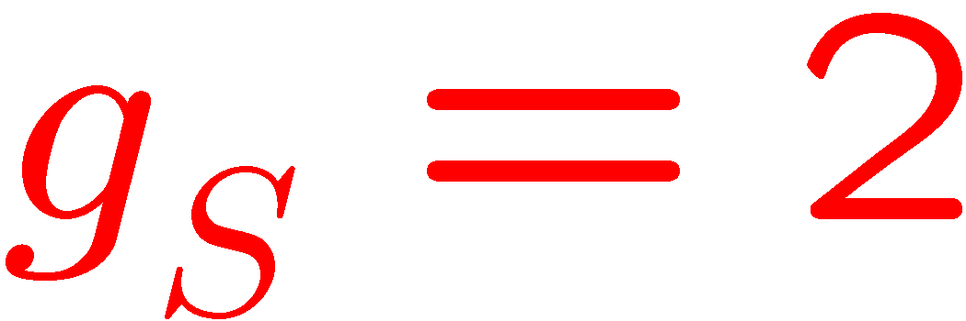
Dirac was surprised when his theory gave the correct magnetic moment of the electron, i.e. g=2
"an unexpected bonus for me, completely unexpected." quoted by A. Pais in Paul Dirac: The Man and His Work, P. Goddard, ed., Cambridge U. Press, New York (1998).
Non-relativistic reduction of the Dirac Equation for an electron in a weak magnetic field.
That was not the end of the story. It became clear in the late 1940s that g > 2 from Hydrogen HFS
Notes:
17

Slide 18
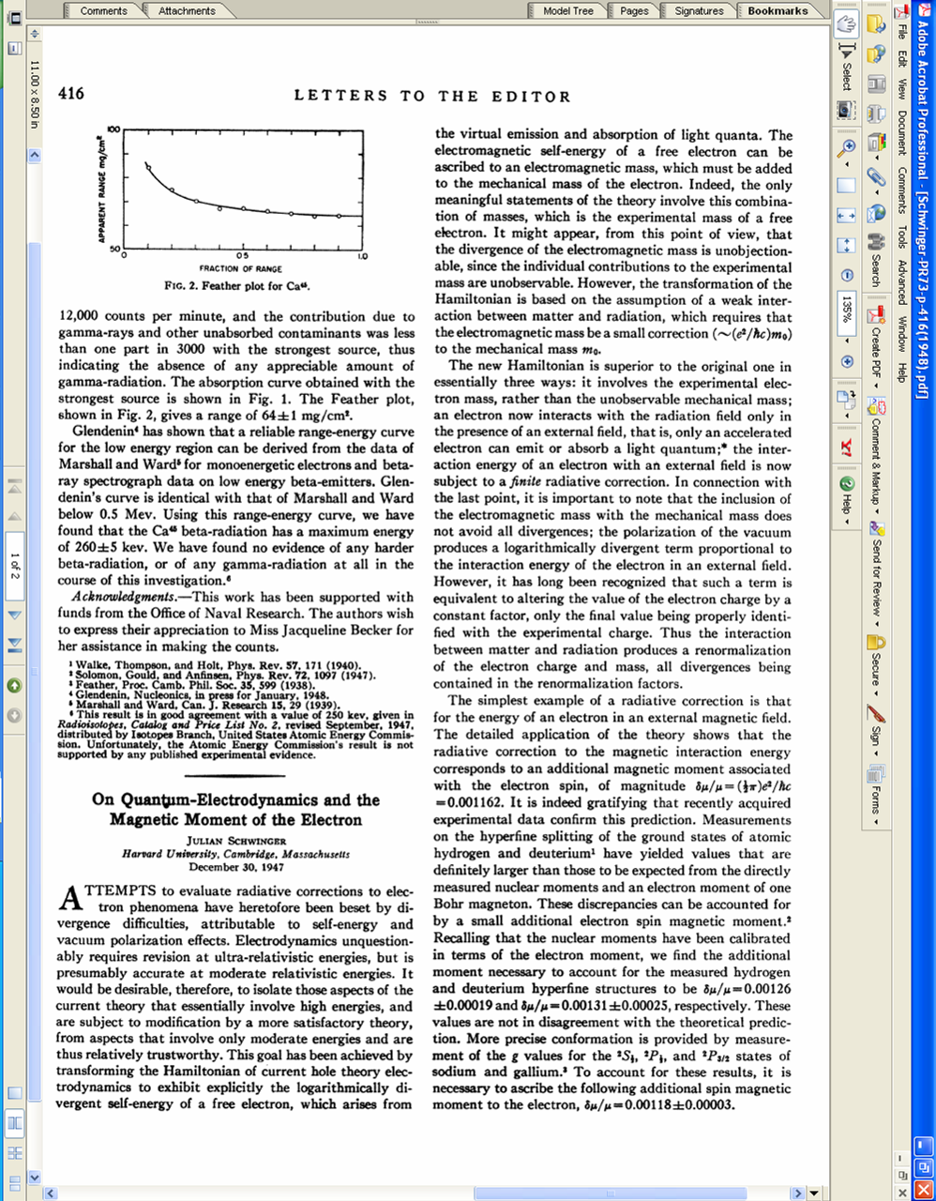
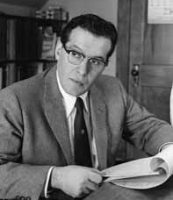
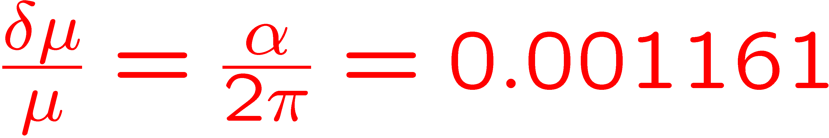
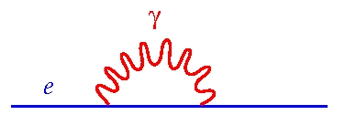
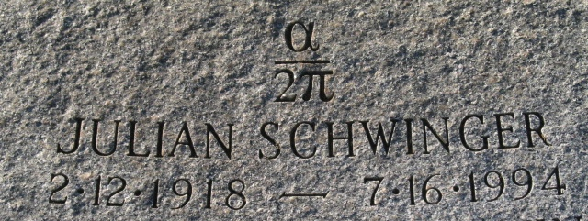
Schwinger
The new Hamiltonian is superior to the original one in essentially three ways:
it involves the experimental electron mass, rather than the unobservable mechanical mass;
an electron now interacts with the radiation field only in the presence of an external field…
the interaction of an electron with an external field is now subject to a finite radiative correction.
absorbed into physical mass and charge
renormalization of mass and charge
Notes:
18

Slide 19
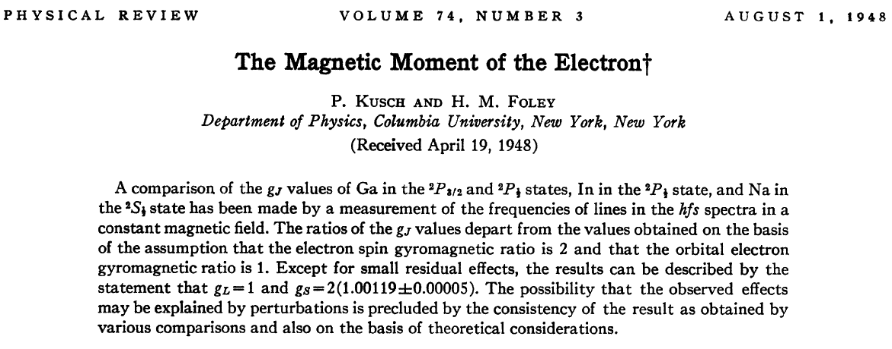
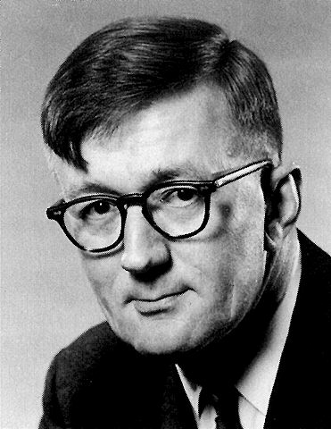
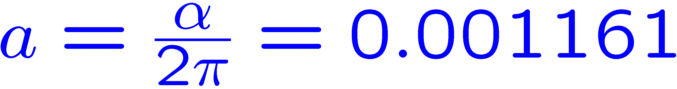
g_{S} measured to 50 ppm
a_{e} to 42 parts per mil
Notes:
19

Slide 20
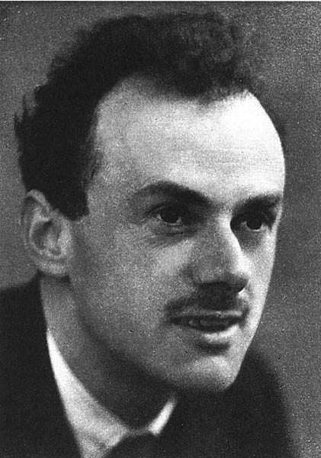
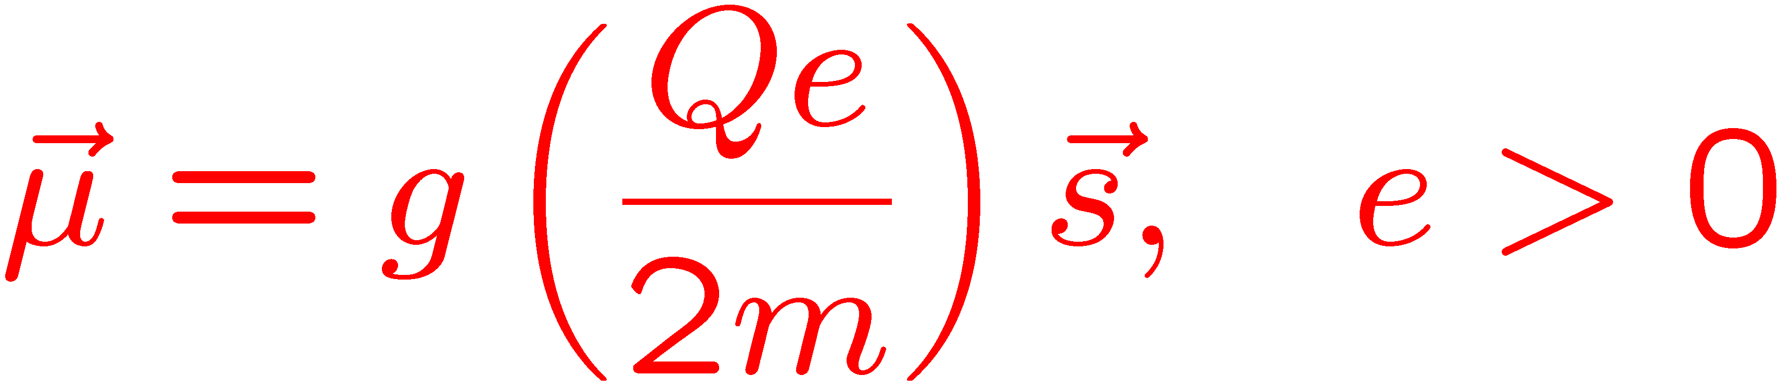
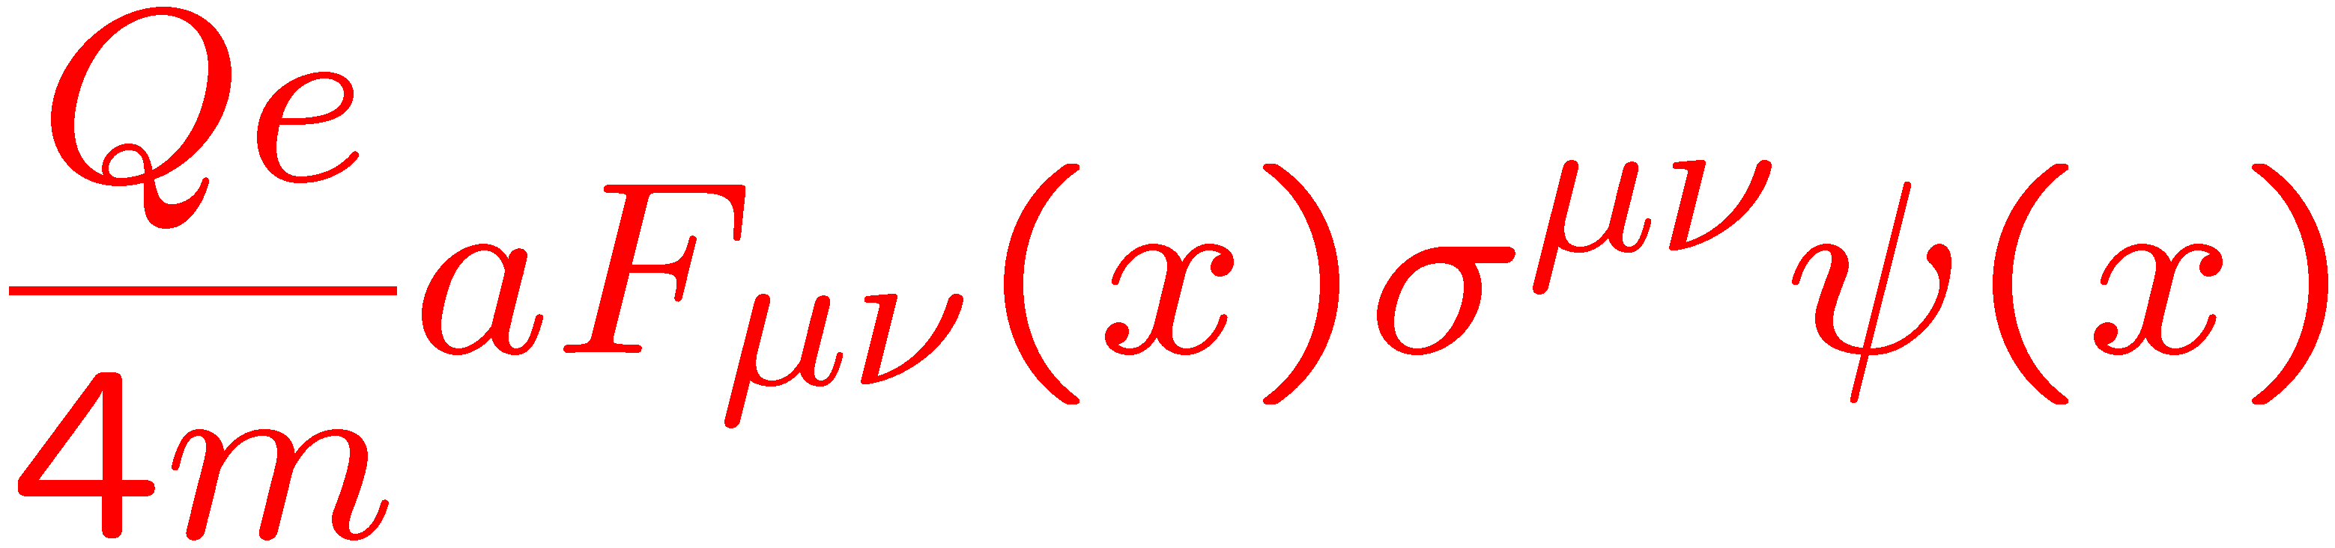
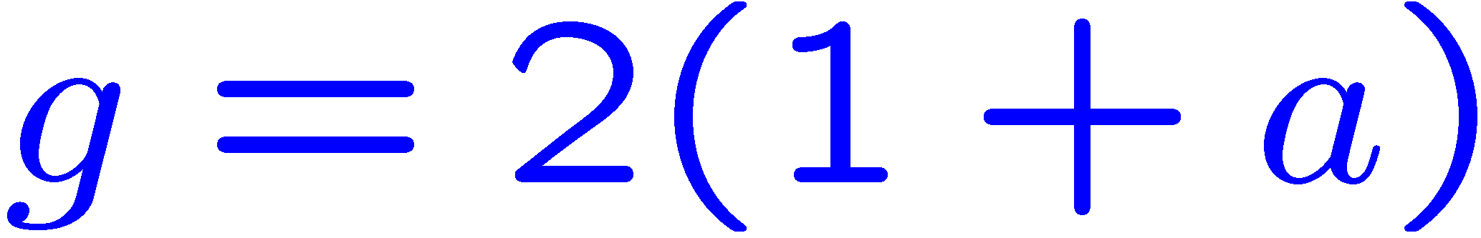
Four technical slides beginning with:
predicted electron magnetic moment
However, experimentally g > 2; need to add a Pauli term
dimension 5 operator
(only from loops)
where a is the anomaly,

Slide 21
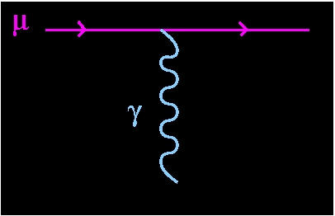
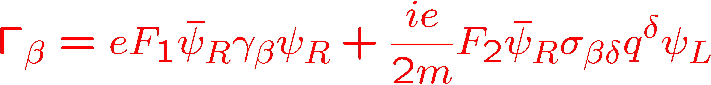


Magnetic and Electric Dipole Interactions
Muon Magnetic Dipole Moment a_{μ}
Flavor conserving chiral changing (like a mass term)

Slide 22



a/g becomes an expansion in (α/π)^{j} from loops
For leptons, radiative corrections, the Schwinger term dominates the value of a ≃ 0.00116…
New Physics contribution to a at some scale Λ
where C could be
or
in weak coupling loop scenarios

Slide 23


The Electric Dipole Moment term:
The same quadratic mass scaling holds on sensitivity to heavy physics.
Relative contribution of higher mass particles to the muon vs. electron anomaly.
where the EDM is defined as

Slide 24




Spin Motion in a Magnetic Field
Particle: q = Qe moving in a magnetic field: momentum turns with cyclotron frequency ω_{C},
spin turns with ω_{S}
Spin turns relative to the momentum with ω_{diff}
which we call ω_{a}

Slide 25




The quantum cyclotron
A single electron in a penning trap, cooled to mK temperatures
Spontaneous emission in the cylindrical trap inhibited by ~140
No fundamental constants needed!

Slide 26

The quantum cyclotron
At 80 mK all ground state

Slide 27





Theory and Experiment
S. Laporta, E. Remiddi
12,672 diagrams
E. Remiddi T. Kinoshita G. Gabrielse

Slide 28
8th and 10th order QED calculations analytically

Slide 29


Experiment and Theory for a_{e}

Slide 30

What would the inventors of QED think about the astoninshing ageement between experiment and theory for a_{e}?
“The main point was that all of us who put QED together, including
especially Feynman, considered it a jerry-built and provisional
structure which would either collapse or be replaced by something
more permanent within a few years. So I find it amazing that it has
lasted for fifty years and still agrees with experiments to twelve
significant figures. It seems that Nature is telling us something.
Perhaps she is telling us that she loves sloppiness.”
Freeman Dyson (private communication) – December 2006
Notes:
30

Slide 31


The Muon
First observed in cosmic rays in 1933
“a particle of uncertain nature”
Paul Kunze,
Z. Phys. 83, 1 (1933)

Slide 32

Identified in 1936
Study of cosmic rays by Seth Neddermeyer and Carl Anderson

Slide 33

So what is the muon?
An excited electron?
  no, μ → e γ was not observed.
Was it related to the electron?
  well it’s decay was 3-body, and only an electron was observed
Did it behave like an electron?
  conservation of angular momentum could be used to guess that it was spin ½

Slide 34



Fitch and Rainwater looked for fine-structure splitting
Stop μ⁻ in matter, forms a muonic Bohr-like atom

Slide 35


The fine-structure splitting depends on the magnetic moment; the 2p → 1s transition is split into 2 lines
The resolution of the NaI detector was not sufficient to see 2 lines, only a broad blob – no nonlinear least square fitting program (no root or PAW then)

Slide 36
using Ge(Li) detector

Slide 37



Measuring the Muon Magnetic Dipole Moment

Slide 38

How do you know where the spin is, and how fast it rotates?

Slide 39

Muon Production: π⁺ → μ⁺ + ν_{μ}
In the rest frame:
  Initial spin is 0
  Final spin is 0 – but the neutrino is left-handed so the muon is polarized!
In the Lab Frame with a pion beam:
  the very forward muons (highest energy) are highly polarized
  the very backward muons (lowest energy) are highly polarized

Slide 40






Garwin, Lederman, Weinrich, PR 105,1415 (1957)
Friedman, Telegdi PR105, 1681 (1957)

Slide 41

The Nevis Experiment
85 MeV π⁺, μ⁺
  Produce a beam of π⁺,μ⁺
  Stop π⁺ in a carbon degrader, permitting muons to stop in a carbon target
  Use a simple telescope to detect e⁺ with E_{e} > 25 MeV
  count e⁺ between 0.75 – 2 μs
  look for the angular distribution (1 + a P cos θ)
  However, the counter only samples e⁺ at 100º
  Use a B field to rotate the spin, so for a small time window, the angular distribution is turned into a distribution of counts vs. magnet current
degrader to stop π⁺ before C target
e+ detector counters

Slide 42


The first muon spin rotation experiment
Fit to
g = 2 ± 10%
Déjà vu of Stern-Gerlach
Measures g not a

Slide 43
“Note added in Proof”
a
± 0.7%

Slide 44


Final Nevis Experiment: PR 118, 271 (1959)
In a magnetic field the muon behaves like a heavy electron!
The generation structure of the Standard Model
Note added in proof
g_{μ} measured to (140 ppm)
a_{μ} to ( 12.4%)
≈ ×3 Kusch and Foley precision

Slide 45

The Spin Equations with an electric field
0
Motional magnetic field

Slide 46

Brookhaven Lab: E821 Arrival time spectrum μ ⁻
γτ
0 – 100 μs
100 – 200 μs
200 – 300 μs
300 – 400 μs
400 – 500 μs
500 – 600 μs
600 – 700 μs
Time modulo 100 μs

Slide 47
BNL E821 Results; It’s now 60 years since Garwin, Lederman, Weinrich measured g=2

Slide 48





Electric Dipole Moment: The search for non-SM CP
torque
E.M. Purcell and N.F. Ramsey Phys. Rev. 78 (1950)

Slide 49

E.M. Purcell and N.F Ramsey PR 78, 807 (1950)
“raises directly the question of parity”

Slide 50



Electric Dipole Moment: P T
Transformation Properties
If CPT is valid, the T violation of an EDM would imply non-standard model CP. Of course, we need new sources of CP to explain why we’re here.

Slide 51
The Muon EDM would modify the precession.
Frozen Spin
A muon EDM would modify the spin equation
the motional electric field will dominate, so the precession plane is tilted.
An up-down oscillation out of phase
with ω_{a}.
0

Slide 52
E821 Data: ^{up-going}/_{down-going} tracks vs. time, (modulo the g-2 frequency):
Back
(g-2)
EDM
(g-2) signal: # Tracks vs time, modulo g-2 period, in phase.
EDM Signal: Average vertical angle modulo g-2 period. Out-of-phase by 90° from g-2; this is the EDM signal
BNL tracker measurement was essentially statistics limited
  1 station (out of 24)
  Late turn-on time
  Small acceptance
  Ran 2 out of 3 years

Slide 53








Principle of the “traditional” EDM measurements
B₀
B₀
E
B₀
E
E=100 kV/m
Notes:
Need to keep B very steady!

Slide 54


Slide 55
Ramsey: Separated Oscillatory Fields
Polarized neutrons
Apply π/2 pulse
Let the spin evolve in the parallel E and B fields
Interrogate the spin with 2nd π/2 pulse
Δ frequency; go to 1.

Slide 56
Ramsey Resonance
Two clocks: The ν_{RF}, and the neutron precession ν_{L}
If ν_{RF}, matches the neutron precession ν_{L} , then get maximum
If the ν_{RF} ν_{L} , then phase difference, φ, accumulates
Look for a fringe shift between
Phil Harris
arXiv:0709.3100v3 [hep-ex] 5 Dec 2007

Slide 57
The Apparatus – model for almost all EDM experiments
Smith, Purcell and Ramsey
interrogate
polarize,
π/2 RF pulse
Larmor precession + EDM precession
region with
n beam
Ramsey method of separated oscillatory fields.
By changing the RF frequency you map out the Ramsey resonance

Slide 58

Several experiments aim for 10⁻²⁸ e cm
Baker, et al,
PRL 97, 131801 (2006)

Slide 59
This all seem so simple, what’s the catch?????
Suppose d_{e} = 5 × 10⁻²⁸ e cm (≃ × 10 present limit)
The magnetic moment precession is huge!
In a field of 100 kV/cm
When does equal this?
Should we give up now????
Can we really control B at this level when applying a large E field? (leakage currents, etc.)
From Ed Hinds LM 2006

Slide 60

Pat Sandars to the rescue
From Ed Hinds LM 2006

Slide 61

YbF: really large internal field
Parpia
Quiney
Kozlov
Titov
18 GV/cm
15 GV/cm
(2011)
15
Effective Field |ηE| (GV/cm)
10
5
5
10
15
20
25
30
Applied Electric Field (kV/cm)
From Ben Sauer LM 2014

Slide 62
Comparing some atomic and molecular systems
YbF, 2011: | |= 14.5 GV/cm (η = 0.56)
|d_{e}|<1.0 x 10⁻²⁷ e.cm (90% c.l.)
Tl, 2002: | |= 72 MV/cm (Eeff = -582 E_{applied})
|d_{e}|<1.6 x 10⁻²⁷ e.cm (90% c.l.)
PbO*, 2013: | |= 25 GV/cm
|d_{e}|<1.7 x 10⁻²⁶ e.cm (90% c.l.)
Eu_{0.5}Ba_{0.5}TiO₃, 2012:
|d_{e}|<6 x 10⁻²⁵ e.cm (90% c.l.)
ThO*: | | = 84 GV/cm (factor of 6 on 2011 YbF)
|d_{e}|<8.7 x 10⁻²⁹ e.cm (90% c.l.)
From Ben Sauer LM 2014

Slide 63
YbF Experiment
Nature 473, 493 (2011)
Prepare
  empty F = 1 HF level
  apply RF to create
Evolve in
  2nd RF pulse → F=0
Figs from Commins & DeMille Lepton Dipole Moments p 555-556

Slide 64
YbF ctd.
Changing the phase φ by varying B, they get interference pattern:
Look for shift between
  the signal is optimized by
  so they operate with
  They had 512 combinations of parameters, some sensitive to EDM some not, that they cycled randomly between,

Slide 65
Storage Cell: ¹⁹⁹Hg - PRL 116, 161601 (2016)
Measurement time 170 s

Slide 66
Electron EDM Experiments: Atomic Beam
ThO Atomic Beam Science 343, 269 (2014) Harvard Yale (ACME)
Measurement time T ≃ 1 ms

Slide 67
Electron EDM Experiment: Trap
¹⁸⁰Hf¹⁹F⁺ in a Paul Trap: Phys. Rev. Lett. 119, 153001 (2017)
How on earth do you apply an electric field to an ion in a trap and not have it fly away???

Slide 68
!!!!!Use rotating E-field bias!!!!!
-E-field defines quantization axis
-Excellent rejection of lab-frame residual
B-field.
ω_{rot} is:
BIG enough that radius
of “micromotion” circle
is small compared to
trap size.
SMALL enough so that
d_{mol} E >> ω_{rot} and the
molecule axis stays
aligned with E.
+
ω_{rot}t
E
+
+
+
One does Zeeman-level
spectroscopy then
in the rotating frame.
Eric Cornell Lepton Moments 2006

Slide 69
Electron EDM Experiment: Trap
¹⁸⁰Hf¹⁹F⁺ in a Paul Trap: Phys. Rev. Lett. 119, 153001 (2017)
How on earth do you apply an electric field to an ion in a trap and not have it fly away???
Apply a rotating electric field!
Measurement time T > 700 ms
with

Slide 70










The present EDM limits are orders of magnitude from the standard-model value
Particle | Present EDM limit (e-cm) | SM value (e-cm)
90% CL
95% CL
90% CL Beam
90% CL Trap
%
References: n PRL 97, 131801 (2006); p, ¹⁹⁹Hg PRL 116, 161601 (2016); e⁻ Science 343, 269 (2014), PRL 119, 15301, (2017), μ PRD 80, 052008 (2009)
Large window for discovery, but it’s very hard to open!

Slide 71
The Physics Case:
From the Proton Driver Workshop in 2004
muon working group summary
(muon trio = MDM, EDM, CLFV
Scenario 1
  LHC finds SUSY
All three will have SUSY enhancements
  to understand the nature of the SUSY space we need to get all the information possible to understand the nature of this new theory

Slide 72
The Physics Case
Scenario 2
  LHC finds Standard Model Higgs at a reasonable mass, nothing else, (g-2) discrepancy could be the only indication beyond neutrino mass of New Physics
Then precision measurements come to the forefront, since they are sensitive to heavier virtual physics.
  μ-e conversion is especially sensitive to other new physics besides SUSY

Slide 73
Well, we seem to be in scenario 2
This means that searches for new physics in precision measurements may be the only way forward at present for the discovery of new physics.
The Muon g-2 experiment is underway here at Fermilab, and has the promise of perhaps a major discovery.
The search for new sources of CP is a very pressing subject, since our existence depended on it.
Thus far, CP in the kaon sector and in the B sector seems to be all Standard Model, and inadequate to explain our existance.
  but the Standard Model CP was found in the second and third generation, not in the first!
Perhaps the muon EDM has a surprise waiting for us to discover.

Slide 74

Thank you
Notes:
74

