Slide 1
A Roadmap for Nuclear Energy Technology
Tanju Sofu
Argonne National Laboratory
Fermilab Colloquium
June 28, 2017
Fermi National Accelerator Laboratory

Slide 2
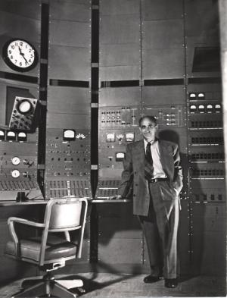
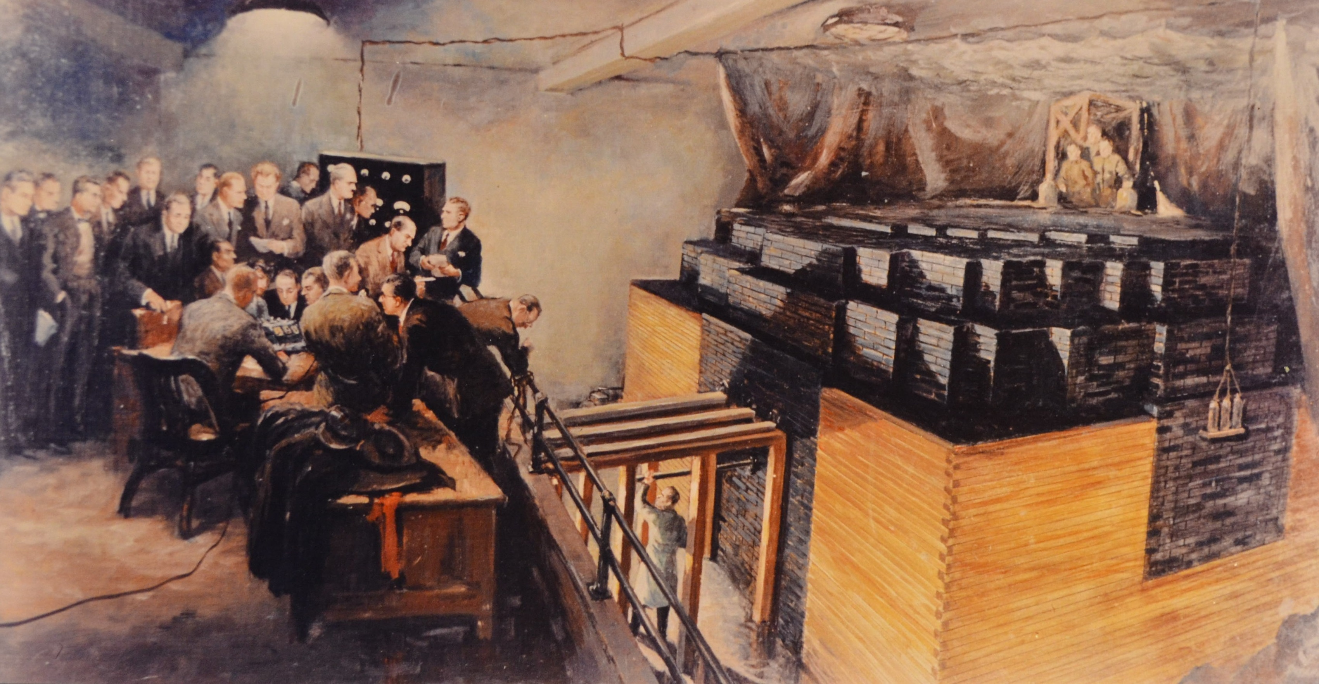
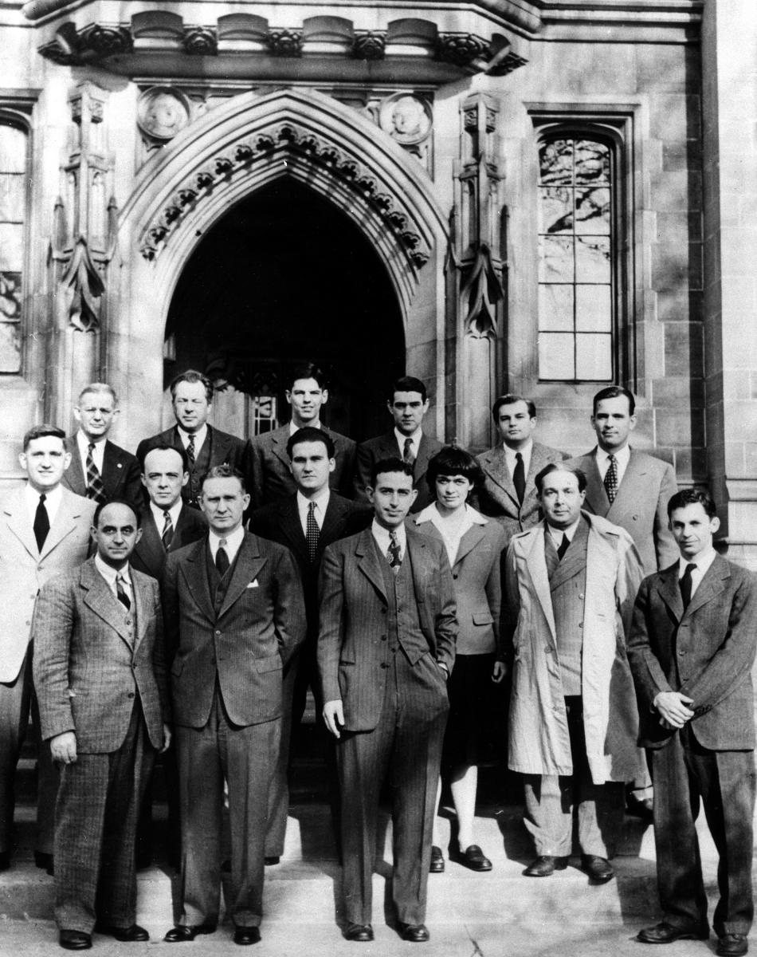
Beginning of the road…
Chicago Pile 1
Notes:
Only 10 years after the discovery of neutron by Chadwick in 1932

Slide 3
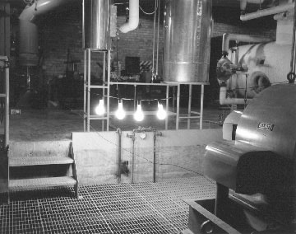
Beginning of the road…
Argonne’s EBR-I produces first ever nuclear generated electricity on December 20, 1951
Notes:
And 9 years after Fermi’s demonstration of nuclear fission in 1942

Slide 4
And 40+ years later…
Notes:
First commercial NPPs started popping up in later 60s, merely 15+ years after EBR-I
And, in about 40 years after EBR-I, the world would have about 400 NPPs built (each a million times+ more powerful) commercially operating around the clock.
Not counting the research reactors, navy ships and submarine systems…
But it all stalled toward the end of 1980s…
Until 2010s…

Slide 5
Outline
Global perspectives
Rollback due to Fukushima and historically low fossil fuel prices
New demand due to rapid urbanization
National perspectives
Pending retirement of nuclear fleet
DOE-NE’s vision for nuclear energy
Beyond the horizon opportunities
Role of advanced reactors
Sustainable fuel cycle
Notes:
Past 60+ some years, we now have 400+ of these (each a million times+ more powerful) around the world, commercially running around the clock.
Not counting the research reactors, navy ships and submarine systems…

Slide 6
Global Nuclear Energy Market
Renewed interest in nuclear energy worldwide is largely driven by:
need to develop carbon-free energy sources, and
rapid development of emerging economies.
Russia
France
S. Korea
China
Restructuring
(exporters)
Growth
(import & export)
U.S.
Canada
U.K.
India
Supply
Phasing out
(D&D)
New Entries
(importers)
Vietnam
Indonesia
Turkey
UAE
Poland
Spain
Sweden
Italy
Germany
Demand

Slide 7
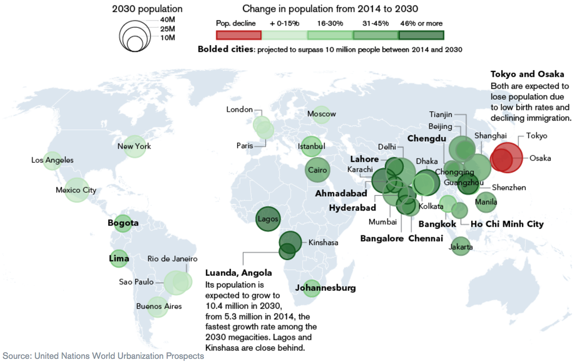
Connection to Rapid Urbanization
Cities with a projected 2030 population of >10M
Notes:
Note that Chicago is not on the map
Note the light-green colors in developed countries
Vs. large, dark green colors in developing countries

Slide 8
Connection to Rapid Urbanization (cont.)
Trend for global urbanization is expected to continue beyond 2030
66% of the world’s population projected to be urban by 2050
In contrast to 30% in 1950, and 55% today
Most urbanized regions today are the population centers in North America and Europe
82% living in urban areas in N. America and 73% in Europe
Asia and Africa are urbanizing faster than the other regions
Projected to become 64% and 56% urban, respectively, by 2050
India, China and Nigeria alone are expected to account for a third of the projected growth of the world’s urban population.
“2014 Revision of World Urbanization Prospects,” United Nations Department of Economic and Social Affairs Population Division, https://esa.un.org/unpd/wup/.

Slide 9
Impact of Rapid Urbanization
Future use of nuclear energy ⬄ Global population growth & urbanization
Concentrated population centers require base-load power
Limited role for distributed renewable energy sources in urban areas
As the world continues to urbanize, sustainability challenges will be increasingly concentrated in developing countries
Energy need outpace population growth, adding to the increased demand for energy and pollution concerns
OECD International Energy Agency’s 2DS study* suggests that the current global nuclear capacity needs to more than doubled by 2050
An increase in global share of nuclear electricity from 11% to 18% during the same period
*Energy system deployment pathway for at least a 50% chance of limiting average global temperature increase to 2ºC by considering a 60% reduction in CO₂ emissions by 2050.

Slide 10
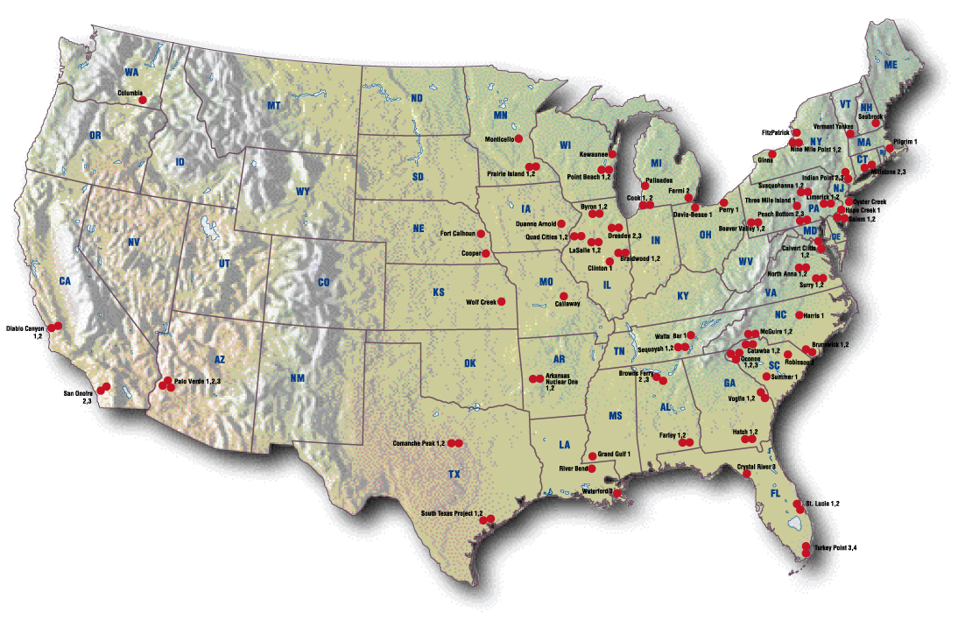
U.S. National Picture
In the U.S., current nuclear fleet of ~100 plants generates about 20 percent of the nation’s annual electricity.

Slide 11
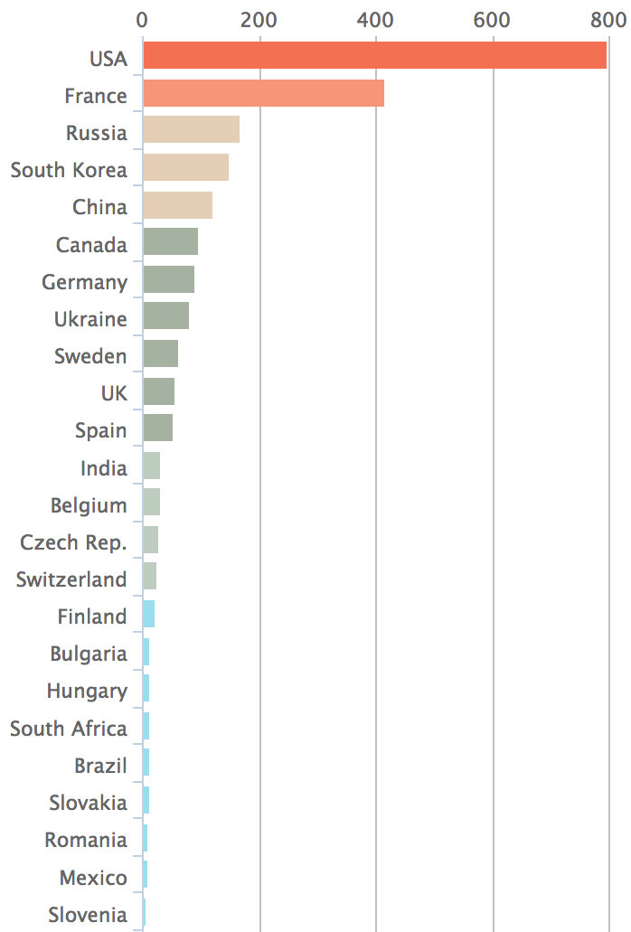
U.S. National Picture (cont.)
~100 nuclear power plants generate 800 million megawatt-hours of energy, representing over 60 percent of the nation’s emissions-free electricity.
Current U.S. nuclear generation represents 500 million tons of avoided carbon emissions
As a reference, the EPA Clean Power Plan is designed to reduce carbon emissions by 750 million tons by 2030

Slide 12
U.S. Nuclear Fleet
The U.S. fleet is based on light-water reactor technology which is a direct descendant from the U.S. Navy propulsion program.
It is the oldest operating nuclear plant fleet in the world and retirements begin around 2030.
Notes:
Throughout 70s, on average 5 NPPs were coming online each year…
What happened in 1979?
The trend in China is very similar to 1970-80 period in the U.S.

Slide 13
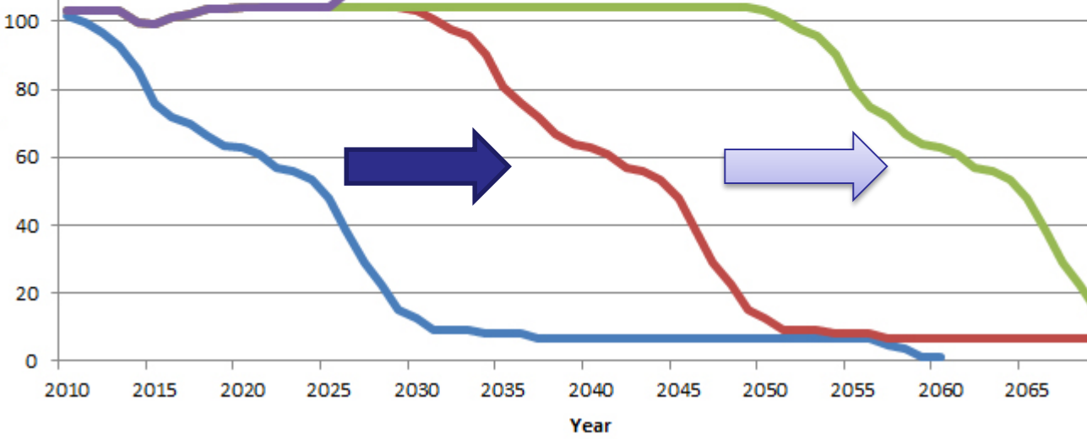
U.S. Nuclear Cliff
Planned decommissioning of the existing plants pose a “retirement cliff”
Already started
Notes:
Note that license renewals do not assure full-life operation (old car analogy).

Slide 14
U.S. Nuclear Cliff (cont.)
Replacement of nuclear fleet with natural gas or coal fired plants will have a large economic, environmental, and climate change impact
Solar
Wind
Hydro
Gas
Coal
New Nuclear

Slide 15
Decarbonization of Electricity Production
Notes:
Emission from NG is 48% of the emission from Coal

Slide 16
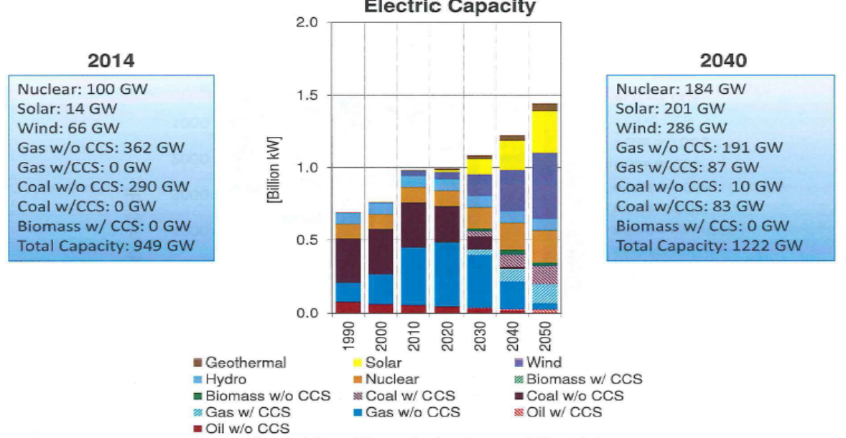
Decarbonization of Electricity Production (cont.)
Several energy sector scenarios* project 1.6-2.4% increase in contributions from nuclear to meet 80% greenhouse-gas reduction goal by 2040
*DOE’s Office of Energy Policy and Systems Analysis (EPSA) Low-Carbon Energy Futures Workshop (January 2016)

Slide 17
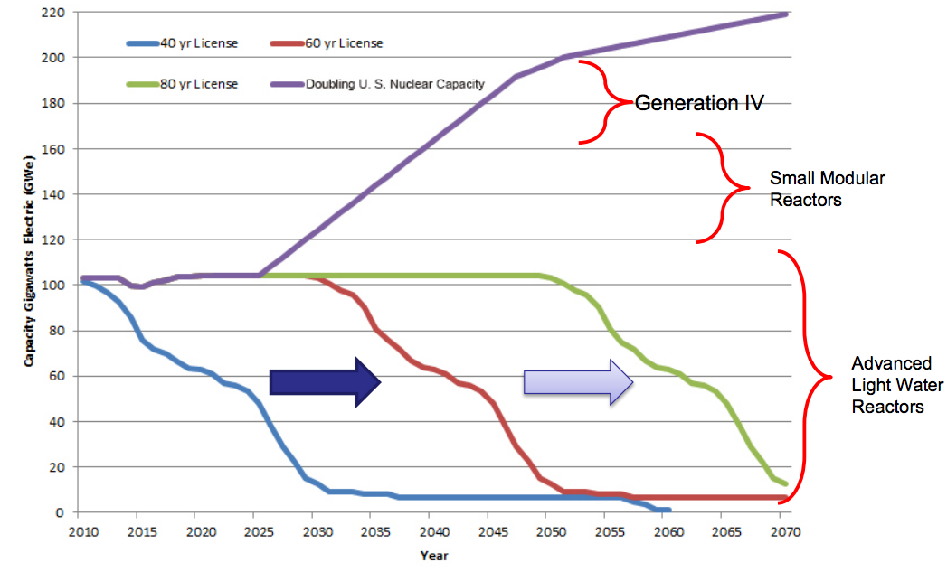
Department of Energy Vision for U.S. Nuclear

Slide 18
Four Generations of Nuclear Reactor Designs
Notes:
Differentiate “light” vs. “heavy” water

Slide 19
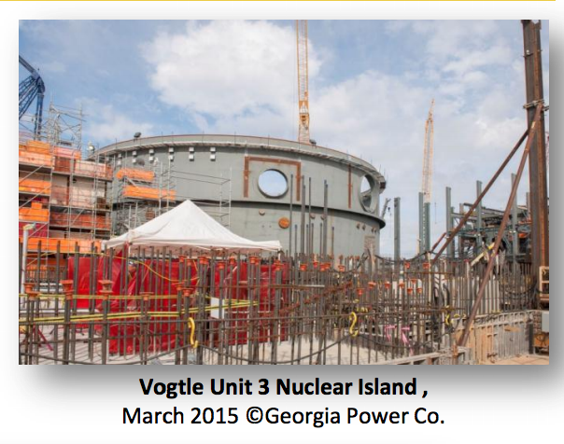
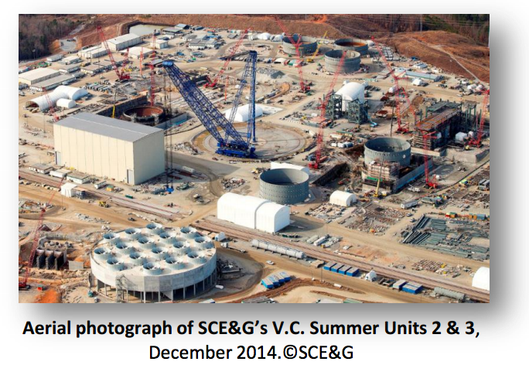
Status of New Builds in U.S.
Gen-III+ designs are an evolutionary step in large water-cooled reactor technology
First new reactors being built in U.S. in 30 years
Watts Bar: 2015
Vogtle: Late 2017
V.C. Summer: 2018-2020
Water-cooled SMR technologies are also of some interest
Passive decay heat removal by natural circulation
Simplified design, below grade siting
Potential for reduction in EPZ
Reduced financial risk (flexibility to add units, right size for cool replacement)

Slide 20
Advanced Reactor Concepts
Advanced reactor concepts under consideration aim for more drastic improvements over existing and evolutionary water-cooled reactors:
Safety
Reliability
Sustainability
Economics
Non-proliferation
Six Generation-IV systems are considered internationally:
Sodium-cooled Fast Reactor (SFR)
High Temperature Gas-cooled Reactor (HTGR, aka VHTR)
Lead- or Lead-Bismuth-cooled Fast Reactor (LFR)
Gas-cooled Fast Reactor (GFR)
Molten Salt Reactor (MSR)
Super-Critical Water-cooled Reactor (SCWR)

Slide 21
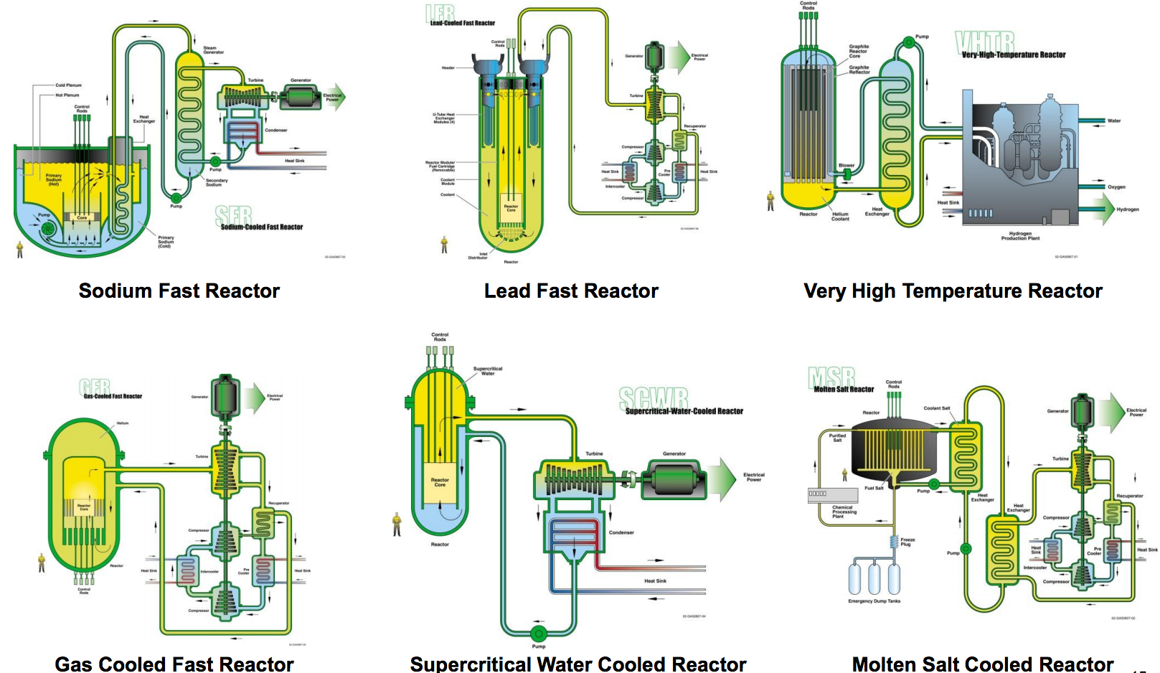
Advanced Reactor Concepts (cont.)

Slide 22
U.S. Commercial Advanced Reactor Designs
Over 30 advanced reactor designs are currently being pursued in the U.S.
Sodium-cooled Fast Reactor
TerraPower, General Electric, ARC Nuclear, Oklo
High Temperature Gas-cooled Reactor
X-Energy, AREVA, Hybrid Energy, Ultra Safe
Molten Salt Reactor
Transatomic Power, Terrestrial Energy, Thorcon, Elysium, FLIBE Energy, TerraPower, Kairos Power
Lead- or LBE-cooled Fast Reactor
Westinghouse, Gen-IV Energy, Lake-Chime, Hydromine
Gas-cooled Fast Reactor
General Atomics

Slide 23
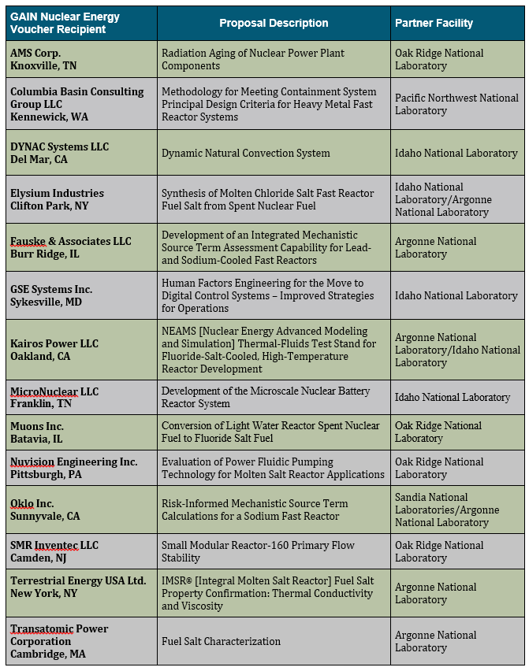
U.S. Commercial Advanced Reactor Designs (cont.)
DOE-NE GAIN Initiative 2017 Voucher Recipients—
announced just this week

Slide 24
Reality Check!
Current energy market leads to diminishing domestic opportunities:
Low natural gas cost
State and federal mandates for direct and indirect subsidies for renewables
Competitive electricity markets
Lack of a permanent repository or fuel cycle program for high-level nuclear waste
What’s at stake? Risk of losing an industry of strategic importance and potential
To address the environmental and future energy security needs
To avoid it, a national strategy is needed to reverse the U.S. nuclear industry’s anticipated decline and expand opportunities abroad

Slide 25
Opportunities
Outlook is different in the developing countries with rapidly growing urban centers
Meeting a significant portion of this worldwide demand for energy with nuclear technology has obvious trade, employment, and environmental benefits
Also non-proliferation arguments against the global nuclear energy infrastructure being dominated by countries with less proven records
U.S. leadership in the nuclear industry can be best established via expanded support for advanced reactor concepts
Deployment of advanced reactors at military bases and government facilities can be pursued to provide limited “first mover” financial incentives
Bolster the basis for advanced reactor and fuel cycle technologies with improved safety, resource utilization and fuel cycle advantages
Collaboration among government and industry to form new public-private partnership models
Promote policies that ensure reduced regulatory uncertainty for the advanced reactor concepts

Slide 26
Summary and Conclusions
Pending “retirement cliff” of existing U.S. nuclear fleet representing over 60 percent of the nation’s emission-free electricity pose a large economic, environmental, and climate change impact.
To meet the challenge, DOE has developed the Vision and Strategy for Development and Deployment of Advanced Reactors
http://energy.gov/ne/downloads/draft-vision-andstrategy-development-and-deployment-advanced-reactors
DOE vision is
Support the current Light Water Reactor fleet
Pursue the construction/operation of Generation III+ reactors
Support the development/licensing/deployment of Small Modular Reactors
Support design/licensing/deployment of advanced (non-LWR) Gen-IV reactors
Among the spectrum of advanced reactors, closed-fuel-cycle systems using reactors with fast-neutron spectrum especially to meet the sustainability goals offer attractive options.

