Slide 1
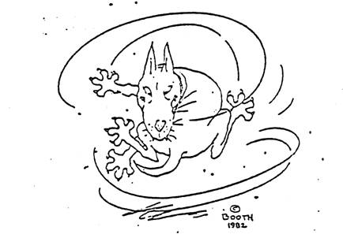
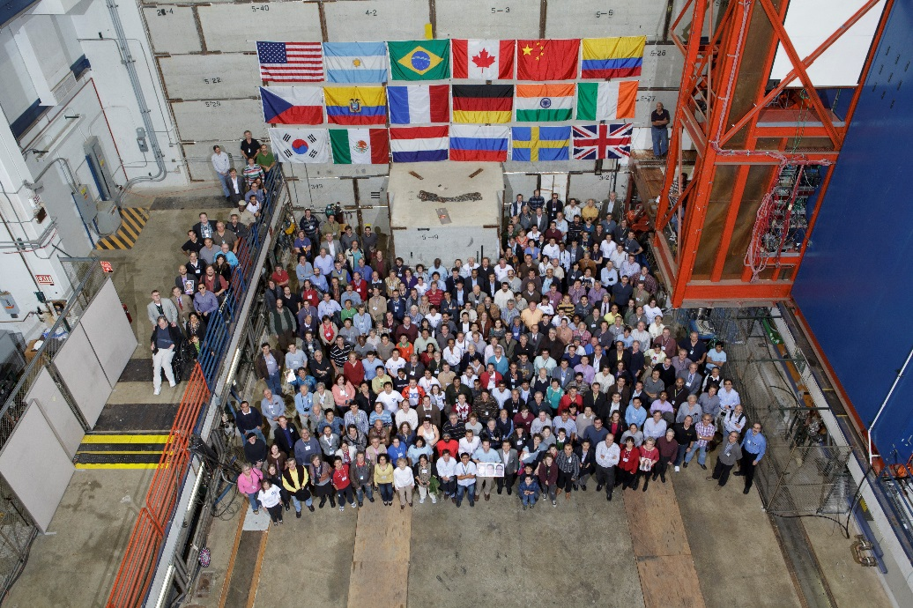
The Voyage of D0
or
On the origin of D0 and its physics accomplishments
The beagle
(on Fermilab’s 50th and D0’s 34th anniversary)

Slide 2
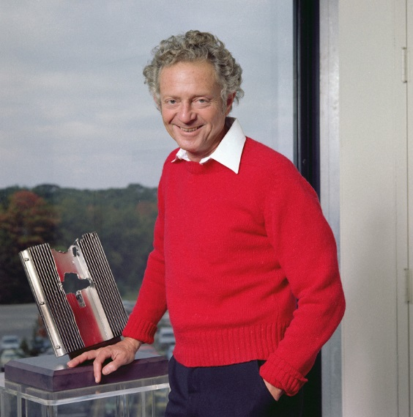
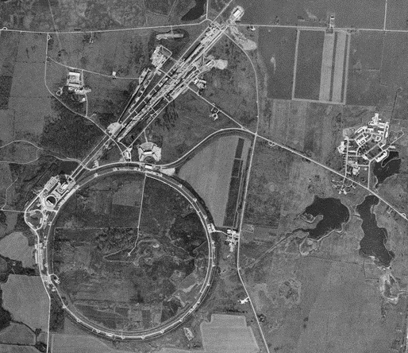
1981 (Fermilab was 16 years old)
_
The pp collider was being built with CDF as the sole experiment. Lederman called for proposals for a ‘small (9m cube), simple and clever’ experiment at D0, moveable on/off beam line, for 2 years of operation starting in 1986. Offers $1M to build it.
19 proto-proposals, 12 survived for PAC evaluation.
In July, 1983, PAC conducted its own crazy experiment in experiment planning -- rejecting all proposals but giving carte blanche Stage I approval for a new one-person experiment that “should be no worse than those proposed”.
DØ point
36

Slide 3
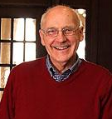
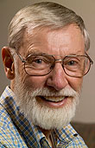
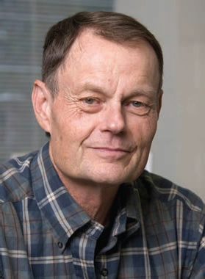
1983
Starting in summer 1983, portions of several proposal groups started discussions of the new experiment.
A first task – choose a name. We tried GEM, BELLA, SuperDØg … & utterly failed to agree, so chose the least common denominator – our address: DØ
Guiding principle – focus on high p_{T} physics with good e, μ, jet ID using scintillating glass calorimetry. No central magnetic field.
In a “September revolution” many concluded that the scintillating glass calorimeter was not workable – high occupancy, radiation damage, hard to calibrate. We decided to go with liquid argon/uranium absorber– with which no one had any experience. So we guaranteed not to be ready in 1986!
In early 1984, Peter Koehler became co-project manager with PG to give D0 some grounding at Fermilab.
Roger Dixon followed as co-PM in about 1988.
Gene Fisk: co-PM about 1986, deputy spokesman in 1988.
35

Slide 4
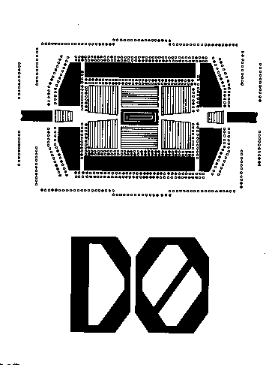
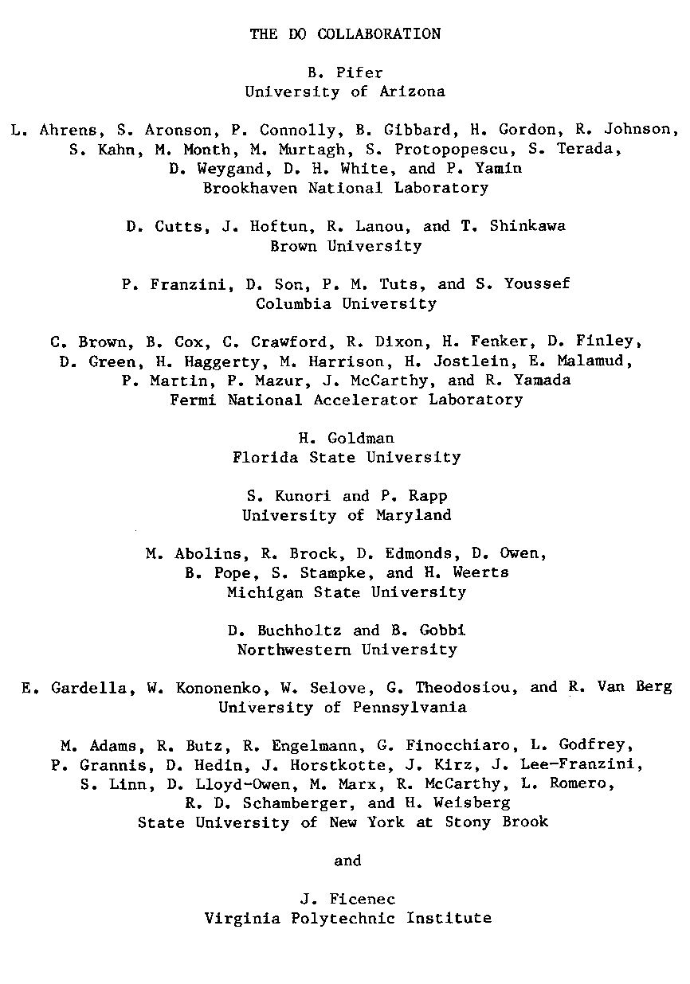
Dec. 1983
Proposal (71 physicists, 12 institutions) presented to PAC. Rousing ovation, no $$
1983 physics landscape:
J/ψ (‘74), SPEAR jets (‘75), open charm (‘76), tau lepton (‘76), Upsilon (‘77), open beauty (‘82), W/Z (‘83), high p_{T} jets (‘84).
The climate of new discoveries led to some over-optimistic claims – monojets, W →t b
1983 Proposal goals viewed with hindsight:
( better than expected ) ( did it ) ( didn’t do )
δm_{W} = 400 MeV
δsin²θ_{W} = 0.0025
Explore narrow Zγ/Wγ states (UA2 hints)
W chg asym , aTGC , W/Z→qq
Study jets to p_{T}=500 GeV
α_{S} from 3/2 jet ratio
Single γ, γγ
5 pb⁻¹
No mention of top, but ‘heavy quarks in Q →Wq to 120 GeV’! (top)
Discover the quark gluon plasma
34

Slide 5
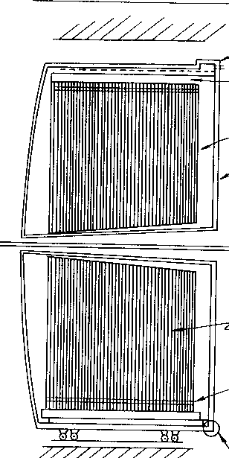
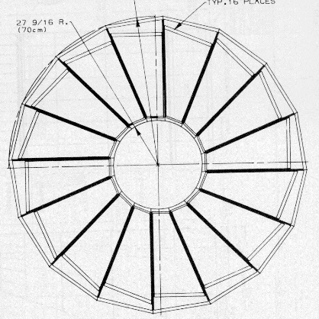
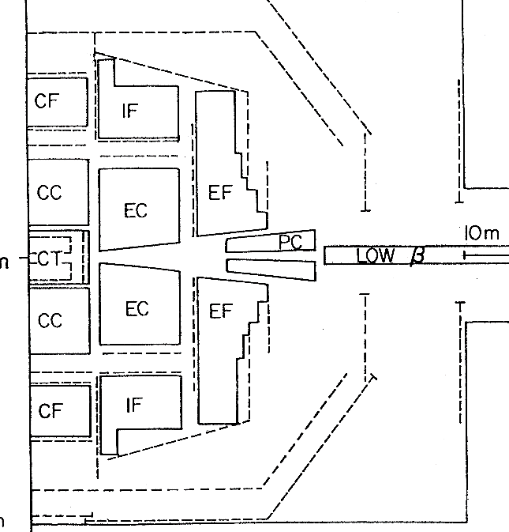
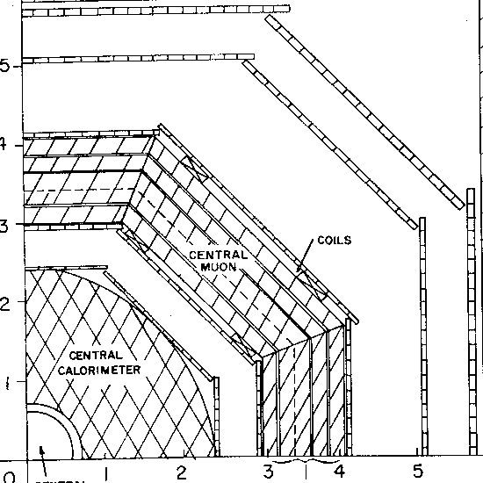
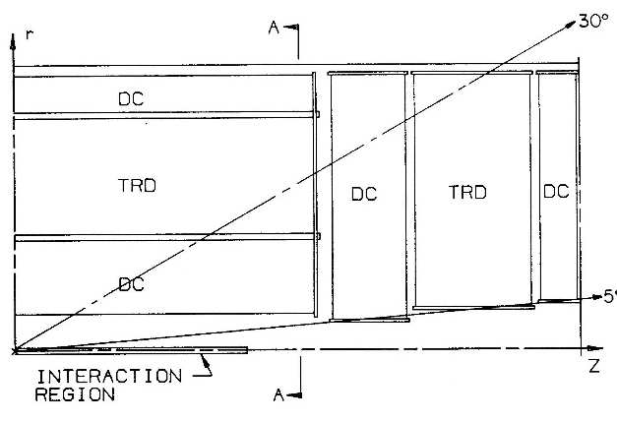
Dec. 1983 proposal
No engineers, just physicists drawing lines on paper.
Central calorimeter pinwheel modules
The big challenge: U/LAr calorimeter: unit gain, fine transverse and longitudinal segmentation, stable calibration, similar response to EM and hadrons
5 calorimeters 5 iron μ toroids
Monolithic end cal (200 tons!): tapered edge for downstream plug calorimeter (with huge particle splash!)
L
Octagonal calorimeter/muon
Inner/outer Drift Ch’s with TRDs between
Half Layout
33

Slide 6
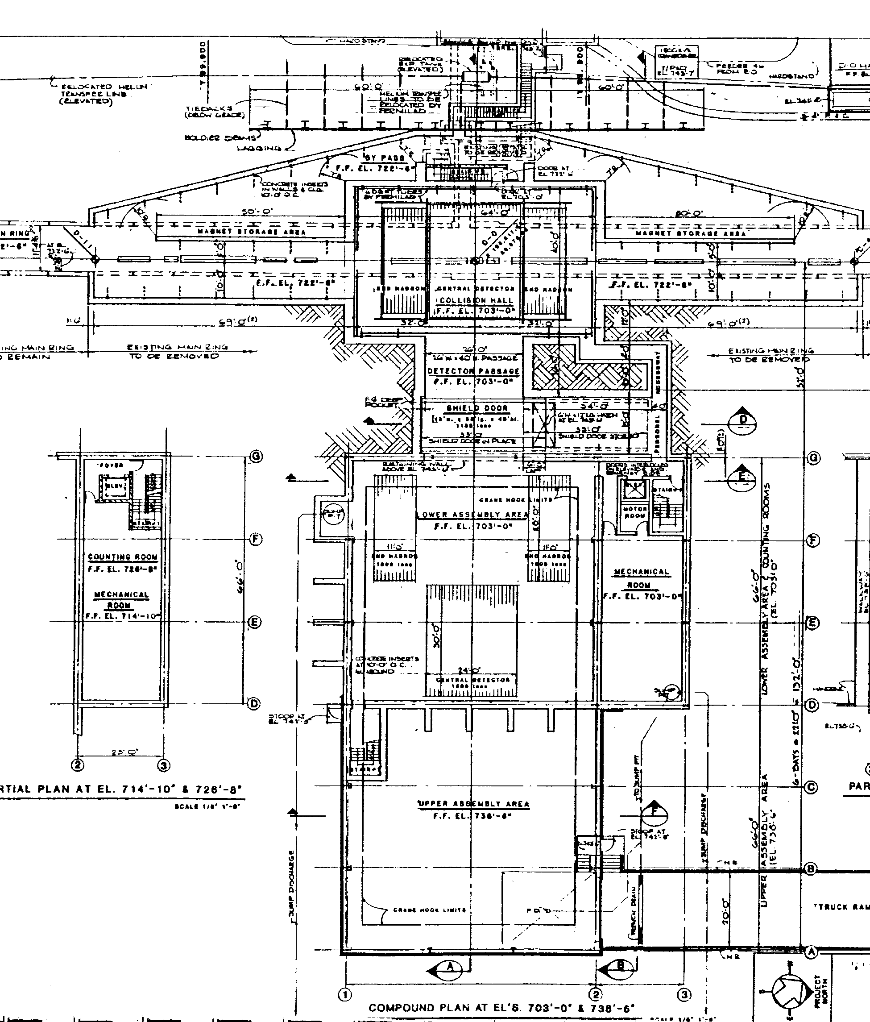
Dec. 1983 proposal
Dollar constraints precluded a main ring bypass like CDF so Main Ring had to go through holes in calorimeters.
Also could not afford moveable shield door for access as for CDF. But D0 had to be removed to install fixed target extraction system.
An overly-excited director suggested a turntable to twirl D0 in and FT magnets out …
or a piston that would shoot D0 up to surface.
We opted for the pedestrian solution of stackable concrete block wall.
Moving electronics house connected to detector via folding cable bridge.
Collision hall
folding cable bridge
assembly hall
moving counting house
32

Slide 7
1984
Feb. 1984 DOE (Big Brother) charged HEPAP to comment on the relative priority of SLD and DØ (not enough funds to start both).
In a split vote of HEPAP, SLD was favored (competing with LEP was the rationale). Big Brother however recognized the case for D0 and did allocate some funds for R&D, and scheduled a Temple (a.k.a. Lehman) review for November 1984.
This meant that a real design with engineering, cost estimate, schedule with milestones, management plan etc. was needed.
In 1984, in another crazy administrative experiment, D0 moved to Accel. Div (to promote competition between CDF/Res.Div. and D0/AD) and into leaky portakamps around the Booster pond. AD knew little about experiments and this adventure was later abandoned.
31

Slide 8
1984
D0 held the first of 30 annual summer workshops at Michigan State Univ. to finalize plans for the November Temple review:
a) Finalize design e) Manpower analysis
b) Update cost estimate f) Establish organization
c) Find cost savings g) Monte Carlo priorities
d) R&D planning
30

Slide 9
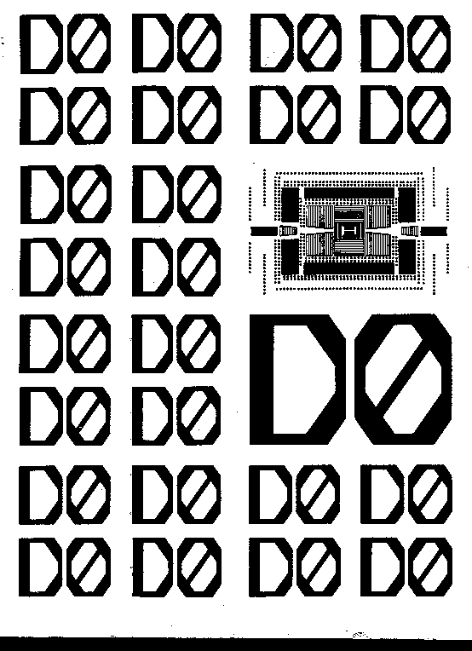
Nov. 1984 Design Report
November 1984 DOE review:
Gave baseline approval (equivalent to CD1 in today’s DOE jargon), but added some contingency to the cost estimate.
Some funding started in FY1985.
One collaborating institution said “Run by 1988 or we quit”. (First D0 collisions were in 1992 with this group still with us – and still active today!)
“Tevatron instantaneous luminosity will not exceed 3x10³⁰ cm⁻²s⁻¹” [J. Peoples, then pbar project leader] so we now expected about 30 pb⁻¹ in the “3 year lifetime” of Tevatron.
29

Slide 10
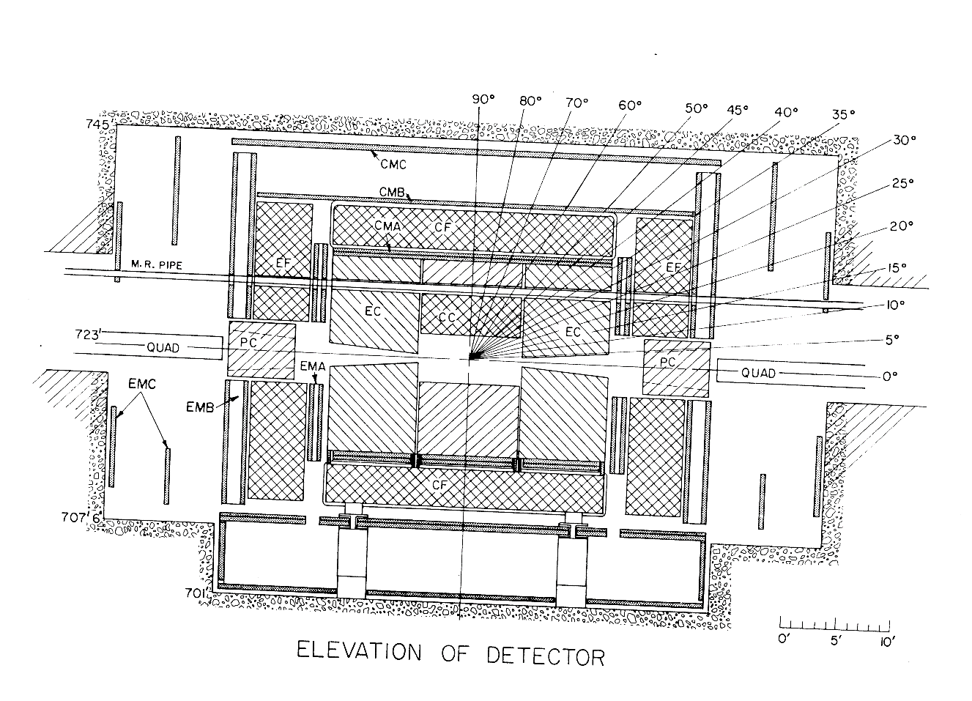
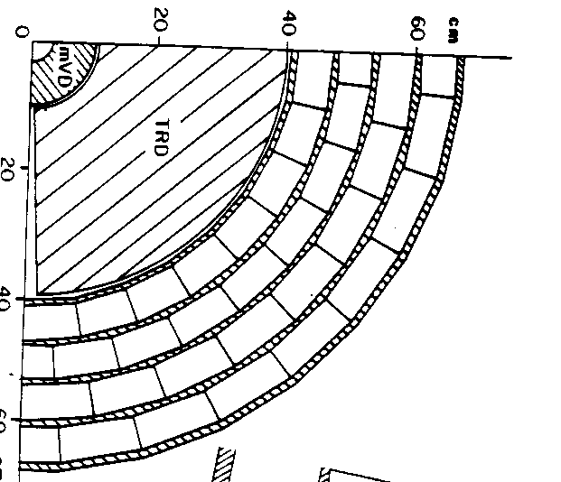
Nov. 1984 Design Report
Layout was now simplified and close to what was built (no intermediate toroids, square up cross sections). Plug calorimeters were later omitted but added plug muon toroid.
Muon toroids use Newport News cyclotron steel
R=75 cm
main ring
Non-magnetic Tracking system
28

Slide 11
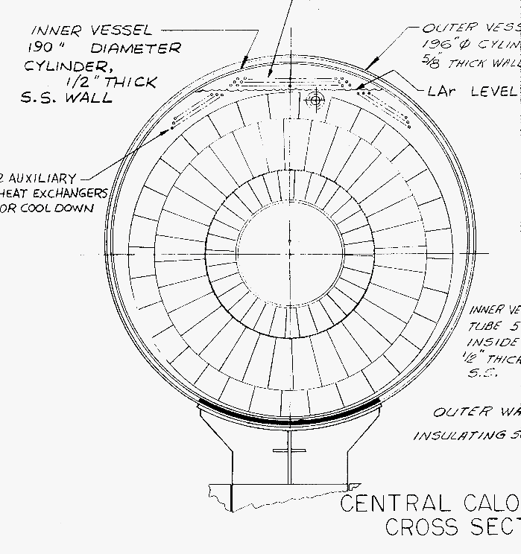
Nov. 1984 Design Report
main ring
About 50,000 calorimeter signal pads arranged in projective geometry: Δη x Δφ = 0.1x0.1 (0.05x0,05 at EM shower maximum).
EM
FH
CH
Central calorimeter end view
Central Cal: 4 depth segments in EM, 4 in fine hadronic, 1 in coarse had.
Similar in End Calorimeters.
Resistive coat on signal pad boards to provide the 2KV drift field.
27

Slide 12
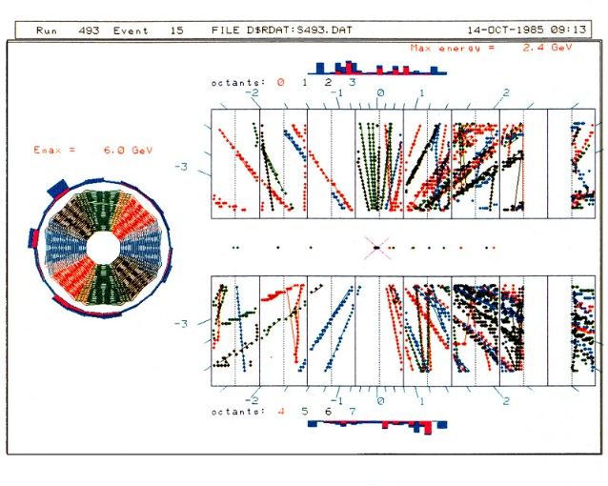
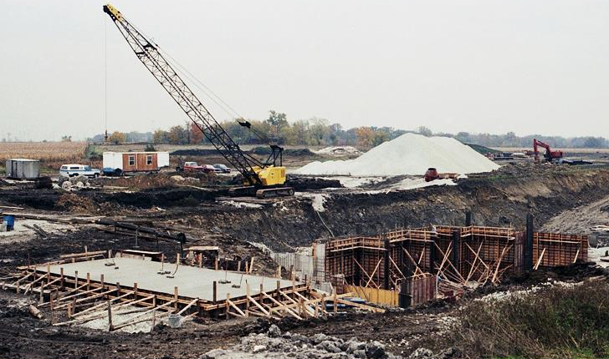
Oct. 1985
On October 14, 1985, CDF recorded the first collisions at 1.6 TeV in their partially complete detector.
Oct. 15, 1985
Meanwhile at D0 …
CDF had first physics Run 0 in 1987 - 1988.
D0 continued to build the detector from 1986 -- 1991
26

Slide 13
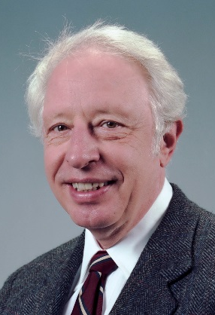
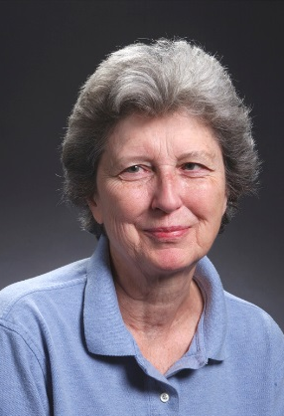
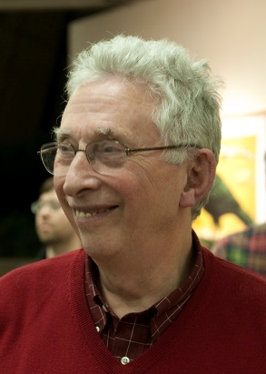
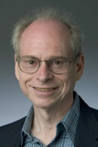
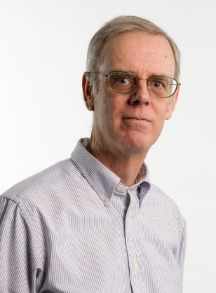
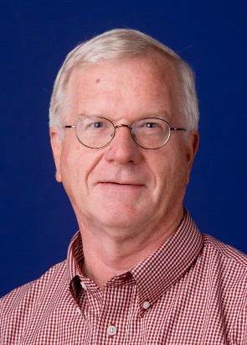
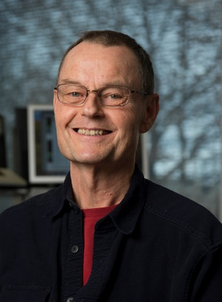
Accelerator performance
Annual luminosity
The 5 year difference between CDF and D0 was offset by the fantastic performance of the Accelerator Division.
In the end, we ran for 15 years and instead of the expected 30 pb⁻¹, accumulated ~10,000 pb⁻¹.
1st CDF run in 1988
Run I ----- Run II ----
The D0 physics achievements rest on the outstanding work of the many people of the Accelerator Division led during the Tevatron years by Rich Orr, Helen Edwards, John Peoples, Gerry Dugan, Steve Holmes, John Marriner, Roger Dixon.
25

Slide 14
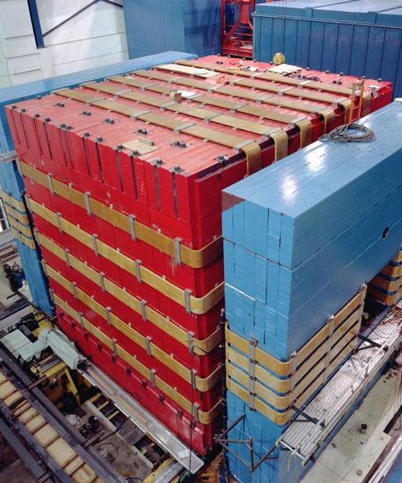
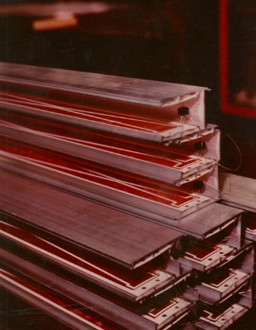
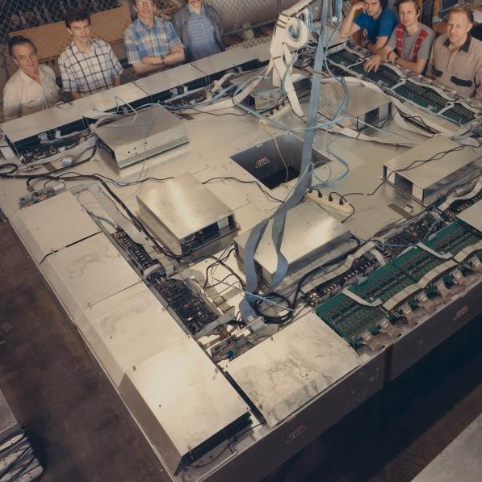
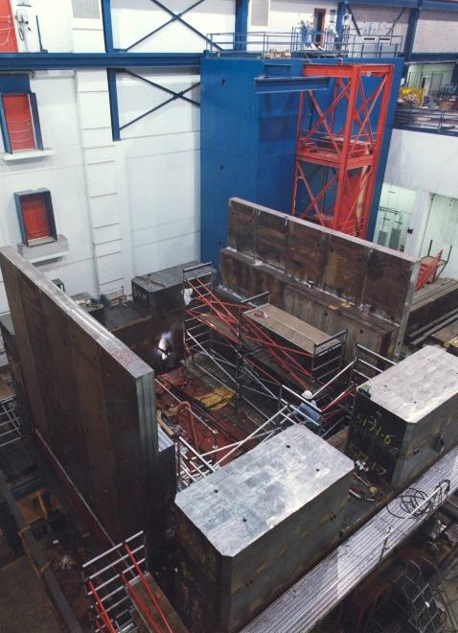
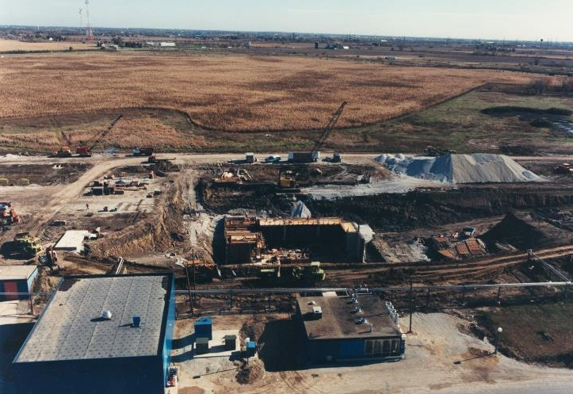
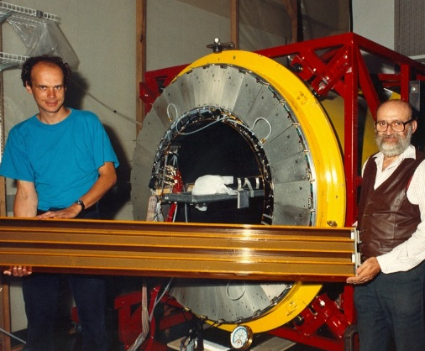
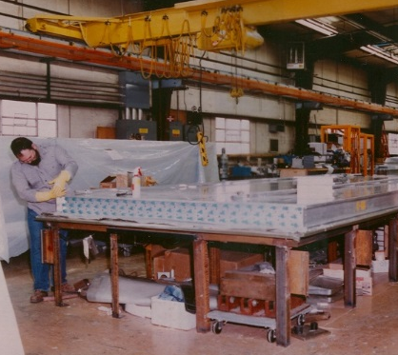
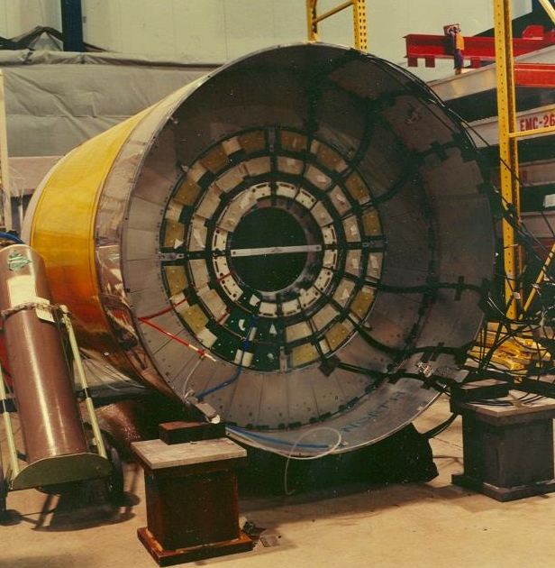
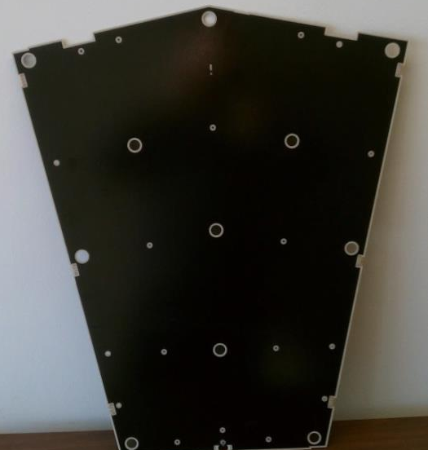
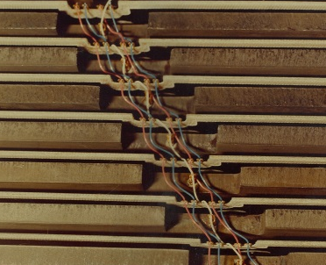
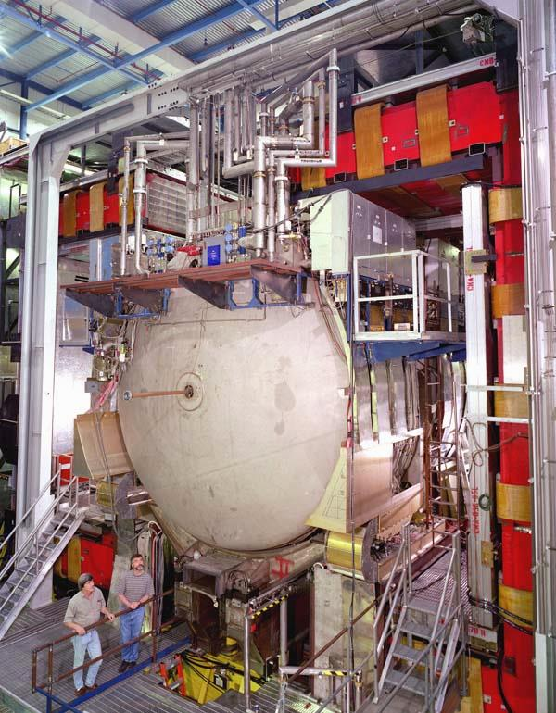
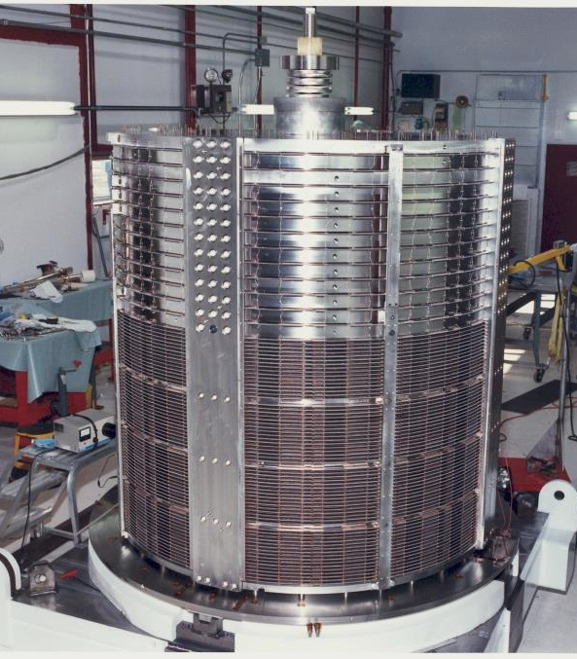
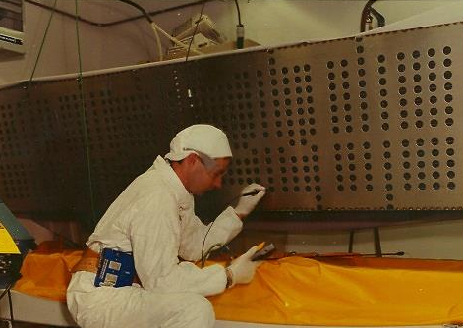
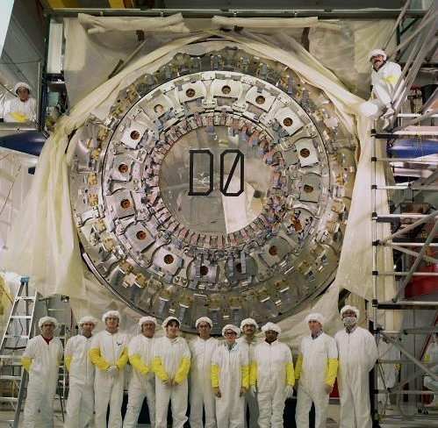
1986 – 1991
As with of one’s children – these photos are reminders of growth and sleepless nights, of interest only to the proud parents
24

Slide 15
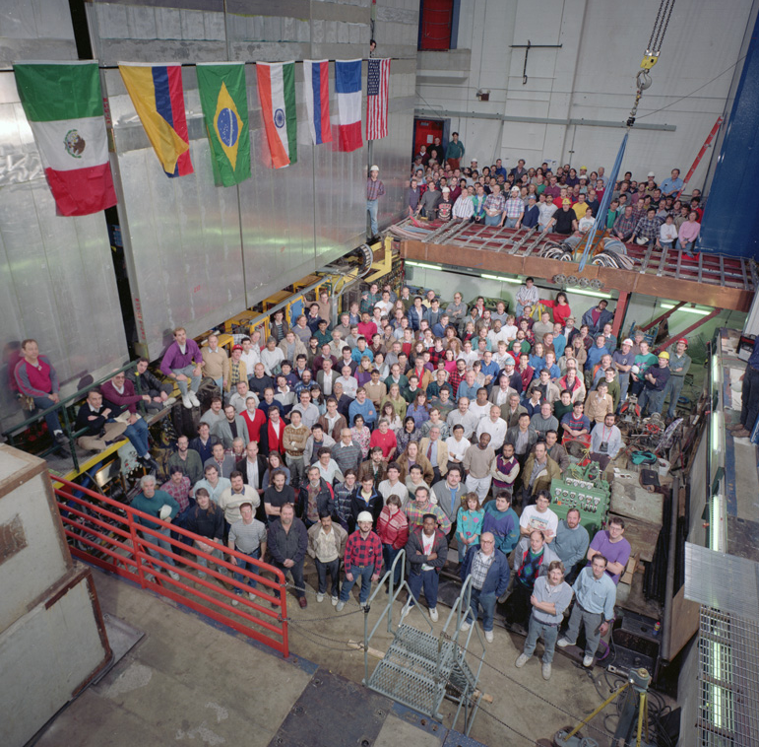
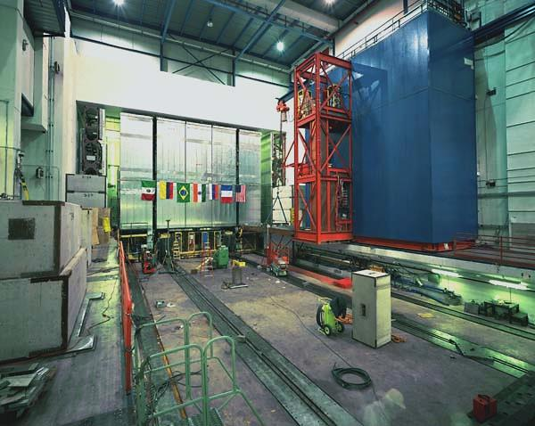
1992 – Roll in
Feb. 14, 1992: DØ gathers to help push the detector into the collision hall
Feb. 15, 1992; at rest in collision hall. 6 inches to spare under the lintel !
23

Slide 16
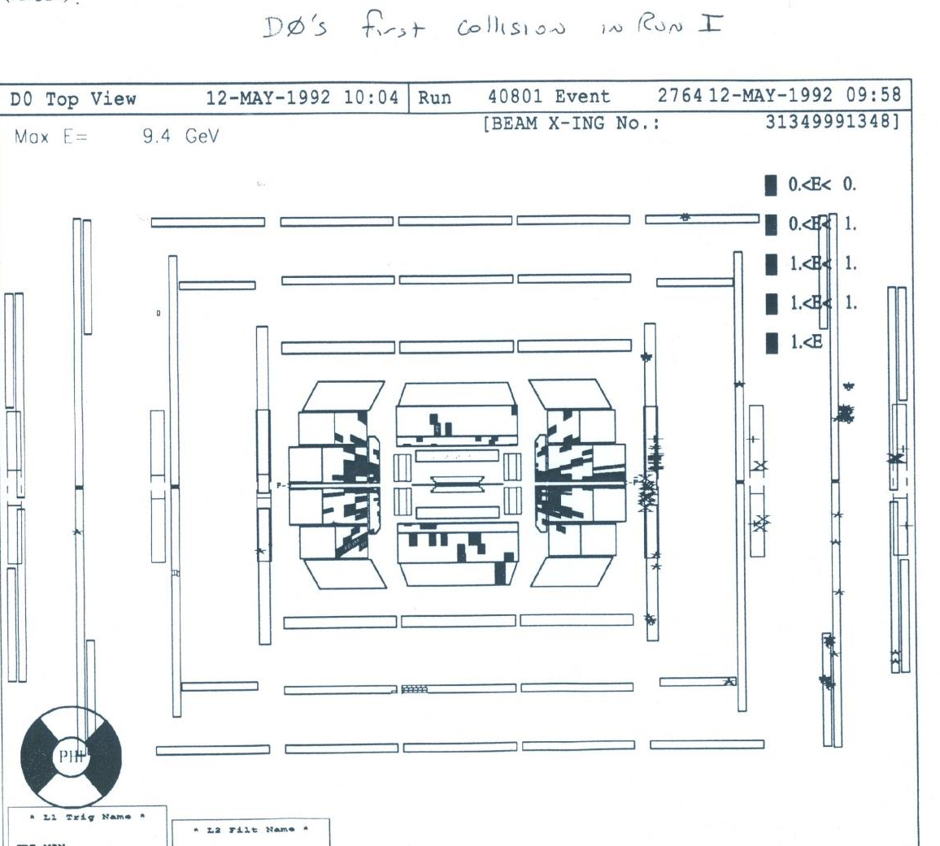
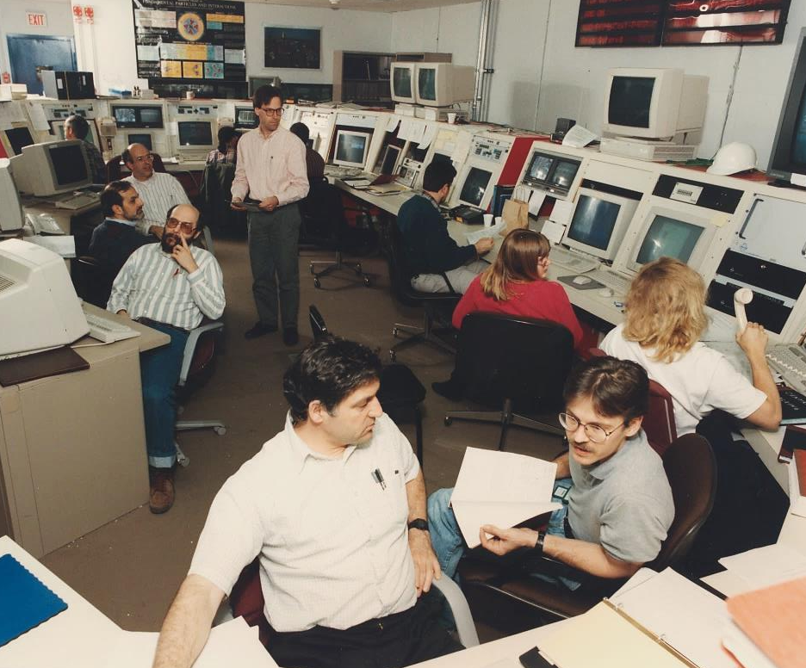
1992 – Collisions
_
May 12, 1992: First pp collisions in DØ.
Almost 9 years to form the collaboration, design, test, build, install and debug and ~$75M EQ funds (+R&D, SWF, operations)
22

Slide 17
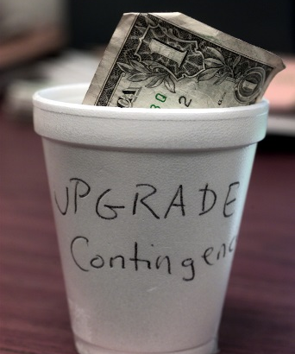
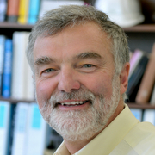
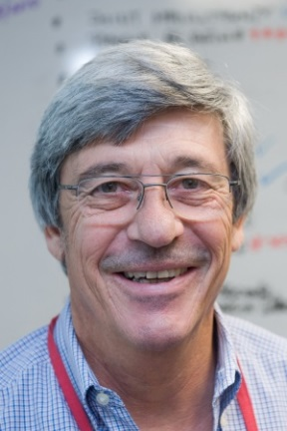

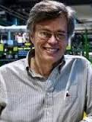

Meanwhile back in 1988
Directorate announced plan to upgrade the collider complex – Main Injector, accumulate more pbars, helical Tevatron orbits, more bunches – and asked for experiments’ plans.
Four years before its first collisions, D0 proposed the upgrade for Run II – to add a solenoid magnet, completely new tracker, improved calorimeter and muon detectors to accommodate shorter bunch crossing times, new trigger due to higher luminosity.
Lots of pushback from PAC (“You can’t do tracking with just 8 stations”, “Why do you want a magnet?” ). Final approval only after Run I ended !
Upgrade/Run II
leaders:
Hugh Montgomery
Mike Tuts
Harry Weerts
Jim Christenson
Jon Kotcher
21

Slide 18

D0 Upgrade Detector
New tracker – Si vertex detector, 8 layers of scintillating fiber tracking, preshower detector … and solenoid magnet.
No Lorentz angle in scint. fibers, so design the solenoid to reverse B field (every two weeks)
All new forward muon detectors – mini drift tubes and scintillator pixels for timing and triggering.
Also … new calorimeter shaping electronics, all new 3 level trigger system.
For Run II, D0, with addition of solenoid and Si vertex detector, evolved toward CDF. CDF with upgrade of forward calorimetry and muons evolved toward D0.
20

Slide 19

OK, so what physics did you do?
QCD
Higgs
Heavy flavors
Top quark
Searches beyond SM
Electroweak
D0 operated with 6 highly interconnected physics groups.
We had about 500 publications but I will spare you a discussion of them all.
Instead I select one highlight per group and a sidelight that tickled my fancy
The 500 publications were possible only with the outstanding support from the Computing Division. We particularly appreciate the effort to maintain the aging D0 systems over past few years.
19

Slide 20




QCD headline
Inclusive cross section of jets measured out to p_{T}=600 GeV (60% of beam momentum) and down to 10º relative to the beam). The agreement with pQCD tells us that our understanding of the structure of the proton extends down to 0.3 attometers.
The jet measurements forced a reduction in the gluon density in the proton.
These data provide a textbook demonstration of the running of α_{S} out to Q=400 GeV.
(Also measured XS’s of dijets, γ, γγ, W, Z, W/Z/γ + jets …)
18

Slide 21


QCD sidebar
Measure the non-perturbative process of two separate scatterings of partons within a single pp collision. For example if the two scatterings produce final states γγ and jj, the double parton cross section is
σ_{DP} = σ_{γγ} σ_{jj} / σ_{eff}
where σ_{eff} is related to the transverse area occupied by the interacting partons. Smaller area → larger overlap → larger σ_{DP} ( smaller σ_{eff} )
_
D0 studied several DP channels. The measured σ_{eff} for the cases J/ψ+J/ψ and J/ψ+Υ (dominated by gg initial states) is smaller than those involving jets and γ’s which are dominated by quarks.
Gluons in a proton seem to occupy smaller transverse area than quarks
17

Slide 22

Heavy Flavor headline
_
An influential D0 result was the first observation of the B_{s} to B_{s} mixing frequency. The frequency is high due to the small mass difference between B_{s}^{S} and B_{s}^{L} states, and thus the measurement is very challenging. Deviations from the SM value of 21 ps⁻¹ would have signaled new particles in the loop diagram.
The measurement gave 17 < Δm_{s} < 21 ps⁻¹ at 90% CL, in excellent agreement with SM.
16

Slide 23



Heavy Flavor sidebar
Conventional wisdom held that hadron colliders would not compete with e⁺e⁻ for heavy quark physics – particularly experiments with small tracking volume like D0!
D0 HF studies included many topics: lifetimes, production cross sections, forward-backward asymmetries, mixing and CP violation studies, CPT tests. D0 also made contributions to exotic (qqqq) heavy quark physics:
_
_
Confirm Belle X(3872) ccuu state in J/ψ π⁺π⁻
_
_
Confirm CDF X(4140) (ccss state in J/ψφ)
_
_
In both cases, D0 showed that these were produced promptly as well as in B decays, helping to confirm their exotic character.
_
_
In 2016, D0 saw a new, manifestly exotic, bsud state X(5568)± → B_{s} π± → (J/ψ φ) π±. Confirmed recently in B_{s} π± → (D_{s}⁺μ⁻ ν) π±. First exotic meson with four different flavored quarks.
15

Slide 24




New Phenomena headline
“400 Physicists Fail to Find Supersymmetry” (NYTimes, ca 1992)
As well as …
Leptoquarks
Randall Sundrum gravitons
scalar quarks
4th generation quarks
dark photons
SUSY Higgs
long lived quarks
Warped extra dimensions
Plus W’/Z’/l’/q’, KK states, cannonballs, quirks, axigluons, etc etc …
About half our papers up until LHC turn-on were titled “Search for …”
14

Slide 25
New Phenomena sidebar
Many find the asymmetry of Maxwell’s equations (the absence of the magnetic monopole, M) to be a deep mystery.
Dirac showed that the monopole charge, g, is related to the fundamental unit of electric charge: g=(2πn)/e (n=integer). For e=electron charge, the monopole coupling to γ’s, α_{S}^{M}, is about 4600n² times α_{S}^{E} (=1/137).
Virtual M loop gives measurable 2γ final state, with scattered beam particles inside the beam pipes.
D0 Limit for spin ½ is m_{M} > 870 GeV.
D0 Run I 70 fb⁻¹
n.b. Monopoles should occupy radius ~O(g/m_{M}) to accommodate the large self energy The lack of scale R<1 TeV implies m_{M}>100 TeV.
And the theory of pointlike monopoles is not well formulated.
S=monopole spin
13

Slide 26

Electroweak headline
7 precision measurables:
(α_{EM}, G_{F}, m_{Z}, m_{W}, sin²θ_{W}, m_{top}, m_{Higgs})
over-constrain the 3 parameters of the SM EW interaction. m_{W} and sin²θ_{W} are the least constrained at present.
Measuring m_{W} is straightforward. Select W→eν events. The most sensitive observable is m_{T}: m_{T}²= 2p_{T}^{e} p_{T}^{ν} (1−cosΔφ). Also use p_{T}^{e} and MET observables.
So *all * you need to do is measure the absolute value of these quantities to 1 part in 10⁴ (in the presence of recoil hadrons, pileup events, detector defects.
D0: m_{W} = 80,376 ± 23 MeV (5.3 fb⁻¹)
The other half of the D0 data is being analyzed. The LHC experiments are now in the game but the Tevatron measurements remain the leaders in precision.
12

Slide 27

Electroweak sidebar
The weak mixing angle, sin²θ_{W} needs added precision. The previous most precise SLD and LEP measurements disagree at the 3.2σ level. Tevatron measurements of F-B asymmetry in Z/γ*→l⁺l⁻ determine sin²θ_{eff}^{l} (≡ S_{eff}) and thus sin²θ_{W} and m_{W} in the context of the SM.
D0 reversal of solenoid & toroid magnets cancels many systematic uncertainties.
D0 published Fwd-Bkwd asymmetry in Z/γ* → ee gives S_{eff} = 0.23137±0.00047
Recent D0 preliminary result in μμ: S_{eff} = 0.22994±0.00066
D0 ee result combined with CDF (both ee and μμ) S_{eff} = 0.23179±0.00035, With D0 μμ, expect final Tevatron combo: δS_{eff} ~ 0.0003 (δm_{W} ~ 15 MeV)
11

Slide 28


Top quark headline
Discovery of top quark by D0 and CDF in March 1995 is the signal achievement of the Tevatron.
no b-tag
b-tag
CDF
D0 used topological variables Aplanarity and H_{T} to separate signal and background: 17 events, 3.8 bknd.
D0
Standard cuts
Relaxed A,HT cuts
background
bknd
top
Fitted mass
CDF relied on b-jet tagging; 50 tags and 22.1 bknd in l+jets, plus 6 dilepton events.
bknd
top
data
Indication of bumps in 2-jets and 3-jets in the hadronically decaying top
Although the top discovery was the beginning of the rule ‘5σ for discovery’, neither collaboration reached 5σ! (but together they did.)
10

Slide 29


Top quark sidebar
s-channel
t-channel
Although discovery and much of top quark investigation was done with tt production, weak
-
production of single top was predicted to be nearly ½ that of pair production due to a combination of running coupling constants and parton distribution functions. Two dominant diagrams. Though a ‘large’ XS, the fewer final state objects and larger backgrounds give a large experimental challenge. Extensive use of multivariate analyses.
D0 measured the t-channel XS, σ_{t}=2.90±0.59 pb and branching fraction B(t→Wb) = 0.90±0.04.
Then, using Γ(t→Wb)(meas) / σ_{t}(meas) = Γ(t→Wb)(SM) / σ_{t}(SM) and
    Γ(t→Wb) = Γ_{tot} x B(t→Wb)
we obtain
Γ_{tot} = {σ_{t} Γ(t→Wb)(SM)} / {B(t→Wb) σ_{t}(SM) }
With measured values, infer Γ_{tot} =2.00 GeV giving τ_{t} = 0.329 ys, in agreement with the SM without need for new physics.
+0.47 −0.43
+0.90 −0.63
9

Slide 30



Higgs boson headline
D0 had 71 individual Higgs boson search
channels. CDF had a similar number and the real Higgs story is the Tevatron combination.
D0 channels
The most sensitive channels are W/Z+H, with final states e.g. lν bb. Verify that that a study of the lν bb final state can find a bb resonance (the Z)
Huge backgrounds; only a few histogram bins of these channels has appreciable s/b.
Combination of all Tevatron searches gives 3.0σ for 125 GeV Higgs.
8

Slide 31

Higgs boson sidebar
Although the Higgs story really belongs to the LHC, the Tevatron contribution for H→bb was significant. LHC μ_{bb} = σ_{obs}/σ_{SM} has been persistently <1. The Tevatron μ_{bb} was >1. The LHC and Tevatron relative uncertainties on μ_{bb} are about the same. The PDG average of Tevatron and LHC are consistent with 1.
PDG 2016
The Tevatron Higgs exclusion plot was the inspiration for stained glass art by Hubert van Hecke, LANL
7

Slide 32
Besides the physics, what are the D0 legacies?
Fine segmentation, unit gain 4π calorimetry with LAr (c.f. ATLAS)
Demonstration that a small compact tracking system with relatively few samples would work in a collider environment (c.f. SiD)
First implementation (with CDF) of a multilevel trigger architecture (all LHC experiments)
Helped (with LEP, SLD, B-Factories, CDF) develop the use of multivariate methods for object identification, leading to MVA techniques for characterizing differences between rare signals and background.
An artistic legacy, such as the forward preshower detector, as displayed at the Museum of Modern Art in New York.
Educating the public: 5500 people have toured the D0 detector since 2011
6

Slide 33











The real legacy is people
Those who lead in building detectors, writing software, operating the experiment, managing the collaboration, guiding the physics analyses are the most valuable legacy for the future of the field.
Those pictured are among the most recent leaders in these sectors, who in turn inherited from the earlier generations.
5

Slide 34









Ouroboros of D0 spokesmen
Hugh Montgomery
Harry Weerts
Paul Grannis
Gregorio Bernardi
John Womersley
Stefan Söldner-Rembold
Jerry Blazey
Terry Wyatt
Darien Wood
Dmitri Denisov
4

Slide 35

Large collaborations
The D0 collaboration is large (>600 people at peak). Seen from the outside it looks like a monolithic entity, but …
From the inside one sees the individual contributions to all aspects of our research, typically in groups of 2 to 4. Every significant achievement bears the thumbprints of a few inventive and dedicated people.
Over time, the loyalty to the collaboration comes to rival that to the institutions that employ us.
The DNA of past collaborations weave their patterns and propagate their experience within the next generation of experiments.
3

Slide 36

Looking back
It has been a privilege to have worked with some 1500 collaborators on the D0 experiment over its 34 year history, and with the hundreds of innovative people at Fermilab whose outstanding support was essential.
The D0 legacy is significant and continues to grow. Important results have still be published.
We have been delighted to have been a large part of making Fermilab’s first 50 years a success. We look forward to the a grand harvest of new discoveries over the next 50 years.
2

Slide 37

Thanks !
/

