Slide 1
The CDF Experiment, and the Italians
Giorgio Bellettini, Fermilab Colloquium
May 3, 2017
The start of the US-Japan-Italy Collaboration
The construction of the run1 detector
The discovery
The powerful run2 detector
The wealth of great physics
The legacy

Slide 2
Frascati-Pisa, the first Italian groups in CDF
In September 1979 at the Electron-Photon conference in Fermilab, Paolo Giromini and I decided to put together two groups for an experiment at the Tevatron collider which was being built.
In December I met at CERN with Alvin Tollestrup and Robert Diebold and proposed to establish a USA-Japan-Italian collaboration to design and operate a magnetic detector at the Tevatron. An agreement between the US and a Japanese group lead by Kunitaka Kondo existed already. The extension to Italy was readily accepted in the US.
By Spring 1980 INFN approved the initiative and two strong Frascati-Pisa groups were in place.

Slide 3
CDF milestones
1981: the detector Design Report
1) 1985: Collisions at 1.6 TeV observed with the calorimeters
2) 1988-1989: ≈ 4 pb⁻¹ Commissioning run at √s = 1.8 TeV
3) 1991-1996: “Run 1” ≈ 110 pb⁻¹ on tape at √s = 1.8 TeV
4) 2001-2011: “Run II” at √s = 1.96 TeV, ≈ 10 fb⁻¹ on tape

Slide 4
The Institutions in the 1981 CDF design report
Argonne,
Chicago,
Fermilab,
Harvard,
Illinois,
LBL,
Purdue,
Texas A&M,
Wisconsin
CDF was born as a
USA-Japan-Italy endeavor
13 Institutions
87 physicists
56 Americans, 15 Japanese , 16 Italians
US
Japan
Italy
KEK
Tsukuba
Frascati,
Pisa

Slide 5
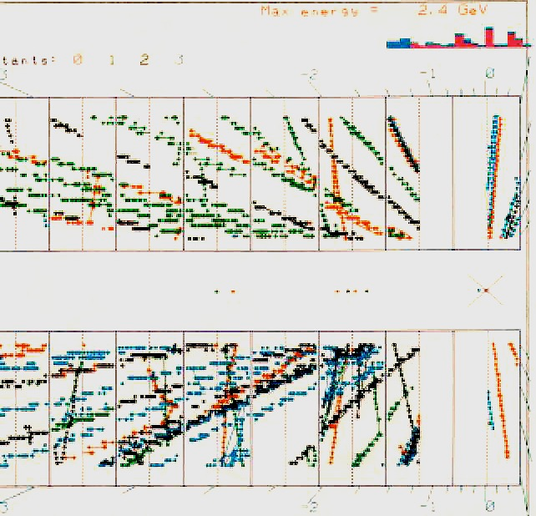
24 events in 1985, and Stefano Miscetti`s Thesis
Tevatron demonstration run in 1985 (at 1600 GeV)

Slide 6
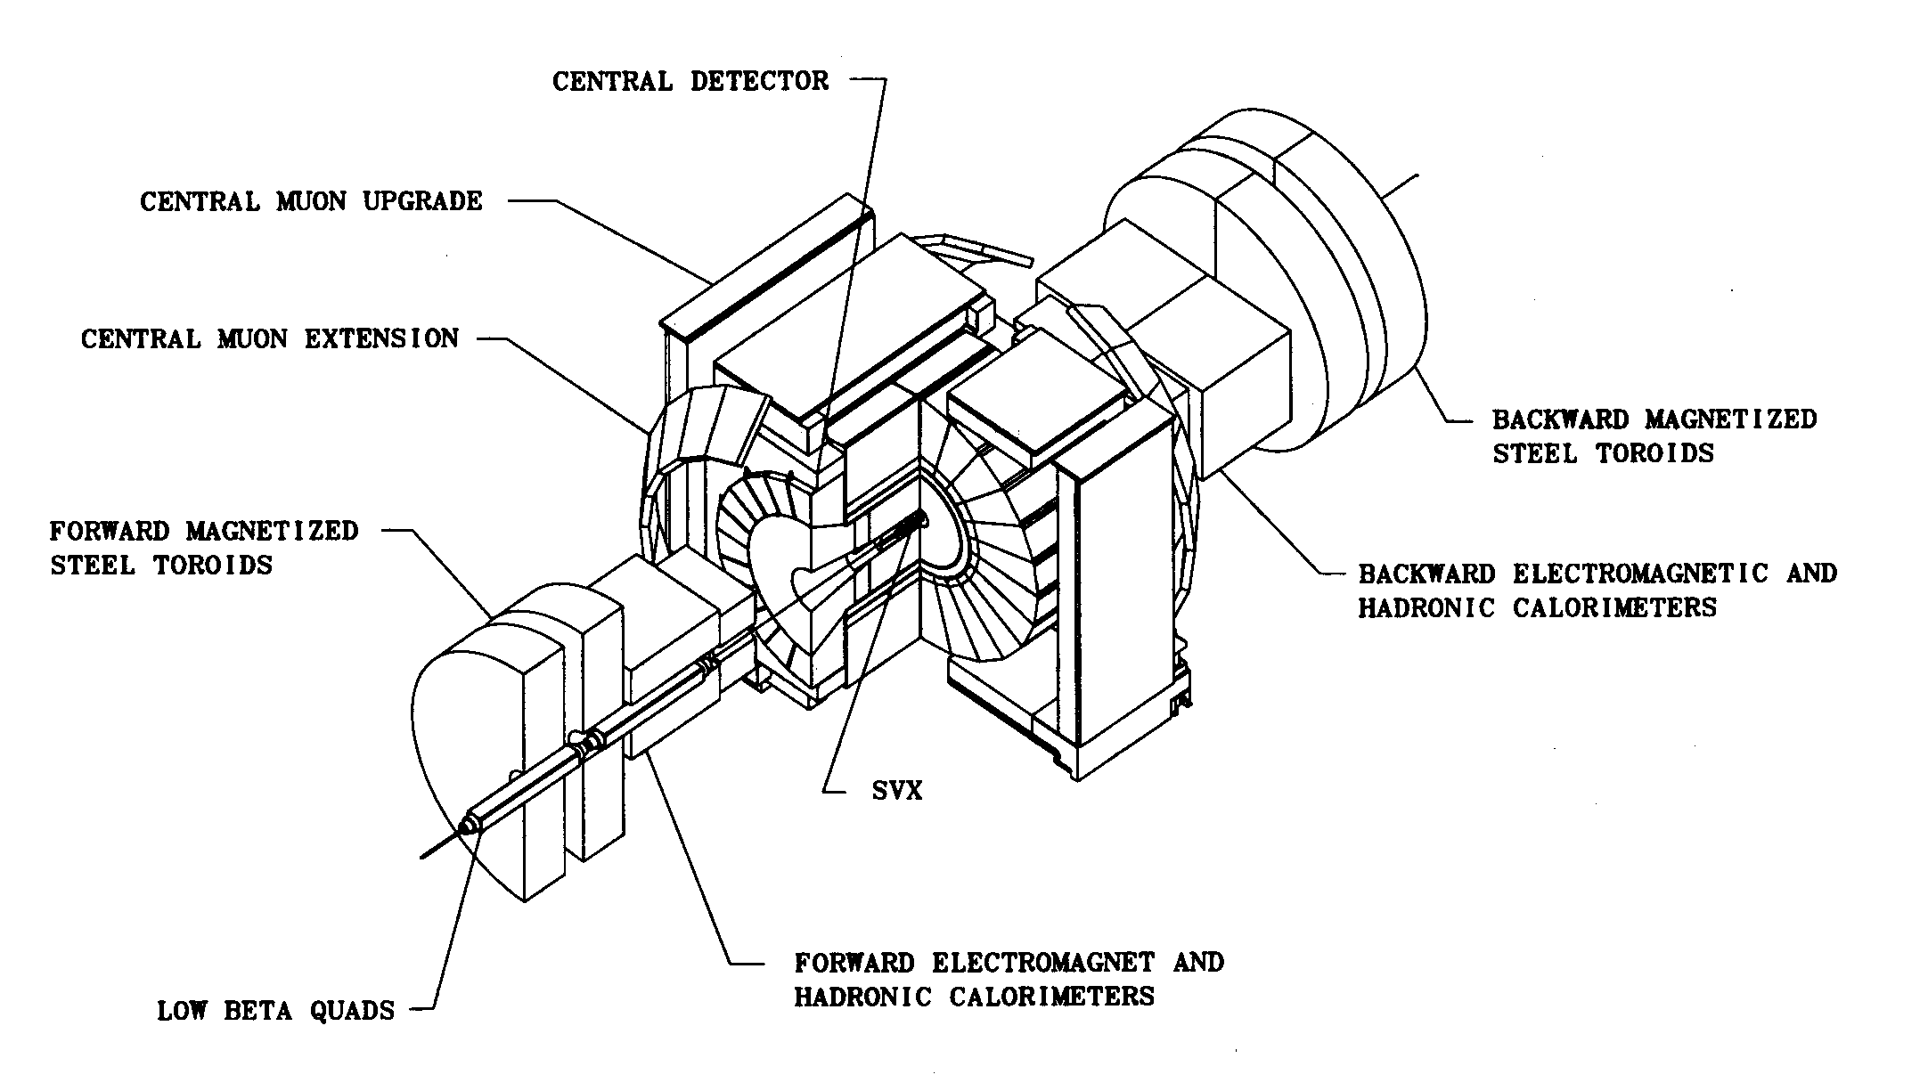
CDF1 detector

Slide 7
CDF1 parts of primary Italian design
1) Small angle spectrometers to measure σ_{tot}
2) Projective towers of plastic scintillator in the central hadronic calorimeter.
3) The silicon vertex detector SVX around the beam pipe.

Slide 8
The CDF small angle spectrometers
Unique measurements at the highest p-pbar energies:
1) Total cross section
2) Elastic scattering
3) Single diffraction

Slide 9
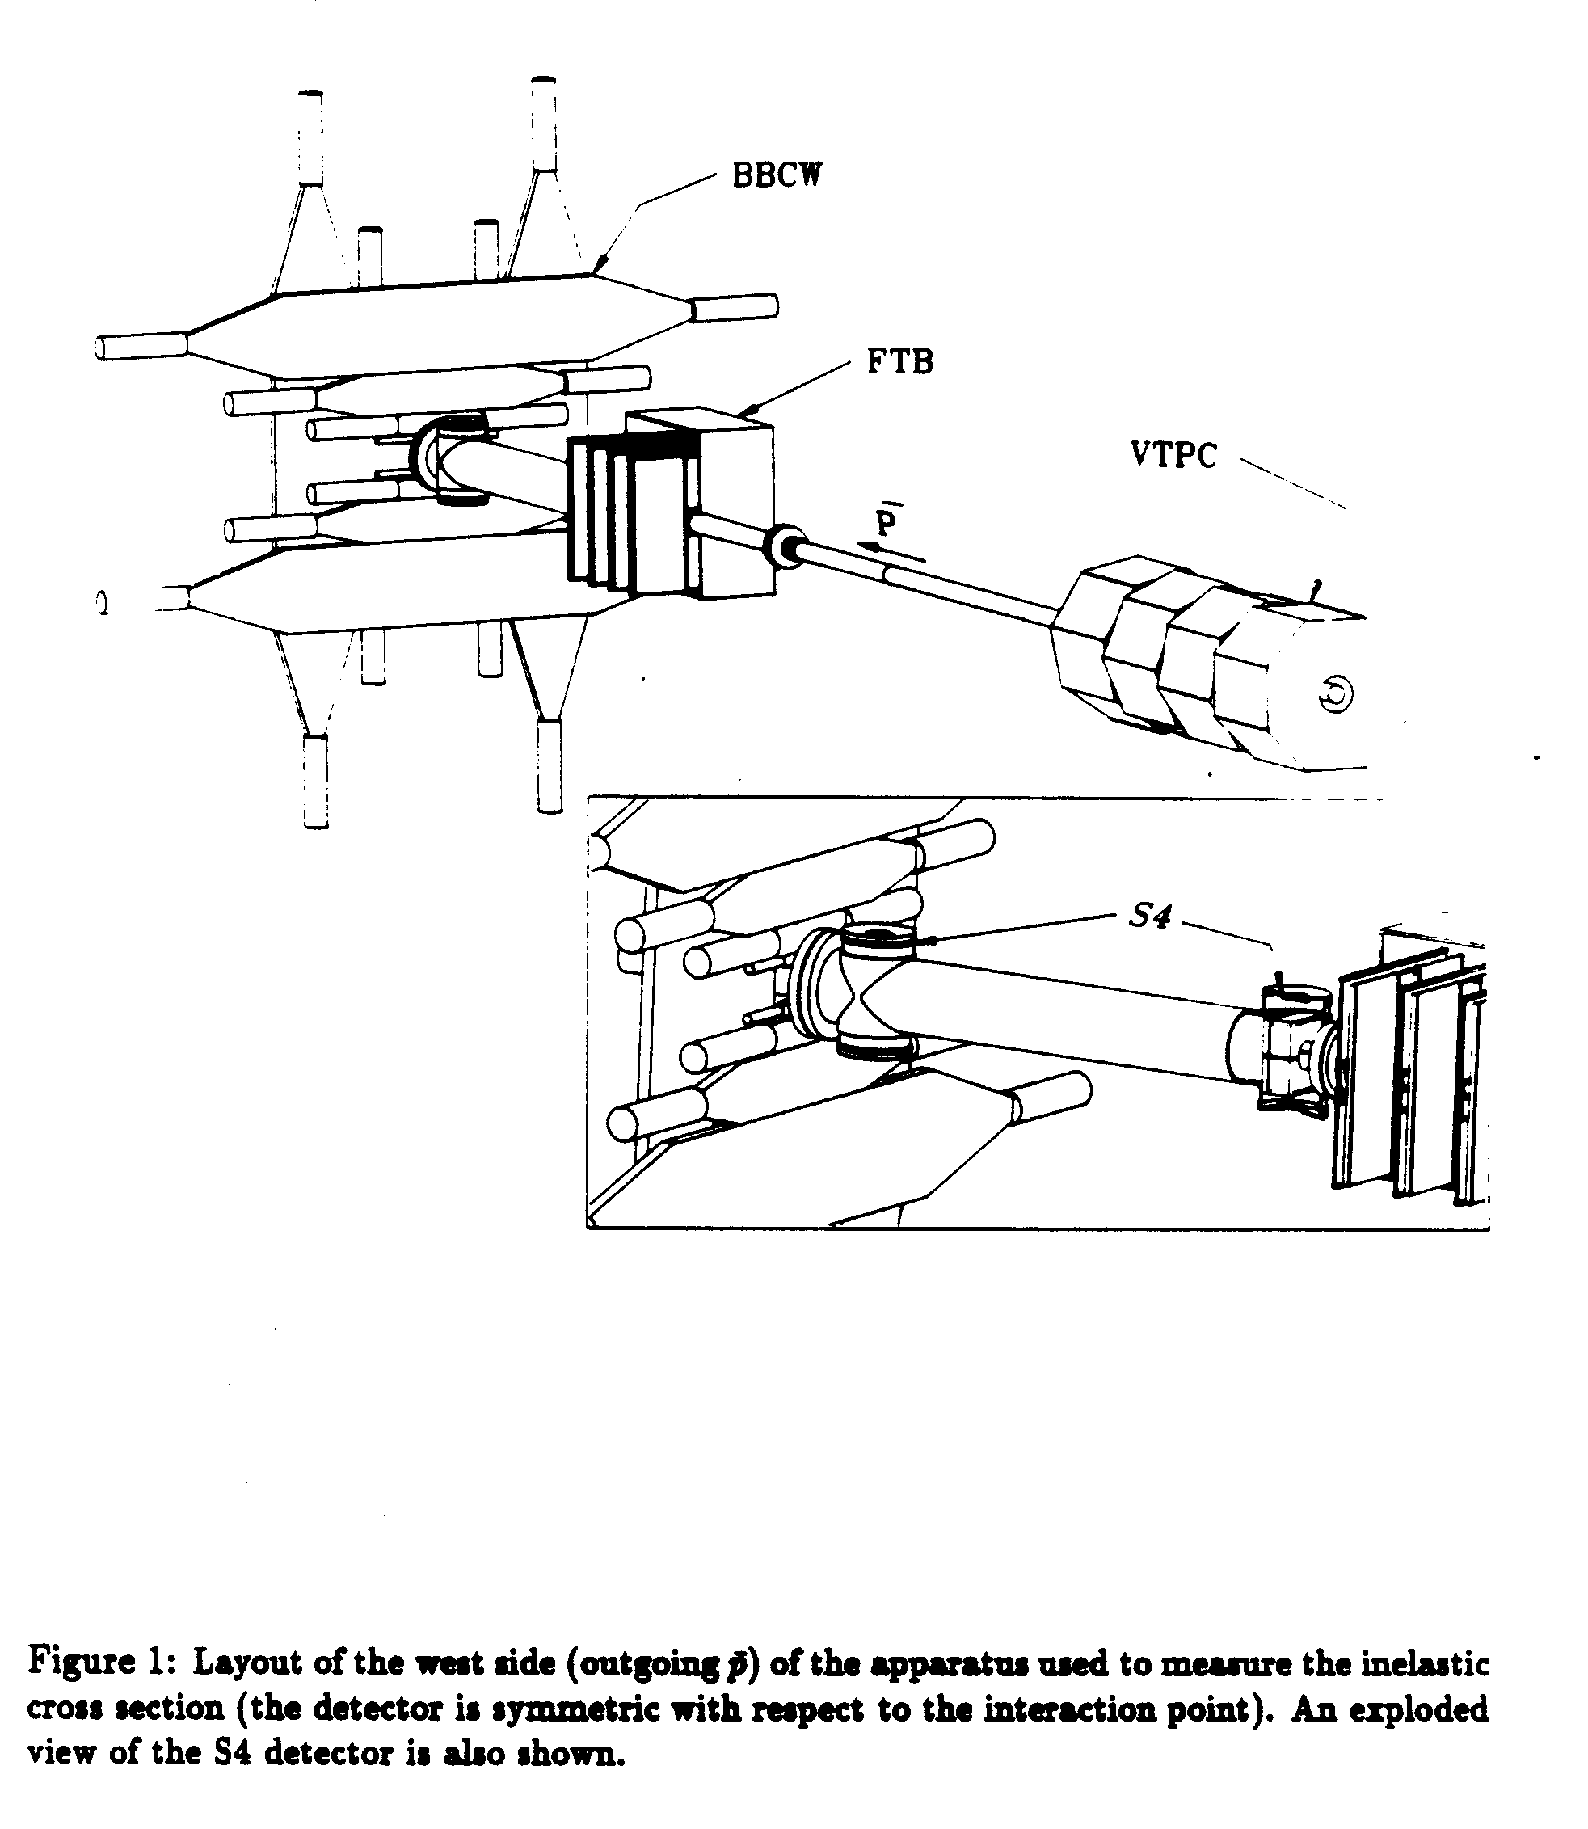
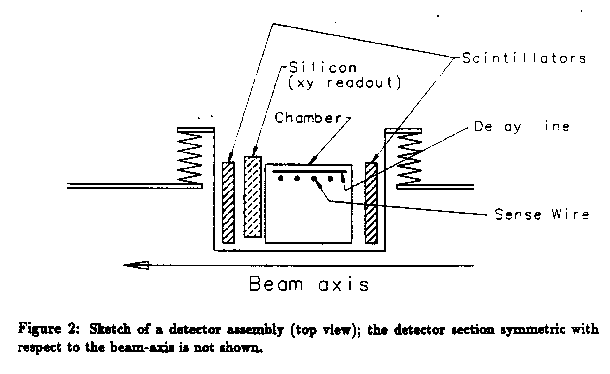
The CDF1 small angle detectors
Two intermediate angle telescopes measured the inelastic rate.
Paolo Giromini was the leader of the Frascati small angle chamber project.
The Pisa group under Guido Tonelli and Giorgio Apollinari were in charge of the silicon detectors.
The momentum of the forward scattered primary could be measured on the antiproton side.

Slide 10
First Physics in 1988
Measurements were made at
√s = 548 and 1800 GeV. The cross section increase with energy discovered at the ISR in p-p was confirmed in p-pbar.

Slide 11
INFN contributions to the hadron calorimeters
(a Fermilab-Purdue-INFN project)
Scintillators, light guides, phototubes, power supplies, laser flasher of the barrel and endwall hadron calorimeter: the sensitive components of 50 barrel and endwall hadron wedges were designed, built and run-in by the Italians.
In 1981-1982 the INFN hardware was moved to Fermilab in 11 ship containers.

Slide 12
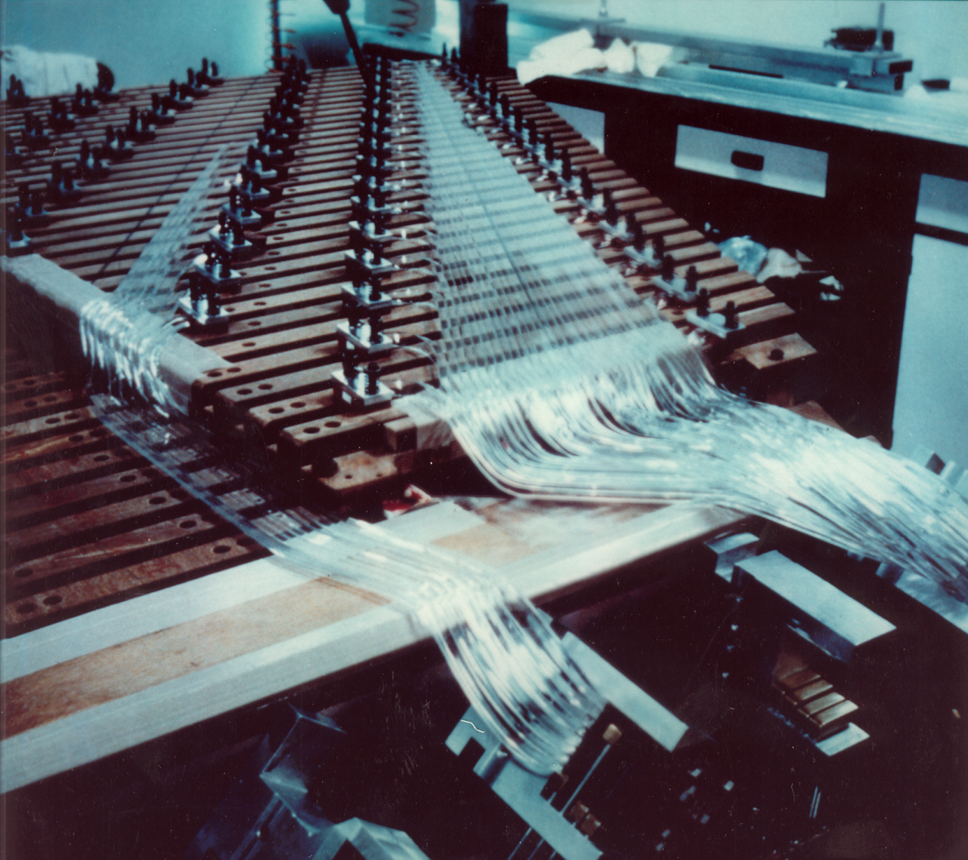
Light guide fabrication in Frascati
The Frascati Group lead by Paolo Giromini gave a major contribution to the central calorimeter.
Sergio Bertolucci was in charge of the light guide construction.
The readout BBQ bars were fabricated in Pisa

Slide 13
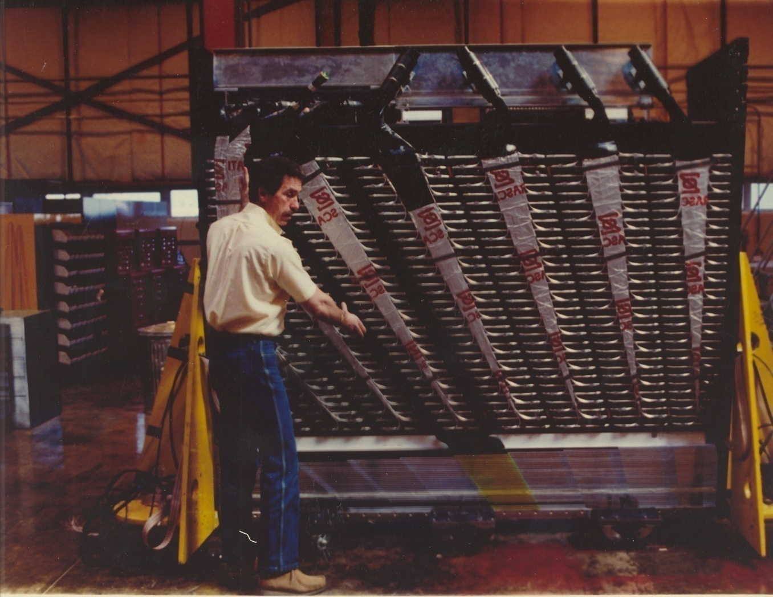
Light guides installed in the central wedge

Slide 14
Young Italians assembling the wedges

Slide 15
The superconduting coil came from Japan

Slide 16
The roman arches of the central calorimeter
Hans Kautsky proved in person that the arches were self-supporting.

Slide 17
The central CDF1 detector
Japan USA Italy
In 1985 the three national flags were displayed on top of the central detector in the assembly hall.

Slide 18
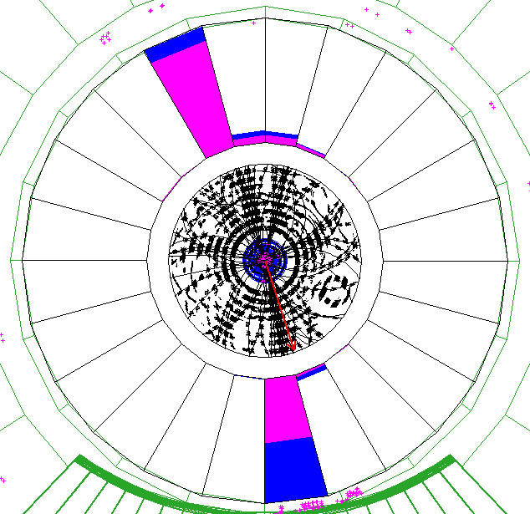
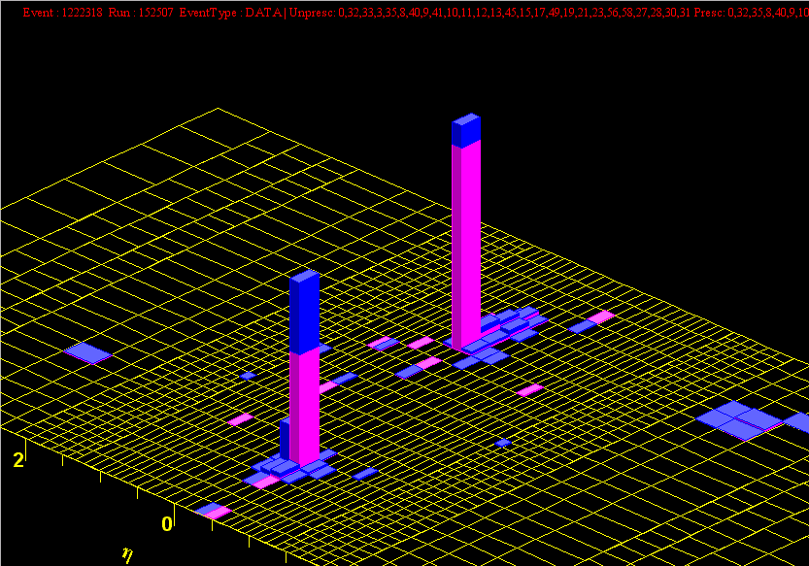
Hadron jets in the CDF calorimeter
M_{jj} = 1364 GeV
  r-φ view
E_{T} = 666 GeV
η vs. φ
EM calorimeter energy
E_{T} = 633 GeV
Hadronic calorimeter energy

Slide 19
The Silicon Vertex Detector proposed by the Italians
The SVX concept in the 1981 Design Report

Slide 20
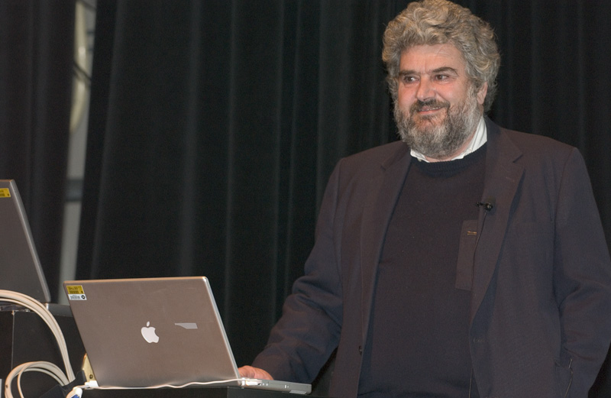
The role of Aldo Menzione
Leader of the Italian campaign to establish the potential of precision tracking with silicon detectors at hadron colliders.
In charge of design, construction and commissioning of the CDF1 silicon vertex detector
Panofsky price in 2009 with Luciano Ristori.

Slide 21
SVX1 (built with Fermilab and LBL)
Proposed in 1981, Approved in 1988,
Operating in 1991
½ of SVX1 is saved in the Pisa University museum.

Slide 22
The discovery

Slide 23
10 years of lower limits to the top quark mass
(95% c.l.)
PETRA/PEP > 22 GeV/c² in 1984
TRISTAN > 26 GeV/c² in 1988
SLC > 41 GeV/c² in 1989
LEP > 45 GeV/c² in 1989
UA1 > 50 GeV/c² in 1990
UA2 > 69 GeV/c² in 1990
CDF > 70 GeV/c² in 1990
UA2 and CDF > 77 GeV/c² in 1991

Slide 24
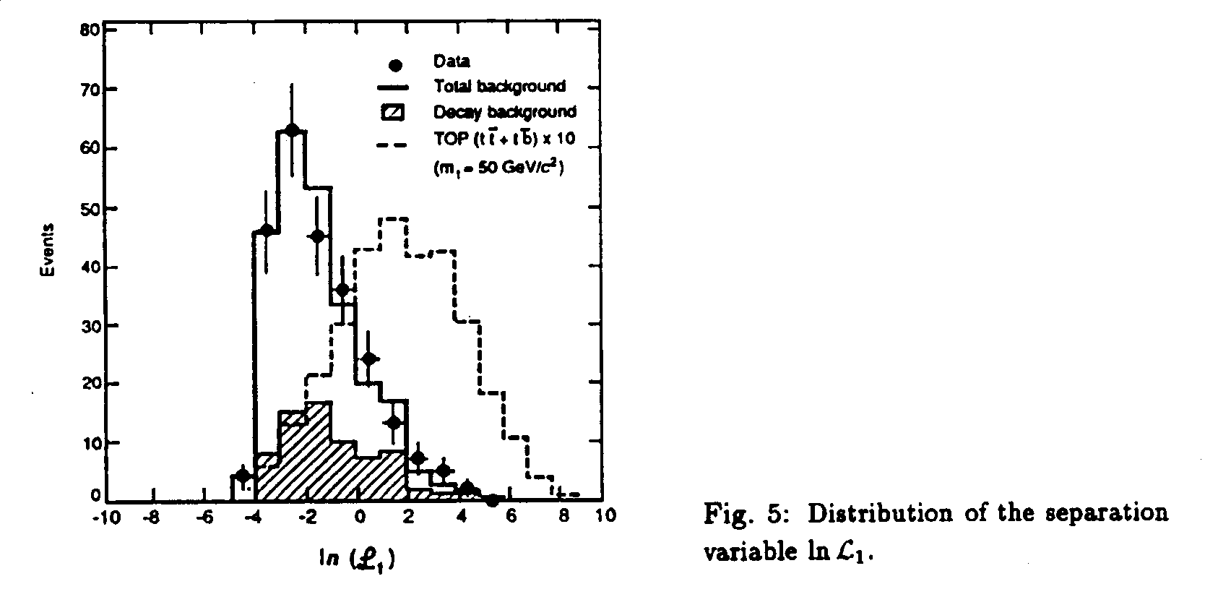
The UA1 top quark kinematic search (M_{top} < M_{W} )
UA1 had built a probability parameter from the transverse momenta of known jet production processes, relative to the values expected from the decay of a heavy top quark:
Top 80 GeV/c²
QCD
A top quark of about 80 GeV would have been above threshold at the SPS.

Slide 25
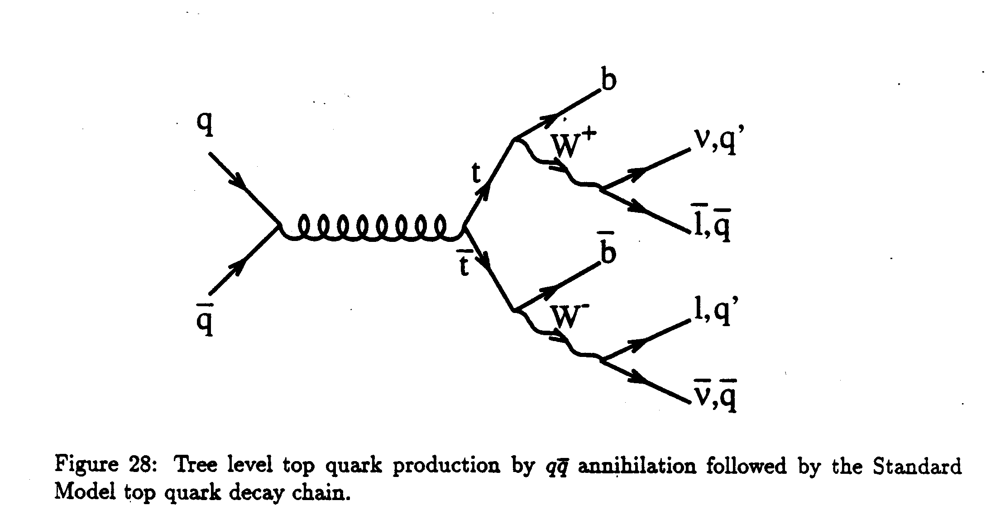
t-tbar events at the Tevatron for M_{top} > M_{W}

Slide 26
CDF kinematic search for a heavy top
(a` la UA1)
Radiated QCD jets have mostly low E_{t}
Decay prongs of slow-moving heavy objects can have larger E_{t}
The heavier the top quark, the greater the excess of large E_{t} jets.

Slide 27
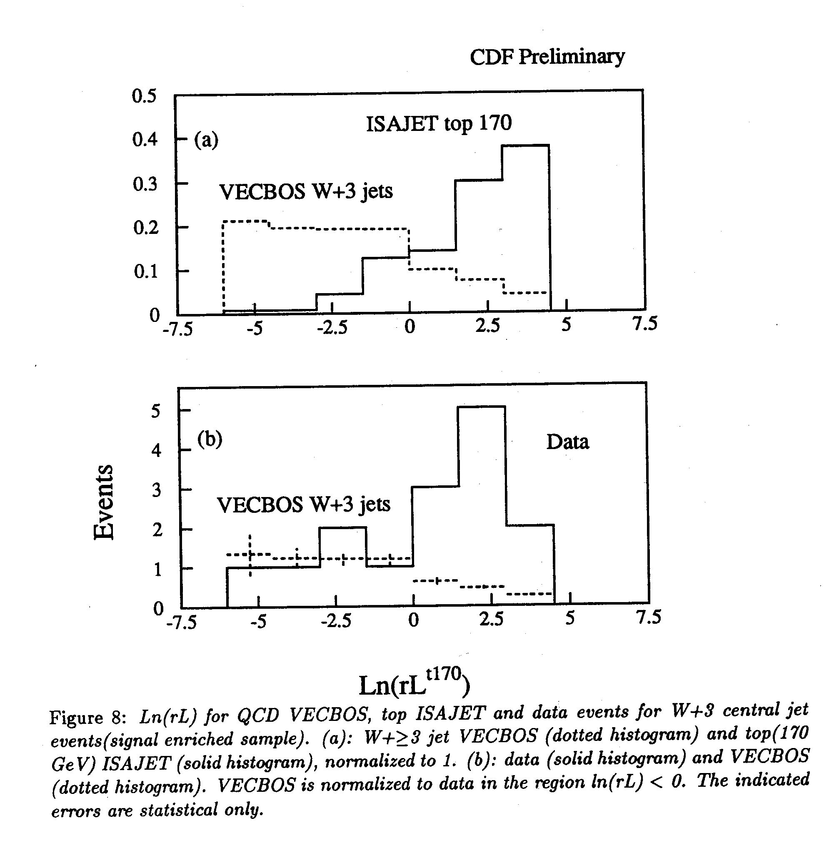
Relative likelihood in single lepton candidate events
(summer 1993)
MONTECARLO
The Pisa group (Hans Grassmann, et al.) simulated the distributions of large transverse energy jets in known W+jets events and in t-tbar events, and found evidence in the data for a contribution of top-like events
DATA

Slide 28
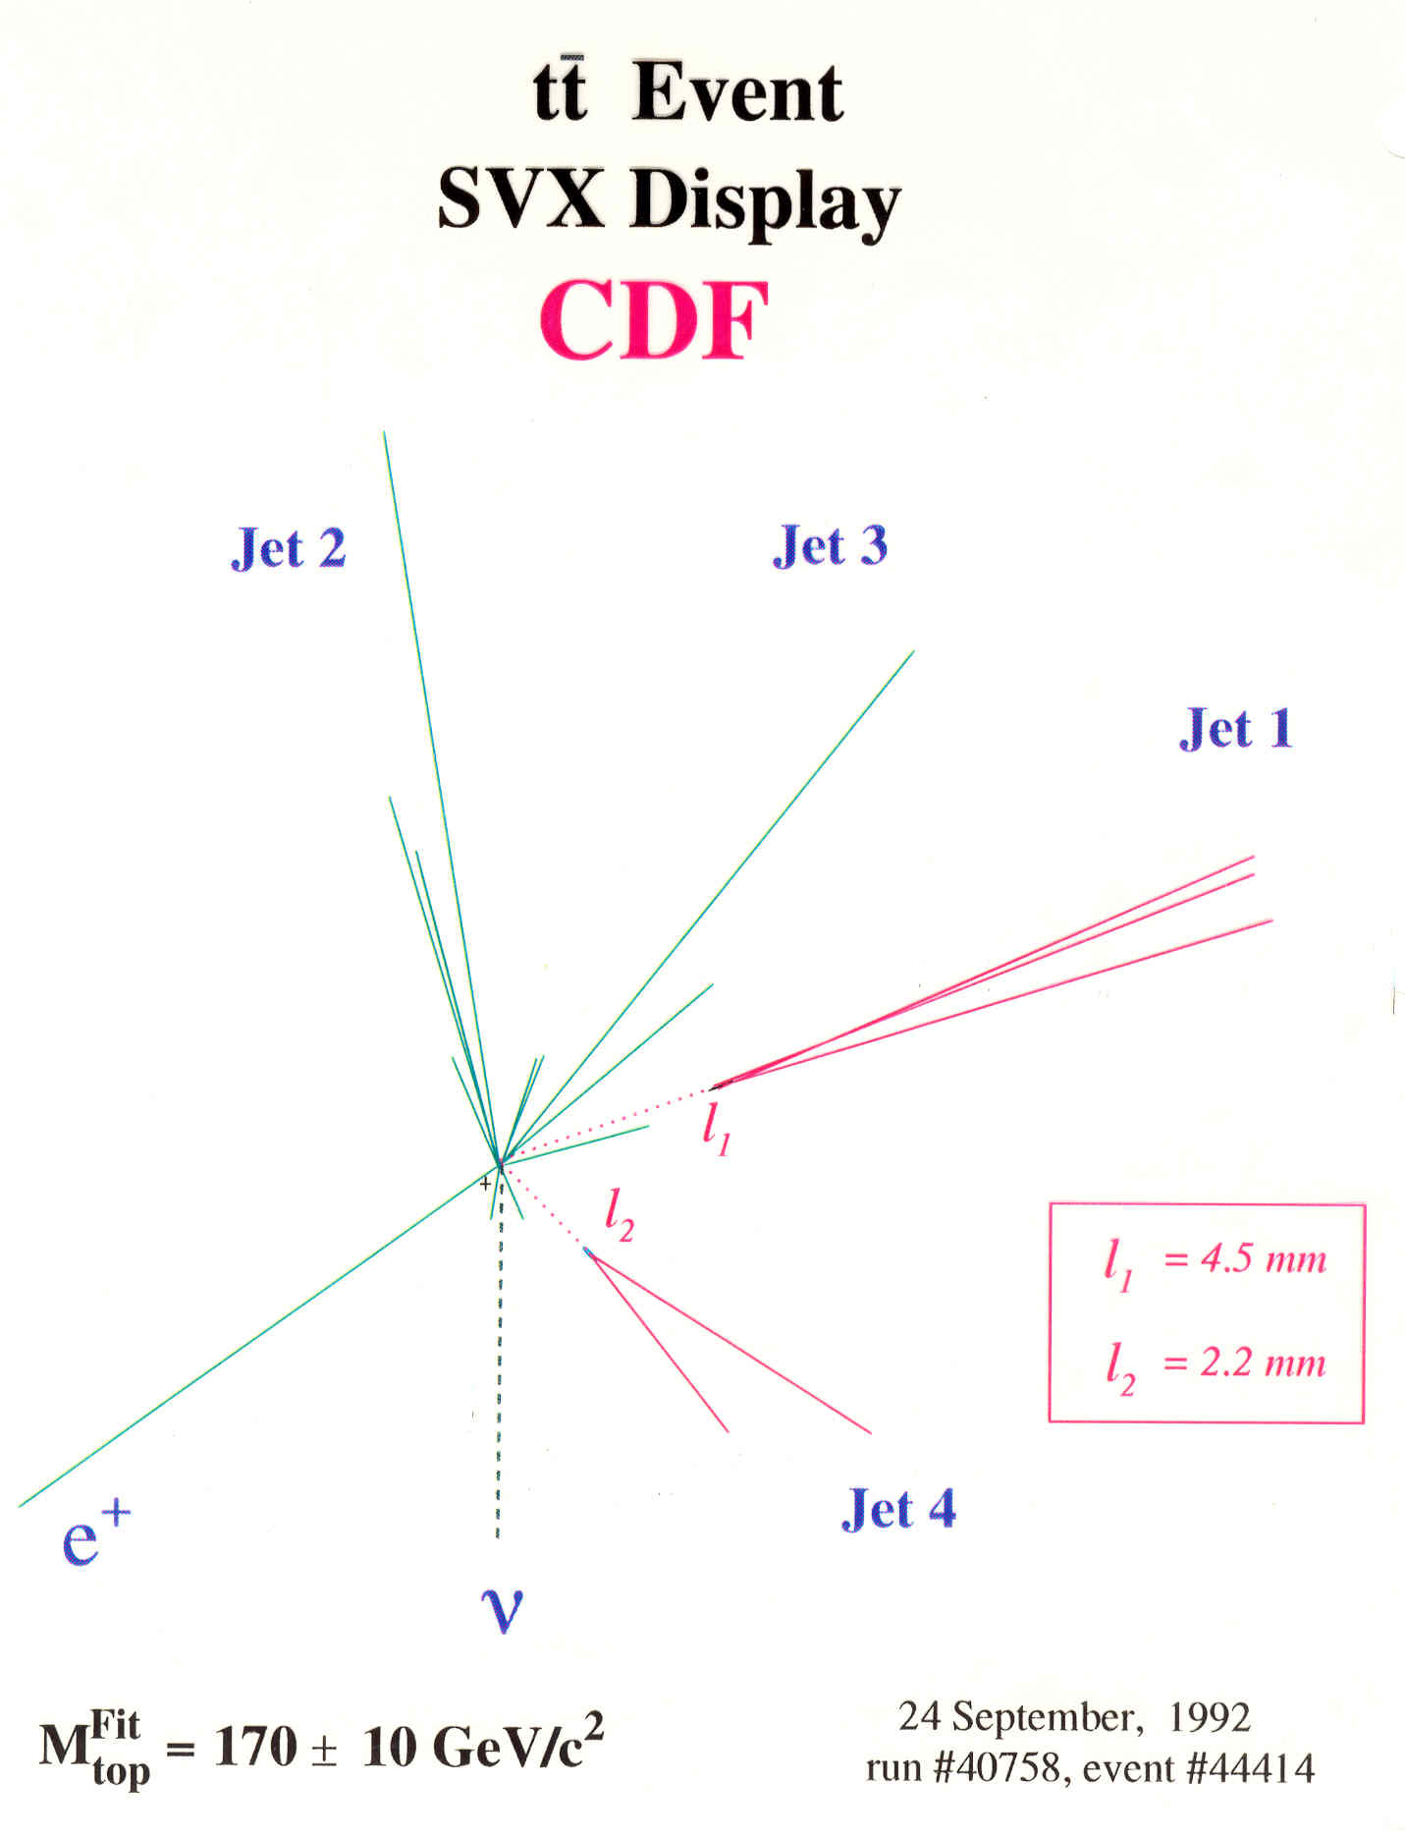
The powerful SVX :
Top pair candidate, 1994
Candidate
Tagging efficiency of b-jet pairs in t-tbar events ≈ 42%
Tagging efficiency of light quark energetic jets ≈ 0.5%.

Slide 29
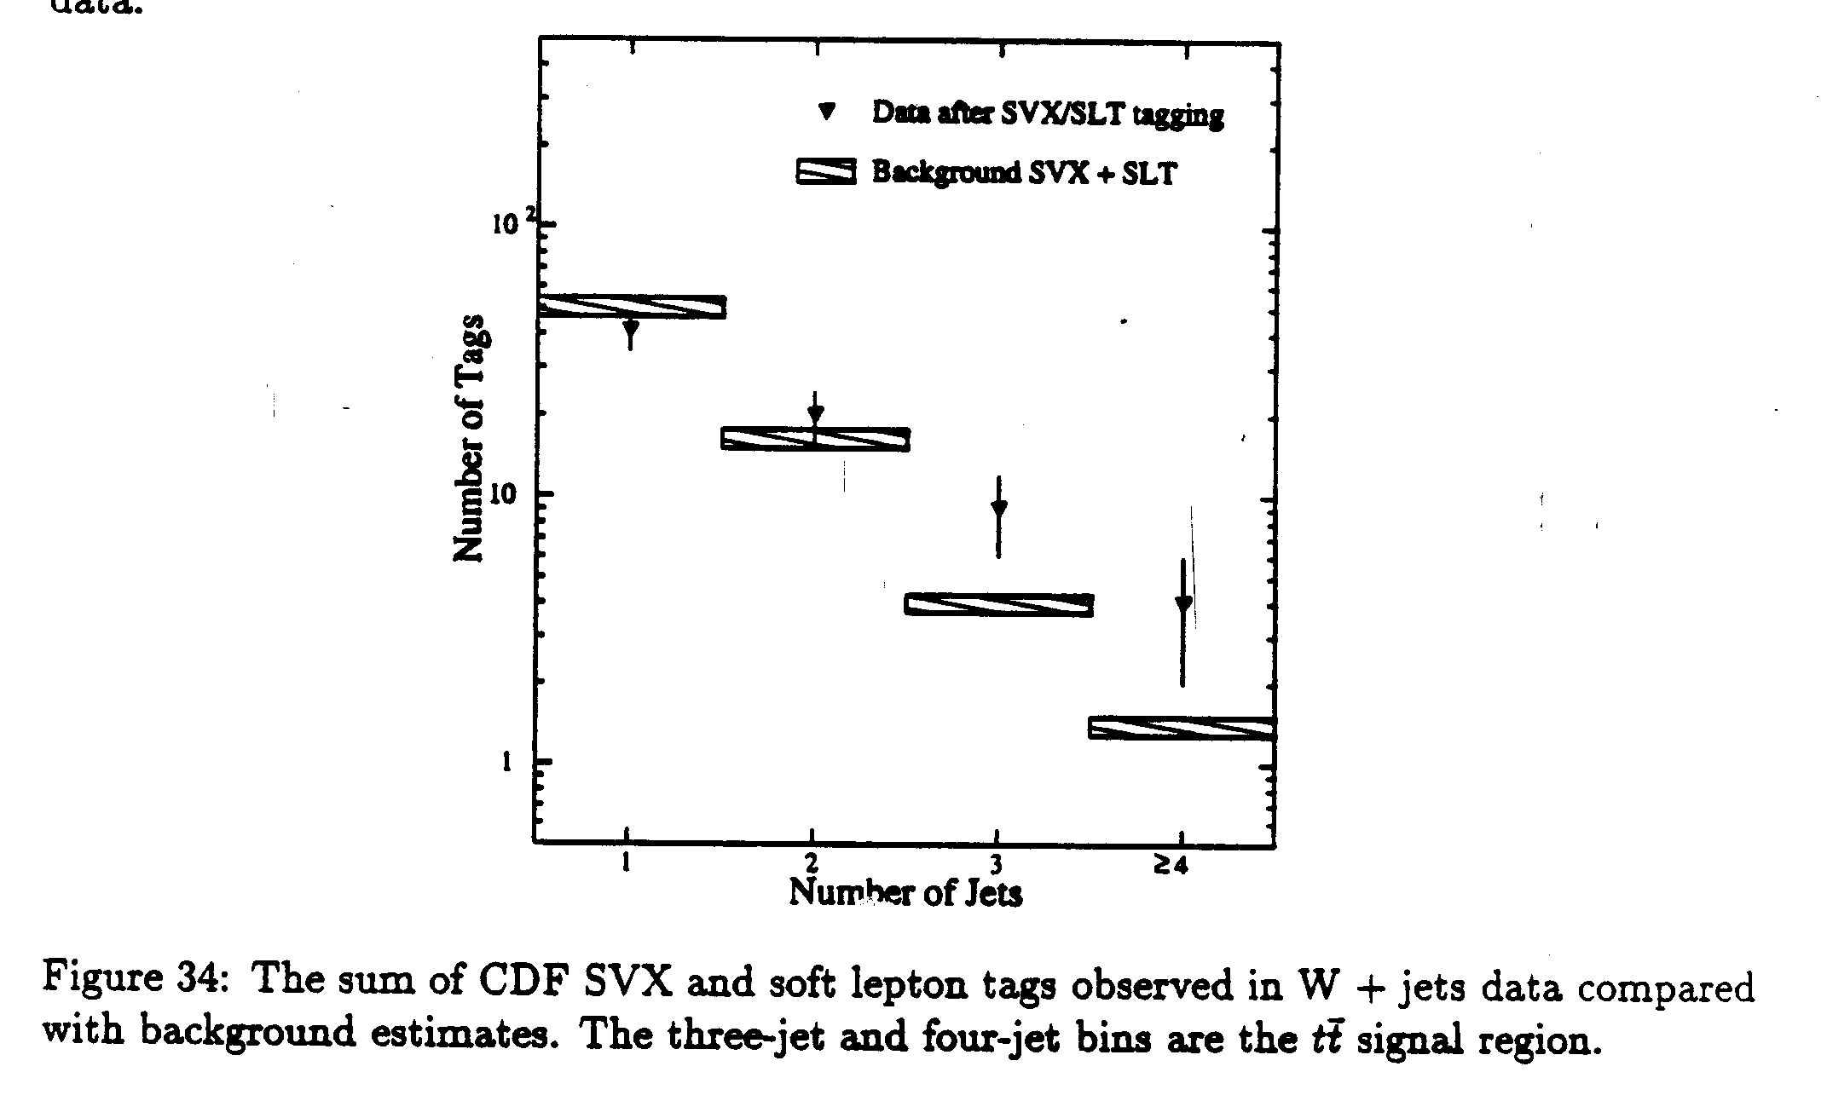
Secondary vertices in the 1994 Evidence Paper
Single lepton sample
Including single and dilepton channels, 15 top-like tags were found against 5.9 expected.
This corresponded to a 2.8 σ fluctuation.

Slide 30
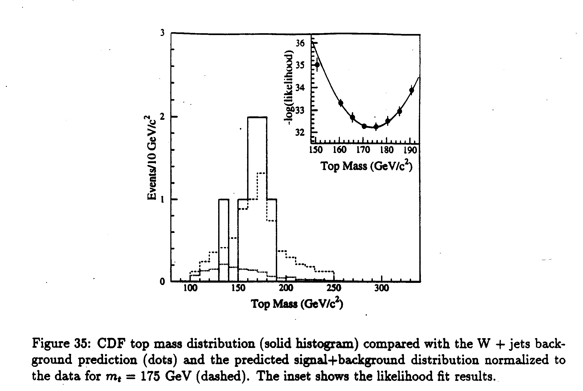
Top quark mass in the Evidence Paper
7 single lepton events could be reconstructed to find the mass. A peak was found at m_{t} = 174 ± 17 GeV/c².

Slide 31
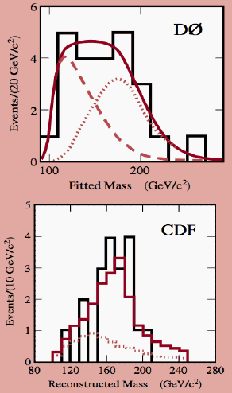


Discovery of the top quark in 1995

Slide 32
Italians in the top quark discovery
Italians in the top discovery
BOLOGNA 8
FRASCATI 5
PADOVA 11
PISA 36
60 Italian authors, ~13% of the CDF Collaboration.
In 1995 a Swiss group (Geneva) was the only other European group in CDF.

Slide 33
The growth of the CDF Collaboration
After the top quark discovery many European groups from Germany, Finland, Russia, United Kingdom, Spain, joined CDF for Run II.
Many non-European Institutions also joined from Canada, Japan, Korea, Taiwan (in 1993)

Slide 34
The increasing Italian participation
1980, Frascati and Pisa
1990, Padova
1992, Bologna
1997, Trieste-Udine
1999, Rome
Discovery of the top quark (1995)
Start of Run 2 (2001)

Slide 35
The Italian summer students
In 1983 the Pisa group started a summer student program by hosting three physics students for a few months at the lab to help in the experiment. At present, the program is still run by former CDF Italians but has expanded greatly beyond CDF, growing up to 36 students in 2016. It involves physics and engineering students to be trained in science and technology in all groups of Fermilab.
The Italian summer students program has contributed significantly to lab science. Several former students are now staff members, even in leadership positions in the lab management.

Slide 36
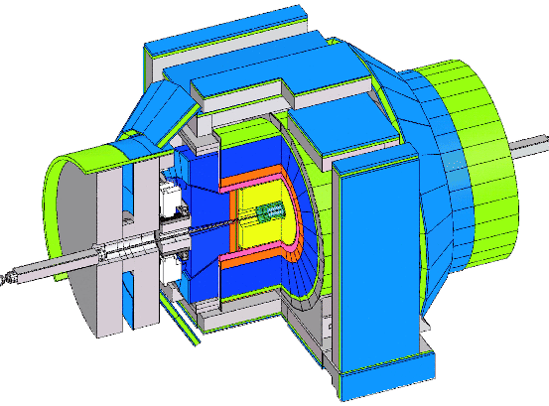
CDF in run2
Remaining from Run1:
the solenoid
the central calorimeter
a fraction of the muon detector
New
the tracker
  SVX2 and ISL
  The central drift chamber COT
the forward calorimeter plugs
the extended muon detector
The time of flight counters
the front-end electronics
the trigger/DAQ electronics
A major effort. The detector was extensively rebuilt.
Bob Kephart and Cathy Newman-Holmes project leaders

Slide 37
Italians in the CDF2 Design Report
(1993)
Bologna, Frascati, Padova, Pisa
63 authors out of 389

Slide 38
The largest Italian contingent (April 2003)
53 CDF groups, about 650 physicists
6 Italian groups, 111 physicists
Bologna: 10 physicists
Frascati: 7
Padova: 22
Pisa: 37
Rome: 21
Trieste/Udine: 14

Slide 39
Italian contributions to the CDF2 detector
The secondary vertex tracker (Pisa-Chicago-LBL)
The Intermediate Silicon Layers (Pisa-Tsukuba-Fermilab)
The laser flasher of the scintillator plug calorimeter (Udine)
The upgraded muon scintillation detectors (Pisa-JINR)

Slide 40
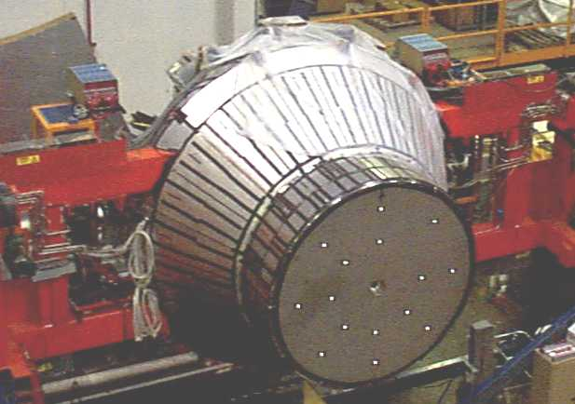
The plug calorimeters
Towers of plastic scintillators, as in the central calorimeter.
Calorimeter coverage was extended to absη = 3.6.

Slide 41
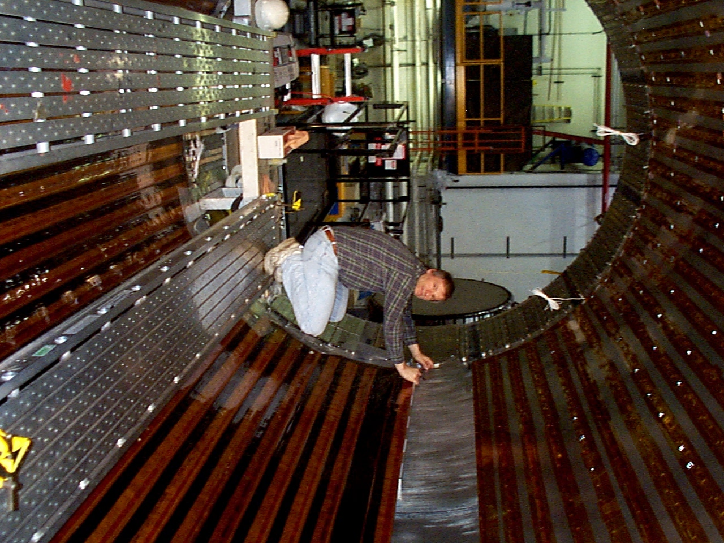
The time of flight counters
The TOF counters were laying on the inner surface of the solenoid

Slide 42
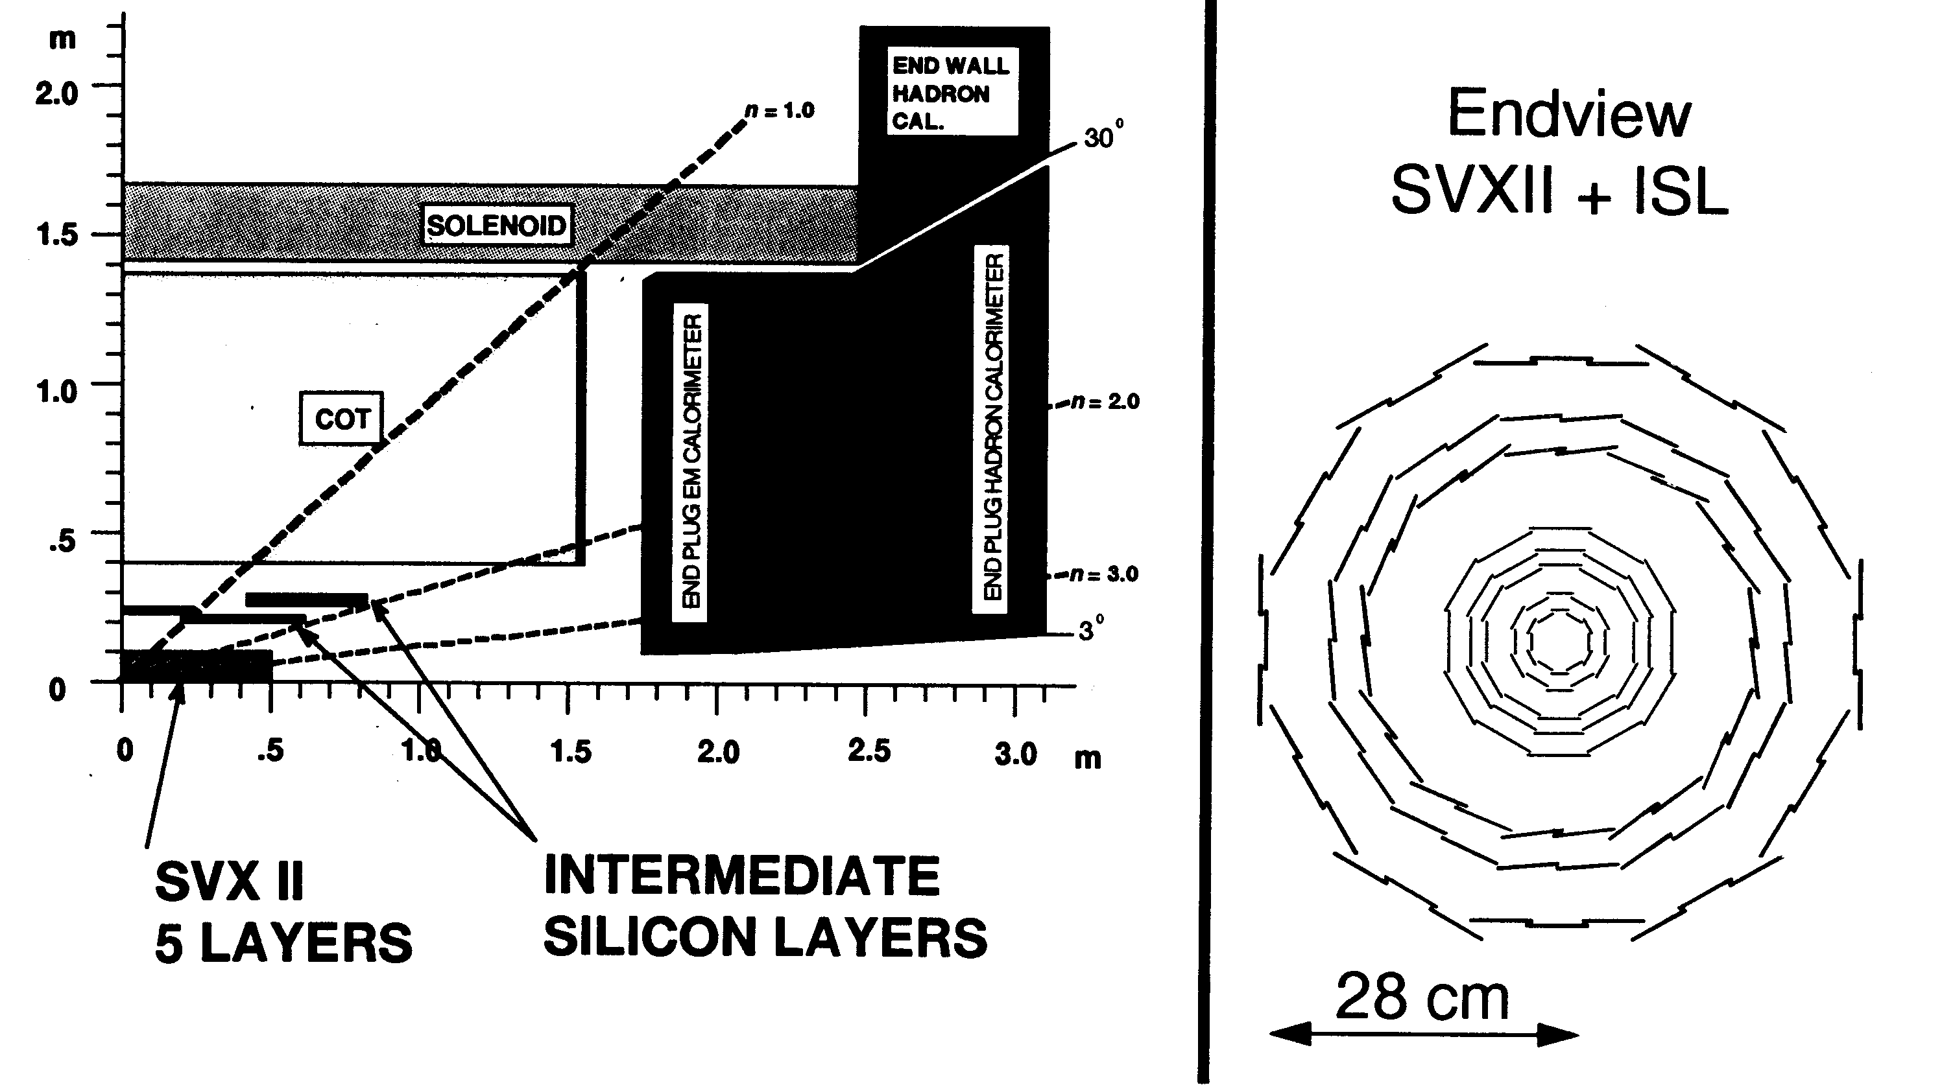
The CDF2 tracker

Slide 43
SVX2
The ~ 100 cm long, second generation SVX2 contained 5 layers of double-side sensors, within 8 cm from the beam axis.

Slide 44
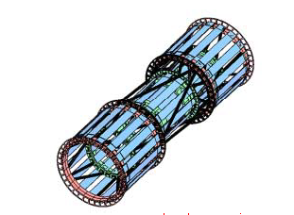
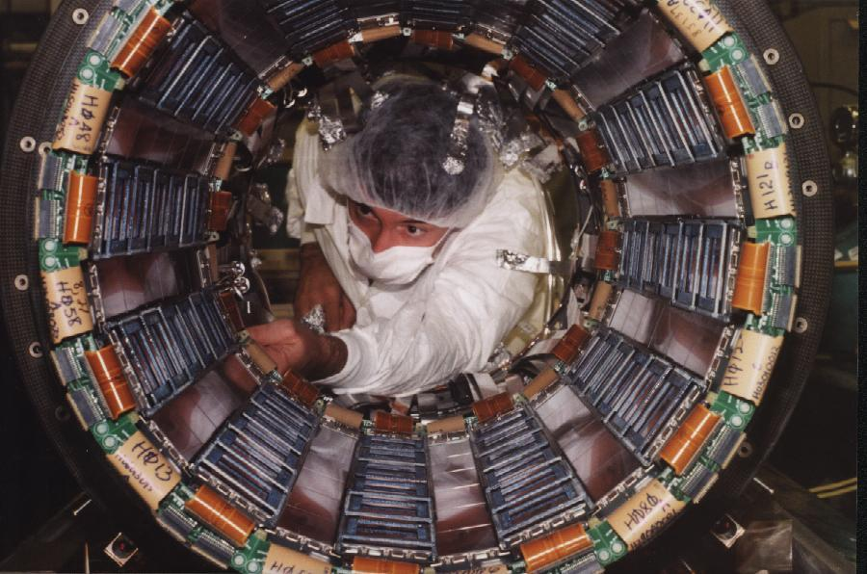
ISL
The ISL construction in Pisa was lead by Giorgio Chiarelli

Slide 45
Central Outer Chamber “COT”
”the hart of CDF”
A Fermilab project
96 wire planes
  30,240 signal wires
  Four z- and four 3º-stereo superlayers,
  ≤0.88 cm wide cells with drift time ≤100 ns

Slide 46
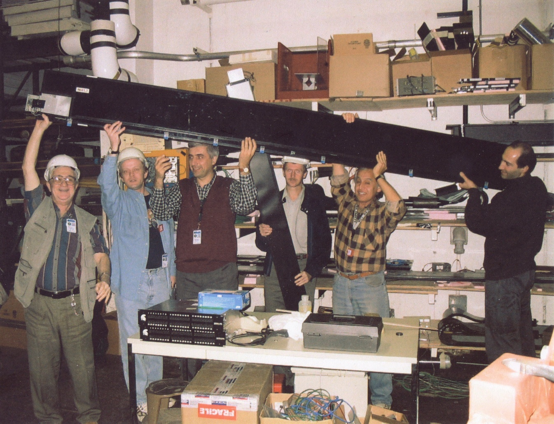
A counter of the outer muon detector
(a JINR contribution)

Slide 47

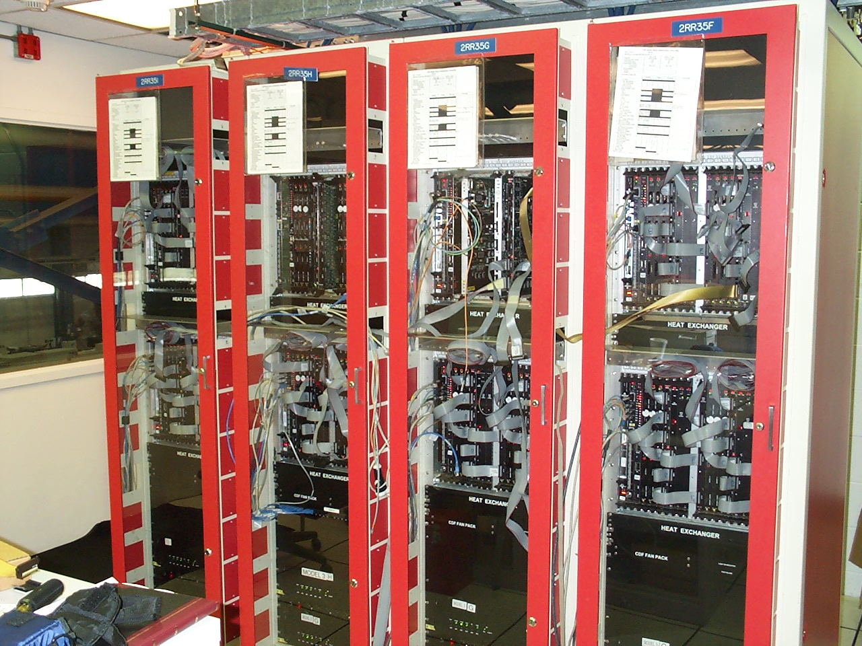
SVT electronics
The electronics of the secondary vertex tracker was a specialized sector of the run2 trigger

Slide 48
Secondary vertex tracker SVT
Fast electronics (XFT) feeds segments of COT tracks to SVT
Associative memory combines them with hits in the SVX and finds tracks which are not likely to come from the primary vertex
Tracks are found in ~20 μs. Triggering at level 2 becomes possible on hadronic Charm and Beauty decays.

Slide 49
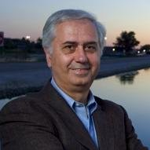
The role of Luciano Ristori
Luciano conceived and proposed to the CDF Collaboration in 1990 an addition to the trigger electronics capable to trigger on secondary vertexes (SVT).
The SVT trigger has made accessible to CDF measurements otherwise impossible at a hadron collider, in the area of hadronic decays of B mesons and baryons, including a precise measurement of the Bs oscillation frequency.
Panofsky price with Aldo Menzione in 2009.

Slide 50
The wealth of great physics

Slide 51
The huge CDF2 physics span
Properties of top quark pair production and decay
Observation of EW production of single top quark
W mass
W, Z single and associated production
Wide field of heavy flavor physics
Single and multi-jets physics
Higgs boson search…
Many results will stay forever in the Physics books

Slide 52
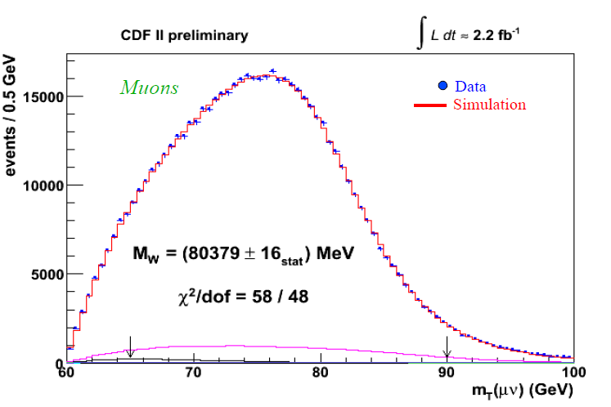
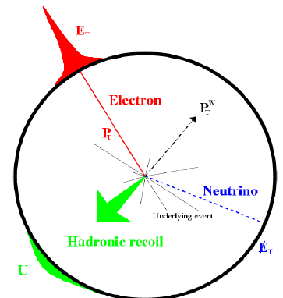
W mass
February 2012
M_{W} = 80387 ± 19 MeV/c² (→ ± 12 (stat.) ± 15 (syst.))
ppbar → WX → eγX

Slide 53
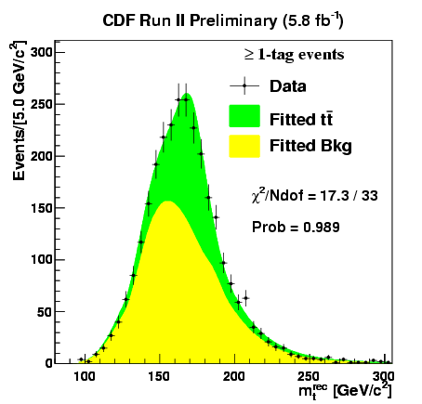
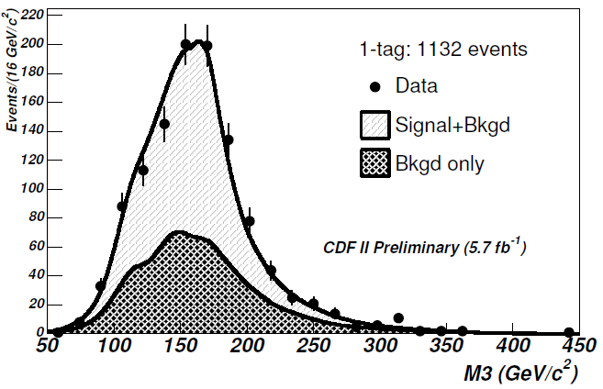
Top quark mass winter 2011
MET+Jets
All-hadronic
Single lepton
All hadronic
Dilepton
Constraint from x-sec
Top mass from t-tbar event fitting
Mass of the hadronically decaying top
https://arxiv.org/pdf/1409.4906.pdf
CDF combination (winter 2011) : m_{top} = 172.70 ± 0.63(stat) ± 0.8(syst) GeV/c²
Tevatron combination (summer 2011): m_{top} = 172.2 ± 0.6(stat) ± 0.8(syst) GeV/c²

Slide 54
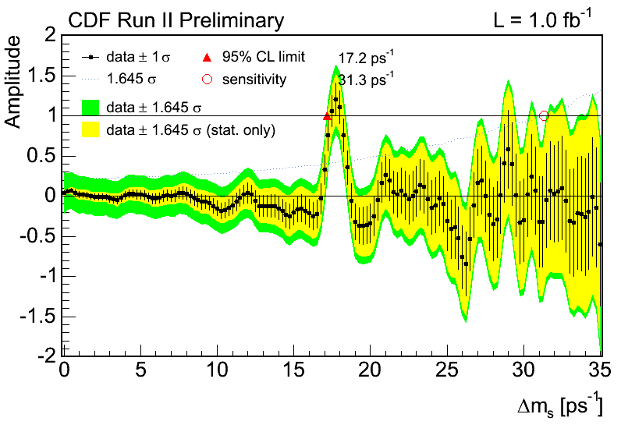
B_{s}⁰ – B_{s}⁰ mixing
__
(PRL 97, 242003 2006)
87 fs (< 30 μm, 0.4%) resolution for fully reconstructed states
5.4 σ significance

Slide 55
Another major contribution of Italians at Fermilab
(courtesy of Peter Garbincius)
Italian collaborators in the E687-E831 (“FOCUS” ) Charm photoproduction experiment contributed the silicon microstrip vertex detector and readout, which were essential for the experiment.
Bologna: Pierluigi Frabetti.
Frascati: Adriano Zallo, Franco Fabbri, Stefano Bianco
3) Milano: Angela Sala, Daniele Pedrini, Dario Menasce, Donatella Torretta, Gianpaolo Bellini, Laura Perasso, Luigi Moroni, Mariella Di Corato, Margherita Vittone, Sandra Malvezzi, Silvano Sala
4) Pavia: Gianluca Boca, Sergio Ratti.

Slide 56
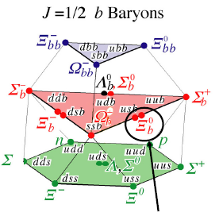
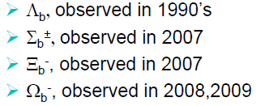
Beauty-baryons observed by CDF
last observed

Slide 57
Evidence for a Higgs boson at the Tevatron
(contributed primarily by H → b-bbar)

Slide 58
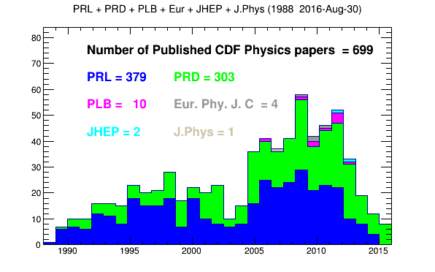
699 published CDF papers (1988-2016)
Also 99 papers published in NIM, with 6168 citations

Slide 59
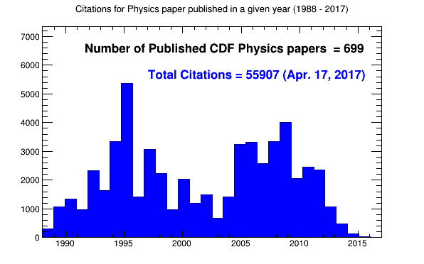
Close to 56.000 citations of CDF papers as of April 2017

Slide 60
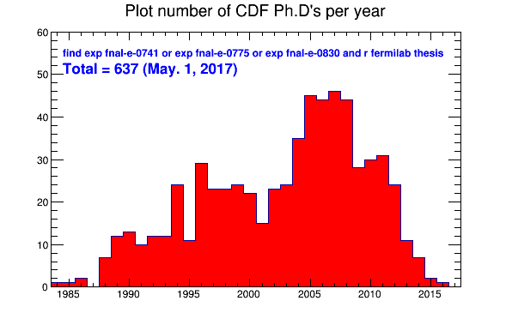
637 Ph.D`s earned with CDF (May 1, 2017)

Slide 61
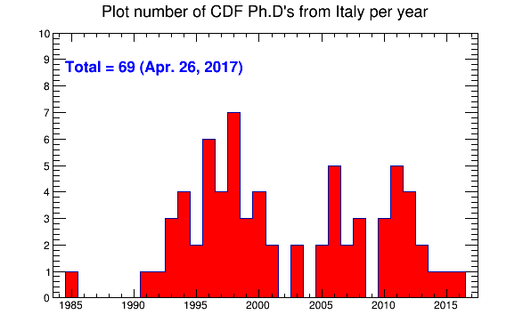
68 Ph.D`s earned by Italians (April 2017)
Pisa 25, Padova 15, Siena 8, Roma 4, Bologna 4, Trieste 3, Trento 2,
Udine 2, Cassino 1, Firenze 1, Milano 1, Pavia 1, Torino 1

Slide 62
Italian CDF Co-Spokespersons
1995 Giorgio Bellettini
1998-2000 Franco Bedeschi
2002-2004 Luciano Ristori
2010 Giovanni Punzi
2012 Luciano Ristori
2015 Giorgio Bellettini
2017 Giorgio Chiarelli

Slide 63
The CDF Collaboration in May 2017
389 authors
62 Italians

Slide 64
The expected CDF legacy measurements
M_{W} , Mop will eventually be combined with D0 (and with LHC)
M_{W} : shooting for a total error ≈ 10 MeV
Mop : shooting for a total error ≈ 0.9 GeV/c²
Many other important analyses are ongoing:
1) Search for anomalous heavy hadron states
2) Search for b-bbar resonces in dijets
3) Associated W+jets production
4) Tevatron combination of F/B asymmetry in t-tbar
5) Tevatron combination of F/B asymmetry in DY
6) Top polarization in the dilepton channel
7) t-tbar cross section with full statistics
8) Central exclusive production…

Slide 65
Final comment
CDF was a great success. Can such a success be repeated?
An excellent accelerator, an excellent detector design, a powerful brain trust. Yes, such a success can be repeated.
A major Italian contribution. This can and must be continued.
3) Great physics was around the corner at the Tevatron. It can happen again.

