Slide 1
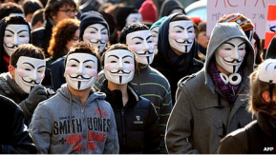
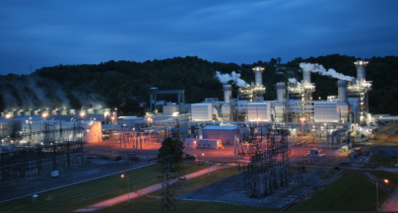

Cyber Informed Engineering
Virginia Wright, Program Manager Domestic Nuclear Cyber Security

Slide 2

INL Background
One in a network of 17 DOE national labs
DOE’s lead lab for nuclear energy
A major center for National Security
INL Vision
INL will change the world’s energy future and secure our critical infrastructure.
INL Mission
Discover, demonstrate, and secure innovative nuclear energy solutions, other clean energy options, and critical infrastructure.
Research in the National Interest that Maintains American Competitiveness & Security

Slide 3
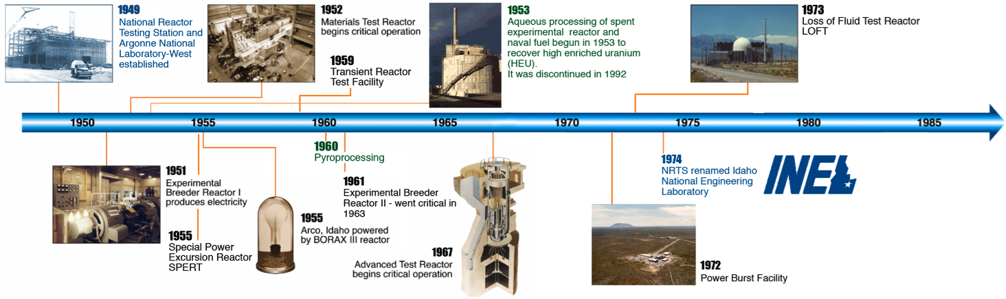
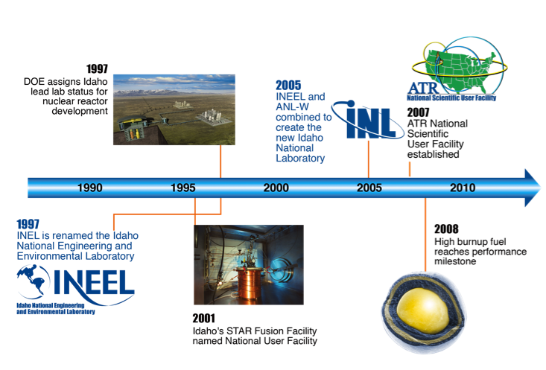
Our History
Nuclear Energy in the U.S.
  1940’ and 1950’s from concept to prototype
  1960’s from prototype to commercialization
  1970’s an industry is launched
  1980’s ensuring safety
  1990’s laying the foundation for a new generation of nuclear power plants
  2000 & beyond a new generation of nuclear power and advanced fuel cycle technologies

Slide 4
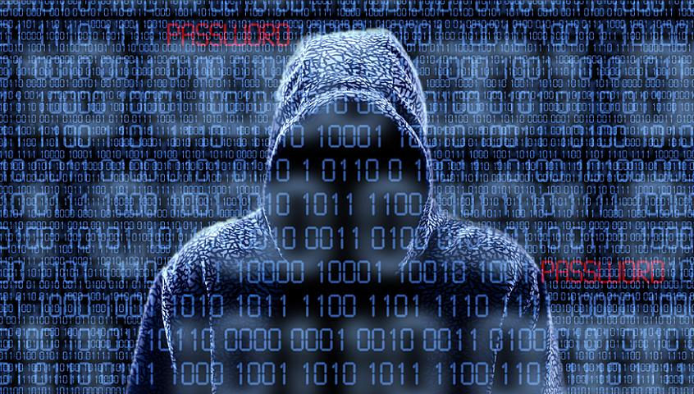
Last Talk We Presented Was On Cyber Threat
Discussed the overall threat picture and expanding adversary capabilities in cyber
Established that digital equipment used has cyber security flaws
Established that adversaries can take advantage of these flaws
Established that adversaries can make these assets behave in undesired ways
Established that airgaps and security zones are not a 100% defense

Slide 5

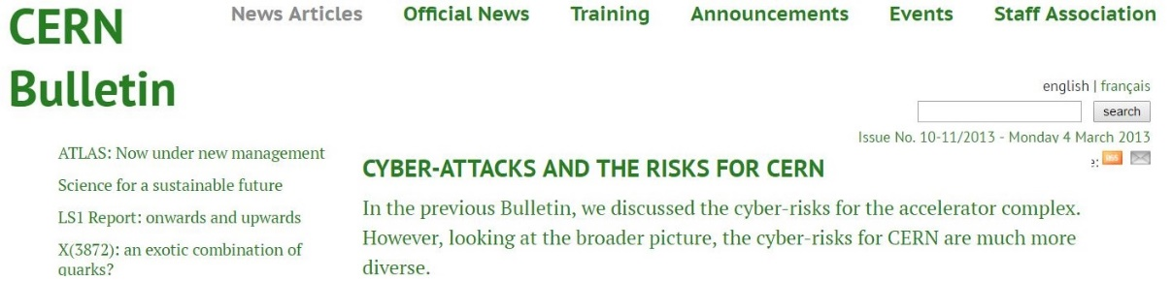
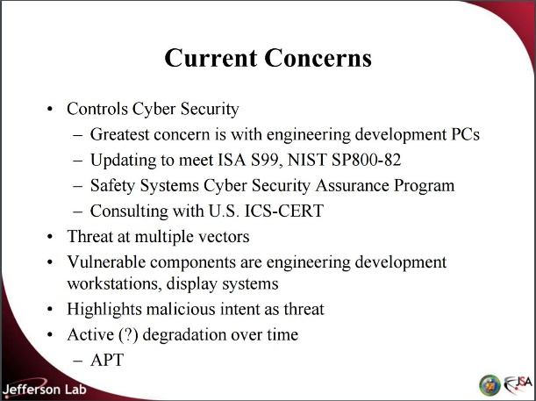
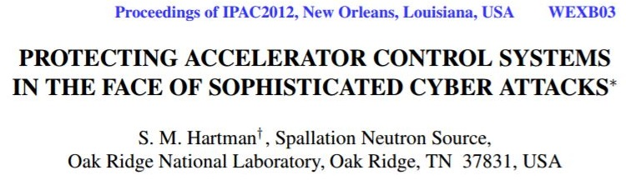
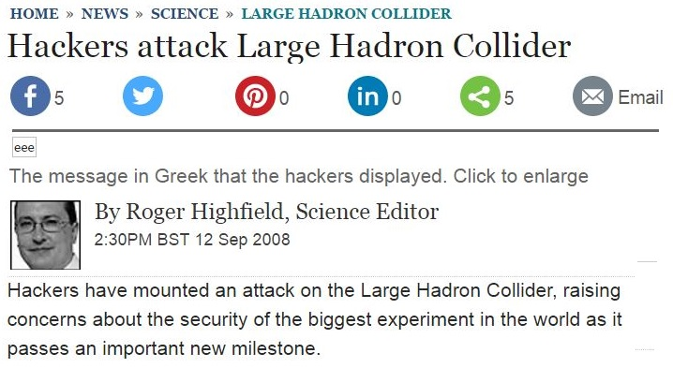
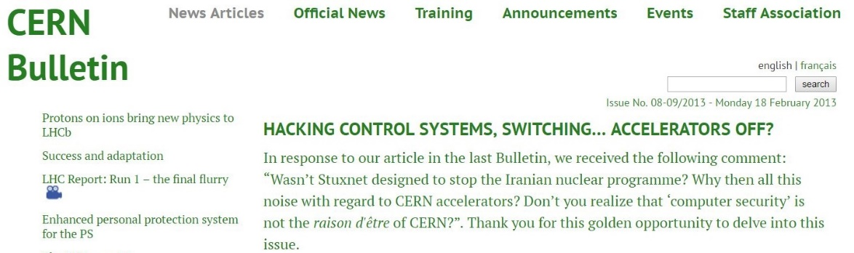

Slide 6


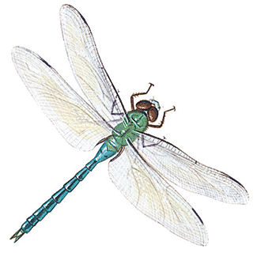


Exploit and Malware Campaigns Receiving Attention
Heartbleed
Dragonfly
Shellshock (Bash Bug)

Slide 7
What Consequences Result from Digital Systems Attack on Accelerators and Research Equipment?
Damage to accelerator facilities (or engineering facilities)
Personnel and environmental exposure
Other safety issues
Theft of ideas
Data inaccuracies
Mission disruption

Slide 8

Easy to Get Overwhelmed
Where should our engineering and technical staff spend their time?

Slide 9
Cyber Informed Engineering

Slide 10

CIE Defined
Simply Stated:
The inclusion of cyber security aspects into the engineering process for digital systems
Expanded:
A body of knowledge and methodology to characterize the risks presented by the introduction of digital technology towards an engineering strategy informed by an awareness of the cyber threat to mitigate such risks.
Cyber
Engineering
Safety
Security

Slide 11
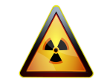
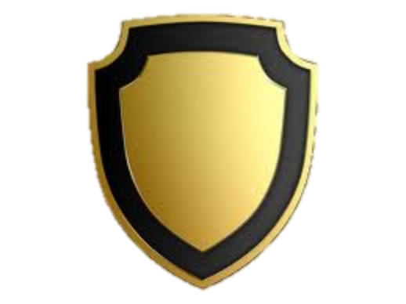
Strata of Cyber Security Threats
Blended Attack
digital & material sabotage
Directed remote attack
(persistent threat)
Cyber security defenses versus unstructured/non-directed cyber threats (Crime, Botnets, etc.)
Directed remote attack with witting insider & supply chain (Nations/groups)
Directed remote attack with unwitting insider (Nations/groups)
Full
Spectrum
USG Response
Disabled Plant
Radiologic
Safety
CIE Impact
Resilient
Systems
Material Control
Defense in Depth
Disrupt
Operations
Detect
Recover & Report
People
Risk
Disrupt
Comms
Industry Compliance
Data Theft
Consequence Scale
Type of Threat
Protections

Slide 12
Why CIE?
Traditional engineering methods do not account for cyber risk
Engineers operate in a “trusted” environment
Belief in isolated networks
Bolt-on cyber security solutions do not work well for digital systems used in engineering applications
Engineering staff are unaware of the potential cyber threat to operational technology
Not about “failure” modes, cyber attacks may make digital systems operate beyond or outside of their imagined capabilities

Slide 13
CIE Framework Elements
Consequence / Impact Analysis
Systems Architecture
Engineered Controls vs. IT Controls
Design Simplification
Resilience Planning
Engineering Information Control
Procurement and Contracting
Controlling Interdependencies
Cyber Culture
Digital Asset Inventories

Slide 14
Consequence / Impact Analysis
The key “imagineer” in the defensive process is the knowledgeable engineer
Cyber-Physical attacks manipulate availability, integrity and confidentiality of processes using data to effect physical consequences
Attacks can be blended - cyber and physical together
Focus on the key adverse consequences with limited resources
Possible adverse consequences may not have been mitigated in the engineering design process
Cause
Effect
Consequences

Slide 15
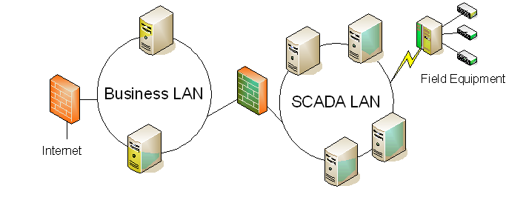
Systems Architecture
Defines how information flows through the system
Engineering staff know more about how data should flow than the cyber staff
Engineering staff know:
  what data should be protected (Confidentiality)
  how data can be externally verified (Integrity)
  how often data should be sampled (Availability)
  Which data flows are most important (Availability)
Remember that the “ideal” architectural model may not be your reality
Cyber technology may be used to support the engineering design
  data diodes
  enclave network design
  network zones,
  virtual machines
Conceptual View

Slide 16
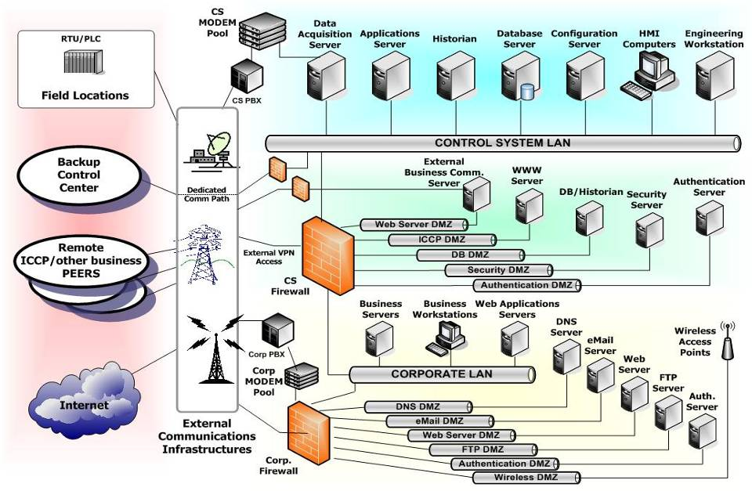
Realistic View of SCADA Architecture
Notes:
Cisco vulnerability?

Slide 17









Myth of Airgaps
Corporate Net connected (firewall) to ICS
Remote access by engineering stations or support vendors
Field devices communication ports with little or no authentication
Required Calibration: laptops & handhelds
Wireless communications instead of hardline networks
Removable media: upgrades & backups
  Flash drives
  CD’s
  External hard drives
  “periodic external connection”
Common Buses: Control & Safety Systems
Primary
Historian
Data Acquisition
Server
Configuration
Server
Engineering
Workstations
Database
Server
Remote Net Router
Operations
Engineering
Business Partners
Vendor Support
HMI
Control System Network
Control System
Modem Pool
HMI
Field Controllers
Field Devices
Industrial
Wireless
Safety System
17

Slide 18
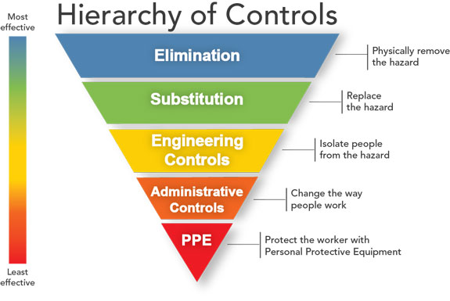
Engineered Controls vs. IT Controls
Consider IT and Engineered controls early in the design lifecycle
Consider how vulnerabilities can be designed out or mitigated through additional engineered controls
Engineered controls may provide more robust protection than add-on IT controls
Engineers should use the IT specialist as part of the requirements and design team
Engineered Controls
IT
Controls

Slide 19
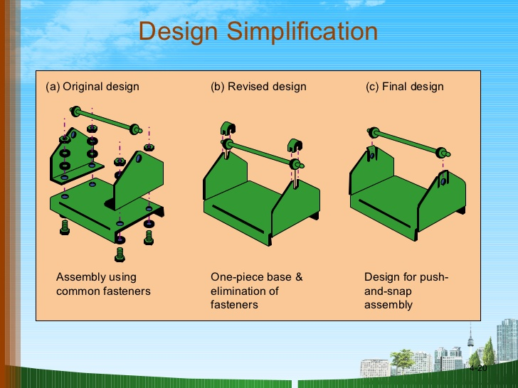
Design Simplification
Reduce design to minimum necessary
  Remember resilience
Be aware of latent functionality
  You may not use it, but a hacker can
Consider non-digital technology where it fits
Do not simplify a design into frailty
Use ALARA (As Low as Reasonably Achievable) as a metaphor

Slide 20
Resilience Planning
Vulnerabilities always exist, known or unknown
Any digital component or system may be compromised
Can’t always stop the process and reboot
Is there an incident response plan
  Has it been exercised?
Is there a cyber COOP?
  Has it been exercised?
How will process be affected by “resilient” operations?
Other contingency planning (additional testing, additional systems, additional staff, etc)
Redundancy is not resilience
Gresham Smith

Slide 21
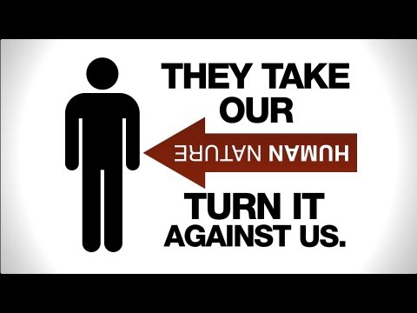
Engineering Information Control
Who should know What about your effort?
  Engineering records
  Drawings
  Requirements
  Specifications
  Designs
  Analysis
  Testing
Procurement contracts must control the vendor / integrator’s sharing of these details
Consider social media, vendor and corporate websites, conferences, etc.
Information should be protected throughout the life of the project, not just during design and installation
Change passwords on digital equipment when authorized users or key vendors leave the organization

Slide 22
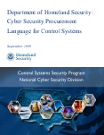
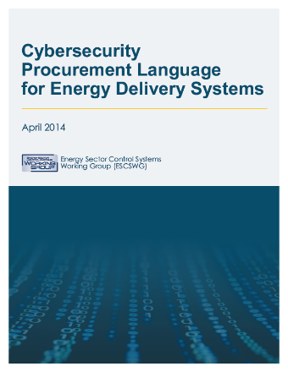
Procurement and Contracting
Cyber security requirements must flow down to vendors, integrators, and third party contractors
  You are only as secure as your least secure vendor
Procurement language must specify the exact requirements a vendor must comply with as a part of the system design, build, integration, or support
These requirements can raise procurement costs, but without them, caveat emptor
Be aware of what a subcontractor puts into your network
  You don’t know where it was before today
Consider even vendor tools such as calibration equipment or diagnostic equipment

Slide 23
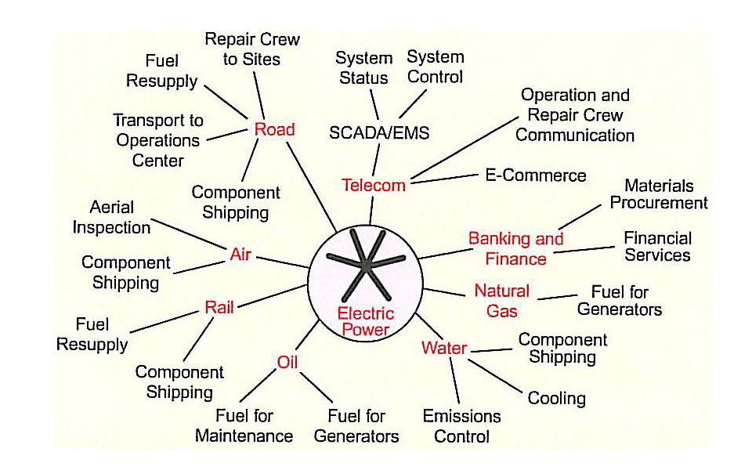
Controlling Interdependencies
Engineering requires many disciplines including safety, quality, maintenance, chemical, and many others
All disciplines should share information on how cyber could affect their area of concern
Ultimate system owner should understand risks from interdependencies
Consider systems such as cooling, water, power, communications, etc.

Slide 24

Cyber Culture
Conversations
Assessments
Scenarios
Collaboration on Projects
Exercises
Explicit Assumptions
Include cyber into engineering and engineering into cyber
Ensure entire staff is enlisted and endorses cyber security approach
Ensure staff understand and follow process and procedures
Even one user can lower security posture
Always safe to take a time out

Slide 25
Digital Asset Inventories
Mechanism for organizations to track:
  Hardware
  Firmware
  Software version levels of all engineering systems
  “Gold disk” copies of software
  Where is your restoration file for configuration data?
  Understand every digital asset to provide protective measures
  Could you pass an “as-built” assessment?
How do you protect this information?
Notes:
See if we can find another image.

Slide 26

Hacking is Hard… You can make it harder

Slide 27
Where to begin?
Consequence / Impact Analysis
Systems Architecture
Engineered Controls vs. IT Controls
Design Simplification
Resilience Planning
Engineering Information Control
Procurement and Contracting
Controlling Interdependencies
Cyber Culture
Digital Asset Inventories
The opportunity to secure ourselves against defeat lies in our own hands…
Sun Tzu

Slide 28
Next Steps for Cyber Informed Engineering
Framework first release, September 30th
Revisions – Your input welcome!
Assessment methodology (April, 2017)
Tools and application aids (April 2017)
Virginia Wright (Ginger)
Domestic Nuclear Cyber Program Manager
Idaho National Laboratory
Virginia.Wright@inl.gov
(208) 526-7021

Slide 29






The National Nuclear Laboratory
29
29
29
29
Business Sensitive
Notes:
29

Slide 30
DOE NE Nuclear-Cybersecurity R&D
Mission:
Enable the safe, secure and reliable deployment of nuclear energy technologies by accelerating the development and integration of cybersecurity technologies and information sharing of threat/mitigation analysis and methodologies with nuclear power plants, research reactors, and fuel cycle facilities
Vision:
NE will have a global leadership role in the deployment of cybersecurity technologies into all facets of nuclear energy systems
  Reactor protection, monitoring and control systems
  Safety, security, and safeguards systems
  Balance of Plant, Emergency Response and Supply Chain
  Cradle-to-grave of nuclear/radiological materials development, use, transport, storage, and disposition

Slide 31
DOE NE Nuclear-Cybersecurity Program
Current State
  Proof of principle
  Develop concepts for the value a future program could add
    Initial funded research portfolio
  Develop insights from NRC, Utilities / Asset Owners, Researchers, Laboratories regarding foundational science needs
Future
  Focus on developing foundational science to enable intelligent digital controls modernization
  Planned Program Outcomes
    Deployable cybersecure digital technologies
    Cybersecurity standards and risk assessment methodologies for components, systems and facilities
    Actionable information sharing forums
    Methods for safe and secure operations, design and licensing
Formal Program Plan under development

Slide 32
NE Nuclear-Cyber R&D Program
Create effective cybersecurity frameworks for anticipatory sensors, controls, and systems that address evolving threats
Develop new cyber-informed risk methodologies and engineering design basis for critical systems in a digital era
Prioritize research, engineering, and technology solutions for dynamic risks, capability gaps and disruptive events
Cybersecurity R&D solutions can prepare for emerging technologies and emerging threats

