Slide 1
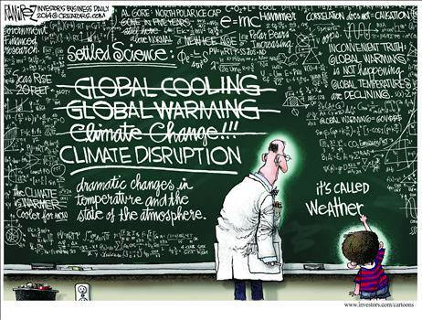
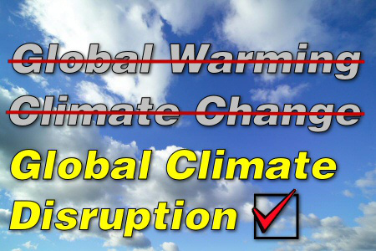
How To Change Minds About Our Changing Climate
Fermi Accelerator National Laboratory
April 7, 2016
Batavia, Illinois
Douglas Sisterson
Environmental Science Division
Argonne National Laboratory

Slide 2
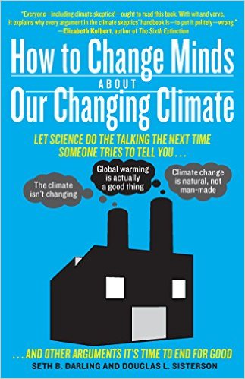
First - What Is Science-Based Evidence?
The process scientists use to get consensus is referred to as the scientific method.
“…it is not sufficient for a scientist to believe he or she is right; nor is it sufficient for a scientist to know he or she is right. Scientists must convince their colleagues that they are right.”
What We Know!
Darling and Sisterson, 2014: How to Change Minds About Our Changing Climate, The Experiment, New York. Page xxii.

Slide 3
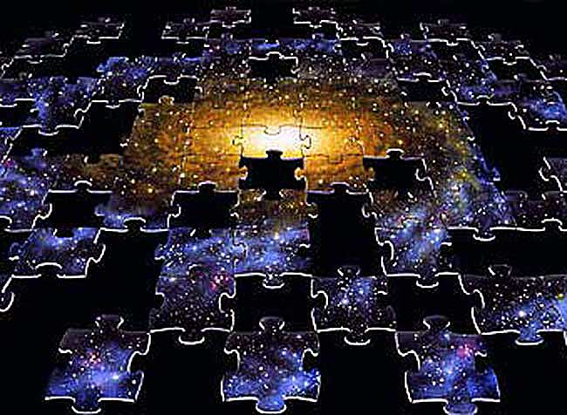
Earth’s Climate: The BIG Picture

Slide 4
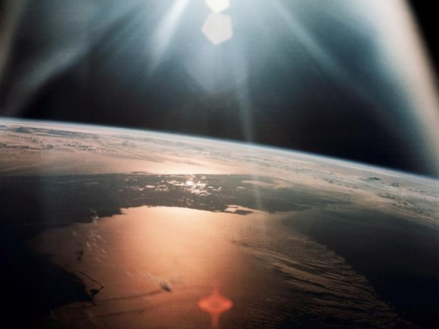
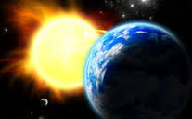
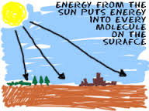
It All Starts With the Sun – Without It There Would Be No Wind or Weather or Climate

Slide 5
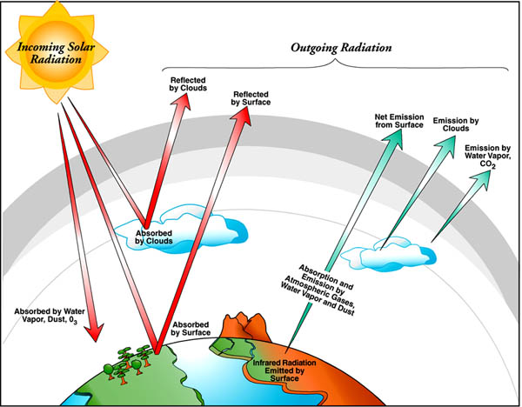
Climate 101: Radiation, Clouds, Greenhouse Gases, and Aerosols
The Earth’s Radiation Budget
Incoming
energy
Outgoing
heat
The Earth receives almost all its energy to heat
the planet from the sun: (solar radiation).

Slide 6
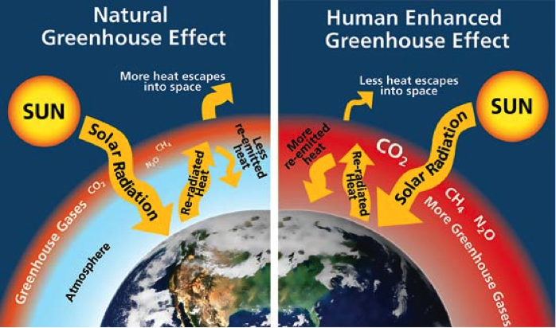
Greenhouse Gases Keep Earth’s Climate Comfortable for Humans
Although the human component is small compared to natural CO2 emissions, it does not take much to change the Earth’s average temperature.

Slide 7
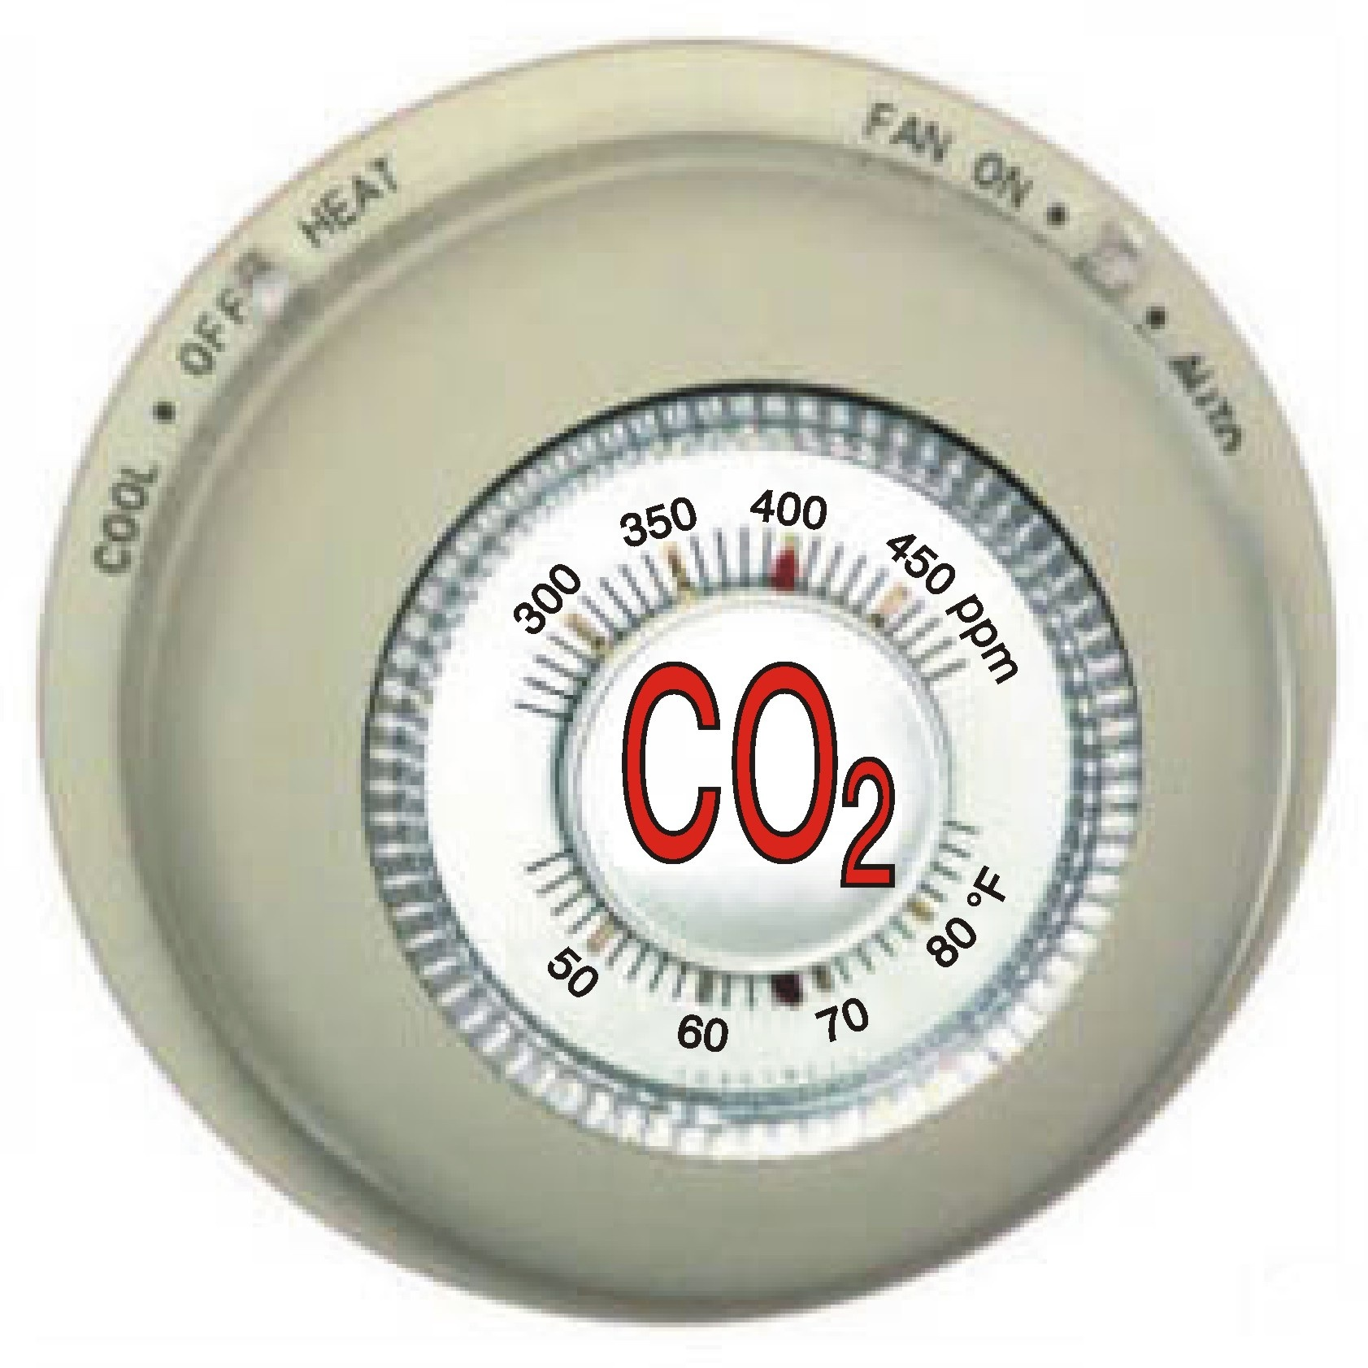
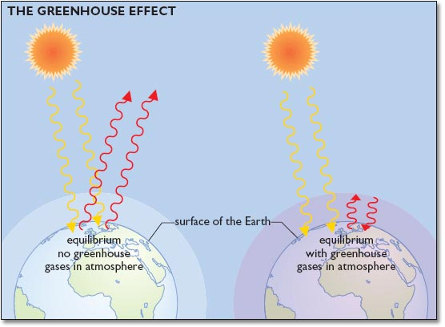
Greenhouse Gases Keep Earth’s Climate Comfortable for Humans
Without greenhouse gases: ~0F
With greenhouse gases: ~60F
Naturally Comfortable
Burrrr!
Only ~0.05% of the Earth’s atmosphere by mass is composed of greenhouse gases (excluding water vapor), and carbon dioxide is the most prevalent. Don’t mess with greenhouse gases!

Slide 8
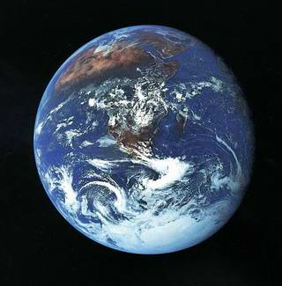
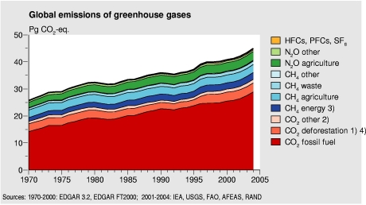
Consensus: Global Warming is the real deal!
Scientific Consensus:
Our Earth is warming on a global scale and it is due to increased, human produced carbon dioxide. It’s “us”!
BUT....Scientists have not reached consensus on timing or regional or local impacts where we live!

Slide 9
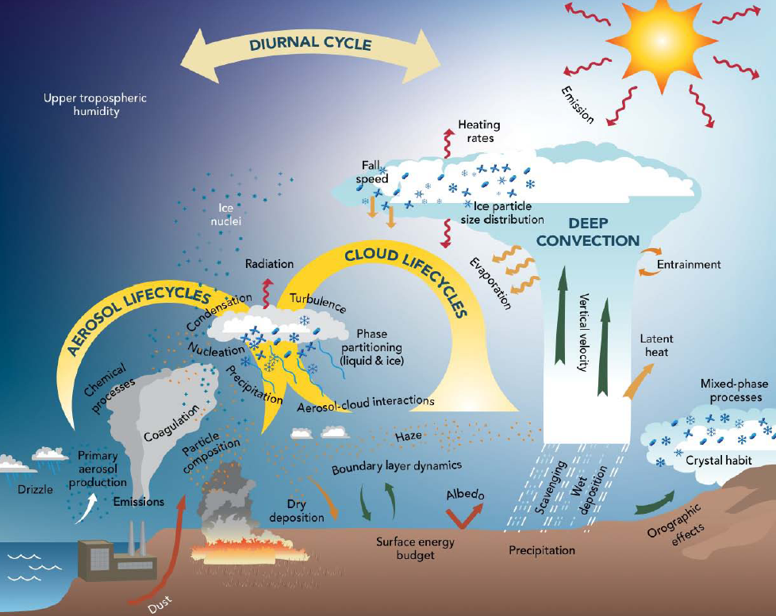
Going from Global Scale to Regional Scale Adds Complexity and Much Uncertainty!
And these are only the Atmospheric Processes!
Need to also consider:
  Oceans
  Glacial/Ice Systems
  Terrestrial Ecology
  Biological Systems
We don’t live in average: We want to know what will happen where we live!

Slide 10
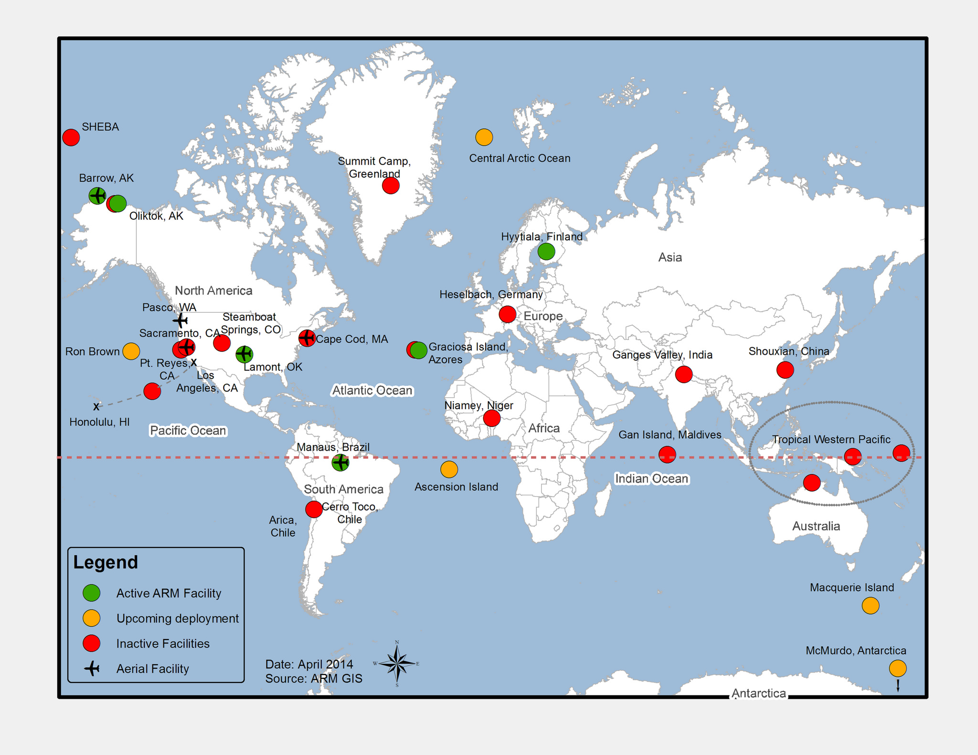
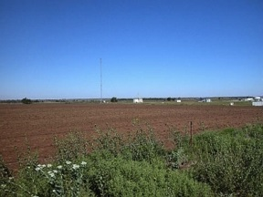
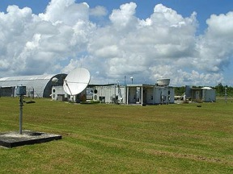
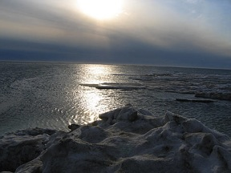
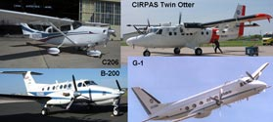
Where Do We Get the Data?
The U.S. Dept. of Energy Atmospheric Radiation Measurement (ARM) Program: First and largest climate research program to deploy a suite of cutting-edge instrumentation to obtain continuous measurements of cloud and aerosol properties that affect our climate.
Established in 1992 and operational since 1995, the ARM Program was designated a Dept. of Energy Office of Science, Office of Biological and Environmental Research scientific user facility in 2004 and named the ARM Climate Research Facility.
WWW.ARM.GOV

Slide 11
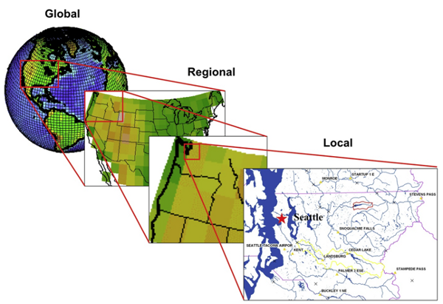
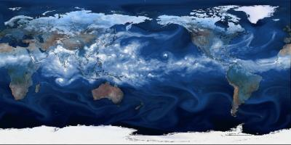
Climate Models: Used To Make Forecasts
Input what processes we know into climate models
And see how well what we know represents what we observe

Slide 12
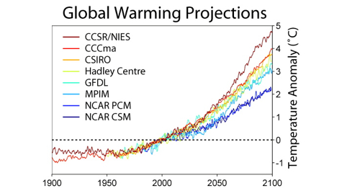
How Do Climate Models Compare?
All model equations are based on real-world field observations and certain immutable laws of physics.
There are dozens of climate models. The International Panel on Climate Change (IPCC) compares the models initially on how well they predict the average global temperature of the earth by doubling the amount of CO2 in the atmosphere.
IPCC AR5 Intercomparison
The 2 to 5 C increase is a small number but it has a huge impact on Earth’s climate!

Slide 13
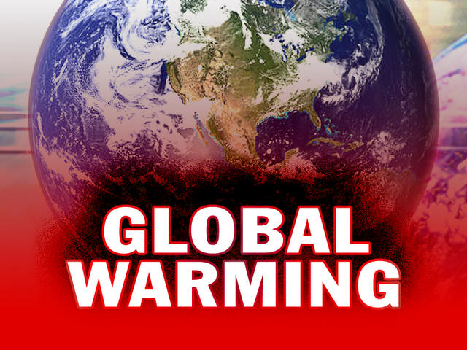
What Do the Climate Models Tell Us About Global Warming?!
Increasing greenhouse gases
lead to a warmer atmosphere, but
the Earth’s atmosphere interacts
with land and oceans.
Increased heat (energy!) will quickly be distributed and used by other processes than just heat waves: melting ice, heating oceans, evaporating water, sunlight interactions with clouds and aerosols, and other factors that drive weather.
The burning of fossil fuel will fuel the weather - resulting in extreme weather events - especially rainfall extremes and sea level rise!

Slide 14
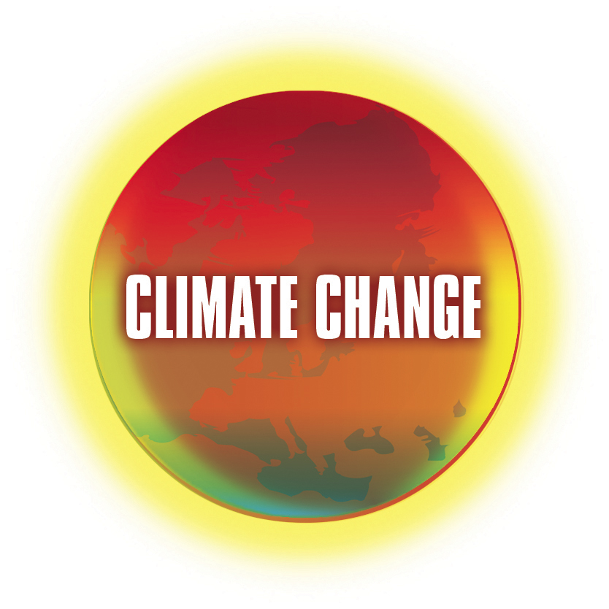
The Term “Global Warming” Can Be Misleading!
←
X
More appropriate to think of increased greenhouse gases causing climate change, not just global warming.

Slide 15
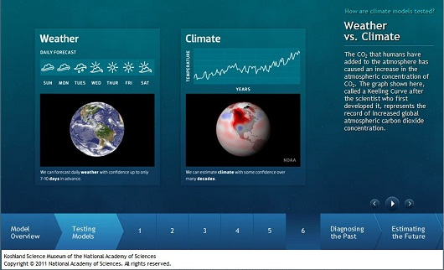
Connection Between Climate and Weather
Climate is defined as the ”30-year average weather” where you live.
The weather is the day-to-day
departure from that average
(temperature, cloudiness,
humidity, rainfall, pressure, etc.)
Climate is what you expect;
weather is what you get!
Therefore, extreme weather
events are predictable as long
As the climate is not changing
(the “100 year flood”).
climate constrains weather

Slide 16
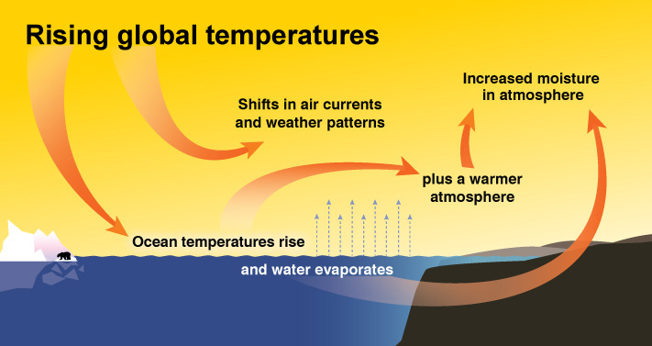
Climate Constrains Weather
Weather is “fuel limited” by climate. A warming climate fuels weather!

Slide 17

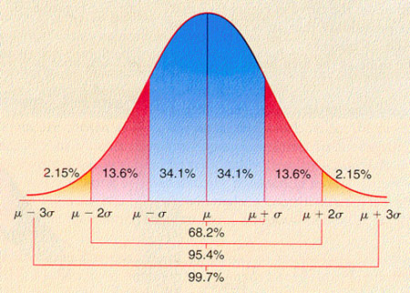
Weather and Extreme Events
The weather is normally predicable because the climate is not changing.
The 100-year flood is defined as the 1% (or less) exceedance probability of the occurrence of a single weather event (i.e., a rainfall amount) for 100 years of data.
But what happens to weather if the climate is changing?
Current thinking is much higher frequency of weather extremes!
Imagine this to be a plot of 100 years of daily rain event amounts on the X-axis and the frequency of occurrence of those amounts on the Y-axis.

Slide 18
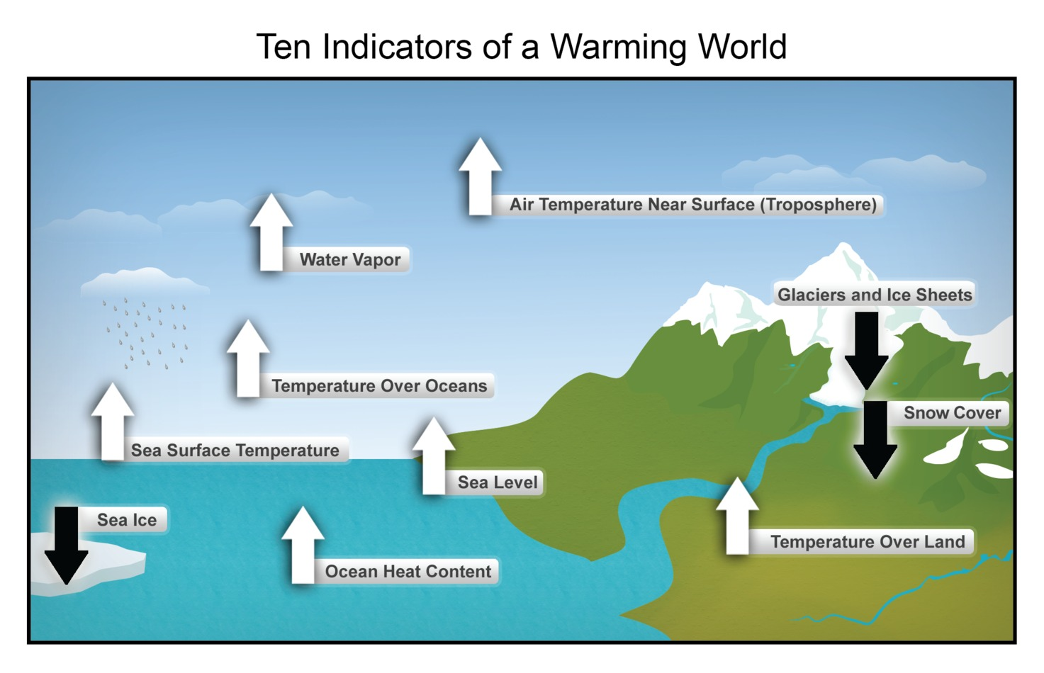
How do Scientists Know the Climate is Really Changing?
These can be measured. They are changing, but not in a good way!

Slide 19
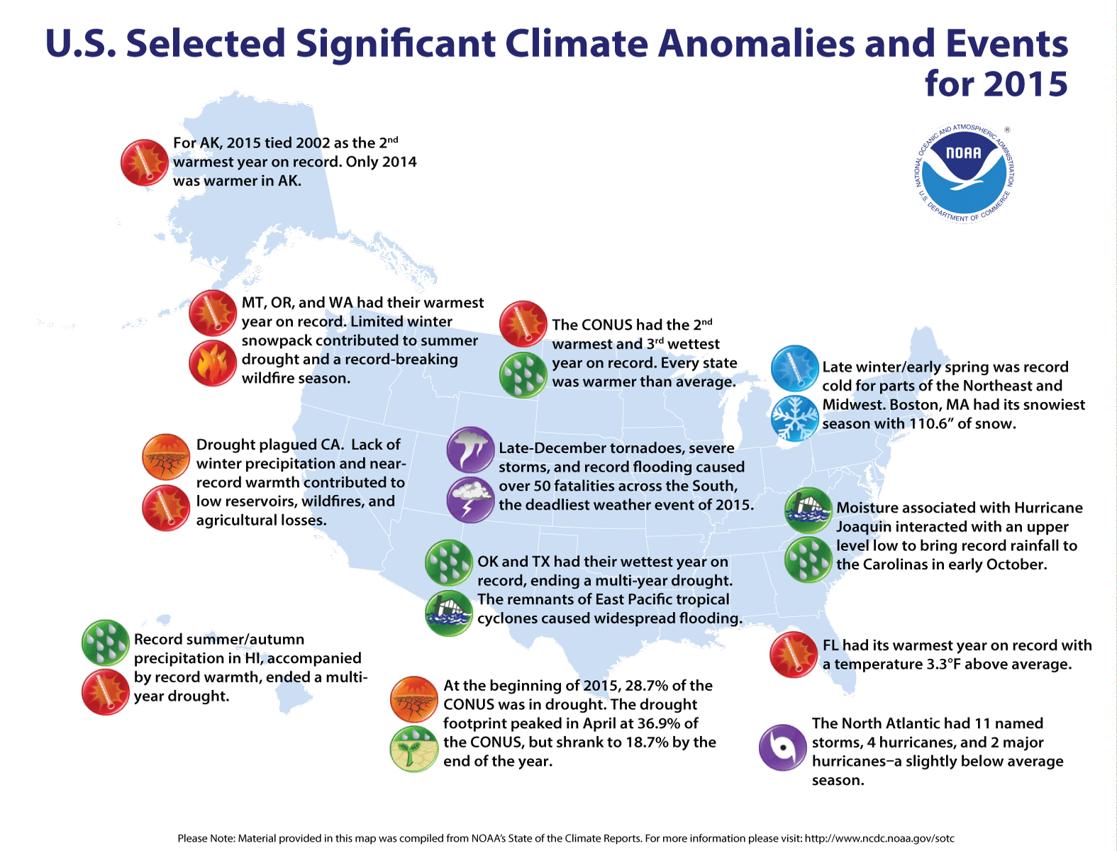
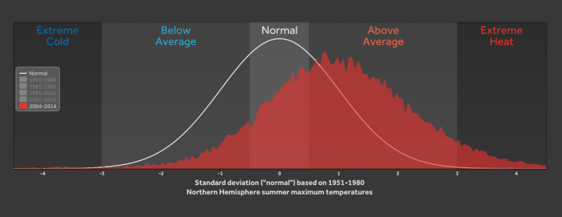
Weather Extremes: What Are the Odds?
Weather patterns used to be known, and more predictable.
Weather extremes are becoming more frequent and less predictable!

Slide 20
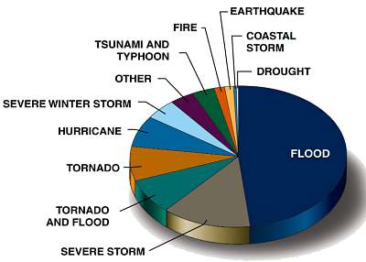
Life-Changing Weather Events Pie Chart
How will this change? Maybe we are not sure if there will be more events, but we are sure that there will be more EXTREME weather events. This is already happening!

Slide 21
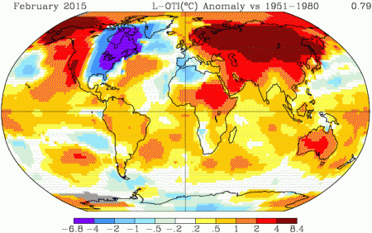
Where was It Warm? Everywhere Else But Here!

Slide 22
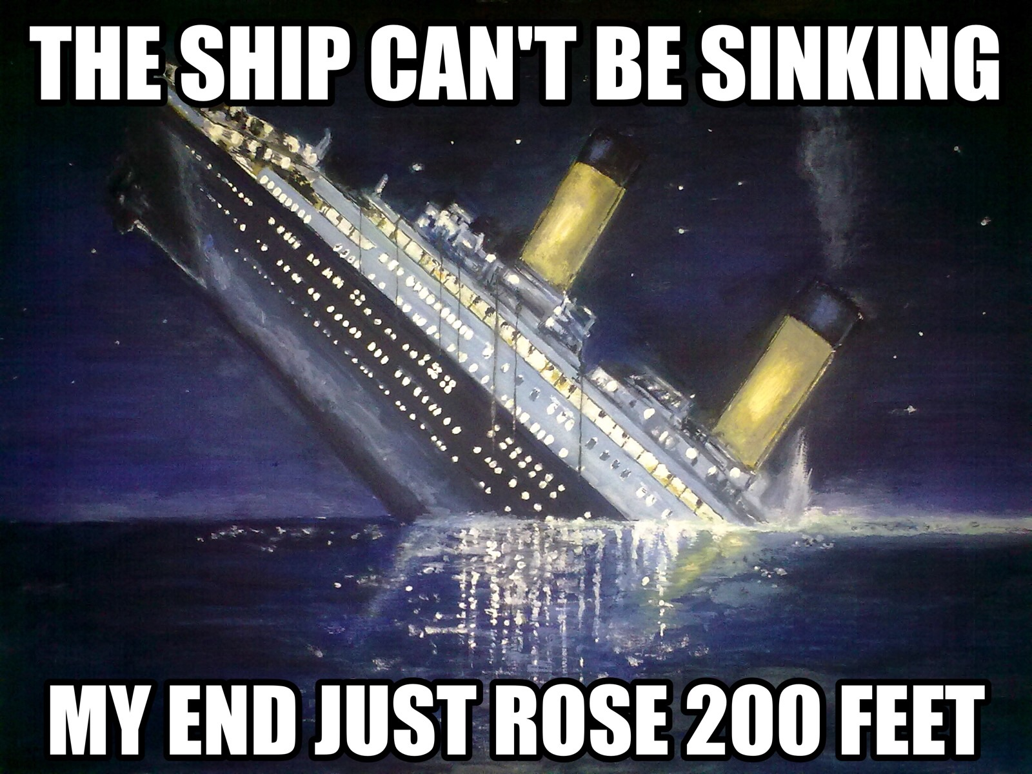
Keep in Mind that Global Warming is a Matter of Perspective!

Slide 23
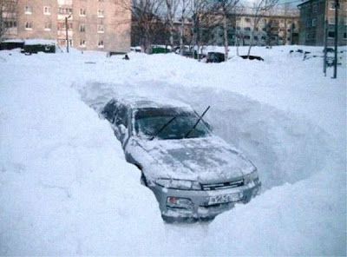
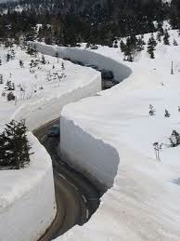
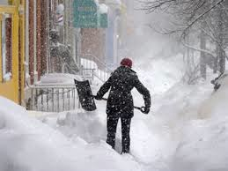
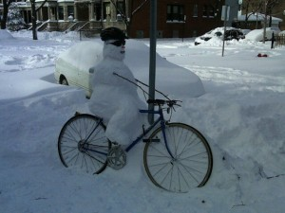
Snowmageddon!

Slide 24
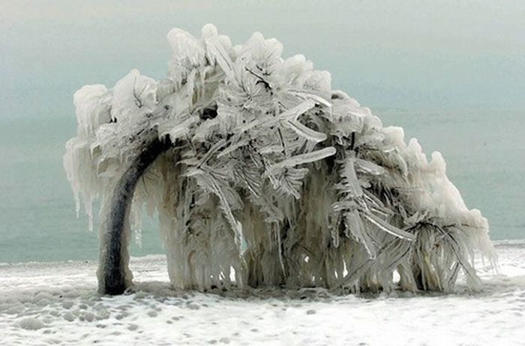
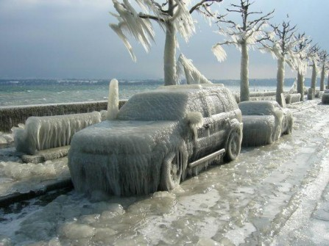
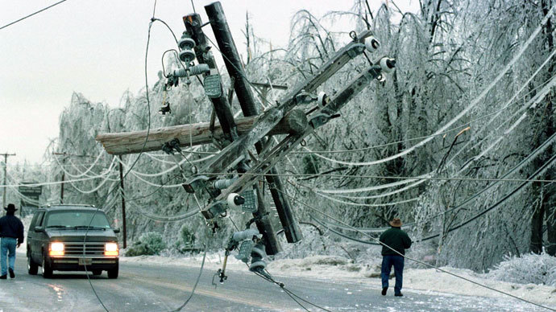
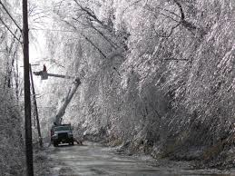
Ice Storms!

Slide 25
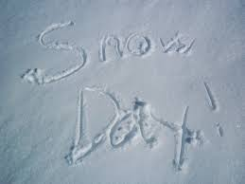
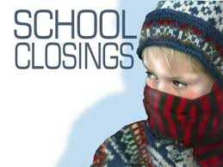
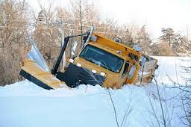
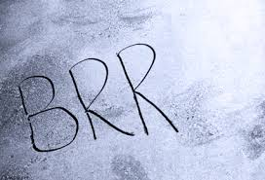
Schools Closed Because of Wind Chill Cold!

Slide 26
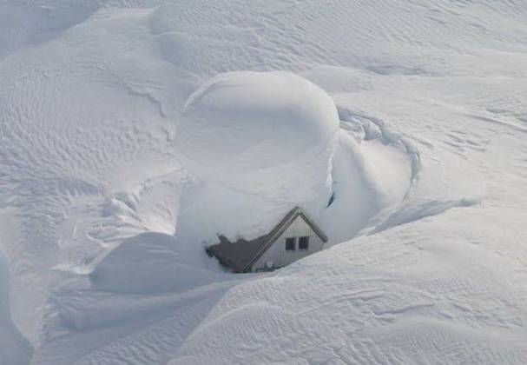
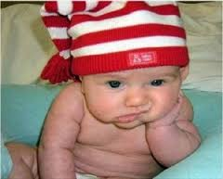
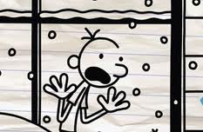
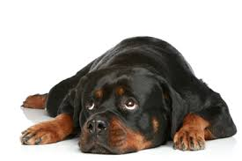
Cabin Fever!

Slide 27
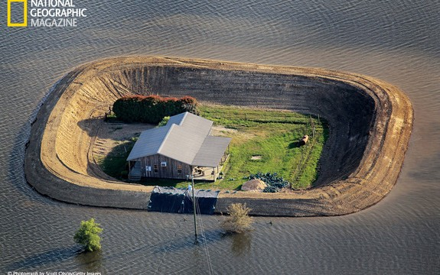
More Intense Floods!

Slide 28

More Intense Droughts

Slide 29

More Intense Hurricanes

Slide 30

More Intense Tornadoes!

Slide 31





More Heat Waves!

Slide 32

More Intense Wildfires Because of Droughts!

Slide 33


Where are we, then?
So what might the climate look like in the upper Midwest in the next 100 years?
Remember, the timing and impacts of the Earth’s changing climate on weather at the regional and local scale is still uncertain.

Slide 34
Regional Climatic Impacts: The Future
What does the average output of over a dozen climate models used by the International Panel on Climate Change predict for the Midwest for 2099?
Summer temperature patterns in Illinois will be more like summers currently experienced in southeast Texas: Considerably warmer but less summertime precipitation.
Under lower-emissions scenario, heat waves like that in Chicago 1995 are projected to occur once every three years; under higher-emissions scenario (the worst case), they will occur nearly three times per year.
Under high-emissions scenario, the balance between precipitation and evaporation and outflow indicates that Lake Michigan will drop nearly 2 feet.

Slide 35
Regional Climatic Impacts: The Future (Continued)
What does the average output of over a dozen climate models used by the International Panel on Climate Change predict for the Midwest for 2099?
Precipitation will decrease during summer leading to water deficits, but will increase during winter and spring. When precipitation occurs, it will be more as heavy downpours. Hence, there will be periods of both floods and water deficits.
A longer growing season provides the potential for increased crop yields, but heat waves, floods, droughts, insects, and weeds will present increasing challenges to managing crops, livestock, and forests.

Slide 36

Regional Climatic Impacts: The Future (Continued)
What does the average output of over a dozen climate models used by the International Panel on Climate Change predict for the Midwest for 2099?
Plant winter hardiness zones in the Midwest are projected to shift one-half to one full zone (warmer) every 30 years, affecting crop yields and where plants can be grown. Most of Illinois will be Zone 6 under the high-emissions scenario.

Slide 37
Regional Climatic Impacts: The Future (Continued)
What does the average output of over a dozen climate models used by the International Panel on Climate Change predict for the Midwest for 2099?
By the end of the century, plants now associated with the Southeast are likely to become established throughout the Midwest.
Native species are very likely to face increasing threats from rapidly changing climate conditions, pests, diseases, and invasive species moving in from warmer regions.

Slide 38

Regional Climatic Impacts
What is the Impact of Global Warming in the Midwest?
Think Houston, Texas!
Scientists have NOT reached consensus on timing or regional impact, but we are getting some good ideas!

Slide 39



Plants and Tree Health in MY Neighborhood – Emerald Ash Bore!

Slide 40






Even The Term “Climate Change” Can Be Misleading!
The impact of global climate change has deep roots!
Economy,
Health,
Politics

Slide 41




It’s not just about the weather!
How might climate change affect humans and our animal friends?

Slide 42

Human Health
Increased
Allergies,
Respiratory stress
Cardiac stress
All due to increased anthropogenic greenhouse gasses as a pollutant!

Slide 43

Human Health Risks and Environmental Factors
Environmental Factors: What are these and what do they mean to patients?
Allergies, bacteria and pollen transport, exposure and dose response: being exposed to different things because of changing wind patterns!
Note that most “threats” are south of the equator.
What about human health issues?
Weather-related issues range from
heat stress to diseases because of more floods or the new topical rain forest that provides an environment for accelerated mutation of viruses!

Slide 44



Human Health and Vector-Borne Diseases
Greer and Fishman, 2008: Climate change and infectious diseases in North America: the road ahead. (http://ecmaj.com/cgi/content/full/178/6/715)
For zoonotic and vector-borne diseases, climate change may:
    Increase the range or abundance of animal reservoirs or insect vectors (i.e., migration in search of more favorable environmental conditions)
    Prolong transmission cycles (i.e., extension of seasons)
    Increase the importation of vectors or animal reservoirs (riding new prevailing winds or piggy-backing on human transportation)

Slide 45

Climate change, along with habitat destruction and pollution, is one of the important stressors that can contribute to species extinction.
Biodiversity
The IPCC estimates that 20-30% of the plant and animal species evaluated so far in climate change studies are at risk of extinction if temperatures reach levels projected to occur by the end of this century.
Fischlin, A., G.F. Midgley, J.T. Price, R. Leemans, B. Gopal, C. Turley, M.D.A. Rounsevell, O.P. Dube, J. Tarazona, A.A. Velichko (2007). Ecosystems, their Properties, Goods, and Services. In: Climate Change 2007: Impacts, Adaptation and Vulnerability . Contribution of Working Group II to the Fourth Assessment Report of the Intergovernmental Panel on Climate Change. Parry, M.L., O.F. Canziani, J.P. Palutikof, P.J. van der Linden, and C.E. Hanson (eds.). Cambridge University Press, Cambridge, United Kingdom.

Slide 46




Biodiversity
Pika
Projected rates of species extinctions are 10 times greater than recently observed global average rates and 10,000 times greater than rates observed in the distant past (as recorded in fossils).
Millennium Ecosystem Assessment (2005). Ecosystems and Human Well-Being: Biodiversity Synthesis (PDF). World Resources Institute, Washington, DC, USA.
Examples of species that are particularly climate sensitive and could be at risk of significant losses include animals that are adapted to mountain environments, such as the pika, animals that are dependent on sea ice habitats, such as ringed seals, and cold-water fish, such as salmon in the Pacific Northwest.
USGCRP (2009). Global Climate Change Impacts in the United States . Karl, T.R., J.M. Melillo, and T.C. Peterson (eds.). United States Global Change Research Program. Cambridge University Press, New York, NY, USA.

Slide 47



Biodiversity
Threat To Ocean Diversity Is Huge: Not only warming but also acidification.
Healthy coral reef
Bleached by acidification

Slide 48
Biodiversity http://climate.audubon.org
Specific groups of birds are at high risk from climate change:
migratory
mountain
island
wetland
Arctic
Antarctic
seabirds
Bird species that thrive only in a narrow environmental range are expected to decline, and to be outnumbered by invasive species.
Half of all bird species in North America - including the bald eagle - are at risk of severe population decline by 2080 (the National Audubon Society concluded in a study released September 2014).

Slide 49



Global Economics
There is cost for solutions.
There is cost of impact!

Slide 50


Taken As A Whole, Perhaps Climate “Change” Is Not The Best Term!
We live in a world of constant change.
Positive mental attitude is a way to deal “with not all change is bad.”
But, climate change is NOT a good thing.

Slide 51

Climate “Disruption” Is Less Misleading
←
X
Climate Disruption
Because increased greenhouse gases are likely to impact more than just the weather, it became more appropriate to think of increased greenhouse gases causing climate disruption, not just climate change.

Slide 52

The Climate Consensus Gap
Why is public opinion so low when science is so certain?
(This is why we wrote the book!)
Skeptics – People that want to understand the climate disruption without getting a PhD in climate science.
Deniers – People that profit from fossil fuels and purposely misdirect and disrupt
science-based evidence of climate for as long as possible.

Slide 53

Natural Cycles, Right?
There have been cycles of global warming over the last 800,000 years – deniers would argue that we are simply in another such cycle.
Close inspection of the science shows that the Earth began warming first and then the CO2 increased
The current cycle shows the CO2 increasing first and then a responding increase in the Earth’s temperature.
Milankovitch Cycles versus climate forcing triggered by the Industrial Revolution

Slide 54

What’s the message?
Climate disruption is not about pointing fingers. It is about identifying and understanding the problem, and taking action to do something about it.
“Climate Change is a fight between
human beings and physics
Bill McKibben
“Failure to act puts our children’s future - and that of all subsequent generations - in peril.”
Seth Darling and Doug Sisterson
“We are the first generation to feel the sting of climate change, and we are the last generation that can do something about it.”
Governor Jay Inslee

Slide 55

So, what do we do about it?

Slide 56




Where Do We Put Our Investments?
There are four additional options to deal with the impact of climate change:
  More Research
  Mitigation
  Adaptation
  Bio- and Geo-Engineering
  Endure Impacts
Suffer the consequences?
Adaption: Build bigger seawalls?
Engineering: Use the planet as a giant experiment?

Slide 57


Alternative Energy Sources and Energy Conservation are a Good Start!
Alternative Clean Energy
Energy Conservation

Slide 58

Make Good Investments - Don’t Put All Your Eggs In One Basket!
A good investor has a diverse portfolio.
But where does the money come from?
(Your wallet!)

Slide 59

Pay Me Now Or Pay Me Later

Slide 60


It Takes World Commitment (Political Will) to Realistic Goals!
The Climate Conference negotiated the Paris Agreement, a global agreement on the reduction of climate change:
The text of which represented a consensus of the representatives of the 196 parties attending it.
The agreement will become legally binding if joined
by at least 55 countries which together represent a
least 55 percent of global greenhouse emissions.
Such parties will need to sign the agreement
in New York between 22 April 2016 (Earth Day)
and 21 April 2017, and also adopt it within
their own legal systems (through ratification,
acceptance, approval, or accession).

Slide 61



Your Future!
It’s not all gloom and doom! If we can all learn about what is happening to our climate (the impact or burning fossil fuel), we can make smarter choices in our lives to reduce our personal carbon footprint.
Understanding through research and accurately modeling how Mother Nature works will help us improve climate forecasting to test solutions to pollution that are needed.
Advances in technology - yet to be discovered by perhaps one of you - may offer viable solutions to mitigating or adapting to climate change that we just don’t have yet.

Slide 62

THANK YOU!
Questions

