Slide 1


Was Einstein Right?
A Centennial Assessment
Clifford Will
University of Florida, Gainesville
Institut d’Astrophysique de Paris
Colloquium, Fermilab, 30 March 2016

Slide 2
Was Einstein Right?
A Centennial Assessment
Einstein triumphant, or was he?
Early struggles and uncertainties
1st century themes
High precision technology (clocks, space)
Frameworks for comparing and testing theories
Theory-experiment synergy
2nd century themes
Strong-field tests
Gravitational-wave tests
Extreme-range tests

Slide 3
Was Einstein Right?
A Centennial Assessment
Early struggles
Highlights from the first century
Prospects for the second century
Geometry bends light
Geometry warps time
Geometry moves mass
Geometry makes waves
Colloquium, Fermilab, 30 March 2016

Slide 4
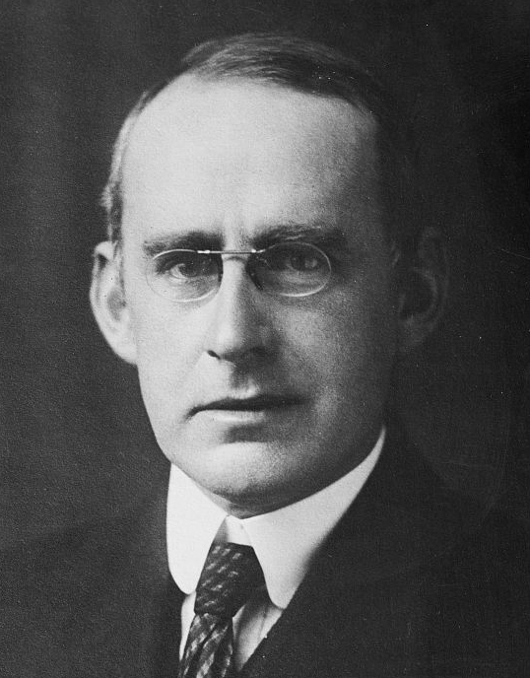
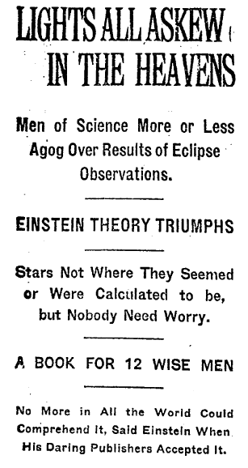
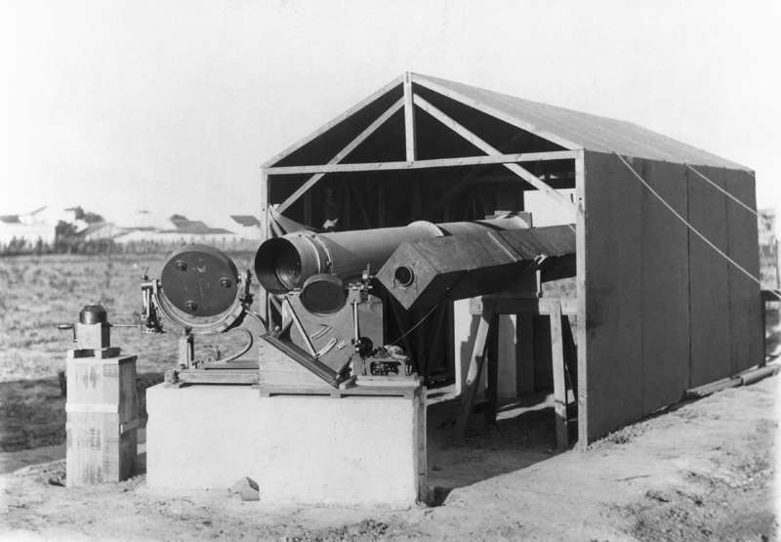
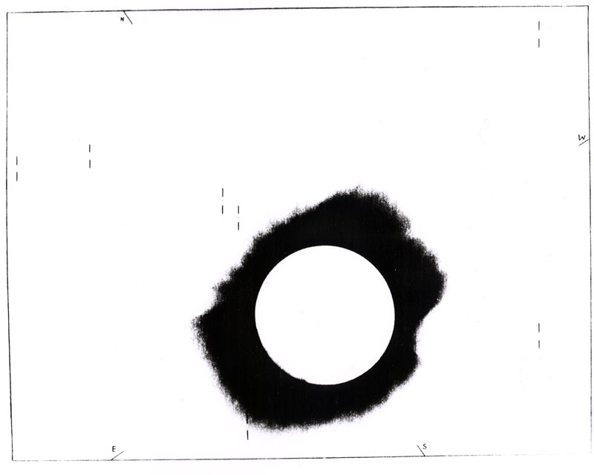
Geometry bends light: The 1919 Eclipse
A. S. Eddington
Sobral site
Photo from Principe

Slide 5
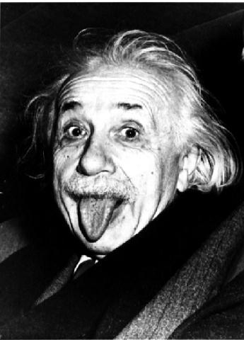
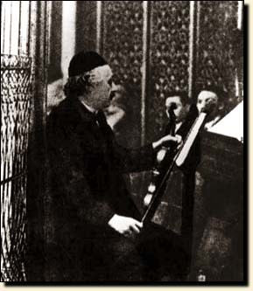
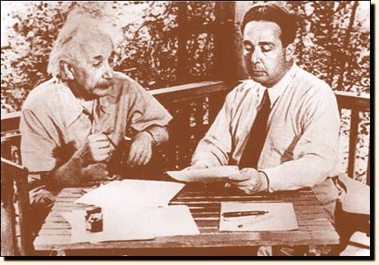
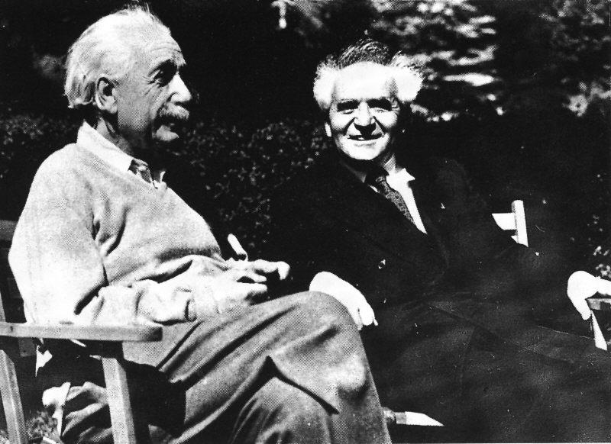
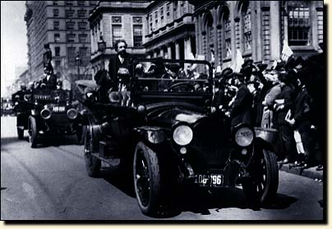
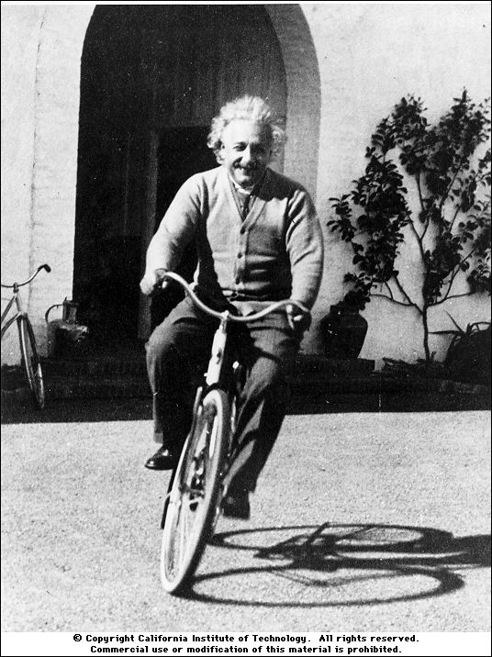

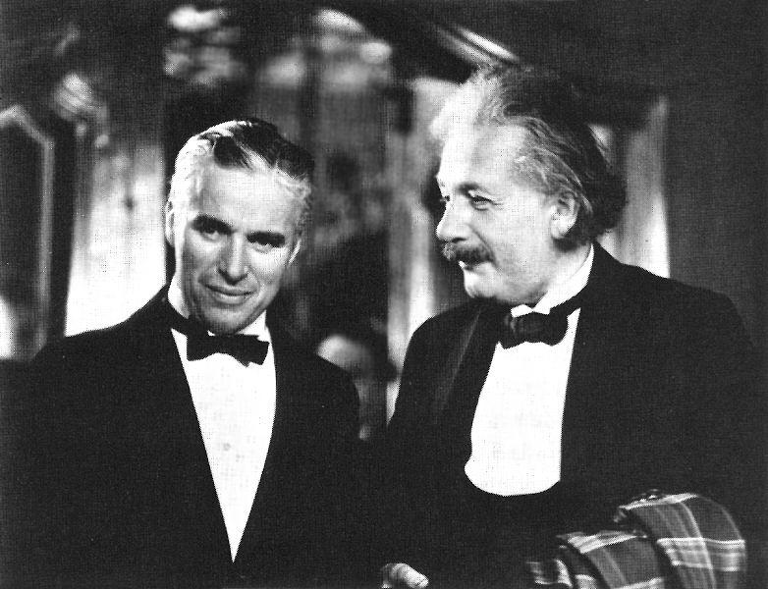
The public
Einstein

Slide 6
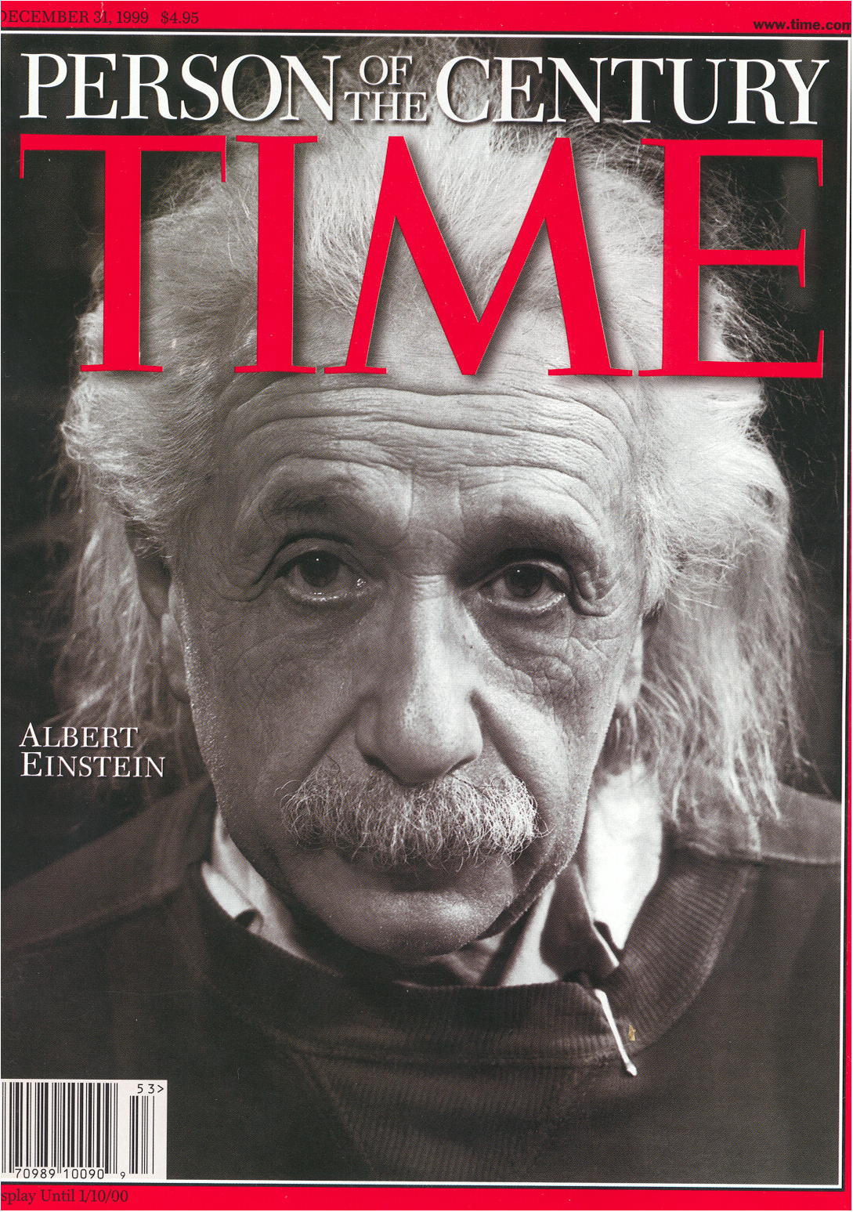
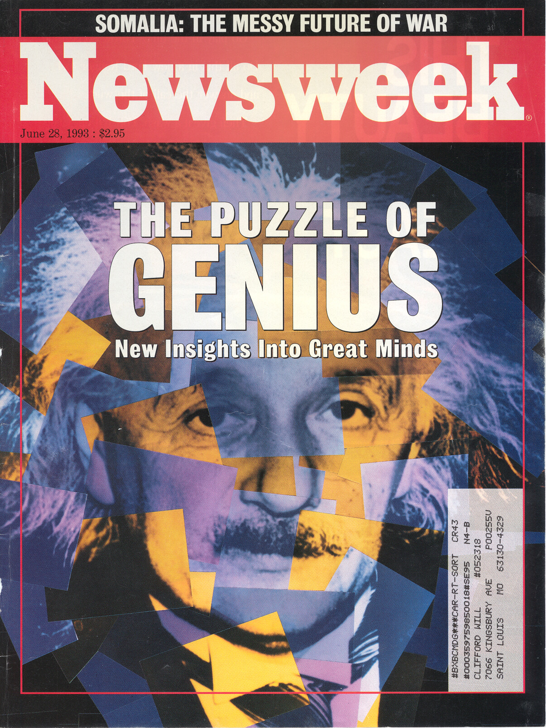

Slide 7
Geometry bends light: The PPN parameter γ
Notes:
1922, 1929, 1936, 1947, 1952

Slide 8






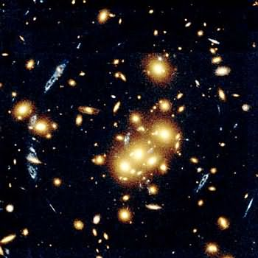

Geometry bends light: Gravitational lenses
Einstein’s gift
to astronomy
Notes:
Renn 1997

Slide 9
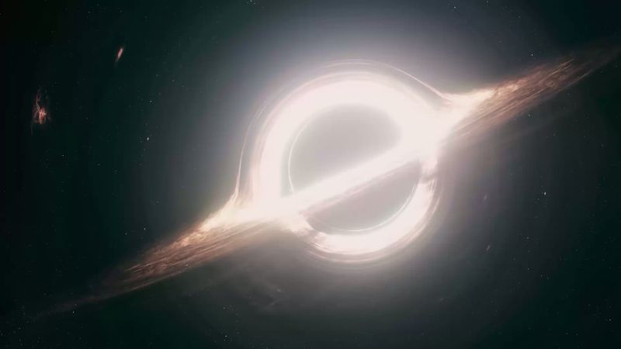
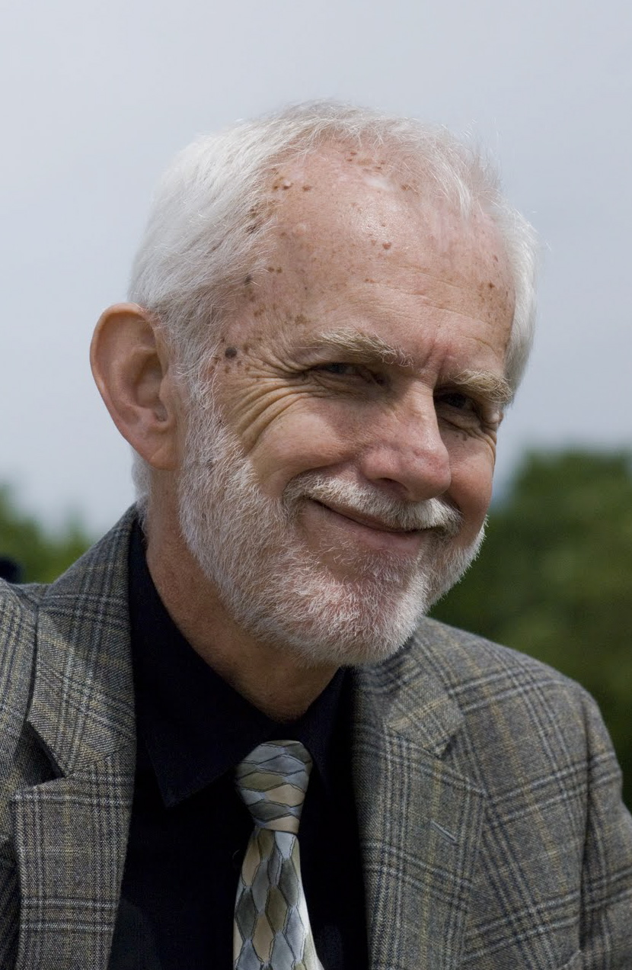
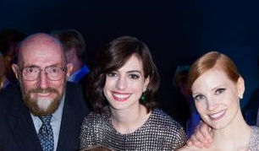
Geometry bends light: and wins an Oscar!
me
Kip
Anne
Jessica
Interstellar, Paramount Pictures, Directed by Christopher Nolan
Starring: Matthew McConaughey, Anne Hathaway, Jessica Chastain, Michael Caine, …
Image based on calculations by Kip Thorne and Double Negative Co.

Slide 10
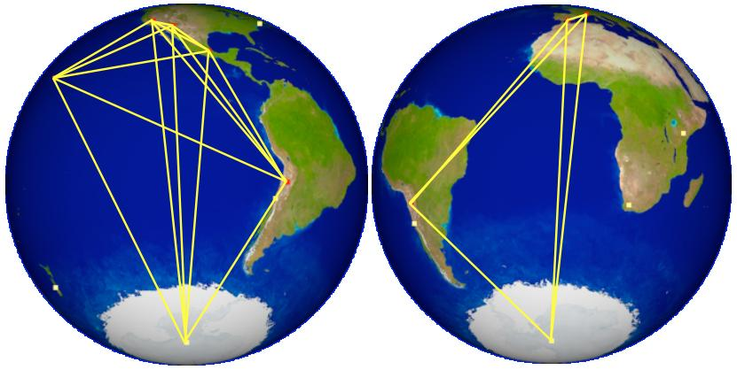
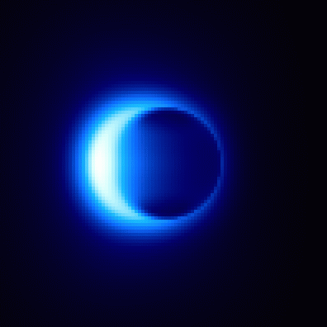
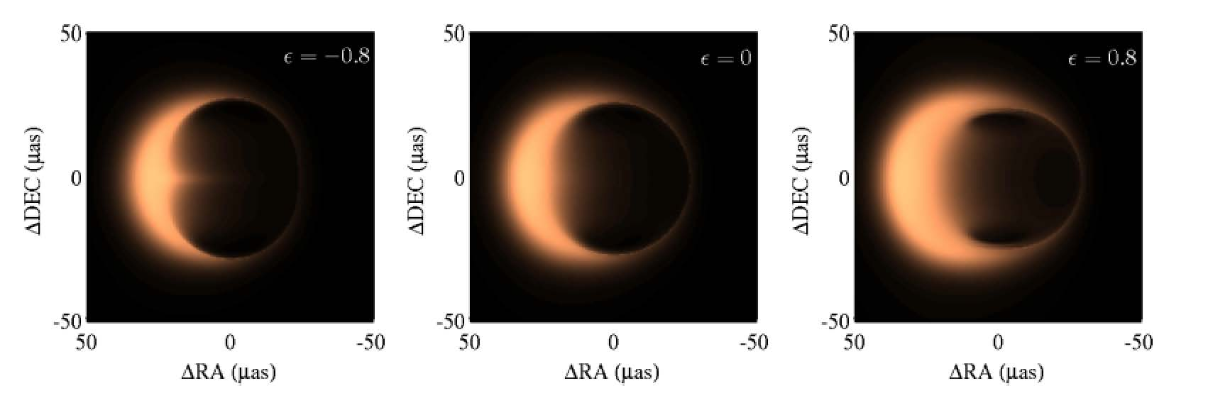
Geometry bends light: Black hole shadows
Event Horizon Telescope (EHT)
- mm wavelength
- horizon scale angular resolution
at SgrA* and M87

Slide 11
Was Einstein Right?
A Centennial Assessment
Early struggles
Highlights from the first century
Prospects for the second century
Geometry bends light
Geometry warps time
Geometry moves mass
Geometry makes waves
Colloquium, Fermilab, 30 March 2016

Slide 12
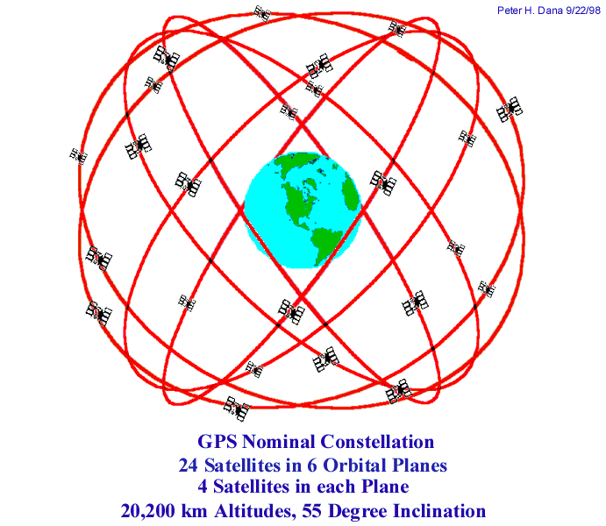
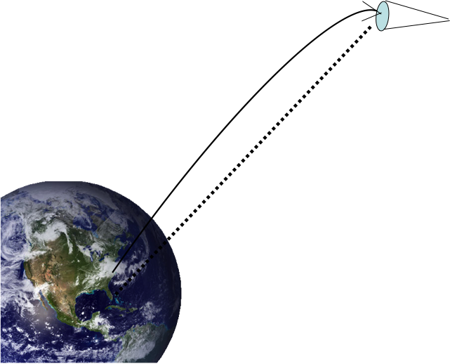
Geometry warps time: The redshift
1907: Einstein’s “happiest thought”
1917: C. E. St. John and others: no Solar redshift effect
1960: Pound-Rebka: gamma rays from ⁵⁷Fe over 23 m
1962, 1972, 1991: finally, the Solar redshift measured
1976: Gravity Probe A
1980s – now: GPS
2010: ²⁷Aluminum ion clocks
over 1/3 m
2017: ACES/PHARAO on the ISS
Gravity Probe A

Slide 13
Was Einstein Right?
A Centennial Assessment
Early struggles
Highlights from the first century
Prospects for the second century
Geometry bends light
Geometry warps time
Geometry moves mass
Geometry makes waves
Colloquium, Fermilab, 30 March 2016

Slide 14
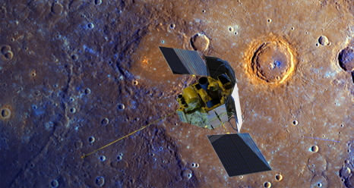
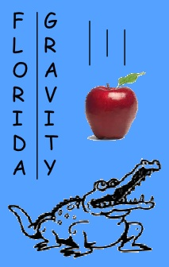
Geometry moves mass: Mercury’s perihelion
1859 Leverrier’s conundrum
1900 A turn-of-the century crisis
1915 “Palpitations of the heart”
575 “
per
century

Slide 15
Pericenter advance and strong-field GR
The Double
Pulsar
Courtesy M. Kramer

Slide 16
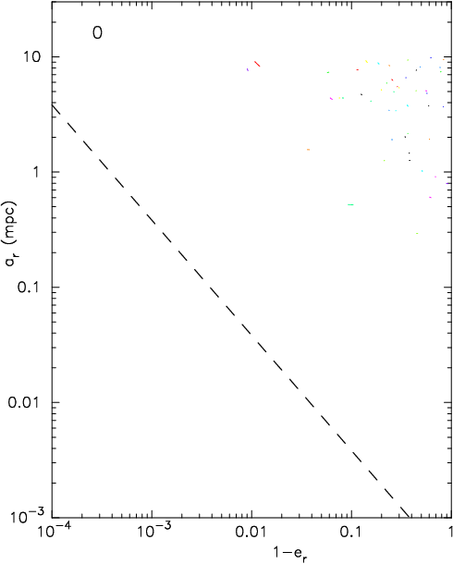
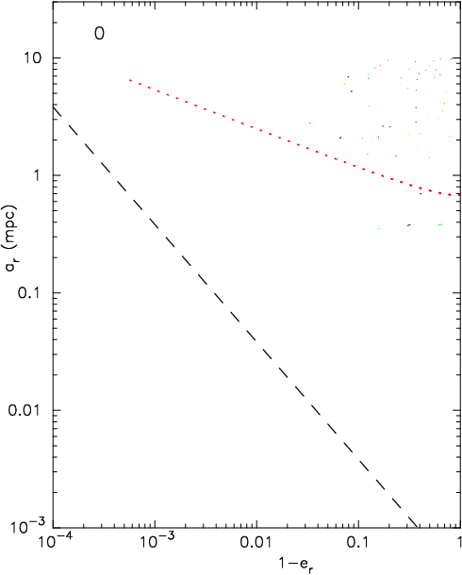


Pericenter advance and strong-field GR
Stellar clusters around SMBH
Schwarzschild
barrier
Hopman & Alexander 2007
Merritt, Alexander, Mikkola & CMW 2011

Slide 17
Was Einstein Right?
A Centennial Assessment
Early struggles
Highlights from the first century
Prospects for the second century
Geometry bends light
Geometry warps time
Geometry moves mass
Geometry makes waves
Colloquium, Fermilab, 30 March 2016

Slide 18

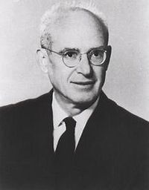
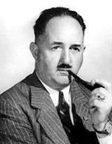
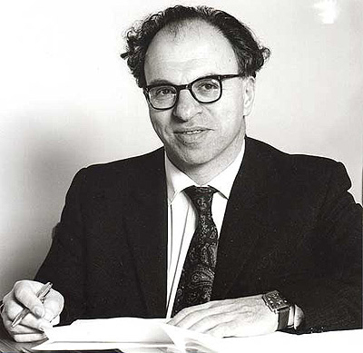
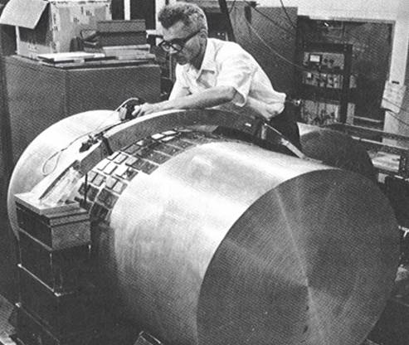

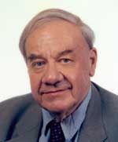
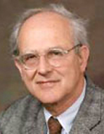
Geometry makes waves
?
Einstein 1916
Eddington 1922
H. P. Robertson
Hermann Bondi 1950s
Einstein & Rosen 1938
Bob Forward
Ron Drever
Rai Weiss
Joseph Weber 1970

Slide 19
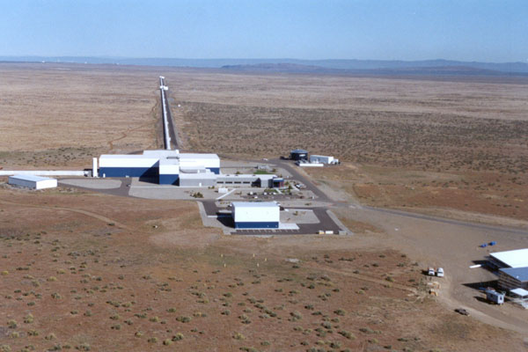
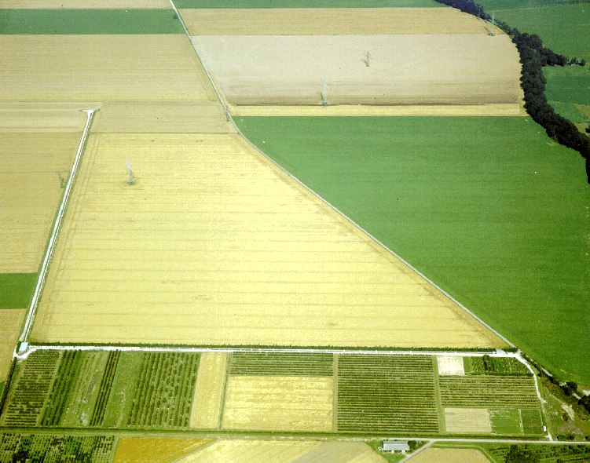
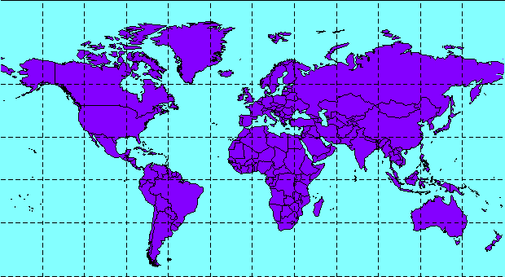
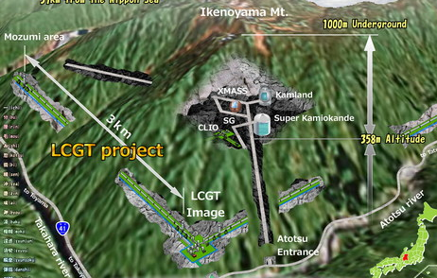
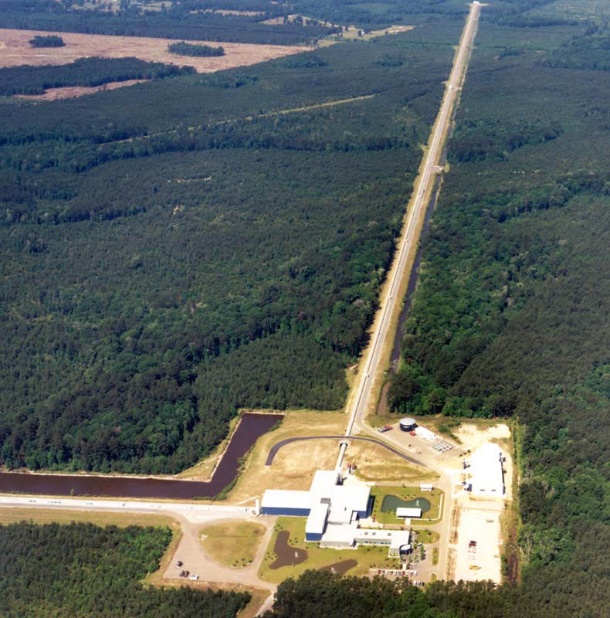
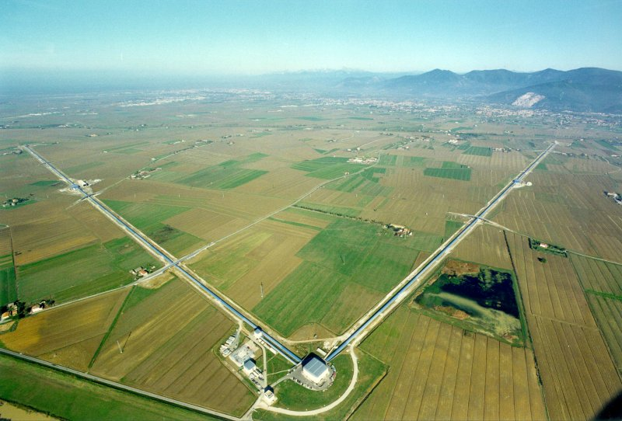
A Global Network of Interferometers
LIGO Hanford 4 km (2015)
GEO Hannover 600 m
Kagra Japan
3 km (2018)
LIGO India
(2022)
Virgo 3 km (2016)
LIGO Livingston 4 km (2015)

Slide 20
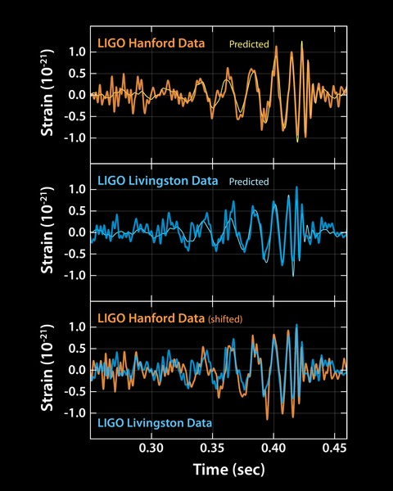
LIGO detects gravitational waves!
Advanced LIGO began operations in summer 2015
14 September, near the end of an “engineering run”
Signals in both LIGO detectors, 7 milliseconds apart
GW150914: a binary
black hole merger

Slide 21
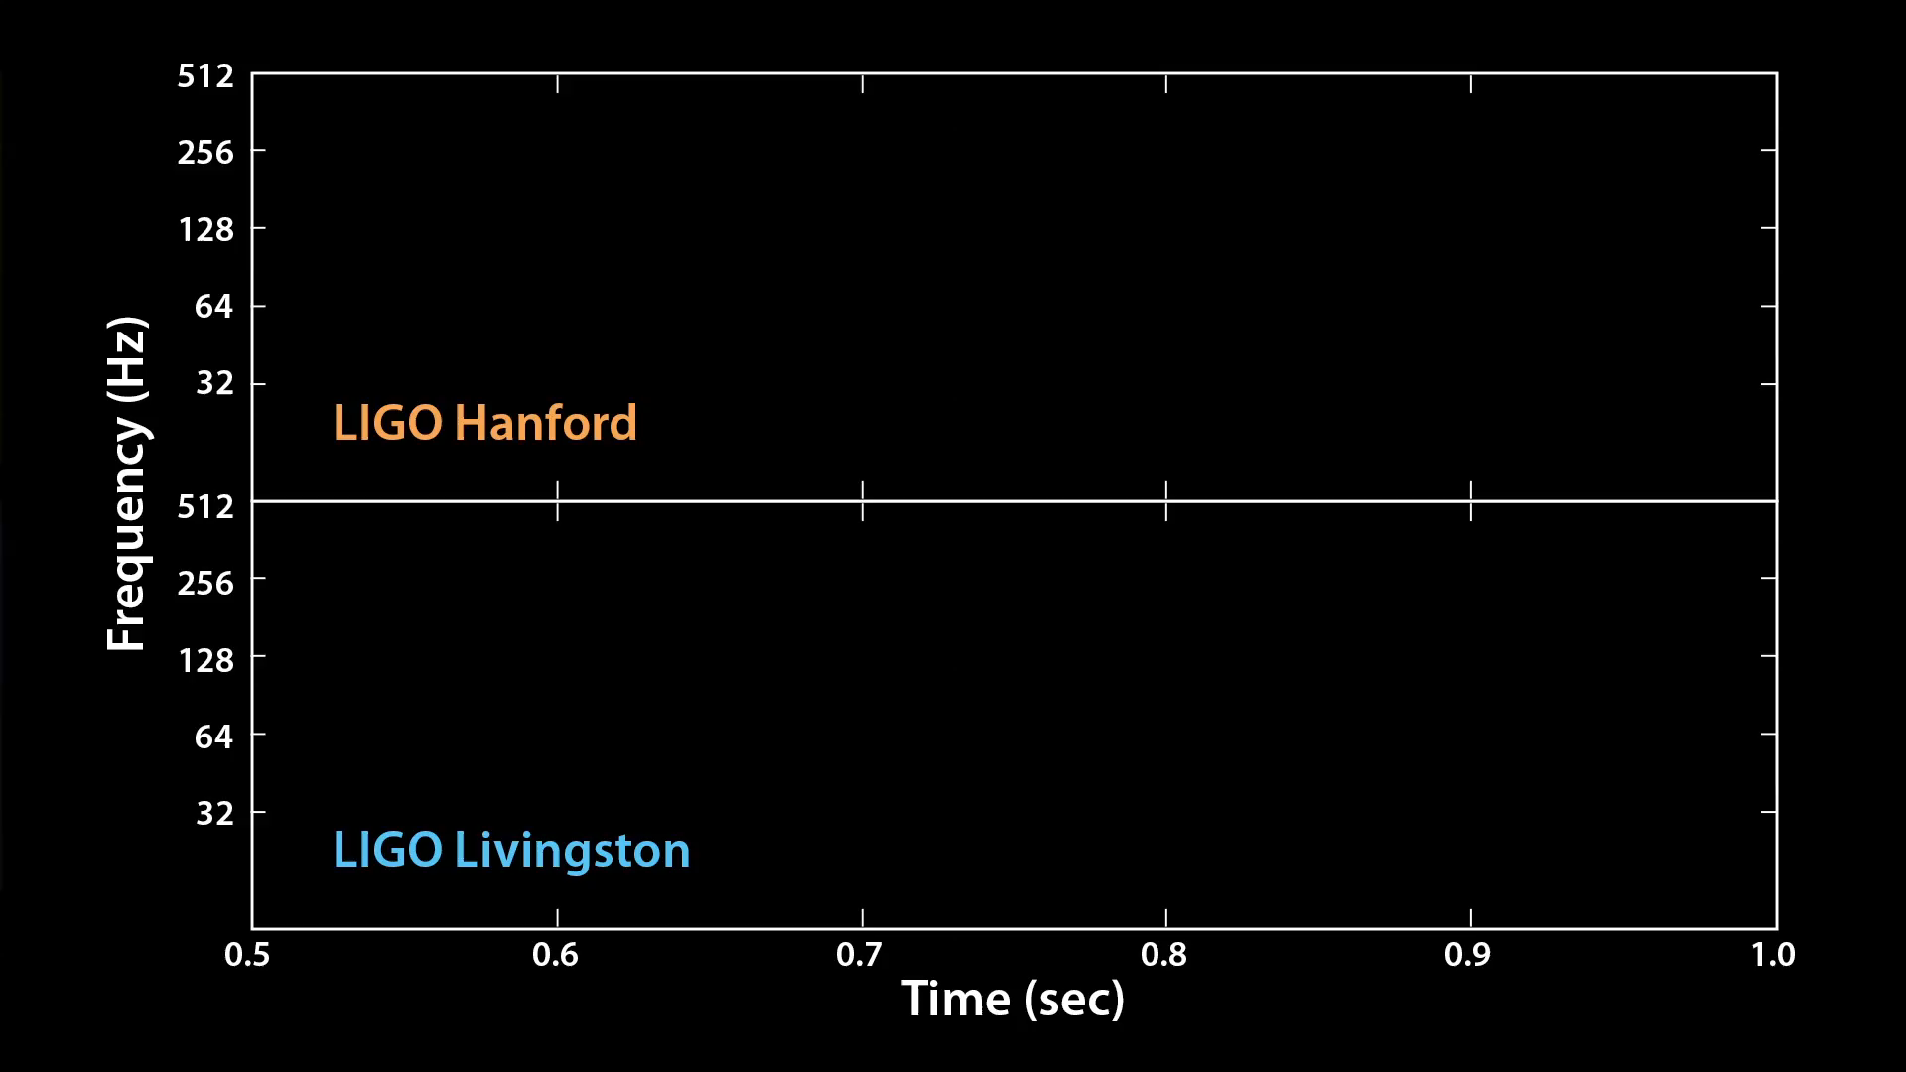
LIGO detects gravitational waves!
Advanced LIGO began operations in summer 2015
14 September, near the end of an “engineering run”
Signals in both LIGO detectors, 7 milliseconds apart
Audio Credit: Caltech/MIT/LIGO Lab
SNR ~ 24, s ~ 5.1, false alarm 1/203,000 yr
3 solar masses converted into energy in 0.2 sec
More power than all the stars in the universe
1st detection of a BBH, masses larger than expected
Revised event rate 2 – 400 /Gpc³/yr
Data on GW150914 publicly available

Slide 22
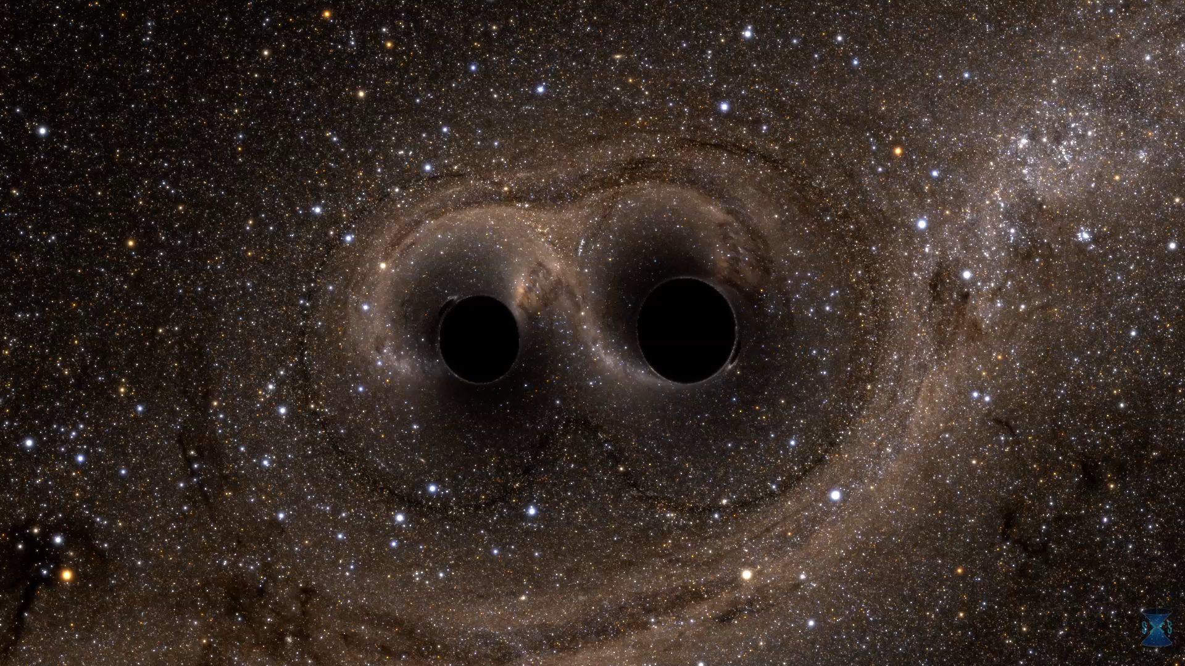
What did GW150914 “look” like?
Credit: The SXS (Simulating eXtreme Spacetimes) Project

Slide 23
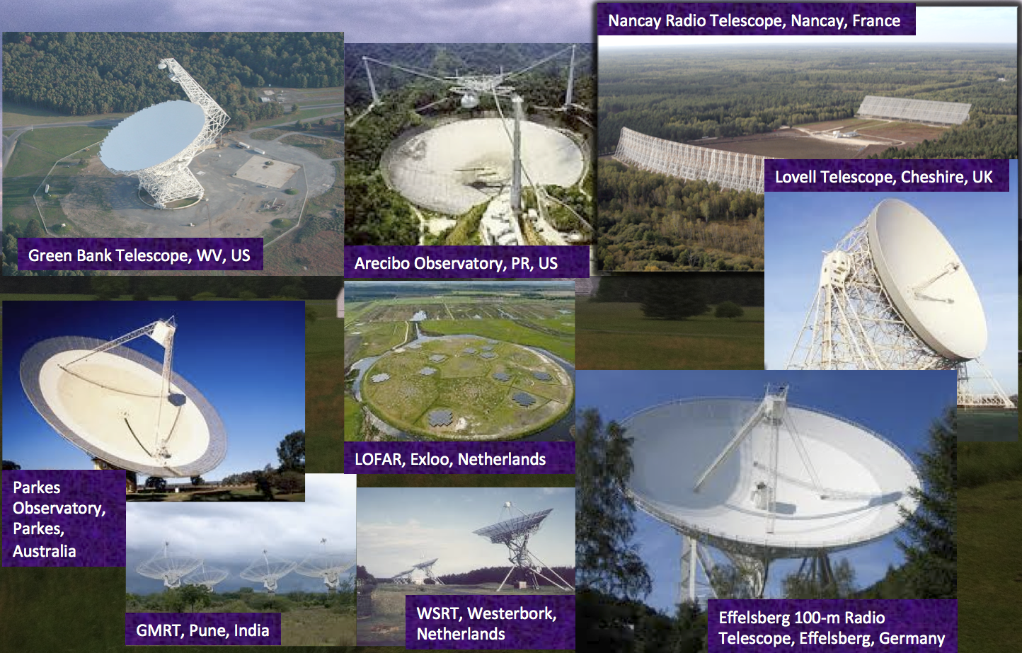
Pulsar Timing Arrays

Slide 24
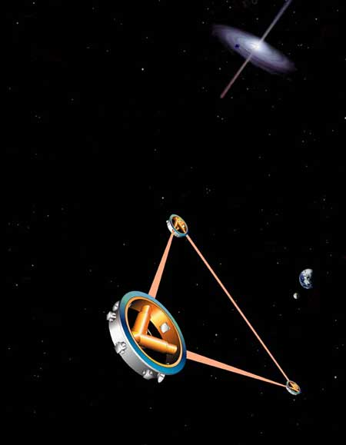
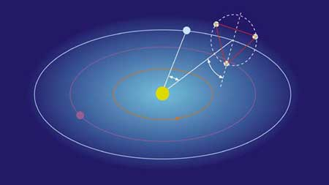
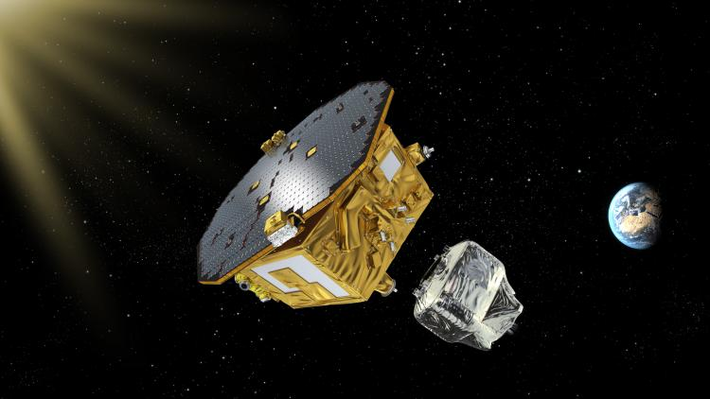
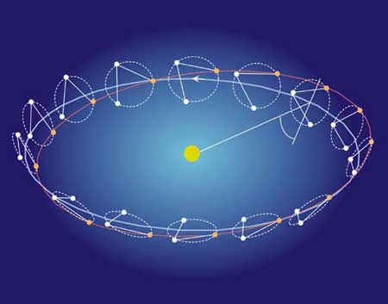
eLISA: a European space interferometer (2034)
with NASA participation

Slide 25
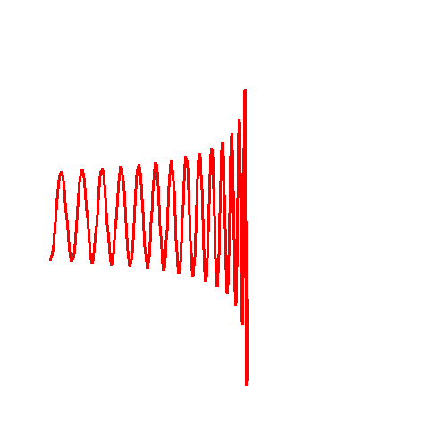
Gravitational-wave tests of GR: Speed
Does the speed depend on wavelength?
Is gravity massive?
CMW, PRD 57, 2061 (1998)
Berti, Buonanno, CMW (2005)
Arun, CMW (2009)
Stavridis, CMW (2009)
Mirshekari, Yunes, CMW (2012)
Source
Detector
From GW150914:
λ_{g} > 10¹³ km
m_{g} < 10⁻²² eV
adLIGO/VIRGO: 10¹² km
eLISA: 10¹⁶ km

Slide 26
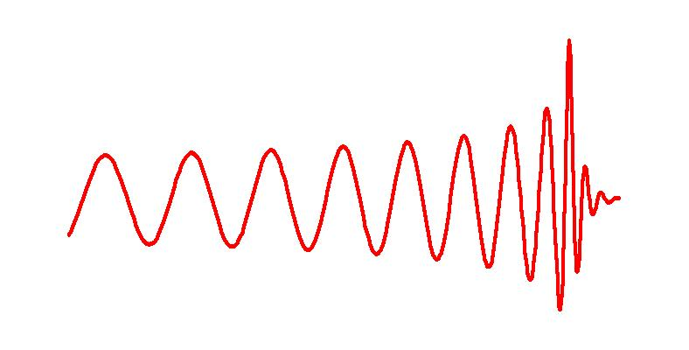
Gravitational-wave tests of GR:
Strong gravity
From GW150914:
bounds on deviations from GR in PN coefficients
Ringdown phase:
Test the no-hair
theorems
Inspiral phase: test alternative theories using precise phase evolution (PPE, PN)
Merger phase:
Numerical relativity
Neutron-star disruption

Slide 27
Gravitational-wave tests of GR: Polarizations
Array of ground based detectors
Modulation due to eLISA’s orbit
Correlation of pulsar timing residuals as a function of angular separation
CMW, Living Reviews in Relativity 17, 4 (2014)

Slide 28
Was Einstein Right?
A Centennial Assessment
Clifford Will
University of Florida, Gainesville
Institut d’Astrophysique de Paris
Colloquium, Fermilab, 30 March 2016

