Slide 1
Guesstimation: approximate answers to any question
Lawrence Weinstein
Old Dominion University
Princeton University Press, 2008
Princeton University Press, 2012

Slide 2
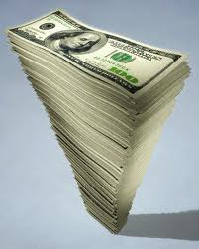
Why estimate?
We are continually bombarded by numbers, good, bad and bogus.
Our deficit is $1 trillion
Every American produces 100 cubic-feet of garbage a year
Do they make sense?
How should we respond?
Answers/estimates lead to actions.
Estimates fall in one of three ‘Goldilocks’ categories:
Too big
Too small
Just right (in the middle)
‘Too big’ or ‘Too small’ lead to obvious actions.
‘In the middle’ requires more thought (and perhaps even actual calculation).

Slide 3
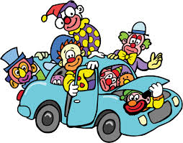
How to estimate (almost) anything
Write down the answer (to within a factor of 10).
Establish lower and upper bounds,
Take their geometric mean.
How many clowns can fit in a Cooper Mini?
This ensures that your estimate will be within a factor of 10.
If you can’t write down the answer, break the question into smaller pieces and go to step 1
Dare to be imprecise!

Slide 4
Making Arithmetic Easy
Million = 1,000,000 = 10⁶
Billion = 1,000,000,000 = 10⁹
Trillion = 1,000,000,000,000 = 10¹²
Counting zeroes gets tiresome,
➔ let’s use scientific notation
Arithmetic is now easy!
Worry mostly about the exponents
Use only ONE significant figure
3×3 = 10
9 / 4 = 2
√10 = π

Slide 5
Millions, billions, trillions, gazillions What do these big numbers really mean?
The FermiLab budget is about $300 Million
The 2012 presidential campaign cost $3 Billion
Our deficit this year will be about $1 Trillion
How much is a million seconds?
One day = 24 hours × 60 min/hr × 60 sec/min ~ 10⁵ sec
Thus 1 million sec = 10⁶ sec × (1 day / 10⁵ sec) = 10 days
1 billion sec = 10⁹ sec × (1 day / 10⁵ sec) = 10⁴ days
~ 30 years
1 trillion sec ~ 3×10⁴ years

Slide 6
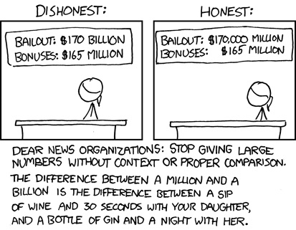
www.xkcd.com

Slide 7
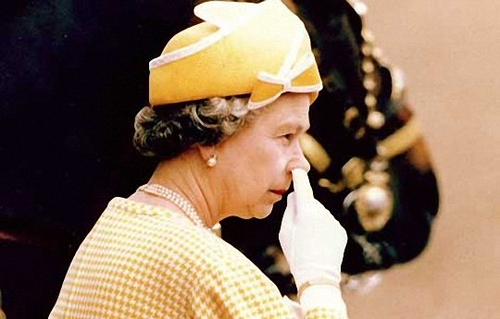
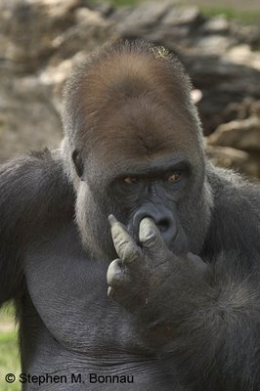
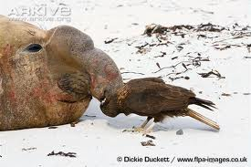
How many people in the world are listening to a speaker now?
picking their nose now?

Slide 8
How many people in the world are listening to a speaker picking their nose now?
The fraction of time you spend doing something typical
equals
The fraction of people doing that something right now
Time spent nose picking:
(7×10⁹) × (10⁻⁴) = 7×10⁵ = almost a million people!

Slide 9
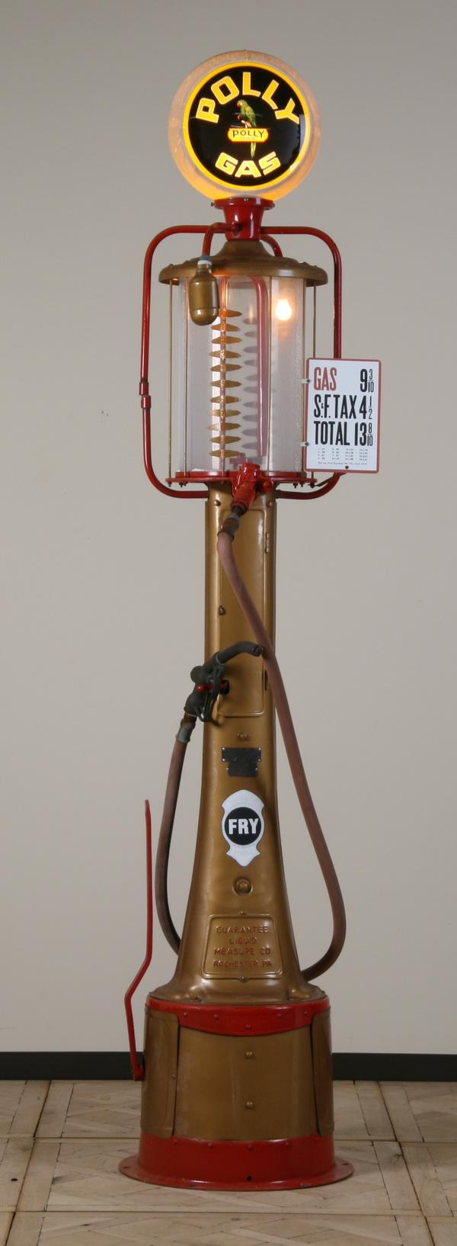
Why do we drive gasoline-powered cars?
Gasoline energy density:
C (coal) < gasoline < CH₄ (methane) ➔ CH₂
1.5 eV per chemical reaction: CH₂ + O ➔ CO₂ + H₂O
At 14 g/mole, 1 kg contains ~10² moles
Energy per kg:
Reality:

Slide 10
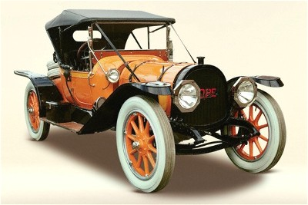
Why do we drive gasoline-powered cars (2) ?
Battery energy density:
D-Battery powered flashlight (hand torch)
1 Watt < power < 10 W
1 hour < time < 1 day
Stored energy:
Columbia Electric Mark III 1897
5-10 D-batteries per kg ➔
100 times less than gasoline

Slide 11
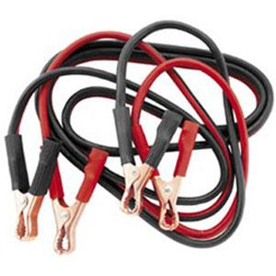
Why do we drive gasoline-powered cars (3) ?
Gasoline energy transfer rate:
Fuel transferred: ~10 gal = 40 L
Time: 10 s < t < 10³ s
That is 10 MegaWatts!
Home power cords only carry 10³ W
We’ll need a very thick power cord!

Slide 12
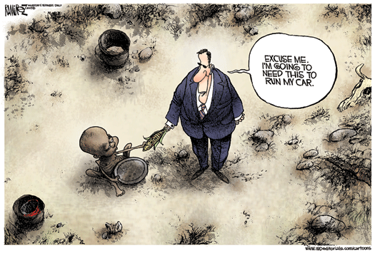
Can we grow our gasoline?
How much cropland would we need to grow corn for ethanol?
How much energy do we each consume?
How much energy do our cars consume?
We each consume 2500 Calories per day.
Our car consumes 1 to 2 gallons (4 to 8 L) of gas per day
We would need 20 times more cropland to grow all our ethanol.
Why are we burning food in our cars?

Slide 13
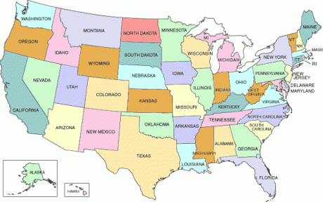
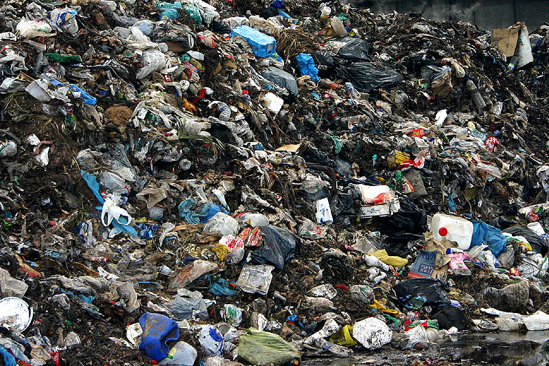
How much trash does the US generate yearly?
1 < trash < 100 pounds per person per week
➔ 500 lbs / person - year
Double it to include businesses ➔ 1000 lbs / person - year
(1/2 ton / person-year) × (3×10⁸ people) = 2×10⁸ tons/year
Landfill space needed for a century’s trash?
That is Virginia Beach or Los Angeles or 10⁻⁴ of the total area of the US
Landfill space is not a problem.

Slide 14
Should you recycle that plastic drink bottle?
What is its value?
Energy density: Plastic ~ gasoline ➔ e = 4×10⁷ J/kg
Mass:
1 g (paperclip) < m < 100 g (4 oz)
➔ m = 10 g
That is worth $0.01
… after collecting, cleaning, sorting and processing.
Landfill space is not a problem.
It’s up to you!

Slide 15
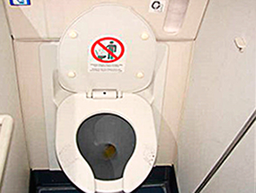
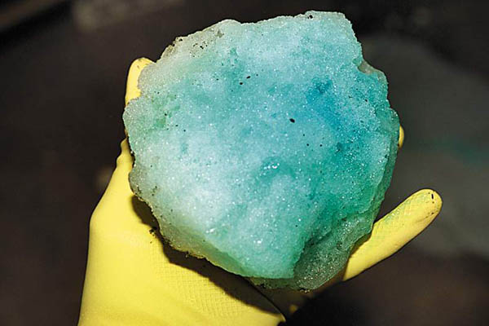
Lightening the Load
Fuel saved if you urinate before flying across country?
Airplane glide ratio g: the number of furlongs it glides for every furlong it descends. 1 < r < 10² ➔ r ≈ 10
Distance across country:
Total distance descended:
Volume of pee:
Energy needed:
Engine efficiency: 0.1 < ε < 1 ➔ ε ≈ 0.3
Fuel needed:
That’s about 20¢ of fuel.

Slide 16
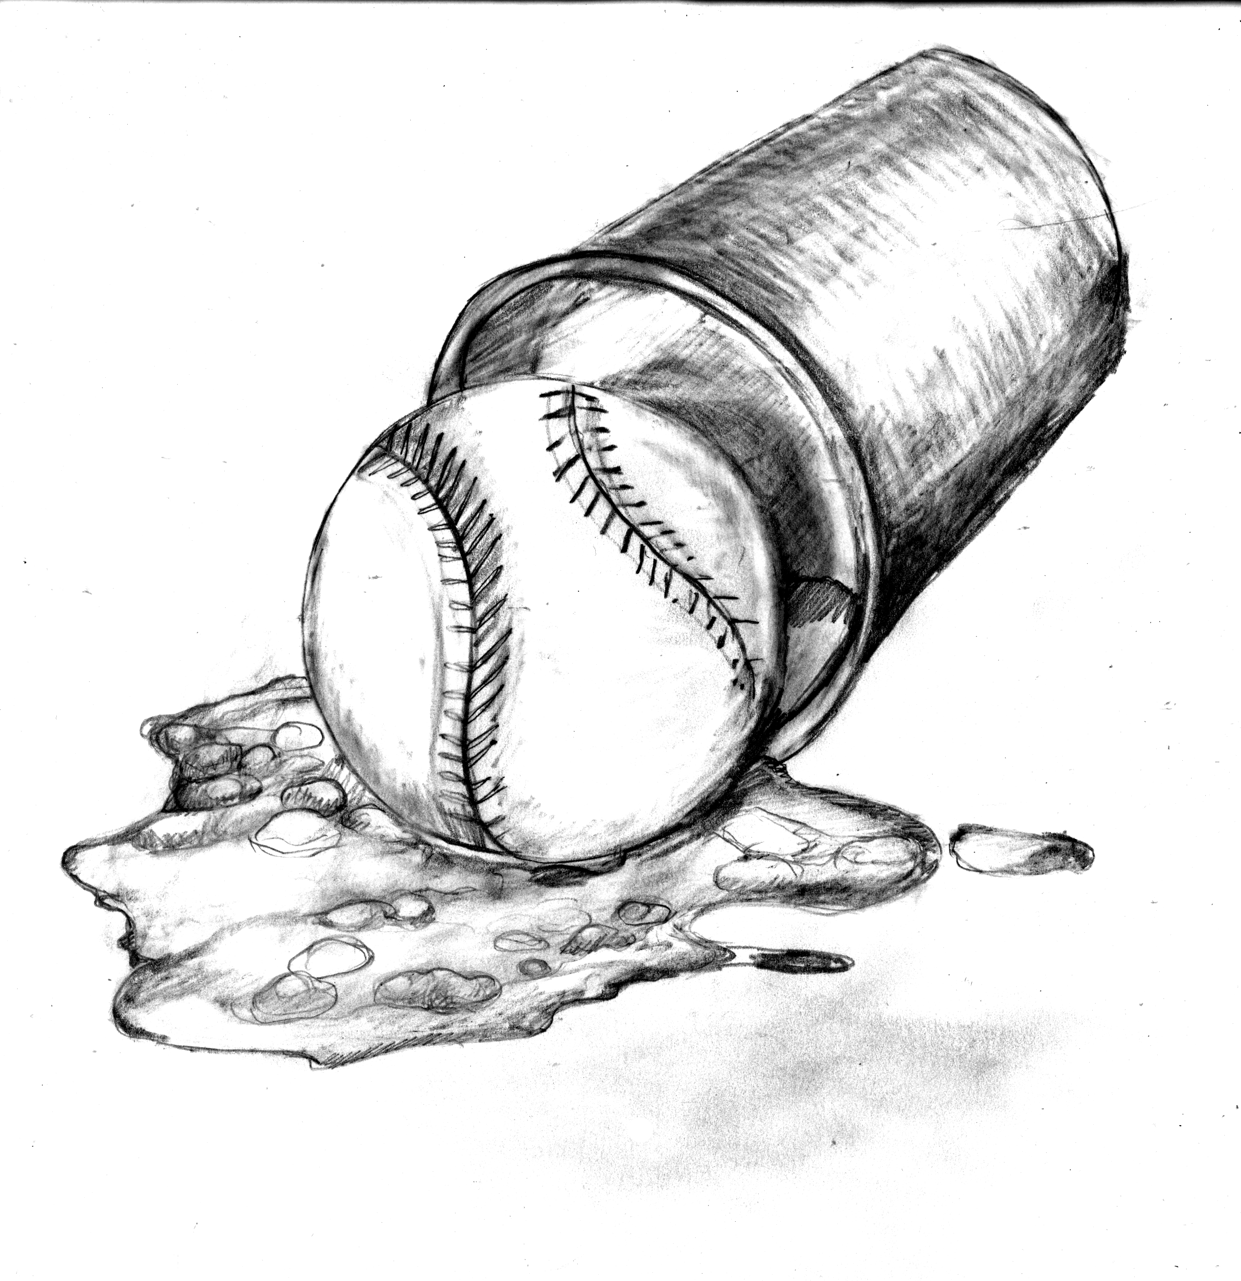
How many foul balls land in beer cups at ball games?
Foul balls per game: 1 < n < 10³ ➔ n = 30
Not caught by fan: 0.1 < c < 1 ➔ c = 0.3
Seats w/ beer: 0.01 < b < 1 ➔ b = 0.1
Cup:seat area: a = (0.1 m)²/(1 m)² = 10⁻²
30 teams, 80 games/team-season
➔2000 games/season
➔20 beer-landings/season

Slide 17
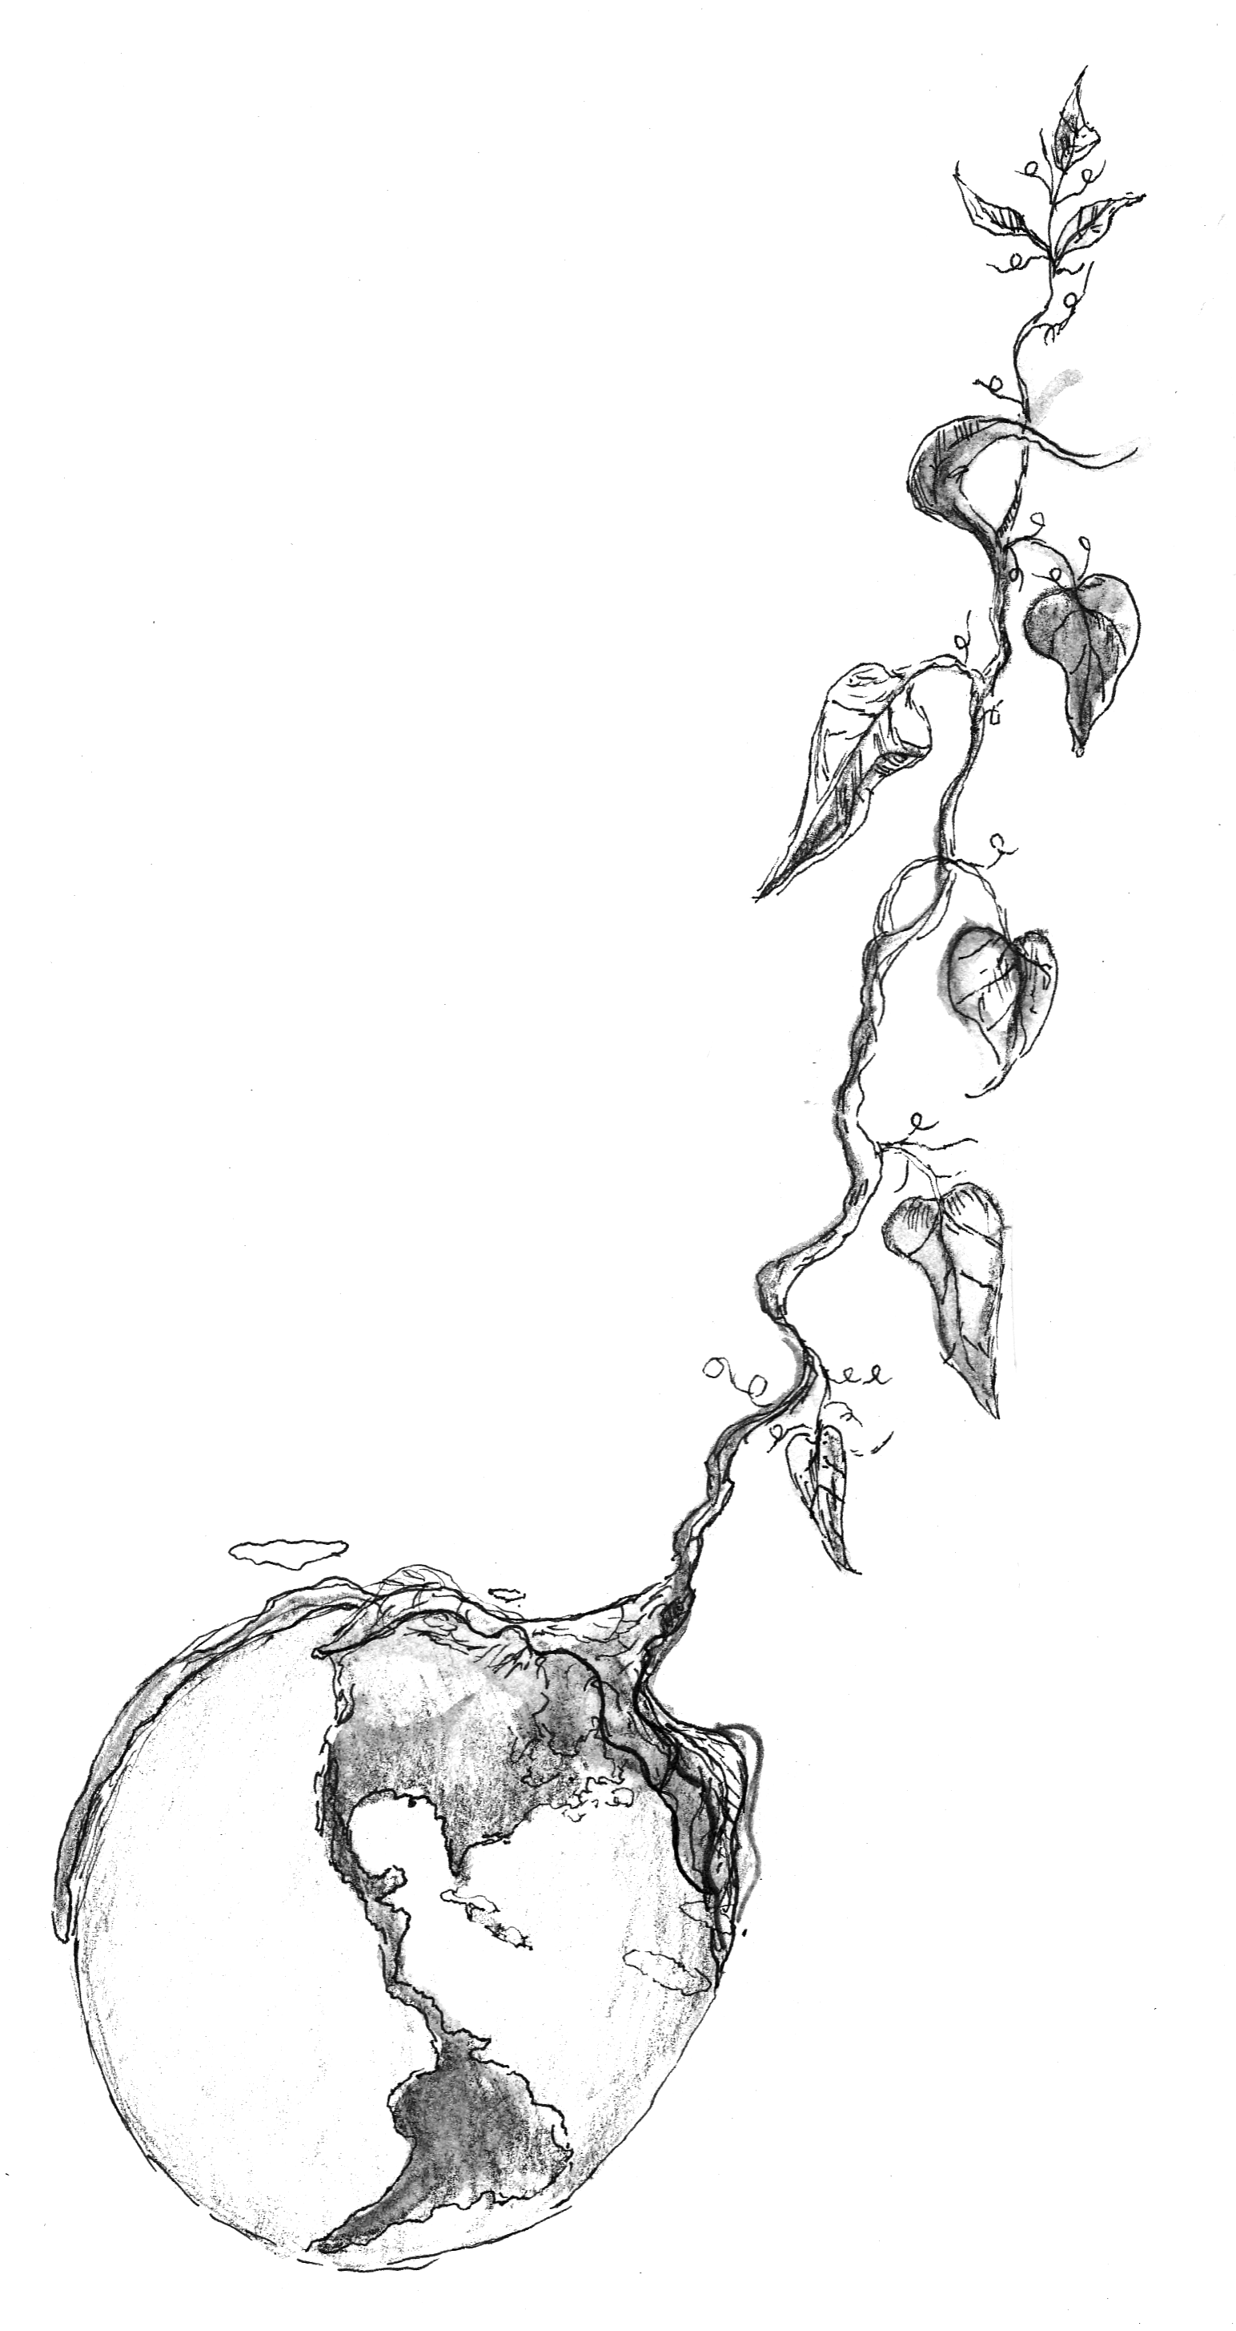
Bean Stalk to Orbit
Hangs down and up from geostationary orbit:
r = 4×10⁴ km ≈ 7R_{E}
Carbon nanotube: ρ ~ 10³ kg/m³
Mass:
Gravity:
Weight:
Tensile strength needed:
Tensile strength available:
Steel:
Carbon nanotube (microscopic):

Slide 18
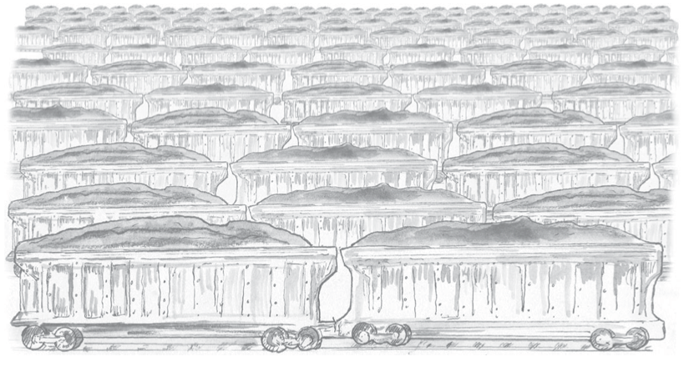
How much coal does a coal-plant need?
A 1-GW_{e} coal-to-electricity power plant needs
At an energy density for coal of 2×10⁷ J/kg (assuming 50% of gasoline), we will need
This is
5×10⁶ tons per year or
5×10⁴ 100-ton railroad cars per year or
5×10² 100-car coal trains per year or
1—2 100-car coal trains per day!

Slide 19
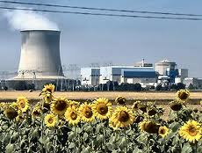
How much Uranium does a nuclear-plant need?
The power plant still needs 10¹⁷ J/yr.
Fissioning one Uranium-235 nucleus will yield about 200 MeV or about 10⁻³ of its mass. Thus we need
If the fuel is 5% enriched (i.e., 5% ²³⁵U and 95% ²³⁸U), then the power plant will consume 20 tons of fuel per year.
This has a volume of 1 m³.
It will fit under your dinner table.

Slide 20
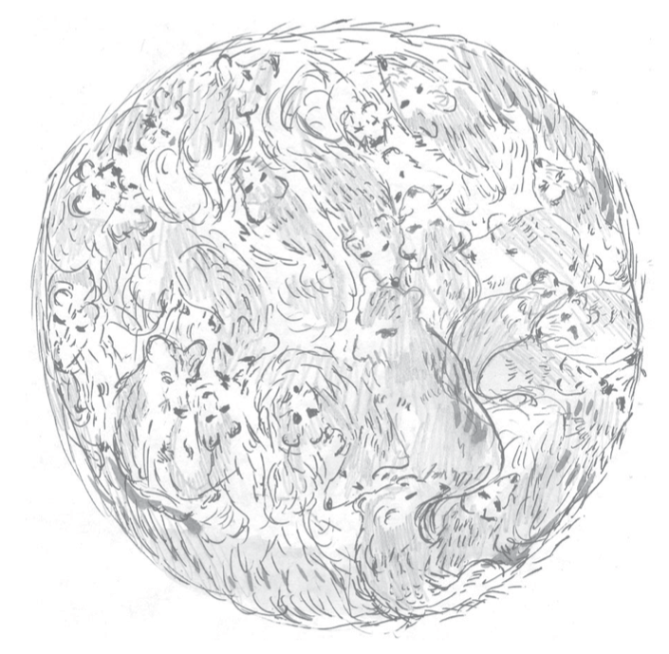
If the Sun were made of gerbils, the Earth would be incinerated. Compare the power density of mammals and the sun.
Humans:
Sun:
Humans have 10⁴ times the power density of the Sun!
(and gerbils are even worse!)

Slide 21
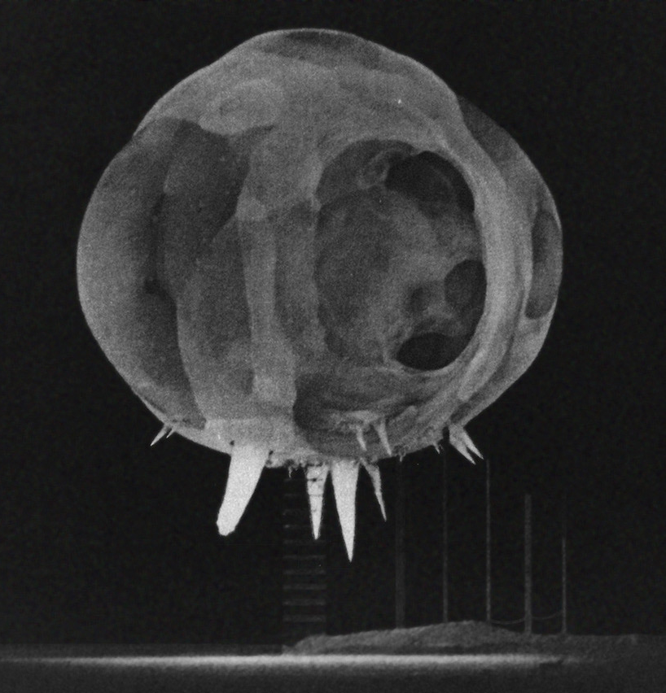
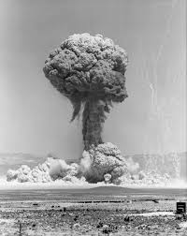
Atomic bombs and confetti
Enrico Fermi was about 10 miles from the Trinity A-bomb test:
About 40 seconds after the explosion the air blast reached me. I tried to estimate its strength by dropping from about six feet small pieces of paper before, during, and after the passage of the blast wave. Since, at the time, there was no wind I could observe very distinctly and actually measure the displacement of the pieces of paper that were in the process of falling while the blast was passing. The shift was about 2 1/2 meters, which, at the time, I estimated to correspond to the blast that would be produced by ten thousand tons of T.N.T.
How did he do that?

Slide 22
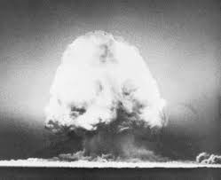
Estimating the A-Bomb
Work done by the shock wave = pressure times volume change
ΔV = area of hemisphere times displacement of paper
Human surface area ~ 1 m²
➔ overpressure less than 10⁴ N/m² (knock you down)
➔ overpressure greater than 10² N/m² (negligible)
➔ P = 10³ N/m²
Now multiply by a few because the energy of the bomb can go into light (photons), nuclear radiation, shock wave, ground pulse …
We get E = 4 kT
Fermi got E = 10 kT
The actual blast was 20 kT
Not too bad!

Slide 23
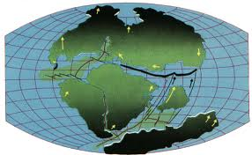
What is the kinetic energy of a drifting continent?
We need to estimate mass (volume and density) and speed.
Volume:
Depth:
width: 5000 km, height: 5000 km
Density: more than water (10³ kg/m³) and less than iron (10⁴)
Speed: the Atlantic Ocean opened 3000 km in 10⁸ years

Slide 24
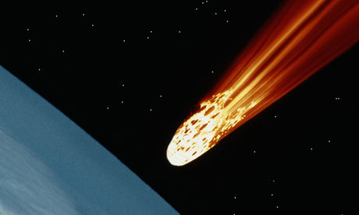
What is the kinetic energy of a 1 km asteroid hitting the Earth (the dinosaur-killer)?
We need to estimate the mass and the velocity.
Assume an iron asteroid (divide by 3 for a rocky one):
The asteroid’s velocity comes from the Sun’s gravity. So does the Earth’s velocity:
This is 10⁶ megatons of TNT!

Slide 25
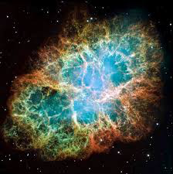
Death by Supernova

Slide 26
Death by Supernova
12 neutrinos (10 MeV+) from SN1987a interacted in the 2000 m³ Kamiokande II water Cherenkov detector.
What effect would they have on a human 1 AU away?
SN1987a distance:
Energy deposited:
Radiation dose:
Death by neutrino!

Slide 27
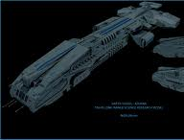
How much energy do we need to travel to the stars?
Distance to Alpha Centauri:
Time to get there:
Velocity needed:
Mass needed: a lot more than the Santa Maria (10² tons) and less than an aircraft carrier (10⁵ tons)
Energy needed:
Fuel needed:
We need 10⁸ times more fuel than payload!

Slide 28
Summary
To estimate:
Dare to be imprecise!
Estimate to within a factor of 10
Take the geometric mean of lower and upper bounds
Break up the question into smaller pieces if necessary.
Remember a few key numbers
Using estimation and without relying on experts we found:
Landfill space is not a problem
Batteries suck
Burning ethanol in cars is a really really bad idea
You won’t save the world by recycling plastic water bottles
Neutrinos can be deadly.
If you see a 1-km asteroid coming, duck!

