Slide 1
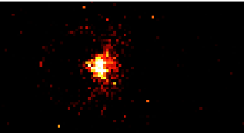

Getting Molecules Into the Quantum Toolkit
Brian Odom

Slide 2
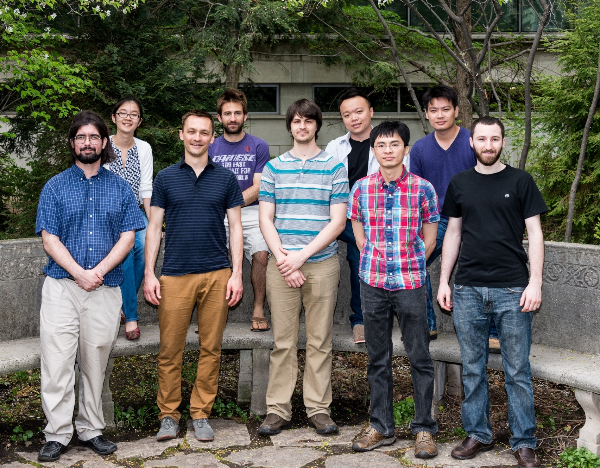
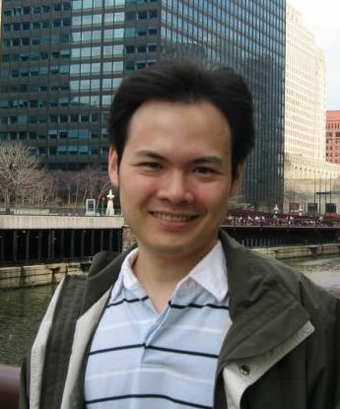





The Team
Grad Students
Mark Kokish
Chien-Yu Lien
Yen-Wei Lin
Chris Seck
Pat Stollenwerk
Ming-Feng Tu
Undergrad
Xiaowen Chen
Postdoc
Zeke Tung
Research Prof.
Matt Dietrich

Slide 3
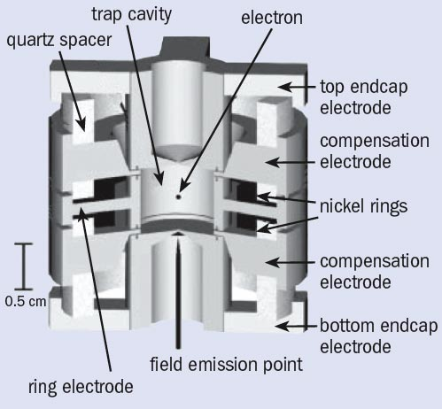
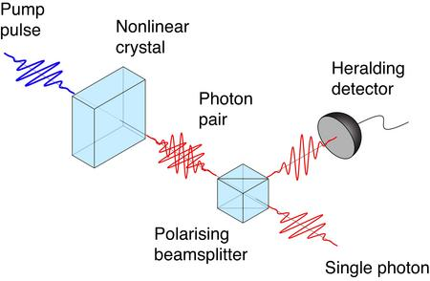

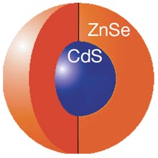
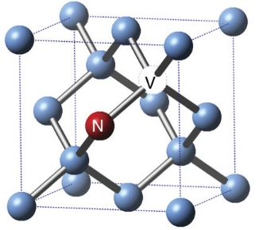
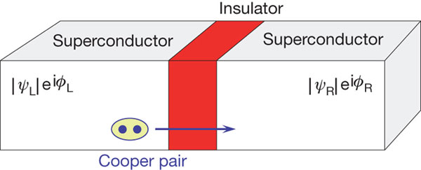
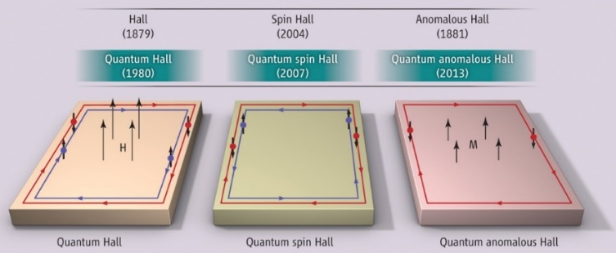
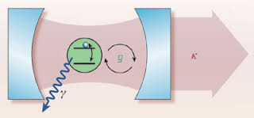
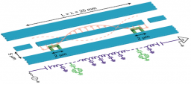
A Peek Inside Today’s Quantum Toolkit
Trapped atoms
Trapped electrons
Single photons
Nitrogen vacancy centers
Quantum dots
Josephson junctions
Hybrid systems
Collective excitations
Cavity QED
Circuit QED

Slide 4
Which Atoms?
Most jobs can be done with a handful of species

Slide 5
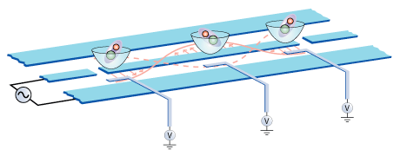
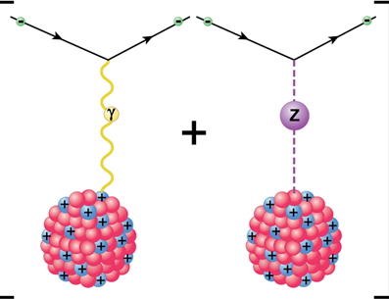
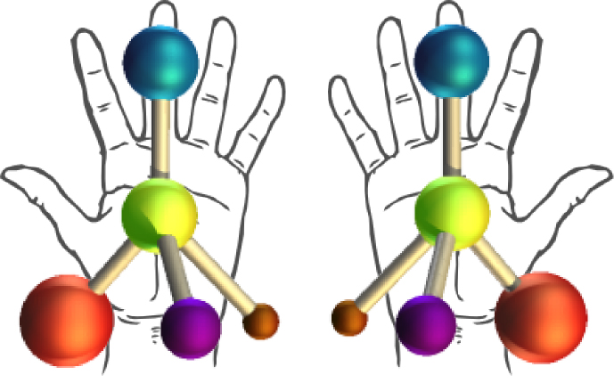
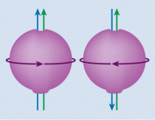
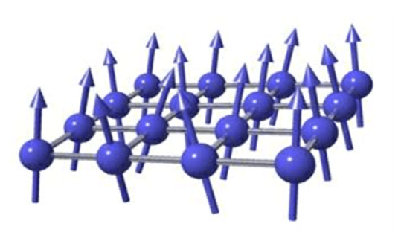
If Trapped Molecules were in the Quantum Toolkit…
(What can molecules do better than atoms?)
Controlled chemistry
Quantum information
Time-varying constants
e⁻
p⁺
?
NJP 11, 055049 (2009)
Parity violation
Chiral parity violation
Time-reversal symmetry
Dipolar quantum gas
T

Slide 6
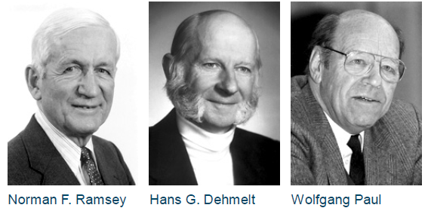
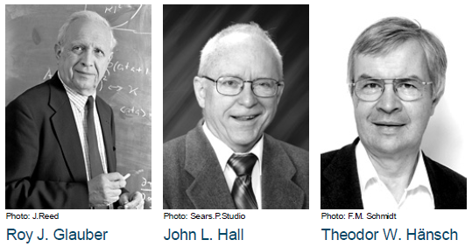
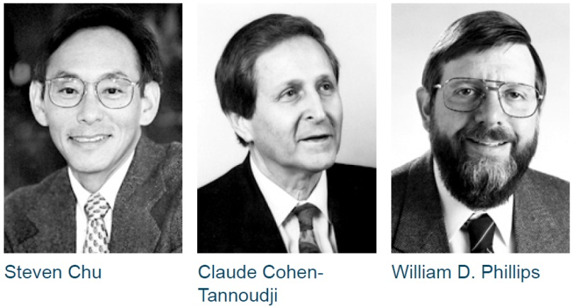
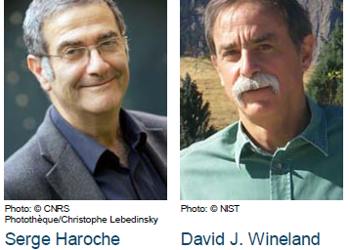
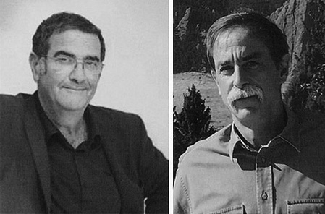
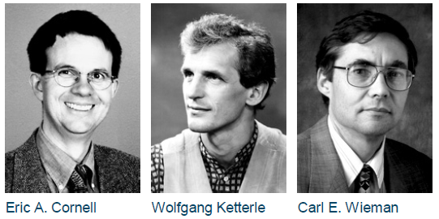
Three Decades of AMO Nobels
1989: Atomic clocks and ion traps
2005: Quantum optics and frequency combs
A
A
A
O
O
O
1997: Atom cooling and trapping
2012: Quantum manipulation
A
A
A
O
A
2001: Bose-Einstein condensates
…notice something missing?
A
A
A

Slide 7
Trapped Molecules: Are We Almost There?
The road has been long
The molecular EDM story:
1966: Sandars proposes molecules for EDM search
1995: Hinds begins YbF work
2011: Hinds / Imperial College group: x2 improvement in eEDM limit
…but we might be getting there
2014: DeMille, Doyle, Gabrielse (ACME): x10 improvement in eEDM limit
2008: Orsay, broadband vibrational cooling
2010: DeMille, laser cooling of molecular translations
2010: Jin/Ye & Willitsch, state-specific trap loading
2010: Drewsen/Schiller, narrowband rotational cooling
2012: Orsay, narrowband rotational cooling
2013: Hudson, ultracold sympathetic cooling of vibrations
2014: Brown & Drewsen, cooling of molecular ion to motional ground state
2014: DeMille, molecular magneto-optic trap (MOT)
2014: Drewsen, cryogenic rotational cooling

Slide 8










Energy Levels for Simplest Molecules
$$A^{1}Σ$$
380 ns
$v=$3
$N=$3
360 nm
$v=$2
$N=$2
$v=$ 1
2000 K
$N=$ 1
20 K
$$X^{1}Σ$$
$v=$ 0
$N=$ 0
Electronic excitation
Vibrational excitation
Rotational excitation
Hydrides: N ~ 0-10 populated at 300K
Oxides: N ~ 0-30 populated at 300K

Slide 9
Use Atomic Ions to Cool Molecular Ions?
…yes and no
Internal state preparation is a challenge!
Options to date:
State-selective sample preparation, e.g. hexapole filtering, Feshbach/photo-association, photo-ionization (Jin/Ye, Nagerl, Cornell, Willitsch)
Broadband vibrational cooling (Orsay)
Narrowband rotational cooling (Drewsen, Schiller, Orsay)
Sympathetic cooling (Doyle, Drewsen, Hudson, Wester, others)
Wanted: fast optical cooling technique to cool rotations from >= 300 K
(i.e. optical pumping like in atoms)
Notes:
How to map excitation

Slide 10
One Motivation: Single-Molecule Spectroscopy
(not yet done)
Cool motion
Cool rotations
Drive transition
Map excitation
Rotational cooling lasers
Ba⁺ Doppler cooling lasers
Spectroscopy laser
Optical cooling is most natural solution for this problem
Other Motivations
High-fidelity state control for QIP
Complement other techniques (e.g. BaF cooling after supersonic expansion)
Notes:
How to map excitation

Slide 11
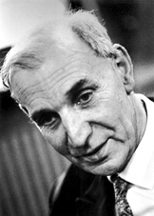
The Plan: Optical Pumping
N
5
4
Excited manifold
3
Alfred Kastler
2
1
6
5
Ground manifold
4
3
2
1
0

Slide 12



Which Upper Manifold To Use?
$$A^{1}Σ$$
400 ns
$v=$3
$N=$3
40,000 K
$v=$2
$N=$2
$v=$ 1
100 ms
$N=$ 1
2000 K
$$X^{1}Σ$$
$v=$ 0
$N=$ 0
Electronic excitation
Vibrational excitation
Rotational excitation
$$Γ∝ {ω }^{3}$$

Slide 13








Electronic Excitation Allows Fast Pumping
$$A^{1}Σ$$
400 ns
$v=$3
$N=$3
$v=$2
pump
$N=$2
$v=$ 1
100 ms
$N=$ 1
$$X^{1}Σ$$
$v=$ 0
$N=$ 0
Electronic excitation
Vibrational excitation
Rotational excitation

Slide 14


Problem #1: Too Many Populated States
N’
J’
P’
3
3
−
$$A^{1}Σ(v′=0)$$
2
2
+
1
1
−
0
0
+
Selection rules:
Parity: +
ΔJ = 0, ±1
J’ – J = -1: P-branch
J’ – J = 0: Q-branch
J’ – J = 1: R-branch
-
N
J
P
4
4
+
$$X^{1}Σ(v=0)$$
3
3
−
2
2
+
How to cover all the levels
Sweep?
10+ lasers?
1
1
−
0
0
+

Slide 15
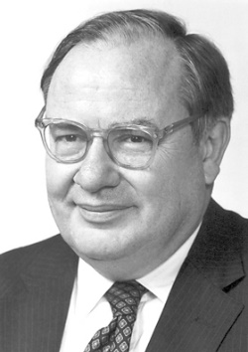



Problem #2: Vibrational Excitation
N’
J’
P’
3
3
−
$$A^{1}Σ(v′=0)$$
2
2
+
1
1
N
−
0
0
+
3
2
1
0
$$X^{1}Σ(v=2)$$
N
J
P
N
3
4
4
+
2
1
0
$$X^{1}Σ(v=0)$$
$$X^{1}Σ(v=1)$$
3
3
−
2
2
+
diatomic molecule
[dīəˈtämik mäləˌkyo͞ol]
1
1
−
0
0
+
a molecule with one atom too many
- Arthur Schawlow, ca. 1950

Slide 16
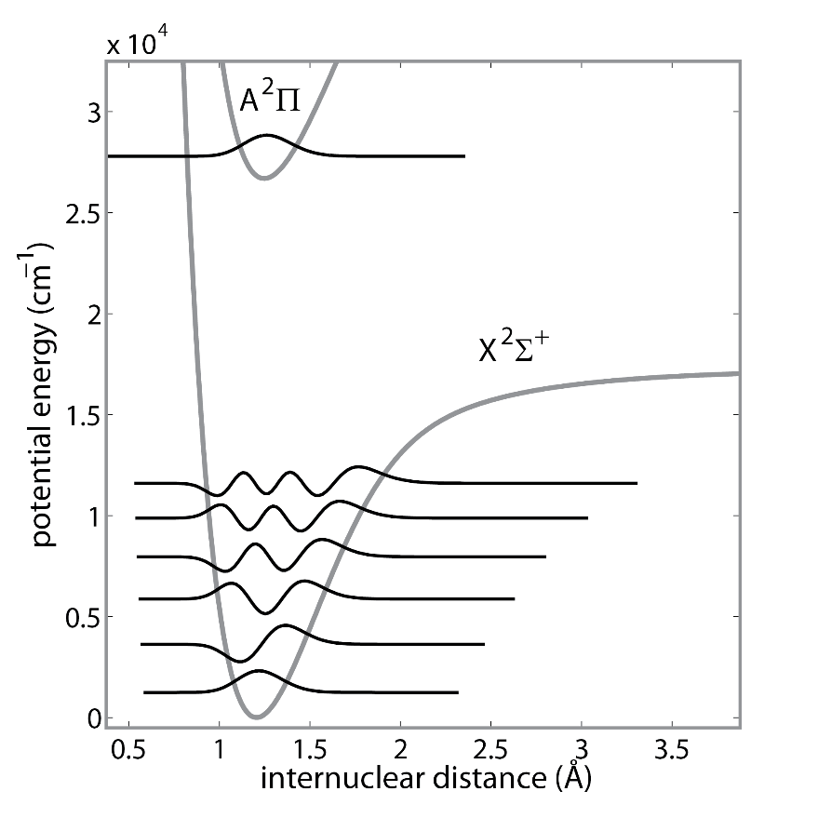

Solution #2: Use Special Molecules
…those with diagonal Franck-Condon factors
AlH⁺
Neutrals
Di Rosa, Eur. Phys. J. D (2004)
and others
Ions
Nguyen, et al., New J. Phys. (2011)
Nguyen, et al., Phys. Rev. A (2011)
~30 cycles before vibrational excitation
Favorites
Other Candidates
AlH⁺ A²Π – X²Σ⁺: F₀₀ = 0.970
BH⁺ A²Π – X²Σ⁺: F₀₀ = 0.986
SiO⁺ B²Σ⁺ – X²Σ⁺: F₀₀ = 0.994
CrF⁺ A⁵Π – X⁵Σ⁺ | ScH⁺ A²Δ – X²Π
CO⁺ B²Σ⁺ – X²Σ⁺ | VF⁺ A⁴Δ – X⁴Π
TiO⁺ A²Σ⁺ – X²Δ | YH⁺A²Δ – X²Σ⁺
N₂⁺ B²Σ_{u}⁺ – X²Σ_{g}⁺ | …
[SiO⁺ also proposed by Campbell $→$
Matsukevich New J. Phys. (2012)]

Slide 17
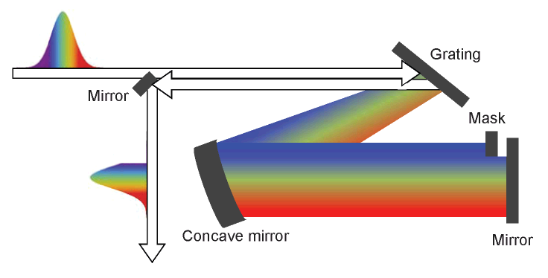
Solution #1: Broadband Laser
Broad-spectrum light generally heats
However, pulse-shaping techniques allow tailoring of spectrum
Used for vibrational cooling of Cs₂
    Viteau, et. al., Science (2008)
Proposed for rotational cooling Cs₂ and AlH⁺, SiO⁺, BH⁺, BaF
    Sofikitis, et. al., New J. Phys. (2009)
    Lien et. al., New J. Phys. (2011)
    Nguyen et. al., Phys. Rev. A (2011)
    Nguyen et. al., New J. Phys. (2011)
    Comparat, Demille, DAMOP 2014
First demonstration, including parity cooling
    Lien et. al., Nature Commun. (2014)

Slide 18


Broadband Cooling for ¹Σ − ¹Σ
N’
J’
P’
3
3
−
$A^{1}$Σ$(v′=0)$
2
2
+
1
1
−
0
0
+
x
Drive P-branch
N
J
P
4
4
+
$$X^{1}Σ(v=0)$$
3
3
−
2
2
+
1
1
−
0
0
+
This protocol preserves parity

Slide 19


Broadband Cooling for AlH⁺
(N’)
J’
P’
3
3.5
+
−
2
2.5
−
$$A^{2}(v′=0)$$
+
1
1.5
+
−
0
0.5
−
+
x
Drive P- and ^{P}Q-branch
N
J
P
4
4.5
3.5
+
$$X^{2}Σ(v=0)$$
3
3.5
2.5
−
2
2.5
1.5
+
1
1.5
0.5
−
0
0.5
+

Slide 20
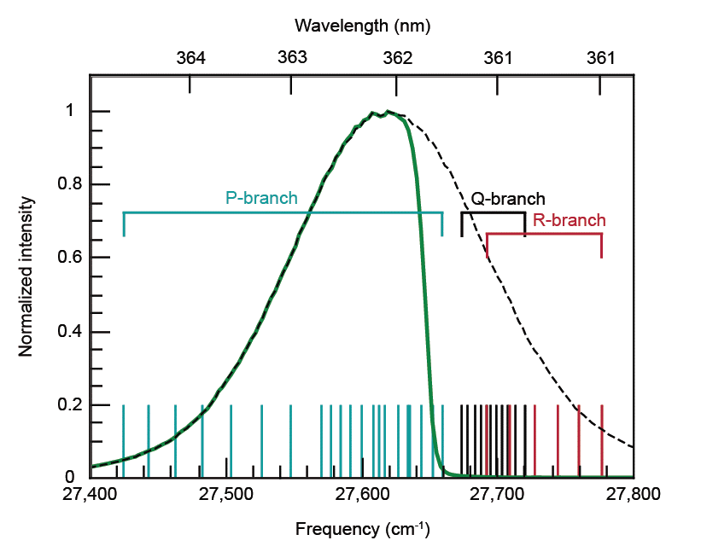



Filtered Spectrum
$$2→1$$
1$→0$
$$3→2$$
(Cutoff is actually sharper than plotted here)

Slide 21
Timescales
    Cooling: rate equation simulation
    Lien et al., New J. Phys. (2011)
Rotational lifetimes
Blackbody:120 s
Decay: 8000 s
Vibrational lifetimes
Blackbody:150 s
Decay: 0.13 s

Slide 22
Spectral Filtering Resolution
Current setup
2400 lines/mm holographic grating
1” optics
diffraction-limited FWHM spectral resolution δν_{d}
single-frequency beam waist at Fourier plane w₀
spatial dispersion α
incident beam waist w_{in}
grating incidence angle θ_{in}
grating period d
Diffraction limit: 0.4 cm⁻¹ = 13 GHz
Measurement (scanned CW & homebuilt spectrometer): 3 cm⁻¹ = 90 GHz

Slide 23
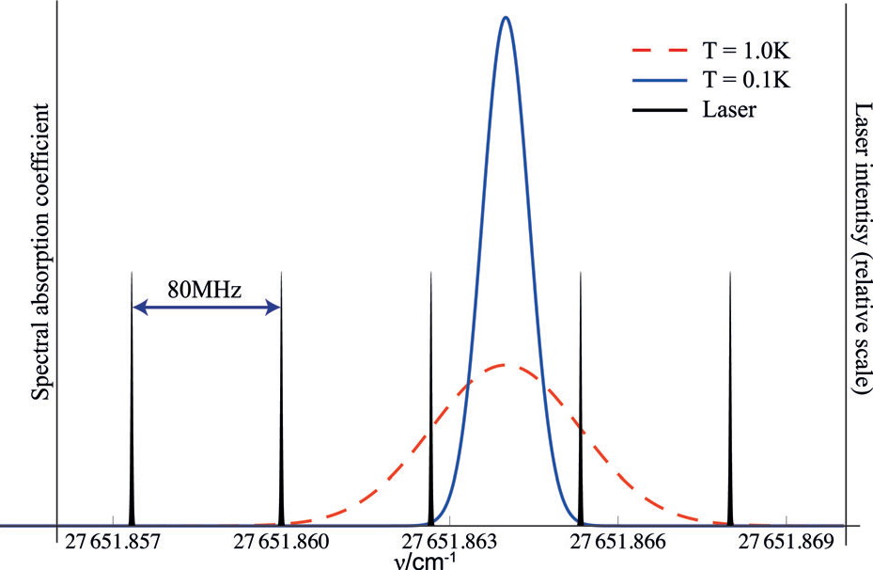
Filtered Broadband Laser Details
Spectral filtering requirements
AlH⁺: 2 B_{e} = 420 GHz
SiO⁺: 4 B_{e} = 84 GHz
Currently achieved: 90 GHz filtering cutoff (at -10 dB point)
Laser specifications
Spectraphysics MaiTai femtosecond laser: 2 W at 724 nm
Double then filter
970 mW after doubling, 290 mW after spectral filtering
For AlH⁺, focus to w₀=100 μm for saturation
Other issues
Coherent dark states
Apply moderate B field
Femtosecond laser has teeth
Rely on Doppler broadening or
modulate comb spectrum

Slide 24
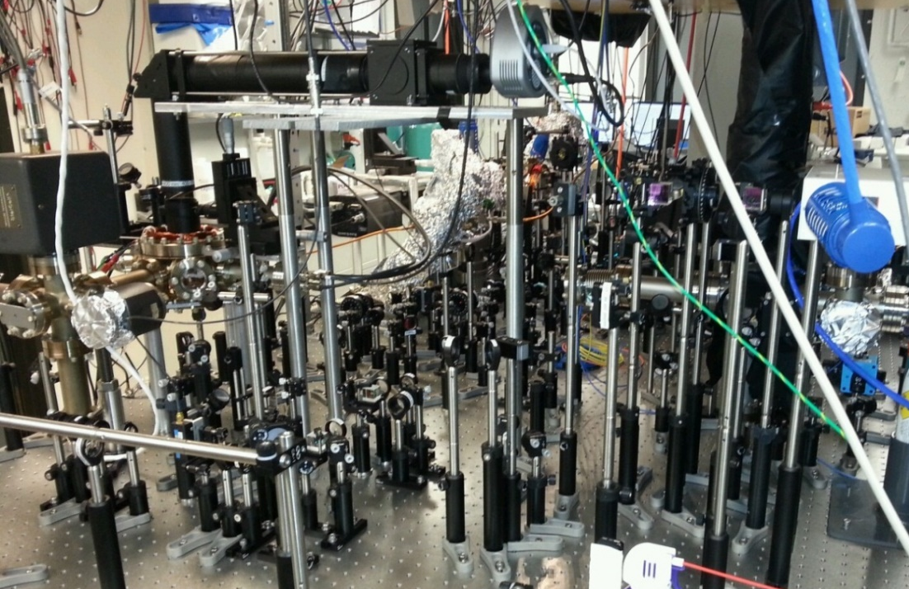
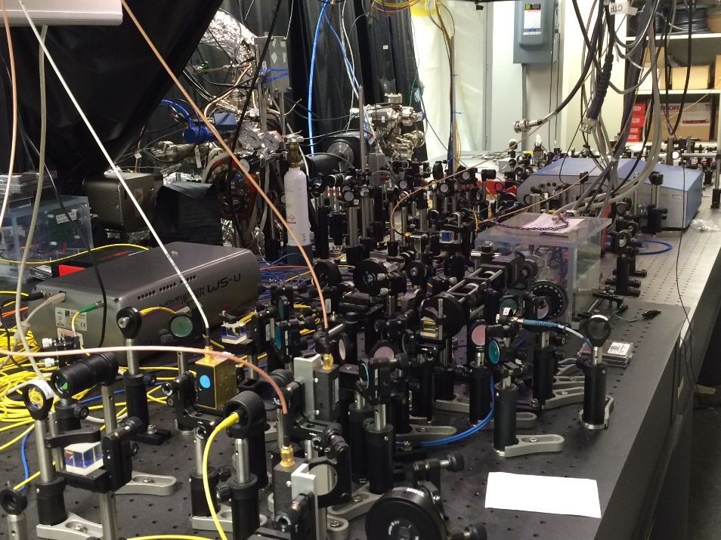
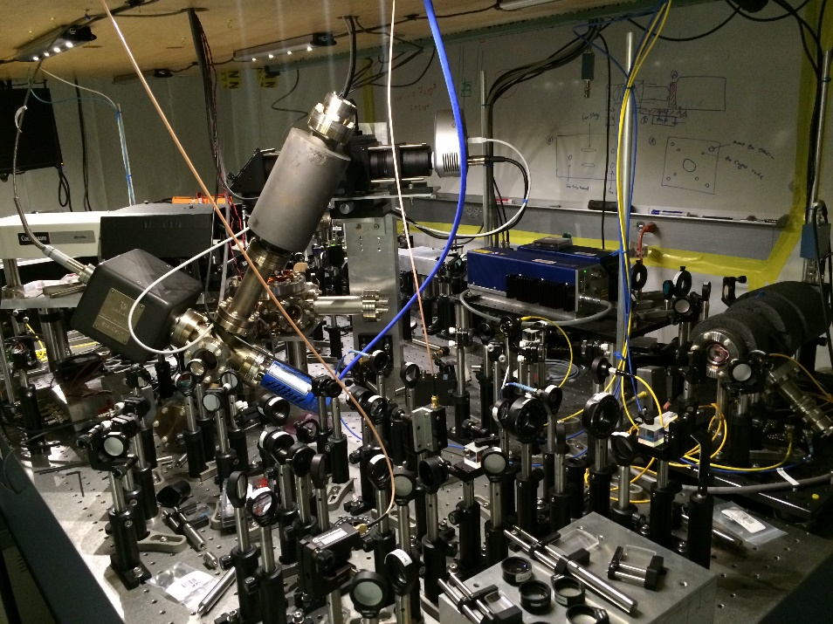
The Lab Setup

Slide 25
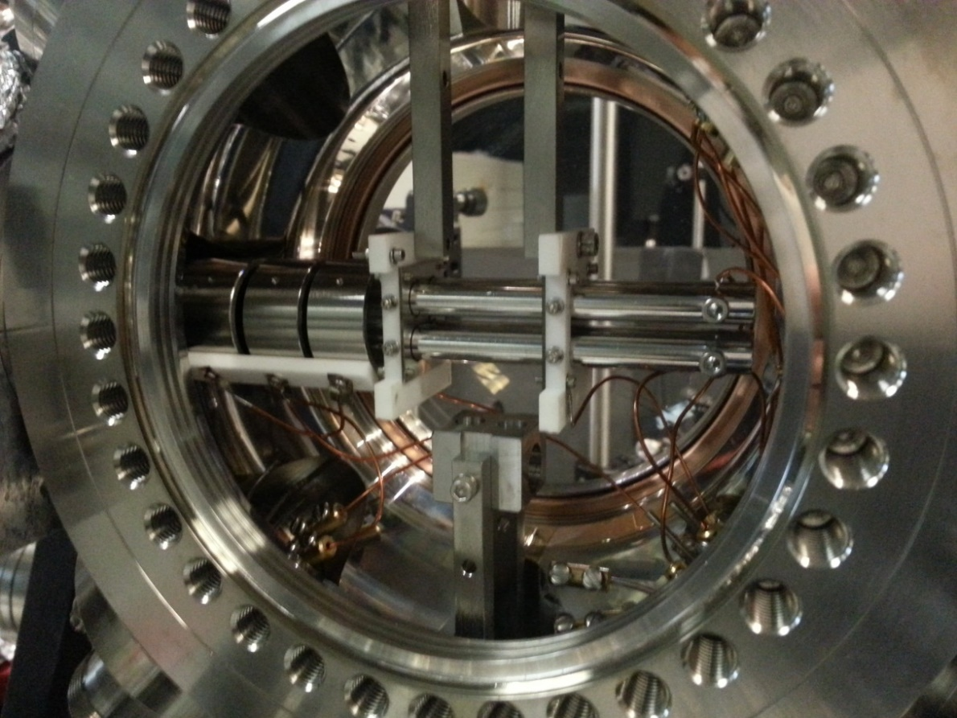
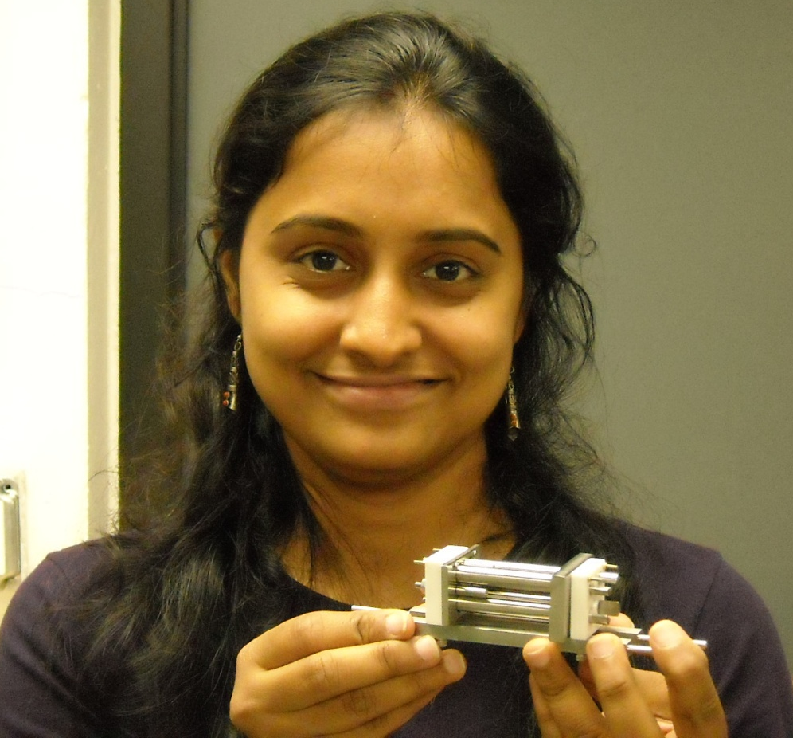
Linear Radiofrequency Trap
RF Trap
Al and Ba ablation targets
Typical operation pressures from 10⁻⁹ to 10⁻¹¹ Torr

Slide 26

Trap Loading, a Smart Way
10¹¹/cm³ ~ 10⁻⁵ Torr (10⁻⁹ Torr chamber pressure)
Rev. Sci. Inst. (2014)

Slide 27
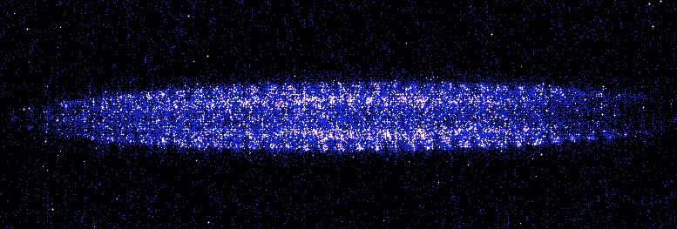
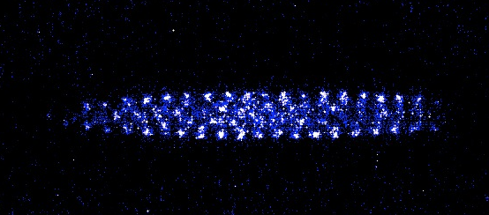
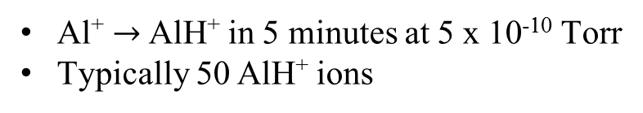
AlH⁺ Loading, a Less Smart Way
Trap parameters:
r₀ = 3 mm
z₀ = 15mm
Ω_{rf} = 2π × 2.4 MHz
Al
Ba
Ba⁺& Al⁺
Ba⁺
Al⁺ $→$ AlH⁺ in 5 minutes at 5 x 10⁻¹⁰ Torr
Typically 50 AlH⁺ ions

Slide 28
REMPD Rotational State Analysis
Resonance-Enhanced Multiphoton Dissociation: (1+1’) REMPD
Lien et. al., PCCP (2011)
Seck et. al., J. Mol. Spectrosc. (2014)

Slide 29
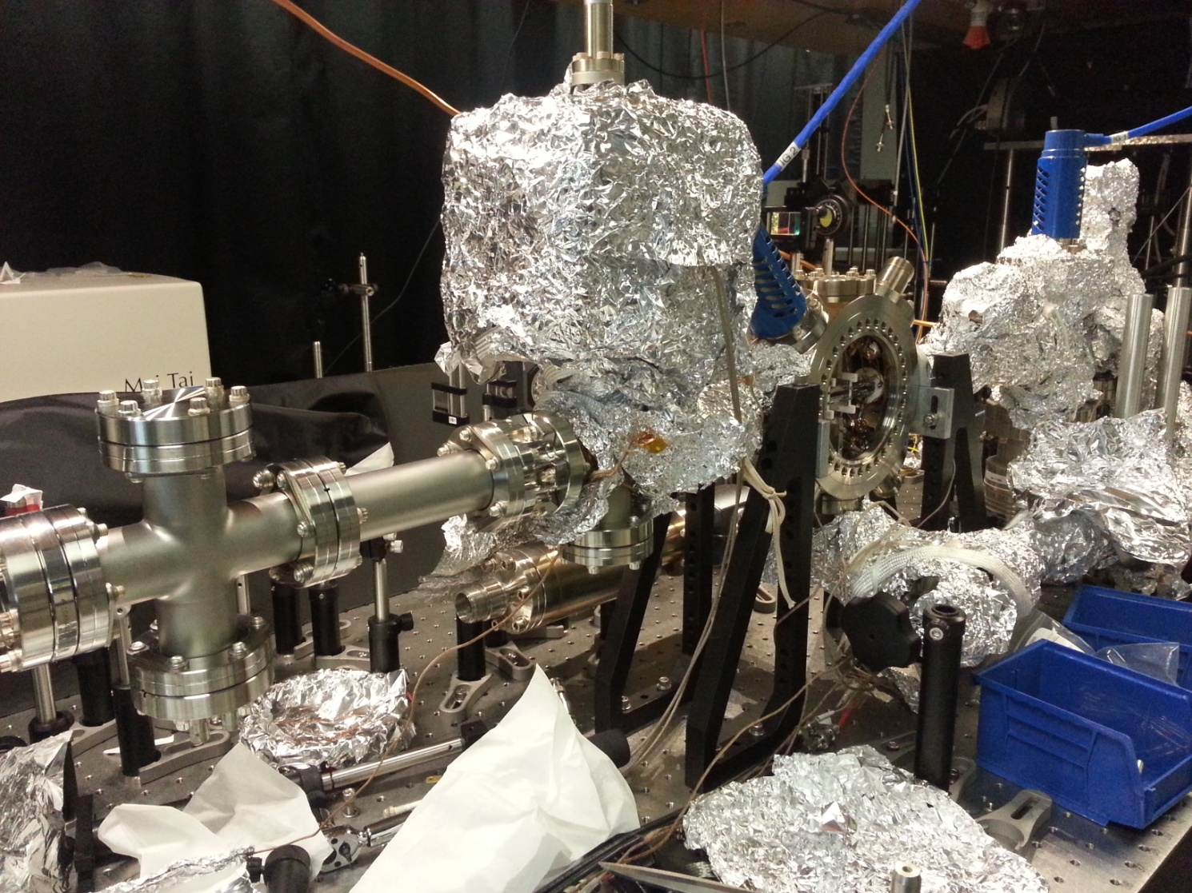
AlH⁺ Apparatus
Ion trap and Einzel Lens
MCP
Pulse Valve
Flight tube, ~50 cm

Slide 30
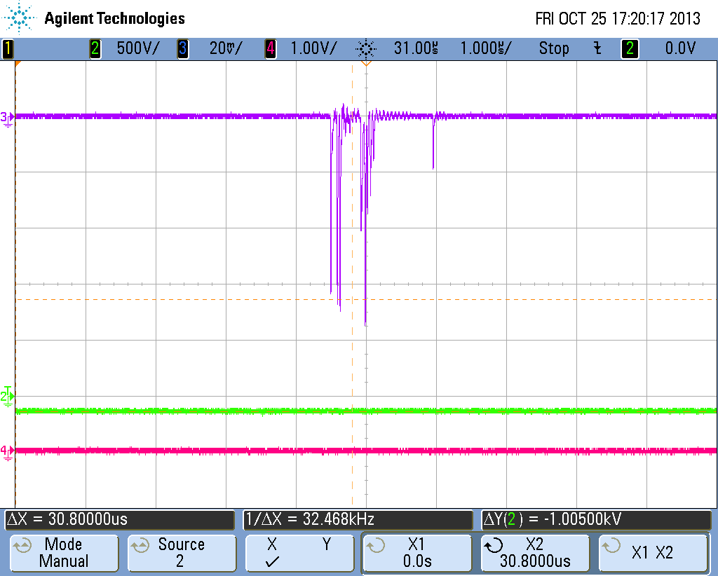
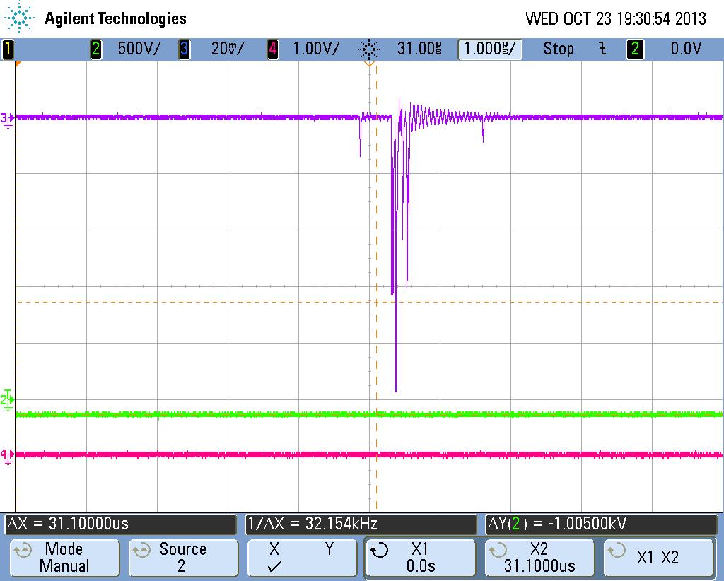
Time-of-Flight Species Analysis
Al⁺
AlH⁺
Al⁺
AlH⁺
Loading process yields 100% AlH⁺ (mass = 28 AMU)
AlH⁺ was in probed quantum state if mass = 27 AMU component appears in trap dump

Slide 31
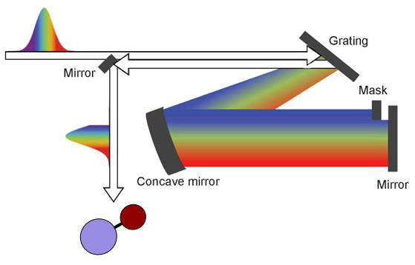
How Well Does it Work?

Slide 32
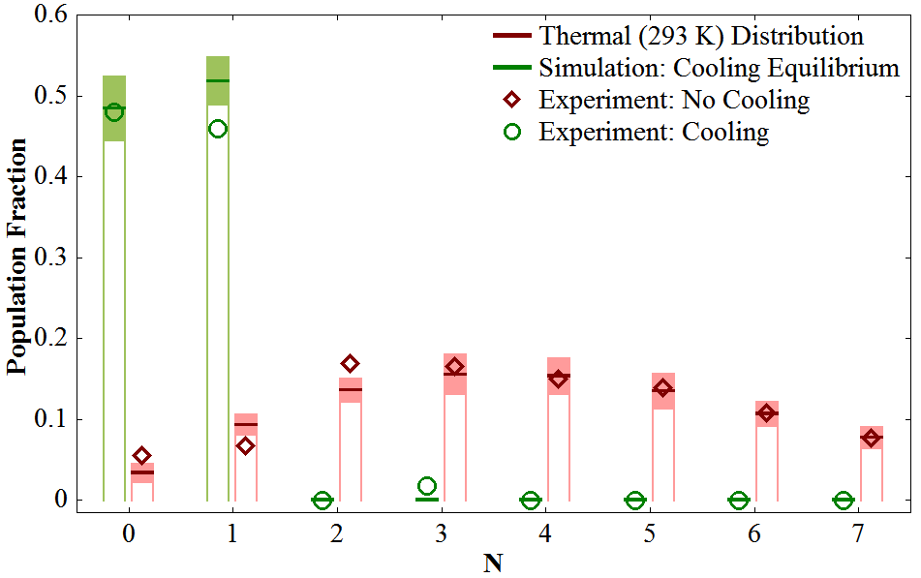
Broadband Cooling Results
Thermal population
$$P\left(N\right)∝\left(2N+1\right)e^{−B_{e}N\left(N+1\right)hc/k_{B}T}$$
⇒ 94(5)% in N = 0, 1

Slide 33



Parity Cooling
(N’)
J’
P’
3
3.5
+
−
2
2.5
−
$$A^{2}(v′=0)$$
+
1
1.5
+
−
$$X^{1}Σ(v=1)$$
0
0.5
−
+
N
~10 μs
3
x
~400 ns
2
N
J
P
1
4
4.5
3.5
+
0
$$X^{2}Σ(v=0)$$
3
3.5
2.5
−
~150 ms
2
2.5
1.5
+
1
1.5
0.5
−
0
0.5
+

Slide 34
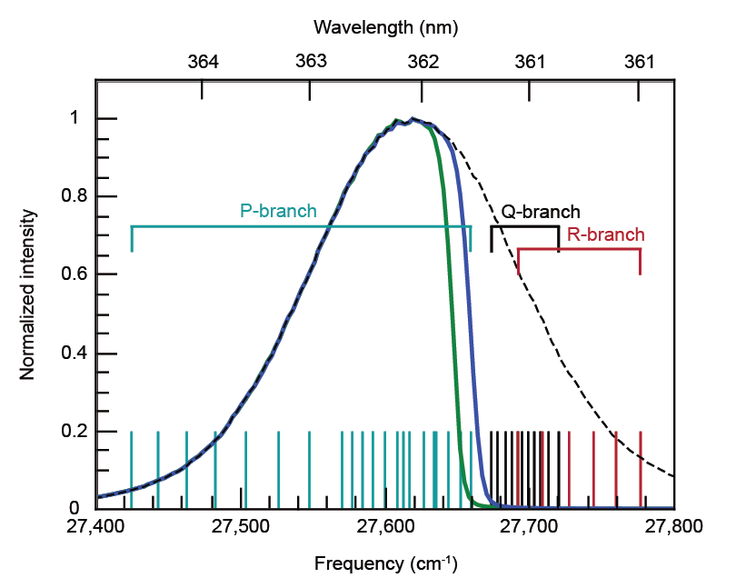


Shift Spectrum for Additional Parity Cooling
$$2→1$$
1$→0$

Slide 35
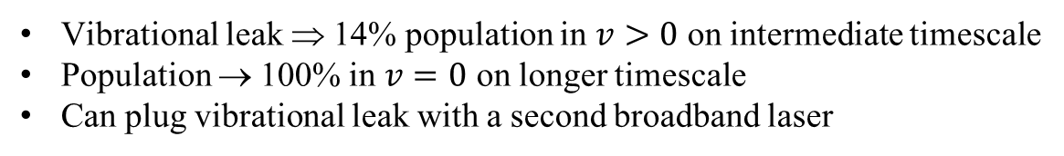
Two Rotational Cooling Timescales
Vibrational leak ⇒ 14% population in $v>0$ on intermediate timescale
Population → 100% in $v=0$ on longer timescale
Can plug vibrational leak with a second broadband laser

Slide 36
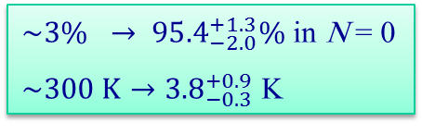
Rotational Cooling Efficiency
${\sim 3\% → 95.4}_{−2.0}^{+1.3}\%$ in N = 0
$\sim 300 K→{3.8}_{−0.3}^{+0.9}$ K
Lien, et. al., Nature Commun. (2014)

Slide 37

Cooling Timescale
$$P_{0}^{d}=P_{0}^{f}−P_{1}^{i}B_{2}e^{−t/τ}$$
τ = 140 (20) ms
(τ_{th} = 127 ms)
Other approaches:
Cryogenic trap & buffer gas
  MgH⁺: 78% in g.s. for single ion, 100 ms (Drewsen 2014)
Narrowband vibrational excitation
  MgH⁺: 37% in g.s., ~10 s (Drewsen 2010)
  HD⁺: 78% in g.s. ~10 s (Schiller 2010)

Slide 38

Imagine: Site-Resolved Fluorescence
SiO⁺ parameters
7000 photons with one vibrational repump laser
4.3 Debye
No hyperfine structure
For d = 10 μm, E_{dd} = 3 Hz
v = 0, N = 1 lifetime = 200 s (300 K BBR-limited)
Possibilities
Observe molecule-molecule entanglement
Study 1D magnetism. (Electric dipoles simulate magnetic dipoles.)
Presence of phonons creates topologically protected zero-energy mode?

Slide 39
Single Molecule Spectroscopy
An easy approach
Cool translational motion
Cool rotations
Drive transition
Map excitation
Readout
4a) Pulse radiation pressure drive –scatter from spectroscopy ion
4b) Amplify motion—scatter from logic ion

Slide 40
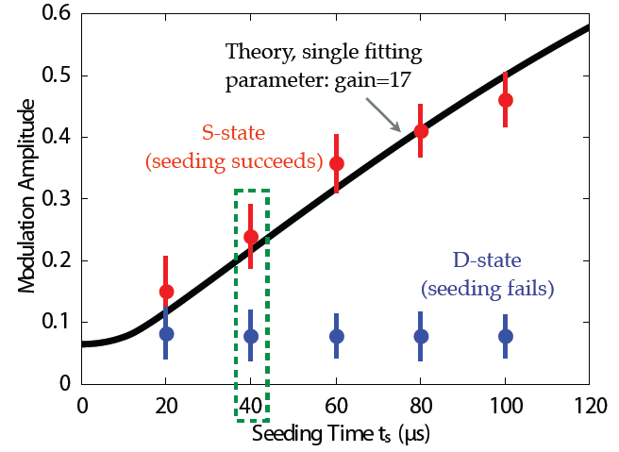

Proof of Principle
Yen-Wei Lin
Lin, et. al., Phys. Rev. A (R) (2013)
Chen, et. al. arXiv (2014)
~ 140 photons scattered here

Slide 41
When is One the Best Number?
Systematics can be excellent
As low as 10⁻¹⁸ (< mHz) level for vibrational spectroscopy, limited by BBR and trap-induced Stark shifts Schiller et al, Phys. Rev. A (2014)
Statistics can be surprisingly competitive
Classic supersonic beam (5 cm length)
    $ε=5×{10}^{−4}$
    N = 10
    $τ=1×{10}^{−4}$ s
  800 mHz $/\sqrt{D}$
Cryogenic beam (30 cm length)
    $ε=1×{10}^{−3}$
    N = $2×{10}^{5}$
    $τ=1.5×{10}^{−3}$ s
  $1 mHz/\sqrt{D}$
Single ion
    $ε=1$
    N = $1$
    $τ=1$s (…?)
  $0.6 mHz/\sqrt{D}$
$$δω=\frac{1}{\sqrt{ε N τ T}}$$
ε = detection efficiency
N = instantaneous number in apparatus,
in target quantum state
τ = coherence time
T = overall experiment time, D days
Note: $δω\sim 1/τ$ for dead-time limited experiments

Slide 42

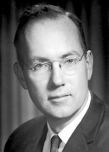
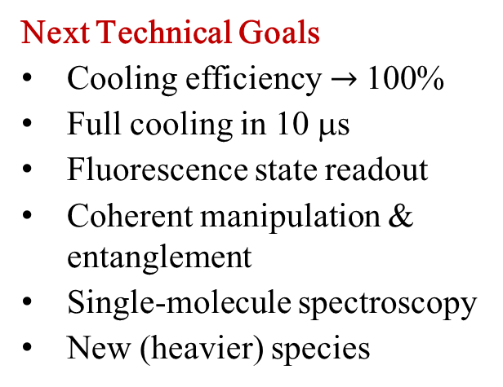
Summary & Outlook
Molecules are closer to becoming part of the quantum toolkit
Simple & efficient rotational cooling: 10 μs / 100 ms from 300 K
(Alternate optical cooling technique: ~10 s from 300 K)
Lots can be done with a few molecular species
  AlH⁺ & SiO⁺Applications
  Precision searches for new physics
  Quantum information processing
  Ultracold state-to-state chemistry
Next Technical Goals
Cooling efficiency$→$100%
Full cooling in 10 μs
Fluorescence state readout
Coherent manipulation & entanglement
Single-molecule spectroscopy
New (heavier) species
laser
[lā zər]
noun
1. a device that generates an intense beam of coherent monochromatic light by stimulated emission. Lasers are used in drilling and cutting, alignment and guidance, surgery, reading bar codes, in playing and recording compact discs, etc.
2. a tool in search of an application
- common wisdom, ca. 1960

Slide 43
Extras…

Slide 44





Narrowband Vibrational-Excitation Approach
  (Drewsen & Schiller groups)
$$A^{1}Σ$$
400 ns
$v=$2
$v=$ 1
100 ms
pump
$$X^{1}Σ$$
$v=$ 0
Electronic excitation
Vibrational excitation
Advantages
  Cool from 300 K with only 1 or 2 narrowband lasers
  Automatically keep population in v = 0
  Any polar hydride
Disadvantages
  Seconds timescale for rotational redistribution
  Hydrides only
Results
  MgH⁺: 37% in g.s., ~10 s (Drewsen group, Nat. Phys. 2010)
  HD⁺: 78% in g.s. ~10 s (Schiller group, Nat. Phys. 2010)

Slide 45
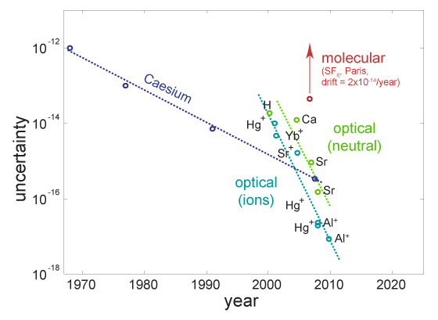
Precision Spectroscopy
Figure adapted from Til Rosenband
Notes:
Some sub

Slide 46


Laser Cooling of Trapped Atoms
$$P$$
Quantum Tools
Translational cooling
Single atom imaging
Internal state manipulation
$$S$$
0.8 mm
Notes:
How to map excitation

Slide 47
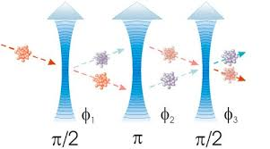
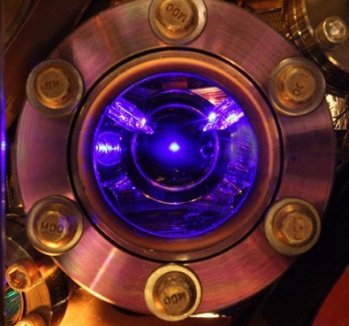



The Cold Atom Shelf of the Toolkit
With laser-cooling as the starting point…
Atom interferometers
Gyroscopes & accelerometers: navigation
Precision measurements: α, 5th forces, GR
Atomic clocks
GPS & other navigation
Tests for time-varying constants
Gravitational redshift
Ultracold quantum gases
Explore new quantum regimes
Model solid state phenomena
Quantum information processors
Computing
Simulation
Communication
Atom-nanoscale interfaces
Sub-optical lattice
Cavity QED
Atomtronics

Slide 48
The Rotational Cooling Landscape
Even for hydrides, many rotational states are populated at room temperature
Combine broadband & swept CW lasers (Orsay)
Easy add-on to vibrational broadband cooling
Needs to start with cold rotations
Narrowband vibrational excitation (Drewsen, Schiller)
Works for any polar hydride
Cooling from 300 K
Only works for hydrides
Slow
Buffer gas cooling (Doyle, Drewsen, Hudson, Wester)
Generality
Decoupling of coolants, motion, and molecules
Reset
Broadband rotational optical cooling (BROC) (Northwestern)
Fast cooling from 300 K
Applicable to non-hydride molecules
Easiest for specialized molecular structure
will compare these
State-selective trap loading (Willitsch, Cornell, various bialkali groups)
Supersonic expansion rotationally cools beams

Slide 49
The Plan: Optical Pumping
A photon carries one quantum of angular momentum
N
5
4
Excited manifold
3
2
Alfred Kastler
1
6
5
Ground manifold
4
3
2
1
0

Slide 50
Solution #1: Broadband Laser
Broad-spectrum light generally heats
However, pulse-shaping techniques allow tailoring of spectrum

Slide 51


milliKelvin Molecular Ion Research
(using sympathetic cooling)
… a few years ago
Michael Drewsen
Aarhus
Stephan Schiller
Dusseldorf
Molhave and Drewsen, PRA 62, 011401(R) (2000)

Slide 52
milliKelvin Molecular Ion Research
(using sympathetic cooling)
… today
Piet Schmidt
PTB
Michael Drewsen
Aarhus
Brian Odom
Northwestern
Yoshiki Moriwaki
Toyama
Tobias Schaetz
MPI-Garching
Stephan Schiller
Dusseldorf
Eric Hudson
UCLA
Ken Brown
Georgia Tech
Stephan Willitsch
Basel
Zhang Chaobo
Nanyang
Kunihiro Okada
Tokyo
Dzmitry Matsukevich
Singapore

Slide 53


Laser Cooling of Trapped Atoms
$$P$$
Quantum Tools
Translational cooling
Internal state manipulation
Single atom imaging
Applications
Ultracold quantum gases
Matter wave gyroscopes
Ultraprecise timekeeping
Quantum information processing
$$S$$
Notes:
How to map excitation

Slide 54

Summary & Outlook
Molecules are closer to becoming part of the quantum toolkit
Simple & efficient rotational cooling: 10 μs / 100 ms from 300 K
(Alternate optical cooling technique: ~10 s from 300 K)
Lots can be done with a few molecular species
Next Technical Goals
Cooling efficiency$→$100%
Full cooling in 10 μs
Fluorescence state readout
Coherent manipulation & entanglement
Single-molecule spectroscopy
New species
  AlH⁺ Applications
  Precision searches for new physics
  Quantum information processing
  Ultracold state-to-state chemistry
laser
[lā zər]
noun
1. a device that generates an intense beam of coherent monochromatic light by stimulated emission. Lasers are used in drilling and cutting, alignment and guidance, surgery, reading bar codes, in playing and recording compact discs, etc.
2. a tool in search of an application
- common wisdom, ca. 1960

