Slide 1


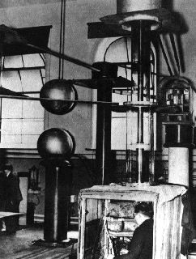
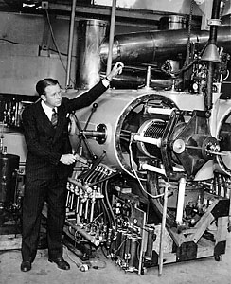
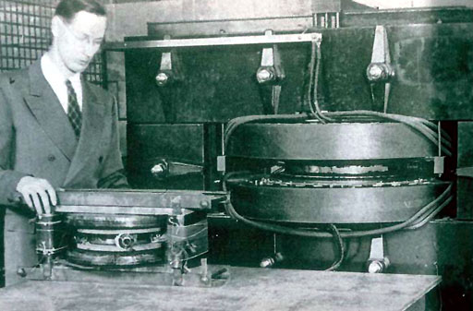
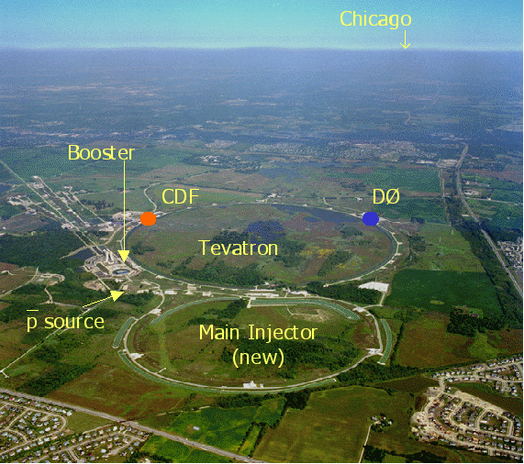
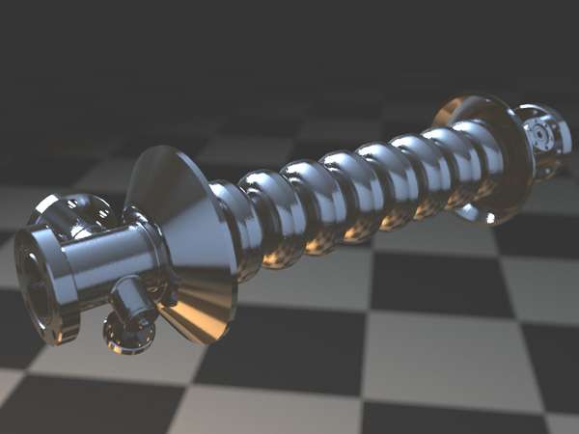
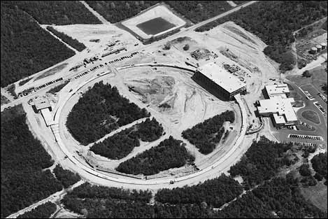
Advanced Structure and Plasma Based Particle Accelerators
Colloquium, Fermi National Accelerator Laboratory, June 17, 2015
Notes:
Walton and Cockroft (1929, 300kV); Ernest Orlando Lawrence’s 27-inch cyclotron (“proton merry-go-around”, 1931); Donald Kerst’s electron betatron (1941);
Alternative Gradient Synchrotron (AGS) at Brookhaven (33GeV protons, 1960); Fermi Lab’s Tevatron; ILC (??)

Slide 2
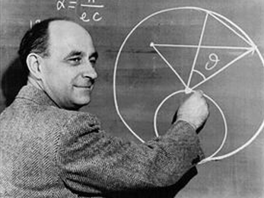
History of Accelerators: Higher Energies from Bright Ideas
“Fermi predicted that future accelerators would grow in power and size. They would not be built on the earth but around it, and physics laboratories would be in outer space… You may expect that at some future time accelerators will change the aspect of the earth and make it resemble the planet Saturn”, Laura Fermi, 1974.
Prediction: 20 TeV CM energy by 1994 at a cost of $170B
NB: SSC would have been 40 TeV CM if it was not cancelled in 1993 (!!)
“What can we learn with High-Energy Accelerators”, Retiring Presidential Address of APS, Columbia, 1954

Slide 3
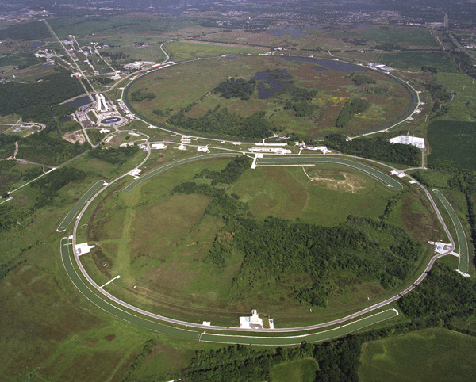
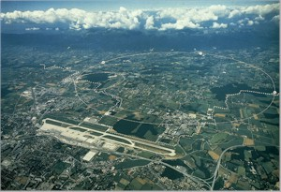
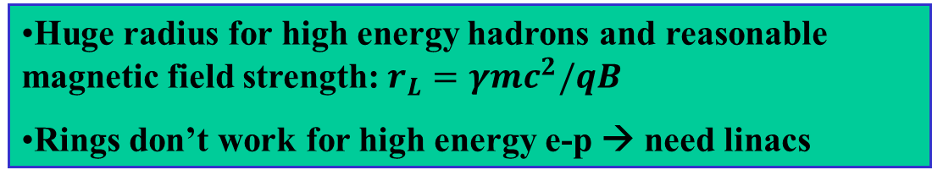
How to shorten an accelerator?
Tevatron: 1 TeV/7km proton/antiproton
LHC: 7 TeV/27km proton-proton
Huge radius for high energy hadrons and reasonable magnetic field strength: $r_{L}=γmc^{2}/qB$
Rings don’t work for high energy e-p → need linacs
Major problem: synchrotron radiation

Slide 4
Shorter Linacs With Higher Accelerating Gradients
SLC 2-mile linac: 50 Gev x 50 GeV collider with L = 10³⁰ cm⁻² sec⁻¹
Conventional linacs are very long: 30km for 500 GeV
Accelerating gradient in SC cavities: 32 MV/m
High gradient acceleration enables miniaturization

Slide 5
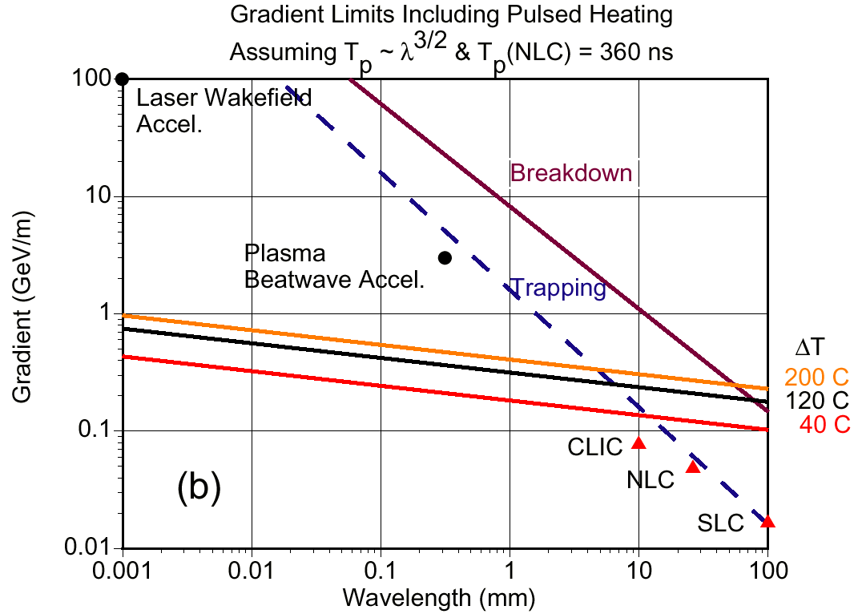
High accelerating gradients require high frequencies
E_{trap} = 10 MeV/m x f [GHz]
Highest frequency possible → laser driven advanced linear accelerators
Credit: David Whittum

Slide 6
The Basics of Laser Acceleration
Linear in electric field acceleration in vacuum is impossible (Lawson-Woodward-Palmer’s theorem)
photon
Cannot stop a photon in vacuum!
Slow electron
Fast electron
Near-field accelerators: possess non-radiative field components due to boundaries (inverse Smith Purcell, PBG, surface wave, plasma wakefield, …)
Far-field accelerators: electrons execute transverse motion in external DC fields (IFEL, inverse CARM, inverse Ion Channel Laser)
??

Slide 7
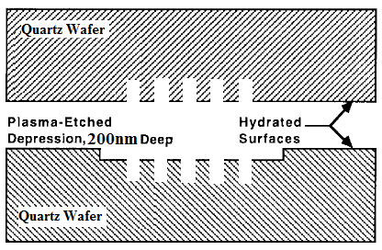
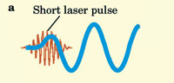
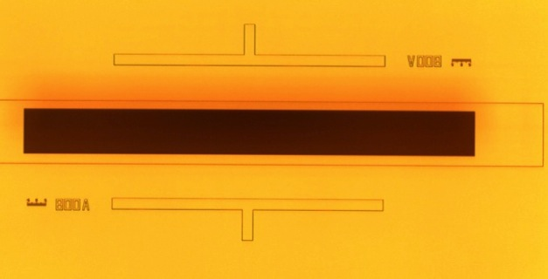
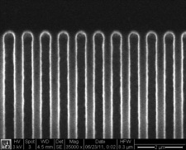
Near-field accelerators
Require boundaries (e.g. apertures in disc-loaded cavities) or a medium supporting non-radiative EM modes (Laser Wakefield Accelerator)
laser
e-beam
λ= 800 nm
E. A. Peralta et. al., Nature 503, 91 (2013)
T. Tajima & J. M. Dawson, PRL‘79

Slide 8
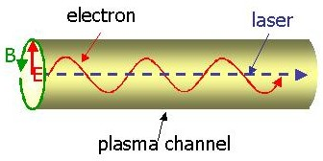
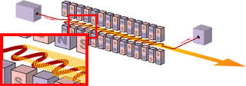

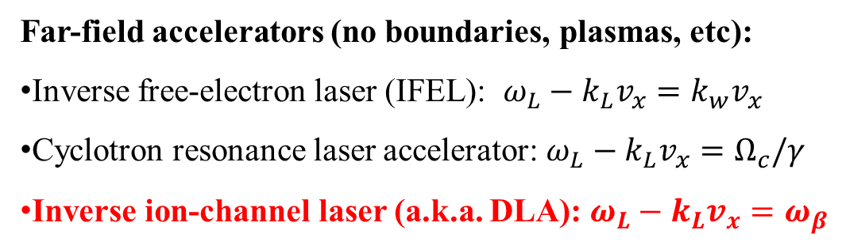
Far-field Accelerators
Far-field accelerators (no boundaries, plasmas, etc):
Inverse free-electron laser (IFEL): ${ω_{L}−k_{L}v_{x}=k}_{w}v_{x}$
Cyclotron resonance laser accelerator: ${ω_{L}−k_{L}v_{x}=Ω}_{c}/γ$
Inverse ion-channel laser (a.k.a. DLA): ${ω_{L}−k_{L}v_{x}=ω}_{β}$
Drawbacks: (a) accelerating gradient reduces with $γ$, (b) large transverse undulating motion, (c) difficult to maintain resonance condition
$$dγ/dz∝1/γ$$
IFEL curse

Slide 9
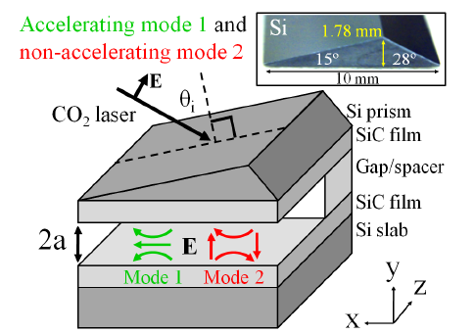
Outline of the Talk
Need for advanced laser-driven accelerators
Plasma based accelerators at ultra-relativistic laser intensities
  Blowing a plasma bubble: accelerating cavities at the speed of light
  Injecting into a plasma bubble
  The ultimate bubble at the Texas Petawatt
  Direct Laser Acceleration in a bubble
Surface Wave Accelerator Based on SiC
Challenges and Opportunities
B. Neuner III, D. Korobkin, G. Ferro, and G. Shvets, PRSTAB 15, 031302 (2012)
X. Wang et. al. (Ditmire, Shvets, Downer), Nature Comm. 4, 1988 (2013)
X. Zhang, V. Khudik, and G. Shvets, PRL 114, 184801 (2015)

Slide 10
How Advanced Accelerators Benefit from Plasma?
Plasma Accelerator:
  Disposable
  No breakdown
  No structure fabrication
  High frequency → high fields
  No need for external injectors → plenty of electrons in the plasma (?!)
Example: n₀=10¹⁸cm⁻³ eE = 100 GeV/m
In traditional (metallic) structures frequency is determined by feature size. In plasma – by its density.

Slide 11
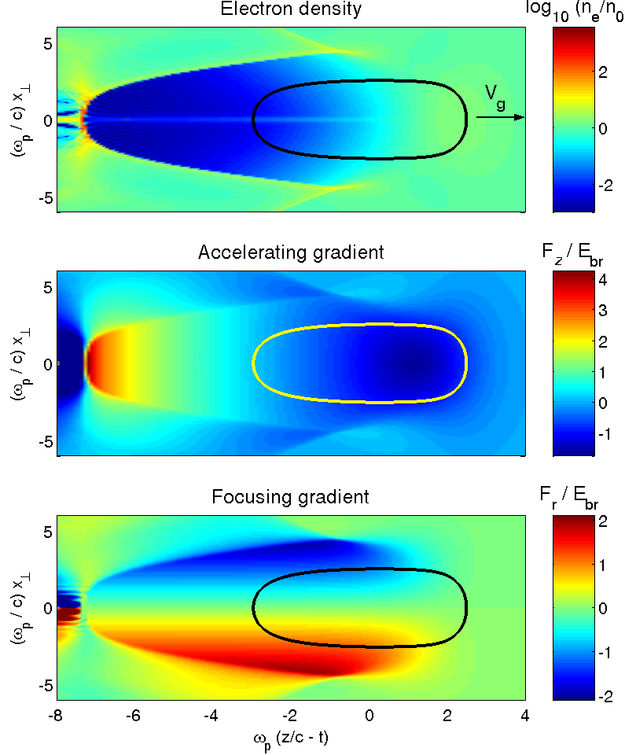
Ultimate nonlinear wake: bubble
sheath
Plasma transversely expelled by the ponderomotive pressure of the laser
Plasma-free bubble forms
Peak acceleration field can considerably exceed the non-relativistic wavebreaking limit
acceleration
deceleration
Focusing throughout the bubble → promising “immersion cathode”

Slide 12
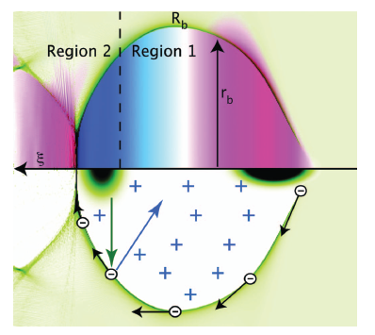
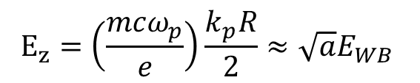

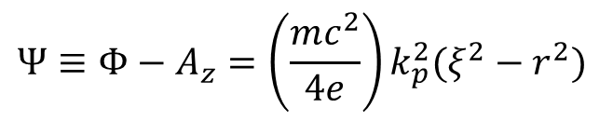
Beyond Wave-breaking Limit: The Bubble
Idealized spherical bubble:
$$Ψ≡Φ−A_{z}=\left(\frac{mc^{2}}{4e}\right)k_{p}^{2}(ξ^{2}−r^{2})$$
for
$$ξ^{2}+r^{2}<R^{2}$$
Fields inside a large bubble can considerably exceed the cold wave-breaking limit:
$$E_{z}=\left(\frac{mcω_{p}}{e}\right)\frac{k_{p}R}{2}≈{\sqrt{a}E}_{WB}$$
Wei Lu et. al., PRL’06; M. Tzoufras et. al., PoP ‘09.
Ponderomotive force of laser expels plasma electrons, balances Coulomb attraction of the ions:

Slide 13
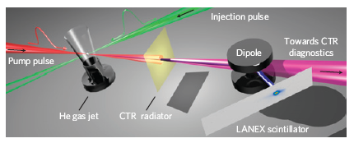
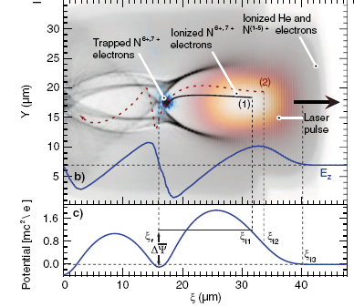
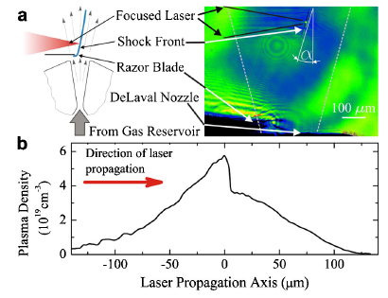
Plasma is an electron injector
Plasma can be used as a cathode → no need for external injectors → works for both LWFA and PWA
Injection from ambient plasma needs to be understood if you want to avoid it → dark current prevention in externally-injected plasma accelerators
Second pulse injection: O. Lundh et.al. (LOA team), Nature Phys. ‘11
Tunnel ionization of inner-shell electrons inside the wake for injection: A. Pak et. al., PRL’10
Use plasma density gradients: C. G. R. Geddes et. al., PRL ’08; K. Schmid et. al. PRSTAB’10

Slide 14
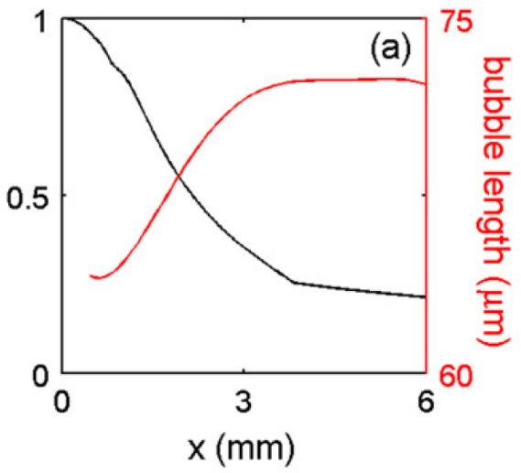
Self-injection from plasma into the bubble
Ultra-relativistic (γ₀ > 100) bubbles → electrons flow around the bubble
What if the bubble is allowed to evolve (expand or shrink)? Injection from plasma!
intensity
Electron sheath around the bubble→ trapping!
S. Kalmykov et. al. PRL 103, 135004 (2009); S.A.Yi et. al., Plasma Phys. Cont. Fusion 53, 014012 (2010)
Parameters: P=1.33 PW, λ=1.054 μm, T=150 fs, r=80 μm, n=2.5×10¹⁷ cm⁻³
Normalized: a=3.3, k_{p}r₀=7.5, ω_{pe}τ_{L}=4.23, P/P_{cr}=19

Slide 15
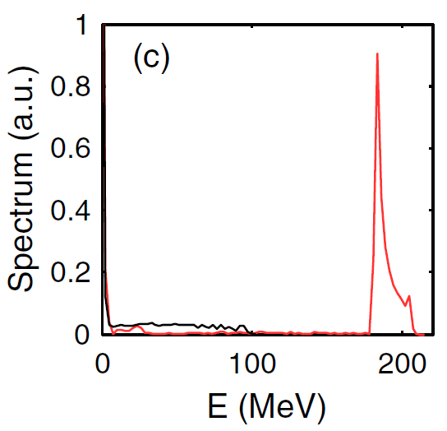
Generation of mono-energetic beams: bubble expansion followed by stabilization
The beam becomes mono-energetic due to bubble expansion up to x=3mm → earlier injected electrons experience weaker field → phase space rotation
x = 2mm
x = 5mm
late injection
x = 5mm
x = 5mm
monochromatic beam emerges
phase space rotation
early injection
x = 2mm: energy spread
x = 2mm

Slide 16
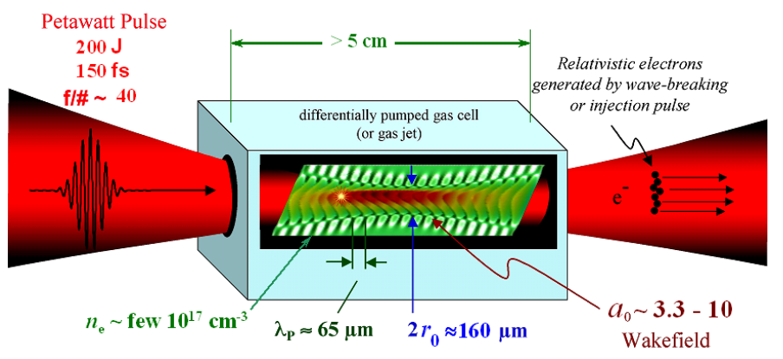
Self-injection and acceleration of mono-energetic 2 GeV electrons at the Texas PW (experiment: M. Downer and the PW Team)
X. Wang et. al. (Ditmire, Shvets, Downer), Nature Communications 4, 1988 (2013)

Slide 17
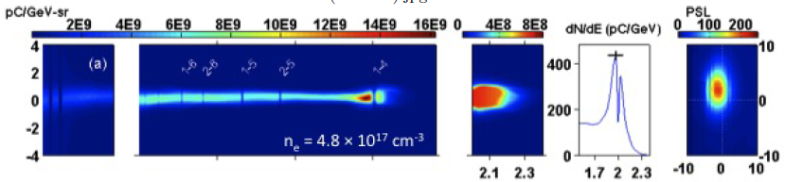
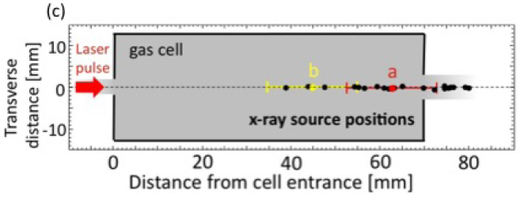
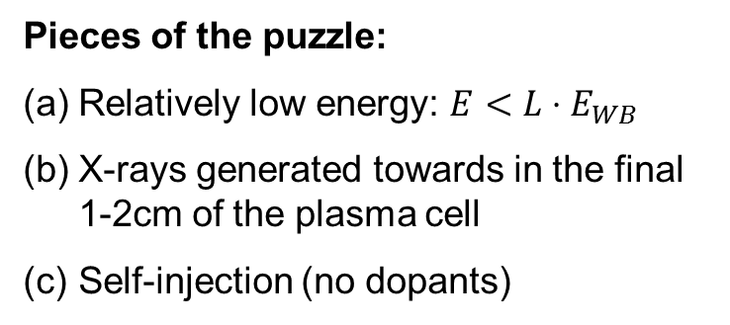
Self-Injected 2-GeV Electrons on TPW: Experimental Results
Pieces of the puzzle:
Relatively low energy: $E<L⋅E_{WB}$
X-rays generated towards in the final 1-2cm of the plasma cell
Self-injection (no dopants)
When are electrons injected? Through what mechanism? Why are X-rays generated towards the end of the gas cell? What was the accelerating gradient?

Slide 18
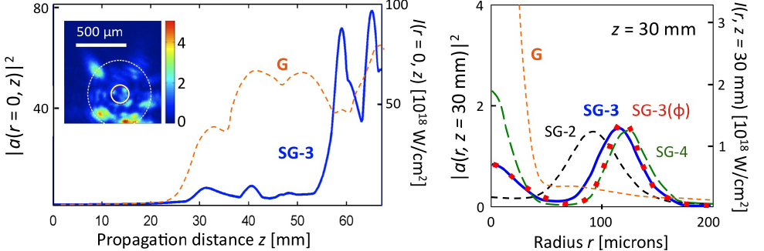
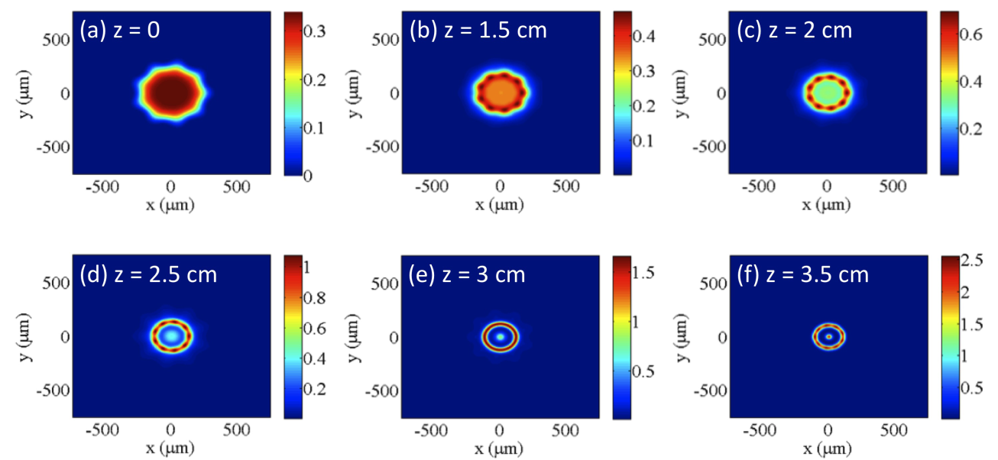



Self-Focusing of the TPW: Modeling
Beam’s shape matters: Gaussian vs super-Gaussian
$$n_{e}=5×{10}^{17}cm^{−3}$$
SG beams develop a Airy-like rings early on → late and rapid focusing → bubble formation and injection
$$P/P_{c}=20$$
$$w_{o}=275μm$$
Low-power profile
The actual amplitude/phase of the beam are unknown
Topological changes due to nonlinear self-focusing is possible: from multiple hot spots to central peak

Slide 19
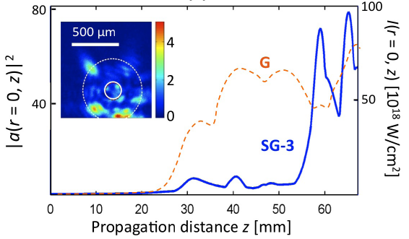
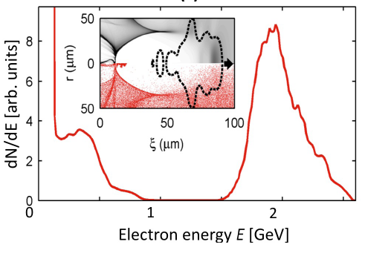
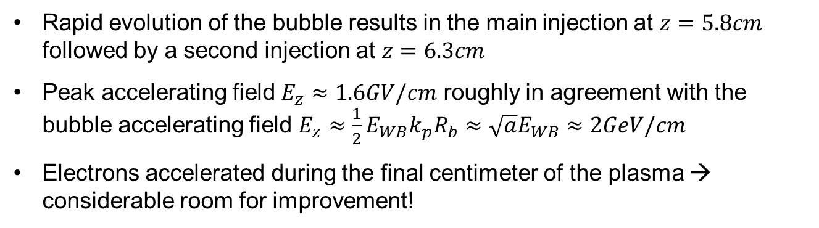
Self-Injected 2-GeV Electrons on TPW: Theoretical Modeling
Rapid evolution of the bubble results in the main injection at $z=5.8cm$ followed by a second injection at $z=6.3cm$
Peak accelerating field $E_{z}≈1.6GV/cm$ roughly in agreement with the bubble accelerating field $E_{z}≈{\frac{1}{2}E}_{WB}k_{p}R_{b}≈\sqrt{a}E_{WB}≈2GeV/cm$
Electrons accelerated during the final centimeter of the plasma → considerable room for improvement!
X. Wang et. al. (Ditmire, Shvets, Downer), Nature Comm. 4, 1988 (2013)

Slide 20
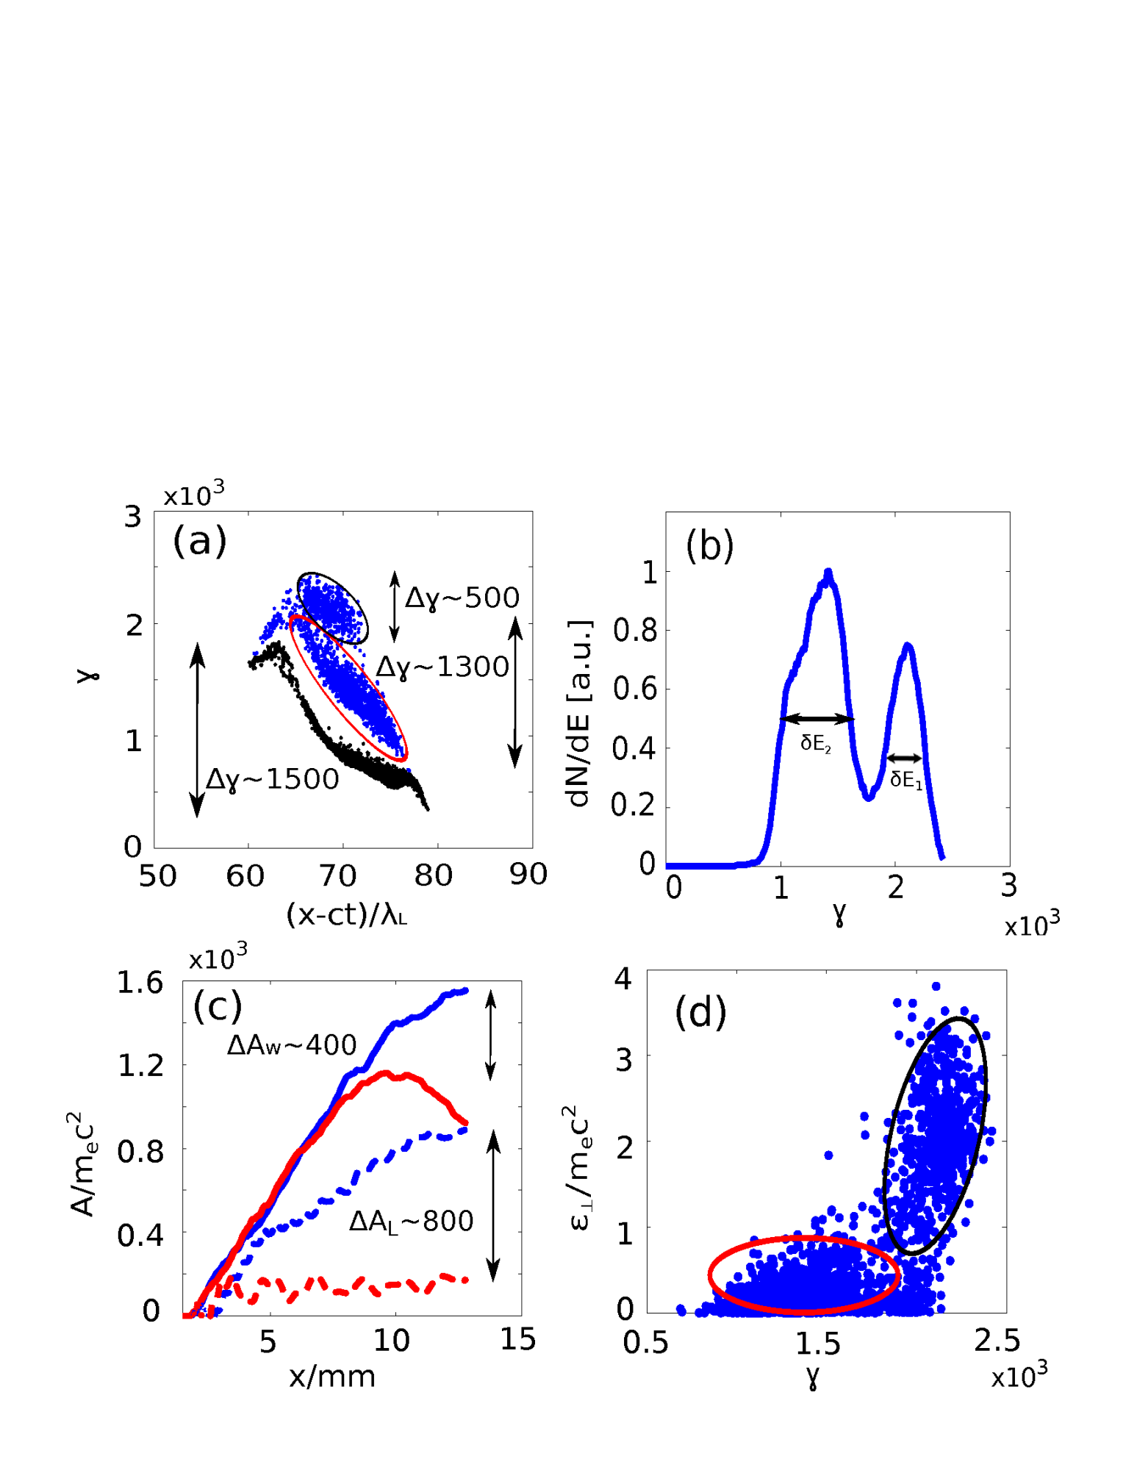
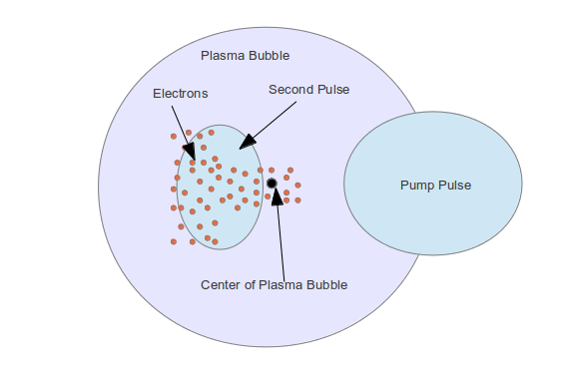

Hybrid Laser Wakefield/Direct Laser Acceleration
$$γ×{10}^{3}$$
Combine far-field and laser-wakefield acceleration mechanisms to mitigate slippage between ultra-relativistic electrons and the plasma bubble → more energy from wake, some energy from laser!
X. Zhang, V. Khudik, and G. Shvets, Phys. Rev. Lett. 114, 184801 (2015)

Slide 21
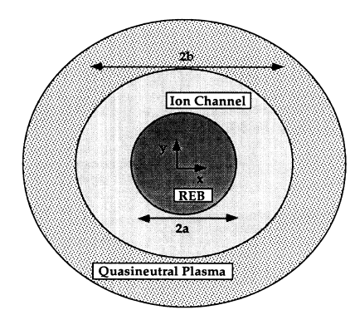
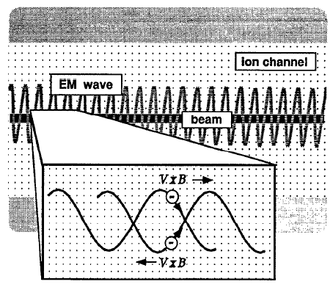
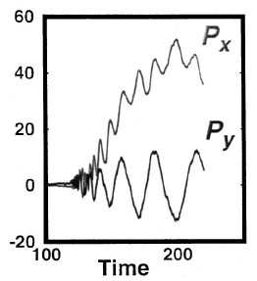
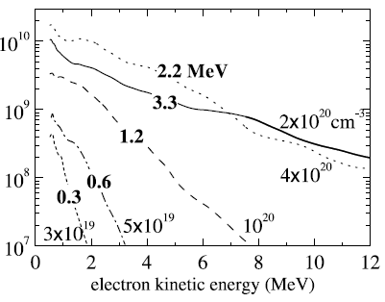
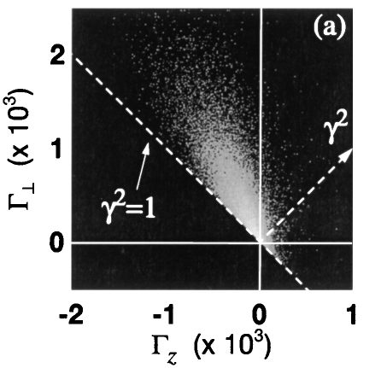
DLA History: From Plasma Channels…
Dave Whittum, Andy Sessler, and John Dawson invent an ion channel laser
D. H. Whittum et. al., PRL’90; Phys. Plasmas ‘92
The MPQ team proposes and realizes the inverse ion channel laser
A. Pukhov et. al., PoP’99; C. Gahn et. al., PRL’99

Slide 22
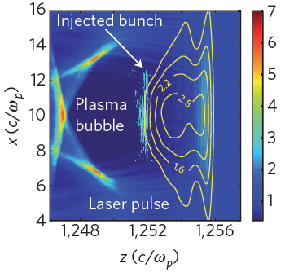
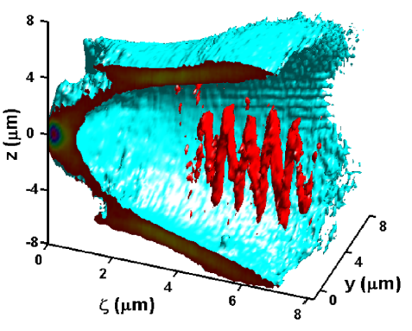
…to Plasma Bubbles!
Dino Jaroszynski produces MeV Gamma rays, possibly via DLA mechanism inside a bubble!! S. Cipiccia et. al., Nature Physics’2011
“In fact, this observation of high harmonic generation could provide the first (albeit somewhat indirect) experimental evidence of DLA, which has so far been elusive.” G. Shvets, Nature Physics’2011
A great deal of theoretical work: Nemeth, et al., PRL’07, PRL; Phuoc, et al., PoP’08, J. L. Shaw et. al., PPCF’14
Big questions: (a) monochromatic beam? (b) best laser pulse format? (c) best injection approach? (d) major paradigm shift of LPAs in the making??

Slide 23
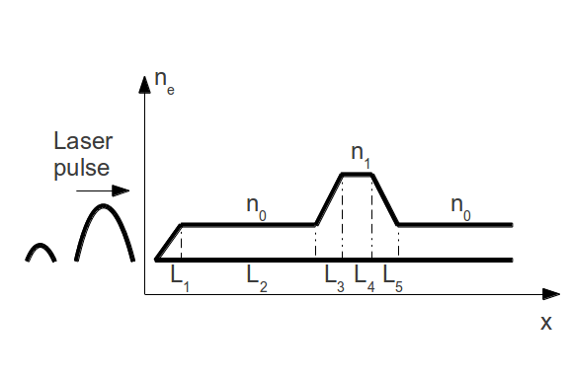
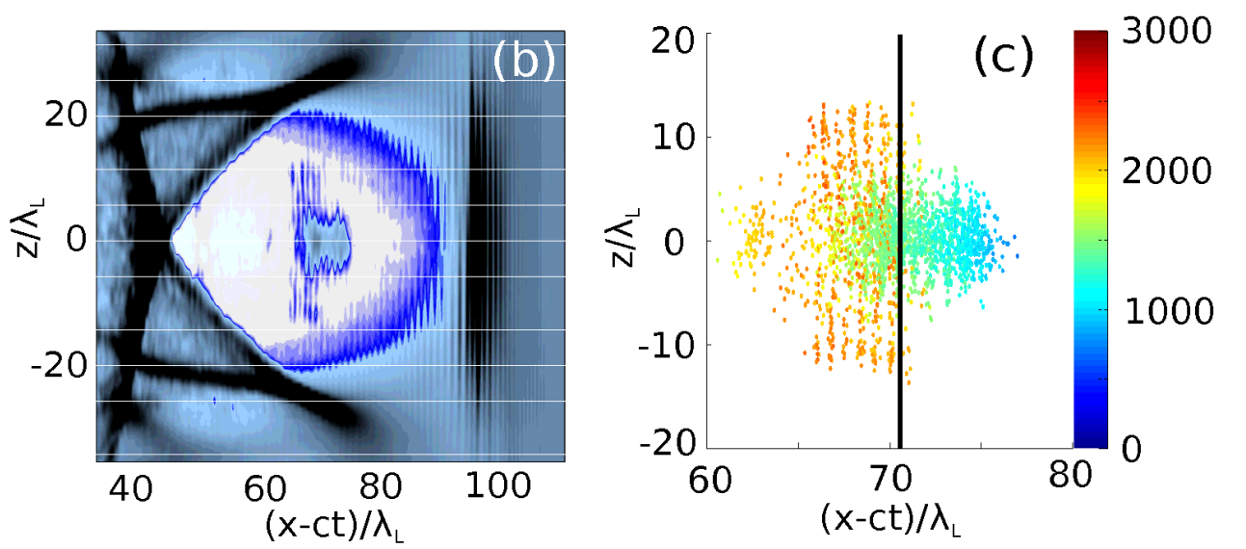



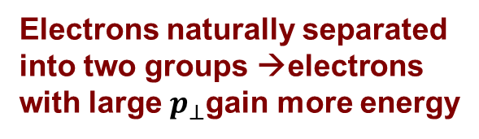
Ultra-relativistic DLA: PIC Simulations
Pump pulse creates a bubble
I₀=2×10¹⁹w/cm^{2;} I₁=4×10¹⁸w/cm²
n₀=1.8×10¹⁸cm^{-3;} n₁=5.4×10¹⁸cm⁻³
$$λ=0.8μm$$
Electrons are self-injected and interact with weaker laser pulse delayed by Δτ=80fs
Electrons naturally separated into two groups →electrons with large $p_{⊥}$gain more energy
delay:80fs
L₂ =1.6mm, L₃ = L₄ = L₅ $≈100μm$
after 1cm propagation
Density bump “shakes” the bubble → side-injection with large $p_{⊥}$→ enables DLA
Pump: $a_{0}=3, τ_{0}=70fs$, $w_{0}=20μm$
Trailing Probe: $a_{0}=1.3$, $τ_{0}=35fs, w_{0}=20μm$

Slide 24
2D PIC simulation of DLA/LWFA
with DLA pulse
non-DLA
DLA
w/o DLA pulse
Strong phase space bifurcation → high-energy DLA electrons are spatially separated from lower-energy non-DLA electrons
Two-peak energy distribution separated by 400 MeV
Bifurcation is absent when the DLA pulse is absent
Notes:
first introduce three plots and one gif.

Slide 25



Synergistic Laser Wakefield/Direct Laser Acceleration: Dephasing Suppression
DLA electrons → strong correlation between total energy $γmc^{2}$ and transverse energy $ε_{⊥}=\frac{p_{z}^{2}}{2γm}+\frac{{mω}_{p}^{2}z^{2}}{4}$
DLA
non-DLA
$$\frac{dζ}{d(ct)}≈\frac{1}{2γ_{b}^{2}}− \frac{1+\left\langle p_{⊥}^{2}{/m}_{e}^{2}c^{2}\right\rangle }{γ^{2}}$$
Strong bifurcation in ${(ε}_{⊥},γ)$ phase space
Synergy between DLA and LWFA → higher energy gain from the wake for the DLA population ← delayed dephasing!
DLA electrons gain extra 200 MeV from the wake and extra 400MeV from the laser (DLA)
X. Zhang et. al. PRL 114, 184801 (2015)
Notes:
first introduce three plots and one gif.

Slide 26







Laser Accelerates, Wake Decelerates?
Deceleration phase
$λ_{1}=0.8μm$ pulse:
$P_{1}=170$TW ($a_{1}=6$)
$τ_{1}=35$fs, $w_{1}=12μ$m
$$n_{0}=4×{10}^{18}cm^{−3}$$
External injection into the decelerating phase
$$p_{x0}=25m_{e}c$$
Gain from laser
The wake decelerates the electrons, but the DLA accelerates them at more than twice the deceleration rate!
What about the “IFEL curse”: $dγ/dz∝1/γ$ ?
Loss to wake

Slide 27















One Step Back, Two Steps Forward: Constant Gradient Direct Laser Acceleration
Initial conditions
$$E_{W}=−40GeV/m$$
Model: constant decelerating field $E_{W}$
Multiple DLA harmonics:
$a_{L}=2$, $v_{p}=c$
$$N=5$$
$$ω_{L}\frac{1+\left\langle {p_{z}^{2}}/{m^{2}c^{2}}\right\rangle }{2γ^{2}}=$$
$$N=3$$
$$=N\frac{ω_{p}}{\sqrt{2γ}}$$
$$N=1$$
$$N=1$$
Transverse energy growth
$$N=3$$
$$N=5$$

Slide 28





How the entire LPA paradigm may be changed by Direct Laser Acceleration
Synchronization of externally injected beam is the key to injecting into the decelerating phase
The main role of the bubble is not accelerate but to provide focusing field to undulating electrons
Excellent source of X-ray and Gamma-ray radiation because of the large undulator parameter ${K=p}_{⊥}/mc$
$$K$$
$$ω_{c}∼2γ^{2}ω_{β}\frac{K^{3}}{1+K^{2}}∼{K^{3}ω}_{L}$$

Slide 29
Surface Wave Accelerator and Radiation Source Based on Silicon Carbide
B. Neuner III, D. Korobkin, G. Ferro, and G. Shvets, PRSTAB 15, 031302 (2012).

Slide 30



Wakes at the $ε<0/ε>0$ double interface
z
$∼$10 μm
Supports ω = kc mode → can accelerate relativistic particles
Almost like a hollow channel PWA, except there is no plasma: optical phonons!
Can be used as a Surface Wave Accelerator Based on SiC (SWABSiC), or
Diagnostics for ultra-short bunches → Coherent Surface Cherenkov Radiation
x
SiC/vacuum SPP’s are excitable by either short bunches and bunch trains (“PWA”) or by a CO₂ laser (direct acceleration)

Slide 31

Modes Supported by SWABSiC
Accelerating (longitudinal) mode
Deflecting (transverse) mode
Phase velocity of the mode:
SiC
SiC
6 μm
SiC
SiC
Super-luminous modes cannot interact with beam
Sub-luminous modes propagate at finite angle with beam (“Cherenkov modes”)
Direct laser excitation → through a prism because the gap is too narrow
Super Luminous
SubLuminous

Slide 32
SWABSiC fabrication: SiC-on-Si growth
Step 1: Grow 1.7 μm of SiC
Si “brick”
Step 2: Spin-coating of 10 µm of PMMA (photoresist) and development/patterning
Step 3: Final Assembly
Accelerator in a pocket…
But not in a wafer holder!
6 µm gap

Slide 33





Optical Characterization of SWABSiC
To Power meter or IR camera
Reflected Beam
Refracted Beam
From Laser
Si
SiC
SiC
Si

Slide 34



Beam-Driven Wake in SWABSiC
y
Cherenkov Wake in SWABSiC
x
To spectrometer
To IR camera
y
$$v_{ph}<c$$
Si
V_{b}
θ
z
Si
x
$$v_{b}>v_{ph}$$
Cherenkov Surface Wake can be excited either by a single short (<30fs) bunch, or by a micro-bunched beam
Can be diagnozed either optically or through energy gain/loss

Slide 35
Outline of the Talk
Need for advanced laser-driven accelerators
Plasma based accelerators at ultra-relativistic laser intensities
  Blowing a plasma bubble: accelerating cavities at the speed of light
  Injecting into a plasma bubble
  The ultimate bubble at the Texas Petawatt
  Direct Laser Acceleration in a bubble
Surface Wave Accelerator Based on SiC
Challenges and Opportunities
B. Neuner III, D. Korobkin, G. Ferro, and G. Shvets, PRSTAB 15, 031302 (2012)
X. Wang et. al. (Ditmire, Shvets, Downer), Nature Comm. 4, 1988 (2013)
X. Zhang, V. Khudik, and G. Shvets, PRL 114, 184801 (2015)

Slide 36




Acknowledgements
Postdocs/Staff:
Vladimir Khudik Dmitriy Korobkin Simeon Trendafilov
PhD Students
Kueifu Lai Xi Zhang Burton Neuner Austin Yi

Slide 37


Meet our group!
Postdocs & Research Staff:
S. Trendafilov (plasma: theory) V. Khudik (plasma: theory) A. Khanikaev (photonics: th)
PhD Students:
Y. Urzhumov (Russia) → ’08 B. Neuner III (USA)→ PhD’11 C. Fietz (USA)→PhD’11 H. Moussavi (Iran)→PhD’12 C. Wu (Taiwan)→PhD’12 Nima Dabidian (Iran) Austin Yi (USA) →PhD’12 Nihal Arju (India) Glen Kelp (Estonia) Kueifu Lai (Taiwan) Xi Zhang (PRC) Carl Siemon (USA) Tzuhsuan Ma (Taiwan)

Slide 38


SWABSiC Fabrication
Step 1: cutting Si discs (D=5cm, t=5mm) into 22x12x5 mm slabs
Step 2: growth of 1.7 μm SiC in Lyon, France
Step 3: cutting Si slabs into prisms (ISP Optics)
28º angle
20 mm
15º angle
1.78 mm
10 mm

Slide 39

Laser-excited wakes for many wavelengths
λ = 11.310 μm
λ = 11.128 μm
λ = 11.065 μm
λ = 10.850 μm
λ = 10.784 μm
λ = 10.723 μm
Accelerating wake
Deflecting wake
Both accelerating (good) and deflecting (parasitic) wakes are experimentally observed
The focus at will be beam-driven wakes
Wakes must be sub-luminal to be excited by the bunch

