Slide 1
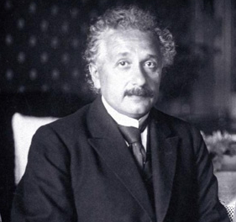
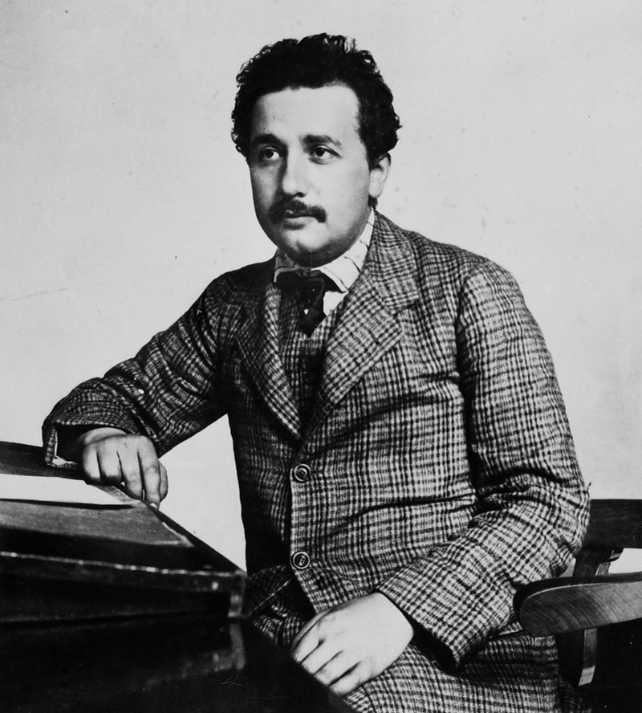
Einstein and quantum mechanics:
It’s not what you think
A. Douglas Stone – Yale University, Applied Physics
Fermilab – 4/22/15
“Quantum mechanics is very impressive. But an inner voice tells me that it is not yet the true Jakob. The theory produces a good deal but hardly brings us closer to the secrets of the Old One. I am at all events convinced that He does not play dice…
Einstein to Born, December 1926
“The other great problem that I have concerned myself with since 1900 is that of radiation and the quantum theory… I have helped create the complex of ideas known by the name of quantum theory…I shall probably devote the rest of my life to the clarification of this problem, however slight the prospects for attaining the goal may be. “
Einstein, 1924
“I have thought a hundred time as much about the quantum problems as I have about Relativity Theory”, Einstein to Otto Stern
“Einstein would be one of the greatest theoretical physicists of all times even if he had not written a single line on relativity”, Max Born
“This quantum question is so enormously important that everyone should be working on it”, Einstein, 1908

Slide 2
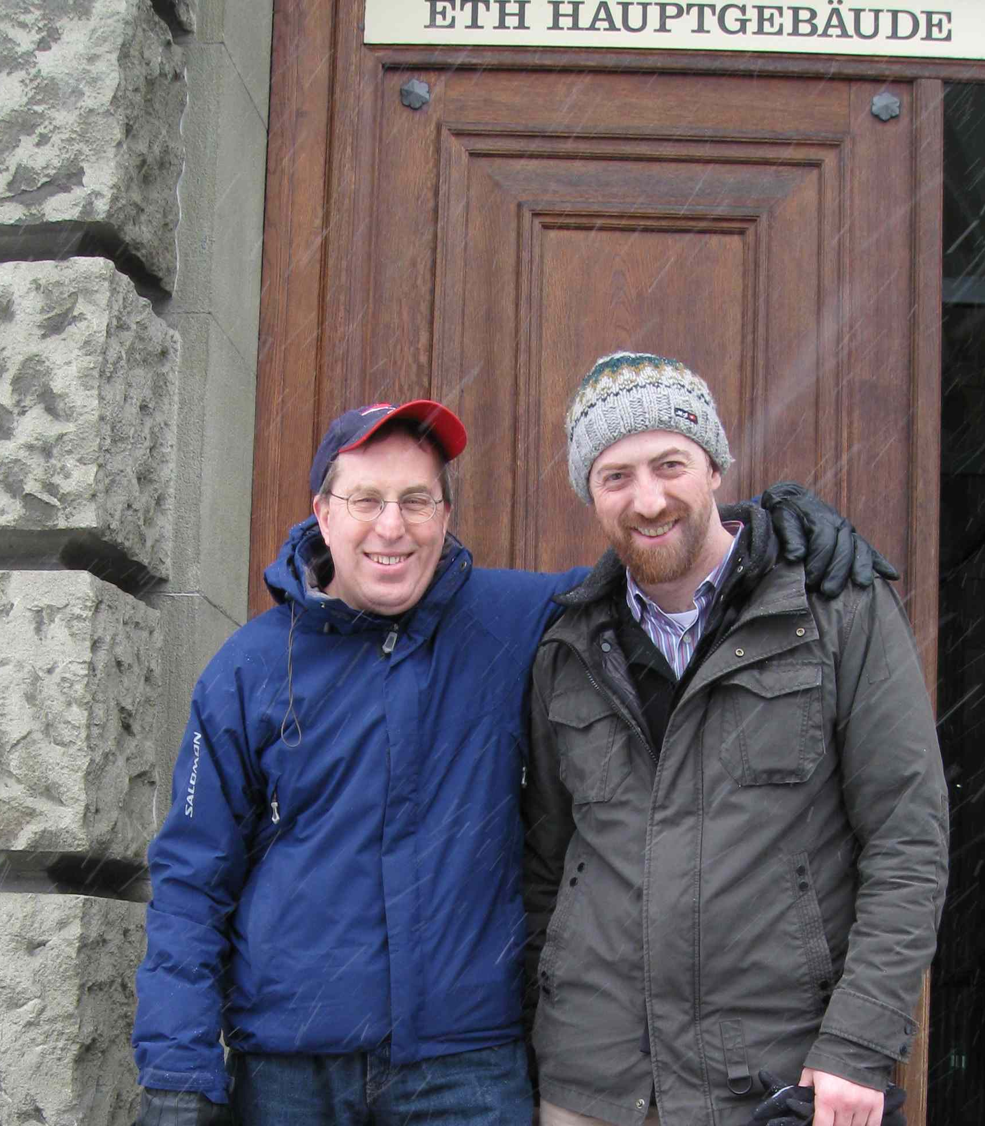
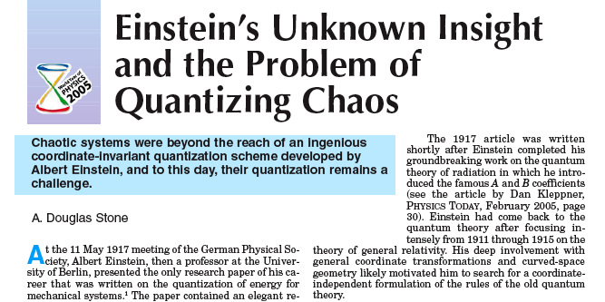

“Let’s see if Einstein can solve our problem?
I knew a lot about one tiny corner of Einstein’s work
But other people didn’t know that… and it was 2005
I had to cram and was surprised by what I found

Slide 3
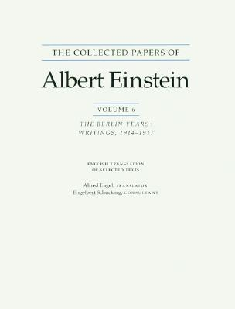
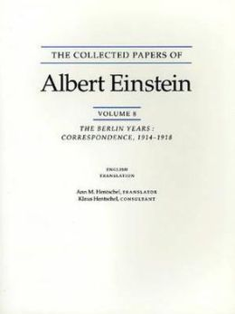
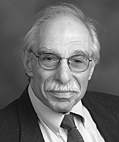
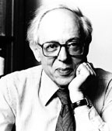

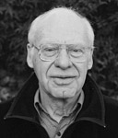
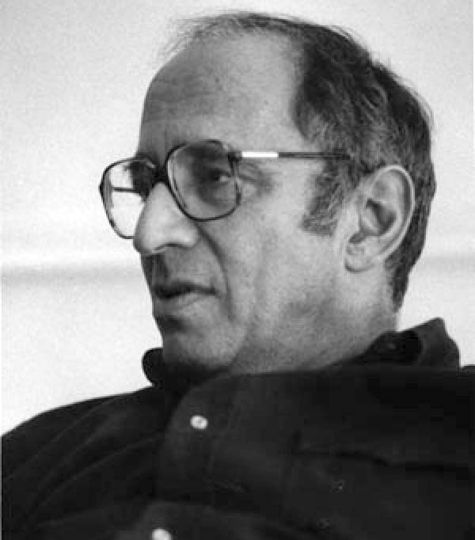
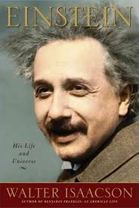
Eight years later…
Martin Klein
Abraham Pais
Folsing
John Stachel
T.S. Kuhn
Isaacson
What did I find?

Slide 4
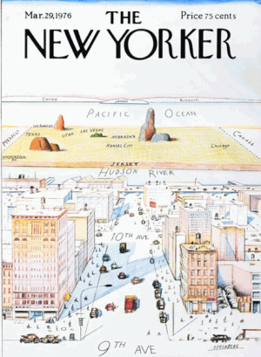
Why was Einstein’s Quantum Theory even more important than Relativity?
Die
Die
Natur Forscher
Natur Forscher
Quantum
Quantum
Relativity
Relativity
Quantum
Understanding the atom was a turning point in history

Slide 5
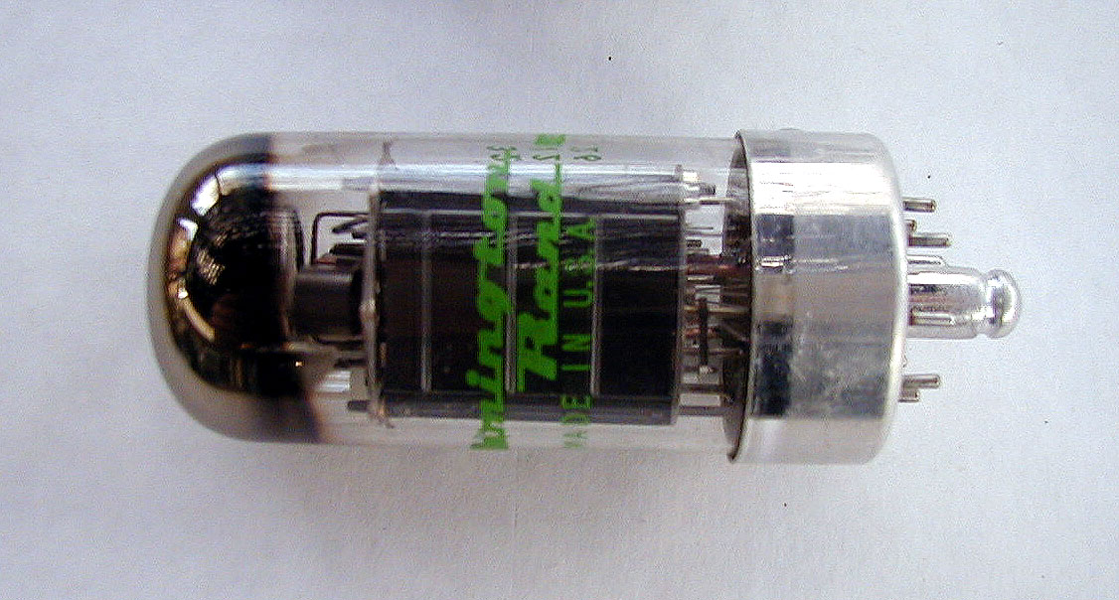
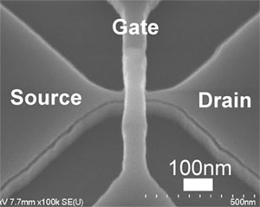
Old and New Electronics
Electronics made from individually assembled components
Electronics embedded into the materials at the micro scale –
requires understanding of quantum structure of matter
Notes:
At the beginning of the new century mankind faced the ultimate challenge. Science and technology ground to a standstill as the
elusive atom held tightly it secrets.
One man alone, The Valiant Swabian, understood what was needed… Revolution. This is his story

Slide 6
Einstein Scientific Timeline
1902-1905
Bern patent office
The Miracle Year
(1905)
1906-7
Bern patent office
1908-10
Bern patent office
Univ. Zurich
Univ. Prague
1911-15
ETH Zurich
Univ. Berlin
Foundations of Stat mech
Quanta of Light
Special Relativity
E=mc²
Brownian Motion
Quantization of Energy
Quantum Theory of Solids
Equivalence Principle
(seed of GR)
Wave-particle Duality
Unsuccessful Quantum Theory of Radiation
General Relativity
Geometric Interpretation of Gravity

Slide 7
Einstein Scientific Timeline
1916-18
Univ Berlin
1919
Univ Berlin
1920-23
Univ Berlin
1924-5
Univ. Berlin
Quantum Theory of Radiation
Randomness in Nature
Gravitational Waves
Cosmology
Eclipse Expedition
confirms GR
Worldwide Fame
Many travels and distractions
Nobel Prize
Begins search for Unified Field Theory
Quantum theory of ideal gas – BEC

Slide 8
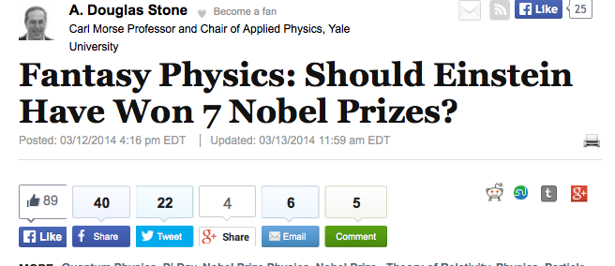
Einstein Scientific Timeline
1926-32
Univ. Berlin
1933-1955
Princeton IAS
Rejection of Quantum Mechanics
Arguments with Bohr et al.
EPR Paper (entanglement)
Failed Attempts at classical Unified Field Theory
=> Einstein introduced many (most?) of the conceptual foundations of quantum theory
20 years: 1905-1925, The most productive in the history of science

Slide 9
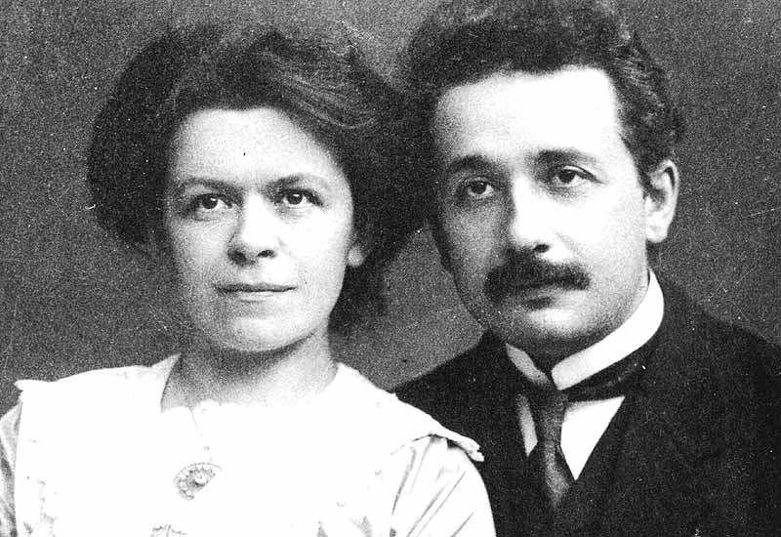
Brief Sketch of Einstein’s Bio before 1905
Born in 1879, Ulm Germany, middle-class Jewish family, Parents Hermann and Pauline Einstein, father and uncle were electrical engineers
Excellent student, but perceived as arrogant, drops out from German high school at age 14, “your mere presence here …”
Self-schools for Zurich Poly, teaches himself calculus, after initial failure in entrance exam is admitted to physics section (1896), excels for first 2 years.
Disappointed at lack of modern topics, stops attending class, infuriates his professors, barely gets degree (1900) and is refused an academic assistant position.
Ekes out a living for next 2 years before getting job at patent office in 1902 due to influence of his former classmate, Marcel Grossmann.
Marries Mileva Maric, Serbian fellow student, who did not pass the degree exams.
Continues has physics studies and publishes several papers on statistical mechanics, similar to Gibbs, while working in patent office from 1902-1904
Forms “Olympia Academy” with friends, Maurice Solovine, Conrad Habicht and Michele Besso, to discuss philosophy, literature and science
“I am a cheerful fellow…and have no talent whatsoever for melancholic moods”
“The Valiant Swabian is not afraid”

Slide 10
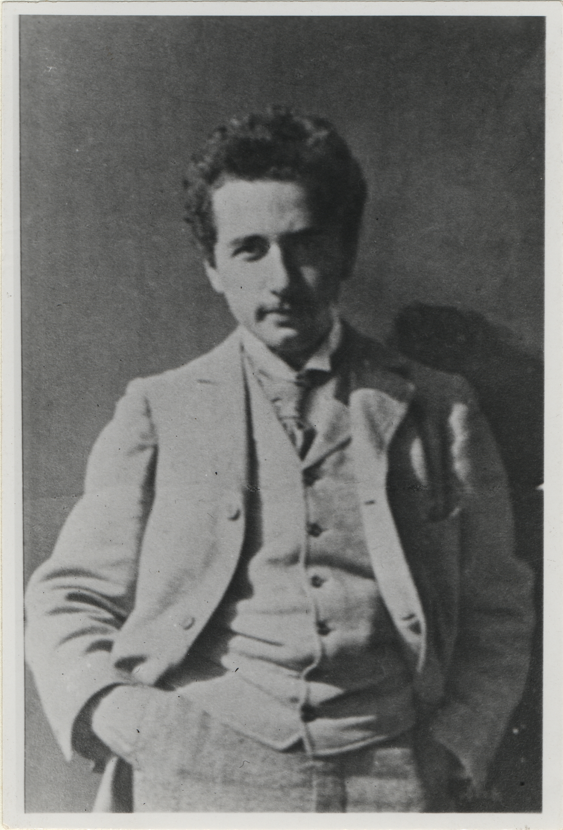
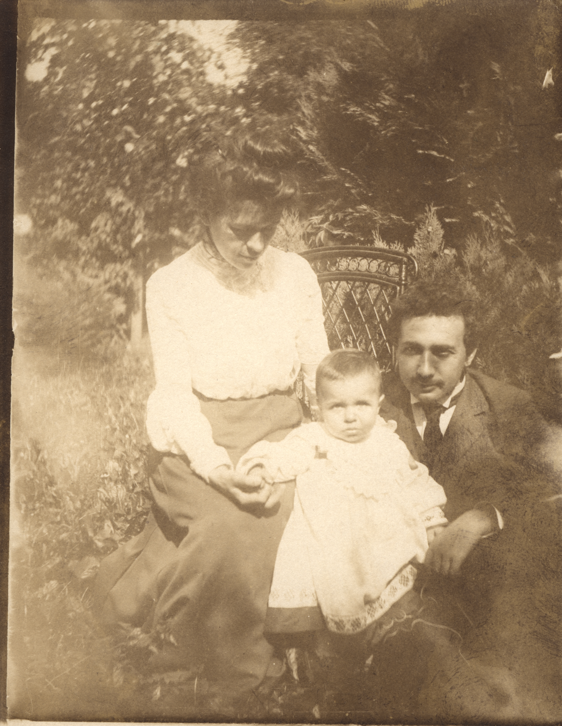
Student at ETH (1898)
Young father, Bern (1904)

Slide 11
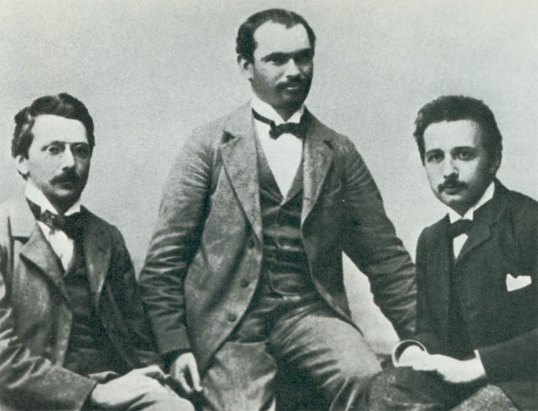
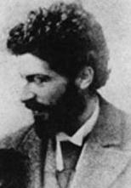
The Olympia Academy
Maurice Solovine
Conrad Habicht
Albert Ritter von Steissbein
MIchele Besso
Notes:
“Man of Hechingen…expert in the noble arts…steeped in the revolutionary science of the cosmos, bursting with knowledge of natural things…powerful guide to those fabulous molecules…

Slide 12
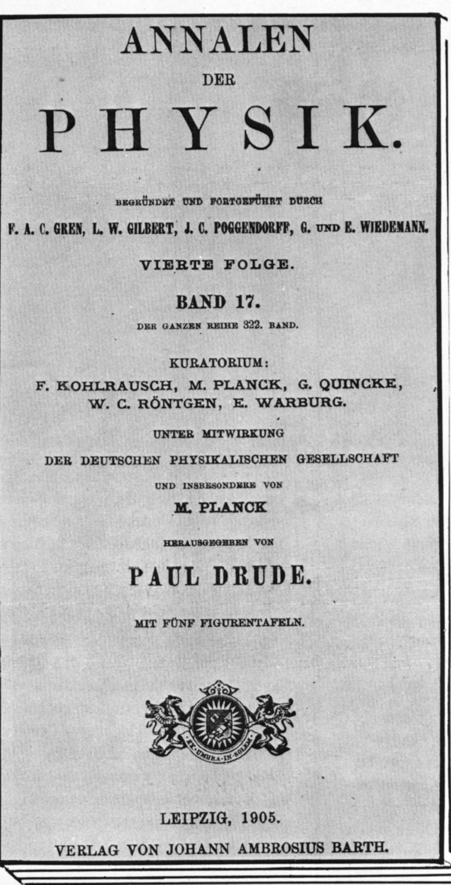
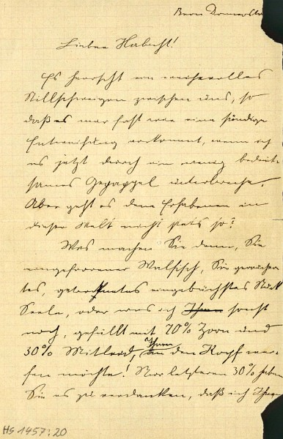
1905 – The Miracle Year
March 1905: Einstein announces his achievements to Habicht:
Dear Habicht, such a solemn air of silence has descended between us that I almost feel as if I am committing a sacrilege when I break it now with some inconsequential babble…
I promise you four papers in return, the first deals with radiation and the energy properties of light and is very revolutionary…
The fourth study is still a mere concept: the electrodynamics of moving bodies by the use of a modification of the theory of space and time.”
Very Revolutionary
Notes:
So what are you up to you frozen whale, you smoked, dried, canned piece of soul…? Why have you not sent me your dissertation? Don’t you know that I am one of the 1^{1/2} fellows that would read it with pleasure, you wretched man?

Slide 13
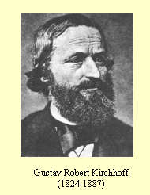
Blackbody Radiation and Planck’s Law
infrared
If all incident radiation is absorbed at all ν => blackbody
Kirchoff (1860): The energy emitted by a BB at frequency ν is described by a universal mathematical function ρ(ν, T) = the law of thermal radiation
“It is a highly important task to find this function. Great difficulties stand in the way of its experimental determination… (Kirchoff)
Best experimental realization was a cavity with a small hole
heated to high T

Slide 14
Modern point of view on BB Law
=> Just a photon gas in thermal equilibrium
polarization/spin
energy per photon
# of photon at T for
each state ν
# of photon states with frequency ν
Rayleigh Law
kT >> hν
hν>>kT
Wien’s Law
Historically, Wien’s “Law” known first

Slide 15
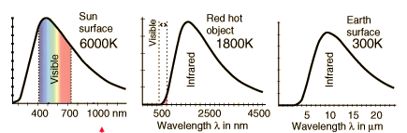
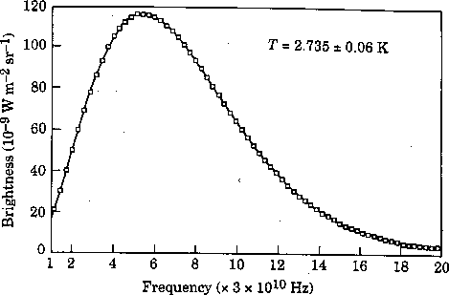
ρ
ρ
ρ
“It would be edifying if the brain matter sacrificed by theoretical physicists on the altar of this universal function ρ could be put on the scales; and there is no end in sight to this cruel sacrifice!” Einstein, 1913
What is he talking about?
Cosmic BB(microwave) background

Slide 16
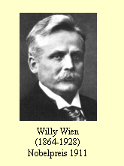
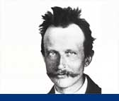
Wien’s Law (1896), conjecture motivated by Maxwellian distribution
Max Planck, professor in Berlin, sets out to derive the radiation law
“This so-called normal energy distribution represents something absolute, and since the search for absolutes has always appeared to me to be the highest form of research, I applied myself vigorously to its solution”, Max Planck
Derives a PDE relating entropy to energy: d²S/dε² = -β/ε => dS/dε = 1/T => Wien
“…it must therefore be concluded that the Wien distribution law for energy is a necessary consequence of [EM theory and thermodynamics]…and that the limits of the validity of this law … coincide with those of the second law of thermodynamics”, Max Planck, 1899, Annalen der Physik
PLANCK WAS COMMITTED!

Slide 17
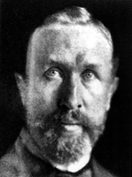
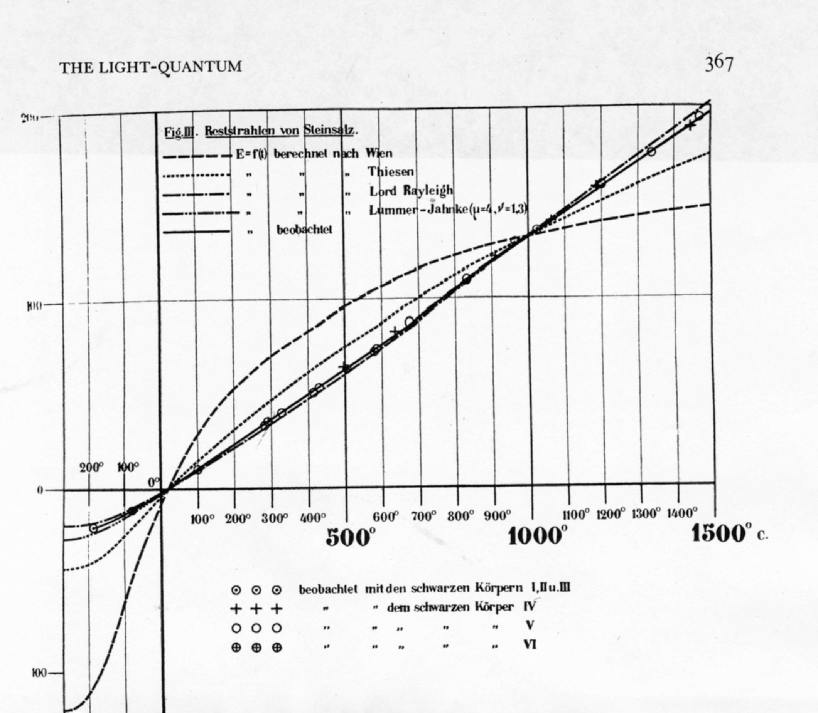
October 19th, 1900: Ferdinand Kurbaum presents latest expt data, Planck is in the audience
ρ
Wien’s Law
Long λ data
T
λ fixed
A theorist’s worst nightmare

Slide 18
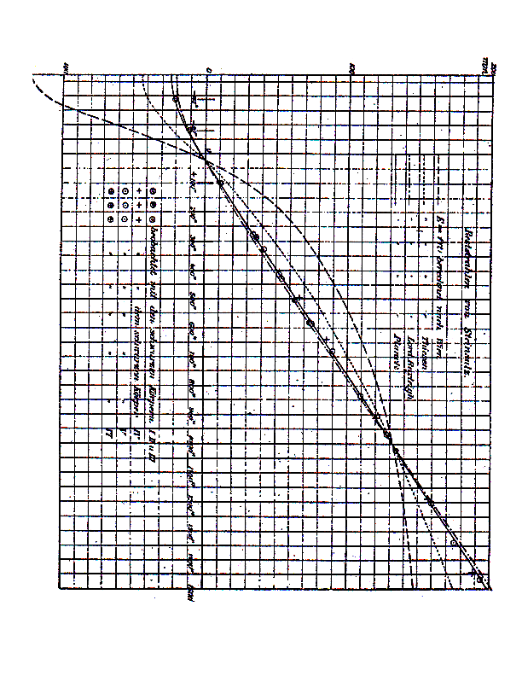
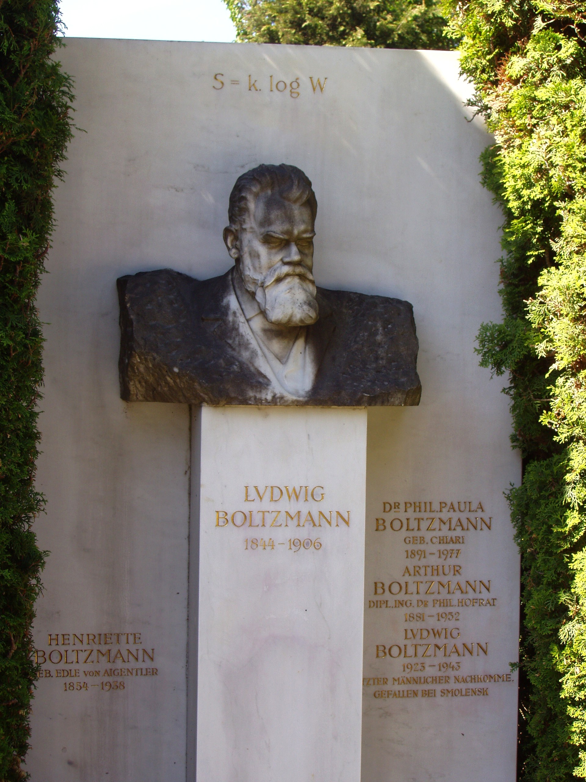
Planck (October 19, 1900):
… Since I myself even in this Society have expressed the opinion that Wien’s law must be necessarily true, I may perhaps be permitted to explain briefly the relationship between the… theory developed by me and the experimental data. ……
I have finally started to construct completely arbitrary expressions for the entropy…I was especially attracted by one of the expressions which is nearly as simple as Wien’s and deserves to be investigated: S''(ε) = -α/ε(β+ ε) … leading to ρ(ν,T) = Cν³/(e^{aν/ T} - 1)
Planck “guesses” the correct answer! It agrees beautifully with expt
Needs a theoretical justification; uses Boltzmann’s relation:
Notes:
“The interesting results of long wavelength spectral energy measurements.. confirm the statement…that Wien’s energy distribution law is not generally valid

Slide 19
“I knew that the problem was of fundamental significance for physics: … a theoretical interpretation had to be found at any cost, no matter how high…”
“We consider, however - this is the most essential part of the whole calculation - E is to be composed of a very definite number of equal parts and use thereto the constant of nature h= 6.55 x 10⁻²⁷ erg-sec …” -
The key idea:
Quantization of energy
(for “resonators”)
u = nhν
“What I did can be described simply as an act of desperation,
But did he believe that energy was really quantized?
… The constant h, multiplied by the common frequency ν of the resonators gives us the energy element ε …, and dividing the total energy E by ε we get the number P of energy elements to be divided over the N resonators...If the ratio P is not an integer, we take for P an integer in the neighborhood (!?)
Notes:
…by nature I am peacefully inclined and reject all doubtful adventures”

Slide 20
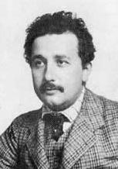
The response:
Nothing, nada, bupkus, zilch, for 4 years
“On a Heuristic Point of View Concerning the Production and Transformation of Light”, A. Einstein, March, 1905
The “revolutionary” paper – not a direct response to Planck
…{light] consists of a finite number of energy quanta, localised in space, which move without being divided and can be absorbed or emitted only as whole.”
What?!!
“The most revolutionary sentence written by a physicist of the 20th century”, Albrecht Folsing
Notes:
“In fact it seems to me that the observations of “black-body” radiation,… the [photoelectric effect] and other phenomena involving the conversion of light can be better understood on the assumption that the energy of the light is distributed discontinuously in space

Slide 21
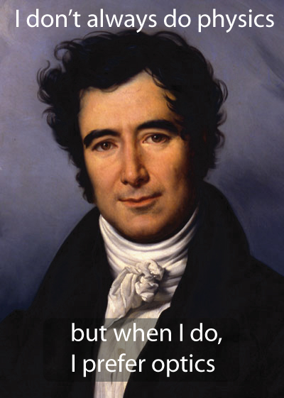
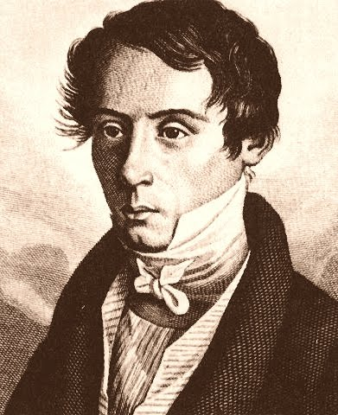
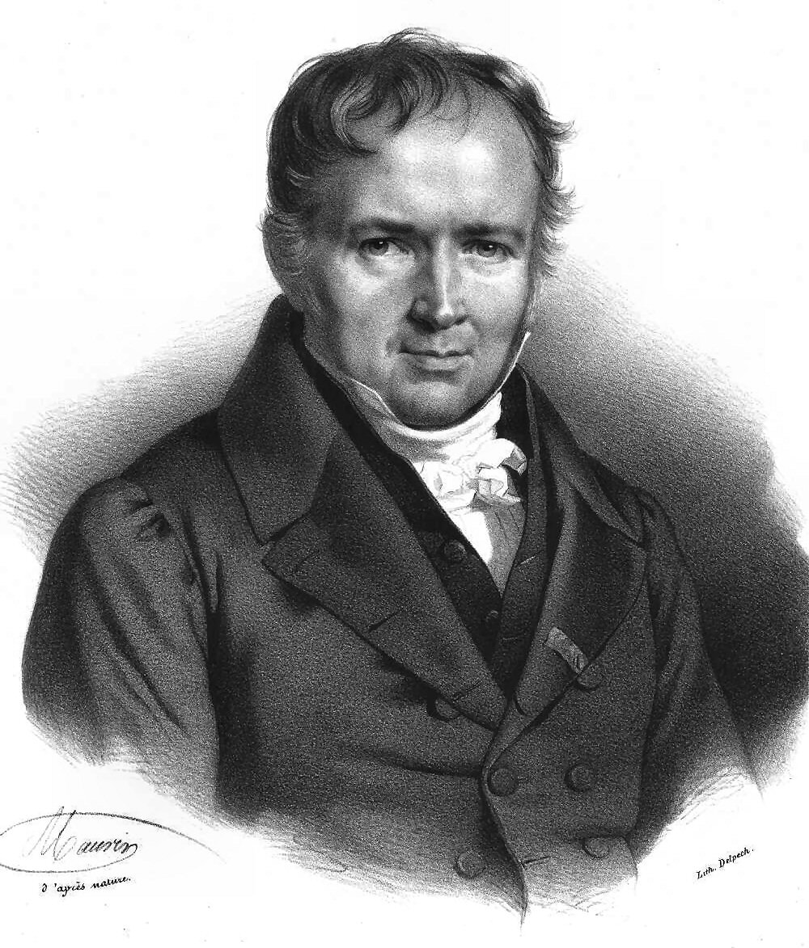
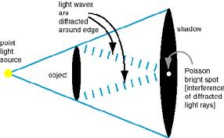
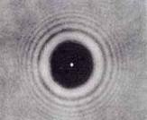
The Spot of Arago
Fresnel
Poisson
But Fresnel had a friend
Francois Arago
Notes:
1818 competition of the French academy of sciences – Explain the properties of light – wave theory submitted by civil engineer Augustin-Jean Fresnel only 30 yrs old – Poisson derives a contradiction from it - Francois Arago does the test and proves it correct. Later Arago is Prime Minister of France and instrumental in the abolition of slavery in the French Colonies.

Slide 22
Very Revolutionary
Wave theory of light had vanquished particle theory since 1820-1830 (Young, Fresnel, Arago…)
Maxwellian E&M was the standard model of the day
There was a transformational technology based wave theory (radio). (Bohr’s joke)
There was little experimental evidence for photons.
No one knows how he thought of it!
It was not widely accepted until 1925! (Compton
Effect, Geiger)

Slide 23
Einstein begins with a paradox: according to the stat mech of the time each EM mode should have
<ε> = kT => ρ(ν) ~ kTν² => UV catastrophe
Rigorous theory is impossible – try heuristic approach – consider the meaning of the Planck Law
Einstein interprets entropy of BB radiation, in analogy
to the Ideal gas, but only in Wien limit:
“Planck’s formula for ρ(ν)…agrees with all expts up to the present…we shall base our calculations on [the Wien] formula...”
Entropy of BB looks like a perfect gas with N= E/hν => BB radiation made of quanta of light with ε=hν
Analysis of Fluorescence, photoelectric effect

Slide 24
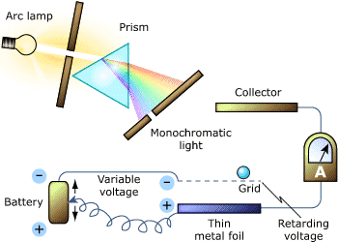
The photoelectric effect
Current depended on frequency, not intensity
Why?

Slide 25
Einstein and the Photoelectric Effect
e⁻
V
e⁻
hν
e⁻
hν
hν
hν
hν
If hν less than binding energy of e⁻, no photoelectrons
If hν greater than energy of e⁻ then a photoelectron is ejected
No good experimental tests for 10 yrs!
No significant theorist believed Einstein was right

Slide 26
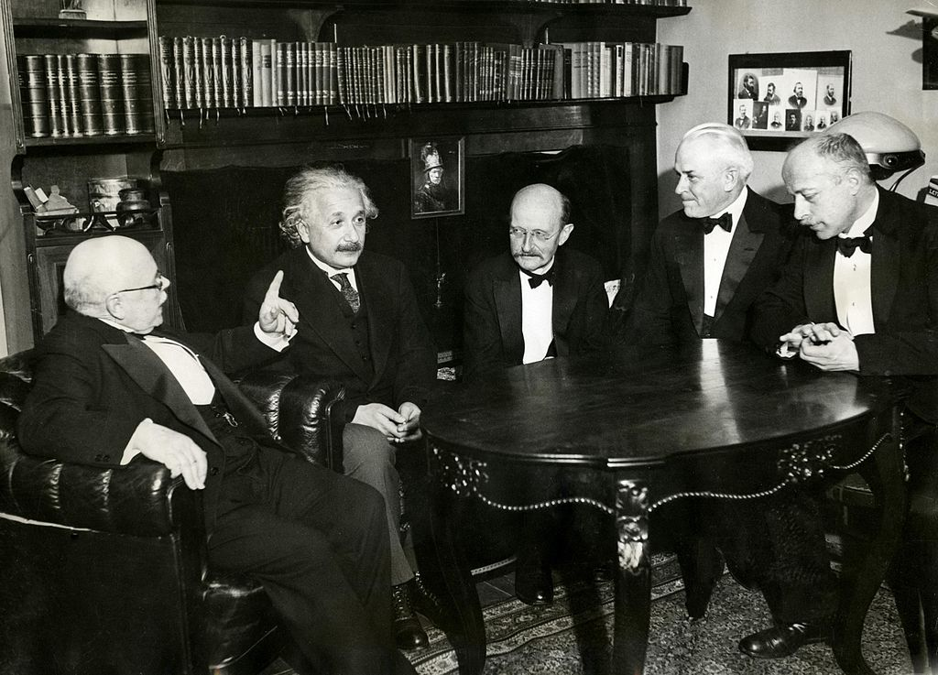
1913: Nernst and Planck lure Einstein from Zurich to Berlin
They apologize to the Prussian Academy for his one major error:
“That he [Einstein] may sometimes have missed the target of his speculations, as for example in his hypothesis of light quanta, cannot really be held against him”, Planck, Nernst et al., 1913
But Millikan was interested in the photoelectric effect

Slide 27
Measuring the Photoelectric Effect
Prediction: eV_{stop} = C - hν

Slide 28
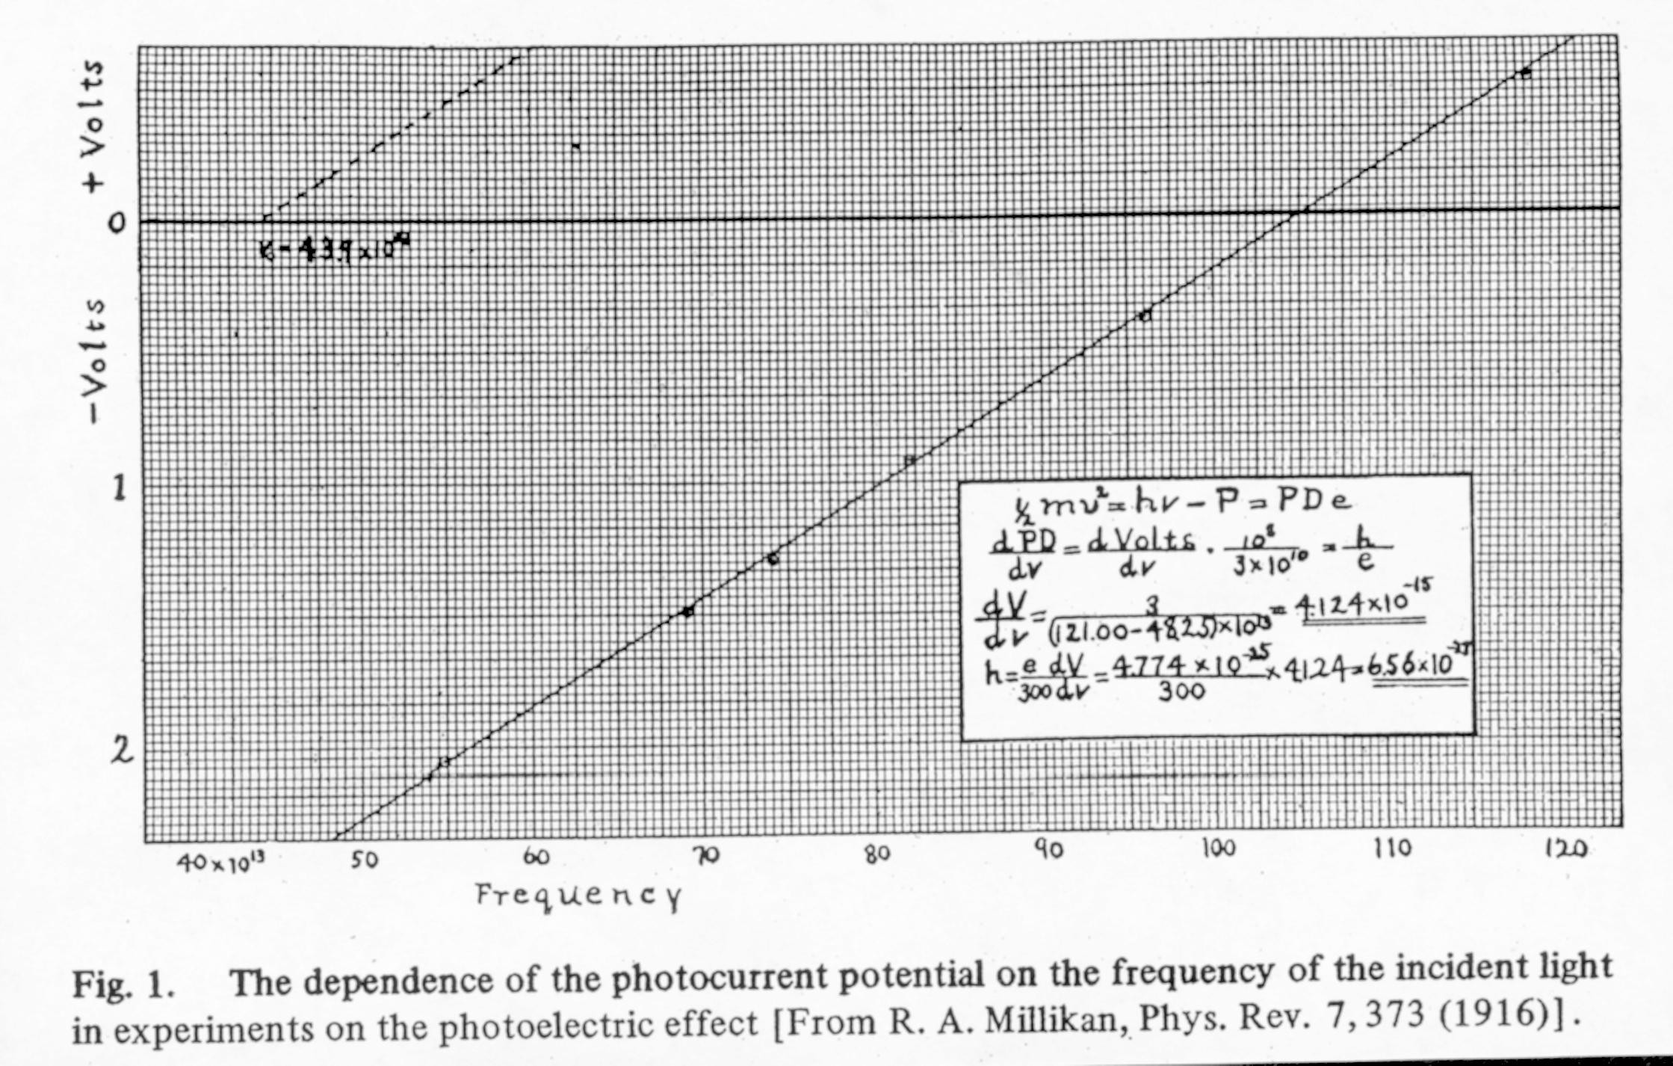
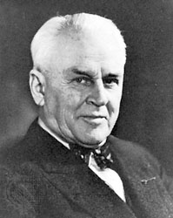

voltage
Robert Millikan
√
frequency
No mention of quanta of light. Photons not accepted until 1925!
”For his services to Theoretical Physics, and especially for his discovery of the law of the photoelectric effect” - citation for the Nobel Prize in Physics, awarded to Einstein in 1921
Notes:
“I spent ten years of my life testing that 1905 equation of Einstein and, contrary to all my expectations, I was compelled to assert its unambiguous experimental verification in spite of its unreasonableness since it seemed to violate everything we knew about the interference of light.” - R. A. Millikan, 1949

Slide 29
1906: Einstein was sole quantist
1906: follow up to light quanta paper, “Planck’s theory differs from Maxwell’s…precisely because Planck’s theory make implicit use of the …hypothesis of light quanta.
What does Planck think? “I am not seeking the meaning of the quantum of action in the vacuum but rather in the place where absorption and emission occur…”, Planck, 1907. (And we should focus on more important topics, i.e. Relativity).
What does Einstein do in this paper? Changes integral over continuous energies to sum over discrete energies:
T. S. Kuhn: in 1906 “Einstein announces the birth of quantum theory”, Why?
Einstein applies Planck distribution to specific heat of solids

Slide 30
Einstein Model for specific heat
Begins: need to modify kinetic theory of heat due to blackbody law: For although one has thought before that the motion of molecules obeys the same laws that hold for the motion of bodies in our world of sense perception. […] we must now assume. […] that the diversity of states that they can assume is less than for bodies within our experience. For we make the additional assumption that […] the energy of elementary structures can only assume the values 0,hν,2hν, etc…”
=> QUANTIZATION OF ENERGY IN MECHANICS
At room T most of the heat capacity of solids is due to vibrations, and for most solids C_{V} per mole has a “universal value” = 3R (Dulong and Petit Law) – but some solids show deviation (Diamond, Silicon…)
Vibrations with hν >kT disappear:
= > 3rd law of thermodynamics (Nernst’s Law)
Notes:
For although one has thought before that the motion of molecules obeys the same laws that hold for the motion of bodies in our world of sense perception.

Slide 31
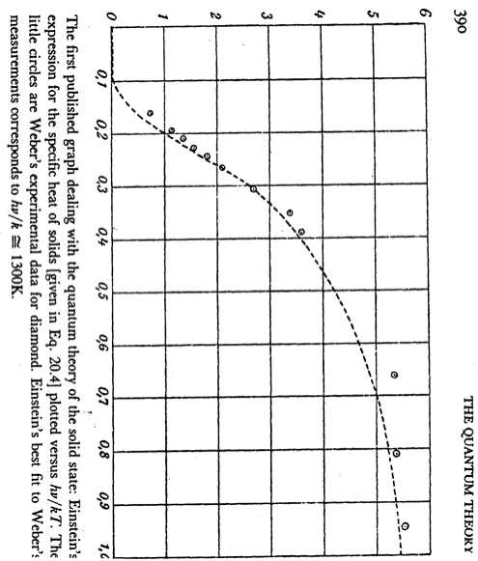
Compares theory with experiment
“ Einstein’s quantum hypothesis is probably the strangest thing ever thought up. If correct, it opens entirely new roads… for molecular theories” , Nobel Laureate, W. Nernst, 1910

Slide 32
1909: Salzburg meeting of German scientists and physicians – Einstein’s coming out party: lectured on “The development of our views on the nature and composition of radiation.”
He analyzes the momentum fluctuations arising from the blackbody radiation acting on a mirror pendulum in the cavity
particle term (qm)
wave term (classical)
“It is therefore my opinion that the next stage of development of theoretical physics will bring us a theory of light which can be regarded as a fusion of the wave theory and the emission [particle] theory.” - Einstein, 1909
“[Einstein’s argument] had no great effect, …Planck was the chairman and he immediately said that it was very interesting but he didn’t quite agree with it…it was far too advanced…”, Paul Epstein.

Slide 33
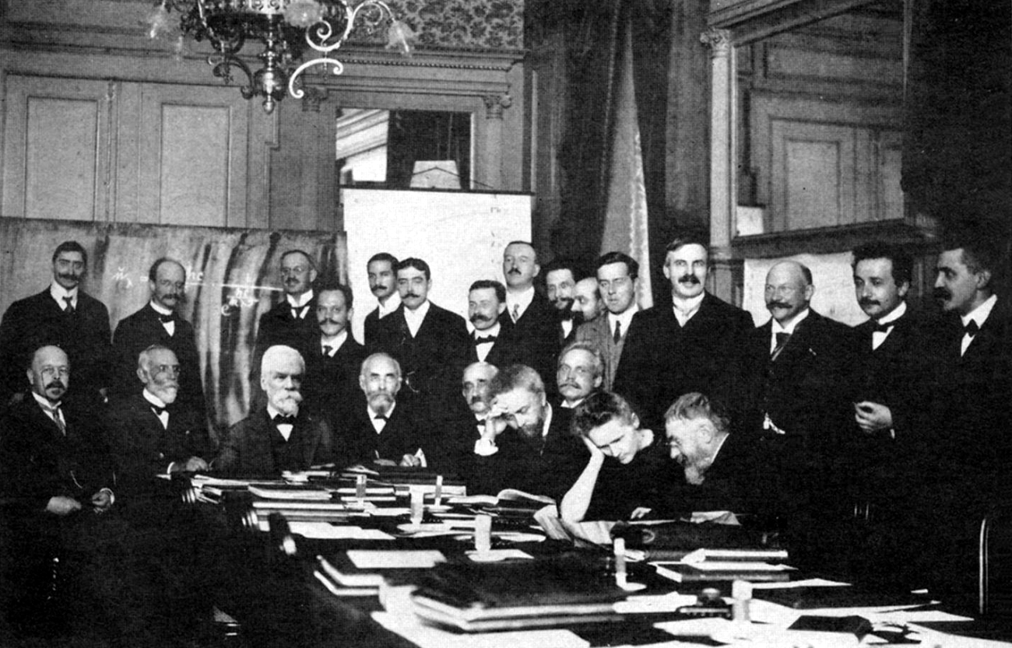
Lamenting the ruins
1909-10 Einstein searches for quantum theory of radiation and fails:
“the riddle of radiation will not yield…”, Einstein, Dec. 1910.
He turns his attention to General Relativity 1911-1915; gives up on the quantum just as the rest of the community wakes up to the problem.
Notes:
“[The conference] resembled the lamentations on the ruins of Jerusalem…I did not find it very stimulating because I found nothing I did not know before”, Einstein to Besso, 1911

Slide 34
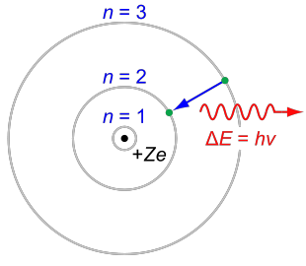
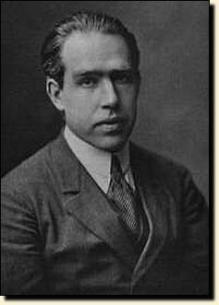
The Bohr Atom, 1913
THIS IS NOT A PHOTON!
Einstein’s reaction: “Then the frequency of the light does not depend at all on the frequency of the electron…this is an enormous achievement. The theory of Bohr must then be right. (1913)

Slide 35
1916: Inspired by Bohr looks at BB radiation again:
E₂
hν = E₂ -E₁
spontaneous emission
Atomic energy levels
E₁
SE has prob/time ~ A, also exist absorption and stimulated emission with prob ~ B.
By balancing emission and absorption (detailed balance), Einstein is able to obtain
the Planck law without any reference to Maxwell’s equation
“…the light quanta are as good as established”, Einstein to Besso, 1916.
“The weakness of the theory lies…in the fact that it leaves the time and direction of the elementary processes to chance; nevertheless I have full confidence in the reliability of the course taken.” - Einstein, 1917
Einstein introduces intrinsic randomness into quantum theory
“The business about causality gives me a lot of trouble…I would be very unhappy to renounce complete causality”, Einstein to Born, 1920
Notes:
A splendid idea has dawned on me concerning absorption and emission of radiation. An amazingly simple derivation of Planck’s formula. I am tempted to say the derivation. Everything quite quantic

Slide 36
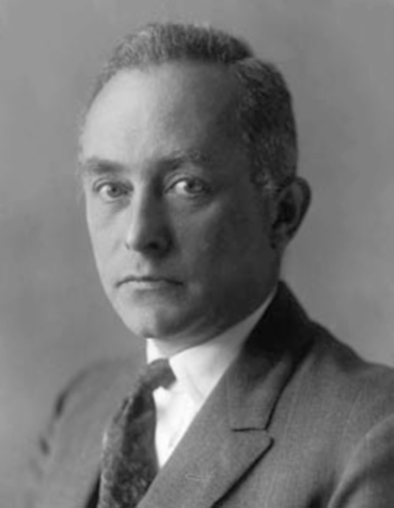
Einstein and ghost (probability) waves
Basic idea: …Upon the emission of light there are two sorts of radiation. They are:
1. An interference radiation, which occurs according to the normal laws of optics but does not transmit any energy…
The energetic radiation. It is composed of indivisible quanta of [energy] hν. Their path is given by the (vanishingly small) flow of energy from the interference
radiation, and therefore they can never reach a spot where this flow is zero…full interference radiation is formed [even if]…only a single quantum is emitted, which thus also can reach the receiving screen at only one spot…
Lorentz, 1922, recapitulating Einstein’s idea of “Ghost Fields”
1925: Max Born introduces same idea for electron waves:
“I am entirely satisfied because my idea to look upon the Schrodinger wave field as a “ghost field” in your sense proves better all the time,
Max Born to Einstein, November 1926

Slide 37
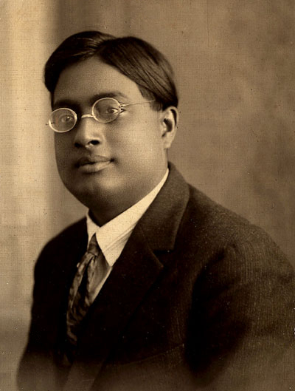
Bose and Einstein (1924-5)
“Respected Sir:
I have ventured to send you the accompanying article for your perusal and opinion. I am anxious to know what you think of it …I do not know sufficient German to translate the paper. If you think the paper worth publication, I shall be grateful if you arrange for its publication in Zeitschrift fur Physik…
Though a complete stranger to you, I do not feel any hesitation in making such a request. Because we are all your pupils…Yours faithfully,
S.N. Bose. Letter of June 4, 1924.
What was the problem?
Can’t treat BB radiation as a photon gas using classical statistics. You get Wien’s Law, not Planck’s
Satyendra Nath Bose, 1924
Notes:
Though a complete stranger to you, I do not feel any hesitation in making such a request. Because we are all your pupils though profiting only by your teachings through your writings…Yours faithfully,

Slide 38
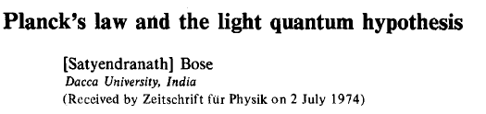

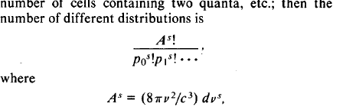
1924
Many years later: “ I had no idea that what I had done was really novel…that it was different from Boltzmann statistics”, S. N. Bose
The key step, he neglects interchanges of quanta;
Few steps later he gets the BB Law
Bose doesn’t say a word about the assumptions underlying this formula!

Slide 39
Einstein: “In my opinion Bose’s derivation of the Planck formula signifies an important advance. The method used also yields the quantum theory of the ideal gas, as I will work out in detail elsewhere”.
Submits paper ten days later with correct equations of massive Bose gas, only partially solved. Doesn’t realize the radical nature of the new statistics”
Two days later, to Ehrenfest, “the essence is still obscure” (July).
December 1924, “the thing with the quantum gas turns out to be very interesting… much of what is true and deep lurking behind it.”
January 1925, full theory of the Bose gas, including BEC: “…an increasing number of molecules go in to the quantum …ground state…part of the gas `condenses’…
“[Bose statistics] expresses an implicit hypothesis about the mutual influence of the molecules of a totally new and mysterious kind”. WHAT IS THIS?
Derives fluctuation formula in exact formal analogy to the photon case (1909),
discusses wave nature of matter, cites De Broglie thesis, suggests interferometry.

Slide 40
Bose: The Epilogue
Einstein writes letter praising Bose to India, he immediately gets a fellowship to study in Europe.
Arrives in Paris, Oct 1924, but doesn’t go to Berlin until Oct 1925; plays no role in understanding “BEC”.
He meets Einstein who suggests a research topic in matrix mechanics, but makes little progress and returns to India soon.
Revered in India, but makes no further contribution to physics.
All of the force-carrying particles in modern physics are called bosons in recognition of his role in the new statistics
“I was not really in science anymore. I was like a comet, a comet which came once and never returned again”.

Slide 41
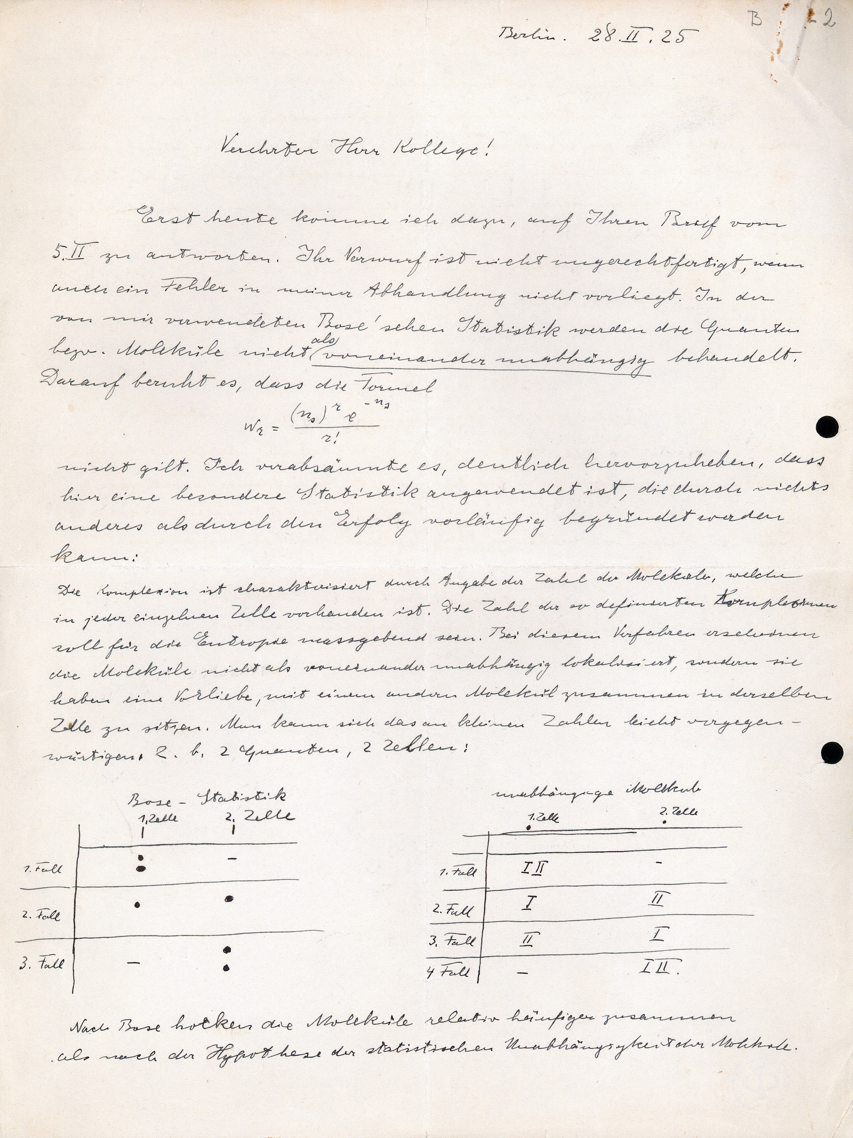
February 1925, Schrodinger writes to Einstein suggesting that he has made an error in his BEC paper
“your reproach is not unjustified, although I have not made a mistake in my paper…In the Bose statistics, which I use, the quanta or molecules are not considered as being mutually independent objects”.
“I had not grasped it before at all despite the fact that Bose’s paper had already come out….[Bose’s work] did not seem particularly interesting to me. Only your theory of gas degeneracy is really something fundamentally new…” Schrodinger, Sept 1925

Slide 42



1925-6: Schrodinger and Heisenberg independently invent the modern form of quantum theory. Einstein plays a critical role in Schrodinger’s thinking.
“My theory was stimulated by de Broglie and by brief but infinitely far-seeing remarks by Einstein” - Schrödinger, 1926.
After a period of reflection Einstein give his verdict
“Quantum mechanics is very impressive. But an inner voice tells me that it is not yet the true Jakob. The theory produces a good deal but hardly brings us closer to the secrets of the Old One. I am at all events convinced that He does not play dice…
Einstein to Born, December 1926, responding to his letter
about the probabilistic interpretation of wavefunction
All the fifty years of conscious brooding have brought me no closer to the answer to the question, ‘what are light quanta?
Why?
Of course today every rascal thinks he knows the answer, but he is deluding himself - Einstein, 1951

Slide 43


“Physics is an attempt to conceptually grasp reality as it is…, independently of its being observed”, Einstein
“Do you really believe that the moon exists only if I look at it?”
“A finely tempered nature longs to escape from the personal life into the world of objective perception and thought”
Nichte Diese Töne!
Notes:
“I believe with Schopenhauer that one of the strongest motives the leads men to art and science is escape from everyday life with its painful crudity and hopeless dreariness, from the fetters of one’s own everyday desires…

