Slide 1
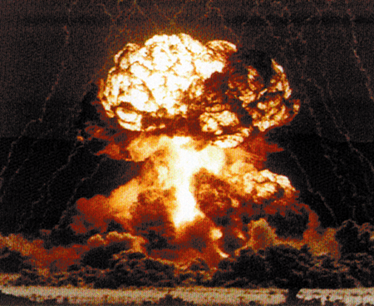
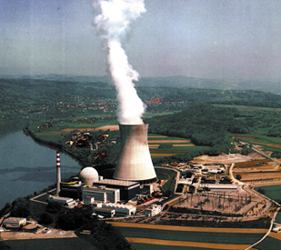
Megatons to Megawatts:
An Overview of the U.S. – Russia
Highly Enriched Uranium Transparency Program
Cindy Boggs
Argonne National Laboratory

Slide 2
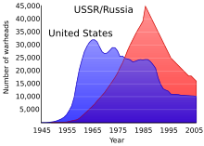
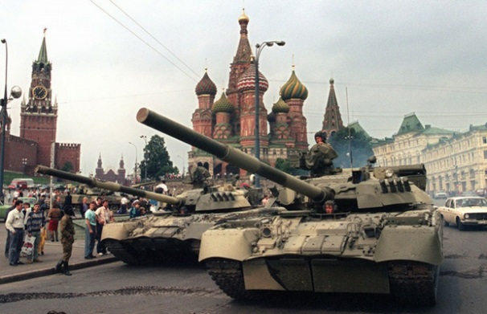
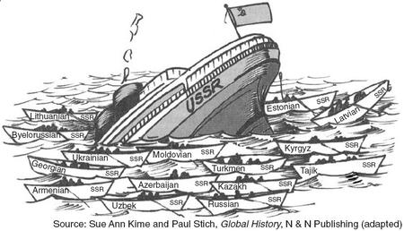
What Was Happening in 1990 – 1991?
Total nuclear weapon inventories were peaking
  USSR = 40,000+
Strategic Arms Reduction Treaty (START I) signed
  Limited U.S. and USSR to 6,000 warheads each
  Dismantling of thousands of warheads begun
The Soviet Union was crumbling
  Revolutions in multiple republics
  Russian coup in August 1991
  USSR formally ceased to exist in December 1991
  Collapse of the Russian economy, instability, and uncertainty

Slide 3
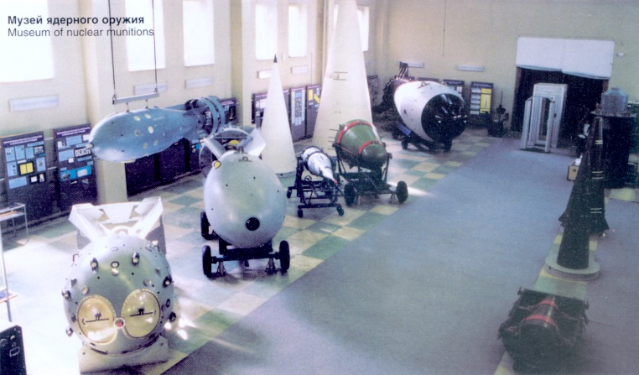
A Question of Nuclear Security
Growing concern over security of Russian nuclear stockpile
  Growing stockpile in storage
  Cutbacks in nuclear upkeep and worker pay
  Newly impoverished workers
  Sub-standard storage bunkers and facilities
  Serious potential consequences
A “Grand Uranium Bargain”
  Proposed by Thomas Neff, Professor at MIT
  NY Times Op Ed, Oct. 24, 1991
  Proposed buying Soviet weapons grade uranium (HEU) for commercial use in U.S.
  Neff personally championed the idea

Slide 4
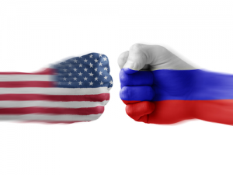
1993: The Highly Enriched Uranium Purchase Agreement
Signed by the U.S. and Russia in February 1993
Was an Agreement, not a Treaty
  Did not require Senate ratification
United States committed to purchase low enriched uranium (LEU) derived from 500 metric tons (MT) of Russian weapons highly enriched uranium (HEU) over a period of 20 years
  “Down-Blending” from HEU to LEU to occur in Russia
Required reciprocal transparency measures to ensure nonproliferation goals are met
Commercial implementation by Executive Agents
  Brokered and monitored by Federal government
  Paid for by commercial entities
  Overall cost: ~ $17 Billion

Slide 5
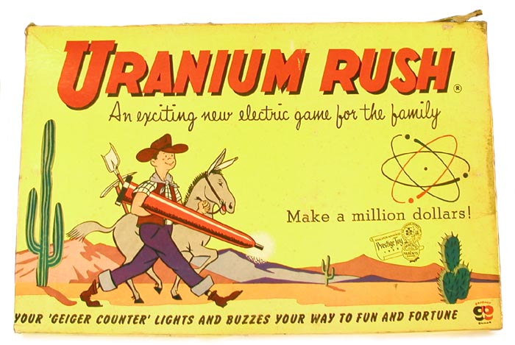
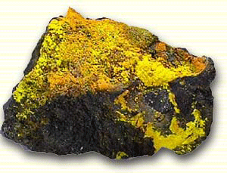
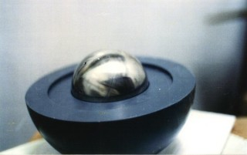
Short Review of Uranium
Uranium is a naturally occurring radioactive metal
  Natural uranium is 0.7% U-235 by weight, 99.3% U-238
  U-235 is fissile
For most nuclear applications, concentration of U-235 isotope must be increased, a process called “enrichment”
  Technically difficult and expensive to do
  Primary barrier to producing a nuclear weapon
Various levels of enrichment
  < 0.7% U-235, depleted uranium
  3-5% U-235, reactor-grade uranium
  < 20% U-235, low enriched uranium (LEU)
  > 20% U-235, highly enriched uranium (HEU)
Nuclear weapons contain a metal core of HEU
  Typically 90% U-235
  25 kg of HEU is the IAEA Quantity of Concern*
*IAEA Safeguards Glossary, International Atomic Energy Agency Vienna, 1987

Slide 6
Down-Blending
HEU Feedstock
Blend Stock
1% U-235
90% U-235
99% U-238
10% U-238
Reactor Grade
5% U-235
95% U-238

Slide 7
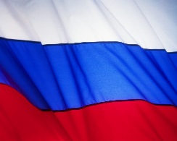

HEU Purchase Agreement:
The Overall Process
Soviet/Russian weapons dismantled and metal HEU components removed
90% HEU metal components were chipped
Uranium chips were oxidized; U metal to U oxide (90% U₃O₈)
Uranium oxide powder was chemically purified
Purified uranium oxide was fluorinated to uranium hexafluoride; U₃O₈ to UF₆ (90%)
90% highly enriched UF₆ was blended with 1.5 % low enriched UF₆ blend stock
Low enriched UF₆ product (reactor grade, 3% - 4.95%) was then shipped to the U.S.
Reactor grade uranium fabricated into nuclear fuel assemblies
Nuclear fuel assemblies used in U.S. nuclear power plants

Slide 8
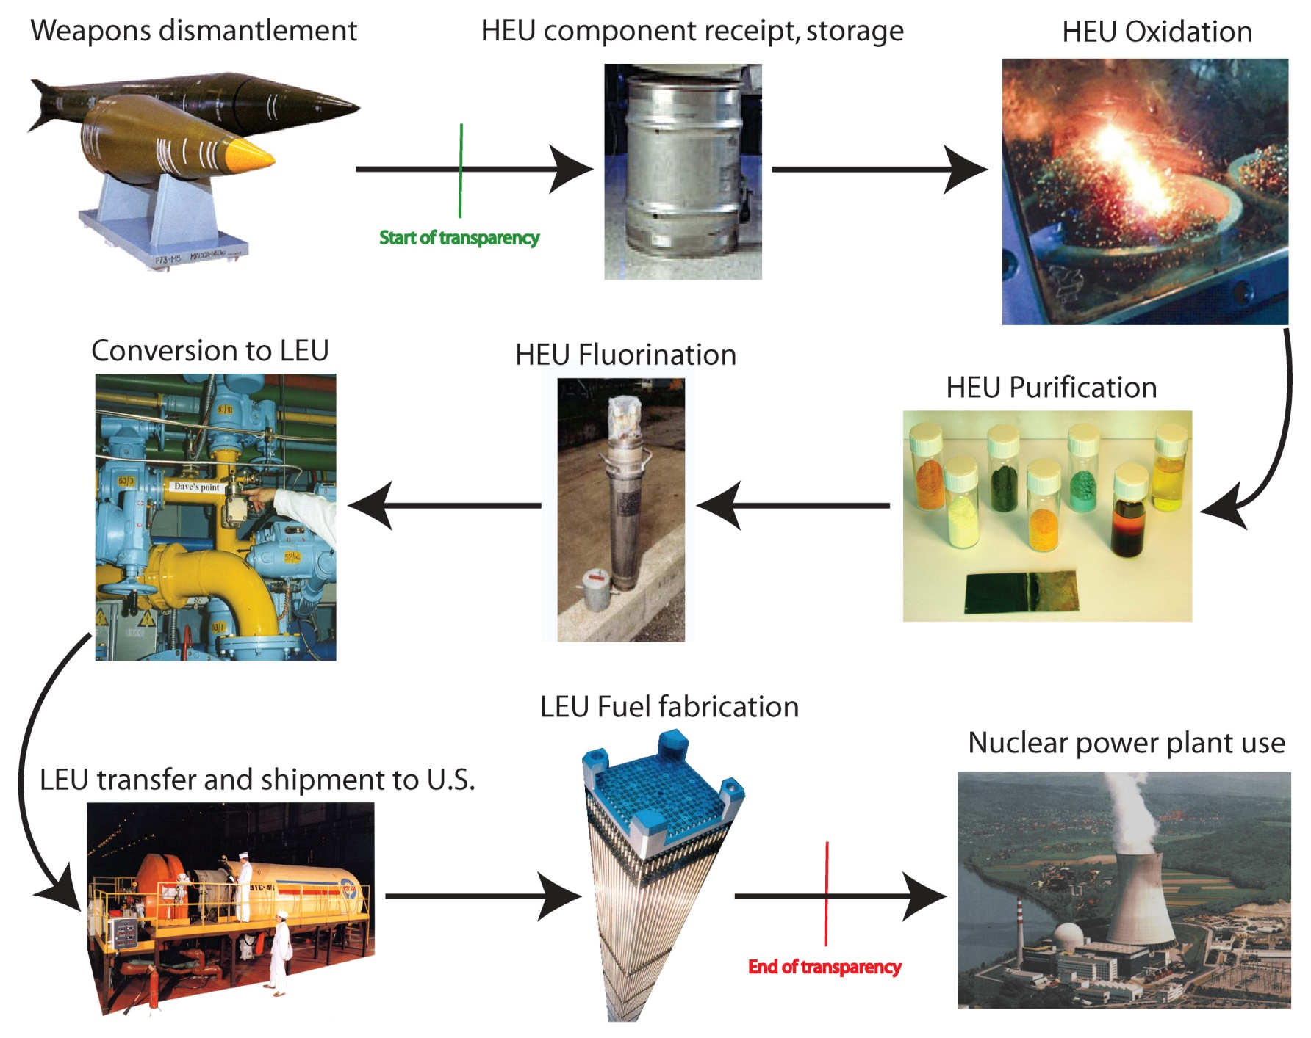
The Conversion Process

Slide 9

Transparency???
Agreed upon measures intended to provide confidence that Russian LEU sold to the U.S. was derived from HEU removed from dismantled Russian nuclear weapons
Objectives were to ensure:
  HEU subject to the Agreement was extracted from Russian nuclear weapons
  Same HEU was oxidized and fluorinated
  Declared quantity of HEU was blended down to LEU and shipped to the U.S.
  LEU delivered to U.S. was for commercial reactor fuel

Slide 10
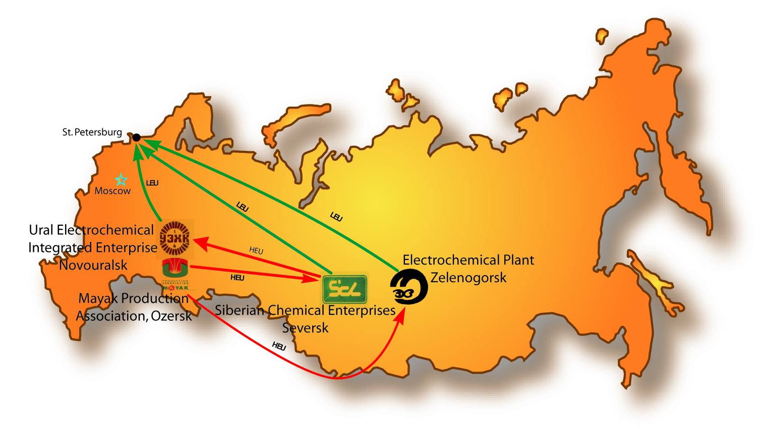
Material Flow: Russia
Russia processed HEU at four sites:
Mayak Production Association
Siberian Chemical Enterprises
Electrochemical Plant
Ural Electrochemical Integrated Plant

Slide 11
Russian Facility/Old name/City
UEIP- Ural Electrochemical Integrate Plant/ Sverdlovsk-44/ Novouralsk
ECP-Electrochemical Plant/ Krasnoyarsk-45/ Zelenogorsk
SChE- Siberian Chemical Enterprise/ Tomsk-7/ Seversk
MPA- Mayak Production Association/ Chelyabinsk-40/ Ozorsk

Slide 12
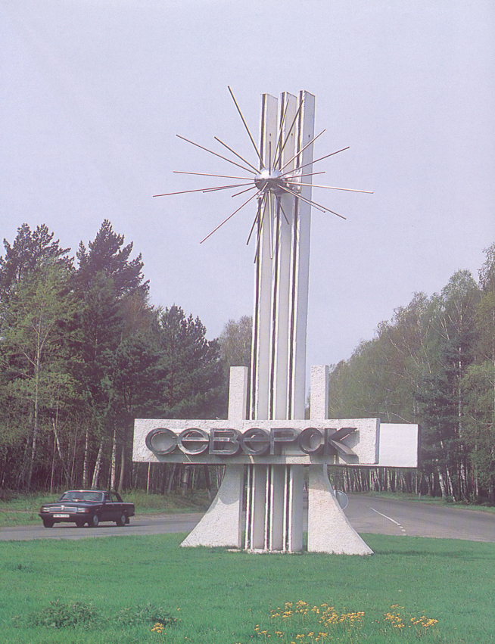



Russian Facilities and Processes
Two Russian facilities received HEU weapon components from dismantled Russian nuclear weapons
  Siberian Chemical Enterprise (SChE)
in Seversk
Received weapons components
Converted metal components to chips
Converted metal chips to oxide
Purified the oxide
Shipped purified oxide to SChE & ECP
Shipped HEUF6 to UEIP
Mayak Production Association (MPA)
in Ozorsk

Slide 13
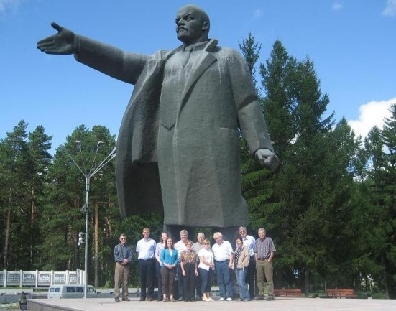
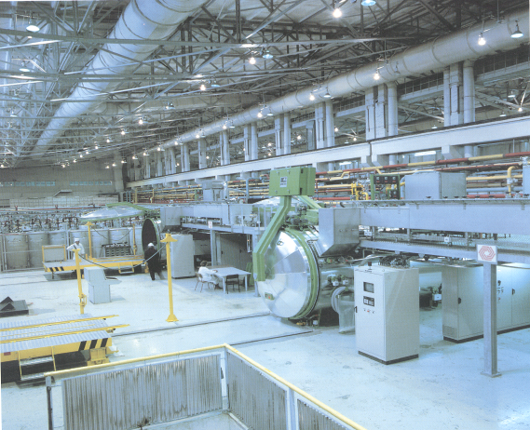

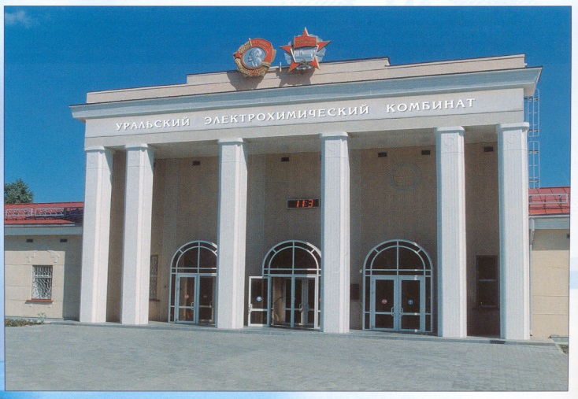

Russian Facilities and Processes
Three Russian facilities converted and down blended HEU to LEU for shipment to the U.S.
Siberian Chemical Enterprise in Seversk
Electrochemical Plant (ECP)
in Zelenogorsk
SChE & ECP received HEU oxide & converted to HEUF₆
UEIP received HEUF6
All 3 down blended HEU into LEU
All 3 Shipped LEU to US
Ural Electrochemical Integrated Plant (UEIP)
in Novouralsk

Slide 14
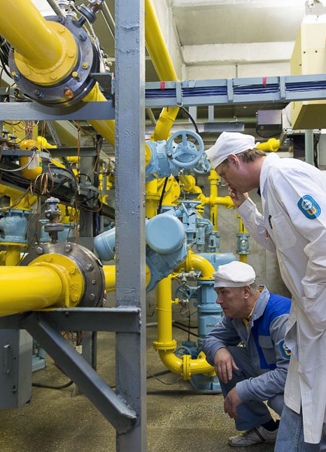
Implementing Transparency
The Program had reciprocal transparency measures
Both countries could conduct monitoring visits and establish a permanent monitoring office
In Russia
  U.S. maintained a Russian-approved list of 100 experts from more than 10 organizations to work in Russia
  6 Special Monitoring Visits (4-5 days) per year at each of the 4 Russian facilities (4-8 persons per visit)
  Transparency Monitoring Office (TMO) at UEIP staffed up to 6-12 months per year by 2-4 persons on 1-2 month assignments
From 1996 through 2013:
  U.S. conducted 385 visits to Russian processing facilities
  Made over 41,000 measurements of uranium enrichment levels in Russian facilities

Slide 15
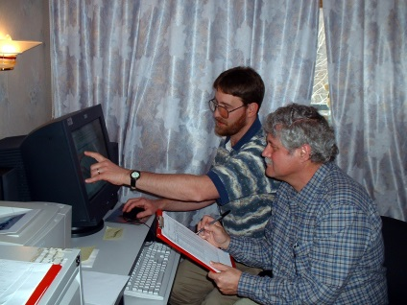
Implementing Transparency cont’d
From 1996 through 2013 for TMO:
  64 Americans from 12 organizations
  233 trips to the TMO
  Staffed 1,282 person weeks
  Equivalent to 6, 410 person days
  TMO monitors made measurements of uranium enrichment levels on approximately 155 tons of HEU
  or approximately two thirds of the HEU received at UEIP
  one-third of all HEU hexafluoride produced

Slide 16
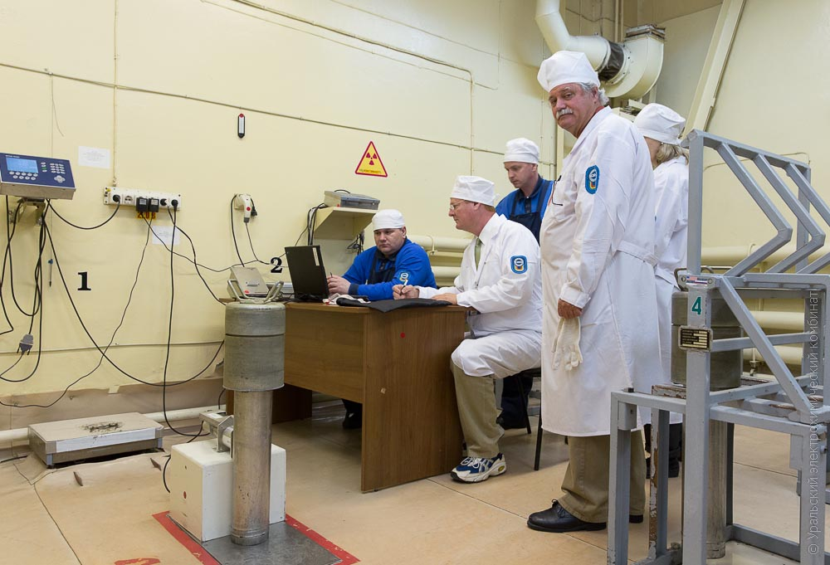
Implementing Transparency
In the U.S.
  Russians could visit Paducah Gaseous Diffusion Plant (Paducah, KY) 6 times annually
  Russians were allowed 2 annual visits to each U.S. fuel fabricator
  Russia briefly maintained monitoring office in Portsmouth Gaseous Diffusion Plant (Piketon, Ohio)
  Russia wanted assurance that the U.S. was not re-enriching the uranium
Non destructive Assay of an HEUF6 cylinder

Slide 17
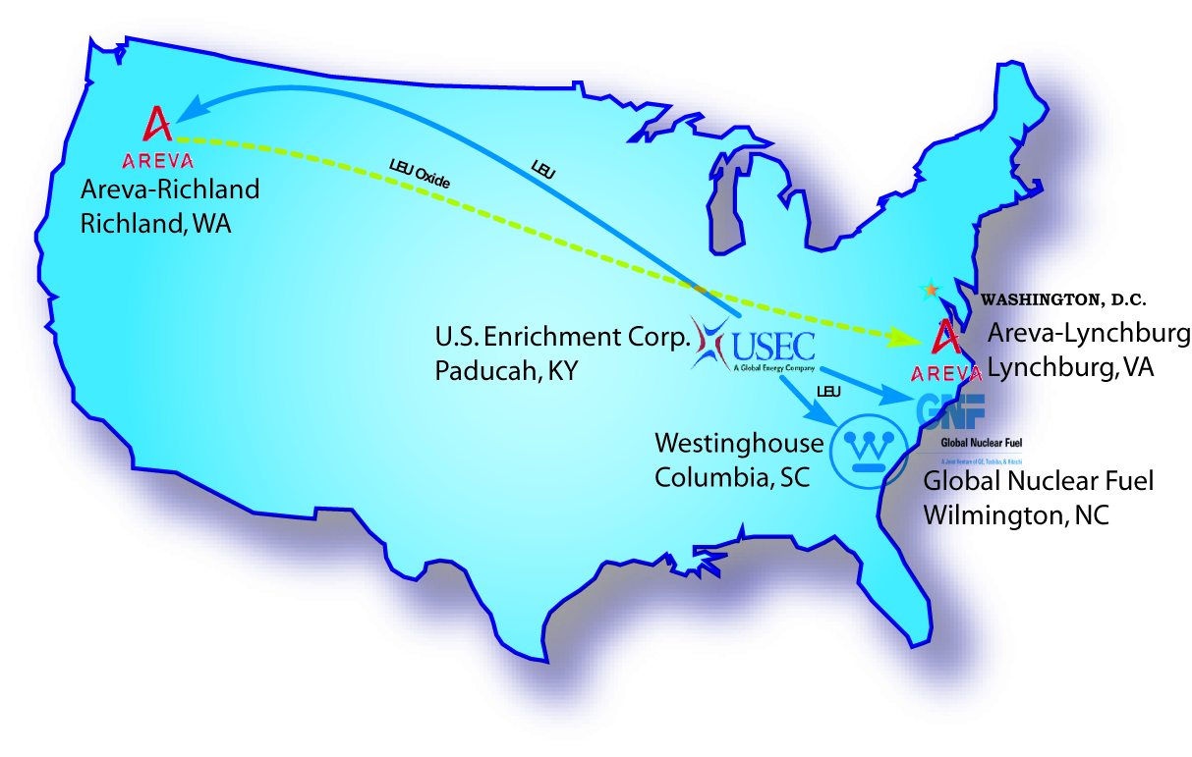
Implementing Transparency
In the U.S.
  Russians could visit Paducah Gaseous Diffusion Plant (Paducah, KY) 6 times annually
  Russians were allowed 2 annual visits to each U.S. fuel fabricator
  Russia briefly maintained monitoring office in Portsmouth Gaseous Diffusion Plant (Piketon, Ohio)
  Russia wanted assurance that the U.S. was not re-enriching the uranium
Material Flow: United States

Slide 18
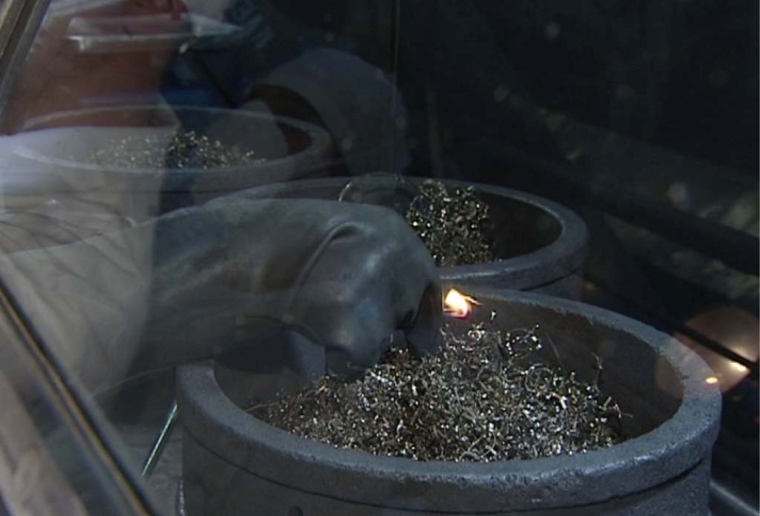
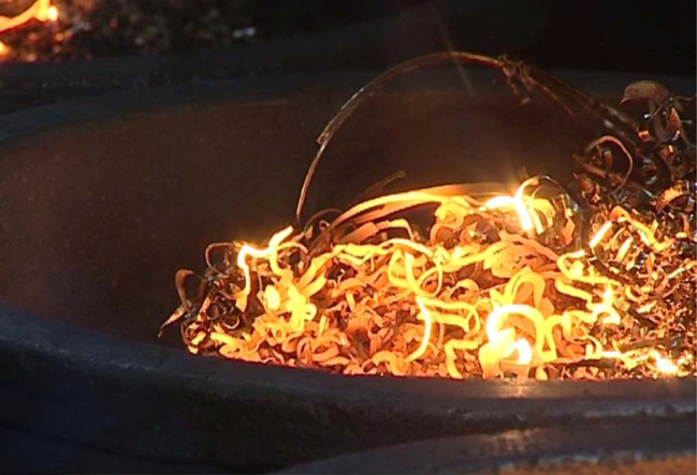
U.S. Monitoring Objectives
Monitoring Objectives
Ensure consistency among Russian declarations, U.S. expert observations, and measurements from U.S.-designed instruments
Develop overall confidence that Russian weapons-usable HEU was converted to LEU under the Agreement
Monitoring Tools
Declarations of Russian shipping, sampling, and process activities
Observations of significant process steps
Measurements on uranium at key processing points

Slide 19
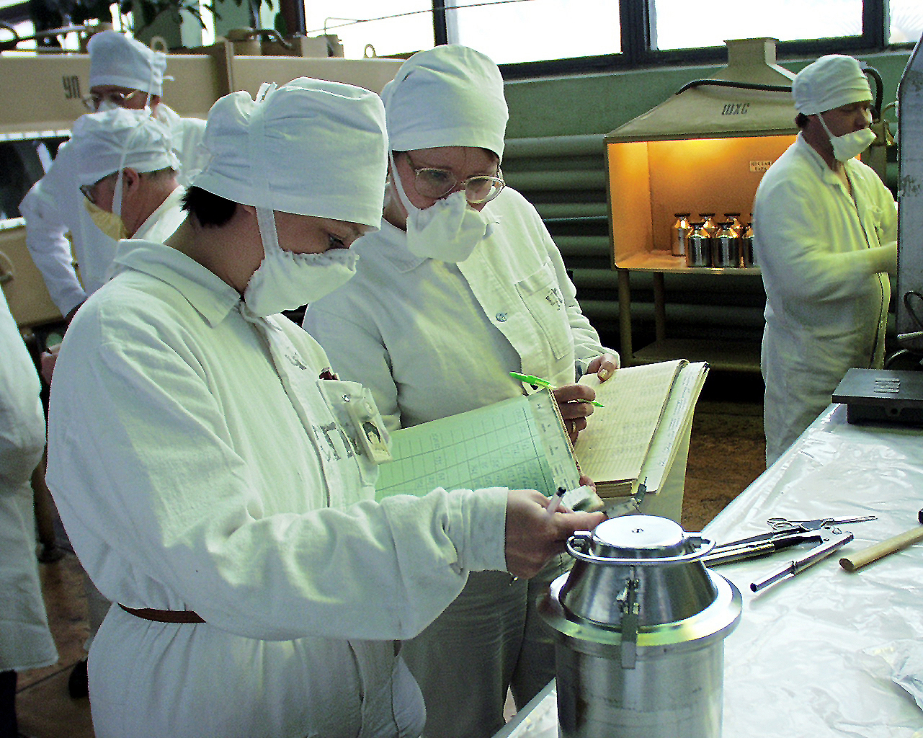
Declarations
The U.S. and Russia exchanged declarations of all material shipped, processed, and sampled under the Agreement

Slide 20
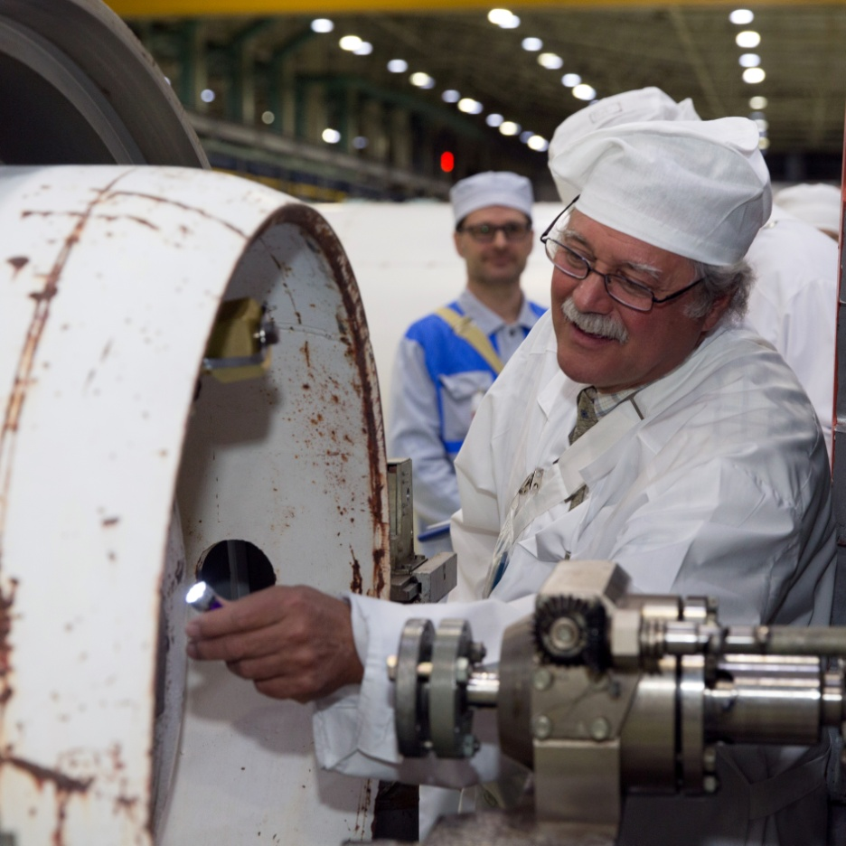
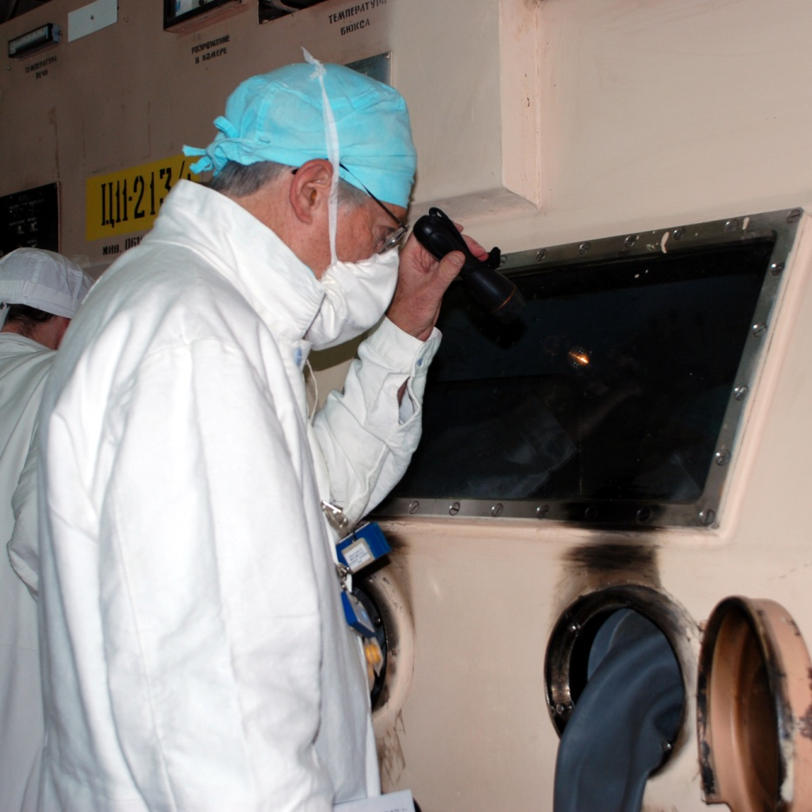
Observations
U.S. experts observed plant operations and major material transformations firsthand

Slide 21
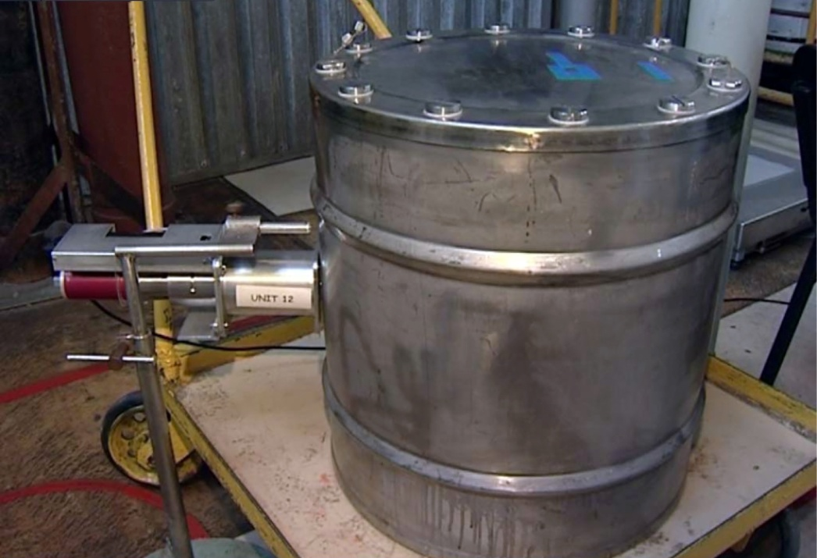
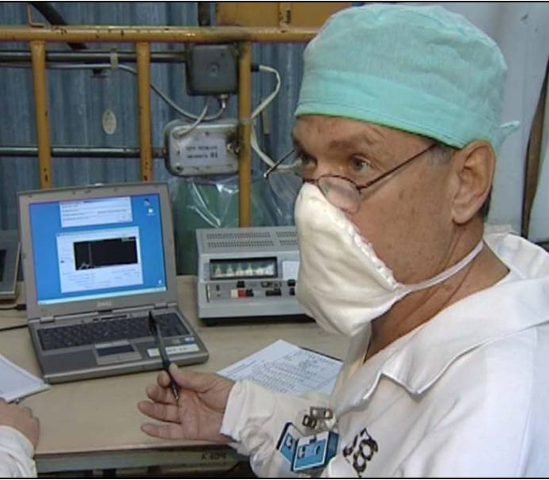
Measurements
U.S. non-destructive assay (NDA) equipment confirmed presence of 90% enriched HEU in sealed containers
Measured HEU metal, oxide, and hexafluoride in storage and process
NDA of weapon components
185 kev

Slide 22
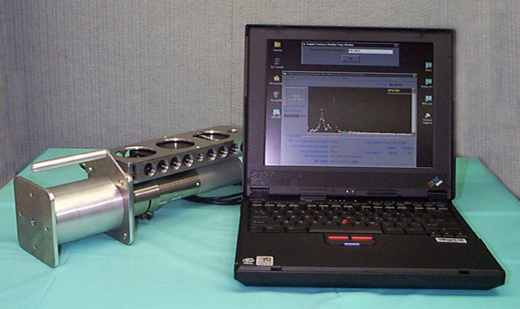
Nondestructive Assay of HEU
Designed by Lawrence Livermore National Laboratory
AMPTEK GAMMA-8000 system, with a low power 30 × 30 mm Scionix-Holland™ NaI(Tl) scintillation detector and pocket-sized AMPTEK MCA8000A MCA.
Used to measure enrichment of weapon components, chips, oxides and hexafluoride
Used at all 4 sites

Slide 23
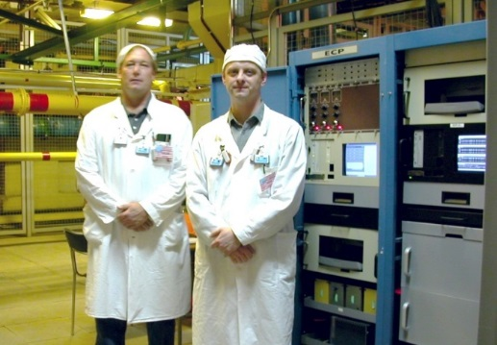
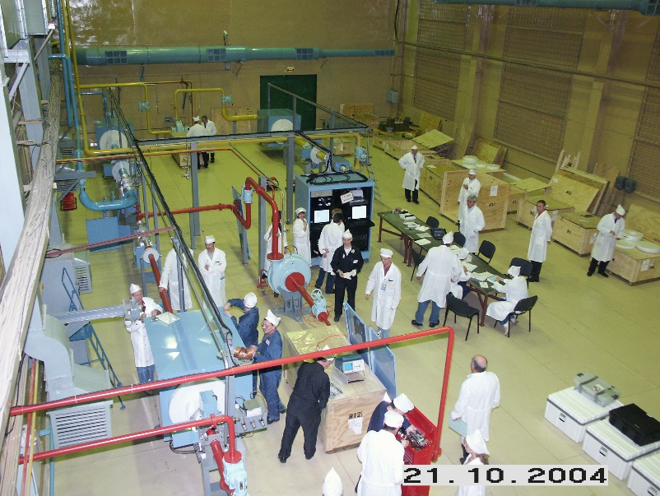
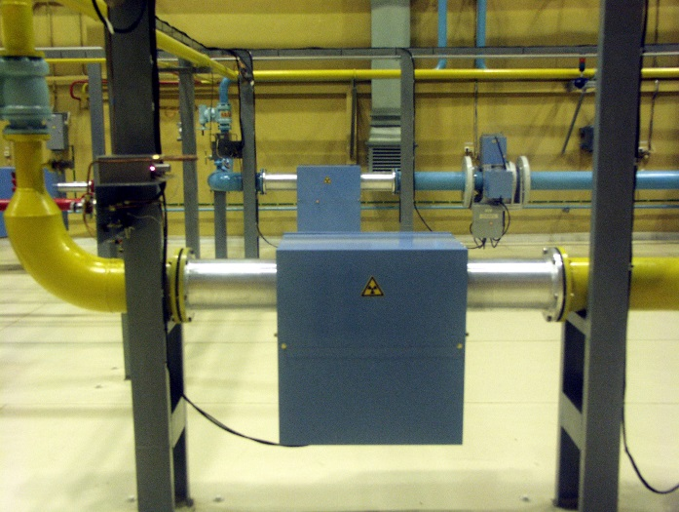
Measurements
The Blend Down Monitoring System performed continuous, unattended HEU, LEU blendstock, and LEU product flow and enrichment measurements
Successfully licensed, installed, and operated at all three Russian blending facilities
  UEIP (Installed January 1999)
  ECP (Installed March 2003)
  SChE (Installed October 2004)

Slide 24
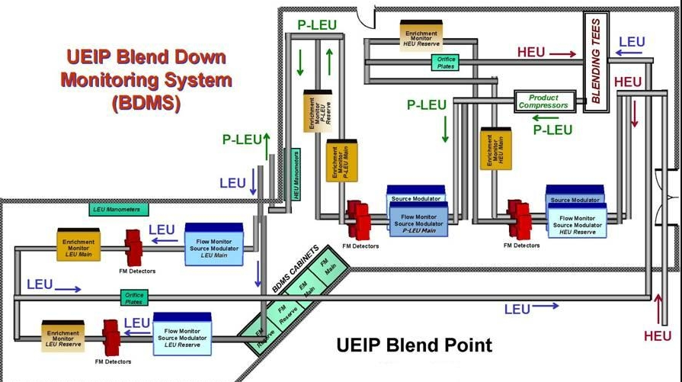
UEIP Blend Down Monitoring System

Slide 25
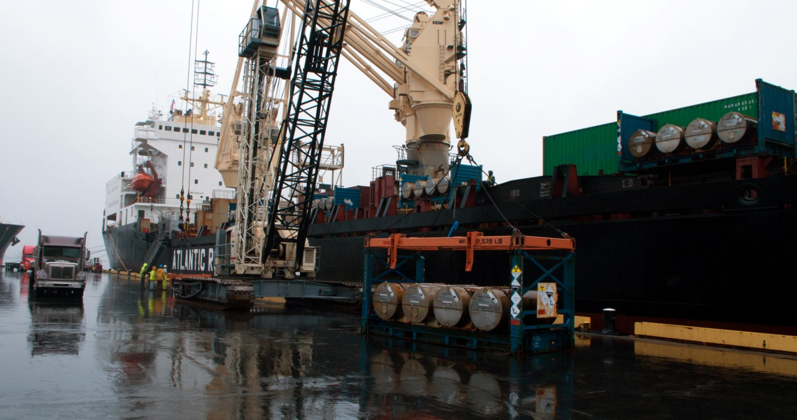
Commercial Implementation
USEC and Tenex specified annual delivery terms for LEU containing 30 MT 90% HEU
USEC received LEU in St. Petersburg
  USEC paid Tenex for SWU component of LEU (final payment 14 March)
  USEC transfered title of an equivalent amount of natural uranium to Tenex

Slide 26
Mutual Benefits
Russian weapons-derived LEU provides nearly half of all U.S. nuclear fuel and generates about 10% of U.S. electricity
Stable Russian access to U.S. and uranium markets
Stable employment for Russian HEU scientists, engineers, and technicians
Russia received $17 billion for the sale of the LEU
500 MT HEU converted into LEU is equal to 20,000 nuclear weapons permanently eliminated
Notes:
30 MT HEU eliminated each year (about 1,200 weapons)
No future opportunity for theft or diversion

Slide 27
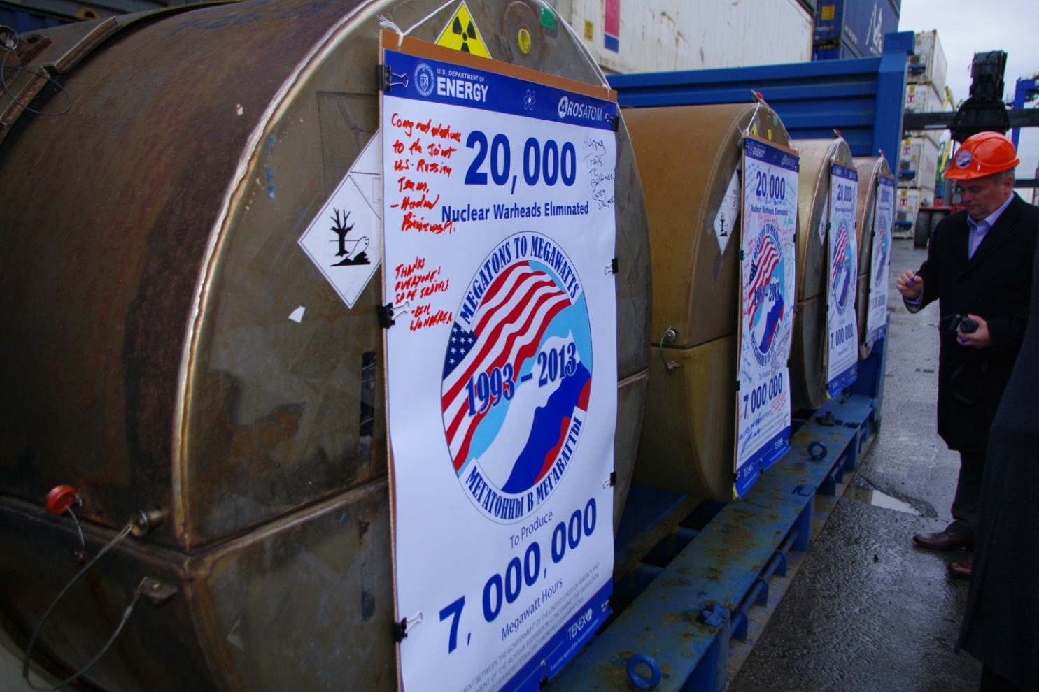
Results After 20 Years
500 MT HEU (20,000 nuclear warheads equivalent) converted into LEU
Final LEU delivery completed in November, 2013
One of the world’s most successful nuclear threat reduction programs
Unique government-industry partnership to convert excess nuclear weapons material into a major source of electricity

Slide 28
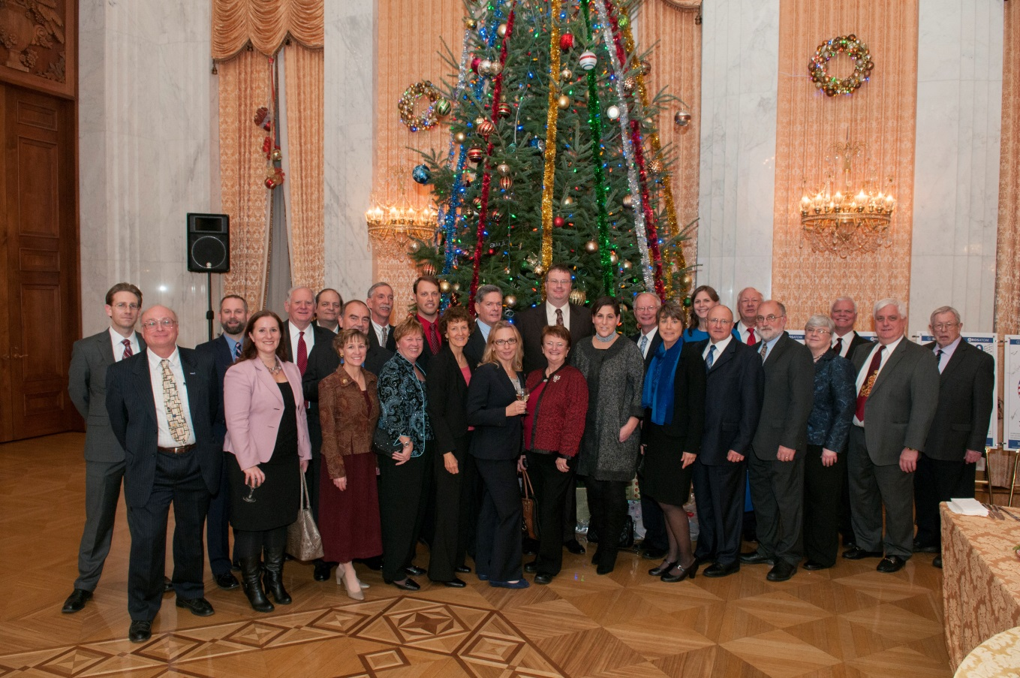
The HEU Transparency Program is widely regarded as the world’s most successful nuclear threat reduction program.

