Slide 1
Superconductivity as the Enabling Technology for All-Electric Aircraft
Cesar A. Luongo ⁽¹⁾ and Philippe J. Masson ⁽²⁾
(1) Engineering Division, Thomas Jefferson National Accelerator Facility (Jefferson Lab)
Newport News, VA, USA
(2) Department of Mechanical Engineering, University of Houston, and
Texas Center for Applied Superconductivity – University of Houston
Houston, TX, USA
Fermi Lab Colloquium– March 18, 2015
Including contributions from: Taewoo Nam &Dimitri Mavris, Aerospace Systems Design Laboratory, Georgia Institute of Technology; Hyun Dae Kim & Gerald Brown, NASA Glenn Research Center; Mark Waters & David Hall, DHC Engineering.
Research funded by NASA-Glenn Research Center and DOD

Slide 2
Outline
Motivation
  Increased Traffic Efficiency, Emissions & Noise
Brief Review of Current Aircraft Technology
  The transition to More- & All-Electric Aircraft
  The case for electric/superconducting machines
Superconducting Machines for Aircraft
  Brief review of past efforts on superconducting rotating machinery for aircraft application
  High fidelity sizing tool
  AC losses in superconducting stators
Design Example
  NASA distributed propulsion aircraft
Conclusions/Path Forward

Slide 3





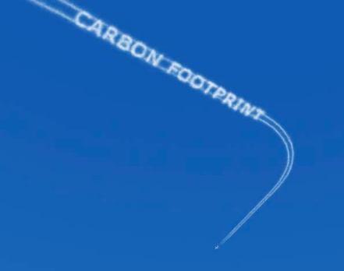
The push for sustainable aviation

Slide 4
Why sustainable aviation?
Transportation accounts for 25% of all greenhouse emissions globally, 11% of that is aircraft (~ 3% of the total)
Air traffic is growing much faster than all other transportation modes, ~ 5%/year over a long trend
At this rate, by 2050 aircraft will be responsible for 10% of all greenhouse emissions (as opposed to today’s 3%)
“Aircraft greenhouse gas emissions might become a serious barrier to aviation growth long-term”
Marion Blakey, FAA Administrator
ICAO, Quebec, May 2007

Slide 5
Air Traffic Growth (in Trillion Passanger-km)
12
10
8
6
4
2
0
Historical
Future
Long-Term Growth
2006 - 2025
GDP = 3.1%
Passenger = 4.9%
Cargo = 6.1%
1985
1995
2005
2015
2025
Source: “Boeing Commercial Airplanes current Product Overview,” presented at San Diego County Regional Airport Authority Advisory Committee, July 12, 2007

Slide 6
The World Fleet Will More Than Double Between ‘05 and ‘25
3%
6%
14%
13%
18%
23%
62%
61%
2005
16,168 airplanes
2025
34,764 airplanes
Regional jets
Single-aisle
Twin-aisle
747 and larger
Source: “Boeing Commercial Airplanes current Product Overview,” presented at San Diego County Regional Airport Authority Advisory Committee, July 12, 2007

Slide 7
Aircraft engine fuel efficiency
35,000 ft., 0.8M, Standard Day
Uninstalled Cruise SFC,(lb/hr/lb)
Certification Date
Source: NASA Glenn
Jet engine technology has gone through a couple of step-changes that enabled higher efficiencies. What is the next step-change?

Slide 8


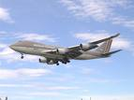



Engine Noise & Regulations
23
Concorde
?
10.0
Average Noise
Level Relative
To Stage 3
(EPNdB)
Stage 2
DC9-10
B-737-200
Negotiated
Out of Service
B-727-200
Average
In Service
Stage 3
0.0
B-747-100
Stage 4
B-727-100
B-747-200
B-747-300
MD-800
A300-600R
A300
A310-222
A330-300
757-200
A 10 dB fleet cumulative reduction from Stage 3
747-400
B 777-200
MD-90-30
-10.0
1960
1970
1980
1990
2000
2010
2020
Year of Certification
Jet engine technology has continued to evolve to match ever more stringent noise regulations. What is the next frontier for ultra-quiet flight?

Slide 9
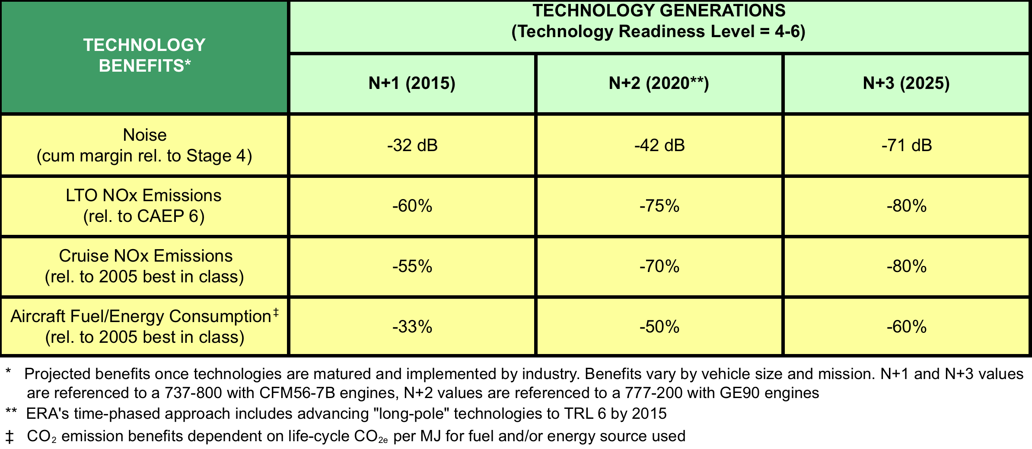
NASA’s Goals for Subsonic Fixed Wing

Slide 10
We need quieter, more fuel efficient, aircraft
What are the expected consequences of air traffic growth? Can we even match some of the forthcoming restrictions?
  We know many of the targets cannot be met with existing technologies. We need step-changes.
What new aeropropulsion concept has the best chance of helping us meet the new targets?
  Electric-driven propulsion offers many advantages and could provide a path to more efficient and quieter flight
  If electric-driven propulsion is the path, are HTS superconductors the breakthrough technology that will enable this revolution?

Slide 11
Typical Modern Commercial Turbo-Fan Propulsion System
Fan produces
>85% of thrust
Jet produces
<15% of thrust
For fuel efficiency and noise, most of the thrust in today’s aero-turbines comes from the fan, not from the jet (very high bypass ratio).

Slide 12
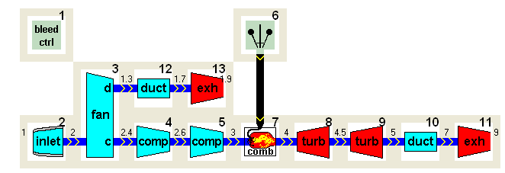
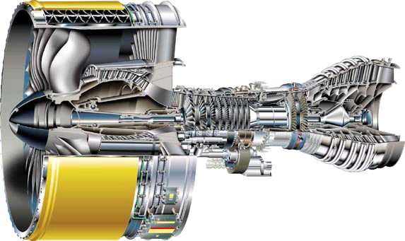
Electric Ducted Fan Concept
Engine core replaced by electric motor
Thrust generated by fan rotation only (minimal loss due to jet engine removal)
Electric Propulsion Motor
Large Aircraft Turbine Engine
Large Aircraft Electric Drive
High Bypass Fan Section with electrical motor
Bypass Fan
Bypass Fan
Section of Aircraft
Section of Aircraft
Engine
Engine
Superconducting
Electrical
Drive Motor
Drive Motor
Superconducting
Superconducting
Motor Replaces
Motor Replaces
Turbine
Turbine
High Bypass Turbofan
Electrical Ducted Fan
.
.

Slide 13
Distributed propulsion for aircraft?
CONS
PROS
Engine and propulsor must be co-located
Turbine shaft RPM limited by sonic speed in propulsion fan blade tip
Torque/speed inflexibly linked
Engine out gives asymmetrical thrust
Electric-driven propulsion opens up a whole new design space allowing for more efficient and reliable aircraft

Slide 14
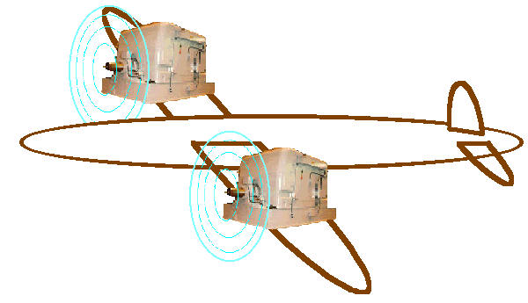
Why Superconducting Machines?
Gas turbine core specific power in the range of 3 – 8 kW/kg
Electrical motors exhibit a specific power < 0.5 kW/kg
Conventional machines have reached their maximum in terms of specific power, and are too heavy for aero-applications
A new technology has to be considered
Superconductivity is the enabling technology

Slide 15
Weight comparison of turbine engines and motors shows turbo-electric aircraft drive is now an option (with superconductivity)
Industrial motors outweigh turbine engines by factor of 5 to 10.
Turbine engine core
All-Superconducting motors may be lighter by a factor of 3.

Slide 16
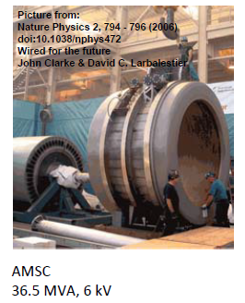
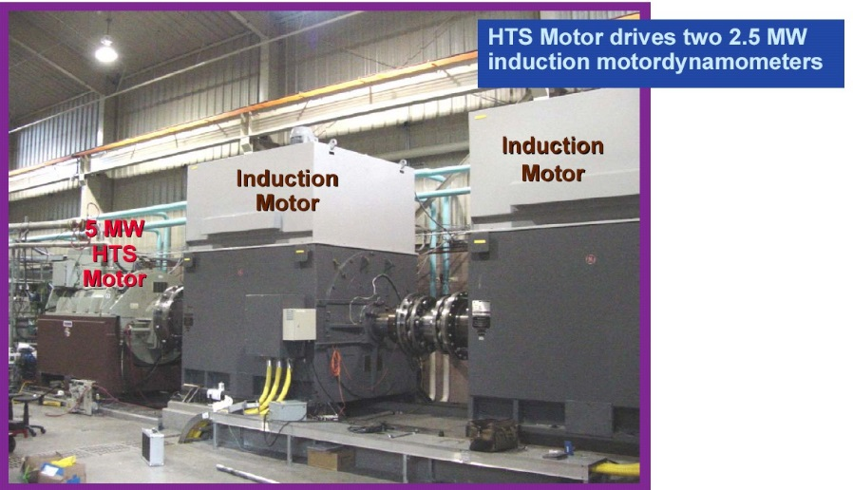
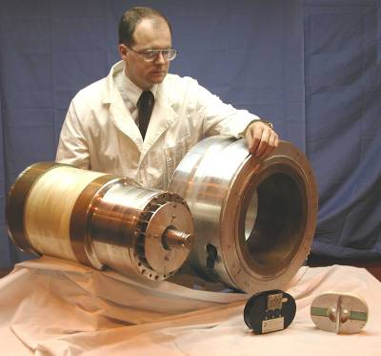
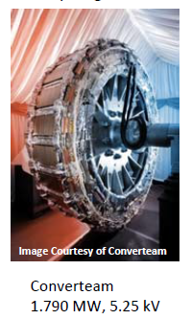
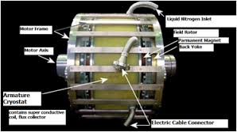
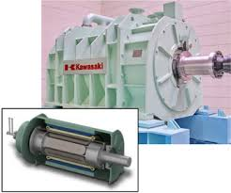
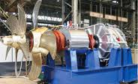
Some Existing Superconducting Machines
2004’s - AMSC
5 MW, 30 K - BSCCO
1990’s - Westinghouse STC
1 MW, 20 K- BSCCO
2008’s - Siemens
4 MVA, 30 K - BSCCO

Slide 17


Superconductivity for propulsion
42 years ago… 1972 Applied Superconductivity Conference
First mention of superconductors in the context of transportation (ship propulsion). Proposal to separate generator/load through “electrical gearbox”
38 years ago… 1976 Applied Superconductivity Conference
First mention of superconducting rotating machinery in the context of airborne applications (superconducting generators for aircraft).

Slide 18
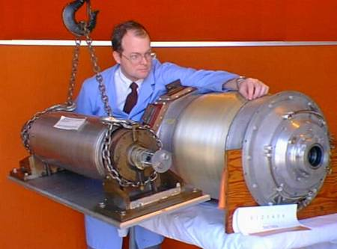
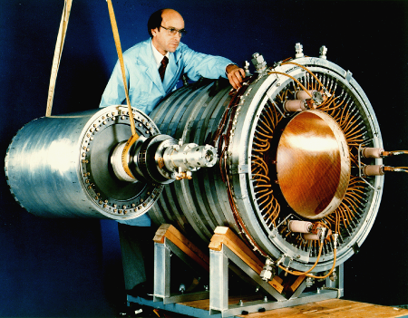
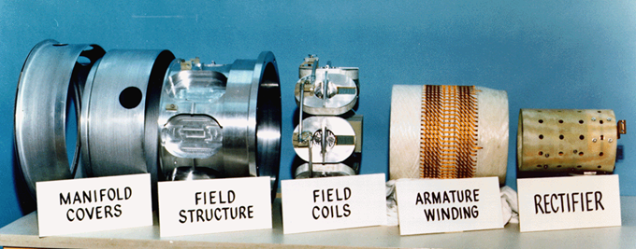
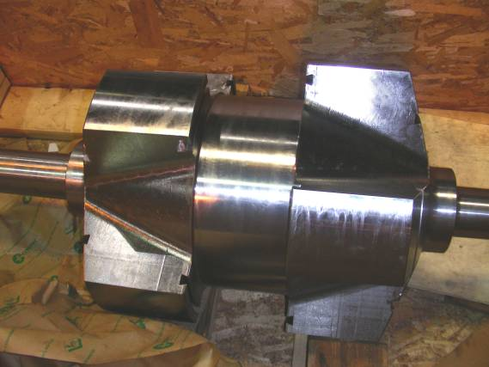
Superconducting generators for airborne application
1970s - Westinghouse
5 MW, 4.5 K - NbTi
1980s - General Electric
20 MW, 4.5 - 8 K - NbTi/Nb₃Sn
1990s - Westinghouse STC
1 MW, 20 K - BSCCO
2006 by LEI Electromagnetics
3MW, 15,000 RPM, 5.3 kW/kg
generator coupled with gas turbine. Uses BSCCO
2007 by GE
1.5 MW,16,000 RPM, 7 kW/kg
generator coupled with gas turbine. Uses HTS coils/stator
Courtesy Dr. Oberly - AFRL

Slide 19
How about cooling?
Option 1: LH2
  If LH2 is onboard as fuel (e.g., fuel cells) then cooling of the superconducting machines is “free” as we need to warm-up hydrogen before introduction to the fuel cell. Excellent synergy obtained.
  However, dense hydrogen storage is an issue, we are not likely to see LH2-fueled aircraft for a long time – the specific energy storage of LH2 is too low for airborne application

Slide 20
How about cooling? (2)
Option 2: Cryogen loaded prior to flight
  Load enough cryogen at airport for the flight duration + margin
  If LH2, it could also be used as fuel and burnt in the engine along with jet fuel after cooling the HTS components (e.g., 95% jet fuel, 5% H2)
Option 3: Cryocoolers
  Obvious choice, but too heavy as of now.

Slide 21
Distributed Propulsion – Power Network
LH2 is used to cool-down superconducting components and power converters
Network dynamic simulation is used to determine the requirements of energy storage devices and reconfiguration
Turboshaft

Slide 22
Cryocooler Weights Could be Reduced Further

Slide 23
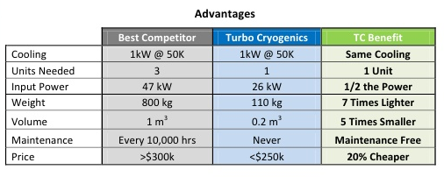

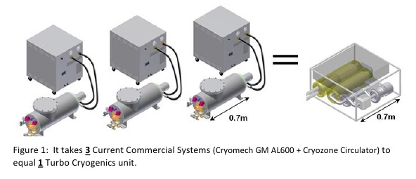
Turbo Cryogenics
Spin-off from Creare
Reverse Turbo Brayton cryocoolers
  Proven technology
  Extremely reliable (Hubble Telescope)
  Maintenance free
  High efficiency
  Distributed cooling

Slide 24
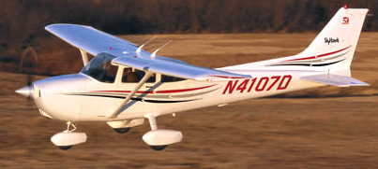
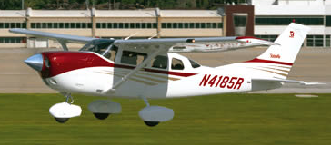
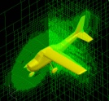
Aircraft Design
Historically, aircraft have been designed using extrapolations of regressed data
Revolutionary designs, however, have no historical database to draw upon, making design by extrapolation impossible.
Modern design methods address the design of revolutionary vehicles through increased reliance on physics-based modeling
Physics-Based Modeling and Simulation
Sensitivity Analysis
Notional Design
Technologies
Probabilistic
and Statistical Techniques
Impact of
Technologies
Risk
Uncertainty
Induced
Drag
Parasite Drag
AR
Taper
Ratio
Wing
Area
Sweep
Need to develop sizing models for electrically driven propulsion

Slide 25

Sizing Model - Amber
High fidelity sizing tool for fully superconducting rotating machines.
  Accurate 3D geometry represented
    Electromagnetics, mechanical and thermal
  Portable code in Python and C
Model for quench propagation
  Address detection and protection
New model /scaling law for AC losses
in superconducting stators
  Based on FEA simulations
  Experimental validation

Slide 26
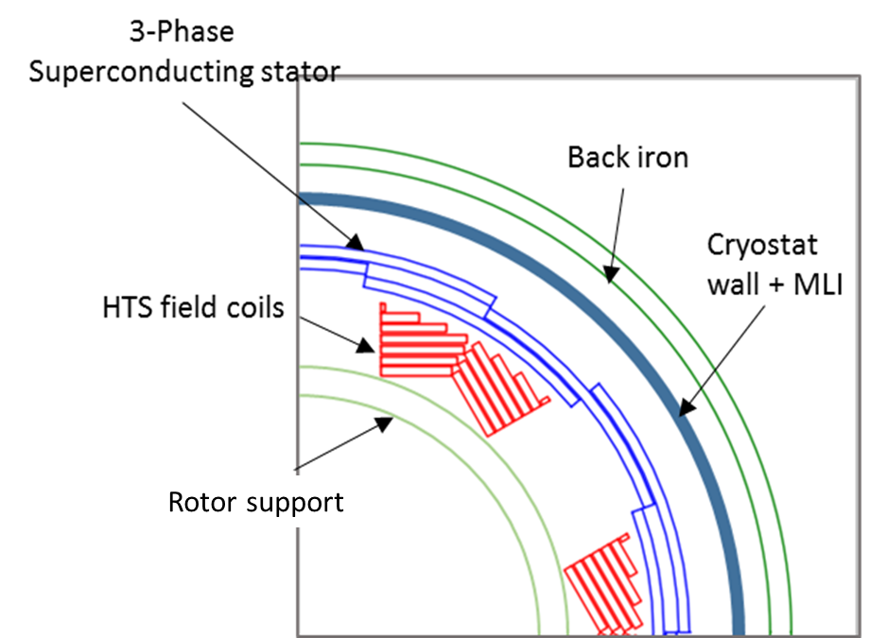
Higher Fidelity Geometry Representation
Accurate 3D geometry represented

Slide 27
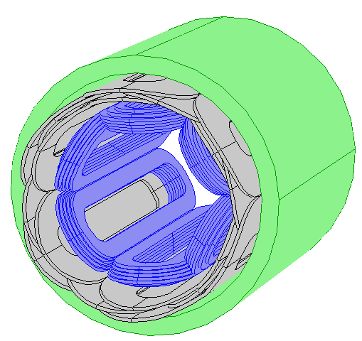
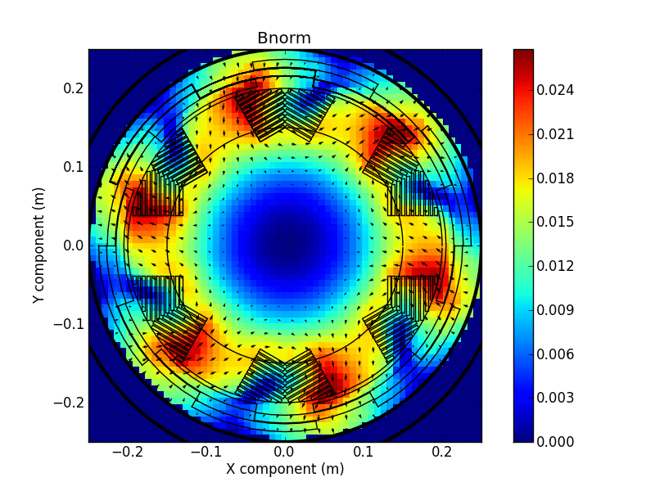
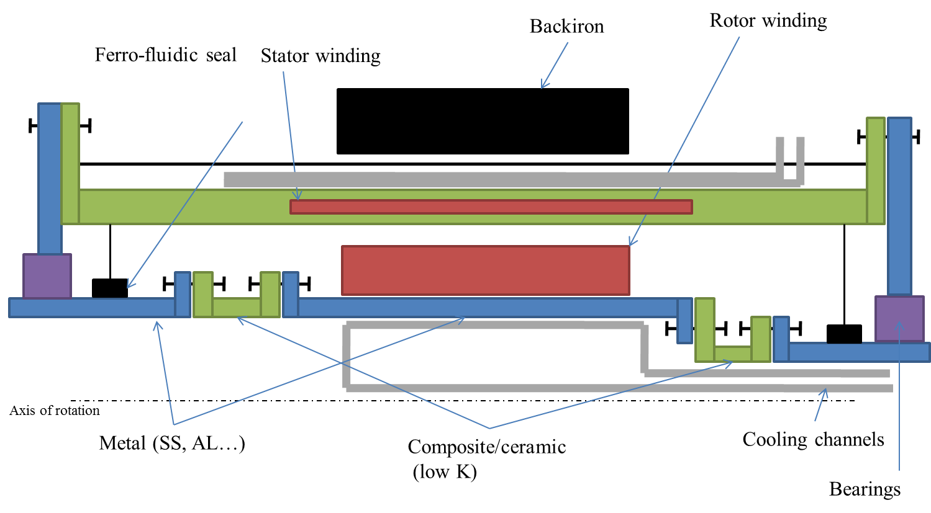
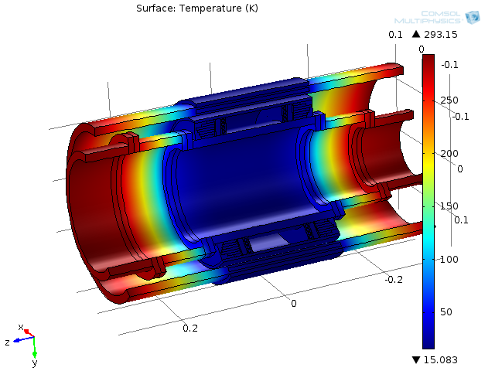
Sizing Model “Amber” Version 1.0
Zeroth order analytical sizing model (2D) used for preliminary optimization (Parallel)
Electromagnetic model (Parallel)
  Geometry accurately represented
  No mesh in air
  Based on integral methods (GFUN – Biot Savart)
Mechanical model
  Geometry accurately represented
  Steel and composite materials
  Thermal and force induced stress
Thermal model
  Total cryogenic heat load and temperature distribution estimated using finite differences
  Cryogenic system based on LH2 or Reversed Turbo-Brayton cryocoolers

Slide 28
Model Architecture
Constraints
Jc(B), AC losses, materials…
Sizing
  Inputs: T, Ks, L/R, p
  For each value of p
    Use gradient based optimization for minimum mass (active) with constraint on AC losses
    Process for N initial conditions (to avoid local minimum)
  Returns
    machine geometry for active components
    Ks, B_{r}⁰, La, R, p
Current adjust
  Addresses discrepancies between analytical and 3D model for
    B_{r}⁰ – adjust rotor current, recalculate margin
    Torque – adjust stator current, recalculate margin
3D Model / Post Proc
  Calculates all machine parameters
    EM - AC losses, Inductances, Torque …
    Mech/Thermal – heat leak, T distr, support/torque transf. components, mass…
Power
RPM
Sizing/Opt
0th order
Current Adjust
EM
3D Model / Post Proc
Mechanical / Thermal
Write files

Slide 29
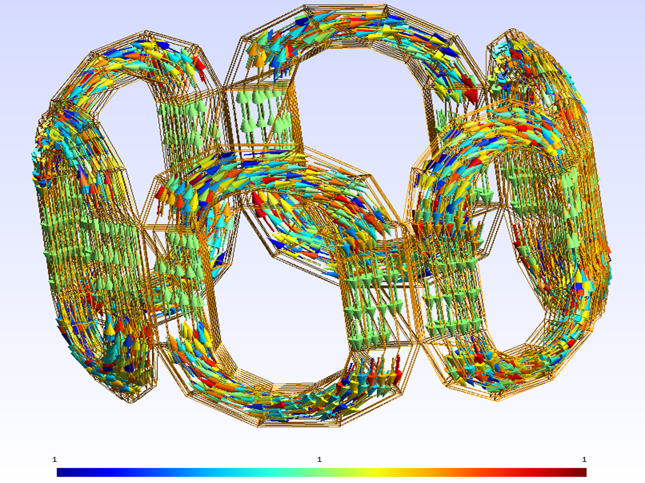
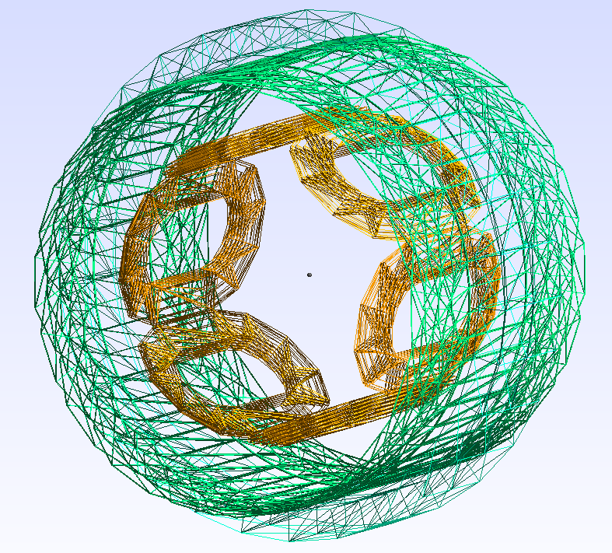
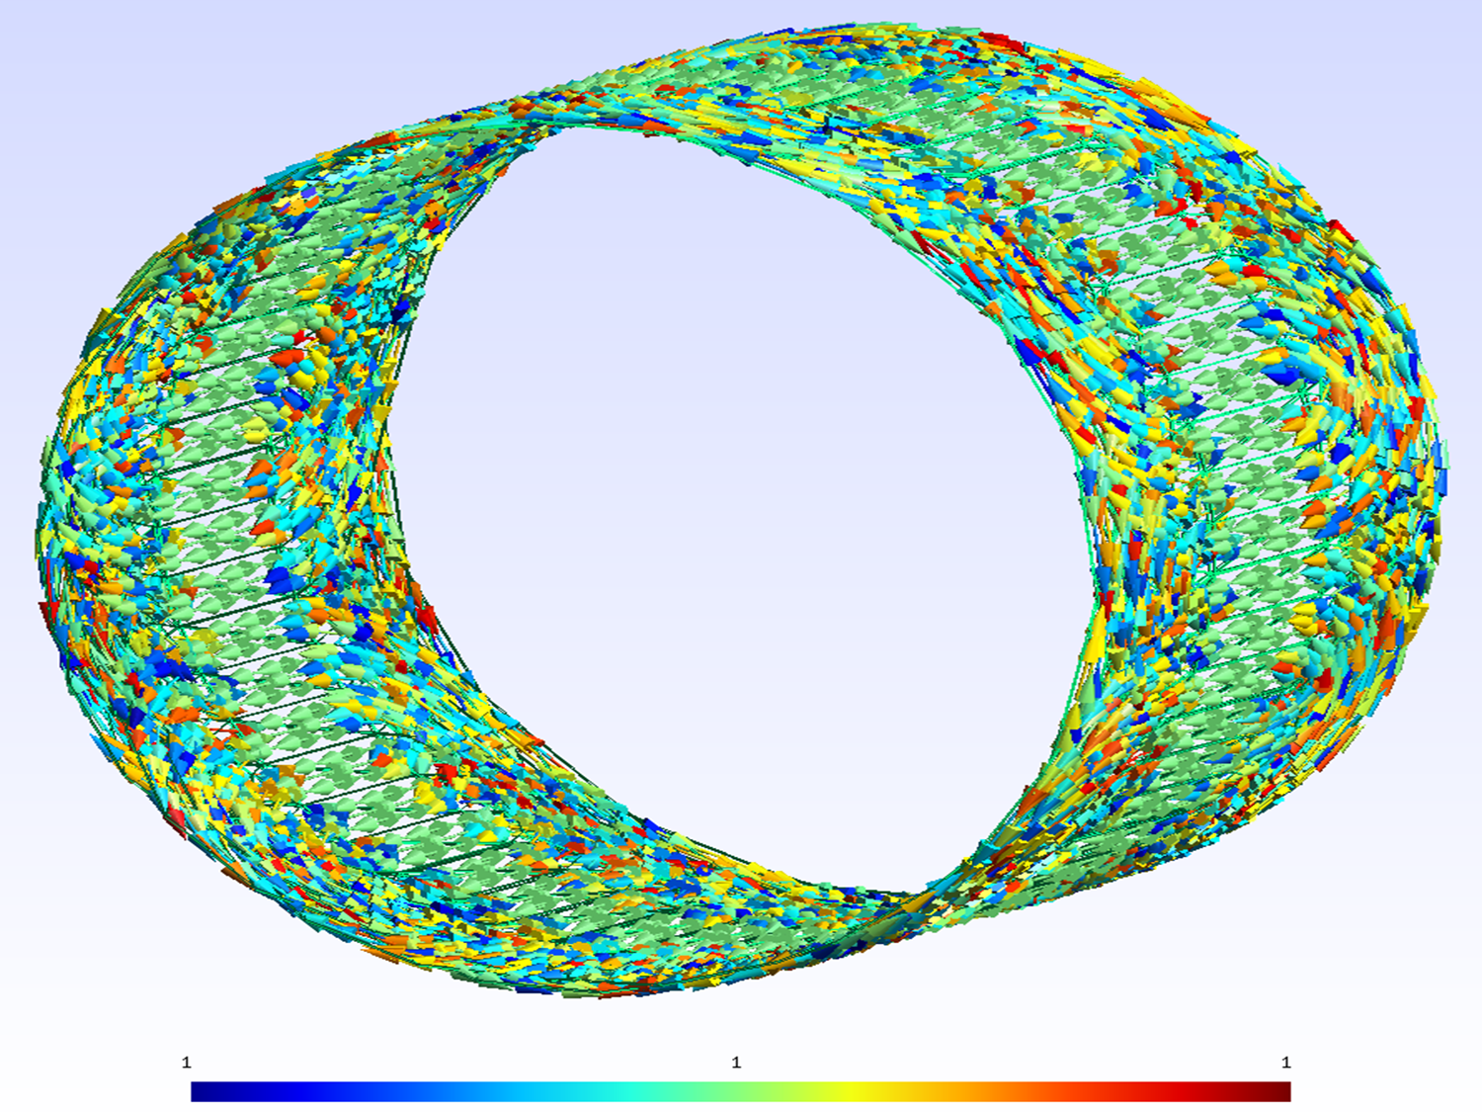
Sources Discretization
Mesh: simple regular or from GMSH
Elements and direction of current/magnetization are stored
Parallel implementation
Full machine consist of list of tetrahedrons with current density or magnetized
Air is not meshed

Slide 30
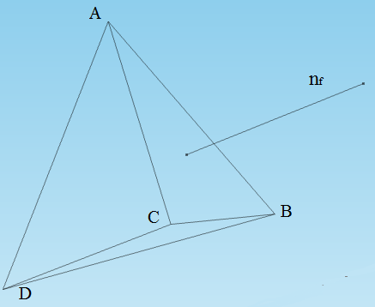
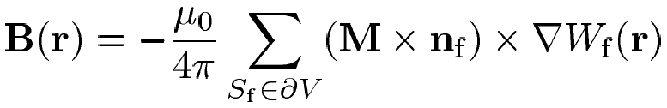

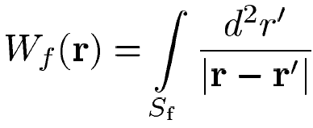
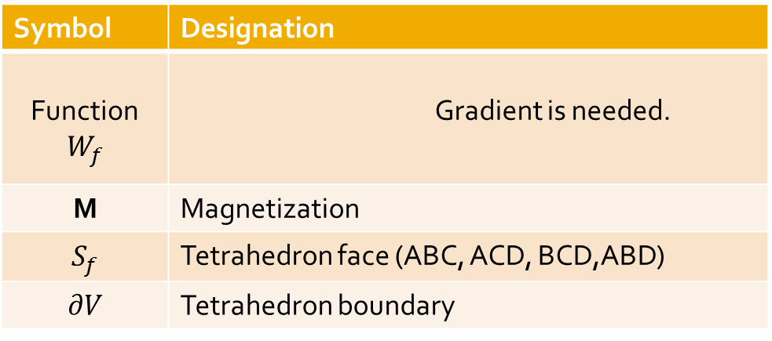
B from Uniform Tetrahedral Sources
Original formulation :
Modified formulation :
Symbol | Designation
Function | Gradient is needed.
M | Magnetization
 | Tetrahedron face (ABC, ACD, BCD,ABD)
 | Tetrahedron boundary

Slide 31
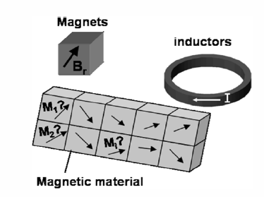
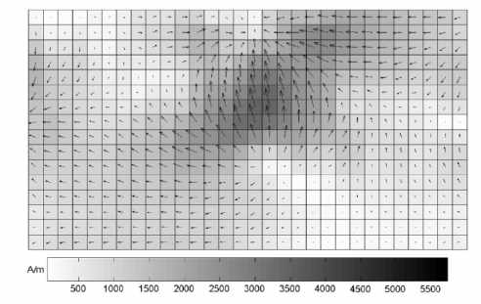
Magnetic Material Magnetization
The contribution of the iron components is numerically computed using the magnetic moments method (gfun).
  The iron is subdivided into uniformly magnetized elements
  The non-linear permeability of the magnetic material is then taken into account through a relaxation method.
  This approach for iron calculations is used in some software such as the Radia module developed by ESRF as an add-on to Mathematica™

Slide 32
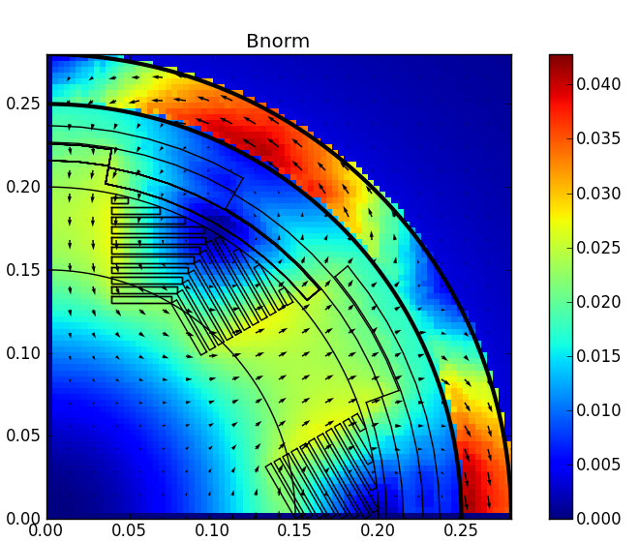
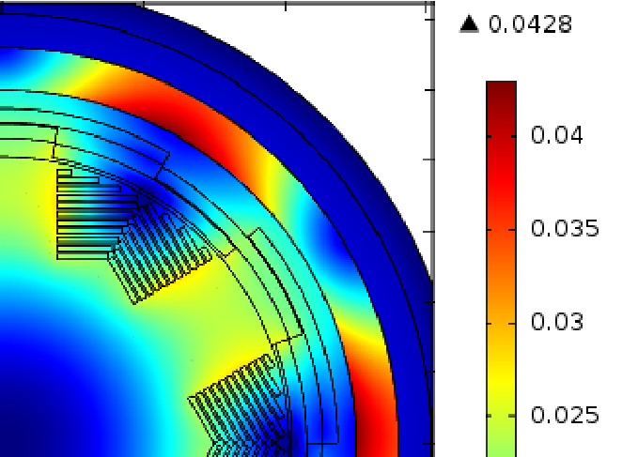
Full Machine – Flux Distribution
COMSOL (2D)
PYTHON (3D)

Slide 33
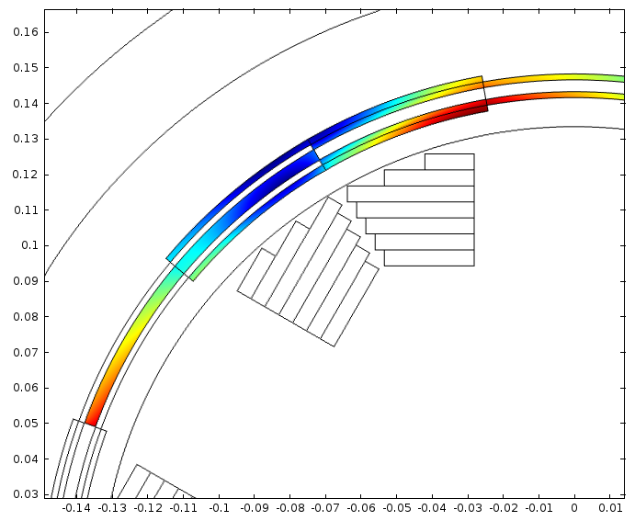
Flux distribution in stator
Flux density contribution from both rotor and stator
Non uniform flux density distribution

Slide 34
Frequency Dependence of AC Losses
3 sources of AC losses in superconductors:
  Magnetization losses
  P_{mag}α B, f, J_{c}
  Coupling losses
  P_{coupl} α B², f²
  Eddy current losses
  P_{Eddy} α B², f²
Magnetization
losses are
dominating for
“large filaments”

Slide 35
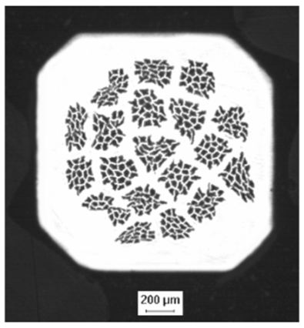
Magnetization (Hysteresis) Losses Calculation
Assumes AC field (alternating)
  Limited to self field
Transport current and applied field are in phase
J_{c}: filament critical current density
λ_{s}: fraction of superconductor
d: filament size
B₀: flux density variation
F: I/Ic

Slide 36
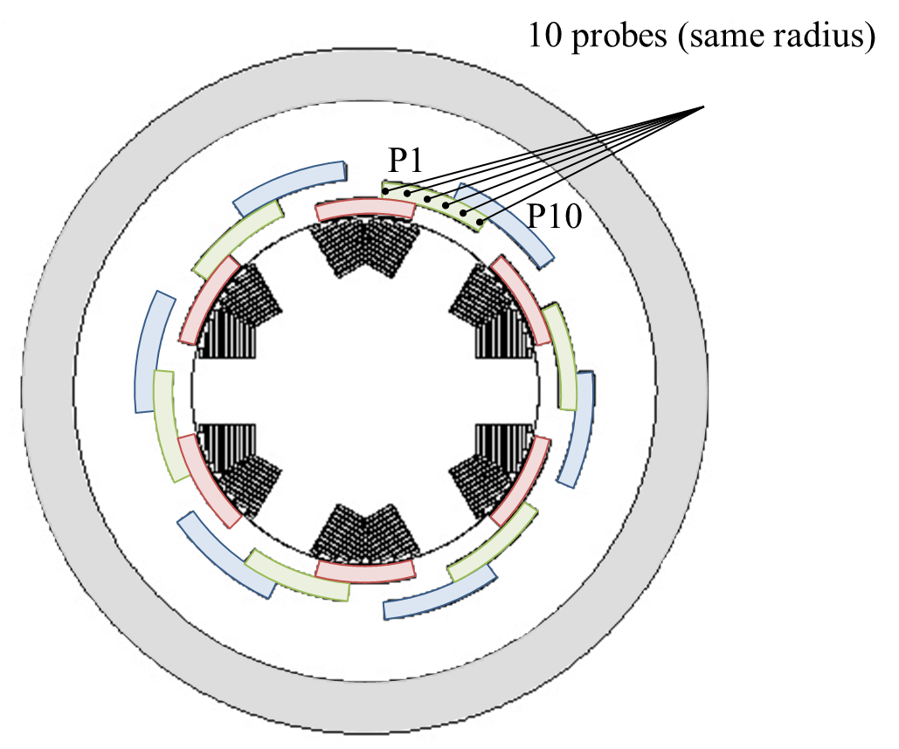
Field Configuration is Sc. Stators
Peak field
Rotating/pulsating
In 1 pole, each stator conductor is in a unique magnetic configuration
Phase angle
rotating-pulsating
Probe #

Slide 37
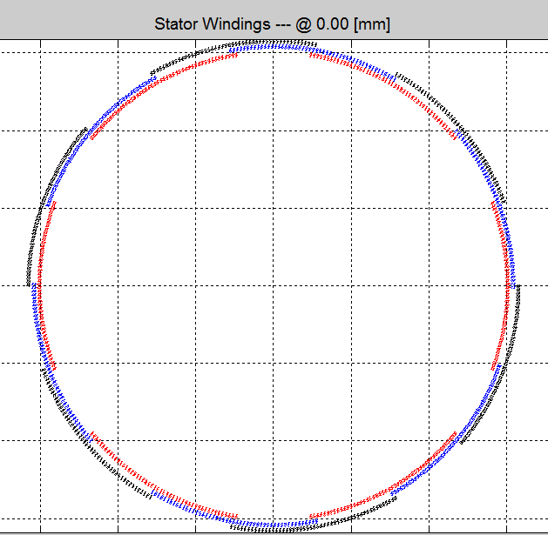
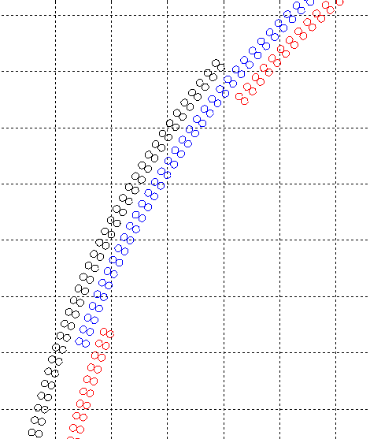
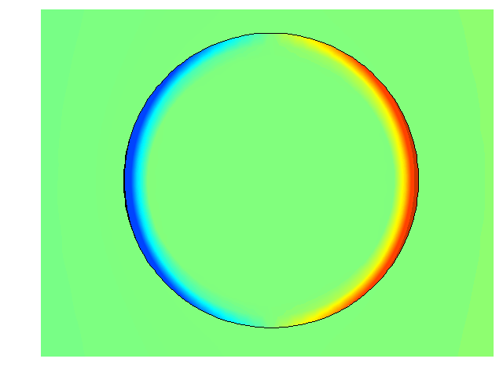
Model Assumptions
Armature
Cross-Section
Filaments are twisted and magnetically decoupled
  Analysis can be done on 1 filament
  Model implemented with H-formulation
  Sc. Modeled using a power law
  Elliptical field and transport current

Slide 38
Dimensional Analysis
Identified parameters:
b*
f*
i*
with
with
with
and n, k, φ, θ
7 variables
Those parameters can be called invariants since the reduced losses q do not change if they do not change.
Reduced losses:
with
with

Slide 39
Alternating field losses – SL (1/3)
n = 20
b* = 20
b* = 1
q* versus f* for various b*
b* = 10
b* = 0.5
b* = 2
b* = 0.25

Slide 40
Alternating field losses (n=20) – SL (2/3)
If we divide the abscissa by b*² ⇒
If we divide the abscissa by b*⁴ ⇒
If we divide the abscissa by b*¹⁰ ⇒
If we divide the abscissa by b*¹⁹ ⇒

Slide 41
Alternating field losses – Scaling Law (3/3)
Data can be normalized with respect to a function of n
with
with
with

Slide 42
Losses in Rotating field Scaling Law
Rotating field: k = 1
Same method
with
Data can be normalized with respect to a function of n
with
with
Coefficients α₁ α₂ α₃ α₄ α₅ are different

Slide 43
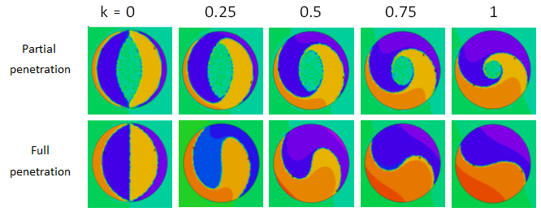
Elliptical field
alt
k = 0.25, 0.5, 0.75
1
0
ell
1
k
Same method
rot
1
Q*
1
X*

Slide 44
Elliptical field – with phase angle
Ratio between losses with and without phase angle can be approximate by:

Slide 45
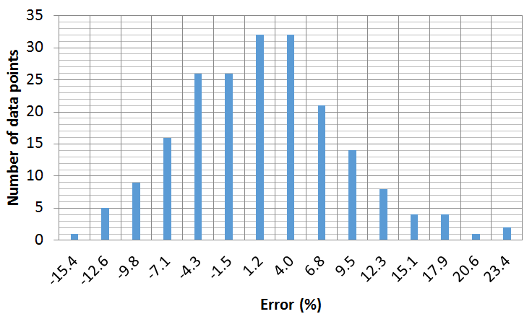
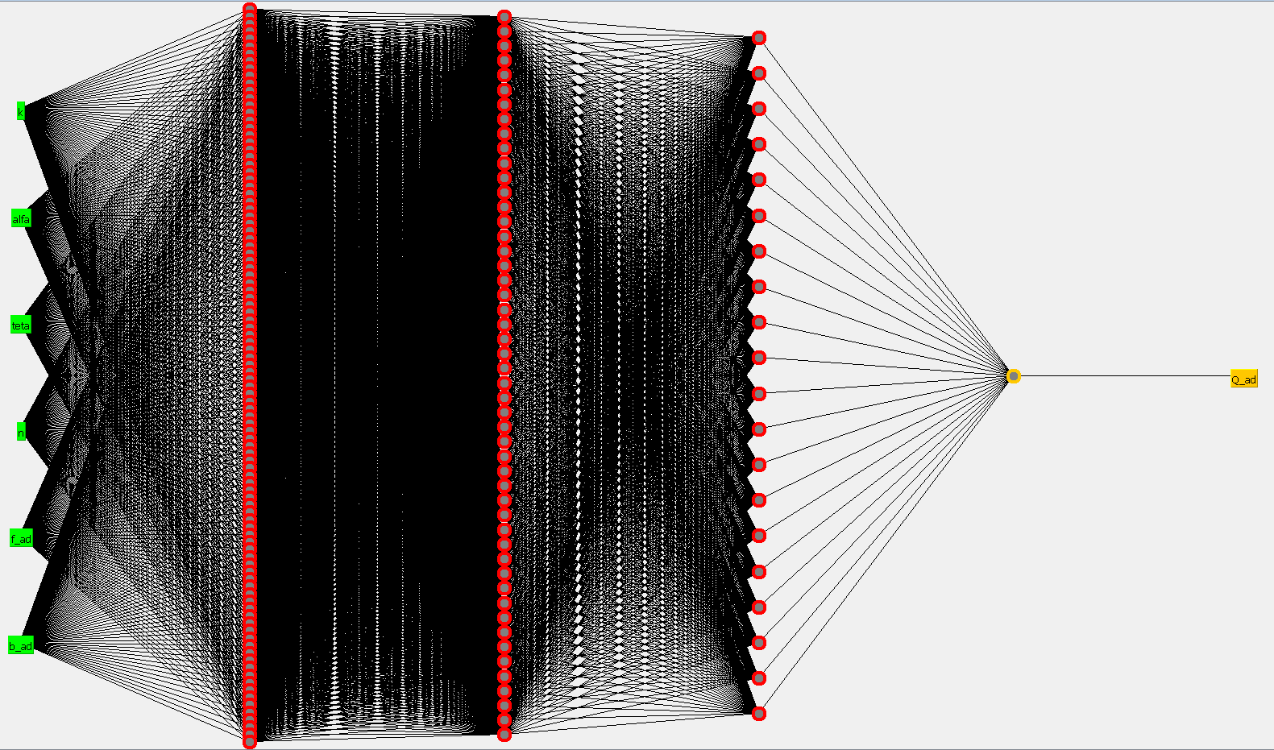
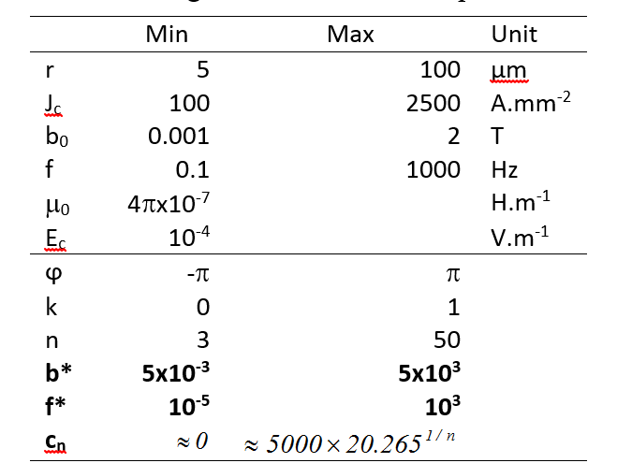
Elliptical Field with Transport Current
2,000 points are used for training.
600 points are used for regression validation
Based on current available data:
  Model is accurate within ~10 %
3 hidden layers:
  First layer: 100 neurons
  Second layer 50 neurons
  Third layer 20 neurons

Slide 46
AC Losses Computation
Power, RPM
Example of Armature
Cross-Section
Constraints
Jc(B), OD…
Machine sizing
Machine geometry + sources
Calculate stator conductor coordinates
Stator conductors coordinates
Simulate rotation at full charge
AC losses
B_{r}, B_{θ} on stator conductors
AC losses model
For stator
i*, f*, b*, k, n, φ, θ
ΔB
AC losses model parameters

Slide 47
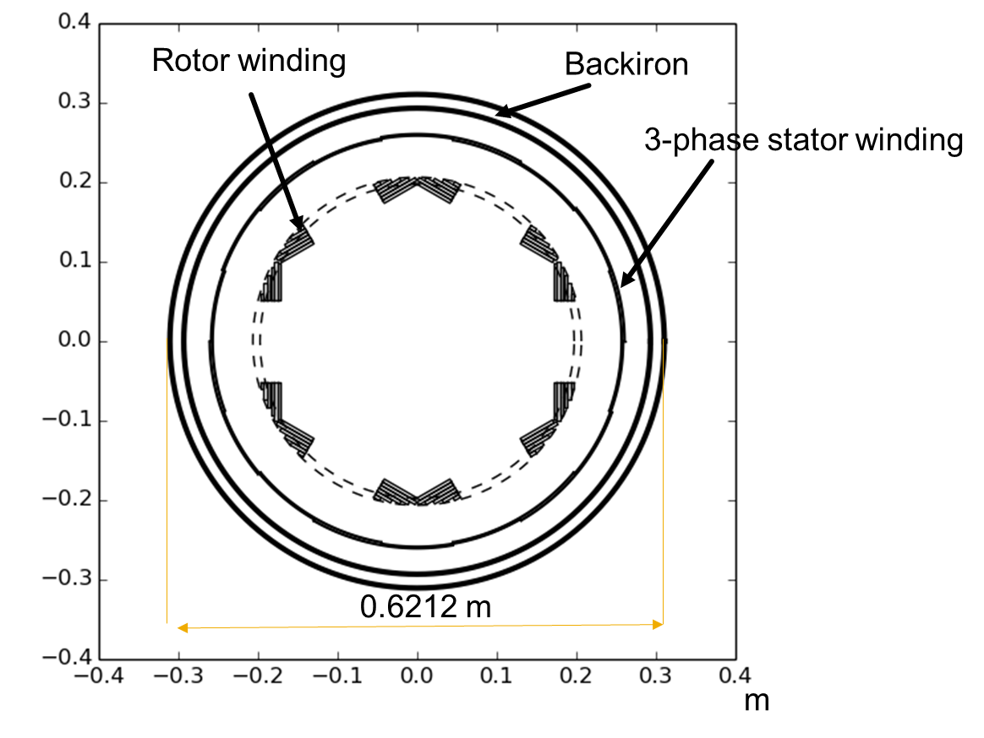
Generator Design Example
REQUIREMENTS
Gas turbine driven generator
Fully Superconducting
12 MW – 8 kRPM
Specific power
> 20 kW/kg
Operating
temperature: 20 K
Superconductor:
MgB2
Losses at 20 K
< 8 kW
Cooled by LH2

Slide 48
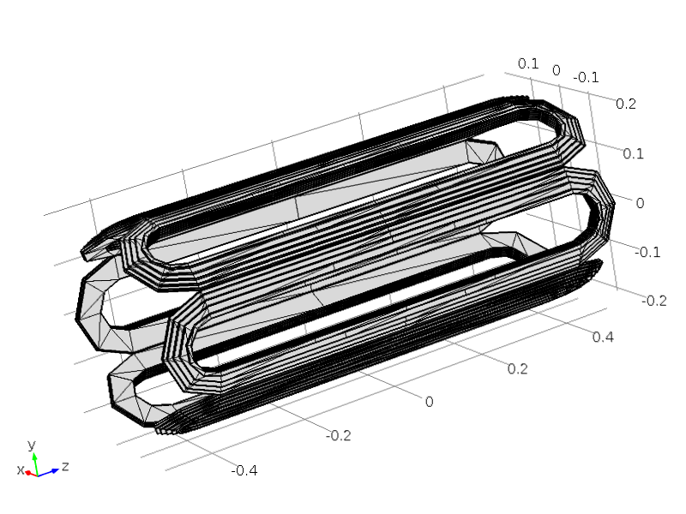
Rotor Design
The rotor is composed of an assembly of racetrack coils
  Active length 0.79 [m]
  Rotor engineering current density 65.8 [A*mm^-2]
  Outer radius winding rotor 0.2063 [m]
Rotor racetracks
  Number of coils per pole 6
  Height of a racetrack 4.00 [mm]
  Gap between racetracks 0.50 [mm]
Conductor: MgB2 tape
  Thickness of superconducting tape 0.40 [mm]
  Buffer between tapes 0.30 [mm]
  Filling factor 57.14 [percent]
Width of Racetracks
  number 1 0.0469 [m]
  number 2 0.0497 [m]
  number 3 0.0420 [m]
  number 4 0.0322 [m]
  number 5 0.0217 [m]
  number 6 0.0084 [m]
Conductor design:
  MgB2 tapes/flat cable

Slide 49

Stator Design
Stator is composed of 3 sets of saddle coils
  Outer winding stator 0.2612 [m]
  Total length 1.06 [m]
  Individual coil thikness 1.27 [mm]
  Gap between phases 0.50 [mm]
  Stator current density 153.8 [A*mm^-2]
  Filling ratio 70.00 [%]
Conductor
  Strand diameter 0.6 [mm]
  Diameter of cable 2.88 [mm]
    23 strands

Slide 50

Mass Estimation
Backiron is composed of magnetic laminations
  Maximum B = 1.9 T
  OD = 0.6212 m
  Length = 0.79 m
  Thickness = 0.0174 m
  Losses ~38 [kW]
Active mass 284.1 [kg]
  Conductors mass 76.9 [kg]
  Back iron mass 207.2 [kg]
Steel mass 19.2 [kg]
Composite mass 124.6 [kg]
Misc. mass 50.0 [kg]
Total estimated mass: 478.0 [kg]
Estimated Specific Power: 25 [kW/kg]

Slide 51

Heat load
AC Losses
  Magnetization Losses = 2000 [W]
    Average ΔB_{stator} = 0.25 T
  Eddy current Loss = 30 [W]
  Coupling Loss = 900 [W]
Conduction losses
  Rotor = 10 [W]
  Stator = 5 [W]
Radiation losses
  ~10 [W]
Total heat load @ 20 K: ~3000 [W]
LH2 with phase change
Cooling flow required
  .07 l/s
Storage
  740 l/hour
  0.74 m^3/hour

Slide 52

Generator Specification
Generator design specifications
  Power=12500 [kW]
  8000 RPM
  MgB2 @ 20 K
  6 poles
  Frequency = 400 Hz
  Nominal Torque = 14902 [N.m]
  OD= 0.6 m
  Length = 1.5 m
  Maximum B at rotor = 0.837 T
  Maximum B at stator = 0.5 T
  Mass = 480 [kg]
  Specific Power = 25 [kW/kg]
  Specific torque = 30 [Nm/kg]
  Losses
    Iron ~38 [kW]
    Cryogenic ~2.9 [kW@20K] – 200 [kW – 20% Carnot]

Slide 53
Example: NASA CESTOL
(Cruise-Efficient Short Take Off and Landing)
In service 2030-2035
Transcontinental US, ~ 170 passengers
Low fuel consumption, low emissions, low noise
Distributed Propulsion/Hybrid Wing Body (HWB)

Slide 54
Various Jet Propulsion System Placements

Slide 55
Distributed Propulsion
The aim is to appropriately distribute propulsive thrust stream to maximize overall vehicle benefits (aerodynamic, propulsive, structural, etc.)
For maximum benefit, integrating the propulsion with the airframe should be emphasized beginning at the conceptual design phase

Slide 56



Hybrid Wing Body (HWB) Aircraft
Hybrid Wing Body (HWB) Aircraft
Early NASA concept (800-passenger, GE90 turbines)
SAX-40 concept by Silent Aircraft Initiative (MIT/Cambridge)
NASA/USAF/Boeing X-48B subscale demo (6.5m wingspan, RC-UAV), flown July 2007

Slide 57

Baseline 12-engine CESTOL* Concept (N+2)
Initial configuration based on the HWB due to its efficiency, low noise, and large internal volume for integrating embedded distributed propulsion
Mission requirements:
  Payload: 40 000 lb (170-passenger class)
  Range: 3000 nm (transcontinental US)
  Speed: Mach 0.8 at 30 000 ft
  Field length: < 5000 ft (< 1500 m, FAR Part 25)
  Climb at Std + 15 °
  Landing flare for passenger comfort with 6° glide
* Cruise-Efficient Short Take-Off and Landing

Slide 58


Distributed Turboelectric-Powered CESTOL Concept (N+3)
Based on earlier baseline HWB 12-engine configuration
But, we propose a distributed turboelectric propulsion system with 16 (instead of 12) superconducting electric fans powered by two larger (more efficient than the 12 smaller engines) turbine-engine-driven superconducting electric generators.

Slide 59
BENEFITS OF TURBO-ELECTRIC PROPULSION
Large core engines are fuel efficient and drive electric generators.
Electric power from generators
is distributed to multiple fans.
Multiple motor-driven fans ingest
boundary layer & give high bypass
ratio for low fuel burn and emissions.
Some fans produce
externally blown lift
for short field length.
Forward fan noise is
shielded by airframe.
Fans fill in vehicle
wake for low drag,
lower fuel burn and
emissions.
Electric power distribution to
multiple fans is more efficient
and lighter than mechanical.
Low velocity core exhaust
produces low noise.
Small diameter core engine inlets
are acoustically treatable.
High-speed core engines
have fewer turbine stages
than direct fan-drive cores.
THE TURBOELECTRIC APPROACH CONTRIBUTES
TO EVERY CORNER OF THE TRADE SPACE

Slide 60

Distributed Turboelectric-Powered CESTOL Concept
2 wing-tip-mounted turbo-generators (all HTS)
  ~ 2x32 MW @SLS, ~ 2x9.5 MW @cruise
  Target weight: 670 kg per generator (incl. cryo.)
  Target size: 61 cm diameter by 42 cm length (elec.)
A set of 16 electric fans
  35” (~90 cm) diameter each propulsor fan
  ~3.8 MW @SLS, ~1.1 MW @cruise, each fan
  Target weight: 134 kg per HTS motor (incl. cryo.)
  Target size: 38 cm diameter by 25 cm length (elec.)
HTS rotating machinery is the enabling technology of future aircraft

Slide 61
Distributed Turboelectric-Powered CESTOL Concept (2)
Design assumptions for HTS gen./motors
  engineering current density in rotor: 120A/mm²
  engineering current density in stator: 120 A/mm²
  HTS filament dimension: 12 μm (for AC loss)
  Generator: 47 kW/kg, motor: 27 kW/kg
  assumed cryocooler weight : 3 kg/kW-input
  assumed fraction of Carnot efficiency: 30%
  operating temperature: 49 K (optimized for weight)
HTS rotating machinery is the enabling technology of future aircraft
Notes:
See notes in red (fill in?)

Slide 62
Conclusions
Electric propulsion: decoupling of turbine & propulsion
  Opening of design space to revolutionary concepts that improve fuel efficiency and noise through aircraft architecture optimization
Superconducting machines specific power:
  HTS inductor/resistive armature: already comparable to gas turbines (5-10 kW/kg) with today’s technology
  All superconducting: much better than turbines (25-50 kW/kg), enabling technology for electric aircraft, but further development needed
Air-worthy vehicles can be designed based on assumed characteristics for superconducting machines

Slide 63
Research Directions
Demonstrate feasible high specific power HTS machines
  Ultimate target: 25 - 50 kW/kg @ 5,000 to 15,000 rpm.
  (~ 3-5x what is achievable with HTS inductor/resistive armature)
Develop HTS conductors for low AC loss stators (all-superconducting machines)
  ≤ 10 micron diameter filaments
  ≤ 10 W/kA-m AC loss at 500 Hz
Develop aero-cryocoolers with ~ 3 kg/kW-input @ 30% Carnot, or,
Explore alternative cooling schemes with minimum weight
Implement higher fidelity HTS machine models
  Structural parts, exciters, bearings, cryostat, leads, etc.
Perform aero studies of advanced electrically driven aircraft - - hybrid wing body, tilt rotorcraft, “tube-and-wing” with ultra high bypass, etc.

Slide 64
THANK YOU!

Slide 65

Superconductivity & Aeropropulsion
Sustainable aviation represents a strong market pull for superconducting machines
  Weight, volume, and efficiency targets have been established based on detailed design studies
  These targets are aggressive but achievable
Our community’s ingenuity will be called upon to help solve these tough challenges to sustain responsible growth of air travel

Slide 66
Back Up Slides

Slide 67
Air Traffic Growth (in Trillion Passanger-km)
12
10
8
6
4
2
0
Historical
Future
Long-Term Growth
2006 - 2025
GDP = 3.1%
Passenger = 4.9%
Cargo = 6.1%
1985
1995
2005
2015
2025
Source: “Boeing Commercial Airplanes current Product Overview,” presented at San Diego County Regional Airport Authority Advisory Committee, July 12, 2007

Slide 68
The World Fleet Will More Than Double Between ‘05 and ‘25
3%
6%
14%
13%
18%
23%
62%
61%
2005
16,168 airplanes
2025
34,764 airplanes
Regional jets
Single-aisle
Twin-aisle
747 and larger
Source: “Boeing Commercial Airplanes current Product Overview,” presented at San Diego County Regional Airport Authority Advisory Committee, July 12, 2007

Slide 69
How to Improve Specific Power?
H_{t} : provided by the stator windings
B_{n} : provided by the rotor excitation
N : rotation speed
P/V (kW/kg) α H_{t}*B_{n}*N
H_{t}
Increase N :
Need a gear box ⇒ higher weight
⇒ lower reliability
B_{n}
Increase H_{t} :
superconductors ⇒ higher current density
cryogenic cooling ⇒ lower resistance
ironless housing ⇒ better conductor density
AC losses
Excitation/Inductor
(rotor, DC)
Increase B_{n} :
superconductor wire ⇒ high flux density
⇒ remove magnetic core
Armature (stator, AC)

Slide 70






Design 1: General Aviation – Fail Safe Study
simple aircraft
mechanical control systems
no hydraulic system
easy to convert into all-electric
Cessna 172
needs to be conduction cooled
motor + cryocooler should be lighter than combustion engine
needs to include fail safe feature for safe landing
Power Requirements
Takeoff | 100 %
Climb | 100 %
Cruise | 45 – 55 %
Descend | Idle – 10 %
Loiter | 35 – 55 %
Landing | Idle – 10 %
Takeoff
Climb
Cruise
Descend
Loiter
Landing
Needs to be provided in case of loss of superconductivity
Typical mission profile of a Cessna 172

Slide 71


Fail Safe Operation: Safety Torque Generation
In case of failure of the superconducting coils, power can be generated
  using a squirrel cage (asynchronous torque)
  permanent magnets (synchronous torque)
Fail safe feature leads to decrease of power density of ~35%

Slide 72



Design 2: Small Jet Propulsion
scaling-up of previous design
assuming LH2 availability as coolant
Small jet
Propulsion Requirements:
1.5 MW
3000 RPM
Ducted fan
Number of patterns increased to match power output
Design summary:
Total size: L=760mm
D=220mm
Rotation speed: 3000 RPM
Power : P=1.5 MW
Power density: 6.6 kW/kg
Operating temperature: 25 K
Same shape factor as gas turbines
Power density in the same range as gas turbine with LH2 cooling (+ with cryocooler)

Slide 73


Design 3: Unmanned Aero Vehicle (2)
Two sets of opposite coils to maximize trapped field
Very compact machine
No current leads
High efficiency
Very high torque density
Simple magnetization system
Magnetic field
concentration
Power: 450 kW
Torque: 1060 Nm
3000 RPM
6 poles
R_{ext} = 153 mm
L=180 mm
60 kg
7.4 kW/kg
4-6 T Trapped flux
magnets
No field on the shaft.
Re-magnetization possible
while rotating

Slide 74
Electro-magnetic Sizing Model
Choice of material
Local optimization (weight / volume)
Applicable to cylindrical and axial flux rotating machines

Slide 75

Armature Thermal Analysis: Circuit Approach
Lumped circuit approach.
Estimates hot spot temperature.
Calculates overloading capability of the armature

Slide 76

Example: Use of HTS motor sizing model
One Turbofan AE 3007 H
Thrust: 8 917 lb.t
Weight: 1 581 lb = 717 kg
Volume: 158 277 in³ = 2 594 dm³
Fan rotation speed: 5 000 rpm
HALE – ROA: High Altitude Long Endurance Remotely Operated Aircraft
Design assumes LH2 cooling
 | Conventional HTS | Fully HTS
Power | 7 MW
RPM | 8000
Temperature | 20 K
Weight | 500 kg |  | 180 kg
Specific Power | 14 kW/kg |  | 38 kW/kg
Specific Torque | 16 Nm/kg |  | 46 Nm/kg
Efficiency | 99.3% |  | 99.5 %
Global Hawk

Slide 77


Why sustainable aviation? (2)
At the current rate of growth, air traffic emission will be a significant part of total CO2 content in the atmosphere, not to mention other pollutants being deposited in sensitive layers of the atmosphere

Slide 78
Noise is also a barrier to air traffic growth

Slide 79
Amber v1.0 – 1/3
Developed in Linux
0th order sizing
  Finds minimum mass with constraint on AC losses
High modularity for easier further development
  GFUN and source field are independent
  Parallelized using MPI
    Run on multi-core processors and clusters
“Open-loop” operation (without sizing/optimization)
  Operation with third party optimization software possible

Slide 80

Amber v1.0 – 2/3
Electro-magnetic
  Scalar potential formulation of excitation coils
  Fixed singularities next to element edges
  in GFUN
    New formulation (V)
  New mesh generator (gmesh)
    More complicated geometries can be
    modeled such as iron rotor cores
  Co-energy calculation
    Reluctance torque and saturated iron
    Torque and fluxes (inductances)
  Reactances and short circuit conditions
  AC losses based on new in-house Lorin’s model

Slide 81

Amber v1.0 – 3/3
Mechanical
  Torque tube sizing for short circuit conditions
  Peak Thermal stress estimation
  Mass and volume of each components
Thermal
  Cooling system embodiment
    Heat transfer coefficients vs. Coolant mass flow
    rate
    Tubing sizing and embodiment
      Pressure drop, exchange surface

Slide 82
Flux Density in Magnetic Material
In a magnetic material:
And also:
Susceptibility
Material magnetic permeability
Magnetization
Susceptibility

Slide 83





Linear System to Solve
Add all elements magnetization to create the H-Field
Replace M with H
Considering
We obtain a linear system easily solved

Slide 84



GFUN – Test in Magnetized Sphere

Slide 85



Air Liquide
Mature technology
Now off-the-shelf product
Temperature range 20K-77K
Large cooling power
Very high efficiency

Slide 86


3D EM Module
Core Modules - Validation
Magnetic field in the air gap due to the stator + rotor + back iron
2D Monte-Carlo Results
3D Parallel Results

Slide 87



FlexPDE Model
H-Formulation:
Electrical behavior, power-law:
where
Transport current constrain:
Boundary conditions:
bp penetration field ratio
k = [0,1] → field configuration
φ = [-π,π] → rotor load angle
ip = [0,1] → penetration current ratio
θ = [0,2π] → current/field phase angle

Slide 88
Dimensional Analysis (1/2)
Dimensional Analysis:
Variable | Usual unit | [kg] | [m] | [s] | [A]
J_{c} | A.m⁻² | 0 | -2 | 0 | 1 | n1
μ₀ | H.m⁻¹ | 1 | 1 | -2 | -2 | n2
r | m | 0 | 1 | 0 | 0 | n3
E_{c} | V.m⁻¹ | 1 | 1 | -3 | -1 | n4
Q (per cycle) | J.m⁻¹ | 1 | 1 | -2 | 0 | n5
B₀ | T | 1 | 0 | -2 | -1 | n6
f | Hz | 0 | 0 | -1 | 0 | n7
ϕ | rad | 0 | 0 | 0 | 0
k | adim | 0 | 0 | 0 | 0
n | adim | 0 | 0 | 0 | 0
4 dimensionless numbers
f* , b* , q*, i*
With transport current I_{t}
This number must be dimensionless.

Slide 89
The Case for Superconductivity in Electrical Aero-propulsion
Physically separating power production from power use gives unprecedented aircraft design freedom
Such design flexibility can be used to enhance lift, reduce drag and provide thrust with lower fuel burn, noise and emissions
Propulsion fans, driven by HTS motors, can be located remotely from engines and can run at different speeds and power levels (for increased efficiency AND operational flexibility) – “breaking the single axle constraint”
What we need: Electrical machinery (generators/motors) exhibiting torque/power density better than turbo-engines

Slide 90
Aircraft Design Space Exploration

Slide 91

Baseline 12-engine CESTOL Concept
Roughly equivalent to today’s B737

Slide 92
Examples of New Design Space
Integrating physics-based HTS machine sizing models with aircraft design tools
DHC Regional Airliner (~ 100 passengers)
NASA’s Distributed Turboelectric CESTOL (Cruise-Efficient Short Take Off and Landing) Transcontinental US (~170 passengers)

Slide 93

Future Regional Jet Concepts
Introduction of superconductivity
2020-2025 In-Service Timeframe 2030-2035
83.33 Wingspan (ft) 100.00
9.285 Aspect Ratio 10.356
109.17 Takeoff Wing Loading (psf) 80.06
0.46 Takeoff Thrust-to-Weight Ratio 0.42
0.0177 Cruise Parasite Drag Coefficient 0.0215
0.58 Cruise Specific Fuel Consumption (lb/lb/hr) 0.37
0.80 Cruise Speed (Mach) 0.80
36,000 Cruise Altitude (ft) 36,000
81,650 TakeOff Gross Weight (lb) 77,311
1,580 Range (n.mi.) 3,245
4,644 Takeoff Field Length (ft) 2,415
3,132 Landing Field Length (ft) 1,755

Slide 94

Electric Propulsion Regional Airliner
Turbine engine
s/c motors
Electrical distribution
s/c generator
Propulsion Fans
Turbine engine operates at high constant speed (max. efficiency) decoupled from fans, speed reduction and control is done electrically

Slide 95

Electric Propulsion Regional Airliner
In-body jet engines and electric motors/fan in nacelles above wing minimize noise on the ground during takeoff and landing

Slide 96


Characteristics of Power Train/Propulsion
Turboshaft Engines
Number 2
Compressor Pressure Ratio 18.0
Combustor Exit Temperature 3,260 °R
Required Power each 13,495 HP
Compressor Face Mach Number 0.60
Inlet Pressure Recovery 0.95
Engine Face Diameter 15.37 in.
Power Turbine Exit Diameter 23.06 in.
Airflow each 44.72 lb/sec
Brake Specific Fuel Consumption 0.366 lb/HP/hr
Weight each 894 lb
Total Weight Uninstalled 1,789 lb
Total Weight Installed 2,389 lb
Generators
Number 2
Efficiency 0.993
Power each 13,401 HP
Outside Diameter 10.24 in.
Weight each 335 lb
Specific power 40 HP/lb
Fans
Number 10
Tip Speed 1,200 fps
Pressure Ratio 1.33
Hub-to-Tip Ratio 0.25
Diameter 28.02 in.
Fan Face Mach Number 0.60
Required Thrust each 3,266 lb
Required Power each 2,680 HP
Inlet Pressure Recovery 0.96
Exhaust Velocity 655 fps
Airflow each 160.5 lb/sec
Weight each 83 lb
Fan Drive Motors
Number 10
Efficiency 0.990
Power each 2,707 HP
Outside Diameter 7.24 in.
Weight each 110 lb
Specific power 25 HP/lb
Total Installed Power Train Weight: 5,108 lb

Slide 97
Integration of Sizing Models to Aircraft Design Synthesis Tools (putting it all together)
Physics-based models for HTS rotating machines can be integrated with existing aircraft design synthesis tools (VISTA)
  First instance of combining aeronautical and electrical engineering skills to explore new design space
  Study the feasibility of electrically-driven propulsion with high-fidelity physics-based standard aircraft design tools
  Fundamental question: Will an electric aircraft be able to fly with assumed size and weight values for the superconducting components + cryocooling overhead? (2030 expected values)

