Slide 1
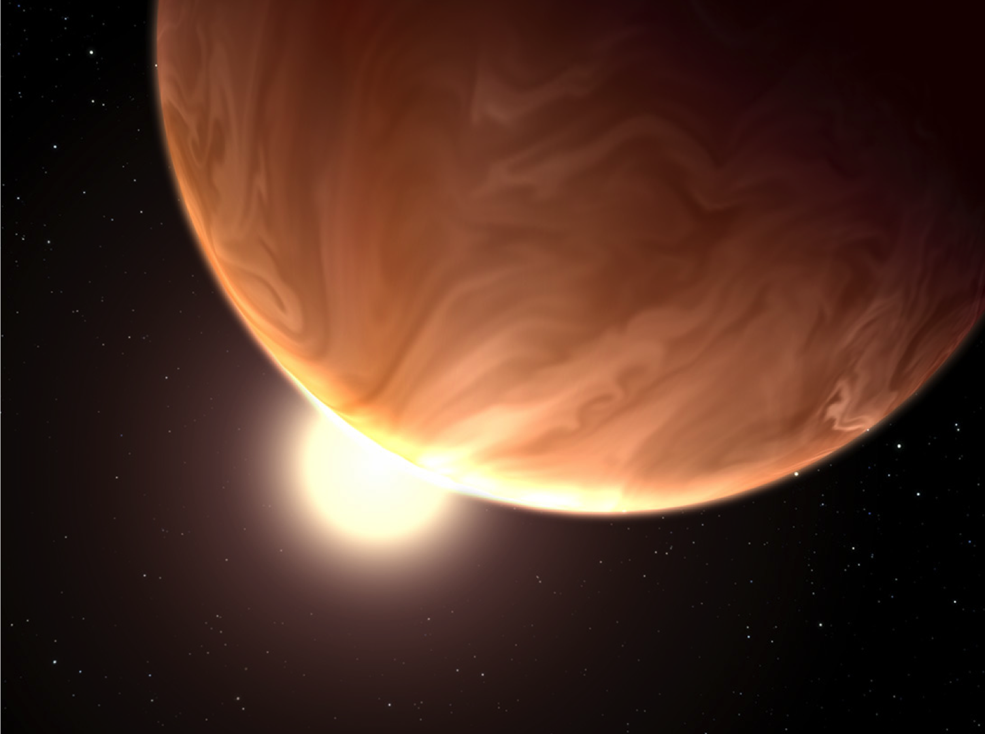
Exoplanets in HD
Jacob Bean
University of Chicago

Slide 2


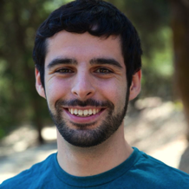

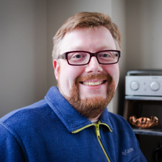
University of Chicago Group & Collaborators
Current members:
Laura Kreidberg
4th year grad student
w/ NSF Fellowship
Megan Bedell
3rd year grad student
w/ NSF Fellowship
Former members:
Molly Simon (u-grad): now at U. Arizona
Hannah Diamond-Lowe (u-grad): now taking a gap year
Gregory Gilbert
1st year grad student
In collaboration with:
Jean-Michel Désert, Jonathan Fortney, Michael Line, Björn Benneke, Sara Seager, Adam Showman, Tiffany Kataria, Zachory Berta-Thompson, Drake Deming, Derek Homeier, David Charbonneau, Nikku Madhusudhan, Peter McCullough, Adam Burrows, & Gregory Henry
Kevin Stevenson
Sagan Fellow
Andreas Seifahrt
Research scientist

Slide 3


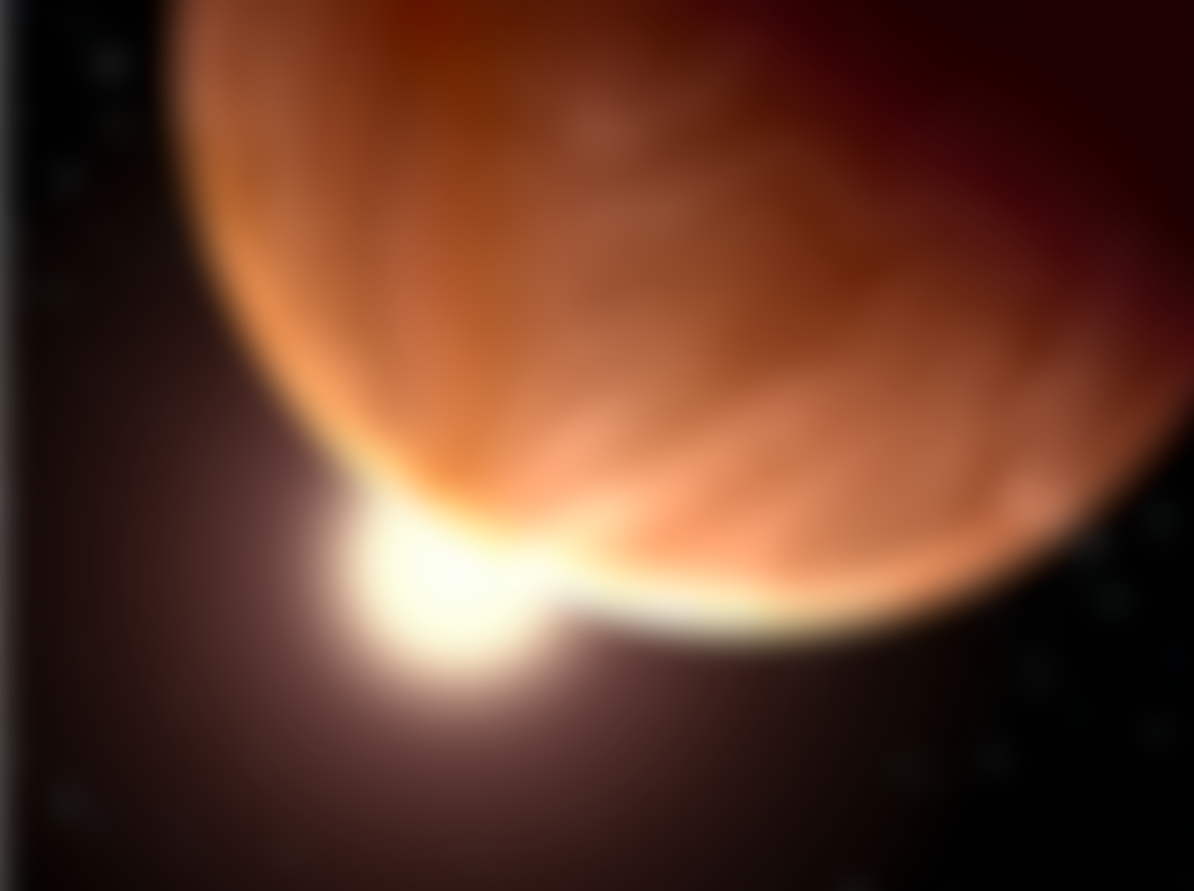
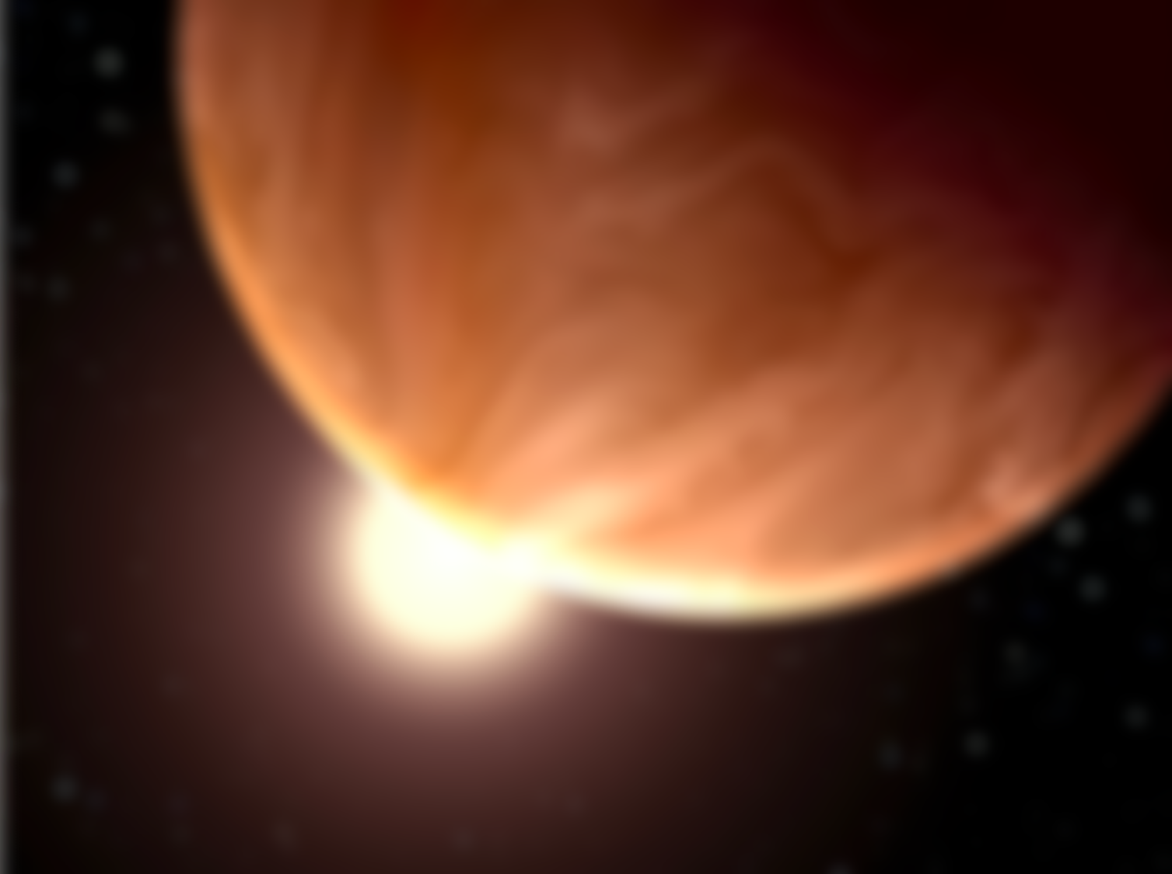

Key Points
A major frontier of exoplanet science is characterization.
Definitive atmospheric characterization requires intensive observations for high-precision measurements.
The current results are a preview of the transformative science that will be enabled by future facilities like the GMT and JWST.

Slide 4
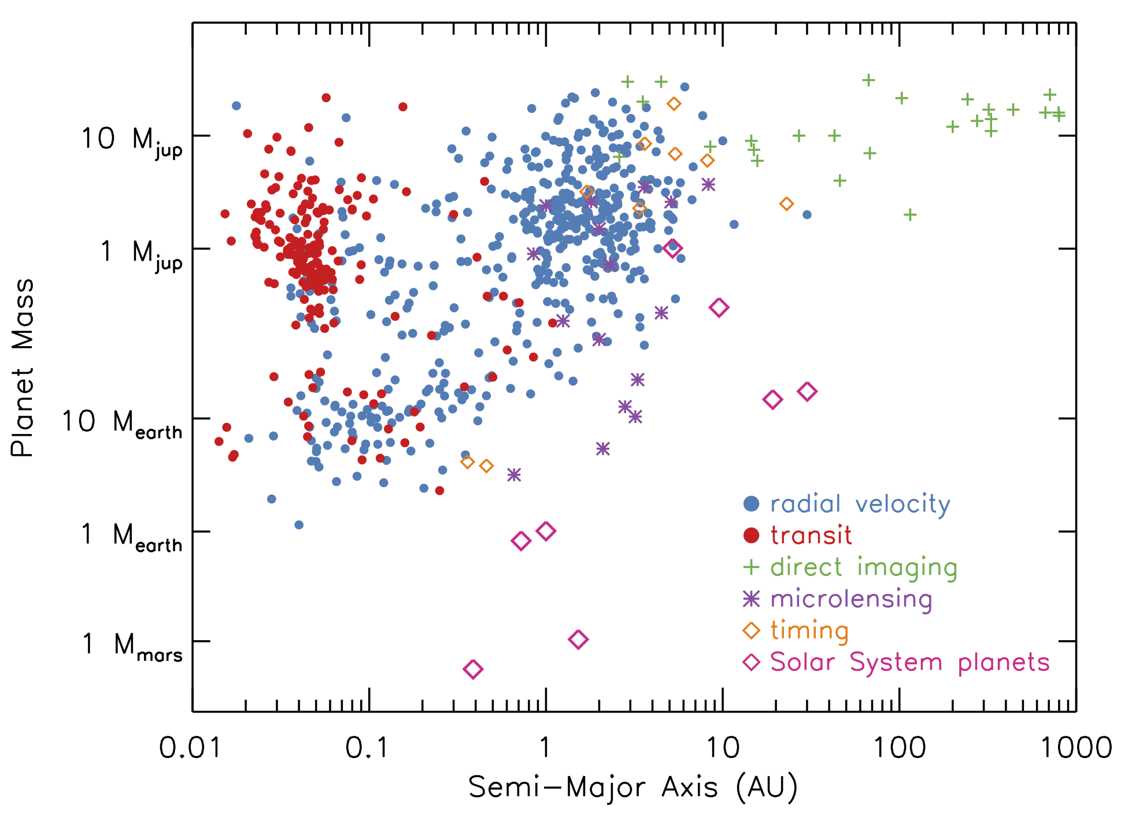
Current status of exoplanet detections
N ≈ 1000

Slide 5
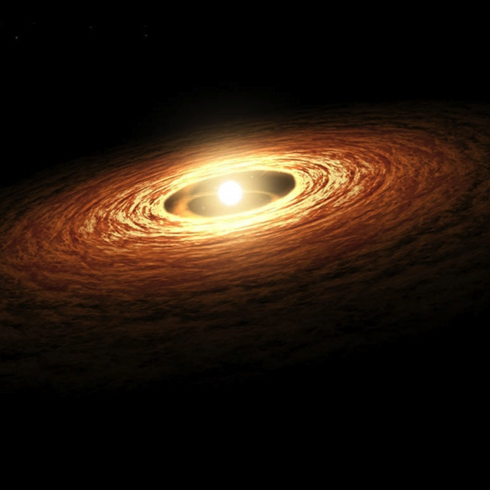
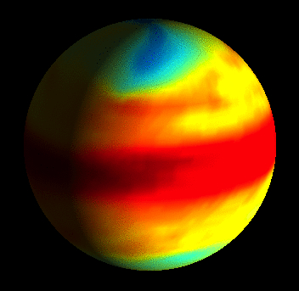
Fundamental Questions for Exoplanet Atmospheres
What are they like?
Where did they come from?

Slide 6
Probing Exoplanet Atmospheres With Transits
Strengths:
Know the mass and radius
Multiple probes of the atmosphere
Can study planets close-in to their host stars
Weaknesses:
Measure planets relative to their stars
Limited (for the most part) to planets that are transiting
Limited to planets in close-in orbits

Slide 7
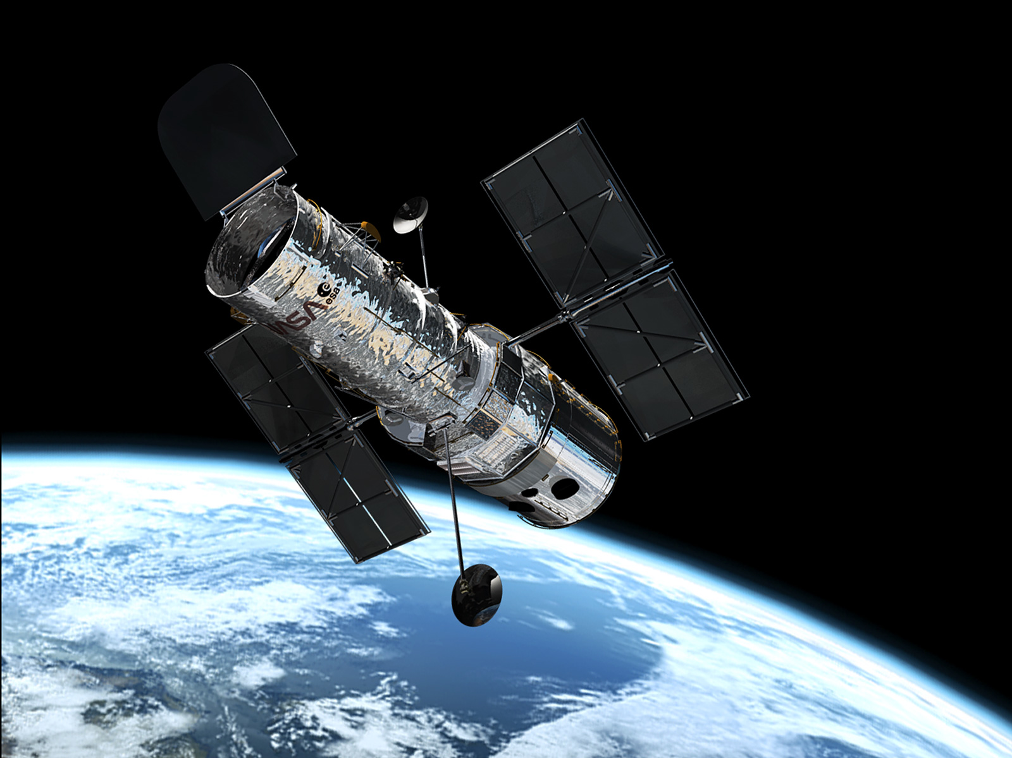
Celebrating 25 years of the Hubble Space Telescope this year!

Slide 8
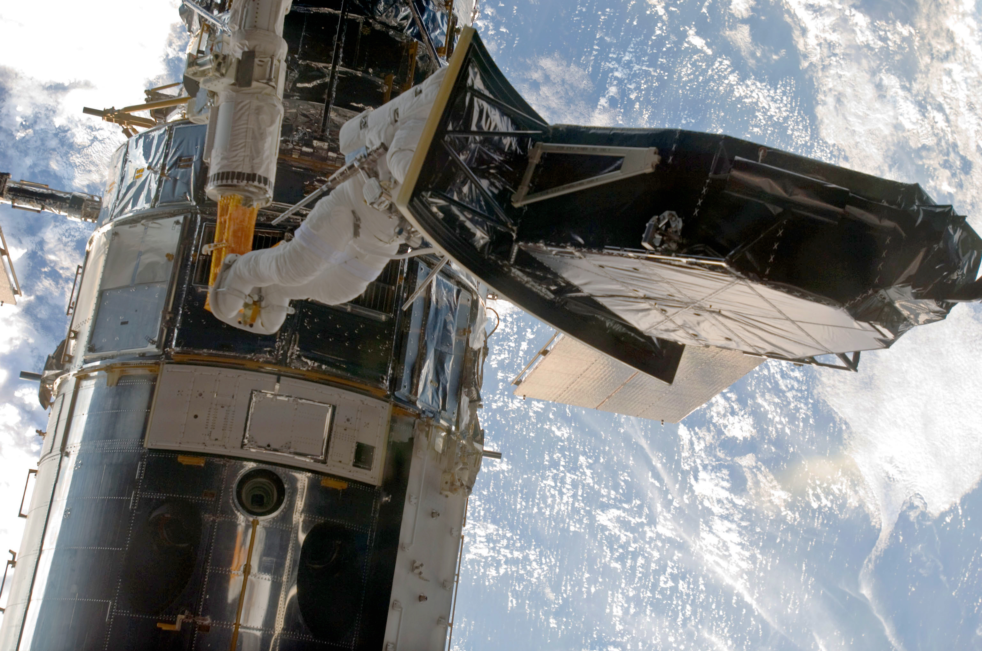
Astronaut Andrew Feustel installs the Wide Field Camera 3 (May 14, 2009)

Slide 9
Probing Exoplanet Atmospheres With Transits

Slide 10
Probing Exoplanet Atmospheres With Transits

Slide 11
Current status of exoplanet detections
N ≈ 1000

Slide 12
Current status of exoplanet detections
N ≈ 1000

Slide 13
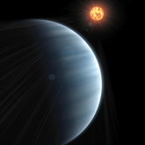
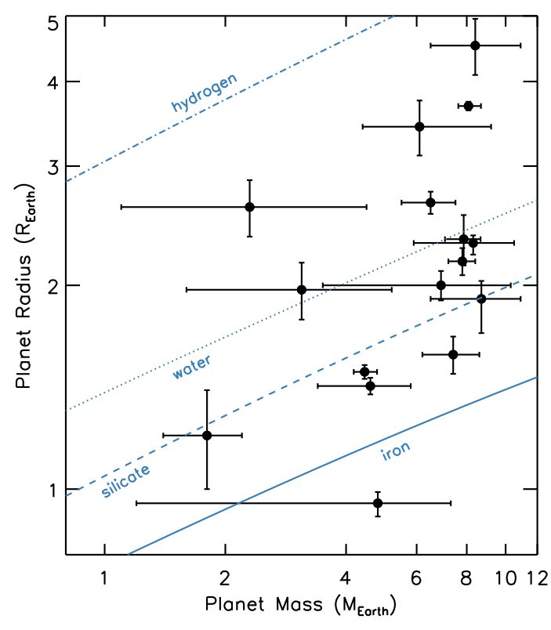
The Super-Earth GJ1214b
“super-Earths”
≡
2 < mass < 10 M_{earth}

Slide 14
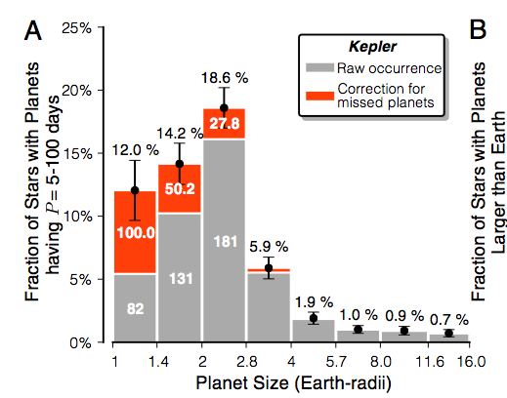
The Super-Earth GJ1214b
Super-Earths are extremely common!
Petigura+ (2014)

Slide 15
The Super-Earth GJ1214b
An extraordinary diversity!
Key question: What are the compositions of these objects?

Slide 16
The Super-Earth GJ1214b
A super-Earth case study on the need for atmospheric characterization
GJ 1214b

Slide 17
The Super-Earth GJ1214b
Transmission spectroscopy predictions
H-rich
(low mean molecular weight)
Transit Depth (%)
Wavelength (micron)
metal-rich
(high mean molecular weight)
Miller-Ricci & Fortney (2010)

Slide 18
The Super-Earth GJ1214b
Figure from Laura Kreidberg Models from Björn Benneke

Slide 19
The Super-Earth GJ1214b
Figure from Laura Kreidberg Models from Björn Benneke

Slide 20
The Super-Earth GJ1214b
Figure from Laura Kreidberg Models from Björn Benneke

Slide 21
The Super-Earth GJ1214b
Figure from Laura Kreidberg Models from Björn Benneke

Slide 22
The Super-Earth GJ1214b
The Super-Earth Deep Field
Goal: distinguish between competing scenarios for GJ1214b’s atmospheric composition
Strategy: 15 transit observations with HST/WFC3 in spatial scan mode
Program consisted of a record 60 orbits
(≈ 4 days of telescope time)
Kreidberg+ (2014, Nature)

Slide 23
Using an instrument designed for faint galaxies to look at bright nearby stars

Slide 24
The Super-Earth GJ1214b
The Super-Earth Deep Field
Goal: distinguish between competing scenarios for GJ1214b’s atmospheric composition
Strategy: 15 transit observations with HST/WFC3 in spatial scan mode
Program consisted of a record 60 orbits
(≈ 4 days of telescope time)
Kreidberg+ (2014, Nature)

Slide 25
The Super-Earth GJ1214b

Slide 26
The Super-Earth GJ1214b
Kreidberg+ (2014, Nature)

Slide 27
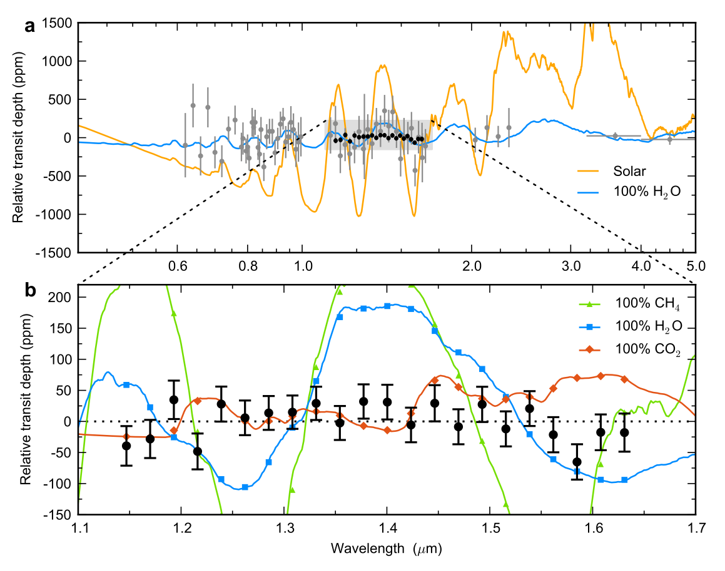
The Super-Earth GJ1214b
High mean molecular weight atmospheres ruled out at high confidence:
H₂O ≠ 16σ
CH₄ ≠ 31σ
CO ≠ 7.5σ
CO₂ ≠ 5.5σ
99.9% N₂ ≠ 5.6σ
Kreidberg+ (2014, Nature)

Slide 28
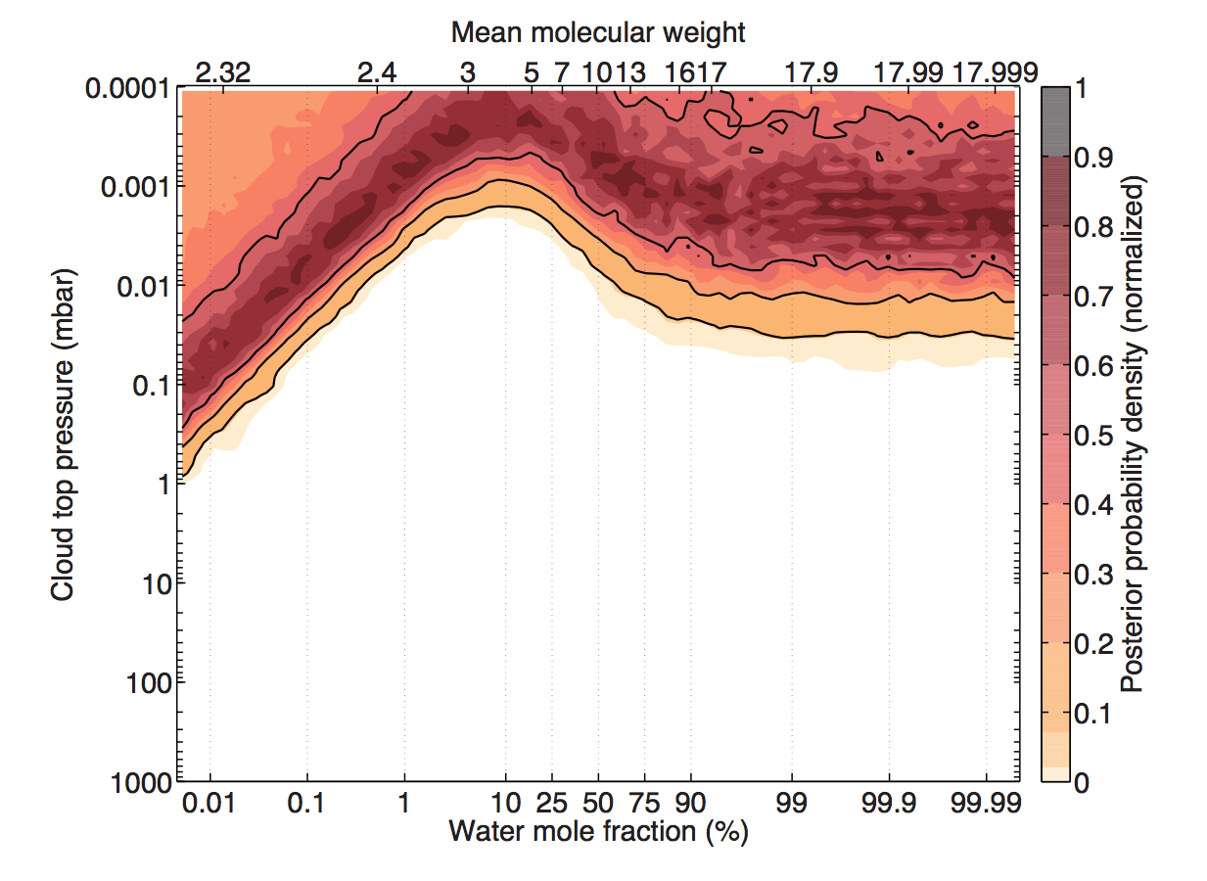
The Super-Earth GJ1214b
High-altitude clouds are required
Modeling by Björn Benneke
Kreidberg+ (2014, Nature)

Slide 29
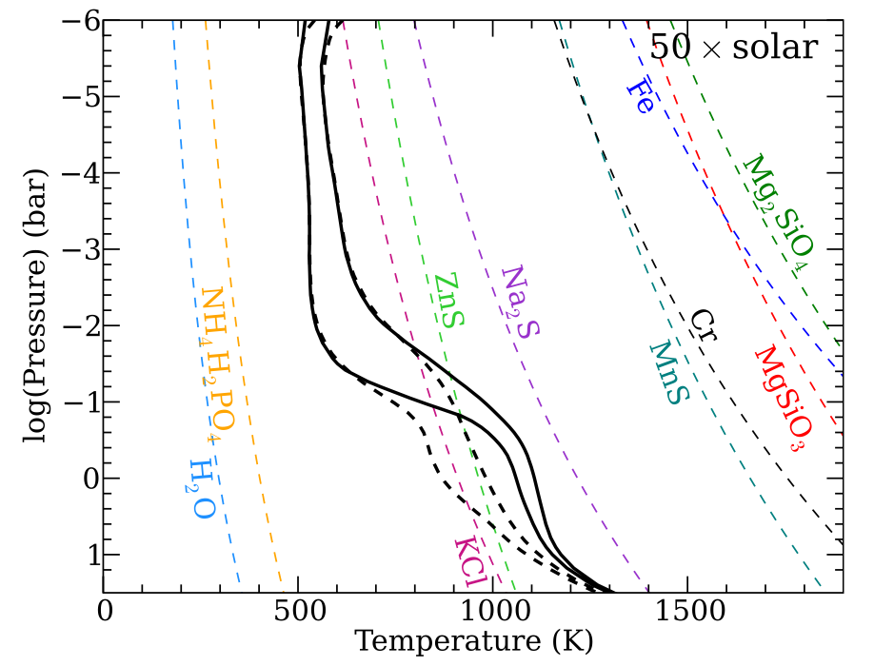
The Super-Earth GJ1214b
Clouds: equilibrium condensates?
Morley+ (2013)

Slide 30
The Super-Earth GJ1214b
Clouds: equilibrium condensates?
The cloud base is here
Morley+ (2013)

Slide 31
The Super-Earth GJ1214b
Clouds: equilibrium condensates?
But the clouds are needed up here
The cloud base is here
Morley+ (2013)

Slide 32
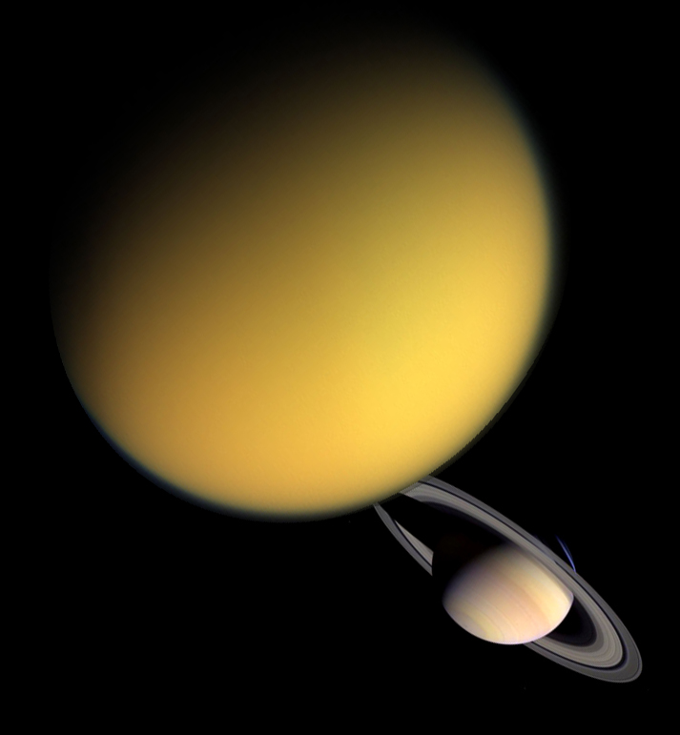
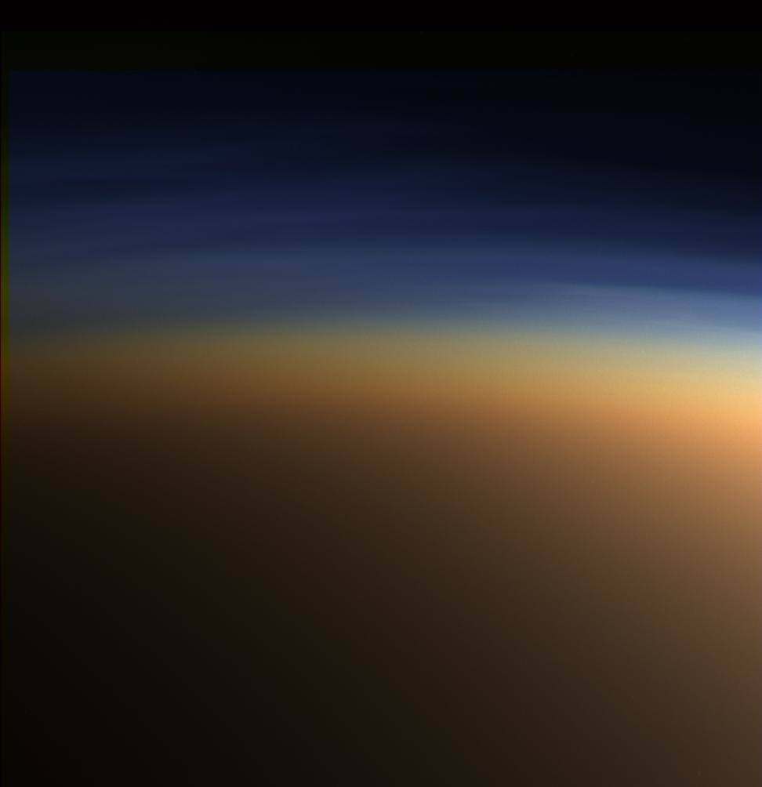
The Super-Earth GJ1214b
Photochemical haze?

Slide 33
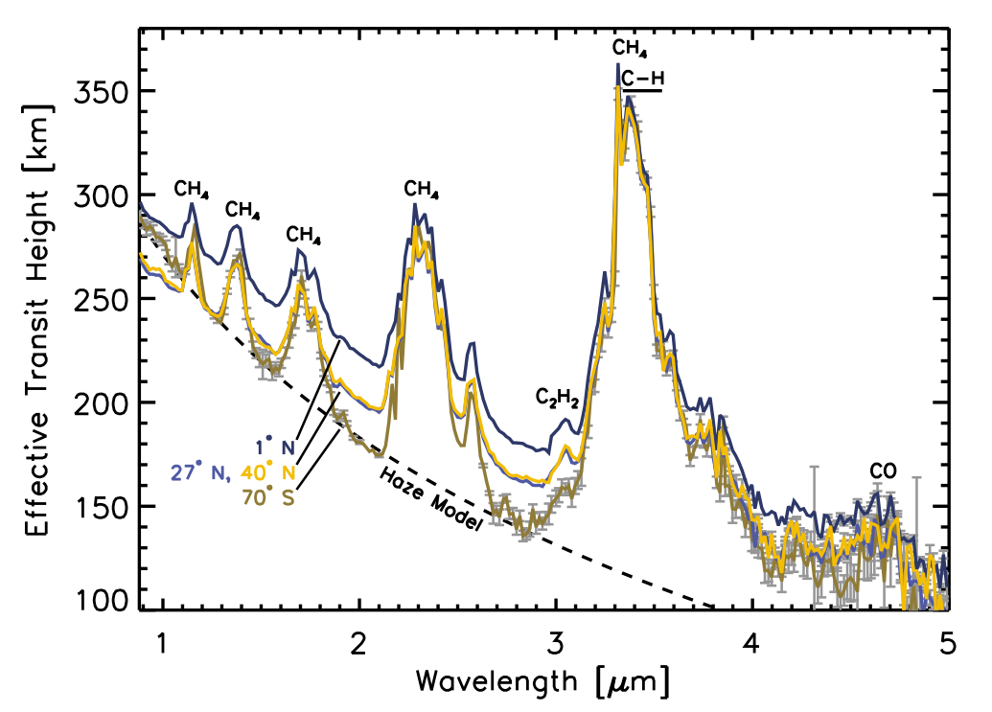
The Super-Earth GJ1214b
Photochemical haze?
Transmission spectra of Titan from Cassini
Robinson+ (2014)

Slide 34
Current status of exoplanet detections
N ≈ 1000

Slide 35
Current status of exoplanet detections
N ≈ 1000

Slide 36
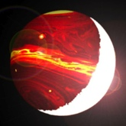
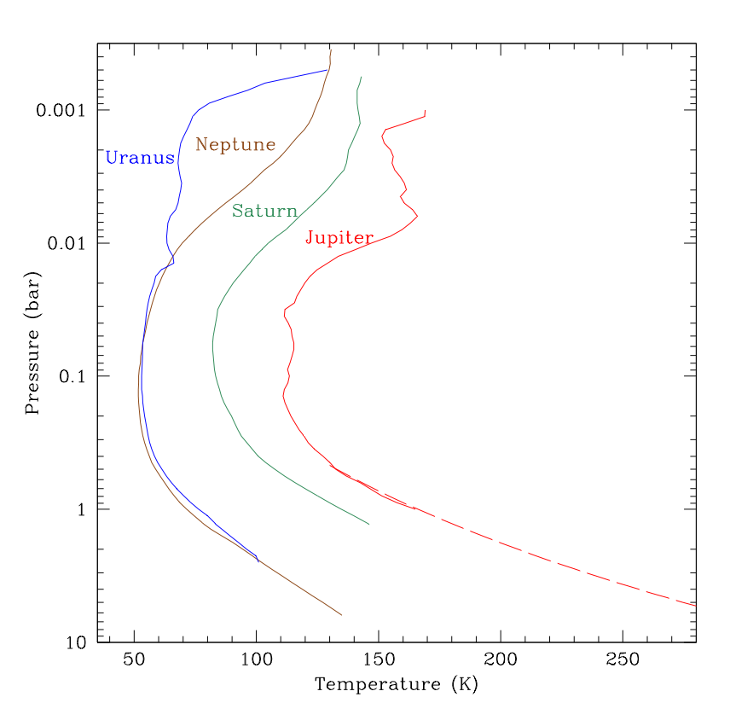
Following the Water in Giant Exoplanets
Key question #1:
What are the thermal structures of hot, giant planet atmospheres?

Slide 37
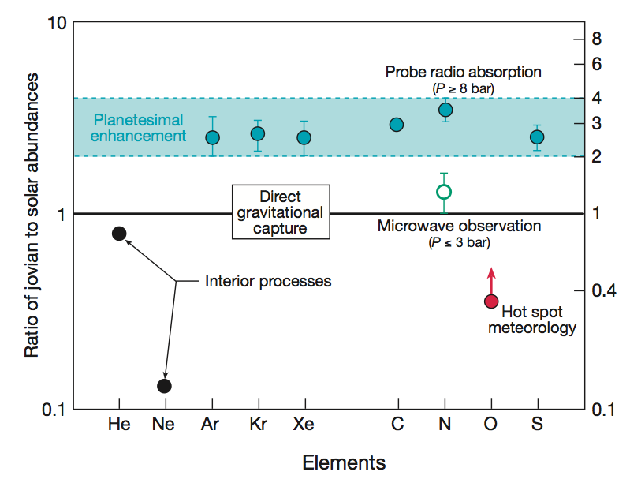
Following the Water in Giant Exoplanets
Key question #2: What is the abundance of water of the Solar System giant planets, and the universality of metal enhancement
Jupiter from the Galileo probe
Owen+ (1999)

Slide 38
Probing Exoplanet Atmospheres With Transits

Slide 39
Following the Water in Giant Exoplanets
model fit by Mike Line
Transmission spectrum of WASP-12b
6σ detection of water absorption
Kreidberg+ (in prep)
Preliminary RESULTS

Slide 40
Following the Water in Giant Exoplanets
Modeling by Mike Line
Kreidberg+ (in prep)
Results highly favor solar abundance pattern
Preliminary RESULTS

Slide 41
Probing Exoplanet Atmospheres With Transits

Slide 42
Probing Exoplanet Atmospheres With Transits

Slide 43
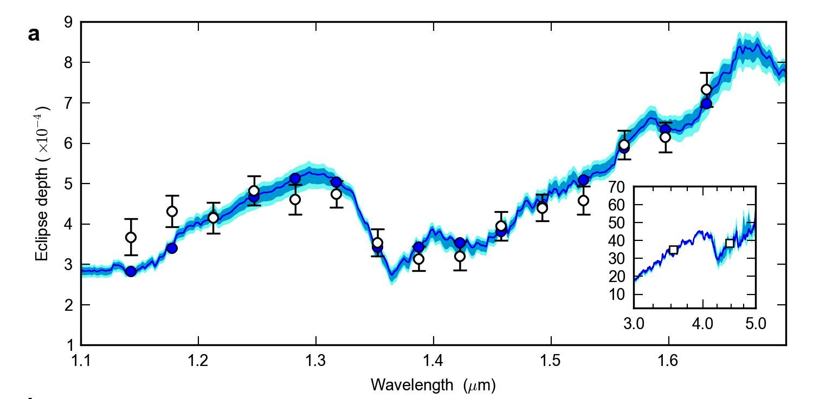
Following the Water in Giant Exoplanets
model fit by Mike Line
dayside emission spectrum of WASP-43b
H₂O
7/11σ detection of water absorption
Derived water abundance is 0.8 – 11.7 times solar
Kreidberg+ (2014b)

Slide 44
Following the Water in Giant Exoplanets
model fit by Mike Line
dayside emission spectrum of WASP-43b
H₂O
Existing Spitzer broadband photometry
7/11σ detection of water absorption
Derived water abundance is 0.8 – 11.7 times solar
Kreidberg+ (2014b)

Slide 45
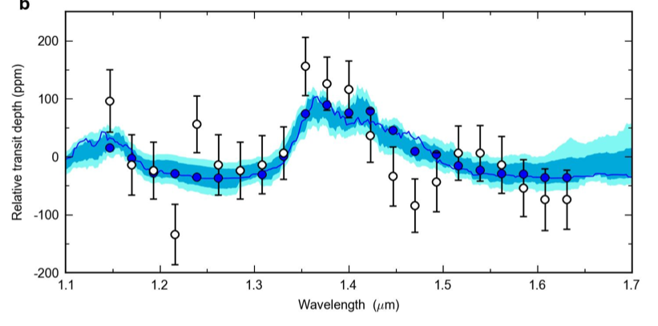
Following the Water in Giant Exoplanets
model fit by Mike Line
transmission spectrum of WASP-43b
5σ detection of water absorption
Derived water abundance is 0.04 – 1.7 times solar
Kreidberg+ (2014b)

Slide 46
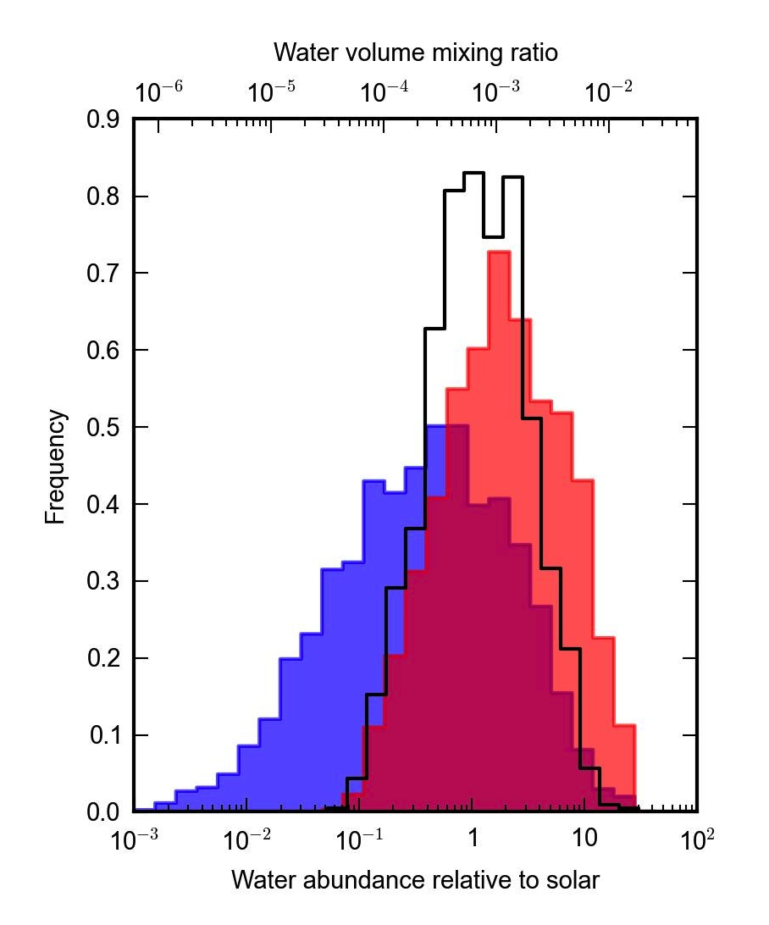
Following the Water in Giant Exoplanets
Combining the constraints from the emission and transmission spectra give:
transmission
emission
combined
O/H = 0.4 – 3.5 x solar!
(assuming solar abundance ratios)
Kreidberg+ (2014b)

Slide 47
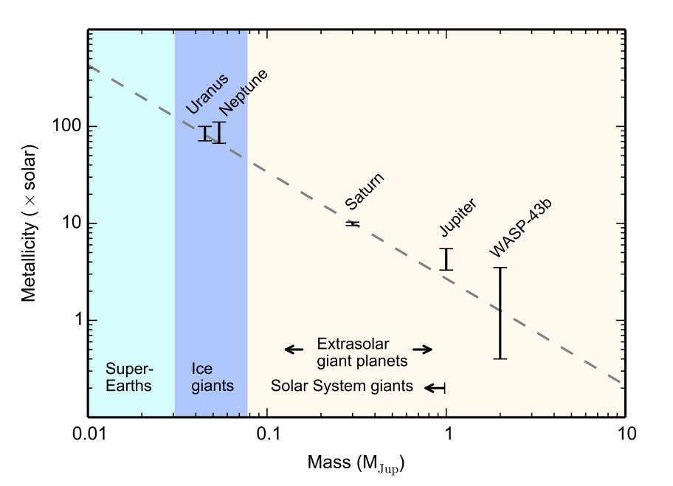
Following the Water in Giant Exoplanets
[Solar System planets: C via CH₄]
[WASP-43b: O via H₂O]
--statistical errors only--
Kreidberg+ (2014b)

Slide 48
Probing Exoplanet Atmospheres With Transits

Slide 49
Probing Exoplanet Atmospheres With Transits

Slide 50
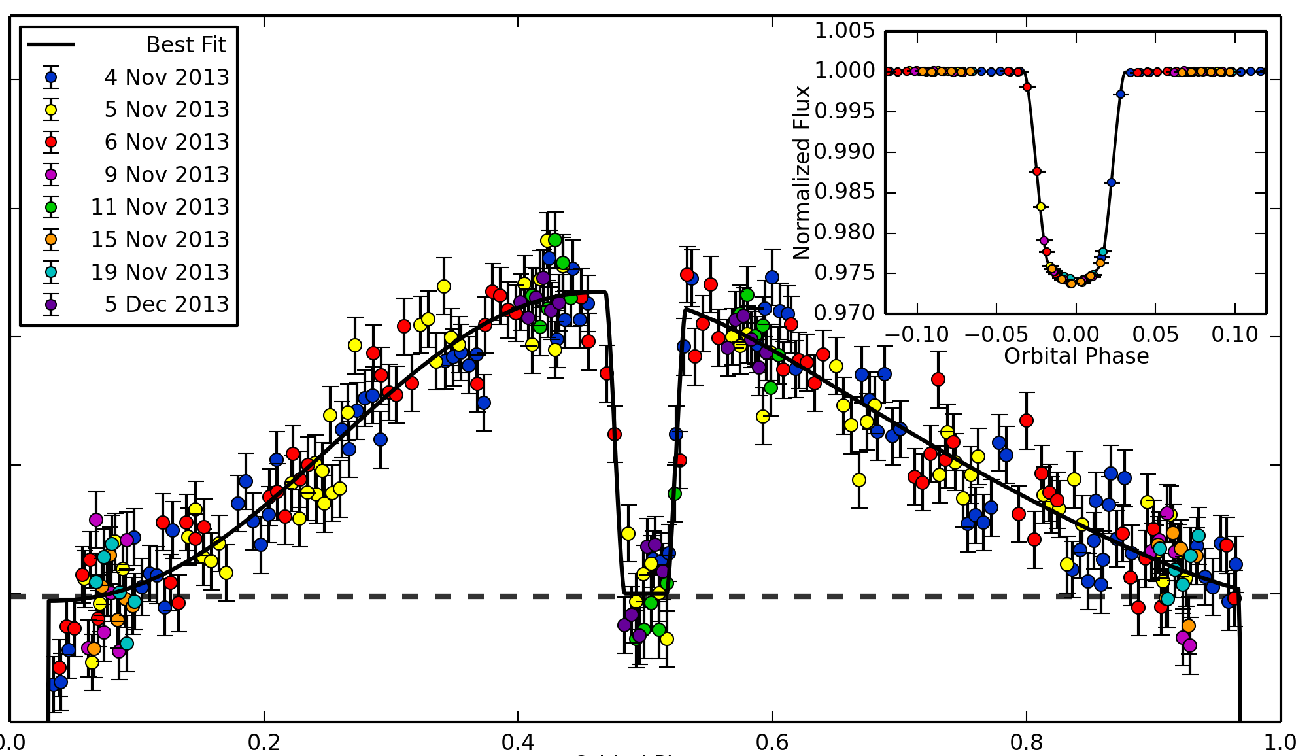
Following the Water in Giant Exoplanets
phase curve of WASP-43b
Relative Flux
3%
400 ppm
Orbital Phase
41 HST orbits over 3 days
3 full orbits of the planet
Stevenson+ (Science, 2014)
Notes:
great SNR!

Slide 51
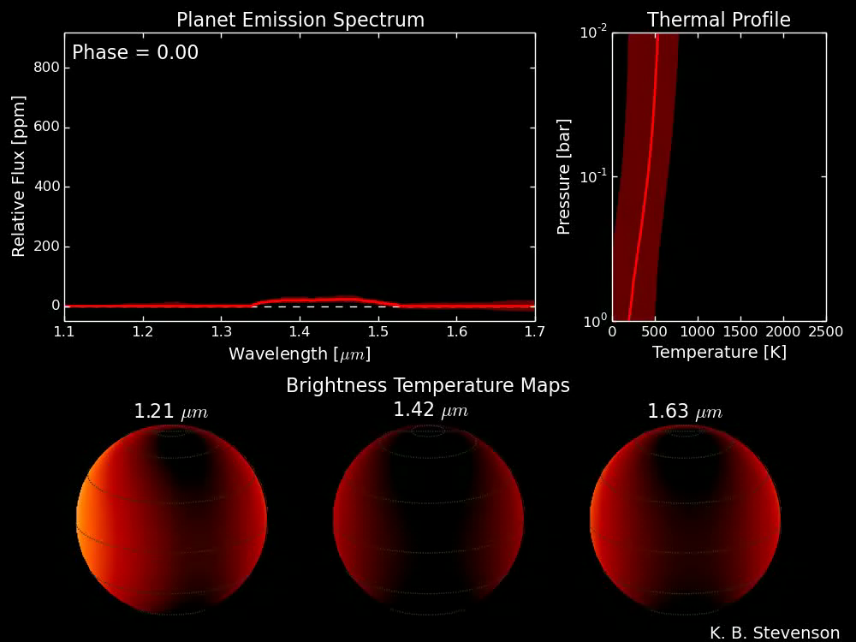
H₂O
Stevenson+ (Science, 2014)

Slide 52
Following the Water in Giant Exoplanets
Kataria+ (submitted)

Slide 53
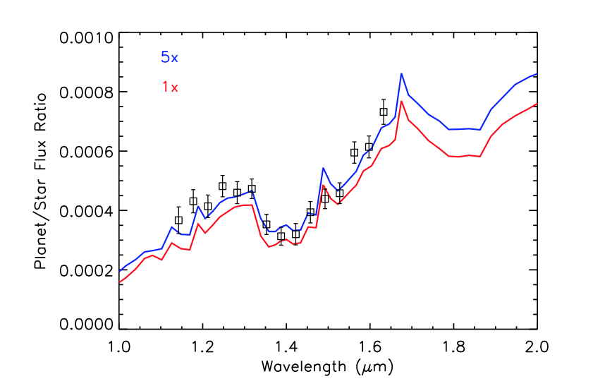
Following the Water in Giant Exoplanets
x metallicity
Kataria+ (submitted)

Slide 54
Fundamental Questions for Exoplanet Atmospheres
What are they like?
Where did they come from?

Slide 55
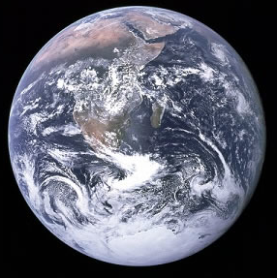
Fundamental Questions for Exoplanet Atmospheres
What are they like?
Where did they come from?
Are any of them habitable?

Slide 56

April 19, 2013

Slide 57
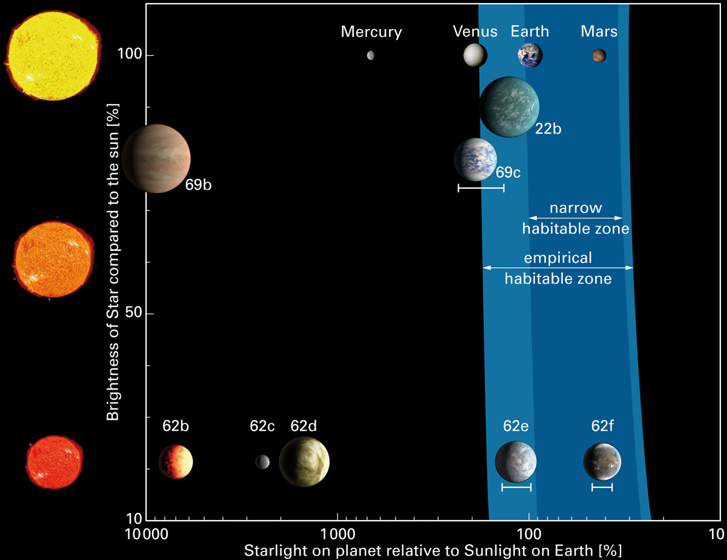
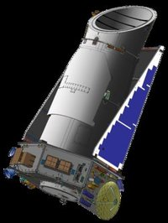

Kepler-62: a five planet system with two super-Earths in the habitable zone

Slide 58
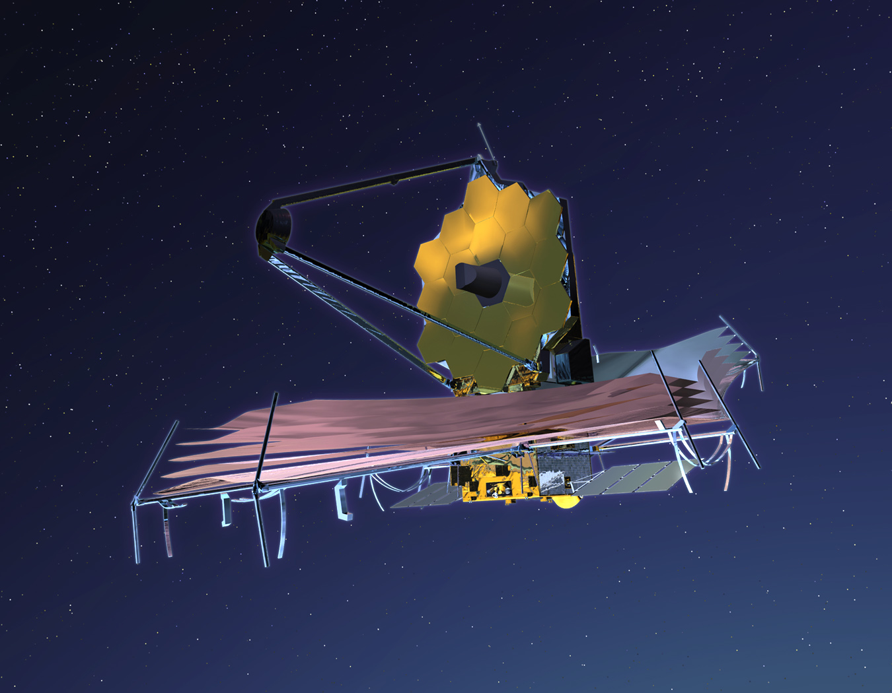
We eagerly await the launch of the
James Webb Space Telescope in 2018

Slide 59
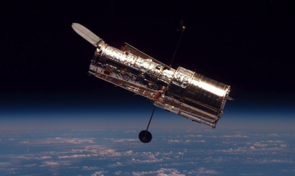
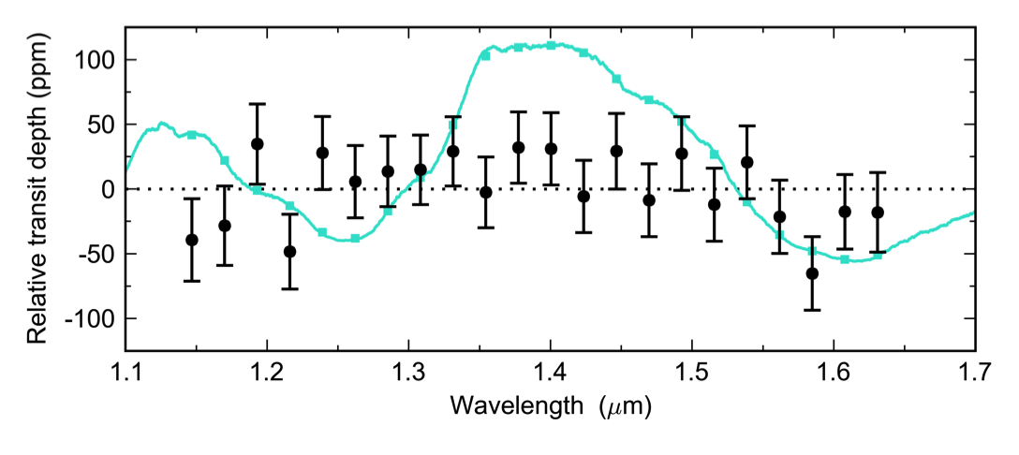
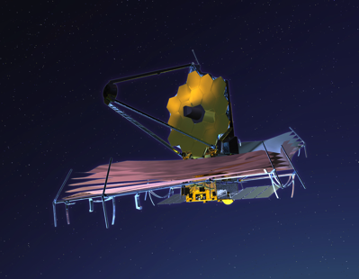
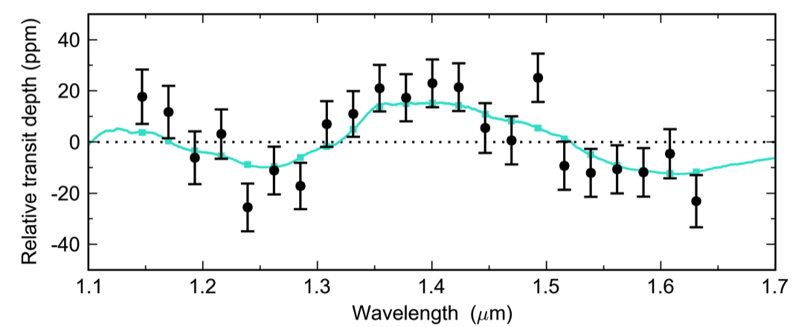
Towards Other Earths
real data!
2014
Kreidberg et al.
precision = 30 ppm
GJ 1214b
R_{p} = 2.7 R_{E}
T = 580 K
simulated data
2019
precision = 10 ppm
Earth 2.0
R_{p} = 1.0 R_{E}
T = 300 K
N₂-rich, trace H₂O atmosphere

Slide 60
Towards Other Earths
real data!
2014
Kreidberg et al.
precision = 30 ppm
GJ 1214b
R_{p} = 2.7 R_{E}
T = 580 K
Key aspect is the detection of such planets around nearby stars
simulated data
2019
precision = 10 ppm
Earth 2.0
R_{p} = 1.0 R_{E}
T = 300 K
N₂-rich, trace H₂O atmosphere

Slide 61
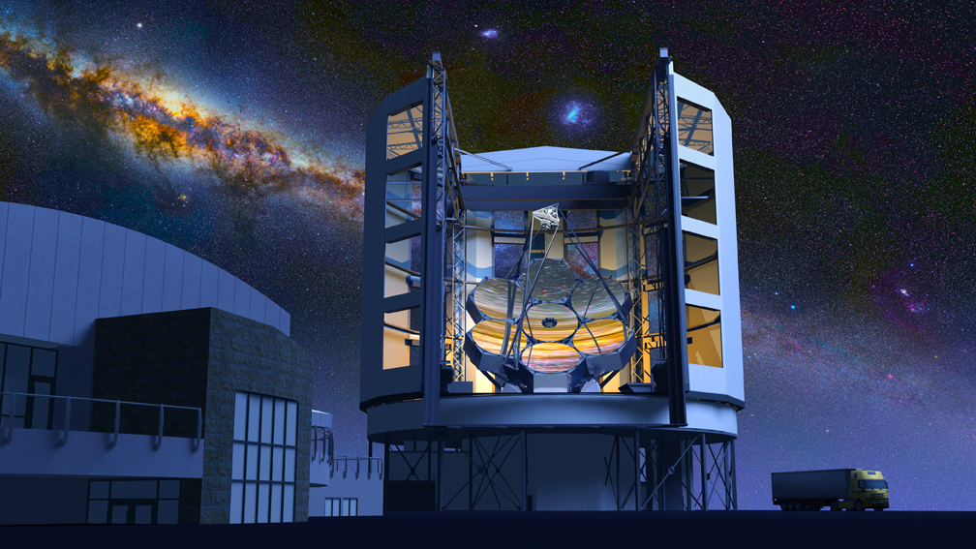
The Giant Magellan Telescope will discover the potentially Earth-like exoplanets that are the key targets for efforts to detect biosignatures.

Slide 62
Extra Slides

Slide 63
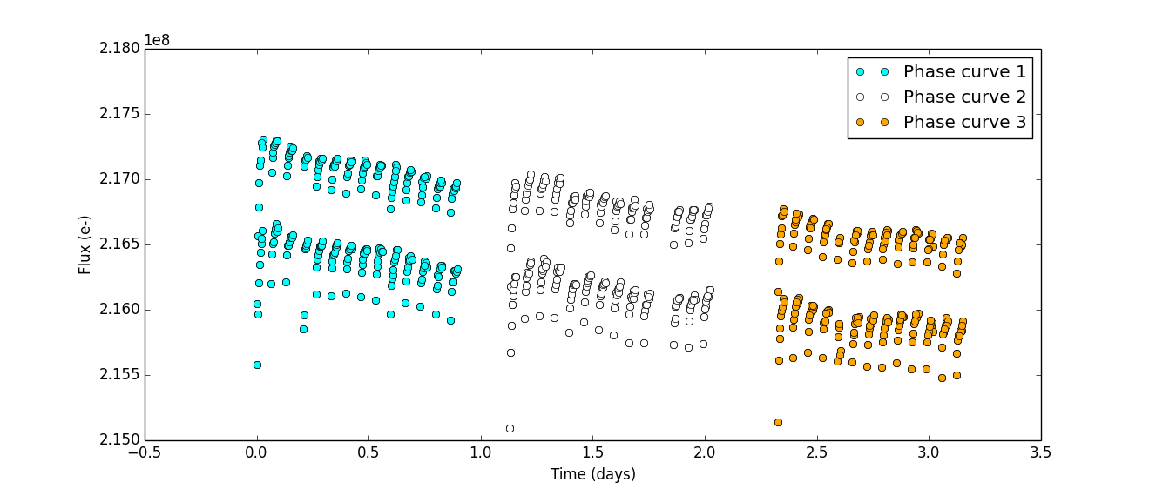

Slide 64
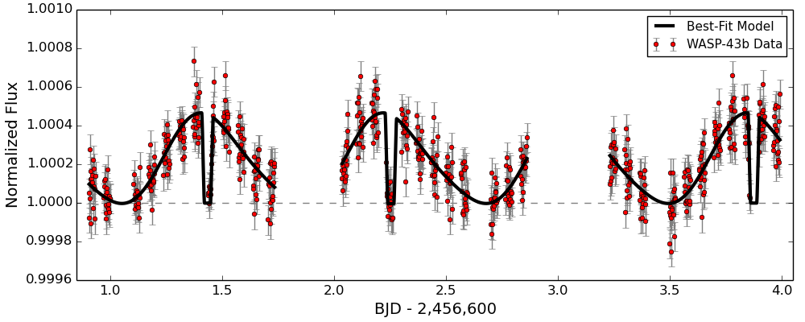

Slide 65
Advantages of High-Precision Spectroscopy with HST/WFC3
Measured transit depths are:
  Consistent over all epochs
  Unbiased by stellar activity
  Not degenerate with limb darkening
Light curve residuals are:
  Gaussian
  Uncorrelated
  Within 10% of predicted photon shot noise
Consistent results obtained using two techniques to correct for instrument systematics
Light curve fits have a median reduced chi-squared of 1.02

Slide 69
Time from central transit (minutes)
Residuals (ppm)

Slide 70
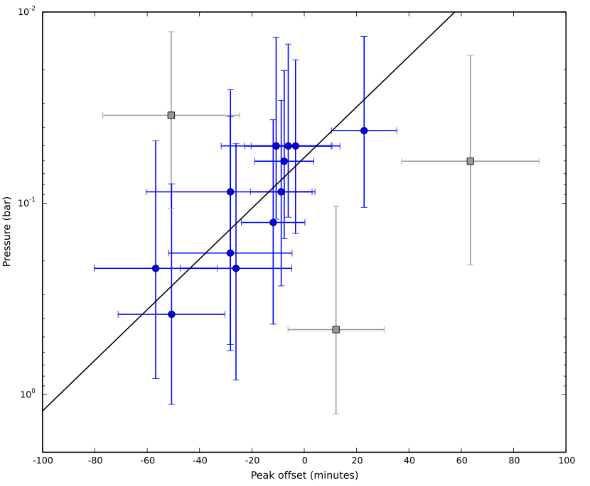
Following the Water in Giant Exoplanets
Stevenson+ (Science in press)

Slide 71
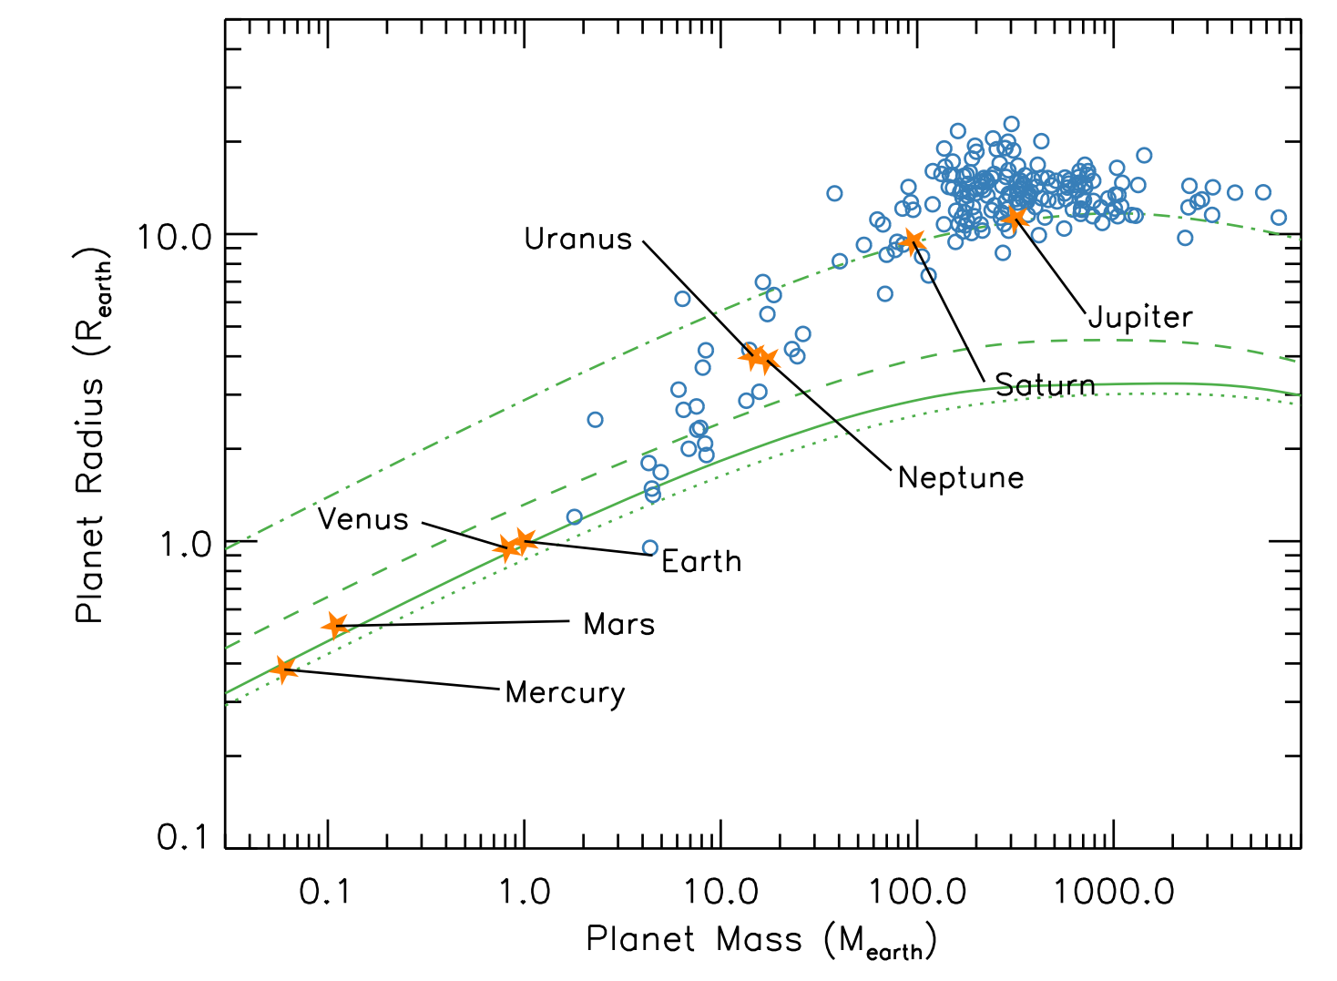
Characterizing planets: mass and radius
N ≈ 200

