Slide 1
Fermilab 50th Anniversary
June 2017
Jim Siegrist
Associate Director for High Energy Physics
Office of Science, U.S. Department of Energy

Slide 2
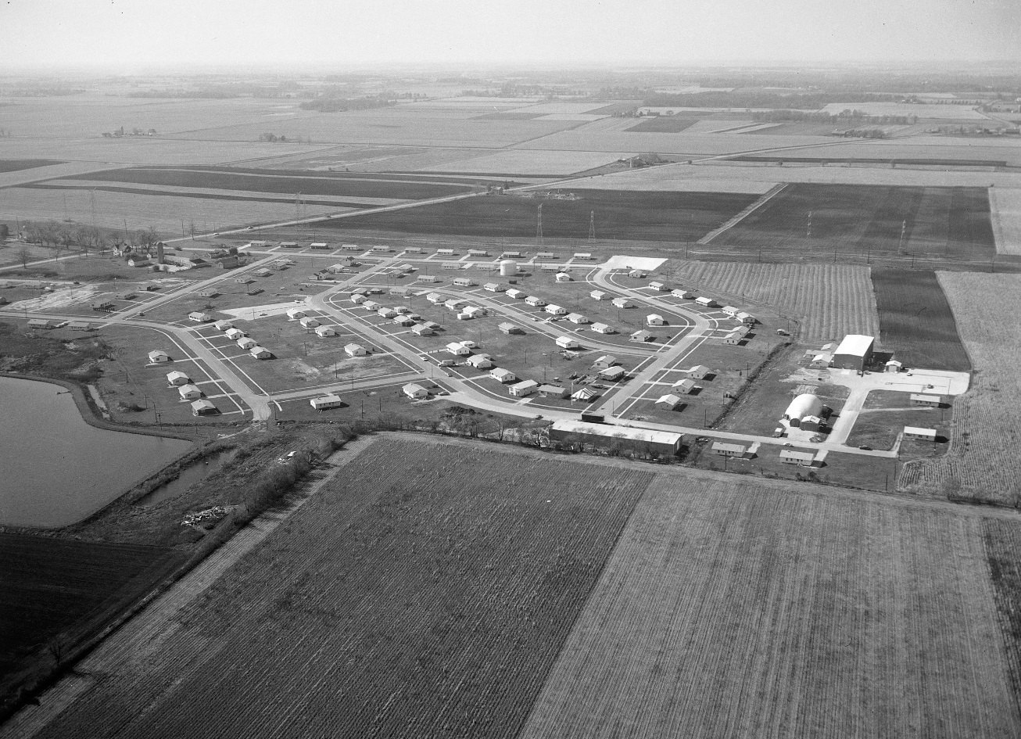
In the Beginning…
There was flyover country.
CERN →
SLAC •

Slide 3
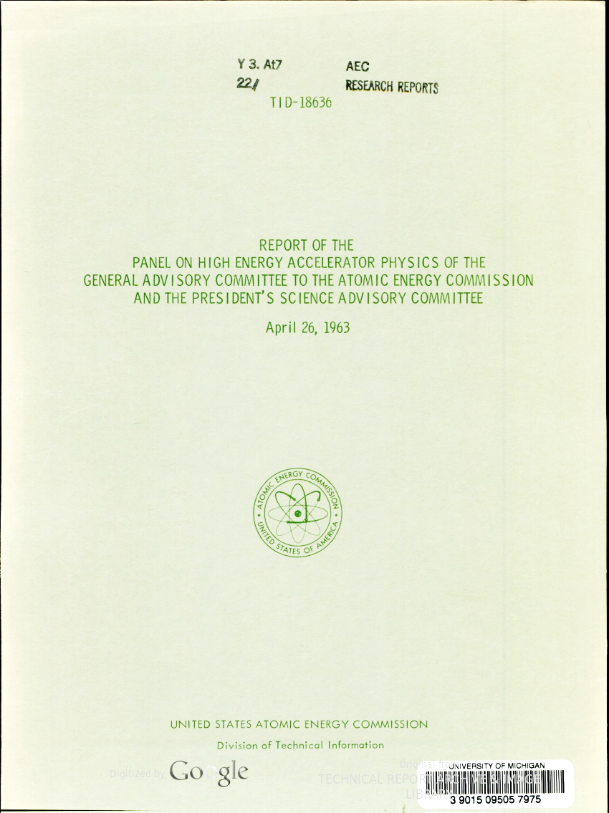
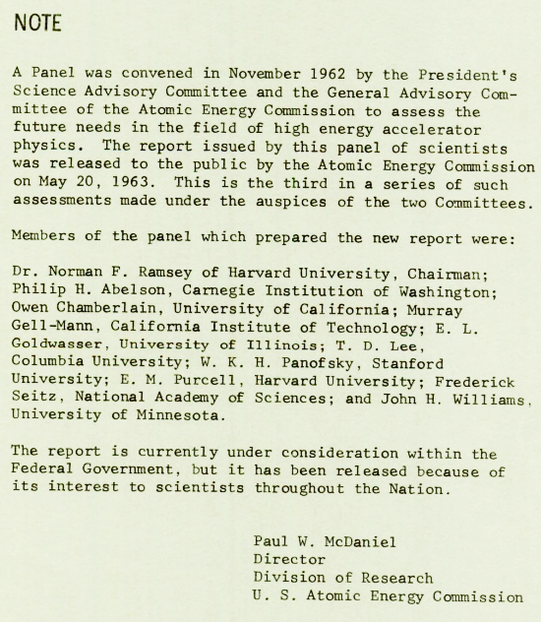
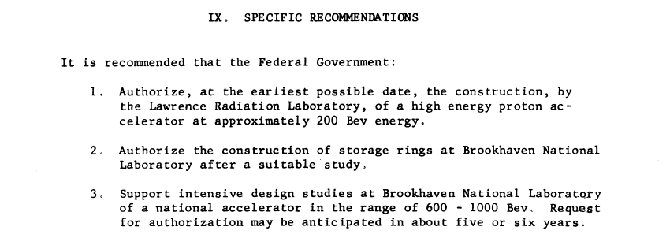
Ramsey’s Report to the U.S. AEC

Slide 4
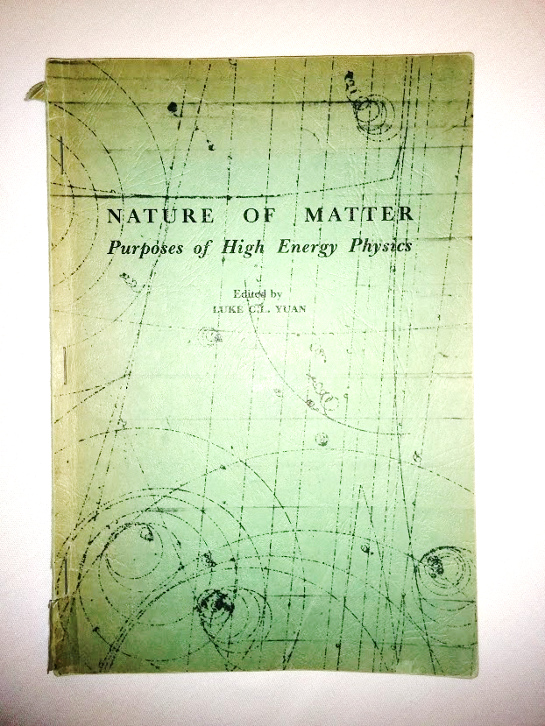
Why Build a National Accelerator?
Produced by Brookhaven National Laboratory under contract with the U.S. Atomic Energy Commission
January 1965
“During the past three years, a group of scientists and engineers at several National Laboratories and universities has been intensively pursing studies on the design and experimental programs for a super high energy accelerator in the energy region of multi-hundred BeV.”
– Luke C.L. Yuan
Note: BeV = billion electonvolts, now referred to as a GeV

Slide 5
Why Build a National Accelerator?
“The only probes now known for examining possible structure of particles are high energy scatterings, preferably of weakly interacting particles such as photons and neutrinos. Hence again the great excitement among particle physicists over the development of intense, high energy, neutrino beams.”
– G. Feinberg, Columbia University

Slide 6
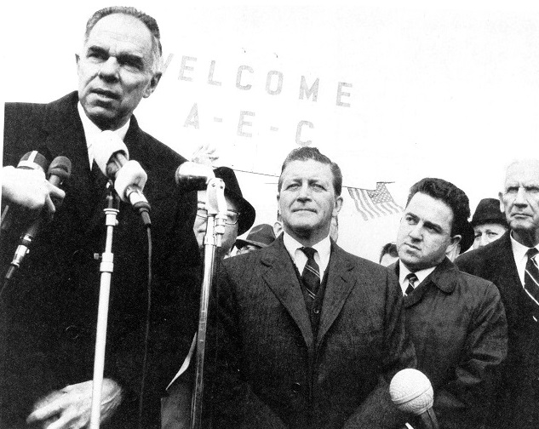
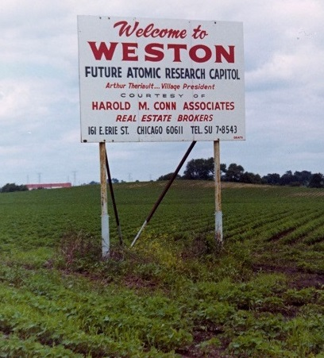
Site Selection: Weston, IL
AEC considered 126 proposals recommending about 200 sites before selecting Weston, IL, as the future home of the National Accelerator Laboratory
Illinois Senator Paul H. Douglas
AEC Chairman Glenn Seaborg
Illinois Governor Otto Kerner
Village President Arthur Theriault

Slide 7
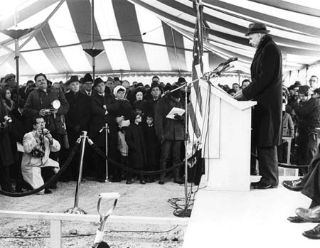
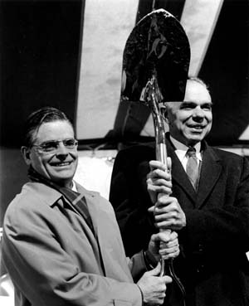
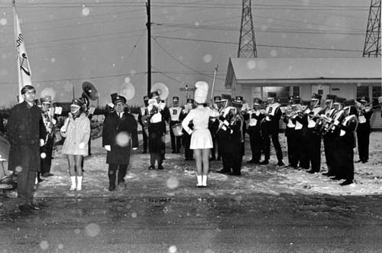
Breaking New Ground in 1968
Batavia High School Band

Slide 8
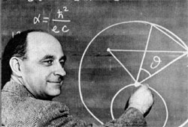
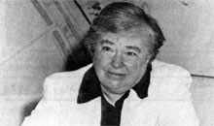
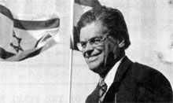
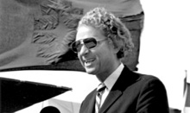
Fermi National Accelerator Laboratory
Among other highlights of his career, in 1933 Enrico Fermi developed the theory of beta decay, postulating that the newly discovered neutron decaying to a proton emits an electron and a particle which he called a "neutrino“
Dedication ceremony in 1974 included Dr. Dixy Lee Ray (AEC Chairman), R. R. Wilson, and Leon Lederman

Slide 9
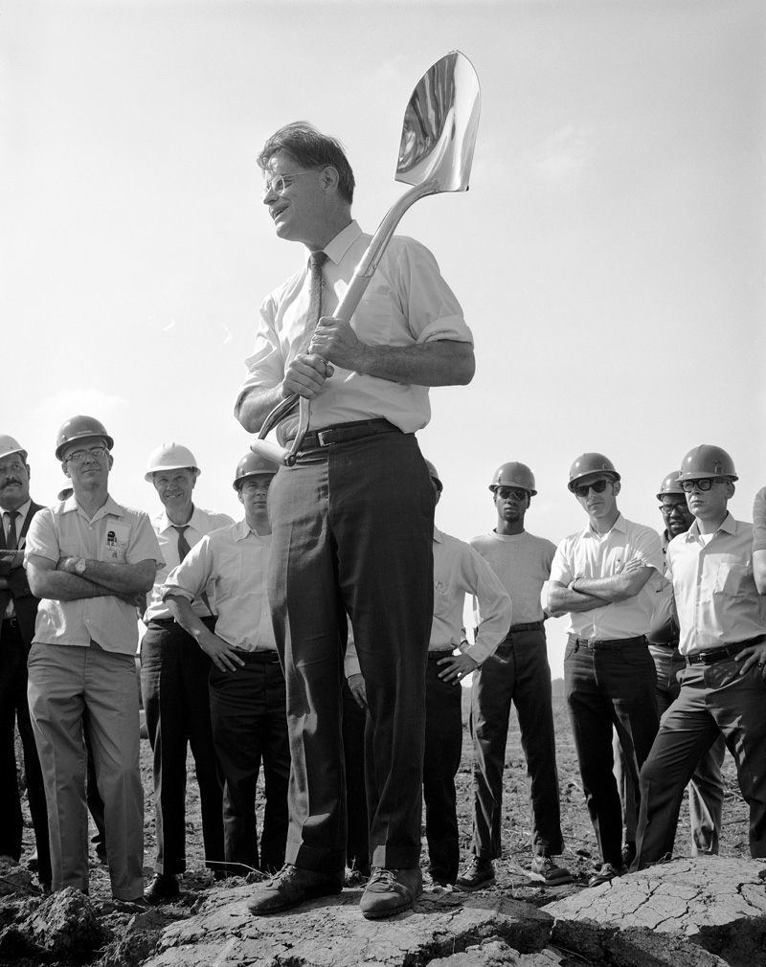
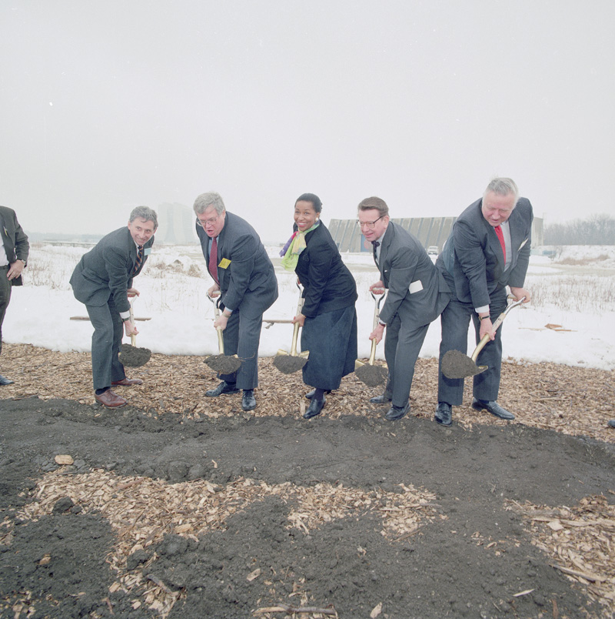
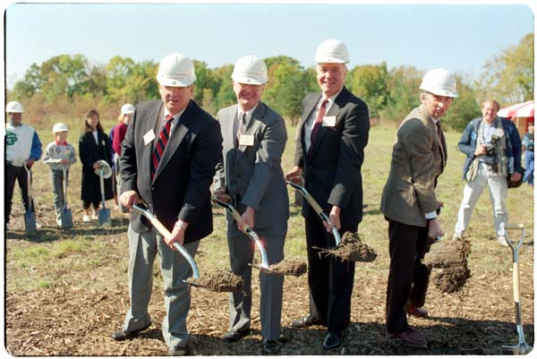
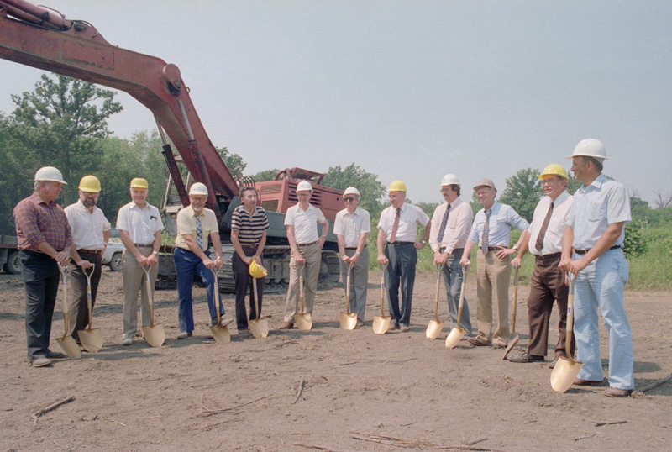
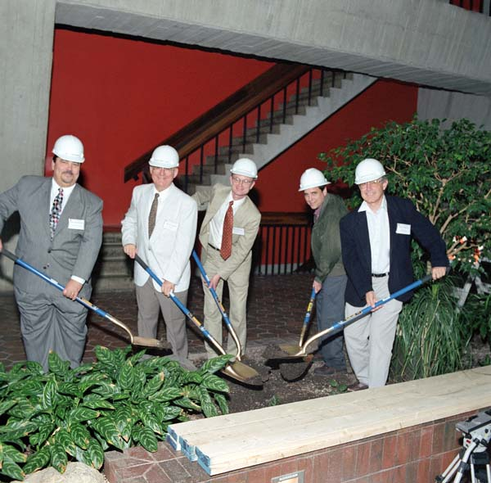
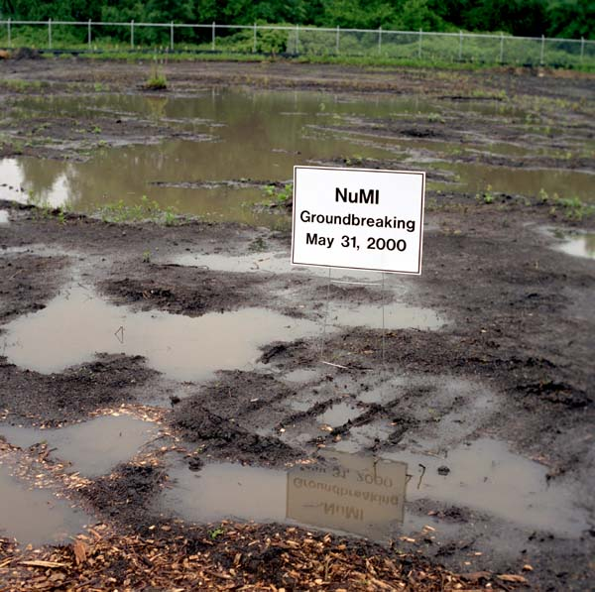
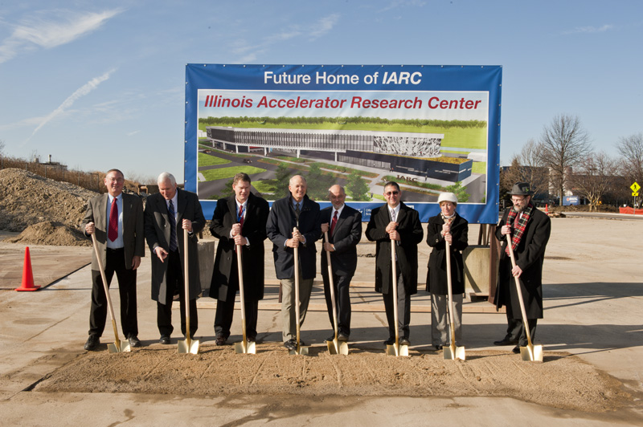
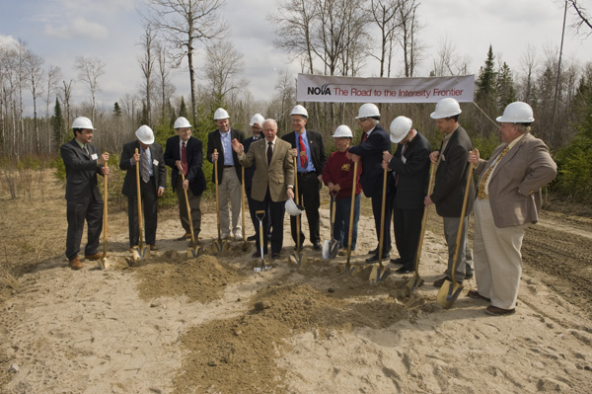
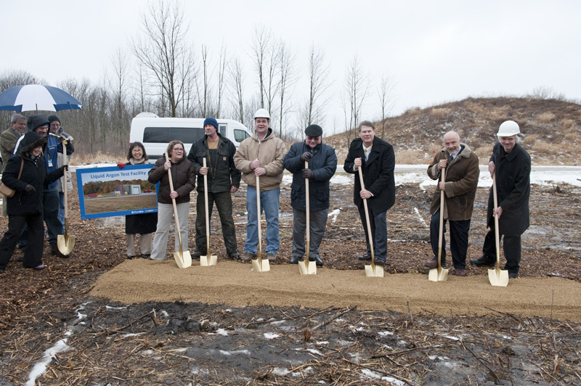
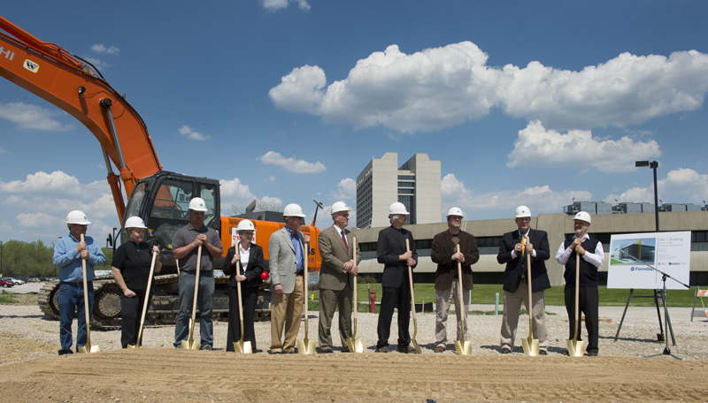
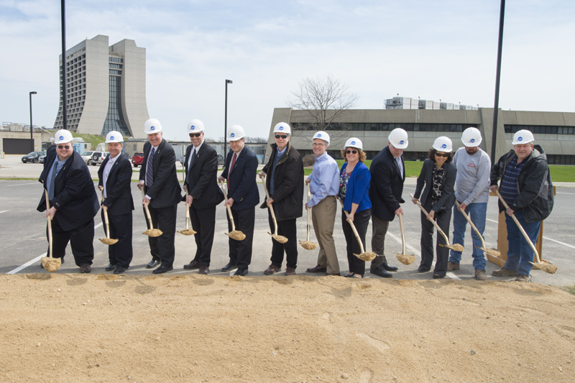
History of Breaking New Ground
1989 – Education Center
1983 – Antiproton
1993 – Main Injector
2000 – NuMI
2009 – NOvA (Ash River)
2012 – LArTF (MicroBooNE)
2013 – Muon g-2
2011 – IARC
2015 – Mu2e
1969 – Main Ring

Slide 10
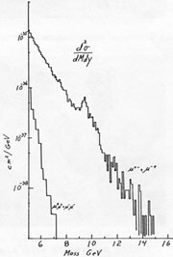
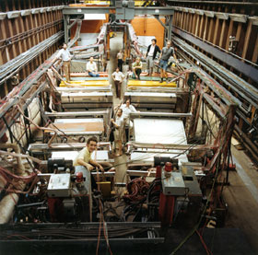
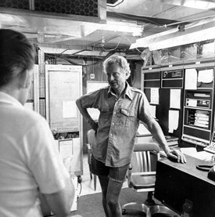
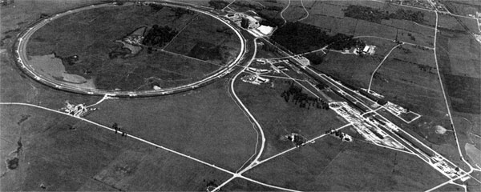
Groundbreaking Discoveries
1977: Bottom Quark

Slide 11
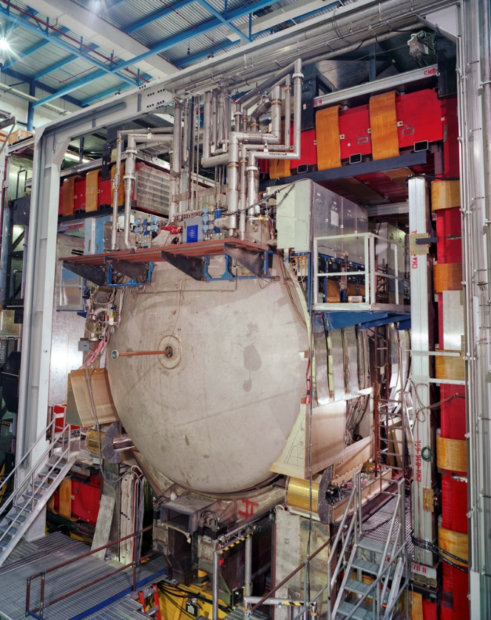
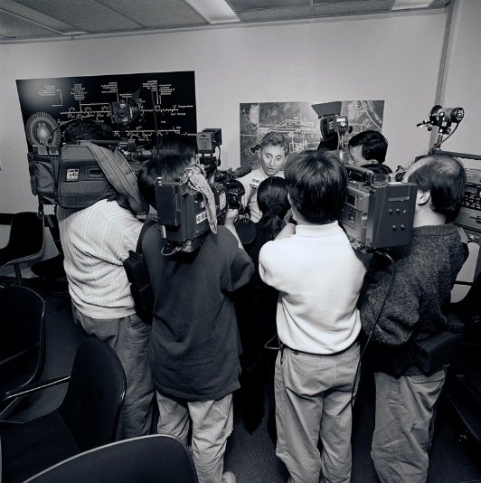
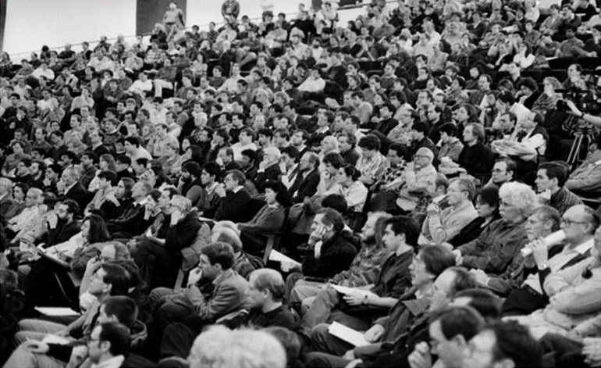
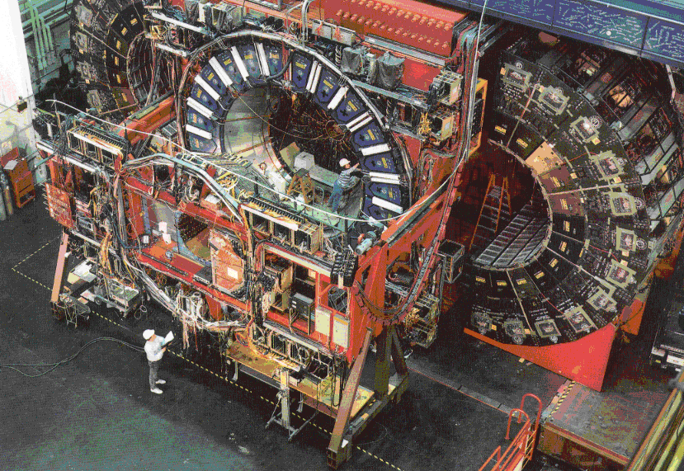
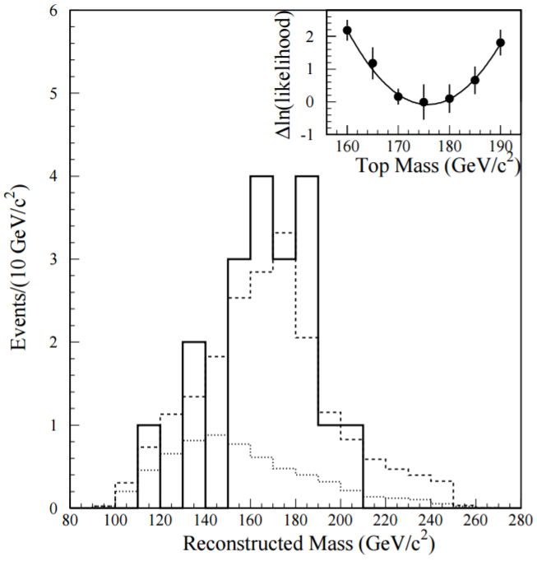
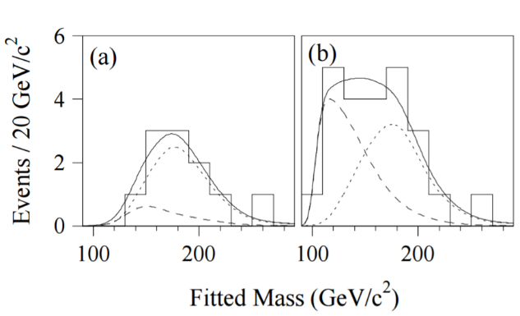
Groundbreaking Discoveries
1995: Top Quark

Slide 12
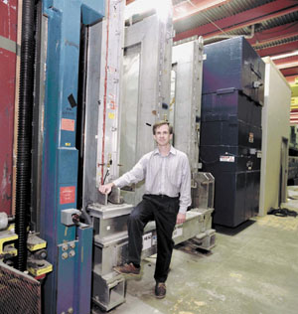
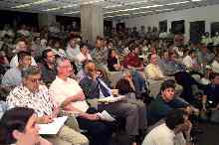
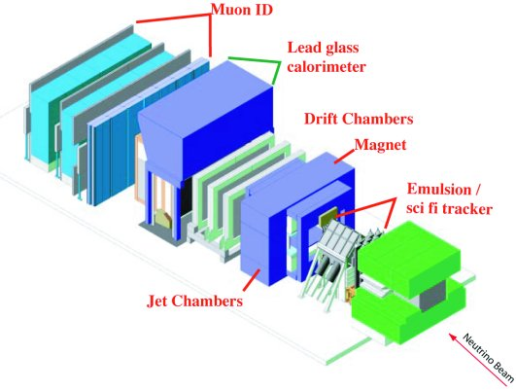
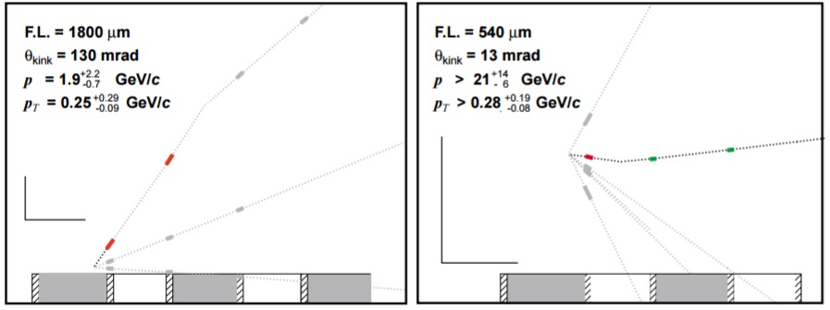
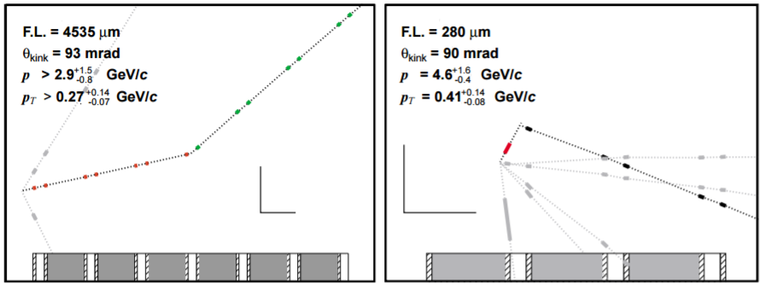
Groundbreaking Discoveries
2000: Tau Neutrino
Notes:
Spokesperson: Byron Lundberg

Slide 13
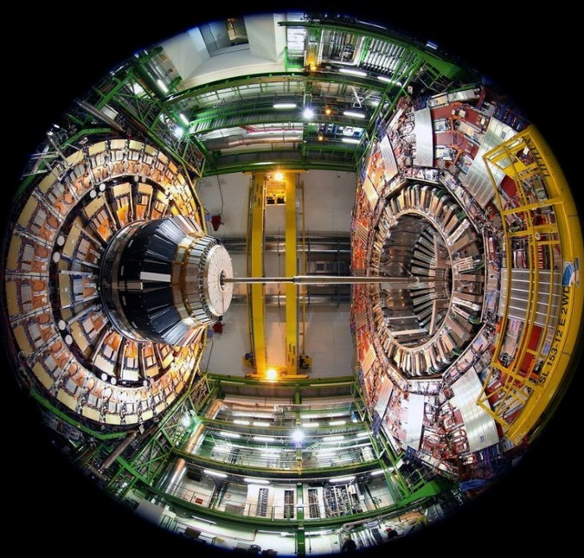
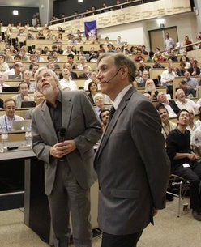
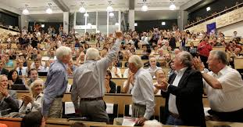
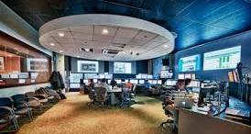
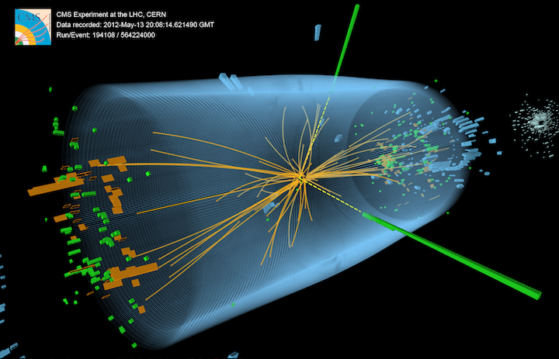
Groundbreaking Discoveries
2012: Higgs boson

Slide 14
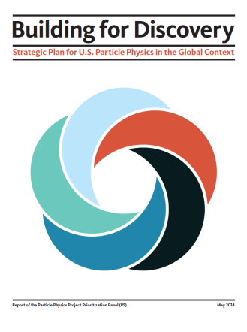
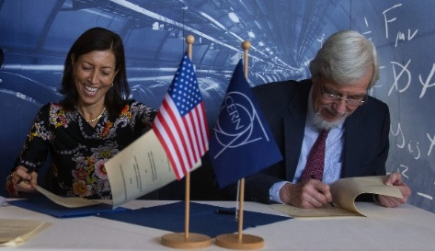
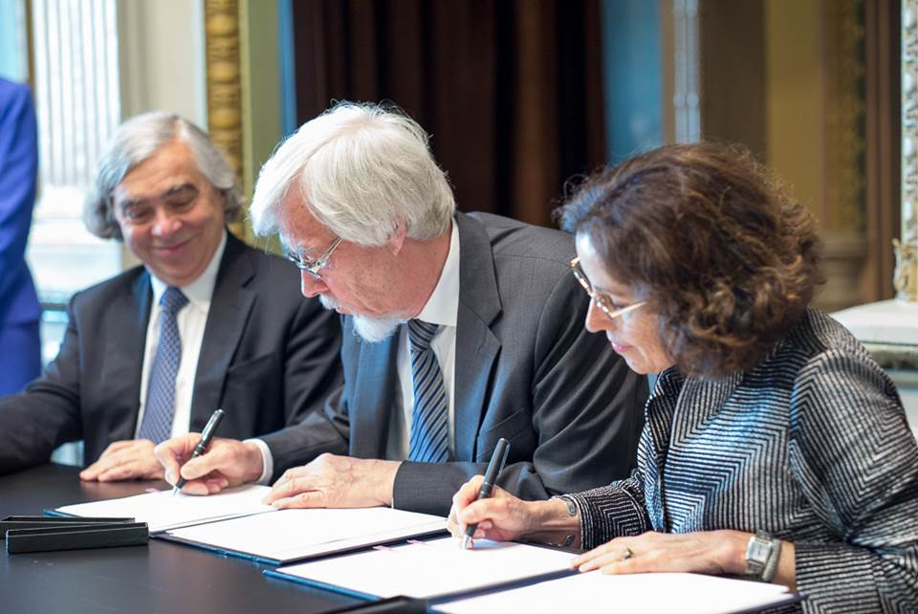
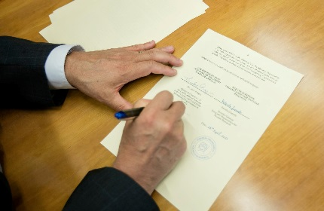
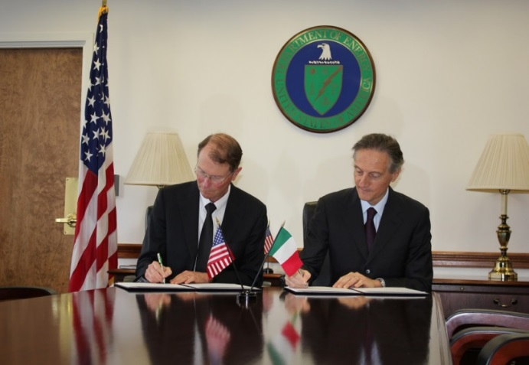
Building a Foundation for the Future
Bilateral U.S.-CERN Agreement (+ Protocols & Addenda!)
DOE-Italy Agreement on High Energy, Astroparticle and Nuclear Physics Research
DOE-MEXT Project Arrangement

Slide 15
Building the Technology for the Future
MicroBooNE
MiniBooNE
ICARUS
ν
ν
Short-Baseline Near Detector
Fermilab Short-Baseline Neutrino Program:
MicroBooNE, ICARUS, and SBND
CERN Neutrino Platform:
ProtoDUNEs
ICARUS: On the Move!
CERN: ProtoDUNE

Slide 16
Building the Future at Fermilab
A U.S.-hosted world-leading neutrino physics program!

Slide 17
The Future is Bright!
“Hence again the great excitement among particle physicists over the development of intense, high energy, neutrino beams.”

